Slide 1
B-Trees
Thomas Schwarz SJ

Slide 2
B-Trees
Standard data structure for Key-Value Stores
Stores records, composed of key and value
Assumes that keys are ordered
Implements CRUD: Create, Read, Update, Delete given a key
Implements range queries: Recover all records with an id in a certain range

Slide 3
B-Trees
B-Trees proper:
Stores records in pages in memory
B+-Tree:
Variant that stores data in pages in storage

Slide 4
B-Trees
B-trees: In memory data structure for CRUD and range queries
Balanced Tree
Each node can have between d and 2d keys with the exception of the root
Each node consists of a sequence of node pointer, key, node pointer, key, …, key, node pointer
Tree is ordered.
All keys in a child are between the keys adjacent to the node pointer

Slide 5
B-Trees
Example: 2-3 tree: Each node has two or three children

Slide 6
B-Trees
Read dog:
Load root, determine location of dog in relation to the keys
Follow middle pointer
Follow pointer to the left
Find “dog”

Slide 7
B-Trees

Slide 8
B-Trees
Search for “auk” :

Slide 9
B-Trees
In-order traversal
Recursive operation
If node contains $l_{0},k_{1},l_{1},k_{2},l_{2},…,l_{d-1},k_{d},l_{d}$
With links $l_{i}$ and keys $k_{i}$:
for i in range(d):
in_order_traversal(l[i])
emit(k[i])
in_order_traversal(l[d])

Slide 10
B-Trees
Example:
in_order of

Slide 11
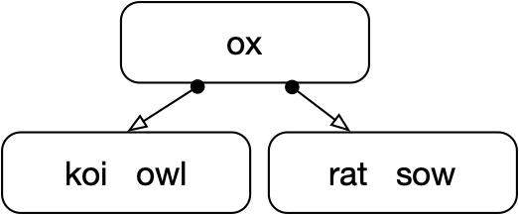
B-Trees
in-order of
'bot'
in-order of
'kit'
in-order of

Slide 12
B-Trees
in-order traversal
ai ant ape ass auk bat bot bug cat doe eel elk emu fly fox kit koi owl ox rat sow

Slide 13
B-Trees
Range Query c - l
Determine location of c and l

Slide 14
B-Trees
Recursively enumerate all nodes between the lines starting with root

Slide 15
B-trees
Capacity: With l levels, minimum of records:
keys
Maximum of records
keys
$$1+2+2^{2}+…+2^{l}$$
$$1(2^{l+1}-1)$$
$$1+3+3^{2}+…+3^{l}$$
$$\frac{2}{2}(3^{l+1}-1)$$

Slide 16
B-trees
Inserts:
Determine where the key should be located in a leaf
Insert into leaf node
Leaf node can now have too many keys
Take middle key and elevate it to the next higher level
Which can cause more “splits”

Slide 17
B-trees

Slide 18
B-trees

Slide 19
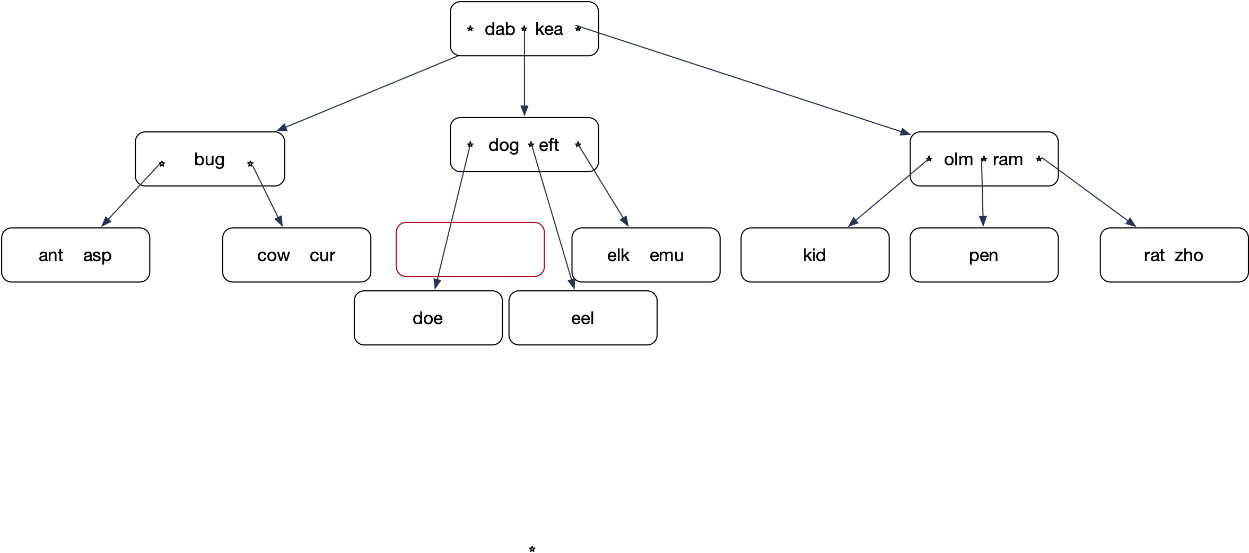
B-trees

Slide 20
B-trees
Insert: Lock all nodes from root on down so that only one process can operate on the nodes
Tree only grows a new level by splitting the root

Slide 21
B-Trees
Using only splits leads to skinny trees
Better to make use of potential room in adjacent nodes
Insert “ewe”.
Node elk-emu only has one true neighbor.
Node kid does not count, it is a cousin, not a sibling

Slide 22
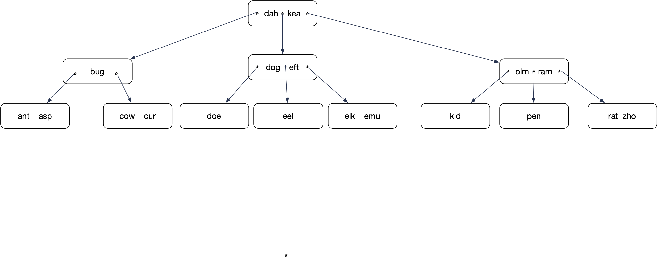
B-tree
Insert ewe into

Slide 23
B-tree
Insert ewe

Slide 24
B-tree
Promote elk. elk is guaranteed to come right after eft.
Demote eft

Slide 25
B-tree
Insert eft into the leaf node

Slide 26
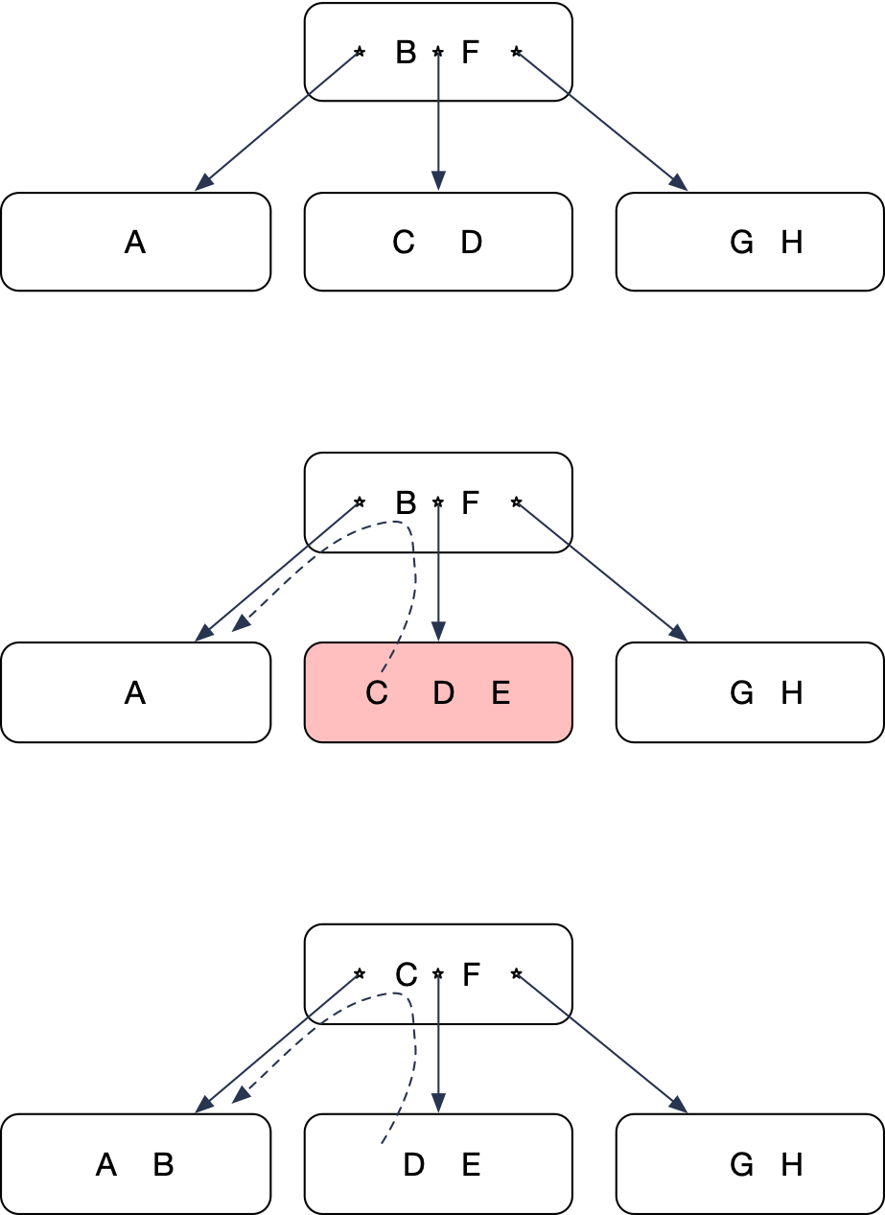
B-tree
Left rotate
Overflowing node has a sibling to the left with space
Move left-most key up
Lower left-most key

Slide 27
B-tree
Now insert “ai”

Slide 28
B-tree
Insert creates an overflowing node
Only one neighboring sibling, but that one is full
Split!

Slide 29
B-tree
Middle key moves up

Slide 30
B-tree
Unfortunately, this gives another overflow
But this node has a right sibling not at full capacity

Slide 31
B-tree
Right rotate:
Move “bot” up
Move “doe” down
Reattach nodes
'bug', 'cat' are bigger than 'bot and smaller than 'doe'

Slide 32
B-tree
Move “bot” up
Move “doe” down
Reattach the dangling node

Slide 33
B-tree
“bot” had moved up
and replaced doe
The “emu” node needs
to receive one key and
one pointer

Slide 34
B-tree

Slide 35
B-Tree
When 'doe' becomes part of the node, a slot for a new left-most node opens up
'bug' 'cat' are larger than 'bot' and smaller than 'doe'

Slide 36
B-tree
Deletes
Usually restructuring not done because there is no need
Underflowing nodes will fill up with new inserts

Slide 37
B-tree
Implementing deletion anyway:
Can only remove keys from leaves
If a delete causes an underflow, try a rotate into the underflowing node
If this is not possible, then merge with a sibling
A merge is the opposite of a split
This can create an underflow in the parent node
Again, first try rotate, then do a merge

Slide 38
B-tree
Delete “kit”
Delete “kit”
“kit” is in an interior node.
Exchange it with the key in the leave
immediately before
“fox”

Slide 39
B-tree
After interchanging “fox” and “kit”, can delete “kit”

Slide 40
B-tree
Now delete “fox”

Slide 41
B-tree
Step 1: Find the key. If it is not in a leaf
Step 2: Determine the key just before it, necessarily in a leaf
Step 3: Interchange the two keys

Slide 42
B-tree
Step 4: Remove the key now from a leaf

Slide 43
B-tree
This causes an underflow
Remedy the underflow by right rotating from the sibling

Slide 44
B-tree
Everything is now in order

Slide 45
B-tree
Now delete fly

Slide 46
B-tree
Switch “fly” with “emu”
remove “fly” from the leaf
Again: underflow

Slide 47
B-tree
Cannot left-rotate: There is no right sibling
Cannot right-rotate: The left sibling has only one key
Need to merge: Combine the two nodes by bringing down “elk”

Slide 48
B-tree
We can merge the two nodes because
the number of keys combined is less than 2 k

Slide 49
B-tree

Slide 50
B-tree
Delete “emu”

Slide 51
B-tree
Switch predecessor, then delete from node

Slide 52
B-tree
Now delete “elk”

Slide 53
B-tree
Results in an underflow

Slide 54
B-tree
Results in an underflow
But can rotate a key into the
underflowing node

Slide 55
B-tree
Result after right-rotation

Slide 56
B-tree
“Now delete “eel”

Slide 57
B-tree
Interchange “eel” with its predecessor
Delete “eel” from leaf:
Underflow

Slide 58
B-tree
Need to merge

Slide 59
B-tree
Merge results in another underflow
Use right rotate
(though merge with right sibling
is possible)

Slide 60
B-tree
“ass” goes up, “bot” goes down
One node is reattached

Slide 61
B-tree
Reattach node

Slide 62
B-tree

Slide 63
In real life
Use B+ tree for better access with block storage
Data pointers / data are only in the leaf nodes
Interior nodes only have keys as signals
Link leaf nodes for faster range queries.

Slide 64
In real life
Storage systems:
Magnetic disk drives
Data stored in blocks of 4KB (originally 512B)
Access:
Seek + Rotate + Latency
~5-15 msec
SSD:
Flash technology
Access:
~1 msec
Unless using several channels

Slide 65
In Real Life
Storage systems:
Transfer unit is a block / page
of size 4KB
We use DRAM as a cache
Store a node in a single page (or fixed-sized set of pages)
Only frequently used nodes should be in DRAM
This would be the upper layers of the hierarchy

Slide 66
In Real Life
Best Strategy:
Treat interior nodes differently
because they are more frequently accessed
because most data is in the leaves
Do not store values, only keys in interior nodes
This way, each node contains the maximum amount of information
Which is used for navigation to the leaf

Slide 67
B+ Tree

Slide 68
B+ Tree
Interior nodes:
Contain only keys
The corresponding record is in a leaf, i.e. the key is repeated in the leaves

Slide 69
B+ Tree

Slide 70
B+ Tree
Real life B+ trees:
Interior nodes have many more keys (e.g. 100)
Leaf nodes have as much data as they can keep
Need few levels:
Faster lookup

Slide 71
B+ Tree
Range queries are easier:
Go to the first key in the range
Then follow the inter-node connections
Size of node is an interesting optimization problem

Slide 72
B+ Trees
Morale:
Data structures live in a concrete world
In Computer Science, underlying technology changes best practices
Therefore:
Computer Science is not a science, but an engineering discipline

Slide 73
B+ Trees
Future memory / storage technologies
Non-volatile memory that combines
Speed of DRAM
Non-volatility of storage
Low cost of bytes of storage
Byte addressable
Research question:
What B-tree is needed for these memories

