Slide 1
Binary Trees
Thomas Schwarz, SJ

Slide 2
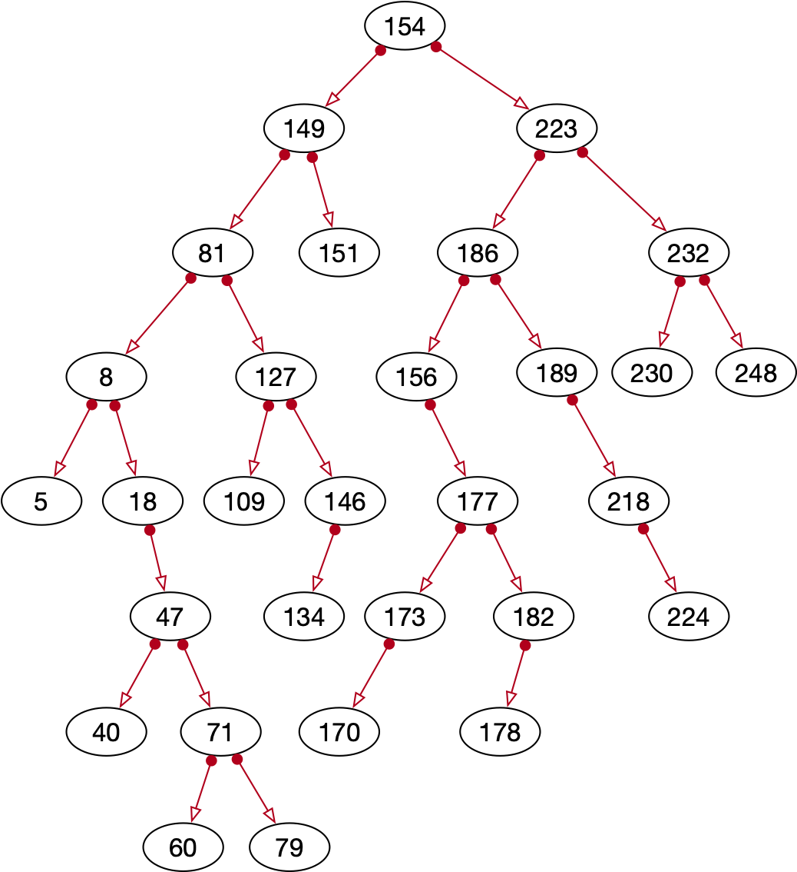
Definition
Binary trees consists of nodes
  Each node has:
    A value (key -- record pair)
    A left subnode
    A right subnode
In computer science, the root of a tree is on top

Slide 3

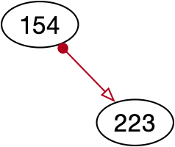
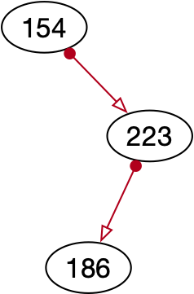
Example
Insert 154
Insert 223
Insert 186

Slide 4
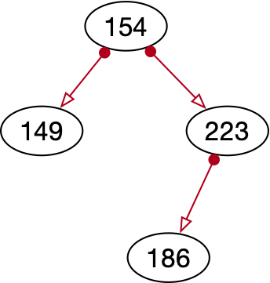
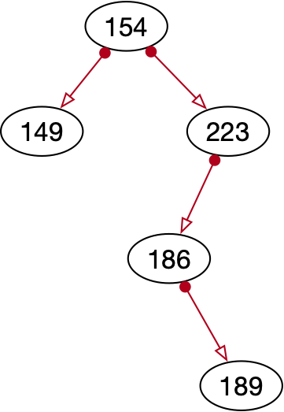
Example
Insert 149
Insert 189

Slide 5
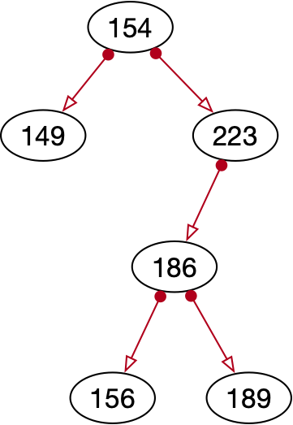
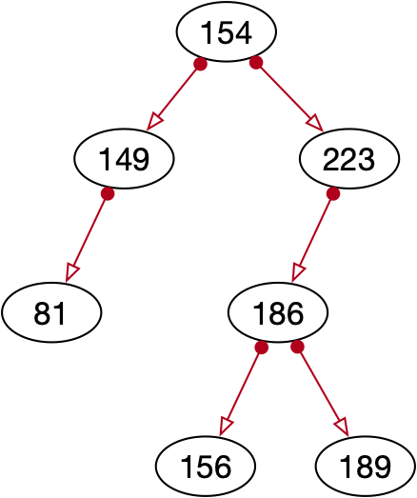
Example
Insert 156
Insert 81

Slide 6
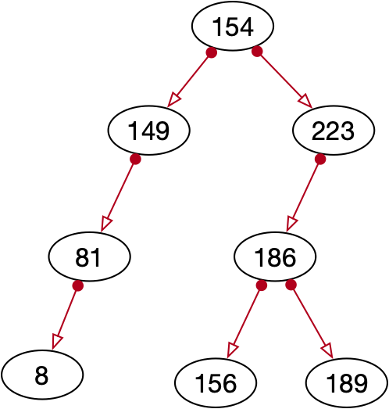
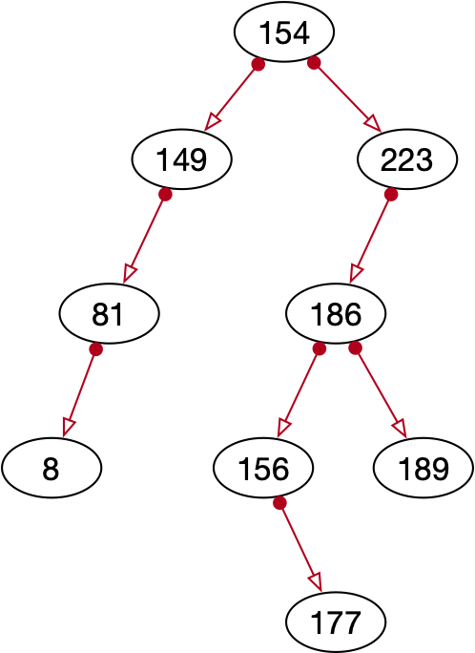
Example
Insert 8
Insert 177

Slide 7
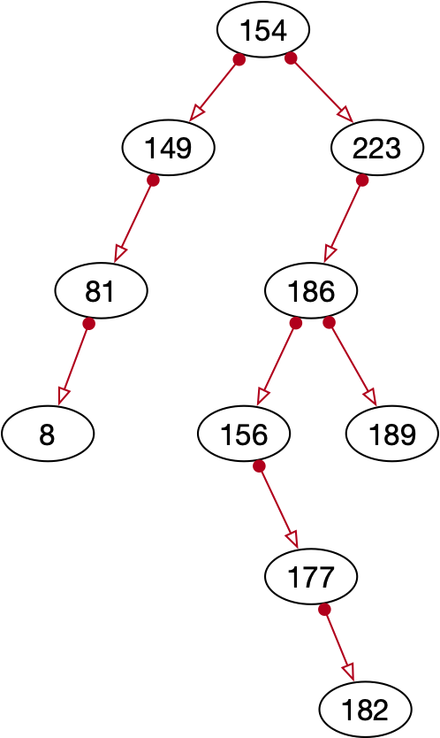
Example
Insert 182

Slide 8
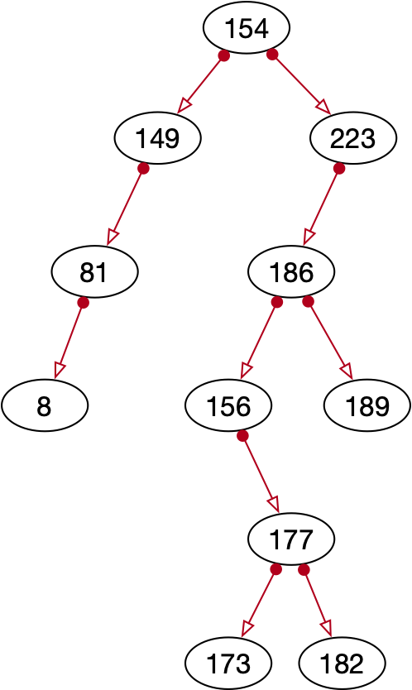
Example
Insert 173

Slide 9
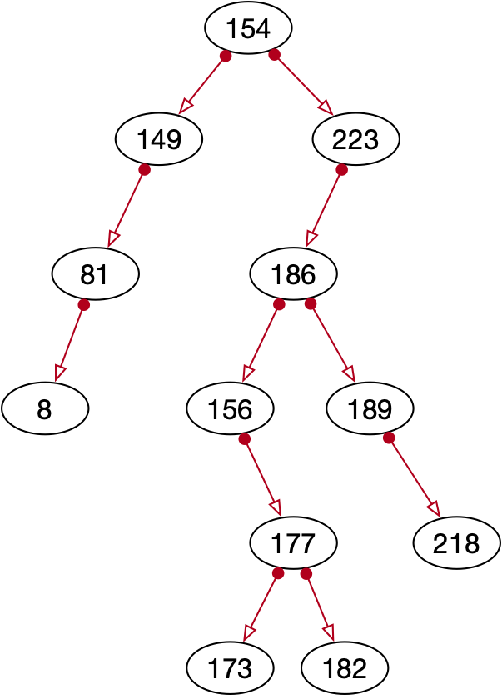
Example
Insert 218

Slide 10
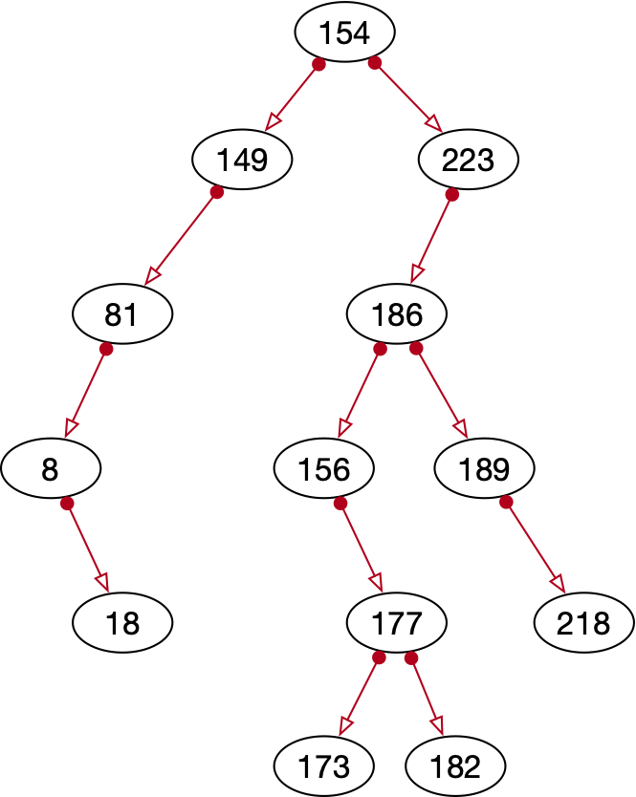
Example
Insert 18

Slide 11
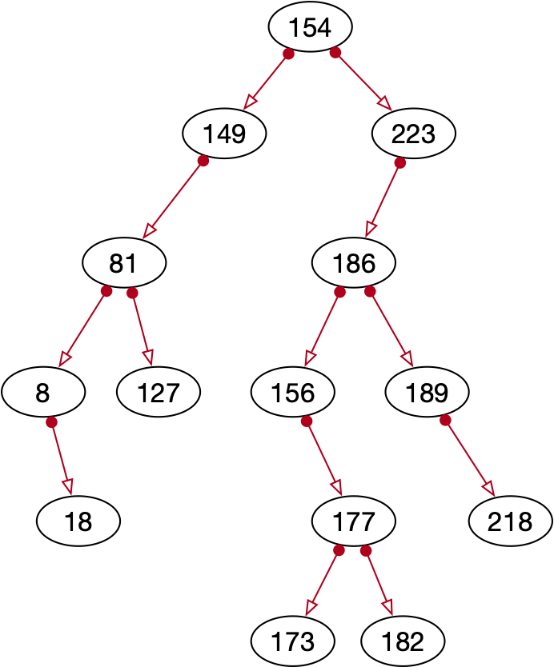
Example
Insert 127

Slide 12
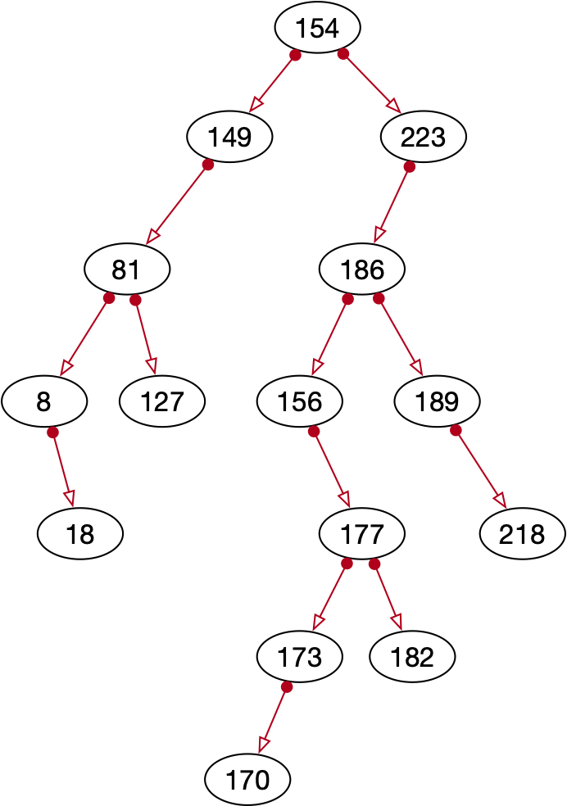
Example
Insert 170

Slide 13
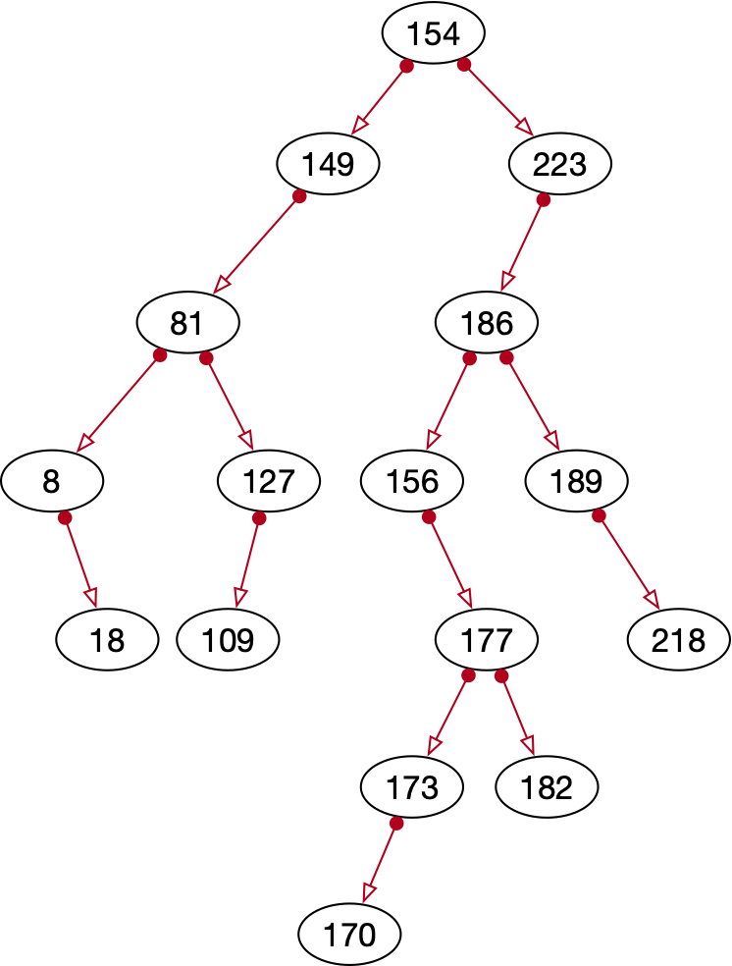
Example
Insert 109

Slide 14
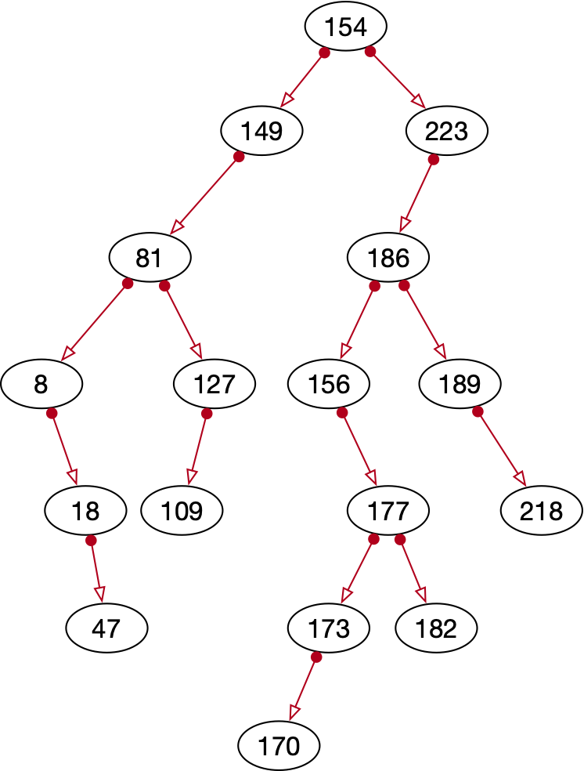
Example
Insert 47

Slide 15
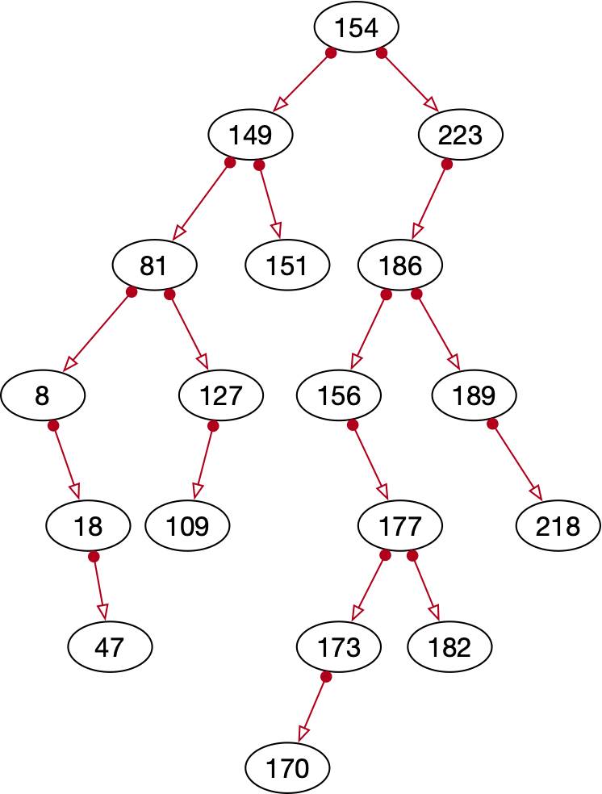
Example
Insert 151

Slide 16
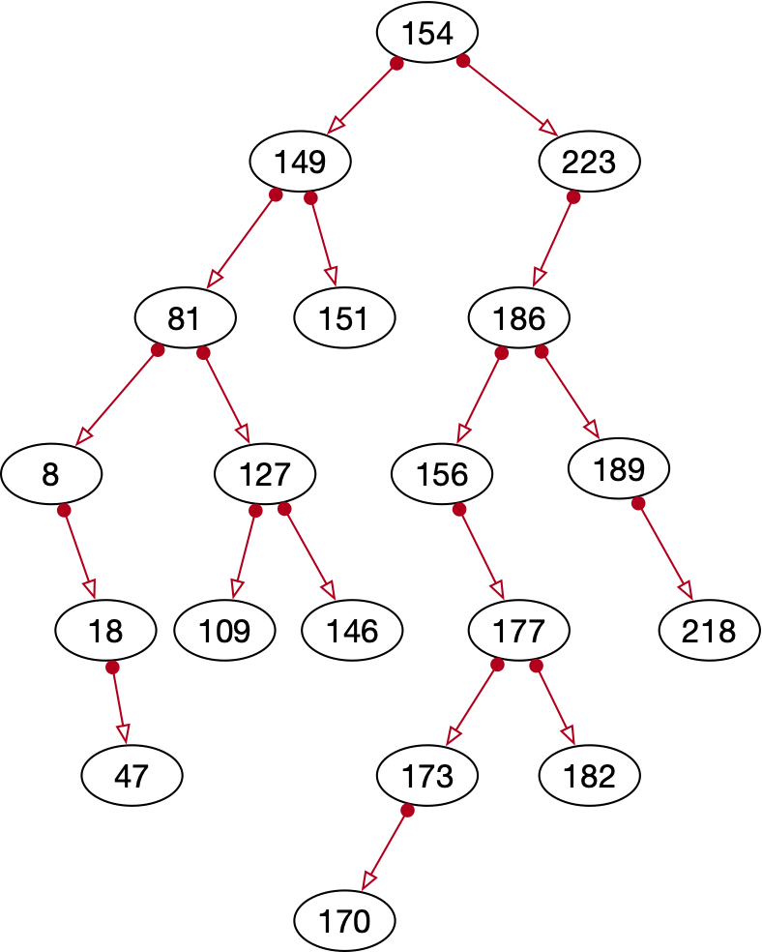
Example
Insert 146

Slide 17
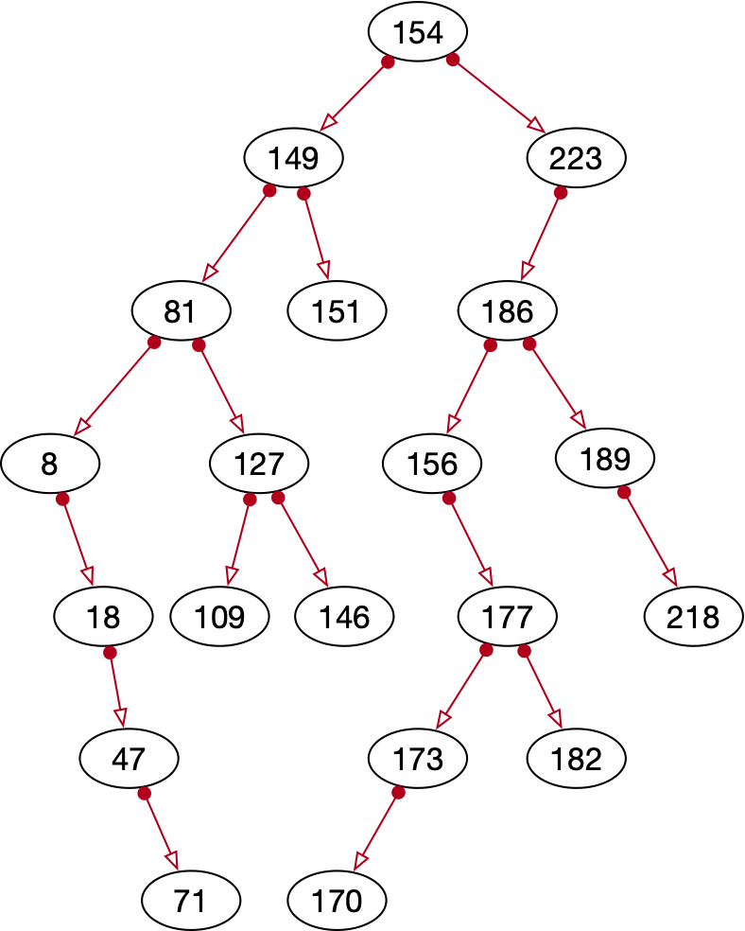
Example
Insert 71

Slide 18
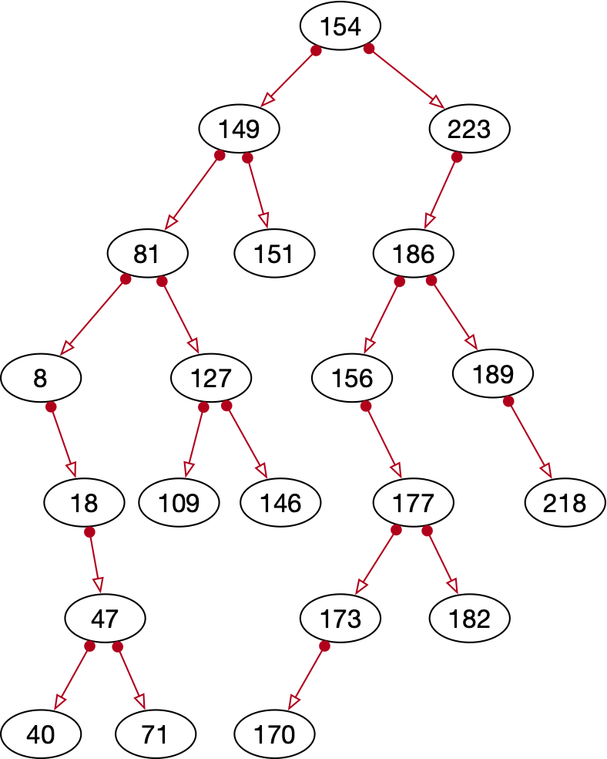
Example
Insert 40

Slide 19
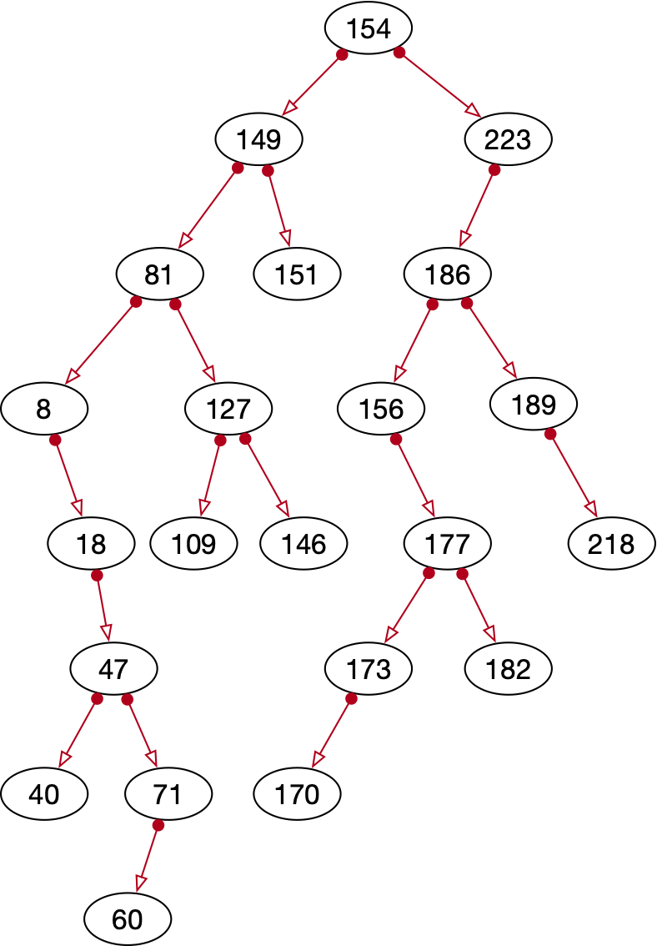
Example
Insert 60

Slide 20
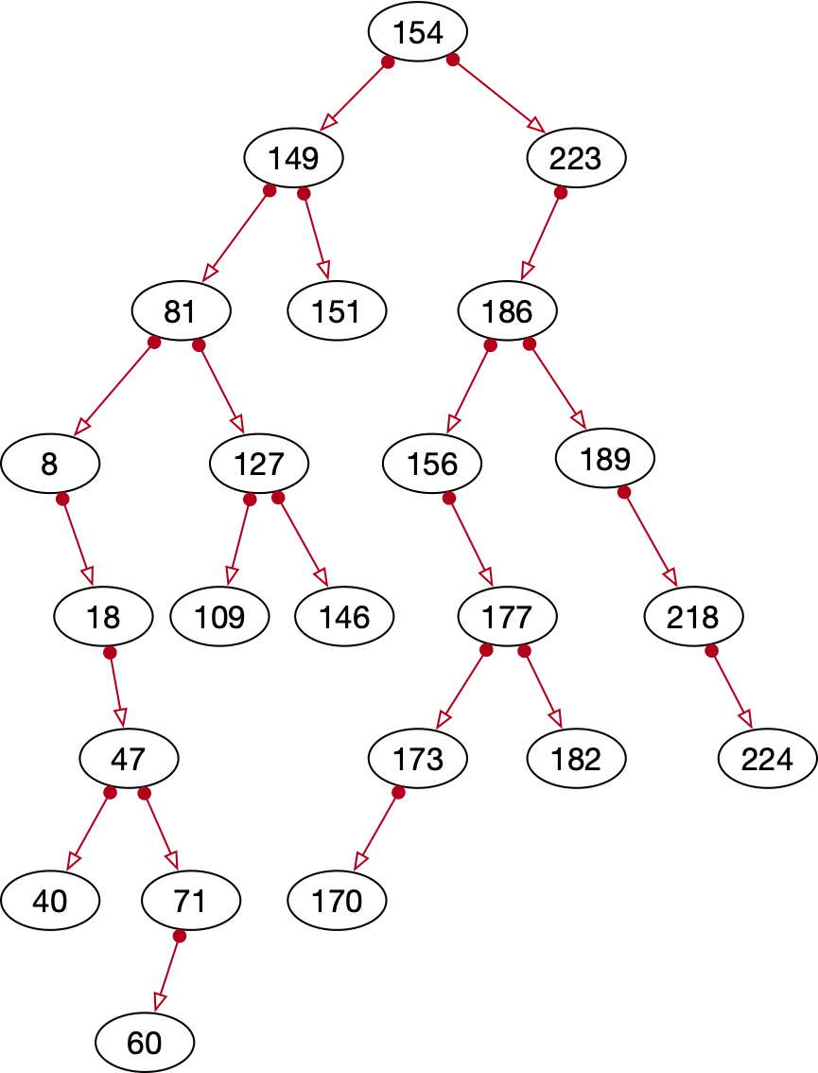
Example
Insert 224

Slide 21
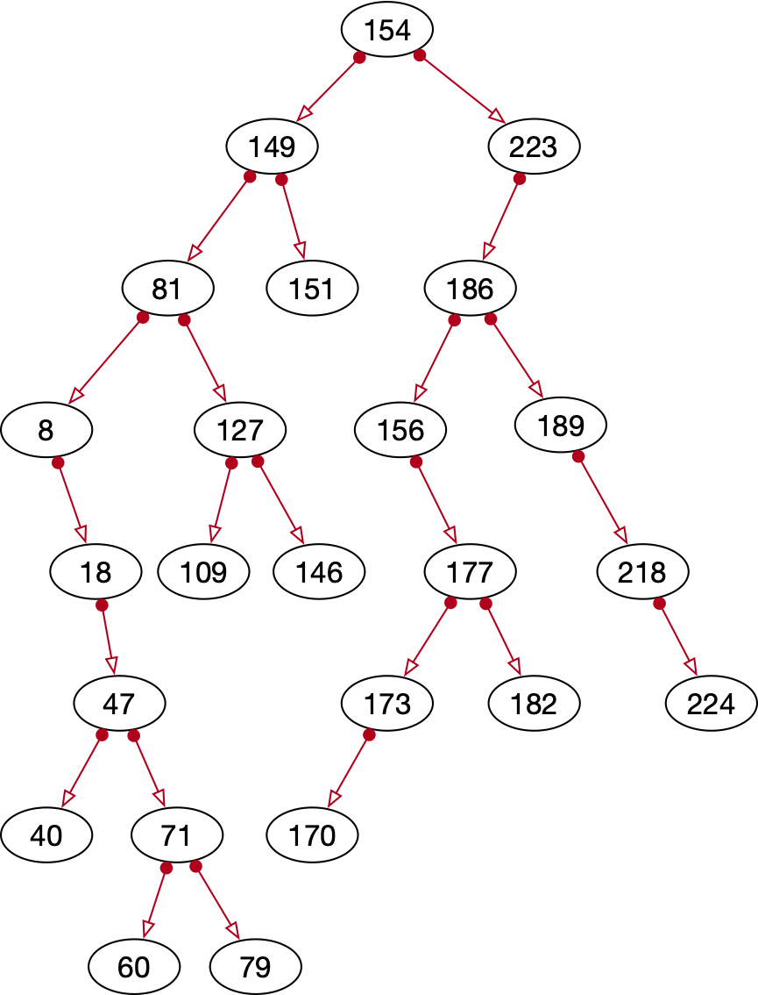
Example
Insert 79

Slide 22
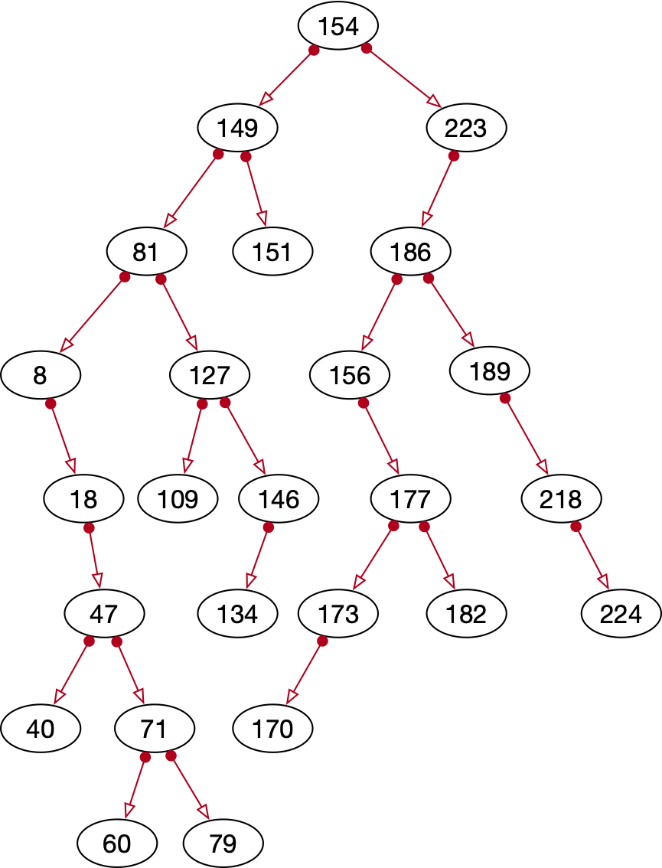
Example
Insert 134

Slide 23
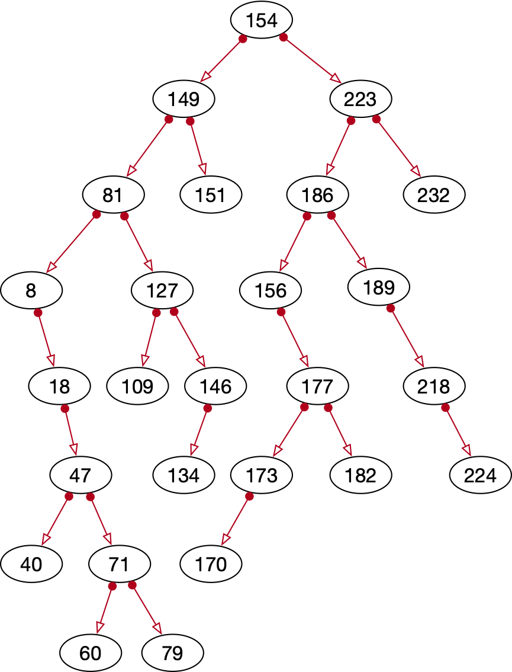
Example
Insert 232

Slide 24
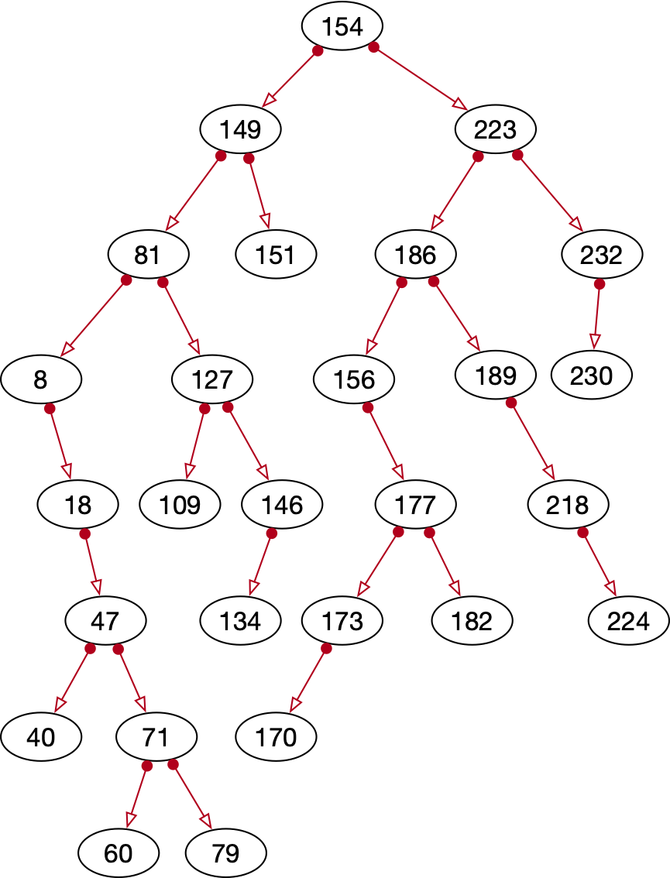
Example
Insert 230

Slide 25
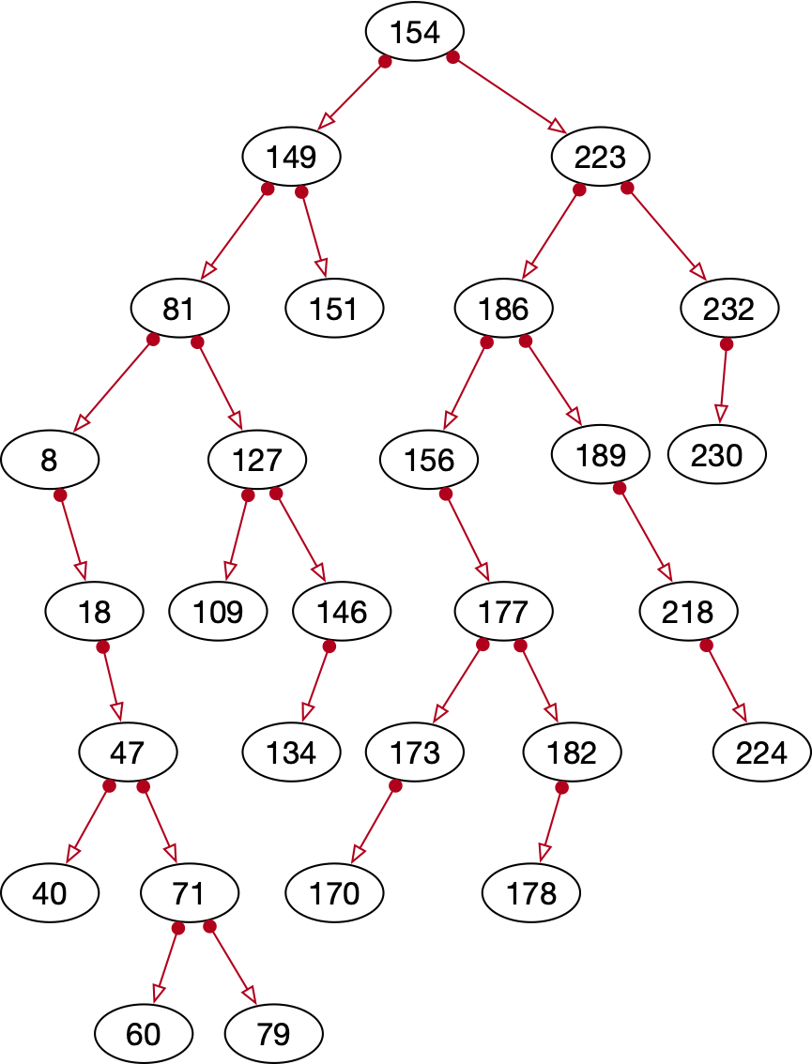
Example
Insert 178

Slide 26
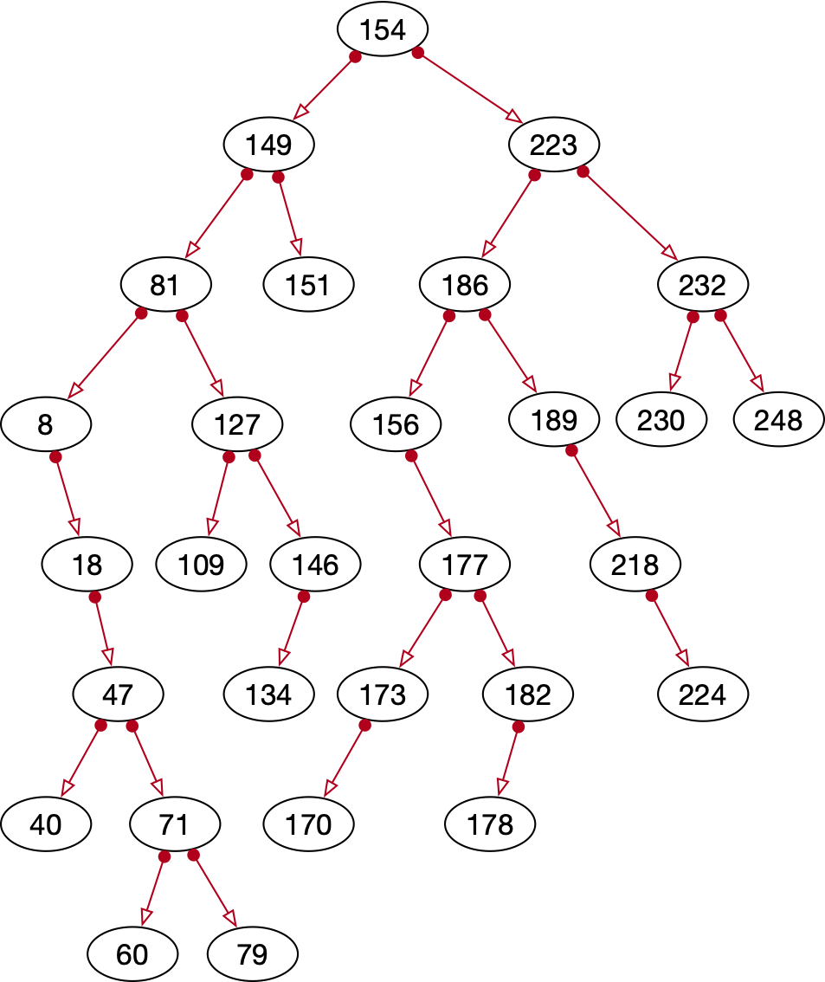
Example
Insert 248

Slide 27
Example
Insert 5

Slide 28
Example
Printing out per layer
[154]
[149, 223]
[81, 151, 186, 224]
[8, 127, 156, 189, 232]
[5, 18, 109, 146, 177, 218, 230, 248]
[47, 134, 173, 182]
[40, 71, 170, 178]
[60, 79]

Slide 29
Example
This example shows very nicely:
  Trees under random insertion become too thin
  Not well balanced

Slide 30
Implementation
Node class
class Node:
def __init__(self, value):
self.value = value
self.left = None
self.right = None
def __repr__(self):
return "Node : {}, Value: {}, Left: {}, Right: {}".format(
hex(id(self)),
self.value,
hex(id(self.left)),
hex(id(self.right)))

Slide 31
Implementation
Tree class:
  Empty tree has a None root
class Binary_Tree:
def __init__(self):
self.root = None

Slide 32
Implementation
Insert is more difficult:
  Start at the root
    If the value to be inserted is smaller than the value at the root, go to the left
    Otherwise go to the right
  Continue until you reach a None-child
    Insert there

Slide 33
Implementation
Special Case:
  The tree is empty
def insert(self, value):
new_node = Node(value)
if not self.root:
self.root = new_node
else:
...

Slide 34
Implementation
def insert(self, value):
new_node = Node(value)
if not self.root:
self.root = new_node
else:
current = self.root
while True:
if value < current.value:
if current.left:
current = current.left
else:
current.left = new_node
return
else:
if current.right:
current = current.right
else:
current.right = new_node
return

Slide 35
Implementation
Note:
  What do we have to change to prevent the same key to be inserted twice?

Slide 36
Showing Contents
Show by level
  Give all the records inserted at a certain level
[154]
[149, 223]
[81, 151, 186, 224]
[8, 127, 156, 189, 232]
[5, 18, 109, 146, 177, 218, 230, 248]
[47, 134, 173, 182]
[40, 71, 170, 178]
[60, 79]

Slide 37
Showing Contents
Idea:
  Put all nodes at a certain level in a queue
  Process the queue by:
    Printing all values
    Adding children to the next queue

Slide 38
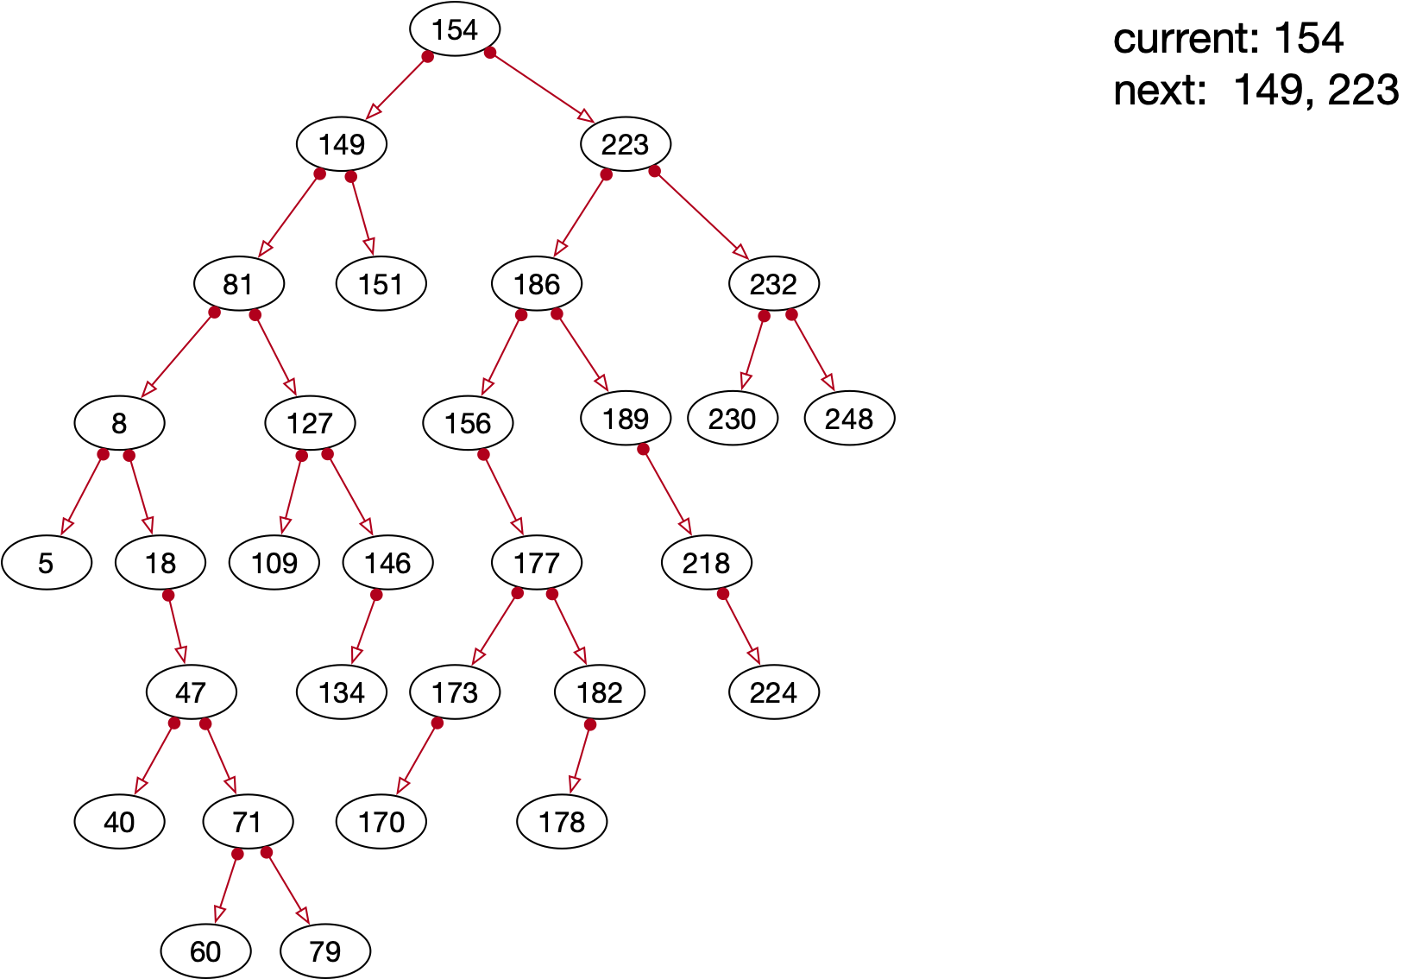
Showing Contents
Example

Slide 39
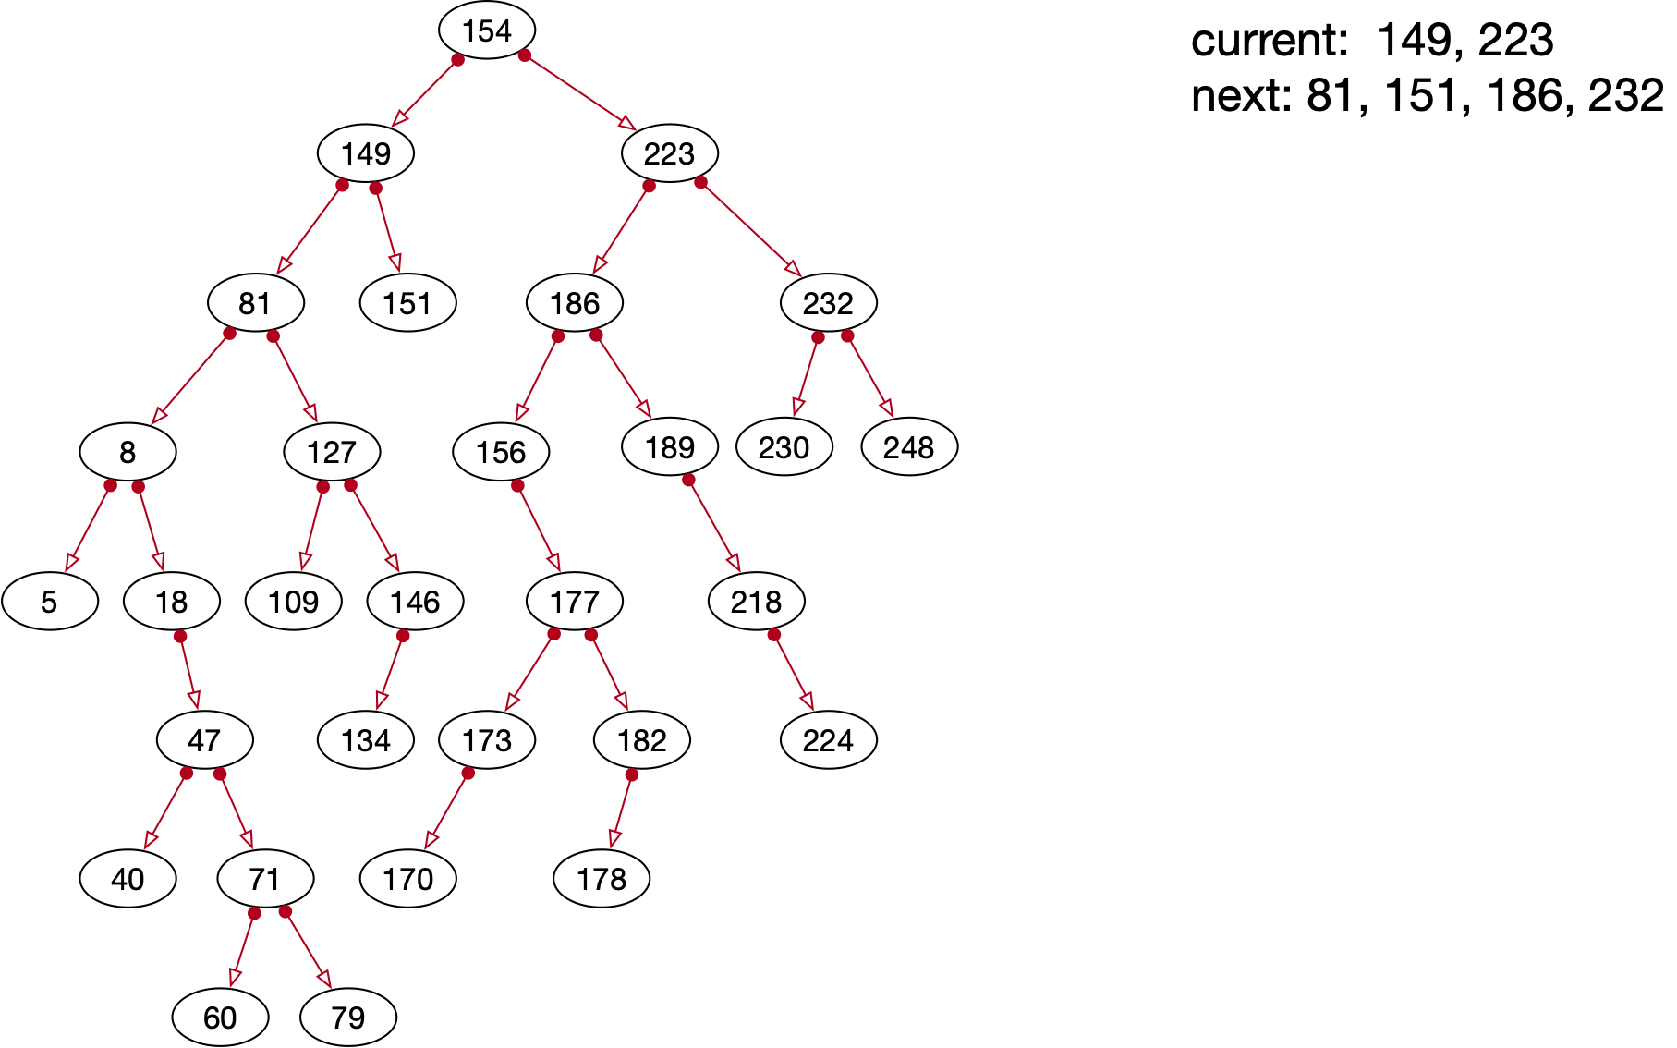
Showing Contents
Example (cont.)

Slide 40
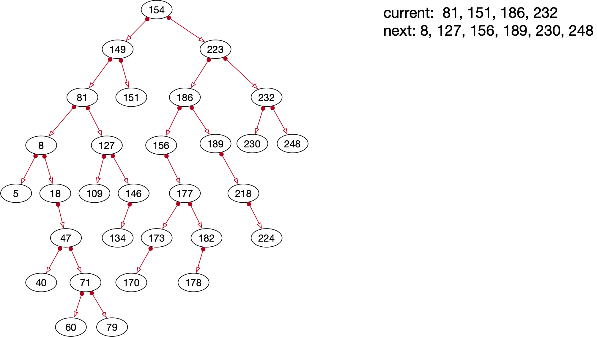
Showing Contents
Example (cont.)

Slide 41
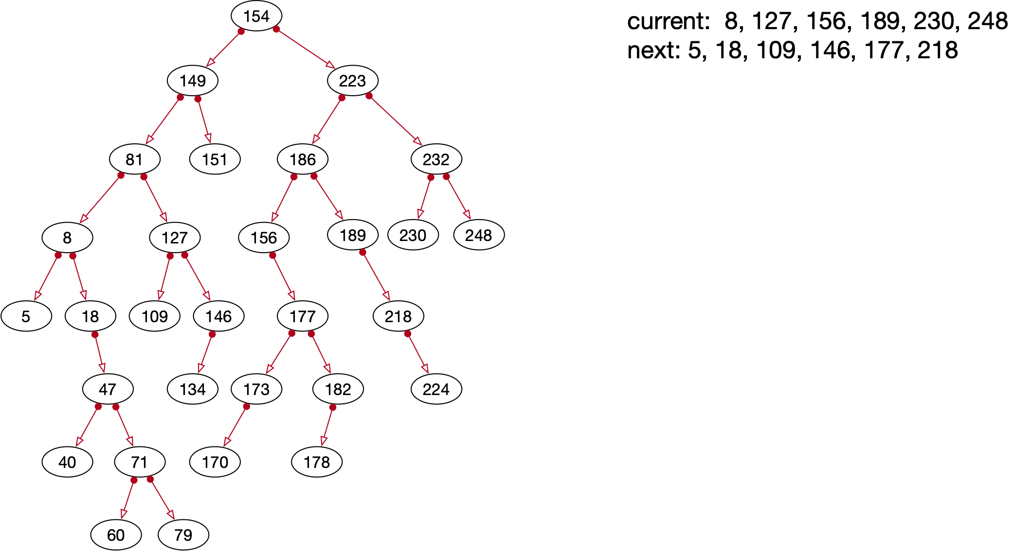
Showing Contents
Example (cont.)

Slide 42
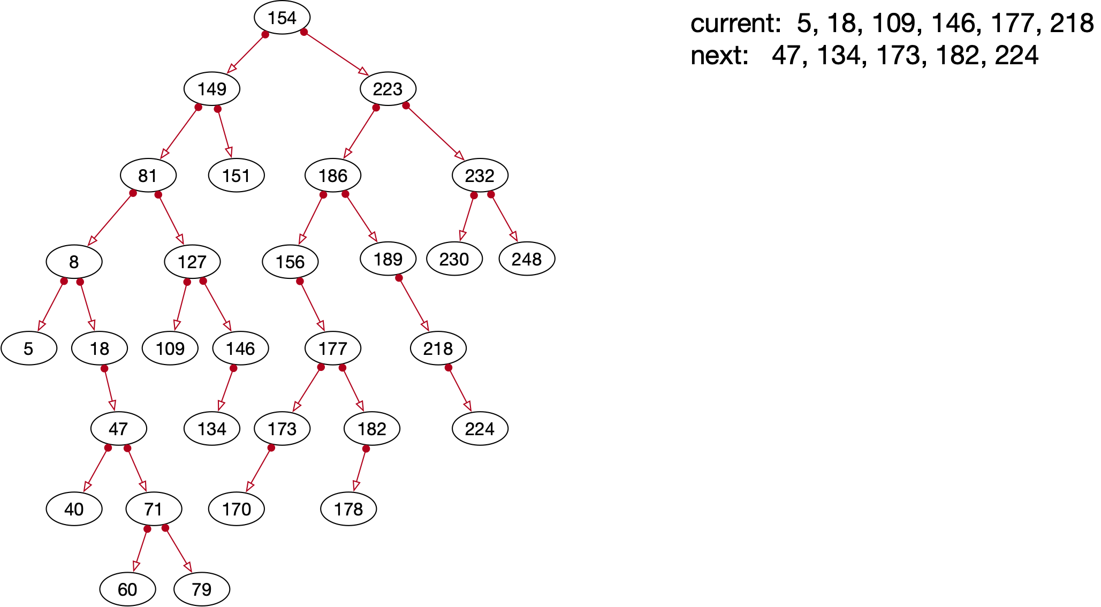
Showing Contents
Example (cont.)

Slide 43
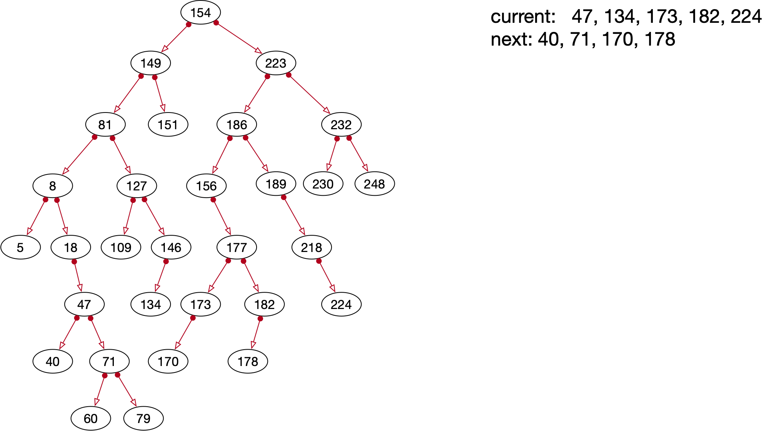
Showing Contents
Example (cont.)

Slide 44
Showing Contents
We can use different implementations for queues
  Such as linked lists
    But it is easier to use Python lists

Slide 45
Showing Contents
def print_layer(self):
current_generation = [self.root]
while True:
print([node.value for node in
current_generation])
next_generation = [ ]
for node in current_generation:
if node and node.left:
next_generation.append(node.left)
if node and node.right:
next_generation.append(node.right)
current_generation = next_generation
if not current_generation:
return

Slide 46
Showing Contents
Other tree traversals are more important
  In-order traversal:
    Traverse the left sub-tree
    Get the root
    Traverse the right sub-tree

Slide 47
Showing Contents
These use recursion:
  A function that calls itself
    For us: have to define a left sub-tree and right sub-tree
def left_tree(self):
result = Binary_Tree()
result.root = self.root.left
return result
def right_tree(self):
result = Binary_Tree()
result.root = self.root.right
return result

Slide 48
Showing Contents
Then to implement in-order
Notice how we are calling the function on the smaller tree
def in_order(self):
if not self.root:
return []
return self.left_tree().in_order() +
[self.root.value] +
self.right_tree().in_order()

Slide 49
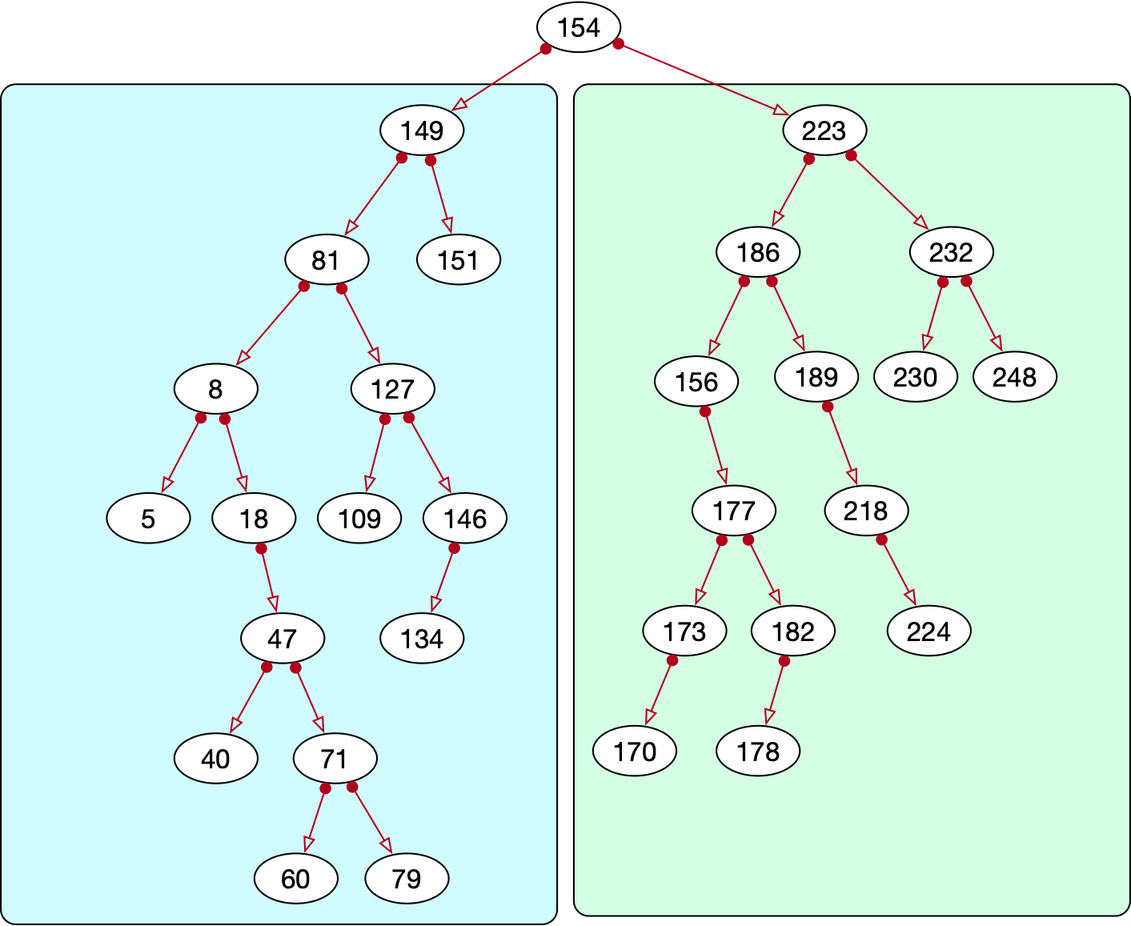
Showing Contents

Slide 50
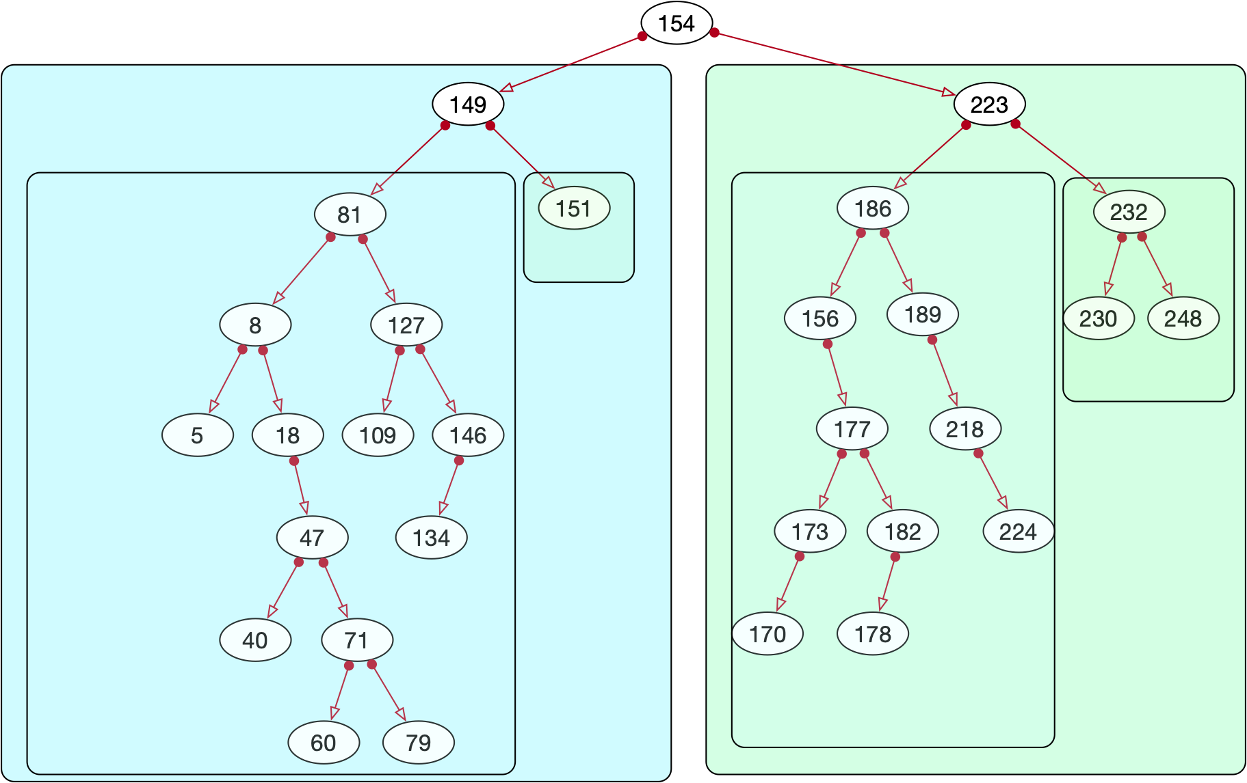
Showing Contents

Slide 51
Showing Contents
In-order traversal:
  Records are printed in order
b = Binary_Tree()
lista = [154,223,186,149,189,156,81,8,177,182,173,
218,18,127,170,109,47,151,146,71,40,60,
224,79,134,232,230,178,248,5, 150, 130]
for x in lista:
b.insert(x)
b.print_layer()
print(b.in_order())

Slide 52
Showing Contents
Result
This is incidentally our first ordering algorithm
  Though not necessarily a very good one
[5, 8, 18, 40, 47, 60, 71, 79, 81, 109, 127, 130, 134, 146, 149, 150, 151, 154, 156, 170, 173, 177, 178, 182, 186, 189, 218, 223, 224, 230, 232, 248]

Slide 53
Showing Contents
Pre-order:
  First root
  Then left-tree
  Then right-tree
def pre_order(self):
if not self.root:
return []
return [self.root.value] +
self.left_tree().pre_order() +
self.right_tree().pre_order()

Slide 54
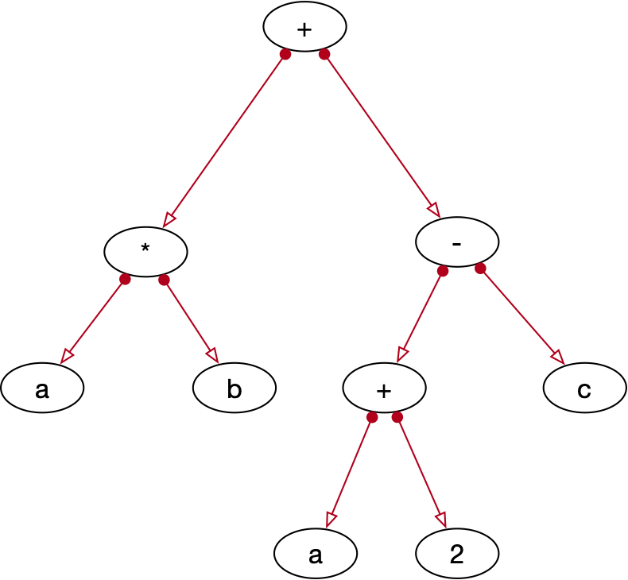
Showing Contents
Application:
  Expression trees
  $$a⋅b+(a+2)-c$$

Slide 55
Showing Contents
Pre-order
  Polish notation:
    $$+*ab-+a2c$$

Slide 56
Showing Contents
Post-order
  First left tree
  Then right tree
  Then root
def post_order(self):
if not self.root:
return []
return self.left_tree().post_order()
+ self.right_tree().post_order()
+ [self.root.value]

Slide 57
Showing Contents
Post-order
  Reverse Polish notation:
    $$ab*a2+c-$$

Slide 58
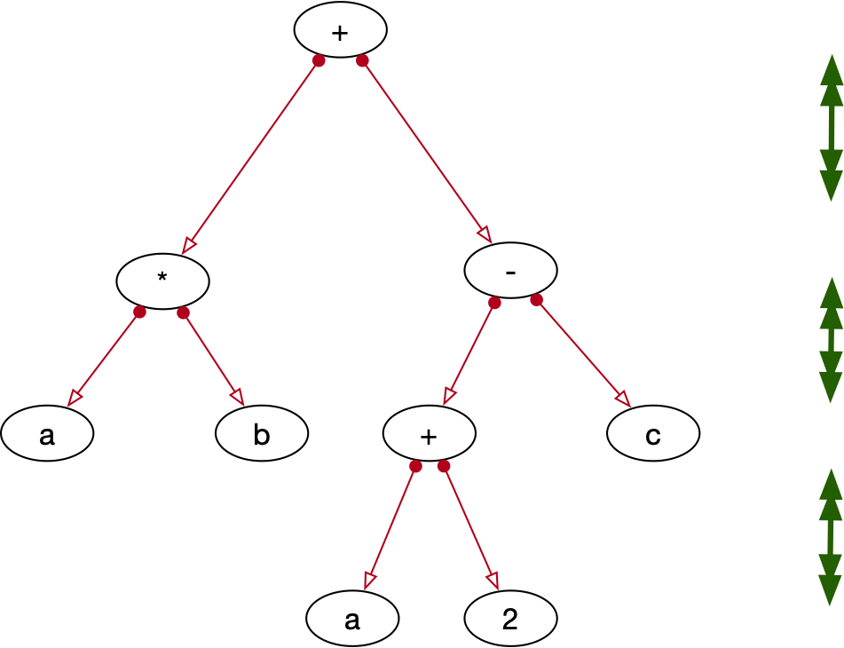
Geometry
Depth of a tree:
  Number of links from root to the furthest node
                Depth is three in this example

Slide 59
Geometry
Use recursion
def depth(self):
if not self.root:
return -1
else:
return 1 + max(self.left_tree().depth(),
self.right_tree().depth())

Slide 60
Geometry
Number of elements in a tree
  Let's use Python length
    Again, use recursion on left and right subtree
def __len__(self):
if not self.root:
return 0
else:
return 1+len(self.left_tree())
+len(self.right_tree())

Slide 61
Finding Data
To find record with certain value:
  Start at root
    Go to the left or the right, depending on whether the value is

Slide 62
def contains(self, value):
if not self.root:
return False
current = self.root
while True:
if not current:
return False
if value == current.value:
return True
if value < current.value:
current = current.left
else:
current = current.right

Slide 63
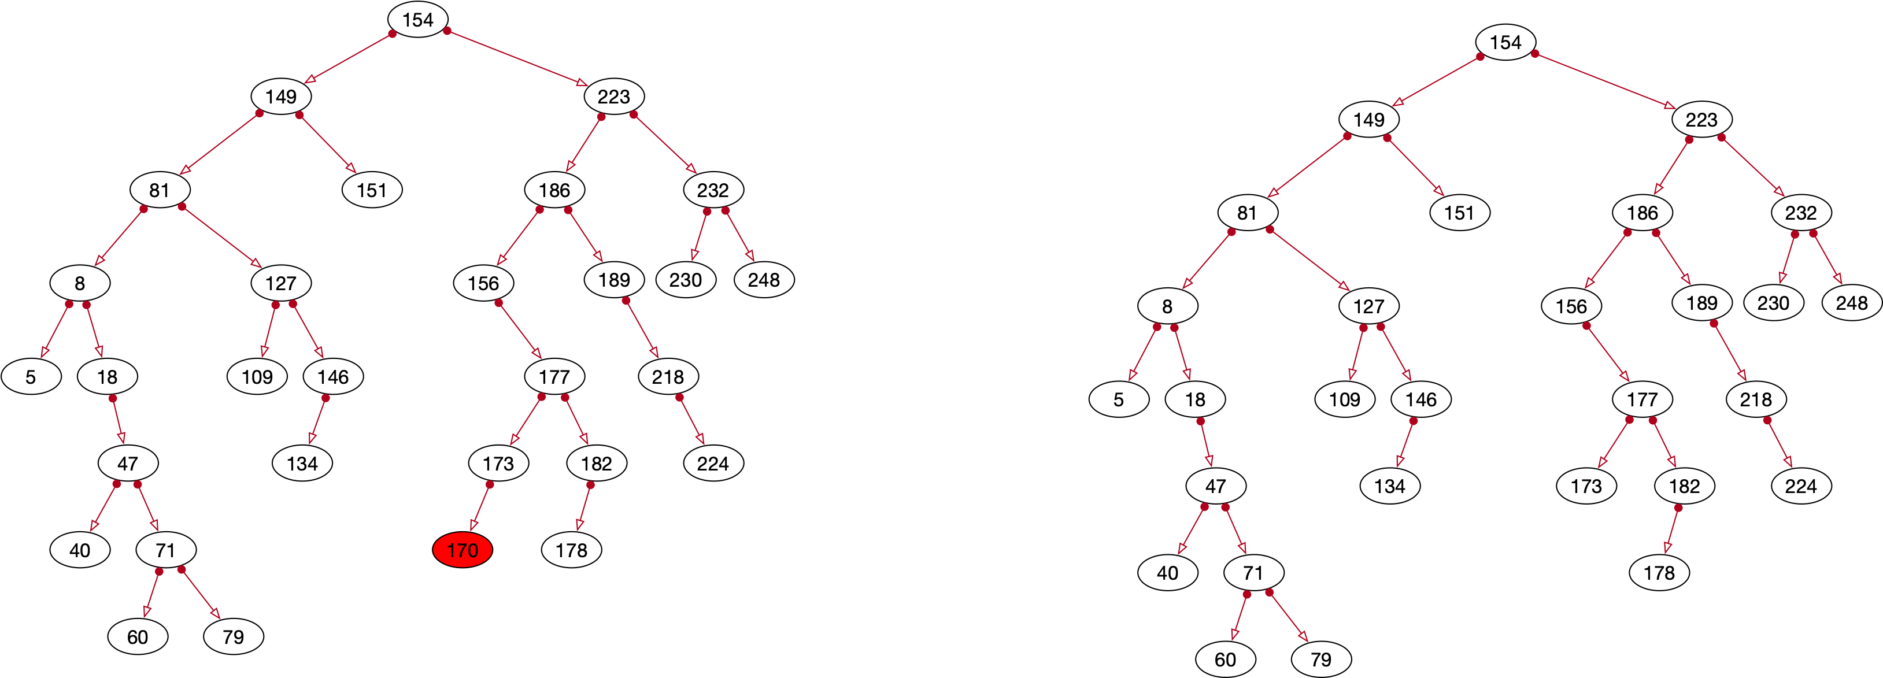
Deleting Data
If the node is a leaf:
  We just delete the leaf

Slide 64

Deleting Data
Special case:
  The node to be deleted is the root
  In which case we need to set the root to None

Slide 65
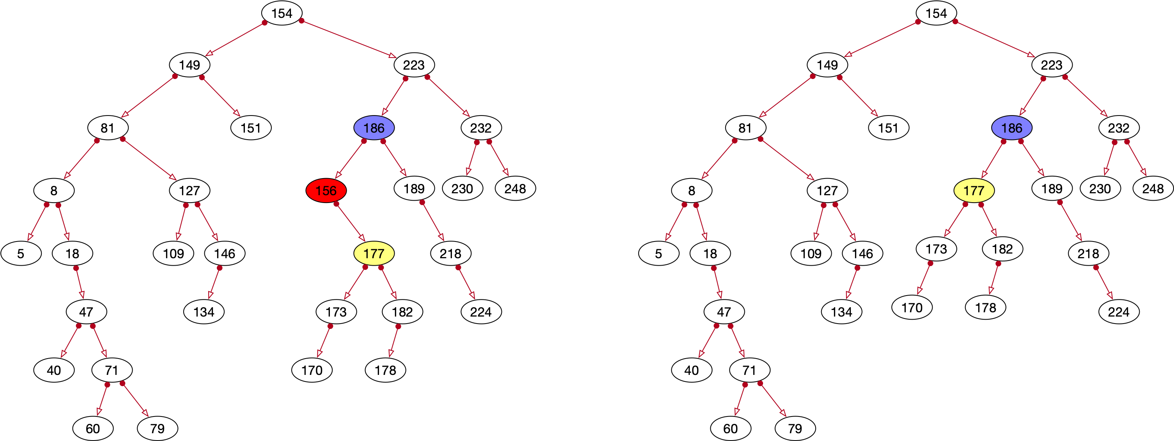
Deleting Data
If the node to be deleted has only one child:
  Replace the sub-tree rooted in the node with the child tree

Slide 66
Deleting Data
If the node to be deleted has two children:
  Find the successor
    Leftmost node in the right subtree
  Save value of the successor
  Delete the successor
    For this we need to find its successor
  Then change the value of the node to be deleted

Slide 67
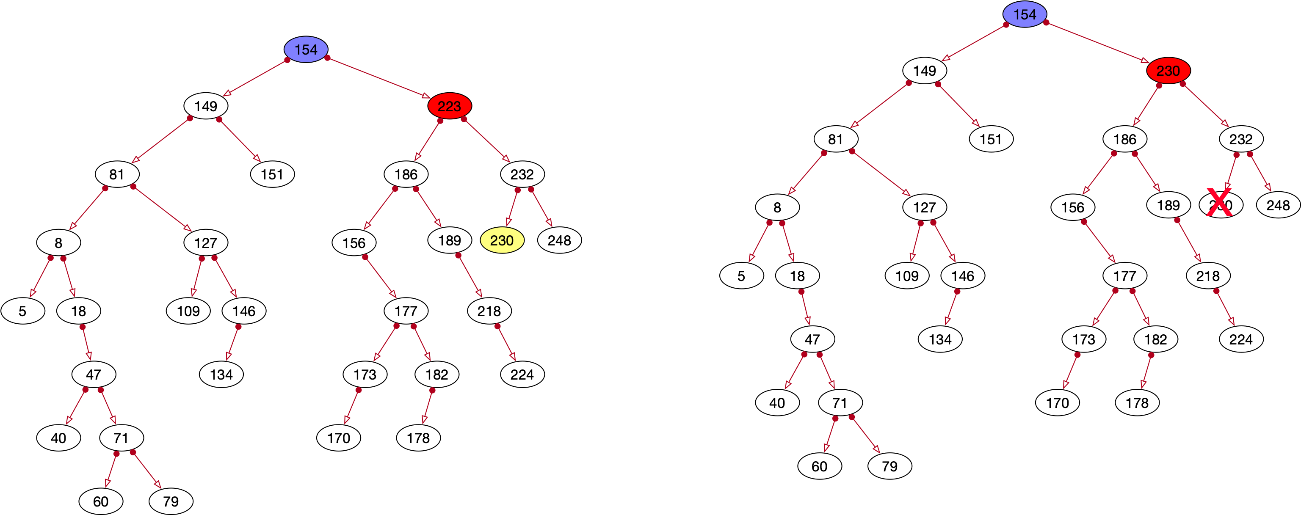
Deleting Data

Slide 68
Implementation
Trick:
  Maintain a queue of all nodes visited
    So that we can go up
      Only problem is if we delete at the very top

