Slide 1
Binary Trees II
Thomas Schwarz, SJ

Slide 2
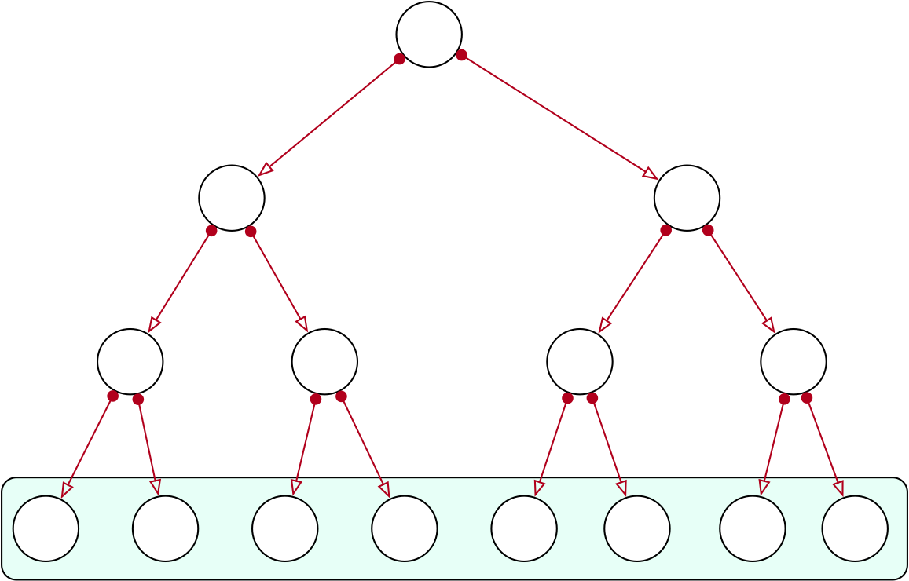
Behavior of Trees
A full binary tree of depth $n$ has
$1+2+2⋅2+2⋅2⋅2+…+2^{n-1}$
$=(111…1)_{2}=2^{n}-1$ places
$$2^{0}$$
$$2^{1}$$
$$2^{2}$$
$$2^{3}$$
Total 15

Slide 3
Behavior of Trees
Reversely:
To store m elements in a binary tree:
Need a tree of depth $d$ such that
$$2^{(d-1)}-1≤m<2^{d}-1$$
Equivalent to
$$2^{d-1}≤m+1<2^{d}$$
$$d-1≤\log_{2}(m+1)<d$$
$$d-1=⌊\log_{2}(m+1)⌋$$

Slide 4
Behavior of Trees
This parsimony is not natural
Random inserts: Trees have much larger depth
Self-modifying trees restructure themselves in order to get closer
Importance:
Searching an element takes time ~ to depth
Inserting an element takes time ~ to depth

Slide 5
Behavior of Trees
Experiment:
Insert n elements into a binary tree
Get the depth
Repeat 10,000 times
Depict mean plus/minus standard deviation

Slide 6
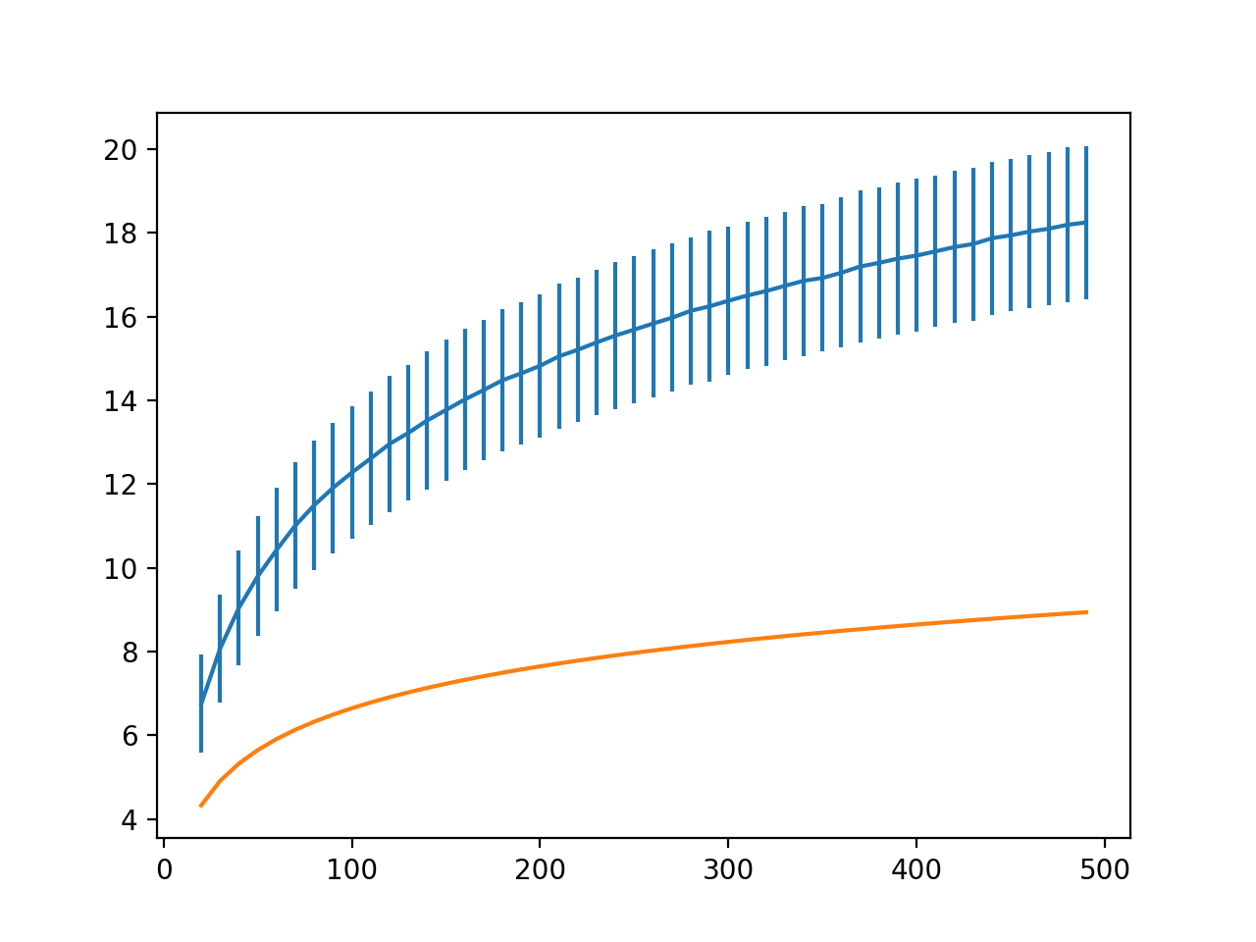
Behavior of Trees

Slide 7
Behavior of Trees
On average
Trees have more than twice necessary depth
But on average
Behavior is still logarithmic
Theory: Height of a random binary search tree for a random permutation of $n$ elements is
$α\log_{e}(n)$ with $α≈4.31107$
$$=2.98821\log_{2}(n)$$
Robson 1979 / Devroye 1986

Slide 8
Decorating Binary Search Trees
General principle for Data Structures:
Can store more information in order to improve performance
Example:
Removal of elements from a binary search tree
Difficult because we need to find parent
Can be made simpler by having a parent pointer

Slide 9
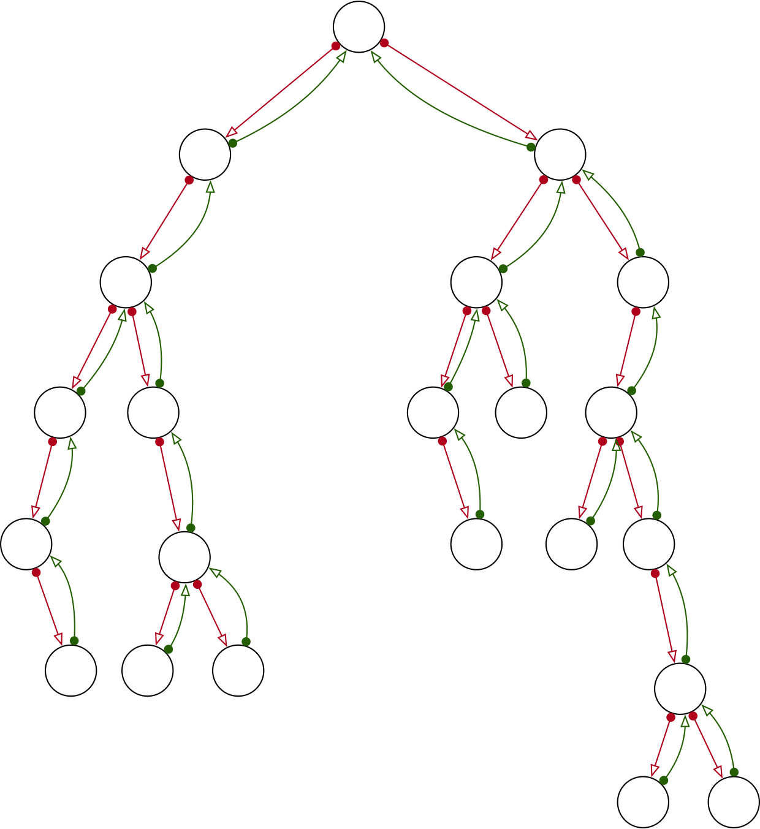
Binary Trees with Parent Link
Each node stores a link to the parent
For root, link is None
Faster deletes at the cost of more storage per node

Slide 10
Binary Trees with Parent Link
Expand to a key-value store by adding a field for record
Add a parent link
class Node:
def __init__(self, value, record):
self.value = value
self.record = record
self.up, self.left, self.right = None, None, None
def __repr__(self):
return "Node : {}, Value: {}, Record: {},
Left: {}, Right: {}, Up: {}".format(
hex(id(self)), self.value, self.record,
hex(id(self.left)), hex(id(self.right)),
hex(id(self.up)))

Slide 11
Binary Trees with Parent Link
We have to maintain the up link:
def insert(self, value, record):
new_node = Node(value, record)
if not self.root:
self.root = new_node
else:
current = self.root
while True:
if value < current.value:
if current.left:
current = current.left
else:
current.left = new_node
new_node.up = current
return

Slide 12
Binary Trees with Parent Link
But deleting a record is still not trivial
Special case when
the tree is empty
def remove(self, value):
if not self.root:
return False

Slide 13
Binary Trees with Parent Link
Deletion
We find the node to delete with a normal look-up
def remove(self, value):
if not self.root:
return False
current = self.root
while True:
if not current:
return False
if value == current.value:
break
if value < current.value:
current = current.left
else:
current = current.right
if current == None:
return False
to_delete = current

Slide 14
Binary Trees with Parent Link
We still need to make additional case distinctions
But we no longer need a stack to keep track of the nodes
Case distinctions:
No children:
Just delete (unless we are deleting the root)
One child
Two children

Slide 15
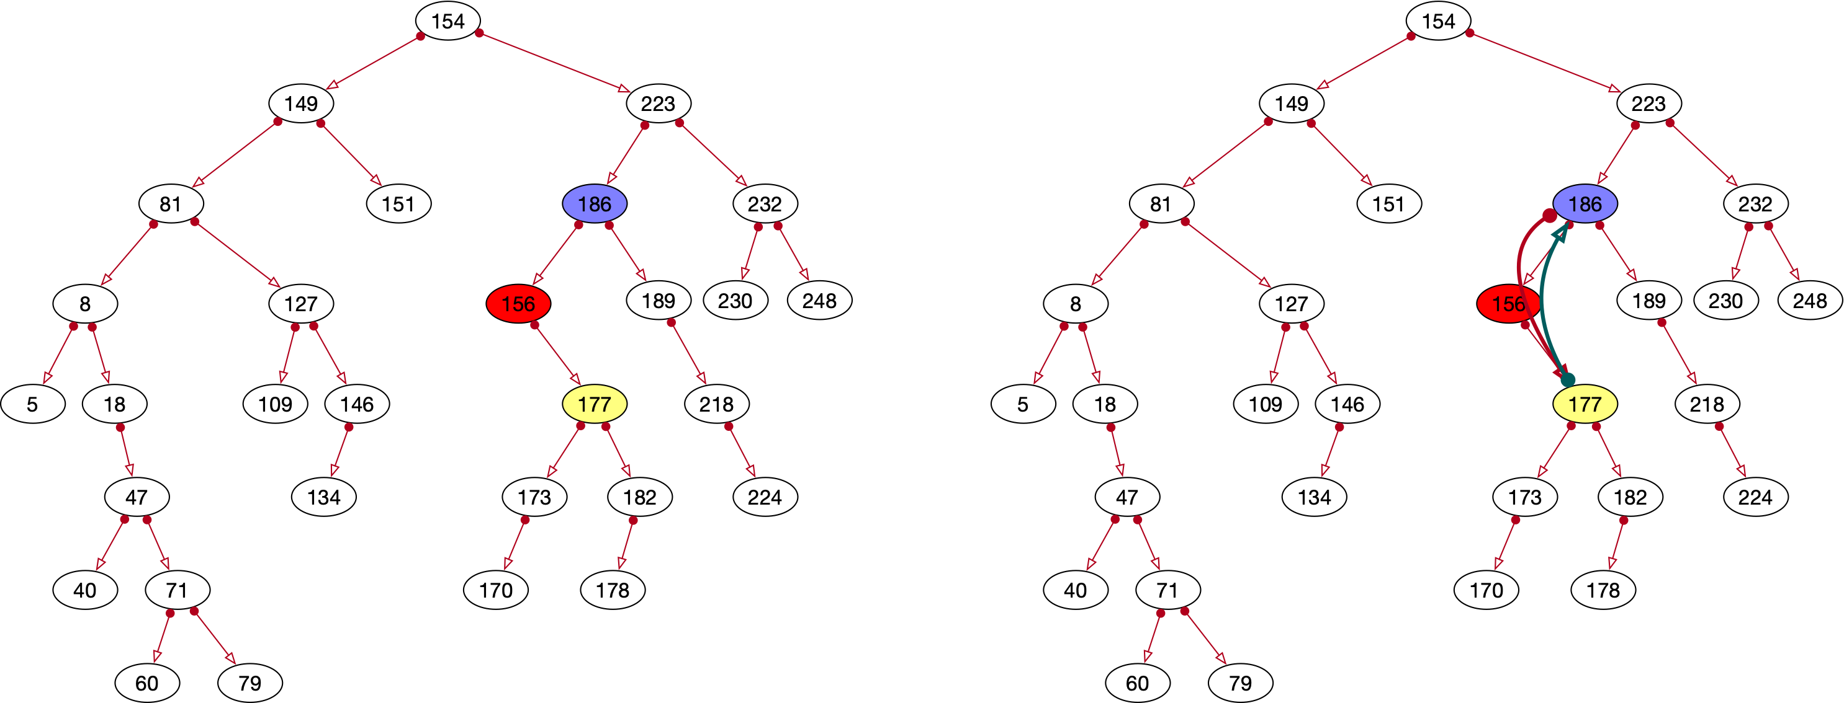
Binary Trees with Parent Link
Removing node with one child
Move child up and reset two links

Slide 16
Binary Trees with Parent Link
Special case if parent is root
elif not to_delete.left and to_delete.right:
# node has only a right child
parent = to_delete.up
if not parent:
self.root = to_delete.right
return True
else:
if parent.left == to_delete:
parent.left = to_delete.right
to_delete.right.up = parent
else:
parent.right = to_delete.right
to_delete.right.up = parent
return True

Slide 17
Binary Trees with Parent Link
Otherwise: reset two links
elif not to_delete.left and to_delete.right:
# node has only a right child
parent = to_delete.up
if not parent:
self.root = to_delete.right
return True
else:
if parent.left == to_delete:
parent.left = to_delete.right
to_delete.right.up = parent
else:
parent.right = to_delete
to_delete.right.up = parent
return True

Slide 18
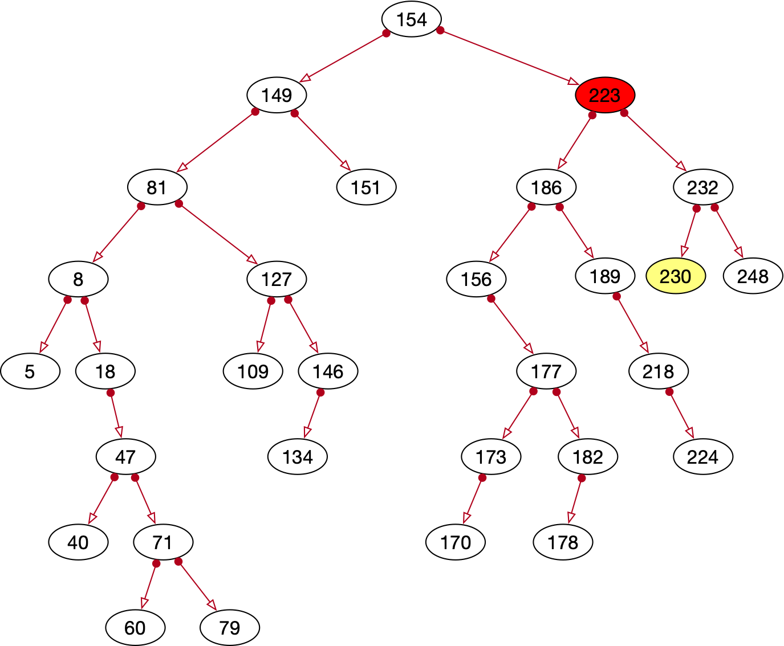
Binary Trees with Parent Link
Two children:
Identify the next node in-order traversal

Slide 19
Binary Trees with Parent Link
Two children:
Find the next node in in-order traversal:
Go to the right: current.right
Then go always to the left
def min_value_node(a_node):
current = a_node
while current.left:
current = current.left
return current

Slide 20
Binary Trees with Parent Link
Two nodes
elif to_delete.left and to_delete.right:
#node has two children
leaf = Binary_Tree.min_value_node(
to_delete.right)
save_value = leaf.value
save_record = leaf.record
self.remove(leaf.value)
to_delete.value = save_value
to_delete.record = save_record

Slide 21
Binary Trees with Parent Link
Safe the values of the resulting leaf
elif to_delete.left and to_delete.right:
#node has two children
leaf =
Binary_Tree.min_value_node(to_delete.right)
print('leaf',leaf)
save_value = leaf.value
save_record = leaf.record
self.remove(leaf.value)
to_delete.value = save_value
to_delete.record = save_record

Slide 22
Binary Trees with Parent Link
Then delete the leaf
I cheat by using recursion
elif to_delete.left and to_delete.right:
#node has two children
leaf =
Binary_Tree.min_value_node(to_delete.right)
print('leaf',leaf)
save_value = leaf.value
save_record = leaf.record
self.remove(leaf.value)
to_delete.value = save_value
to_delete.record = save_record

Slide 23
Binary Trees with Parent Link
Non-recursive in-order traversal
Here is a tree with an additional set of links for in-order traversal

Slide 24
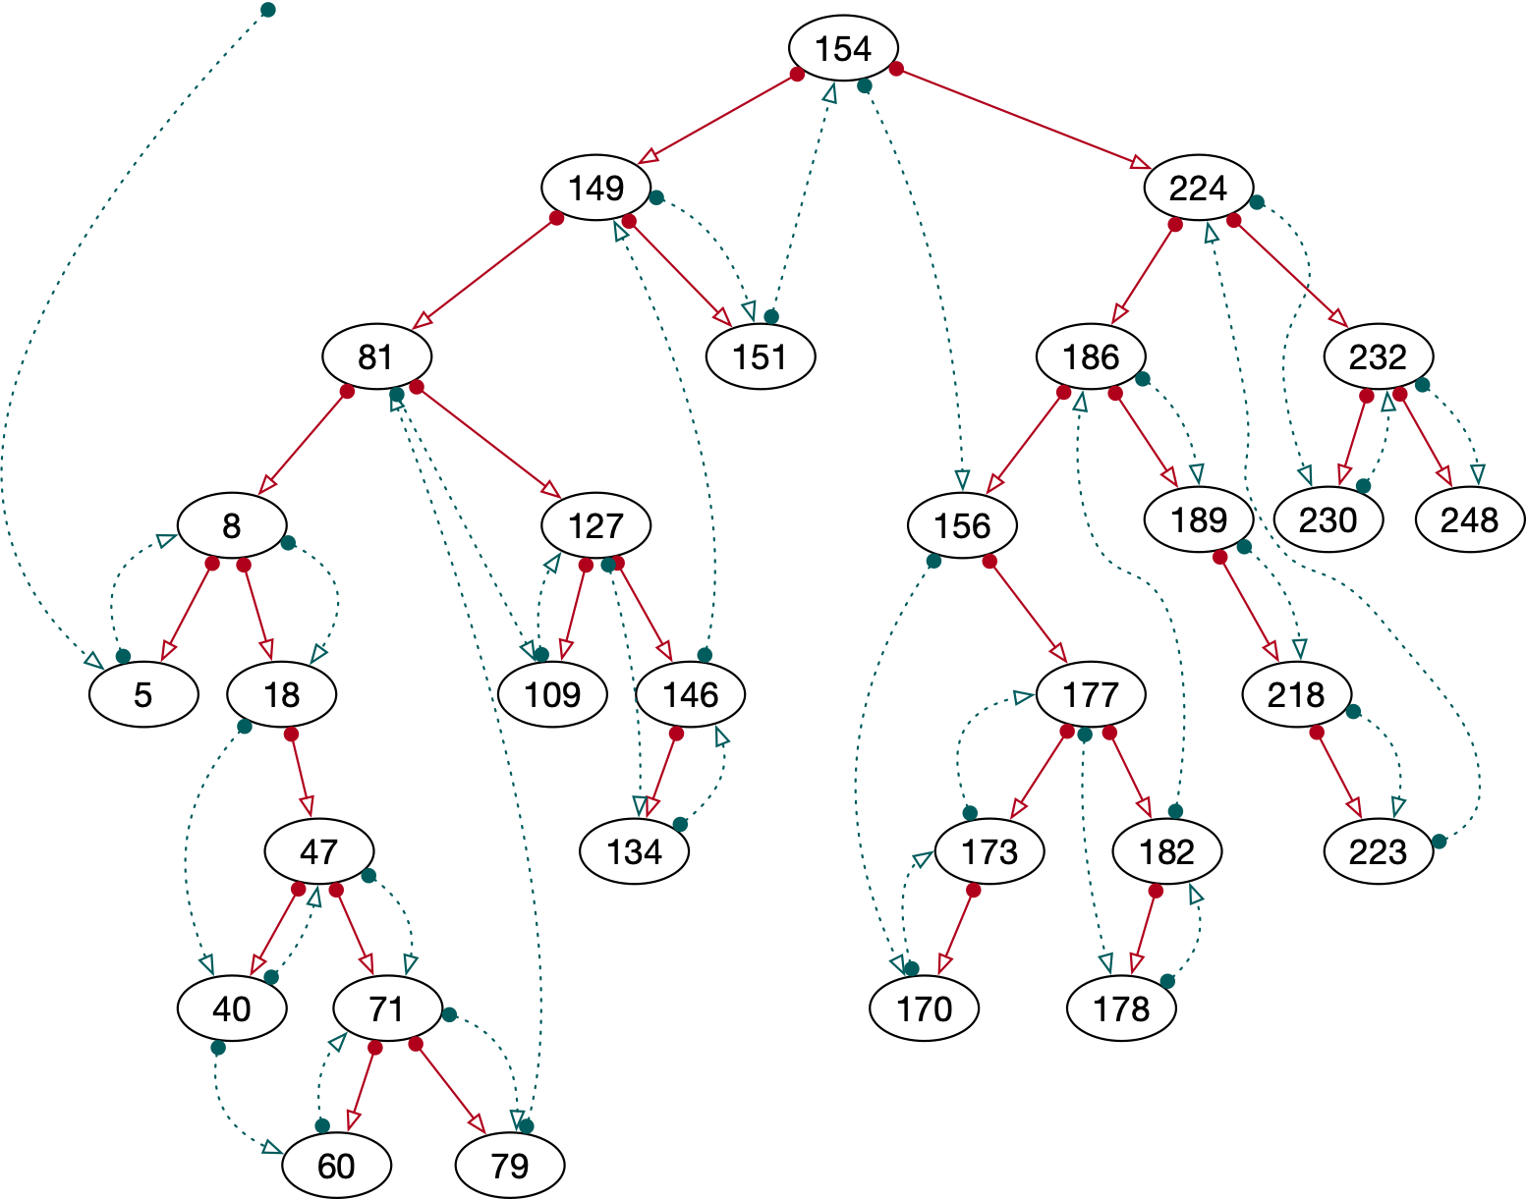

Slide 25
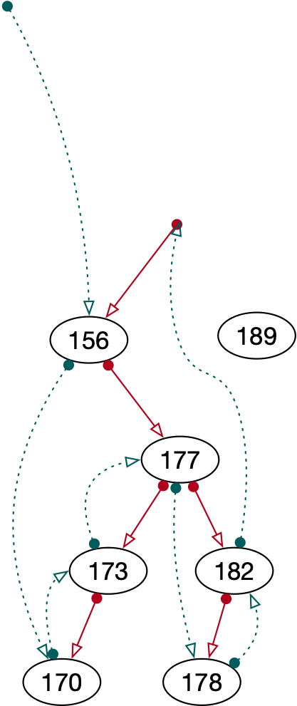
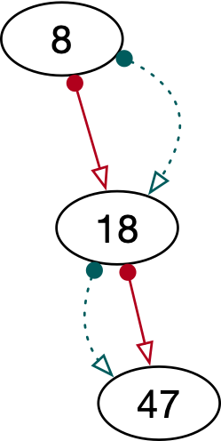
Binary Trees with Parent Link
What is the next node:
If the node has a right child:
Go one to the right, then go to the left as much as possible

Slide 26
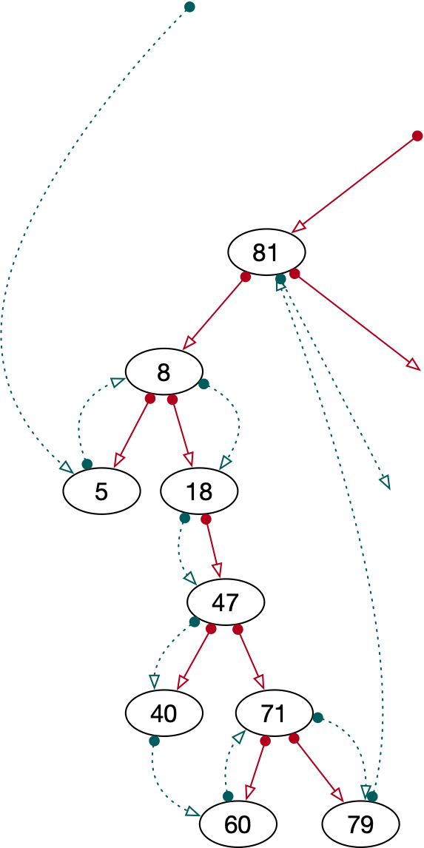
Binary Trees with Parent Link
What is the next node if there is no right child:
If parent is to the left:
Follow parents if they are to the left
Then take the first parent to the right

Slide 27
Binary Trees with Parent Link
Thus:
Can do in-order traversal without a stack or recursion

Slide 28
Binary Trees
using
Arrays

Slide 29
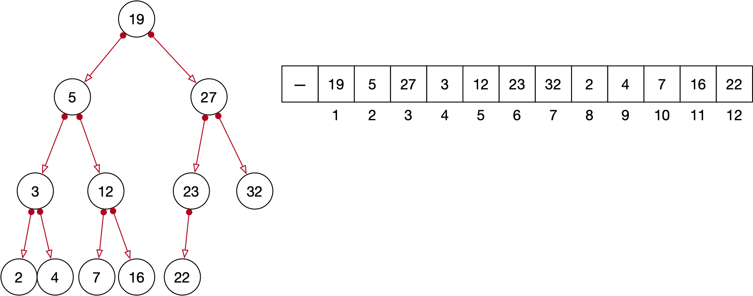
Using Arrays
In a tree, each node has up to two children
Can organize nodes in an array
Leave first spot open

Slide 30
Using Arrays
Left child of node at index $i$
Located at index $2i$
Right child of node at index $i$
Located at index $2i+1$

Slide 31
Using Arrays
Parent of node at index $i$ is located at index $i//2$
Mathematical notation: $⌊\frac{i}{2}⌋$

Slide 32
Using Arrays
Right children are at odd indices, left children are even indices

Slide 33
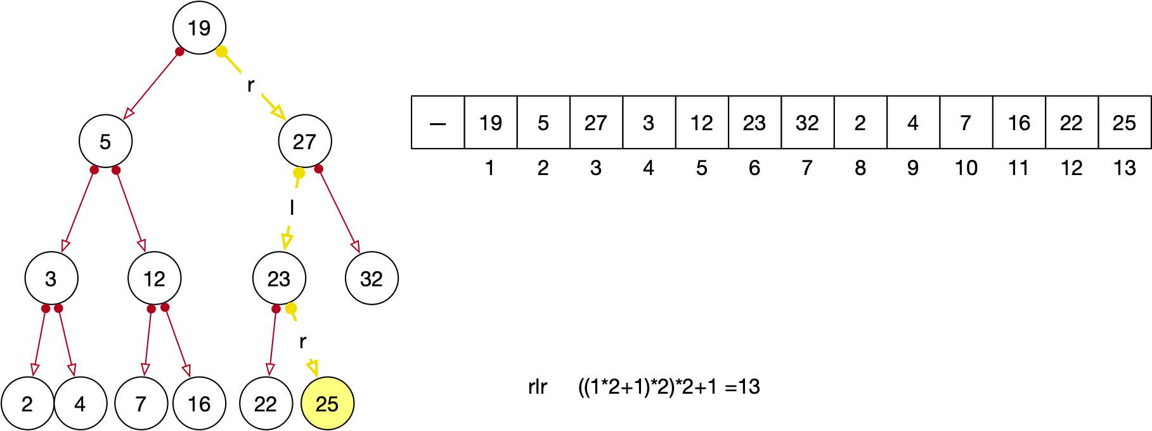
Using Arrays
We can calculate the index if we are given a sequence of directions

Slide 34
Using Arrays
Define $r(n):=2n+1$, $l(n):=2n$
Then node is at index $(o_{m}∘o_{m-1}∘…∘o_{2}∘o_{1})(1)$
where $o_{i}=\{\begin{matrix}l & \text{if we go left in step}i \\ r & \text{if we go right in step}i\end{matrix}$
$$r∘l∘r(1)$$

Slide 35
Using Arrays
Can we do something about the unused first element in the array?
We just need to adjust the index: by adding 1 and subtracting 1

Slide 36
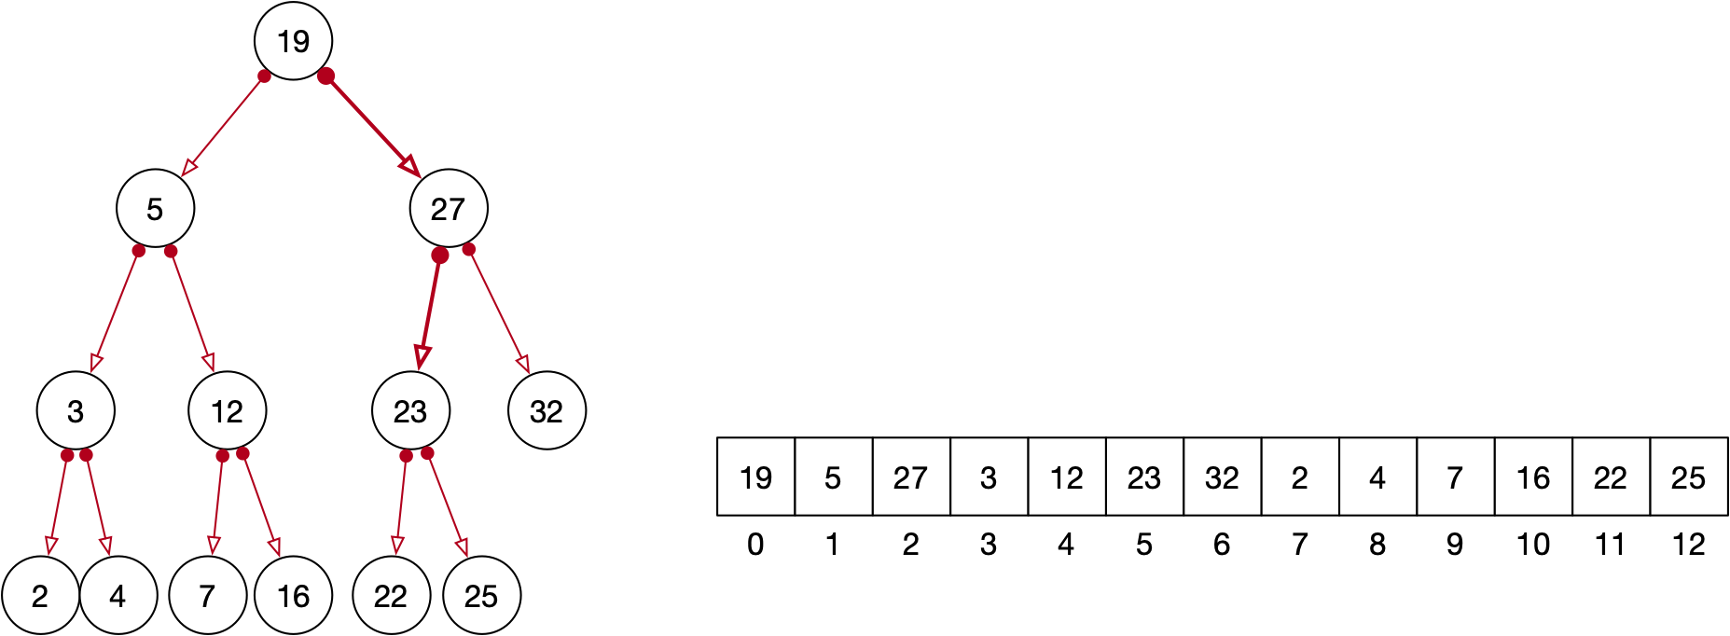
Using Arrays
Children of node $i$ are now $2⋅(i+1)-1=2⋅i+1$ and $(2⋅(i+1)+1)-1=2⋅i+2$

Slide 37
Using Arrays
Parent of a node located at index $i$ is located
at index $⌊\frac{i+1}{2}⌋-1$

Slide 38
Using Arrays
One advantage:
We automatically have a way to find the parent

Slide 39
Priority Queue
ADT with
Insertion
Popping maximum element
Example: insert 5, insert 4, insert 10, pop, insert 7, insert 3, pop, insert 2, pop, pop
Returns on insert 5, insert 4, insert 10, pop, insert 7, insert 3, pop, insert 2, pop, pop: 10
Returns on insert 5, insert 4, insert 10, pop, insert 7, insert 3, pop, insert 2, pop, pop: 7
Returns on insert 5, insert 4, insert 10, pop, insert 7, insert 3, pop, insert 2, pop, pop: 5
Returns on insert 5, insert 4, insert 10, pop, insert 7, insert 3, pop, insert 2, pop, pop: 4

Slide 40
Priority Queues
Simplistic implementation
A list
Whenever we look for an element, we look for the minimum of the list
Run time: Proportional to the length of the list

Slide 41
Priority Queues
Favorite implementation:
Heap:
A complete binary tree
Tree is maximum balanced
That is partially ordered

Slide 42
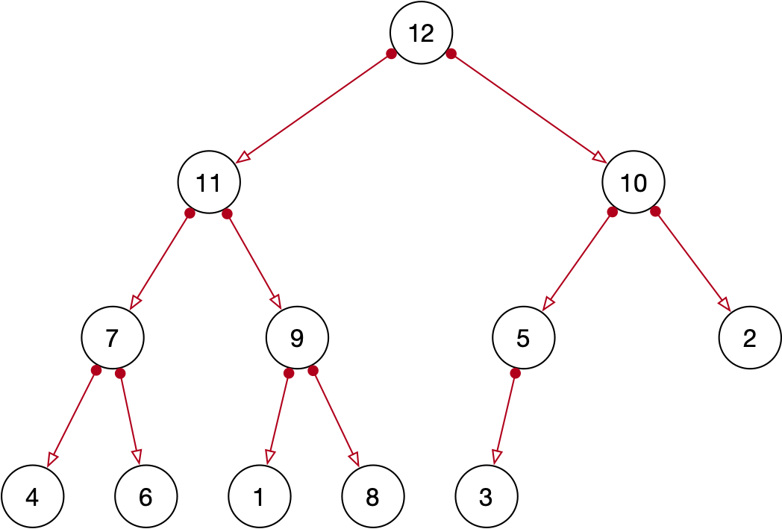
Priority Queues
Heaps as binary tree
Complete:
No nodes missing
Last generation filled from left
Partially ordered:
parent has larger value than child

Slide 43
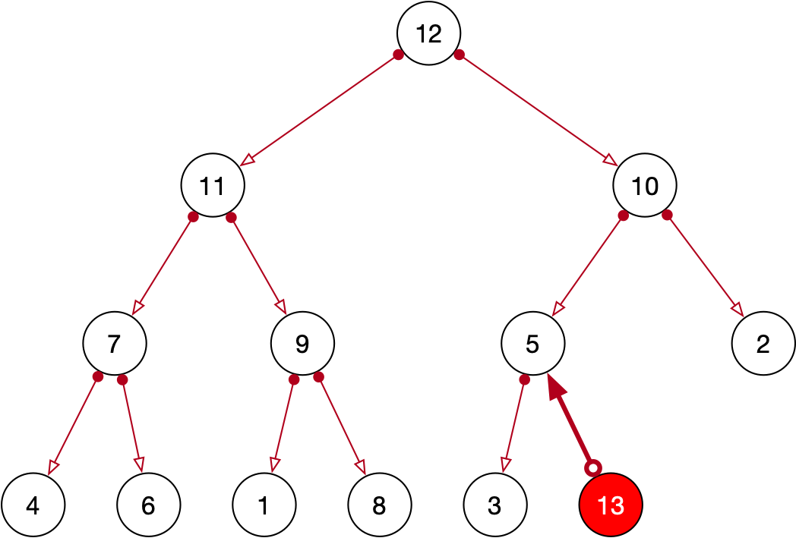
Priority Queues
Operations: Insertion
Insert at the next spot
If the new node is larger than the parent:
swap with parent

Slide 44
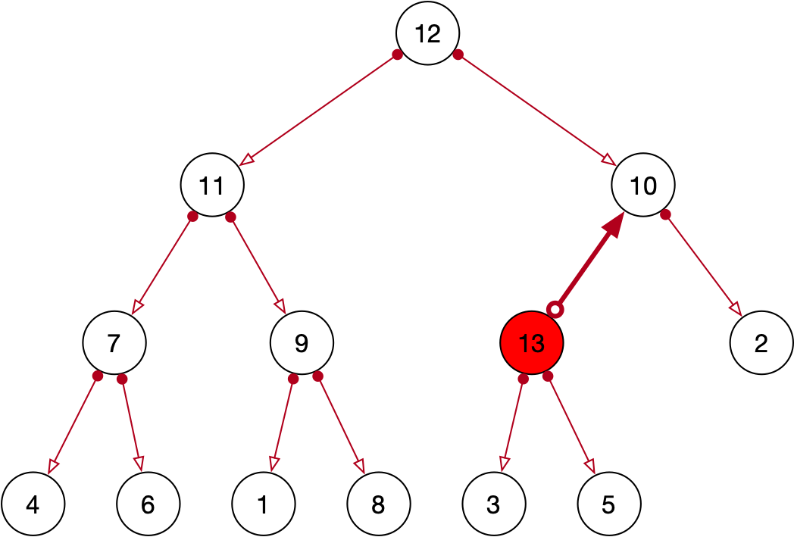
Priority Queues
This is repeated
if necessary

Slide 45
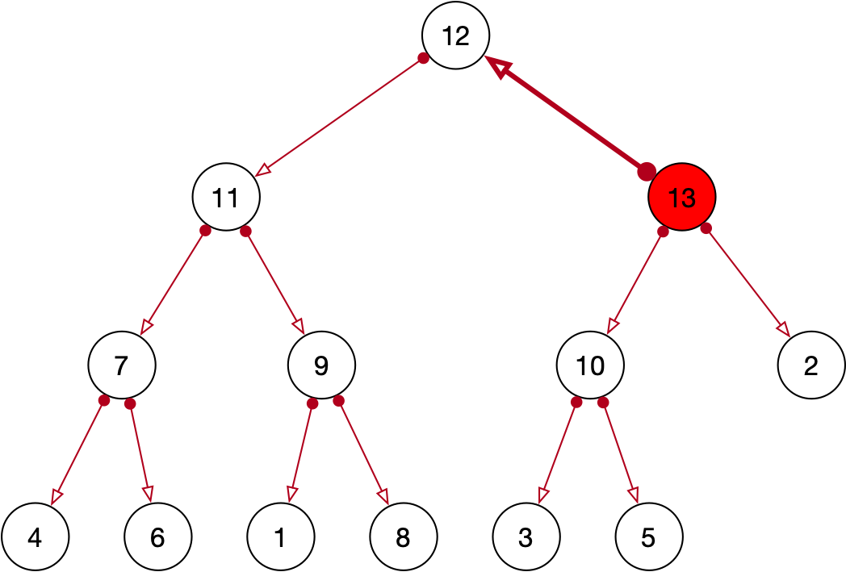
Priority Queues
Notice:
The only violation of order can be with parent

Slide 46
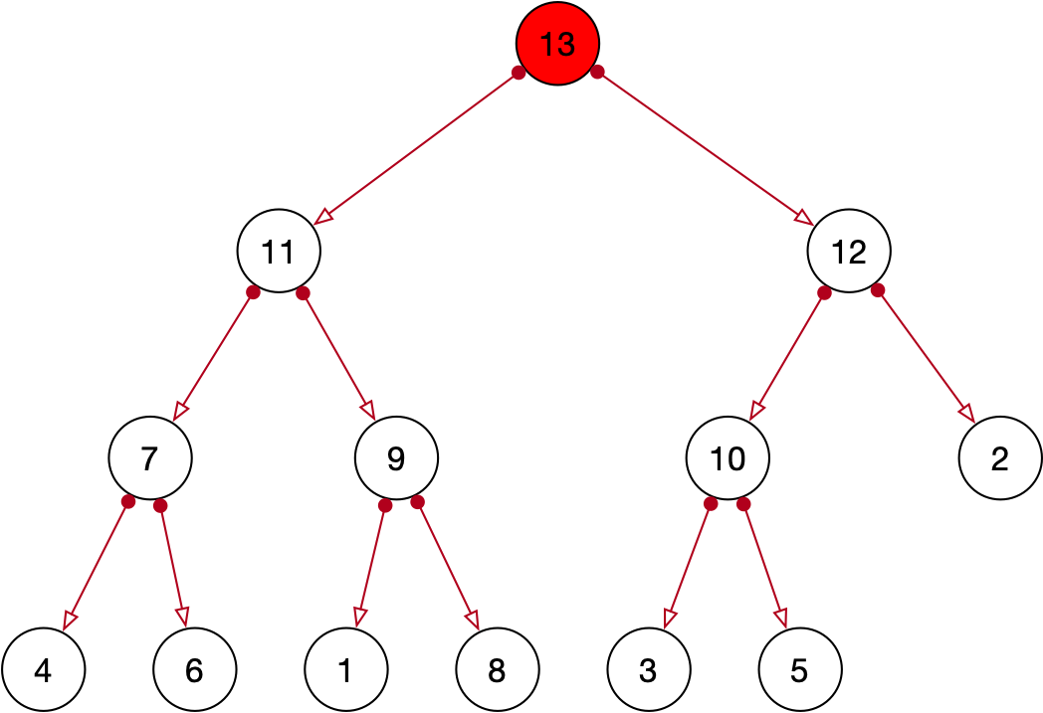
Priority Queues
There are at most $\log_{2}(n)$ swaps
Compared to $n$

Slide 47
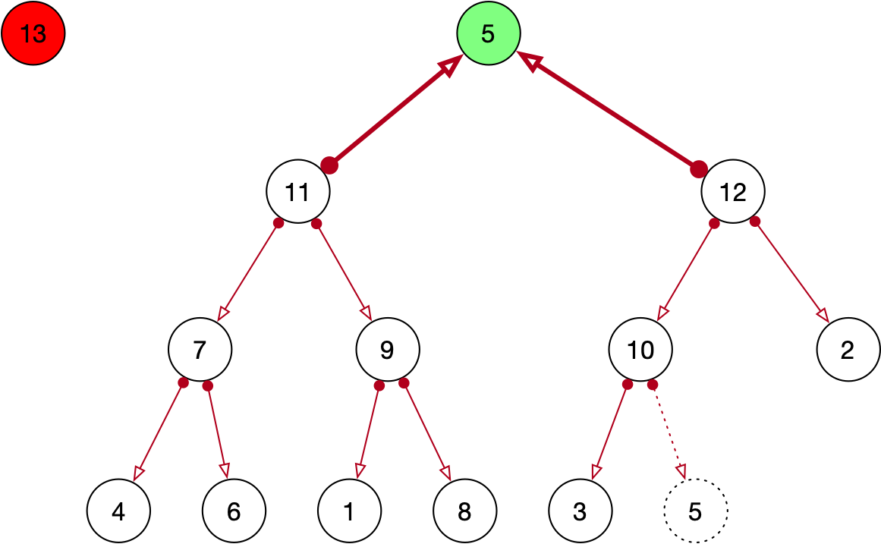
Priority Queues
Remove Maximum:
Maximum is at the top, remove it
Move last element into the top position

Slide 48
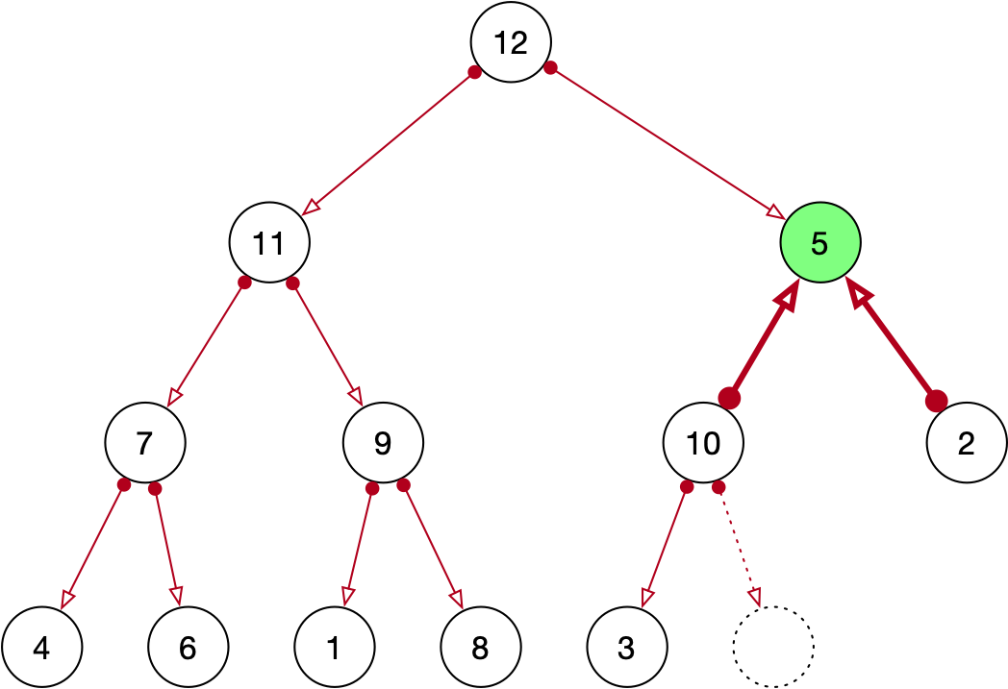
Priority Queues
Then restore the heap property
Move up the larger sibling

Slide 49
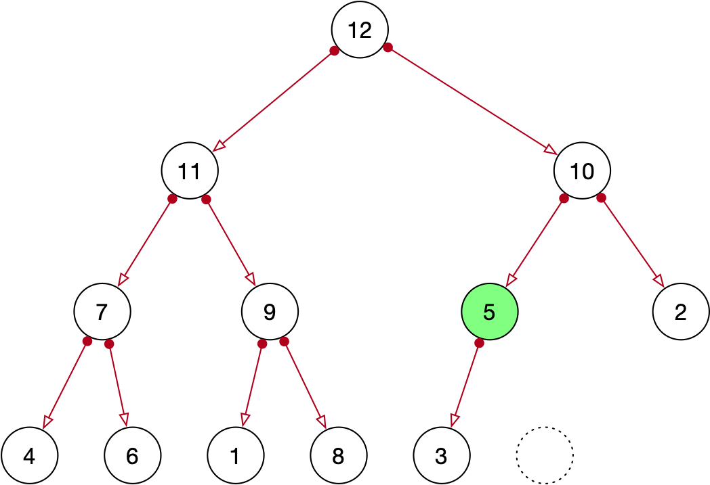
Priority Queues
Until there is no violation

Slide 50
Priority Queues
Implementation:
Need to implement two "heapify" operations
Going up for insert
Going down for extract maximum

Slide 51
Priority Queues
Define a class PQ with class methods for index calculation
class PQ:
def __init__(self):
self.array = []
def up(index):
return (index+1)//2-1
def left(index):
return 2*index + 1
def right(index):
return 2*index + 2

Slide 52
Priority Queues
Insert at the end of the array
but note the index
def insert(self, value):
n = len(self.array)
self.array.append(value)
while n>0:
parent = PQ.up(n)
print(n, parent, 'indices')
if self.array[parent] < value:
self.array[n], self.array[parent] =
self.array[parent], self.array[n]
n = parent
else:
return

Slide 53
Priority Queues
Adjust by swapping with parent
Index of current element is n
def insert(self, value):
n = len(self.array)
self.array.append(value)
while n>0:
parent = PQ.up(n)
print(n, parent, 'indices')
if self.array[parent] < value:
self.array[n], self.array[parent] =
self.array[parent], self.array[n]
n = parent
else:
return

Slide 54
Priority Queues
Calculate the parent node
def insert(self, value):
n = len(self.array)
self.array.append(value)
while n>0:
parent = PQ.up(n)
if self.array[parent] < value:
self.array[n], self.array[parent] =
self.array[parent], self.array[n]
n = parent
else:
return

Slide 55
Priority Queues
And swap if necessary
def insert(self, value):
n = len(self.array)
self.array.append(value)
while n>0:
parent = PQ.up(n)
if self.array[parent] < value:
self.array[n], self.array[parent] =
self.array[parent], self.array[n]
n = parent
else:
return

Slide 56
Priority Queues
Then reset the index
def insert(self, value):
n = len(self.array)
self.array.append(value)
while n>0:
parent = PQ.up(n)
print(n, parent, 'indices')
if self.array[parent] < value:
self.array[n], self.array[parent] =
self.array[parent], self.array[n]
n = parent
else:
return

Slide 57
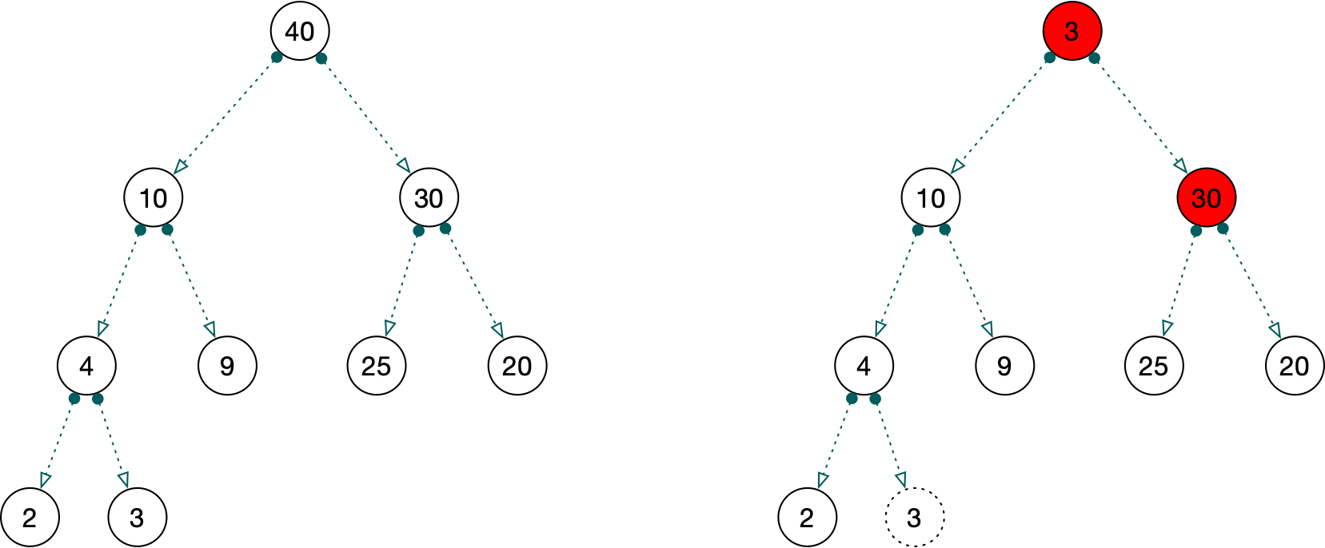
Priority Queues
Extract maximum:
Maximum is always at position 0
Swap its value with the last element in the array
Then heapify:

Slide 58
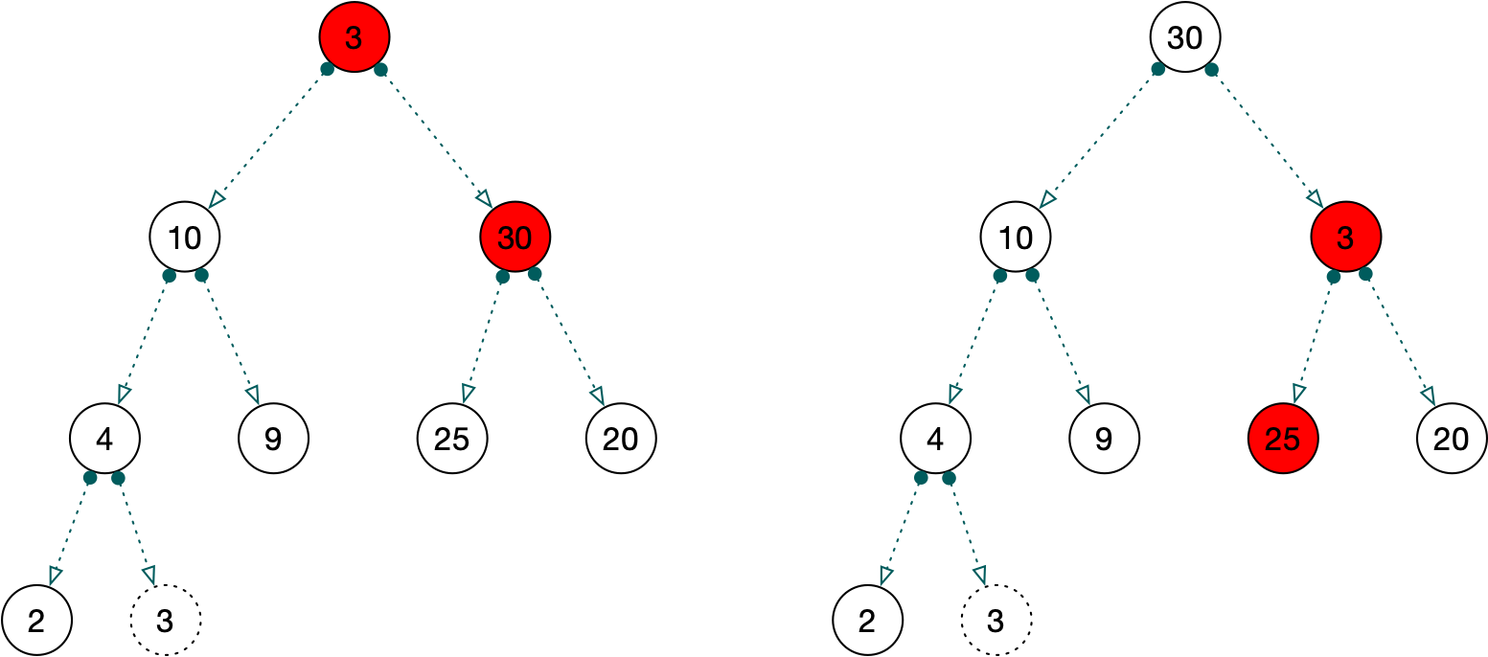
Priority Queues
This is also recursive, but proceeds from top to bottom

Slide 59
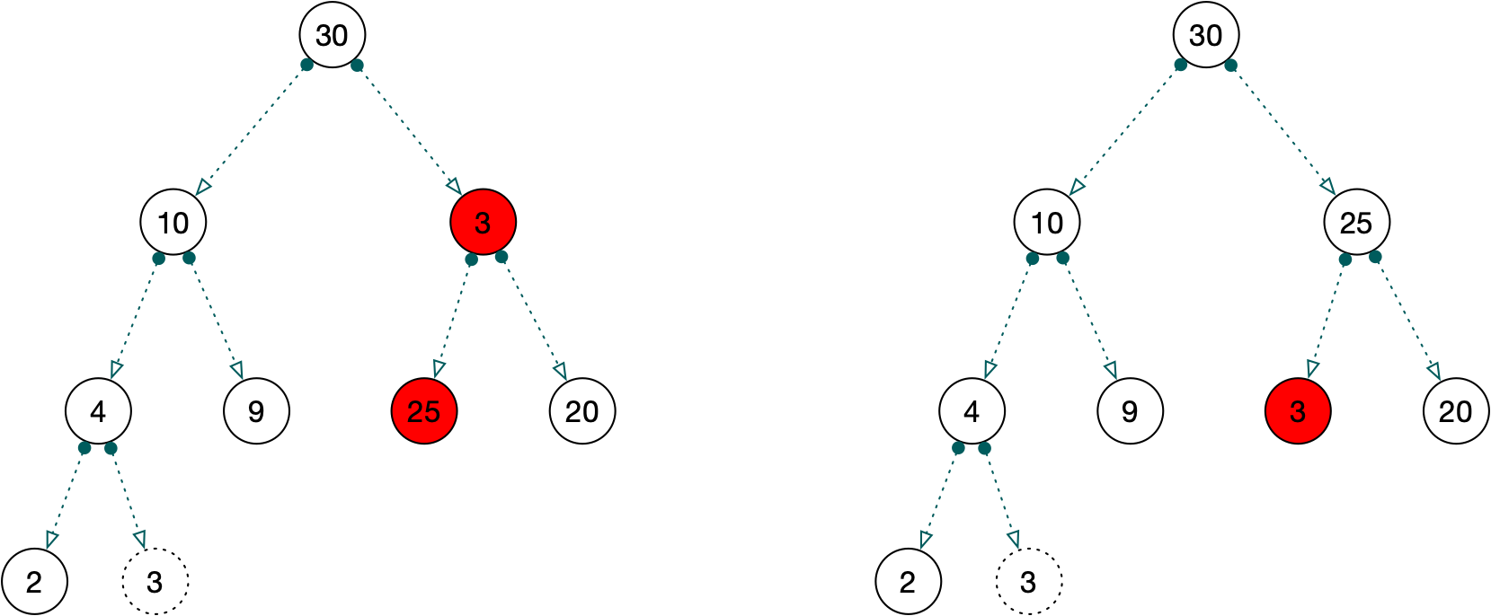
Priority Queues

Slide 60
Priority Queues
Swap last and first node
Delete from node
def get_max(self):
ret_val = self.array[0]
last = self.array[-1]
del self.array[-1]
self.array[0] = last
n=0

Slide 61
Priority Queues
Now recursively recover the heap property
Make case distinctions according to whether
both children exist
only the left child exist
no children present

Slide 62
Priority Queues
Both children exist
def get_max(self):
...
while n < len(self.array):
left = PQ.left(n)
right = PQ.right(n)
if right < len(self.array):
if self.array[n] > self.array[left] and
self.array[n] > self.array[right]:
return ret_val
if self.array[left] < self.array[right]:
m = right
else:
m = left
self.array[n], self.array[m] = self.array[m], self.array[n]
n = m

Slide 63
Priority Queues
Heap property is not violated
def get_max(self):
...
while n < len(self.array):
left = PQ.left(n)
right = PQ.right(n)
if right < len(self.array):
if self.array[n] > self.array[left] and
self.array[n] > self.array[right]:
return ret_val
if self.array[left] < self.array[right]:
m = right
else:
m = left
self.array[n], self.array[m] = self.array[m], self.array[n]
n = m

Slide 64
Priority Queues
Select the larger of the two children for swapping
def get_max(self):
...
while n < len(self.array):
left = PQ.left(n)
right = PQ.right(n)
if right < len(self.array):
if self.array[n] > self.array[left] and
self.array[n] > self.array[right]:
return ret_val
if self.array[left] < self.array[right]:
m = right
else:
m = left
self.array[n], self.array[m] =
self.array[m], self.array[n]
n = m

Slide 65
Priority Queues

Slide 66
Priority Queues
Swap
def get_max(self):
...
while n < len(self.array):
left = PQ.left(n)
right = PQ.right(n)
if right < len(self.array):
if self.array[n] > self.array[left] and
self.array[n] > self.array[right]:
return ret_val
if self.array[left] < self.array[right]:
m = right
else:
m = left
self.array[n], self.array[m] =
self.array[m], self.array[n]
n = m

Slide 67
Priority Queues
Swap
def get_max(self):
...
while n < len(self.array):
left = PQ.left(n)
right = PQ.right(n)
if right < len(self.array):
if self.array[n] > self.array[left] and
self.array[n] > self.array[right]:
return ret_val
if self.array[left] < self.array[right]:
m = right
else:
m = left
self.array[n], self.array[m] =
self.array[m], self.array[n]
n = m

Slide 68
Priority Queues
And do not forget to set yourself up for recursion
def get_max(self):
...
while n < len(self.array):
left = PQ.left(n)
right = PQ.right(n)
if right < len(self.array):
if self.array[n] > self.array[left] and
self.array[n] > self.array[right]:
return ret_val
if self.array[left] < self.array[right]:
m = right
else:
m = left
self.array[n], self.array[m] =
self.array[m], self.array[n]
n = m

Slide 69
Priority Queues
Only one child can exist (but then it has to be the left one)
Heap property might not be violated
elif left < len(self.array):
if self.array[n] > self.array[left]:
return ret_val
m = left
self.array[n], self.array[m] =
self.array[m], self.array[n]
n = m

Slide 70
Priority Queues
Only one child can exist (but then it has to be the left one)
But if it is, we have only one candidate for swapping
elif left < len(self.array):
if self.array[n] > self.array[left]:
return ret_val
m = left
self.array[n], self.array[m] =
self.array[m], self.array[n]
n = m

Slide 71
Priority Queues
Per defensive programming, we pretend that we might have to go on:
elif left < len(self.array):
if self.array[n] > self.array[left]:
return ret_val
m = left
self.array[n], self.array[m] =
self.array[m], self.array[n]
n = m

Slide 72
Priority Queues
Difficult Homework:
Extract Maximum and insertion of a new element are sometimes combined
In this case, we can save work by:
inserting the new element at the beginning of the array
work ourselves downwards to restore the heap property
Implement this

Slide 73
Priority Queues
Other operations:
peek
returns the maximum, but does not remove it
is_empty
checks whether the array is empty

Slide 74
Priority Queues
Costs of operations
Priority queue with $n$ elements uses $\log_{2}(n)$ steps in order to heapify
Peek and is_empty run in constant time

Slide 75
Priority Queues
Python implementation of priority queues
heapq implements a minimum heap
Uses a Python list
heapq.heappush(lista, element)
heapq.heappop(lista)

Slide 76
Priority Queues
This is an efficient implementation
We can "kludge" a max heap implementation for integers by observing that the maximum of numbers is the negative of the negative integers
def smallpush(lista, element):
heapq.heappush(lista, -element)
def smallpop(lista):
return -heapq.heappop(lista)

Slide 77
Running Medians
Task:
We are given a stream of numbers
At any time, want to be able to determine the median of these numbers
Example:
We get 5, 3, 1, 10, 2
Median is now 3
We then get 12, 1, 2
We have seen 1,1,2,2,3,5,10,12
Median is now 2.5 (mean of 2 and 3)

Slide 78
Running Medians
Naïve implementation
Just keep an ordered list around
Better way:
Keep two sublists of equal size
Small and Big
All elements in Small are smaller than all elements in Big
Use heaps in order to easily extract the maximum of Small and the minimum of Big

Slide 79
Running Medians
Adding a new number:
If the left heap is smaller, then insert there
If the left and right heap have equal size, insert in the right heap
But need to maintain the invariant:
All elements in the left heap are smaller (or equal) than all elements in the right heap

Slide 80
Running Medians
Example: Inserting 5 into
Left: 0, 1, 1, 2, 2 Right: 3, 4, 6, 7, 7, 9
We need to insert into Left, but this violates the invariant
Extract the minimum from right (3)
Add the minimum to the left
Add 5 to right
Left: 0, 1, 1, 2, 2, 3 Right: 4, 5, 6, 7, 7, 9

Slide 81
Running Medians
Insert another 5:
Left: 0, 1, 1, 2, 2, 3 Right: 4, 5, 6, 7, 7, 9
Rule say insert to the Right:
Since max(left) < 5:
No problem:
Left: 0, 1, 1, 2, 2, 3 Right: 4, 5, 5, 6, 7, 7, 9

Slide 82
Running Medians
Insert another 5:
Insert into Left:
But min(right) = 4 which is smaller than 5
Inserting 5 into left violates the invariant
Need to do something about it:
Extract minimum from Right
Insert this minimum into Left
Insert new element into Right
Left: 0, 1, 1, 2, 2, 3, 4 Right: 5, 5, 6, 7, 7, 9

Slide 83
Running Medians
Calculating medians:
If len(Left) < len(Right):
Median is peek(Right)
Otherwise:
Median is (peek(Right)+peek(Left))/2

