Slide 1
Hashing
Thomas Schwarz, SJ

Slide 2
Dictionary
ADS for key-value pairs
  CRUD operations:
    Create
    Read
    Update
    Delete
  Does not assume nor support ordering of keys

Slide 3
Dictionary
Example:
  A compiler takes a variable name (= key)
  and associates various data such as type etc. (value)

Slide 4
Direct Addressing
If the key space is small
  Use Direct Addressing
    Array for all possible key values with pointers to values
    Null-pointers (None) if key not in the dictionary

Slide 5
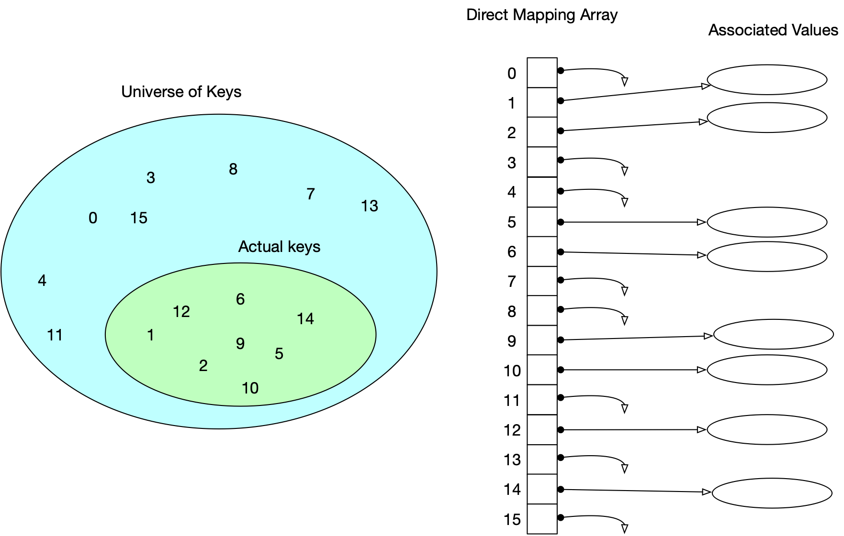
Direct Addressing

Slide 6
Direct Addressing
Direct addressing:
  Number of actual keys needs to be close to the number of possible keys
  Keys need to be convertible to indices

Slide 7
Direct Addressing
Direct addressing:
  Number of actual keys needs to be close to the number of possible keys
  Keys need to be convertible to indices

Slide 8
Direct Addressing
Variants: The value can be stored directly in the array
  E.g.: When the value has fixed length

Slide 9
Hash Tables
If the universe $U$ of keys is large
  Table with $|U|$ entries is too big
  And most of its entries would be Nones
Use a hash function
  $$h:U⟶\{0,1,…,m-1\}$$
  with few collisions
    A collision are two elements of $U$ that map to the same number
    $$u_{1},u_{2}∈U,u_{1}≠u_{2},h(u_{1})=h(u_{2})$$

Slide 10
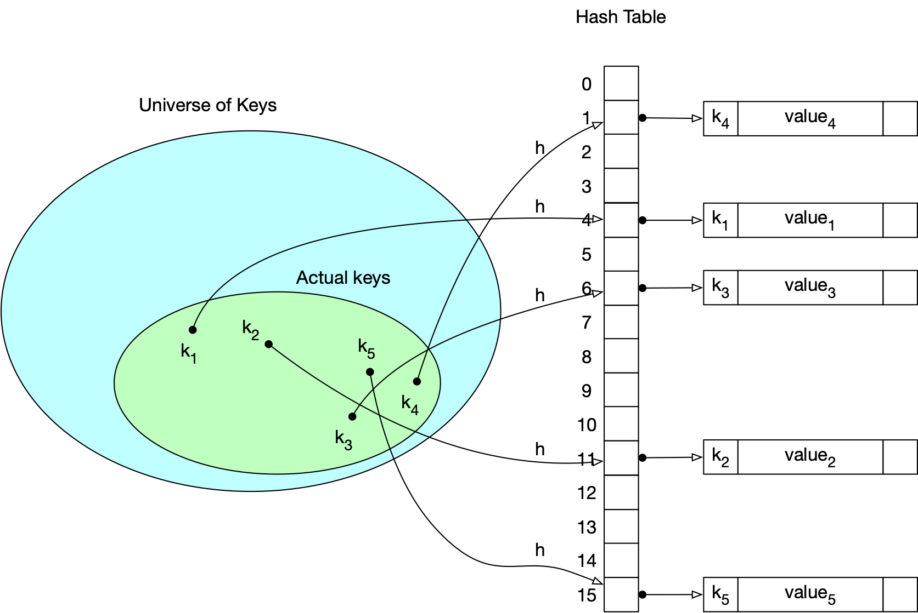
Hash Tables

Slide 11
Hash Tables
Collisions happen and they must be resolved
  Chaining:
    create a linked list of key-value pairs

Slide 12
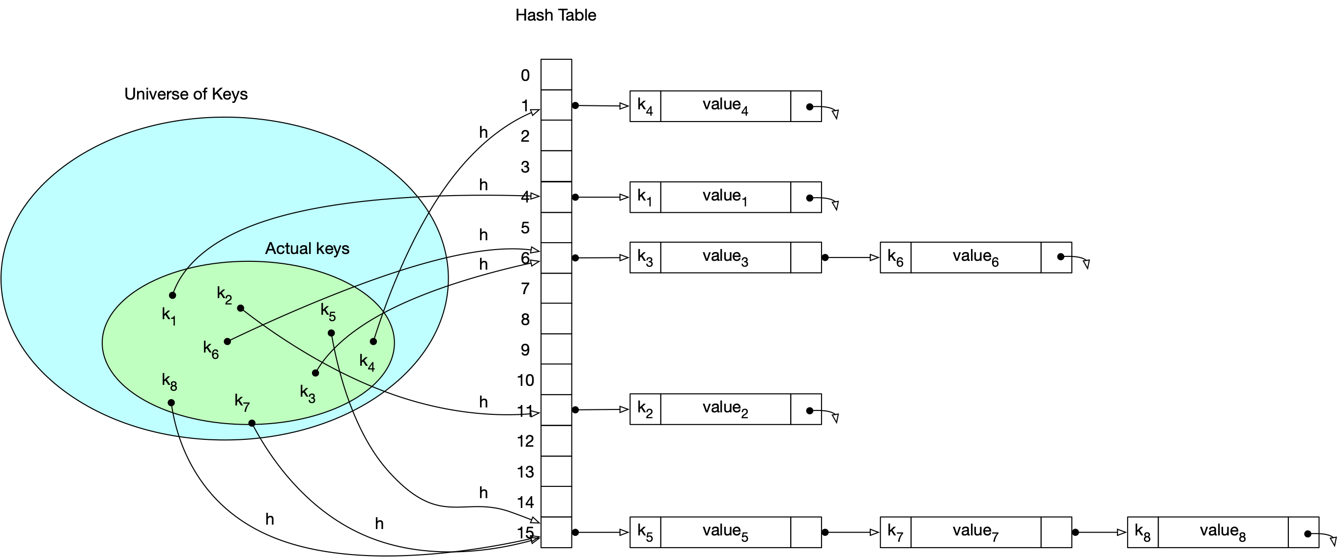
Hash Tables

Slide 13
Hash Tables
Bucketing
  A linked list is not necessarily the best way to store key-value pairs
  If the hash table is large, the data will be stored in the pages of a storage system
  Can have buckets with a given maximum capacity
    However, we might need to have overflow buckets

Slide 14
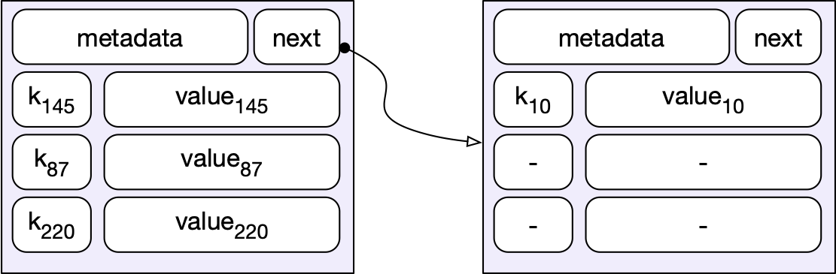
Hash Tables
A potential design for buckets:
  Each bucket has a next pointer to an overflow area
  And in this case a fixed capacity to store key-value pairs
      Here: a full bucket with one overflow record

Slide 15
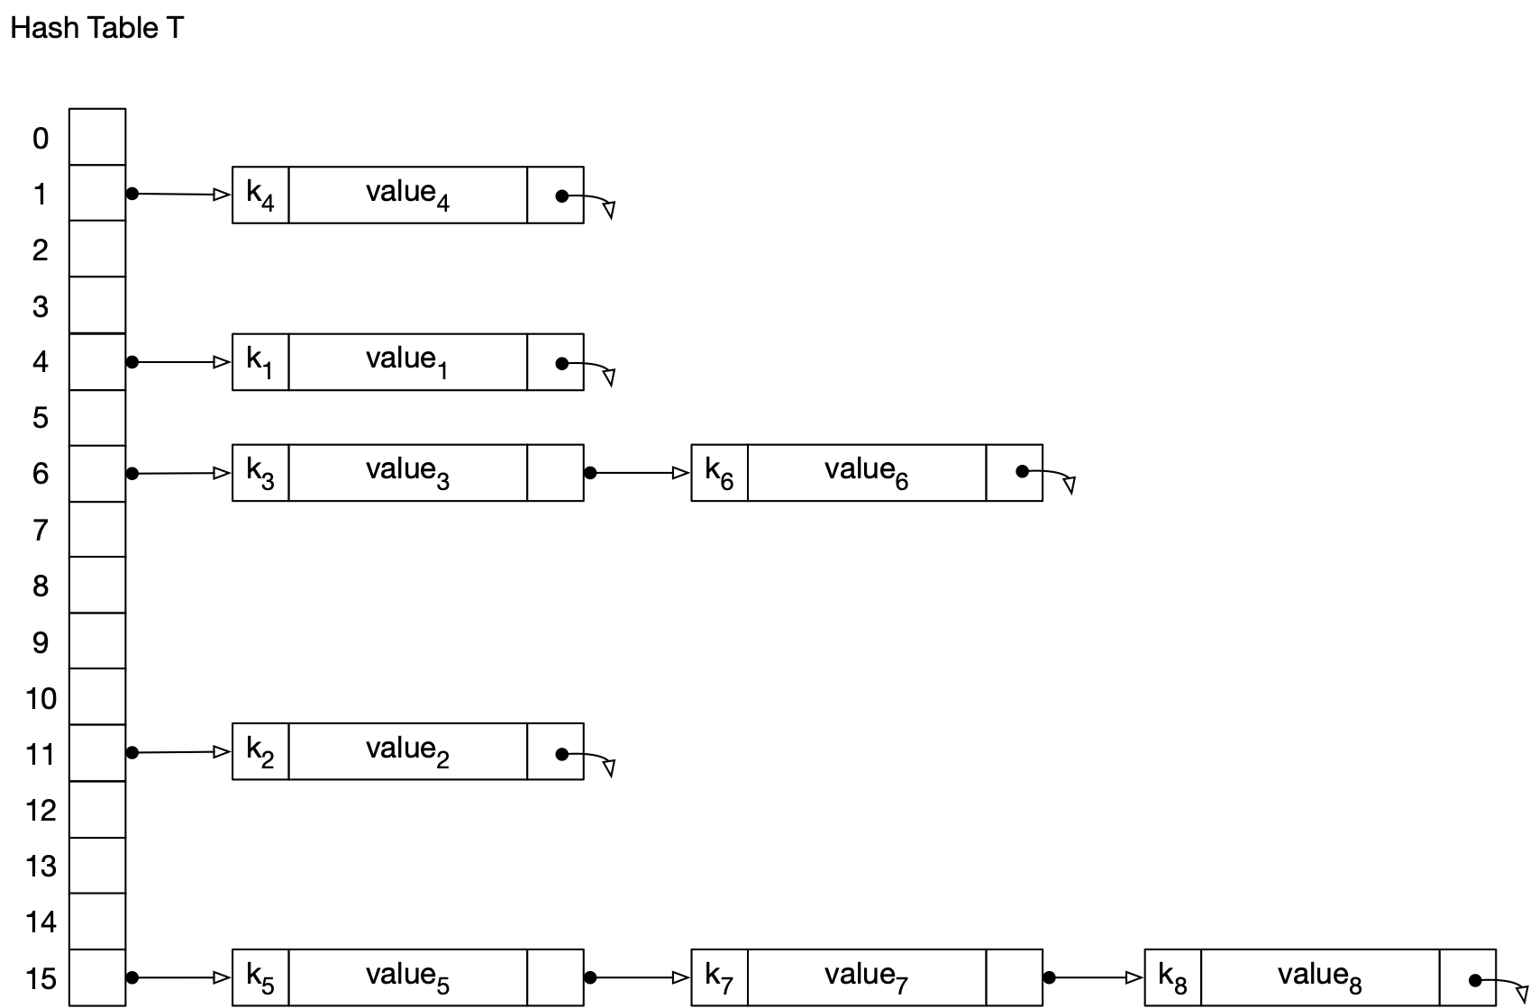
Performance of Hashing with Chaining
Vocabulary:
  A hash table $T$ has $m$ slots
  with $n$ records.
  Its load factor is $α=n/m$.
$m$ = 16
$n$ = 8
$$α=\frac{1}{2}$$

Slide 16
Performance of Hashing with Chaining
Worst performance:
  The hash function maps all record keys to the same slot
  Finding a key-value pair then takes
    $n$ accesses to a key-value pair if the record is not there
    On average $(n+1)/2$ accesses if the record is there
      because $(1+2+…+n)/n=\frac{(n+1)n}{2n}=\frac{n+1}{2}$

Slide 17
Performance of Hashing with Chaining
Why would this happen:
  The hash function is bad
    This happens if people make up their own hash functions
  The data is cooked
    "Adversary model": Evaluate algorithms and ADS by finding the worst possible instance of data
    Someone controls the input and is attacking your system
  Bad luck
    Murphy's law: If something bad can happen, it will happen eventually

Slide 18
Performance of Hashing with Chaining
Average performance analysis:
  Assume that a hash function is equally likely to send a record to a certain slot
  This can be de facto guaranteed with cryptographically secure hash functions (see below)

Slide 19
Performance of Hashing with Chaining
Call $n_{i}$ the number of records (= key-value pairs) that are hashed to slot $i$ ($i∈\{0,1,…,n-1\}$)
Then $n_{0}+n_{1}+…n_{m-2}+n_{m-1}=n$
Expected number of records accessed for an unsuccessful search:
  Equal to the length of the chain, i.e. to $n_{i}$
  On average: $\frac{n_{0}+n_{1}+n_{2}+…+n_{m-2}+n_{m-1}}{m}=\frac{n}{m}=α$
  Total expected work: Need to calculate the hash function etc.
    $Θ(1+α)$ (the one because $α$ can be zero.)

Slide 20
Performance of Hashing with Chaining
Successful search:
  In a list of $r$ records, we access on average $\frac{r+1}{2}$ records
  If each record were in a random slot:
    Average number of records accessed during a successful search is therefore
      $$\frac{\frac{n_{0}+1}{2}+\frac{n_{1}+1}{2}+…\frac{n_{m-2+1}}{2}+\frac{n_{m-1}+1}{2}}{m}$$
      $$=\frac{n_{0}+n_{1}+…+n_{m-2}+n_{m-1}+m}{2m}$$
      = $\frac{n+m}{2m}=\frac{1}{2}α+1=Θ(1+α)$

Slide 21
Performance of Hashing with Chaining
Successful search:
  But records are more likely to be in full slots
  Therefore, this analysis is false
    Probability that two keys are in the same slot is $\frac{1}{m}$
    A search for a record visits exactly those records that:
      Are in the same slot
      And have been inserted before

Slide 22
Performance of Hashing with Chaining
Order all records $[k_{0},v_{0}],[k_{1},v_{1}],…,[k_{n-1},v_{n-1}]$ by insertion
  Then search for $k_{i}$ touches all records with $k_{0},k_{1},…,k_{i-1}$
    But only if they are inserted into the same slot
      which happens with probability $\frac{1}{m}$
  Therefore:
    Search for record $i$ looks at $\frac{i}{m}$ records plus itself

Slide 23
Performance of Hashing with Chaining
Search for record $i$ looks at $\frac{i}{m}$ records plus itself
On average:
  $\frac{1}{n}\left(\overset{n-1}{\underset{i=0}{∑}}(\frac{i}{m}+1)\right)$
  $=1+\frac{1}{nm}\overset{n-1}{\underset{i=0}{∑}}i$
  $=1+\frac{n(n-1)}{2nm}$
  $=1+\frac{n}{2m}-\frac{1}{2nm}$ = $1+\frac{1}{2}α-\frac{1}{2nm}$

Slide 24
Hash Functions
A good hash function:
  each key is equally likely to hash to any of the $m$ slots
  independently where any other keys are hashed to
Usually cannot be ascertained:
  We do not know enough about the distribution of keys

Slide 25
Hash Functions
Example:
  Assume that keys are random number between 0 and 1
  Good hash function is:
    $$h(k)=⌊k⋅m⌋$$
import random
m=5
def hash(u):
return int(u*m)

Slide 26
Hash Functions
Interpreting keys as natural numbers
  Many hash functions work on natural numbers
  Need to translate to integers:
    Example:
      For strings:
        convert encoding to numerical representation
def str_to_int(astring):
result = 0
for letter in astring:
result = ord(letter) + 256*result
return result

Slide 27
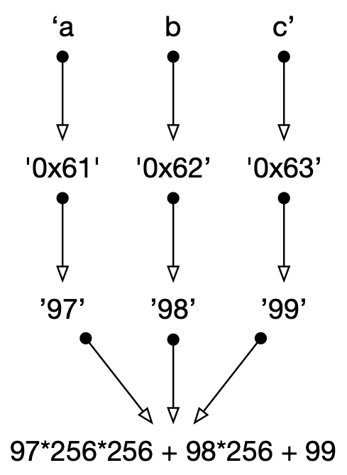
Hash Functions
Example
def str_to_int(astring):
result = 0
for letter in astring:
result = ord(letter) + 256*result
return result

Slide 28
Hash Functions
Caution:
  The transformation and the hash function combination can have weird effects
    E.g. A string obtained by swapping to letters might have the same hash
      Which could be useful or could be very bad

Slide 29
Hash Functions
Simple hash functions:
  Division method:
    Convert keys to integers
    Then hash to the integer obtained as remainder by division with $m$
def hash(key):
      return key_2_int(key)%m

Slide 30
Hash Functions
Division method:
  If $m$ is a power of 2:
    Hash is the last bits
      Which is usually bad
  If $m=2^{p}-1$ and keys are strings:
    swapping two letters does not change the hash value
  Better experience:
    Primes close to a power of 2

Slide 31
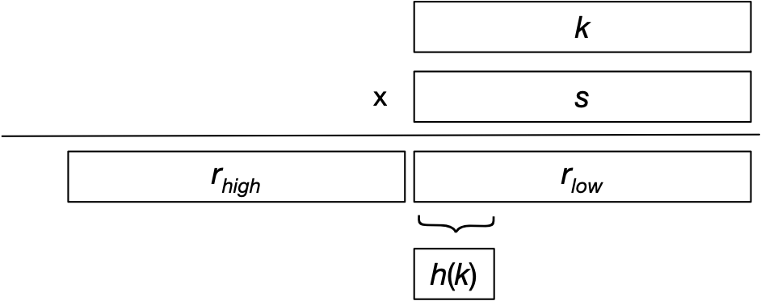
Hash Functions
Multiplication Method:
Key $k$ is a l bit value
Use a constant $s$ of size l bits
Multiply: $ks$, a 2l bit value
Select hash as upper bits of the lower half

Slide 32
Hash Functions
How to select $s$:
  D. Knuth proposes to use the first l bits of $\frac{\sqrt{5}-1}{2}$

Slide 33
Hash Functions
Example:
  32-bit keys
  $$s=⌊(\sqrt{5}-1)/2⌋$$
  Extract 14 bits:
    Shift right by 18 (14+18 = 32)
    Then mask with 14 ones: b11 1111 1111 1111 = 0x3fff
s = int((math.sqrt(5)-1)/2 * 2**32)
def hash(x):
return (s*x >> 18) & 0x3fff

Slide 34
Hash Functions
Cryptographically secure hash functions:
  Hash functions have applications in security
    Instead of storing a password, store the hash of a password together with the user name
      "user_name", h(pass_word)
    When user enters the password:
      System calculates the hash of the entered password
      And compares with the hash

Slide 35
Hash Functions
Cryptographically secure hash functions:
  Generate long hashes (224 - 512 bits)
  If an attacker steals the user database:
    Attacker has only the hash, but not the password
Cryptographically secure hash function $h$:
  Impossible to calculate $x$ from $h(x)$

Slide 36
Hash Functions
This is why you should not choose words in a language as password: "peaches"
  Attacker can try out
    All words in English (~200,000),
    All words in Hindi ShabdSagar (~93,000 - 250,000)

Slide 37
Hash Functions
Secure hash functions are the result of competitions and public scrutiny
  Provide pre-image resistance:
    Impossible to find $x$ from $h(x)$
  Provide collision resistance:
    Impossible to find $x$ and $y$ such that $h(x)=h(y)$
  Certified by NIST and similar institutions
    SHA-3 (NIST)
    Blake3 (latest considered to be safe)

Slide 38
Hash Functions
Should you use cryptographically secure hash functions?
  If your data cannot be generated by an adversary
  If you can live with small inadequacies
    Not necessary
Otherwise:
  Extract as many bits as needed from a cryptographically secure hash function
  Pay the performance costs

Slide 39
Open Addressing Hashing
Idea: Records (= key-value pair) are stored in the hash table itself
  Collisions are resolved by storing a record elsewhere

Slide 40
Open Addressing Hashing
Linear probing:
  If a slot is occupied, go to the next slot

Slide 41
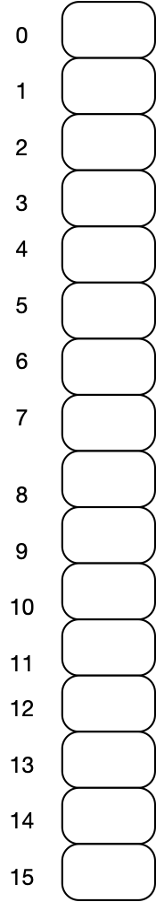
Open Addressing Hashing
Linear Probing Example:
  16 slots
  Hash function %16

Slide 42
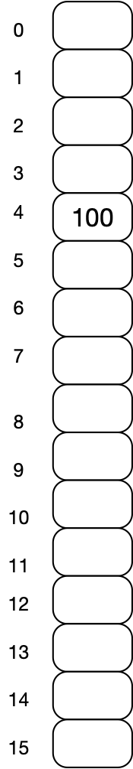
Open Addressing Hashing
Linear Probing Example:
  16 slots
  Hash function %16
  Insert 100
  100%16 = 4
    Insert into slot 4

Slide 43
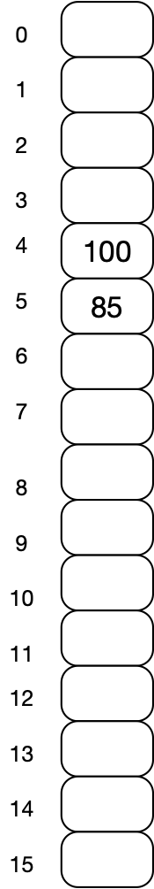
Open Addressing Hashing
Insert 85
85%16 = 5
Insert into slot 5

Slide 44
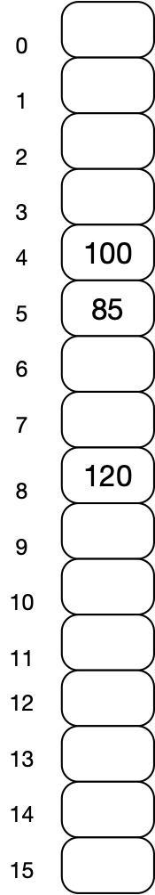
Open Addressing Hashing
Insert 120
  120%16 = 8

Slide 45
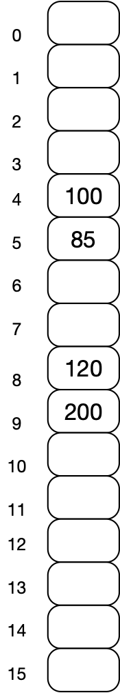
Open Addressing Hashing
Insert 200
  200%16 = 8
  But slot 8 is occupied
  Put into slot 9

Slide 46
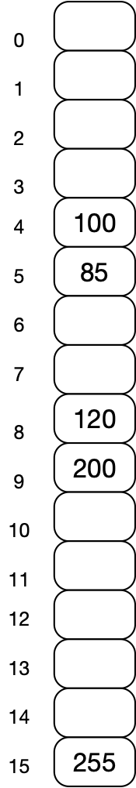
Open Addressing Hashing
Insert 255
  255%16 = 15

Slide 47
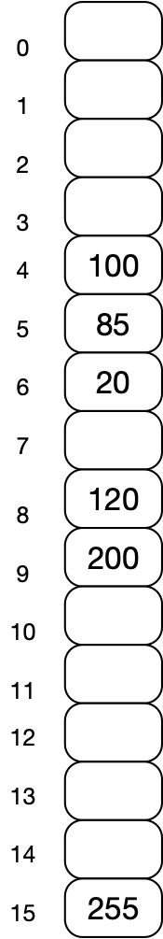
Open Addressing Hashing
Insert 20
  20%16 = 4
  Try slot 4
  Then slot 5
  Then insert into slot 6

Slide 48
Open Addressing Hashing
Linear probing implementation
class Hashtable:
def __init__(self, slots):
self.array = [None]*slots
self.hash = lambda x : x%slots

Slide 49
Open Addressing Hashing
Linear probing implementation
class Hashtable:
def __repr__(self):
retVal = ''
for i in range(len(self.array)):
retVal += '{}: {}\n'.format(i, self.array[i])
return retVal

Slide 50
Open Addressing Hashing
Linear probing implementation
class Hashtable:
def insert(self, key, value):
slot = self.hash(key)
while True:
if self.array[slot]:
slot = (slot+1).len(self.array)
else:
self.array[slot] = (key,value)
return

Slide 51
Open Addressing Hashing
Notice that the next slot can wrap around
  Need to reset it to zero then
class Hashtable:
def insert(self, key, value):
slot = self.hash(key)
while True:
if self.array[slot]:
slot = (slot+1).len(self.array)
else:
self.array[slot] = (key,value)
return

Slide 52
Open Addressing Hashing
Linear probing: Reading
  We need to follow the same sequence of slots
def read(self, key):
slot = self.hash(key)
while True:
if not self.array[slot]:
return None
else:
if key == self.array[slot][0]:
return self.array[slot][1]
else:
slot = (slot+1)%len(self.array)

Slide 53
Open Addressing Hashing
This code contains an unspoken assumption:
  There is a free slot:
    Otherwise, we will loop forever!
def read(self, key):
slot = self.hash(key)
while True:
if not self.array[slot]:
return None
else:
if key == self.array[slot][0]:
return self.array[slot][1]
else:
slot = (slot+1)%len(self.array)

Slide 54
Open Addressing Hashing
E.g. use a for loop
def read(self, key):
slot = self.hash(key)
for i in range(len(self.array)):
if not self.array[slot]:
return None
else:
if key == self.array[slot][0]:
return self.array[slot][1]
else:
slot = (slot+1)%len(self.array)

Slide 55
Open Addressing Hashing
This type of unspoken assumption can destroy your application
  A bug that only happens under very specific circumstances
  Address this by
    limiting the loop to at most $m$ iterations

Slide 56
Open Addressing Hashing
Intuitive Analysis for failed search with probing
  We go to the slot $h(\text{key})$:
      $1$ access
  With probability $α$, that slot is occupied and we need to go to the next one:
      $1+α$ accesses
    With probability $α$, that next one is occupied too, with total probability $α^{2}$:
        $1+α+α^{2}$ accesses

Slide 57
Open Addressing Hashing
Intuitive Analysis for failed search with probing
  In total: $1+α+α^{2}+α^{3}+…$ accesses
  $$=\frac{1}{1-α}$$
E.g.: $α=0.5$: two slots accessed
E.g.: $α=0.9$: ten slots accessed

Slide 58
Open Addressing Hashing
Expected number in a successful search:
  $$\frac{1}{α}\log_{e}(\frac{1}{1-α})$$
E.g.: $α=0.5$ : 1.387 slots accessed
E.g.: $α=0.9$ : 2.559 slots accessed

Slide 59
Open Addressing Hashing
Probe sequence
  Linear probing for key $c$:
    $$h(c),h(c)+1,h(c)+2,…$$
  Can lead to conveying / primary clustering:
    Contiguous areas of slots
Use a secondary hash function $h_{2}$
  Should have a range co-prime to the number of slots
  Linear probing with secondary hash function for key $c$
    $h(c),h(c)+1⋅h_{2}(c),h(c)+2⋅h_{2}(c),h(c)+3⋅h_{2}(c),…$

Slide 60
Open Addressing Hashing
Quadratic probing:
  Use a probe sequence
    $$h(c),h(c)+1^{2},h(c)+2^{2},h(c)+3^{2},h(c)+4^{2},…$$
      wrapping around 0, i.e. modulo $m$

Slide 61
Open Addressing Hashing
In practice:
  Linear probing can still be faster because cache loads transfer contiguous sets of memory

Slide 62
Hashing
Hash schemes work extremely well:
  If load factor can be estimated
If size of the hash table needs to grow dynamically, things are no longer so easy
  Extendible hashing
  Linear hashing

