Slide 1
Linear Hashing

Slide 2
Linear Hashing
Extensible Hashing:
Uses a lot of metadata to reflect history of splitting
But only splits buckets when they are needed
Linear Hashing
Splits buckets in a predefined order
Minimal meta-data
Sounds like a horrible idea, but …

Slide 3
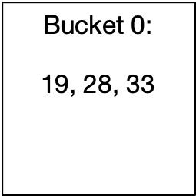
Linear Hashing
Assume a hash function that creates a large string of bits
We start using these bits as we extend the address space
Start out with a single bucket, Bucket 0
All items are located in Bucket 0
Items with keys 19, 28, 33

Slide 4
Linear Hashing
Eventually, this bucket will overflow
E.g. if the load factor is more than 2
Bucket 0 splits
All items in Bucket 0 are rehashed:
Use the last bit in order to determine whether the item goes into Bucket 0 or Bucket 1
Address is
$$h_{1}(c)=c(mod2)$$

Slide 5
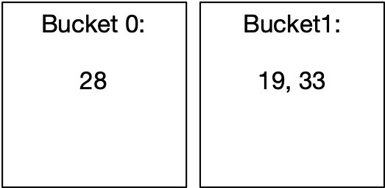
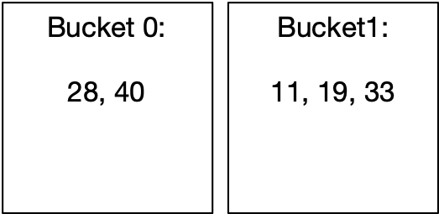
Linear Hashing
After the split, the hash table has two buckets:
After more insertions, the load factor again exceeds 2

Slide 6
Linear Hashing
Again, the bucket splits.
But it has to be Bucket 0
For the rehashing, we now use two bits, i.e.
But only for those items in Bucket 0
$$h_{2}(c)=c(mod4)$$

Slide 7
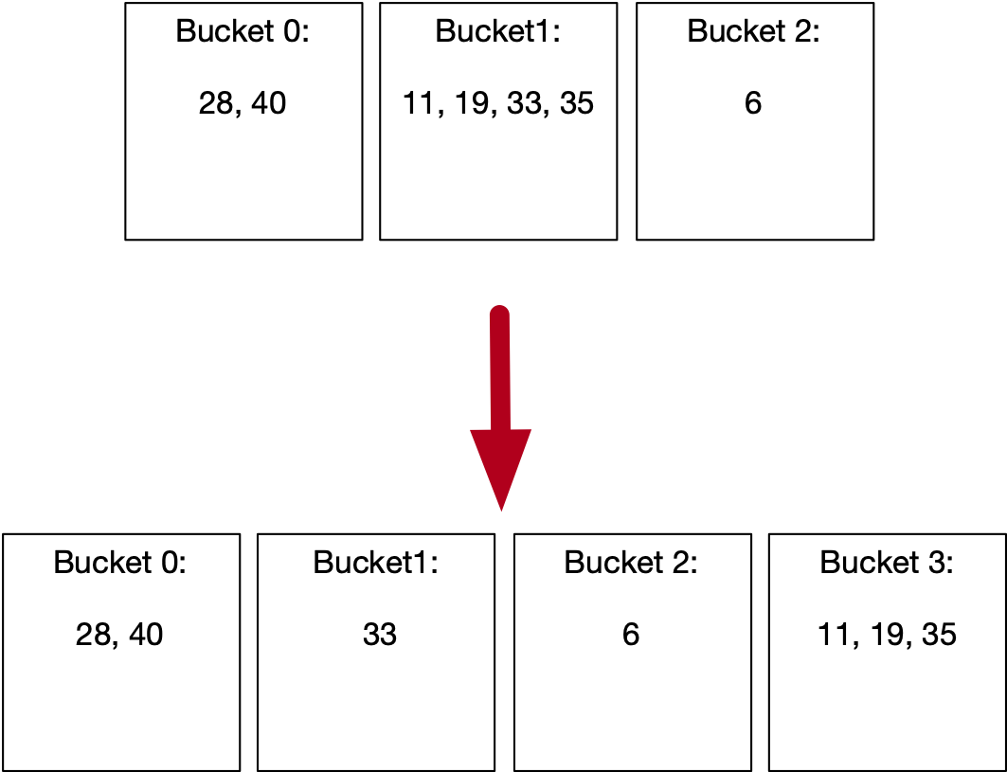
Linear Hashing
After some more insertions, Bucket 1 will split

Slide 8
Linear Hashing
The state of a linear hash table is described by the number of buckets
The level is the number of bits that are being used to calculate the hash
The split pointer points to the next bucket to be split
The relationship is
This is unique, since always
$$N$$
$$l$$
$$s$$
$$N=2^{l}+s$$
$$s<2^{l}$$

Slide 9
Linear Hashing
Addressing function
The address of an item with key is calculated by
This reflects the fact that we use more bits for buckets that are already split
$$c$$
def address(c):
a = hash(c) % 2**l
if a < s:
a = hash(c) % 2**(l+1)
return a

Slide 10
Linear Hashtable Evolution
$$N=1=2^{0}+0$$
def address(c):
a = hash(c) % 2**l
if a < s:
a = hash(c) % 2**(l+1)
return a
Number of buckets: 1
Split pointer: 0
Level: 0

Slide 11
Linear Hashtable Evolution
$$N=2=2^{1}+0$$
def address(c):
a = hash(c) % 2**l
if a < s:
a = hash(c) % 2**(l+1)
return a
Number of buckets: 2
Split pointer: 0
Level: 1
Add items with hashes 40 and 11
This gives an overflow and we split Bucket 0

Slide 12
Linear Hashtable Evolution
$$N=3=2^{1}+1$$
def address(c):
a = hash(c) % 2**l
if a < s:
a = hash(c) % 2**(l+1)
return a
Number of buckets: 3
Split pointer: 1
Level: 1
split Bucket 0
Create Bucket 2
Use new hash function on items in Bucket 0
No items were moved

Slide 13
Linear Hashtable Evolution
$$N=3=2^{1}+1$$
def address(c):
a = hash(c) % 2**l
if a < s:
a = hash(c) % 2**(l+1)
return a
Number of buckets: 3
Split pointer: 1
Level: 1
Add items 6, 35
Because of overflow, we split
Bucket 1

Slide 14
Linear Hashtable Evolution
$$N=4=2^{2}+0$$
def address(c):
a = hash(c) % 2**l
if a < s:
a = hash(c) % 2**(l+1)
return a
Number of buckets: 4
Split pointer: 0
Level: 2

Slide 15
Linear Hashtable Evolution
$$N=4=2^{2}+0$$
def address(c):
a = hash(c) % 2**l
if a < s:
a = hash(c) % 2**(l+1)
return a
Number of buckets: 4
Split pointer: 0
Level: 2
Now add keys 8, 49
Creates an overflow!
Need to split!

Slide 16
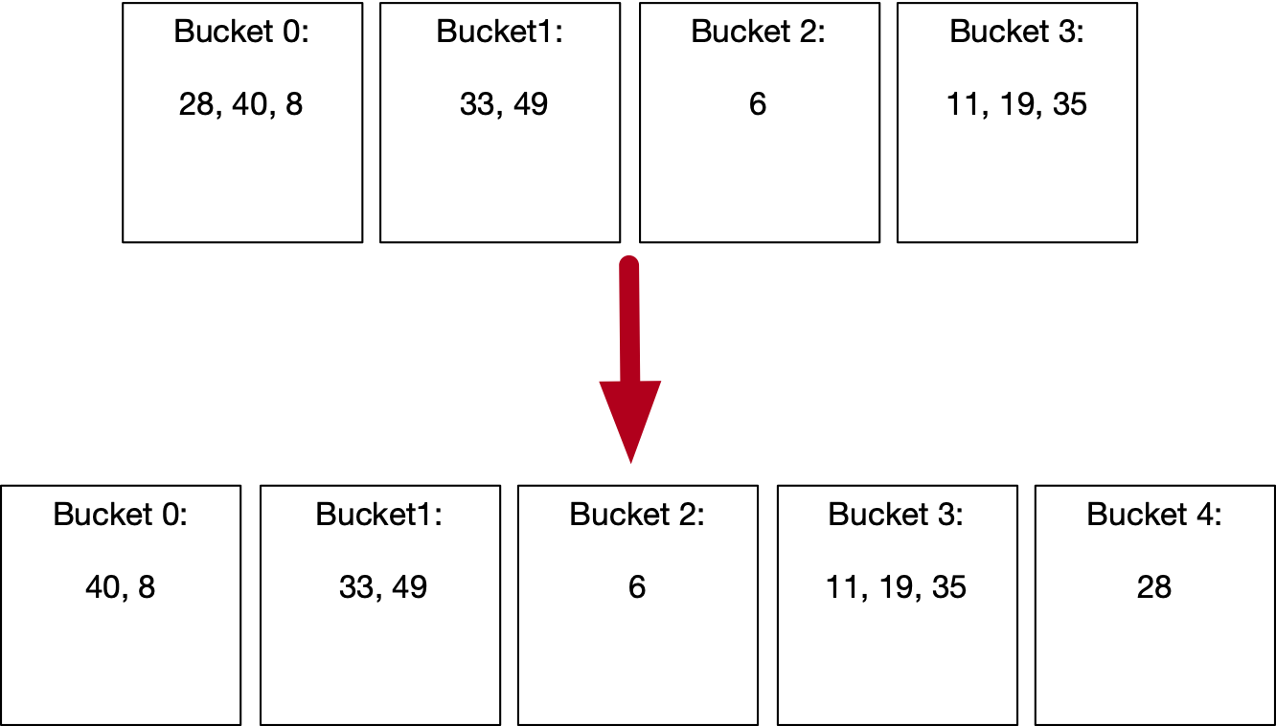
Linear Hashtable Evolution
$$N=5=2^{2}+1$$
def address(c):
a = hash(c) % 2**l
if a < s:
a = hash(c) % 2**(l+1)
return a
Number of buckets: 1
Split pointer: 1
Level: 2
Create Bucket 4.
Rehash Bucket 0.

Slide 17
Linear Hashtable Evolution
$$N=5=2^{2}+1$$
def address(c):
a = hash(c) % 2**l
if a < s:
a = hash(c) % 2**(l+1)
return a
Number of buckets: 5
Split pointer: 1
Level: 2
Creates an overflow!
Need to split!

Slide 18
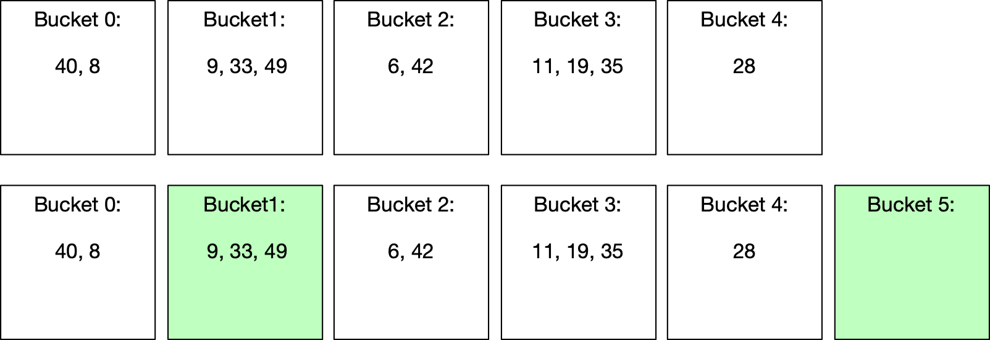
Linear Hashtable Evolution
$$N=6=2^{2}+2$$
def address(c):
a = hash(c) % 2**l
if a < s:
a = hash(c) % 2**(l+1)
return a
Number of buckets: 1
Split pointer: 2
Level: 2
Split
No item actually moved, but average load factor is now
again under 2.

Slide 19
Linear Hashtable Evolution
$$N=6=2^{2}+2$$
def address(c):
a = hash(c) % 2**l
if a < s:
a = hash(c) % 2**(l+1)
return a
Number of buckets: 6
Split pointer: 2
Level: 2

Slide 20
Linear Hashtable Evolution
$$N=7=2^{2}+3$$
def address(c):
a = hash(c) % 2**l
if a < s:
a = hash(c) % 2**(l+1)
return a
Number of buckets: 7
Split pointer: 3
Level: 2

Slide 21
Linear Hashtable Evolution
$$N=7=2^{2}+3$$
def address(c):
a = hash(c) % 2**l
if a < s:
a = hash(c) % 2**(l+1)
return a
Number of buckets: 7
Split pointer: 3
Level: 2

Slide 22
Linear Hashtable Evolution
$$N=8=2^{3}+0$$
def address(c):
a = hash(c) % 2**l
if a < s:
a = hash(c) % 2**(l+1)
return a
Number of buckets: 8
Split pointer: 0
Level: 3

Slide 23
Linear Hashtable Evolution
$$N=8=2^{3}+0$$
def address(c):
a = hash(c) % 2**l
if a < s:
a = hash(c) % 2**(l+1)
return a
Number of buckets: 8
Split pointer: 0
Level: 3

Slide 24
Linear Hashtable Evolution
$$N=9=2^{3}+1$$
def address(c):
a = hash(c) % 2**l
if a < s:
a = hash(c) % 2**(l+1)
return a
Number of buckets: 9
Split pointer: 1
Level: 3

Slide 25
Linear Hashtable Evolution
$$N=9=2^{3}+1$$
def address(c):
a = hash(c) % 2**l
if a < s:
a = hash(c) % 2**(l+1)
return a
Number of buckets: 9
Split pointer: 1
Level: 3

Slide 26
Linear Hashtable Evolution
$$N=10=2^{3}+2$$
def address(c):
a = hash(c) % 2**l
if a < s:
a = hash(c) % 2**(l+1)
return a
Number of buckets: 10
Split pointer: 2
Level: 3

Slide 27
Linear Hashing
Observations:
Buckets split in fixed order
0, 0,1, 0, 1, 2, 3, 0, 1, 2, 3, 4, 5, 6, 7, 0, 1, 2, …, 15, 0, …
Address calculation is modulo , i.e. the l least significant bits
Buckets 0, 1, …, s-1 and 2**l, 2**l+1, … N-1 are already split, they have on average half the size of the buckets s, s+1, …, 2**l.
$$2^{l}$$

Slide 28
Linear Hashing
Observations:
An overflowing bucket is not necessarily split immediately
Sometimes, a split leaves all keys in the splitting bucket or moves them all to the new bucket
On average, a bucket will have α items in them

Slide 29
Linear Hashing Rules
Buckets are numbered $0,1,…,N-1$
Number of buckets $N$, split pointer $s$, and level $l$ are related by
$N=2^{l}+s$ (with $s<2^{l}$)
Warning: There is a variant where we start with any number of buckets instead of one. This relationship then no longer holds.
Address of record with key hashing to $c$ is
$c(mod2^{l})$ or $c(mod2^{l+1})$

Slide 30
File State
The file state of an LH file is determined by the number $n$ of buckets
level $l$
split pointer $s$
Formula: $n=2^{l}+s$ with $l$ as high as possible, i.e. with $s∈\{0,1,…{,2}^{l}-1\}$

Slide 31
File State
Clarification regarding the literature
The original LH scheme can start with any number of buckets
In this class, we are using the most common case

Slide 32
Exercise
What is the level and the state of an LH file with 13 buckets?

Slide 33
Solution
We write $13=2^{3}+5$
Level is $l=⌊\log_{2}(13)⌋=3$
Split pointer is $s=13-l$

Slide 34
Exercise
Where would the records with the following (randomly picked) keys be inserted?
82
27
37

Slide 35
Solution
Level is 3, so we use first remainder modulo $2^{3}=8$ and $2^{4}=16$ second
$82(mod8)=2$. Since $2<5$, we rehash: $82(mod16)=2$ and we insert into bucket 2
$27(mod8)=3$. Since 3 < 5, we rehash: $27(mod16)=11$. We insert into bucket 11
$37(mod8)=5$. Since $5≮5$, we do not rehash but insert into bucket 5.

Slide 36
Exercise
Where would the records with the following (randomly picked) keys be inserted?
48
60
63
71

Slide 37
Solution
$48(mod8)=0$. Rehash: $48(mod16)=0$ and insert into bucket 0.
$60(mod8)=4$. Rehash: $60(mod16)=12$ and insert into bucket 12.
$63(mod8)=7$. Rehash not necessary. Insert into bucket 7.
$71(mod8)=7.$ No rehash is necessary.

Slide 38
Exercise
Where would the records with the following (randomly picked) keys be inserted?
98
75
25
30

Slide 39
Solution
$98(mod8)=2$. Rehash: $98(mod16)=2$. Insert into bucket 2
$75(mod8)=3$. Rehash: $75(mod16)=11$. Insert into bucket 11
$25(mod8)=1$. Rehash: $25(mod16)=9$. Insert into bucket 9.
$30(mod8)=6$. Insert into bucket 6.

Slide 40
Exercise
Give the level and split pointer values as an LH file moves from 6 buckets to 20

Slide 41
Solution
Nr o Buckets | Level | Split Ptr
6 | 2 | 2
7 | 2 | 3
8 | 3 | 0
9 | 3 | 1
10 | 3 | 2
11 | 3 | 3
12 | 3 | 4
13 | 3 | 5
14 | 3 | 6
15 | 3 | 7
16 | 4 | 0
17 | 4 | 1
18 | 4 | 2
19 | 4 | 3
20 | 4 | 4

Slide 42
Interpretation
We can encapsulate the behavior of the level and split pointer into the following algorithm
We increment the split pointer
If the split pointer equals $2^{\text{level}}$ then set the split pointer to zero and increment the level
def split(level, split_pointer):
split_pointer += 1
if split_pointer == 2**level:
split_pointer = 0
level += 1
return (level, split_pointer)

Slide 43
Programming Exercise
Using a programming platform of your choice, implement the LH addressing algorithm
Insert 1000 records with key uniformly selected between 0 and $2^{32}-1$ into an LH file with (a) 12 and (b) 25 buckets.
Look at the size of the buckets.

Slide 44
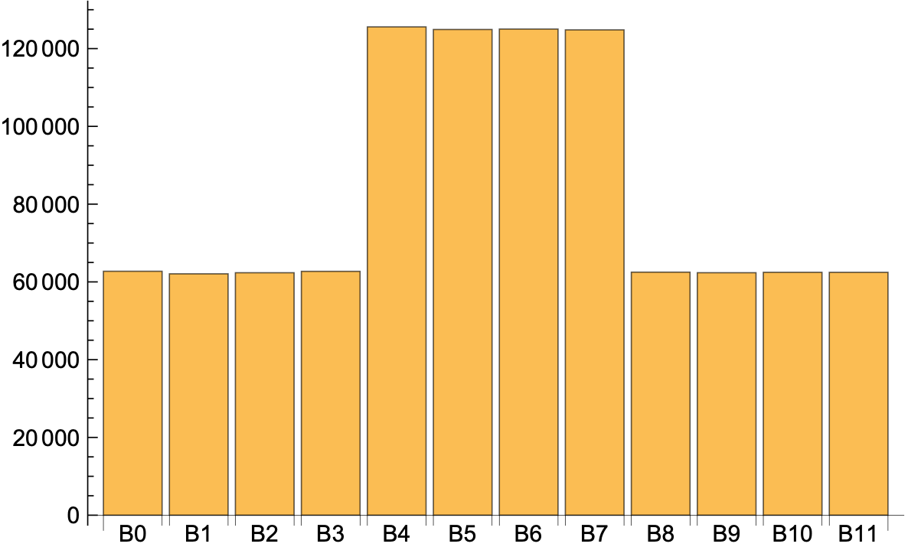
Solution
I changed the number to 1,000,000
For 12 buckets:

Slide 45
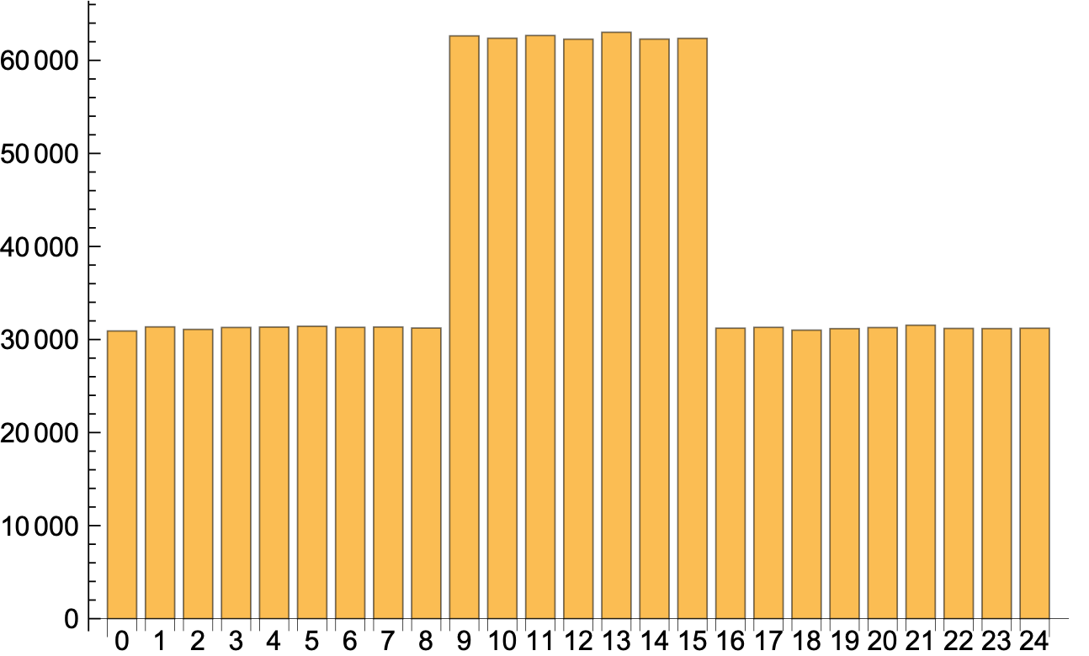
Solution
Here is the chart for 25 buckets

Slide 46
Interpretation
Even with a perfect hash function, an LH file has buckets of equal size only if the number of buckets is a power of two.
Otherwise, there are buckets already split in the current round and those not yet split.
The latter have about twice as many records

