Slide 1
Linked List 2
Thomas Schwarz, SJ

Slide 2
Iterators
The current_node programming paradigm is an iterator
  An iterator has:
    A method to access the current object
    A method to move forward
    And sometimes a method to move backwards
    Methods to compare two different iterators

Slide 3
Linked List Performance
We can estimate performance of linked -- list operations by looking at the number of nodes accessed
Assume a list with $n$ nodes
  Inserting at the head: 1 node
  Inserting at the tail: n nodes
  Inserting in the middle: $n/2$ on average
  Deleting at the head: 1 node
  Deleting at the tail: $n$ node
  Deleting in the middle: $n/2$ on average

Slide 4
Linked List Performance
Implementing a stack:
  We access one node
Implementing a queue:
  Insert at the head, pop at the tail
  Or: Insert at the tail, pop at the head
    One is going to use n nodes

Slide 5
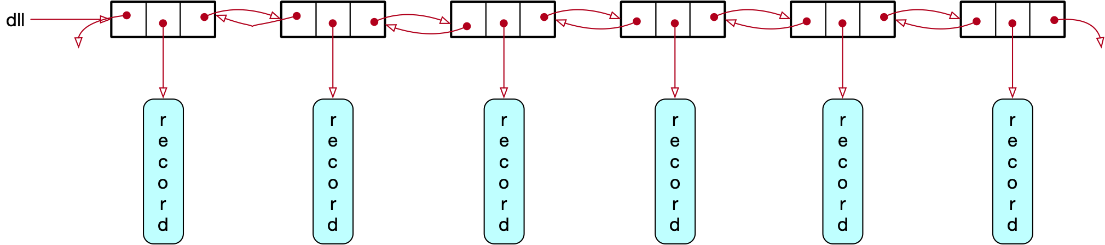
Double Linked List
To overcome the performance penalty,
  use a double linked list
    Each node has now a forward and a backward pointer

Slide 6
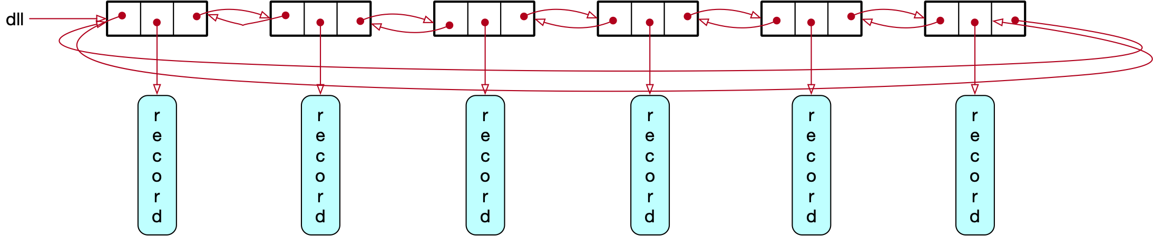
Double Linked List
And then connect head and tail in order to give a circular double linked list
The backward pointer of head allows easy access to the tail
But:
  For an insert or a delete, we now need to set four pointers instead of two

Slide 7
Double Linked List
Nodes now have a forward and a backward pointer
class Node:
def __init__(self, my_record):
self.forward = None
self.back = None
self.record = my_record
def __repr__(self):
string = "Class Node "
string += str(id(self))
string += ", forward is " + str(id(self.forward))
string += ", backward is " + str(id(self.forward))
string += ", record is " + str(self.record)
return string

Slide 8
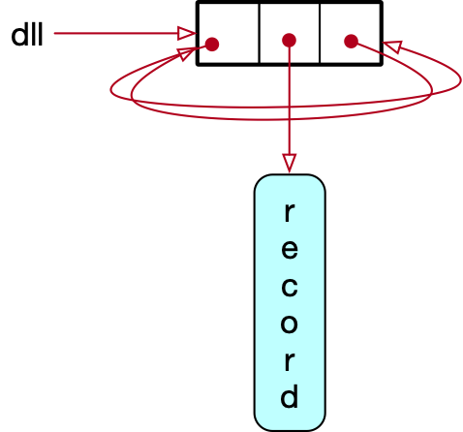
Double Linked List
Creating a double linked list
  Initially the list is empty
  Create a new node
  Then adjust the head and the two node pointers

Slide 9
Double Linked List
1
if not self.head:
self.head = new_node
new_node.forward = new_node
new_node.back = new_node
3
2

Slide 10
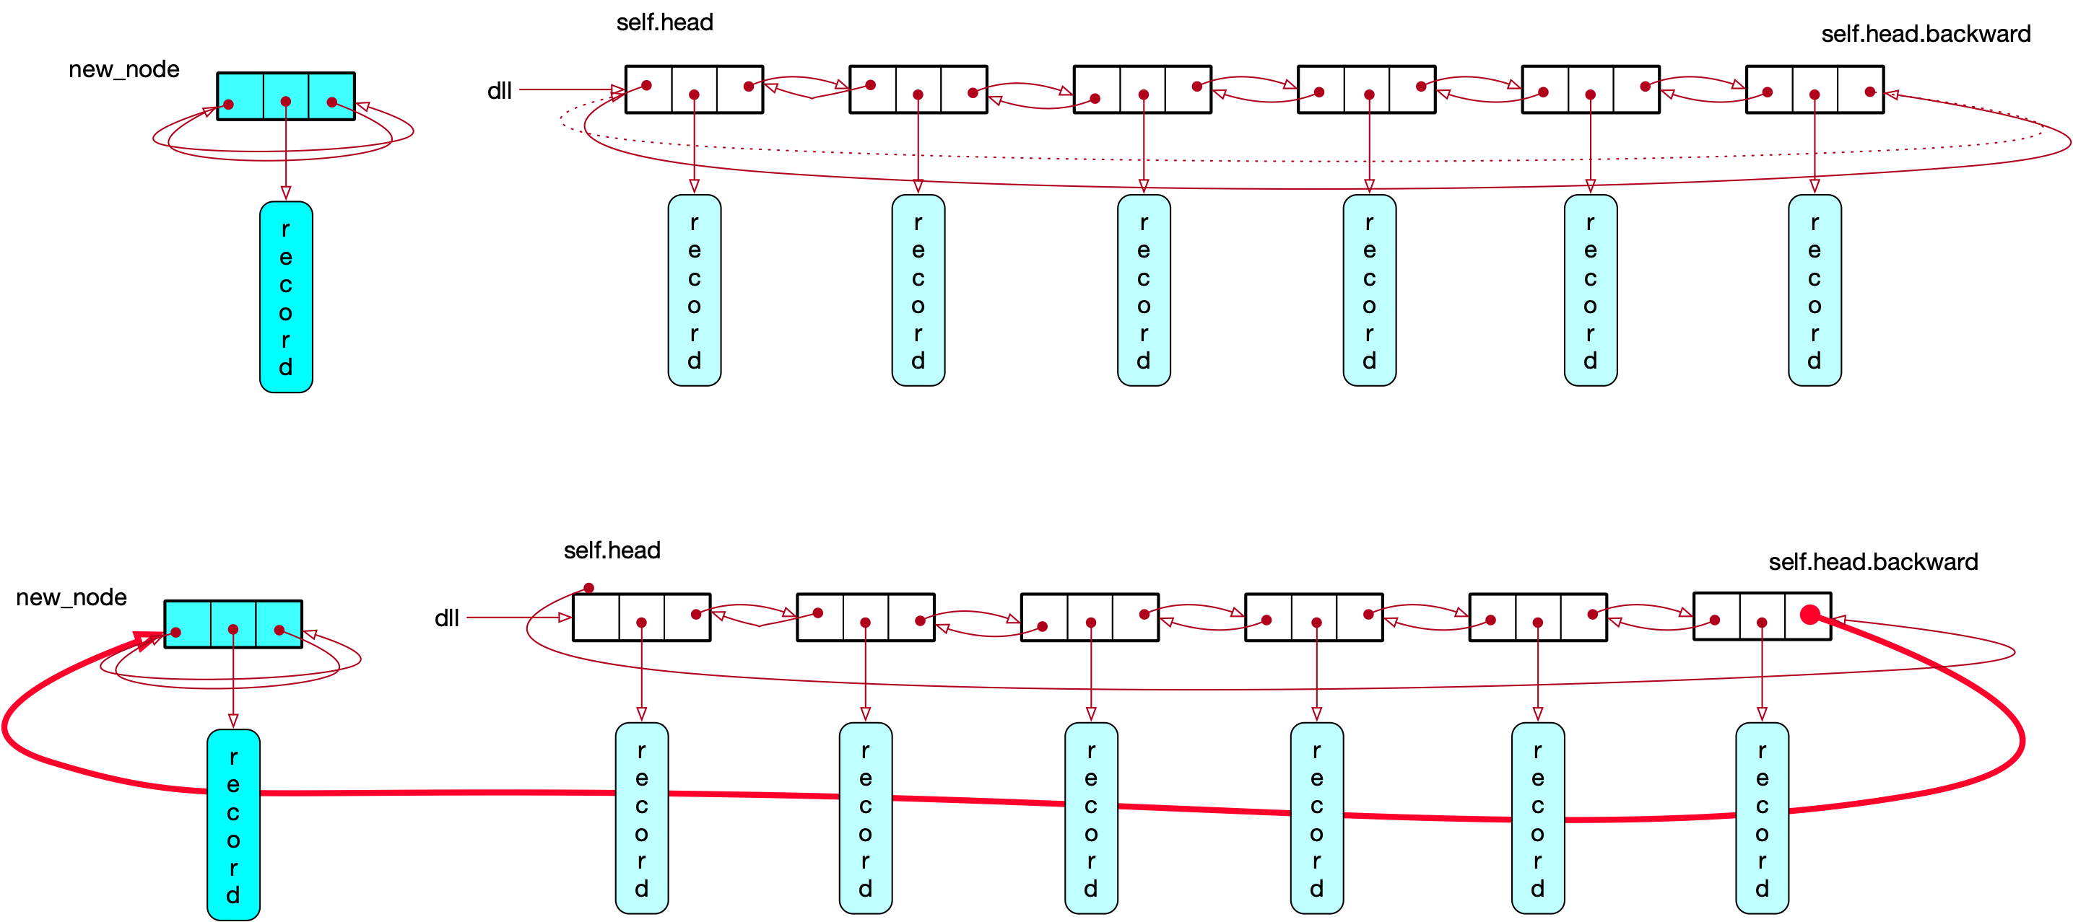
Double Linked List
Inserting at the head:
  Create new node
  Then change the forward pointer of the tail to the new node

Slide 11
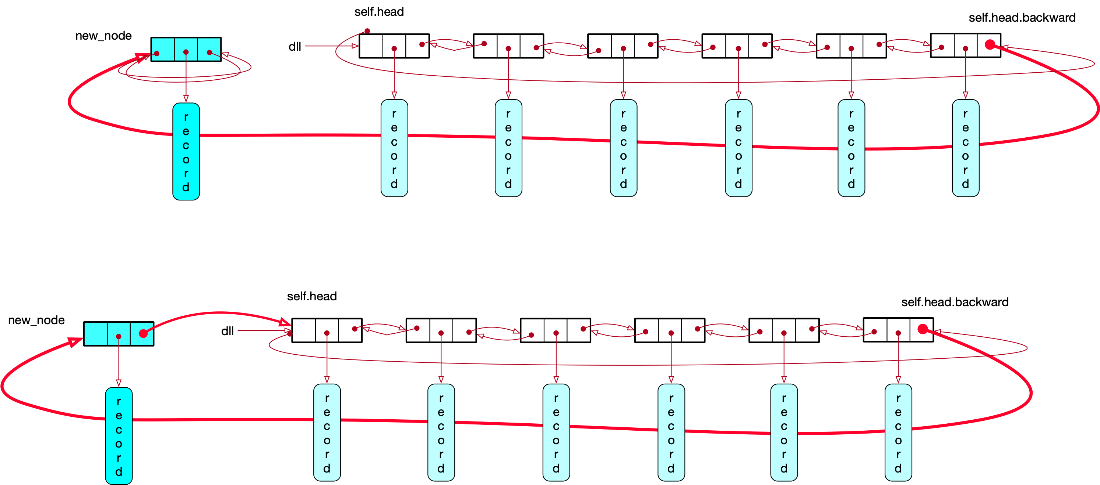
Double Linked List
Set new_node forward to self.head

Slide 12
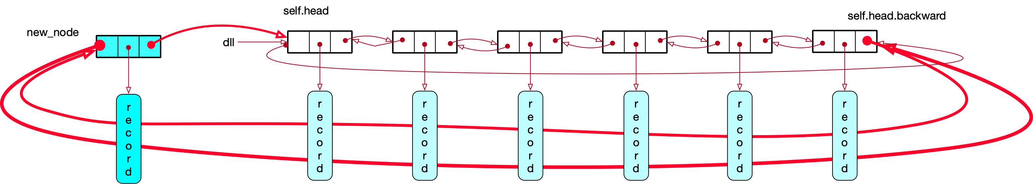
Double Linked List
Set new_node.backward to the tail

Slide 13
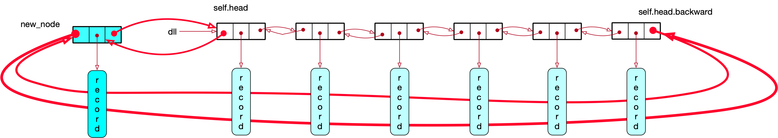
Double Linked List
Set self.head.backward to new_node

Slide 14
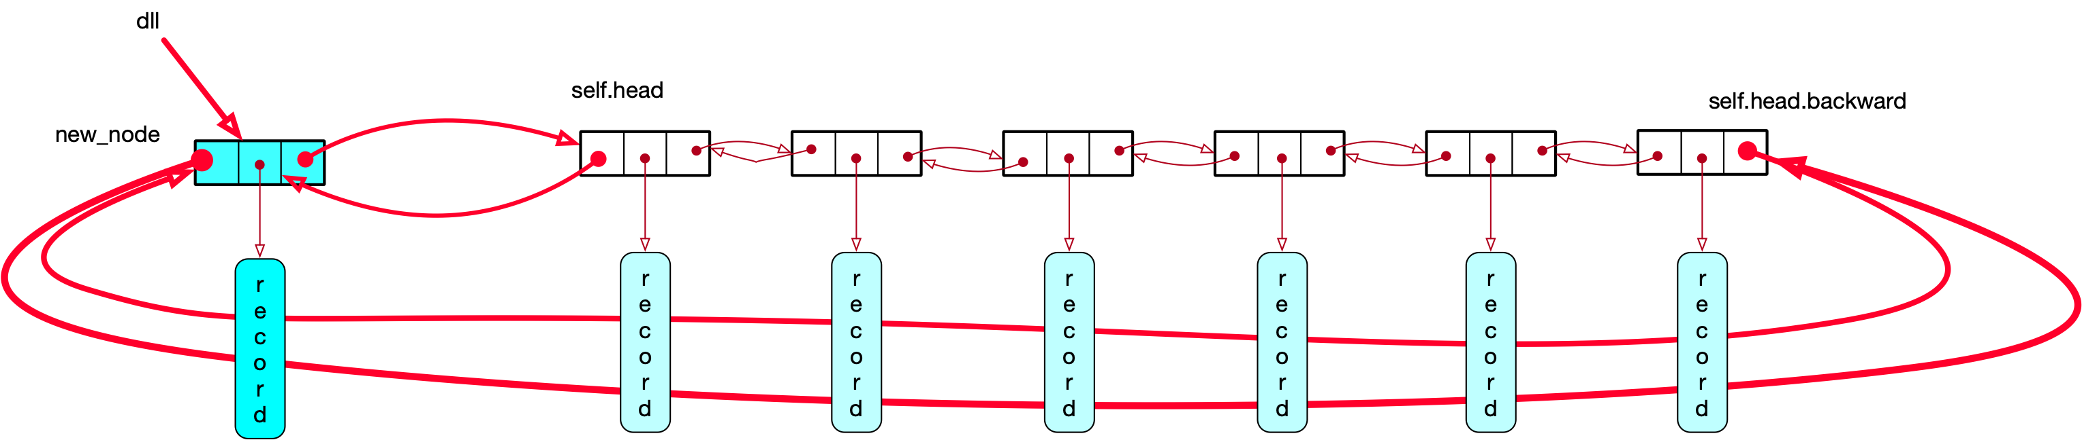
Double Linked List
Finally, set dll.head to the new_node

Slide 15
Double Linked List
Code:
  Order is important!
    Easy part: inserting into an empty list
def insert_head(self, record):
new_node = Node(record)
if not self.head:
self.head = new_node
new_node.forward = new_node
new_node.back = new_node

Slide 16
Double Linked List
Order of operations is important!
  Otherwise, we loose access or need a temporary variable
def insert_head(self, record):
new_node = Node(record)
if not self.head:
...
else:
self.head.back.forward = new_node
new_node.back = self.head.back
self.head.back = new_node
new_node.forward = self.head
self.head = new_node

Slide 17
Double Linked List
Printing all records from left to right
  Use the current_node paradigm:
def print_it_forward(self):
current = self.head
while current:
print(current.record)
current = current.forward
if current == self.head:
return

Slide 18
Double Linked List
Printing all nodes from right to left
def print_it_backward(self):
current = self.head.back
while current:
print(current.record)
current = current.back
if current == self.head.back:
return

Slide 19
Double Linked List
We can also build an explicit iterator class
  Iterators
    provide access to the record
    allow us to move to the next record
    allow us to move to the previous record
    can compare two iterators

Slide 20
Double Linked List
Implementation
class DLL_Iterator:
def __init__(self, dll):
self.current_node = dll.head
self.dll = dll
def forward(self):
self.current_node = self.current_node.forward
def backward(self):
self.current_node = self.current_node.back
def get_record(self):
return self.current_node.record
def at_tail(self):
return self.current_node == self.dll.head.back
def at_head(self):
return self.current_node == self.dll.head
def __eq__(self, other):
return self.dll == other.dll and self.current_node == other.current_node

Slide 21
Double Linked List
Example based on iterator
it = DLL_Iterator(dll)
while True:
print(it.get_record())
it.forward()
if it.at_head():
break

Slide 22
Double Linked List
Homework:
  Add to the iterator class to set an iterator to the tail

Slide 23
Double Linked List
Maintaining an ordered double linked list
  Add a field key to the Node class
class Node:
def __init__(self, my_record, key):
self.forward = None
self.back = None
self.record = my_record
self.key = key

Slide 24
Double Linked List
Only difference:
  Now need to insert in the middle of a list
  One special case:
    Inserting in an empty list
  Normal case
    Inserting between two nodes
      which can be identical

Slide 25
Double Linked List
Special case:
  If the list is empty, self.head is None
class OLL:
"""implements an ordered list of double linked nodes """
def __init__(self):
self.head = None

Slide 26
Double Linked List
Special case:
  If the list is empty, self.head is None
  Do not forget to set the forward and back pointers
class OLL:
"""implements an ordered list of double linked nodes """
def insert(self, my_record, my_key):
new_node = Node(my_record, my_key)
if self.head:
......
else:
self.head = new_node
new_node.forward = new_node
new_node.back = new_node

Slide 27
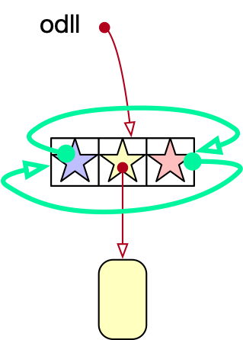
Double Linked List
else:
self.head = new_node
new_node.forward = new_node
new_node.back = new_node

Slide 28
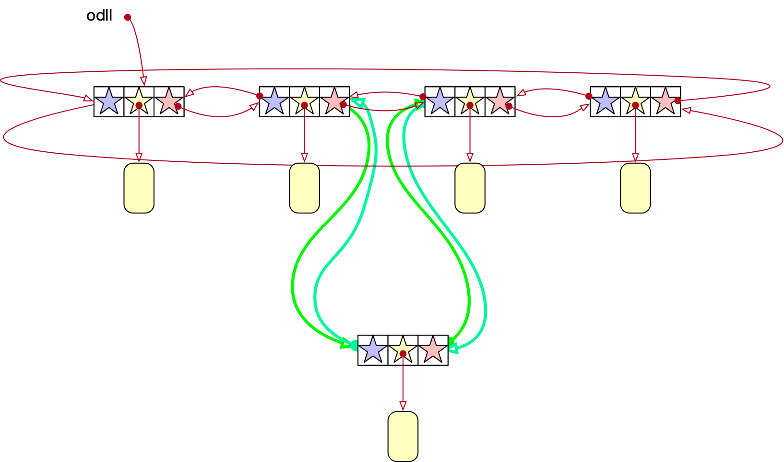
Double Linked List
Inserting between two nodes
  Implement as a class (not instance) method
    Reset four pointers

Slide 29
Double Linked List
def insert_before_after(new_node, left, right):
left.forward = new_node
new_node.back = left
new_node.forward = right
right.back = new_node

Slide 30
Double Linked List
Need to find the insertion point:
  Slightly tricky, because if the inserted key is larger than the present key, we do not want to circle around
  Special case: The key to be inserted is smaller, so the new node becomes the head.
  In which case we insert between the head and head.back
    Even if they are the same node

Slide 31
Double Linked List
Special case if we insert at the beginning, because we then need to reset self.head
  Notice that it says OLL.insert_before_after because this is a class method
if self.head:
current_node = self.head
if my_key < self.head.key:
OLL.insert_before_after(new_node,
self.head,
self.head.forward)
self.head = new_node

Slide 32
Double Linked List
Otherwise, we need to find the insertion point
  Start out with current_node = self.head
  Then move to the right until current_node.forward has a larger key
    This gives us the insertion point

Slide 33
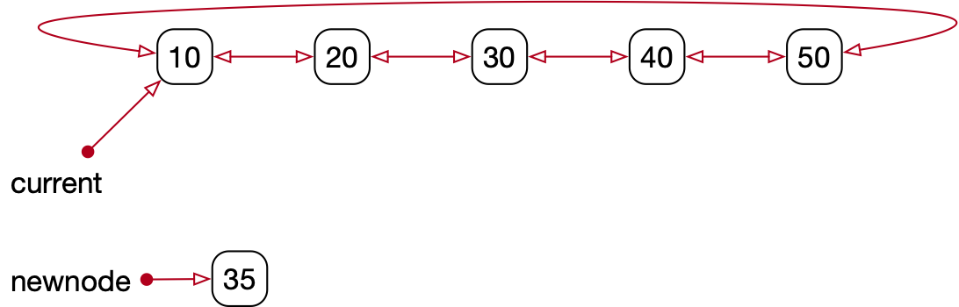
Double Linked List
Finding the insertion point
  Already excluded that we need to insert before the head
  key is 35, which is more than current.forward.key
  Move current to the left

Slide 34
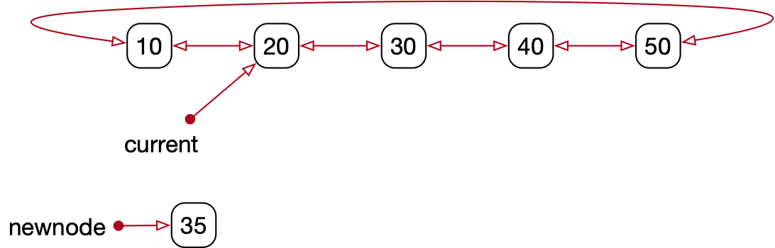
Double Linked List
Finding the insertion point
  current.forward.key is 30 is
  still less than 35
  move

Slide 35
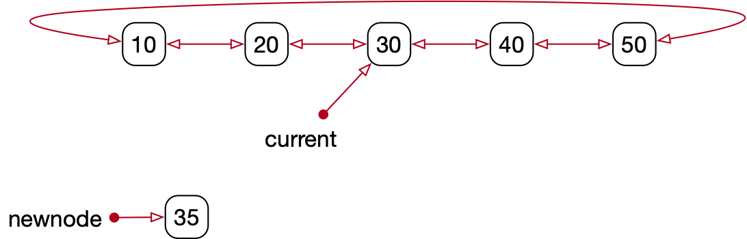
Double Linked List
Finding the insertion point:
  But not any longer: current.forward.key is 40

Slide 36
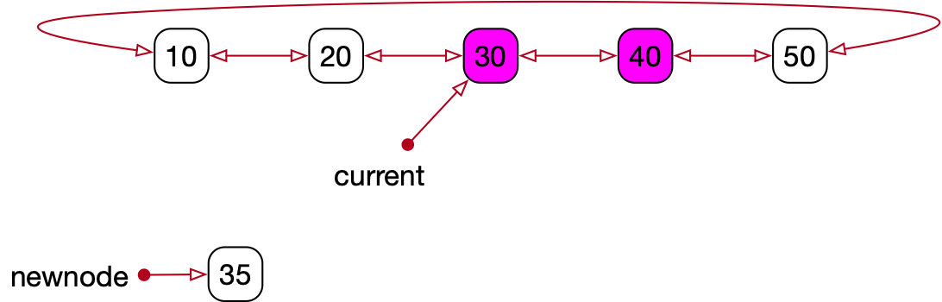
Double Linked List
Finding the insertion point
  Now we have found the insertion point
  Insert between current and current.forward

Slide 37
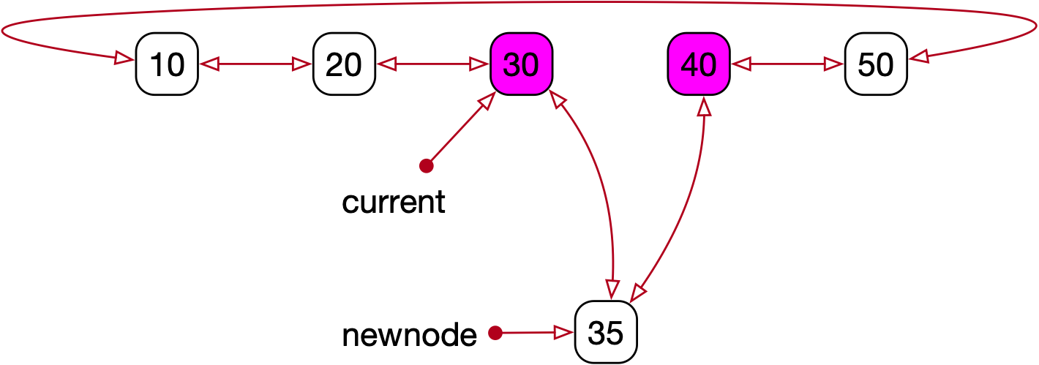
Double Linked List
Found the insertion point and inserted

Slide 38
Double Linked List
Walk through the list
  Can but not have to use iterators
def show(self):
if not self.head:
print('empty')
return
print(self.head.key, self.head.record, sep=': ')
current_node = self.head.forward
while current_node != self.head:
print(current_node.key, current_node.record, sep= ': ')
current_node = current_node.forward

Slide 39
Double Linked List
Deleting a record
  Need to find the record first
    Then delete the node
      Special case:
        This is the only node
          In which case forward and back pointer point to the same node

Slide 40
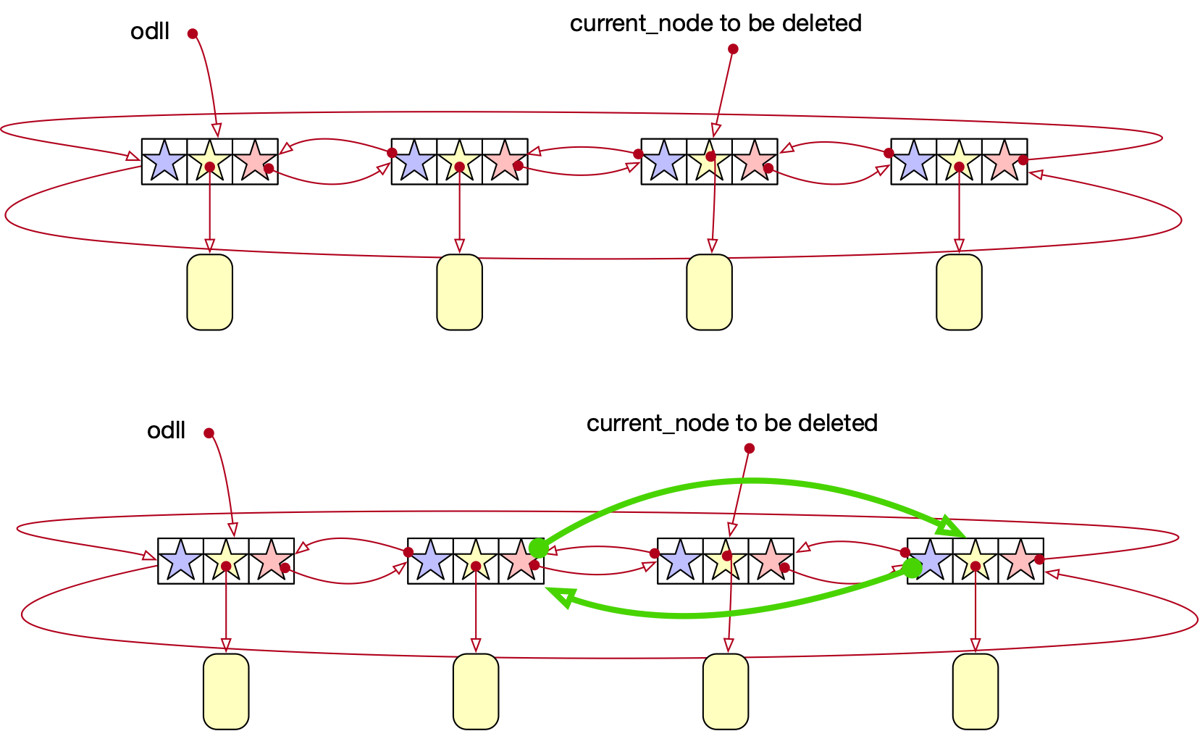
Double Linked List
Deleting a node from several nodes:

Slide 41
Double Linked List
Deleting the only node
  Just set self.head to None
def delete(self, key):
current_node = self.head
if current_node.forward == current_node:
# there is only one node left
self.head = None

Slide 42
Double Linked List
Otherwise:
  Use the current_node pointer (effectively an iterator) in order to find the node to be deleted
  But be careful, because the key might not be there
    After going to the next node, check that we are not at the beginning

Slide 43
Double Linked List
def delete(self, key):
current_node = self.head
if current_node.forward == current_node:
# there is only one node left
self.head = None
return
while True:
if current_node.key == key:
self.delete_node(current_node)
return
else:
current_node = current_node.forward
#Check that we have not reached the beginning of the list
if current_node == self.head:
return

Slide 44
Double Linked List
Deletion itself is fairly simple
def delete_node(self, current_node):
if self.head == current_node:
self.head = current_node.forward
left = current_node.back
right = current_node.forward
left.forward = right
right.back = left

Slide 45
Double Linked List
But needs to take care of the case where we delete the head of the list
  Though we can verify that we only need to reset head.
def delete_node(self, current_node):
if self.head == current_node:
self.head = current_node.forward
left = current_node.back
right = current_node.forward
left.forward = right
right.back = left

Slide 46
Double Linked List
Performance
  Storage costs
    Python is generous with using storage
        Each object has a number of fields
      If we implement in a high performance language like C
        Per record, need a node with three pointers
          3*32 or 3*64 bits = 12B, 24B per object

Slide 47
Double Linked List
Timing measured in number of nodes
  Double linked list as a Stack
    insert / delete at head (1 node)
  Double linked list as a Queue
    insert at head / delete at tail (1 / 2 nodes)
    insert at tail / delete at head (2 / 1 nodes)
  Sometimes Stack and Queue are combined in a single structure: Deque

Slide 48
Double Linked List
Performance
  Ordered linked list:
    Finding a record, inserting a record, deleting a record
    Timing is $n/2$ nodes on average

Slide 49
Software Engineering
This is highly non-trivial code
  I know because of the mistakes that I make

Slide 50
Software Engineering
Two core problems of Software Engineering:
  How to get people to work on code together successfully

Slide 51
Software Engineering
Second problem:
  How can we guarantee correctness of code
    Formal methods
      Not popular because very difficult
    Testing
      Difficult because we need to test for all things that are likely to go wrong

Slide 52
Software Engineering
Test generation:
  Think about all things that could have an influence
    E.g. node deletion: location of node with respect to other nodes
      Lonely node
      Node at the beginning
      Node at the end
      Node in the middle
      Node first after head
      ...

Slide 53
Software Engineering
Test Generation:
  Write a test for all of these cases

Slide 54
Software Engineering
Idea of unit tests
  Divide tasks into modules
    Implementing a cyclical ordered linked list would be a module
  Modularization:
    Makes design easier
    Allows small groups to generate software
    Can test already at the unit level

Slide 55
Software Engineering
Unit tests in Python
  Can have code that only executes if the module is the one that is called
  But not if the module is imported
if __name__ == '__main__':
oll = OLL()
oll.insert('z',1)
oll.insert('a', 100000)
oll.insert('d', 2)
oll.insert('e', 3)
for _ in range(10):
x = random.getrandbits(16)
print(x)
oll.insert( 3*str(x),x )
oll.show()

Slide 56
Software Engineering
One of the big problems is software maintenance
  The programmer or someone else will add functionality and / or change the implementation
  A simple code addition can break code elsewhere
  Therefore:
    Test the interface in the unit test
    So that an addition / modification that breaks an interface can be caught

Slide 57
Software Engineering
Hence:
  Test your algorithms
    By making all case distinction
    And verifying your code with paper and pencil
      This is formal method (very) light

Slide 58
Software Engineering
Hence:
  Test your implementation
    By making all case distinctions
      And writing test code for them
        Even better: print out what the result of your test should be

Slide 59
Software Engineering
What to do when you detect an error
  READ the ERROR MESSAGE
  Identify the location of the fault
    The error happened there or before on the execution path
  Adorn your code with additional print statements
    To help you locate the statement that causes the error

Slide 60
Software Engineering
What type of errors should you expect:
  Typos and similar mechanical errors that are not detected by the UI
  Violated assumptions
    You deal with that by making your assumptions explicit
      You do not need to write them down, just acknowldge them

Slide 61
Software Engineering
Debugging is more of an art than science
  Experience helps a lot

