Slide 1
Linked Lists
Thomas Schwarz SJ

Slide 2
Linked Lists
Effective container data structure
Container ADT:
Insert, Update, Read, Delete records
Records can be anything
e.g. strings
e.g. BLOBs (binary large objects)

Slide 3
Linked Lists
Linked Lists consists of Nodes
Nodes are connected by forward pointers
And have pointers to the record contents
Pointers: Addresses of objects in memory
This is how Python finds objects
E.g. if you define a class without __str__ and __repr__ dunder, this is how an instance will be printed
It prints the id of the object
CPython: Guaranteed to be the memory location
Unless ...

Slide 4
Linked Lists
>>> class X:
def __init__(self):
self.x = 0
>>> x=X()
>>> print(x)
<__main__.X object at 0x7facf6f1cee0>
>>>

Slide 5
Linked Lists
Implementing a node
Need fields for
next node (by default Null)
object stored in linked list

Slide 6
Linked Lists
class Node:
def __init__(self, my_record):
self.next_node = None
self.record = my_record

Slide 7
Linked Lists
class Node:
def __repr__(self):
string = "Class Node "
string += str(id(self))
string += ", next is " + str(id(self.next_node))
string += ", record is " + str(self.record)
return string
We use the id-trick in order to find the memory address of the nodes in CPython

Slide 8
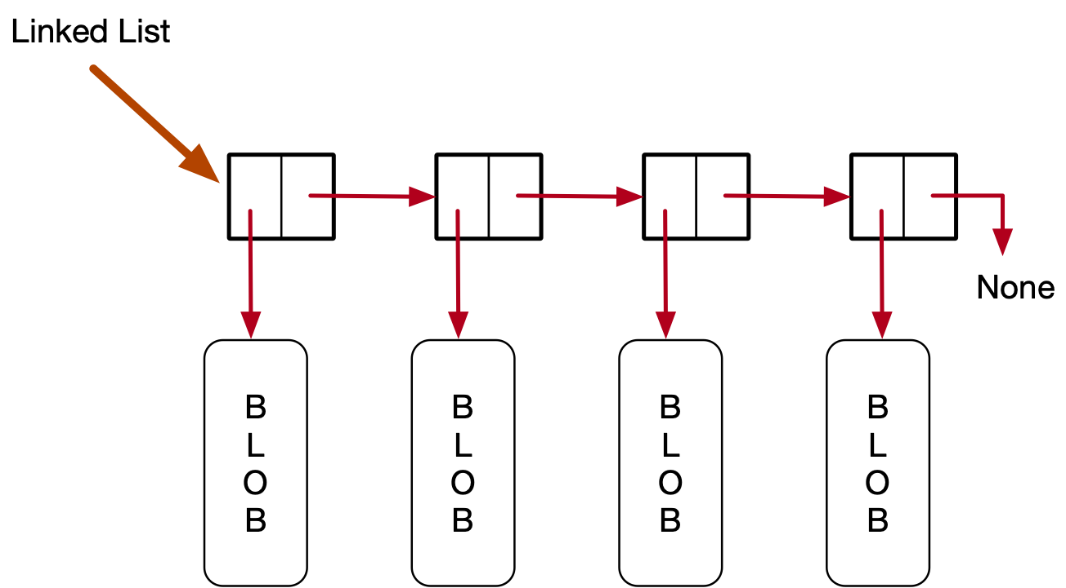
Linked Lists
Next task is to link the nodes
A linked list is given by its initial node, the head

Slide 9
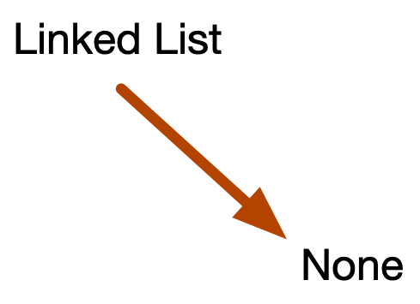
Linked Lists
To create a linked list:
Create a pointer to null
class Linked_List:
def __init__(self):
self.head = None

Slide 10
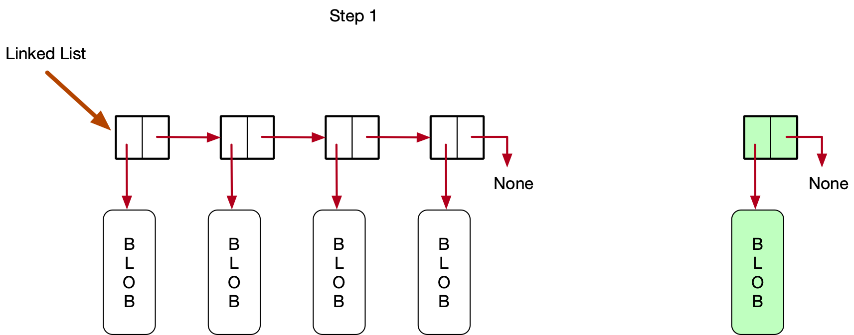
Linked Lists
We insert at the front of a linked list
Step 1: We create a node that points to the record that we want to insert

Slide 11
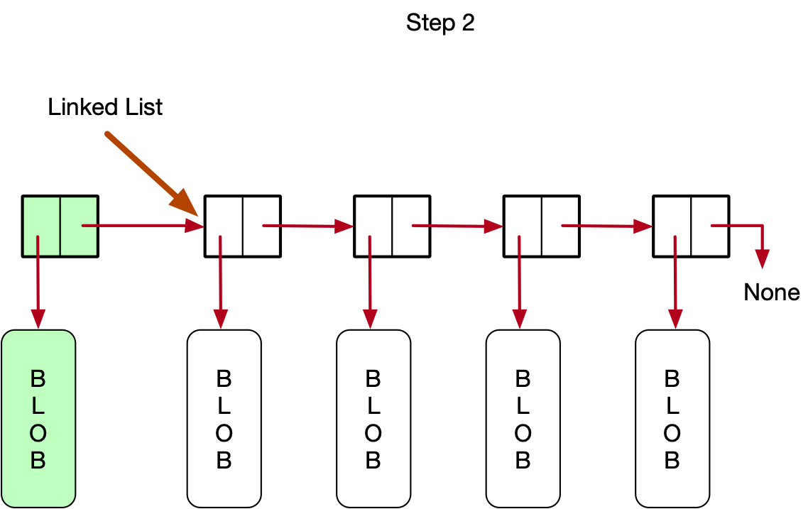
Linked Lists
Step 2: We have the new node point to the same node as the linked list does

Slide 12
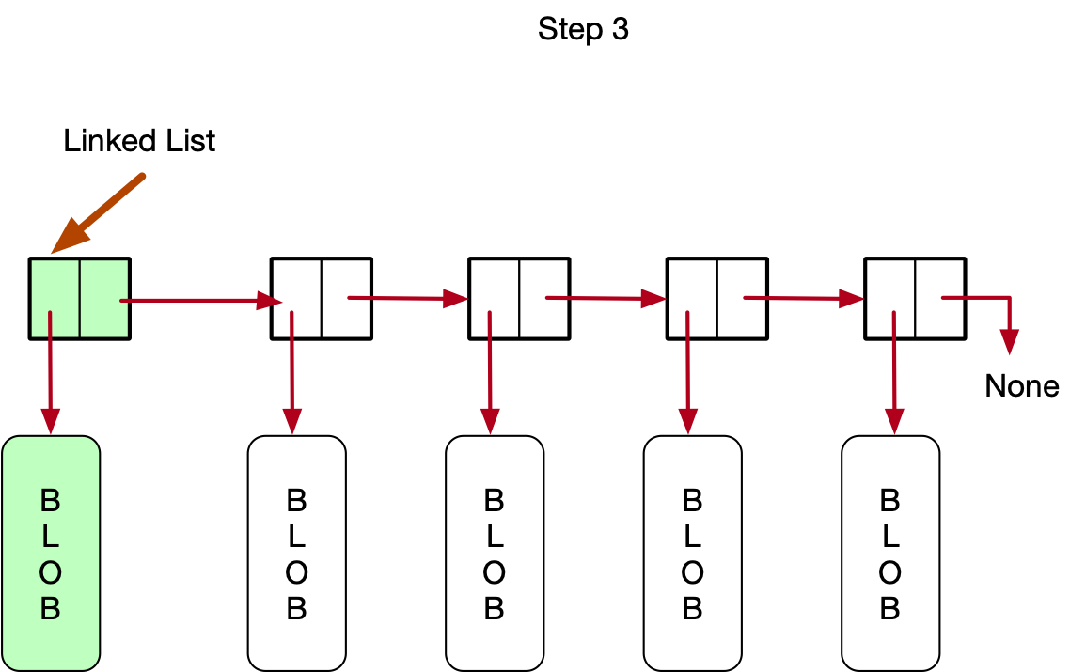
Linked Lists
Step 3: We reset the head of the linked list

Slide 13
Linked List
Python Code
class Linked_List:
...
def insert(self, record):
new_node = Node(record)
new_node.next_node = self.head
self.head = new_node

Slide 14
Linked List
Python Code
class Linked_List:
...
def insert(self, record):
new_node = Node(record)
new_node.next_node = self.head
self.head = new_node

Slide 15
Linked List
Python Code
class Linked_List:
...
def insert(self, record):
new_node = Node(record)
new_node.next_node = self.head
self.head = new_node

Slide 16
Linked List
Why do we execute Step 2 before Step 3
Many programming languages support threads
Independent streams of instructions accessing the same memory structure
Not really well implemented in Python
If we set the head to the new node, there is a moment where the linked list only contains the new node

Slide 17
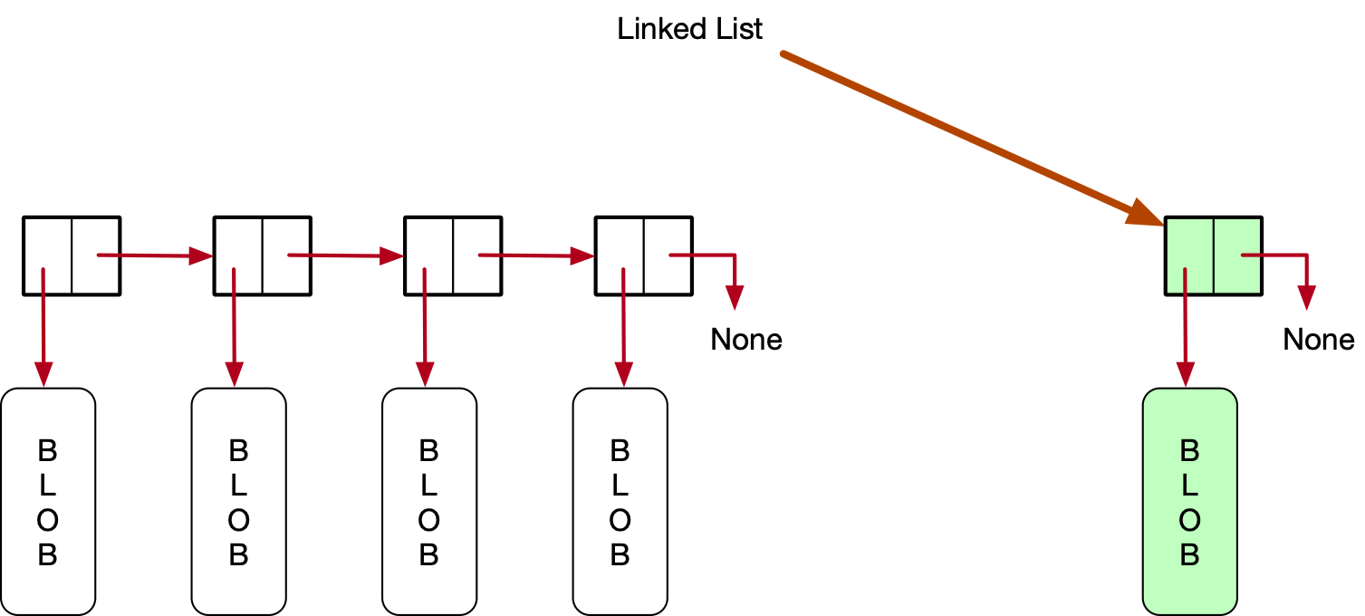
Linked List
Doing Step 3 before Step 2 leads to a temporary bad state

Slide 18
Linked List
Printing out the contents of a linked list
Idea: Create a node pointer current
Let current walk through the list of nodes
At each step, print out the contents of the record

Slide 19
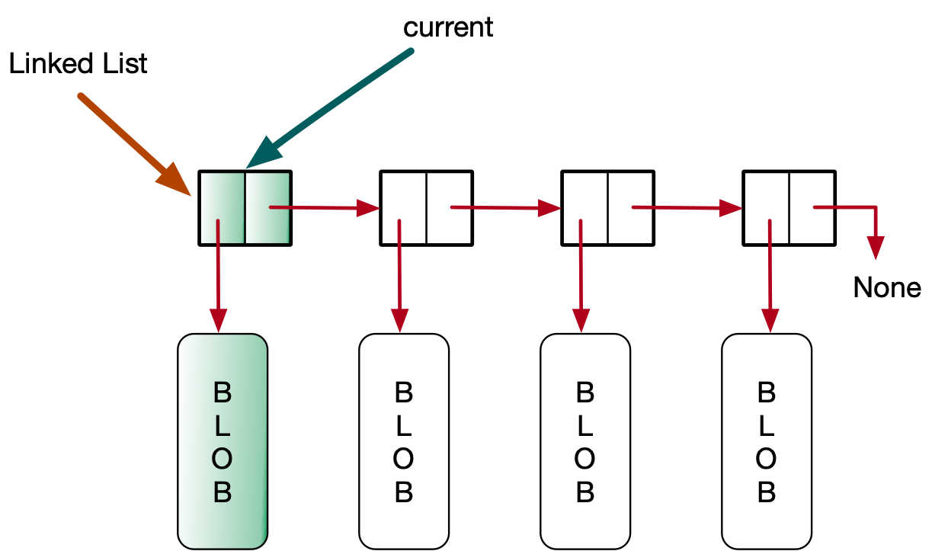
Linked List
Set current_node to the head

Slide 20
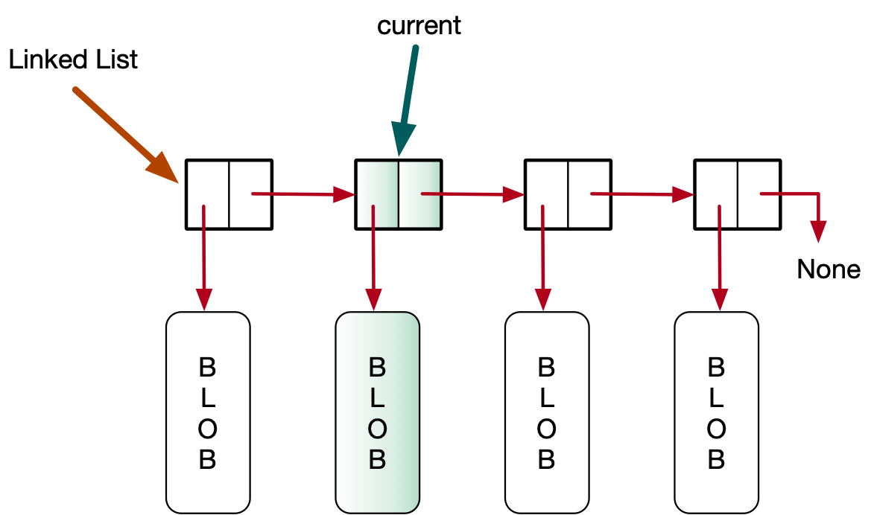
Linked List
Set current_node to current_node.next_node

Slide 21
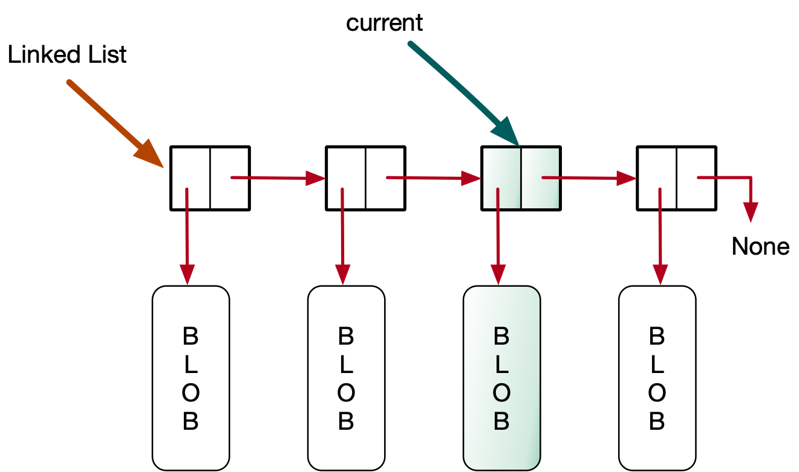
Linked List
And so on

Slide 22
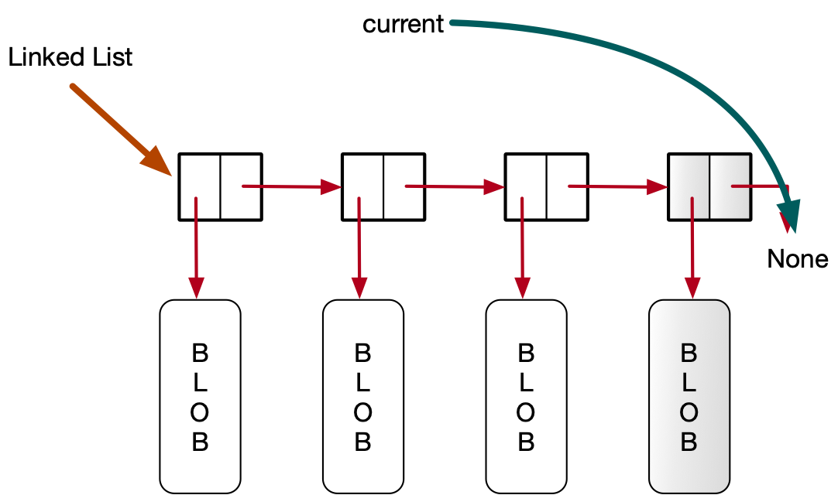
Linked List
Until we hit the end, i.e. until current_node becomes None

Slide 23
Linked List
Python code:
Use a current_node pointer
Adjust current_node pointer to current_node.next_node
Repeat until current_node becomes None
def __str__(self):
output = '['
current_node = self.head
while current_node:
output += str(current_node.record) + ', '
current_node = current_node.next_node
return output + ']'

Slide 24
Linked List
def __str__(self):
output = '['
current_node = self.head
while current_node:
output += str(current_node.record) + ', '
current_node = current_node.next_node
return output + ']'

Slide 25
Linked List
def __str__(self):
output = '['
current_node = self.head
while current_node:
output += str(current_node.record) + ', '
current_node = current_node.next_node
return output + ']'

Slide 26
Linked List
def __str__(self):
output = '['
current_node = self.head
while current_node:
output += str(current_node.record) + ', '
current_node = current_node.next_node
return output + ']'

Slide 27
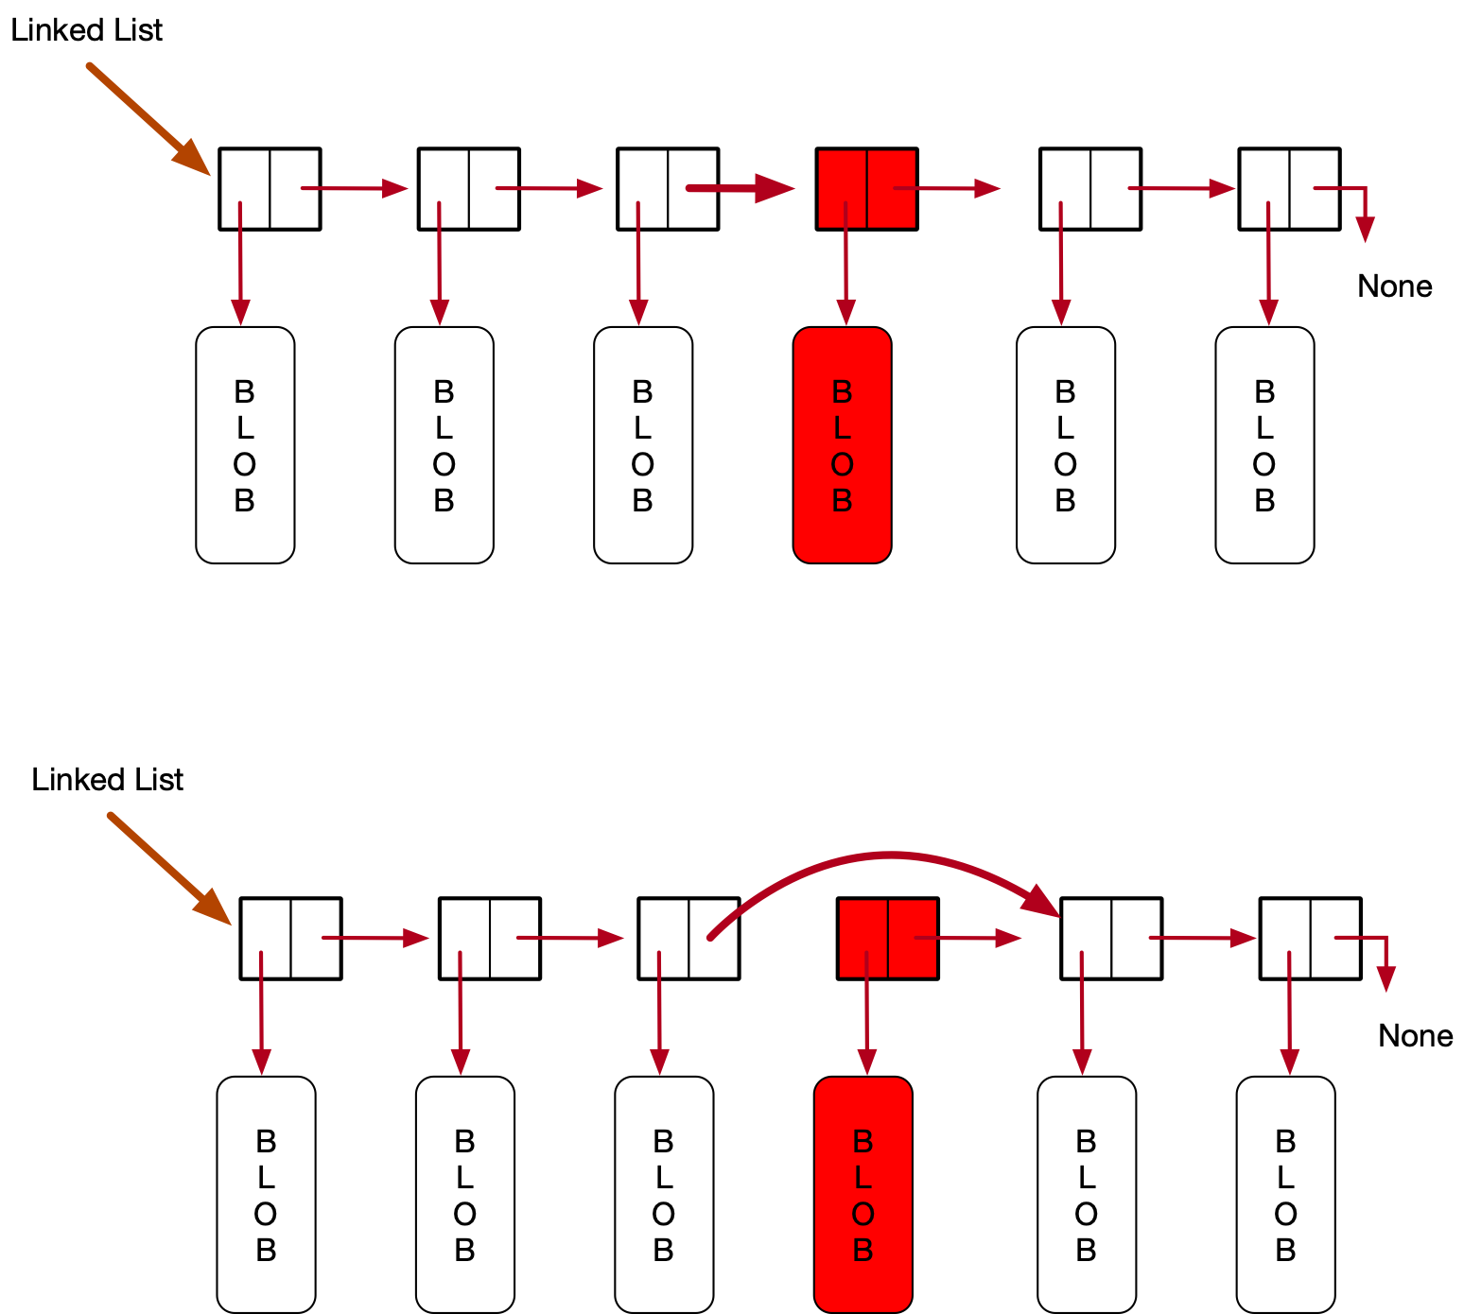
Linked List
Deleting from a linked list
We need to reset the next link of the node to the right of the one to be deleted

Slide 28
Linked List
To do so, we need to look ahead
We use a current_node pointer as usual
We advance, until current_node.next_node.record has the record to be deleted.

Slide 29
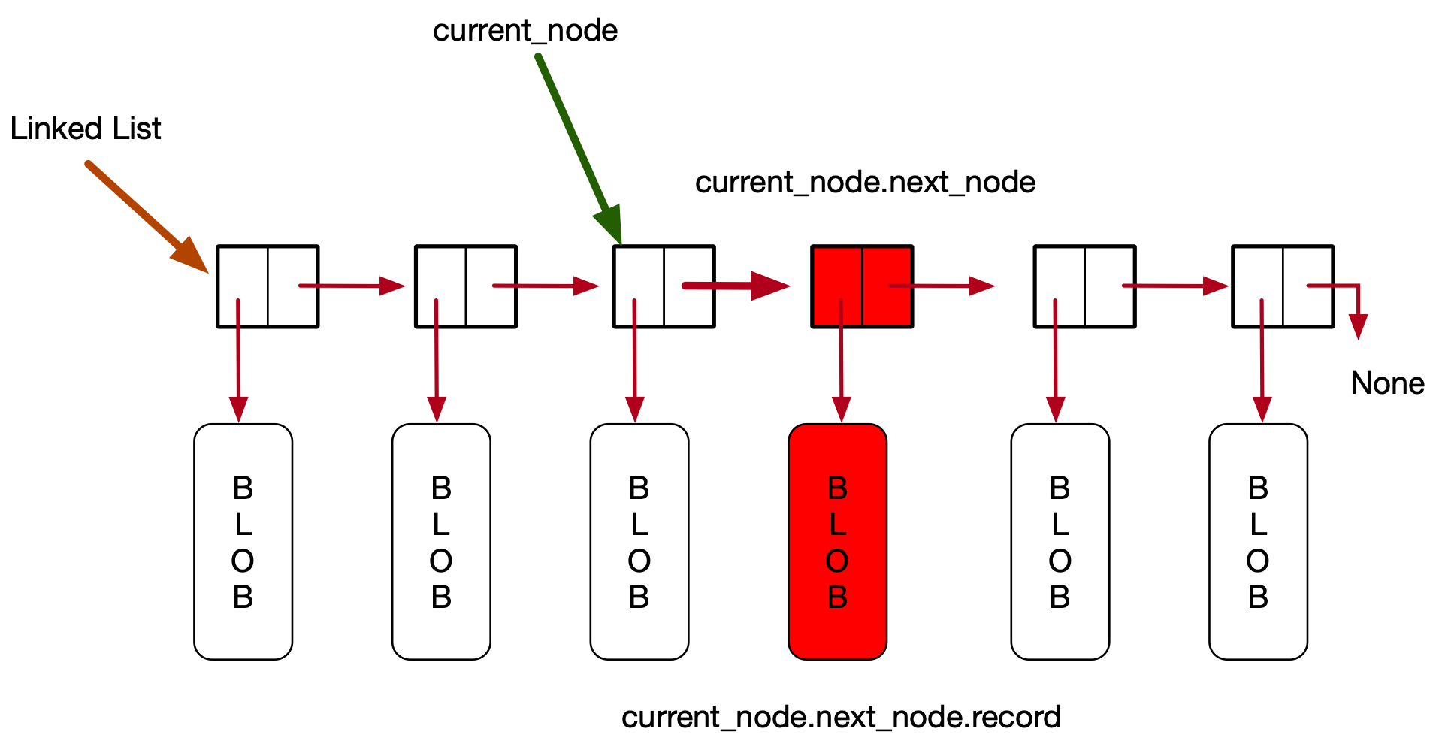
Linked List

Slide 30
Linked List
There are a number of special cases
The linked list is empty
The record to be deleted is in the first node
The record to be deleted does not exist
The record to be deleted is in the last node
This is actually not a problem
You need to check your algorithm with all these cases

Slide 31
Linked List
Another problem:
Should we return a value
One possibility:
Return True if we remove a record
Return False if we do not, because there was no such record

Slide 32
Linked List
If the linked list is empty, return False
def remove(self, record):
if not self.head:
return False

Slide 33
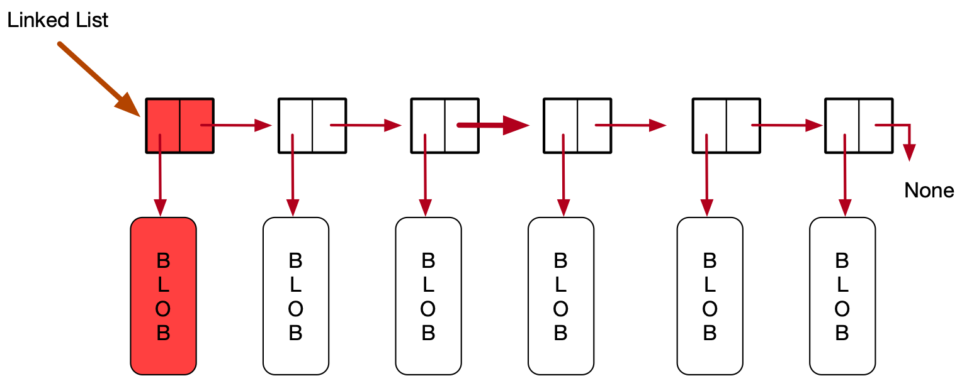
Linked List
current_node points to the node before the one to be deleted
This is impossible if the record is in the first node
if self.head.record == record:
self.head = self.head.next_node
return True

Slide 34
Linked List
If the record is not there, we just run out of nodes
We need to be careful: we cannot check for a record in a node that is not there
This is an important trick:
We first check that current_node.next_node exists
And then current_node.next_node.record
current_node = self.head
while current_node.next_node and current_node.next_node.record != record:
current_node = current_node.next_node

Slide 35
Linked List
We run out of nodes when next_node is None
But otherwise, we have identified the deletion point and now can delete
if not current_node.next_node:
return False
else:
current_node.next_node =
current_node.next_node.next_node

Slide 36
Linked List
def remove(self, record):
if not self.head:
return False
if self.head.record == record:
self.head = self.head.next_node
return True
current_node = self.head
while current_node.next_node and current_node.next_node.record !=
record:
current_node = current_node.next_node
if not current_node.next_node:
return False
else:
current_node.next_node = current_node.next_node.next_node

Slide 37
Linked List as Stack
We insert at the head of the linked list
Why don't we pop at the head of the linked list?
This implements a stack as a linked list

Slide 38
Linked List as Stack
Idea:
Remove leading node

Slide 39
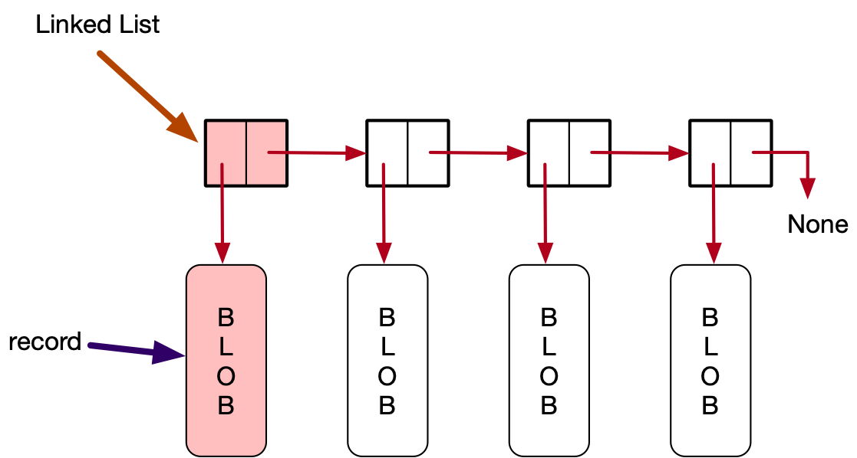
Linked List as Stack
Step 1:
Safe guard the record
In self.head.record

Slide 40
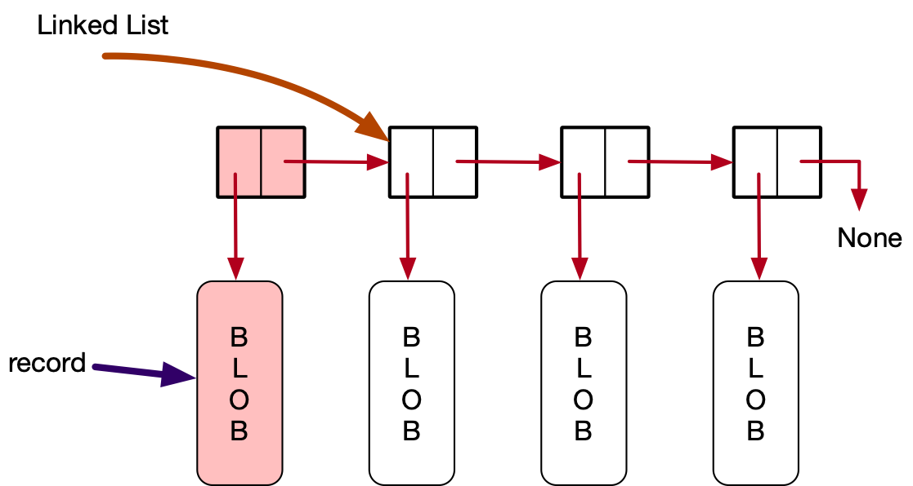
Linked List as Stack
Step 2:
Reset self.head to the next node

Slide 41
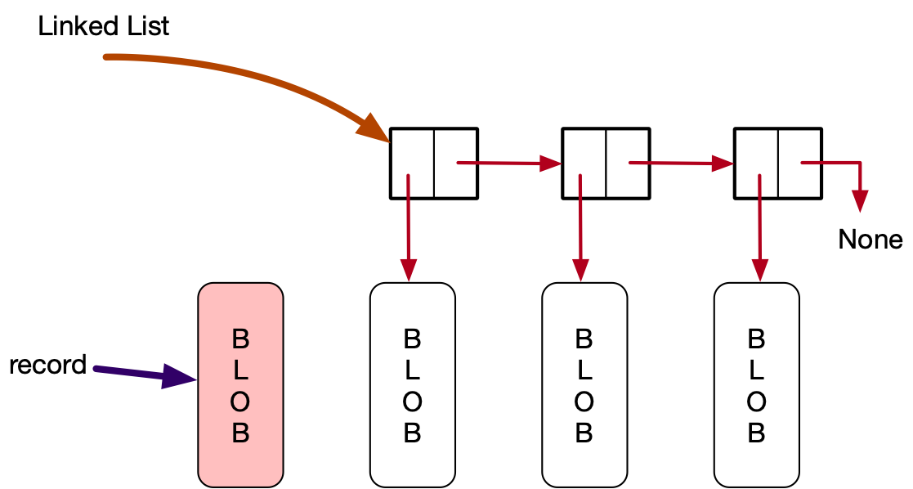
Linked List as Stack
Automatic:
There are no links to the previous head
The Garbage collection can remove the node

Slide 42
Linked List as Stack
Python code:
Add error handling if the linked list is empty
def pop(self):
if not self.head:
raise ValueError('Popping from empty stack')
record = self.head.record
self.head = self.head.next_node
return record

Slide 43
Linked List as Queue
Now we need to either pop at the tail or push at the tail
Push at the tail
Idea: Have a current node pointer walk through the list
Check if the current.next_node is None
If it is: This is the last node and we insert the new node there

Slide 44
Linked List as Queue
Create a new node

Slide 45
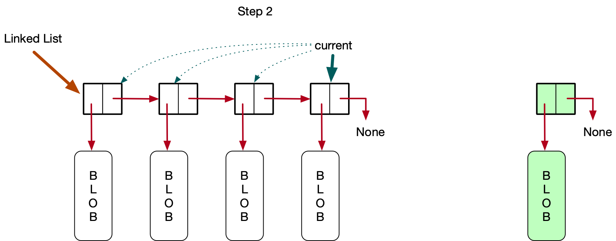
Linked List as Queue
Adjust current to find the last node in the linked list

Slide 46
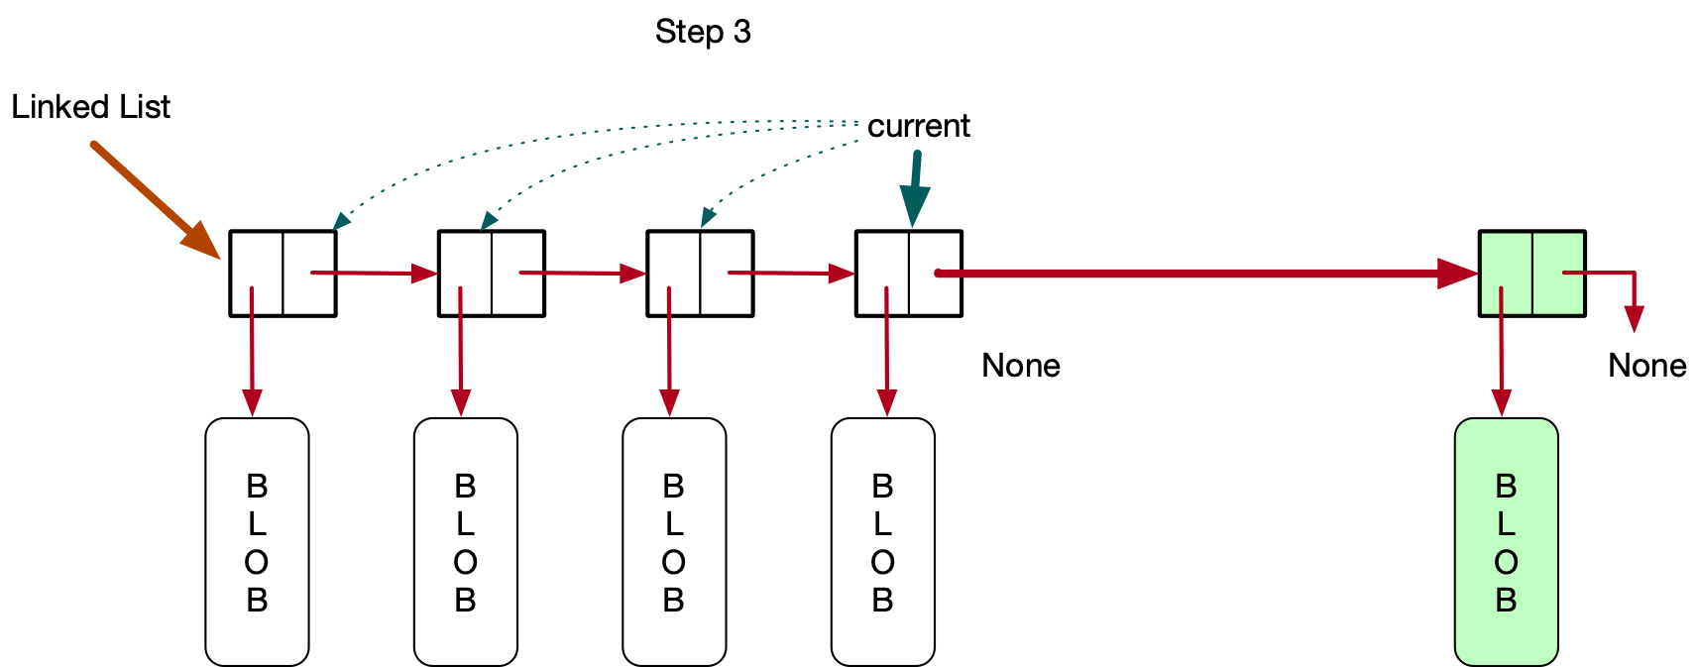
Linked List as Queue
Reset the next_node in the current node

Slide 47
Linked List as Queue
Create new node
def push(self, record):
new_node = Node(record)
if not self.head:
self.head = new_node
return
current_node = self.head
while current_node.next_node:
current_node = current_node.next_node
current_node.next_node = new_node

Slide 48
Linked List as Queue
Special case:
The linked list is empty
def push(self, record):
new_node = Node(record)
if not self.head:
self.head = new_node
return
current_node = self.head
while current_node.next_node:
current_node = current_node.next_node
current_node.next_node = new_node

Slide 49
Linked List as Queue
Set current_node to the beginning of queue
Then move until current_node.next_node is None
def push(self, record):
new_node = Node(record)
if not self.head:
self.head = new_node
return
current_node = self.head
while current_node.next_node:
current_node = current_node.next_node
current_node.next_node = new_node

Slide 50
Linked List as Queue
Now, current_node is pointing to the last node
So we can connect it to the new node
def push(self, record):
new_node = Node(record)
if not self.head:
self.head = new_node
return
current_node = self.head
while current_node.next_node:
current_node = current_node.next_node
current_node.next_node = new_node

Slide 51
Ordered Linked List
A different type of records:
Key and rest of record
Example: customer data is organized by giving the customer a unique identifier
We look up customer data by using the unique ID
Ordered Linked List:
Linked list where records are ordered by a key

Slide 52
Ordered Linked List
Have a node structure that has both key and record
k1 < k2 < k3 < k4
Advantage: Avoid records that duplicate the key

Slide 53
Ordered Linked List
Modify the current node structure to have a key
class Node:
def __init__(self, key, my_record):
self.key = key
self.next_node = None
self.record = my_record
def __repr__(self):
string = "Class Node "
string += str(id(self))
if self.next_node:
string += ", next is " + str(id(self.next_node))
else:
string += ", end node "
string += ", record is " + str(self.record)
string += ", key is " + str(self.key)
return string

Slide 54
Ordered Linked List
We implement an Ordered Linked List as a class
Initially empty
class OLL:
def __init__(self):
self.head = None

Slide 55
Ordered Linked List
The linked list assures that the keys increase as we move from the head to the tail
This is done by careful structuring of the insert function

Slide 56
Ordered Linked List
First exceptional case:
The list is empty
Then just make the new_node the head

Slide 57
Ordered Linked List
Python Code
The list is empty if self.head is None
def insert(self, key, record):
new_node = Node(key, record)
if not self.head:
self.head = new_node
return

Slide 58
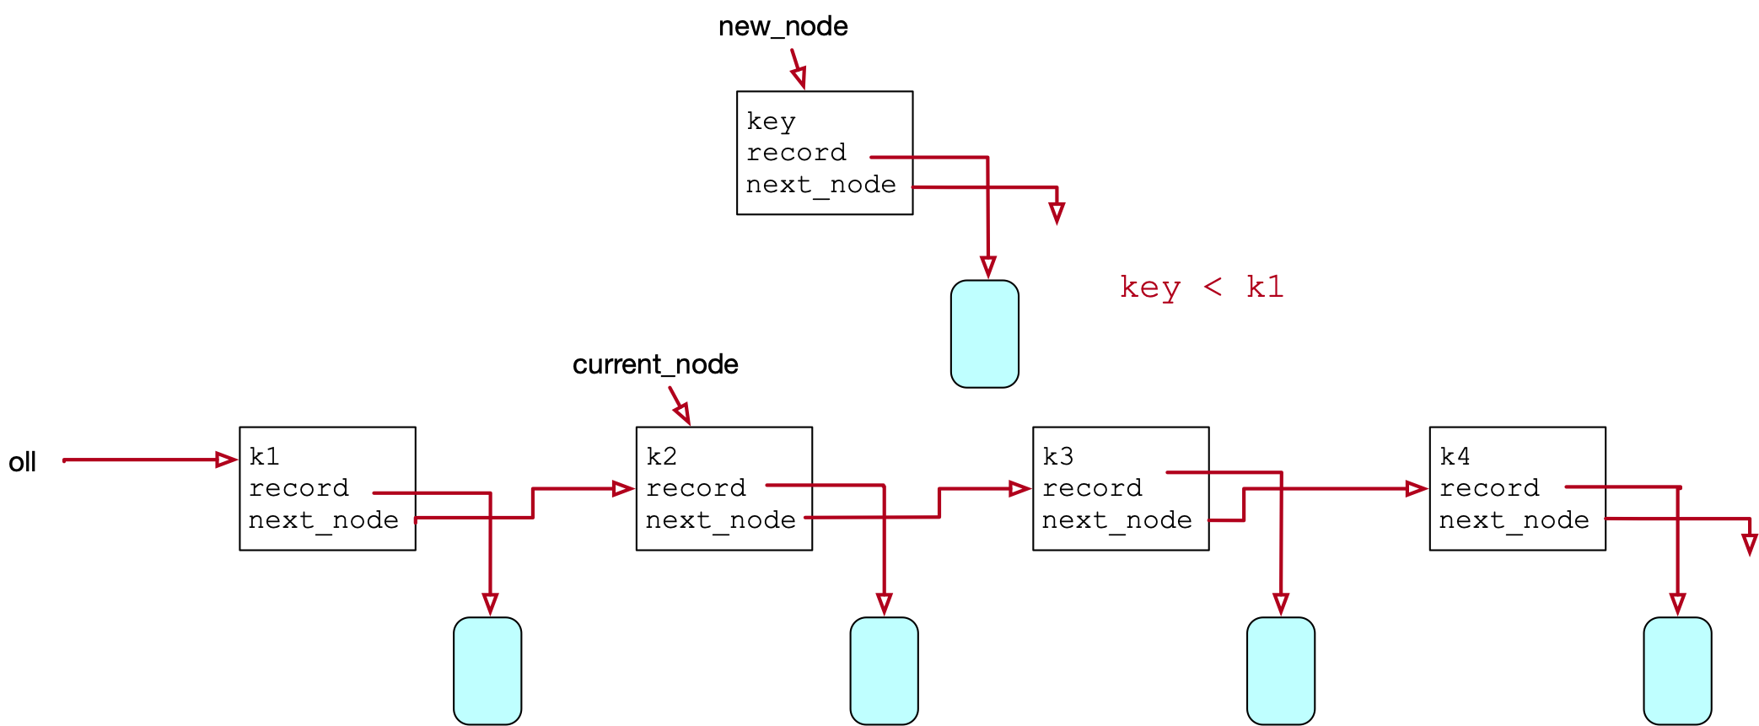
Ordered Linked List
Second special case:
The new key is the smallest and we need to insert at the beginning

Slide 59
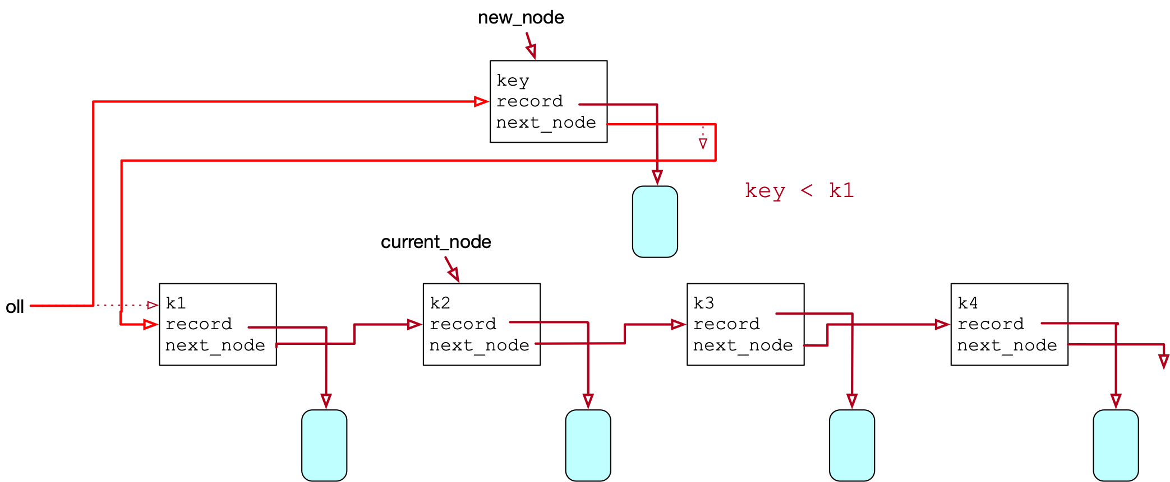
Ordered Linked List
Need to change two pointers
oll needs to point to the new node
new_node needs to point to the old oll.head

Slide 60
Ordered Linked List
elif key < self.head.key:
new_node.next_node = self.head
self.head = new_node
return

Slide 61
Ordered Linked List
Normal case: We insert in the middle

Slide 62
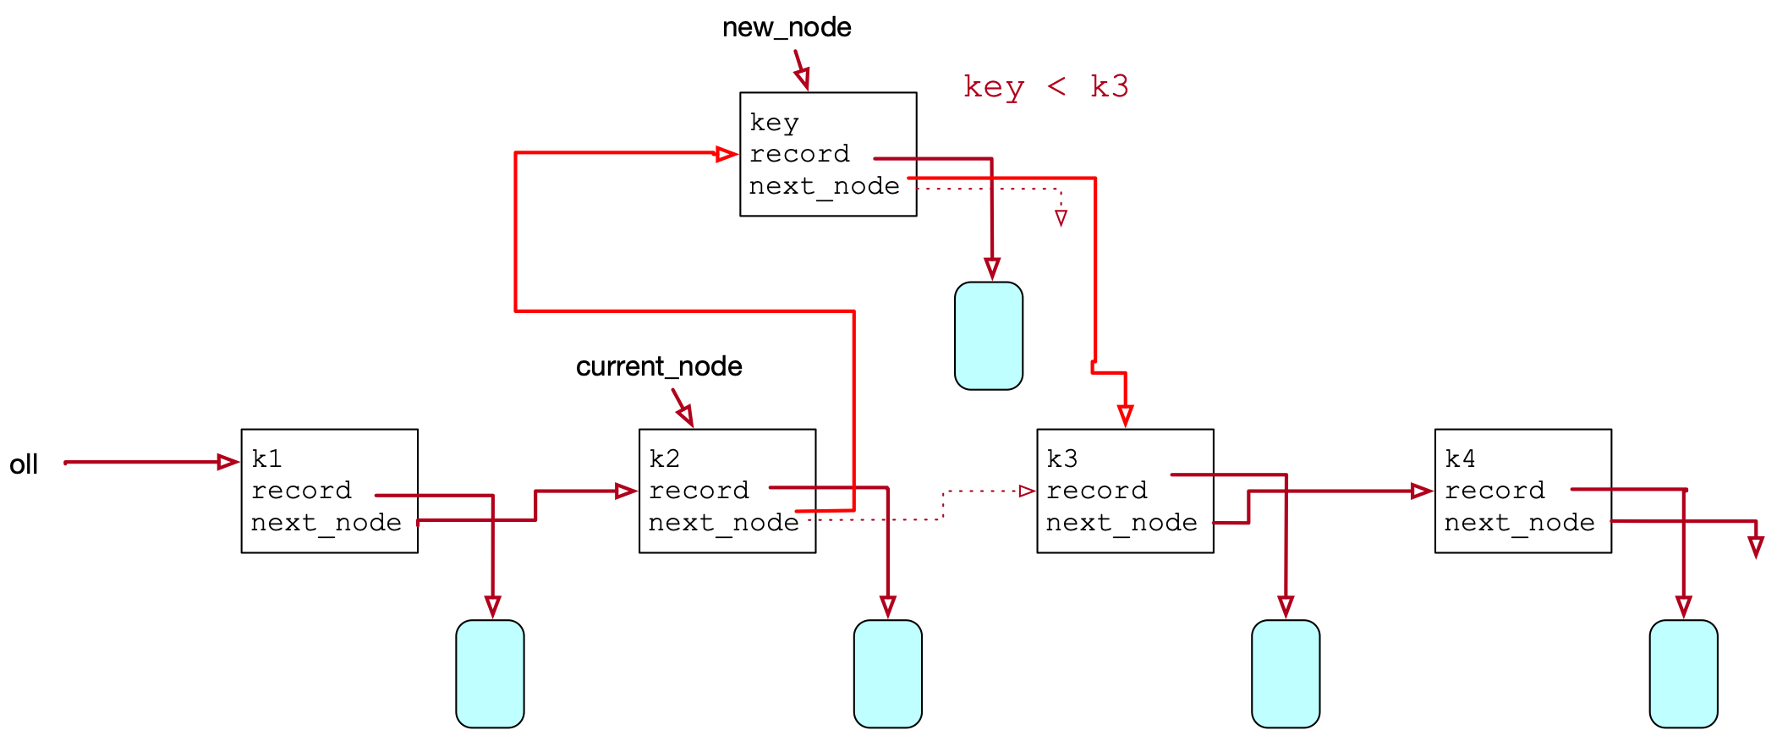
Ordered Linked List
Normal case: We insert in the middle
Need to change two pointers

Slide 63
Ordered Linked List
Trick:
Do not loose access, therefore set the pointer in new_node first

Slide 64
Ordered Linked List
else:
current_node = self.head
while current_node:
if current_node.next_node and key < current_node.next_node.key:
new_node.next_node = current_node.next_node
current_node.next_node = new_node
return
current_node = current_node.next_node

Slide 65
Ordered Linked List
Final case: The new key is the largest and we need to insert at the end
This can be achieved with the previous code
But if current_node points to the last node
Then current_node.next_node is None

Slide 66
Ordered Linked List

Slide 67
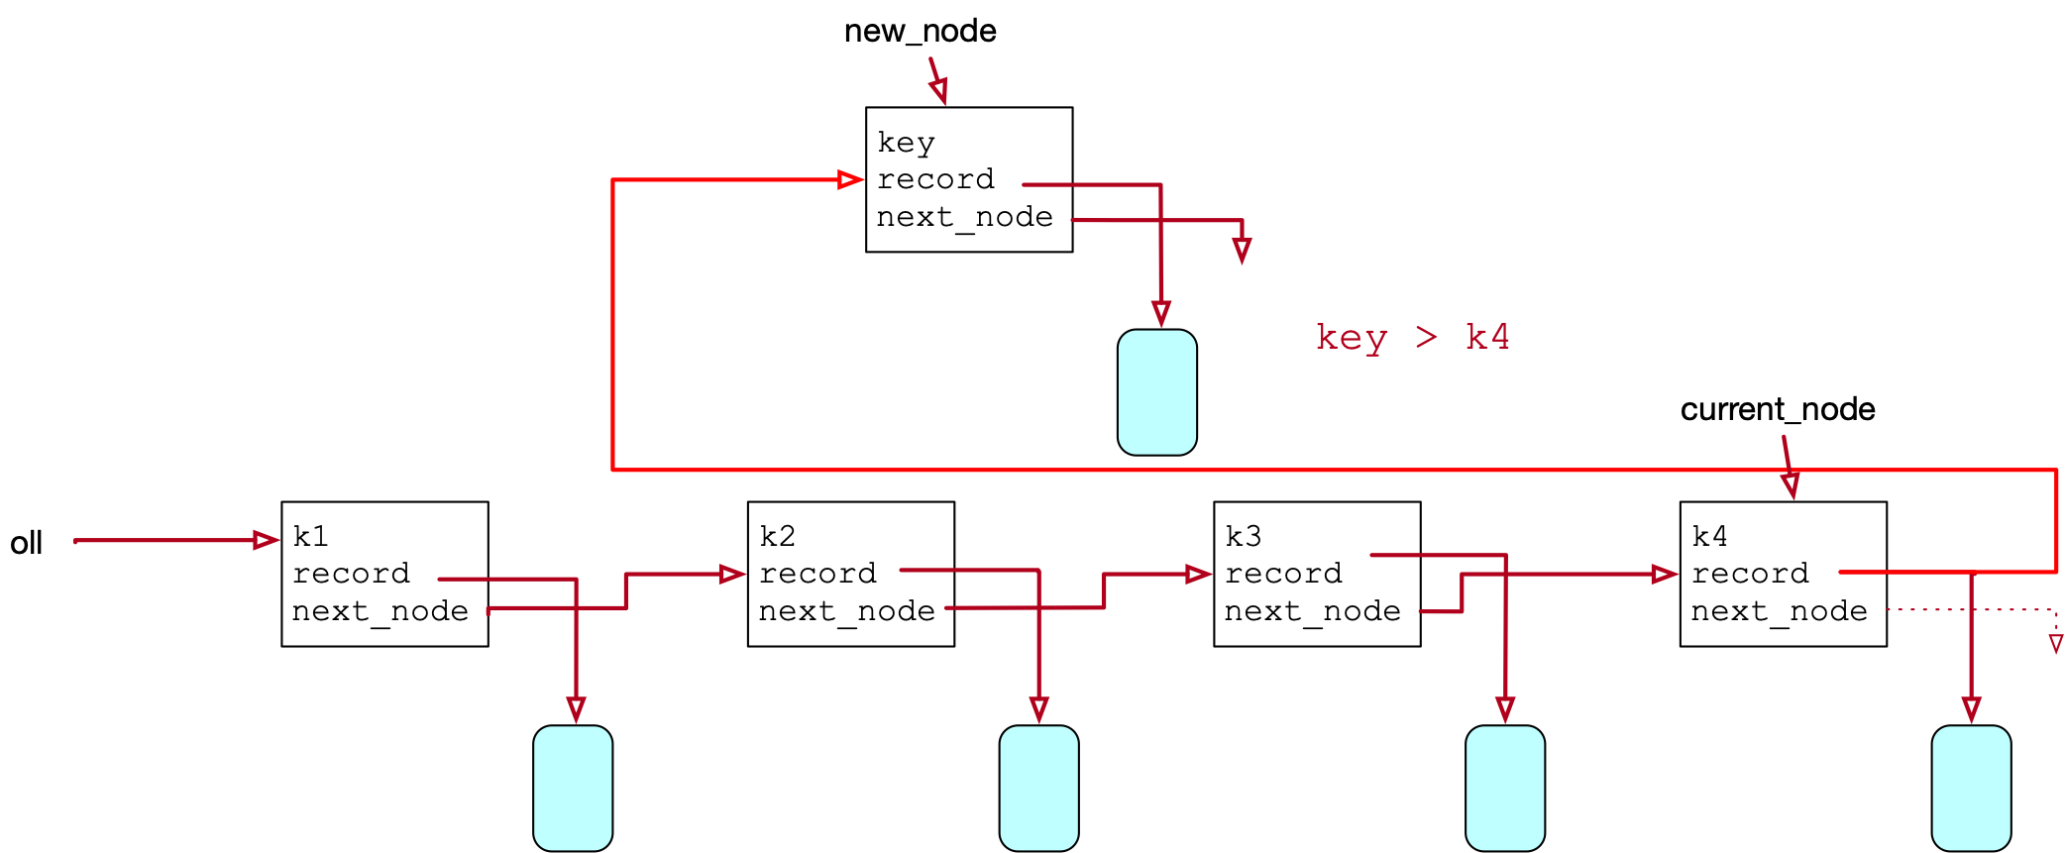
Ordered Linked List
Resetting new_node.next_node to current_node.next does not cause any harm

Slide 68
Ordered Linked List
We need to add one clause to the if statement:
if current_node.next == None

Slide 69
Ordered Linked List
else:
current_node = self.head
while current_node:
if (not current_node.next_node or
current_node.next_node and key <
current_node.next_node.key):
new_node.next_node = current_node.next_node
current_node.next_node = new_node
return
current_node = current_node.next_node

Slide 70
Ordered Linked List
How do we delete a record by key
Case 1: Deleting first record

Slide 71
Ordered Linked List
def delete(self, key):
if not self.head:
return False
elif self.head.key == key:
self.head = self.head.next_node
return True

Slide 72
Ordered Linked List
Deletion by key:
Find the node before the node with the key
Reset the next-node link in that node
Special cases:
the list is empty: return False
the node to be deleted is the first:
Reset the list.head to the next node and return True

Slide 73
Ordered Linked List
Delete first node:

Slide 74
Ordered Linked List
Common case: Delete in the middle or at the tail

Slide 75
Ordered Linked List
If we fall of the end of the list:
key was not present: return False

Slide 76
Ordered Linked List
Homework
def delete(self, key):
if not self.head:
return False
elif self.head.key == key:
***
return True
else:
current_node = self.head
while current_node:
if current_node.next_node and key == current_node.next_node.key:
****
elif not current_node.next_node:
return False
current_node = current_node.next_node
return False

