Slide 1
Abstract Data Structures
Thomas Schwarz, SJ

Slide 2
Algorithms
Recipe for a computation
  Can have a large effect on the resources a computation takes

Slide 3
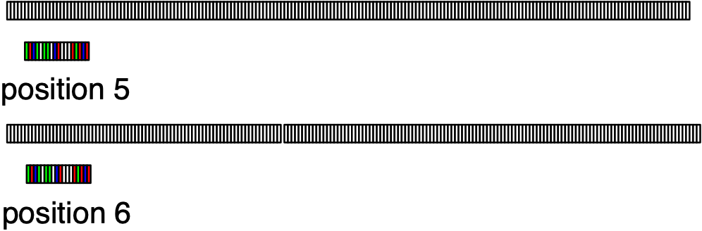
Algorithms
  Example:
    Finding a string of length 100 in a human genome
      Naive method: Compare string letter for letter against all positions in about 3 billion letters
      300,000,000,000 comparisons

Slide 4
Algorithms
  Example:
    Finding a string of length 100 in a human genome
      Slightly better by breaking off comparisons when we know we cannot have a match
        On average $(3/4+2/4+3/16+4/32+…)×3000000000$comparisons
    Can be done with less than 3000000000 comparisons!

Slide 5
Algorithms
Two criteria
  Correctness
    Formal methods, testing
  Resource consumption
    Speed, memory use

Slide 6
Example:
Collatz Conjecture
Collatz sequence (a.k.a. hailstorm sequence)
  Take a number
    If the number is even, divide the number by 2
    If the number is odd, multiply by 3 and add 1
  Repeat to get the Collatz sequence
    Example:
      9, 28, 14, 7, 22, 11, 34, 17, 52, 26, 13, 40, 20, 10, 5, 16, 8, 4, 2, 1
Collatz Conjecture: All Collatz sequences terminate in 1

Slide 7
Example:
Collatz Conjecture
Implementing the Collatz conjecture tester:
  First, implement the Collatz step
def collatz_step(n):
if n%2:
return 3*n+1
else:
return n//2

Slide 8
Example:
Collatz Conjecture
We can calculate a Collatz sequence:
def collatz_sequence(n):
sequence = [n]
while True:
n = collatz_step(n)
sequence.append(n)
if n == 1:
return sequence

Slide 9
Example:
Collatz Conjecture
Assume we want to test the Collatz conjecture for all numbers smaller than 1,000,000
  Observation 1:
    If a Collatz sequence contains a number, it will contain the sequence for that number
      Collatz sequence for 11:
        11, 34, 17, 52, 26, 13, 40, 20, 10, 5, 16, 8, 4, 2, 1
      Collatz sequence for 9:
        9, 28, 14, 7, 22, 11, 34, 17, 52, 26, 13, 40, 20, 10, 5, 16, 8, 4, 2, 1

Slide 10
Example:
Collatz Conjecture
Consequence:
  If we see a number for which the Collatz conjecture holds, we do not need to continue calculating the sequence

Slide 11
Example:
Collatz Conjecture
Smart algorithm:
  Remember whether a number has already appeared in a Collatz sequence
  Whenever we encounter such a number, we can stop
  Therefore: keep a list of all Collatz numbers and update it

Slide 12
Example:
Collatz Conjecture
When could the Collatz conjecture go wrong:
  One possibility:
    Just go off and get larger and larger numbers
  Alternative:
    We repeat the same sequence over and over again

Slide 13
Example:
Collatz Conjecture
def is_collatz(i):
sequence = set([i])
while True:
i = collatz_step(i)
if i==1:
return True
if i in sequence:
return False
sequence.add(i)
if i < NN and collatz[i]:
for x in sequence:
if x < NN:
collatz[x] = True

Slide 14
Example:
Collatz Conjecture
Then check for all numbers between 2 and 1,000,000
print('starting')
for i in range(2,NN):
if collatz[i]:
continue
if not is_collatz(i):
print(i)
print('finishing')

Slide 15
Data Structures
Fundamental objects of computation
  Built from smaller objects such as integers, floating point numbers, pixels, codes (utf-8, ASCII)
  Using basic aggregation such as arrays, unions, fields provided by software

Slide 16
Abstract Data Structures
ADT encapsulate the behavior of a data structure
Using an interface for interaction

Slide 17
Abstract Data Structures
Example:
  Counter
    Counters can be incremented and decremented
    They have an integer value that can be read
    They are initialized with a zero value
    Behavior is abstractly defined:
      Decrementing a counter with zero value creates an error or has no effect
        This is a design decision
      Incrementing a counter always increases the value by one

Slide 18
Abstract Data Structures
Standard Implementation of an ADT uses a Python class
  But not necessarily

Slide 19
Abstract Data Structures
Silly Example:
  The Counter ADT in Python
    Silly because we could just use an int with a couple of functions
  Counters can be incremented and decremented
  They have a value that can be returned
  Null 0 is an absolute minimum

Slide 20
Abstract Data Structures
class Counter( ):
def __init__(self):
self.count = 0
def add(self):
self.count += 1
def dec(self):
if self.count >=1:
self.count -= 1
def get_count(self):
return self.count
def is_null(self):
return self.count==0

Slide 21
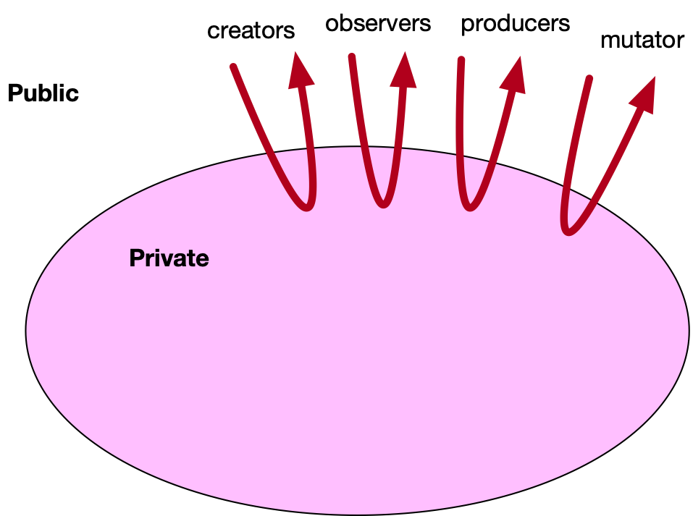
Abstract Data Structures
ADT provides an interface to the world
  Creator: Create an instance
  Observer: Get something from the ADT
  Producer: Create new instances from old instances
  Mutators: Change an instance of the ADT

Slide 22
Abstract Data Structures
Example:
  Strings:
    Different implementations:
      Pascal strings: an array of characters plus a length
      Unix strings: an array of characters with a null symbol at the end

Slide 23
Abstract Data Structures
Example:
  Strings:
    ADT String provides an interface that is:
      Formal enough to reason about strings
      Allows to re-implement the data structure

Slide 24
Abstract Data Structures
Example:
  Strings:
    Creator: a constructor that creates a string
    Observer: get character at second last position
    Mutator: replace all substrings of a certain form with a different form
    Producer: concatenate two strings

