Slide 1
Recursion
Thomas Schwarz, SJ

Slide 2
“The power of recursion evidently lies in the possibility of defining an infinite set of objects by a finite statement. In the same manner, an infinite number of computations can be described by a finite recursive program, even if this program contains no explicit reference.”
Algorithms +Datastructures = Programs
N.E. Wirth, 1976

Slide 3
Recursion as a Universal Tool
Recursion possible:
Solution depends partially on solution(s) to (a) smaller problem(s)
Recursion function consists of
Base Case
Call to function with smaller arguments

Slide 4
Examples for Recursion
Euclidean Algorithm
Base case: one number is zero
Recursion: express the problem using smaller numbers
$$a>b⇒\text{gcd}(a,b)=\text{gcd}(b,a\%b)$$

Slide 5
Examples of Recursion:
Efficient Calculations of Powers
Naive power calculation:
This uses n multiplications.
Can do better by setting acc = x, but that still uses $n-1$ multiplications
def power(x,n):
acc = 1
for _ in range(n):
acc *= x

Slide 6
Examples of Recursion:
Efficient Calculations of Powers
There is a better way with recursion
If $n$ is even, $n=2m$: $x^{n}$ is the product of $x^{m}$ with itself.
If n is odd, $n=2m+1$: $x^{n}$ is $x^{m}⋅x^{m}⋅x$
This leads to very simple Python code

Slide 7
Examples of Recursion:
Efficient Calculations of Powers
Direct Python Implementation:
def power(x, n):
if n == 0:
return 1
if n == 1:
return x
if n%2 == 0:
return power(x,n//2)*power(x,n//2)
return power(x,n//2)*power(x,n//2)*x

Slide 8
Examples of Recursion:
Efficient Calculations of Powers
Why does this work
A formal proof can assure that we did not make an implementation mistake
Proof is by induction
Base Cases: n=0 and n=1 are directly in the code
Induction Step: Assume it works for all inputs up to, but not including n
Need to show that it also works for n

Slide 9
Examples of Recursion:
Efficient Calculations of Powers
Case distinction:
If $n$ is even:
Then $x^{n}=x^{n//2}⋅x^{n//2}$ and the code works
If $n$ is odd
Then $x^{n}=x⋅x^{n//2}⋅x^{n//2}$ and the code works
Here, we are using the induction hypothesis

Slide 10
Examples of Recursion:
Efficient Calculations of Powers
As you can see, recursion and induction match each other closely

Slide 11
Examples of Recursion:
Efficient Calculations of Powers
Performance:
Best case: $n$ is a power of 2, i.e. $n=2^{m}$
By induction: show that the algorithm takes m steps.
Each step uses one multiplication.
Total of $m=\log_{2}(n)$ multiplications

Slide 12
Examples of Recursion:
Efficient Calculations of Powers
Performance:
Worst case: $n$ is always odd
$n=1,3,7,…$ $=a_{1},a_{2},a_{3},…$
Next element in this sequence is calculated from the previous: $a_{j}=2⋅a_{j-1}+1$
Can prove by induction:
$$a_{j}=2^{j}-1$$

Slide 13
Examples of Recursion:
Efficient Calculations of Powers
Performance:
Worst case: $n=2^{m}-1$
Two multiplications per step
There are $m-1$ steps
Total is $2m-2$ multiplications
Which is $2\log_{2}(n)-2$ multiplications

Slide 14
Examples of Recursion:
Efficient Calculations of Powers
Performance: $O(log(n))$

Slide 15
Examples of Recursion:
Efficient Calculations of Powers
Implementation using binary operations
def power(x, n):
if n == 0:
return 1
if n == 1:
return x
m = n >> 1
r = n&0x01
p = power(x,m)
if r:
return p*p*x
return p*p

Slide 16
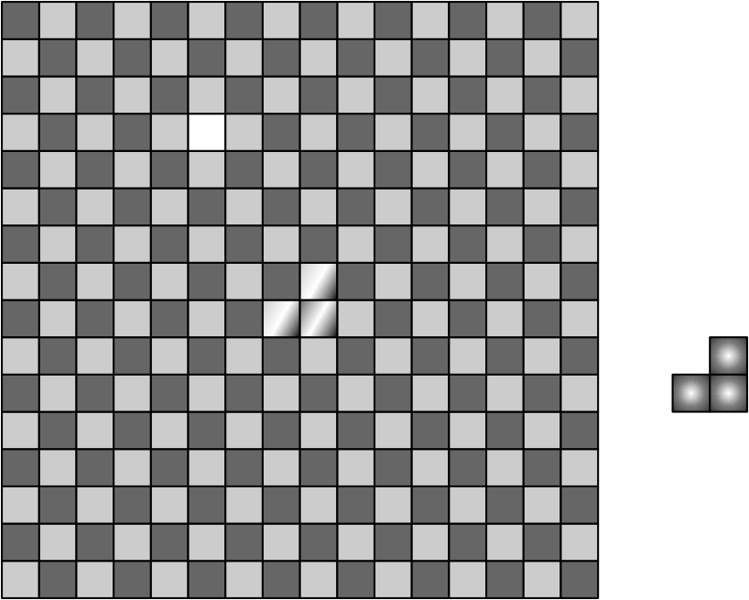
Examples of Recursion:
Triominos
We are given a chess board of size $2^{m}×2^{m}$ with one field removed.
Write a program that shows how to tessellate the chess board with a triomino

Slide 17
Examples of Recursion:
Triominos
Notice:
The chess board has $2^{m}×2^{m}≡(-1)^{m}×(-1)^{m}≡1(mod3)$ fields.
A Triomino has three fields
So, maybe it is possible

Slide 18
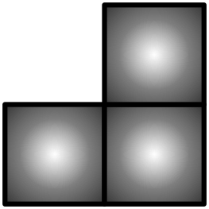
Examples of Recursion:
Triominos
Base Case:
$m=1$.
A two-by-two chess board has four fields.
Remove one, and you have a triomino

Slide 19
Examples of Recursion:
Triominos
Recursion:
A $2^{m}×2^{m}$ chessboard consists of four $2^{m-1}×2^{m-1}$ chessboards.
Take such a board with one field removed.

Slide 20
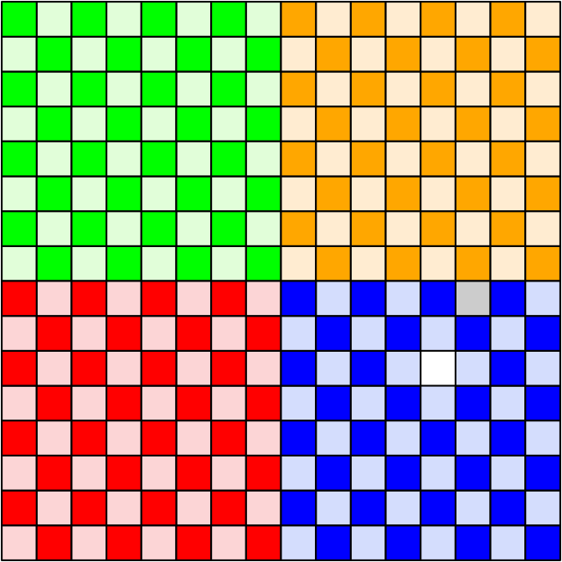
Examples of Recursion:
Triominos
Divide the board into four equal parts

Slide 21
Examples of Recursion:
Triominos
One of them (here the blue one) has the missing field.
Create a list of triominos that fill this up

Slide 22
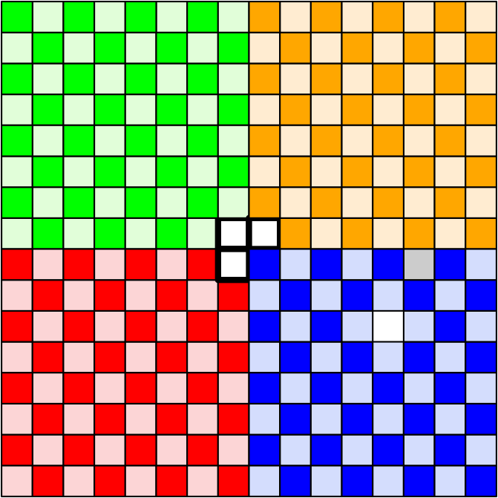
Examples of Recursion:
Triominos
Place a Triomino in the middle, cutting out one field from each of the other sub-boards.

Slide 23
Examples of Recursion:
Triominos
Add this triomino to the list.
The three remaining boards (green, orange, red) can now be covered with triominos

