Slide 1
Back-Tracking
Thomas Schwarz, SJ

Slide 2
Complete Enumeration
You are given:
A set of numbers, e.g. $S=\{1,5,12,14,19,20,21\}$
A target number $t$
Your task is to find a subset of $S$ such that the sum of the letters in the subset is as close to $t$ as possible.

Slide 3
Complete Enumeration
Complete enumeration solves this by
creating all subsets
selecting the one that works best
One possibility is to use recursion for complete enumeration

Slide 4
Complete Enumeration
Base case:
Subsets of the empty set are just the empty set
Subsets of a set with one element $x$ are just $∅,x$

Slide 5
Complete Enumeration
Recursive Case:
Subsets of the set $\{a_{1},…,a_{n}\}$ are:
Subsets of $\{a_{1},…,a_{n-1}\}$
Subsets consisting of a subset of $\{a_{1},…,a_{n-1}\}$ and $a_{n}$

Slide 6
Complete Enumeration
How to represent sets?
Python has a type sets, but the elements need to be hashable
And sets are not hashable
Could use frozen_sets, but these are ugly
So, create the set of subsets as a list

Slide 7
Complete Enumeration
Implementation:
def subsets(a_list):
if len(a_list) == 0:
return []
if len(a_list) == 1:
return [[], [a_list[-1]]]
lst = a_list[-1]
menge = subsets(a_list[:-1])
return menge + [ x+[lst] for x in menge]

Slide 8
Complete Enumeration
Example: $S=\{1,5,12,14,19,20,21\}$ target 37:
lista = [1, 5, 12, 14, 19, 20, 21]
for subset in subsets(lista):
if sum(subset) == 37:
print(subset)
[1, 5, 12, 19]
[5, 12, 20]

Slide 9
Complete Enumeration
If you want to find the best approximation, you need to remember the best value so far
def find(lista, target):
best = sum(lista)+1
best_seen = []
for subset in subsets(lista):
if abs(sum(subset) - target) < best:
best = abs(sum(subset) - target)
best_seen = subset
return best, best_seen

Slide 10
Complete Enumeration
Example: Target is 43
Best: 1, [5, 19, 20]

Slide 11
Complete Enumeration
Complete enumeration of subsets generates $2^{n}$ subsets
Therefore, is exponential
In general: complete enumeration with recursion creates a call tree with $b^{n}$ or $b^{n+1}$ leaves

Slide 12
Back Tracking
Idea:
We do not always need to go down to the leaves of the tree, but can stop earlier

Slide 13
Back Tracking
Example:
The n-queens problem
Place n-queens on a $n×n$ chessboard so that no queen threatens any other
Queens can move vertically, horizontally, and diagonally

Slide 14
Back Tracking
Strategy:
We notice that there can be only one queen per column
And that there has to be one in every column to get the total number to $n$

Slide 15
Back Tracking
Add queen to a partial solution
Check whether queen placement is possible
If not, stop this branch in the tree
Trick is to use recursion so that we do not have to administer walking up and down the tree

Slide 16
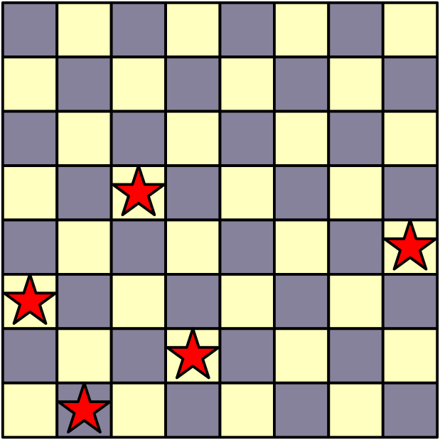
Back Tracking
We encode the problem by having a list board
$i^{\text{th}}$ queen is located in row $i$ and column board[i]
E.g. board = [1,3,0,7,2]
col 7
row 3

Slide 17
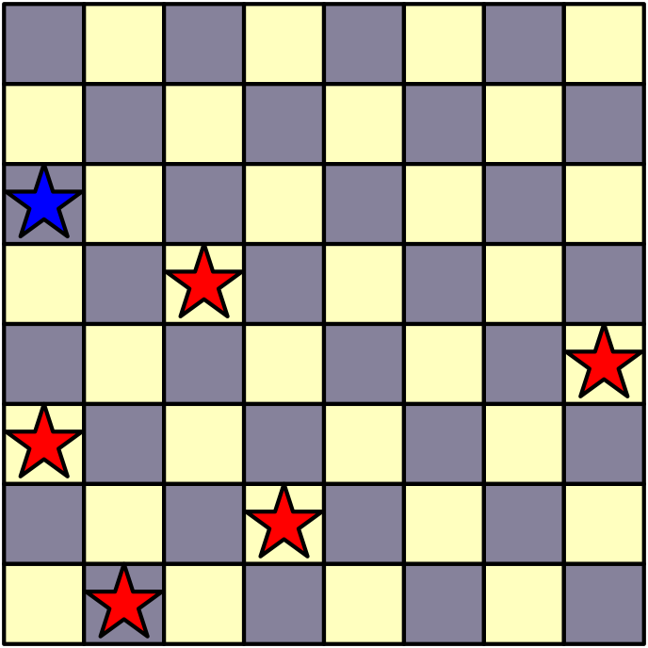
Back Tracking
E.g. board[1,3,0,7,2]
We then assign the next queen in row 5
We try out: 0, 1, 2, … , 7
0 does not work

Slide 18
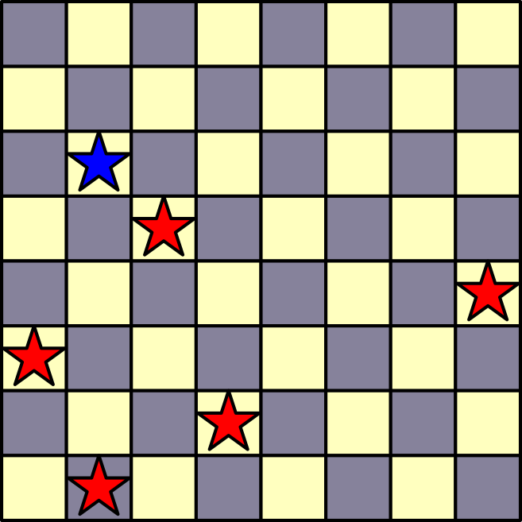
Back Tracking
E.g. board[1,3,0,7,2]
We then assign the next queen in row 5
We try out: 0, 1, 2, … , 7
1 does not work
2 does not work
3 does not work

Slide 19
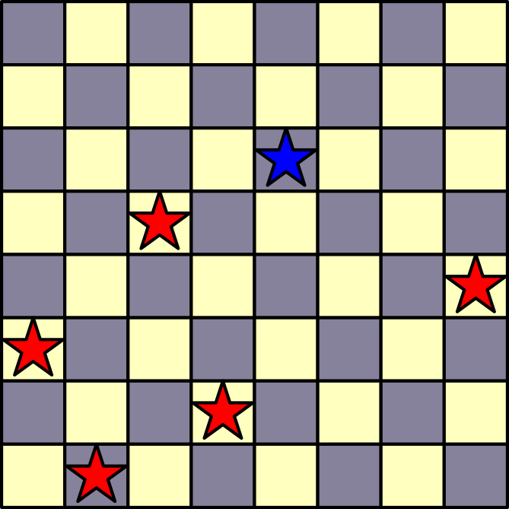
Back Tracking
E.g. board[1,3,0,7,2]
4 works
And then we try further recursively

Slide 20
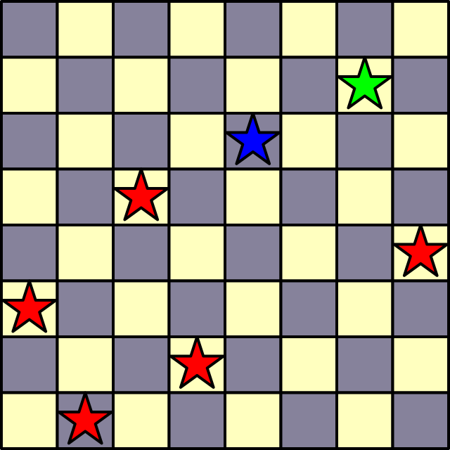
Back Tracking
E.g. board[1,3,0,7,2]
4 works
And then we try further recursively

Slide 21
Back Tracking
E.g. board[1,3,0,7,2]
4 works
And try more, but now we are stuck

Slide 22
Back Tracking
E.g. board[1,3,0,7,2]
Need to undo, but the OS-stack takes care of that
Our recursive calls just return

Slide 23
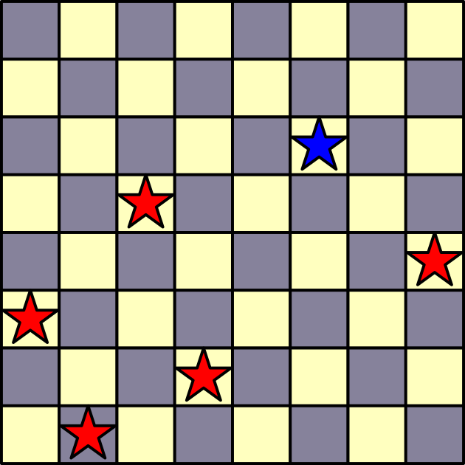
Back Tracking
E.g. board[1,3,0,7,2]
Back in this situation and now 5 works
But you can already see that the next step does not

Slide 24
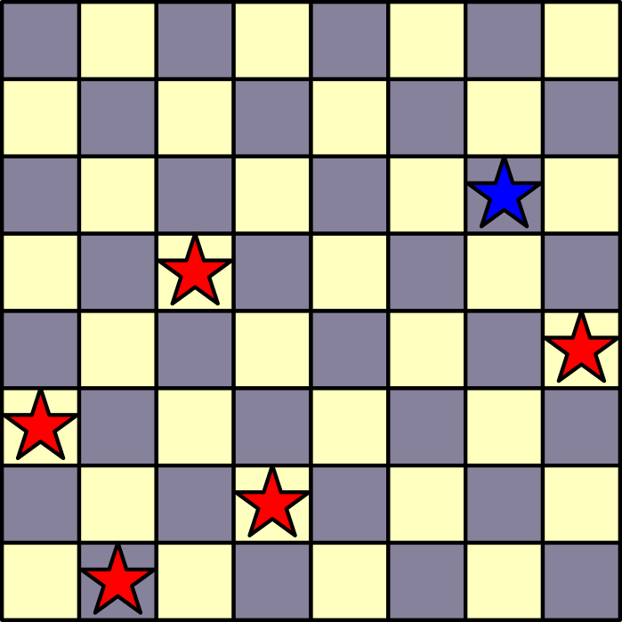
Back Tracking
E.g. board[1,3,0,7,2]
Back in this situation and now 6 works

Slide 25
Back Tracking
E.g. board[1,3,0,7,2]
Recursion tries to place something in row 6
Nothing works, so this was a dead-end

Slide 26
Back Tracking
We implement this as a double loop
Inner loop tries placement
Outer loop is implemented via recursion

Slide 27
Back Tracking
Need to check validity:
Set-up guarantees that queens are in different columns
Need to check that a new queen is not in the same row or in one of the two diagonals with any already placed queen
def is_valid(board):
current_queen_row, current_queen_col = len(board)-1, board[-1]
for row, col in enumerate(board[:-1]):
diff = abs(current_queen_col - col)
if diff == 0 or diff == current_queen_row - row:
return False
return True

Slide 28
Back Tracking
We now count how many solutions there are
def n_queens(n, board = []):
if n == len(board):
return 1
count = 0
for col in range(n):
board.append(col)
if is_valid(board):
count += n_queens(n, board)
board.pop()
return count

Slide 29
Back Tracking
Notice how we add and a remove a value from the board
def n_queens(n, board = []):
if n == len(board):
return 1
count = 0
for col in range(n):
board.append(col)
if is_valid(board):
count += n_queens(n, board)
board.pop()
return count

Slide 30
Back Tracking
Back-tracking can be used if
We can construct partial solutions
We can verify that a partial solution is invalid
Can we verify if the solution is complete

Slide 31
Back Tracking
Back-tracking can be used if
We can construct partial solutions
We can verify that a partial solution is invalid
Can we verify if the solution is complete

Slide 32
Back Tracking
$n$ queens problem:
Can we construct partial solutions?
Yes, just use partial boards
Can we verify that a partial solution is invalid
Yes, if a queen is in the same row or in the same diagonal with one placed before
Can we verify if the solution is complete
Yes, when we have reached a board of length n.

Slide 33
Back Tracking
Example: Sudoku Solver
Given an initial sudoku position
Add one new number at a time
Check whether that number violates any of the rules
Finish when all numbers have been placed

