Slide 1
Divide and Conquer
Algorithms

Slide 2
Divide and Conquer
Generic recipe for many solutions:
  Divide the problem into two or more smaller instances of the same problem
  Conquer the smaller instances using recursion (or a base case)
  Combine the answers to solve the original problem

Slide 3
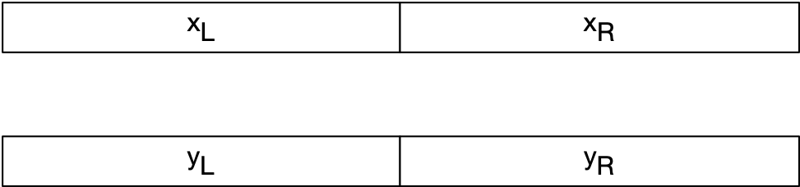
Integer Multiplication
Assume we want to multiply two n-bit integers with n a power of two
  Divide: break the integers into two n/2-bit integers
$$x=2^{\frac{n}{2}}x_{L}+x_{R}$$
$$y=2^{\frac{n}{2}}y_{L}+y_{R}$$

Slide 4
Integer Multiplication
  Conquer: Solve the problem of multiplying of n/2 bit integers by recursion or a base case for n=1, n=2, or n=4
$$x=2^{\frac{n}{2}}x_{L}+x_{R}$$
$$y=2^{\frac{n}{2}}y_{L}+y_{R}$$
$$x_{L}⋅y_{L}$$
$$x_{L}⋅y_{R}$$
$$x_{R}⋅y_{L}$$
$$x_{R}⋅y_{R}$$

Slide 5
Integer Multiplication
Now combine:
  In the naïve way:
$$x⋅y=(x_{L}⋅2^{\frac{n}{2}}+x_{R})⋅(y_{L}⋅2^{\frac{n}{2}}+y_{R})$$
$$=x_{L}⋅y_{L}⋅2^{n}+(x_{L}⋅y_{R}+x_{R}⋅y_{L})⋅2^{\frac{n}{2}}+x_{R}⋅y_{R}$$

Slide 6
Integer Multiplication
$$x⋅y=(x_{L}2^{\frac{n}{2}}+x_{R})⋅(y_{L}2^{\frac{n}{2}}+y_{R})$$
We count the number of multiplications
  Multiplying by powers of 2 is just shifting, so they do not count
  number of bit multiplications for integers with bits:
    Recurrence:
$$=x_{L}⋅y_{L}2^{n}+(x_{L}⋅y_{R}+x_{R}⋅y_{L})⋅2^{\frac{n}{2}}+x_{R}⋅y_{R}$$
$$T(n)$$
$$2^{n}$$
$$T(0)=1$$
$$T(n+1)=4T(n)$$

Slide 7
Integer Multiplication
Solving the recursion
Intuition:
$$T(0)=1$$
$$T(n+1)=4T(n)$$
$$T(n)=4T(n-1)=4^{2}T(n-2)=4^{3}T(n-3)=…=4^{n}T(0)=4^{n}$$

Slide 8
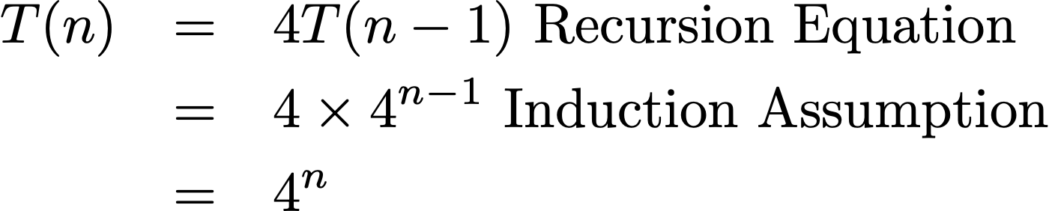
Integer Multiplication
Proposition:
Proof by induction:
  Induction base:
  Induction step: Assume $T(n-1)=4^{n-1}$ . Show $T(n)=4^{n}$
    Proof:
$$T(n)=4^{n}$$
$$T(0)=1=4^{0}$$

Slide 9
Integer Multiplication
Since the number of bits is
  Number of multiplications is
  This is not better than normal multiplication
$$m=2^{n}$$
$$S(m)=T(n)=4^{n}=(2^{n})^{n}=m^{2}$$

Slide 10
Integer Multiplication
Now combine:
  Instead:
  Use
  This reuses two multiplications that are already used
$$x⋅y=(x_{L}2^{\frac{n}{2}}+x_{R})⋅(y_{L}2^{\frac{n}{2}}+y_{R})$$
$$=x_{L}⋅y_{L}⋅2^{n}+(x_{L}⋅y_{R}+x_{R}⋅y_{L})⋅2^{\frac{n}{2}}+x_{R}⋅y_{R}$$
$$(x_{L}⋅y_{R}+x_{R}⋅y_{L})=(x_{L}+x_{R})⋅(y_{L}+y_{R})-x_{L}⋅y_{L}-x_{R}⋅y_{R}$$

Slide 11
Integer Multiplication
We need to deal with the potential overflow in calculating
$$(x_{L}+x_{R})⋅(y_{L}+y_{R})$$

Slide 12
Integer Multiplication
Now, we only do three multiplications of bit numbers in order to multiply two bit numbers
The recurrence becomes
$$2^{n}$$
$$2^{n+1}$$
$$T(0)=1$$
$$T(n+1)=3T(n)$$

Slide 13
Integer Multiplication
Solving the recurrence
  Heuristics:
$$T(0)=1$$
$$T(n+1)=3T(n)$$
$$T(n)=3T(n-1)=3^{2}T(n-2)=…=3^{n}T(0)=3^{n}$$

Slide 14
Integer Multiplication
As before prove exactly using induction

Slide 15
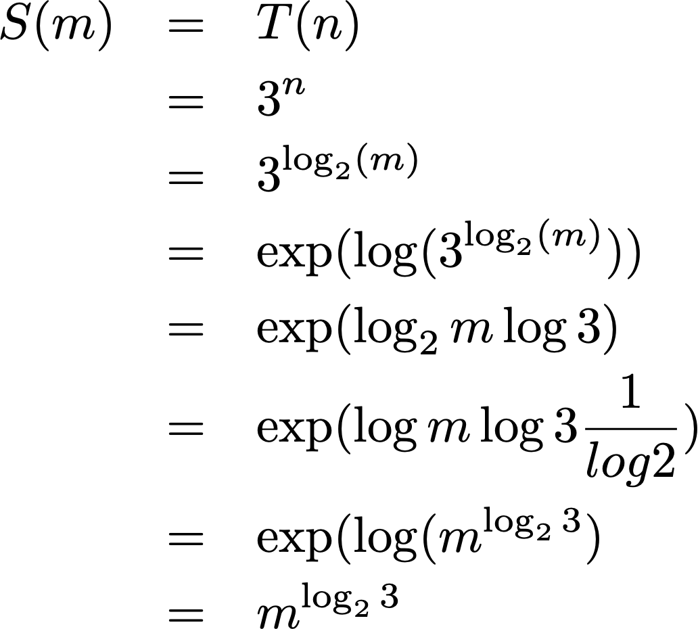
Integer Multiplication
The multiplication of two -bit numbers takes
$$m=2^{n}$$

Slide 16
Integer Multiplication
This way, multiplication of m-bit numbers takes bit multiplications
$$m^{1.58496}$$

Slide 17
Integer Multiplication
Can be used for arbitrary length integer multiplication
Base case is 32 or 64 bits
But can still do better using Fast Fourier Transformation

Slide 18
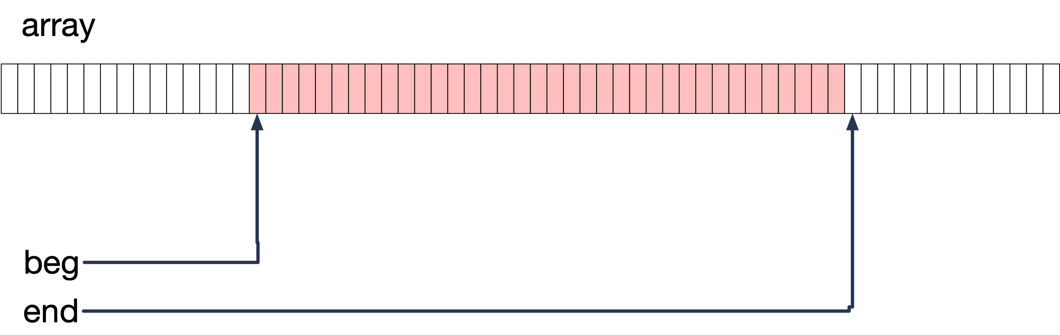
Binary Search
Given an array of ordered integers, a pointer to the beginning and to the end of a portion of the array, decide whether an element is in the slice
Search(array, beg, end, element)

Slide 19
Binary Search
Divide: Determine the middle element. This divides the array into two subsets
Conquer: Compare the element with the middle element. If it is smaller, find out whether the element is in the left half, otherwise, whether the element is in the right half
Combine: Just return the answer to the one question

Slide 20
Binary Search
def binary_search(array, beg, end, key):
if beg >= end:
return False
mid = (beg+end)//2
if array[mid]==key:
return True
elif array[mid] > key:
return binary_search(array, beg, mid, key)
else:
return binary_search(array, mid+1, end, key)
test = [2, 3, 5, 6, 12, 15, 17, 19, 21, 23, 27, 29,
31, 33, 35, 39, 41]
print(binary_search(test, 0, len(test), 21))
print(binary_search(test, 0, len(test), 22))

Slide 21
Binary Search
Let be the runtime of binary_search on a subarray with n elements
Recursion: There is a constant c such that
$$T(n)$$
$$T(1)≤c$$
$$T(n)≤T(n//2)+c$$

Slide 22
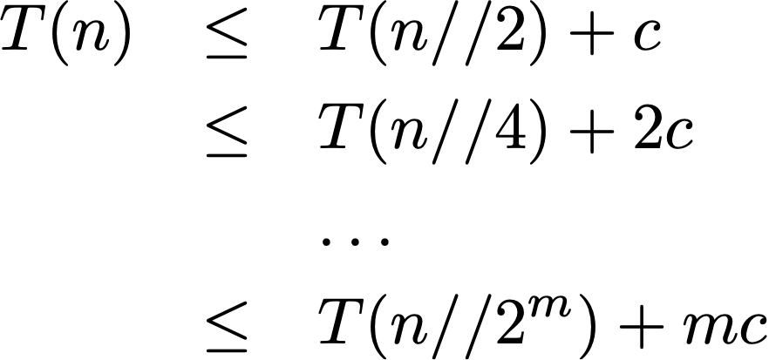
Binary Search
Solving the recurrence
If then
$$m≥\log_{2}n$$
$$T(n)≤T(1)+mc=(m+1)c$$

Slide 23
Binary Search
With other words, binary search on n elements takes time
$$∝\log_{2}(n)$$

Slide 24
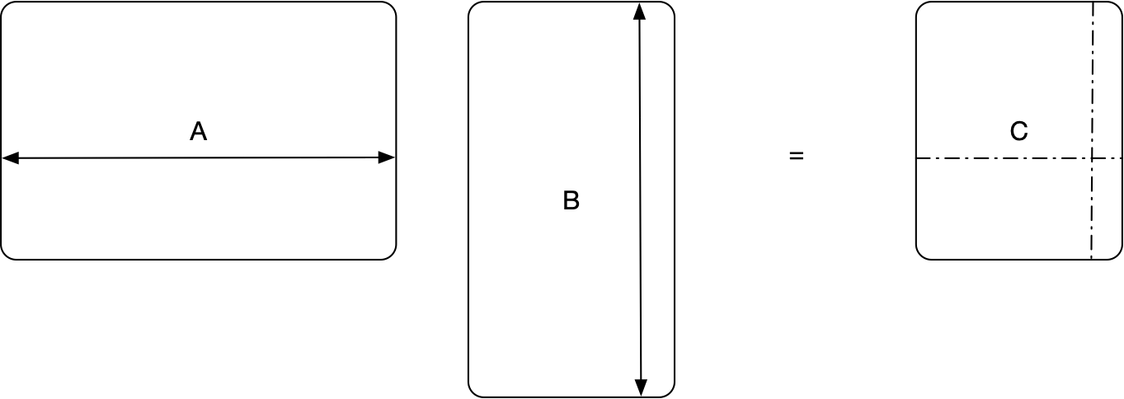
Strassen Multiplication
Definition of Matrix Multiplication
  $$(a_{i,j})_{{1≤i≤m \atop 1≤j≤n}}⋅(b_{j,k})_{{1≤j≤n \atop 1≤k≤p}}=(\overset{n}{\underset{j=1}{∑}}a_{i,j}b_{j,k})_{{1≤i≤m \atop 1≤k≤p}}$$
row i
i row
j column
column j

Slide 25
Strassen Multiplication
Cost of definition:
$n^{2}$ multiplications for all $mk$ elements in the product
  Square $n×n$ matrices: $n^{4}$ elements

Slide 26
Strassen Multiplication
Divide and conquer: Assume $n=2^{r}$ is a power of two.
We can use the following theorem:
  Break each matrix into four submatrices of size $2^{r-1}×2^{r-1}$ and calculate
$$\left(\begin{matrix}A_{11} & A_{12} \\ A_{21} & A_{22}\end{matrix}\right)⋅\left(\begin{matrix}B_{11} & B_{12} \\ B_{21} & B_{22}\end{matrix}\right)=\left(\begin{matrix}A_{11}B_{11}+A_{12}B_{21} & A_{11}B_{21}+A_{12}B_{22} \\ A_{21}B_{11}+A_{22}B_{21} & A_{21}B_{21}+A_{22}B_{22}\end{matrix}\right)$$

Slide 27
Strassen Multiplication
As is, a divide and conquer algorithm gives us 8 multiplication of matrices half the size.
Let $m(n)$ be the number of multiplications needed to multiply two $2^{n}×2^{n}$ matrices using divide and conquer
Obviously: $m(1)=1$
Recursion: $m(n+1)=8m(n)$

Slide 28
Strassen Multiplication
Claim: $m(n)=2^{3n}$
Proof: Induction base: $m(0)=1=2^{3⋅0}$
Induction step:
  Hypothesis: $m(n)=2^{3n}$
  To show: $m(n+1)=2^{3(n+1)}$
    Proof:
$$m(n+1)=8m(n)=8⋅2^{3n}=2^{3}⋅2^{3n}=2^{3n+3}=2^{3(n+1)}$$

Slide 29
Strassen Multiplication
That is the same as the normal algorithm!!!!!!!!!!!!!!!!!!!!!!!!!!!!

Slide 30
Strassen Multiplication
Strassen: Can use 7 matrix multiplications to calculate all eight products
  $$M_{1}:=(A_{1,1}+A_{2,2})(B_{1,1}+B_{2,2})$$
  $$M_{2}:=(A_{2,1}+A_{2,2})B_{1,1}$$
  $$M_{3}:=A_{1,1}(B_{1,2}-B_{2,2})$$
  $$M_{4}:=A_{2,2}(B_{2,1}-B_{1,1})$$
  $$M_{5}:=(A_{1,1}+A_{1,2})B_{2,2}$$
  $$M_{6}:=(A_{2,1}-A_{1,1})(B_{1,1}+B_{1,2})$$
  $$M_{7}:=(A_{1,2}-A_{2,2})(B_{2,1}+B_{2,2})$$

Slide 31
Strassen Multiplication
Then can get all the submatrices on the right:
$$C_{1,1}=M_{1}+M_{4}-M_{5}+M_{7}$$
$$C_{1,2}=M_{3}+M_{5}$$
$$C_{2,1}=M_{2}+M_{4}$$
$$C_{2,2}=M_{1}-M_{2}+M_{3}+M_{6}$$

Slide 32
Strassen Multiplication
Now the recurrence becomes
  $$m(n+1)=7m(n),m(0)=1$$
which is obviously solved by
  $m(n)=7^{n}$.

Slide 33
Strassen Multiplication
Remember that the size of the matrix was $2^{n}×2^{n}$.
Thus, if $M(n)$ is the number of multiplications for an $n×n$ matrix with power of 2 rows, then
  $$M(n)=m(\log_{2}(n))=7^{\log_{2}(n)}$$
Since
  $$\log_{2}(7^{\log_{2}(n)})=\log_{2}(n)\log_{2}(7)=\log_{2}(7)\log_{2}(n)=\log_{2}(n^{\log_{2}(7)})$$
    $$M(n)=n^{\log_{2}(7)}≈n^{2.80735}$$

Slide 34
Strassen Multiplication
The algorithm can be extended for matrices that
  have number of rows = number of columns not a power of 2
  are not square

Slide 35
Merge-Sort
Idea:
  It is easy to create a single sorted array out of two sorted arrays
    Look at the first elements in each array
      Move the smaller one into the target array

Slide 36
Merge-Sort
def merge(arr1, arr2):
target = [ ]
ione, itwo = 0,0
while ione<len(arr1) and itwo<len(arr2):
if arr1[ione]<arr2[itwo]:
target.append(arr1[ione])
ione += 1
else:
target.append(arr2[itwo])
itwo += 1
if ione == len(arr1):
target += arr2[itwo:]
else:
target += arr1[ione:]

Slide 37
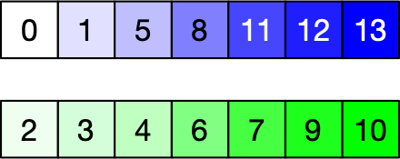
Merge-Sort
Example
  Merge
  Initialize target list, set two indices equal to 0

Slide 38
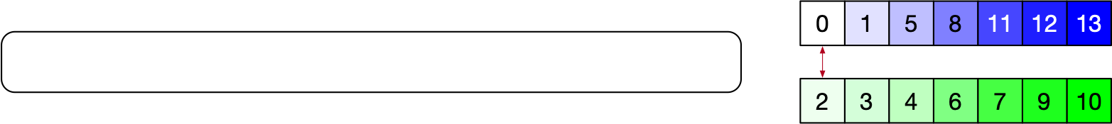
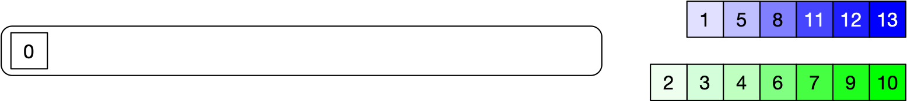
Merge-Sort
Compare elements at indices
  0 < 2: Select 0 and move first index to right

Slide 39

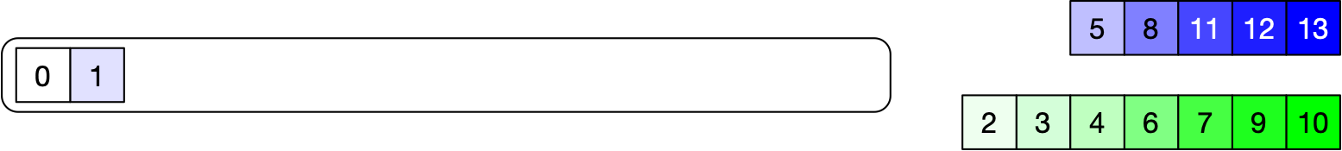
Merge-Sort
Repeat

Slide 40

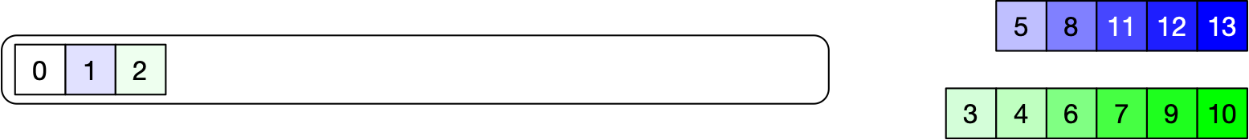
Merge-Sort

Slide 41
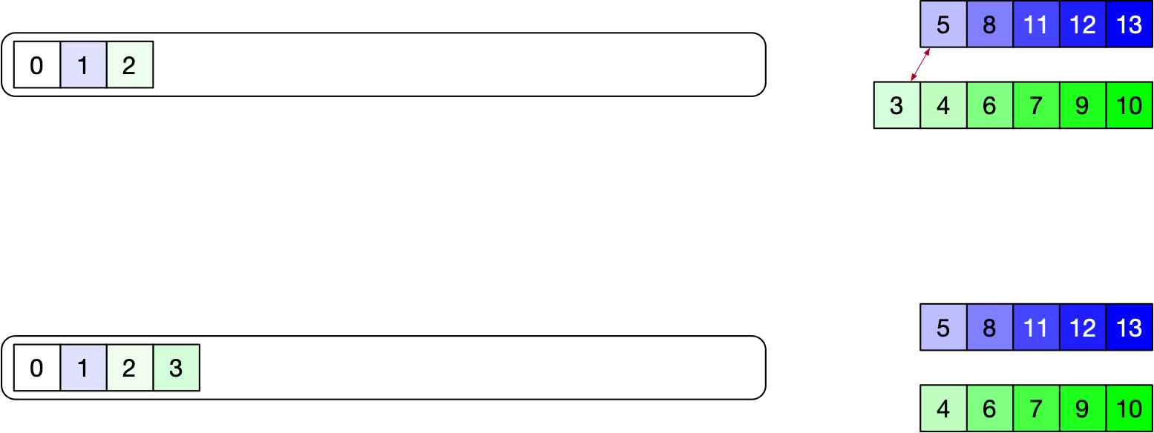
Merge-Sort

Slide 42
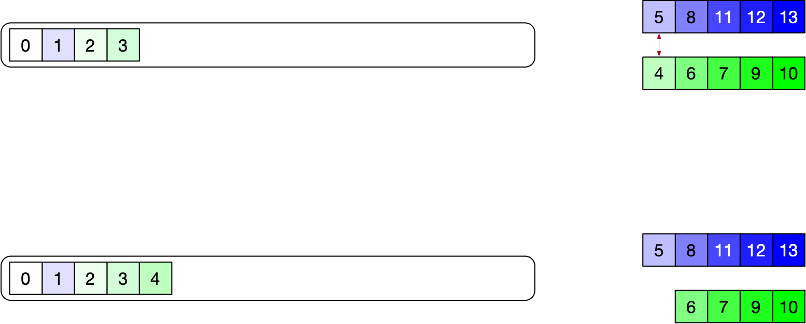
Merge-Sort

Slide 43
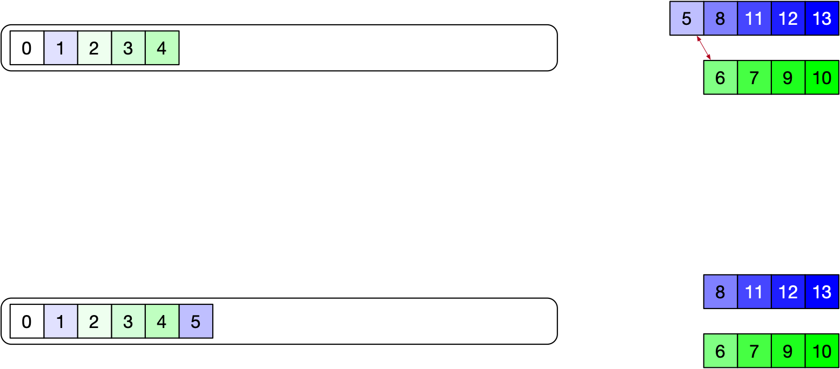
Merge-Sort

Slide 44
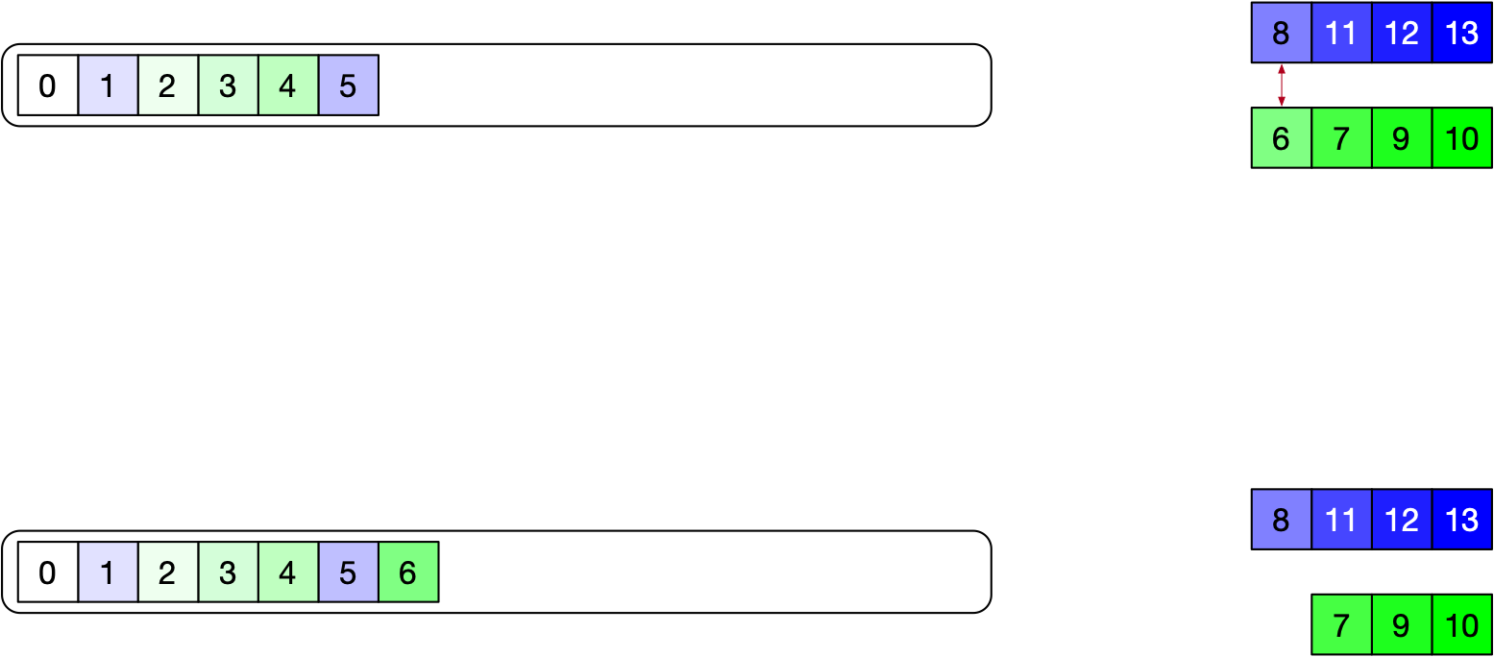
Merge-Sort

Slide 45
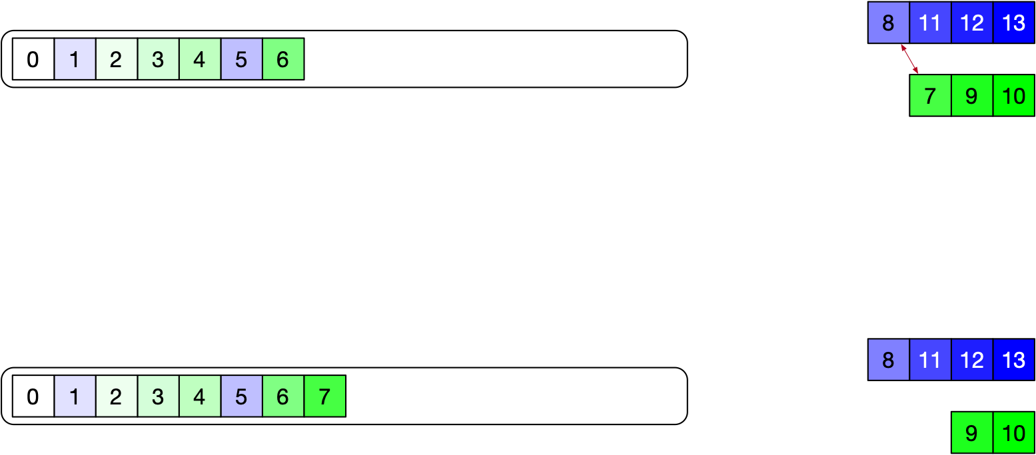
Merge-Sort

Slide 46
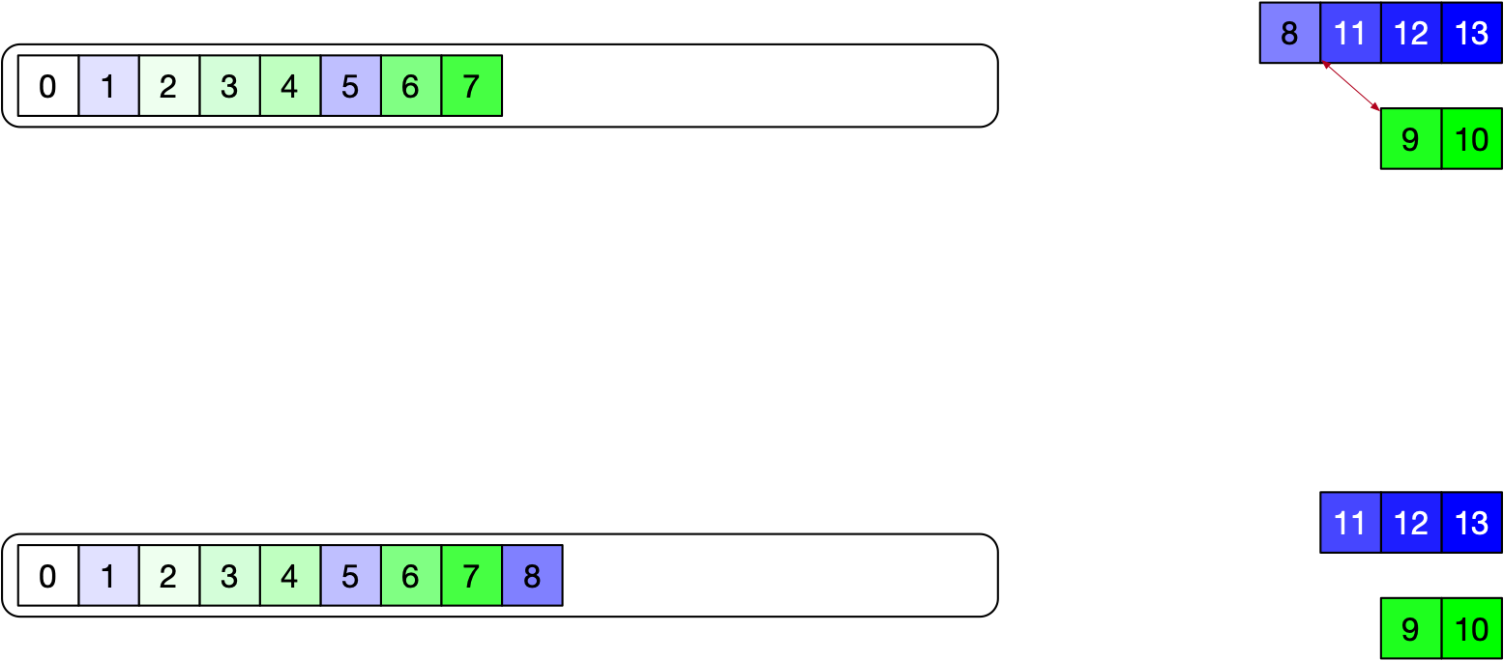
Merge-Sort

Slide 47
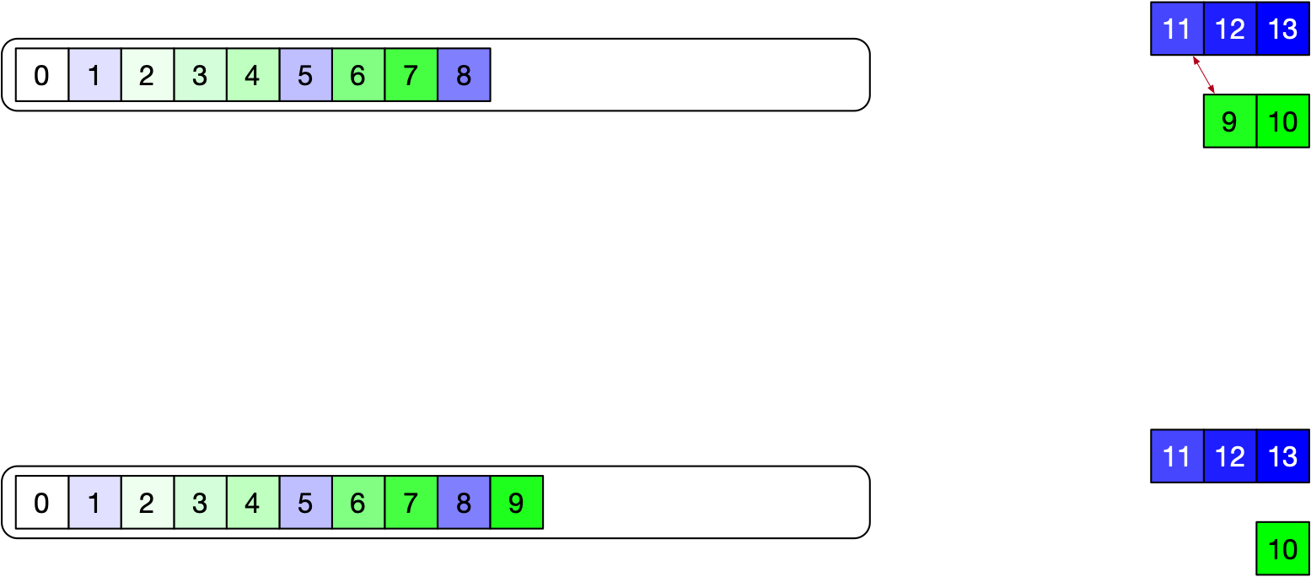
Merge-Sort

Slide 48
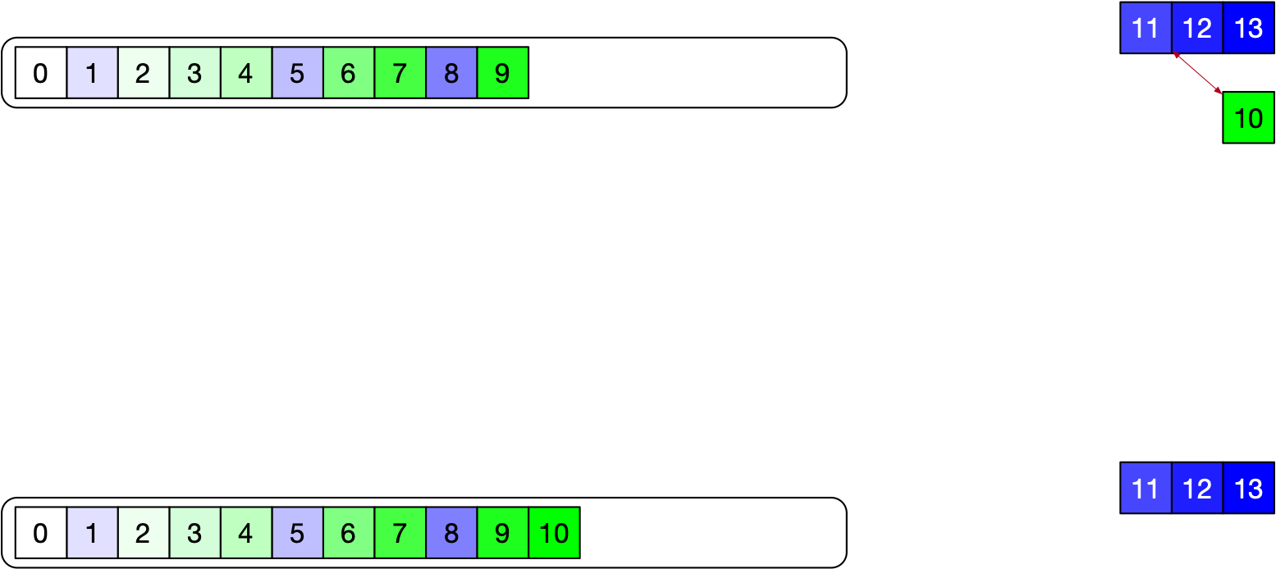
Merge-Sort

Slide 49
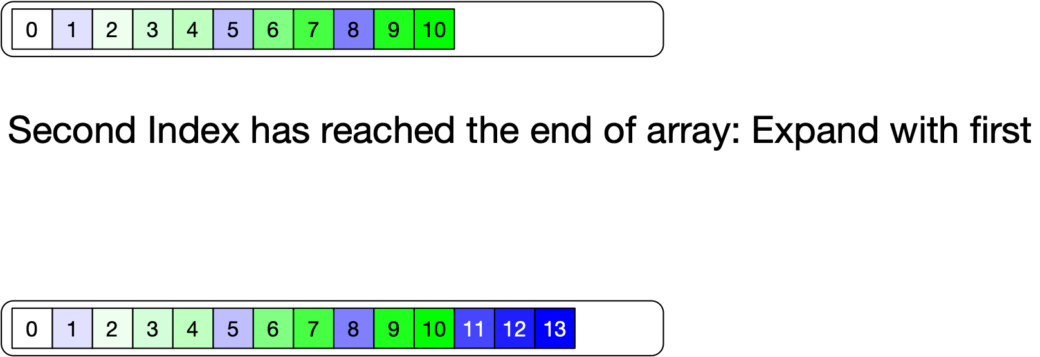
Merge-Sort

Slide 50
Merge-Sort
Divide and conquer:
  Divide array in two halves
  Apply recursively merge-sort
  Merge both arrays
mid = len(arr)//2
arr1, arr2 = arr[:mid], arr[mid:]
arr1 = merge_sort(arr1)
arr2 = merge_sort(arr2)

Slide 51
Merge-Sort
def merge_sort(arr):
if len(arr) < 2:
return arr
mid = len(arr)//2
arr1, arr2 = arr[:mid], arr[mid:]
arr1 = merge_sort(arr1)
arr2 = merge_sort(arr2)
return merge(arr1, arr2)

Slide 52
Merge-Sort
In practice:
  Merge-sort is not so good on very small arrays
  Use something as bad as bubble-sort for arrays of small size

Slide 53
Merge-Sort
Performance:
  Merge of two arrays with $n_{1}+n_{2}=n$ elements total?
  Up to $n-1$ comparisons
  Recurrence formula for the number of comparisons is approximately
    $$C(n)=2⋅C(n/2)+n$$

Slide 54
Merge-Sort
Ad hoc solution of the recurrence relation
  $$C(n)=2C(n/2)+n$$
  $=2⋅(2C(n/4)+\frac{n}{2})+n=4C(n/4)+n+n$
  $=8C(n/8)+n+n+n$
  $=16C(n/16)+n+n+n+n$
  $…$
  $=n+n+…n=log(n)(n+1)$

Slide 55
Quick-Sort
Merge Sort:
  Divide is simple
  Work is done in the merge step
Quick Sort
  Work is done in the divide step
  Conquer part is simple
  Key Idea:
    Pick a pivot, form two arrays: those smaller than the pivot and those larger than the pivot

Slide 56
Quick-Sort
Partition Step
  Hoare (1959) superseded by simpler Lomuto's scheme
  Idea:
    Have two indices $i$ and $j$
    Pick pivot to be the last element
      Loop invariant: Elements up to $i$ are smaller than pivot
          Elements between $i$ and $j$ are larger than the pivot
      Loop on $j$, adjusting $i$ if necessary

Slide 57
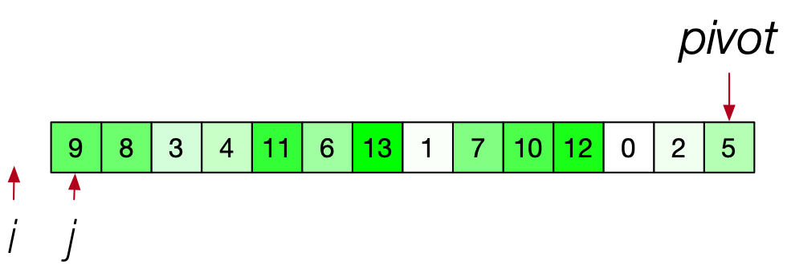
Quick-Sort
Example:
  Introduce pivot 5 (last element) and indices $i$ and $j$

Slide 58
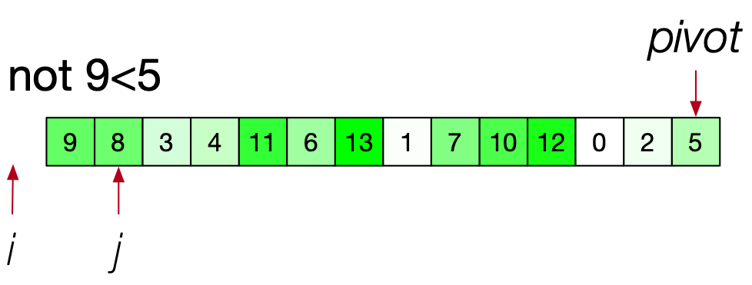
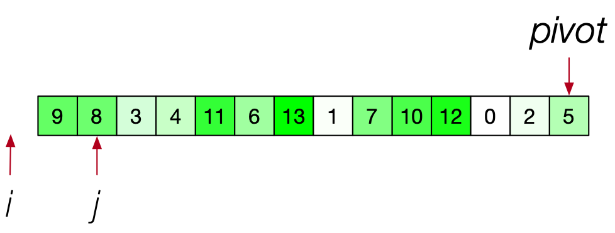
Quick-Sort
advance only j

Slide 59
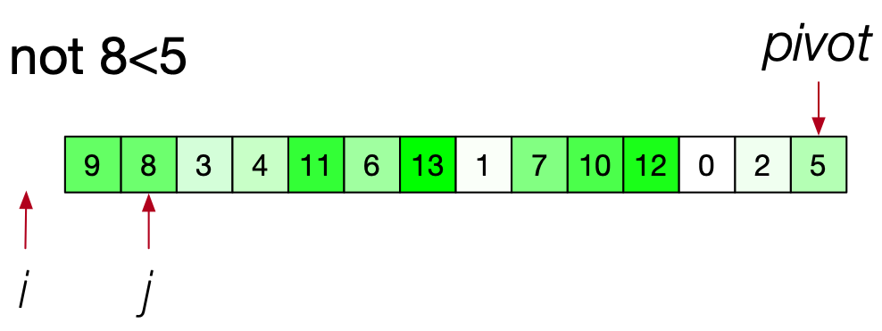
Quick-Sort
is arr[j] < pivot?
only advance j

Slide 60
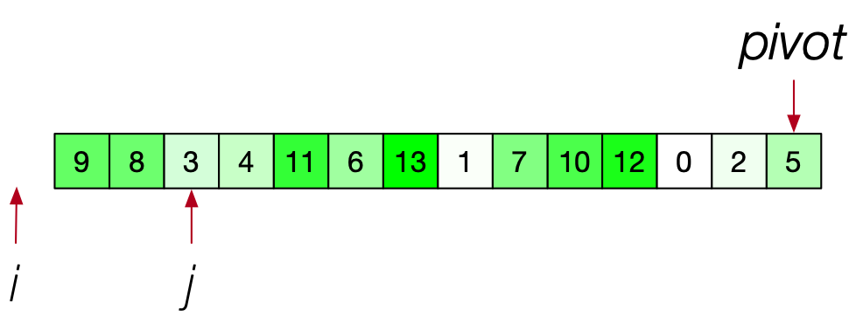
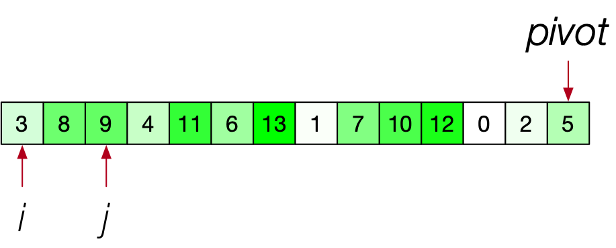
Quick-Sort
3 < 5:
advance i
exchange arr[i] and arr[j]
now advance j

Slide 61
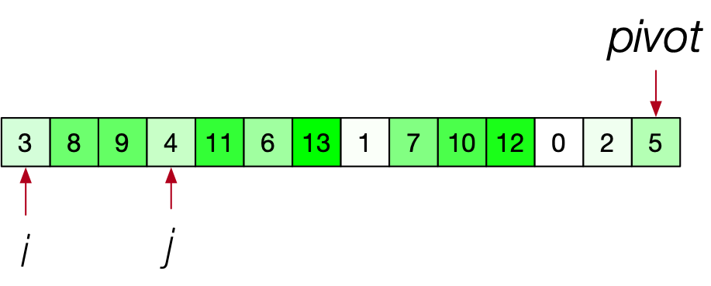
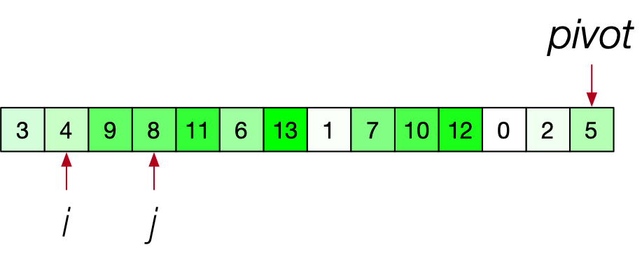
Quick-Sort
4<5 so advance i and swap
advance j

Slide 62
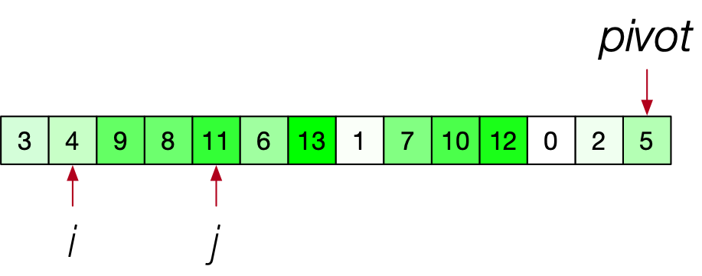
Quick-Sort
arr[j] > pivot:
Just advance j

Slide 63
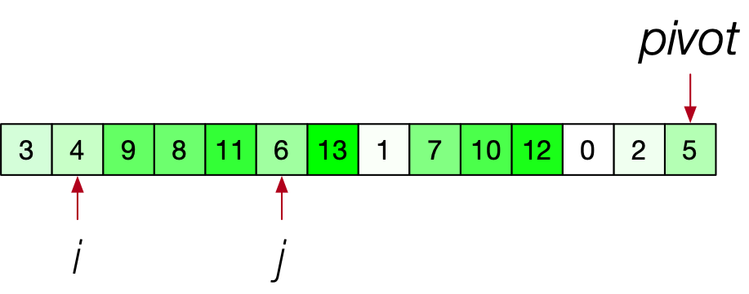
Quick-Sort
6 > 5: Just advance j

Slide 64
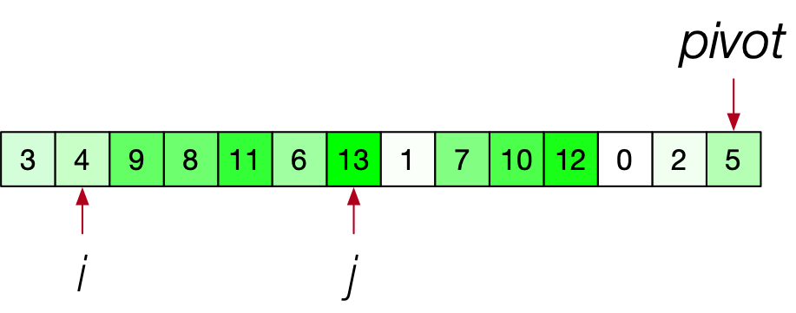
Quick-Sort
Just advance j

Slide 65

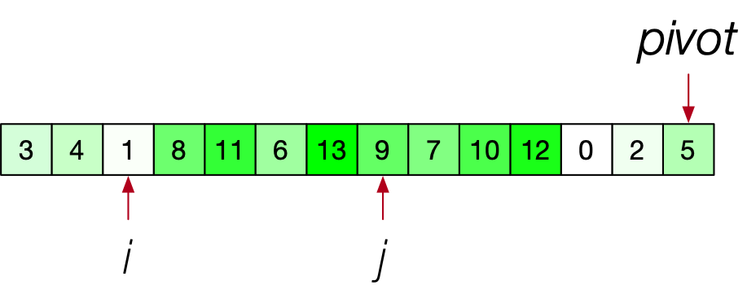
Quick-Sort
arr[j] < pivot:
    advance i
    swap
advance j

Slide 66

Quick-Sort
advance j

Slide 67
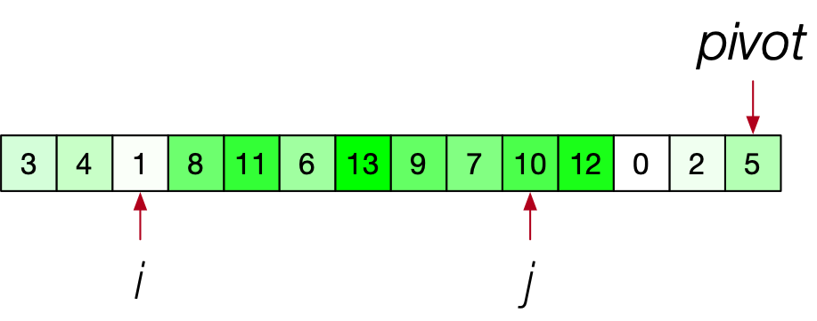
Quick-Sort
advance j

Slide 68

Quick-Sort
advance j

Slide 69

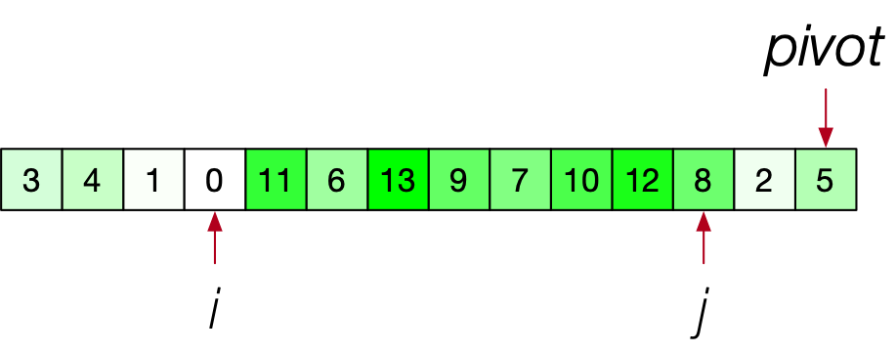
Quick-Sort
arr[j] < pivot: advance i, then swap
advance j

Slide 70
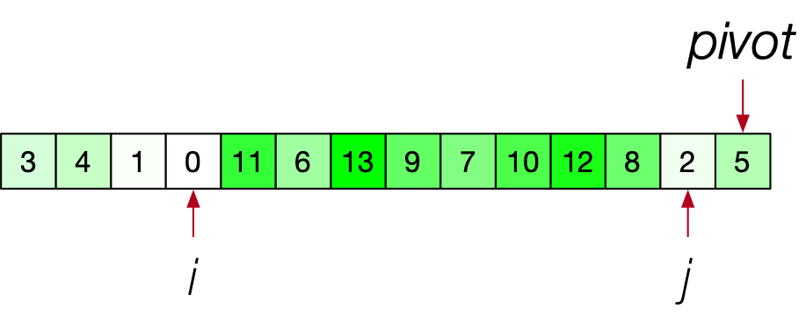
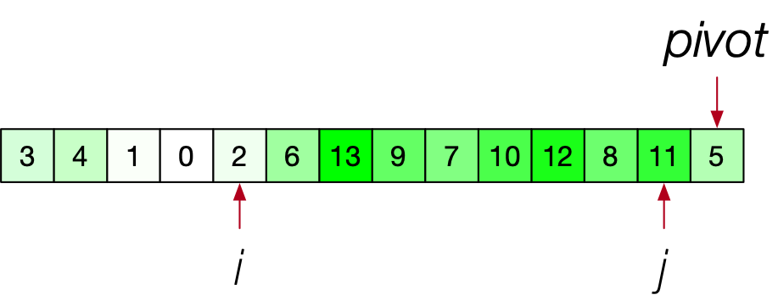
Quick-Sort
2<5:
advance i and swap
Reached end of array
      advance i and swap with pivot

Slide 71
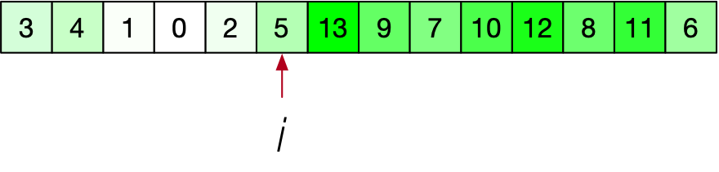
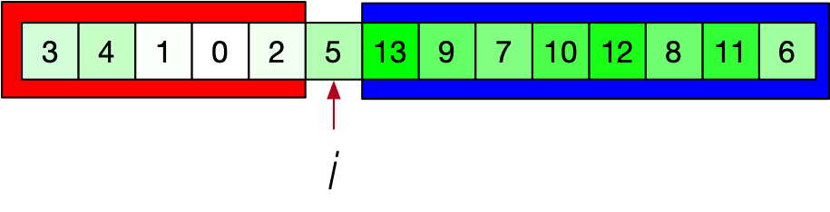
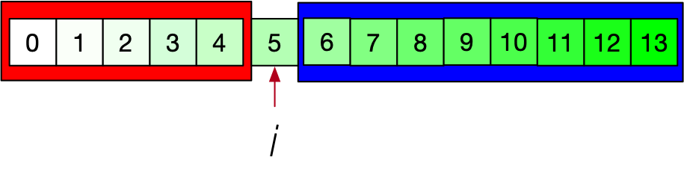
Quick-Sort
Recursively sort left part and right part

Slide 72
Quick-Sort
Analysis of quick-sort
  Each partition of an array of length $n$
    has $n-1$ comparisons
    and $Θ(n)$ work

Slide 73
Quick-Sort
Worst case behavior:
  The pivot is always the maximum or minimum element
    E.g. the array is ordered or reversely ordered
    E.g. all elements are the same
  Number of comparisons $T(n)$
    Recurrence then:
      $$T(n)=T(n-1)+(n-1)=T(n-2)+(n-2)+(n-1)$$
      $$=…=1+2+…+(n-2)+(n-1)$$
      $$=\frac{1}{2}(n^{2}-n)=Θ(n^{2})$$

Slide 74
Quick-Sort
Best case:
  We split the array in halves
  $$T(n)=(n-1)+2T(n/2)$$
  $=(n-1)+2⋅(\frac{n}{2}-1)+4T(\frac{n}{4})$
  $=(n-1)+2⋅(\frac{n}{2}-1)+4⋅(\frac{n}{4}-1)+8T(\frac{n}{8})$
  $≈(n-1)+(n-1)+(n-1)+…(n-1)$
      with $\log_{2}(n)$ addends
  $≈n\log_{2}(n)$

Slide 75
Quick-Sort
If we can guarantee that the partitioning step always split to a ratio better than $1:a$:
  $$Θ(n⋅\log_{2}(n))$$
for any ratio $1:a$

Slide 76
Quick-Sort
How to make Quick-Sort faster:
  Pivot selection is crucial
      Bad selection happens for natural arrays (almost ordered)
    Use a random pivot
    Use a small sample of array elements and select the median
    ...
  For small arrays, use bubble sort

Slide 77
Quick-Sort
Despite its quadratic worst case:
  Quicksort recognized as one of the fastest sorting methods
Quicksort is in place

