Slide 1
Selecting and Sorting
Thomas Schwarz, SJ

Slide 2
Permutations
A permutation of the set $\{1,2,…,n\}$ is a reordering of the numbers where each number between 1 and n appears exactly once.

Slide 3
Permutations
How many permutations are there?
Use recurrence!
In a permutation of $\{1,2,…,n\}$, where is the $n$ located?
There are $n-1$ other numbers.
This gives us $n-2$ gaps and spots before and after

Slide 4
Permutations
Let $n!$ be the number of permutations of $n$ elements
This gives us the recurrence
$$n!=n⋅(n-1)!$$
which can be unfolded very simply
$n!=\overset{n}{\underset{i=1}{∏}}i$

Slide 5
Permutations
How do we determine its asymptotic growth?
$$n!=\overset{n}{\underset{i=1}{∏}}i$$
Use Logarithms!

Slide 6
Permutations
Approximation of the factorial
Use $logn!=\overset{n}{\underset{i=1}{∑}}log(i)$
Use an integral!

Slide 7
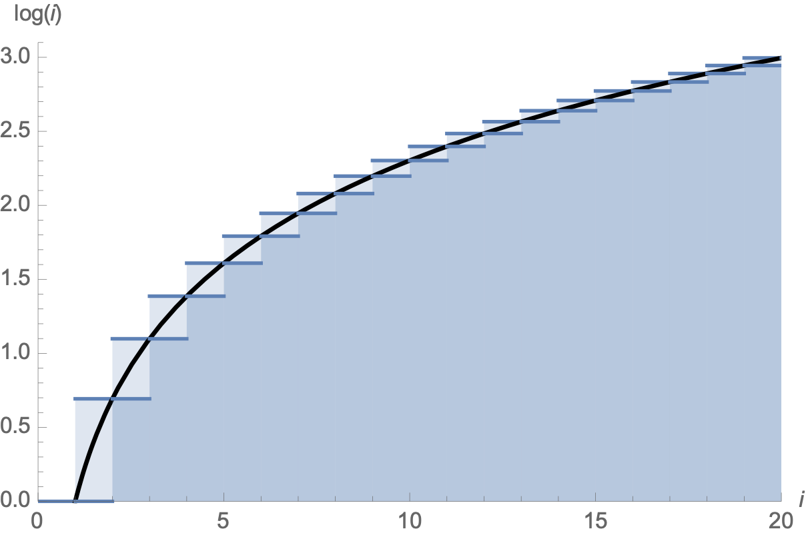
Permutations
$$\overset{n-1}{\underset{i=1}{∑}}log(i)<∫_{1}^{n}log(x)dx<\overset{n}{\underset{i=1}{∑}}logi$$

Slide 8
Permutations
$log(n!)=\overset{n}{\underset{i=1}{∑}}log(i)$
$≈∫_{i=1}^{n}log(x)dx$
$=[xlogx-x]_{1}^{n}$
$=nlog(n)-n+1$

Slide 9
Permutations
Therefore
$n!≈exp(nlog(n)-n-1)$
$=exp(log(n^{n})-n+1)$
$=n^{n}⋅e^{-n}⋅e$
$=e⋅{\left(\frac{n}{e}\right)}^{n}$

Slide 10
Permutations
An analysis of the error substituting the Riemann sum for an integral gives Stirling’s formula (invented by de Moivre)
$\sqrt{2π}n^{n+\frac{1}{2}}e^{-n}≤n!≤en^{n+\frac{1}{2}}e^{-n}$

Slide 11
Simple Sorting Algorithms
Thomas Schwarz, SJ

Slide 12
Simple Sorting
Sorting algorithms can be in-place:
No additional memory is needed
Sorting algorithms can be based on swaps

Slide 13
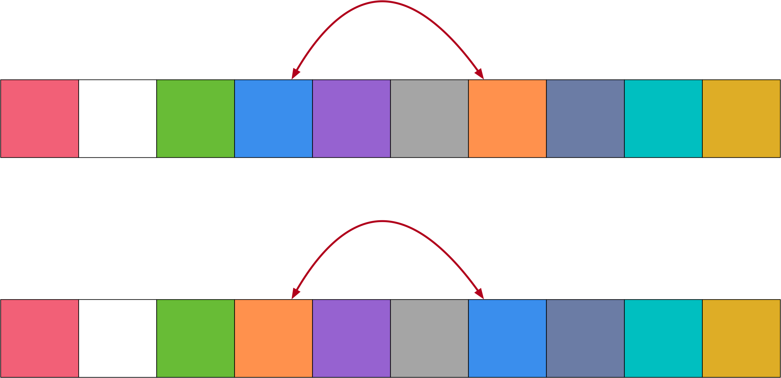
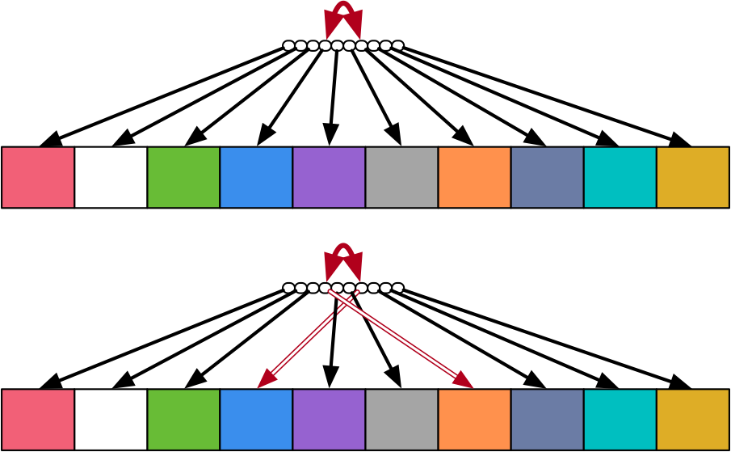
Simple Sorting
Implementing in-place sorting with swaps
Do not move large objects:
Instead move pointers to objects: (also more natural in Python)
temp = blue.copy()
blue = orange.copy()
orange = temp.copy()
arr[3],arr[6] = arr[6],arr[3]

Slide 14
Bubble Sort
Thomas Schwarz, SJ

Slide 15
Bubble Sort
Idea of bubble sort:
Repeatedly swap adjacent elements in an array until they are in order
Reminder: Swaps in Python are easy:
arr[i],arr[i+1] = arr[i+1],arr[i]
while not done:
for i in range(len(arr)-1):
if arr[i] > arr[i+1]:
arr[i],arr[i+1]=arr[i+1],arr[i]

Slide 16
Bubble Sort
Example: Sort
First pass: Check first pair
Swap and move on
No swap necessary, move on

Slide 17
Bubble Sort
Example:
Swap and move on
Swap and move on
Swap and move on

Slide 18
Bubble Sort
Example:
Swap and move on
Array is still not sorted, so we need to continue
However: Notice that the maximum element has been picked up and is now at the correct position
We only have to order the first $n-1$ positions

Slide 19
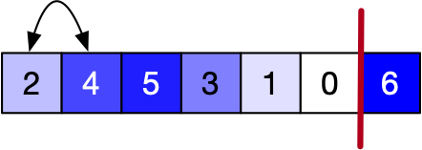
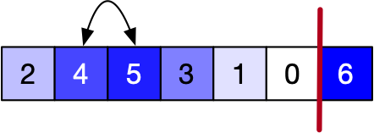
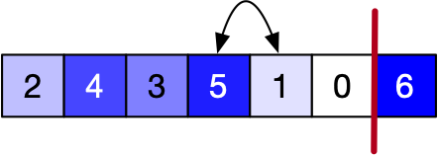
Bubble Sort
Example
Second pass:

Slide 20
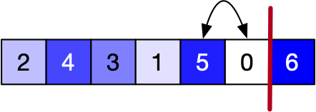
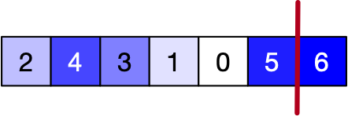
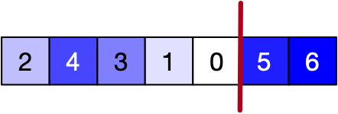
Bubble Sort
Example (Second Pass):
The maximum in the remaining array has now reached its correct point

Slide 21
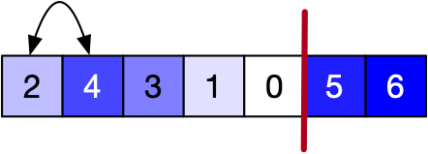
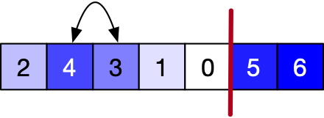
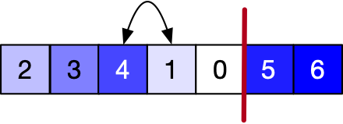
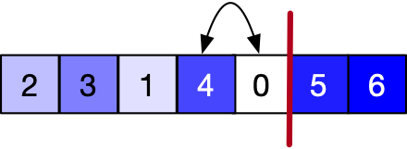
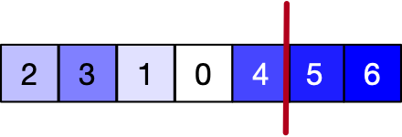
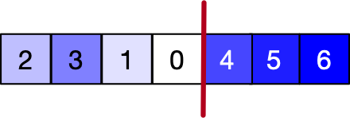
Bubble Sort
Example: Third Pass
Third largest element has bubbled up to the correct place

Slide 22
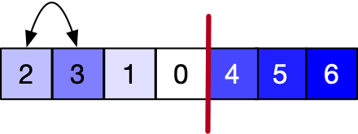
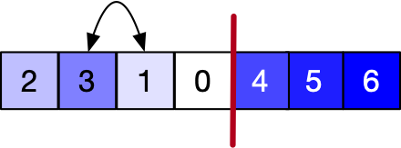
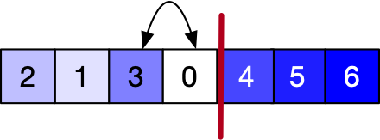
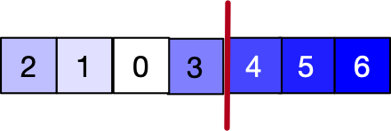
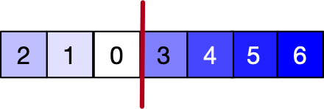
Bubble Sort
Fourth pass
Now 3 has bubbled up

Slide 23
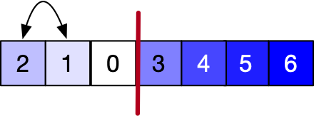
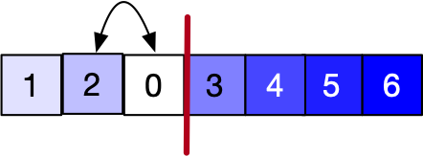
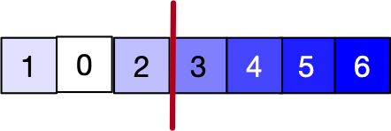
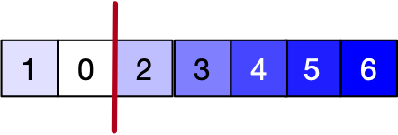
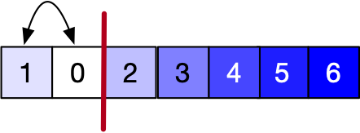
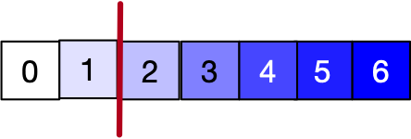
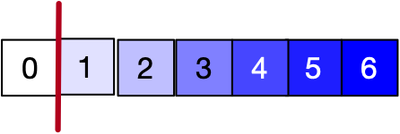
Bubble Sort
Fifth Pass
2 has bubbled up
Final Pass
1 has bubbled up, and a singleton is always sorted:

Slide 24
Bubble Sort
We need one less pass than there are array elements
And we do not need to look at the last elements of the array
def bubblesort(arr):
n = len(arr)
for i in range(n-1):
for j in range(n-i-1):
if arr[j] > arr[j+1]:
arr[j],arr[j+1]=arr[j+1],arr[j]

Slide 25
Bubble Sort
Potential improvements:
After each pass, the elements after the last swap are already in order
We can skip the corresponding passes
But need to keep track of the last swap

Slide 26
Bubble Sort
Performance:
At pass $i,i=0,1,…,n-2$, we compare $n-i-1$ values
This means, we make
$(n-1)+(n-2)+…+2+1=\frac{n(n-1)}{2}$ comparisons

Slide 27
Bubble Sort
If we use the last swap trick:
Best case behavior: The array is sorted, we did not do any swap, and we are done after a single pass with $n-1$ comparisons

Slide 28
Bubble Sort
Bubble sort is known to be the least efficient sort for data that is not already sorted
Among the sorting algorithms that do not try to be horrible

Slide 29
Cocktail Sort
Bubble sort will move small elements only slowly to their correct position
Cocktail sort makes one pass from the left to the right
Moves maximum to its rightful spot
Then the next pass from the right to the left
Moves minimum to its rightful spot
Then the next pass from left to the right starting with second element and ending before the last one

Slide 30
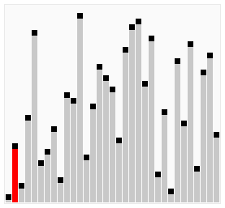
Cocktail Sort

Slide 31
Insertion Sort
Thomas Schwarz, SJ

Slide 32
Insertion Sort
Idea:
Break the array into a sorted and an unsorted part
Move first element of the unsorted part into the correct position in the sorted array

Slide 33
Insertion Sort
Example:
Sort
Reddish part is unsorted: initially whole array
Greenish part is sorted: initially empty

Slide 34
Insertion Sort
Example:
First element in the red part is 4:
Insert 4 into the green part

Slide 35
Insertion Sort
Example
Next unsorted element is 2
Compare with 4
Insert in front of 4

Slide 36
Insertion Sort
Example
Next unsorted element is 6
Compare with 2, then 4
Insert after 4

Slide 37
Insertion Sort
Example
Next unsorted element is 5
Compare with 2, 4, 6
Insert before 6

Slide 38
Insertion Sort
Example
Next unsorted element is 3
Compare with 2, then 4
Insert before 4

Slide 39
Insertion Sort
Example
Next comes 1
Compare with 2
Insert before 2

Slide 40
Insertion Sort
Example
Final unsorted element is 0
Compare with 1
Insert before 1
We are done

Slide 41
Insertion Sort
Performance:
Inserting at a specific index in an array means moving the elements after the insertion
This is a big hidden cost
Inserting at a specific index into a linked list only involves finding the insertion point and constant link resetting work
However, we can now avoid comparisons
To insert into a sorted array of length $i$
only need on average $\frac{i}{2}+1$ comparisons

Slide 42
Insertion Sort
Average case:
Pass $i$ has $1+\frac{i}{2}$ comparisons
Total of $\overset{n-1}{\underset{i=0}{∑}}(1+\frac{i}{2})=n+\frac{1}{2}\frac{n(n-1)}{2}$ comparisons

Slide 43
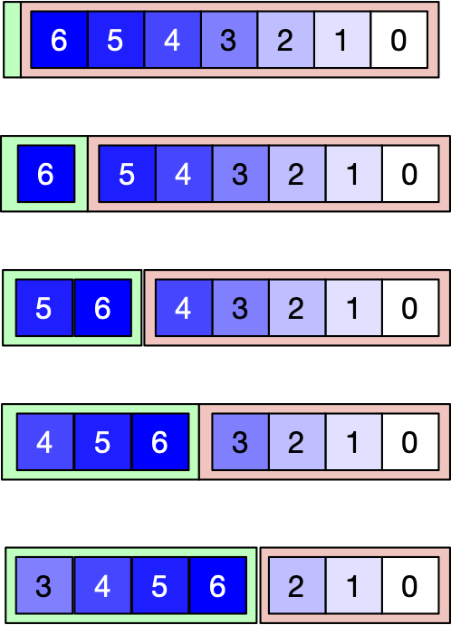
Insertion Sort
Best Case:
Only one comparison per pass:
New element inserted into the sorted part is smaller than the current minimum of the part
Original array is ordered from maximum to minimum

Slide 44
Selection

Slide 45
Selection Problems
Given an unordered array:
Find the $k$-largest (-smallest) element in an unordered array
Naïve Solution:
Sort (usually in time $Θ(nlogn)$ )
Pick element $n-k$ or $k$ of the sorted array

Slide 46
Selection Problem
Finding the maximum
Finding the maximum and minimum at the same time
Finding the $k$^{th} largest element
Finding the median

Slide 47
Maximum
Obvious algorithm:
$n-1$ comparisons
def max(array):
result = array[0]
for i in range(1, len(array)):
if array[i]>result:
result = array[i]
return result

Slide 48
Maximum
Toy algorithm:
Partition array into $⌊n/2⌋$ pairs.
(There might be an additional element).
Use one comparison in order to select the largest of each pair (plus the odd one out if exists)
These form an array of length $⌊n/2⌋+1$
Recursively call the toy algorithm

Slide 49
Maximum
What is the recurrence relation?

Slide 50
Maximum
$$T(n)=T(n-⌊n/2⌋)+⌊n/2⌋$$
T(2) = 1
Now use substitution to get an idea of solving the recurrence

Slide 51
Maximum
Assume $n$ is a power of 2

Slide 52
Maximum
Recurrence then becomes
$$T(n)=T(n/2)+n/2,T(2)=1$$
$=T(n/4)+n/4+n/2$
$=T(n/8)+n/8+n/4+n/2$
$…$
$=T(2)+2+4+8+…+n/8+n/4+n/2$
$=n-1$

Slide 53
Maximum
Now prove by induction for all $n∈N$
$$T(n)=T(n-⌊n/2⌋)+⌊n/2⌋$$
$$T(2)=1$$

Slide 54
Maximum
Induction Hypothesis: $T(m)=m-1$ if $m<n$.
$T(n)$
$$=T(n-⌊n/2⌋)+⌊n/2⌋$$
$$=n-⌊n/2⌋-1+⌊n/2⌋$$
$$=n-1$$

Slide 55
Maximum
In fact:
Theorem: Finding the maximum of an array of length $n$ costs at least $n-1$ comparisons
Proof: Place all elements into three buckets:
One for not-looked at
One for won all comparisons
One for lost at least one comparison

Slide 56
Maximum
A single comparison can involves 6 cases
X-X: move two elements from X, one into W, one into L
X-W: move one element from X into W or move one element from X into W and one from W into L
X-L: move one element from X into W or one into L
W-W: move one element from W to L
W-L: nothing or move one element from W to L
L-L: nothing

Slide 57
Maximum
To have finished the algorithm:
No elements left in X
Only one element left in W
Otherwise, can construct counterexample

Slide 58
Maximum
One left in X: could be the maximum
Two (or more) left in W:
Which one is the maximum?

Slide 59
Maximum
Each comparison sends at most one element to $L$
At best, $n-1$ comparisons

Slide 60
Combined Maximum and Minimum
Combined Maximum and Minimum
Naïve algorithm:
Calculate the max, then the min (can exclude the max)
$m-1+m-2=2m-3$ comparisons

Slide 61
Combined Maximum and Minimum
A better algorithm
Divide the array into pairs
Compare the values of each pair
Place the winner of each pair in one array, the looser of each array in a second array
(Or use swapping so that the winners are in even position and the losers are in odd positions)
Now use maximum and minimum on the two sub-arrays

Slide 62
Combined Maximum and Minimum
Case 1: $n$ is even
There are $n/2$ pairs or $n/2$ comparisons
Run maximum on even indexed array elements
This gives us $n/2-1$ comparisons
Same for minimum
Total is $n/2+n/2-1+n/2-1=\frac{3n}{2}-2$ comparisons

Slide 63
Combined Maximum and Minimum
Case: $n$ is odd
Run algorithm on the first $n-1$ elements
$\frac{3n-3}{2}-2$ comparisons
Then add two comparisons to see whether the last element is either minimum or maximum
Total of $\frac{3n-3}{2}$ comparisons

Slide 64
Combined Maximum and Minimum
Can we do better?
Use a more sophisticated bin method
X - not looked at, W - won every comparison, L - lost every comparison, Q - at least one win and at least one loss

Slide 65
Combined Maximum and Minimum
To be successful, need to move everything out of X and have only one element in W and L
Otherwise can have a counter-example

Slide 66
Combined Maximum and Minimum
Just counting the moves is not sufficient
Example:
We compare an element $w∈W$ with an element $l∈L$
Possibly: $w<l$
And we move both elements to the $Q$ bucket
So, possible to move all $n$ elements out of $X$ into $W∪L$ in $n/2$ comparisons and $n-2$ elements out of $W∪L$ into $Q$ in $n/2-1$ comparisons
Only gives $n-1$ moves!

Slide 67
Combined Maximum and Minimum
Use an adversary argument
Algorithm can only depend on the knowledge of the previous comparisons when making a decision
An adversary is allowed to change all values as long as the results of the comparisons stay the same
If $w∈W$ and $l∈L$, then the only thing the algorithm knows is that $w$ has won all of its comparisons and $l$ has lost all of its comparisons
Adversary therefore is allowed to change the value of $l$ downward
Adversary guarantees that $w>l$.

Slide 68
Combined Maximum and Minimum
With the help of the adversary who substitutes values when needed
Potential: $\frac{3}{2}|X|+|W|+|L|$
Calculate net changes for comparisons between buckets

Slide 69
Combined Maximum and Minimum
Compare X with X
Net change (-2, 1, 1, 0)
Potential change: 1

Slide 70
Combined Maximum and Minimum
Compare X with W
Case 1: $x∈X,w∈W,x<w$ Net change (-1,0,1,0)
Case 2: $x∈X,w∈W,x>w$ Net change(-1,0,0,1)
The adversary can prevent Case 2 by decreasing $x$
Possible because this is the first time that we look at $x$
Potential changes by $\frac{1}{2}$

Slide 71
Combined Maximum and Minimum
Compare $X$ with $L$
similar as before

Slide 72
Combined Maximum and Minimum
Compare $X$ with $Q$
The element in $X$ changes to either $W$ or $L$
Net change (-1, 1, 0, 0) or (-1, 0, 1, 0 )
Potential change $\frac{1}{2}$

Slide 73
Combined Maximum and Minimum
Compare W with W
One element looses
Net change (0, -1, 0, 1)
Potential change 1

Slide 74
Combined Maximum and Minimum
Compare $W$ with $L$
Adversary guarantees that the element in $W$ wins by making all of them bigger
This works because each element in $W$ has only seen wins and that does not change if the elements are made bigger.
No change

Slide 75
Combined Maximum and Minimum
Compare $W$ with $Q$
Since the elements in $W$ have always won, the adversary can make them larger
No net change

Slide 76
Combined Maximum and Minimum
Comparisons with $L$ are the same as with $W$
Comparisons within $Q$ are useless, but make no changes

Slide 77
Combined Maximum and Minimum
With the help of the adversary
Potential changes by at most 1
Initial Potential: $\frac{3}{2}n$
Final Potential: $2$
Need at least $\frac{3n-4}{2}$ comparisons

Slide 78
Selection Sort
Thomas Schwarz, SJ

Slide 79
Selection Sort
Divide array in sorted and unsorted parts
At each step, insert the minimum of the unsorted part at the end of the sorted part

Slide 80
Selection Sort
Example:
Array is divided into a sorted (green) and unsorted portion
We keep the index $i$ of the first element in the unsorted portion

Slide 81
Selection Sort
Example:
$i=0$
Find the index $j$ of the minimum of the elements in the unsorted array
Implemented in numpy as argmin
In Python, write your own function
Minimum here is 0: $j=6$
j = np.argmin(arr[i:])+i

Slide 82
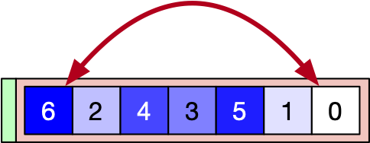
Selection Sort
Example:
Now swap the elements at $i$ and $j$
Increment $i$ to $1$
arr[i], arr[j] = arr[j], arr[i]
i=i+1

Slide 83
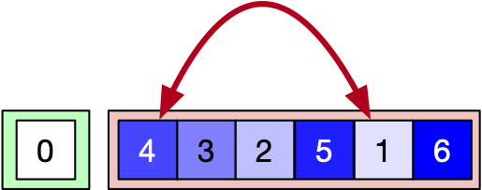
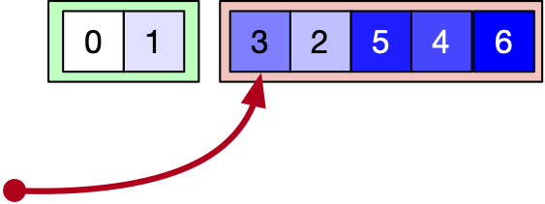
Selection Sort
Example:
Minimum is now 1: $j=5$
Swap array elements at $i$ and $j$ and increment $i$

Slide 84
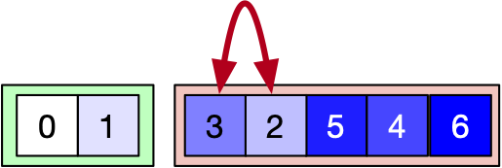
Selection Sort
Example:

Slide 85
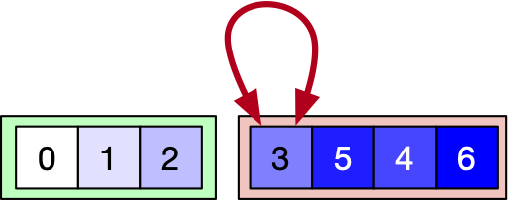
Selection Sort
Example:

Slide 86
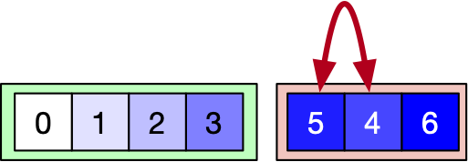
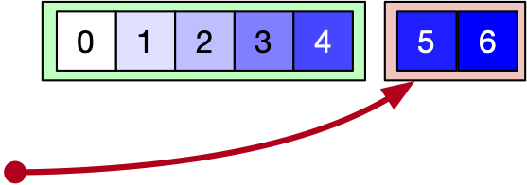
Selection Sort
Example:

Slide 87
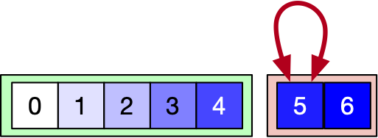
Selection Sort
Example:

Slide 88
Selection Sort
Example:
We can stop at $i=\text{len}(\text{arr})-1$ because the array is now sorted

Slide 89
Selection Sort
Performance
At pass $i$:
Need to find minimum among $n-i$ elements
Costs $n-i-1$ comparisons
Total costs: $(n-1)+(n-2)+…+2+1+0=\frac{1}{2}n(n-1)$ comparisons
$$Θ(n^{2})$$

Slide 90
Selection Sort
In practice:
Among quadratic sorting algorithms:
Usually the best performing one

Slide 91
Sorting by Comparison
Many sorting algorithms use comparisons
An algorithm needs to be able to sort with all orders of inputs, i.e. distinguish between $n!$ arrangements of the input by order
assuming all elements are different

Slide 92
Sorting by Comparison
Sorting algorithm makes a comparison, then decides on what to do
Can be represented as a binary tree

Slide 93
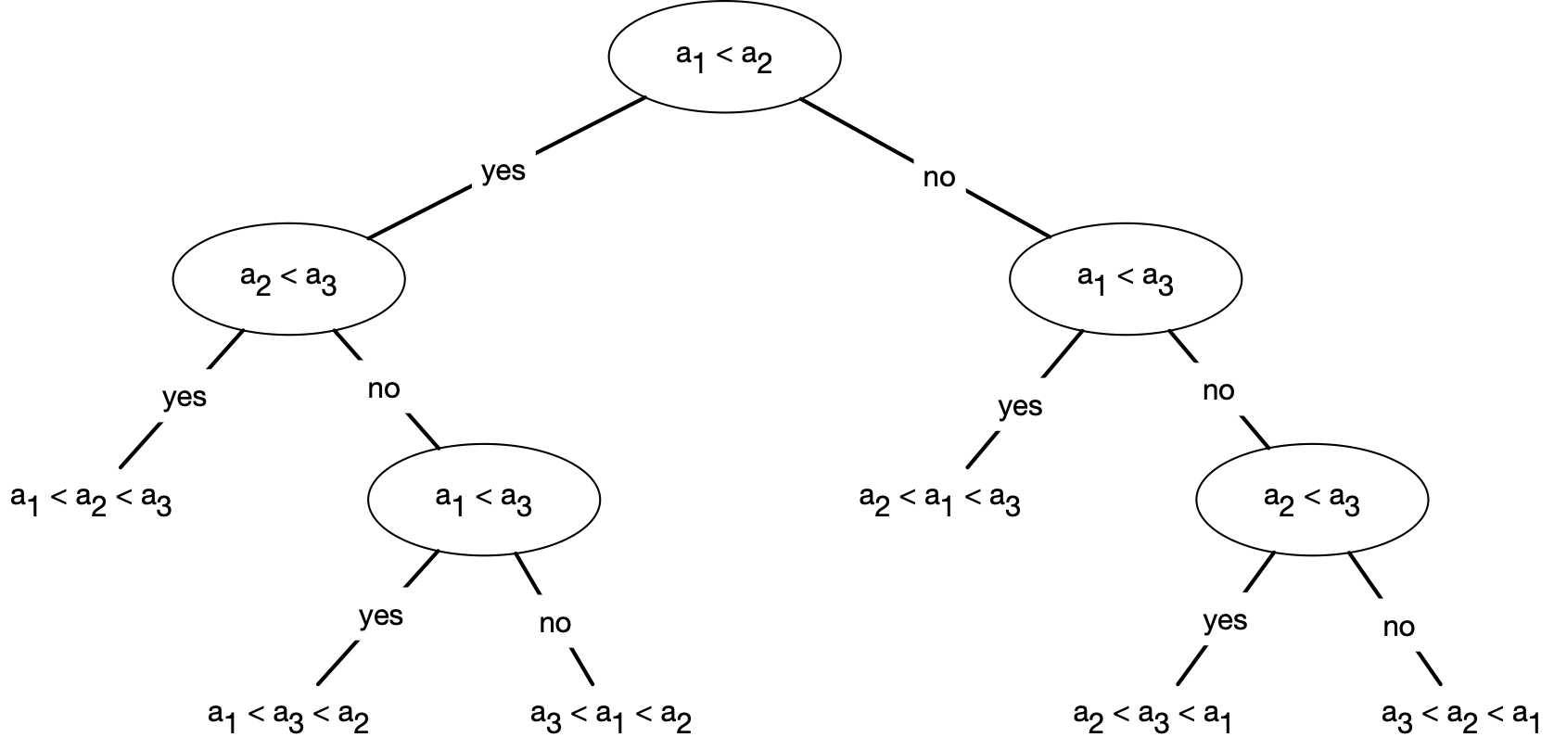
Sorting by Comparison
A fictitious algorithm for sorting three elements
as a Decision Tree

Slide 94
Sorting by Comparison
Represent any comparison based algorithm by such a tree
Any run of the algorithm represents a path from the root to a leaf node
Leaf nodes represent an algorithm finishing,
So they need to have an ordering, i.e. a permutation of the input array

Slide 95
Sorting by Comparison
How many steps does a tree with $N$ leaves have?
A tree of height $h$ has how many leaves?
Height 0: only root, one leaf
Height 1: only root plus one or two leaves: $≤2$
Height 2: at most two nodes at height one have at most $≤2^{2}$ leaves
Induction: Height $h$ has at most $2^{h}$ leaves

Slide 96
Sorting by Comparison
Relationship between height of decision tree and number of elements to be sorted:
Need to have at least $n!$ leaves:
$2^{h}≥n!$
which implies
$$h≥\log_{2}(n!)=\frac{1}{log(2)}log(n!)$$
$≈\frac{1}{log(2)}nlog(n)-n+1$
$=Θ(nlog(n))$

Slide 97
Sorting by Comparison
Since the height of the decision tree is the worst time runtime, we have
The runtime of a comparison based sorting algorithm is at least $Θ(nlog(n))$

Slide 98
Better Sorting Algorithms

Slide 99
Heap-Sort
Example of a sorting algorithm that uses additional space
But variants make it an in-place algorithm
A version of selection sort with the right data structure for the unordered part
Idea:
Insert all elements into a heap
Then empty the heap with calls of extract-min
Get the same elements back, but in order
Performance:
$$≈log(1)+log(2)+…+log(n-1)+log(n)≈log(n)n$$

Slide 100
Heap-Sort
Details:
Step 1: convert array into a maximum heap
Idea:
Elements in the second half are all leaves
Form their own sub-heaps
Need to learn how to convert two sub-heaps and a parent into a proper head

Slide 101
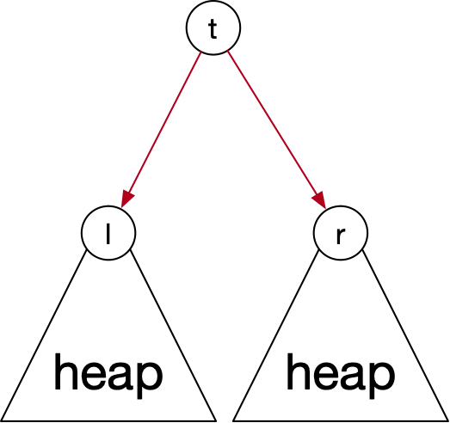
Heap-Sort
How to heapify two sub-heaps?
If $t≥l$ and $t≥r$: ensemble already a heap
If $l=max(\{t,l,r\})$: exchange $t$ and $l$
But now the left might no longer be a heap

Slide 102
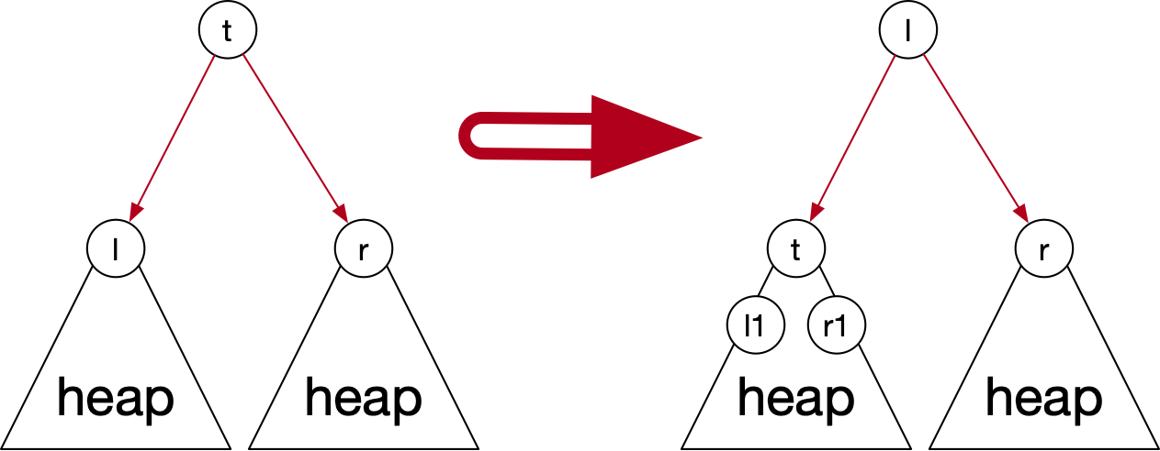
Heap-Sort
Because the root of the left heap has become smaller, the heap property there is no longer guaranteed
We need to continue heapifying there

Slide 103
Heap-Sort
def heapify(arr, i):
l, r = left(i), right(i)
if l < len(arr):
if arr[i] < arr[l]:
largest = l
else:
largest = i
if r < len(arr):
if arr[r] > arr[largest]:
largest = r
if largest == i:
return
else:
arr[i], arr[largest] = arr[largest], arr[i]
heapify(arr, largest)

Slide 104
Heap-Sort
Performance of heapify: $O(log(n))$
To guarantee result is a heap:
left and right subheap need to be heaps indeed

Slide 105
Heap-Sort
To create a heap:
use heapify working back
Can start at location $⌊\text{len}(\text{arr})/2⌋$
We can even show: runtime of make_heap is linear
def make_heap(arr):
for i in range( int(len(arr)/2), 0, -1):
heapify(arr,i)

Slide 106
Heap-Sort
Heap-sort:
Make array into a heap
Extract the maximum
move it to the last element of the array
Repeat

Slide 107
Heap-Sort
def heap_sort(arr):
for i in range(len(arr)-1, 1, -1):
arr[0], arr[i] = arr[i], arr[0]
arr.heap_size = arr.heap_size - 1
heapify(arr, i)
Performance:
Making the array into a heap: $O(n)$
Extracting the maximum and putting it at the end: $Θ(1)$
Heapify the array again: $O(\log_{2}(n)+O(\log_{2}(n-1))+…+O(\log_{2}(2))+O(\log_{2}(1)))$

Slide 108
Heap Sort Example
Example
First phase: heapify into a max heap
Easier to start indices with 1
$$j=7,l=14,r=15$$
Heap property is true

Slide 109
Heap Sort Example
$$j=6,l=12,r=13$$
Heap property maintained

Slide 110
Heap Sort Example
$$i=5,\text{left}=10,\text{right}=11$$
Heap property needs to be restored:
Exchange 8 for 12
No need to continue

Slide 111
Heap Sort Example
$$j=4,l=8,r=9$$
Exchange 4 with 7

Slide 112
Heap Sort Example
$$j=3,l=6,r=7$$
Exchange 3 with 13
Test result $j=7,l=14$: exchange 3 with 5

Slide 113
Heap Sort Example
$$j=2,l=4,r=5$$
Exchange 11 with 12
Then check heap property with $i=4,l=8,r=9$

Slide 114
Heap Sort Example
$$j=1,l=2,r=3$$
Exchange 9 with 13 and check $i=3,l=6,r=7$

Slide 115
Heap Sort Example
Second phase:
Extract maxima:
Exchange 13 with 3 and heapify:
Exchange 3 with 9
Exchange 3 with 11

Slide 116
Heap Sort Example
Exchange 3 with 10
Can stop here

Slide 117
Heap Sort Example
Extract maximum again
Exchange 12 with last element of heap
Now heapify again
(change 2 with 10)
(change 2 with 8)
(can stop here)

Slide 118
Heap Sort Example
Extract maximum:
Heapify:

Slide 119
Heap Sort Example
Extract maximum
Heapify
We can stop here because the left and right index point to elements outside the heap

Slide 120
Heap Sort Example
Extract maximum
Heapify

Slide 121
Heap Sort Example
Extract maximum
Heapify

Slide 122
Heap Sort Example
Extract maximum
Heapify

Slide 123
Heap Sort Example
Extract maximum
Heapify

Slide 124
Heap Sort Example
Extract maximum
Heapify

Slide 125
Heap Sort Example
Extract maximum
Heapify

Slide 126
Heap Sort Example
Extract maximum
Heapify

Slide 127
Heap Sort Example
Extract maximum
Heapify

Slide 128
Heap Sort Example
Extract maximum
Extract maximum

Slide 129
Linear Time Sorting
Counting sort
Assume we want to sort numbers in $\{1,2,…,k-1,k\}$
Create a dictionary with keys in $\{1,2,…,k-1,k\}$
E.g. as an array Int(1:k)
Walk through the array, updating the count
Once the count is done, go through the dictionary in order of the keys, emitting as many keys as the count

Slide 130
Linear Time Sorting
Counting sort:
create a counting array:
Walk through the array and calculate counts
Emit keys according to count
1 2 2 2 3 3 3 4 4 5 5 7 8 9 10 10 10 12

Slide 131
Linear Time Sorting
If there are $n$ elements in the array, then counting sort uses
$∼k$ to create and evaluate the counting array
$∼n$ to update the counting array
Therefore: counting sort run-time is $Θ(n+k)$

Slide 132
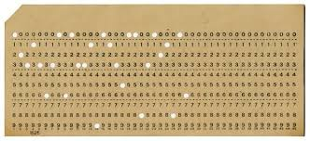
Linear Time Sorting
Radix Sort
Imagine sorting punch cards with by ID in the first columns

Slide 133
Linear Time Sorting
Simple Method:
Create heaps of cards based on the first digit
Then recursively sort the heaps

Slide 134
Linear Time Sorting
Better method:
Sort according to the last digit
Then use a stable sort to sort after the second-last digit
Then use a stable sort to sort after the third-last digit

Slide 135
Linear Time Sorting
Stable sort:
Leave order of elements with the same key during sorting
Insertion sort, merge sort, bubble sort, counting sort are all stable
Heap sort, selection sort, shell sort, and quick sort are not

Slide 136
Linear Time Sorting
Radix sort:
for i in range(length(key), 0, -1):
stable_sort on digit i of key

Slide 137
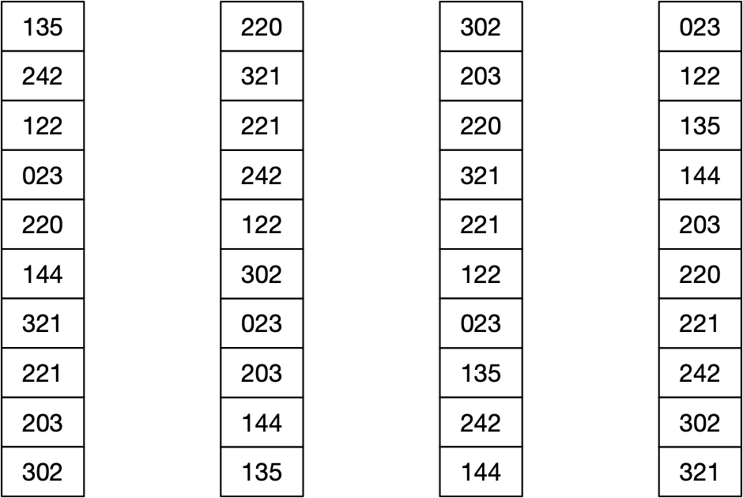
Linear Time Sorting

Slide 138
Linear Time Sorting
Radix sort correctness
What would be a loop invariant?

Slide 139
Linear Time Sorting
Assume $n$ keys of $d$ digits in $\{0,1,…,r-1\}$
Use counting sort to sort in time $Θ(n+r)$
Radix sort then takes $Θ(d(n+r))$ time

Slide 140
Linear Time Sorting
Given $n$ numbers of $b$ bits each
Assume $b=O(log(n))$
Choose $r=⌊\log_{2}(n)⌋$.
Divide the $b$-bit numbers into “digits” of length $r$
Thus, each round of radix sort takes time $Θ(n+2^{r})$
There are $⌈\frac{b}{r}⌉$ rounds
So, radix sort takes $Θ(\frac{b}{r}(n+2^{r}))=Θ(\frac{b}{r}(n+n))=Θ(n)$ time!

