Slide 1
Stacks
Thomas Schwarz, SJ

Slide 2
Stacks
Stacks:
Named after a stack of papers or a stack of dishes in a cafeteria
When you put a dish on the stack, it slightly goes down
When you take a dish off the stack, the stack slightly goes up

Slide 3
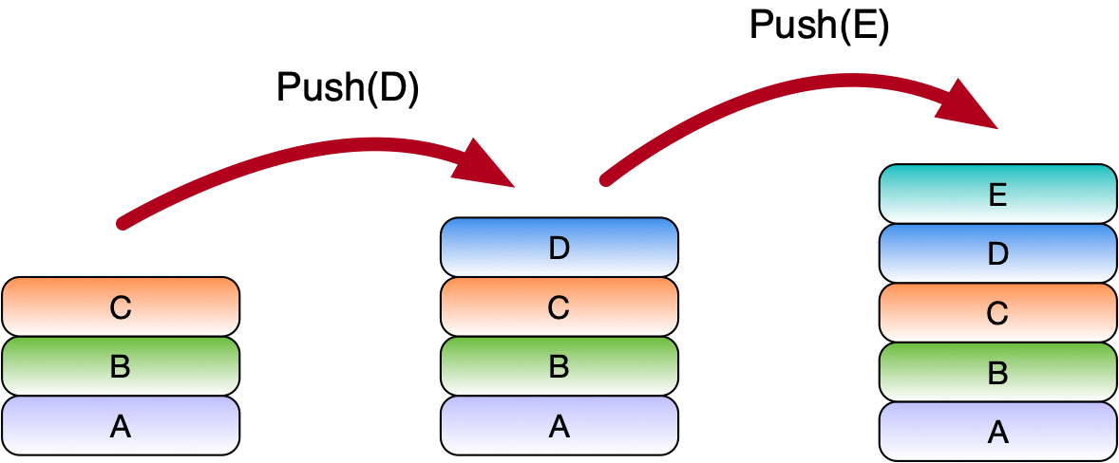
Stacks
Stack a.k.a. LIFO queue
Last In -- First Out
Two operations:
Push(object)

Slide 4
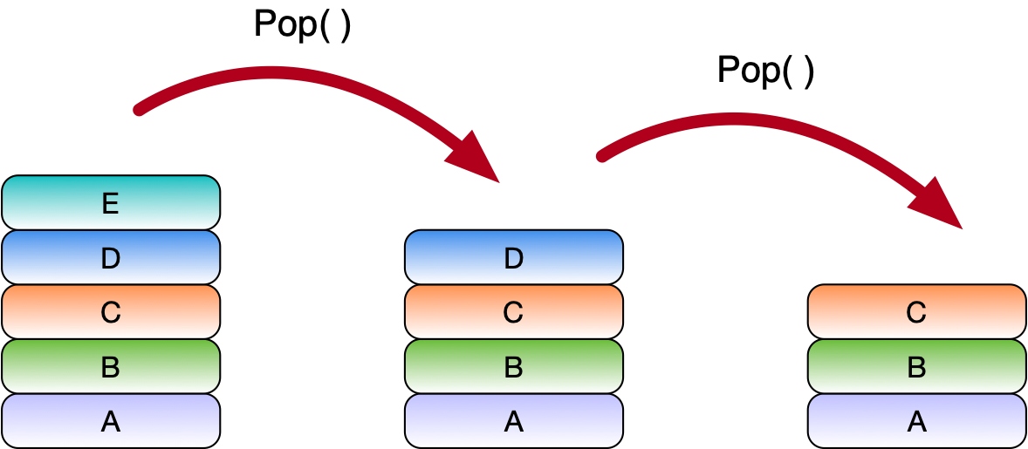
Stacks
Two operations:
Pop( ) returns uppermost object

Slide 5
Stacks
Your turn:
An initially empty stack
What is the content of the stack after the following series of operations
And what is the result of the last operation?
push(A), push(B), pop( ), push(C), push(D),
push(E), push(F), pop( ), pop( )

Slide 6
Stacks
push(A), push(B), pop( ), push(C), push(D),
push(E), push(F), pop( ), pop( )
Last pop returns E

Slide 7
Stacks
There are two auxiliary methods:
peek( )
Look at the last element pushed on a stack
Raises error or returns empty is stack is empty
Does not change the stack
is_empty( )
returns True if the stack is empty

Slide 8
Python Implementation
Can use a Python list
pop( ) removes the last element
append( ) adds at the end

Slide 9
Python Implementation
Use an internal component that is a Python list
class Stack:
def __init__(self):
self.array = []
def peek(self):
return self.array[-1]
def pop(self):
return self.array.pop()
def push(self, value):
self.array.append(value)
def is_empty(self):
return len(self.array)==0
def __str__(self):
return str(self.array)

Slide 10
Parenthesization
Is an expression with parentheses well balanced?
E.g. well-balanced: ( ( ) ( ) ) ( ( ( ) ) )
Not well-balanced: ( ( ( ) )

Slide 11
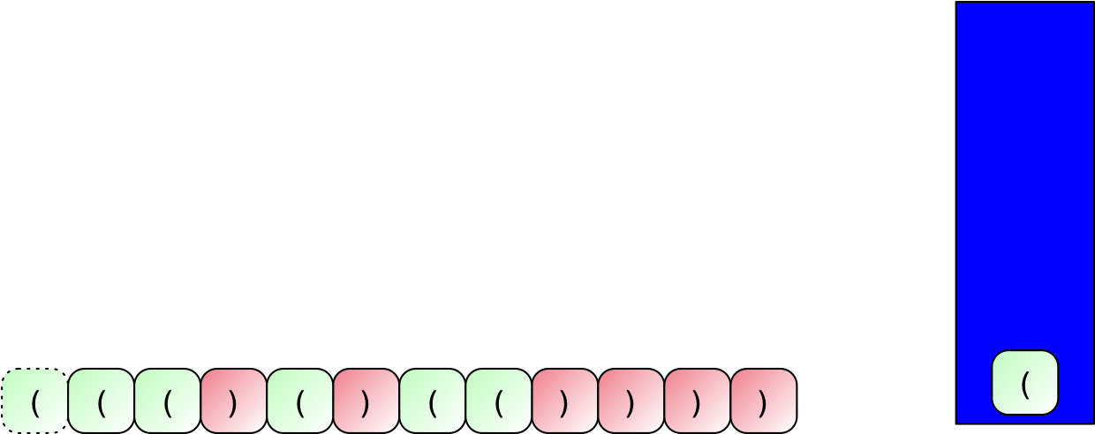
Parenthesization
Example:
Process from left to right
Push on stack

Slide 12
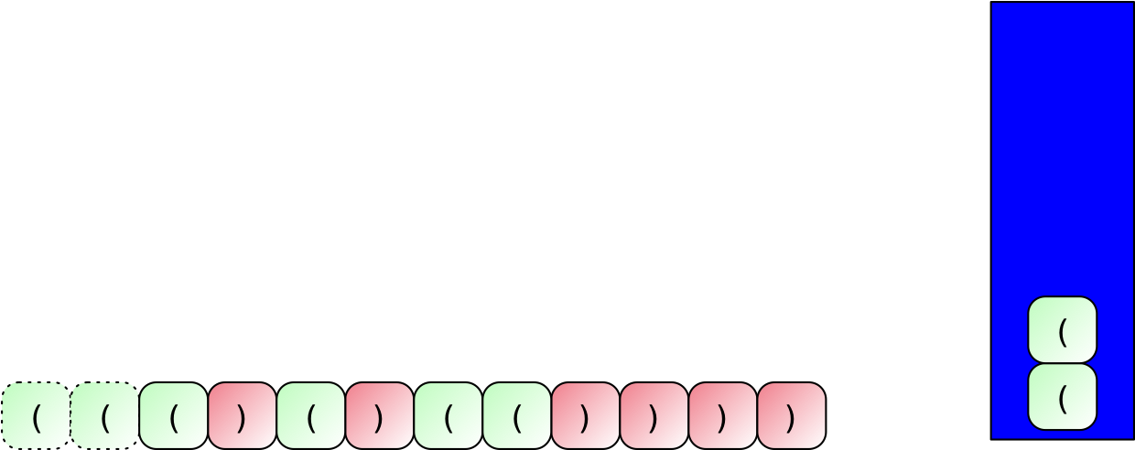
Parenthesization

Slide 13
Parenthesization
When we push a closing parenthesis, we see whether we can pop by combining with an opening parenthesis

Slide 14
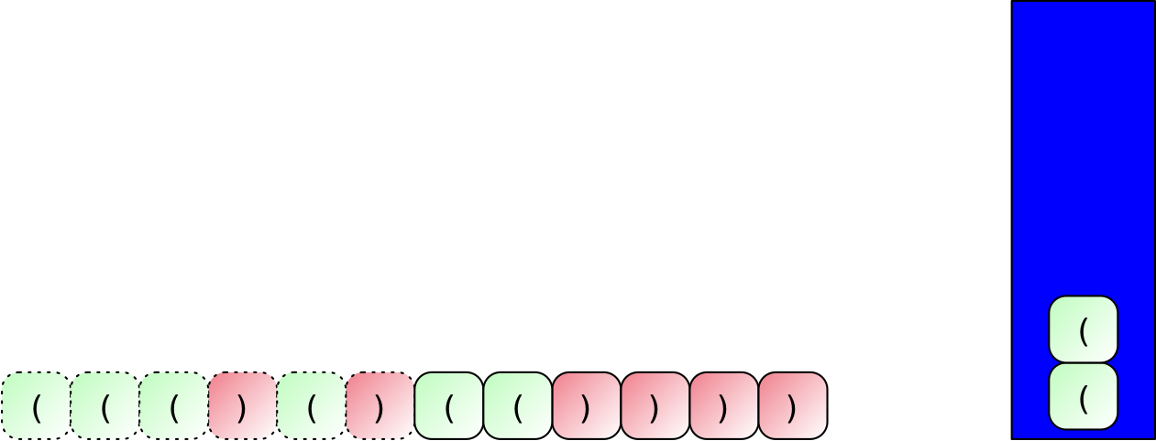
Parenthesization

Slide 15
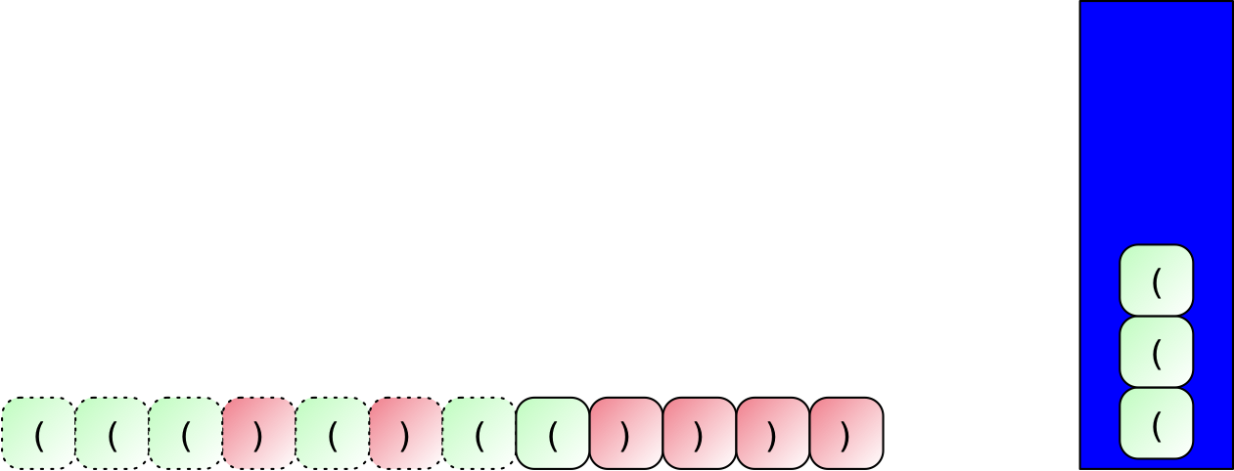
Parenthesization

Slide 16
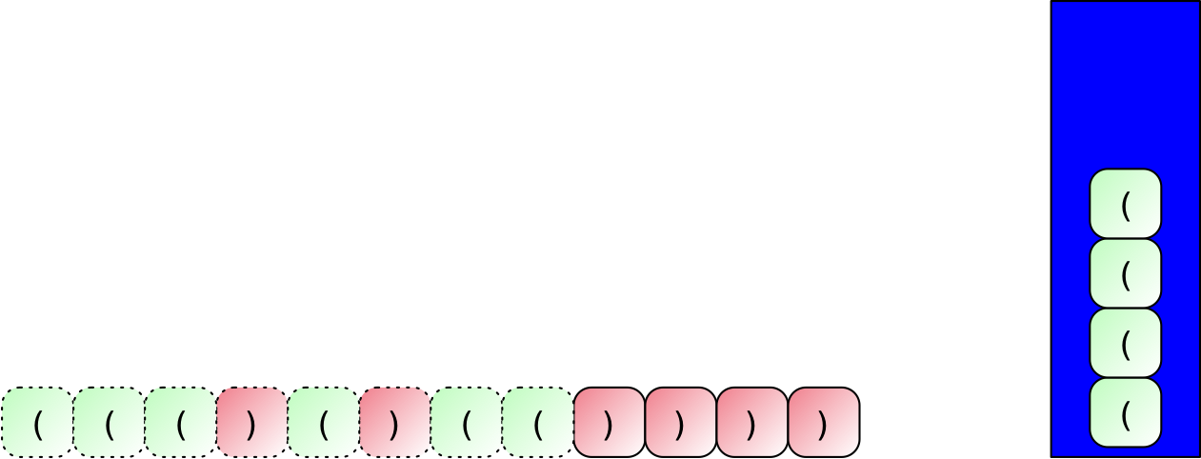
Parenthesization

Slide 17
Parenthesization

Slide 18
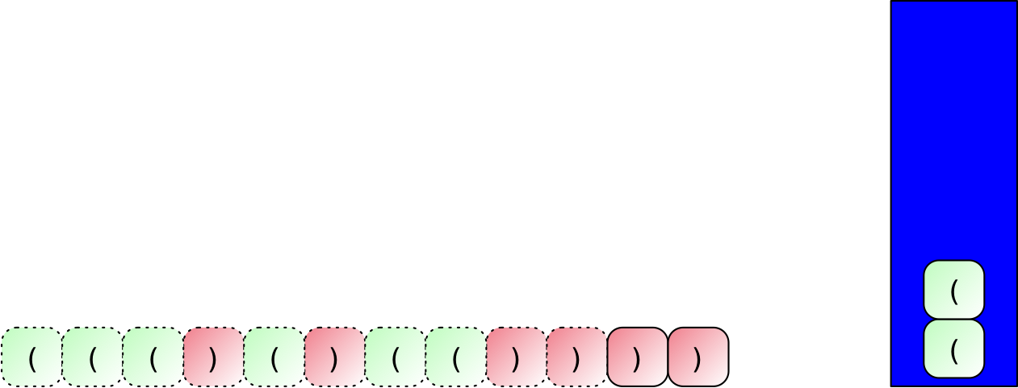
Parenthesization

Slide 19
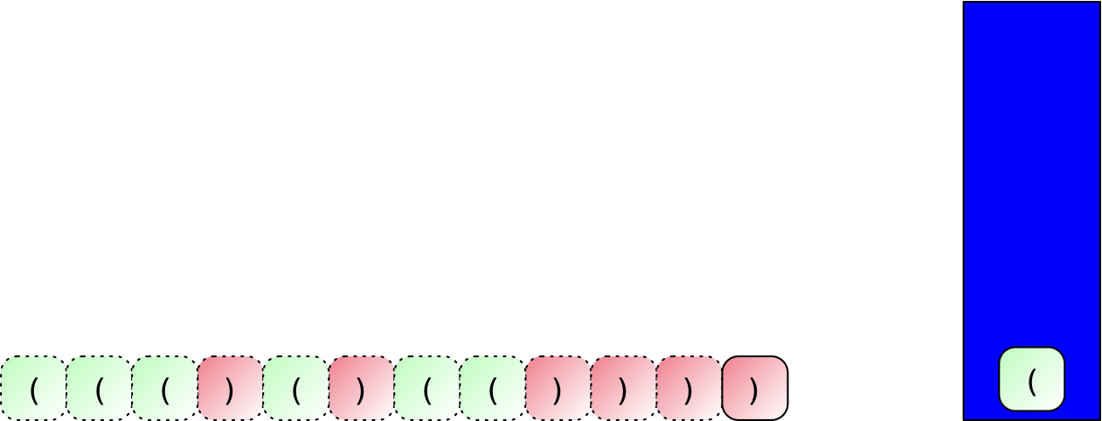
Parenthesization

Slide 20
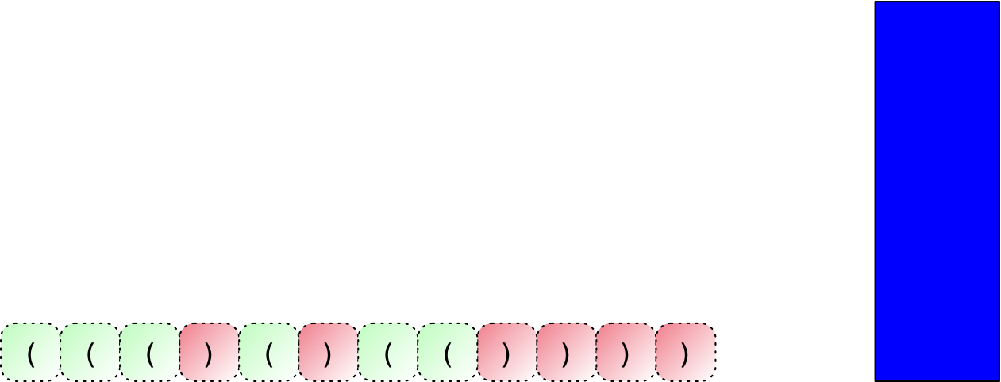
Parenthesization
The stack is empty, the string has been accepted

Slide 21
Parenthesization
This can be extended to several types of parentheses
Example: "[ ( ] ) ( )" is malformed

Slide 22
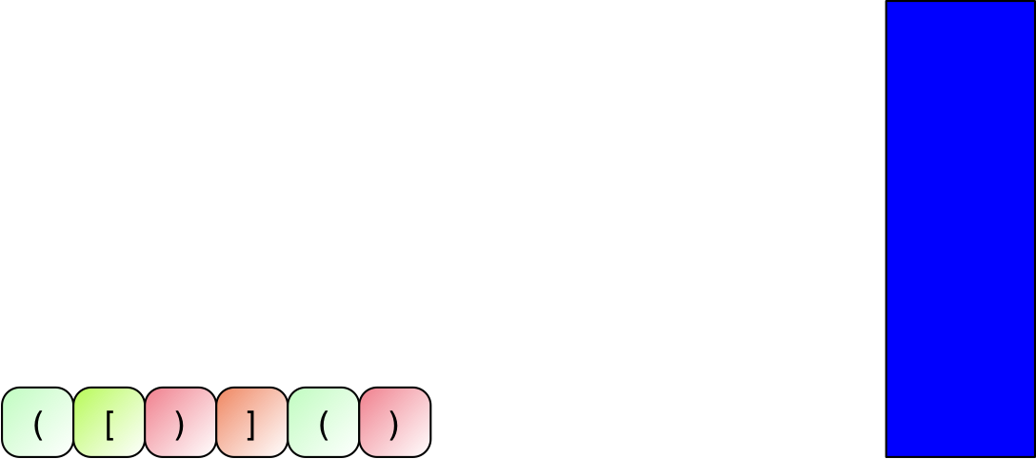
Parenthesization

Slide 23
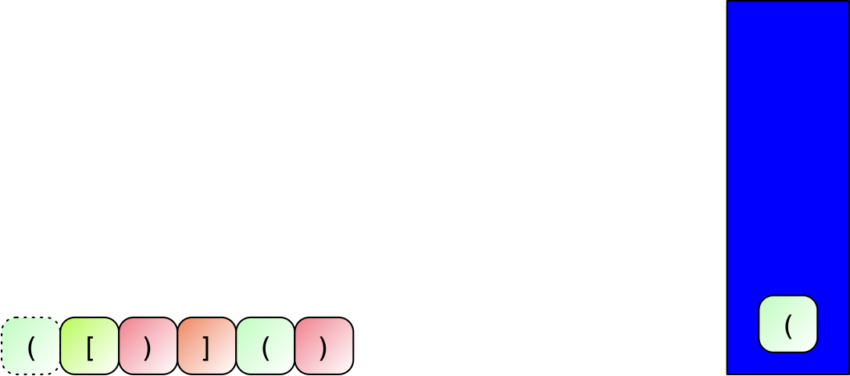
Parenthesization

Slide 24
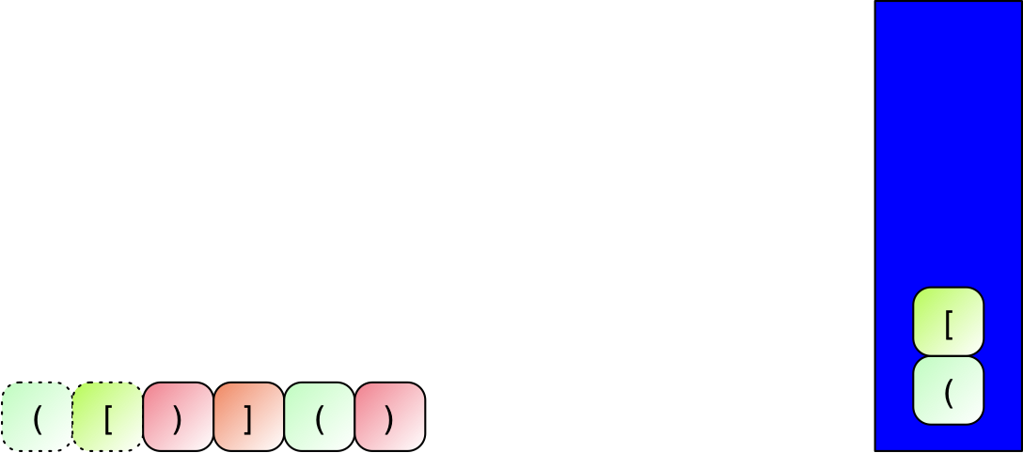
Parenthesization

Slide 25
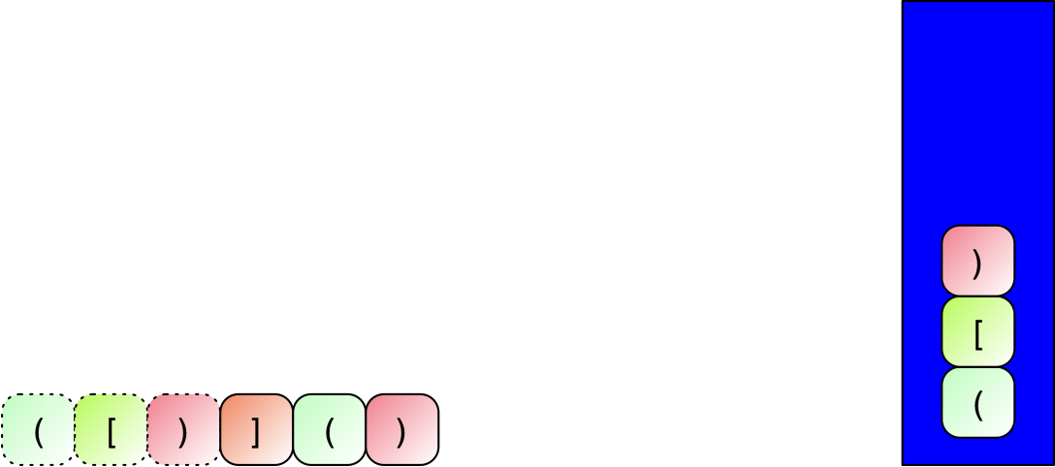
Parenthesization
We try to push a ')' but cannot match it with previous one
This is how we can recognize a bad parenthesization

Slide 26
Parenthesization
When-ever a closing parenthesis is encountered:
We try to match
In which case we pop the other part of the pair
And if that is not possible
We declare defeat
conflict

Slide 27
Parenthesization
Implementation
Interface:
Use the keyboard to enter parentheses, one at a time
Use 'Stop' to indicate the end of the expression
while True:
inp = input(': ')
if inp == 'Stop':
return

Slide 28
Parenthesization
Creating an internal stack importing stack
Processing 'Stop'
Expression is well-formed if the stack is empty
import stack
def test():
my_stack = stack.Stack()
while True:
print(my_stack)
inp = input(': ')
if inp == 'Stop':
return my_stack.is_empty()

Slide 29
Parenthesization
Process parentheses:
Opening brackets are pushed
def test():
my_stack = stack.Stack()
while True:
print(my_stack)
inp = input(': ')
if inp == 'Stop':
return my_stack.is_empty()
elif inp == '(':
my_stack.push('(')
elif inp == '[':
my_stack.push('[')

Slide 30
Parenthesization
Closing brackets are processed
If the stack is empty:
Expression not balanced
If top element matches:
Pop the top element
If the top element does not match
Expression not balanced
elif inp == ')':
if my_stack.is_empty():
return False
elif my_stack.peek( ) == '(':
my_stack.pop( )
else:
return False

Slide 31
Reverse Polish Notation
Polish Notation was invented to show that arithmetical expressions can be expressed without parentheses
Reverse Polish Notation (RPN) used in calculators until rather recently
Central idea: Enter operands, then the operation

Slide 32
Reverse Polish Notation
Example:
$$(3+4)*(5-7)+1$$
Take operands, place operator afterwards
$$(3+4)*(5-7),1,+$$
$$(3+4),(5-7),*,1,+$$
$$3,4,+,5,7-,*,1,+$$
Notice that we are using commata to separate constituents of the expression

Slide 33
Reverse Polish Notation
Example:
$$1,2,3,4,+,5,-,6,*,/,+$$
$$1,2,3+4,5,-,6,*,/,+$$
$$1,2,3+4,5,-,6,*,/,+$$
$$1,2,((3+4)-5),6,*,/,+$$
$$1,2,(((3+4)-5)⋅6),/,+$$
$$1,\frac{2}{((3+4)-5)⋅6},+$$
$$1+\frac{2}{((3+4)-5)⋅6}$$

Slide 34
Reverse Polish Notation
We can use a stack to evaluate an arithmetic expression in RPN
Processing $3,5,+,7,2,-,*$ from left to right
Push 3 then 5 on a stack [3,5]
When processing the '+' operator, pop the last two from the stack, add them and push the result [8]
Push 7, then 2 on the stack [8,7,2]
When processing the '-' operator, pop the last two and push the difference [8,5]
Processing the '*' operator: Pop the last two and push the product [40]
This is the result

Slide 35
Reverse Polish Notation
Assume we are given an expression in RPN
Separated by spaces
Return None plus emit error message if expression is malformed

Slide 36
Reverse Polish Notation
We first take the string and split it (around white spaces)
We then separately handle operators and integers
If we try to pop from an empty stack, we know that the expression is malformed
def rpn(a_string):
my_stack = stack.Stack()
components = a_string.split()
print(components)
for x in components:
if x in ['+', '-', '*', '/']:
...
else:
...

Slide 37
Reverse Polish Notation
An operator:
Try to pop twice and then push the result of the operation applied on the popped numbers
if x in ['+', '-', '*', '/']:
try:
a = my_stack.pop()
b = my_stack.pop()
if x == '+':
my_stack.push(a+b)
elif x == '-':
my_stack.push(b-a)
elif x == '*':
my_stack.push(a*b)
elif x == '/':
my_stack.push(b/a)
except IndexError:
print('Expression malformed', x, my_stack)
return None

Slide 38
Reverse Polish Notation
If the component is not an operator:
Make it into a number
And push it
else:
try:
a = int(x)
except ValueError:
print('Expression malformed', x)
return None
my_stack.push(a)

Slide 39
Reverse Polish Notation
At the end: the stack should house a single number
Pop it
Nota bene: The stack cannot be empty at this point
But it could have more than one number
Deal with this as homework

