Slide 1
Graph Algorithms
Thomas Schwarz, SJ

Slide 2
Searching in Graphs
Exploring a maze
  You are in the middle of a maze
    How do you get out
  Ariadne's solution:
    Use a thread of glittering jewels in order to avoid using the same edges several times
  Follow a wall
    Works for simple mazes

Slide 3
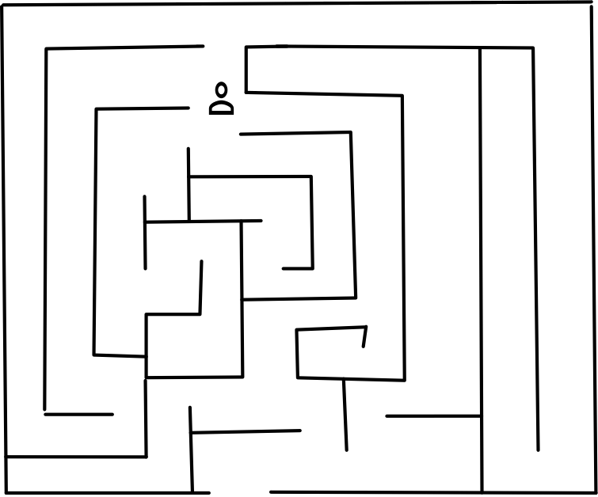
Trémaux's Algorithm
Trémaux's Algorithm aka Hansel and Gretel's aka Ariadne's
  Carry bread and leave bread crumbs on each path you follow
  If you come to an intersection, follow one where there are no bread crumbs, if you can
  If you come to an intersection and everything has already been marked or you are at a dead-end, turn around if you came at a path that has only one thread of crumbs
If not, follow a path that has only one trail of crumbs.

Slide 4
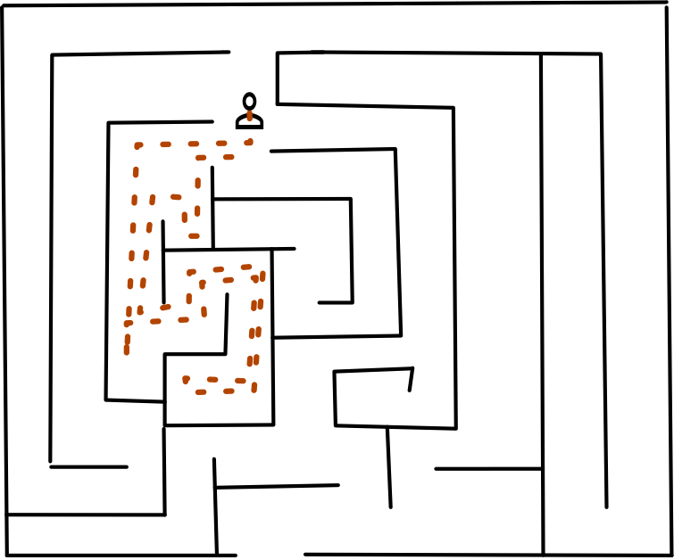
Trémaux's Algorithm
Example

Slide 5
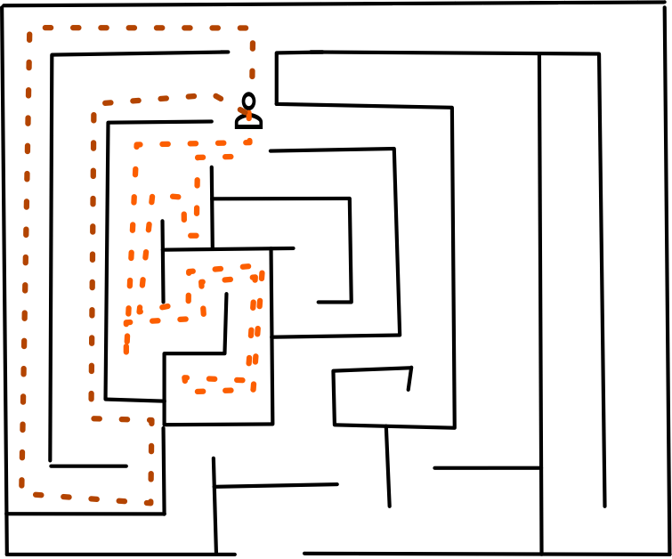
Trémaux's Algorithm

Slide 6
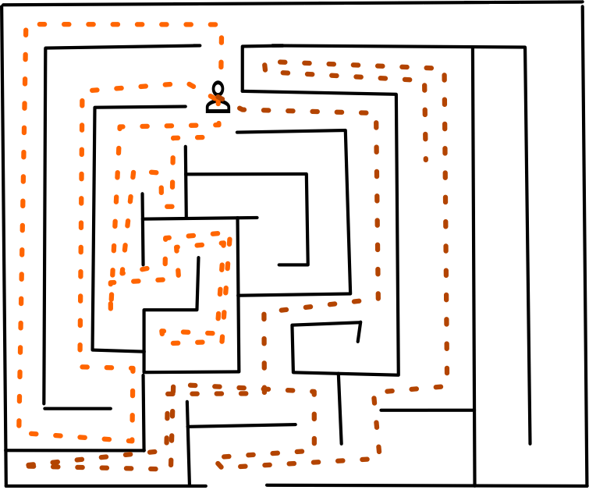
Trémaux's Algorithm

Slide 7
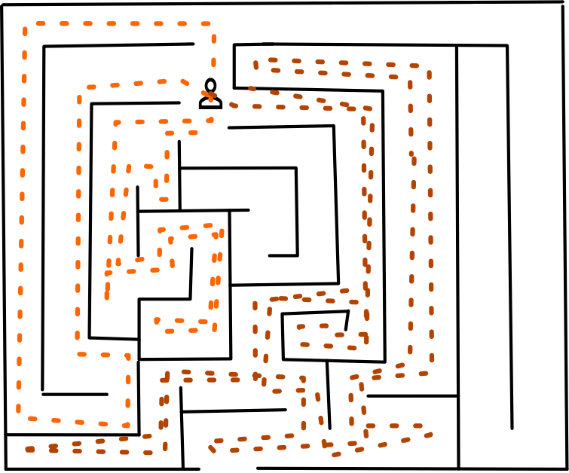
Trémaux's Algorithm

Slide 8
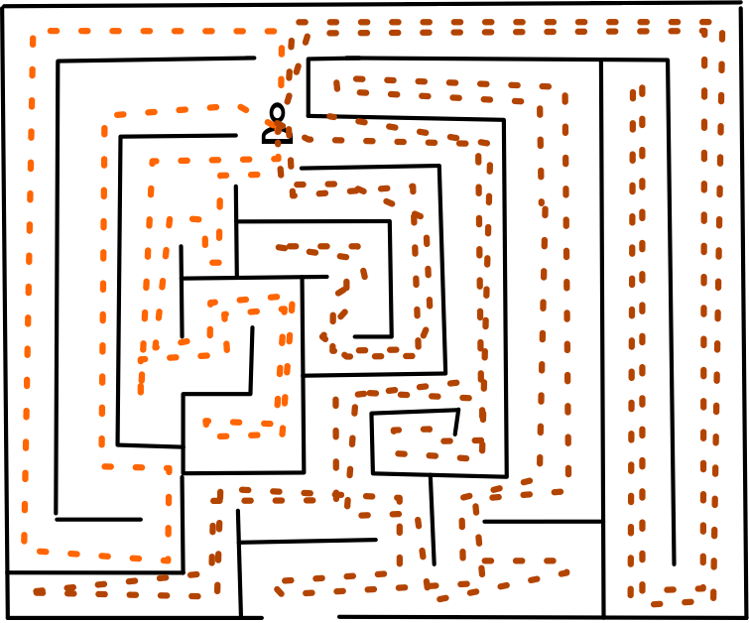
Trémaux's Algorithm

Slide 9
Trémaux's Algorithm
https://en.wikipedia.org/wiki/File:Tremaux_Maze_Solving_Algorithm.gif

Slide 10
Trémaux's Algorithm
At the end:
  All paths will be double marked and you will end up at the starting point
  This means that you walked by the entry

Slide 11
Searching in Graphs
We can use this idea for defining the first graph exploration algorithm.
  Goal is to visit all vertices
  We use a timer:
    Starts out at 0
    Incremented every time we do something
  All nodes get marked with a
    Discovery time: First time that we see the node
    Finishing time: When we are done with the node

Slide 12
Breadth First Search
Color a vertex
  white: vertex has not yet been discovered
  gray: vertex has been discovered, but still needs to be a base for exploration
  black: vertex has been dealt with

Slide 13
Breadth First Search
bfs(G,s):
for v in G.vertices:
    v.color = 'white'
    v.dist = inf
    v.pred = None
    s.color = 'gray'
    s.dist = 0
    s.pred = None
    queue = []
    queue.append(s)
    while queue:
    u = queue.pop(0)
    for v in u.adjacency:
    if v.color == 'white'
    v.color = 'gray'
    v.dist = u.dist+1
    v.pred = u
    queue.append(v)
    u.color = 'black'

Slide 14
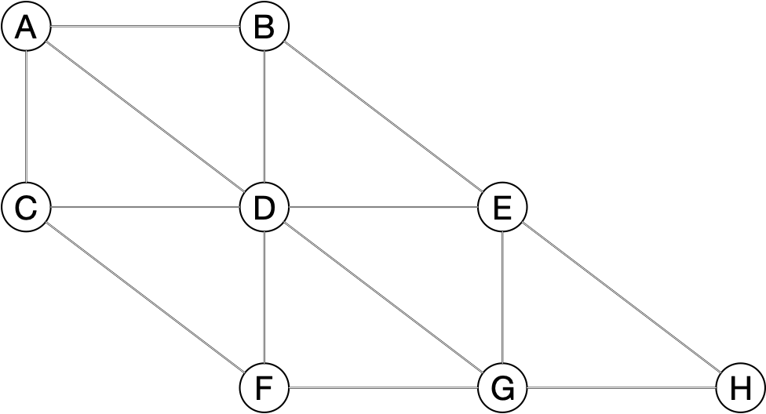
Breadth First Search
Example: s=A

Slide 15
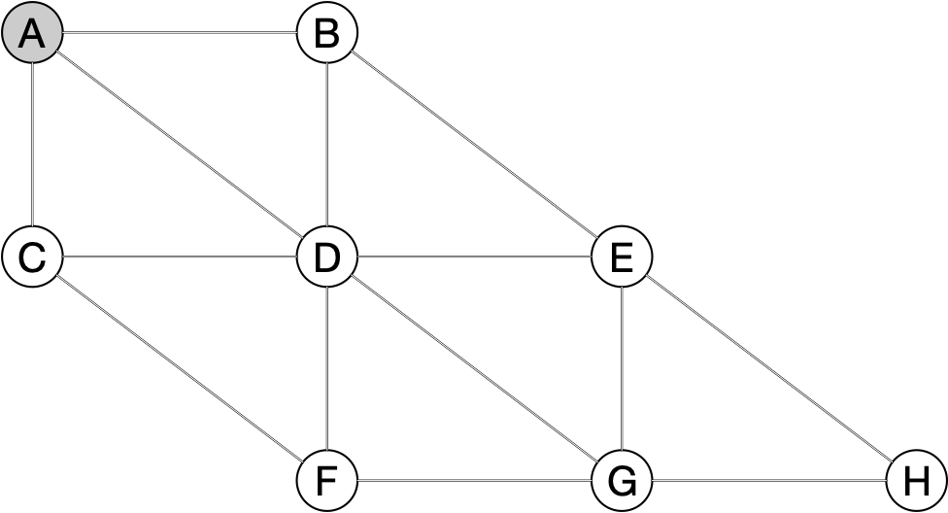
Breadth First Search
    while queue:
    u = queue.pop(0)
    for v in u.adjacency:
    if v.color == 'white'
    v.color = 'gray'
    v.dist = u.dist+1
    v.pred = u
    queue.append(v)
    u.color = 'black'
queue = {A}

Slide 16
Breadth First Search
    while queue:
    u = queue.pop(0)
    for v in u.adjacency:
    if v.color == 'white'
    v.color = 'gray'
    v.dist = u.dist+1
    v.pred = u
    queue.append(v)
    u.color = 'black'
queue = { }
u = A

Slide 17
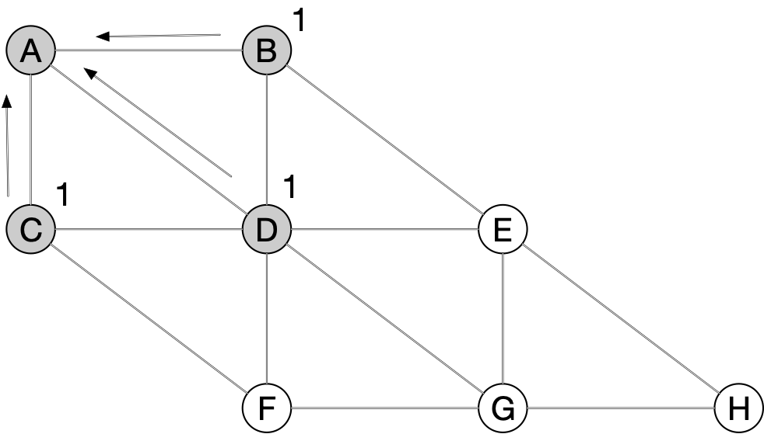
Breadth First Search
    while queue:
    u = queue.pop(0)
    for v in u.adjacency:
    if v.color == 'white'
    v.color = 'gray'
    v.dist = u.dist+1
    v.pred = u
    queue.append(v)
    u.color = 'black'
queue = { }
u = A
queue = {B,C,D}

Slide 18
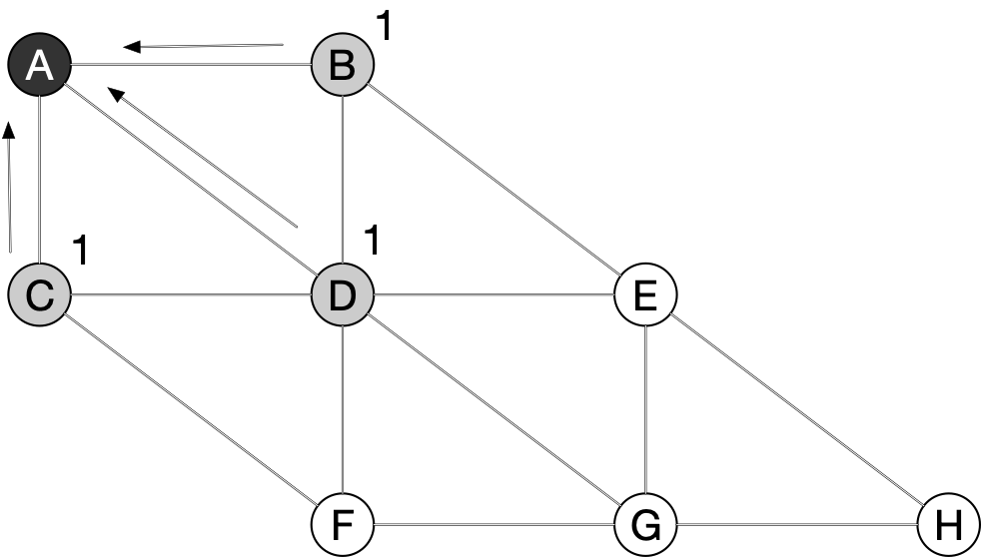
Breadth First Search
    while queue:
    u = queue.pop(0)
    for v in u.adjacency:
    if v.color == 'white'
    v.color = 'gray'
    v.dist = u.dist+1
    v.pred = u
    queue.append(v)
    u.color = 'black'
queue = { }
u = A
queue = {B,C,D}

Slide 19
Breadth First Search
    while queue:
    u = queue.pop(0)
    for v in u.adjacency:
    if v.color == 'white'
    v.color = 'gray'
    v.dist = u.dist+1
    v.pred = u
    queue.append(v)
    u.color = 'black'
queue = {C,D }
u = B
queue = {C,D}

Slide 20
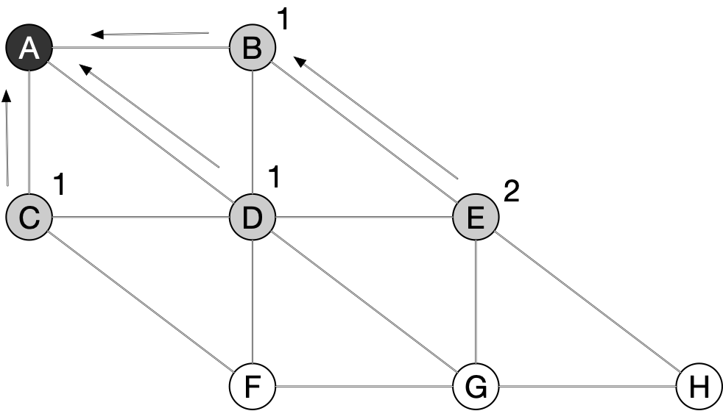
Breadth First Search
    while queue:
    u = queue.pop(0)
    for v in u.adjacency:
    if v.color == 'white'
    v.color = 'gray'
    v.dist = u.dist+1
    v.pred = u
    queue.append(v)
    u.color = 'black'
queue = {C,D }
u = B
queue = {C, D, E}

Slide 21
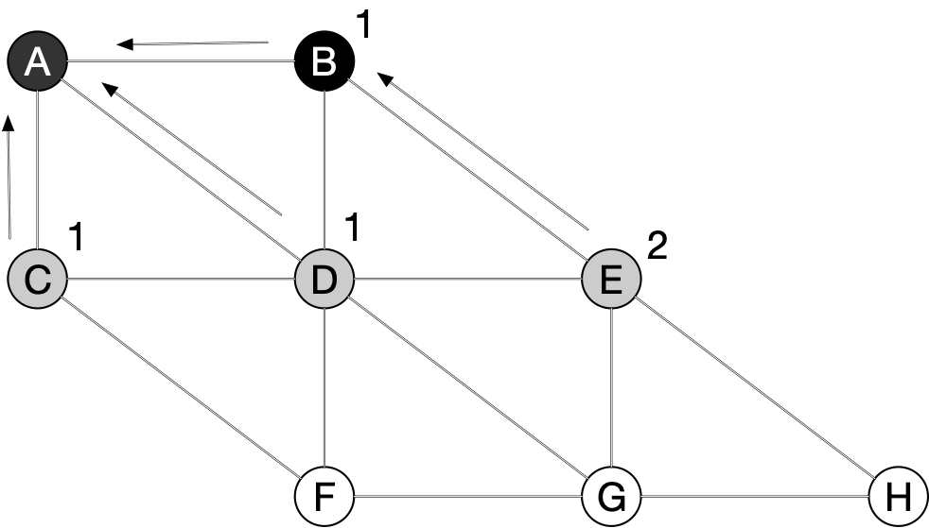
Breadth First Search
    while queue:
    u = queue.pop(0)
    for v in u.adjacency:
    if v.color == 'white'
    v.color = 'gray'
    v.dist = u.dist+1
    v.pred = u
    queue.append(v)
    u.color = 'black'
queue = {C,D,E}
u = B
queue = {C,D,E}

Slide 22
Breadth First Search
    while queue:
    u = queue.pop(0)
    for v in u.adjacency:
    if v.color == 'white'
    v.color = 'gray'
    v.dist = u.dist+1
    v.pred = u
    queue.append(v)
    u.color = 'black'
queue = {C,D,E}
u = C
queue = {D,E}

Slide 23
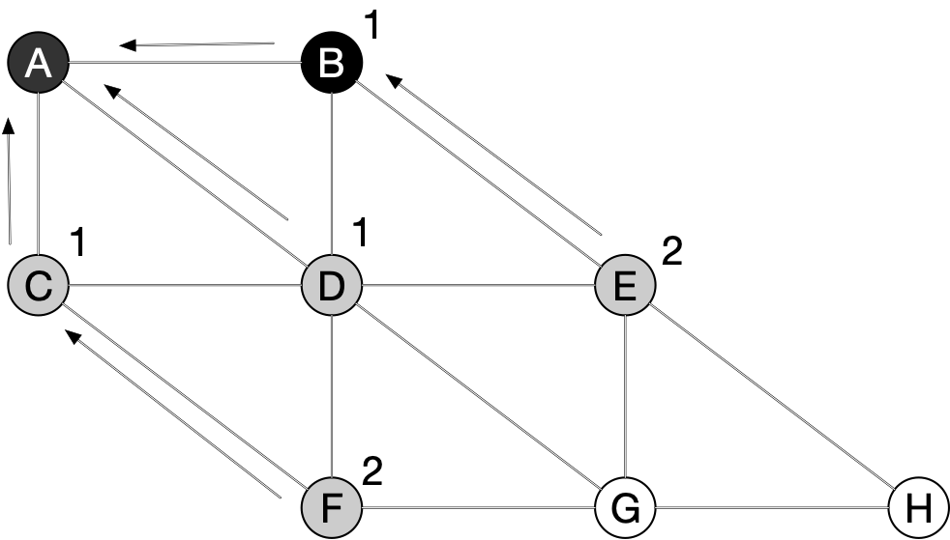
Breadth First Search
    while queue:
    u = queue.pop(0)
    for v in u.adjacency:
    if v.color == 'white'
    v.color = 'gray'
    v.dist = u.dist+1
    v.pred = u
    queue.append(v)
    u.color = 'black'
queue = {D,E}
u = C
queue = {D, E, F}

Slide 24
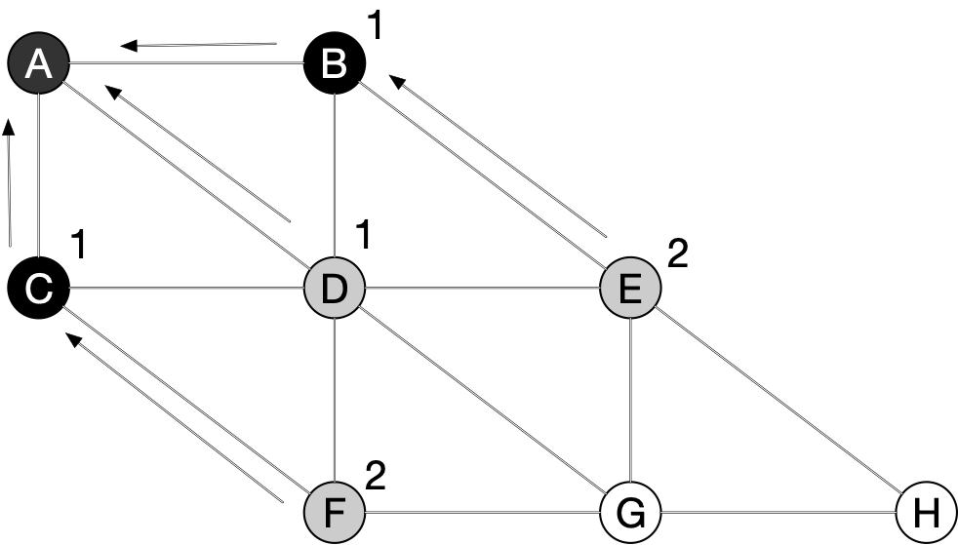
Breadth First Search
    while queue:
    u = queue.pop(0)
    for v in u.adjacency:
    if v.color == 'white'
    v.color = 'gray'
    v.dist = u.dist+1
    v.pred = u
    queue.append(v)
    u.color = 'black'
queue = {D,E,F}
u = C
queue = {D, E, F}

Slide 25
Breadth First Search
    while queue:
    u = queue.pop(0)
    for v in u.adjacency:
    if v.color == 'white'
    v.color = 'gray'
    v.dist = u.dist+1
    v.pred = u
    queue.append(v)
    u.color = 'black'
queue = {D,E,F}
u = D
queue = {E, F}

Slide 26
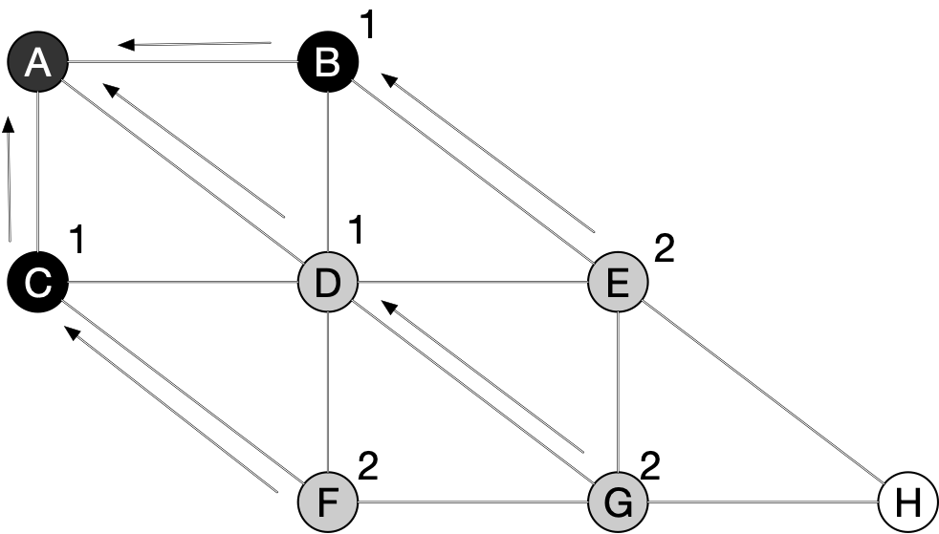
Breadth First Search
    while queue:
    u = queue.pop(0)
    for v in u.adjacency:
    if v.color == 'white'
    v.color = 'gray'
    v.dist = u.dist+1
    v.pred = u
    queue.append(v)
    u.color = 'black'
queue = {E,F}
u = D
queue = {E, F, G}

Slide 27
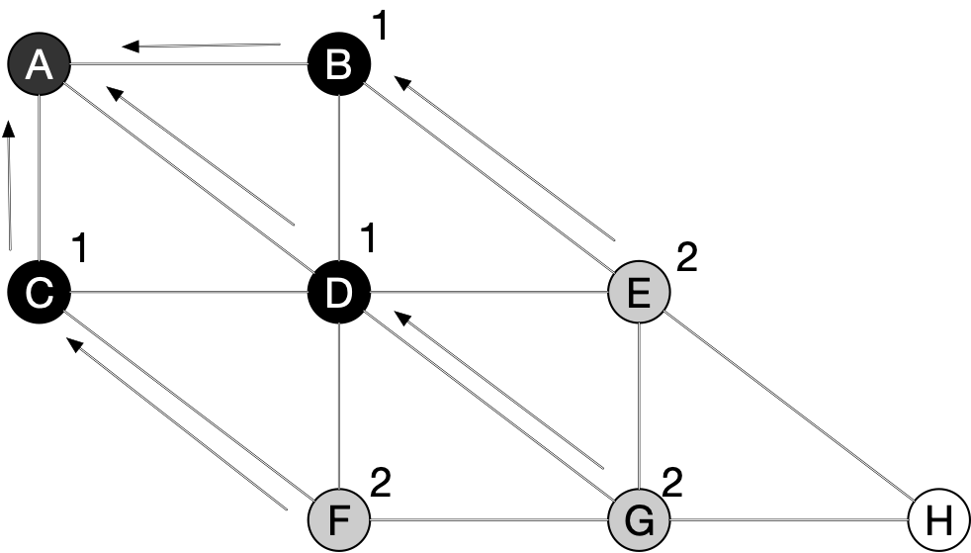
Breadth First Search
    while queue:
    u = queue.pop(0)
    for v in u.adjacency:
    if v.color == 'white'
    v.color = 'gray'
    v.dist = u.dist+1
    v.pred = u
    queue.append(v)
    u.color = 'black'
queue = {E,F,G}
u = D
queue = {E, F, G}

Slide 28
Breadth First Search
    while queue:
    u = queue.pop(0)
    for v in u.adjacency:
    if v.color == 'white'
    v.color = 'gray'
    v.dist = u.dist+1
    v.pred = u
    queue.append(v)
    u.color = 'black'
queue = {E,F,G}
u = E
queue = { F, G}

Slide 29
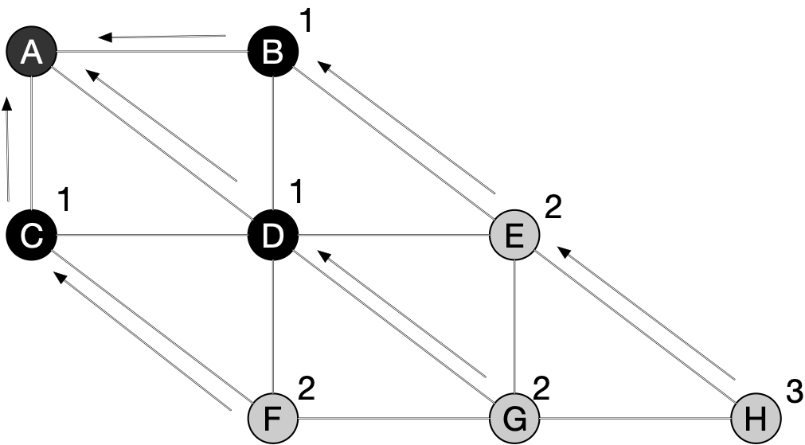
Breadth First Search
    while queue:
    u = queue.pop(0)
    for v in u.adjacency:
    if v.color == 'white'
    v.color = 'gray'
    v.dist = u.dist+1
    v.pred = u
    queue.append(v)
    u.color = 'black'
queue = {F,G}
u = E
queue = { F, G, H}

Slide 30
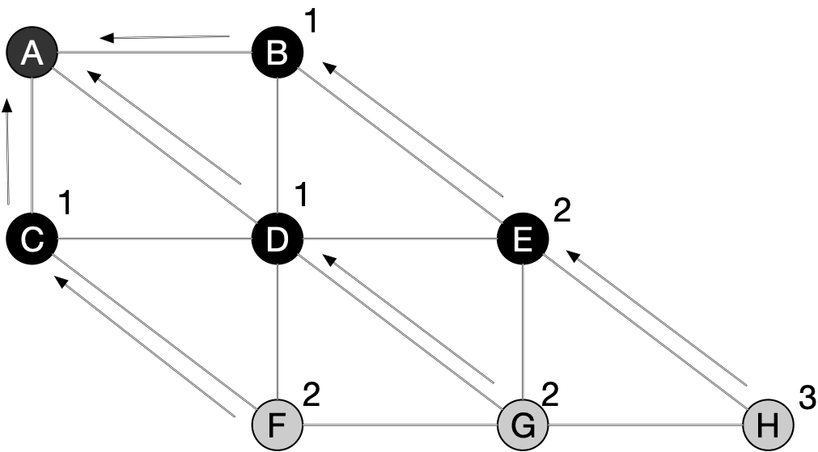
Breadth First Search
    while queue:
    u = queue.pop(0)
    for v in u.adjacency:
    if v.color == 'white'
    v.color = 'gray'
    v.dist = u.dist+1
    v.pred = u
    queue.append(v)
    u.color = 'black'
queue = {F,G,H}
u = E
queue = { F, G, H}

Slide 31
Breadth First Search
    while queue:
    u = queue.pop(0)
    for v in u.adjacency:
    if v.color == 'white'
    v.color = 'gray'
    v.dist = u.dist+1
    v.pred = u
    queue.append(v)
    u.color = 'black'
queue = {G,H}
u = F
queue = {G, H}

Slide 32
Breadth First Search
    while queue:
    u = queue.pop(0)
    for v in u.adjacency:
    if v.color == 'white'
    v.color = 'gray'
    v.dist = u.dist+1
    v.pred = u
    queue.append(v)
    u.color = 'black'
queue = {G,H}
u = F
queue = {G, H}

Slide 33
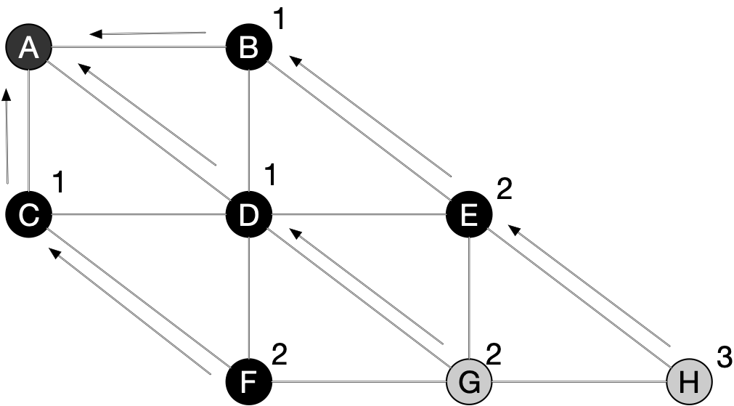
Breadth First Search
    while queue:
    u = queue.pop(0)
    for v in u.adjacency:
    if v.color == 'white'
    v.color = 'gray'
    v.dist = u.dist+1
    v.pred = u
    queue.append(v)
    u.color = 'black'
queue = {G,H}
u = F
queue = {G, H}

Slide 34
Breadth First Search
    while queue:
    u = queue.pop(0)
    for v in u.adjacency:
    if v.color == 'white'
    v.color = 'gray'
    v.dist = u.dist+1
    v.pred = u
    queue.append(v)
    u.color = 'black'
queue = {G,H}
u = G
queue = {H}

Slide 35
Breadth First Search
    while queue:
    u = queue.pop(0)
    for v in u.adjacency:
    if v.color == 'white'
    v.color = 'gray'
    v.dist = u.dist+1
    v.pred = u
    queue.append(v)
    u.color = 'black'
queue = {G,H}
u = G
queue = {H}

Slide 36
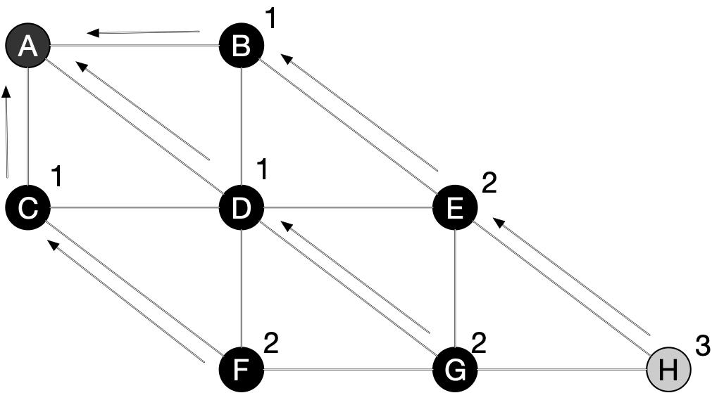
Breadth First Search
    while queue:
    u = queue.pop(0)
    for v in u.adjacency:
    if v.color == 'white'
    v.color = 'gray'
    v.dist = u.dist+1
    v.pred = u
    queue.append(v)
    u.color = 'black'
queue = {H}
u = G
queue = {H}

Slide 37
Breadth First Search
    while queue:
    u = queue.pop(0)
    for v in u.adjacency:
    if v.color == 'white'
    v.color = 'gray'
    v.dist = u.dist+1
    v.pred = u
    queue.append(v)
    u.color = 'black'
queue = { }
u = H
queue = { }

Slide 38
Breadth First Search
    while queue:
    u = queue.pop(0)
    for v in u.adjacency:
    if v.color == 'white'
    v.color = 'gray'
    v.dist = u.dist+1
    v.pred = u
    queue.append(v)
    u.color = 'black'
queue = { }
u = H
queue = { }

Slide 39
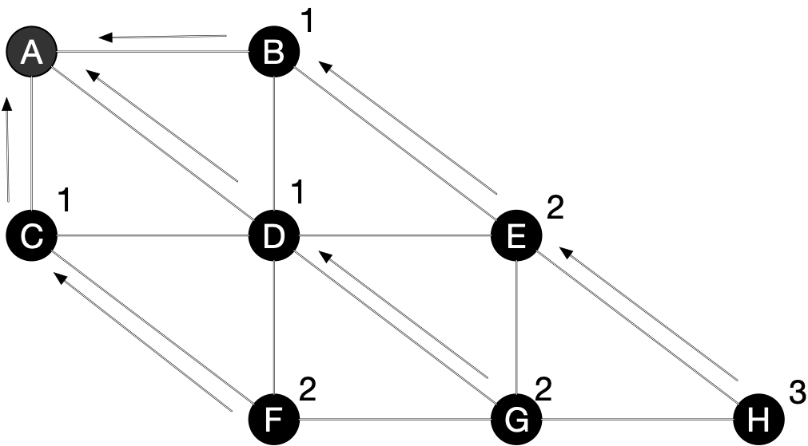
Breadth First Search
    while queue:
    u = queue.pop(0)
    for v in u.adjacency:
    if v.color == 'white'
    v.color = 'gray'
    v.dist = u.dist+1
    v.pred = u
    queue.append(v)
    u.color = 'black'
queue = { }
u = H
queue = { }

Slide 40
Breadth First Search
As you can see, BFS is just a version of Dijkstra's algorithm
Distance calculates accurately the distance from the starting point
The pred property allows us to generate a shortest path from the initial node
We now prove these properties exactly

Slide 41

Breadth First Search
Lemma: Let $G=(E,V)$ be an undirected or directed graph. Let $s∈V$ be an arbitrary vertex. Then for any edge $(u,v)∈E$
  $$δ(s,v)≤δ(s,u)+1$$
Recall: $δ(a,b)$ is the length of a shortest path from $a$ to $b$

Slide 42
Breadth First Search
Proof:
  Assume first that $δ(s,u)=∞$, i.e. there is no path from $s$ to $u$
    Then $δ(s,v)≤∞=δ(s,u)+1$ regardless whether there is a path from $s$ to $v$.

Slide 43
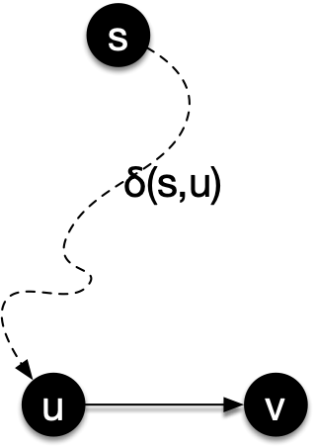
Breadth First Search
Proof:
  Next assume that $δ(s,u)<∞$, i.e. that there is a path from $s$ to $u$.
    Extend this path to a path from $s$ to $v$.
    This path has length $δ(s,u)+1$.
    Then $δ(s,v)=min(\text{Lenght of a path from}s\text{to}v)$
            $≤\text{Length of this path}$
            $=δ(s,u)+1$

Slide 44
Breadth First Search
Lemma: Let Let $G=(E,V)$ be an undirected or directed graph. Let $s∈V$ be an arbitrary vertex. Run BFS on $G$ and $s$. Then for every vertex $v∈V$, $v.\text{dist}≥δ(s,v)$.
  This means that the calculated distance in BFS is at least as large as the actual distance

Slide 45
Breadth First Search
Proof by induction on the number of enqueue operations
  Notice that v.dist is assigned just when we are about to enqueue it
    while queue:
    u = queue.pop(0)
    for v in u.adjacency:
    if v.color == 'white'
    v.color = 'gray'
    - - > v.dist = u.dist+1
    v.pred = u
    queue.append(v)
    u.color = 'black'

Slide 46
Breadth First Search
Induction Start:
  When $s$ is enqueued all distance properties are infinity
    with the exception of $s$ which has dist 0
  At this point, for every vertex $v∈V$, $v.\text{dist}≥δ(s,v)$

Slide 47
Breadth First Search
Induction step:
  The value of the distance property only changes when we make the assignment just before enqueuing a white vector
  Induction hypothesis implies $u.\text{dist}≥δ(s,u)$
  Therefore $v.\text{dist}=u.\text{dist}+1≥δ(s,u)+1≥δ(s,v)$
    while queue:
    u = queue.pop(0)
    for v in u.adjacency:
    if v.color == 'white'
    v.color = 'gray'
    - - > v.dist = u.dist+1
    v.pred = u
    queue.append(v)
    u.color = 'black'

Slide 48
Breadth First Search
Afterwards, the vertex v is no longer white and never changes its distance value

Slide 49
Breadth First Search
We now need to see more closely how the algorithm works:
  We can think of the queue as the boundary between black and white vertices that moves slowly away from $s$
Lemma: If the queue has vertices $(v_{1},v_{2},…,v_{n})$ with $v_{1}$ being the head, then
  $v_{n}.\text{dist}≤v_{1}.\text{dist}$+1
    and
  $v_{i}.\text{dist}≤v_{i+1}.\text{dist}$ for $i=1,2,…,n-1$

Slide 50
Breadth First Search
Proof by induction on the number of queue operations
  Initially, the queue has only $s$ in it, so the property certainly holds
  The queue changes through enqueuing and dequeuing operations

Slide 51
Breadth First Search
If the head $v_{1}$ is dequeued, $v_{2}$ becomes the new head.
  (If there is no $v_{2}$ then the queue is empty, and the assertion holds vacuously)
  Before dequeuing, $v_{1}.\text{dist}≤v_{2}.\text{dist}$, therefore $v_{n}.\text{dist}≤v_{1}.\text{dist}+1≤v_{2}.\text{dist}$
  Therefore, the first inequality is true
  The second assertion just looses the first inequality

Slide 52
Breadth First Search
If a new element $v_{n+1}$ is enqueued, we just dequeued a vertex $u$ and are adding all white vertices adjacent to u
Therefore, $v_{n+1}.\text{dist}=u.\text{dist}+1$.
By induction hypothesis, $u.\text{dist}≤v_{1}.\text{dist}$ because $u$ and $v_{1}$ were just in the same queue
    while queue:
    u = queue.pop(0)
    for v in u.adjacency:
    if v.color == 'white'
    v.color = 'gray'
    - - > v.dist = u.dist+1
    v.pred = u
    queue.append(v)
    u.color = 'black'

Slide 53
Breadth First Search
Therefore
  $$v_{r+1}.\text{dist}=u.\text{dist}+1≤v_{1}.\text{dist}+1$$
Proving the first assertion

Slide 54
Breadth First Search
From the induction hypothesis, we also have
  $$v_{n}.\text{dist}≤u.\text{dist}+1$$
which implies that
  $$v_{n}.\text{dist}≤u.\text{dist}+1≤v_{n+1}.\text{dist}$$
This is the only new part of the second assertion

Slide 55
Depth First Search
Breadth first search uses a queue
  In Python, a queue is a list to which you append and from which you pop
  C++ and Java have libraries that implement queues
def bfs(G, s):
for u in G.Vertices:
u.color = “white”
u.d = infty
u.pred = Null
s.color=“gray”
s.d = 0
s.pred = Null
queue = Queue.queue()
queue.enqueue(s)
while queue:
u = queue.head()
for v in u.adjacency_list:
if v.color==“white”
v.color = “gray”
v.d = u.d + 1
v.pred = u
queue.enqueue(v)
u.color=“black”

Slide 56
Depth First Search
Depth first search replaces the queue with a stack
  This changes the behavior of the algorithm considerably
  Remarkably, the resulting Depth First Search is the more important and interesting algorithm

Slide 57
Depth First Search
Depth first search
Version 1
  Change queue into stack
  Get rid of the distance
def dfs(G, s):
for u in G.Vertices:
u.color = “white”
u.d = infty
u.pred = Null
s.color=“gray”
s.pred = Null
queue = Stack.stack()
stack.push(s)
while stack:
u = stack.pop()
for v in u.adjacency_list:
if v.color==“white”
v.color = “gray”
v.pred = u
stack.push(v)
u.color=“black”

Slide 58
Depth First Search
We add visiting times to our nodes:
  Discovered time
    When a node turns gray
  Finished time
    When a node turns black
Because
  some derived algorithms use it
  in order to argue about DFS
Whenever we change a node color, we increment a clock

Slide 59
Depth First Search
Unlike BFS, a typical DFS will want to classify all nodes
  Have a DFS_Visit(start_node) that starts in a node and visit what can be available
  Have a DFS( ) function that uses the visit function repeatedly if necessary

Slide 60
Depth First Search
dfs_visit(u):
global clock
clock += 1
u.d = clock
u.color = 'gray'
for each v in u.adjacency:
if v.color == 'white'
v.pred = u
dfs_visit(v)
u.color = 'black'
clock += 1
u.f = clock

Slide 61
Depth First Search
dfs(G):
for vertex in G.V:
vertex.color = 'white'
vertex.pred = None
global clock = 0
for vertex in G.V:
      if vertex.color = 'white':
      dfs_visit(vertex)

Slide 62
Depth First Search
Understanding the algorithm
  The stack is hidden in the recursive call
  We can unroll it
  But need to be careful as something on the stack can be already found and processed via another route

Slide 63
Depth First Search
dfs_visit(u):
stack = [u]
while stack:
u = stack.pop()
if u.color=='white'
for v in u.adjacency:
if v.color=='white':
stack.push(v)

Slide 64
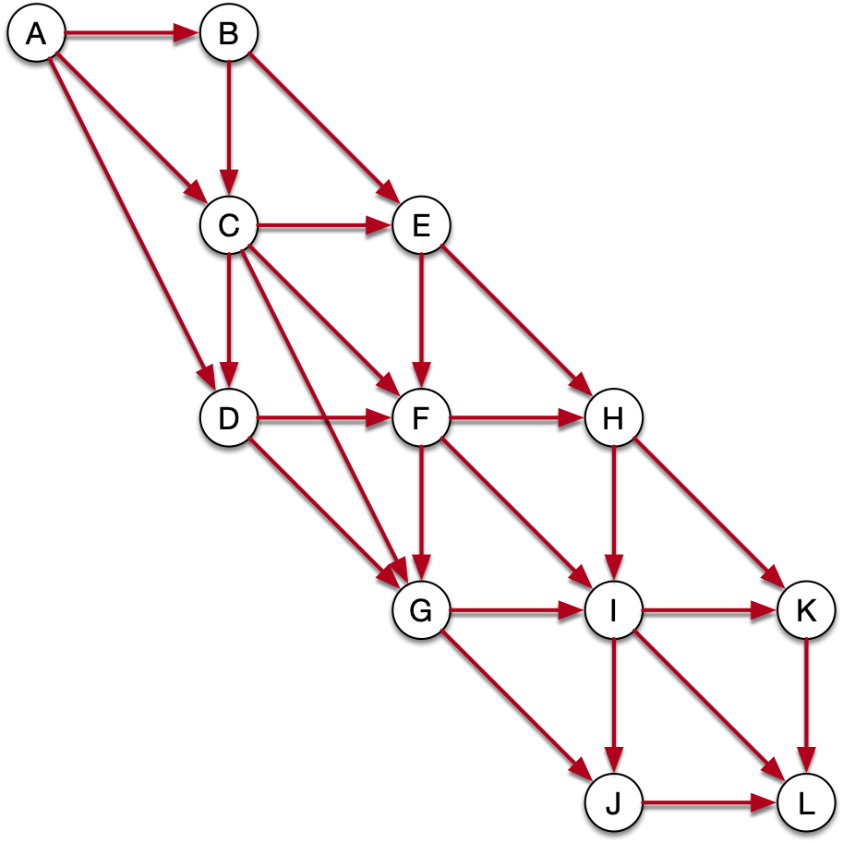
Depth First Search
Start with C
OS stack is
dfs_visit(C)
ç
dfs_visit(u):
u.color = 'gray'
for each v in u.adjacency:
if v.color == 'white'
dfs_visit(v)
u.color = 'black

Slide 65
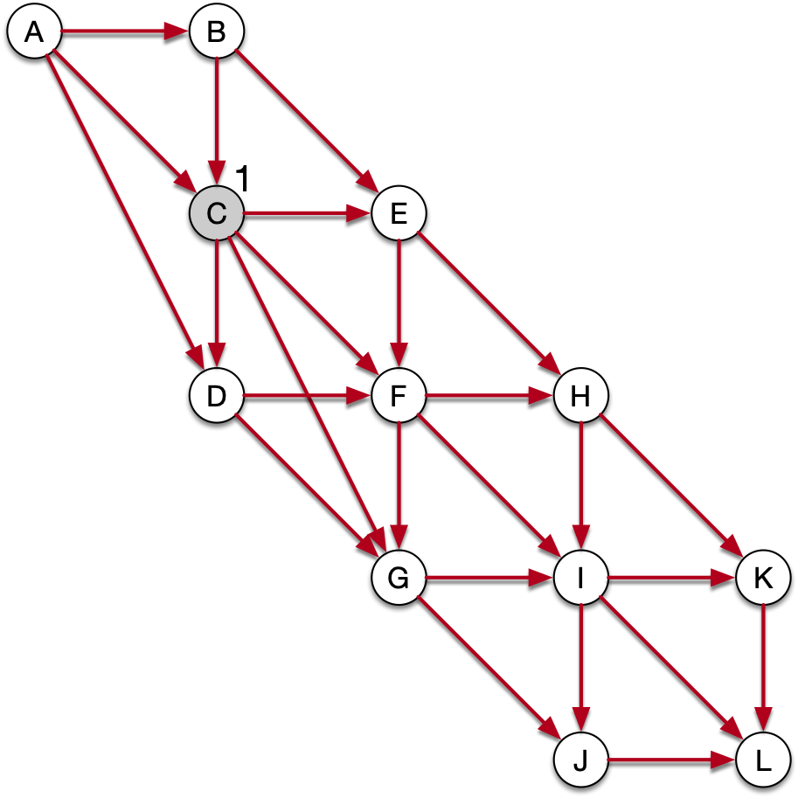
Depth First Search
Start with C
OS stack
dfs_visit(C)
dfs_visit(u):
u.color = 'gray'
for each v in u.adjacency:
if v.color == 'white'
dfs_visit(v)
u.color = 'black
ç
We set the clock to 1
We pick arbitrarily E
from the adjacency list

Slide 66
Depth First Search
OS stack
dfs_visit(E)
dfs_visit(C)
dfs_visit(u):
u.color = 'gray'
for each v in u.adjacency:
if v.color == 'white'
dfs_visit(v)
u.color = 'black
ç
We call dfs_visit(E)

Slide 67
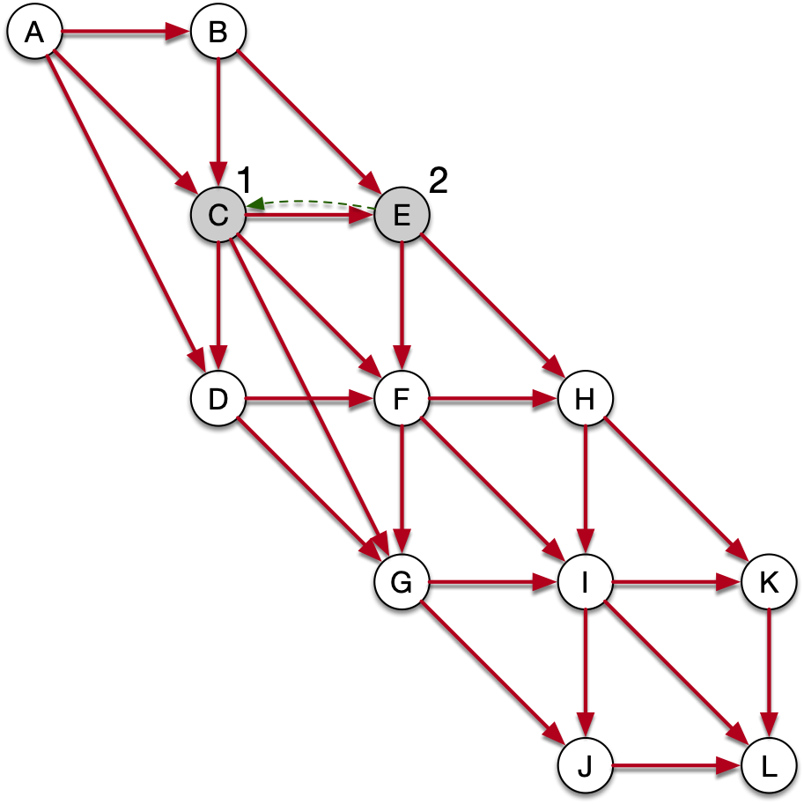
Depth First Search
OS stack
dfs_visit(E)
dfs_visit(C)
dfs_visit(u):
u.color = 'gray'
for each v in u.adjacency:
if v.color == 'white'
dfs_visit(v)
u.color = 'black
ç
u = E, set E's discovery
time and set the
predecessor link

Slide 68
Depth First Search
OS stack
dfs_visit(E)
dfs_visit(C)
dfs_visit(u):
u.color = 'gray'
for each v in u.adjacency:
if v.color == 'white'
dfs_visit(v)
u.color = 'black
ç
we pick v = H

Slide 69
Depth First Search
OS stack
dfs_visit(E)
dfs_visit(C)
dfs_visit(u):
u.color = 'gray'
for each v in u.adjacency:
if v.color == 'white'
dfs_visit(v)
u.color = 'black
ç
we pick v = H and call
dfs_visit(H)

Slide 70
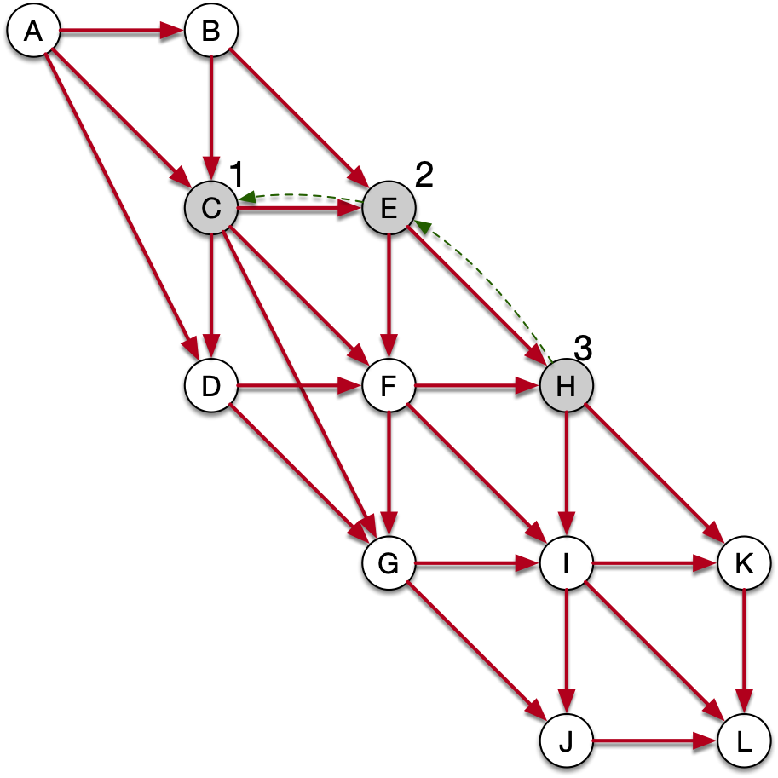
Depth First Search
OS stack
dfs_visit(H)
dfs_visit(E)
dfs_visit(C)
dfs_visit(u):
u.color = 'gray'
for each v in u.adjacency:
if v.color == 'white'
dfs_visit(v)
u.color = 'black
ç
we pick v = H and call
dfs_visit(H)
this colors H gray

Slide 71
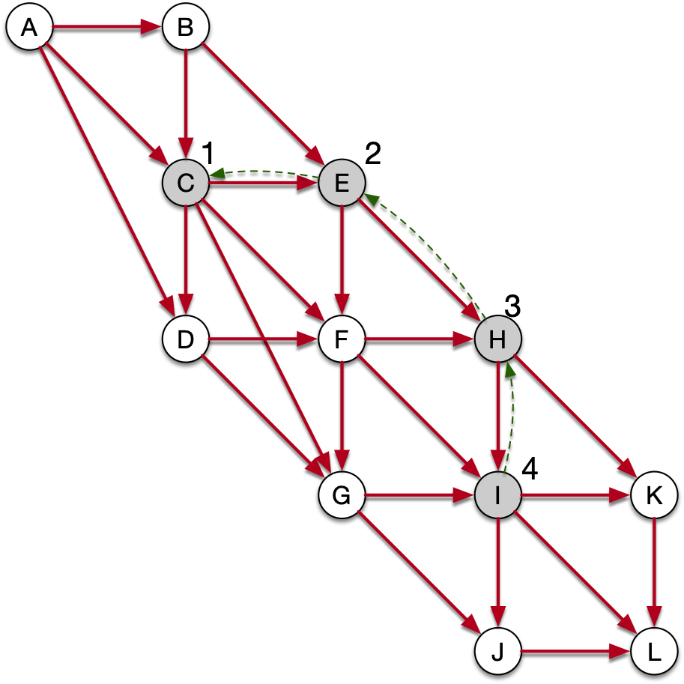
Depth First Search
OS stack
dfs_visit(I)
dfs_visit(H)
dfs_visit(E)
dfs_visit(C)
dfs_visit(u):
u.color = 'gray'
for each v in u.adjacency:
if v.color == 'white'
dfs_visit(v)
u.color = 'black
we pick v = I and call
dfs_visit(I)
this colors I gray

Slide 72
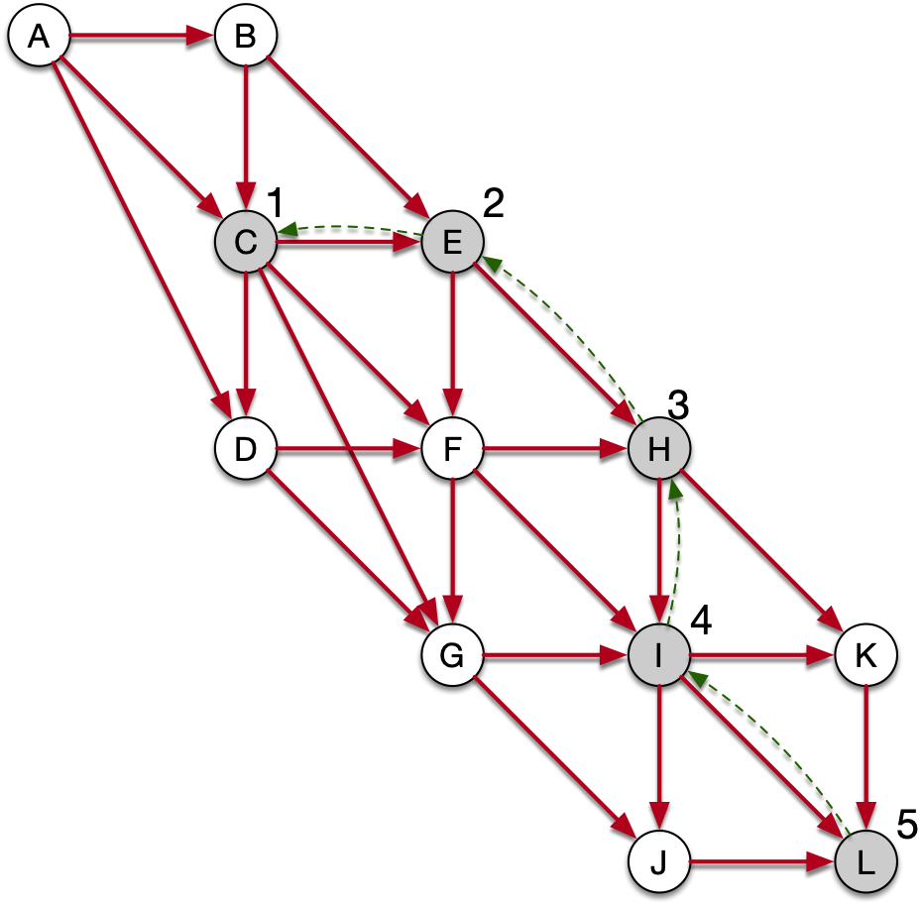
Depth First Search
OS stack
dfs_visit(L)
dfs_visit(I)
dfs_visit(H)
dfs_visit(E)
dfs_visit(C)
dfs_visit(u):
u.color = 'gray'
for each v in u.adjacency:
if v.color == 'white'
dfs_visit(v)
u.color = 'black
we pick v = L and call
dfs_visit(L)
this colors L gray

Slide 73
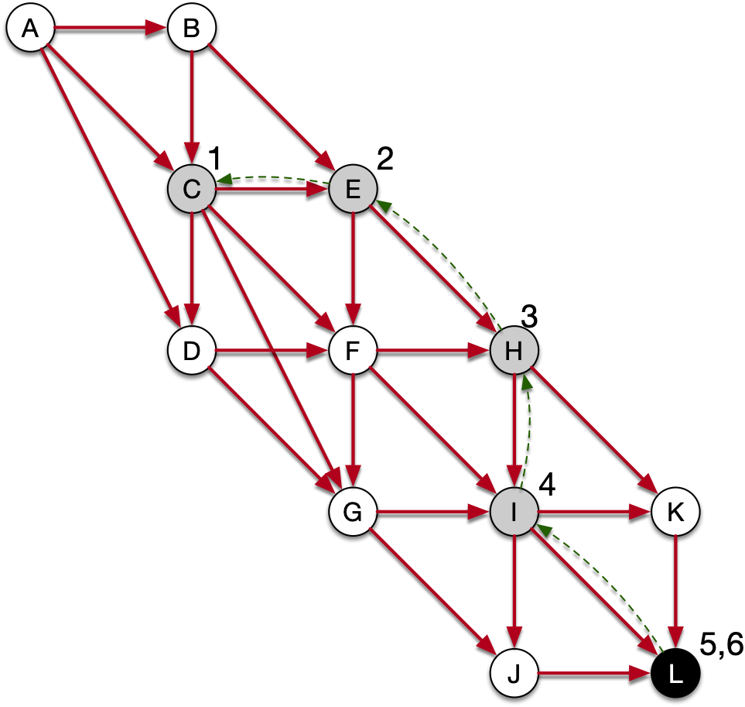
Depth First Search
OS stack
dfs_visit(L)
dfs_visit(I)
dfs_visit(H)
dfs_visit(E)
dfs_visit(C)
dfs_visit(u):
u.color = 'gray'
for each v in u.adjacency:
if v.color == 'white'
dfs_visit(v)
u.color = 'black
L has no vertices in
the adjacency list
Therefore, we finally
go to the last line

Slide 74
Depth First Search
OS stack
dfs_visit(I)
dfs_visit(H)
dfs_visit(E)
dfs_visit(C)
dfs_visit(u):
u.color = 'gray'
for each v in u.adjacency:
if v.color == 'white'
dfs_visit(v)
u.color = 'black
We finish dfs_visit(L)
and are back at the
execution of dfs_visit(I)

Slide 75
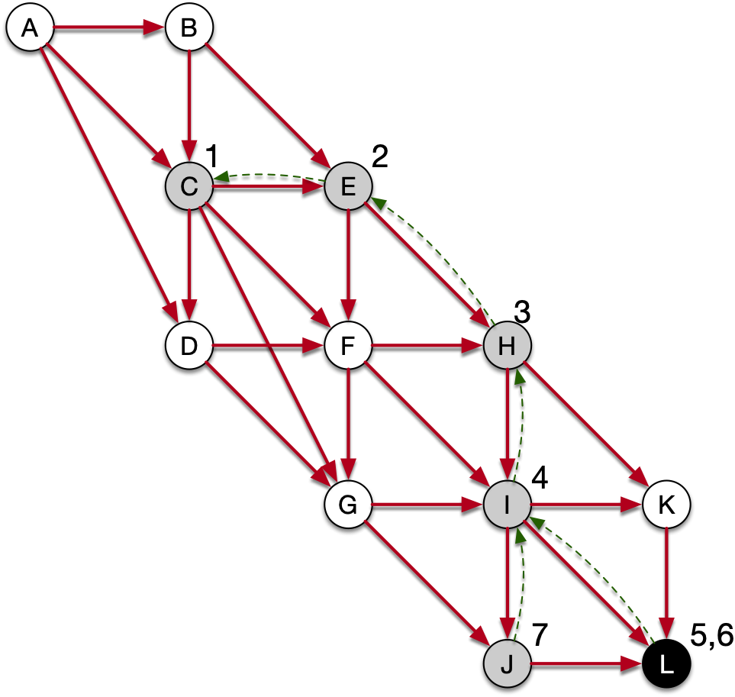
Depth First Search
OS stack
dfs_visit(J)
dfs_visit(I)
dfs_visit(H)
dfs_visit(E)
dfs_visit(C)
dfs_visit(u):
u.color = 'gray'
for each v in u.adjacency:
if v.color == 'white'
dfs_visit(v)
u.color = 'black
We pick a white vertex
reachable from I: J

Slide 76
Depth First Search
OS stack
dfs_visit(J)
dfs_visit(I)
dfs_visit(H)
dfs_visit(E)
dfs_visit(C)
dfs_visit(u):
u.color = 'gray'
for each v in u.adjacency:
if v.color == 'white'
dfs_visit(v)
u.color = 'black
There are no white nodes
in the adjacency list of J

Slide 77
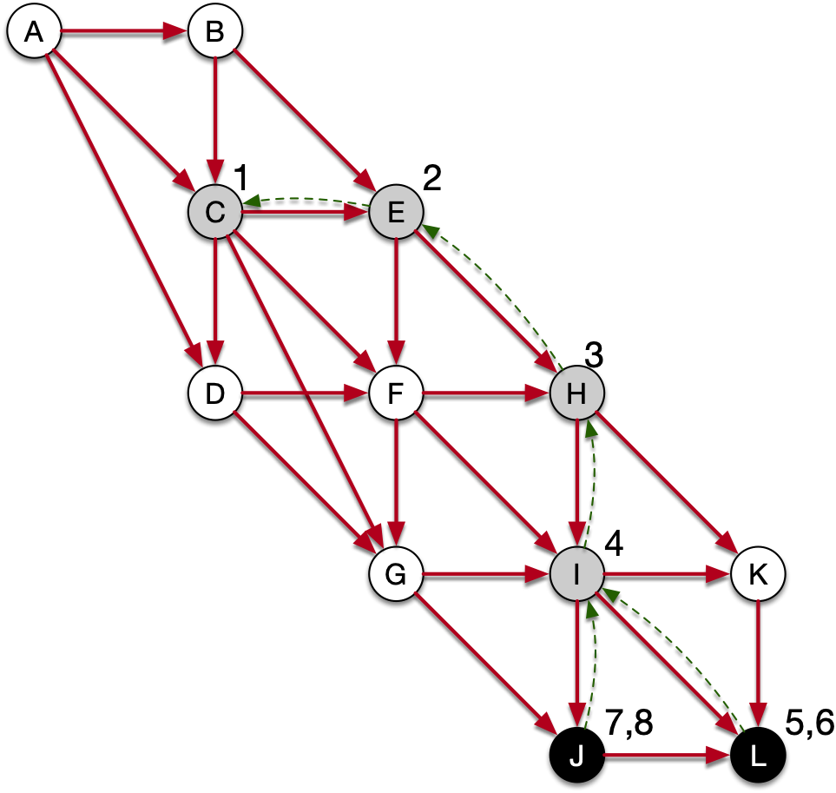
Depth First Search
OS stack
dfs_visit(I)
dfs_visit(H)
dfs_visit(E)
dfs_visit(C)
dfs_visit(u):
u.color = 'gray'
for each v in u.adjacency:
if v.color == 'white'
dfs_visit(v)
u.color = 'black
We close the call on J and
are back to dfs_visit(I)

Slide 78
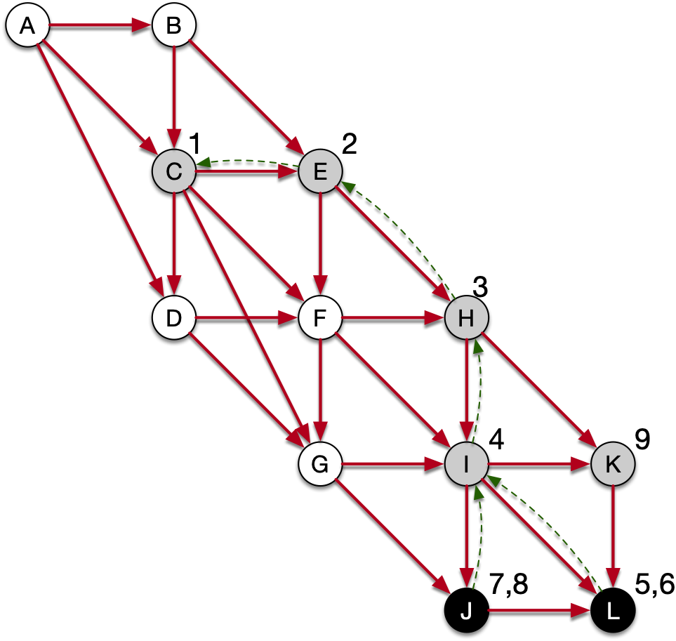
Depth First Search
OS stack
dfs_visit(K)
dfs_visit(I)
dfs_visit(H)
dfs_visit(E)
dfs_visit(C)
dfs_visit(u):
u.color = 'gray'
for each v in u.adjacency:
if v.color == 'white'
dfs_visit(v)
u.color = 'black
dfs_visit(I) now goes to K

Slide 79
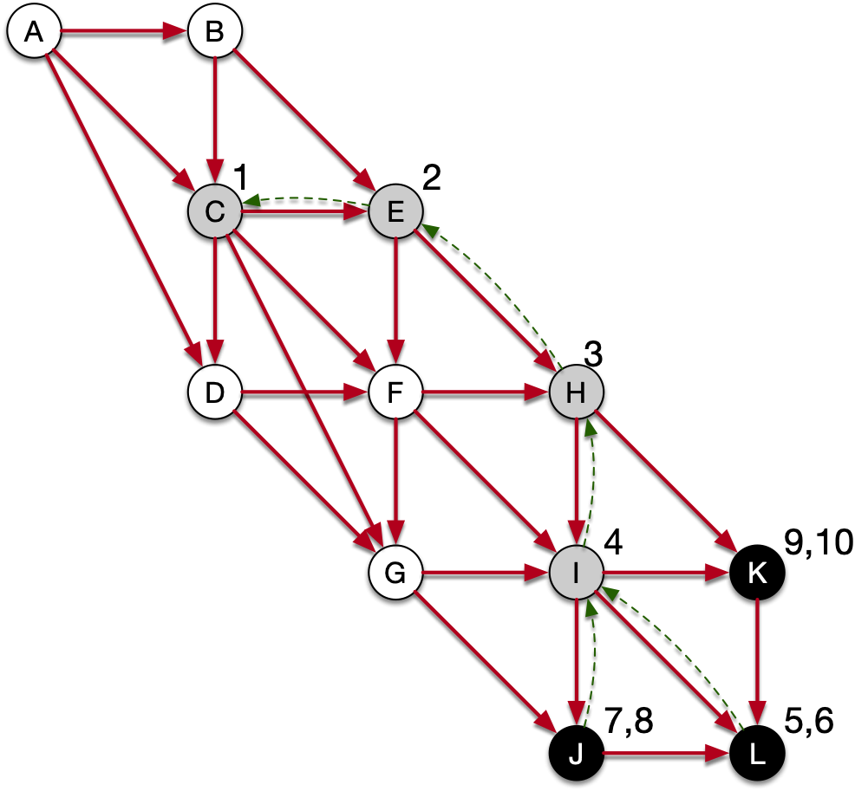
Depth First Search
OS stack
dfs_visit(I)
dfs_visit(H)
dfs_visit(E)
dfs_visit(C)
dfs_visit(u):
u.color = 'gray'
for each v in u.adjacency:
if v.color == 'white'
dfs_visit(v)
u.color = 'black
dfs_visit(K) finishes

Slide 80
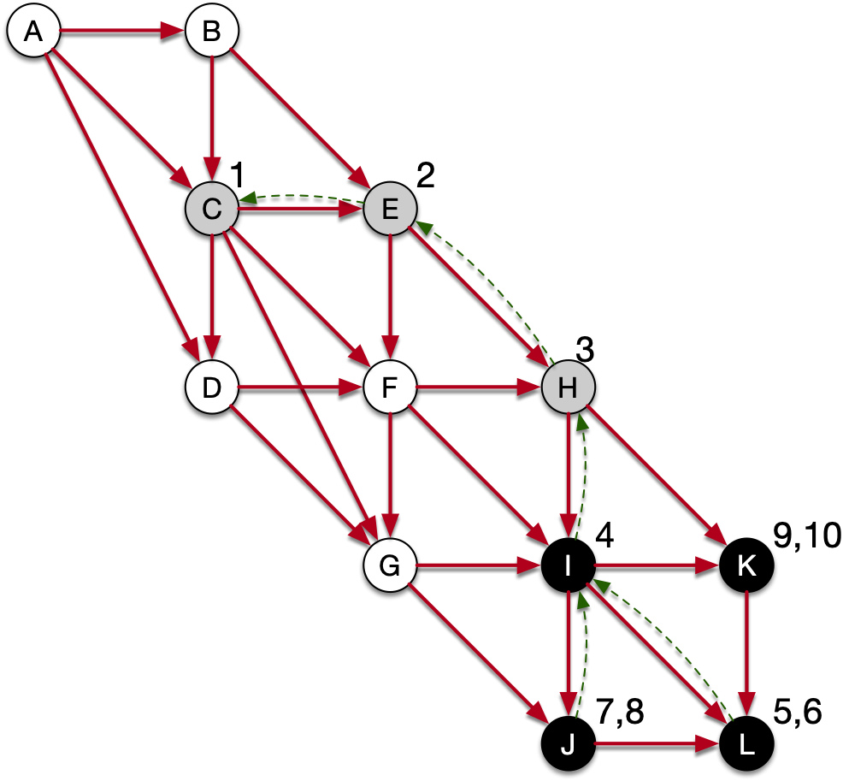

Depth First Search
OS stack
dfs_visit(H)
dfs_visit(E)
dfs_visit(C)
dfs_visit(u):
u.color = 'gray'
for each v in u.adjacency:
if v.color == 'white'
dfs_visit(v)
u.color = 'black
dfs_visit(I) runs again
but finds no white vertices,
so it finishes

Slide 81

Depth First Search
OS stack
dfs_visit(H)
dfs_visit(E)
dfs_visit(C)
dfs_visit(u):
u.color = 'gray'
for each v in u.adjacency:
if v.color == 'white'
dfs_visit(v)
u.color = 'black
dfs_visit(I) runs again
but finds no white vertices,
so it finishes

Slide 82
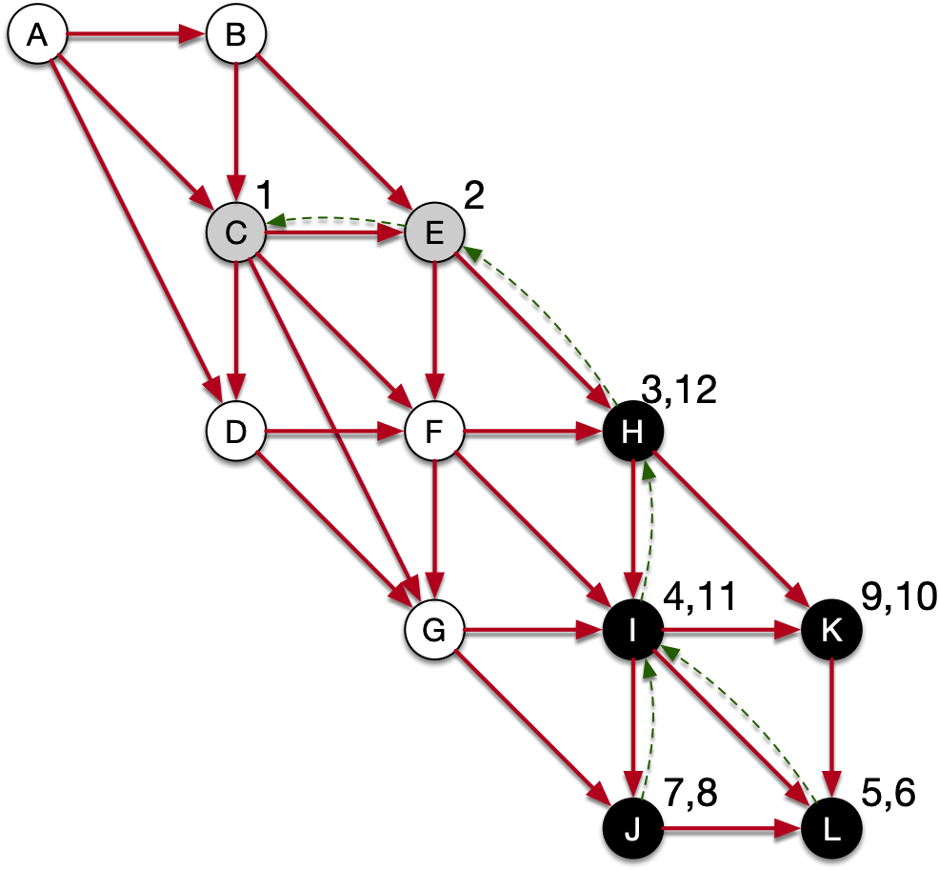
Depth First Search
OS stack
dfs_visit(E)
dfs_visit(C)
dfs_visit(u):
u.color = 'gray'
for each v in u.adjacency:
if v.color == 'white'
dfs_visit(v)
u.color = 'black
dfs_visit(H) runs again
but finds no white vertices,
so it finishes

Slide 83
Depth First Search
OS stack
dfs_visit(E)
dfs_visit(C)
dfs_visit(u):
u.color = 'gray'
for each v in u.adjacency:
if v.color == 'white'
dfs_visit(v)
u.color = 'black
dfs_visit(E) runs again

Slide 84

Depth First Search
OS stack
dfs_visit(F)
dfs_visit(E)
dfs_visit(C)
dfs_visit(u):
u.color = 'gray'
for each v in u.adjacency:
if v.color == 'white'
dfs_visit(v)
u.color = 'black
Finds F

Slide 85
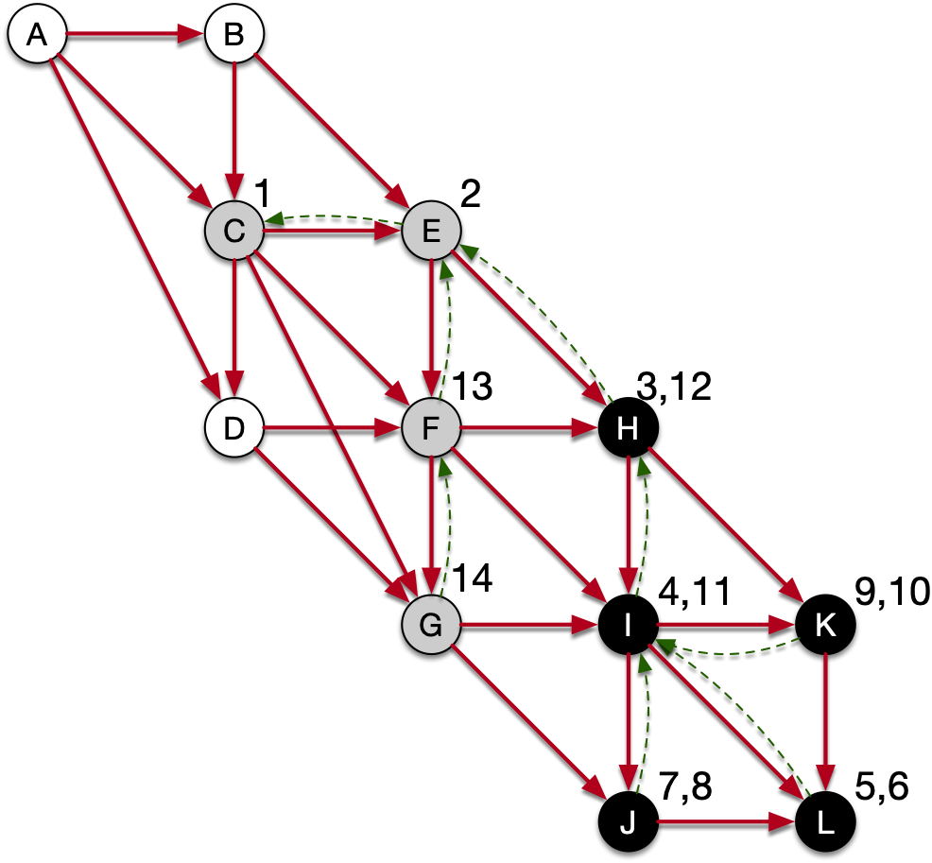
Depth First Search
OS stack
dfs_visit(G)
dfs_visit(F)
dfs_visit(E)
dfs_visit(C)
dfs_visit(u):
u.color = 'gray'
for each v in u.adjacency:
if v.color == 'white'
dfs_visit(v)
u.color = 'black
Finds G

Slide 86
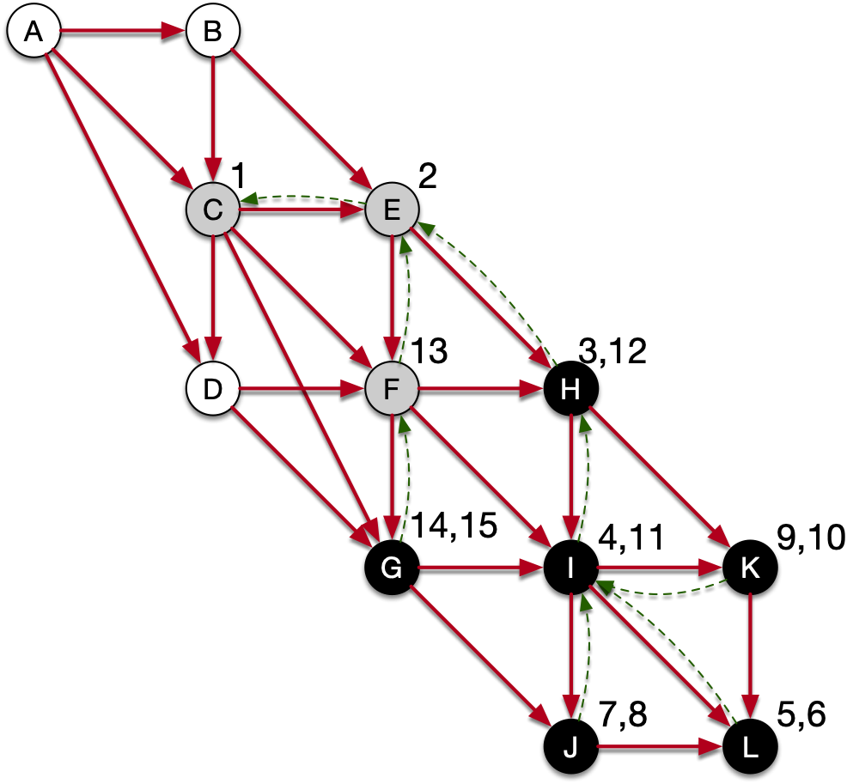
Depth First Search
OS stack
dfs_visit(F)
dfs_visit(E)
dfs_visit(C)
dfs_visit(u):
u.color = 'gray'
for each v in u.adjacency:
if v.color == 'white'
dfs_visit(v)
u.color = 'black
Nothing left in G

Slide 87
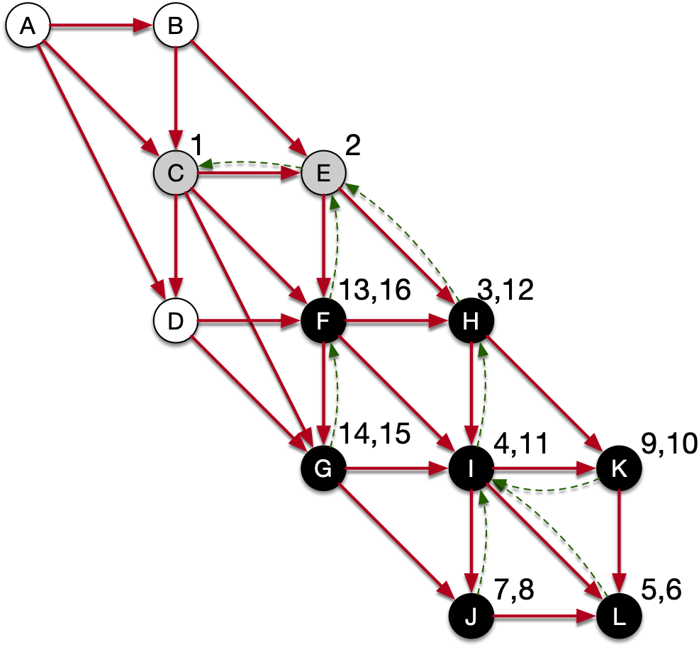
Depth First Search
OS stack
dfs_visit(E)
dfs_visit(C)
dfs_visit(u):
u.color = 'gray'
for each v in u.adjacency:
if v.color == 'white'
dfs_visit(v)
u.color = 'black
Nothing left in F

Slide 88
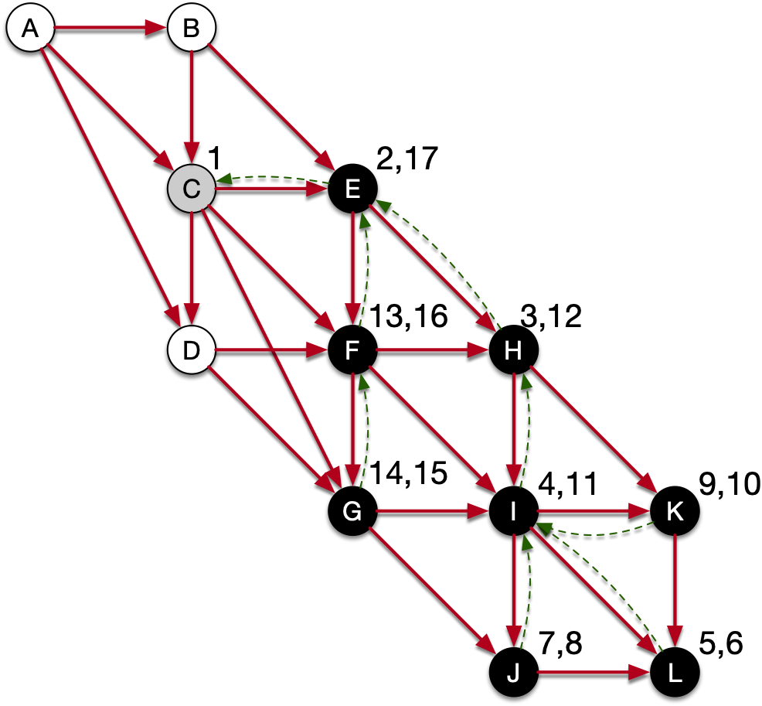
Depth First Search
OS stack
dfs_visit(C)
dfs_visit(u):
u.color = 'gray'
for each v in u.adjacency:
if v.color == 'white'
dfs_visit(v)
u.color = 'black
Finishing E

Slide 89
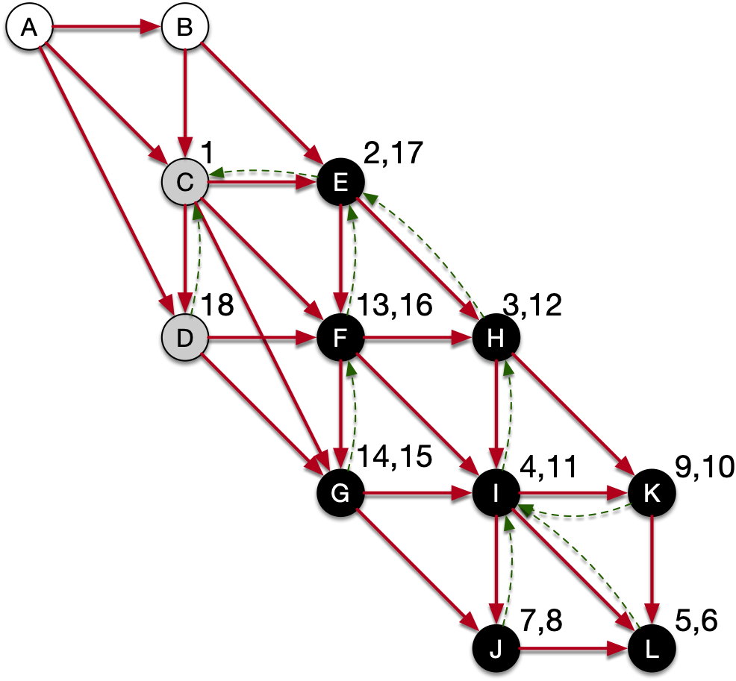
Depth First Search
OS stack
dfs_visit(D)
dfs_visit(C)
dfs_visit(u):
u.color = 'gray'
for each v in u.adjacency:
if v.color == 'white'
dfs_visit(v)
u.color = 'black
Last white vector in
the adjacency list of
C is D

Slide 90
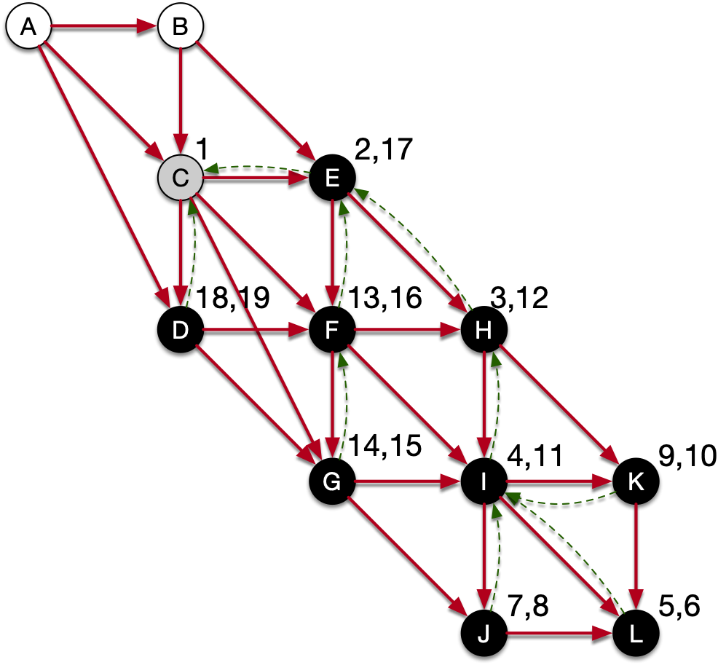
Depth First Search
OS stack
dfs_visit(D)
dfs_visit(C)
dfs_visit(u):
u.color = 'gray'
for each v in u.adjacency:
if v.color == 'white'
dfs_visit(v)
u.color = 'black
D has no white vertices
in its adjacency list

Slide 91
Depth First Search
OS stack
dfs_visit(C)
dfs_visit(u):
u.color = 'gray'
for each v in u.adjacency:
if v.color == 'white'
dfs_visit(v)
u.color = 'black
We are back in C

Slide 92
Depth First Search
OS stack
dfs_visit(C)
dfs_visit(u):
u.color = 'gray'
for each v in u.adjacency:
if v.color == 'white'
dfs_visit(v)
u.color = 'black
Now we close C

Slide 93
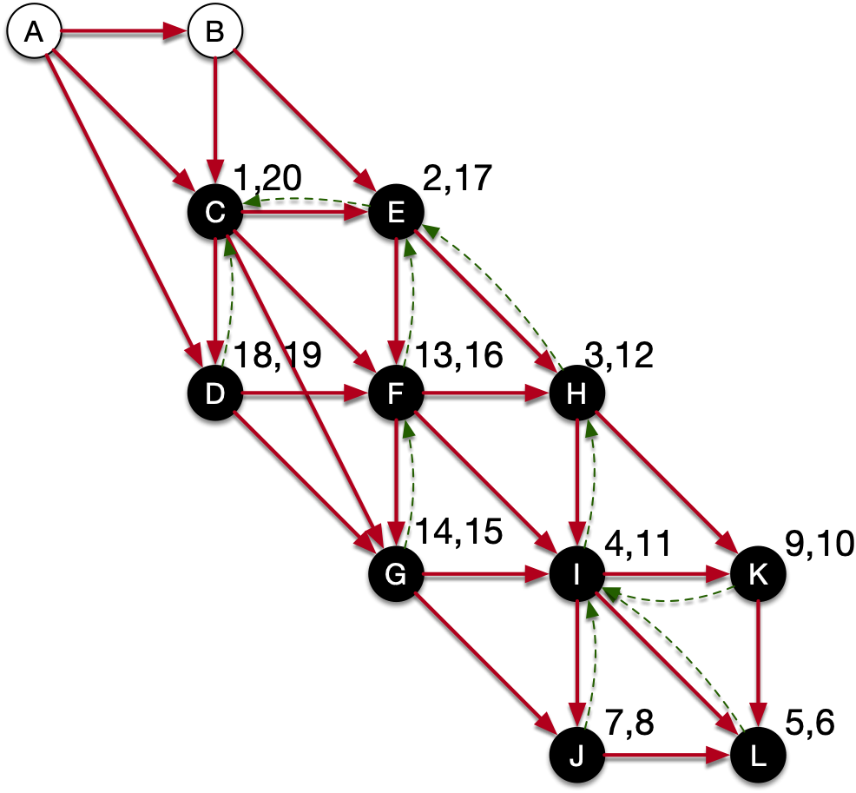
Depth First Search
OS stack
dfs_visit(u):
u.color = 'gray'
for each v in u.adjacency:
if v.color == 'white'
dfs_visit(v)
u.color = 'black
Now we close C

Slide 94
Depth First Search
At this point, the original call to dfs_visit(C) is done
However, since there are still white nodes left, we have to pick one of them and visit again.
We pick A

Slide 95
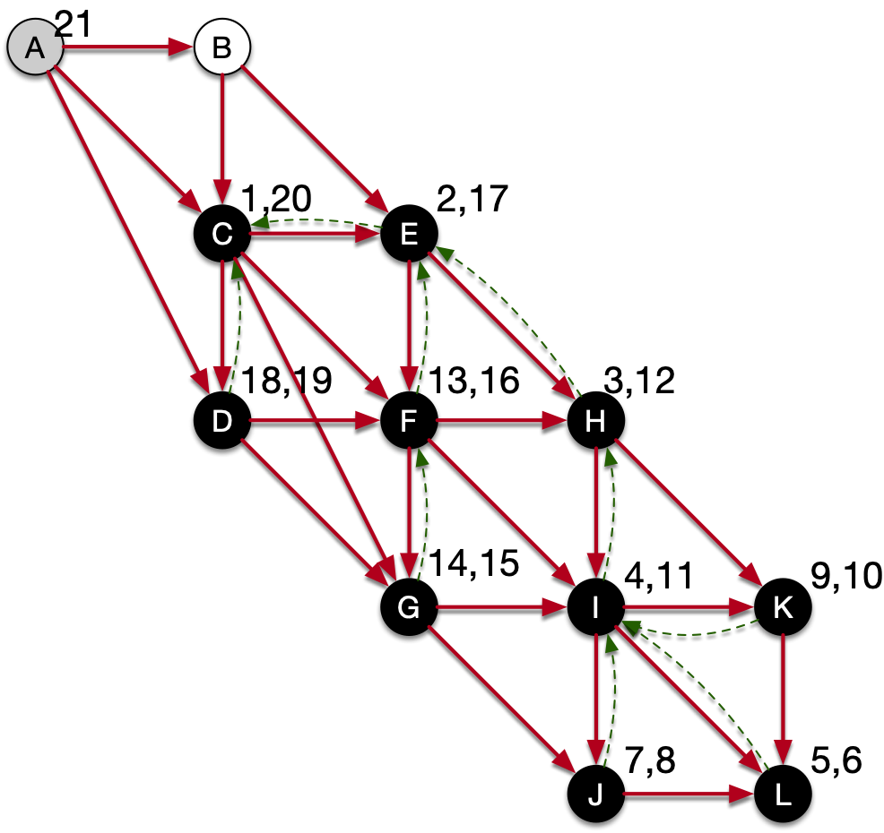
Depth First Search
OS stack
dfs_visit(A)
dfs_visit(u):
u.color = 'gray'
for each v in u.adjacency:
if v.color == 'white'
dfs_visit(v)
u.color = 'black
A is the only node in
the stack

Slide 96
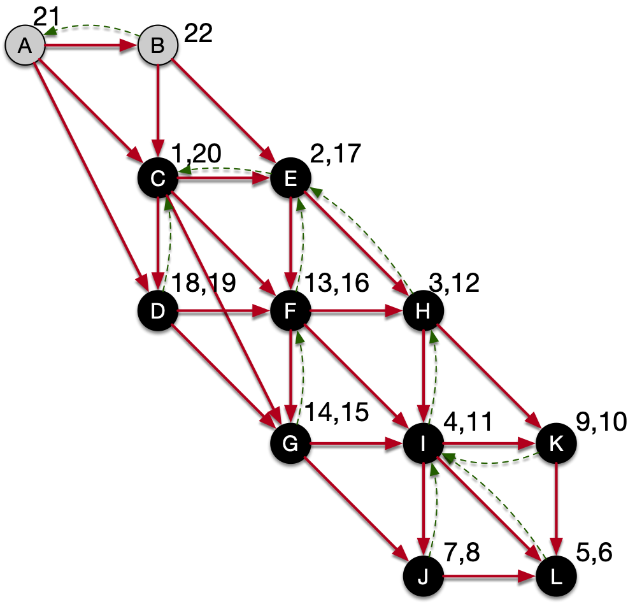
Depth First Search
OS stack
dfs_visit(B)
dfs_visit(A)
dfs_visit(u):
u.color = 'gray'
for each v in u.adjacency:
if v.color == 'white'
dfs_visit(v)
u.color = 'black
We discover B from A

Slide 97
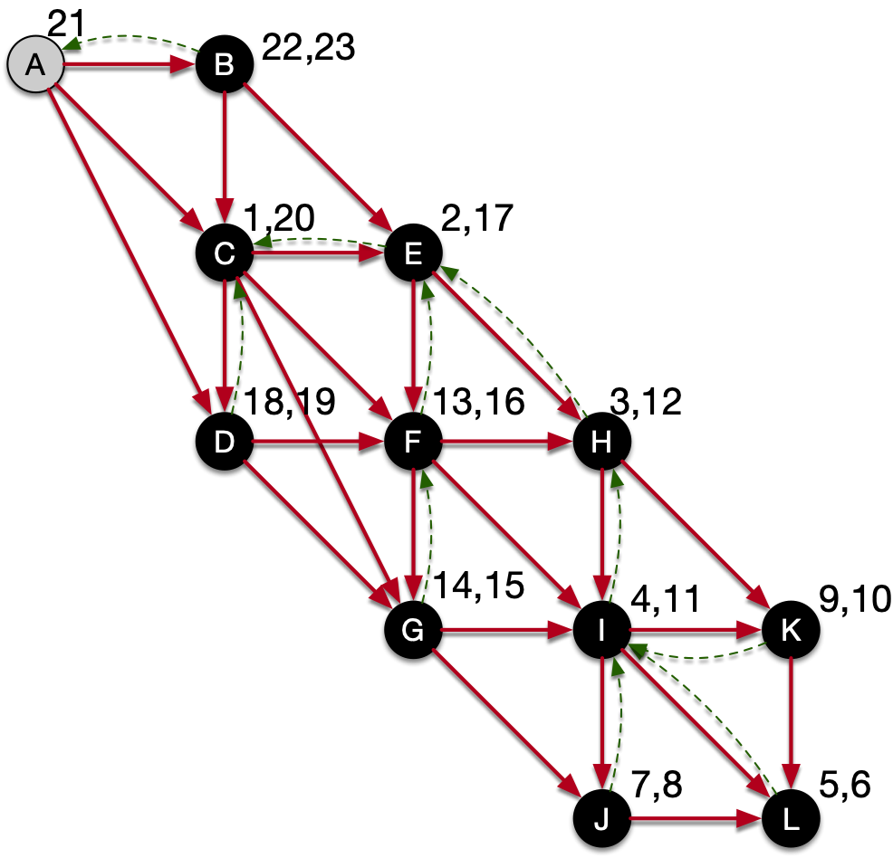
Depth First Search
OS stack
dfs_visit(A)
dfs_visit(u):
u.color = 'gray'
for each v in u.adjacency:
if v.color == 'white'
dfs_visit(v)
u.color = 'black
We can finish B

Slide 98
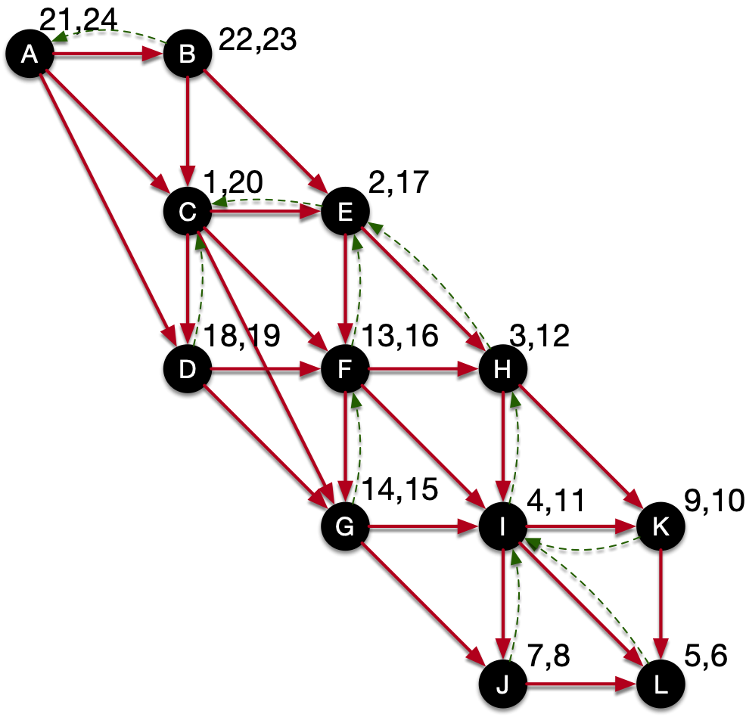
Depth First Search
OS stack
dfs_visit(A)
dfs_visit(u):
u.color = 'gray'
for each v in u.adjacency:
if v.color == 'white'
dfs_visit(v)
u.color = 'black
We can finish A

Slide 99
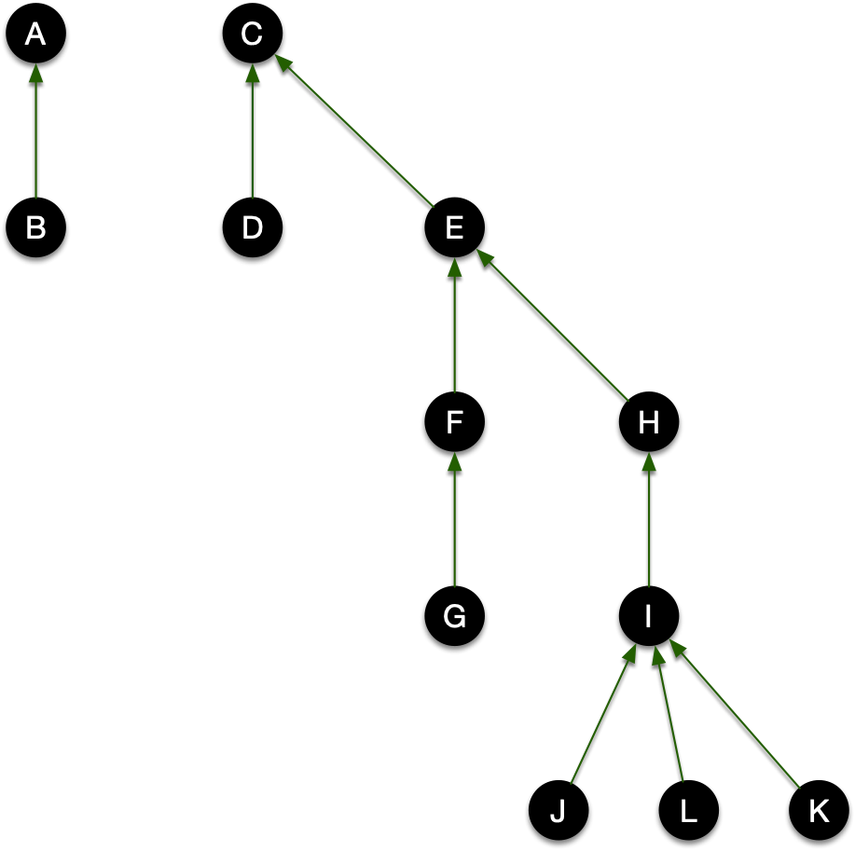
Depth First Search
Now we are done
  The predecessor relationship has given us a nice set of trees — a "forest"

Slide 100
Depth First Search
Runtime of algorithm
  We look at all the elements of the adjacency lists
  For each, we do constant work
  But we also need to do some initial work for all vertices
  Runtime is $Θ(max(|V|,|E|)$

Slide 101
Depth First Search
Properties:
  Parenthesis Theorem
    If for two nodes
      If $[u.d,u.f]∩[v.d,v.f]=∅$ then neither u and v are descendants in the predecessor forest
      If $[u.d,u.f]⊂[v.d,v.f]$ then u is a descendant of v
      If $[u.d,u.f]⊃[v.d,v.f]$ then v is a descendant of u

Slide 102
Depth First Search
White Path Theorem
  $v$ is a descendant of $u$ exactly if
  At the time of discovery of $u$ there is a path from $u$ to $v$ consisting entirely of white vertices

Slide 103
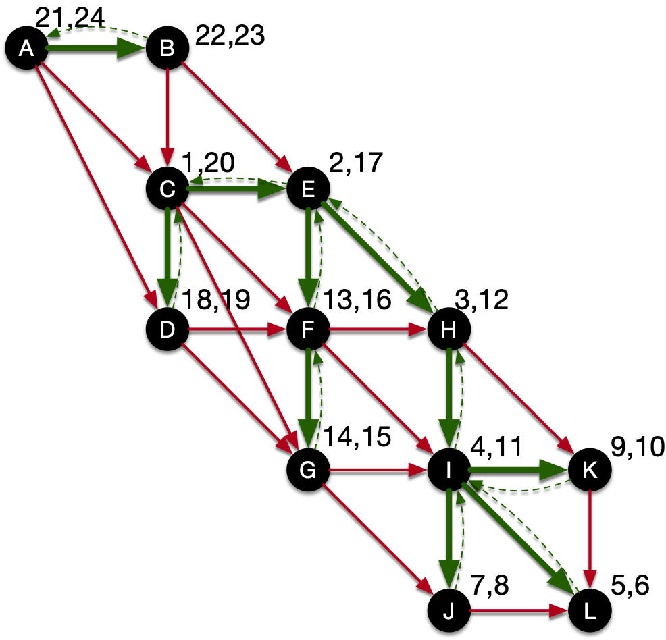
Depth First Search
Classification of edges:
  Tree edges are edges in the depth first tree

Slide 104
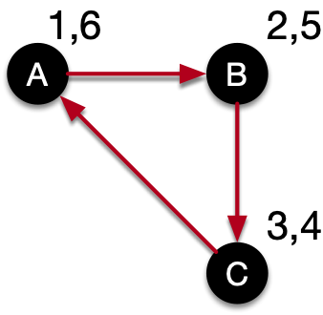
Depth First Search
Back edges are edges go from a descendant to an ancestor
  Simple example:
    Start in A, discover B, discover C
    Edge from C to A is a back edge

Slide 105
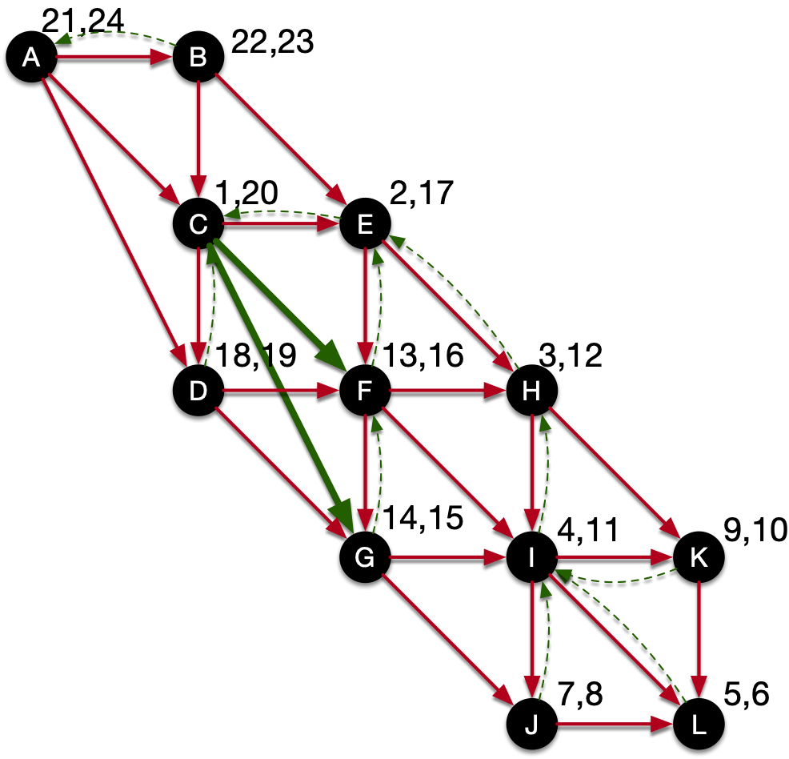
Depth First Search
Forward edges
  Edges connecting an ancestor to a descendant, but that are not in the tree

Slide 106

Depth First Search
Cross Edges: anything else
  Can be in the same tree or connecting different trees

Slide 107
Depth First Search
If we look at an edge (u,v) during depth first search for the first time
  (In an undirected graph, we look at each edge twice)
  If v is white: tree edge
  If v is gray: back edge
  If v is black: forward or cross edge

Slide 108
Depth First Search
In a depth first search on an undirected graph, every edge is either a tree edge or a back edge
  Let $(u,v)$ be an edge and assume that $u$ is discovered first: $u.d<v.d$
  The algorithm discovers and finishes $v$ before $u$, so $u.f>v.f$
  If DFS uses the edge $(u,v)$ from $u$, then $v$ is white, and $(u,v)$ becomes a tree edge
  If DFS uses the edge $(u,v)$ from $v$, then $u$ is gray at this moment and this becomes a back edge.

