Slide 1
Spanning Trees
Thomas Schwarz, SJ

Slide 2
Problem
Networking: LAN
  Switches are connected by links
    Cycles can create problems:
      Broadcast radiation
        A broadcast or multicast message is repeatedly received by the same switch and resend and resend and resend and resend …

Slide 3
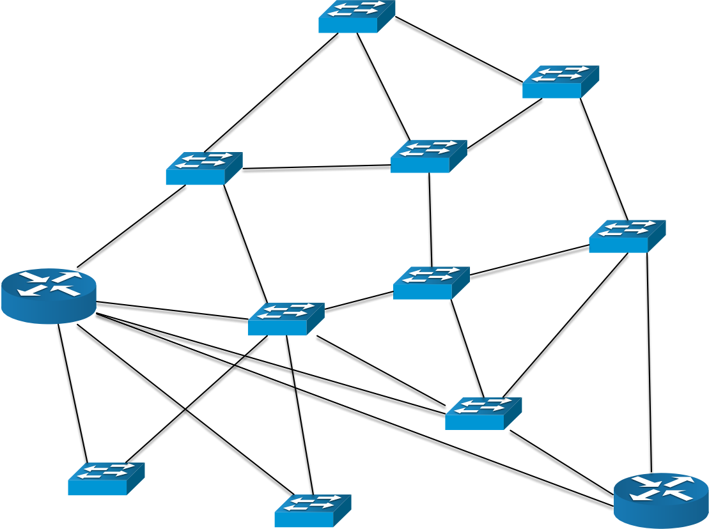
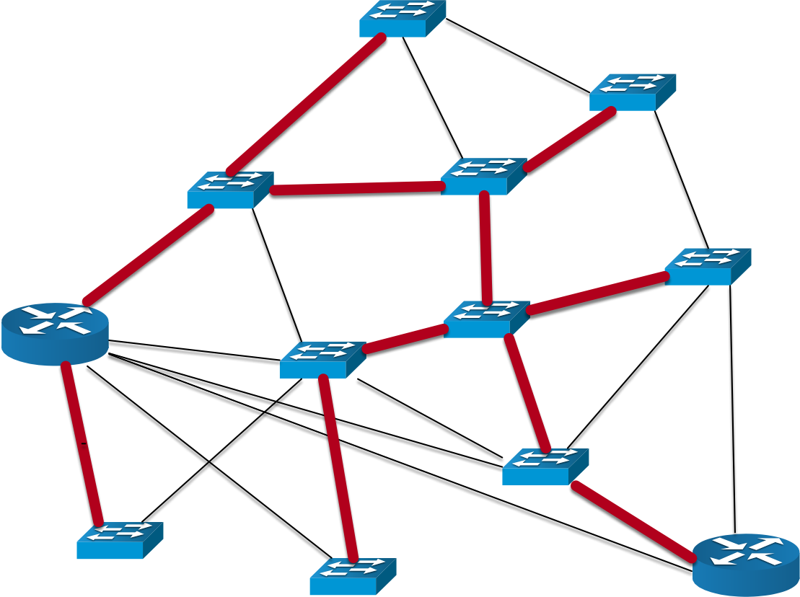
Problem
Solution:
  Use an acyclic subgraph that contains all switches for broadcasting, multicasting, and in general for addressing purposes

Slide 4
Trees
A tree is a graph that is:
  acyclic
  connects all vertices

Slide 5
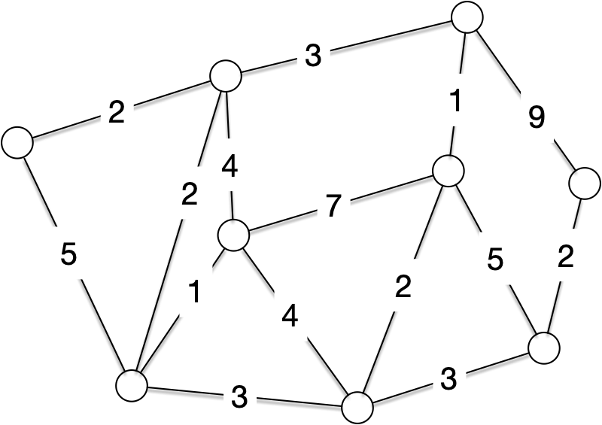
Weighted Graphs
We look at graphs where each edge has a weight
  Depending on application, some weights can be negative or all weights have to be positive

Slide 6
Weighted Graphs
Other example:

Slide 7
Minimum Spanning Trees
Given a weighted graph:
  Find a subset $T$ of edges such that
    connects all vertices
    is acyclic
    Total weight is minimal
      $w(T)=\underset{(u,v)∈T}{∑}w(u,v)⟶∞$
    Called a minimum weight spanning tree, but "weight" is usually omitted

Slide 8
Minimum Spanning Trees
Two greedy algorithms, Kruskal's and Prim's
Use a loop invariant:
  Let $A$ be the set of edges currently selected
  Invariant: $A$ is a subset of some minimum spanning tree
  At each step of the algorithm: only add an edge $(u,v)$ if the invariant remains true after inserting the edge
  Such an edge is a safe edge

Slide 9
Minimum Spanning Trees
Generic MST algorithm
  $A=∅$
  While $A$ is not a spanning tree
    Find a safe edge
    Add the safe edge to A
  Return A

Slide 10
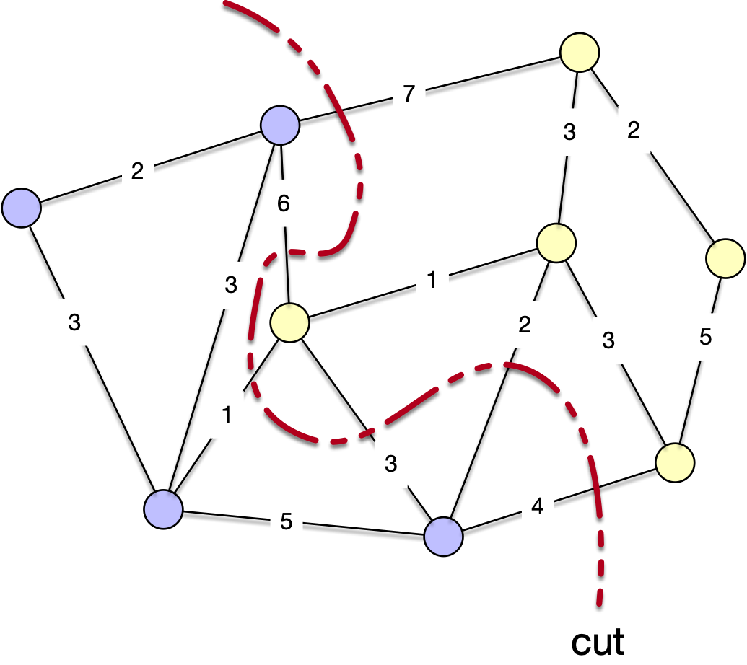
Minimum Spanning Trees
A cut is a partition of the vertices of the graph

Slide 11
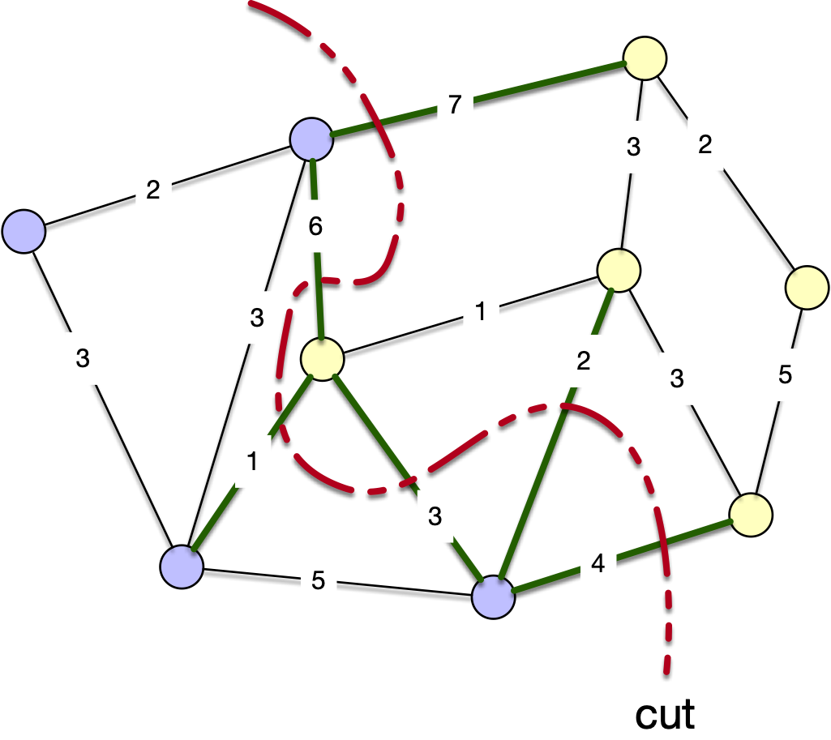
Minimum Spanning Trees
Edges can "cross the cut"

Slide 12
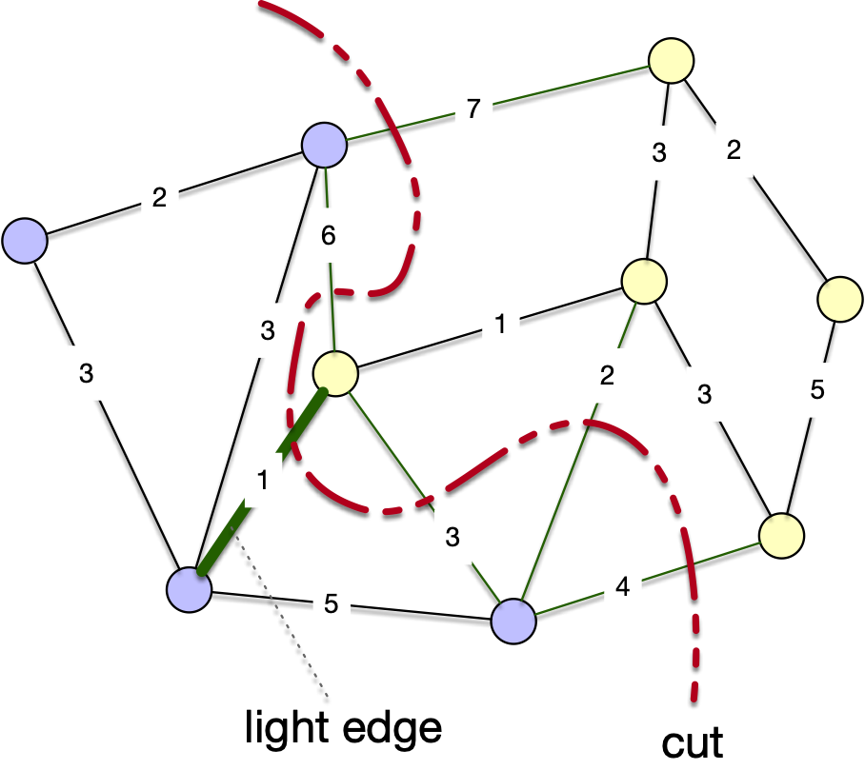
Minimum Spanning Trees
Edges are "light" if the cross the cut and no other edge crossing the cut has a smaller weight

Slide 13
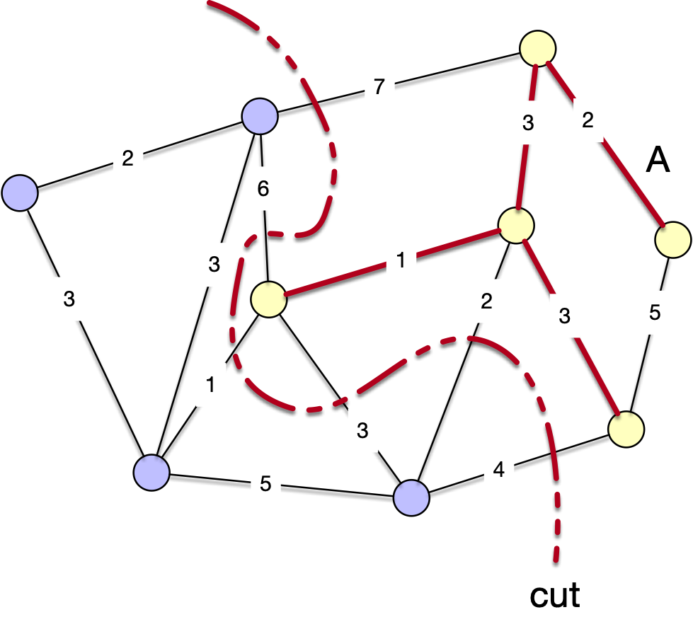
Minimum Spanning Trees
A cut respects $A$ if no edge of A crosses the cut

Slide 14
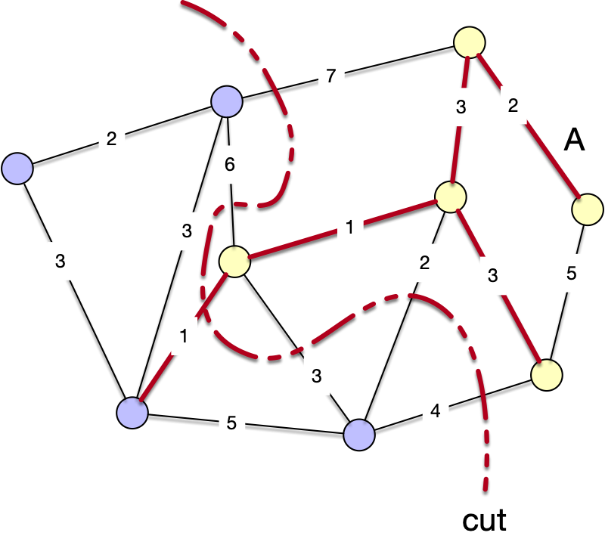
Minimum Spanning Trees
Theorem: Let A be a subset of $E$ included in some minimum spanning tree, let $(S,E-S)$ be a cut respecting A and let $(u,v)$ be a light edge crossing the cut. Then this edge is safe

Slide 15
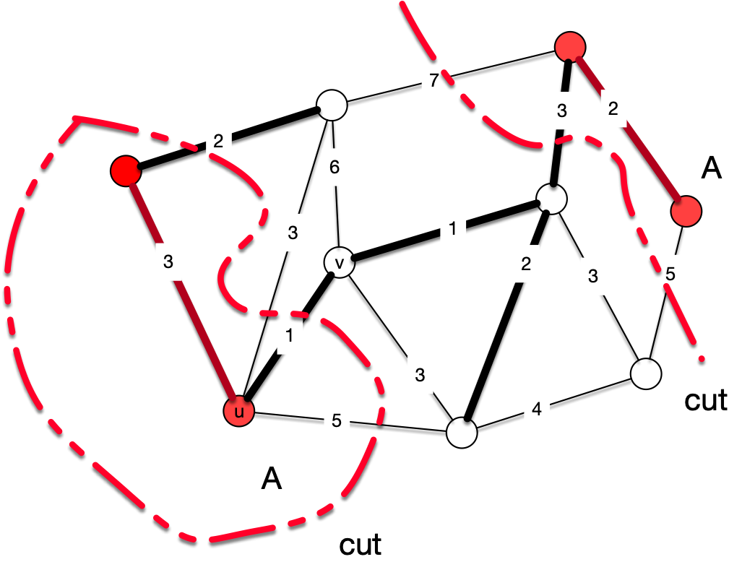
Minimum Spanning Trees
Proof:
  We have a subgraph A that is part of a minimum spanning tree $T$
  We have a minimum weight crossing edge $(u,v)$ crossing the cut that separates A from the rest of the graph
This set A has two different
connected components and
consists of red vertices
T is given by the fatter edges

Slide 16
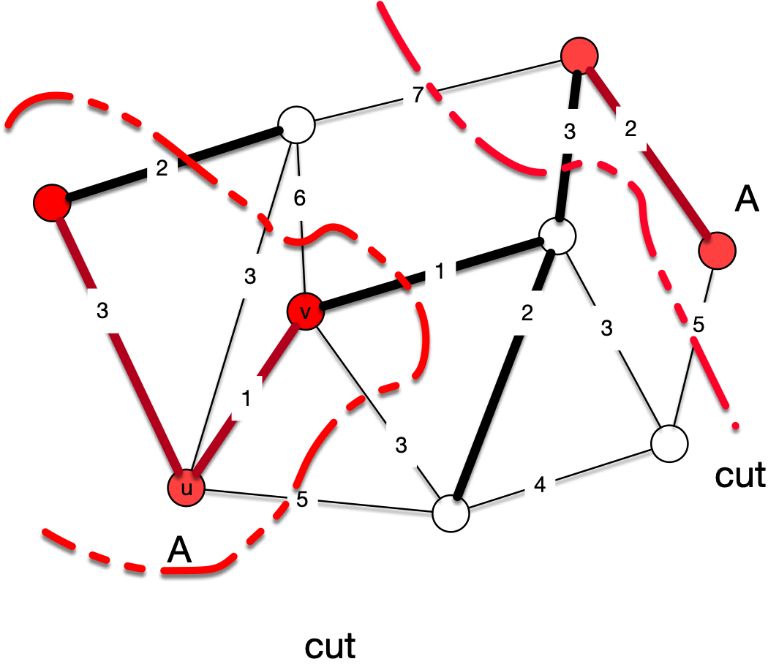
Minimum Spanning Trees
Case 1: The edge is part of T
Then there is nothing to show since adding the edge still gives us a subgraph that is part of a minimum spanning tree

Slide 17
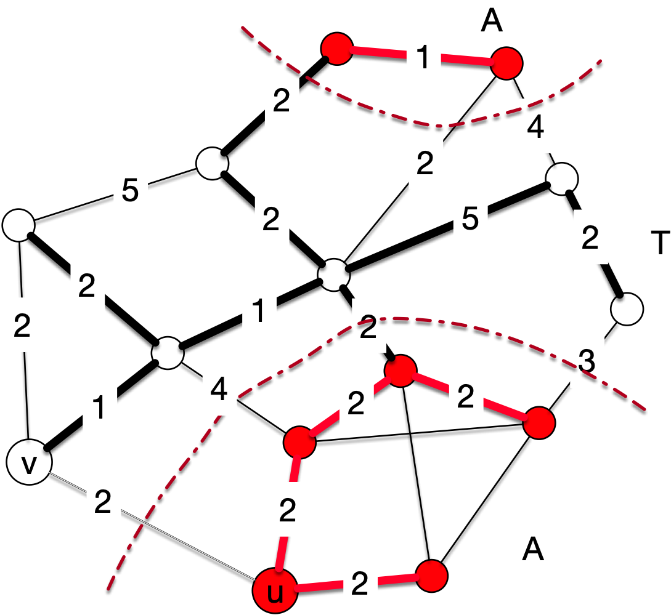
Minimum Spanning Trees
Case 2: The edge is not part of T
Edges and vertices in
A are red
Edges in T are fat
This includes the red
edges
u and v are at the lower
left
5
8

Slide 18
Minimum Spanning Trees
In this case, we need to construct a new minimum weight spanning tree
Observe that there has to be an edge of T that crosses the cut
  Because we can travel from every node to every node in T and not all nodes are in A

Slide 19

Minimum Spanning Trees
This edge in T that crosses the cut also has weight 2 in our example, but for sure, it has weight $≥$ the weight of $(u,v)$
There is another edge
5
8

Slide 20
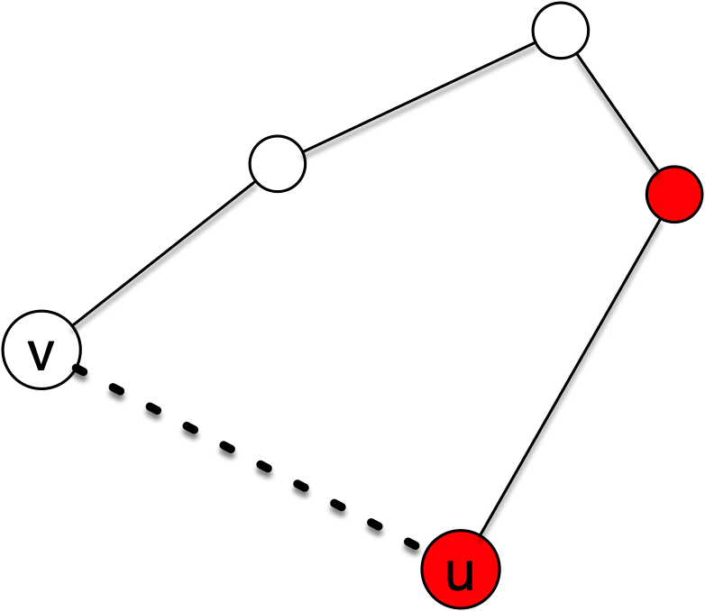
Minimum Spanning Trees
There has to be a path from $u$ to $v$ in $T$ because $T$ is a spanning tree

Slide 21
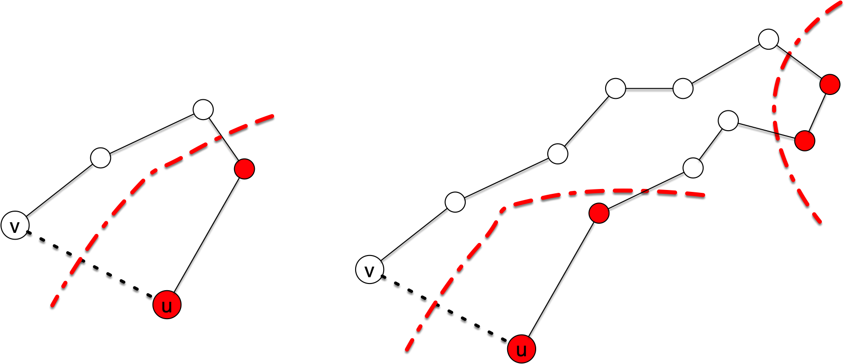
Minimum Spanning Trees
This path has to have at least one edge that crosses the cut

Slide 22

Minimum Spanning Trees
Take one of these edges and replace it with $(u,v)$ in $T$
Call the result $T^{′}$

Slide 23
Minimum Spanning Trees
$T^{′}$ still connects all of the vertices
  If $a,b$ are two vertices that are connected in T by the deleted edge:
    Can reroute through the edge $(u,v)$
  $T^{′}$ has a weight changed by replacing the weight of $(u,v)$ with the weight of the deleted edge
    But because the weight of $(u,v)$ is minimal among all edges crossing the cut and the deleted edge also crossed the cut, $T^{′}$ weight can only be lower
Thus, $A$ after adding the edge $(u,v)$ fulfills still the invariant. qed

Slide 24
Kruskal's Algorithm
Kruskal's algorithm works by joining subtrees
  Start out with all vertices being their own subtrees
      Thus, the cut is around all of the vertices
  While we have more than one subtree:
    We select a cutting edge (i.e. between different subtrees) with minimum weight
    This combines two subtrees

Slide 25
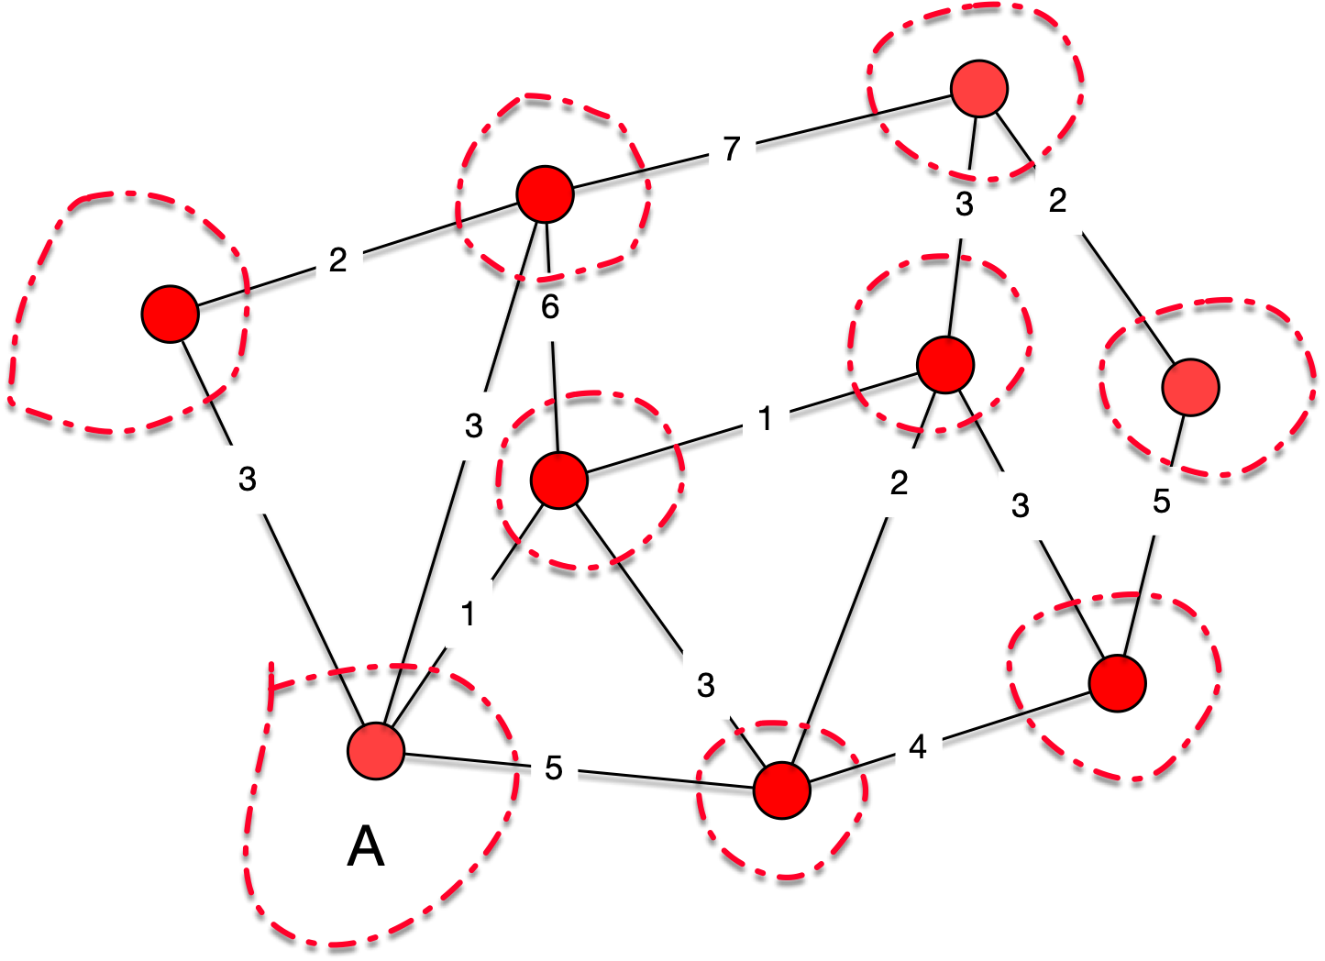
Kruskal's Algorithm

Slide 26
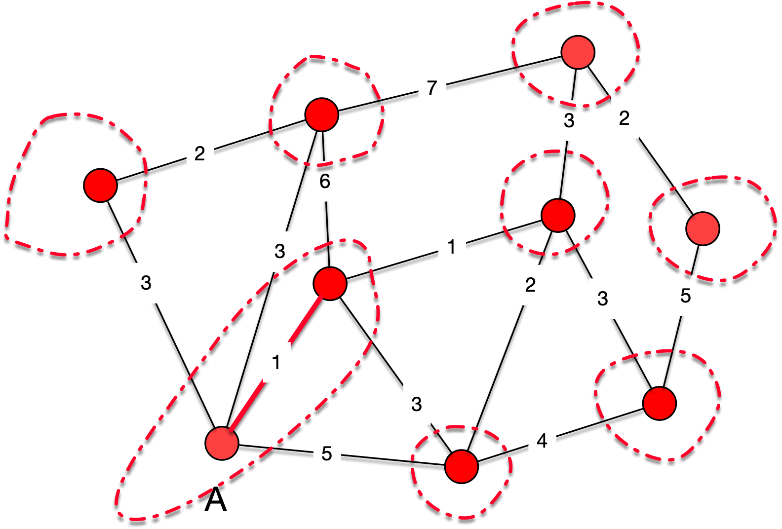
Kruskal's Algorithm

Slide 27
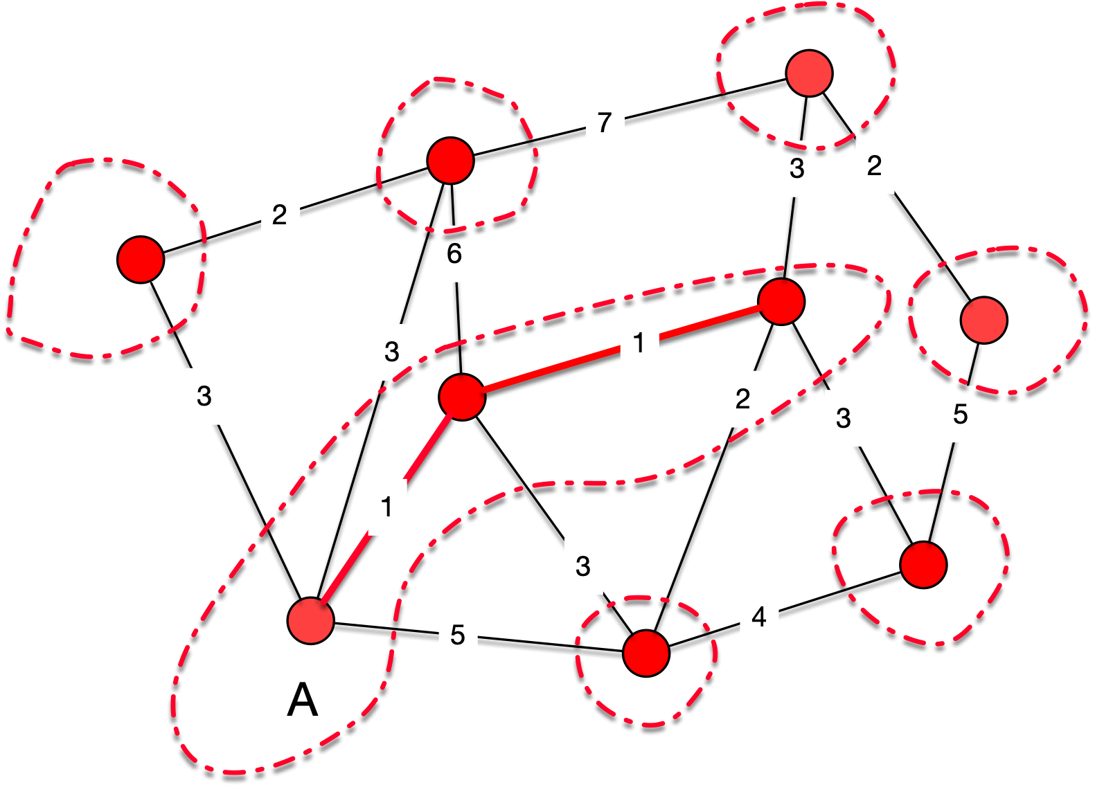
Kruskal's Algorithm

Slide 28
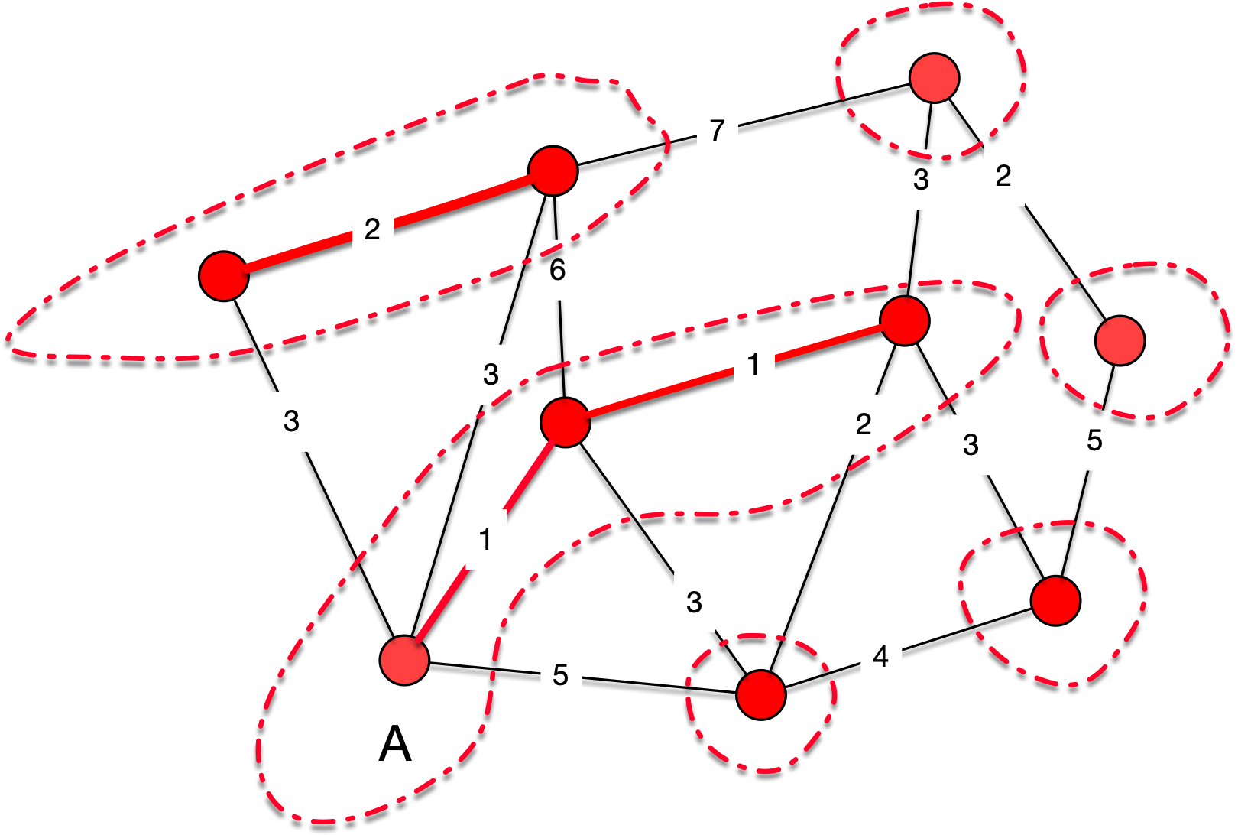
Kruskal's Algorithm

Slide 29
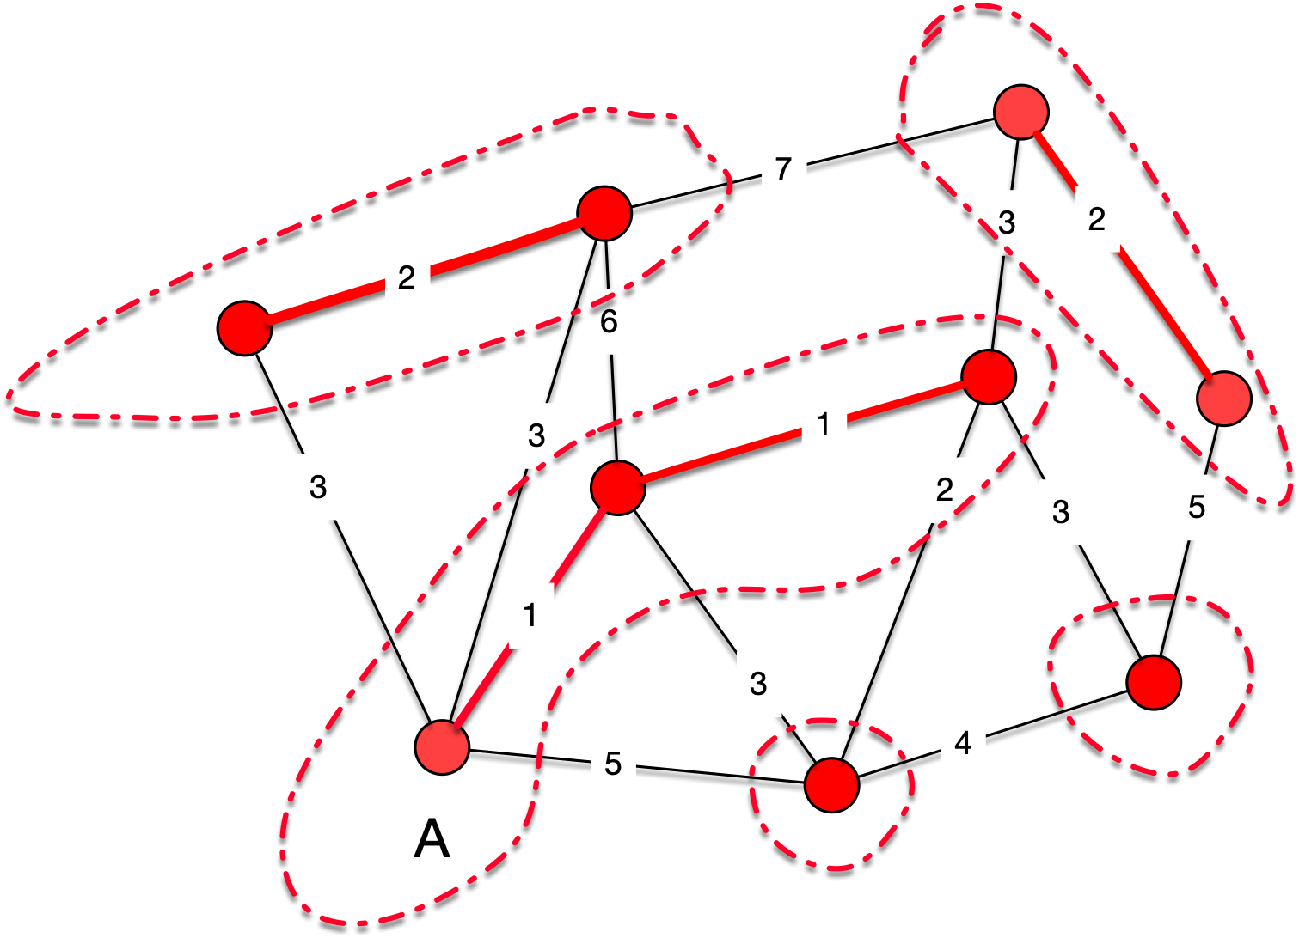
Kruskal's Algorithm

Slide 30
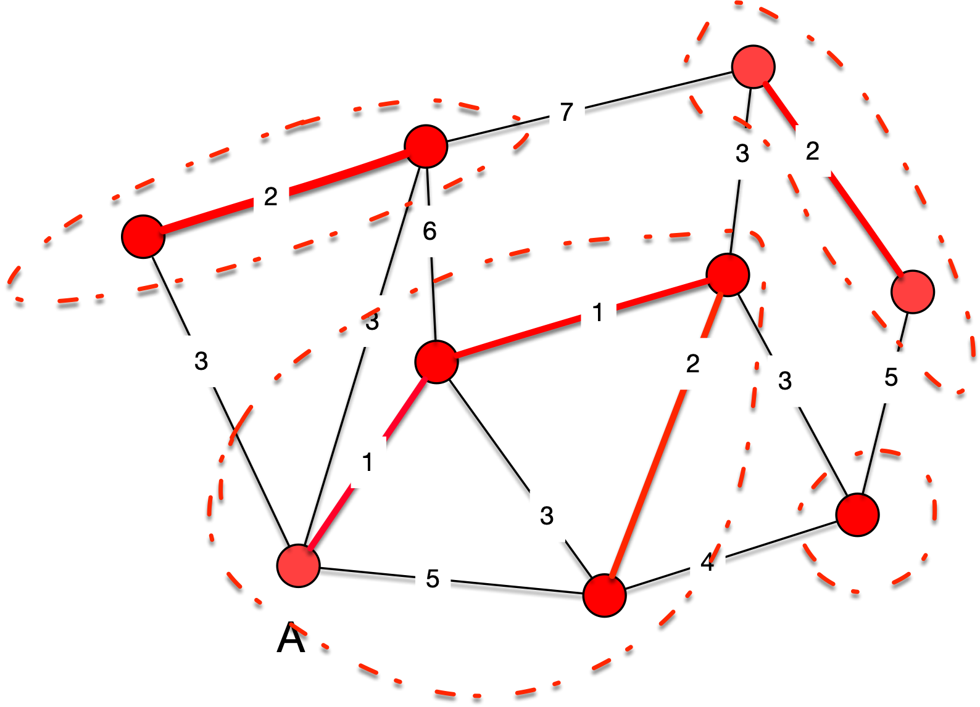
Kruskal's Algorithm

Slide 31
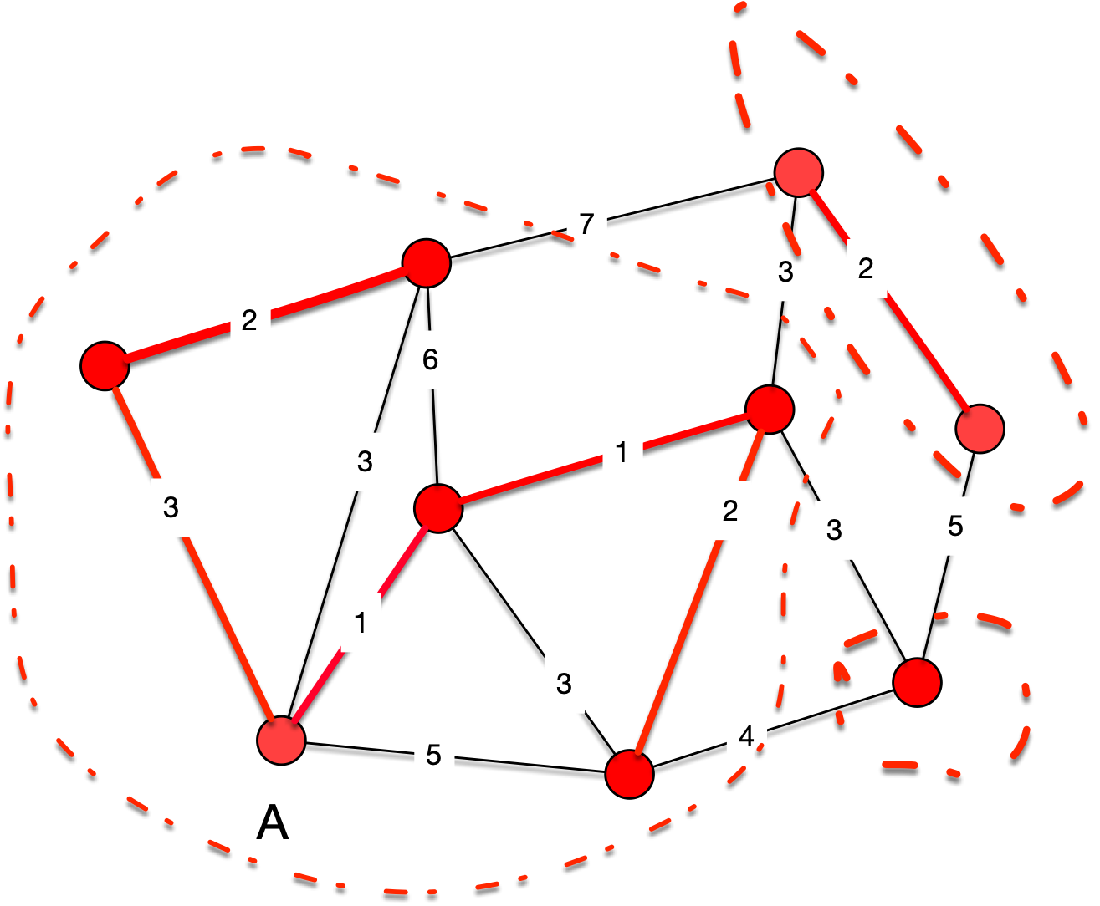
Kruskal's Algorithm

Slide 32
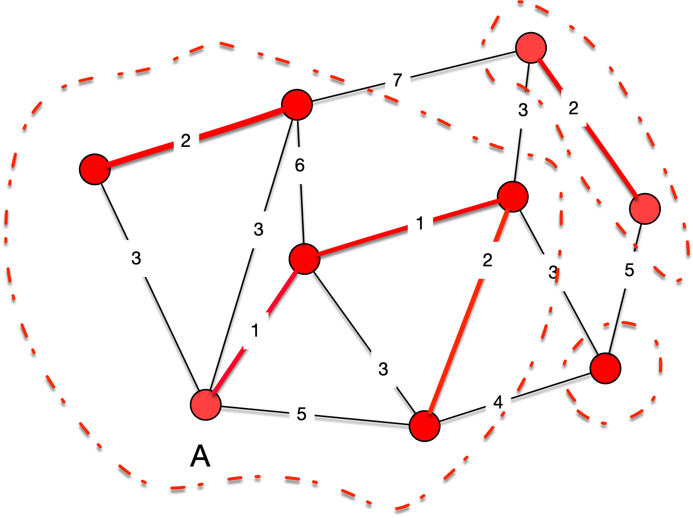
Kruskal's Algorithm

Slide 33
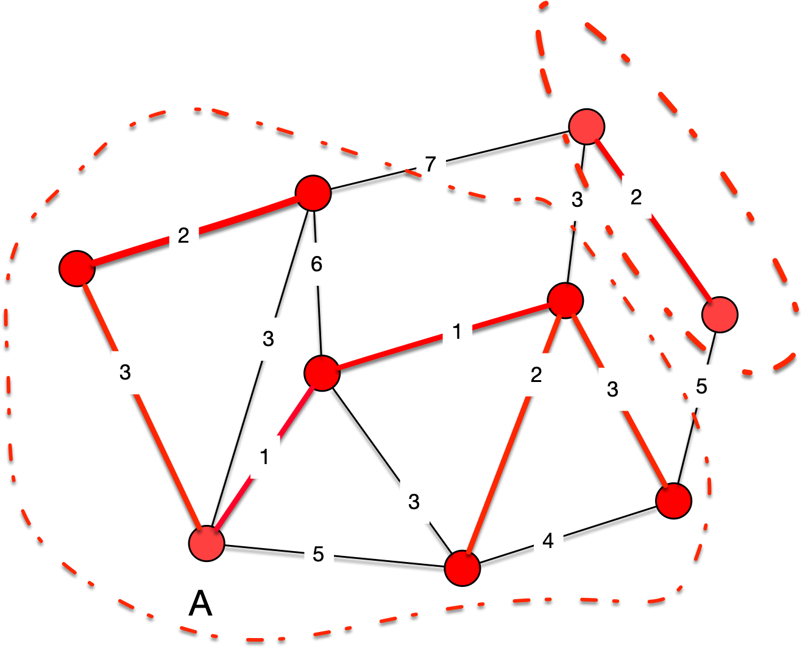
Kruskal's Algorithm

Slide 34
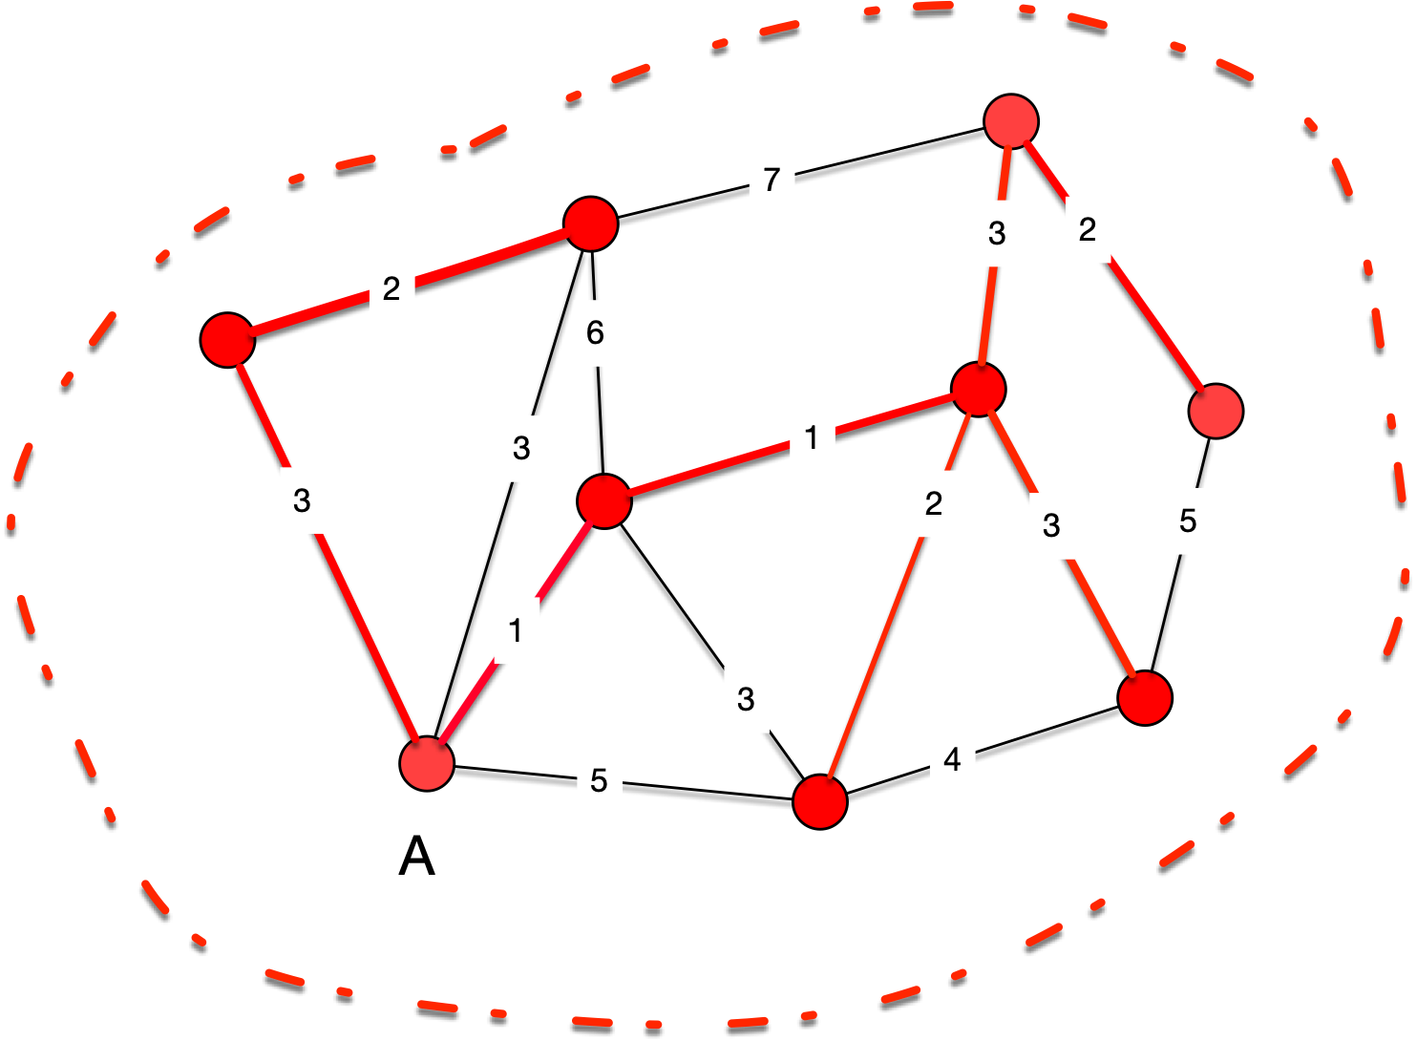
Kruskal's Algorithm

Slide 35
Kruskal's Algorithm
Because Kruskal's algorithm only adds safe edges, it generates a minimum weight spanning tree
How to organize it?
  We can order all of the edges by weight
  And then remove edges if they no longer are cutting edges
  Best way:
    Maintain vertices in the same subtree in a set
    Determine quickly whether something is in a set

Slide 36
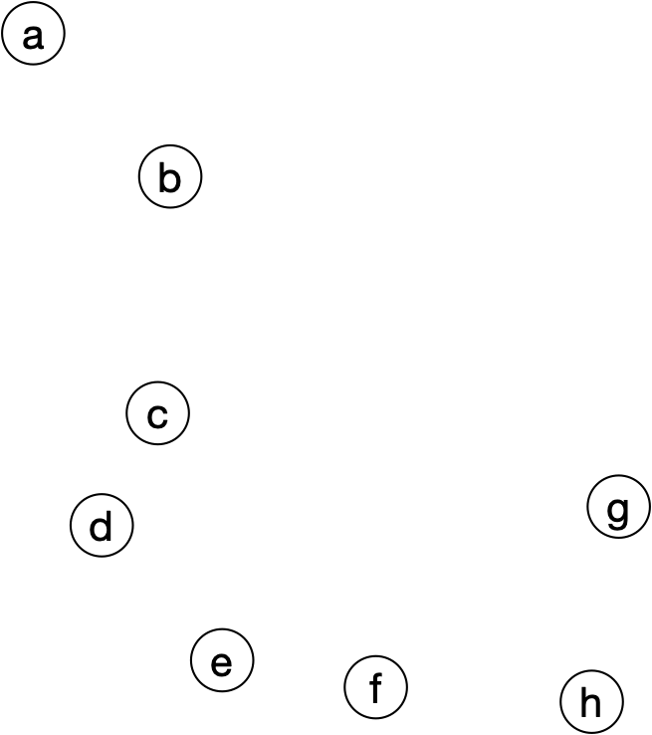
Kruskal's Algorithm
Best solution known to humanity for the disjoint set problem:
  have vertices organized by a directed edge to the "set leader"
$\{a\},\{b\},\{c\},\{d\},\{e\},\{f\},\{g\},\{h\}$

Slide 37
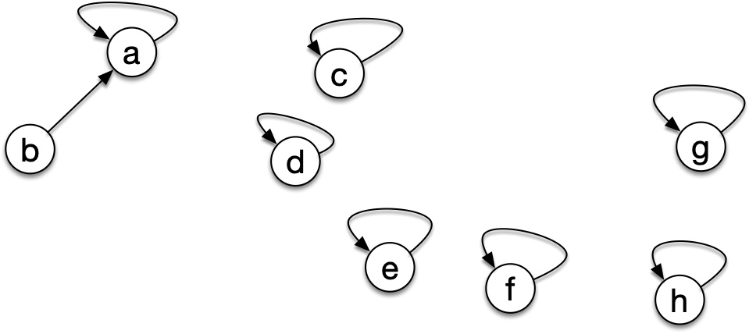
Kruskal's Algorithm
If we unite $\{a\}$ and $\{b\}$, we have one point to the other
$\{a,b\},\{c\},\{d\},\{e\},\{f\},\{g\},\{h\}$

Slide 38
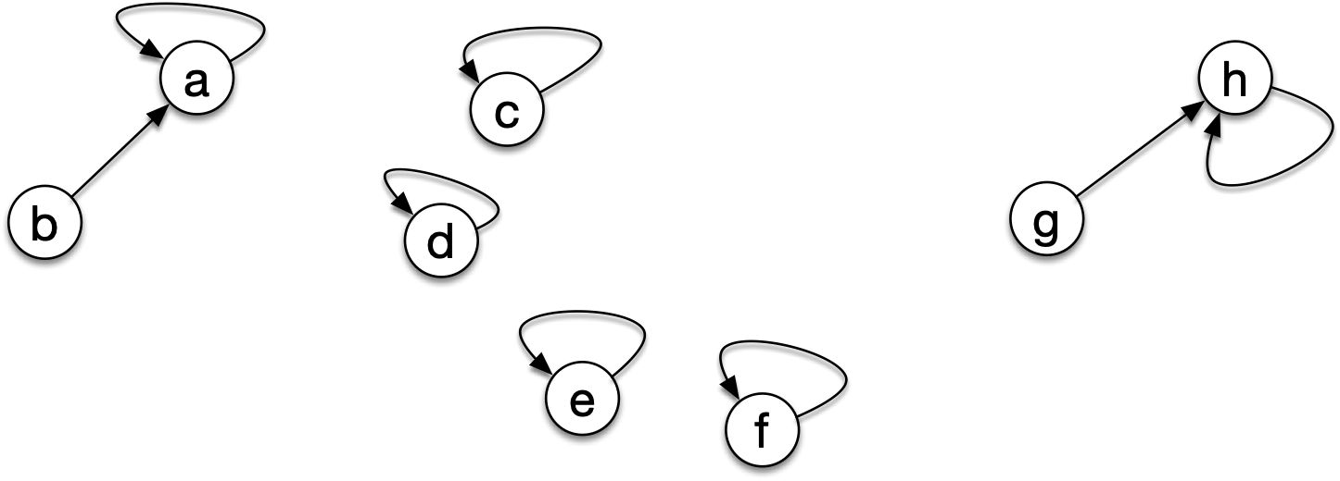
Kruskal's Algorithm
Same if we unite $\{g\}$ and $\{h\}$
$$\{a,b\},\{c\},\{d\},\{e\},\{f\},\{g,h\},$$

Slide 39
Kruskal's Algorithm
If we ask whether b and g are in two different components, we follow the arrow and see whether the leaders are the same or not.
$$\{a,b\},\{c\},\{d\},\{e\},\{f\},\{g,h\},$$

Slide 40
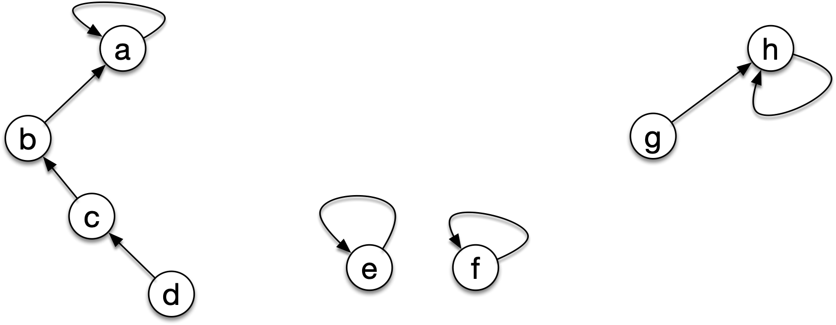
Kruskal's Algorithm
This can be optimized:
  There is the possibilities of having long chains
$$\{a,b,cd\},\{e\},\{f\},\{g,h\},$$

Slide 41
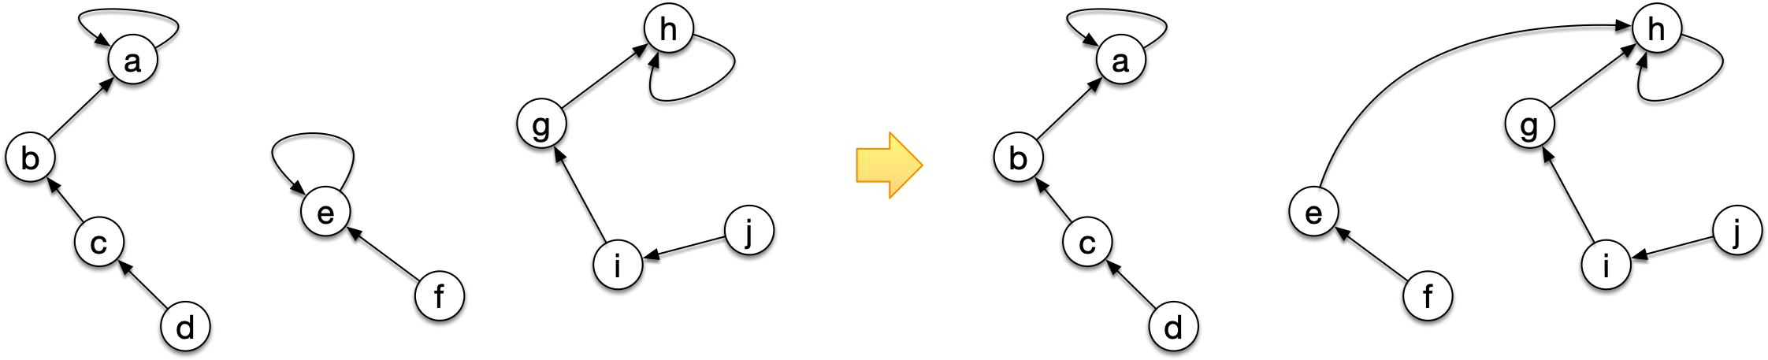
Kruskal's Algorithm
When we join, we connect one leader to the other leader
  Always make the larger set the head
$$\{a,b,cd\},\{e,f\}∪\{g,h,i,j\},$$

Slide 42
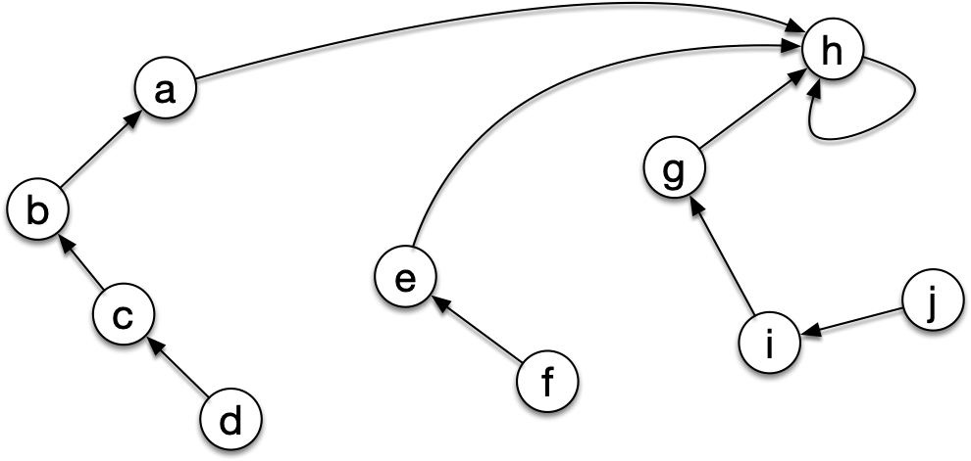
Kruskal's Algorithm
When we do a look up:
  What is the head of c?
  Follow three links to get to 'h'

Slide 43
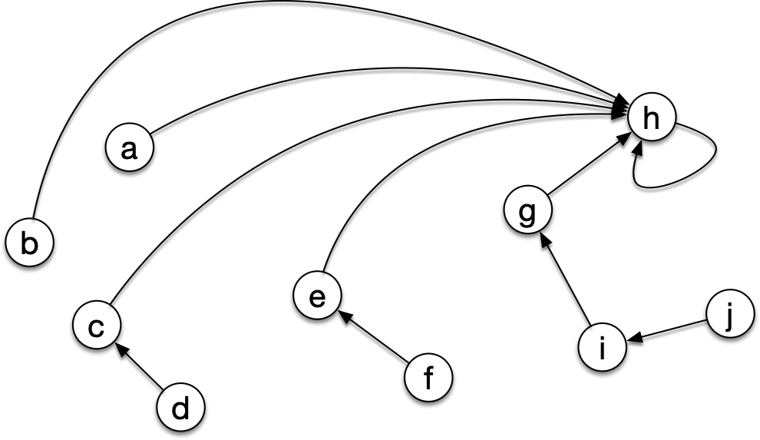
Kruskal's Algorithm
When we do a look up:
  Reconnect the node and all we travel to directly to the head

Slide 44
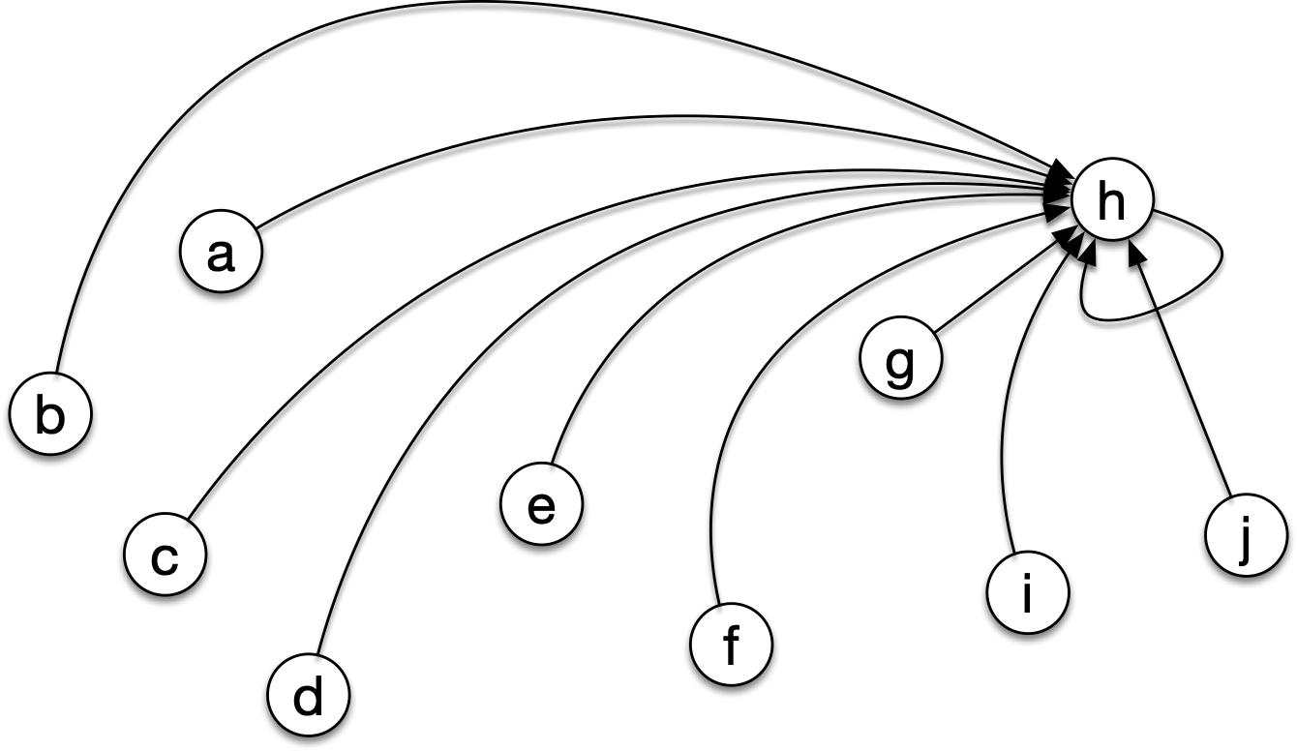
Kruskal's Algorithm
Best possible case: Every node points directly to the head

Slide 45
Kruskal's Algorithm
With this "disjoint union data structure":
  Maintaining the disjoint set data structure costs $α(|V|)$ per operation where $α$ is a function that grows very slowly
  Kruskal's algorithm then runs in time $O(|E|log(|E|))$

Slide 46
Prim's Algorithm
Prim's algorithm starts $A$ at a single node and then adds edges to it.
Thus, the intermediate results are always connected
  Maintain a priority queue of all other vertices
    The vertices are ordered by distance to $A$

Slide 47
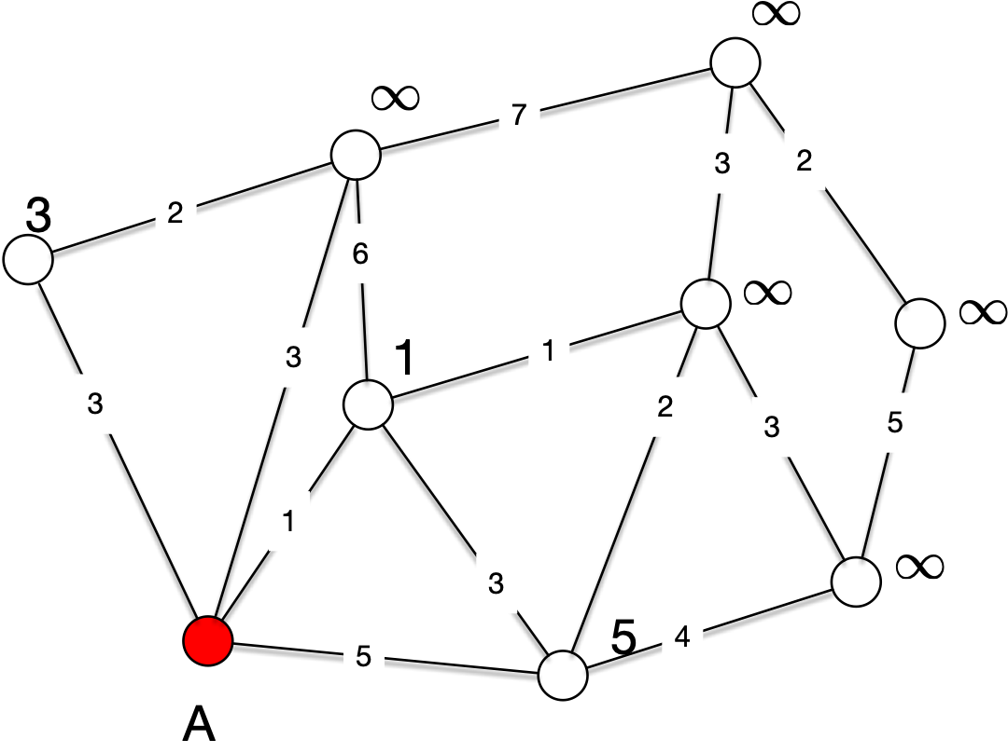
Prim's Algorithm
We use the same example as before
We can start at any node
3

Slide 48
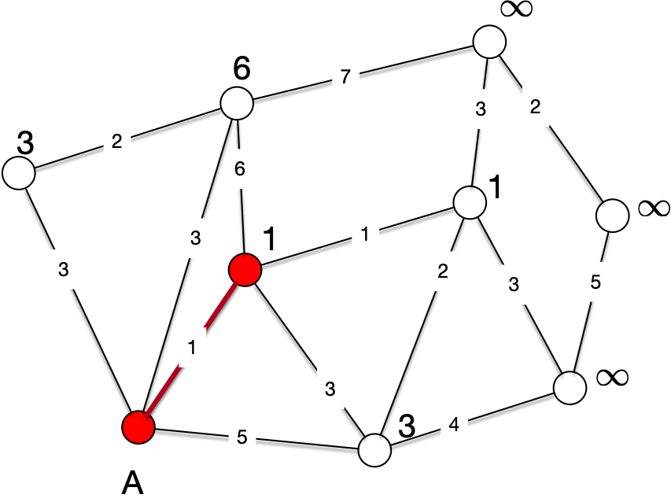
Prim's Algorithm
The priority queue tells us which node to select
After selecting edge and node, we need to update some nodes
Namely those in the adjacency list of the new node
3

Slide 49
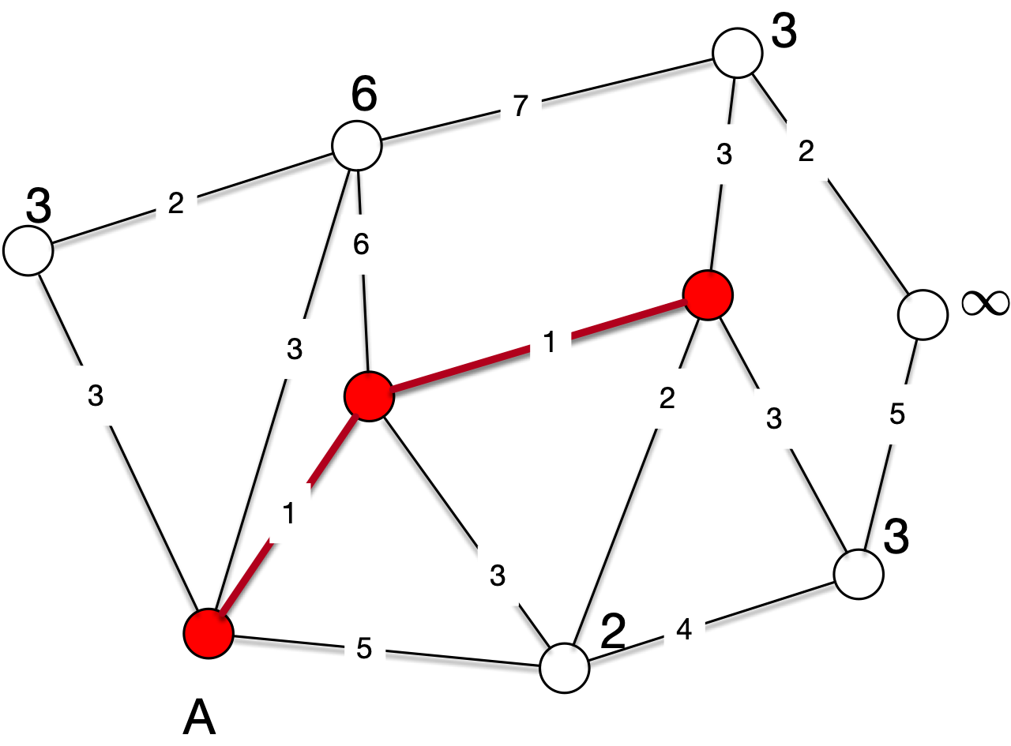
Prim's Algorithm
3

Slide 50
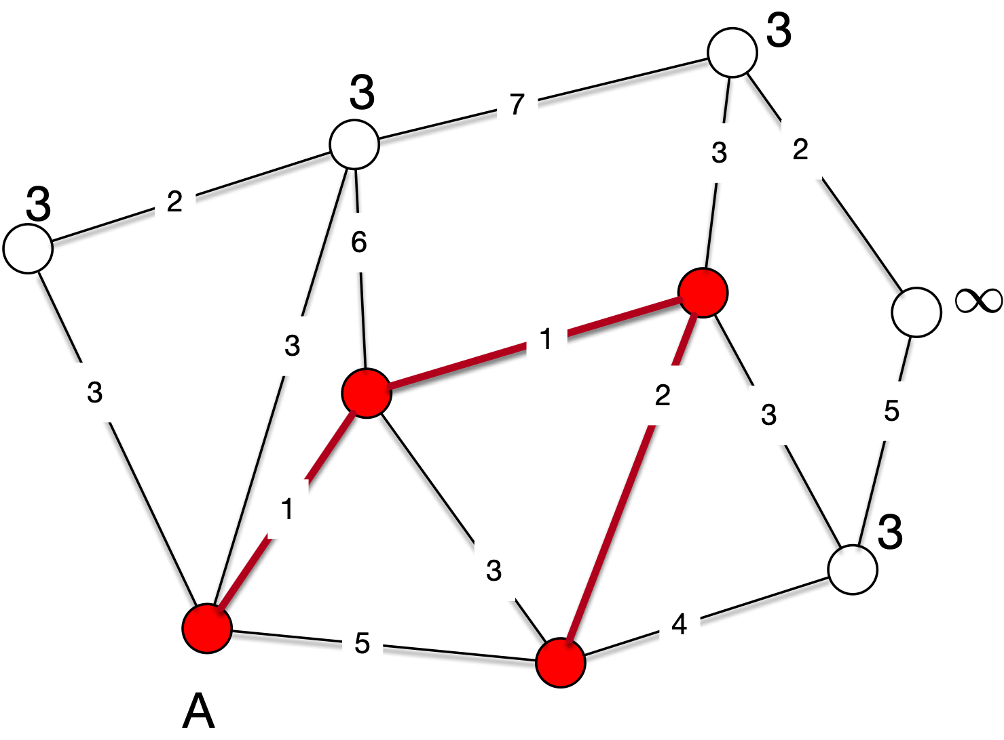
Prim's Algorithm

Slide 51
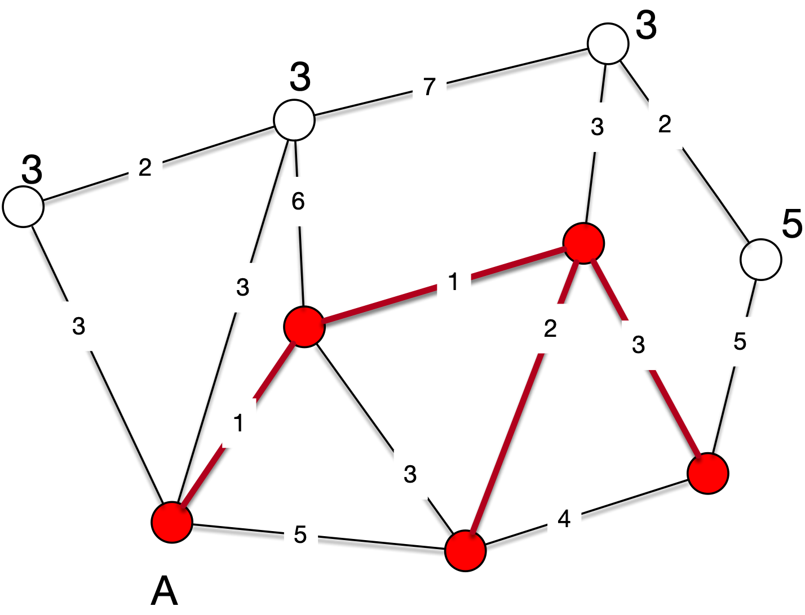
Prim's Algorithm

Slide 52
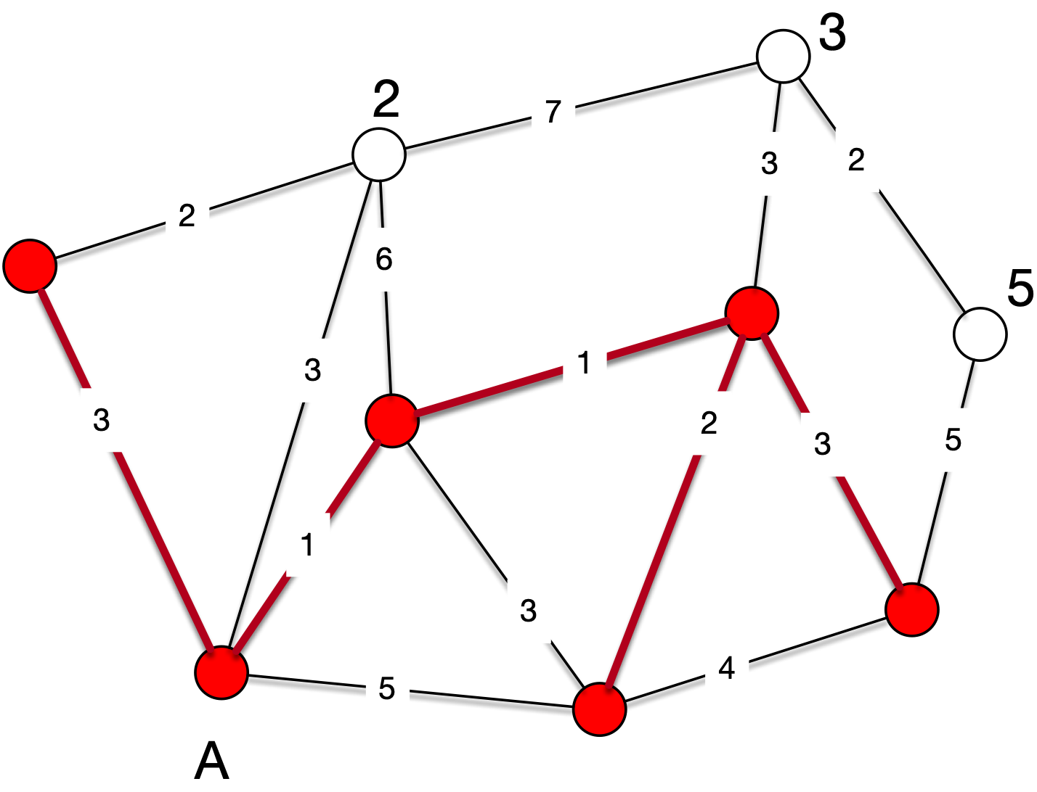
Prim's Algorithm

Slide 53
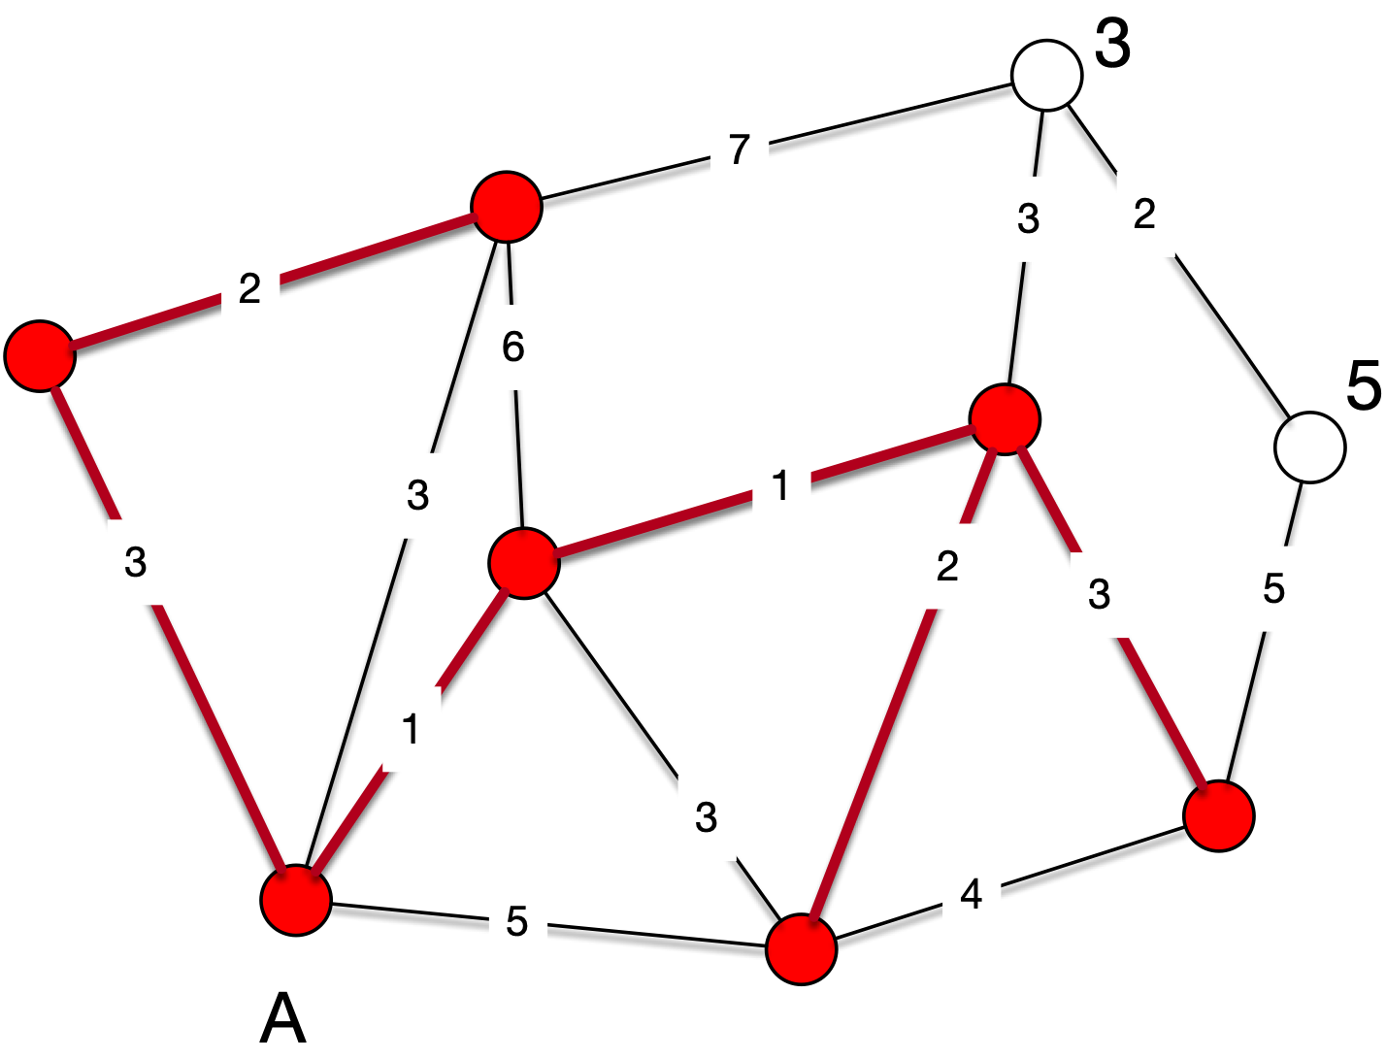
Prim's Algorithm

Slide 54
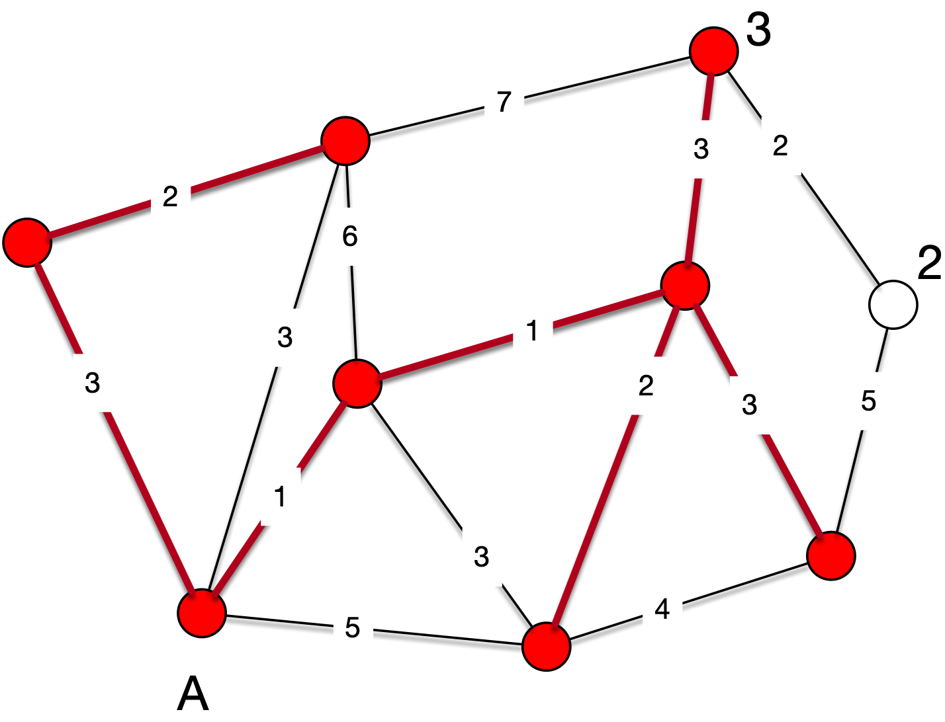
Prim's Algorithm

Slide 55
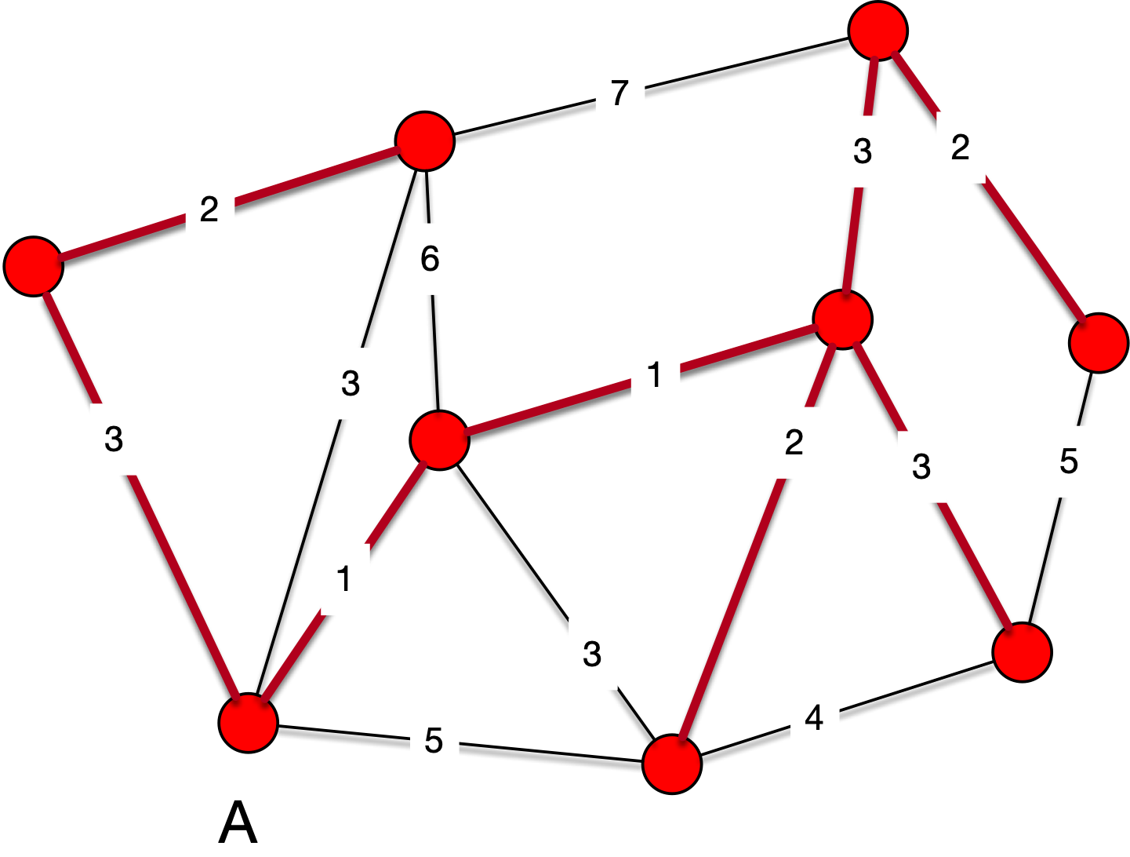
Prim's Algorithm

Slide 56
Prim's Algorithm
Because Prim's algorithm only selects safe edges, it correctly calculates a minimum spanning tree
The run-time of Prim's algorithm depends on the implementation of the priority heap
  The best type is a Fibonacci heap
    In which case the run time is $O(|E|+Vlog(|V|))$
  Or we can use a normal priority heap which gives us
    $$O(Elog(V))$$

