Slide 1
The Master Theorem

Slide 2
A family of Recursion
Equations
Divide and conquer frequently lead to recursions of the form
$$T(n)=aT(n/b)+f(n)$$

Slide 3
A family of Recursion
Equations
Solve Recurrence:

Slide 4
A family of Recursion
Equations

Slide 5
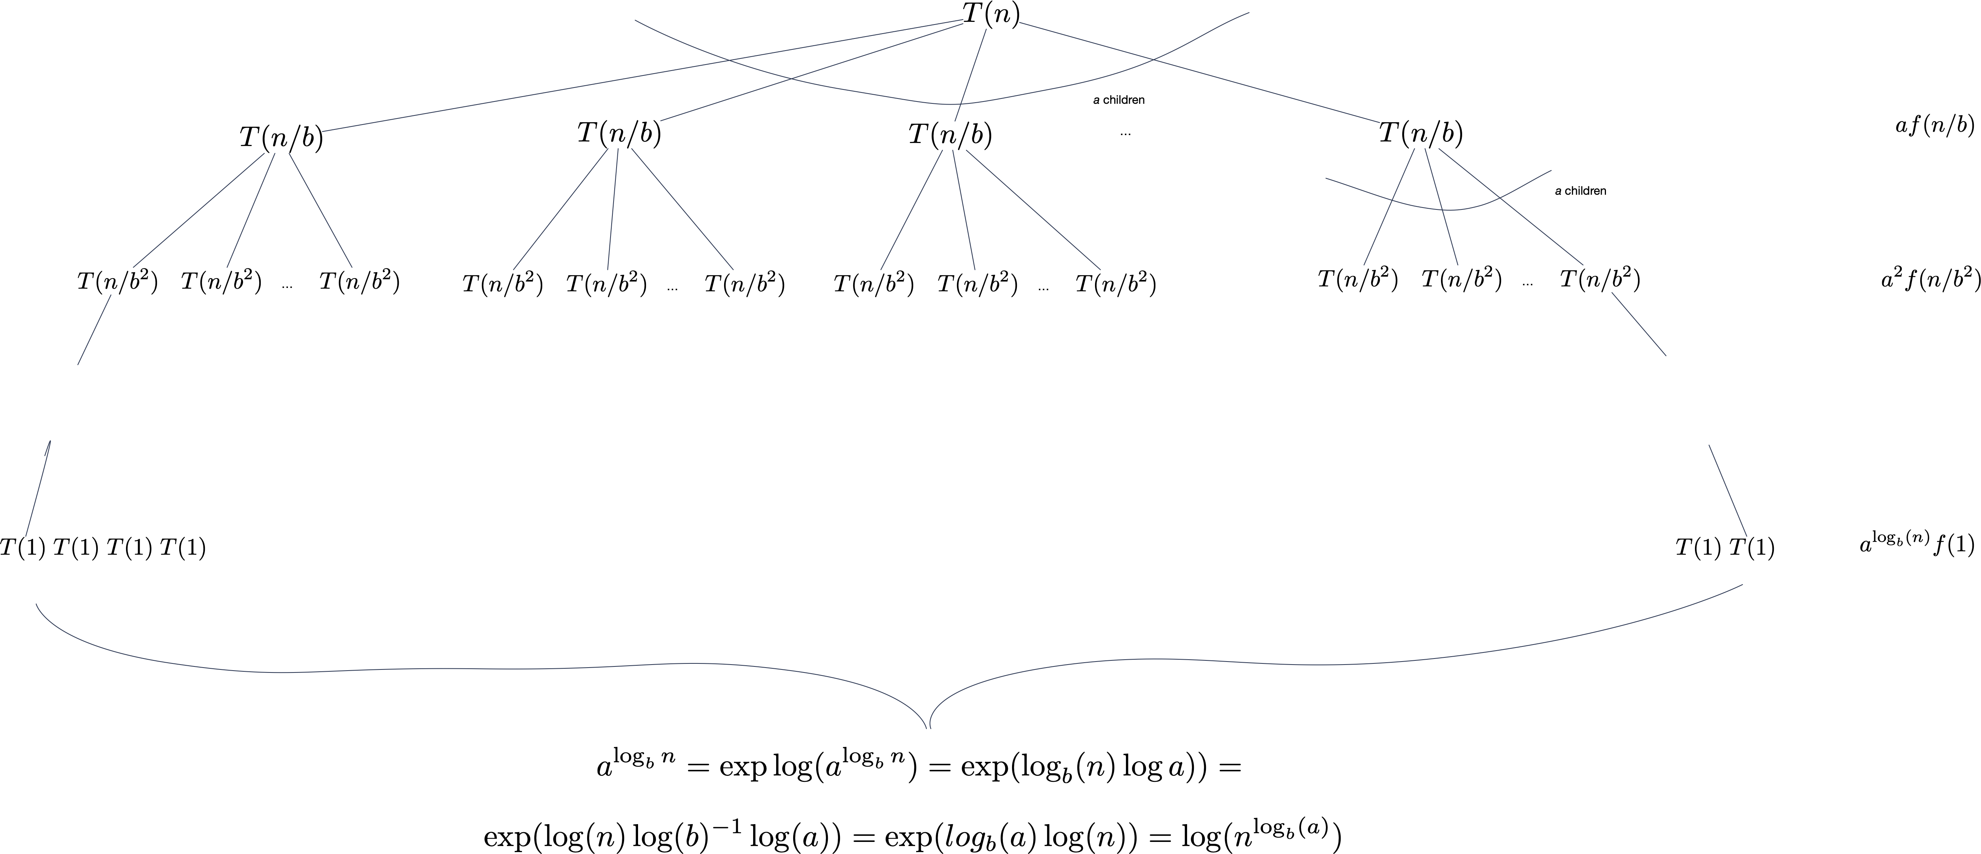
A family of Recursion
Equations

Slide 6
A family of Recursion
Equations
Total is
Need to compare f with power of n in order to see what dominates
$$(\overset{\log_{b}n-1}{\underset{j=0}{∑}}a^{j}f(n/b^{j}))+cn^{\log_{b}a}$$

Slide 7
A family of Recursion
Equations
$$f(n)=O(n^{\log_{b}a-ϵ})⟹T(n)=Θ(n^{\log_{b}a})$$
$$f(n)=Θ(n^{\log_{b}a})⟹T(n)=Θ(n^{\log_{b}a}logn)$$
$$f(n)=Ω(n^{\log_{b}a+ϵ})\text{and}af(n/b)≤cf(n)\text{eventually}⟹T(n)=Θ(f(n))$$

Slide 8
A family of Recursion
Equations
There are gaps between the three cases, where the master theorem does not apply

Slide 9
Examples
$$T(n)=2T(n/2)+n$$
$$n^{\log_{2}2}=n=f(n)\text{Case 2}$$
$$T(n)=Θ(nlogn)$$

Slide 10
Examples
$$T(n)=3T(n/2)+n$$
$$\log_{2}3=1.58496$$
$$n=O(n^{\log_{2}3-0.1})$$
$$⟹T(n)=Θ(n^{\log_{2}3})$$

Slide 11
Examples
$$T(n)=T(n/2)+n$$
$$a=1,b=2$$
$$\log_{2}1=0$$
$$n=Ω(n^{0+1/2})$$
$$⟹T(n)=Θ(n)$$

Slide 12
Examples
$$T(n)=3T(n/3)+nlogn$$
$$a=3b=3\text{so compare with}n$$
$$nlogn∉Θ(n)$$
$$nlogn∉Ω(n^{1+ϵ})$$
Falls into the gap between Case 2 and Case 3

