Slide 1
Activity:
Linear Hashing

Slide 2
File State
The file state of an LH file is determined by the number $n$ of buckets
  level $l$
  split pointer $s$
  Formula: $n=2^{l}+s$ with $l$ as high as possible, i.e. with $s∈\{0,1,…{,2}^{l}-1\}$

Slide 3
File State
Clarification regarding the literature
  The original LH scheme can start with any number of buckets
  In this class, we are using the most common case

Slide 4
Exercise
What is the level and the state of an LH file with 13 buckets?

Slide 5
Solution
We write $13=2^{3}+5$
  Level is $l=⌊\log_{2}(13)⌋=3$
  Split pointer is $s=13-l$

Slide 6
Exercise
Where would the records with the following (randomly picked) keys be inserted?
82
27
37

Slide 7
Solution
Level is 3, so we use first remainder modulo $2^{3}=8$ and $2^{4}=16$ second
$82(mod8)=2$. Since $2<5$, we rehash: $82(mod16)=2$ and we insert into bucket 2
$27(mod8)=3$. Since 3 < 5, we rehash: $27(mod16)=11$. We insert into bucket 11
$37(mod8)=5$. Since $5≮5$, we do not rehash but insert into bucket 5.

Slide 8
Exercise
Where would the records with the following (randomly picked) keys be inserted?
48
60
63
71

Slide 9
Solution
$48(mod8)=0$. Rehash: $48(mod16)=0$ and insert into bucket 0.
$60(mod8)=4$. Rehash: $60(mod16)=12$ and insert into bucket 12.
$63(mod8)=7$. Rehash not necessary. Insert into bucket 7.
$71(mod8)=7.$ No rehash is necessary.

Slide 10
Exercise
Where would the records with the following (randomly picked) keys be inserted?
98
75
25
30

Slide 11
Solution
$98(mod8)=2$. Rehash: $98(mod16)=2$. Insert into bucket 2
$75(mod8)=3$. Rehash: $75(mod16)=11$. Insert into bucket 11
$25(mod8)=1$. Rehash: $25(mod16)=9$. Insert into bucket 9.
$30(mod8)=6$. Insert into bucket 6.

Slide 12
Exercise
Give the level and split pointer values as an LH file moves from 6 buckets to 20

Slide 13
Solution
Nr o Buckets | Level | Split Ptr
6 | 2 | 2
7 | 2 | 3
8 | 3 | 0
9 | 3 | 1
10 | 3 | 2
11 | 3 | 3
12 | 3 | 4
13 | 3 | 5
14 | 3 | 6
15 | 3 | 7
16 | 4 | 0
17 | 4 | 1
18 | 4 | 2
19 | 4 | 3
20 | 4 | 4

Slide 14
Interpretation
We can encapsulate the behavior of the level and split pointer into the following algorithm
  We increment the split pointer
  If the split pointer equals $2^{\text{level}}$ then set the split pointer to zero and increment the level
def split(level, split_pointer):
split_pointer += 1
if split_pointer == 2**level:
split_pointer = 0
level += 1
return (level, split_pointer)

Slide 15
Programming Exercise
Using a programming platform of your choice, implement the LH addressing algorithm
Insert 1000 records with key uniformly selected between 0 and $2^{32}-1$ into an LH file with (a) 12 and (b) 25 buckets.
Look at the size of the buckets.

Slide 16
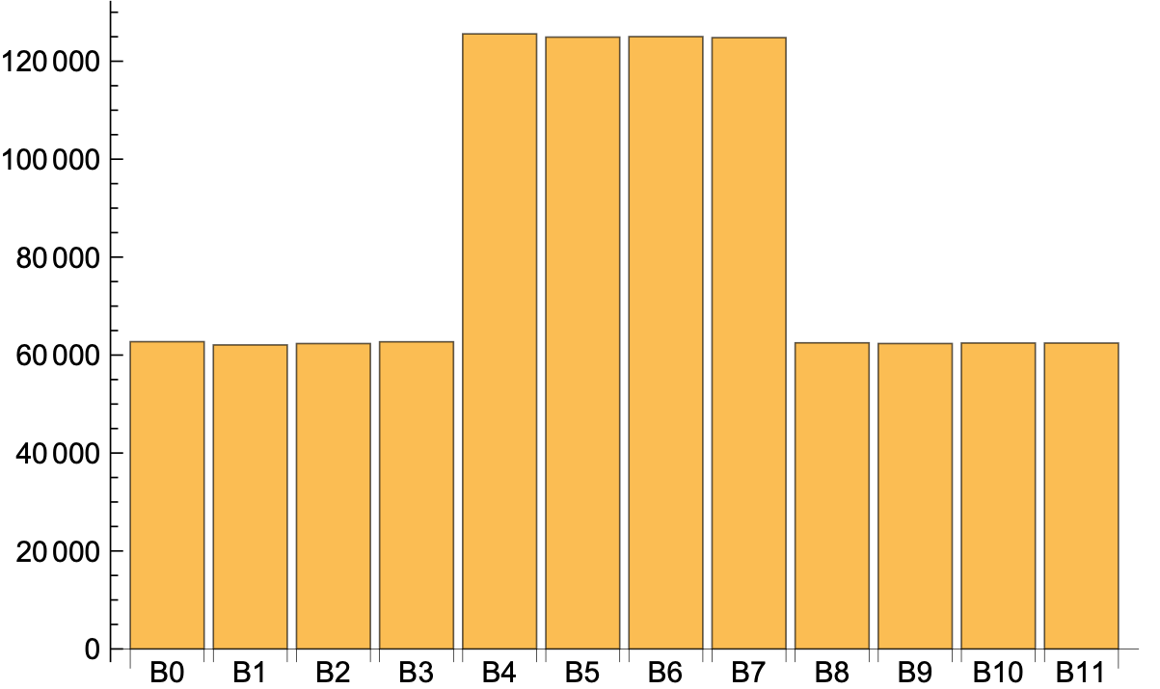
Solution
I changed the number to 1,000,000
  For 12 buckets:

Slide 17
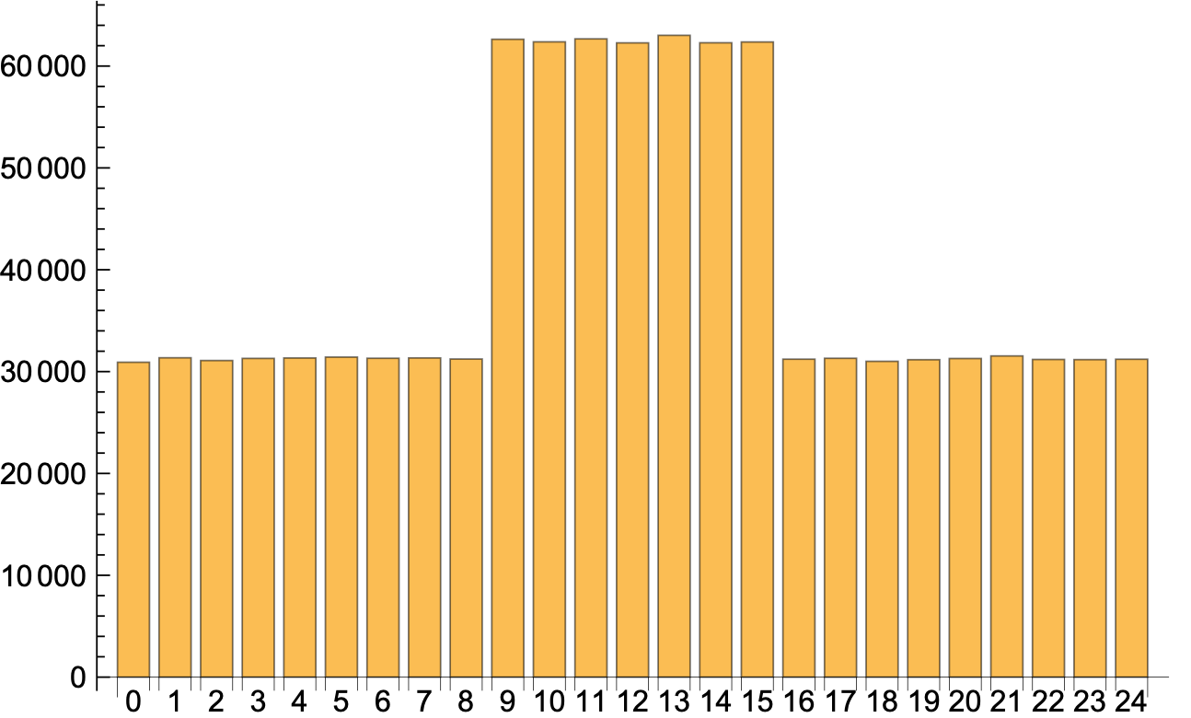
Solution
Here is the chart for 25 buckets

Slide 18
Interpretation
Even with a perfect hash function, an LH file has buckets of equal size only if the number of buckets is a power of two.
Otherwise, there are buckets already split in the current round and those not yet split.
  The latter have about twice as many records

