Slide 1
Data Structures
Algorithms

Slide 2
Types of Data Structures
Organize data to make access / processing fast
Speed depends on the internal organization
Internal organization allows different types of accesses
Problems:
Large data is nowadays distributed over several data centers
Need to take advantage of storage devices

Slide 3
Types of Data Structures
Internal Memory
DRAM: fast access, byte addressable
Storage
Hard Disk Drives
Data in blocks
Decent for streaming (consecutive blocks)
Bad for random access (~10 msec per access)
Solid State Disks
Data in blocks (called pages)
Decent access times (~1msec per access)

Slide 4
Types of Data Structures
Thread safe:
Several threads can safely access data structure
Need collaboration between threads
Implemented with locks
Implemented without locks
Difficult to do
Needs atomic instructions

Slide 5
Types of Data Structures
Caches can make big performance differences
Cache aware algorithms
Get the parameter of the caches
Cache oblivious algorithms
Work well for all cache sizes
Dumb algorithms
Do not pay attention to caches at all
Frequent surprises with bad performance

Slide 6
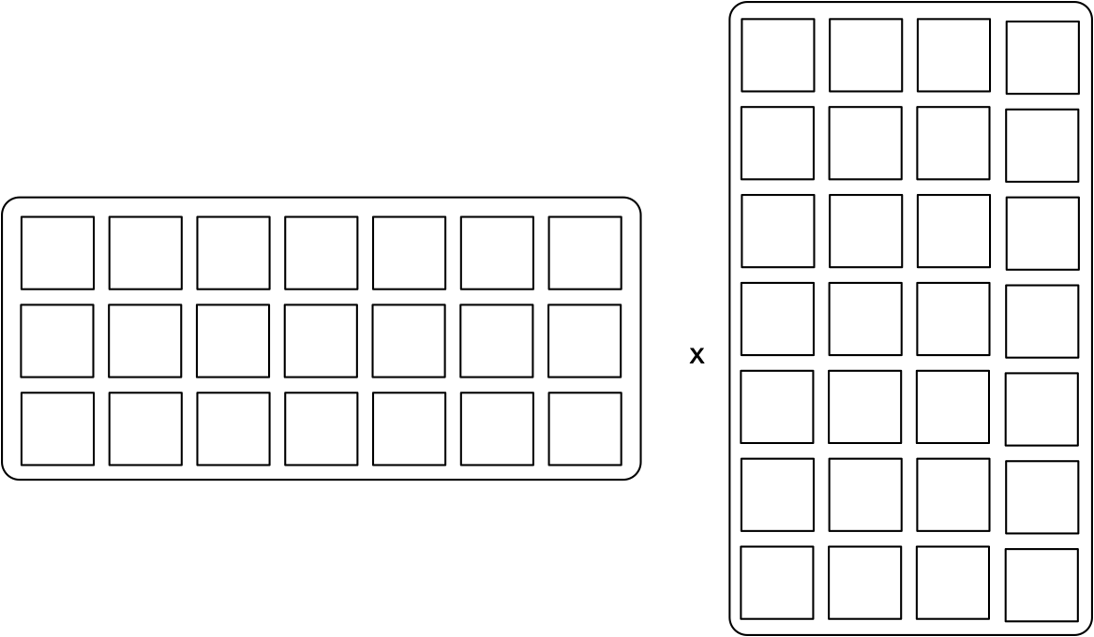
Example
Multiplying two big, non-dense matrices
Cache aware:
Break matrices into subsquares
Three subsquares fit comfortably into cache

Slide 7
Example
Cache Oblivious
Use a Divide and Conquer Algorithm that subdivides the sub-squares repeatedly
Only cold cache misses when a new subsquare needs to be loaded into cache.

Slide 8
Types of Data Structure
Dictionary — Key - Value Store
CRUD operations: create, read, update, delete
Solutions differ regarding read and write speeds

Slide 9
Types of Data Structure
Range Queries (Big Table, RP)
CRUD and range operation

Slide 10
Types of Data Structure
Priority queue:
Insert, retrieve minimum and delete it

Slide 11
Types of Data Structure
Log:
Append, Read

Slide 12
B-Trees
B-trees: In memory data structure for CRUD and range queries
Balanced Tree
Each node can have between d and 2d keys with the exception of the root
Each node consists of a sequence of node pointer, key, node pointer, key, …, key, node pointer
Tree is ordered.
All keys in a child are between the keys adjacent to the node pointer

Slide 13
B-Trees
Example: 2-3 tree: Each node has two or three children

Slide 14
B-Trees
Read dog:
Load root, determine location of dog in relation to the keys
Follow middle pointer
Follow pointer to the left
Find “dog”

Slide 15
B-Trees

Slide 16
B-Trees
Search for “auk” :

Slide 17
B-Trees
Range Query c - l
Determine location of c and l

Slide 18
B-Trees
Recursively enumerate all nodes between the lines starting with root

Slide 19
B-trees
Capacity: With l levels, minimum of nodes:
keys
Maximum of nodes
keys
$$1+2+2^{2}+…+2^{l}$$
$$1(2^{l+1}-1)$$
$$1+3+3^{2}+…+3^{l}$$
$$\frac{2}{2}(3^{l+1}-1)$$

Slide 20
B-trees
Inserts:
Determine where the key should be located in a leaf
Insert into leaf node
Leaf node can now have too many nodes
Take middle node and elevate it to the next higher level
Which can cause more “splits”

Slide 21
B-trees

Slide 22
B-trees

Slide 23
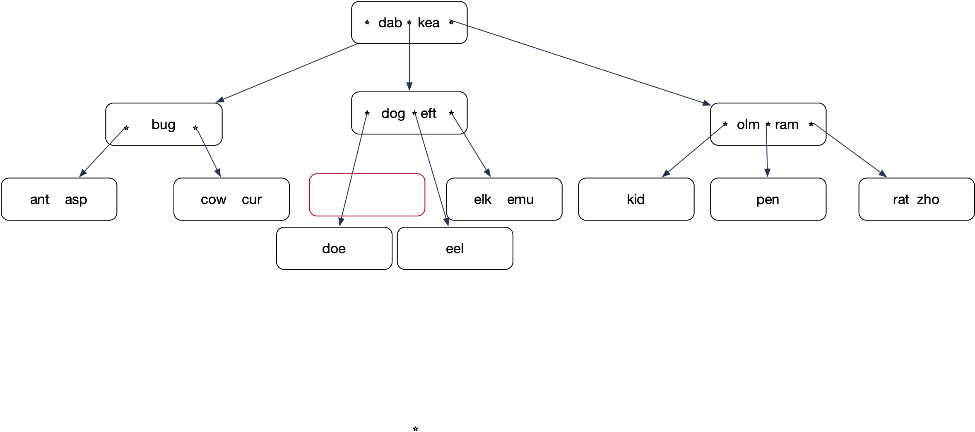
B-trees

Slide 24
B-trees
Insert: Lock all nodes from root on down so that only one process can operate on the nodes
Tree only grows a new level by splitting the root

Slide 25
B-Trees
Using only splits leads to skinny trees
Better to make use of potential room in adjacent nodes
Insert “ewe”.
Node elk-emu only has one true neighbor.
Node kid does not count, it is a cousin, not a sibling

Slide 26
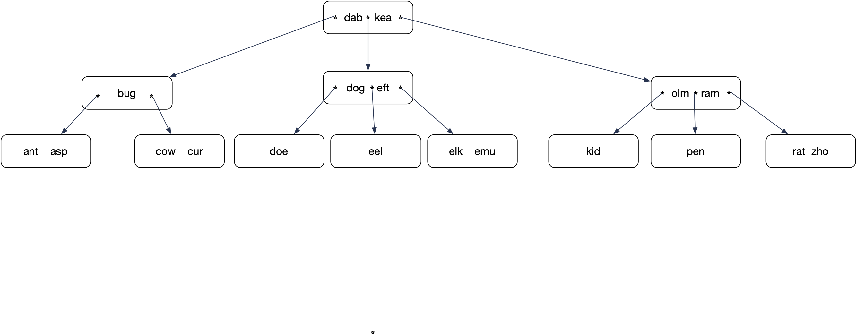
B-tree
Insert ewe into

Slide 27
B-tree
Insert ewe

Slide 28
B-tree
Promote elk. elk is guaranteed to come right after eft.
Demote eft

Slide 29
B-tree
Insert eft into the leaf node

Slide 30
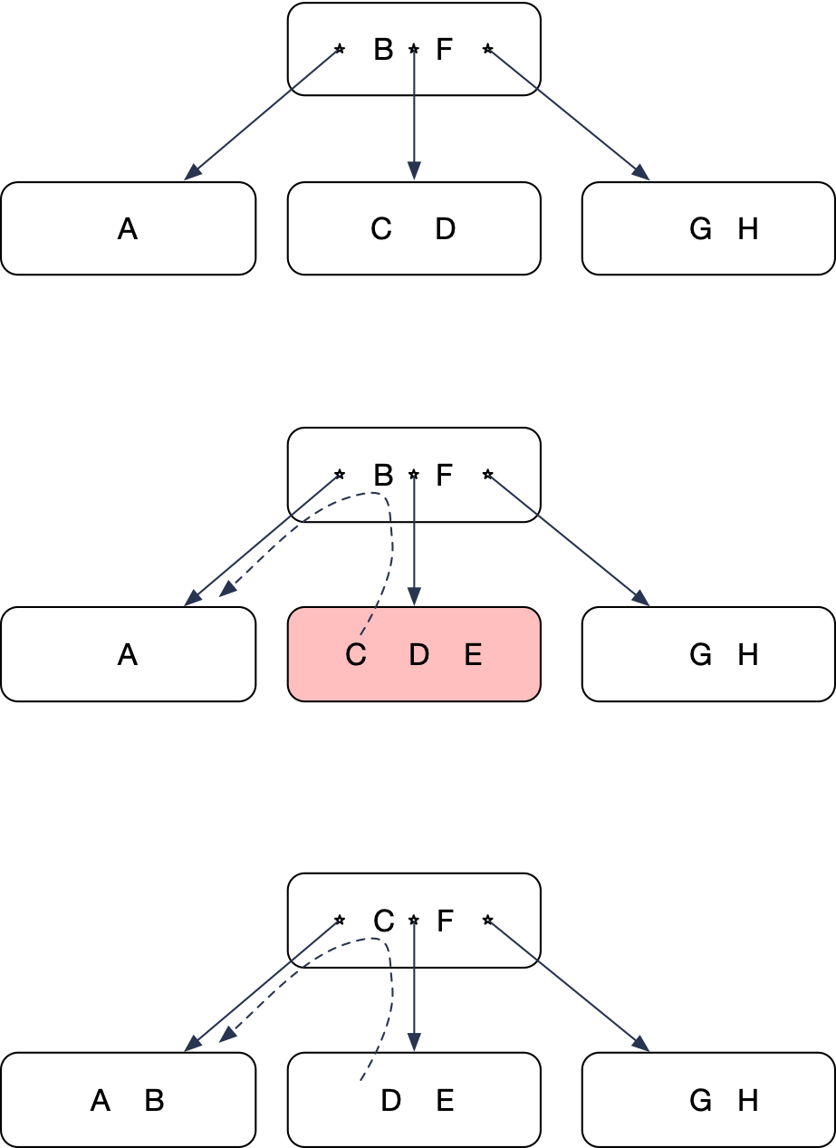
B-tree
Left rotate
Overflowing node has a sibling to the left with space
Move left-most key up
Lower left-most key

Slide 31
B-tree
Now insert “ai”

Slide 32
B-tree
Insert creates an overflowing node
Only one neighboring sibling, but that one is full
Split!

Slide 33
B-tree
Middle key moves up

Slide 34
B-tree
Unfortunately, this gives another overflow
But this node has a right sibling not at full capacity

Slide 35
B-tree
Right rotate:
Move “bot” up
Move “doe” down
Reattach nodes

Slide 36
B-tree
Move “bot” up
Move “doe” down
Reattach the dangling node

Slide 37
B-tree
“bot” had moved up
and replaced doe
The “emu” node needs
to receive one key and
one pointer

Slide 38
B-tree

Slide 39
B-tree
Deletes
Usually restructuring not done because there is no need
Underflowing nodes will fill up with new inserts

Slide 40
B-tree
Implementing deletion anyway:
Can only remove keys from leaves
If a delete causes an underflow, try a rotate into the underflowing node
If this is not possible, then merge with a sibling
A merge is the opposite of a split
This can create an underflow in the parent node
Again, first try rotate, then do a merge

Slide 41
B-tree
Delete “kit”
Delete “kit”
“kit” is in an interior node.
Exchange it with the key in the leave
immediately before
“fox”

Slide 42
B-tree
After interchanging “fox” and “kit”, can delete “kit”

Slide 43
B-tree
Now delete “fox”

Slide 44
B-tree
Step 1: Find the key. If it is not in a leaf
Step 2: Determine the key just before it, necessarily in a leaf
Step 3: Interchange the two keys

Slide 45
B-tree
Step 4: Remove the key now from a leaf

Slide 46
B-tree
This causes an underflow
Remedy the underflow by right rotating from the sibling

Slide 47
B-tree
Everything is now in order

Slide 48
B-tree
Now delete fly

Slide 49
B-tree
Switch “fly” with “emu”
remove “fly” from the leaf
Again: underflow

Slide 50
B-tree
Cannot left-rotate: There is no left sibling
Cannot right-rotate: The right sibling has only one key
Need to merge: Combine the two nodes by bringing down “elk”

Slide 51
B-tree
We can merge the two nodes because
the number of keys combined is less than 2 k

Slide 52
B-tree

Slide 53
B-tree
Delete “emu”

Slide 54
B-tree
Switch predecessor, then delete from node

Slide 55
B-tree
Now delete “elk”

Slide 56
B-tree
Results in an underflow

Slide 57
B-tree
Results in an underflow
But can rotate a key into the
underflowing node

Slide 58
B-tree
Result after left-rotation

Slide 59
B-tree
“Now delete “eel”

Slide 60
B-tree
Interchange “eel” with its predecessor
Delete “eel” from leaf:
Underflow

Slide 61
B-tree
Need to merge

Slide 62
B-tree
Merge results in another underflow
Use right rotate
(though merge with right sibling
is possible)

Slide 63
B-tree
“ass” goes up, “bot” goes down
One node is reattached

Slide 64
B-tree
Reattach node

Slide 65
B-tree

Slide 66
In real life
Use B+ tree for better access with block storage
Data pointers / data are only in the leaf nodes
Interior nodes only have keys as signals
Link leaf nodes for faster range queries.

Slide 67
B+ Tree

Slide 68
B+ Tree
Real life B+ trees:
Interior nodes have many more keys (e.g. 100)
Leaf nodes have as much data as they can keep
Need few levels:
Fast lookup

Slide 69
Hashing
Central idea of hashing:
Calculate the location of the record from the key
Hash functions:
Can be made indistinguishable from random function
SH3, MD5, …
Often simpler
ID modulo slots

Slide 70
Hashing
Can lead to collisions:
Two different keys map into the same address
Two ways to resolve:
Open Addressing
Have a rule for a secondary address, etc.
Chaining
Can store more than one datum at an address

Slide 71
Hashing
Open addressing example:
Linear probing: Try the next slot

Slide 72
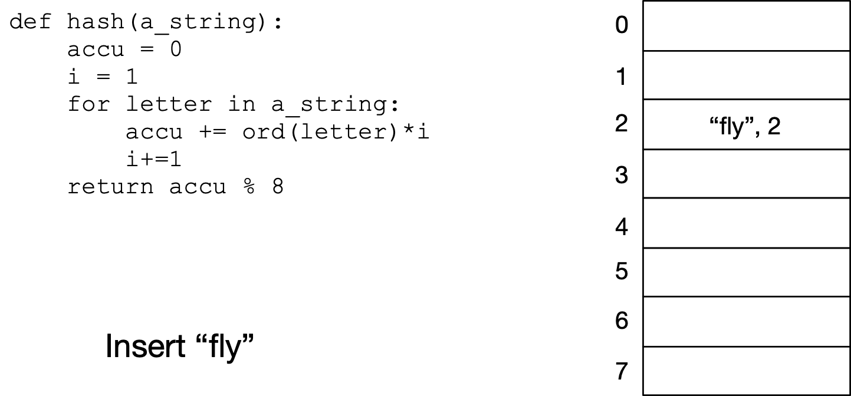
Hashing Example

Slide 73
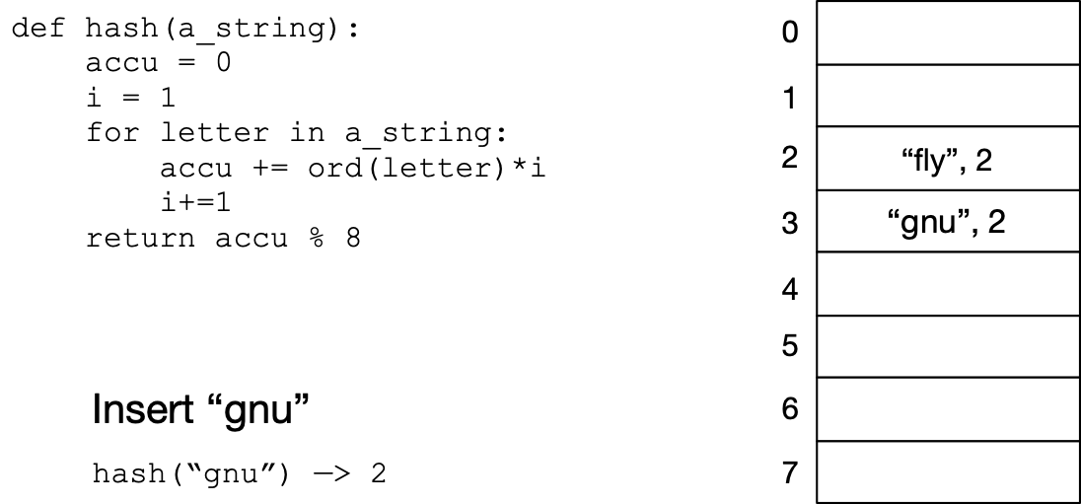
Hashing Example
Since spot 2 is taken, move to the next spot

Slide 74
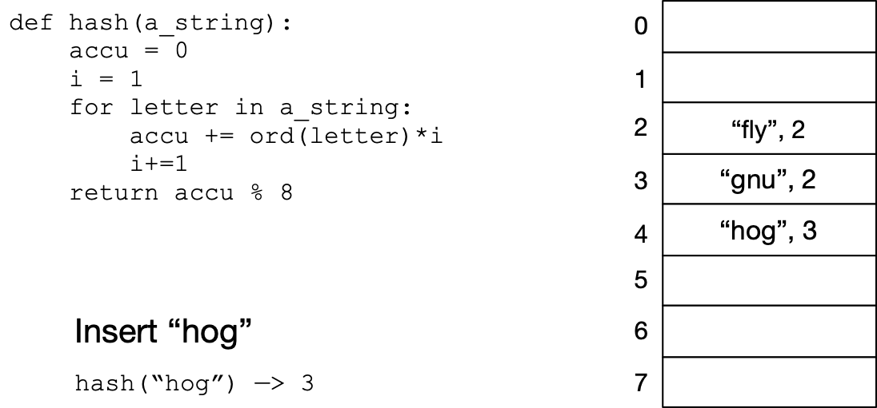
Hashing Example
Since spot is taken, move to the next

Slide 75
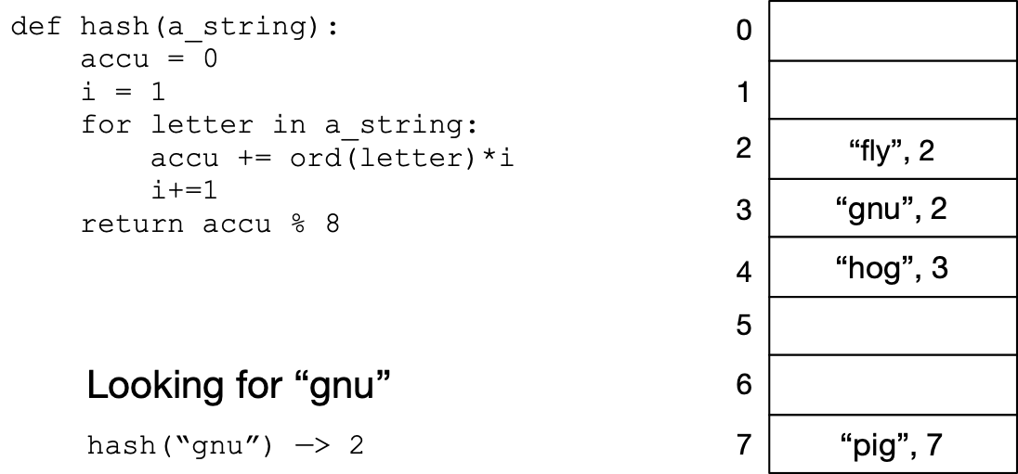
Hashing Example
Try out location 2. Occupied, but not by “gnu”

Slide 76
Hashing Example
Try out location 3. Find “gnu”

Slide 77
Hashing Example
Look at location 3: someone else is there
Look at location 4: someone else is there
Look at location 5: nobody is there, so if it were in the
dictionary, it would be there

Slide 78
Hashing
Linear probing leads to convoys:
Occupied cells tend to coalesce
Quadratic probing is better, but might perform worse with long cache lines
Large number of better versions are used:
Passbits
Cuckoo hashing
Uses two hash functions
Robin Hood hashing …

Slide 79
Hashing
Chaining
Keep data mapped to a location in a “bucket”
Can implement the bucket in several ways
Linked List

Slide 80
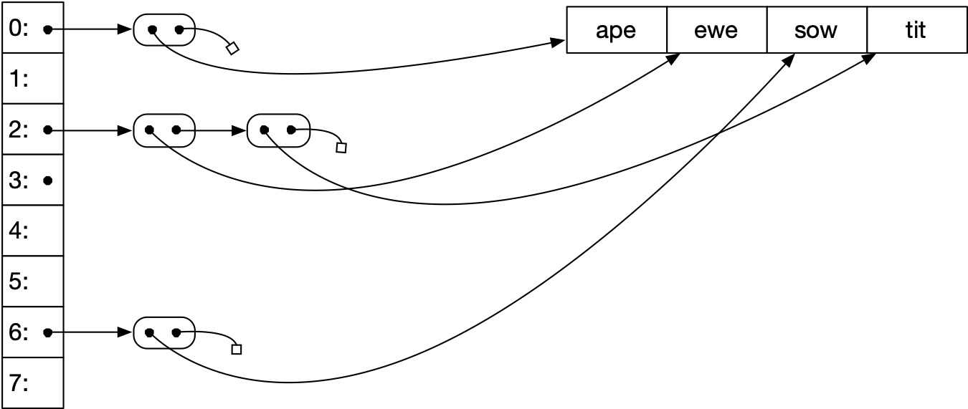
Hashing
Chaining Example with linked lists

Slide 81
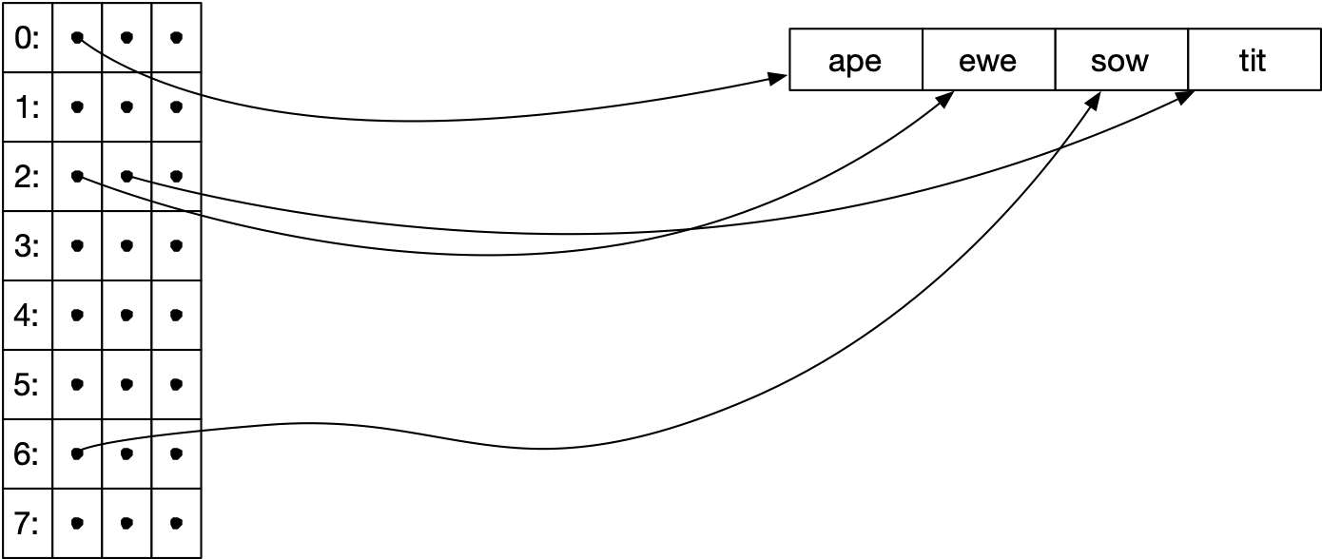
Hashing Example
Chaining Example with an array of pointers
(with overflow pointer if necessary)

Slide 82
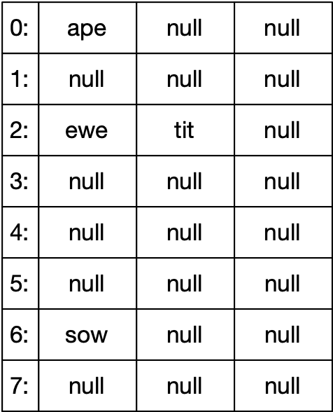
Hashing Example
Chaining with fixed buckets
Each bucket has two slots and a pointer
to an overflow bucket

Slide 83
Hashing
Extensible Hashing:
Load factor α = Space Used / Space Provided
Load factor determines performance
Idea of extensible hashing:
Gracefully add more capacity to a growing hash table

Slide 84
Linear Hashing

Slide 85
Linear Hashing
Extensible Hashing:
Uses a lot of metadata to reflect history of splitting
But only splits buckets when they are needed
Linear Hashing
Splits buckets in a predefined order
Minimal meta-data
Sounds like a horrible idea, but …

Slide 86
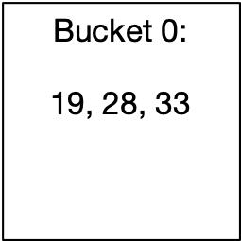
Linear Hashing
Assume a hash function that creates a large string of bits
We start using these bits as we extend the address space
Start out with a single bucket, Bucket 0
All items are located in Bucket 0
Items with keys 19, 28, 33

Slide 87
Linear Hashing
Eventually, this bucket will overflow
E.g. if the load factor is more than 2
Bucket 0 splits
All items in Bucket 0 are rehashed:
Use the last bit in order to determine whether the item goes into Bucket 0 or Bucket 1
Address is
$$h_{1}(c)=c(mod2)$$

Slide 88
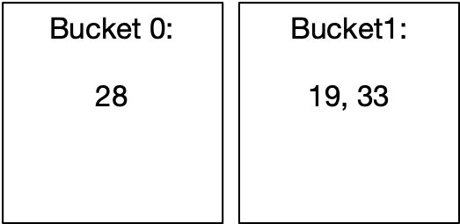
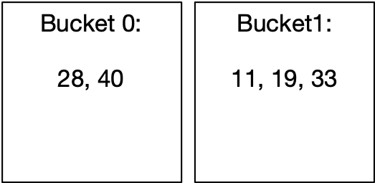
Linear Hashing
After the split, the hash table has two buckets:
After more insertions, the load factor again exceeds 2

Slide 89
Linear Hashing
Again, the bucket splits.
But it has to be Bucket 0
For the rehashing, we now use two bits, i.e.
But only for those items in Bucket 0
$$h_{2}(c)=c(mod4)$$

Slide 90
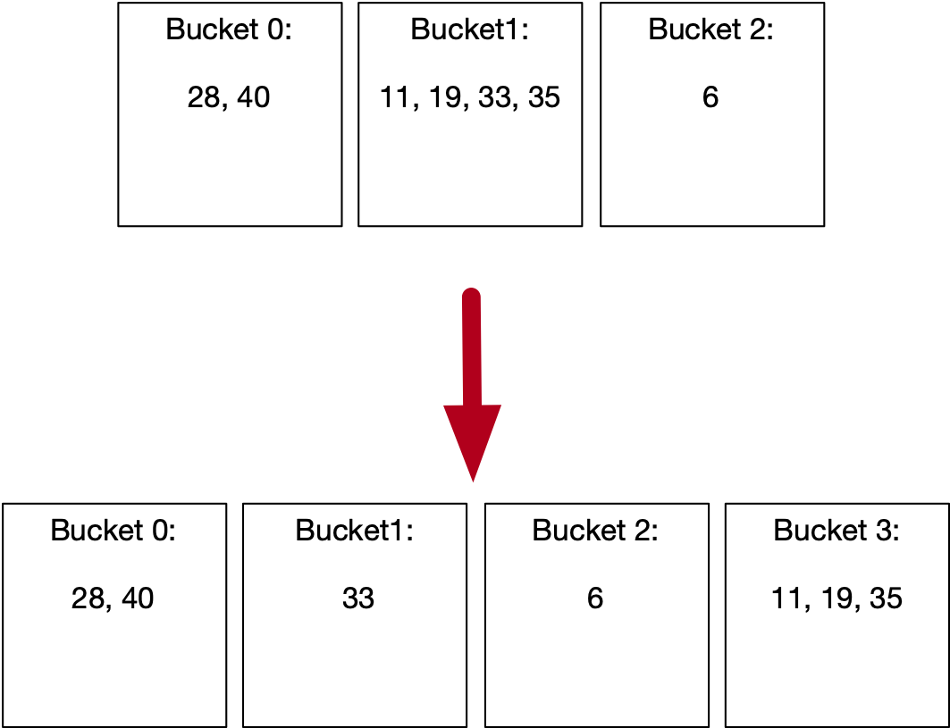
Linear Hashing
After some more insertions, Bucket 1 will split

Slide 91
Linear Hashing
The state of a linear hash table is described by the number of buckets
The level is the number of bits that are being used to calculate the hash
The split pointer points to the next bucket to be split
The relationship is
This is unique, since always
$$N$$
$$l$$
$$s$$
$$N=2^{l}+s$$
$$s<2^{l}$$

Slide 92
Linear Hashing
Addressing function
The address of an item with key is calculated by
This reflects the fact that we use more bits for buckets that are already split
$$c$$
def address(c):
a = hash(c) % 2**l
if a < s:
a = hash(c) % 2**(l+1)
return a

Slide 93
Linear Hashtable Evolution
$$N=1=2^{0}+0$$
def address(c):
a = hash(c) % 2**l
if a < s:
a = hash(c) % 2**(l+1)
return a
Number of buckets: 1
Split pointer: 0
Level: 0

Slide 94
Linear Hashtable Evolution
$$N=2=2^{1}+0$$
def address(c):
a = hash(c) % 2**l
if a < s:
a = hash(c) % 2**(l+1)
return a
Number of buckets: 2
Split pointer: 0
Level: 1
Add items with hashes 40 and 11
This gives an overflow and we split Bucket 0

Slide 95
Linear Hashtable Evolution
$$N=3=2^{1}+1$$
def address(c):
a = hash(c) % 2**l
if a < s:
a = hash(c) % 2**(l+1)
return a
Number of buckets: 3
Split pointer: 1
Level: 1
split Bucket 0
Create Bucket 2
Use new hash function on items in Bucket 0
No items were moved

Slide 96
Linear Hashtable Evolution
$$N=3=2^{1}+1$$
def address(c):
a = hash(c) % 2**l
if a < s:
a = hash(c) % 2**(l+1)
return a
Number of buckets: 3
Split pointer: 1
Level: 1
Add items 6, 35
Because of overflow, we split
Bucket 1

Slide 97
Linear Hashtable Evolution
$$N=4=2^{2}+0$$
def address(c):
a = hash(c) % 2**l
if a < s:
a = hash(c) % 2**(l+1)
return a
Number of buckets: 4
Split pointer: 0
Level: 2

Slide 98
Linear Hashtable Evolution
$$N=4=2^{2}+0$$
def address(c):
a = hash(c) % 2**l
if a < s:
a = hash(c) % 2**(l+1)
return a
Number of buckets: 4
Split pointer: 0
Level: 2
Now add keys 8, 49
Creates an overflow!
Need to split!

Slide 99
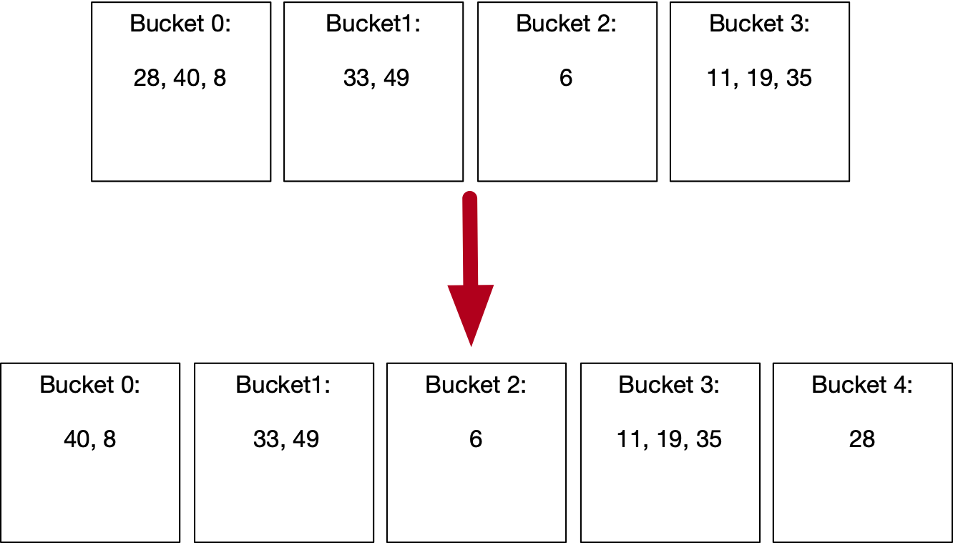
Linear Hashtable Evolution
$$N=5=2^{2}+1$$
def address(c):
a = hash(c) % 2**l
if a < s:
a = hash(c) % 2**(l+1)
return a
Number of buckets: 1
Split pointer: 1
Level: 2
Create Bucket 4.
Rehash Bucket 0.

Slide 100
Linear Hashtable Evolution
$$N=5=2^{2}+1$$
def address(c):
a = hash(c) % 2**l
if a < s:
a = hash(c) % 2**(l+1)
return a
Number of buckets: 5
Split pointer: 1
Level: 2
Creates an overflow!
Need to split!

Slide 101
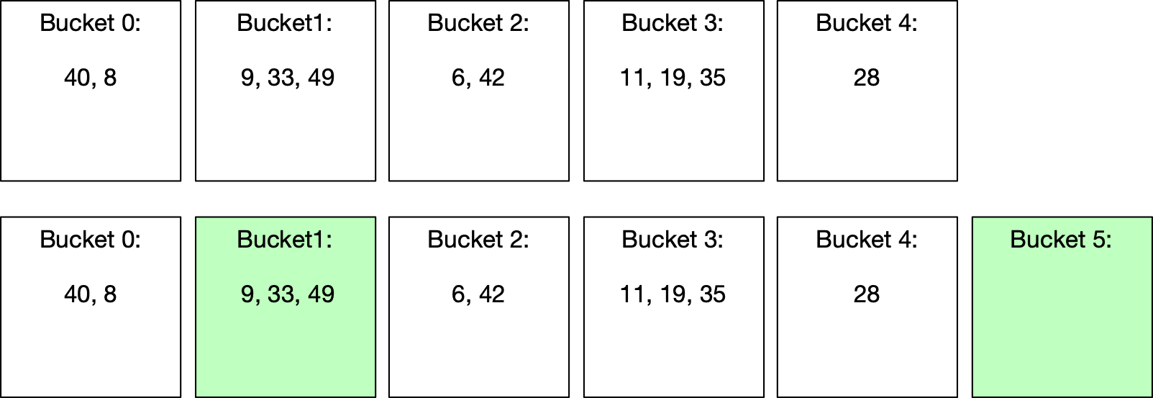
Linear Hashtable Evolution
$$N=6=2^{2}+2$$
def address(c):
a = hash(c) % 2**l
if a < s:
a = hash(c) % 2**(l+1)
return a
Number of buckets: 1
Split pointer: 2
Level: 2
Split
No item actually moved, but average load factor is now
again under 2.

Slide 102
Linear Hashtable Evolution
$$N=6=2^{2}+2$$
def address(c):
a = hash(c) % 2**l
if a < s:
a = hash(c) % 2**(l+1)
return a
Number of buckets: 6
Split pointer: 2
Level: 2

Slide 103
Linear Hashtable Evolution
$$N=7=2^{2}+3$$
def address(c):
a = hash(c) % 2**l
if a < s:
a = hash(c) % 2**(l+1)
return a
Number of buckets: 7
Split pointer: 3
Level: 2

Slide 104
Linear Hashtable Evolution
$$N=7=2^{2}+3$$
def address(c):
a = hash(c) % 2**l
if a < s:
a = hash(c) % 2**(l+1)
return a
Number of buckets: 7
Split pointer: 3
Level: 2

Slide 105
Linear Hashtable Evolution
$$N=8=2^{3}+0$$
def address(c):
a = hash(c) % 2**l
if a < s:
a = hash(c) % 2**(l+1)
return a
Number of buckets: 8
Split pointer: 0
Level: 3

Slide 106
Linear Hashtable Evolution
$$N=8=2^{3}+0$$
def address(c):
a = hash(c) % 2**l
if a < s:
a = hash(c) % 2**(l+1)
return a
Number of buckets: 8
Split pointer: 0
Level: 3

Slide 107
Linear Hashtable Evolution
$$N=9=2^{3}+1$$
def address(c):
a = hash(c) % 2**l
if a < s:
a = hash(c) % 2**(l+1)
return a
Number of buckets: 9
Split pointer: 1
Level: 3

Slide 108
Linear Hashtable Evolution
$$N=9=2^{3}+1$$
def address(c):
a = hash(c) % 2**l
if a < s:
a = hash(c) % 2**(l+1)
return a
Number of buckets: 9
Split pointer: 1
Level: 3

Slide 109
Linear Hashtable Evolution
$$N=10=2^{3}+2$$
def address(c):
a = hash(c) % 2**l
if a < s:
a = hash(c) % 2**(l+1)
return a
Number of buckets: 10
Split pointer: 2
Level: 3

Slide 110
Linear Hashing
Observations:
Buckets split in fixed order
0, 0,1, 0, 1, 2, 3, 0, 1, 2, 3, 4, 5, 6, 7, 0, 1, 2, …, 15, 0, …
Address calculation is modulo , i.e. the l least significant bits
Buckets 0, 1, …, s-1 and 2**l, 2**l+1, … N-1 are already split, they have on average half the size of the buckets s, s+1, …, 2**l.
$$2^{l}$$

Slide 111
Linear Hashing
Observations:
An overflowing bucket is not necessarily split immediately
Sometimes, a split leaves all keys in the splitting bucket or moves them all to the new bucket
On average, a bucket will have α items in them

