Slide 1
Skip Lists
Thomas Schwarz, SJ

Slide 2
Skip List Motivation
San Francisco
22nd Street
Bayshore
South San Francisco
San Bruno
Millbrae
Burlingame
San Mateo
Hayward Park
Hillsdale
Belmont
San Carlos
Redwood City
Menlo Park
Palo Alto
California Ave.
San Antonio
Mountain View
Sunnyvale
Lawrence
Santa Clara
College Park
San José
Tamien
Capitol
Blossom Hill
Morgan Hill
San Martin
Gilroy
Can you guess what this list is?

Slide 3
Skip List Motivation
San Francisco
22nd Street
Bayshore
South San Francisco
San Bruno
Millbrae
Burlingame
San Mateo
Hayward Park
Hillsdale
Belmont
San Carlos
Redwood City
Menlo Park
Palo Alto
California Ave.
San Antonio
Mountain View
Sunnyvale
Lawrence
Santa Clara
College Park
San José
Tamien
Capitol
Blossom Hill
Morgan Hill
San Martin
Gilroy
Caltrain stations from San Francisco South
Underlined stations are for the "Baby Bullet"
You can take time of your trip if you use the baby bullet, and then switch to a local
That is how skip lists improve on linked lists.

Slide 4
Ordered Linked List
Start with a normal ordered linked list
  Nodes consist of key plus pointer to data plus link to next node

Slide 5
Ordered Linked List
How do we find a record with a given key c?
  Use the pointer to the list in order to find the first node
  Compare the key of the node with c
  If they are equal, you found the record
  If they are not equal, continue until you find the record
  If you get to the null pointer at the very end or if you find a node with key > c then the record is not there

Slide 6
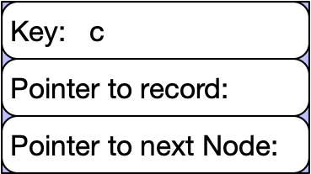
Ordered Linked Lists
How do you insert a record?
  Create a new node with a key c

Slide 7
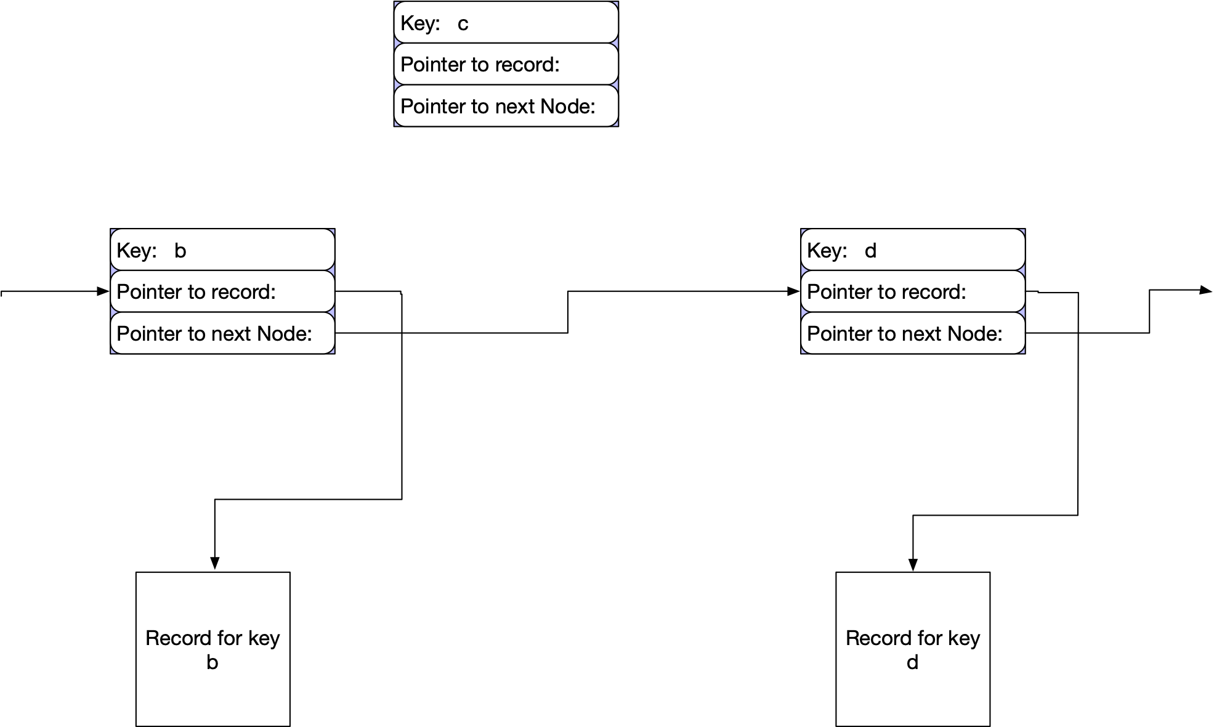
Ordered Linked Lists
How do you insert a record?
Pretend that you look for the record
Find the node before and after

Slide 8
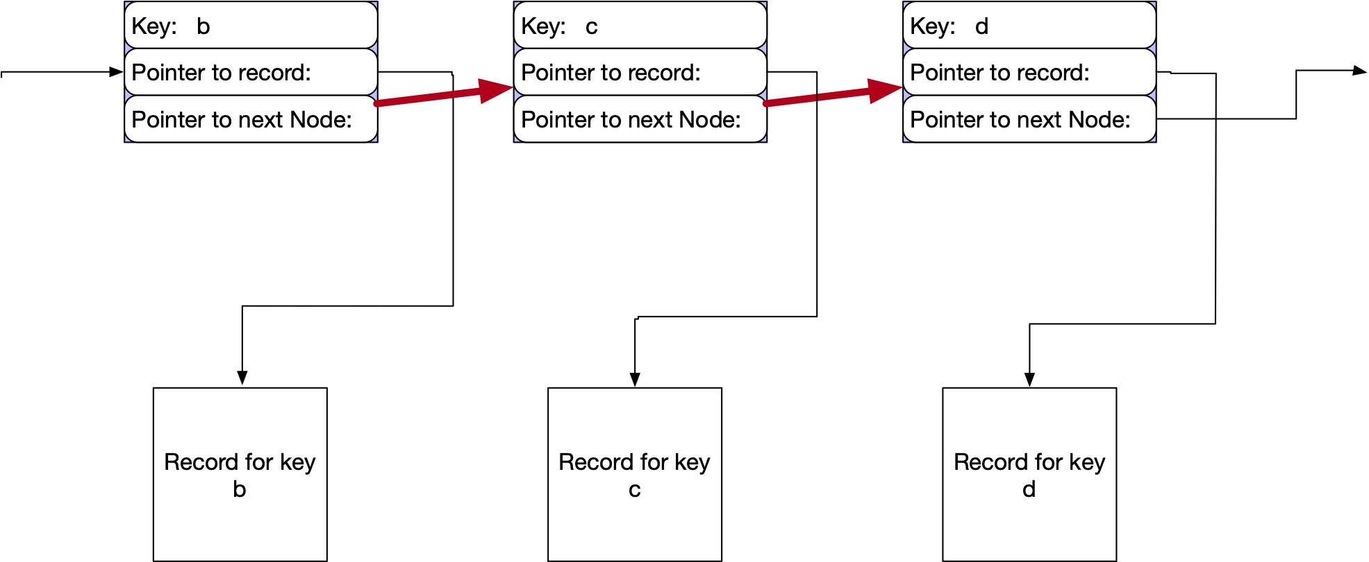
Ordered Linked Lists
How do you insert a record?
Now set two pointers to connect the previous to the new and the new node to the following node.

Slide 9
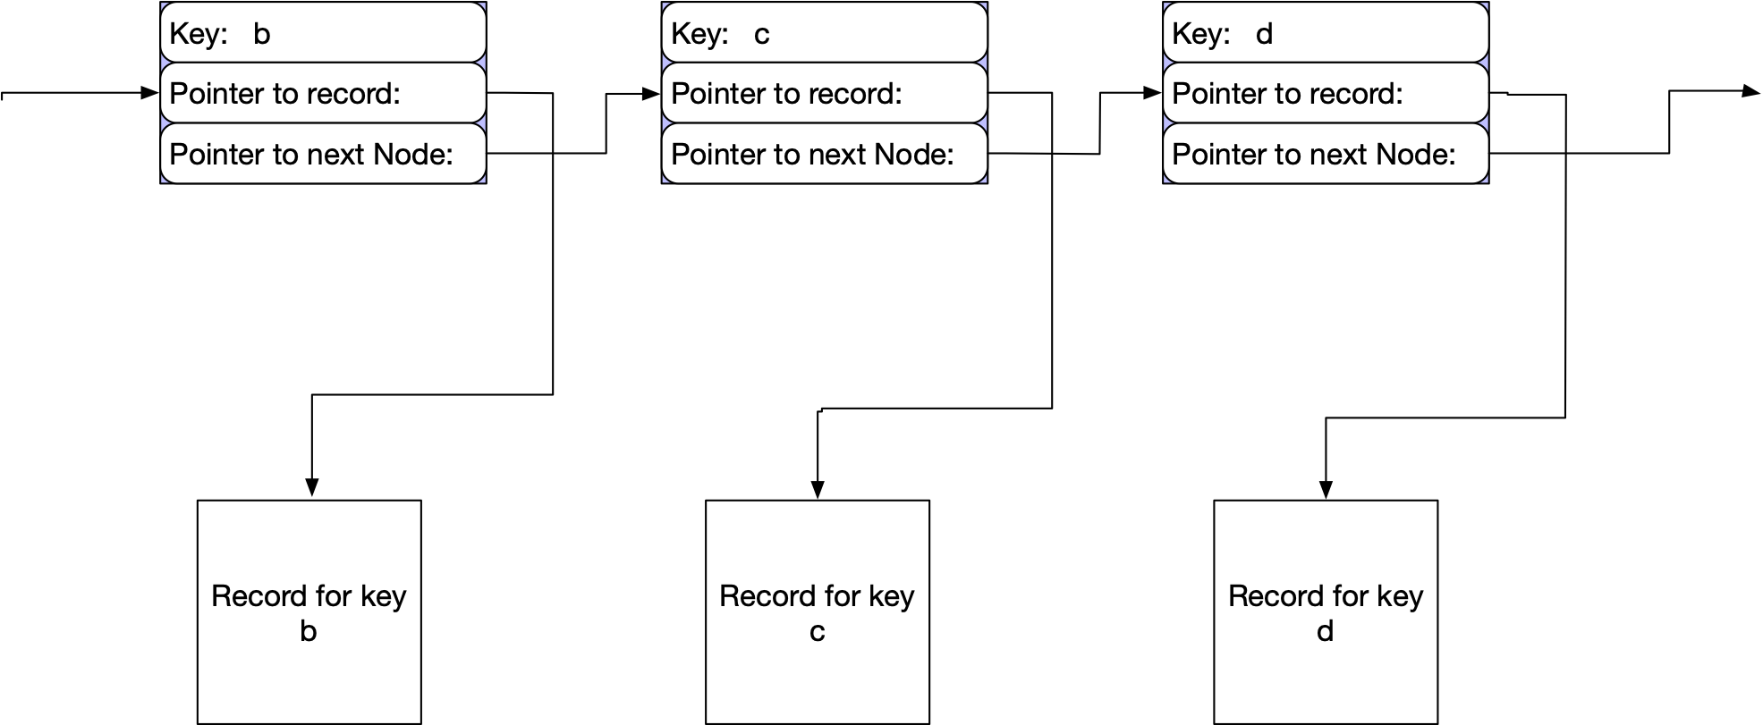
Ordered Linked Lists
How do you delete a record?
  Find previous and subsequent node

Slide 10
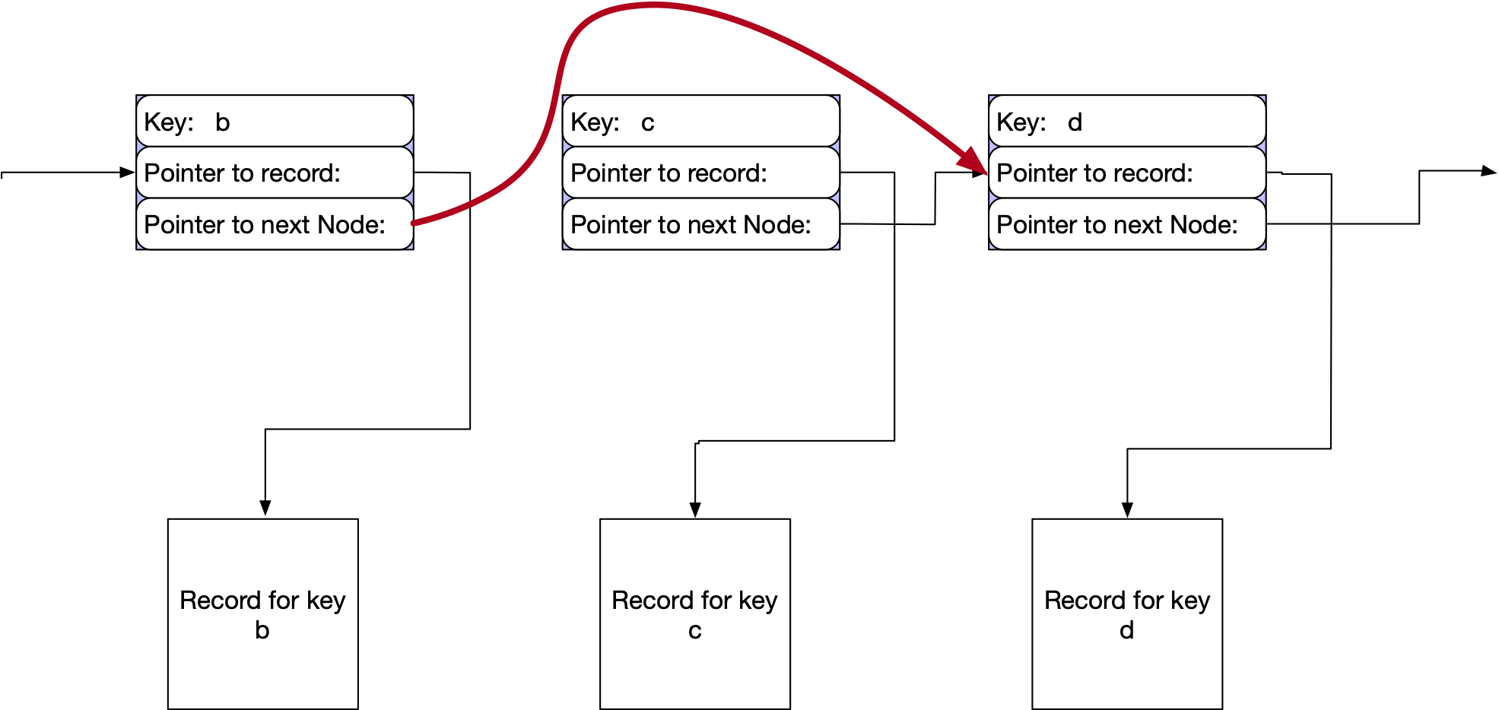
Ordered Linked Lists
How do you delete a record?
Change one pointer

Slide 11
Ordered Linked Lists
Analysis
  Assume ordered list has n elements
  Insert: Needs to insert after visiting on average n/2 elements, afterwards constant reconstruction work
  Deletes: Needs to delete node after visiting on average n/2 nodes
  Reads / Updates: Needs to find node after visiting on average n/2 nodes

Slide 12
Ordered Linked Lists with a Baby Bullet
One simple way to speed up look-up in linked lists is to have shortcuts between nodes.
  An ordinary ordered linked list
  The same ordered linked lists with short-cuts

Slide 13
Ordered Linked Lists with a Baby Bullet
To find a record with key c or an insertion point for the record with key c:
  Use the baby-bullet links until the node pointed to has a key value larger than c or does not exist
  Then switch to the normal links

Slide 14
Ordered Linked Lists with a Baby Bullet
How to maintain the Baby Bullet stations
  Strategy 1:
    Whenever the distance between two baby bullet stations is too large, we introduce a new station in the middle
  Strategy 2:
    Whenever we insert a record, the corresponding node becomes a baby bullet train station with a given probability

Slide 15
Ordered Linked Lists with a Baby Bullet
Analysis
  Assume n nodes per list, m nodes that are baby bullet nodes
  Average distance between two baby bullet nodes is$n/m$
  On average, will need $m/2$ baby bullet stations and then $(n/m)/2=\frac{n}{2m}$ normal stations to find a record / insertion point.

Slide 16
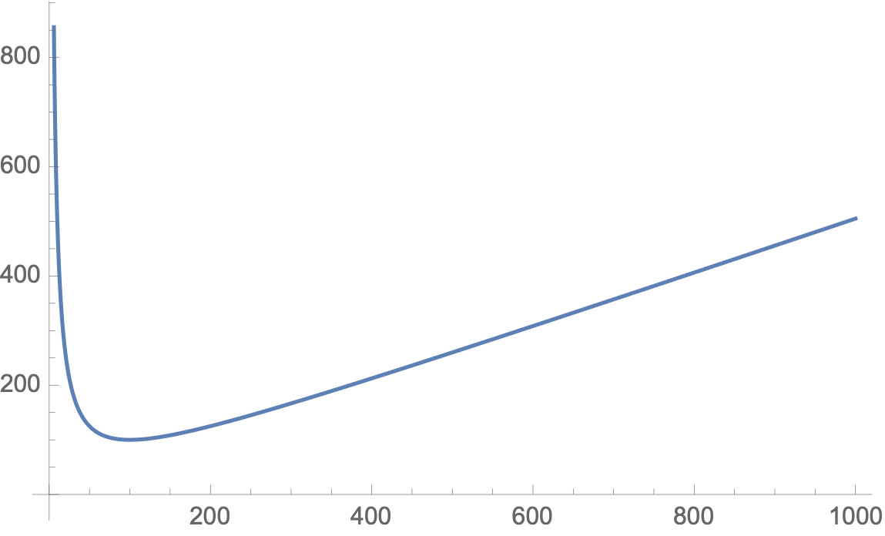
Ordered Linked Lists with a Baby Bullet
Minimize $f(m,n)=\frac{m}{2}+\frac{n}{2m}$ with respect to $m$ for constant $n$:
For $n=10000$:

Slide 17
Ordered Linked Lists with a Baby Bullet
Calculate the derivative and set it equal to zero
  $\frac{δf(m,n)}{δm}=\frac{1}{2}-\frac{n}{2m^{2}}$ is zero if
  $$m=±\sqrt{n}$$
This suggests that our two strategies will not work well for growing lists
One possibility: Make a new node a baby bullet train station with a probability that slowly sinks in dependence on the number of elements inserted

Slide 18
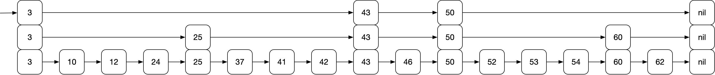
Puig's Skip List
Skip List: Create more and more nodes at a higher level
  For searches, inserts, deletes use the highest level, then if you overshoot, go down one level

Slide 19
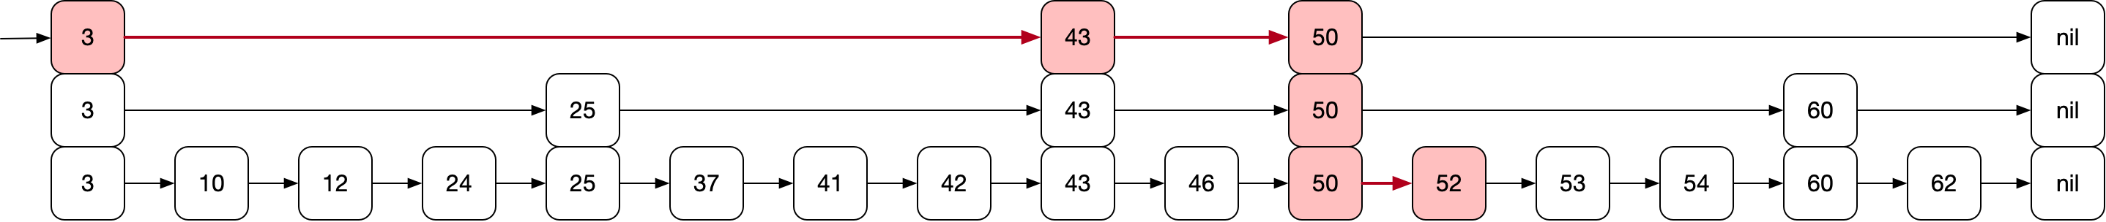
Puig's Skip List
Example:
  Searching for 52
    start out at three level 2
    move to 43 level 2
    move to 50 level 2
    overshoot: move to 50 level 1
    overshoot: move to 50 level 0
    move to 52

Slide 20
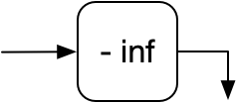
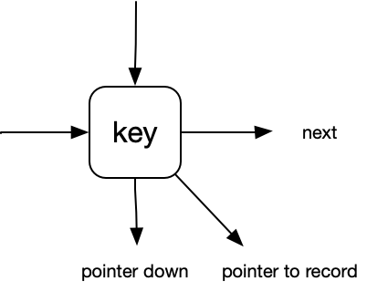
Puig's Skip List
Creating a skip list
  Start out with a start node with one level
  With a sentinel value of - infinity
Nodes have
  key (assumed to be an integer)
  pointer to next on the same level
  pointer to down node (or nil if we are at level 0)
  pointer to record if we are at level 0

Slide 21
Puig's Skip List
Construction
  Beginning node has to have the maximum level of any other nodes
  Could have a last node with key infinity to finish or could have pointers having a null value

Slide 22
Puig's Skip List
Searching for a record with key c
  Start in the highest level start node; set it to currentNode
    Guaranteed to have level equal to the highest level node in the list
  Follow the forward pointer
    If forward pointer points to a key with key larger than c or the forward pointer is null:
      Follow the downward pointer: currentNode = currentNode.down
      If downward pointer is zero, then the record with key c does not exist
    Otherwise:
      Follow the forward pointer: currentNode = currentNode.next

Slide 23
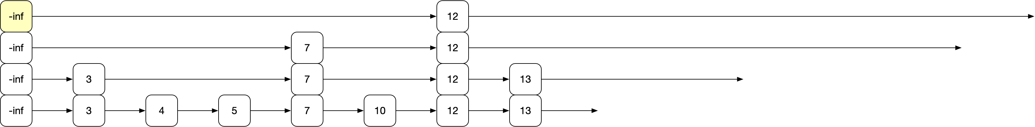
Puig's Skip List
Example: Looking for node 23
Start out in the highest level start node
Get the key of the next node at this level
  curpoint.next.key is 12

Slide 24
Puig's Skip List
Since 12 < 23, follow the next pointer

Slide 25
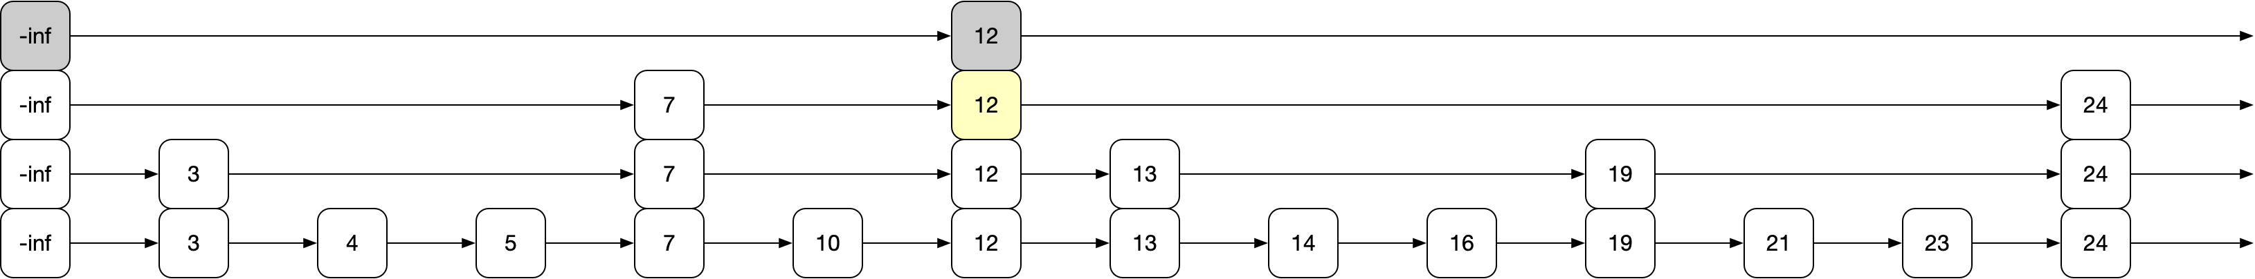
Puig's Skip List
The key in the next node is 25, which is larger than 23
Go down

Slide 26
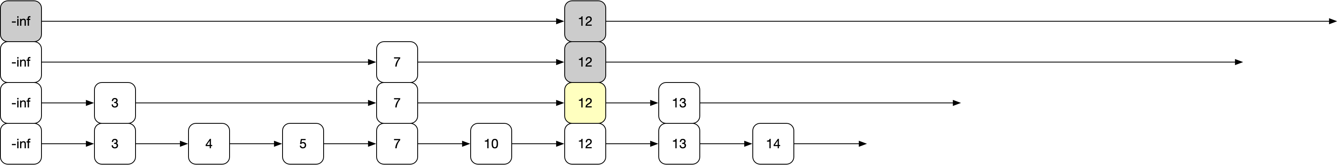
Puig's Skip List
The key in the next node at this level is 24, which is larger than 23
Go down one more to level 1

Slide 27
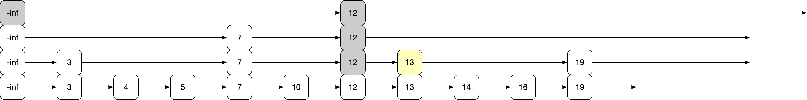
Puig's Skip List
The key in the next node is 13, so we follow the next link
The current node now has key 13 and is at level 1
Since the key in the next node is 19, which is < 23 we follow the next link

Slide 28
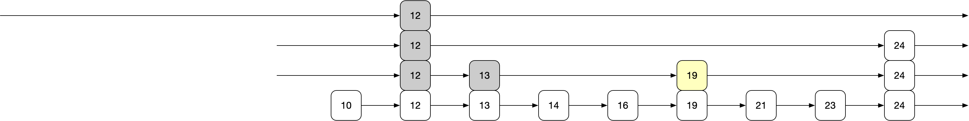
Puig's Skip List
Current node has key 19 and next node has key 24
Therefore, we follow the downward pointer

Slide 29
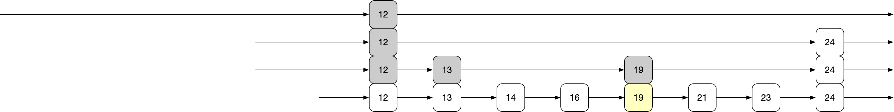
Puig's Skip List
Current node has level 0, next node has key 21
Set current node to the next node

Slide 30
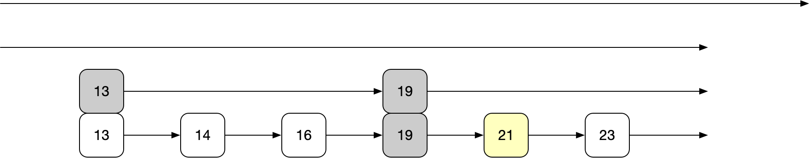
Puig's Skip List
Current node has key 21 and next node has key 23
Go to it

Slide 31
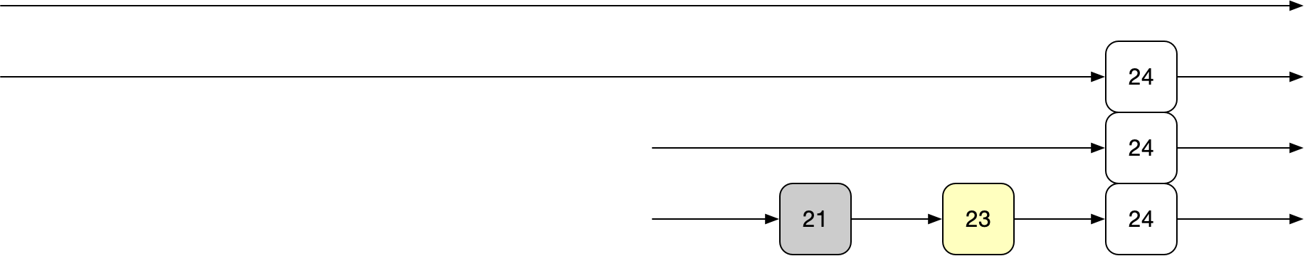
Puig's Skip List
Current node has the key we are looking for
Follow the record link to retrieve the record

Slide 32
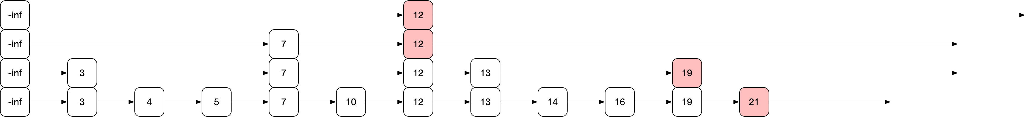
Puig's Skip List
To insert a node:
  Do a search, but remember each last level node
  Example: Inserting 22

Slide 33
Puig's Skip List
Node insertion:
  Determine the level probabilistically
    Use base probability p
    With probability $p$ : Node goes up one level
    With probability $p^{2}$: Node goes up two levels
    With probability $p^{3}$: Node goes up three levels
    etc.

Slide 34
Puig's Skip List
Node Insertion:
  In practice: determine a maximum level maxLevel
import random
def level(maxLevel, p):
level = 0
while (level < maxLevel):
if random.random() > p: #stop with probability 1-p
return level
level += 1

Slide 35
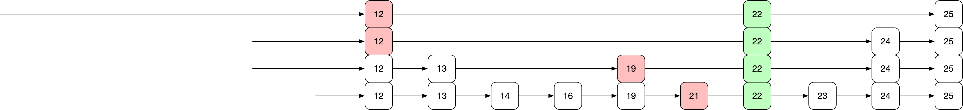
Puig's Skip List
At each level of the node, splice the node into the existing levels
Assume we have a level 4 new node
Need to set four next pointers in the new nodes
Switch the predecessor pointers to the new nodes

Slide 36
Puig's Skip List
Final result:

Slide 37
Puig's Skip List
Deletion:
  Works similar to ordered linked lists

Slide 38
Puig's Skip List
Analysis
  To show: Searches (inserts, and deletes) in time $Θ(logn)$ for a list of $n$ elements
  Can show: Probability that a search exceeds time $Clog(n)$ vanishes fast

Slide 39
Puig's Skip List
The expected number of nodes in each level is
    $np^{0}=n$ for level 0
    $np^{1}=pn$ for level 1
    $np^{2}=p^{2}n$ for level 2
    etc.

Slide 40
Puig's Skip List
Define $L(n)$ to be the level (in dependence on $n$) where there are $\frac{1}{p}$ nodes.
  Recall that $\frac{1}{p}$ is larger than one
  From what we just have seen:
    $np^{L(n)}=\frac{1}{p}$
  which implies
    $n={\frac{1}{p}}^{L(n)+1}$ or $L(n)=\log_{\frac{1}{p}}(n)-1$

Slide 41
Puig's Skip List
Analysis:
  Trick: go backward from node
    Although all nodes and levels are known, we act as if we discover them while backtracking the search path
  Let $c(k)$ be the costs of going up $k$ levels in an infinite list
    When we go towards the beginning, we either can move up (with probability $p$) or move right (with probability $1-p$)

Slide 42
Puig's Skip List
  $$c(k)=p(1+\text{cost move up})+(1-p)(1+\text{cost move left})$$
  $=p(1+c(k-1))+(1-p)(1+c(k))$
  $=p+(1-p)+pc(k-1)+(1-p)c(k)$
  $=1+p⋅c(k-1)+(1-p)⋅c(k)$
  This means (by subtracting $(1-p)⋅c(k)$ on both sides
  $p⋅c(k)=1+p⋅c(k-1)$
  or $c(k)=\frac{1}{p}+c(k-1)$.
  This implies $c(k)=\frac{k}{p}$.

Slide 43
Puig's Skip List
Since we are in an infinite list, we cannot just set $k=∞$.
Let's set $k=L(n)$.
At that level, there are $1/p$ nodes and $1/p$ leftward moves
At level $L(n)+1$, we expect one node
At level $L(n)+2$, we have on average $p$ nodes
etc.
In total, there are $\overset{∞}{\underset{l=1}{∑}}p^{l-1}=\frac{1}{1-p}$ nodes at and above $L(n)$

Slide 44
Puig's Skip List
Therefore:
  $L(n)/p$ moves to get to level $L(n)$
  Afterwards, on average $\frac{1}{1-p}$ moves to the top of the initial node
For a total of $\frac{L(n)}{p}+\frac{1}{1-p}=\frac{\log_{\frac{1}{p}}n}{p}++\frac{1}{1-p}=Θ(log(n))$

Slide 45
Puig's Skip List
Practical considerations:
  If we have an idea about the maximum length $N$ of a list, use a maximum level of $L(N)=\log_{\frac{1}{p}}(N)$
  We do not need to keep nodes at different levels separate:
    Just have nodes with $L(N)$ pointers at different levels

