Slide 1
Reductions
Thomas Schwarz, SJ

Slide 2
Reduction
So far we have shown:
  There are problems that are not tractable algorithmically
    Halting Problem
  We defined a class $P$ of problems that are considered computationally tractable, even as the instance size scales up
  We have defined a class $NP$ of problems where we can verify a solution effectively

Slide 3
Reduction
Fundamental Conjecture in Complexity
  $$P≠NP$$
Reason why people believe in this conjecture
  There are problems that are $NP$-complete
A problem $P∈NP$ is $NP$-complete if
  $$(P∈P)⇒(P=NP)$$

Slide 4
Reduction
Can use the solution of one problem to solve another problem
Example: Matrix multiplication and Matrix Squaring
  If you can solve matrix multiplication, you can certainly solve matrix squaring
  However, it also works the other way around:
    Multiply square matrix $A$ with square matrix $B$
    Calculate left side of ${\left(\begin{matrix}0 & A \\ B & 0\end{matrix}\right)}^{2}=\left(\begin{matrix}AB & 0 \\ 0 & BA\end{matrix}\right)$
  From the algorithmic standpoint: squaring a matrix is exactly as complicated as multiplying two matrices

Slide 5
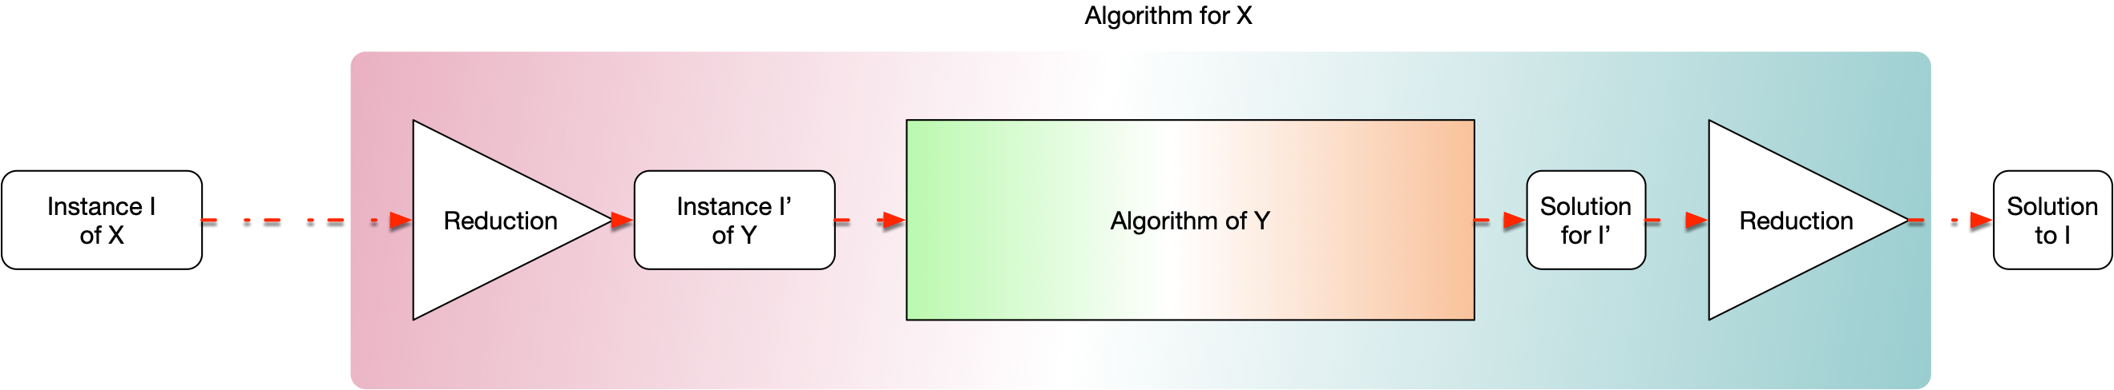
Reduction
Formally, problem X reduces to problem Y if there is a reduction that converts instances of X to instances of Y and a translation that takes a solution of Y and makes it into a solution for X that solves the original instance.

Slide 6
Reduction
Matrix multiplication reduces to matrix squaring
  Reduce: Given $A,B$, construct $\left(\begin{matrix}0 & A \\ B & 0\end{matrix}\right)$
  calculate the square
  translate result $\left(\begin{matrix}AB & 0 \\ 0 & BA\end{matrix}\right)⟶AB$

Slide 7
Reduction
We usually apply reduction to existence problems
  Answer is True/False
  No translation is needed

Slide 8
Reduction
X reduces polynomially to Y
  Reduction works in polynomial time
Write $X≤_{P}Y$
  Read( Y is at least as hard as X)

Slide 9
Reduction
Assume $X≤_{p}Y$ and $Y∈P$. Then $X∈P$.
Proof: if we have a polynomial reduction, then the diagram below explains how we get a polynomial time algorithm for X

Slide 10
A New Formal Definition of
$NP$ - complete
$X∈NP$ is $NP-\text{complete}$
  IF AND ONLY IF
$$∀Y∈NP:Y≤_{P}X$$

Slide 11
A New Formal Definition of
$NP$ - complete
Theorem:
  $X∈NP$-complete AND $X∈P$
    IMPLIES
  $$P=NP$$

Slide 12
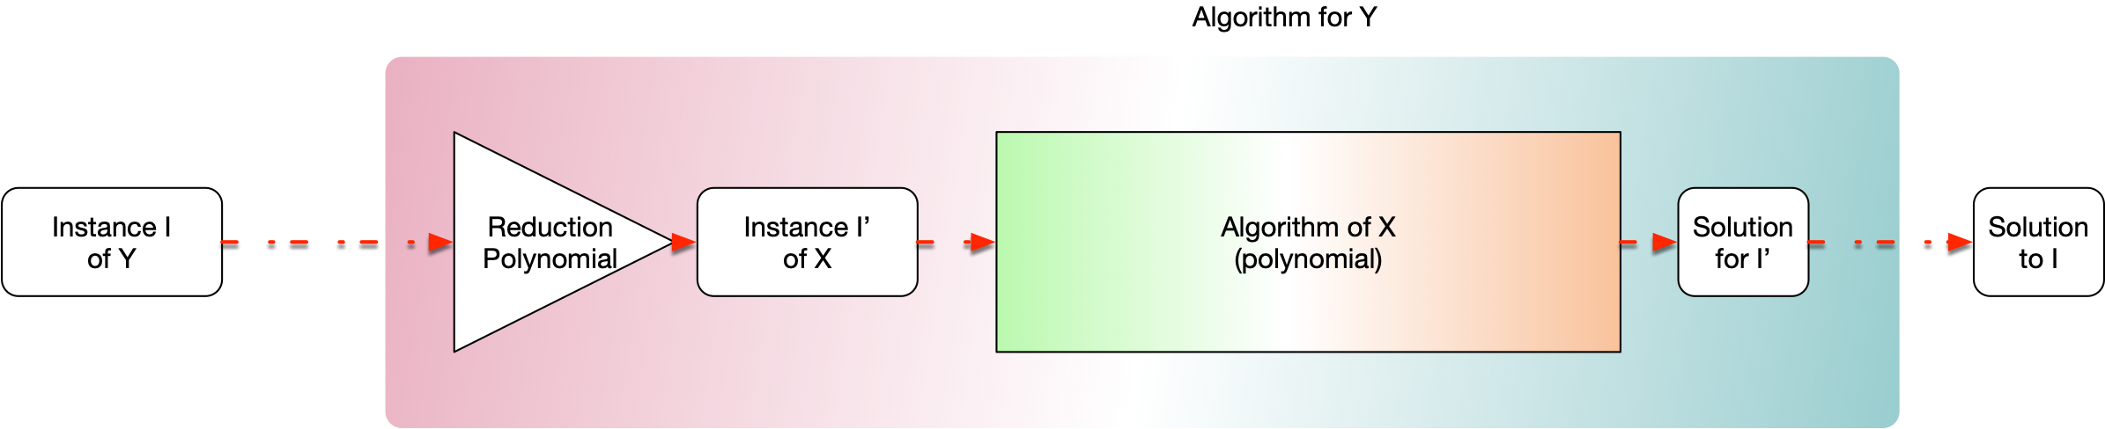
A New Formal Definition of
$NP$ - complete
Proof:
  If $Y∈NP$, then by completeness
  $$Y≤_{P}X$$
  Thus:
  There is a polynomial time algorithm for Y
  Thus: $Y∈P$

Slide 13
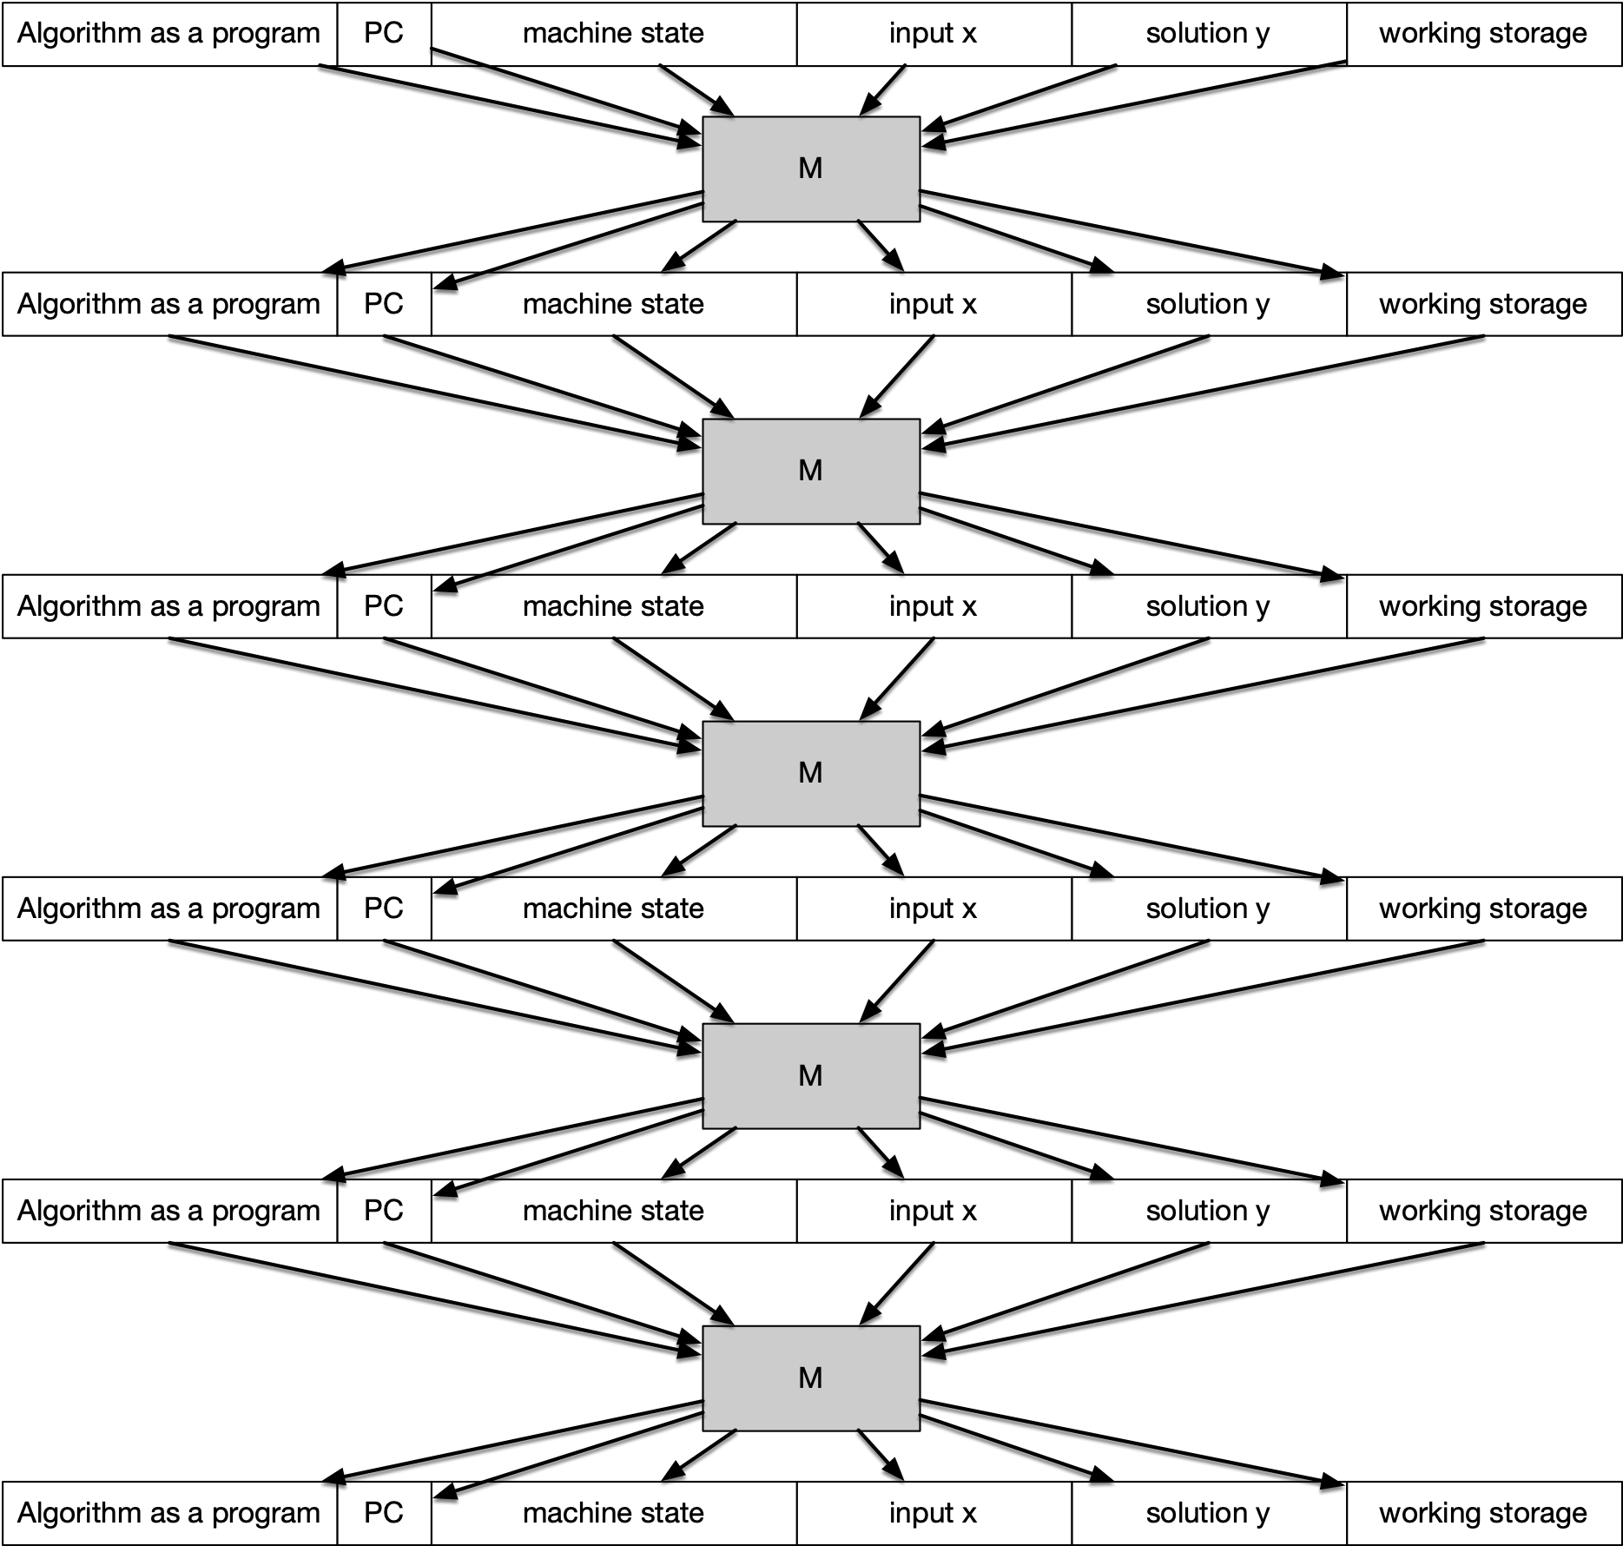
A New Formal Definition of
$NP$ - complete
Circuit Satisfiability is $NP$ - complete
  We have argued that we can express any problem in $NP$ using a circuit
Guessed Solution
This reduces the problem to Circuit Satisfiability
Therefore:
  Circuit Satisfiability remains $NP-\text{complete}$
Verifier

Slide 14
Family of $NP$-complete problems
Boolean Formula Satisfiability:
  Given a boolean formula, determine whether there is an assignment to the variables such that the formula becomes true
  Given an assignment, can check the truth value of the formula in polynomial time
  Thus, Boolean Formula Satisfiability is in $NP$
$$(x⇒\overline{y})∨(x∧y∨z)∨(x∧\overline{y}∧\overline{z}∧(x⊕y))$$

Slide 15
Family of $NP$-complete problems
We can reduce boolean formula satisfiability to boolean circuit satisfiability
  Need to show that boolean circuit satisfiability is at least as hard as boolean formula satisfiability
  Given an instance of boolean circuit satisfiability, show that it can be reduced to boolean formula satisfiability

Slide 16
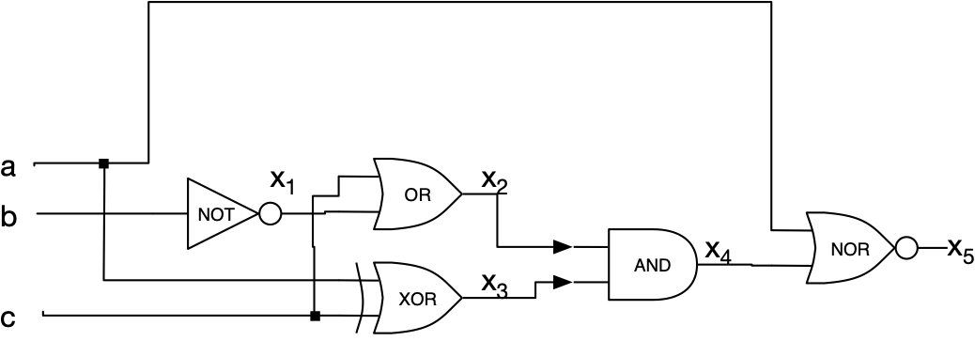
Family of $NP$-complete problems
Need to "translate" a boolean circuit into a formula
Each circuit element becomes part of a Boolean formula
$x_{1}=\overline{b}$, $x_{2}=c∨x_{1}$, $x_{3}=a⊕c$, $x_{4}=x2∧x3$ $x_{5}=¬(x_{4}∨a)$
Make this into a single formula
$$x_{1}=(¬b)∧(x_{2}=c∨x_{1})∧…$$

Slide 17
Family of $NP$-complete problems
Final formula is satisfiable exactly if the circuit is satisfiable
Translation is in polynomial time

Slide 18
Family of $NP$-complete problems
3-SAT : Satisfiability of a boolean formula in conjunctive normal form with clauses with three literals
$$(a∨\overline{b}∨c)∧(a∨a∨c)∧(b∨\overline{d}∨d)∧(\overline{a}∨\overline{d}∨\overline{f})…$$

Slide 19
Family of $NP$-complete problems
Reduction to Boolean Formula Satisfiability
  Need to transform the boolean circuit satisfiability problem to 3-SAT
  Reduction: $3-\text{SAT}≤_{P}\text{Boolean Circuit Sat}$
  As before, describe the circuit in a boolean formula
  However, now each gate can be expressed with only three-clause conditions:

Slide 20
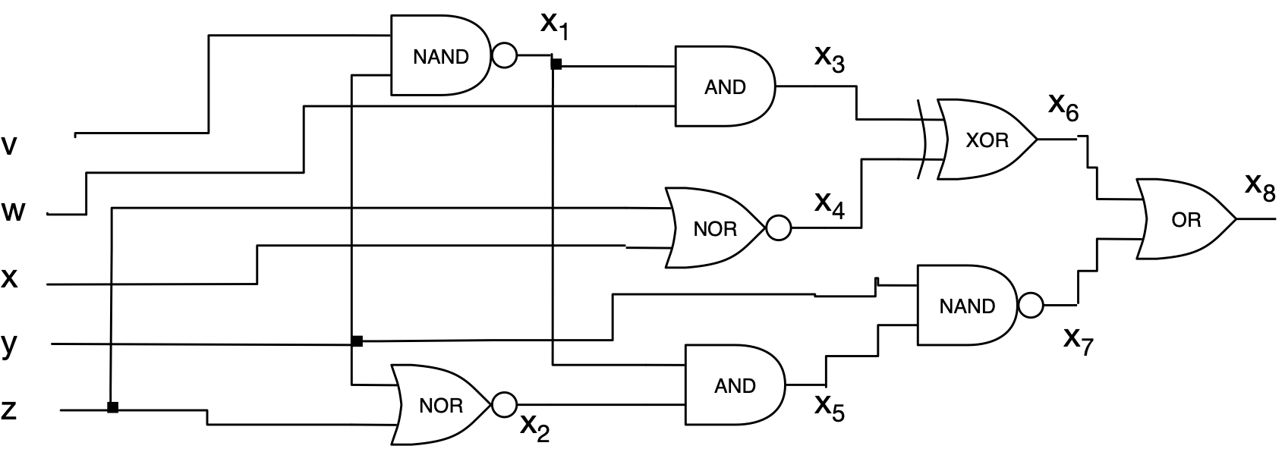
Family of $NP$-complete problems
Translate the circuit into one with two-entry boolean gates
$$\left(x_{1}=¬(v∧y)\right)∧\left((x_{2}=¬(z∨y))\right)∧\left(x_{3}=x_{1}∧w\right)∧\left(x_{4}=¬(x∨z\right)∧$$
$$\left(x_{5}=x_{1}∧x_{2}\right)∧\left(x_{6}=x_{3}⊕x_{4}\right)∧\left(x_{7}=¬(y∧x_{5})\right)∧\left(x_{8}=x_{6}∨x_{7}\right)∧x_{8}$$

Slide 21
Family of $NP$-complete problems
Clauses directly represent gates
Transform the clauses into conjunctive normal form with three literals
  Trick
    $$x=(x∨p∨q)∧(x∨¬p∨q)∧(x∨p∨¬q)∧(x∨¬p∨¬q)$$
    $$x∨y=(x∨y∨p)∧(x∨y∨¬p)$$
This blows up the representation, but only by a constant amount

Slide 22
Family of $NP$-complete problems
As before, the circuit is satisfiable if and only if the formula is satisfiable
Ergo: We can solve 3-SAT implies we can solve Boolean Circuit Satisfiability

Slide 23
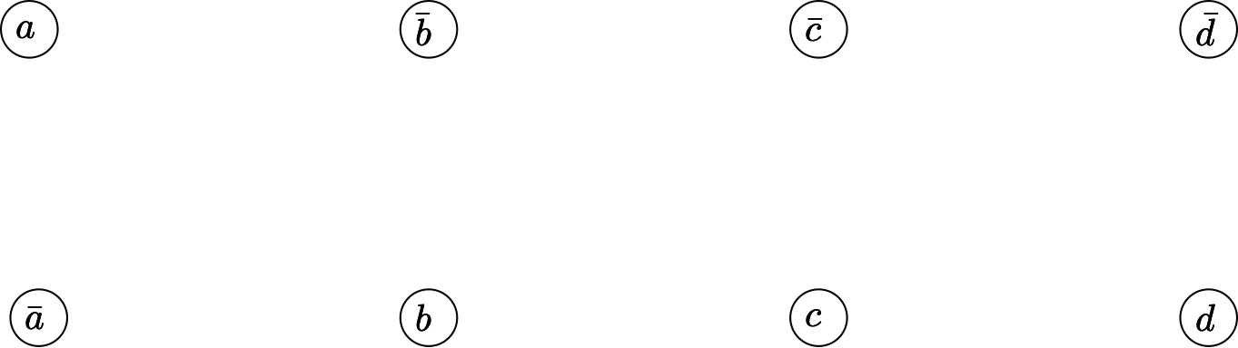
Family of $NP$-complete problems
What about 2-SAT
  Clauses are of the form $(a∨b)$, which is equivalent to $¬a⇒b$
  Create a graph:
    Vertices are variables and their negation

Slide 24
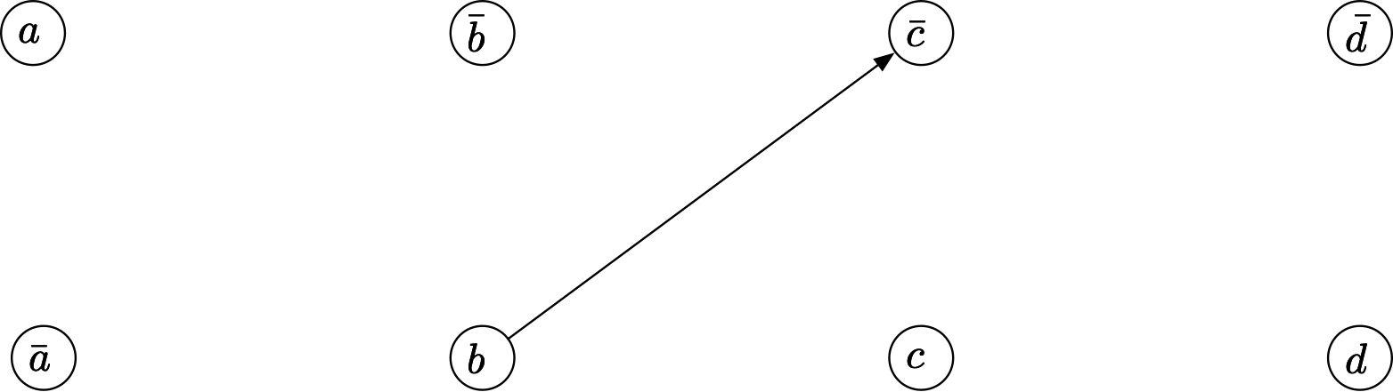
Family of $NP$-complete problems
Draw an edge if there is a clause equivalent to $x⇒y$ in the formula
$b⇒¬c$ is equivalent to $(¬b∨¬c)$

Slide 25
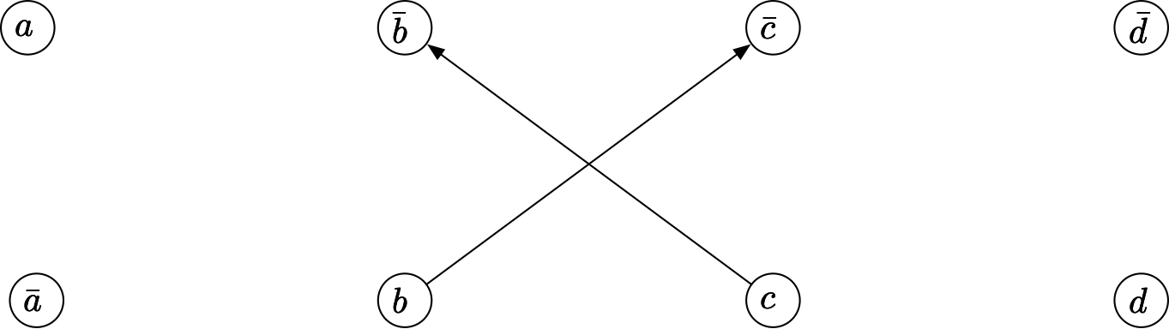
Family of $NP$-complete problems
Draw an edge if there is a clause equivalent to $x⇒y$ in the formula
$b⇒¬c$ is equivalent to $(¬b∨¬c)$
which is equivalent also to $c⇒¬b$

Slide 26
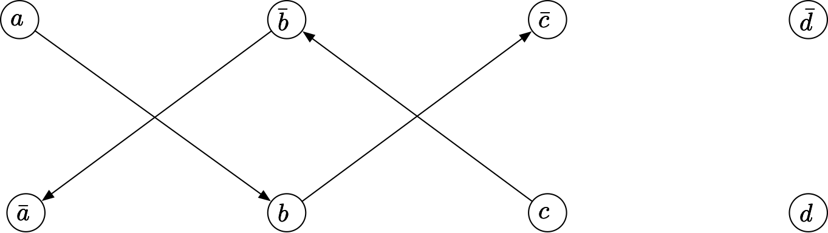
Family of $NP$-complete problems
Draw an edge if there is a clause equivalent to $x⇒y$ in the formula
$a⇒b$ means $(¬a∨b)$
which also means $¬b⇒¬a$

Slide 27
Family of $NP$-complete problems
Assume that $x$ and $¬x$ are in a cycle. Then we can conclude that $x$ implies $¬x$ that implies $x$.
Thus, there is no possibility to find a truth assignment that works
If there is never such a cycle, then we just start with one variable and assign it true, then we follow the implications et cet.

Slide 28
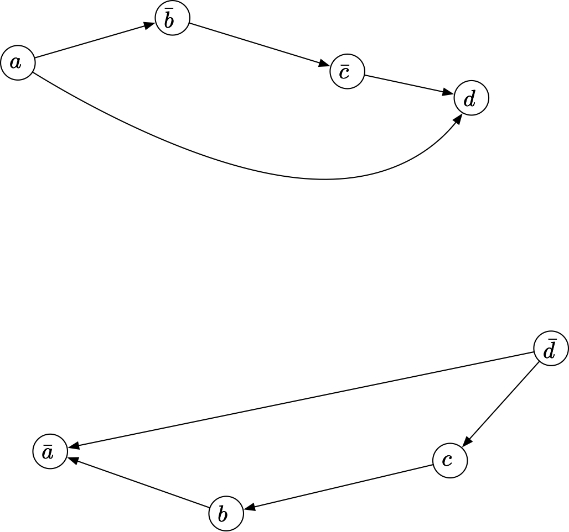
Family of $NP$-complete problems
Example:
  Assign b=True
  Then a=False
  Then c=True
  Then d=False

Slide 29
Family of $NP$-complete problems
To calculate this, we calculate the strongly connected components
If there is a component that contains at most one of a variable and its negation, then assign those literals True
  By working through all the components, we obtain a satisfiable assignment
If there is a component that contains both a variable and its negative, then the formula is not satisfiable
ERGO: we can solve 2-SAT with DFS in polynomial time

Slide 30
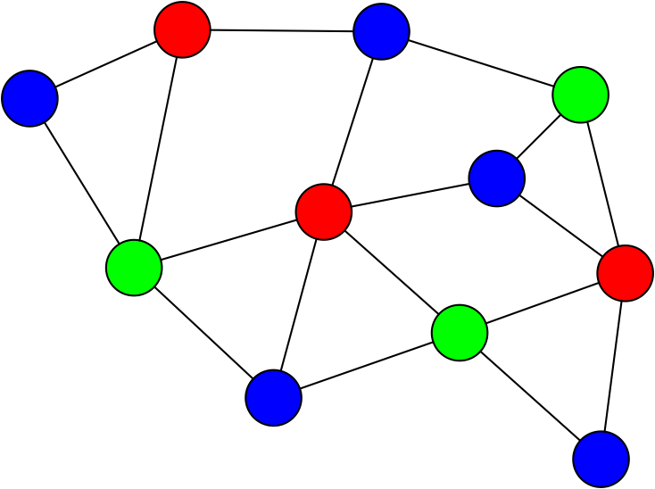
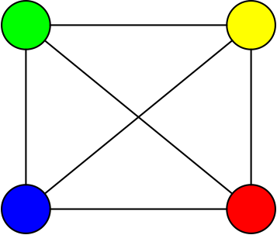
Graph 3-Colorability
Graph 3-colorability
  Given a graph, can we color its vertices with three colors such that no edge is between vertices with the same color
3 colorable
not 3 colorable

Slide 31
Graph 3-Colorability
Claim: $3-\text{SAT}≤_{P}3-\text{color}$
Given a $3-\text{SAT}$ instance, we construct (in polynomial time) an instance of $3-\text{color}$ such that the graph is colorable if and only if the boolean formula is satisfiable

Slide 32
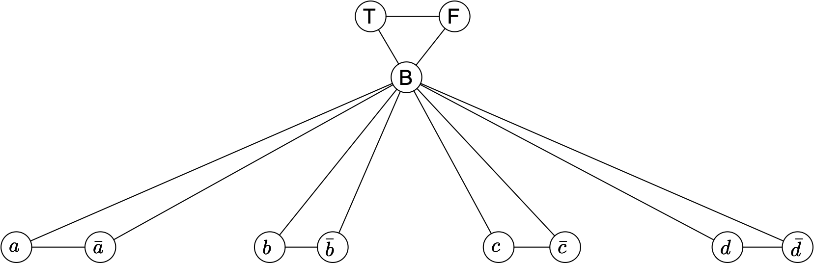
Graph 3-Colorability
We create a node for each variable and its negation
We also create a triangle with labels B, False, and True
Connect as shown below

Slide 33
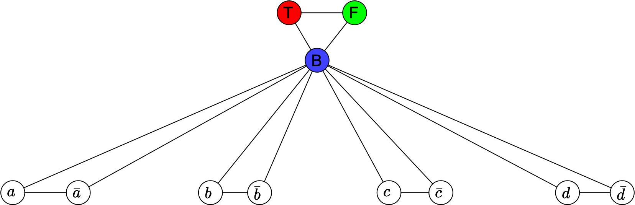
Graph 3-Colorability
This graph is clearly colorable
  Start with the upper triangle

Slide 34
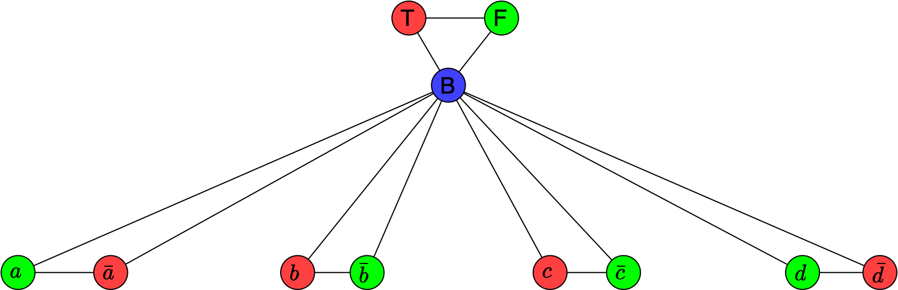
Graph 3-Colorability
Then for each variable, we get to decide whether we want to color the variable or its negation with the same color as True
This "encodes" a truth assignment to the variables

Slide 35
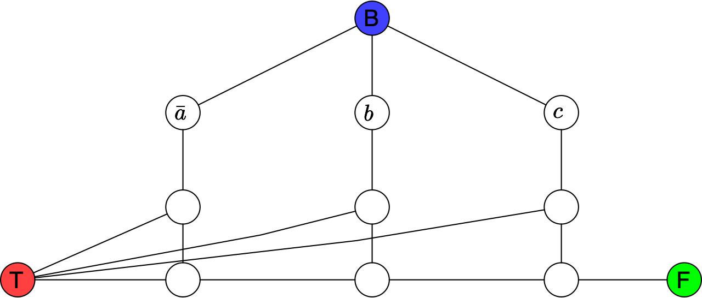
Graph 3-Colorability
Add for each clause in the formula a 6-node 13-edge gadget
  Add the six nodes, then add edges as shown below
Example: $¬a∨b∨c$

Slide 36
Graph 3-Colorability
If the graph is three colorable, then:
  The gadget ensures that at least one element in the clause is True
Example: $¬a∨b∨c$

Slide 37
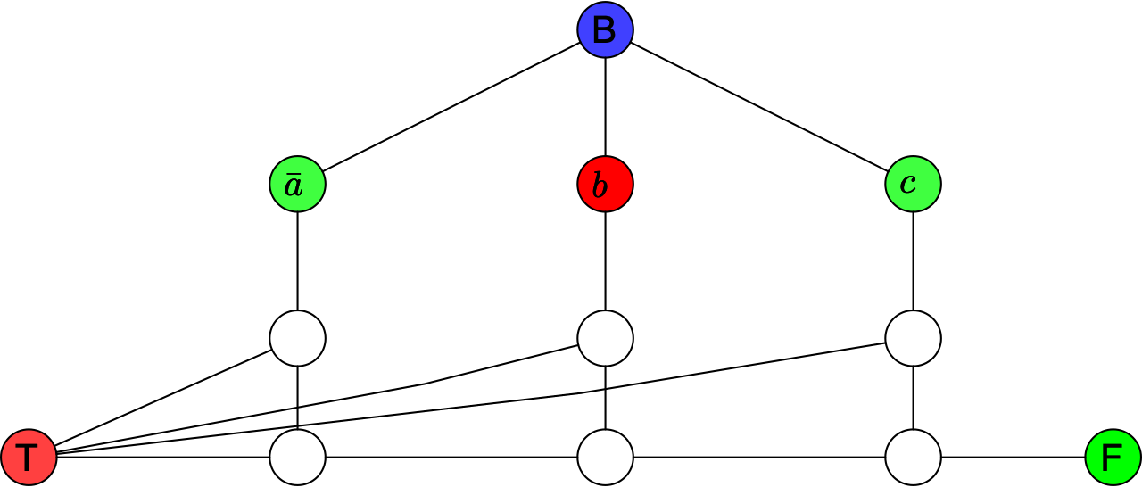
Graph 3-Colorability
Assume that we have an assignment to the variables that satisfies the formula and all of the clauses
  Clause is $¬a∨b∨c$ and $a$ and $b$ are true and $c$ is false
  Color the variable nodes accordingly:

Slide 38
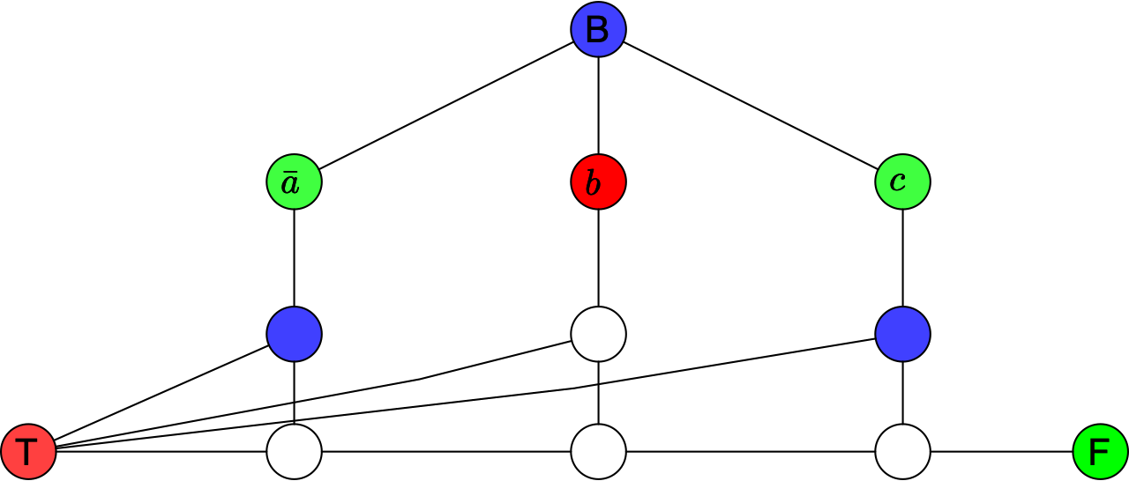
Graph 3-Colorability
Some node colors now follow by necessity

Slide 39
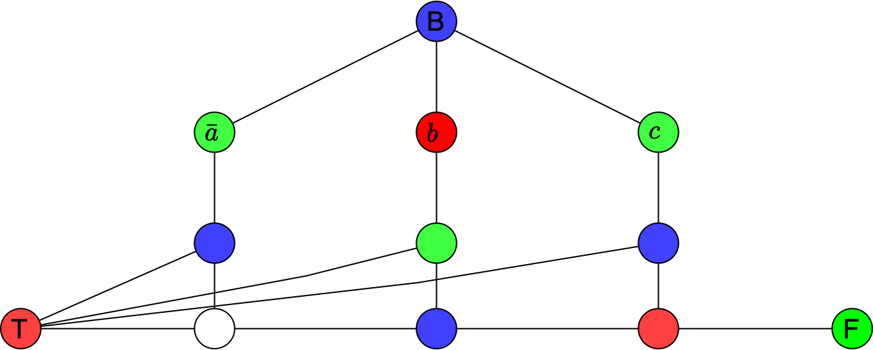
Graph 3-Colorability
Color the node under a True-colored vertex with the False color and the one underneath with Blue

Slide 40
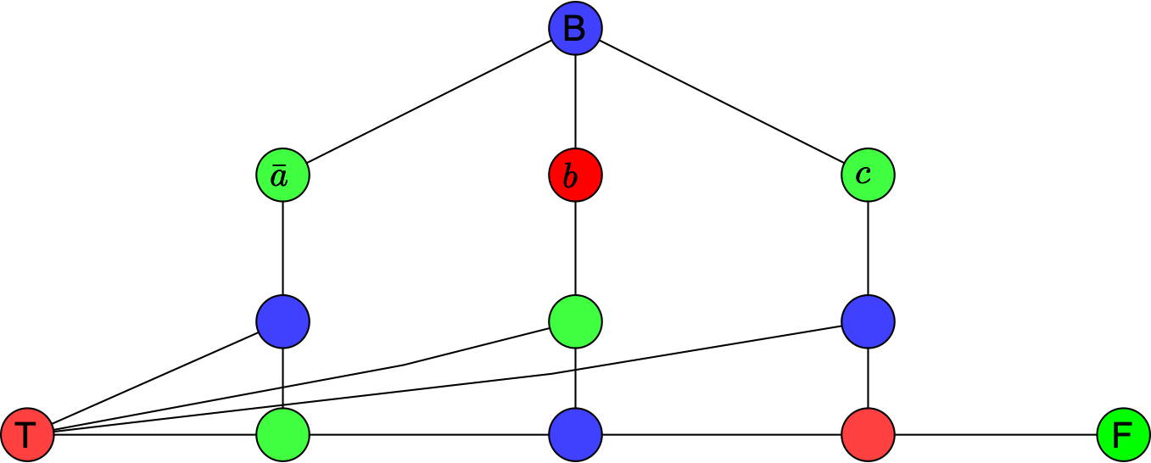
Graph 3-Colorability
The last vertex color follows

Slide 41
Graph 3-Colorability
This gadget is now three-colored
  Do the same thing for all gadgets
  Get a three coloring of the graph

Slide 42
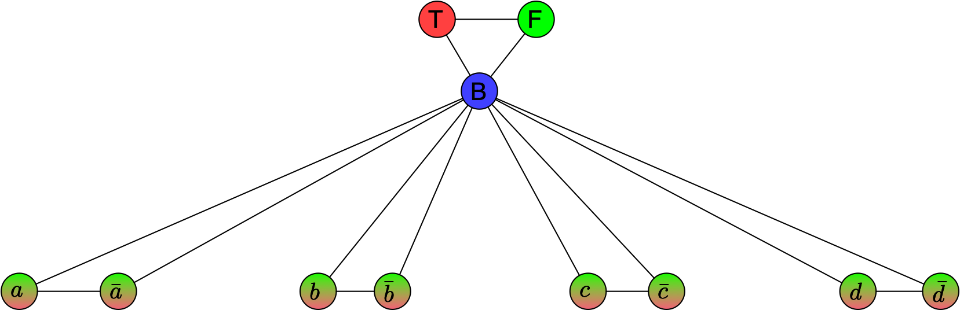
Graph 3-Colorability
Vice versa, assume that you have a three coloring
The base part of the graph assures that each literal is colored either with Red (for True) or with Green (for False)

Slide 43
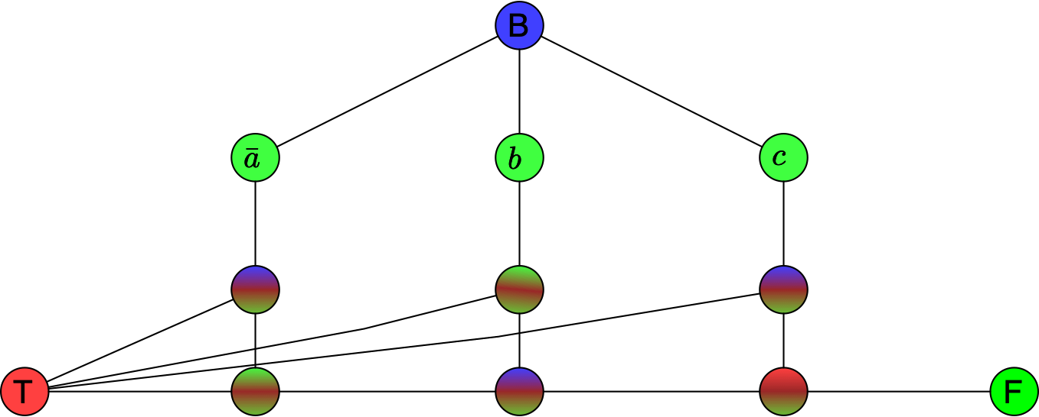
Graph 3-Colorability
If the three coloring where to assign Green (the color of Falsehood) to the literal nodes, then what would happen

Slide 44
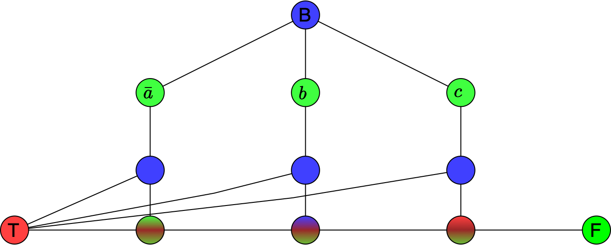
Graph 3-Colorability
We can deduce some colors
  The middle layer of nodes has to be blue, because they have a Red neighbor (the true node) and a Green neighbor

Slide 45
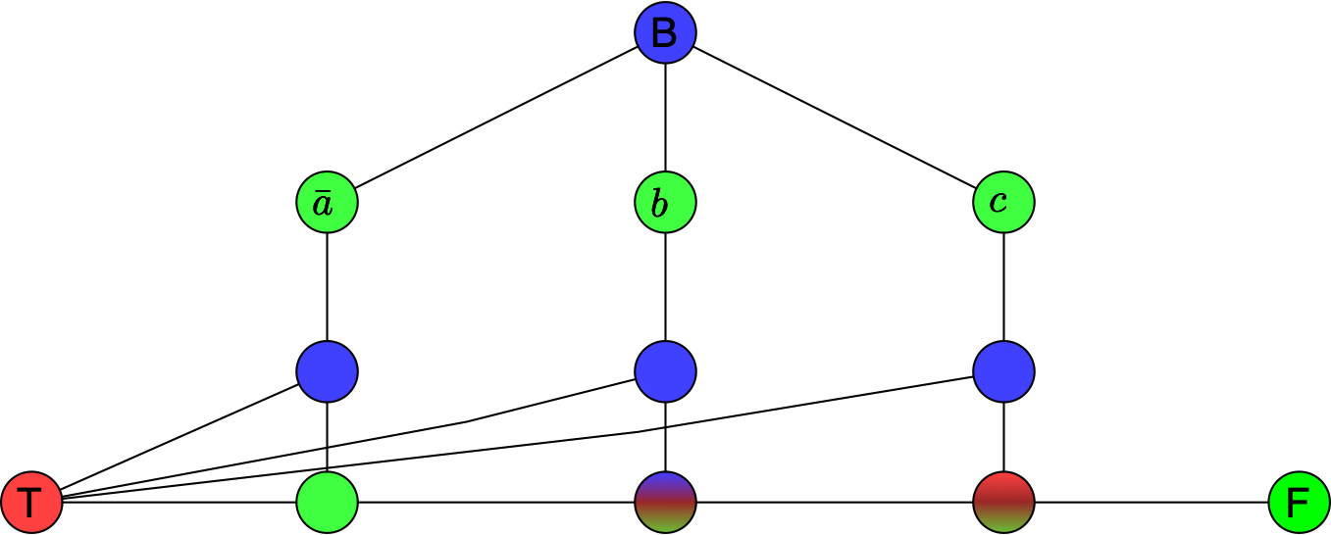
Graph 3-Colorability
The vertex on the lower row and to the left needs to be Green because it has a Blue and a Red neighbor

Slide 46
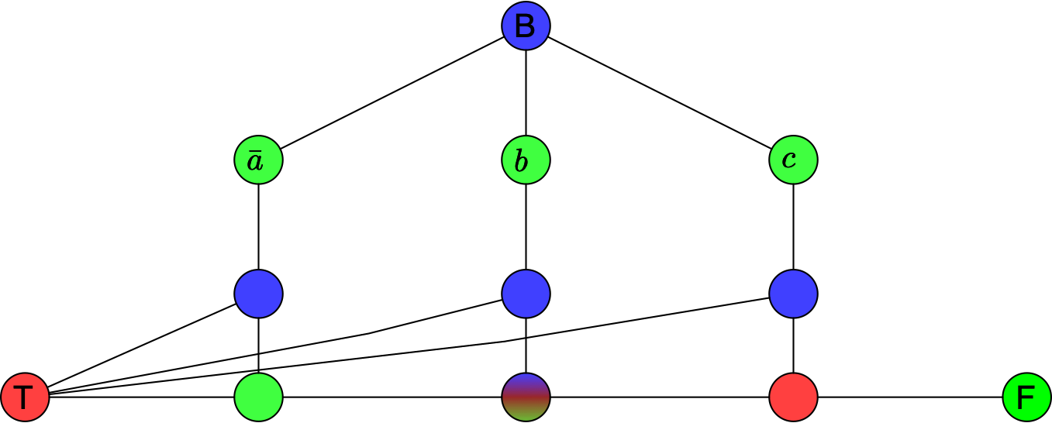
Graph 3-Colorability
The vertex on the lower row on the right has to be Red

Slide 47
Graph 3-Colorability
But now the middle node has a Red, a Green, and a Blue neighbor
Thus the graph is not 3-colorable
Therefore: The graph is 3-colorable implies that in the gadget, one vertex is colored Red (the color of Truth)
  Not to be confused with https://www.youtube.com/watch?v=8epG4AezdYg which is just propaganda but the color of the Holy Spirit

Slide 48
Graph 3-Colorability
So, the complete graph is 3-colorable if in all gadgets at least one of the literal nodes is colored Red
Then all clauses are satisfied
Then the formula is satisfied

Slide 49
Consequences
There is a large set of known NP-complete problems
  Many problems that appear in practice can be shown to be NP-complete
    You look through the catalogue of NP-complete problems and reduce your problem to one of them
    (If I can solve my problem polynomially, then I can solve that problem polynomially, but that would mean that $P=NP$, which we believe to be false)
  If this is the case:
    You cannot expect a solution that scales well
    But it might be perfectly solvable for the instance sizes that you need to solve

