Slide 1
Computability
Algorithms 2020

Slide 2
Hilbert’s Program
Grundlagenkrise in Mathematics (~ 1900):
  How to be sure that Mathematics is true
    Attempts suffer from paradoxes
      Example Naïve Set Theory: Russel’s set of all sets that do not contain themselves as an element
Answers to the Grundlagenkrise
  Intuitionism:
    Mathematics is a human activity, it does not discover universal truth
  Logicism:
    All mathematics derives from logic
  Formalism:
    Mathematics is a game with certain rules that conform to our thinking processes

Slide 3
Hilbert’s Program
A formulation of all mathematics
Completeness:
  Proof that all true mathematical statements can be proved in the formalism.
Consistency:
  Proof that no contradiction can be obtained in the formalism of mathematics.
Conservation:
  Proof that any result about "real objects" obtained using reasoning about "ideal objects" (such as uncountable sets) can be proved without using ideal objects.
Decidability
  There is an algorithm for deciding the truth or falsity of any mathematical statement.

Slide 4
Hilbert’s Program
Hilbert’s program:
  Find an algorithm that can decide the truth or falsity of an arbitrary statement in first-order predicate calculus applied to integers
Gödel’s incompleteness result (1931)
  No such effective procedure can exist

Slide 5
Hilbert’s Program
Formalization of “effective procedure”
  Each procedure should be described finitely
  Each procedure should consist of discrete steps, each of which can be carried out mechanically
  Number of proposals
    λ-calculus
    Turing machines (in different versions)
    RAM machines (computers with infinite memory)

Slide 6
Hilbert’s Program
Church Turing Result:
  λ-calculus and Turing machines have the same computational power
Church Hypothesis
  Turing machines are equivalent to our intuitive notion of a computer
  What is computable by a human is what is computable by a computer which is what is computable by a Turing machine

Slide 7
Turing
Early career is as a Mathematical Logician
  Idea: What is computable
  Proposes the Turing machine as a simple example of what a Mathematician can calculate (without the brilliance)
    I.e.: A very simple formal way to compute
    Idea: If something is possible in that simple system then a human Mathematician can do it as well

Slide 8
Turing
Entscheidungsproblem: Can every true statement in first order logic (with quantifiers) be derived in first order logic
Answers a dream of Gottfried Leibniz: Build a machine that could manipulate symbols in order to determine the truth values of mathematical statements.

Slide 9
Turing
Made it plausible that a Mathematician is not more powerful than the Turing calculus
Proved limitations on what a Turing calculus can achieve
Post thought that Turing’s machine was too complicated and proposed a cleaner definition of the machine

Slide 10
Post-Turing Machine
A Turing machine consists of
  An infinitely-long tape divided into squares that are initially blank (denoted by a symbol ‘b’)
  A read-write head that can read and write symbols
  A control unit that consists of a state machine
    In a given state and when reading a given symbol:
      The machine goes to a new state
      The machine writes a new symbol
      The machine moves to the left or the right by one step.

Slide 11
Post-Turing Machines
Turing machine input
  A string on the tape, with all other symbols being blanks.
Turing machine output
  Turing machines can make decisions:
    By writing them on the tape
    By entering an “accepting” or a “rejecting” state
    These possibilities are actually equivalent
http://morphett.info/turing/turing.html

Slide 12
Post-Turing Machines
Turing machine programs:
  A program consists of a set of transition rules:
    Current state, Current Symbol —> New State, New Symbol, Move
Note: All Turing machine programs are finite

Slide 13
Post-Turing Machine
Despite its simplicity, a Turing machine can imitate any computer (known today)

Slide 14
Post Turing Machine
Turing machine programs
  consists of lines
<curr. state> <curr. symb> <new symb> <dir> <new state>

Slide 15
Turing Machine Example
Palindrome detector
  Accepts if the input — binary string surrounded by blanks — is a palindrome
  Algorithm:
    Find the left-most symbol, erase it, and remember it
    Go to the right until we are over a blank
    Move one to the left and check the symbol, erasing it
    Continue until
      A discrepancy is discovered
      Until no more symbols are left over

Slide 16
Turing Machine Example
go to the left until we find a blank
now we are at the beginning of the word
  we erase the symbol, but remember the symbol (through the state) and go right
state0, 0, 0, left, state0
state0, 1, 1, left, state0
state0, b, b, right, state1
state1, 0, b, right, state_seen_zero
state1, 1, b, right, state_seen_one

Slide 17
Turing Machine Example
we go right until we hit a blank, then we go back one step to compare
state_seen_zero, 0, 0, right, state_seen_zero
state_seen_zero, 1, 1, right, state_seen_zero
state_seen_zero, b, b, left, state0end
state_seen_one, 0, 0, right, state_seen_one
state_seen_one, 1, 1, right, state_seen_one
state_seen_one, b, b, left, state1end

Slide 18
Turing Machine Example
We are now over the last symbol
  If the symbol does not match, we go to the non-acceptance state
  If the symbol matches, we start moving left until we hit the blank that we created
state0end, 1, b, stop, not_accepted
state0end, 0, b, left, state_go_left
state1end, 0, b, stop, not_accepted
state1end, 1, b, left, state_go_left

Slide 19
Turing Machine Example
We just go left until we hit the blank, at which point we go right and start over
state_go_left, 0, 0, left, state_go_left
state_go_left, 1, 1, left, state_go_left
state_go_left, b, b, right, state1

Slide 20
Turing Machine Example
When do we stop:
  If there are only blanks on the tape
    We are then in state1 and we encounter another blank
state1, b, b, stop, accept

Slide 21
Turing Machine Example
You can run this example at
  http://morphett.info/turing/

Slide 22
The Universal Turing Machine
We can extend the model of the Turing machine
  E.g. we can have Turing machines with two tapes
  But we do not get anything more,
    Because we can emulate a Turing machine with two tapes with a Turing machine with one tape
    How?
      Even cells are for tape 0, odd cells are for tape 1, and a more complicated state machine

Slide 23
The Universal Turing Machine
We can emulate a Turing machine with n tapes with a standard one
  This becomes a model for a RAM machine with n memory cells
  RAM machine stores program in some dedicated memory locations

Slide 24
The Universal Turing Machine
We can also build a universal Turing machine
  Initially: a Turing machine program plus input, separated by blanks
  Machine then simulates the execution of a Turing machine
  Machine halts when the simulated Turing machine halts

Slide 25
The Universal Turing Machine
A single machine that can emulate all possible Turing machines!!

Slide 26
Diagonalization Proofs
Mathematical technique developed by Cantor
  Trick is applying something to itself
  Example: We can count all rational numbers
    Use the following scheme

Slide 27
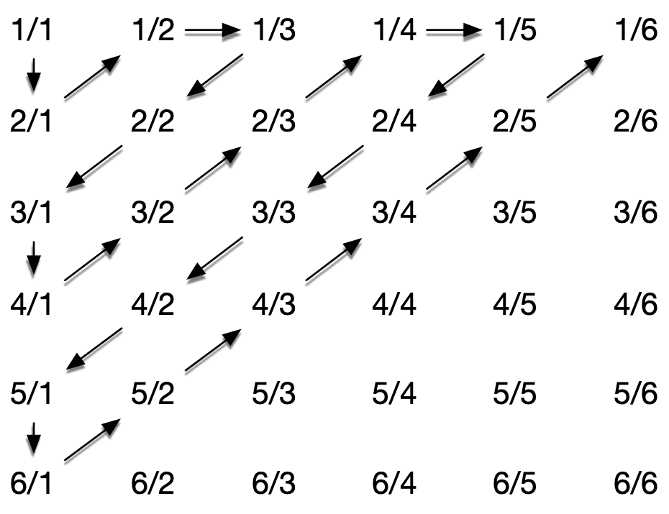
Diagonalization Proofs

Slide 28
Diagonalization Proofs
Cantor:
  The real numbers in [0,1] are not countable
  Assume that they are:
    Let be an enumeration of real numbers
    Write the numbers as binary numbers, leave out the leading dot
$$s_{1},s_{2},s_{3},s_{4},s_{5},…$$

Slide 29
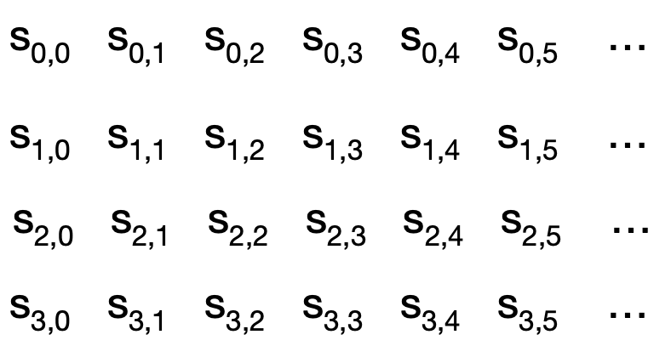
Diagonalization Proofs

Slide 30
Diagonalization Proofs
Now define a new number defined by the enumeration itself
  The i^{th} binary digit of t is the opposite of the i^{th} digit of the i^{th} number
$$t_{i}=1-s_{i,i}$$

Slide 31
Diagonalization Proofs
If this would be an enumeration of all real numbers in [0,1], then t would appear in the enumeration
  Suppose it is the j^{th} element
  Look at the j^{th} digit of t
  So, this is not possible
Ergo: we cannot enumerate the numbers in [0,1]
$$s_{j,j}=t_{j}=1-s_{j,j}$$

Slide 32
Diagonalization Proofs
This is a similar argument to Russell’s paradox:
  X = The set of all set that do not have themselves as an element.
  Is
$$X∈X$$

Slide 33
Diagonalization Proofs
The universal Turing machine allows us to do the same type of self-application to show impossibilities

Slide 34
Impossibility
Can everything (whatever that means) be computed
Halting Problem: Will a program stop executing
Answer: There is no algorithm that can decide whether a given program will stop executing
  Though most of the time, we can decide so easily

Slide 35
Proof: The Halting Problem is not-computable
Assume that we have a program that can decide the halting problem
  Input:
    A program — basically a long string
    An input
  Output: A decision — the program will halt on that input or the program will not halt on that input

Slide 36
Proof: The Halting Problem is not-computable
Assume that there is such a program
def halting(program, input):
      #something really complicated
      if b:
      return True
      else:
              return False

Slide 37
Proof: The Halting Problem is not-computable
Now, we create a new program
def z(program):
    if halting(program, program):
    while True:
    x = 0
    else:
    print(“I am done”)

Slide 38
Proof: The Halting Problem is not-computable
What happens if we calculate z(z)
  Perfectly legit, since z is a program
  Will z halt or not?
    If z halts on z,
      Then halting(z,z) is True.
      Then we execute “while True”
      Therefore z does not halt
def z(program):
    if halting(program, program):
    while True:
    x = 0
    else:
    print(“I am done”)

Slide 39
Proof: The Halting Problem is not-computable
What happens if we calculate z(z)
  Perfectly legit, since z is a program
  Will z halt or not?
    If z does not halts on z,
      Then halting(z,z) is False.
      Therefore we print “I am done”
      Therefore z does halt
def z(program):
    if halting(program, program):
    while True:
    x = 0
    else:
    print(“I am done”)

Slide 40
Proof: The Halting Problem is not-computable
This is a contradiction
  Therefore, the function halting cannot exist.
  Therefore, the halting problem cannot be solved by computation

