Slide 1
P and NP Complexity Classes
Algorithms

Slide 2
Motivation
Design of an algorithm is an important task of a Computer Scientist
  Need to show that an algorithm is correct
  Need to show how an algorithm behaves
  Need to know whether an efficient algorithm can exist

Slide 3
Motivation
Complexity Theory
  Presents classes of algorithms and suspects differences between them
  Needed to formulate modern cryptography

Slide 4
Class P
Most algorithms considered to be effective are polynomial time bound
In reality, algorithms with runtimes in are useless in many circumstances
Class P: set of problems for which there exists a polynomially bound algorithm that solves them
$$∃k∈N\text{runtime(n)}∈O(n^{k})$$
$$Ω(n^{k}),k>2$$

Slide 5
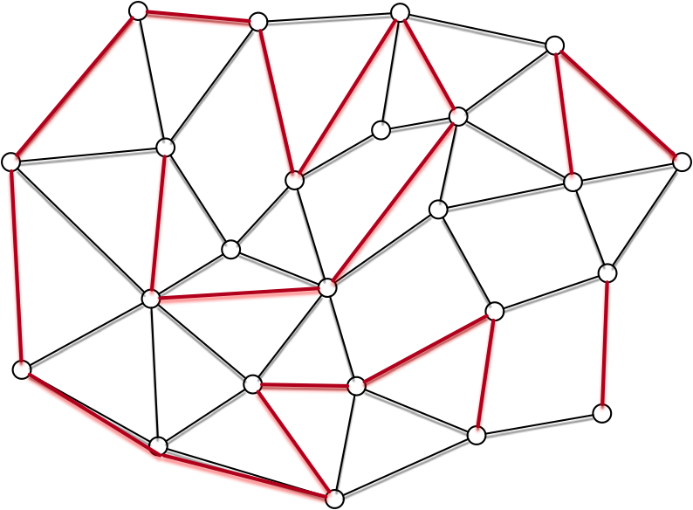
Class NP
Algorithms in P can be “efficiently” calculated
Sometimes, problems are hard to solve but easy to verify
Example: Finding a path of length n in a graph
NP: Class of problems for which a solution can be solved in polynomial time
Alternative Formulation: Can be solved by a non-deterministic algorithm that is polynomially bound
  The algorithm “guesses” a solution and then verifies it

Slide 6
A Conjecture and a Theorem
Conjecture:
Theorem: There exists problems such that
  These problems are called NP-complete
  The existence of NP-complete problems is evidence that the conjecture might be true
$$P≠NP$$
$$p∈NP$$
$$p∈P⟹P=NP$$

Slide 7
A Conjecture and a Theorem
There are very similar problems that are in different classes
  Graphs
    Eulerian tour: A cycle that visits every edge at least once (though it usually visits vertices several times):
    Hamiltonian cycle: A simple cycle that visits every vertex exactly once (but usually does not visit every edge)
$$P$$
$$NPC$$

Slide 8
A Conjecture and a Theorem
There are very similar problems that are in different classes
  Graphs:
    Shortest Path between two vertices
    Existence of a path of certain length
$$P$$
$$NPC$$

Slide 9
A Conjecture and a Theorem
There are very similar problems that are in different classes
  Satisfiability
    Given a boolean formula in conjunctive normal form, find a variable assignment that makes the formula true.
$$(¬a∨b)(a∨¬b∨c)(a∨c)(¬a∨b∨¬c)$$
$$a=1,b=1,c=1$$

Slide 10
A Conjecture and a Theorem
There are very similar problems that are in different classes
  Satisfiability
    Many problems can be formulated in terms of satisfiability

Slide 11

Human-Computer Authentication
Click in the triangle defined by the secret icons

Slide 12
Human-Computer Authentication
Safety question
  How many interactions do need to be observed in order to find the secret?
  One problem: people usually click on the center of the triangle
  Greater problem: Evaluation can be formulated as a satisfiability problem
    Good (non-P) algorithms exists to solve them usually fast
    Can be shown that few interactions need to be observed in order to deduce the secret

Slide 13
A Conjecture and a Theorem
There are very similar problems that are in different classes
  Satisfiability
    2-CNF Satisfiability
      Decide satisfiability if the or-clauses can have one or two variables
    3-CNF Satisfiability
      Decide satisfiability if the or-clause can have three (or less) variables
$$P$$
$$NPC$$

Slide 14
Existence vs. Solution
Decision problem: Answer is yes or no
Optimization problem: Find a feasible solution
Can change optimization problems into decision problem
  Example: Finding longest path in a graph
  Decision Problem: is there a path of length l
  Solve the decision problem repeatedly in order to find the maximum length of a path
  Once found the maximum length, remove edges one by one to see whether the maximum length has changed
  So, solving the decision problem allows you to find a solution

Slide 15
Encodings
We look at the run-time in dependence on the size of the problem
But the size of the problem can change if we use a different encoding
Example: Knapsack
  Rectangle is of size
  Can encode numbers in unary
    Then dynamic programming is in P
  Can encode numbers in binary
    Then dynamic programming is not in P
    If l is the number of digits, then rectangle is of size
$$n×m$$
$$2^{l}×2^{l}$$

Slide 16
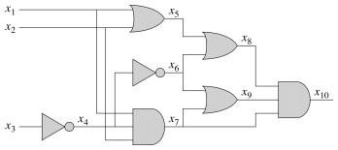
A first problem in NPC
A boolean circuit consists of the normal gates and has no cycles (input feeding back)
Decision problem: Is a circuit satisfiable, i.e. is there a selection of inputs such that the circuit output is 1

Slide 17
A first problem in NPC
Given a description of the circuit, we can check in polynomial time whether a given assignment satisfies the circuit

Slide 18
A first problem in NPC
Assume a decision problem in NP.
Thus, there exists an algorithm A that verifies a solution y for problem x in polynomial time
The idea is to translate this into a circuit

Slide 19
A first problem in NPC
The algorithm is executed on a computer with program counter PC, machine state, and working storage
The computer has as input the algorithm (program), the problem x and the solution

Slide 20
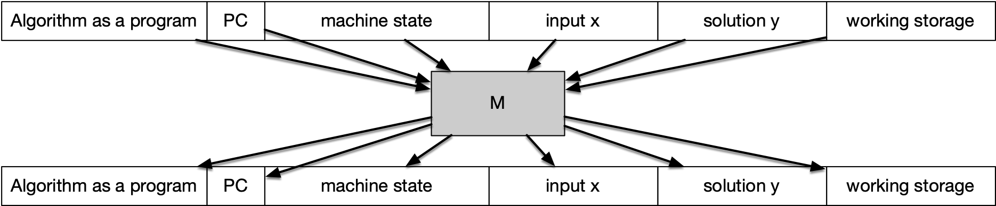
A first problem in NPC
The computer then executes a first step. This is emulated by a Boolean circuit.
The circuit M is independent of the instruction executed and the input

Slide 21
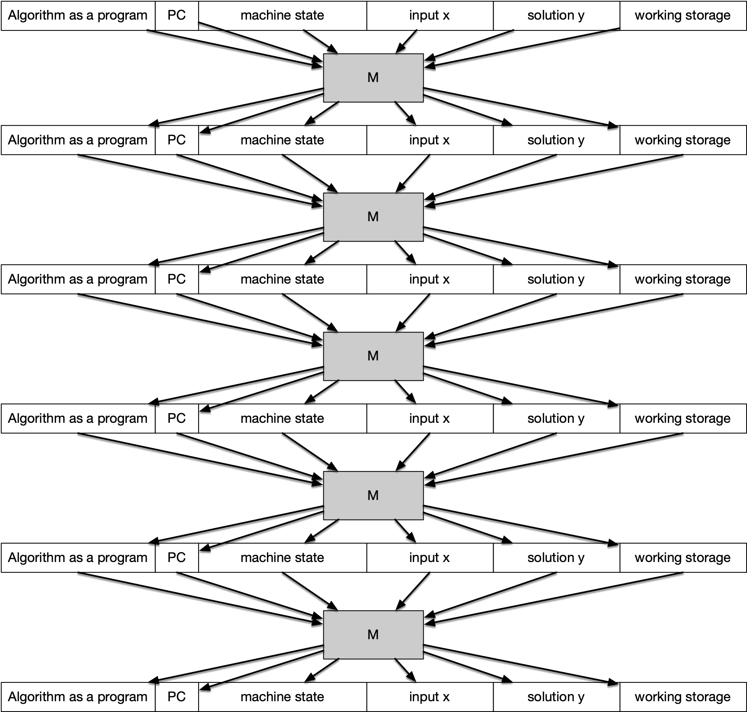
A first problem in NPC
We repeat this over and over

Slide 22
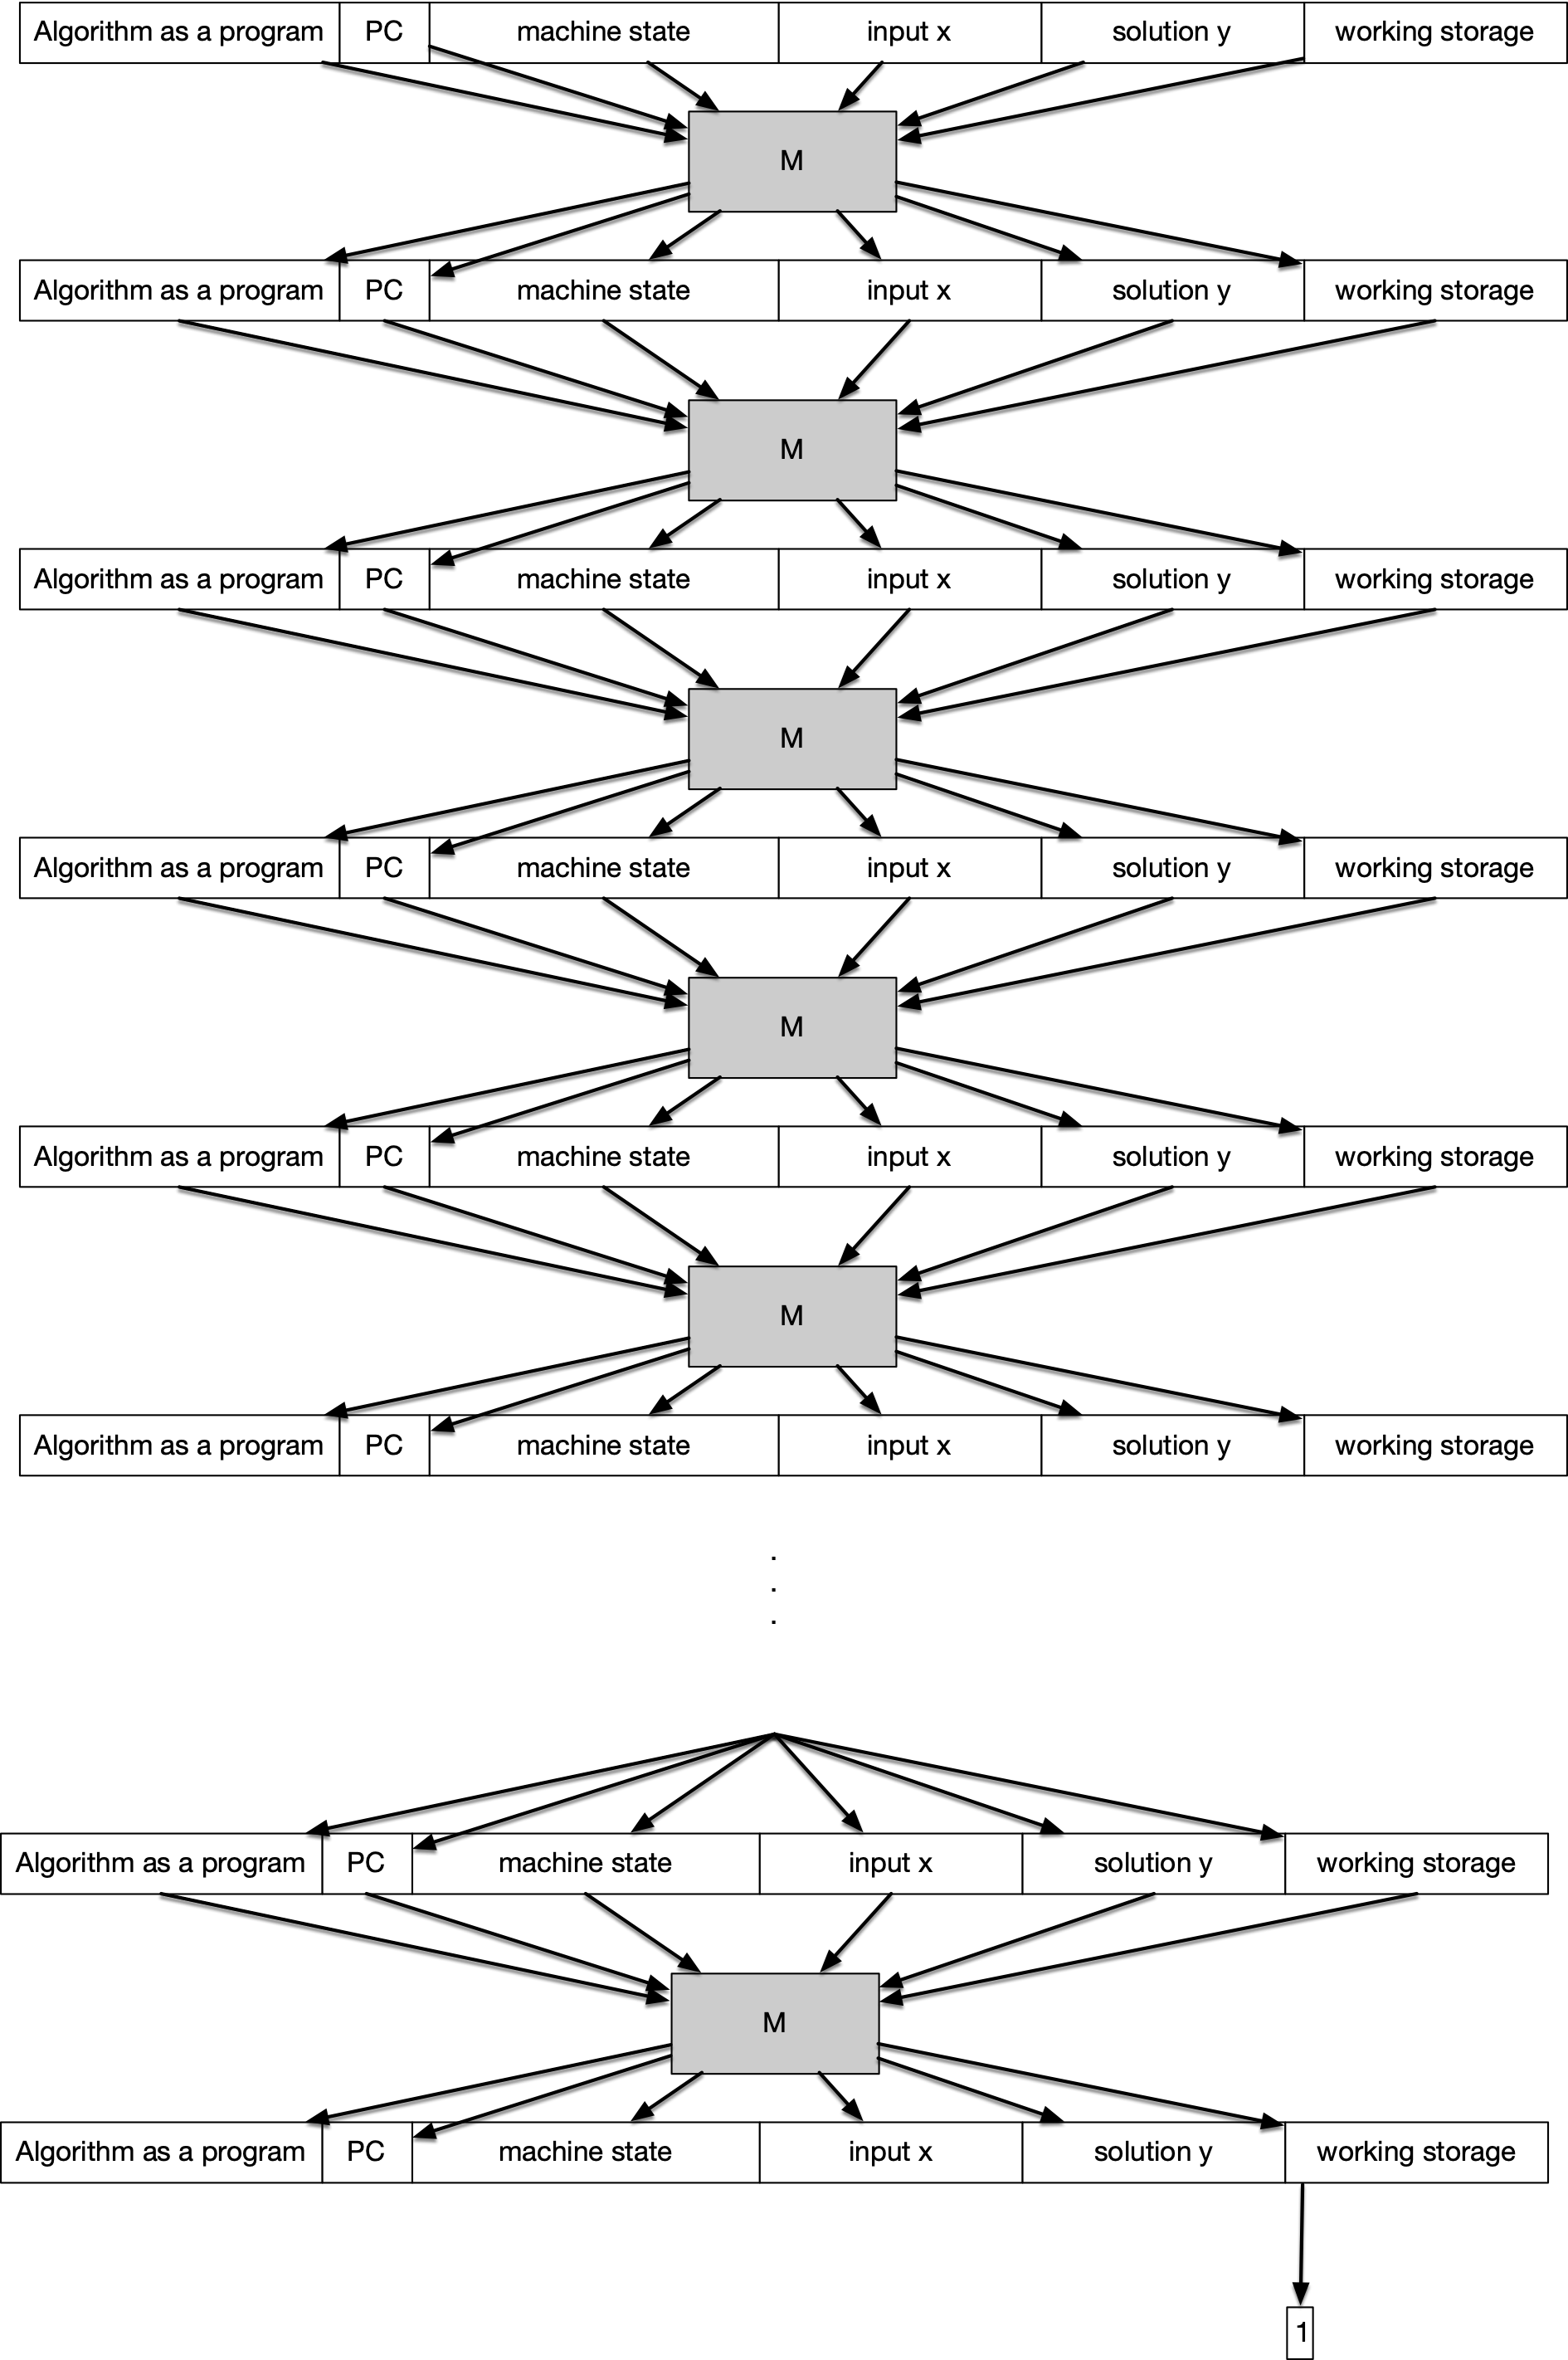
A first problem in NPC
Eventually, the first bit in working storage will contain the answer, 0 for failure and 1 for solution worked

Slide 23
A first problem in NPC
What is the size of the circuit?
  Since the algorithm runs in worst case time
  The working storage is smaller than
  The aux. machine state is smaller than
  Program, PC, x, y are smaller than
First row is smaller than
$$f(n)∈R[n]$$
$$f(n)$$
$$f(n)$$
$$f(n)$$
$$f(n)^{6}$$

Slide 24
A first problem in NPC
The number of rows is smaller than
Total size of the circuit is smaller than
  which is still a polynomial
$$f(n)$$
$$f(n)^{7}$$

Slide 25
A first problem in NPC
Given a problem in NP
  Can construct the circuit in polynomial time
    Details are skipped over
Circuit has input y (the guessed solution)
And outputs whether for a given x the solution y is indeed a solution
If circuit-satisfiability is in P:
  Can decide whether a given x has a solution in polynomial time
Therefore, the original problem would be in P

