Slide 1
Distances in Graphs

Slide 2
Distance Algorithms
Calculating distances in graphs
  Single source - single destination
  Single source - all destinations
  All sources - all destinations
  Directed Graphs
  Undirected Graphs

Slide 3
Distance Algorithms
Graph has only positive weights
Graph can have negative weights
  but not a negative cycle

Slide 4
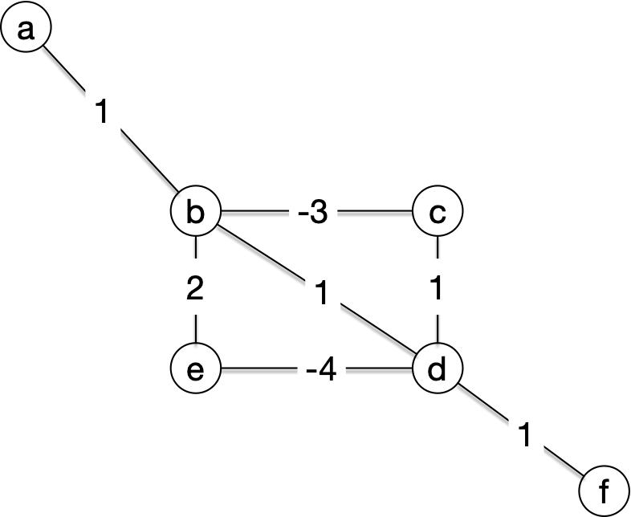
Distance Algorithms
Negative cycle example:
  What is the distance from a to f

Slide 5
Distance Algorithms
a-b-d-f costs 3
a-b-c-d-f costs 0
a-b-c-d-e-d-e-b-d-f costs -2
and a few more times around the cycle costs even less

Slide 6
Distance Algorithms
Single Source Algorithms:
Relaxation
  Fundamental approach to maintain estimates for distances
  Assume for each vertex, we have an upper bound for the distance from the source
  Relaxation then improves the distance bound towards the true value

Slide 7
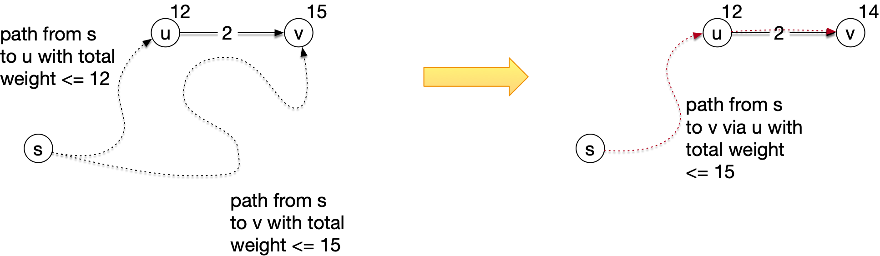
Distance Algorithms
Example

Slide 8
Distance Algorithms
Relaxation:
  $u.d$ distance bound for distance between $s$ and $u$
  Let $(u,v)∈E$. We relax along $(u,v)$ by setting
    $$v.d←min\left(v.d,u.d+w(u,v)\right)$$

Slide 9
Distance Algorithms
Relaxation:
  In addition, we can maintain a predecessor field at all nodes
  Because we do not only want the distance, but also how we got there
  When we relax, we set the predecessor field in $v$ to $u$ if we replace $v.d$ with $u.d+w(u,v)$ because the latter is smaller

Slide 10
Bellman-Ford
Bellman-Ford Single Source Distance Algorithm
  We initialize by:
    Source $s$ gets distance 0 and itself as predecessor
    Every node $u$ adjacent to $s$ gets distance $w(s,u)$ and predecessor

Slide 11
Bellman-Ford
Best path from source $s$ to node $u$ cannot have more than $|V|-1$ edges in it
  So, we relax with every edge a total of $|V|-1$ times
  If we can relax afterwards, something is fishy:
    We have found evidence for a negative cycle

Slide 12
Bellman-Ford
def Bellman_Ford(s, V, E):
  initialize(s,V,E)
  for i in range(len(V)-1):
    for (u,v) in E:
      relax(u,v)
  for (u,v) in E:
    if relax(u,v) changes the distance in v:
      return 'negative weight cycle detected'
  return 'done'

Slide 13
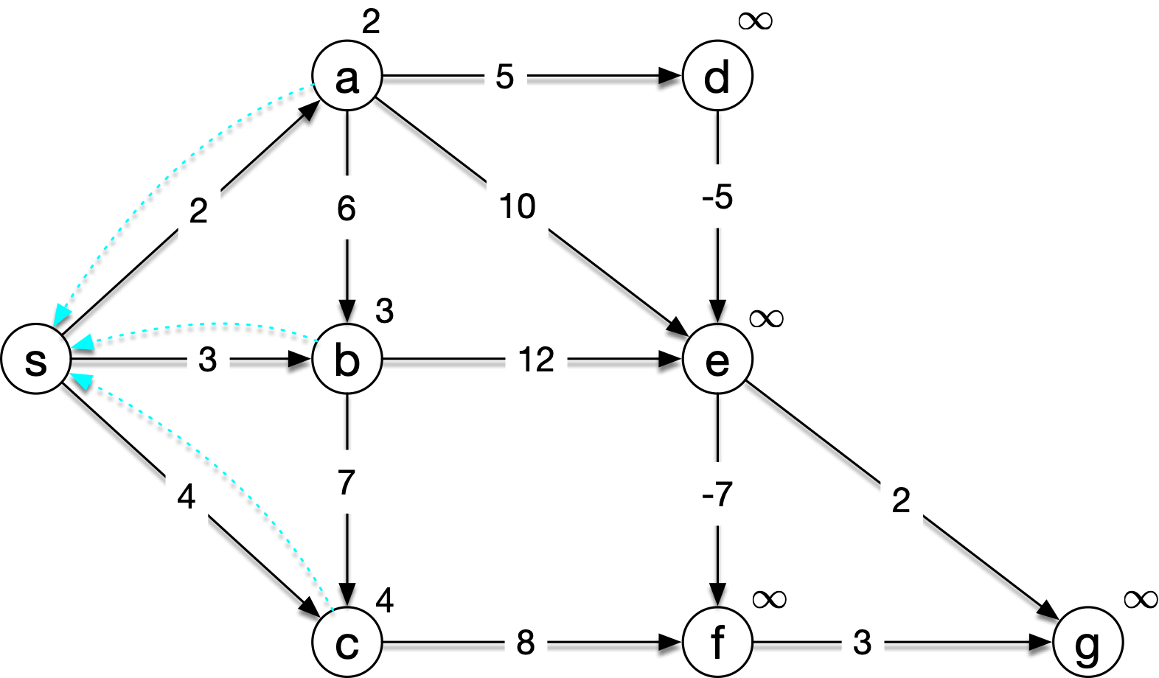
Bellman-Ford
Example: After initialization

Slide 14
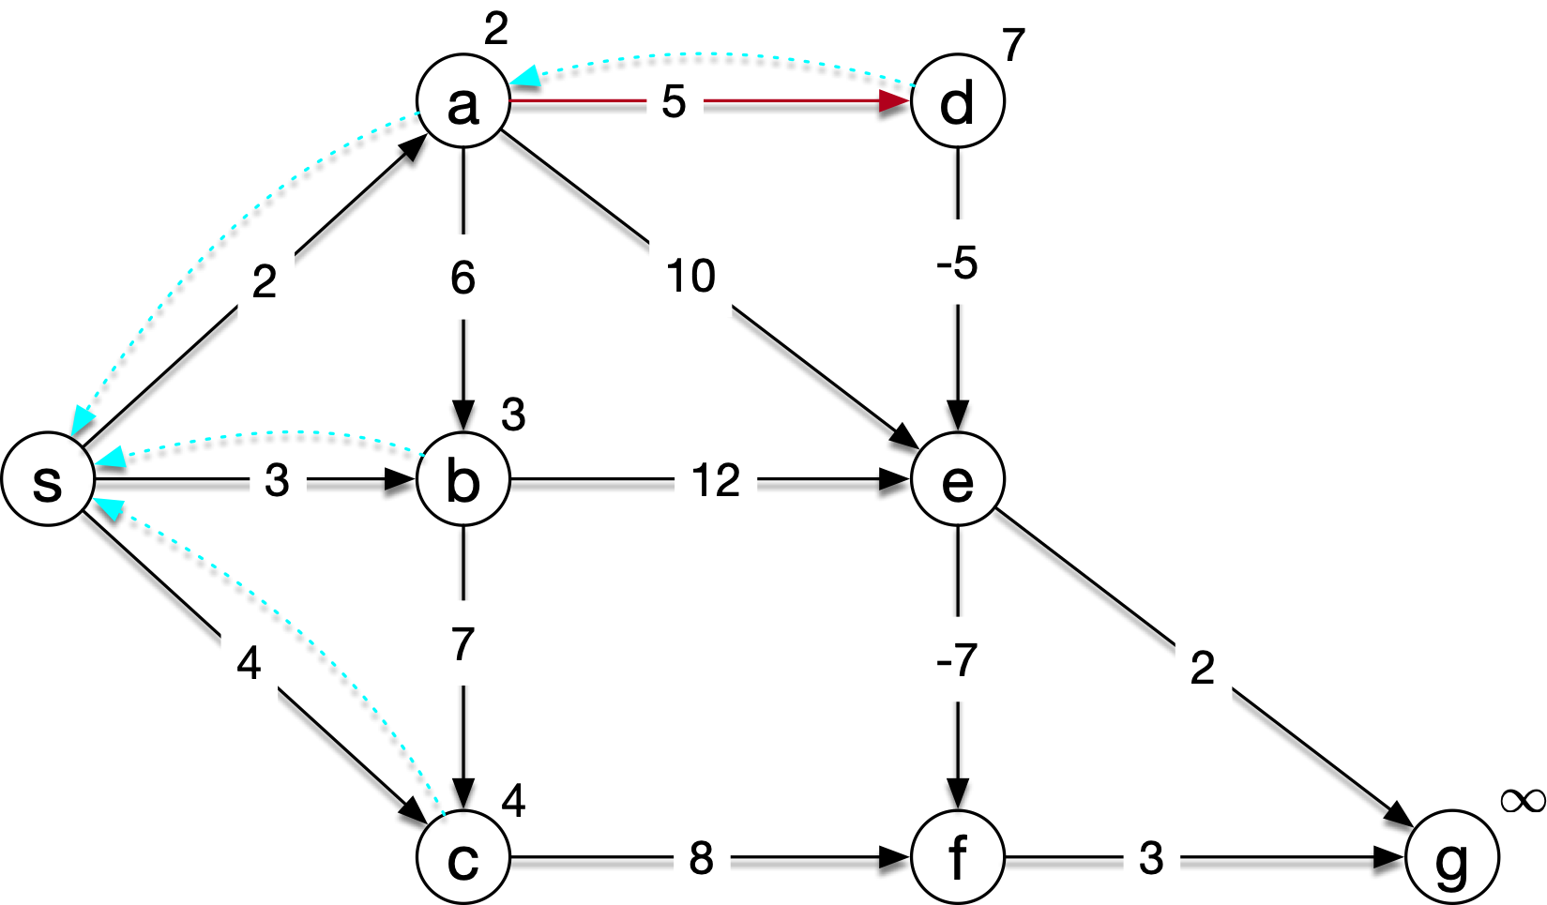
Bellman-Ford
Relax here

Slide 15
Bellman-Ford
Relax here

Slide 16
Bellman-Ford
Relax here

Slide 17
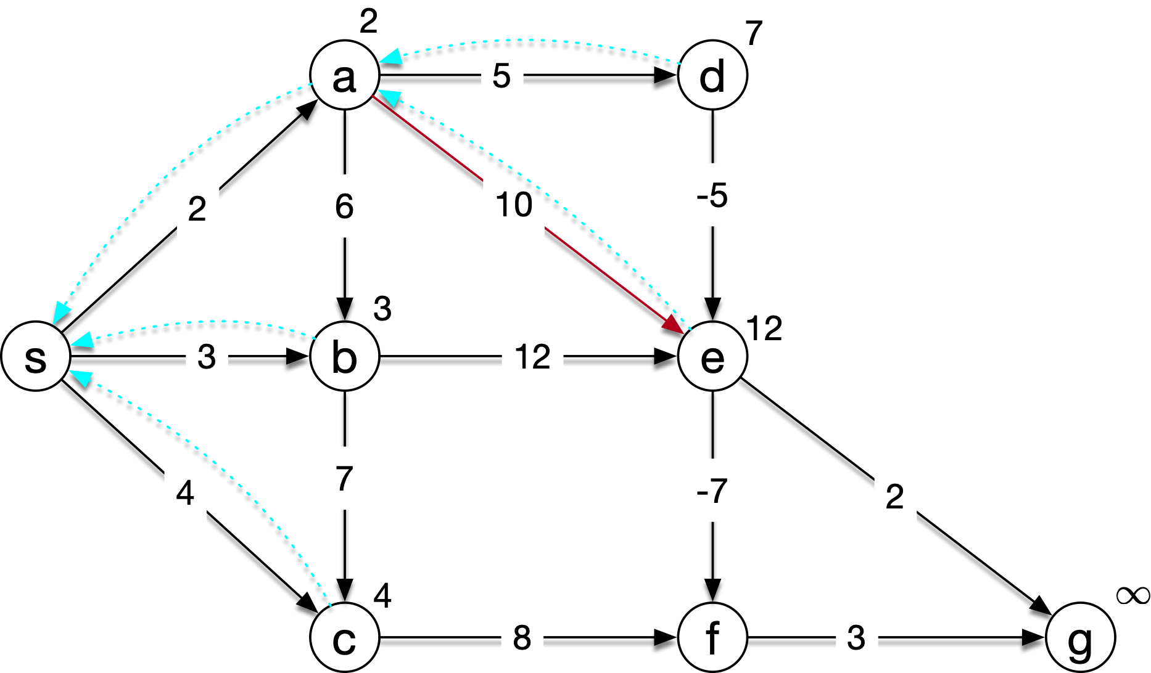
Bellman-Ford
Relax here

Slide 18
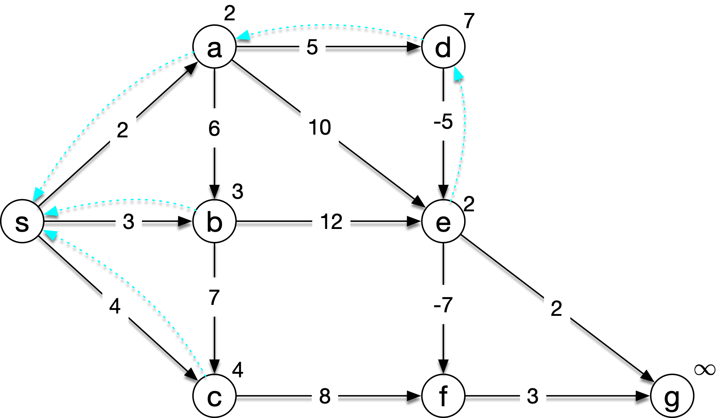
Bellman-Ford
Relax here

Slide 19
Bellman-Ford
Relax here

Slide 20
Bellman-Ford
Relax here

Slide 21
Bellman-Ford
Relax here

Slide 22
Bellman-Ford
Relax here

Slide 23
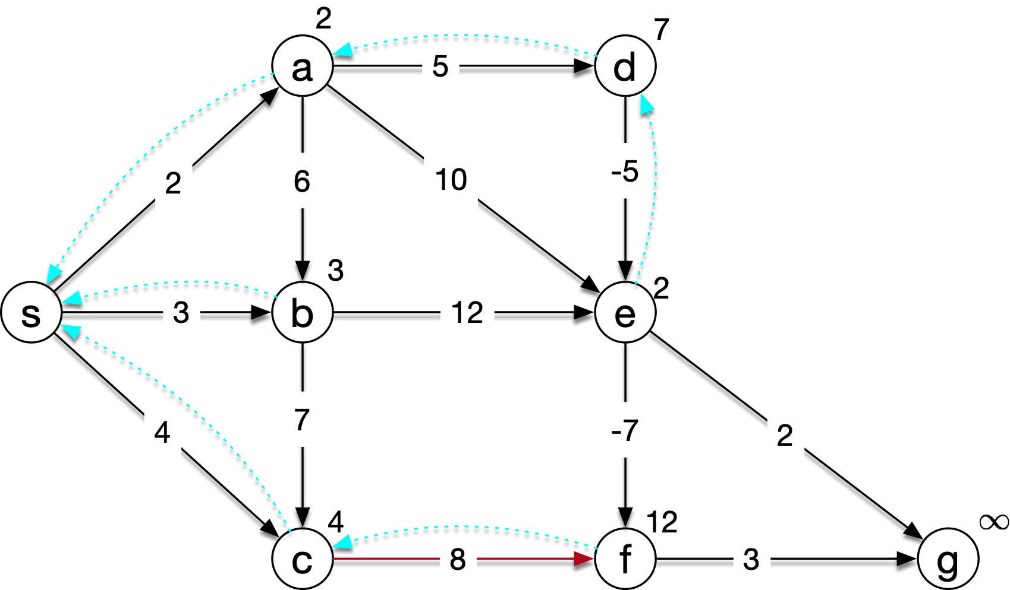
Bellman-Ford
Relax here

Slide 24
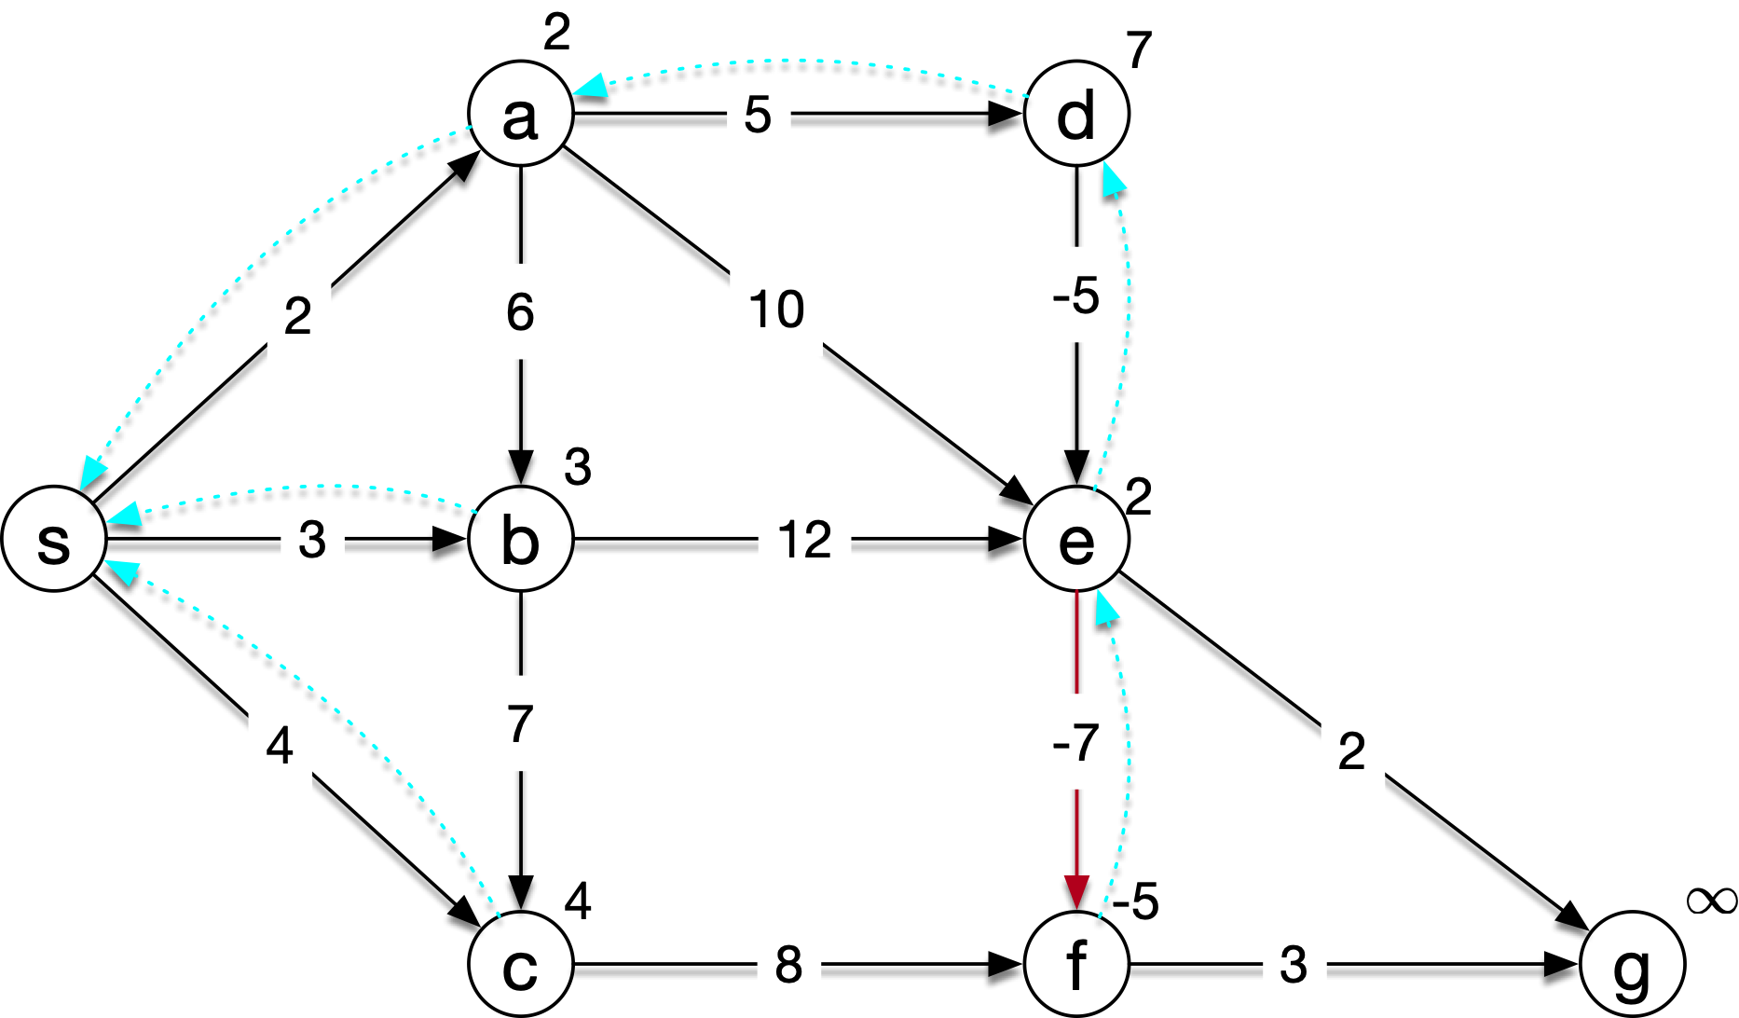
Bellman-Ford
Relax Here

Slide 25
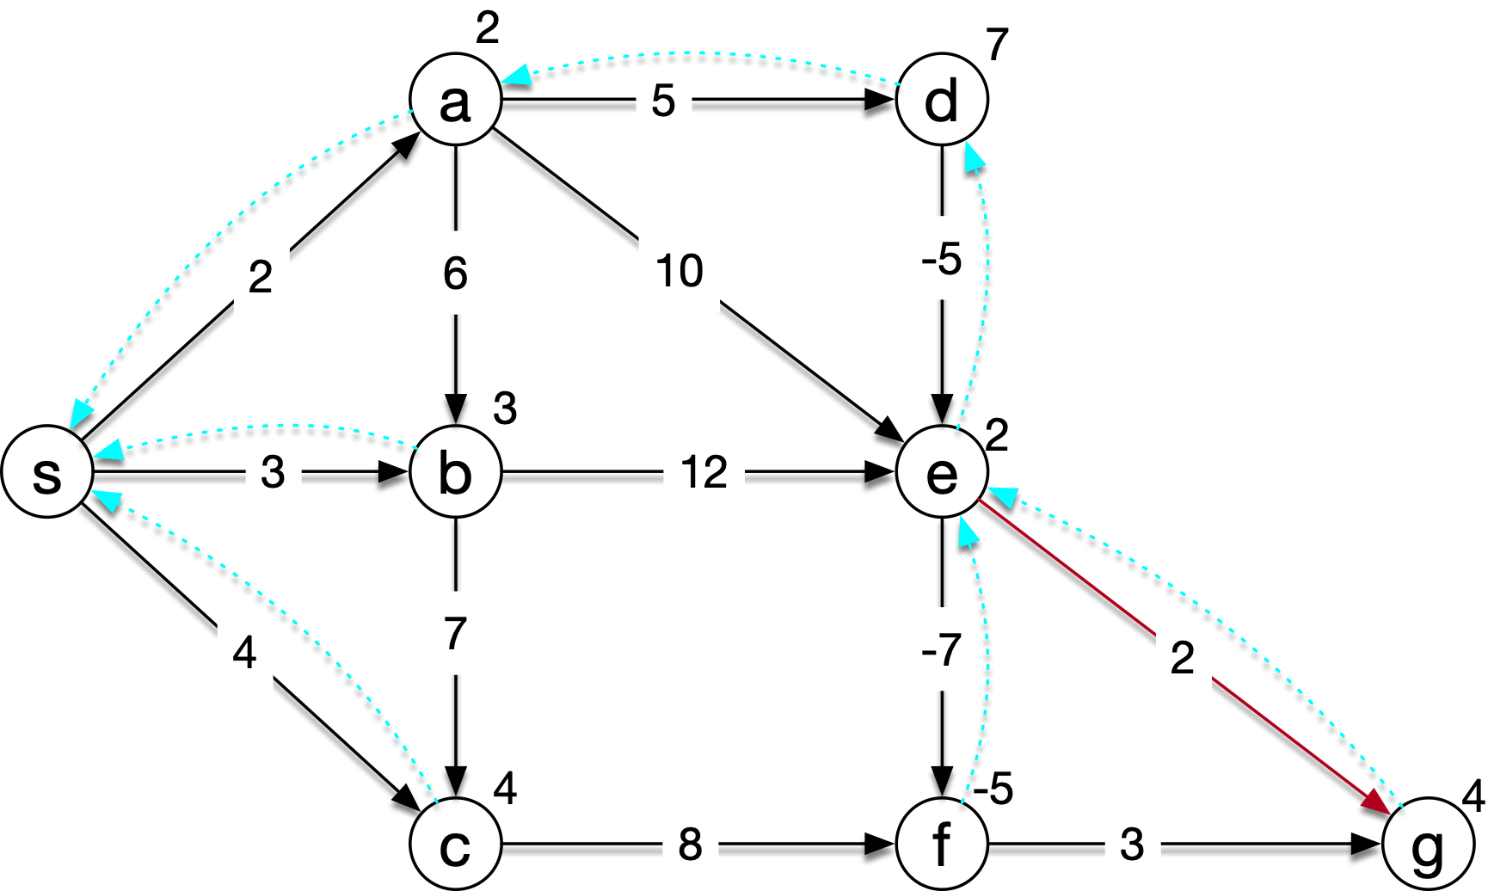
Bellman-Ford
Relax Here

Slide 26
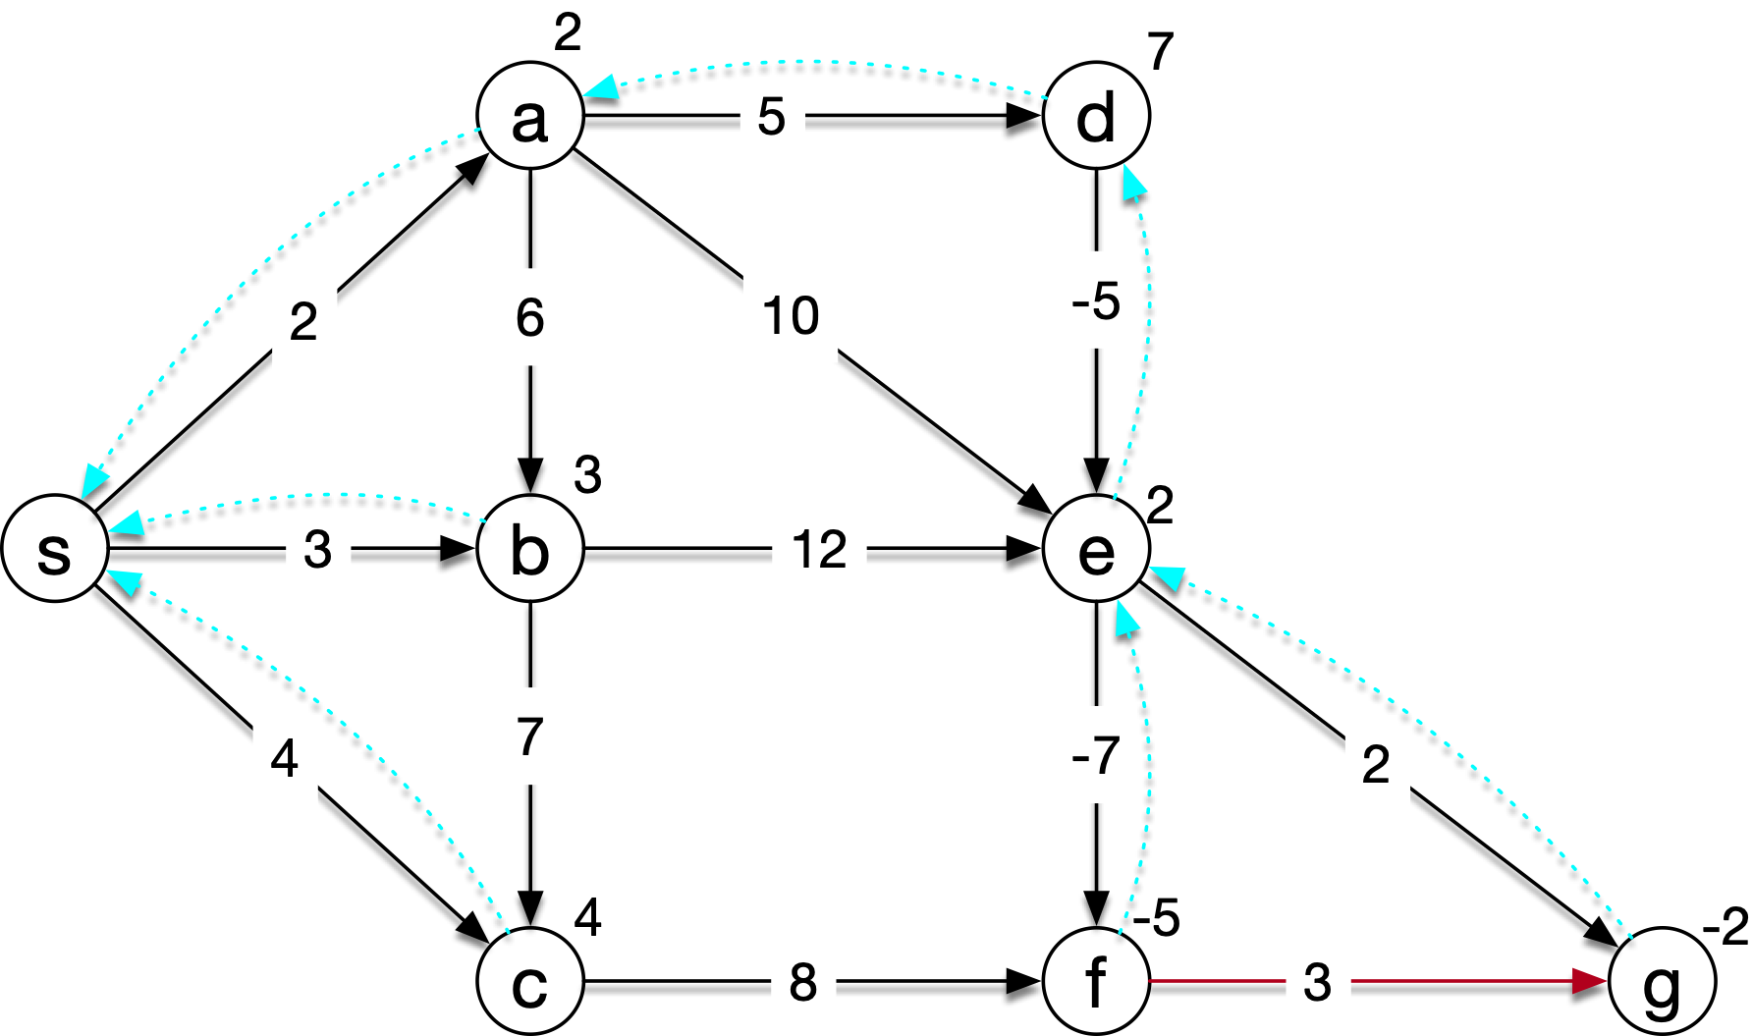
Bellman-Ford
Relax Here

Slide 27
Bellman-Ford
Now, we can start again

Slide 28

Bellman-Ford
Relax Here

Slide 29
Bellman-Ford
Relax Here

Slide 30
Bellman-Ford
Relax Here

Slide 31
Bellman-Ford
Relax Here

Slide 32
Bellman-Ford
Relax Here

Slide 33
Bellman-Ford
Relax Here

Slide 34
Bellman-Ford
Relax Here

Slide 35
Bellman-Ford
Relax Here

Slide 36
Bellman-Ford
Relax Here

Slide 37
Bellman-Ford
Relax Here

Slide 38
Bellman-Ford
Relax Here

Slide 39
Bellman-Ford
Relax Here

Slide 40
Bellman-Ford
Relax Here

Slide 41
Bellman-Ford
The second round, nothing changed
  This was an easy example, after all
We can therefore shortcut the rest, decide that there are no cycles, and finish

Slide 42
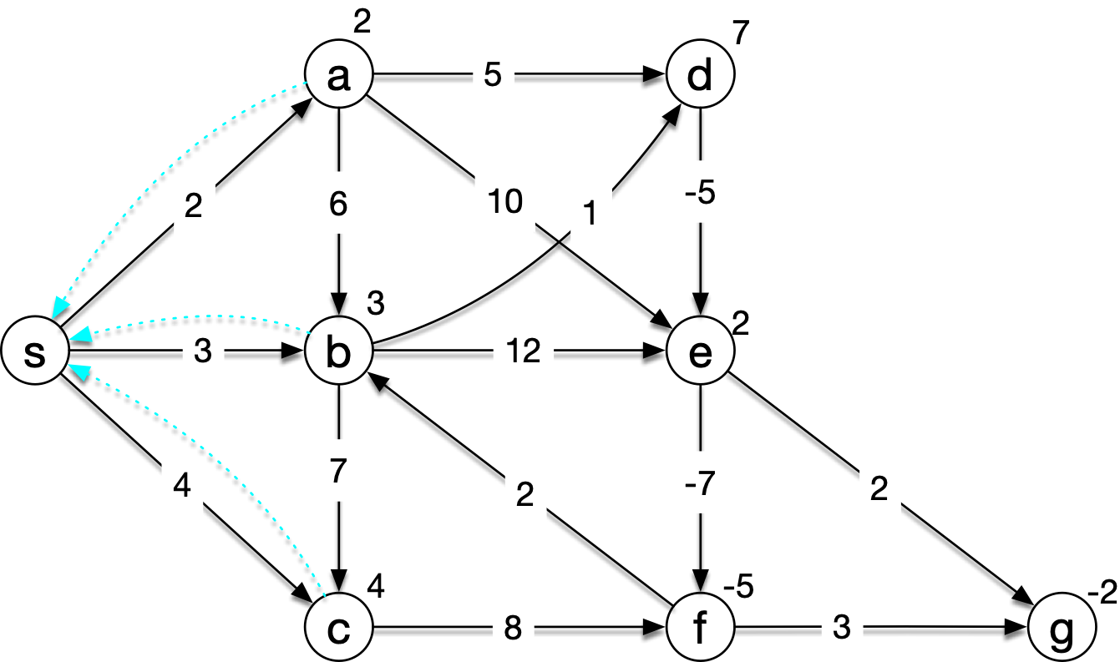
Bellman-Ford
Now, let's create a negative weight cycle b-d-e-f-b

Slide 43
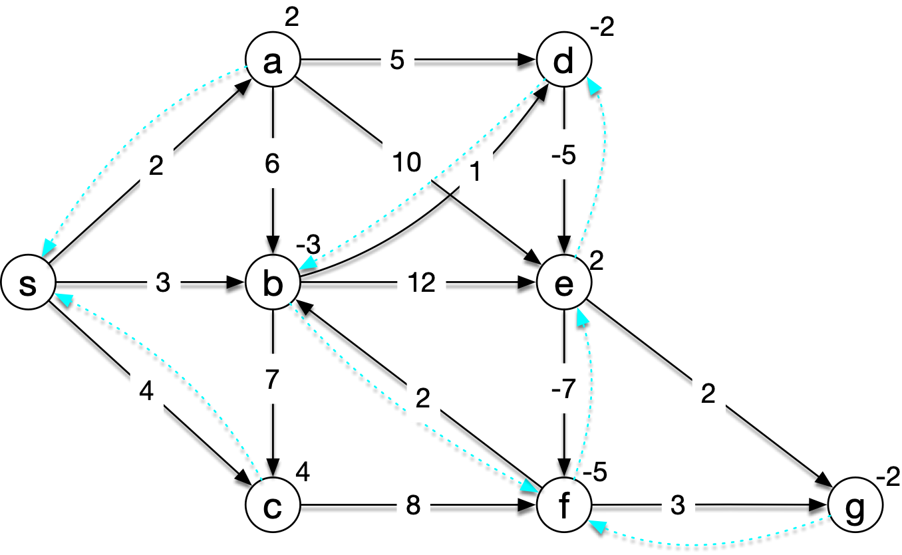
Bellman-Ford
The first time around, we would get something like this
  Your mileage will vary because of choices in the ordering of edges

Slide 44

Bellman-Ford
If we relax along d-e, we get

Slide 45

Bellman-Ford
Then we can relax along e-f

Slide 46

Bellman-Ford
Then along f-b

Slide 47

Bellman-Ford
After we relax with (b,d), we see that the predecessor graph no longer reaches s. We also can see that every time we relax with the edges in the graph, we lower distances,

Slide 48
DAG's
If we have a directed acyclic graph:
  We can use topological sort of vertices: $U=[u_{1},u_{2},u_{3},…,u_{n}]$
  We then execute
    for u in U:
      for v in u.adjacency:
        relax with (u,v)
  This is a very fast algorithm for DAG's only

Slide 49
Dijkstra's Algorithm
Single source all destinations algorithms that only assumes that weights are all positive
Also uses a Greedy strategy
Builds a subset S of nodes for which the exact distance is known

Slide 50
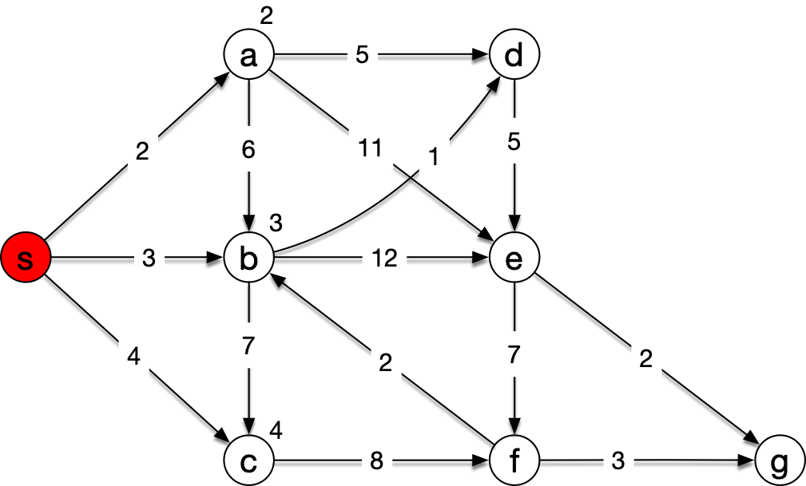
Dijkstra's Algorithm
Example:
  Dijkstra starts with just the source in $S$
  We initialize all nodes (but do not write infinities here)

Slide 51
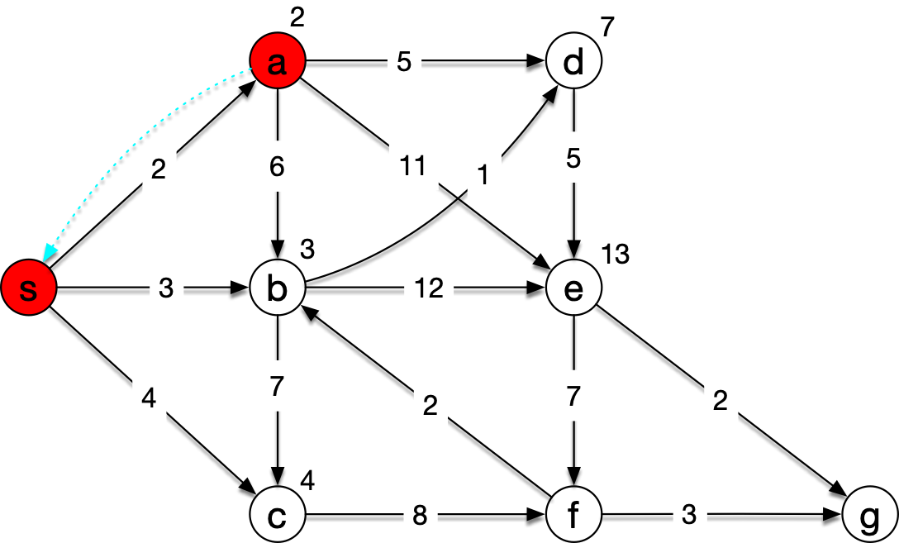
Dijkstra's Algorithm
Dijkstra then adds the node $u$ with the smallest distance to S and then uses the edges adjacent to $u$ to relax
Add a and relax (a,b), (a,d), and (a,e)

Slide 52
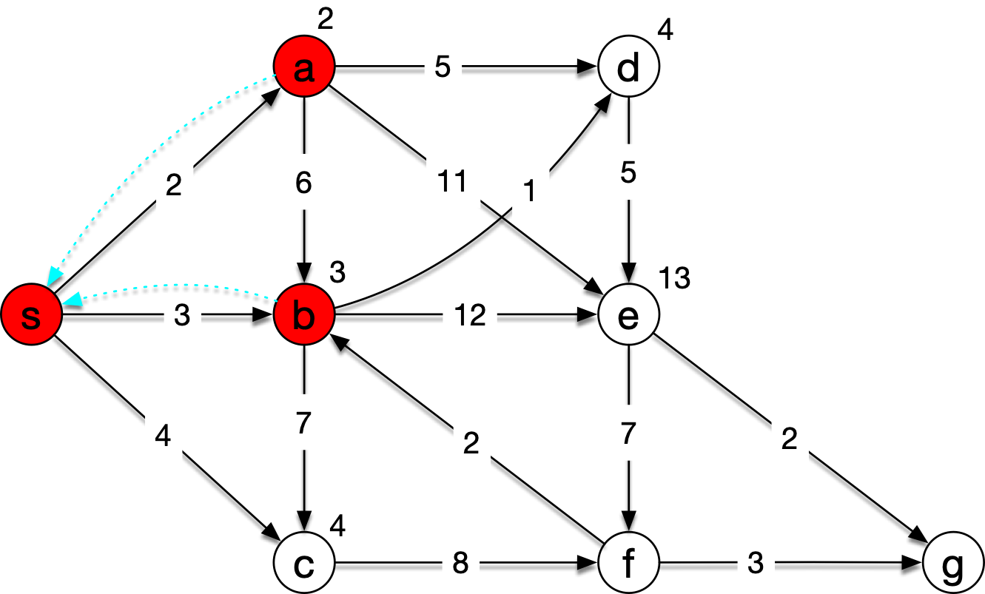
Dijkstra's Algorithm
The current distances from s are 2, 3, 4, 7, and 13
We pick b and relax along its outgoing edges

Slide 53
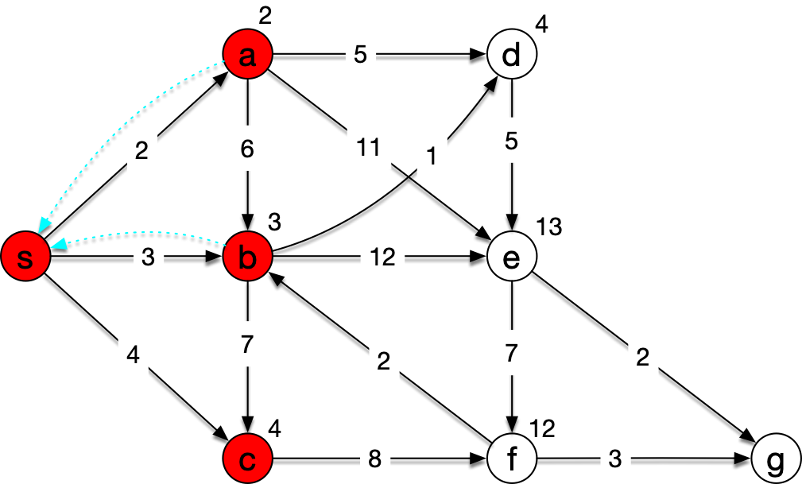
Dijkstra's Algorithm
Now c and d is the lowest distance node, pick c

Slide 54
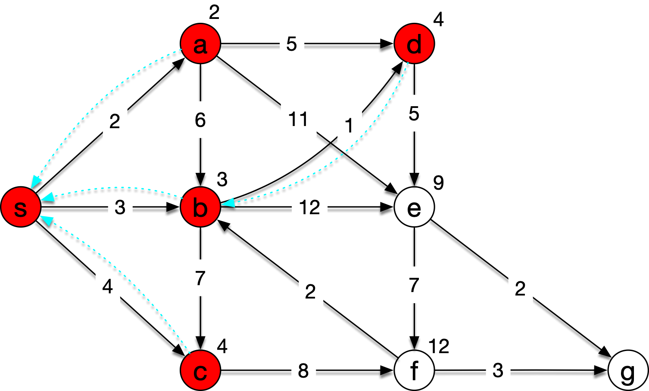
Dijkstra's Algorithm
Now pick d

Slide 55
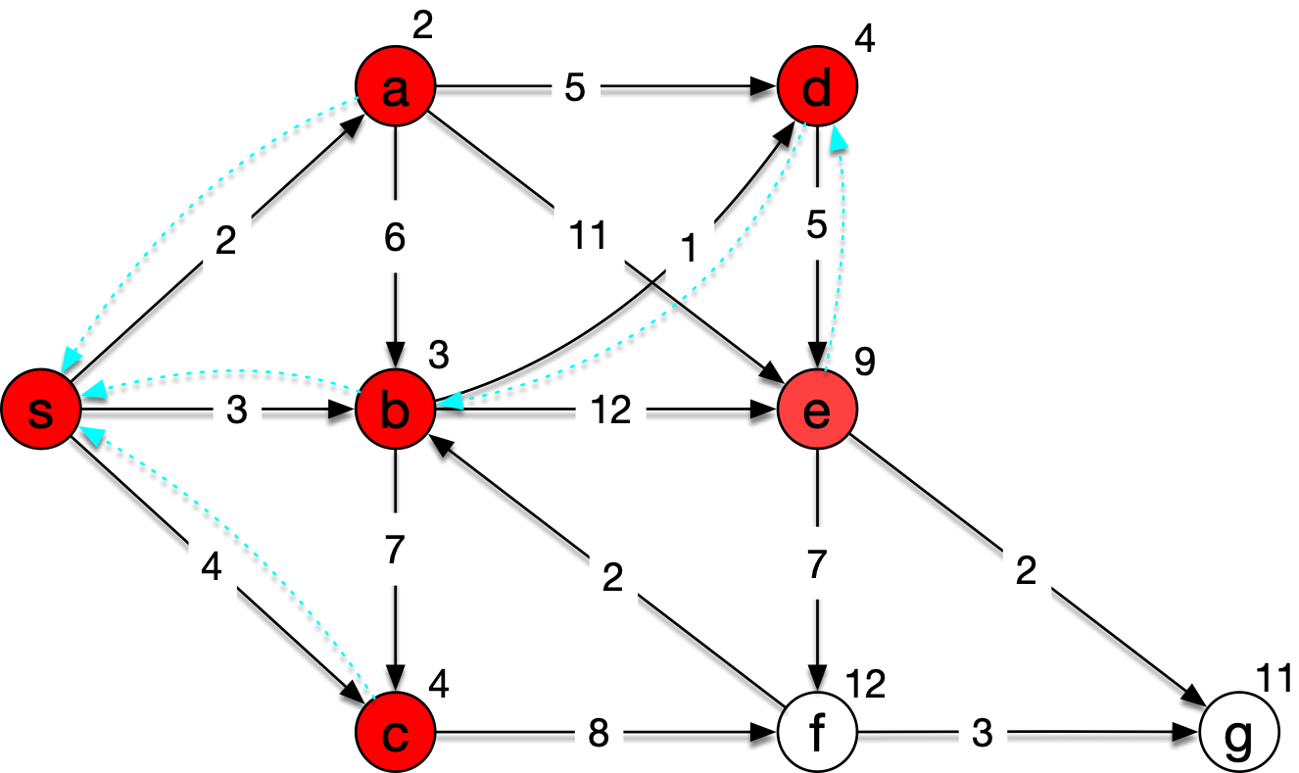
Dijkstra's Algorithm
Then e

Slide 56
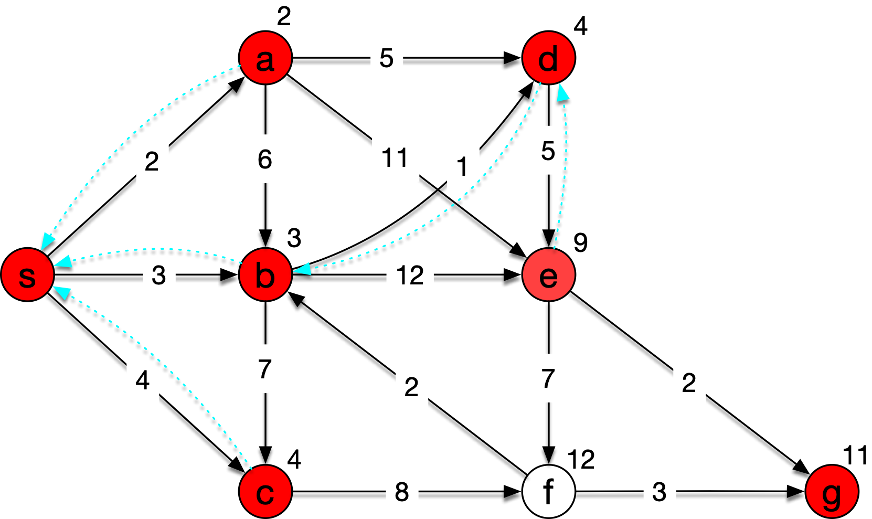
Dijkstra's Algorithm
g

Slide 57
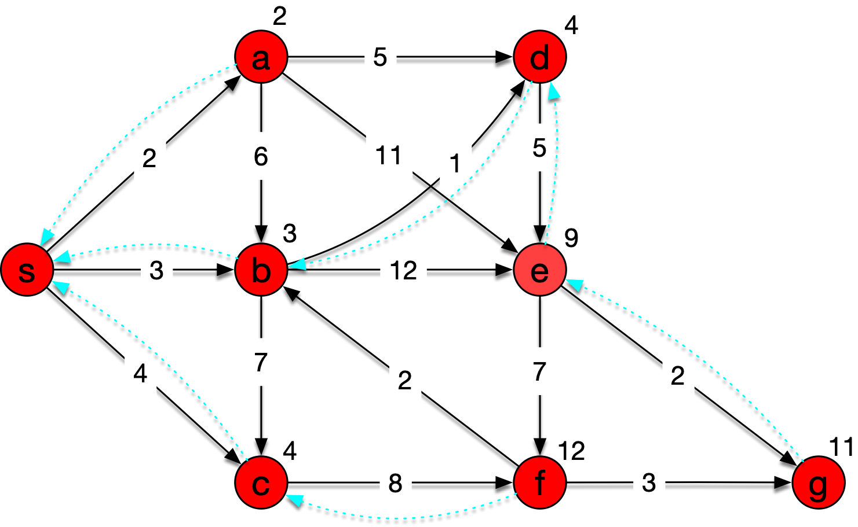
Dijkstra's Algorithm
And finally f

Slide 58
Dijkstra's Algorithm
To find the best way from s to g, we just start in g and follow the predecessor link
g <— e <— d <—b<—s

Slide 59
Dijkstra's Algorithm
def dijkstra(s, V, E):
  initialize(s,V,E)
  S = [ ]
  pq = priorityqueue(V)
  while pq:
      u = pq.pop
      S.append(u)
      for v in u.adjacent:
        relax(u,v) #changes possibly v.d
        #and therefore pq

Slide 60
Dijkstra's Algorithm
Correctness of Dijkstra's algorithm
  Loop invariant for while loop:
    All nodes in S have the correct distance from s

Slide 61
Dijkstra's Algorithm
Initially, the loop invariant is vacuously true
Now we need to show that each iteration of the while loop leaves the invariant valid
  Assume that this is not true
  And that we went wrong when $u$ was selected and put into S

Slide 62
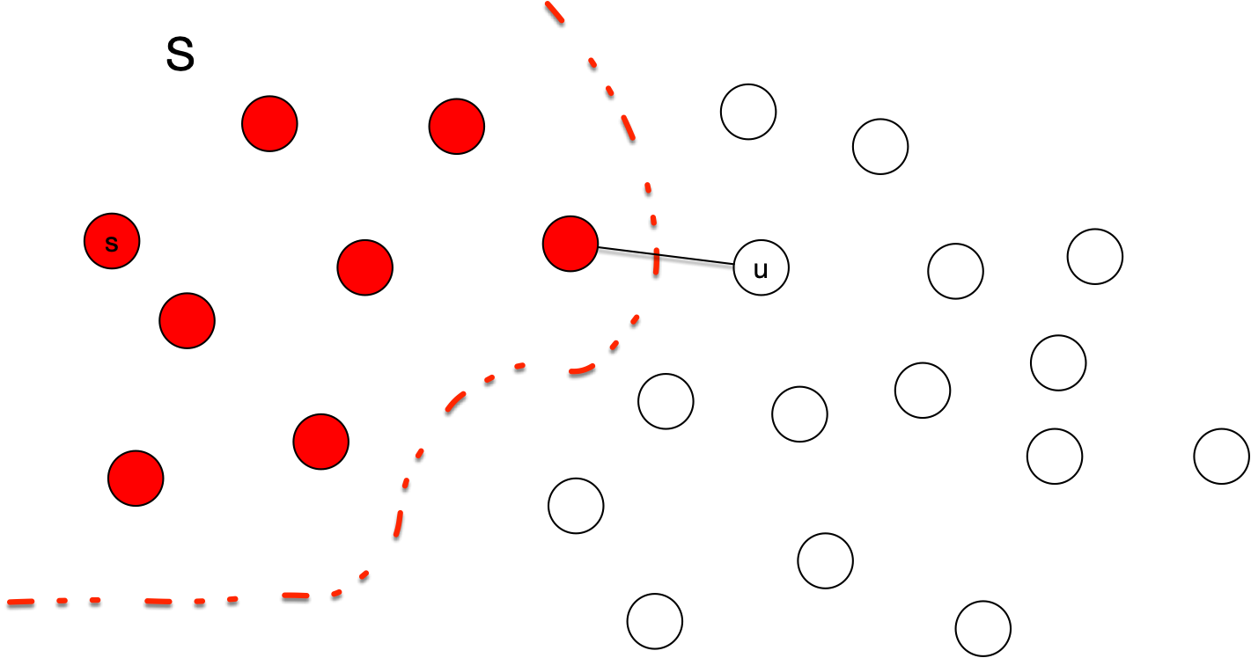
Dijkstra's Algorithm

Slide 63
Dijkstra's Algorithm
We can exclude the case that $s=u$ so $S≠∅$
We can also exclude the case that there is no path between $s$ and $u$
  Because then the distance field in $u$ would never be updated and stay at infinity, which is the correct value

Slide 64
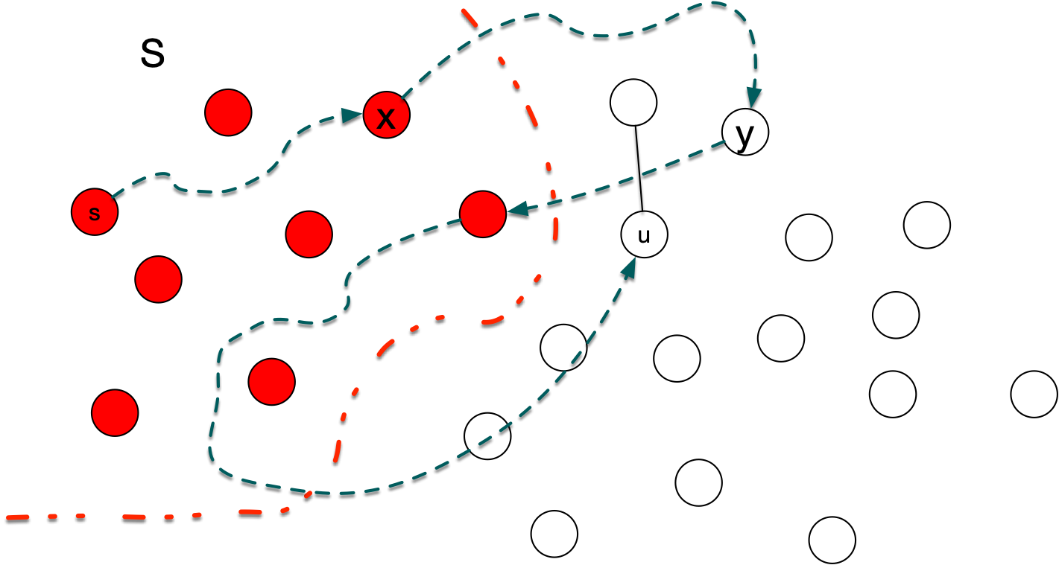
Dijkstra's Algorithm
So, there is a path from $s$ to $u$ that leads from $S$ to outside of S.
Let $x$ be the last vertex on this path so that the part from $s$ to $x$ is completely in S and $y$ the first node not in S

Slide 65
Dijkstra's Algorithm
By the invariant, $x∈S$ has the correct distance field with $x.d=δ(s,x)$
Because $x∈S$, we relaxed along the edge $(x,y)$
  Because $x$ and $y$ are on a shortest path from $s$ to $u$, the shortest path from $s$ to $y$ also goes through $x$
  Therefore, $y.d=x.d+w(x,y)=δ(x,s)+w(x,y)$ at this time
  But then this value can no longer change, so it is still true

Slide 66
Dijkstra's Algorithm
Now, we selected $u$ before $y$
  This implies $u.d≤y.d$
  But because $y$ is on the shortest path to $u$
  $$y.d=δ(s,y)≤δ(s,u)≤u.d≤u.d$$
  Which implies that $δ(s,y)=δ(s,u)$ and $y=u$ (because all weights are positive)
  But we have already seen that $y.d=u.d$ was set correctly
This contradiction proves correctness

Slide 67
Dijkstra's Algorithm
Dijkstra's algorithm runs in time dependent on the implementation of the priority queue
We update the priority queue potentially for each edge analyzed, which is all of them
  Easiest implementation uses time quadratic in the number of vertices
This gives a total runtime quadratic in the number of vertices because $|E|=O(|V|^{2})$

Slide 68
Floyd's and Warshal's Algorithm
Dynamic programming approach to the all sources - all destinations shortest path problem
What is the shortest path from $u$ to $v$ going through nodes in $\{v_{1},v_{2},…,v_{k}\}$ as intermediaries?
  Call its length $δ_{k}(u,v)$
  Two cases: $v_{k}$ is not on the shortest path:
    $$δ_{k}(u,v)=δ_{k-1}(u,v)$$
  Or: $v_{k}$ is on the shortest path
    $$δ_{k}(u,v)=δ_{k-1}(u,u_{k})+δ_{k-1}(u_{k},v)$$

Slide 69
Floyd's and Warshal's Algorithm
Start out with $δ_{0}(u,v)=\{\begin{matrix}w(u,v) & \text{if there is an edge between}u\text{and}v \\ ∞ & \text{if there is no edge}\end{matrix}$
Calculate $δ_{k}(u,v)=min(δ_{k-1}(u,v),δ_{k-1}(u,u_{k})+δ_{k-1}(u_{k},v))$
If $k=|V|$, then $δ_{k}(u,v)=δ(u,v)$
To reconstruct shortest path, give way points.
  If $u_{k}$ is an intermediate node, then put $u_{k}$ down for the connection $(u,v)$

Slide 70
Floyd's and Warshal's Algorithm
We can use a single matrix $D$ for the distance calculation
Initially, $D$ contains the weights and $Π$ only nones
D = W
for k in {1 … n}:
for i in {1 … n}:
for j in {1 … n}:
d[i,j] = min(d[i,j], d[i,k]+d[k,j]

Slide 71
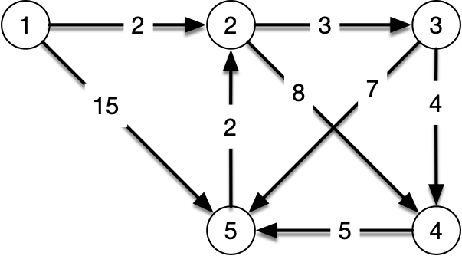
Floyd's and Warshal's Algorithm
Example:
Set-up
 | 1 | 2 | 3 | 4 | 5
1 | 0 | 2 |  |  | 15
2 |  | 0 | 3 | 8
3 |  |  | 0 | 4 | 7
4 |  |  |  | 0 | 5
5 |  | 2 |  |  | 0
 | 1 | 2 | 3 | 4 | 5
1
2
3
4
5

Slide 72
Floyd's and Warshal's Algorithm
Example:
k=1: no changes
 | 1 | 2 | 3 | 4 | 5
1 | 0 | 2 |  |  | 15
2 |  | 0 | 3 | 8
3 |  |  | 0 | 4 | 7
4 |  |  |  | 0 | 5
5 |  | 2 |  |  | 0
 | 1 | 2 | 3 | 4 | 5
1
2
3
4
5
for k in {1 … n}:
for i in {1 … n}:
for j in {1 … n}:
d[i,j] = min(d[i,j], d[i,k]+d[k,j]

Slide 73
Floyd's and Warshal's Algorithm
Example:
k=2
 | 1 | 2 | 3 | 4 | 5
1 | 0 | 2 | 5 | 10 | 15
2 |  | 0 | 3 | 8
3 |  |  | 0 | 4 | 7
4 |  |  |  | 0 | 5
5 |  | 2 | 5 | 10 | 0
 | 1 | 2 | 3 | 4 | 5
1 |  |  | 2 | 2
2
3
4
5 |  |  | 2 | 2
for k in {1 … n}:
for i in {1 … n}:
for j in {1 … n}:
d[i,j] = min(d[i,j], d[i,k]+d[k,j]

Slide 74
Floyd's and Warshal's Algorithm
Example:
k=3
 | 1 | 2 | 3 | 4 | 5
1 | 0 | 2 | 5 | 9 | 15
2 |  | 0 | 3 | 7 | 10
3 |  |  | 0 | 4 | 7
4 |  |  |  | 0 | 5
5 |  | 2 | 5 | 10 | 0
 | 1 | 2 | 3 | 4 | 5
1 |  |  | 2 | 3 | 3
2 |  |  |  | 3 | 3
3
4
5 |  |  | 2 | 2
for k in {1 … n}:
for i in {1 … n}:
for j in {1 … n}:
d[i,j] = min(d[i,j], d[i,k]+d[k,j]

Slide 75
Floyd's and Warshal's Algorithm
Example:
k=4
 | 1 | 2 | 3 | 4 | 5
1 | 0 | 2 | 5 | 9 | 12
2 |  | 0 | 3 | 7 | 10
3 |  |  | 0 | 4 | 7
4 |  |  |  | 0 | 5
5 |  | 2 | 5 | 10 | 0
 | 1 | 2 | 3 | 4 | 5
1 |  |  | 2 | 3 | 3
2 |  |  |  | 3 | 3
3
4
5 |  |  | 2 | 2
for k in {1 … n}:
for i in {1 … n}:
for j in {1 … n}:
d[i,j] = min(d[i,j], d[i,k]+d[k,j]

Slide 76
Floyd's and Warshal's Algorithm
Example:
k=5
 | 1 | 2 | 3 | 4 | 5
1 | 0 | 2 | 5 | 9 | 12
2 |  | 0 | 3 | 7 | 10
3 |  | 9 | 0 | 4 | 7
4 |  | 7 | 10 | 0 | 5
5 |  | 2 | 5 | 9 | 0
 | 1 | 2 | 3 | 4 | 5
1 |  |  | 2 | 3 | 3
2 |  |  |  | 3 | 3
3 |  | 5
4 |  | 5 | 5
5 |  |  | 2 | 2
for k in {1 … n}:
for i in {1 … n}:
for j in {1 … n}:
d[i,j] = min(d[i,j], d[i,k]+d[k,j]

Slide 77
Floyd's and Warshal's Algorithm
Going from 1 to 5:
D matrix: 12
$Π$ matrix: go through 3
1 to 3: go through 2
3 to 5: direct
Example:
 | 1 | 2 | 3 | 4 | 5
1 | 0 | 2 | 5 | 9 | 12
2 |  | 0 | 3 | 7 | 10
3 |  | 9 | 0 | 4 | 7
4 |  | 7 | 10 | 0 | 5
5 |  | 2 | 5 | 9 | 0
 | 1 | 2 | 3 | 4 | 5
1 |  |  | 2 | 3 | 3
2 |  |  |  | 3 | 3
3 |  | 5
4 |  | 5 | 5
5 |  |  | 2 | 2
for k in {1 … n}:
for i in {1 … n}:
for j in {1 … n}:
d[i,j] = min(d[i,j], d[i,k]+d[k,j]

Slide 78
Floyd's and Warshal's Algorithm
Going from 5 to 4:
D matrix: 9
$Π$ matrix: go through 2
5 to 2: direct
2 to 4: go through 3
2 to 3: direct
3 to 4: direct
route is 5-2-3-4
Example:
 | 1 | 2 | 3 | 4 | 5
1 | 0 | 2 | 5 | 9 | 12
2 |  | 0 | 3 | 7 | 10
3 |  | 9 | 0 | 4 | 7
4 |  | 7 | 10 | 0 | 5
5 |  | 2 | 5 | 9 | 0
 | 1 | 2 | 3 | 4 | 5
1 |  |  | 2 | 3 | 3
2 |  |  |  | 3 | 3
3 |  | 5
4 |  | 5 | 5
5 |  |  | 2 | 2
for k in {1 … n}:
for i in {1 … n}:
for j in {1 … n}:
d[i,j] = min(d[i,j], d[i,k]+d[k,j]

