Slide 1
Huffman Coding
Greedy Algorithms

Slide 2
Prefix-free Codes
Binary, variable length code
Binary: code symbols are 0 and 1
Variable length: code words have variable length
To allow decoding:
no prefix of a code word can be part of another code word
Otherwise:
Cannot decide easily between prefix and complete

Slide 3
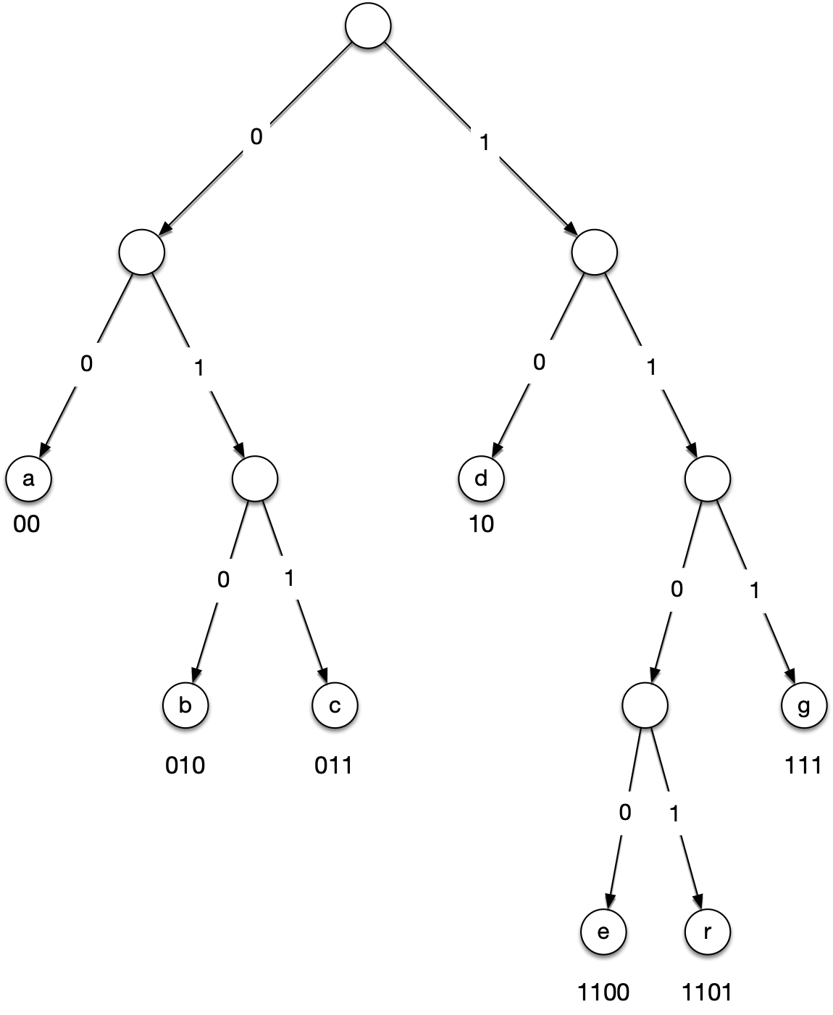
Prefix-free Codes
Prefix codes can be represented as binary trees
Left branch is labelled with 0, right with 1
Leaves correspond to symbols
Path to leaf is code for symbol

Slide 4
Prefix-free Codes
Start at top
1010100010100101

Slide 5
Prefix-free Codes
Start at top
First letter is 1:
Go to the right
1010100010100101

Slide 6
Prefix-free Codes
Start at top
First letter is 1:
Go to the right
Have processed 1
1010100010100101

Slide 7
Prefix-free Codes
Start at top
First letter is 1:
Go to the right
Have processed 1
1010100010100101

Slide 8
Prefix-free Codes
Start at top
First letter is 1:
Go to the right
Have processed 1
Second letter is 0:
1010100010100101

Slide 9
Prefix-free Codes
Start at top
First letter is 1:
Go to the right
Have processed 1
Second letter is 0:
Go to the left
1010100010100101

Slide 10
Prefix-free Codes
Start at top
First letter is 1:
Go to the right
Have processed 1
Second letter is 0:
Go to the left
We are in a leaf
1010100010100101

Slide 11
Prefix-free Codes
Start at top
First letter is 1:
Go to the right
Have processed 1
Second letter is 0:
Go to the left
We are in a leaf
Emit the value of the leaf: d
1010100010100101

Slide 12
Prefix-free Codes
Restart at the top
Next letter is 1
1010100010100101

Slide 13
Prefix-free Codes
Restart at the top
Next letter is 1
Go to the right
1010100010100101

Slide 14
Prefix-free Codes
Restart at the top
Next letter is 1
Go to the right
Process repeats
1010100010100101

Slide 15
Prefix-free codes
Decoding 1010100010100101
Start at top
Follow bits
10 — d
10 — d
10 — d
00 — a
010 — b
10 — d
…

Slide 16
Prefix-free Codes
Your turn:
1100111110101101000

Slide 17
Answer
Your turn:
1100111110101101000
1100 - e
111 - g
1101 - f
011 - c
010 - b
00 - a

Slide 18
Huffman Coding
Obviously, there are many binary trees with a certain number of leaves
If the symbols appear with different frequencies, then we want to encode frequent ones with short codes and infrequent ones with longer codes
Huffman Coding:
Greedy algorithm to calculate an optimal encoding

Slide 19
Huffman Coding
Measure of goodness
Frequency of symbols
Depth of corresponding leaf = length of encoding
Average Encoding Costs
$$f(x)$$
$$d(x)$$
$$B=\underset{x}{∑}f(x)⋅d(x)$$

Slide 20
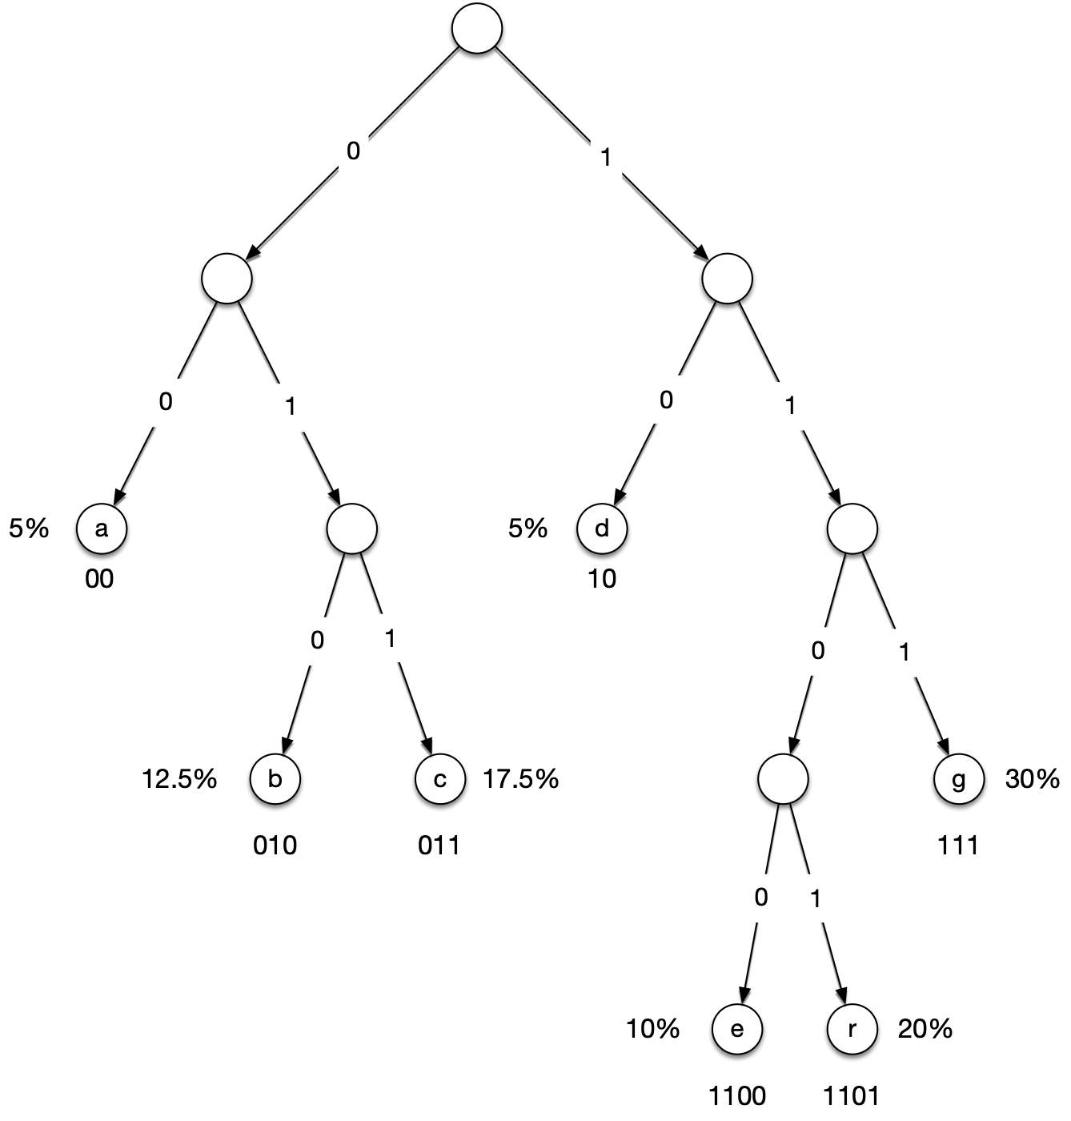
Huffman Coding
$$B=2×0.05+3×0.125+3×0.175+2×0.05+4×0.1+4×0.2+3×0.3=3.12$$

Slide 21
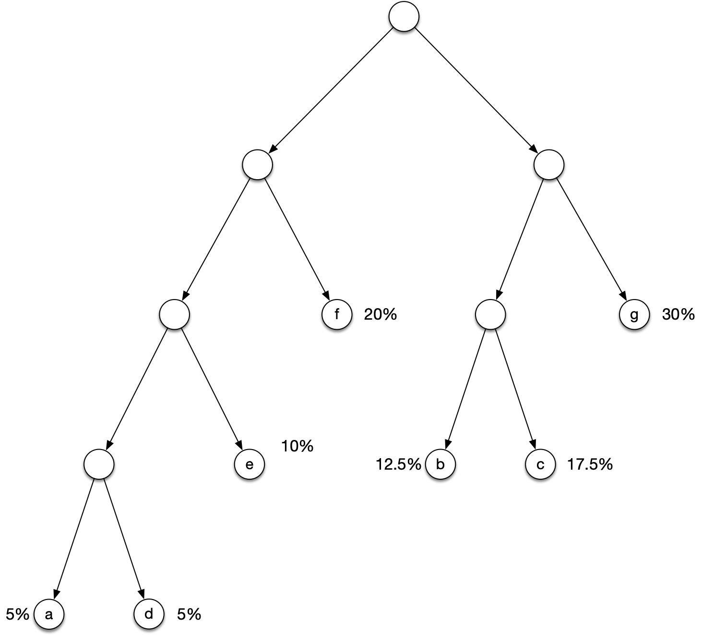
Huffman Coding
$$B=4×0.05+4×0.05+3×0.1+2×0.2+3×0.125+3×0.175+2×0.3=2.6$$

Slide 22
Huffman Coding
As we can see, different trees have different expected encoding length

Slide 23
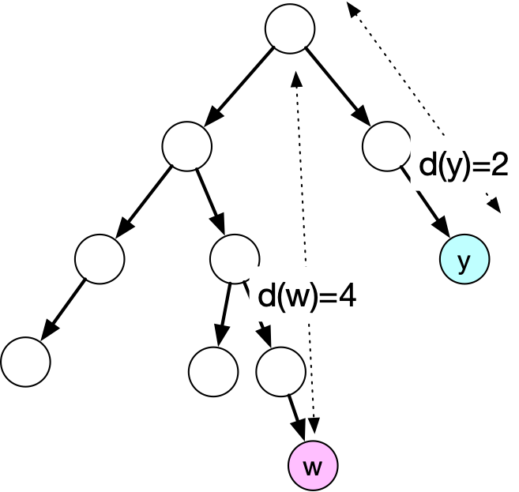
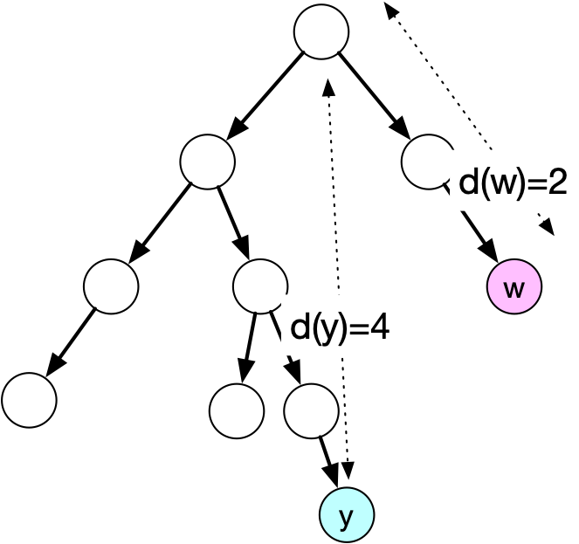
Huffman Coding
Let T be a binary (encoding) tree and let T’ be the tree obtained by swapping two leaves y and w.
Then the difference in the B-values is
$$(f(y)-f(w))(d_{T}(w)-d_{T^{′}}(y))$$
T
T'

Slide 24
Huffman Coding
Proof:
The only difference are the addends corresponding to y and w

Slide 25
Huffman Coding
What does $B(T^{′})-B(T)=(f(y)-f(w))(d_{T}(w)-d_{T}(y))$ mean?
If $f(y)>f(w)$ then $y$ better be up higher in the tree or we can gain by swapping

Slide 26
Huffman Coding
Lemma: There exists an optimal tree such that the two lowest-frequency symbols are neighbors
Furthermore, they have the highest distance from the root

Slide 27
Huffman Coding
Proof:
Let y and w be the two symbols with the lowest frequency
If there is a tie, take the ones with the biggest depth
We are going to show that we can transform the tree into a better (or equally good) one where they are neighbors
Assume that $d_{T}(w)≥d_{T}(y)$

Slide 28
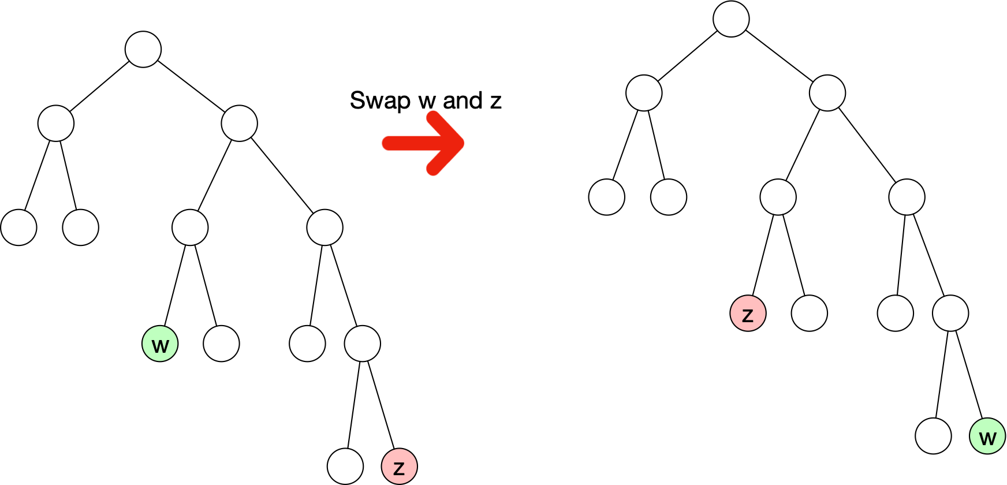
Huffman Coding
Assume that there is another leaf $z$ at larger distance than $w$
$z$ has higher frequency and higher distance from root

Slide 29
Huffman Coding
T
T'
How does the B-value change?
$$B(T^{′})-B(T)=(f(z)-f(w))(d_{T}(w)-d_{T}(z))$$
It goes down, i.e. the new tree is better
$$≥0$$
$$≤0$$

Slide 30
Huffman Coding
We now know that we can have a better or equally good tree where $w$ is a leaf at furthest distance from the root
Case distinctions based on the sibling of $w$
$y$ and $w$ are siblings
$w$ has another sibling
$w$ has no sibling

Slide 31
Huffman Coding
Case Distinction:
Case 1: y and w are siblings
We are done, this is what we are supposed to show

Slide 32
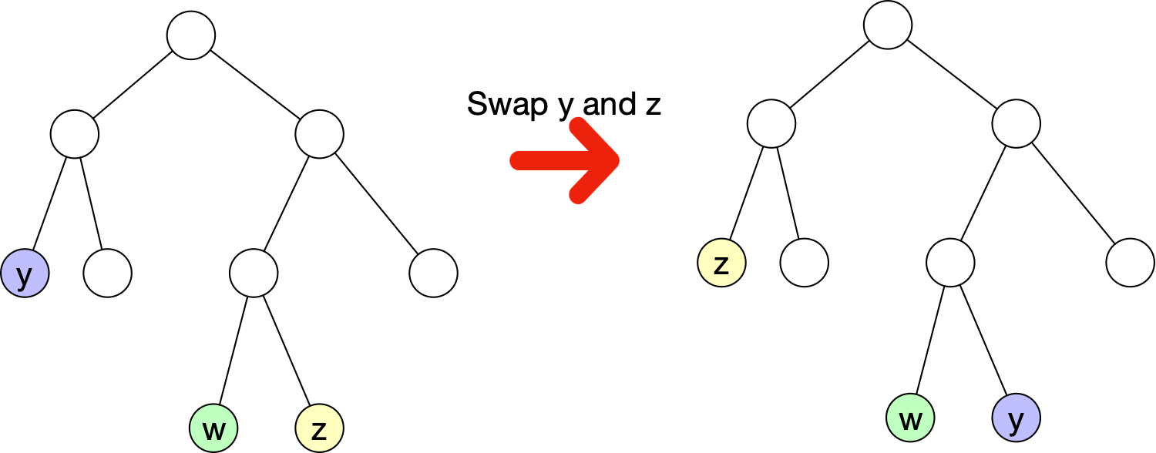
Huffman Coding
Case 2: w has a sibling z
Then $f(z)≥f(y)$ and $d_{T}(z)=d_{T}(w)≥d_{T}(y)$
$$B(T^{′})-B(T)=(f(y)-f(w))(d_{T}(w)-d_{T}(y))$$

Slide 33
Huffman Coding
Since $f(z)≥f(y)$ and $d_{T}(z)=d_{T}(w)≥d_{T}(y)$
If we swap y and z
$B(T^{′})-B(T)=(f(y)-f(z))(d_{T}(z)-d_{T}(y))$ is zero or negative
We are lowering the $B$-value, so we get a better (or equally good) tree
$$≤0$$
$$≥0$$

Slide 34
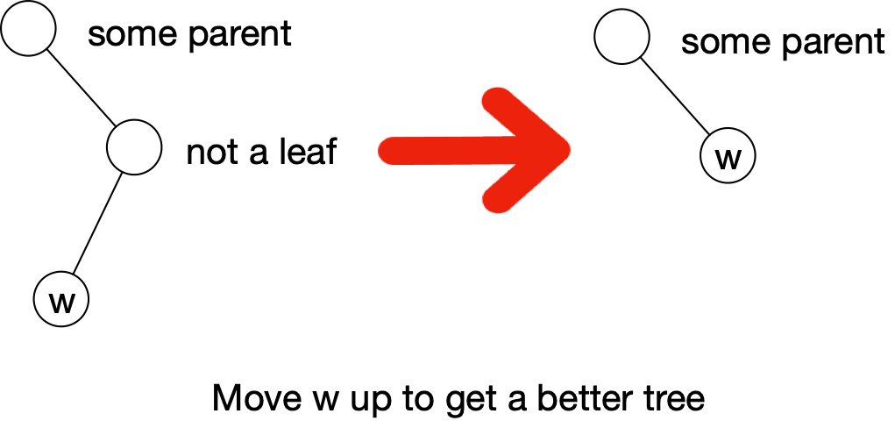
Huffman Coding
Case 3:
w has no sibling
Then we can move w up and get a better tree
The only thing that changes is $d_{T}(w)$, which becomes lower

Slide 35
Huffman Coding
The "Greedy" property
A greedy algorithm is a step-by-step algorithm
At each step, make an optimal decision based only on the information in the current step
In our case:
How do we reduce the problem of finding an optimal tree to a simpler one
Already know that the two least frequent symbols are siblings in an optimal tree

Slide 36
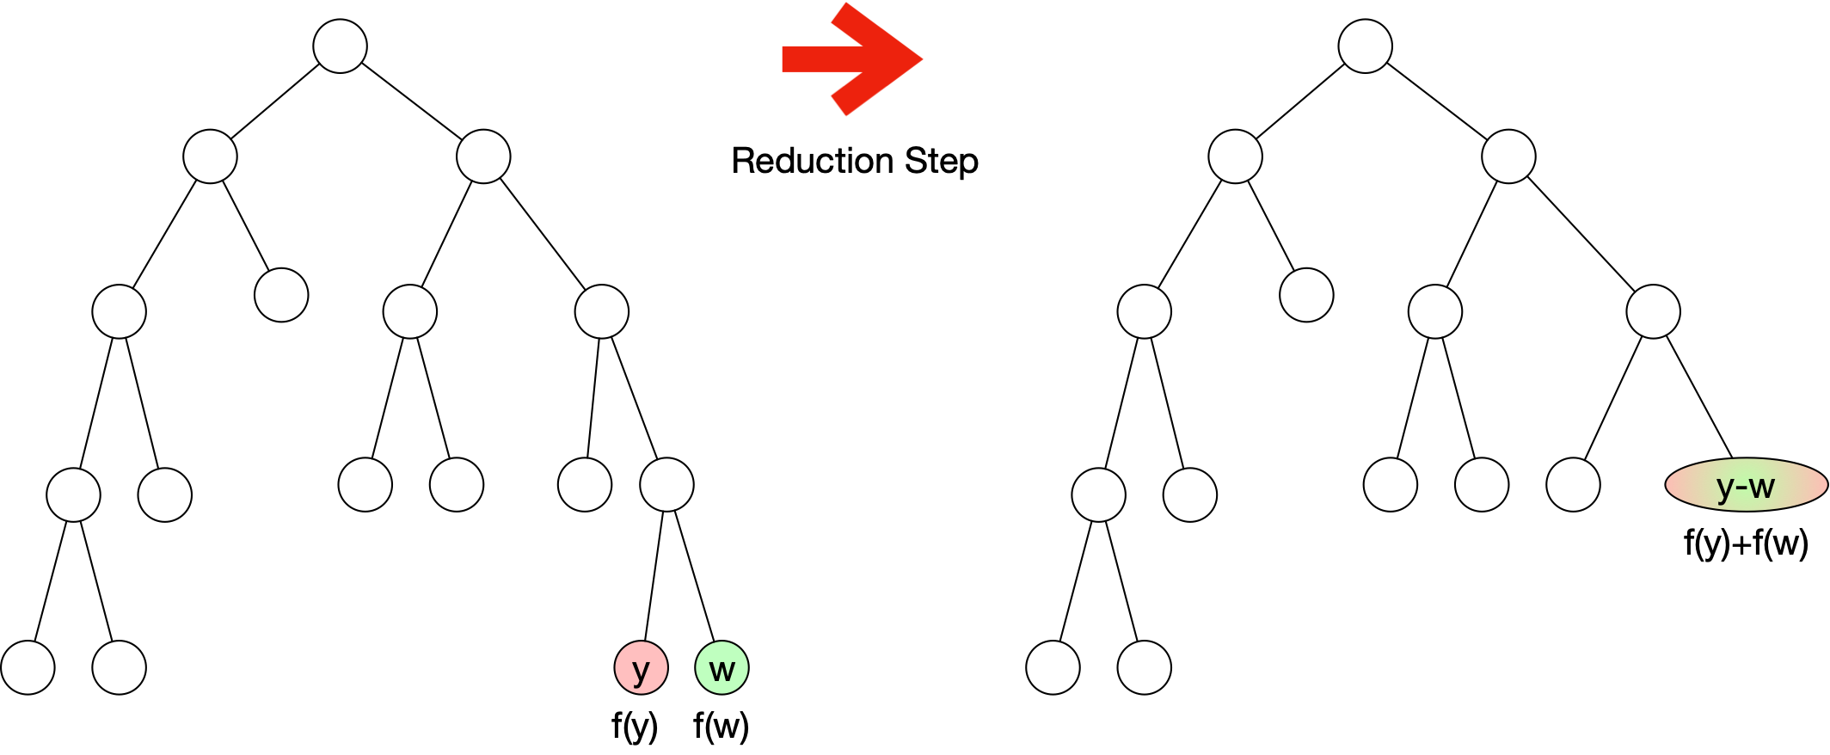
Huffman Coding
Reduction step:
Merge the two least frequent code symbols

Slide 37
Huffman Coding
Create a new 'character' $\overline{yw}$
Left: alphabet is $Σ$ Right: alphabet is $Σ-\{y,w\}∪\{\overline{yw}\}$

Slide 38
Huffman Coding
Create a new 'character' $\overline{yw}$
Frequency is $f(\overline{yw})=f(y)+f(w)$

Slide 39
Huffman Coding
Everything else stays the same

Slide 40
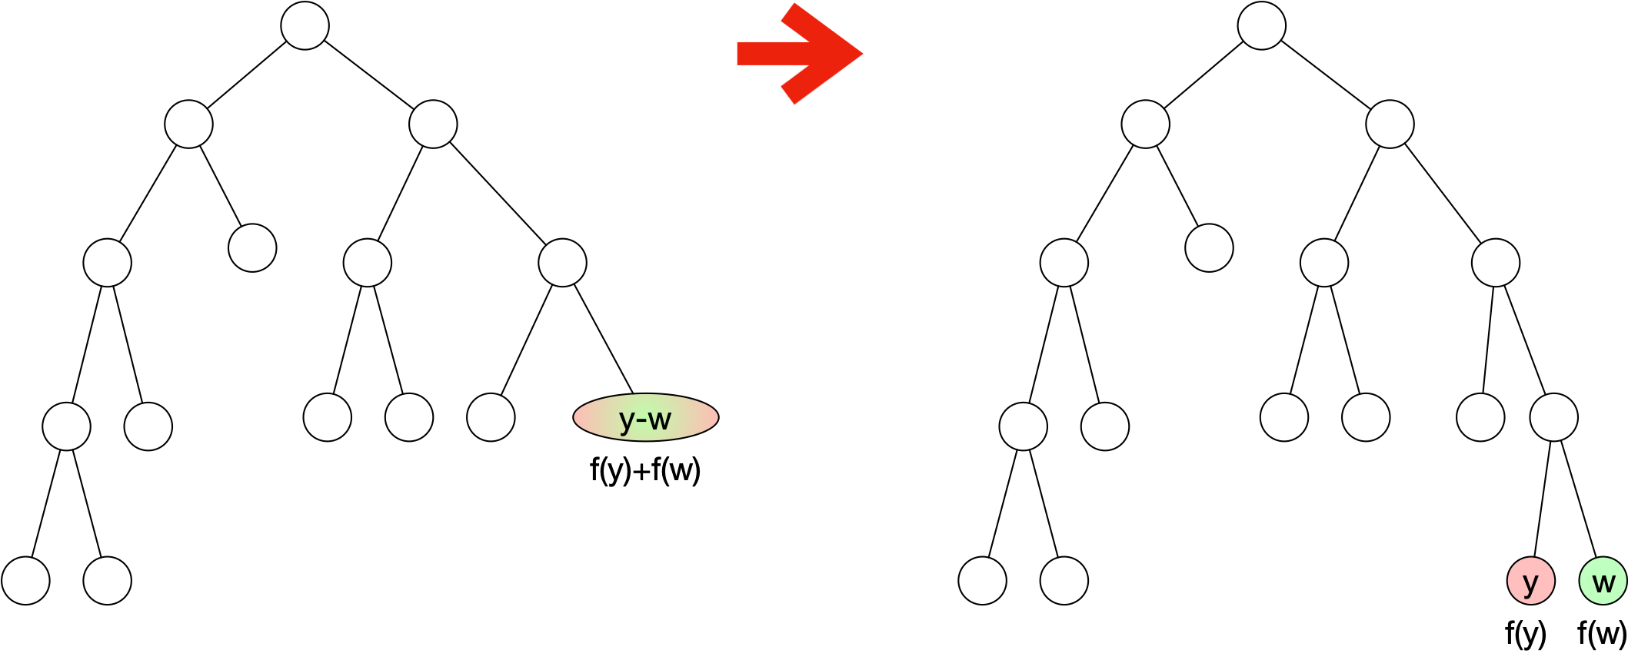
Huffman Coding
Need to show that this step does not counter optimality.
Lemma: If the tree $T$ obtained on the alphabet $Σ-\{y,w\}+\{\overline{yw}\}$ is optimal, then the tree $T^{′}$ replacing the $\overline{yw}$ node with $y$ and $w$ is also optimal

Slide 41
Huffman Coding
Proof:
First we calculate the change in the B-values

Slide 42
Huffman Coding
Proof:
First we calculate the change in the B-values
$$B(T^{′})-B(T)=\underset{c∈Σ^{′}}{∑}f_{T^{′}}(c)d_{T^{′}}(c)-\underset{c∈Σ}{∑}f_{T}(c)d_{T}(c)$$
Using the definition

Slide 43
Huffman Coding
Proof:
First we calculate the change in the B-values
$$B(T^{′})-B(T)=\underset{c∈Σ^{′}}{∑}f_{T^{′}}(c)d_{T^{′}}(c)-\underset{c∈Σ}{∑}f_{T}(c)d_{T}(c)$$
$$=f_{T^{′}}(\overline{yw})d_{T^{′}}(\overline{yw})-f_{T}(y)d_{T}(y)-f_{T}(w)d_{T}(w)$$
We are summing up mostly over the same elements,
so most addends cancel out and this is what it is left

Slide 44
Huffman Coding
Proof:
First we calculate the change in the B-values
$$B(T^{′})-B(T)=\underset{c∈Σ^{′}}{∑}f_{T^{′}}(c)d_{T^{′}}(c)-\underset{c∈Σ}{∑}f_{T}(c)d_{T}(c)$$
$$=f_{T^{′}}(\overline{yw})d_{T^{′}}(\overline{yw})-f_{T}(y)d_{T}(y)-f_{T}(w)d_{T}(w)$$
$$=f_{T^{′}}(\overline{yw})d_{T^{′}}(\overline{yw})-f_{T}(y)d_{T}(y)-f_{T}(w)d_{T}(y)$$
y and w are siblings and therefore have the same distance from the root

Slide 45
Huffman Coding
Proof:
First we calculate the change in the B-values
$$B(T^{′})-B(T)=\underset{c∈Σ^{′}}{∑}f_{T^{′}}(c)d_{T^{′}}(c)-\underset{c∈Σ}{∑}f_{T}(c)d_{T}(c)$$
$$=f_{T^{′}}(\overline{yw})d_{T^{′}}(\overline{yw})-f_{T}(y)d_{T}(y)-f_{T}(w)d_{T}(w)$$
$$=f_{T^{′}}(\overline{yw})d_{T^{′}}(\overline{yw})-f_{T}(y)d_{T}(y)-f_{T}(w)d_{T}(y)$$
$$=(f_{T}(y)+f_{T}(w))(d_{T}(y)-1)-f_{T}(y)d_{T}(y)-f_{T}(w)d_{T}(y)$$
The combined node is located at a level one up compared to the single nodes for y and w

Slide 46
Huffman Coding
Proof:
First we calculate the change in the B-values
$$B(T^{′})-B(T)=\underset{c∈Σ^{′}}{∑}f_{T^{′}}(c)d_{T^{′}}(c)-\underset{c∈Σ}{∑}f_{T}(c)d_{T}(c)$$
$$=f_{T^{′}}(\overline{yw})d_{T^{′}}(\overline{yw})-f_{T}(y)d_{T}(y)-f_{T}(w)d_{T}(w)$$
$$=f_{T^{′}}(\overline{yw})d_{T^{′}}(\overline{yw})-f_{T}(y)d_{T}(y)-f_{T}(w)d_{T}(y)$$
$$=(f_{T}(y)+f_{T}(w))(d_{T}(y)-1)-f_{T}(y)d_{T}(y)-f_{T}(w)d_{T}(y)$$
$$=-f_{T}(y)-f_{T}(w)$$

Slide 47
Huffman Coding
So, by dividing the node $\overline{yw}$ we have to pay a penalty of $f(y)+f(w)$.

Slide 48
Huffman Coding
Now, assume that the left tree is optimal and the right tree is not optimal

Slide 49
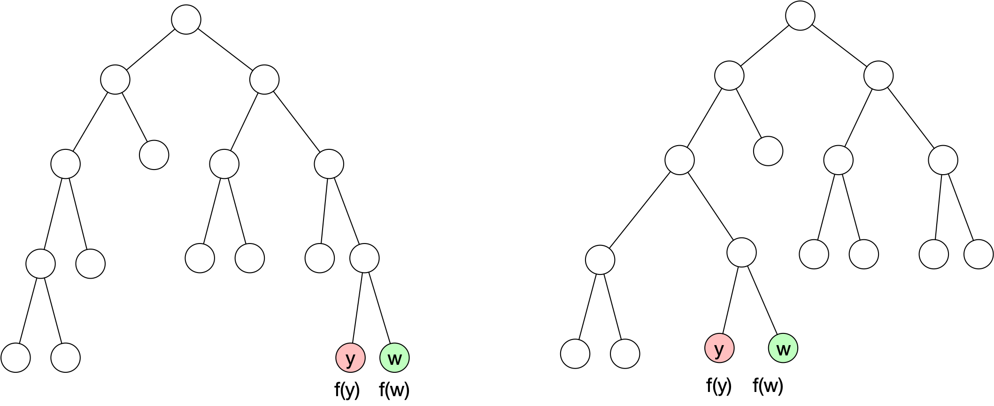
Huffman Coding
Then there exists a tree $S$ that is better the tree with $y$ and $w$
We can assume that in this tree, $y$ and $w$ are leave nodes because of the previous lemma
T
S

Slide 50
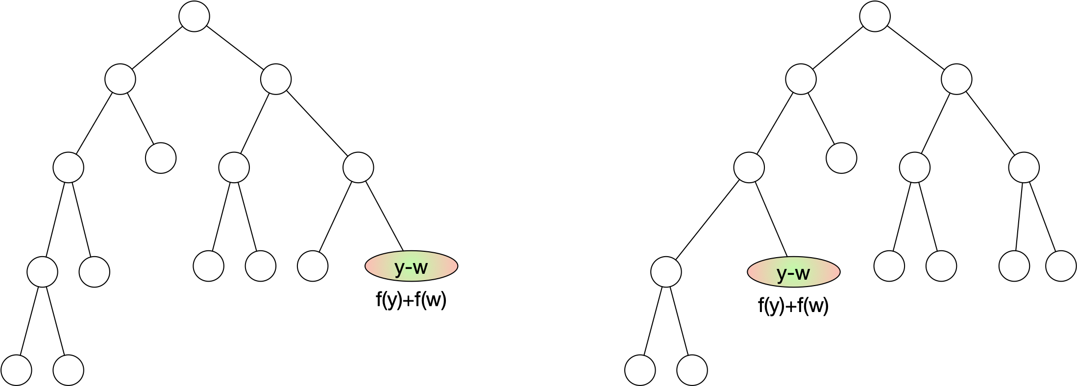
Huffman Coding
We now do the same merge step for $S$ and $T$
T after merging
S after merging

Slide 51
Huffman Coding
The B-value for the tree on the right is the B-value of S minus $f(w)+f(y)$
Which is equal or worse than of the tree on the left

Slide 52
Huffman Coding
The B-value for the tree on the right is the B-value of S minus $f(w)+f(y)$
Which is equal or worse than of the tree on the left
Which is the B-value of T plus $f(w)+f(y)$

Slide 53
Huffman Coding
Thus, S does not have a better B-value

Slide 54
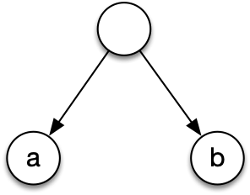
Huffman Coding
Huffman’s algorithm:
If there is only one symbol, create a single node tree
Otherwise, select the two most infrequent symbols
Combine them with a common ancestor
Give the common ancestor the sum of the frequencies
Treat the ancestor as a symbol with this frequency
Repeat until there is only one symbol

Slide 55
Huffman Coding
Example:
Absolute frequencies are
a — 120
b — 29
c — 534
d — 34
e — 2549
f — 321
g — 45

Slide 56
Huffman Coding
Example:
Absolute frequencies are
a — 120, b — 29, c — 534, d — 34, e — 2549, f — 321, g — 45
Combine b and d into (bd)

Slide 57
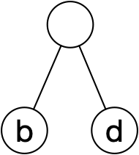
Huffman Coding
Example:
Absolute frequencies are
a — 120, b — 29, c — 534, d — 34, e — 2549, f — 321, g — 45
Combine b and d into (bd)
a - 120, c - 534, e -2549, f-321, g - 45, 63
a — 120, b — 29, c — 534, d — 34, e — 2549, f — 321, g — 45

Slide 58
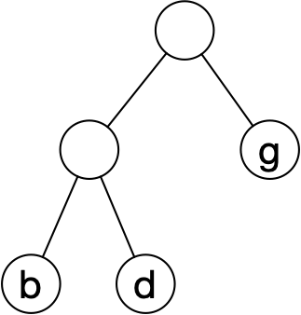
Huffman Coding
Example:
a - 120, c - 534, e -2549, f-321, g - 45, 63
Combine g and
a - 120, c - 534, e - 2549, f - 321, - 108
a — 120, b — 29, c — 534, d — 34, e — 2549, f — 321, g — 45

Slide 59
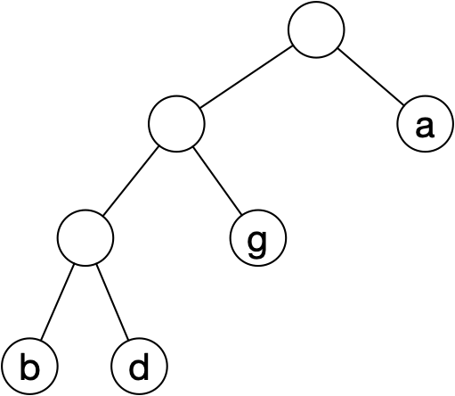
Huffman Coding
Example:
a - 120, c - 534, e - 2549, f - 321, - 108
Combine a and
Obtain c - 534, e - 2549, f - 321, - 228
a — 120, b — 29, c — 534, d — 34, e — 2549, f — 321, g — 45

Slide 60
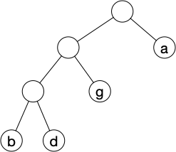
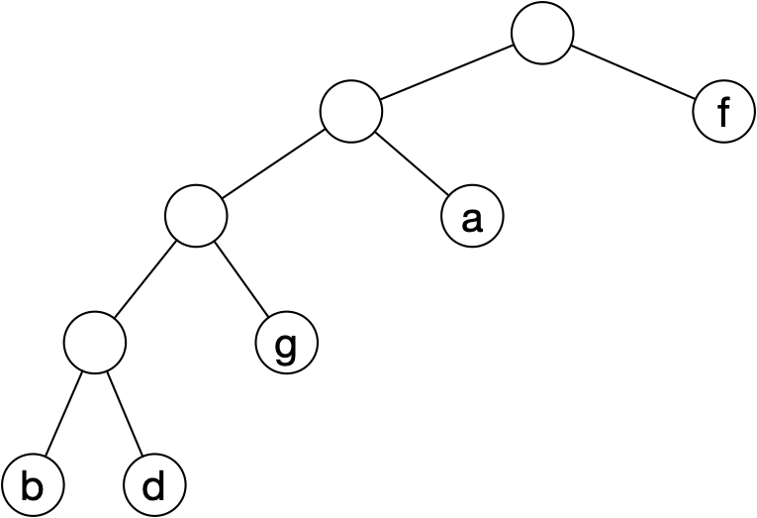
Huffman Coding
Example:
c - 534, e - 2549, f - 321, - 228
Combine f and
c - 534, e - 2549, - 549
a — 120, b — 29, c — 534, d — 34, e — 2549, f — 321, g — 45

Slide 61
Huffman Coding
c - 534, e - 2549, - 549
Combine c with the tree
Then combine with e
a — 120, b — 29, c — 534, d — 34, e — 2549, f — 321, g — 45

Slide 62
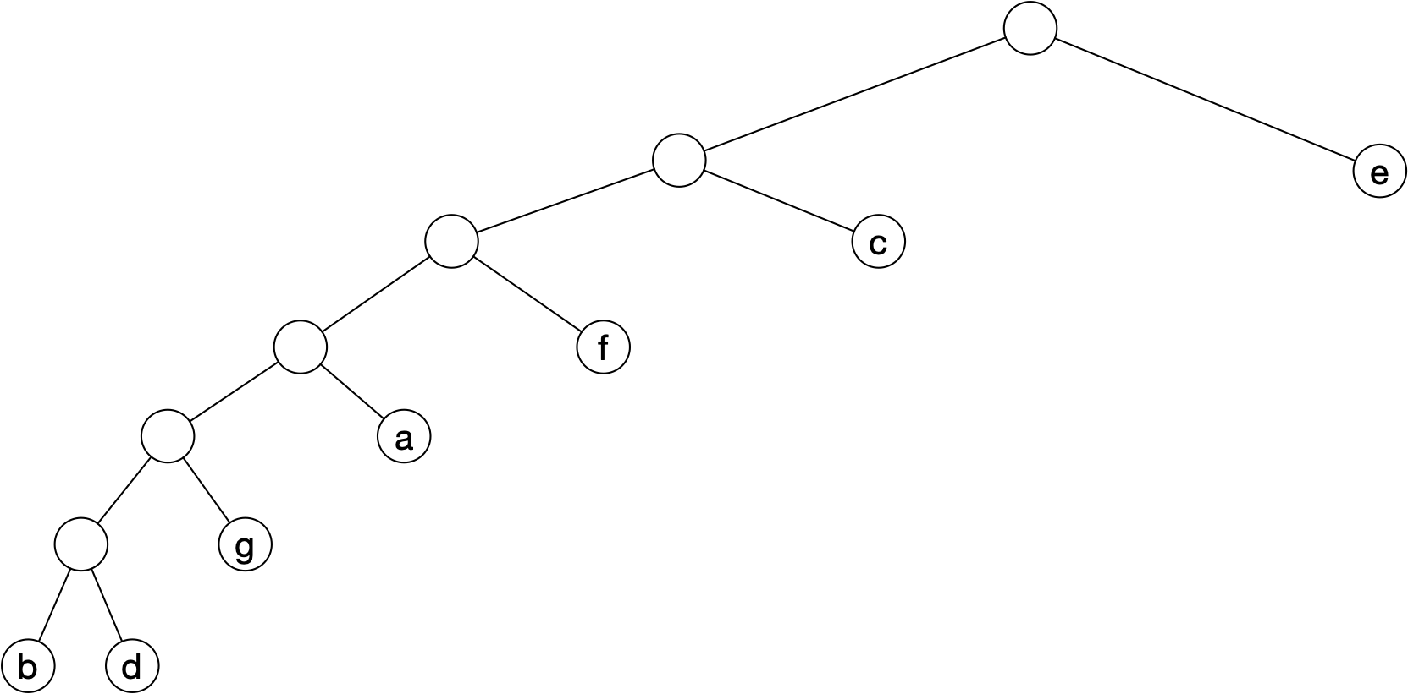
Huffman Coding
Result is

Slide 63
Huffman Coding
B-value needs relative frequencies
>>> total = 120+29+534+34+2549+321+45
>>> 29/total*6+34/total*6+45/total*5+120/total*4+321/total*3+534/total*2+2549/total*1
1.5591960352422907

Slide 64
Huffman Coding
Notice how much choice we have in building this tree
We can switch the order of the trees that we put together
For this one, the encoding is
e - 1
c - 01
f - 001
a - 0001
g - 00001
b - 000000
d - 000001

Slide 65
Huffman Coding
Try it out yourself
a — 0.23
e — 0.35
i — 0.16
o — 0.15
u — 0.11

Slide 66
Huffman Coding
Solution
Have a — 0.23, e — 0.35, i — 0.16, o — 0.15, u — 0.11
First combine o and u for 'ou' with frequency 0.26
a — 0.23
e — 0.35
i — 0.16
ou — 0.26

Slide 67
Huffman Coding
Solution
Have a — 0.23, e — 0.35, i — 0.16, ou — 0.26
Combine i and a
e - 0.35
ai - 0.39
ou - 0.26

Slide 68
Huffman Coding
Solution
Have e - 0.35, ai - 0.39, ou - 0.26
Combine ou with e
e(ou) 0.61
ai 0.39

Slide 69
Huffman Coding
Solution
Have e(ou) - 0.61 ai - 0.39
Combine to get (e(ou)) (ai) with frequency 1.00

Slide 70
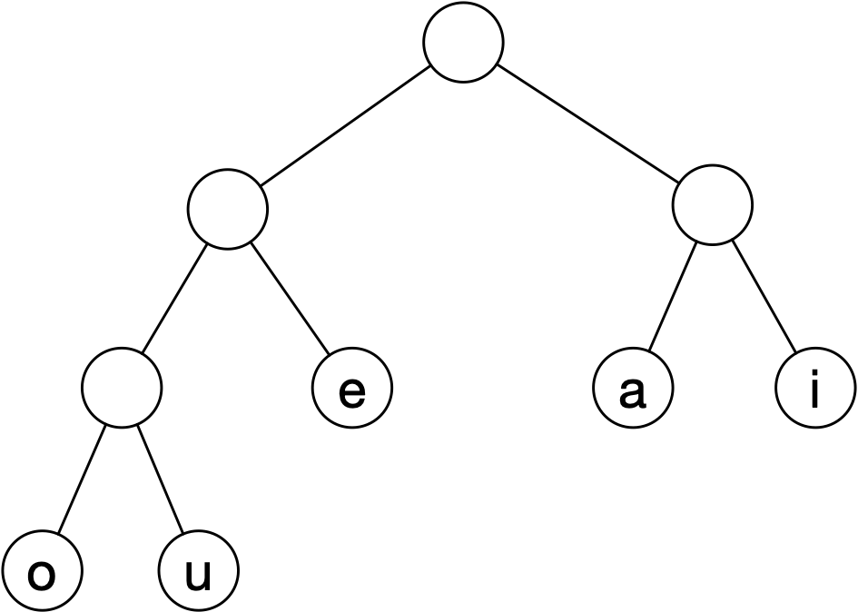
Huffman Coding
Solution
Have (e(ou)) (ai) with frequency 1.00
Translate to tree

Slide 71
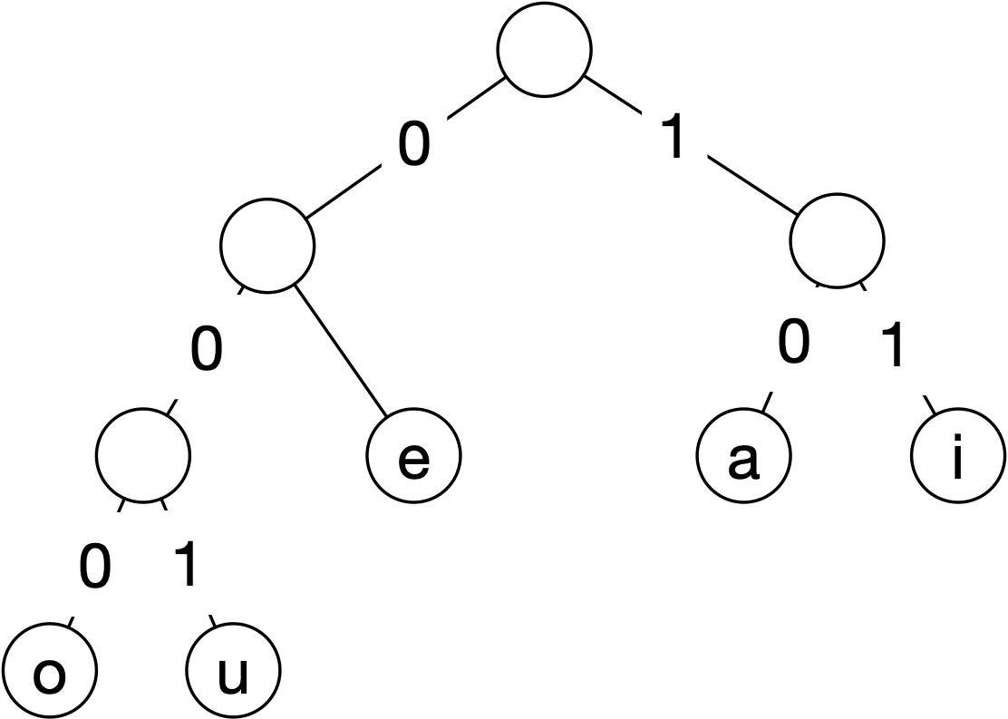
Huffman Coding
Solution
Label tree edges

Slide 72
Huffman Coding
Solution
Read off encoding
a — 10
e — 01
i — 11
o — 000
u — 001

Slide 73
Huffman Coding
Solution
Determine B-value from tree
a — 0.23
e — 0.35
i — 0.16
o — 0.15
u — 0.11
3*0.11+3*0.15+2*0.16+2*0.35+2*0.23=
2.2600000000000002

