Slide 1
Greedy Algorithms
Algorithms

Slide 2
The Change Making Problem
A given country uses a weird set of coins
  1, 3, 5, 8
How do you make change with the least number of coins?
  With these coins, it is not so obvious
  Normally, we can just start out with the largest coin that fits, but not in this case
  Making change for 15:
    Use an 8, a 5 and two 1s
    But three 5s is better

Slide 3
The Change Making Problem
To solve the change making problem, we can use dynamic programming
Some notation: $v_{i}$ value of coin $i,i∈\{1,...,n\}$
  Best number of coins for change of $x$ is
    Best number of coins for change of $x-v_{1}$ plus one
    Best number of coins for change of $x-v_{2}$ plus one
    …
    Best number of coins for change of $x-v_{n}$ plus one

Slide 4
The Change Making Problem
To organize the calculation
  Create a tableau
    For row $i$, column $j$:
      How many coins to make change for an amount of $i$ with coins $1,…,j$

Slide 5
The Change Making Problem
Example: Coins with values 1, 3, 5, 8 to make change of 15
Value | ones | threes | five | eights
1
2
3
4
5
6
7
8
9
10
11
12
13
14
15

Slide 6
The Change Making Problem
Example: Coins with values 1, 3, 5, 8 to make change of 15
First column is easy
Value | ones | threes | five | eights
1 | 1
2 | 2
3 | 3
4 | 4
5 | 5
6 | 6
7 | 7
8 | 8
9 | 9
10 | 10
11 | 11
12 | 12
13 | 13
14 | 14
15 | 15

Slide 7
The Change Making Problem
Second column asks how many threes I should use
  Example for value 10:
    Can use none
      Cost is 10
    Can use one three
      Cost is 1+7
    Can use two threes
      Cost is 2+4
    Can use three threes
      Cost is 3+1
Value | ones | threes | five | eights
0 | 0 | 0 | 0 | 0
1 | 1
2 | 2
3 | 3
4 | 4
5 | 5
6 | 6
7 | 7
8 | 8
9 | 9
10 | 10 | ???
11 | 11
12 | 12
13 | 13
14 | 14
15 | 15

Slide 8
The Change Making Problem
Second column asks how many threes I should use
  Formula is
  $$min\{T_{i-v_{j}ν,j-1}+ν|ν=0,1,…,⌊\frac{i}{v_{i}}⌋\}$$
  $T_{i-v_{j}v,j-1}$ costs of making change of $i-νv_{j}$ with coins up to $j-1$
  $+ν$ costs of using $ν$ coins of value $v_{j}$
Value | ones | threes | five | eights
0 | 0 | 0 | 0 | 0
1 | 1
2 | 2
3 | 3
4 | 4
5 | 5
6 | 6
7 | 7
8 | 8
9 | 9
10 | 10 | ???
11 | 11
12 | 12
13 | 13
14 | 14
15 | 15

Slide 9
The Change Making Problem
Our alternatives are:
  No threes: 10
  One three: 7+1=8
  Two threes 4+2=6
  Three threes 1+3=4
Value | ones | threes | five | eights
0 | 0 | 0 | 0 | 0
1 | 1
2 | 2
3 | 3
4 | 4
5 | 5
6 | 6
7 | 7
8 | 8
9 | 9
10 | 10 | 4
11 | 11
12 | 12
13 | 13
14 | 14
15 | 15

Slide 10
The Change Making Problem
Filling in the other values
Value | ones | threes | five | eights
0 | 0 | 0 | 0 | 0
1 | 1 | 1
2 | 2 | 2
3 | 3 | 1
4 | 4 | 2
5 | 5 | 3
6 | 6 | 2
7 | 7 | 3
8 | 8 | 4
9 | 9 | 3
10 | 10 | 4
11 | 11 | 5
12 | 12 | 4
13 | 13 | 5
14 | 14 | 6
15 | 15 | 5

Slide 11
The Change Making Problem
Now on to five
  The first values are simple since we cannot use a five
Value | ones | threes | five | eights
0 | 0 | 0 | 0 | 0
1 | 1 | 1
2 | 2 | 2
3 | 3 | 1
4 | 4 | 2
5 | 5 | 3
6 | 6 | 2
7 | 7 | 3
8 | 8 | 4
9 | 9 | 3
10 | 10 | 4
11 | 11 | 5
12 | 12 | 4
13 | 13 | 5
14 | 14 | 6
15 | 15 | 5

Slide 12
The Change Making Problem
Now on to five
  The first values are simple since we cannot use a five
Value | ones | threes | five | eights
0 | 0 | 0 | 0 | 0
1 | 1 | 1 | 1
2 | 2 | 2 | 2
3 | 3 | 1 | 1
4 | 4 | 2 | 2
5 | 5 | 3
6 | 6 | 2
7 | 7 | 3
8 | 8 | 4
9 | 9 | 3
10 | 10 | 4
11 | 11 | 5
12 | 12 | 4
13 | 13 | 5
14 | 14 | 6
15 | 15 | 5

Slide 13
The Change Making Problem
Now on to five
  At value 5:
    Can use a five
    Can not use a five:
      3 coins according to previous column
Value | ones | threes | five | eights
0 | 0 | 0 | 0 | 0
1 | 1 | 1 | 1
2 | 2 | 2 | 2
3 | 3 | 1 | 1
4 | 4 | 2 | 2
5 | 5 | 3 | 1
6 | 6 | 2
7 | 7 | 3
8 | 8 | 4
9 | 9 | 3
10 | 10 | 4
11 | 11 | 5
12 | 12 | 4
13 | 13 | 5
14 | 14 | 6
15 | 15 | 5

Slide 14
The Change Making Problem
Now on to five
  At value 6:
    Can use 5
      Costs: 1+1
    Cannot use 5
      Costs 2
Value | ones | threes | five | eights
0 | 0 | 0 | 0 | 0
1 | 1 | 1 | 1
2 | 2 | 2 | 2
3 | 3 | 1 | 1
4 | 4 | 2 | 2
5 | 5 | 3 | 1
6 | 6 | 2 | 2
7 | 7 | 3
8 | 8 | 4
9 | 9 | 3
10 | 10 | 4
11 | 11 | 5
12 | 12 | 4
13 | 13 | 5
14 | 14 | 6
15 | 15 | 5

Slide 15
The Change Making Problem
Now on to five
  At value 8:
    Can use 5
      Costs: 1+1
    Cannot use 5
      Costs 4
Value | ones | threes | five | eights
0 | 0 | 0 | 0 | 0
1 | 1 | 1 | 1
2 | 2 | 2 | 2
3 | 3 | 1 | 1
4 | 4 | 2 | 2
5 | 5 | 3 | 1
6 | 6 | 2 | 2
7 | 7 | 3 | 3
8 | 8 | 4 | 2
9 | 9 | 3
10 | 10 | 4
11 | 11 | 5
12 | 12 | 4
13 | 13 | 5
14 | 14 | 6
15 | 15 | 5

Slide 16
The Change Making Problem
Now on to five
  At value 9:
    Can use 5
      Costs: 2+1
    Cannot use 5
      Costs 3
Value | ones | threes | five | eights
0 | 0 | 0 | 0 | 0
1 | 1 | 1 | 1
2 | 2 | 2 | 2
3 | 3 | 1 | 1
4 | 4 | 2 | 2
5 | 5 | 3 | 1
6 | 6 | 2 | 2
7 | 7 | 3 | 3
8 | 8 | 4 | 2
9 | 9 | 3 | 3
10 | 10 | 4
11 | 11 | 5
12 | 12 | 4
13 | 13 | 5
14 | 14 | 6
15 | 15 | 5

Slide 17
The Change Making Problem
Now on to five
  At value 10:
    Can use two 5s
    Can use one 5
      Costs: 3+1
    Can use no 5s
      Costs 3
Value | ones | threes | five | eights
0 | 0 | 0 | 0 | 0
1 | 1 | 1 | 1
2 | 2 | 2 | 2
3 | 3 | 1 | 1
4 | 4 | 2 | 2
5 | 5 | 3 | 1
6 | 6 | 2 | 2
7 | 7 | 3 | 3
8 | 8 | 4 | 2
9 | 9 | 3 | 3
10 | 10 | 4 | 2
11 | 11 | 5
12 | 12 | 4
13 | 13 | 5
14 | 14 | 6
15 | 15 | 5

Slide 18
The Change Making Problem
Now on to five
  At value 11:
    Can use two 5s
      Costs 2+1
    Can use one 5
      Costs: 2+1
    Can use no 5s
      Costs 5
Value | ones | threes | five | eights
0 | 0 | 0 | 0 | 0
1 | 1 | 1 | 1
2 | 2 | 2 | 2
3 | 3 | 1 | 1
4 | 4 | 2 | 2
5 | 5 | 3 | 1
6 | 6 | 2 | 2
7 | 7 | 3 | 3
8 | 8 | 4 | 2
9 | 9 | 3 | 3
10 | 10 | 4 | 2
11 | 11 | 5 | 3
12 | 12 | 4
13 | 13 | 5
14 | 14 | 6
15 | 15 | 5

Slide 19
The Change Making Problem
Now on to five
  At value 12:
    Can use two 5s
      Costs 2+2
    Can use one 5
      Costs: 3+1
    Can use no 5s
      Costs 4
Value | ones | threes | five | eights
0 | 0 | 0 | 0 | 0
1 | 1 | 1 | 1
2 | 2 | 2 | 2
3 | 3 | 1 | 1
4 | 4 | 2 | 2
5 | 5 | 3 | 1
6 | 6 | 2 | 2
7 | 7 | 3 | 3
8 | 8 | 4 | 2
9 | 9 | 3 | 3
10 | 10 | 4 | 2
11 | 11 | 5 | 3
12 | 12 | 4 | 4
13 | 13 | 5
14 | 14 | 6
15 | 15 | 5

Slide 20
The Change Making Problem
Now on to five
  At value 13:
    Can use two 5s
      Costs 2+1
    Can use one 5
      Costs: 4+1
    Can use no 5s
      Costs 5
Value | ones | threes | five | eights
0 | 0 | 0 | 0 | 0
1 | 1 | 1 | 1
2 | 2 | 2 | 2
3 | 3 | 1 | 1
4 | 4 | 2 | 2
5 | 5 | 3 | 1
6 | 6 | 2 | 2
7 | 7 | 3 | 3
8 | 8 | 4 | 2
9 | 9 | 3 | 3
10 | 10 | 4 | 2
11 | 11 | 5 | 3
12 | 12 | 4 | 4
13 | 13 | 5 | 3
14 | 14 | 6
15 | 15 | 5

Slide 21
The Change Making Problem
Now on to five
  At value 14:
    Can use two 5s
      Costs 2+1
    Can use one 5
      Costs: 3+1
    Can use no 5s
      Costs 6
Value | ones | threes | five | eights
0 | 0 | 0 | 0 | 0
1 | 1 | 1 | 1
2 | 2 | 2 | 2
3 | 3 | 1 | 1
4 | 4 | 2 | 2
5 | 5 | 3 | 1
6 | 6 | 2 | 2
7 | 7 | 3 | 3
8 | 8 | 4 | 2
9 | 9 | 3 | 3
10 | 10 | 4 | 2
11 | 11 | 5 | 3
12 | 12 | 4 | 4
13 | 13 | 5 | 3
14 | 14 | 6 | 3
15 | 15 | 5

Slide 22
The Change Making Problem
Now on to five
  At value 15:
    Can use three 5s
      Costs 3
    Can use two 5s
      Costs 2+3
    Can use one 5
      Costs: 4+1
    Can use no 5s
      Costs 5
Value | ones | threes | five | eights
0 | 0 | 0 | 0 | 0
1 | 1 | 1 | 1
2 | 2 | 2 | 2
3 | 3 | 1 | 1
4 | 4 | 2 | 2
5 | 5 | 3 | 1
6 | 6 | 2 | 2
7 | 7 | 3 | 3
8 | 8 | 4 | 2
9 | 9 | 3 | 3
10 | 10 | 4 | 2
11 | 11 | 5 | 3
12 | 12 | 4 | 4
13 | 13 | 5 | 3
14 | 14 | 6 | 3
15 | 15 | 5 | 3

Slide 23
The Change Making Problem
Now on to eights
  At value 15:
    Can use one eight
      Costs 1+3
    Can use no eights
      Costs: 3
Value | ones | threes | five | eights
0 | 0 | 0 | 0 | 0
1 | 1 | 1 | 1
2 | 2 | 2 | 2
3 | 3 | 1 | 1
4 | 4 | 2 | 2
5 | 5 | 3 | 1
6 | 6 | 2 | 2
7 | 7 | 3 | 3
8 | 8 | 4 | 2
9 | 9 | 3 | 3
10 | 10 | 4 | 2
11 | 11 | 5 | 3
12 | 12 | 4 | 4
13 | 13 | 5 | 3
14 | 14 | 6 | 3
15 | 15 | 5 | 3 | 3

Slide 24
The Change Making Problem
Alternative: Memoization and Recursion
  Instead of using a tableau
    (or rather two, one to remember the best choice)
  Can use recursion and memoization
    Simplest form:
      What was the last coin that was added
        It has to be one of the coins: e.g. 1, 3, 5, or 8
        The costs are the cost of making change for the amount minus the value of the coin plus one for the coin itself

Slide 25
The Change Making Problem
Alternative: Memoization and Recursion
  Recursion
    $$c(n)=min\{c(n-v_{i})+1\}$$
    where the minimum is taken over all different coin values
    We also write the coin which causes the minimum to be selected

Slide 26
The Change Making Problem
For memoization in Python:
  have a global dictionary for the costs and the best choice of coin (last_coin)
  Also, add the values of the coins in a list
last_coin = {0:0}
costs = {0:0}
values = [1,3,5,7,8]

Slide 27
The Change Making Problem
Here is very simple Python code
def getChange(n):
if n in costs:
return costs[n]
best = 100000
bestcoin = 0
for x in range(len(values)):
if values[x] > n:
break
alternativeCost = getChange(n-values[x])+1
if alternativeCost < best:
best = alternativeCost
bestcoin = values[x]
costs[n] = best
last_coin[n] = bestcoin
return best

Slide 28
The Change Making Problem
0 0 0
1 1 1
2 2 1
3 1 3
4 2 1
5 1 5
6 2 1
7 1 7
8 1 8
9 2 1
10 2 3
11 2 3
12 2 5
13 2 5
14 2 7
15 2 7
16 2 8
17 3 1
18 3 3
19 3 3
20 3 5
And here is the output
  Amount to make change for
  Number of coins needed
  Last coin used
Example:
  For 20, use a 5, left 15
  For 15, use a 7, left 8
  For 8, use 8

Slide 29
The Change Making Problem
But we do not have this problem with normal coin sets
  US$-cents: 1, 5, 10, 25, 100
  Euro-cents: 1, 5, 10, 20, 50, 100, 200

Slide 30
The Change Making Problem
Cashier's Algorithm
  Always select the largest coin smaller or equal the current amount
  Will not always work
    Another example: US Postage Stamps before forever
      1, 5, 25, 32, 100
      Make change for 121
        Cashier's algorithm: 100+5+5+5+5+1
        Better choice 32+32+32+25

Slide 31
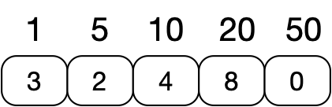
The Change Making Problem
But sometimes the Cashier's Algorithm is the best
  Assume that we have coins of 1, 5, 10, 20, and 50
  Proof by induction that the cashier's algorithm always give the best change
  Represent the change as an array
    Coefficient $i$ of array: number of $i$-th coins
    Example:
        one way of making change for 213

Slide 32
The Change Making Problem
Proof:
Assume $C=[c_{1},c_{5},c_{10},c_{20},c_{50}]$ is the result of the cashier's algorithm for an amount of
  $$c_{1}+c_{5}⋅5+c_{10}⋅10+c_{20}⋅20+c_{50}⋅50$$
                Assume $A=[a_{1},a_{5},a_{10},a_{20},a_{50}]$ is an alternative with less coins for the same amount
      $$a_{1}+a_{5}⋅5+a_{10}⋅10+a_{20}⋅20+a_{50}⋅50$$
      but $a_{1}+a_{5}+a_{10}+a_{20}+a_{50}<c_{1}+c_{5}+c_{10}+c_{20}+c_{50}$

Slide 33
The Change Making Problem
Proof:
Want to show that $A=C$.

Slide 34
The Change Making Problem
Proof:
  Lemma 1: An optimal solutions has not more than four pennies
    Otherwise replace with a 5 cent piece
  Lemma 2: An optimal solution has not more than one 10 cent piece
    Otherwise replace with a 20 cent piece
  Lemma 3: An optimal solution cannot have two twenty cent pieces and one 10 cent piece
    Otherwise replace with a 50 cent piece

Slide 35
The Change Making Problem
Proof:
  Lemma 5: Maximum number of pennies in an optimal solution is four
    Follows from Lemma 1
  Lemma 6: If the optimal solution has only pennies and five cents, then the amount is at most nine
    Follows from Lemma 2 and Lemma 5

Slide 36
The Change Making Problem
Lemma 7: The maximum amount for an optimal solution with only pennies, 5 cent and 10 cent pieces is 19
Lemma 8: The maximum amount for an optimal solution with only 1 cent, 5 cent, 10 cent, and 20 cent pieces is 49

Slide 37
The Change Making Problem
Proof:
  Assume that the number of 50 cent coins in A and C differ.
  Because of how C is defined, the number of 50 cent coins in A has to be lower $a_{50}<c_{50}$.
  However, the difference needs to be made up with coins of smaller value
  But an optimal solution cannot have more than 49 cents in smaller coins
  Contradiction

Slide 38
The Change Making Problem
Proof:
  So, the number of 50 cent coins does not differ
    If there are $x$ 50 cent coins, then look at the best solution for amount-$x$ coins.
    $C$ and $A$ with the 50 cent coins removed are still two different solutions for the same amount
  Now apply the same argument to the 20 cent coins.
  Et cetera

Slide 39
The Change Making Problem
We call the cashier's algorithm a greedy algorithm:
  We solve the problem by going to a smaller problem
    E.g. Making change for 134 cents.
    Lay out 50 cents
    Making change for 84 cents.
    …
  At each step, we select something optimal

Slide 40
Greedy Algorithms
Many algorithms run from stage to stage
  At each stage, they make a decision based on the information available
A Greedy algorithm makes decisions
  At each stage, using locally available information, the greedy algorithm makes an optimal choice
Sometimes, greedy algorithms give an overall optimal solution
Sometimes, greedy algorithms will not result in an optimal solution but often in one good enough

Slide 41
Divisible Items Knapsack Problem
Given a set of items
  Each item has a weight
  Each item has a value
Select a subset
  Constraint:
  Objective Function:
$$S$$
$$w(x)$$
$$v(x)$$
$$M⊂S$$
$$\underset{x∈M}{∑}w(x)<W$$
$$\underset{x∈M}{∑}v(x)⟶max$$

Slide 42
Divisible Items Knapsack Problem
Order all items by impact
In order of impact (highest first), ask whether you want to include the item
  And you include it if the sum of the weights of the items already selected is smaller than
$$\text{impact}(x)=\frac{v(x)}{w(x)}$$
$$W$$

Slide 43
Optimal Rental
Set of activities
  Each activity has a start time and a finish time
  Each activity needs to use your facility
  Only one activity at a time
  Make the rental agreements that maximize the number of rentals
$$S=\{a_{1},a_{2},…,a_{n}\}$$
$$0≤s_{i}<f_{i}<∞$$

Slide 44
Optimal Rental
Two activities and are compatible iff
This means that activity finishes before activity
$$a_{i}$$
$$a_{j}$$
$$[s_{i},f_{i})∩[s_{j},f_{j})=∅$$
$$i<j$$
$$j$$

Slide 45
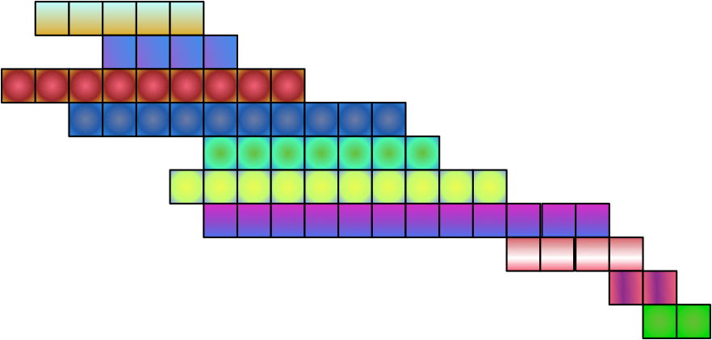
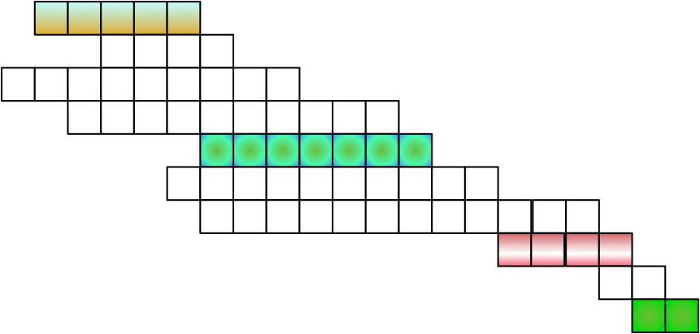
Optimal Rental
i | 1 | 2 | 3 | 4 | 5 | 6 | 7 | 8 | 9 | 10
si | 1 | 3 | 0 | 2 | 6 | 5 | 6 | 15 | 18 | 19
fi | 6 | 7 | 9 | 12 | 13 | 15 | 18 | 19 | 20 | 21
Example:
  A compatible set is $\{A_{1},A_{5},A_{8},A_{10}\}$
  Another compatible set is $\{A_{3},A_{9}\}$

Slide 46
Optimal Rental
Optimal rental with a dynamic programming algorithm
  Subproblems: Define to be the set of activities that start after finishes and finish before starts
$$S_{ik}$$
$$a_{i}$$
$$a_{k}$$
i | 1 | 2 | 3 | 4 | 5 | 6 | 7 | 8 | 9 | 10
si | 1 | 3 | 0 | 2 | 6 | 5 | 6 | 15 | 18 | 19
fi | 6 | 7 | 9 | 12 | 13 | 15 | 18 | 19 | 20 | 21
$$S_{1,8}=\{a_{5}\}$$

Slide 47
Optimal Rental
We want to find an optimal rental plan for
  Assume that there is an optimal solution that contains activity
  By selecting , we need to decide what to do with the time before starts and after finishes
  These sets are and
$$S_{ik}$$
$$a_{j}∈S_{i,k}$$
$$a_{j}$$
$$a_{j}$$
$$a_{j}$$
$$S_{ij}$$
$$S_{jk}$$

Slide 48
Optimal Rental
Assume that is part of an optimal solution for
  Then is divided into the ones that end before and the ones that start after
$$a_{j}$$
$$A_{i,k}$$
$$S_{i,k}$$
$$A_{i,k}$$
$$a_{j}$$
$$a_{j}$$
$$A_{i,j}=A_{i,k}∩S_{i,k}$$
$$A_{j,k}=A_{i,k}∩S_{j,k}$$
$$A_{i,k}=A_{i,j}∪\{a_{j}\}∪A_{j,k}$$

Slide 49
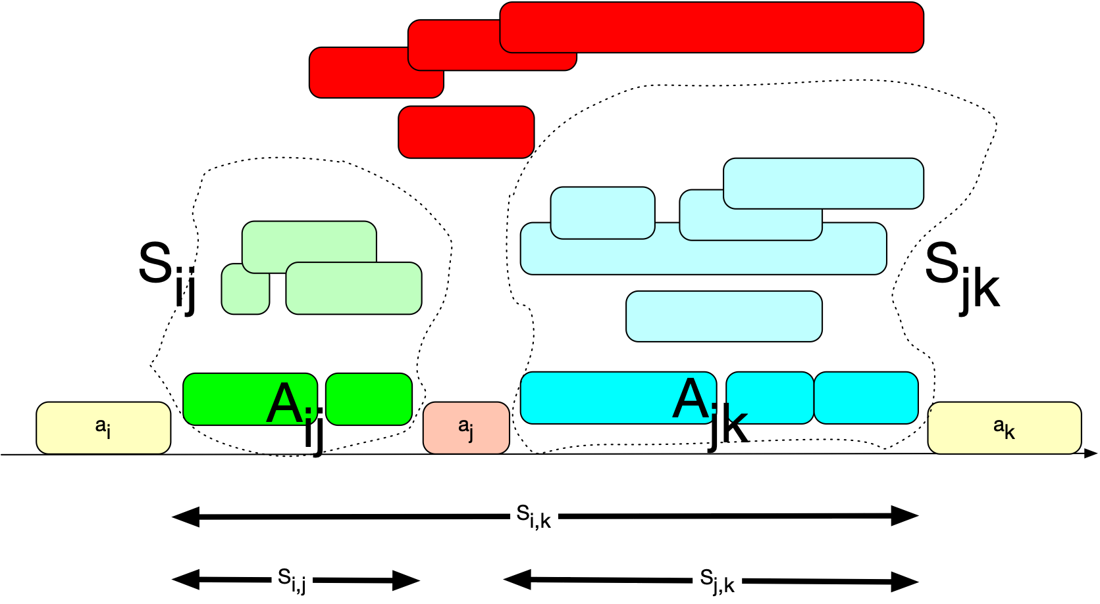
Optimal Rental

Slide 50
Optimal Rental
Clearly, is an optimal solution for
is an optimal solution for
For if not, we could construct a better solution for
$$A_{i,j}$$
$$S_{i,j}$$
$$A_{j,k}$$
$$S_{j,k}$$
$$S_{i,k}$$

Slide 51
Optimal Rental
We can therefore solve recursively the problem for by looking at all possible activities for
  Define Max number of compatible activities in
  Then:
    The 0 is necessary because there might be no activity in
$$S_{i,k}$$
$$a_{j}$$
$$C[i,k]=$$
$$S_{i,k}$$
$$C[i,k]=max(0,max(C[i,j]+C[j,k]+1|a_{j}∈S_{i,k}))$$
$$S_{i,k}$$

Slide 52
Optimal Rental
The recursion leads to a nice dynamic programming problem
$$C[i,k]=max(0,max(C[i,j]+C[j,k]+1|a_{j}∈S_{i,k}))$$

Slide 53
Optimal Rental
But can we do better?

Slide 54
Optimal Rental
Start out with the initial problem
  Select the activity that finishes first
    this would be
  This leaves most space for all other activities
    Call $S_{1}$ the set of activities compatible with $a_{1}$
        These are those starting after $a_{1}$
    Similarly, call $S_{k}$ the set of activities starting after $a_{k}$
$$a_{1}$$

Slide 55
Optimal Rental
Theorem: For any non-empty problem $S_{k}$ let $a_{m}$ be the activity with the smallest end time. Then $a_{m}$ is contained in an optimal solution
Proof:
  Let $A_{k}$ be a solution
    i.e. the maximum sized compatible subset in $S_{k}$
    Let $a_{1}∈A_{k}$ be the activity with earliest finish time
    If $a_{m}=a_{1}$ then we are done

Slide 56
Optimal Rental
Theorem: For any non-empty problem $S_{k}$ let $a_{m}$ be the activity with the smallest end time. Then $a_{m}$ is contained in an optimal solution
Proof:
  Otherwise replace $a_{1}$ with $a_{m}$ in $A_{k}$
    $A_{k}^{′}=A_{k}-\{a_{1}\}∪\{a_{m}\}$
    Since $a_{m}$ is the first to finish, this is a set of compatible activities
    Therefore, there exists an optimal solution with $a_{m}$

Slide 57
Optimal Rental
Result of the Theorem:
    We can find an optimal solution (but not necessarily all optimal solutions) by always picking the first one to finish.

Slide 58
Optimal Rental
Example
Select
Exclude , , and as incompatible
Choose , , and for the complete solution
i | 1 | 2 | 3 | 4 | 5 | 6 | 7 | 8 | 9 | 10
si | 1 | 3 | 0 | 2 | 6 | 5 | 6 | 15 | 18 | 19
fi | 6 | 7 | 9 | 12 | 13 | 15 | 18 | 19 | 20 | 21
$$a_{1}$$
$$a_{2}$$
$$a_{3}$$
$$a_{4}$$
$$a_{5}$$
$$a_{8}$$
$$a_{10}$$

Slide 59
Greedy Algorithms
Greedy algorithms
  Determine the optimal substructure
  Develop a recursive solution
  Show that making the greedy choice is best
  Show that making the greedy choice leads to a similar subproblem
  Obtain a recursive algorithm
  Convert the recursive algorithm to an iterative algorithm

