Slide 1
Divide and Conquer
Algorithms

Slide 2
Divide and Conquer
Generic recipe for many solutions:
Divide the problem into two or more smaller instances of the same problem
Conquer the smaller instances using recursion (or a base case)
Combine the answers to solve the original problem

Slide 3
Integer Multiplication
Assume we want to multiply two n-bit integers with n a power of two
Divide: break the integers into two n/2-bit integers
$$x=2^{\frac{n}{2}}x_{L}+x_{R}$$
$$y=2^{\frac{n}{2}}y_{L}+y_{R}$$

Slide 4
Integer Multiplication
Conquer: Solve the problem of multiplying of n/2 bit integers by recursion or a base case for n=1, n=2, or n=4
$$x=2^{\frac{n}{2}}x_{L}+x_{R}$$
$$y=2^{\frac{n}{2}}y_{L}+y_{R}$$
$$x_{L}⋅y_{L}$$
$$x_{L}⋅y_{R}$$
$$x_{R}⋅y_{L}$$
$$x_{R}⋅y_{R}$$

Slide 5
Integer Multiplication
Now combine:
In the naïve way:
$$x⋅y=(x_{L}⋅2^{\frac{n}{2}}+x_{R})⋅(y_{L}⋅2^{\frac{n}{2}}+y_{R})$$
$$=x_{L}⋅y_{L}⋅2^{n}+(x_{L}⋅y_{R}+x_{R}⋅y_{L})⋅2^{\frac{n}{2}}+x_{R}⋅y_{R}$$

Slide 6
Integer Multiplication
$$x⋅y=(x_{L}2^{\frac{n}{2}}+x_{R})⋅(y_{L}2^{\frac{n}{2}}+y_{R})$$
We count the number of multiplications
Multiplying by powers of 2 is just shifting, so they do not count
number of bit multiplications for integers with bits:
Recursion:
$$=x_{L}⋅y_{L}2^{n}+(x_{L}⋅y_{R}+x_{R}⋅y_{L})⋅2^{\frac{n}{2}}+x_{R}⋅y_{R}$$
$$T(n)$$
$$2^{n}$$
$$T(0)=1$$
$$T(n+1)=4T(n)$$

Slide 7
Integer Multiplication
Solving the recursion
Intuition:
$$T(0)=1$$
$$T(n+1)=4T(n)$$
$$T(n)=4T(n-1)=4^{2}T(n-2)=4^{3}T(n-3)=…=4^{n}T(0)=4^{n}$$

Slide 8
Integer Multiplication
Proposition:
Proof by induction:
Induction base:
Induction step: Assume . Show
Proof:
$$T(n)=4^{n}$$
$$T(0)=1=4^{0}$$
$$T(n)=4^{n-1}$$
$$T(n+1)=4^{n}$$

Slide 9
Integer Multiplication
Since the number of bits is
Number of multiplications is
This is not better than normal multiplication
$$m=2^{n}$$
$$S(m)=T(n)=4^{n}=(2^{n})^{n}=m^{2}$$

Slide 10
Integer Multiplication
Now combine:
Instead:
Use
This reuses two multiplications that are already used
$$x⋅y=(x_{L}2^{\frac{n}{2}}+x_{R})⋅(y_{L}2^{\frac{n}{2}}+y_{R})$$
$$=x_{L}⋅y_{L}⋅2^{n}+(x_{L}⋅y_{R}+x_{R}⋅y_{L})⋅2^{\frac{n}{2}}+x_{R}⋅y_{R}$$
$$(x_{L}⋅y_{R}+x_{R}⋅y_{L})=(x_{L}+x_{R})⋅(y_{L}+y_{R})-x_{L}⋅y_{L}-x_{R}⋅y_{R}$$

Slide 11
Integer Multiplication
We need to deal with the potential overflow in calculating
$$(x_{L}+x_{R})⋅(y_{L}+y_{R})$$

Slide 12
Integer Multiplication
Now, we only do three multiplications of bit numbers in order to multiply two bit numbers
The recursion becomes
$$2^{n}$$
$$2^{n+1}$$
$$T(0)=1$$
$$T(n+1)=3T(n)$$

Slide 13
Integer Multiplication
Solving the recurrence
Heuristics:
$$T(0)=1$$
$$T(n+1)=3T(n)$$
$$T(n)=3T(n-1)=3^{2}T(n-2)=…=3^{n}T(0)=3^{n}$$

Slide 14
Integer Multiplication
As before prove exactly using induction

Slide 15
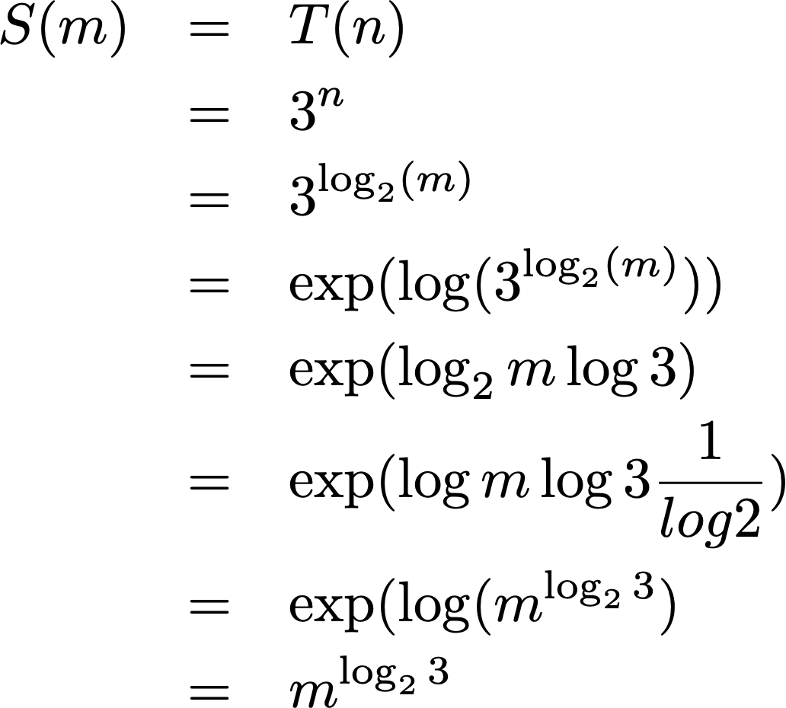
Integer Multiplication
The multiplication of two -bit numbers takes
$$m=2^{n}$$

Slide 16
Integer Multiplication
This way, multiplication of m-bit numbers takes bit multiplications
$$m^{1.58496}$$

Slide 17
Integer Multiplication
Can be used for arbitrary length integer multiplication
Base case is 32 or 64 bits
But can still do better using Fast Fourier Transformation

Slide 18
Binary Search
Given an array of ordered integers, a pointer to the beginning and to the end of a portion of the array, decide whether an element is in the slice
Search(array, beg, end, element)

Slide 19
Binary Search
Divide: Determine the middle element. This divides the array into two subsets
Conquer: Compare the element with the middle element. If it is smaller, find out whether the element is in the left half, otherwise, whether the element is in the right half
Combine: Just return the answer to the one question

Slide 20
Binary Search
def binary_search(array, beg, end, key):
if beg >= end:
return False
mid = (beg+end)//2
if array[mid]==key:
return True
elif array[mid] > key:
return binary_search(array, beg, mid, key)
else:
return binary_search(array, mid+1, end, key)
test = [2, 3, 5, 6, 12, 15, 17, 19, 21, 23, 27, 29,
31, 33, 35, 39, 41]
print(binary_search(test, 0, len(test), 21))
print(binary_search(test, 0, len(test), 22))

Slide 21
Binary Search
Let be the runtime of binary_search on a subarray with n elements
Recursion: There is a constant c such that
$$T(n)$$
$$T(1)≤c$$
$$T(n)≤T(n//2)+c$$

Slide 22
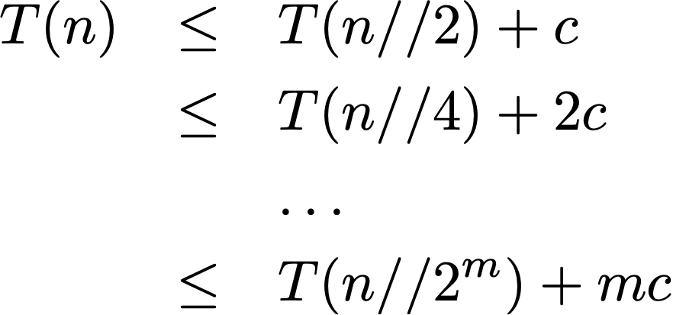
Binary Search
Solving the recursion
If then
$$m≥\log_{2}n$$
$$T(n)≤T(1)+mc=(m+1)c$$

Slide 23
Binary Search
With other words, binary search on n elements takes time
$$∝\log_{2}(n)$$

Slide 24
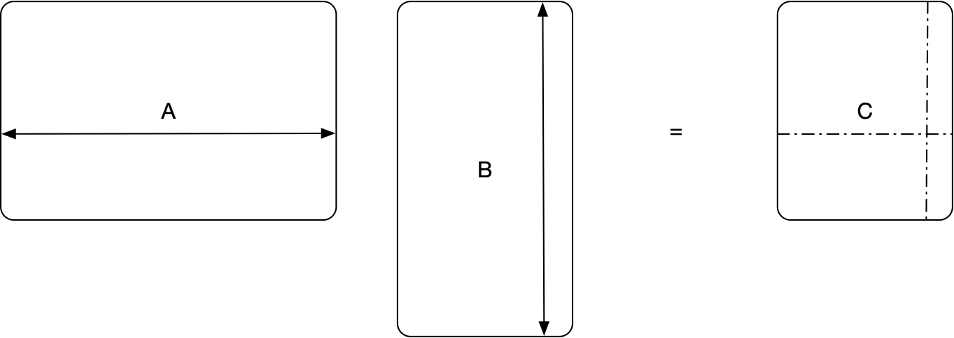
Strassen Multiplication
Definition of Matrix Multiplication
$$(a_{i,j})_{{1≤i≤m \atop 1≤j≤n}}⋅(b_{j,k})_{{1≤j≤n \atop 1≤k≤p}}=(\overset{n}{\underset{j=1}{∑}}a_{i,j}b_{j,k})_{{1≤i≤m \atop 1≤k≤p}}$$
row i
i row
j column
column j

Slide 25
Strassen Multiplication
Cost of definition:
$n^{2}$ multiplications for all $mk$ elements in the product
Square $n×n$ matrices: $n^{4}$ elements

Slide 26
Strassen Multiplication
Divide and conquer: Assume $n=2^{r}$ is a power of two.
We can use the following theorem:
Break each matrix into four submatrices of size $2^{r-1}×2^{r-1}$ and calculate
$$\left(\begin{matrix}A_{11} & A_{12} \\ A_{21} & A_{22}\end{matrix}\right)⋅\left(\begin{matrix}B_{11} & B_{12} \\ B_{21} & B_{22}\end{matrix}\right)=\left(\begin{matrix}A_{11}B_{11}+A_{12}B_{21} & A_{11}B_{21}+A_{12}B_{22} \\ A_{21}B_{11}+A_{22}B_{21} & A_{21}B_{21}+A_{22}B_{22}\end{matrix}\right)$$

Slide 27
Strassen Multiplication
As is, a divide and conquer algorithm gives us 8 multiplication of matrices half the size.
Let $m(n)$ be the number of multiplications needed to multiply two $2^{n}×2^{n}$ matrices using divide and conquer
Obviously: $m(1)=1$
Recursion: $m(n+1)=8m(n)$

Slide 28
Strassen Multiplication
Claim: $m(n)=2^{3n}$
Proof: Induction base: $m(0)=1=2^{3⋅0}$
Induction step:
Hypothesis: $m(n)=2^{3n}$
To show: $m(n+1)=2^{3(n+1)}$
Proof:
$$m(n+1)=8m(n)=8⋅2^{3n}=2^{3}⋅2^{3n}=2^{3n+3}=2^{3(n+1)}$$

Slide 29
Strassen Multiplication
That is the same as the normal algorithm!!!!!!!!!!!!!!!!!!!!!!!!!!!!

Slide 30
Strassen Multiplication
Strassen: Can use 7 matrix multiplications to calculate all eight products
$$M_{1}:=(A_{1,1}+A_{2,2})(B_{1,1}+B_{2,2})$$
$$M_{2}:=(A_{2,1}+A_{2,2})B_{1,1}$$
$$M_{3}:=A_{1,1}(B_{1,2}-B_{2,2})$$
$$M_{4}:=A_{2,2}(B_{2,1}-B_{1,1})$$
$$M_{5}:=(A_{1,1}+A_{1,2})B_{2,2}$$
$$M_{6}:=(A_{2,1}-A_{1,1})(B_{1,1}+B_{1,2})$$
$$M_{7}:=(A_{1,2}-A_{2,2})(B_{2,1}+B_{2,2})$$

Slide 31
Strassen Multiplication
Then can get all the submatrices on the right:
$$C_{1,1}=M_{1}+M_{4}-M_{5}+M_{7}$$
$$C_{1,2}=M_{3}+M_{5}$$
$$C_{2,1}=M_{2}+M_{4}$$
$$C_{2,2}=M_{1}-M_{2}+M_{3}+M_{6}$$

Slide 32
Strassen Multiplication
Now the recurrence becomes
$$m(n+1)=7m(n),m(0)=1$$
which is obviously solved by
$m(n)=7^{n}$.

Slide 33
Strassen Multiplication
Remember that the size of the matrix was $2^{n}×2^{n}$.
Thus, if $M(n)$ is the number of multiplications for an $n×n$ matrix with power of 2 rows, then
$$M(n)=m(\log_{2}(n))=7^{\log_{2}(n)}$$
Since
$$\log_{2}(7^{\log_{2}(n)})=\log_{2}(n)\log_{2}(7)=\log_{2}(7)\log_{2}(n)=\log_{2}(n^{\log_{2}(7)})$$
$$M(n)=n^{\log_{2}(7)}≈n^{2.80735}$$

Slide 34
Strassen Multiplication
The algorithm can be extended for matrices that
have number of rows = number of columns not a power of 2
are not square

