Slide 1
Solving Recurrences
Thomas Schwarz, SJ

Slide 2
Recurrences
The equivalent of differential equations in the discrete
  Calculate an amount based on differences or quotients
  And one or more initial values
Some categories are simple to solve
  E.g. linear recurrences
    $f_{n}$ is a linear combination of previous values
      $f_{n}=f_{n-2}+f_{n-3};f_{1}=f_{2}=f_{3}=1$ (Padovan numbers)
      $f_{n}=2f_{n-1}+f_{n};f_{1}=0,f_{2}=1$ (Pell numbers)

Slide 3
Recurrences
Statements about sequences defined by recurrences are usually proven via induction
Example: Pell numbers $p_{n}=2p_{n-1}+p_{n-2};p_{0}=0,p_{1}=1$
Matrix formula:
  $$\left(\begin{matrix}p_{n+1} & p_{n} \\ p_{n} & p_{n-1}\end{matrix}\right)={\left(\begin{matrix}2 & 1 \\ 1 & 0\end{matrix}\right)}^{n}$$

Slide 4
Proving $\left(\begin{matrix}p_{n+1} & p_{n} \\ p_{n} & p_{n-1}\end{matrix}\right)={\left(\begin{matrix}2 & 1 \\ 1 & 0\end{matrix}\right)}^{n}$
for Pell numbers
Induction Proof
  Induction Base
  Induction Step:
    Induction Hypothesis
    To show:

Slide 5
Proving $\left(\begin{matrix}p_{n+1} & p_{n} \\ p_{n} & p_{n-1}\end{matrix}\right)={\left(\begin{matrix}2 & 1 \\ 1 & 0\end{matrix}\right)}^{n}$
for Pell numbers
Induction Proof
  Induction Base
  Induction Step:
    Induction Hypothesis
    To show:

Slide 6
Proving $\left(\begin{matrix}p_{n+1} & p_{n} \\ p_{n} & p_{n-1}\end{matrix}\right)={\left(\begin{matrix}2 & 1 \\ 1 & 0\end{matrix}\right)}^{n}$
for Pell numbers
Induction Proof
  Induction Base
    For $n=1$, the left side is
    $\left(\begin{matrix}p_{2} & p_{1} \\ p_{1} & p_{0}\end{matrix}\right)=\left(\begin{matrix}2⋅1+0 & 1 \\ 1 & 0\end{matrix}\right)=\left(\begin{matrix}2 & 1 \\ 1 & 0\end{matrix}\right)={\left(\begin{matrix}2 & 1 \\ 1 & 0\end{matrix}\right)}^{1}$
    which is equal to the right side.
  Induction Step:
    Induction Hypothesis
    To show:

Slide 7
Proving $\left(\begin{matrix}p_{n+1} & p_{n} \\ p_{n} & p_{n-1}\end{matrix}\right)={\left(\begin{matrix}2 & 1 \\ 1 & 0\end{matrix}\right)}^{n}$
for Pell numbers
Induction Step
    Induction Hypothesis:
      $$\left(\begin{matrix}p_{n+1} & p_{n} \\ p_{n} & p_{n-1}\end{matrix}\right)={\left(\begin{matrix}2 & 1 \\ 1 & 0\end{matrix}\right)}^{n}$$
    To show:
      $$\left(\begin{matrix}p_{n+2} & p_{n+1} \\ p_{n+1} & p_{n}\end{matrix}\right)={\left(\begin{matrix}2 & 1 \\ 1 & 0\end{matrix}\right)}^{n+1}$$

Slide 8
Proving $\left(\begin{matrix}p_{n+1} & p_{n} \\ p_{n} & p_{n-1}\end{matrix}\right)={\left(\begin{matrix}2 & 1 \\ 1 & 0\end{matrix}\right)}^{n}$
for Pell numbers
To show: $\left(\begin{matrix}p_{n+2} & p_{n+1} \\ p_{n+1} & p_{n}\end{matrix}\right)={\left(\begin{matrix}2 & 1 \\ 1 & 0\end{matrix}\right)}^{n+1}$
LHS $=\left(\begin{matrix}2p_{n+1}+p_{n} & 2p_{n}+p_{n-1} \\ p_{n+1} & p_{n}\end{matrix}\right)$
$=\left(\begin{matrix}2 & 1 \\ 1 & 0\end{matrix}\right)⋅\left(\begin{matrix}p_{n+1} & p_{n} \\ p_{n} & p_{n-1}\end{matrix}\right)$
$=\left(\begin{matrix}2 & 1 \\ 1 & 0\end{matrix}\right)⋅{\left(\begin{matrix}2 & 1 \\ 1 & 0\end{matrix}\right)}^{n}$
$={\left(\begin{matrix}2 & 1 \\ 1 & 0\end{matrix}\right)}^{n+1}$

Slide 9
Pell Equation
Use the power of Linear Algebra II
  Calculate eigenvalues and eigenvectors and obtain
        with
$$\left(\begin{matrix}2 & 1 \\ 1 & 0\end{matrix}\right)=U⋅\left(\begin{matrix}1-\sqrt{2} & 0 \\ 0 & 1+\sqrt{2}\end{matrix}\right)⋅U^{-1}$$
$$U^{-1}=\left(\begin{matrix}-\frac{1}{2\sqrt{2}} & -\frac{-1-\sqrt{2}}{2\sqrt{2}} \\ \frac{1}{2\sqrt{2}} & -\frac{1-\sqrt{2}}{2\sqrt{2}}\end{matrix}\right)$$
$$U=\left(\begin{matrix}1-\sqrt{2} & 1+\sqrt{2} \\ 1 & 1\end{matrix}\right)$$

Slide 10
Pell Equation
Why is this cool:
  This Jordan decomposition works very well with matrix powers
    The core is $D=\left(\begin{matrix}1-\sqrt{2} & 0 \\ 0 & 1+\sqrt{2}\end{matrix}\right)$
  Then:$P^{n}=(UDU^{-1})⋅(UDU^{-1})⋅…⋅(UDU^{-1})=UD^{n}U^{-1}$
    Where $D^{n}=\left(\begin{matrix}(1-\sqrt{2})^{n} & 0 \\ 0 & (1+\sqrt{2})^{n}\end{matrix}\right)$

Slide 11
Pell Equation
This gives us a nice formula, which we can also prove by induction:
Since $1+\sqrt{2}>>1-\sqrt{2}$ and the latter is negative, for large n
        $p_{n}≈\frac{(1+\sqrt{2})^{n}}{2\sqrt{2}}$
$$p_{n}=\frac{(1+\sqrt{2})^{n}-(1-\sqrt{2})^{n}}{2\sqrt{2}}$$

Slide 12
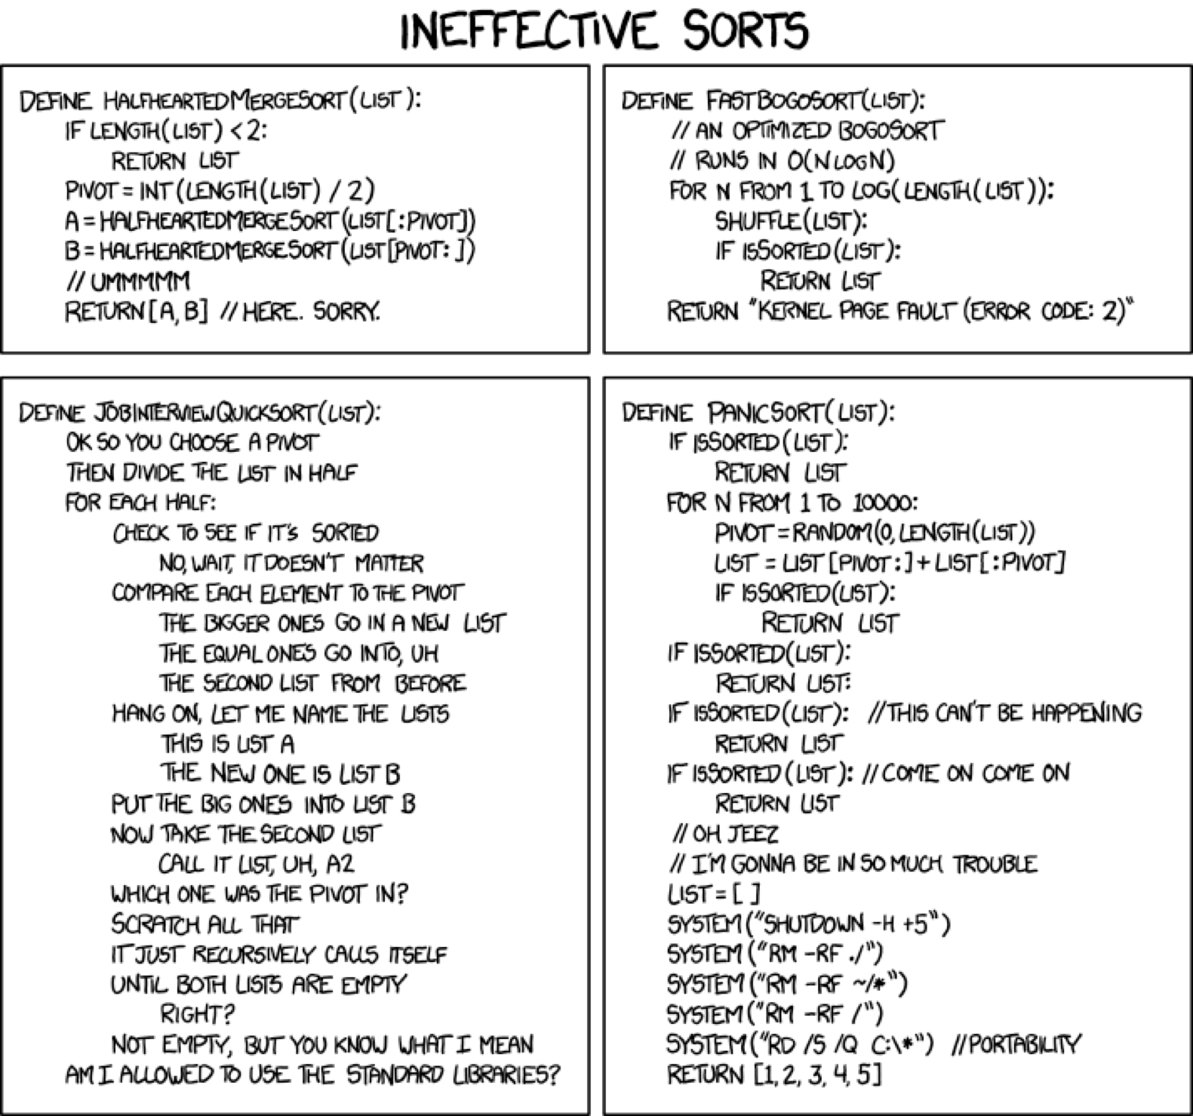
Analysis of Mergesort

Slide 13
Analysis of Quicksort
We want to sort an array
Idea of quicksort:
  Pick a random pivot
  Divide the array in elements smaller and larger than the pivot
  Recursively order the two subarrays
  Combine the two subarrays into one

Slide 14
Analysis of Quicksort
Example of a divide and conquer algorithm:
  We divide the array into two parts i.e. we divide the problem into sub-problems
  We recursively sort the sub-arrays, i.e we solve the sub-problems
  We combine the sub-arrays, i.e. we conquer the problem by combining the sub-problems

Slide 15
Analysis of Quicksort
Ideally: Pivot is always in the middle
  Then, time $T$ to sort $n$ elements is
    $$T(n)=T(n/2)+T(n/2)+cn$$
      Here, $c$ is a constant representing the work of choosing the pivot, dividing the array and merging the arrays
    An exact formula:
      Would round up and down and be more clear on the linear work:
    $$T(n)=T(⌈\frac{n}{2}⌉)+T(⌊\frac{n}{2}⌋)+O(n)$$

Slide 16
Analysis of Quicksort
How to solve $T(n)=T(n/2)+T(n/2)+cn$ ?
  Substitution method:
    Substitute formula into itself
    $T(n)=2T(n/2)+cn$
    $=2(2T(\frac{n}{4})+c\frac{n}{2})+cn$ $=4T(\frac{n}{4})+cn+cn$
    $=8T(\frac{n}{8})+cn+cn+cn$
        $=…$$=2^{m}T(\frac{n}{2^{m}})+m⋅cn$

Slide 17
Analysis of Quicksort
$$T(n)=2^{m}T(\frac{n}{2^{m}})+m⋅cn$$
$m=⌈\log_{2}(n)⌉:$
$T(n)=2^{m}T(1)+cmn≤(n+1)cmn=O(log(n)n)$

Slide 18
Analysis of Quicksort
Worst behavior:
  The pivot is the maximum or the minimum
    One of the list is empty
    The other list contains everything but the pivot
    Recurrence is now
      $$T(n)=cn+T(n-1)$$

Slide 19
Analysis of Quicksort
Solving $T(n)=cn+T(n-1)$
Substitution method:
  $$T(n)=cn+T(n-1)$$
  $=cn+c(n-1)+T(n-2)$
  $=cn+c(n-1)+c(n-2)+T(n-3)$
  $…$
  $=c(n+(n-1)+(n-2)+…2)+T(1)$
  $=c\frac{(n+2)(n-1)}{2}+T(1)$

Slide 20
Analysis of Quicksort
In the worst case, quicksort is quadratic

Slide 21
A family of Recursion
Equations
Divide and conquer frequently lead to recursions of the form
$$T(n)=aT(n/b)+f(n)$$

Slide 22
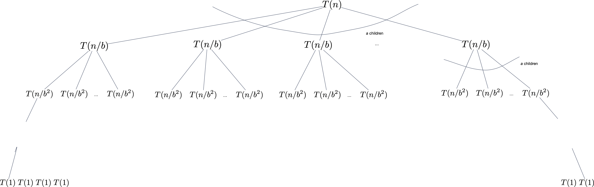
A family of Recursion
Equations
Solve Recurrence using a tree:

Slide 23
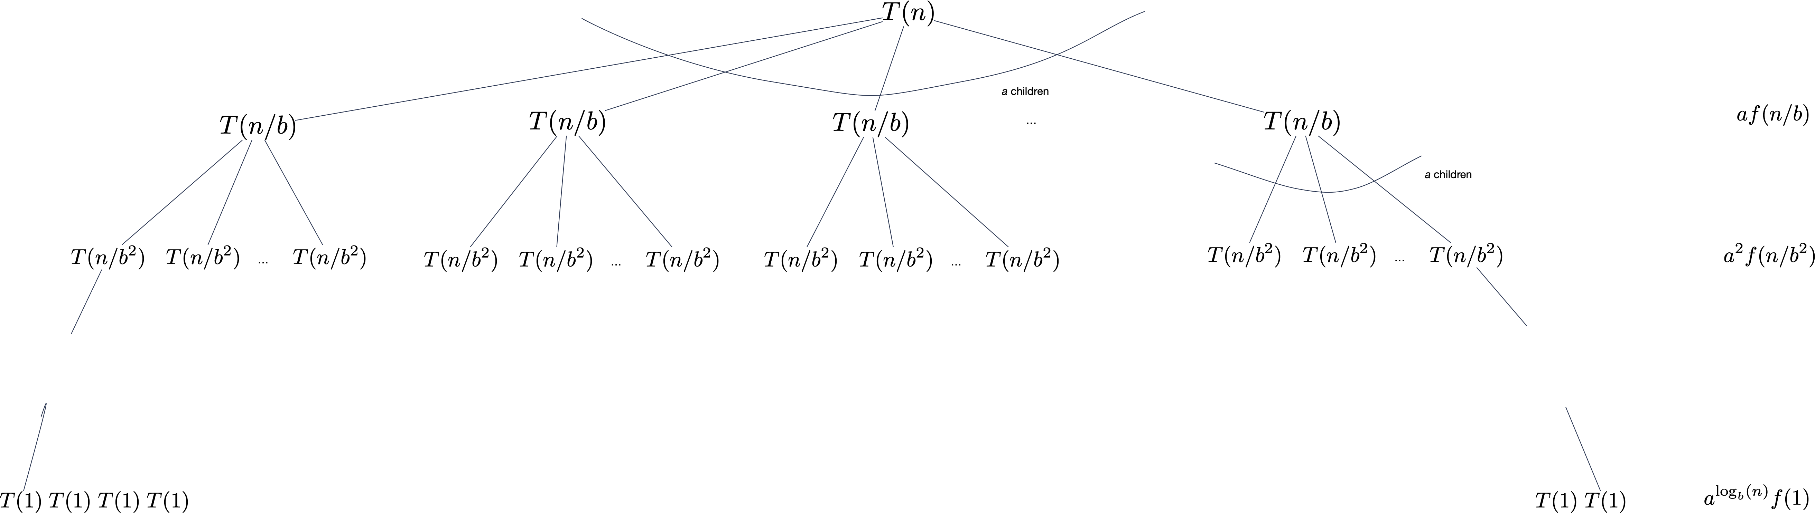
A family of Recursion
Equations

Slide 24
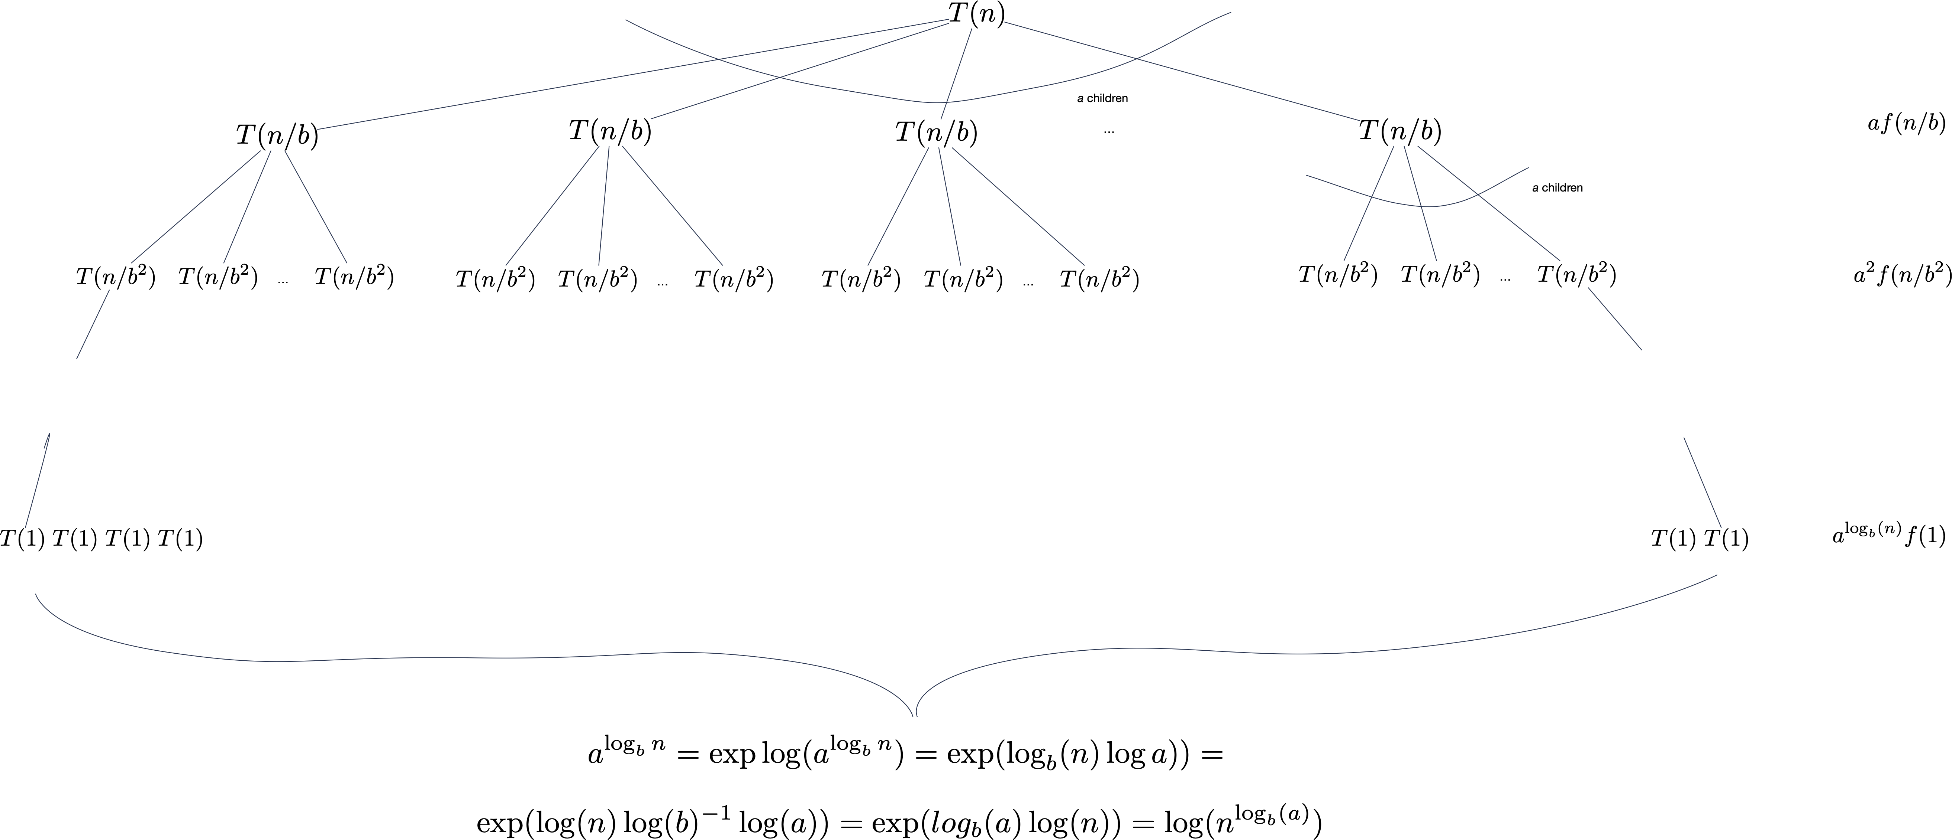
A family of Recursion
Equations

Slide 25
A family of Recursion
Equations
Total is
  Need to compare f with power of n in order to see what dominates
$$\overset{\log_{b}n-1}{\underset{j=0}{∑}}a^{j}f(n/b^{j})+cn^{\log_{b}a}$$

Slide 26
A family of Recursion
Equations
$$f(n)=O(n^{\log_{b}a-ϵ})⟹T(n)=Θ(n^{\log_{b}a})$$
$$f(n)=Θ(n^{\log_{b}a})⟹T(n)=Θ(n^{\log_{b}a}logn)$$
$$f(n)=Ω(n^{\log_{b}a+ϵ})\text{and}af(n/b)≤cf(n)\text{eventually}⟹T(n)=Θ(f(n))$$

Slide 27
A family of Recursion
Equations
There are gaps between the three cases, where the master theorem does not apply

Slide 28
Examples
$$T(n)=2T(n/2)+n$$
$$n^{\log_{2}2}=n=f(n)\text{Case 2}$$
$$T(n)=Θ(nlogn)$$

Slide 29
Examples
$$T(n)=3T(n/2)+n$$
$$\log_{2}3=1.58496$$
$$n=O(n^{\log_{2}3-0.1})$$
$$⟹T(n)=Θ(n^{\log_{2}3})$$

Slide 30
Examples
$$T(n)=T(n/2)+n$$
$$a=1,b=2$$
$$\log_{2}1=0$$
$$n=Ω(n^{0+1/2})$$
$$⟹T(n)=Θ(n)$$

Slide 31
Examples
$$T(n)=3T(n/3)+nlogn$$
$$a=3b=3\text{so compare with}n$$
$$nlogn∉Θ(n)$$
$$nlogn∉Ω(n^{1+ϵ})$$
Falls into the gap between Case 2 and Case 3

Slide 32
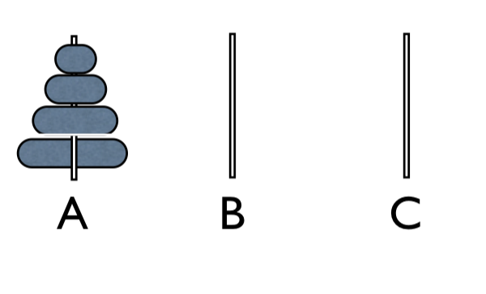
Tower of Hanoi
n disks of n different parameters are on Peg A.
Need to move them to Peg C subject to
  Can only one disk at a time
  Can only place smaller disk on bigger ones

Slide 33
Tower of Hanoi: Algorithm
Recursive Solution
  One disk: Just move the disk (1 move)
  General case: Move top n-1 disks from A to C. Move remaining disk to B. Move n-1 disks from C to A

Slide 34
Tower of Hanoi: Evaluation
If $T(n)$ is the number of moves for n disks, then
$$T(1)=1$$
$$T(n+1)=2T(n)+1$$

Slide 35
Solving the recurrence
$$T(n)=2T(n-1)+1$$
$$=2(2T(n-2)+1)+1=4T(n-2)+2+1$$
$$=2^{3}T(n-3)+4+2+1$$
$$=2^{4}T(n-4)+2^{3}+2^{2}+1$$
$$=⋮$$
$$=2^{n-1}+2^{n-2}+…2^{2}+2^{1}+2^{0}$$
$$=2^{n}-1$$

Slide 36
Tower of Hanoi:
Proof
Given the recurrence relation $T(1)=1;T(n+1)=2T(n)+1$
Show that $T(n)=2^{n}-1$
Proof by induction:
  Base case: For $n=1$, we have $T(1)=1=2^{1}-1$
Induction step:
  Hypothesis: $T(n)=2^{n}-1$
  To show: $T(n+1)=2^{n+1}-1.$
  Proof:
  $T(n+1)=2T(n)+1=2(2^{n}-1)+1=2^{n+1}-2+1=2^{n+1}-1$

Slide 37
The Upper Bound Trap
What is wrong here.
  Show that $T(1)=1;T(n+1)=2T(n)+1$ implies $T(n)≤2^{n}$
  Induction base: same as before
  Induction step:
    Hypothesis: $T(n)=2^{n}$
    To show: $T(n+1)≤2^{n+1}$
    Proof Attempt:
      $T(n+1)=2T_{n}+1$ (recurrence)
      $≤2⋅2^{n}+1$ (induction hypothesis)
      $=2^{n+1}+1$
      And we are stuck

Slide 38
The Upper Bound Trap
However, we can prove a stronger proposition and the proof goes through:
  Show that $T(1)=1;T(n+1)=2T(n)+1$ implies $T(n)≤2^{n}-1$
  Induction base: same as before
  Induction step:
    Hypothesis: $T(n)≤2^{n}-1$
    To show: $T(n+1)≤2^{n+1}$
    Proof:
      $T(n+1)=2T_{n}+1$ (recurrence)
      $≤2⋅(2^{n}-1)+1$ (induction hypothesis)
      $=2^{n+1}-1$
      And we are done

Slide 39
Linear Recurrence Examples
Pell numbers
  $$P_{0}=0,P_{1}=1,P_{n}=2P_{n-1}+P_{n-2}$$
Example of linear recurrence
  Assume solution is of the form $a^{n}$
  This results in
    $$a^{n}=2a^{n-1}+a^{n-2}$$
  We can divide by $a^{n-2}$ to get
    $$a^{2}=2a+1$$
      $$⇒a^{2}-2a+1-2=0⇒(a-1)^{2}=2$$
  This means $a=1-\sqrt{2}$ or $a=1+\sqrt{2}$

Slide 40
Linear Recurrence Example
Reversely, for these $a$ : $a^{n}=2a^{n-1}+a^{n-2}$
Solutions are given by linear combinations
  with $a_{1}=1+\sqrt{2}$, $a_{2}=1-\sqrt{2}$
  $$P_{n}=ca_{1}^{n}+da_{2}^{n}$$
Now we need to fit the two initial conditions
    $$ca_{1}^{0}+da_{2}^{0}=0,ca_{1}^{1}+da_{2}^{1}=1$$
  The first equation gives $c=-d$, the second gives $c(1+\sqrt{2})-c(1-\sqrt{2})=1$, which is equivalent to $c=\frac{1}{2\sqrt{2}}$
  Thus, the closed form is $P_{n}=\frac{(1+\sqrt{2})^{n}+(1-\sqrt{2})^{n}}{2\sqrt{2}}$

