Slide 1
Sorting and Element Selection
Thomas Schwarz, SJ

Slide 2
Permutations
A permutation of the set $\{1,2,…,n\}$ is a reordering of the numbers where each number between 1 and n appears exactly once.

Slide 3
Permutations
How many permutations are there?
Use recurrence!
In a permutation of $\{1,2,…,n\}$, where is the $n$ located?
There are $n-1$ other numbers.
This gives us $n-2$ gaps and spots before and after

Slide 4
Permutations
Let $n!$ be the number of permutations of $n$ elements
This gives us the recurrence
$$n!=n⋅(n-1)!$$
which can be unfolded very simply
$n!=\overset{n}{\underset{i=1}{∏}}i$

Slide 5
Permutations
How do we determine its asymptotic growth?
$$n!=\overset{n}{\underset{i=1}{∏}}i$$
Use Logarithms!

Slide 6
Permutations
Approximation of the factorial
Use $logn!=\overset{n}{\underset{i=1}{∑}}log(i)$
Use an integral!

Slide 7
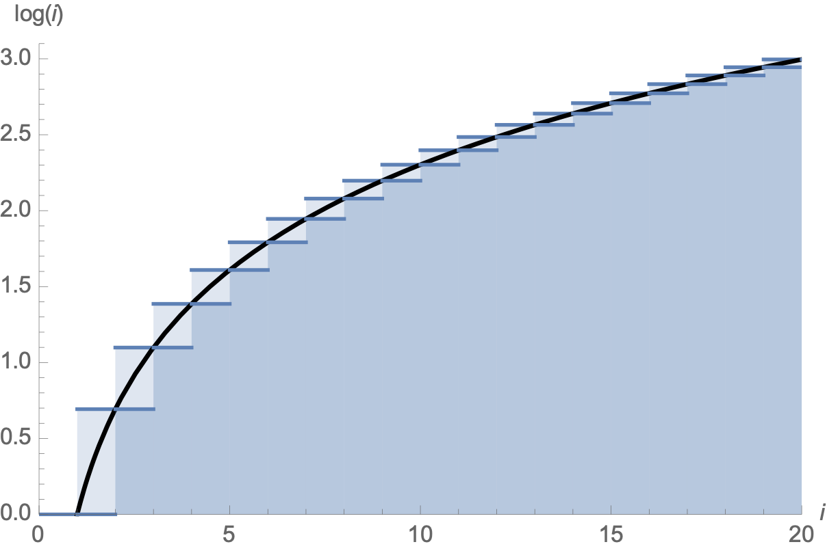
Permutations
$$\overset{n-1}{\underset{i=1}{∑}}log(i)<∫_{1}^{n}log(x)dx<\overset{n}{\underset{i=1}{∑}}logi$$

Slide 8
Permutations
$log(n!)=\overset{n}{\underset{i=1}{∑}}log(i)$
$≈∫_{i=1}^{n}log(x)dx$
$=[xlogx-x]_{1}^{n}$
$=nlog(n)-n+1$

Slide 9
Permutations
Therefore
$n!≈exp(nlog(n)-n-1)$
$=exp(log(n^{n})-n+1)$
$=n^{n}⋅e^{-n}⋅e$
$=e⋅{\left(\frac{n}{e}\right)}^{n}$

Slide 10
Permutations
An analysis of the error substituting the Riemann sum for an integral gives Stirling’s formula (invented by de Moivre)
$\sqrt{2π}n^{n+\frac{1}{2}}e^{-n}≤n!≤en^{n+\frac{1}{2}}e^{-n}$

Slide 11
Sorting by Comparison
Many sorting algorithms use comparisons
An algorithm needs to be able to sort with all orders of inputs, i.e. distinguish between $n!$ arrangements of the input by order
assuming all elements are different

Slide 12
Sorting by Comparison
Sorting algorithm makes a comparison, then decides on what to do
Can be represented as a binary tree

Slide 13
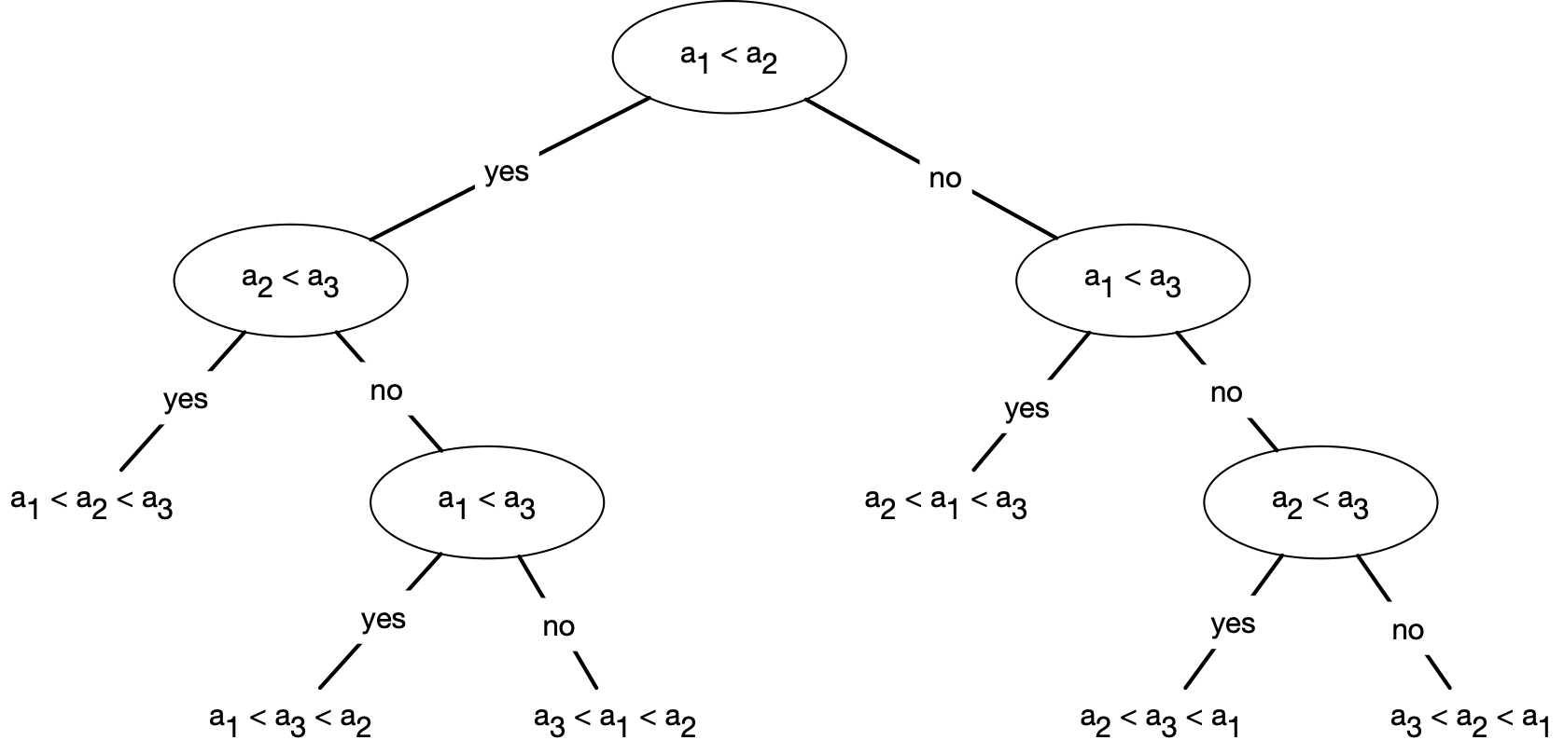
Sorting by Comparison
A fictitious algorithm for sorting three elements
as a Decision Tree

Slide 14
Sorting by Comparison
Represent any comparison based algorithm by such a tree
Any run of the algorithm represents a path from the root to a leaf node
Leaf nodes represent an algorithm finishing,
So they need to have an ordering, i.e. a permutation of the input array

Slide 15
Sorting by Comparison
How many leaves does a tree with $N$ leaves have?
A tree of height $h$ has how many leaves?
Height 0: only root, one leaf
Height 1: only root plus one or two leaves: $≤2$
Height 2: at most two nodes at height one have at most $≤2^{2}$ leaves
Induction: Height $h$ has at most $2^{h}$ leaves

Slide 16
Sorting by Comparison
Relationship between height of decision tree and number of elements to be sorted:
Need to have at least $n!$ leaves:
$2^{h}≥n!$
which implies
$$h≥\log_{2}(n!)=\frac{1}{log(2)}log(n!)$$
$≈\frac{1}{log(2)}nlog(n)-n+1$
$=Θ(nlog(n))$

Slide 17
Sorting by Comparison
Since the height of the decision tree is the worst time runtime, we have
The runtime of a comparison based sorting algorithm is $Ω(nlog(n))$

Slide 18
Linear Time Sorting
Counting sort
Assume we want to sort numbers in $\{1,2,…,k-1,k\}$
Create a dictionary with keys in $\{1,2,…,k-1,k\}$
E.g. as an array Int(1:k)
Walk through the array, updating the count
Once the count is done, go through the dictionary in order of the keys, emitting as many keys as the count

Slide 19
Linear Time Sorting
Counting sort:
create a counting array:
Walk through the array and calculate counts
Emit keys according to count
1 2 2 2 3 3 3 4 4 5 5 7 8 9 10 10 10 12

Slide 20
Linear Time Sorting
If there are $n$ elements in the array, then counting sort uses
$∼k$ to create and evaluate the counting array
$∼n$ to update the counting array
Therefore: counting sort run-time is $Θ(n+k)$

Slide 21
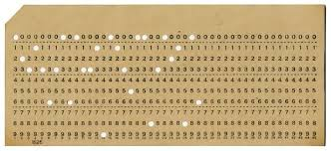
Linear Time Sorting
Radix Sort
Imagine sorting punch cards with by ID in the first columns

Slide 22
Linear Time Sorting
Simple Method:
Create heaps of cards based on the first digit
Then recursively sort the heaps

Slide 23
Linear Time Sorting
Better method:
Sort according to the last digit
Then use a stable sort to sort after the second-last digit
Then use a stable sort to sort after the third-last digit

Slide 24
Linear Time Sorting
Stable sort:
Leave order of elements with the same key during sorting
Insertion sort, merge sort, bubble sort, counting sort are all stable
Heap sort, selection sort, shell sort, and quick sort are not

Slide 25
Linear Time Sorting
Radix sort:
for i in range(length(key), 0, -1):
stable_sort on digit i of key

Slide 26
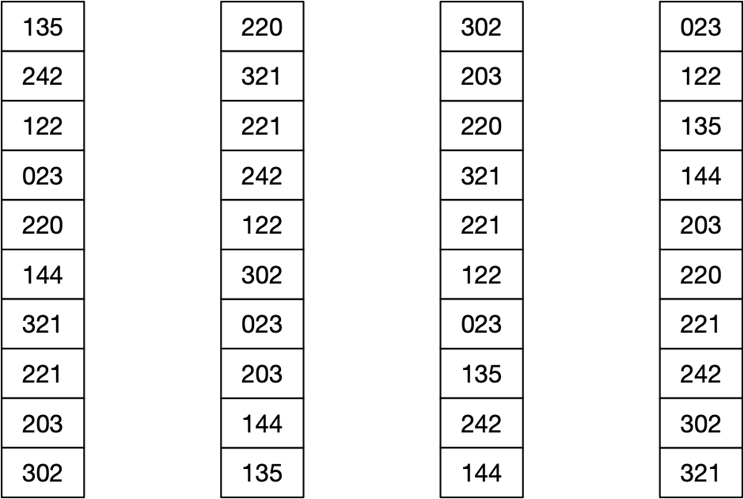
Linear Time Sorting

Slide 27
Linear Time Sorting
Radix sort correctness
What would be a loop invariant?

Slide 28
Linear Time Sorting
Assume $n$ keys of $d$ digits in $\{0,1,…,r-1\}$
Use counting sort to sort in time $Θ(n+r)$
Radix sort then takes $Θ(d(n+r))$ time

Slide 29
Linear Time Sorting
Given $n$ numbers of $b$ bits each
Assume $b=O(log(n))$
Choose $r=⌊\log_{2}(n)⌋$.
Divide the $b$-bit numbers into “digits” of length $r$
Thus, each round of radix sort takes time $Θ(n+2^{r})$
There are $⌈\frac{b}{r}⌉$ rounds
So, radix sort takes $Θ(\frac{b}{r}(n+2^{r}))=Θ(\frac{b}{r}(n+n))=Θ(n)$ time!

Slide 30
Selection

Slide 31
Selection Problems
Given an unordered array:
Find the $k$-largest (-smallest) element in an unordered array
Naïve Solution:
Sort (usually in time $Θ(nlogn)$ )
Pick element $n-k$ or $k$ of the sorted array

Slide 32
Selection Problem
Finding the maximum
Finding the maximum and minimum at the same time
Finding the $k$^{th} largest element
Finding the median

Slide 33
Maximum
Obvious algorithm:
$n-1$ comparisons
def max(array):
result = array[0]
for i in range(1, len(array)):
if array[i]>result:
result = array[i]

Slide 34
Maximum
Toy algorithm:
Partition array into $⌊n/2⌋$ pairs.
(There might be an additional element).
Use one comparison in order to select the largest of each pair (plus the odd one out if exists)
These form an array of length $⌊n/2⌋+1$
Recursively call the toy algorithm

Slide 35
Maximum
What is the recurrence relation?

Slide 36
Maximum
$$T(n)=T(n-⌊n/2⌋)+⌊n/2⌋$$
T(2) = 1
Now use substitution to get an idea of solving the recurrence

Slide 37
Maximum
Assume $n$ is a power of 2

Slide 38
Maximum
Recurrence then becomes
$$T(n)=T(n/2)+n/2,T(2)=1$$
$=T(n/4)+n/4+n/2$
$=T(n/8)+n/8+n/4+n/2$
$…$
$=T(2)+2+4+8+…+n/8+n/4+n/2$
$=n-1$

Slide 39
Maximum
Now prove by induction for all $n∈N$
$$T(n)=T(n-⌊n/2⌋)+⌊n/2⌋$$
$$T(2)=1$$

Slide 40
Maximum
Induction Hypothesis: $T(m)=m-1$ if $m<n$.
$T(n)$
$$=T(n-⌊n/2⌋)+⌊n/2⌋$$
$$=n-⌊n/2⌋-1+⌊n/2⌋$$
$$=n-1$$

Slide 41
Maximum
In fact:
Theorem: Finding the maximum of an array of length $n$ costs at least $n-1$ comparisons
Proof: Place all elements into three buckets:
One for not-looked at
One for won all comparisons
One for lost all comparisons

Slide 42
Maximum
A single comparison can involves 6 cases
X-X: move two elements from X, one into W, one into L
X-W: move one element from X into W or move one element from X into W and one from W into L
X-L: move one element from X into W or one into L
W-W: move one element from W to L
W-L: nothing or move one element from W to L
L-L: nothing

Slide 43
Maximum
To have finished the algorithm:
No elements left in X
Only one element left in W
Otherwise, can construct counterexample

Slide 44
Maximum
One left in X: could be the maximum
Two (or more) left in W:
Which one is the maximum?

Slide 45
Maximum
Each comparison sends at most one element to $L$
At best, $n-1$ comparisons

Slide 46
Combined Maximum and Minimum
Combined Maximum and Minimum
Naïve algorithm:
Calculate the max, then the min (can exclude the max)
$m-1+m-2=2m-3$ comparisons

Slide 47
Combined Maximum and Minimum
A better algorithm
Divide the array into pairs
Compare the values of each pair
Place the winner of each pair in one array, the looser of each array in a second array
(Or use swapping so that the winners are in even position and the losers are in odd positions)
Now use maximum and minimum on the two sub-arrays

Slide 48
Combined Maximum and Minimum
Case 1: $n$ is even
There are $n/2$ pairs or $n/2$ comparisons
Run maximum on even indexed array elements
This gives us $n/2-1$ comparisons
Same for minimum
Total is $n/2+n/2-1+n/2-1=\frac{3n}{2}-2$ comparisons

Slide 49
Combined Maximum and Minimum
Case: $n$ is odd
Run algorithm on the first $n-1$ elements
$\frac{3n-3}{2}-2$ comparisons
Then add two comparisons to see whether the last element is either minimum or maximum
Total of $\frac{3n-3}{2}$ comparisons

Slide 50
Combined Maximum and Minimum
Can we do better?
Use a more sophisticated bin method
X - not looked at, W - won every comparison, L - lost every comparison, Q - at least one win and at least one loss

Slide 51
Combined Maximum and Minimum
To be successful, need to move everything out of X and have only one element in W and L
Otherwise can have a counter-example

Slide 52
Combined Maximum and Minimum
Just counting the moves is not sufficient
Example:
We compare an element $w∈W$ with an element $l∈L$
Possibly: $w<l$
And we move both elements to the $Q$ bucket
So, possible to move all $n$ elements out of $X$ into $W∪L$ in $n/2$ comparisons and $n-2$ elements out of $W∪L$ into $Q$ in $n/2-1$ comparisons
Only gives $n-1$ moves!

Slide 53
Combined Maximum and Minimum
Use an adversary argument
Algorithm can only depend on the knowledge of the previous comparisons when making a decision
An adversary is allowed to change all values as long as the results of the comparisons stay the same
If $w∈W$ and $l∈L$, then the only thing the algorithm knows is that $w$ has won all of its comparisons and $l$ has lost all of its comparisons
Adversary therefore is allowed to change the value of $l$ downward
Adversary guarantees that $w>l$.

Slide 54
Combined Maximum and Minimum
With the help of the adversary who substitutes values when needed
Potential: $\frac{3}{2}|X|+|W|+|L|$
Calculate net changes for comparisons between buckets

Slide 55
Combined Maximum and Minimum
Compare X with X
Net change (-2, 1, 1, 0)
Potential change: 1

Slide 56
Combined Maximum and Minimum
Compare X with W
Case 1: $x∈X,w∈W,x<w$ Net change (-1,0,1,0)
Case 2: $x∈X,w∈W,x>w$ Net change(-1,0,0,1)
The adversary can prevent Case 2 by decreasing $x$
Possible because this is the first time that we look at $x$
Potential changes by $\frac{1}{2}$

Slide 57
Combined Maximum and Minimum
Compare $X$ with $L$
similar as before

Slide 58
Combined Maximum and Minimum
Compare $X$ with $Q$
The element in $X$ changes to either $W$ or $L$
Net change (-1, 1, 0, 0) or (-1, 0, 1, 0 )
Potential change $\frac{1}{2}$

Slide 59
Combined Maximum and Minimum
Compare W with W
One element looses
Net change (0, -1, 0, 1)
Potential change 1

Slide 60
Combined Maximum and Minimum
Compare $W$ with $L$
Adversary guarantees that the element in $W$ wins by making all of them bigger
This works because each element in $W$ has only seen wins and that does not change if the elements are made bigger.
No change

Slide 61
Combined Maximum and Minimum
Compare $W$ with $Q$
Since the elements in $W$ have always won, the adversary can make them larger
No net change

Slide 62
Combined Maximum and Minimum
Comparisons with $L$ are the same as with $W$
Comparisons within $Q$ are useless, but make no changes

Slide 63
Combined Maximum and Minimum
With the help of the adversary
Potential changes by at most 1
Initial Potential: $\frac{3}{2}n$
Final Potential: $2$
Need at least $\frac{3n-4}{2}$ comparisons

Slide 64
Selection
Find the $k$^{th} largest element
Algorithm 1: Use the idea of quicksort
Find a random pivot and partition around it
Now use recursion:
If $k≤\text{len}(A_{>p})$ find the $k$^{th} largest element in $A_{>p}$
If $k=\text{len}(A_{>p})+1$, select $p$
If $k>\text{len}(A_{>p})$, find the $k-\text{len}(A_{<p})-1$ largest element in $A_{<p}$
$$A_{<p}$$
$$A_{>p}$$

Slide 65
Selection
Worst case behavior:
Pivot is always the maximum
Search in array of length one less
Partitioning an array of length takes $Θ(n)$ time
Worst time: $∼n+(n-1)+(n-2)+…+2+1$
$$=\frac{n(n+1)}{2}$$
$$=Θ(n^{2})$$

Slide 66
Selection
Expected behavior:
Let $T(n)$ be the expected run-time on input array $n$
How does the pivot fall in an array?

Slide 67
Selection
Call either $T(k)$ or $T(l)=T(n-k-1)$ or are done
Bad luck assumption:
its always the one for the larger array
All positions of the pivot are equally probable

Slide 68
Selection
Gives a recurrence
$$T(n)≤2\overset{n-1}{\underset{i=⌊n/2⌋}{∑}}\frac{1}{n}T(i)+dn$$
where $dn$ is the costs of partitioning
Now assume that $T(n)≤cn$

Slide 69
Selection
Then:
$T(n)≤\frac{2}{n}\overset{n-1}{\underset{i=⌊n/2⌋}{∑}}\frac{1}{n}T(i)+dn$
$≤\frac{2c}{n}\left(\overset{n-1}{\underset{i=1}{∑}}i-\overset{⌊n/2⌋}{\underset{i=1}{∑}}i\right)+dn$
$=\frac{2c}{n}\left(\frac{(n-1)n}{2}-\frac{(⌊n/2⌋-1)⌊n/2⌋}{2}\right)+dn$
$≤\frac{2c}{n}\left(\frac{(n-1)n}{2}-\frac{(n/2-2)(n/2-1)}{2}\right)+dn$

Slide 70
Selection
$$≤\frac{2c}{n}\left(\frac{(n-1)n}{2}-\frac{(n/2-2)(n/2-1)}{2}\right)+dn$$
$$=\frac{2c}{n}\left(\frac{n^{2}-n}{2}-\frac{n^{2}/4-3n/2+2}{2}\right)+dn$$
$$=\frac{c}{n}\left(\frac{3n^{2}}{4}+\frac{n}{2}-2\right)+dn$$
$$=c(\frac{3n}{4}+\frac{1}{2}-\frac{2}{n})+dn$$

Slide 71
Selection
$$=c(\frac{3n}{4}+\frac{1}{2}-\frac{2}{n})+dn$$
$$=cn-\left(\frac{cn}{4}-\frac{c}{2}-dn\right)$$
which is $≤$ cn if and only if

Slide 72
Selection
$\frac{cn}{4}-\frac{c}{2}-dn≥0$
$⟺cn≥2c+4dn$
$⟺c≥2c/n+4d$
If we assume $n≥4$, then the right side is at most $\frac{c}{2}+4d$
Thus, if $c>8d$ then the previous calculation goes through

Slide 73
Selection
We have shown
$T(n)<Cn$ if $n≥4$ and $C≥8d$
Make C larger if necessary to obtain
$$T(1)≤C,T(2)≤2C,T(3)≤3C,T(4)≤4C$$
Then: Induction base works and Induction hypothesis works.
So: expected runtime is linear
But: we can do better

Slide 74
Selection
Linear worst case selection
Idea: Improve the selection of the pivot!
Need to take at most linear time for the pivot selection

Slide 75
Selection
Divide the $n$ elements of the input array into $⌊n/5⌋$ groups of five elements and possibly one additional group
In each group, choose the median (middle element)
In the last one, you might need to break a tie
Then select the median of the medians by recurrence

Slide 76
Selection
Show that the median of medians divides the array fairly well
Show that adding up the costs, we still are linear

Slide 77
Selection
About half the medians are below the median of medians
About half the medians are atop of the median of medians
This allows us to guarantee that a certain number of elements is below and a certain number of elements is above the median of medians

Slide 78
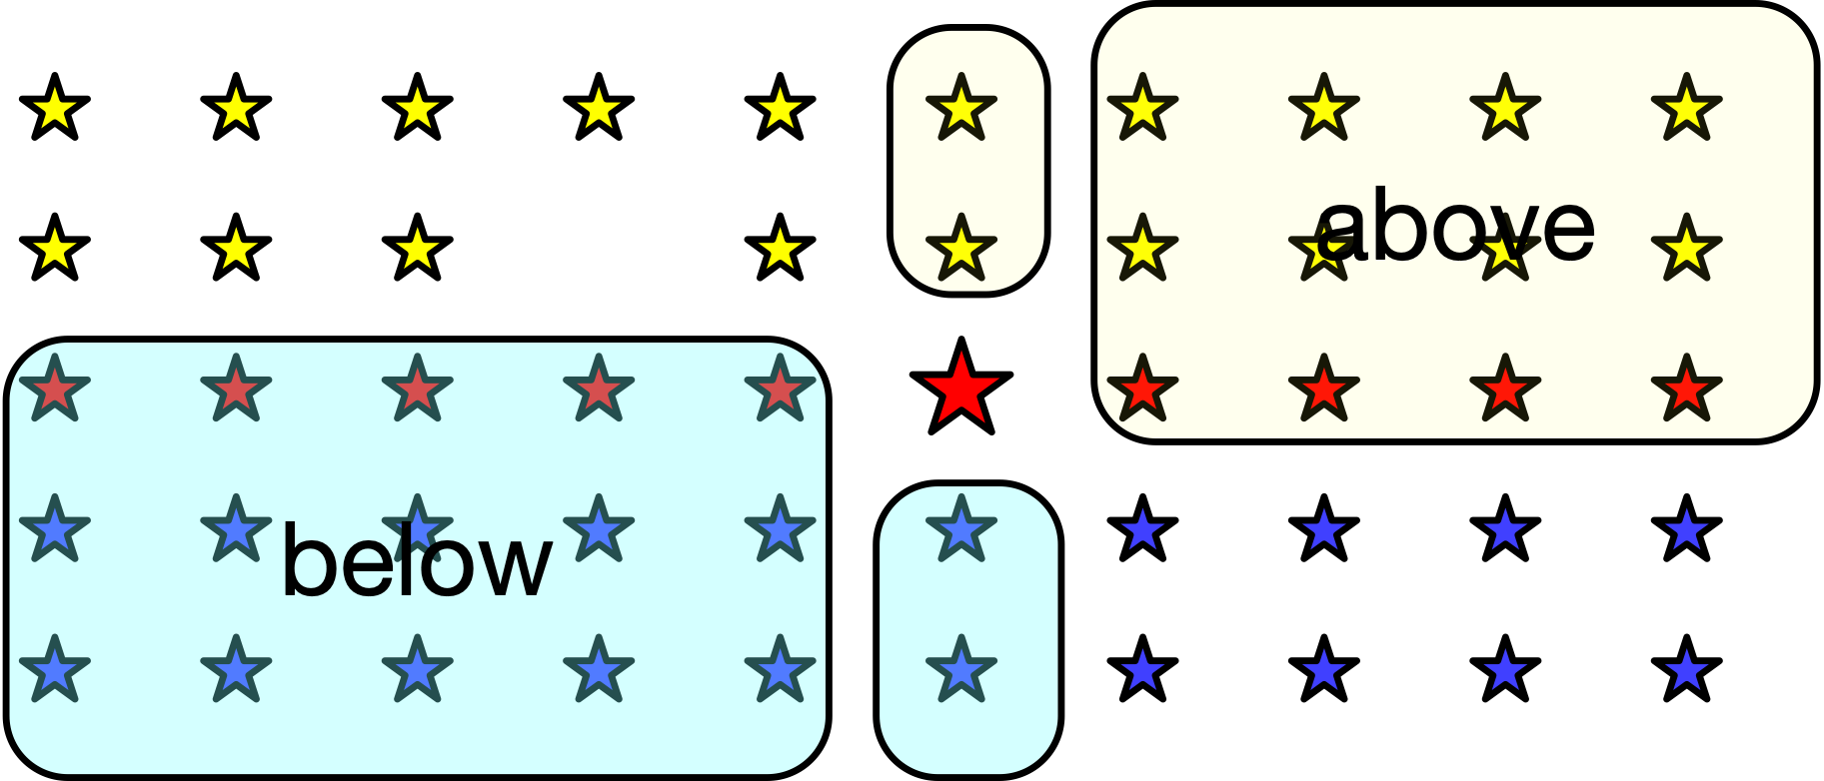
Selection
A number of elements are below and above
the median of medians for sure.

Slide 79
Selection
At least half of the medians are greater or equal than the median of medians
At least half of the $⌈n/5⌉$ contributes at least three elements that are larger
Discard the group that is smaller and the group with the median of median
The number of elements larger than the median of medians is at least
$$3\left(⌈\frac{1}{2}⌈\frac{n}{5}⌉⌉-2\right)$$

Slide 80
Selection
$3\left(⌈\frac{1}{2}⌈\frac{n}{5}⌉⌉-2\right)≥\frac{3n}{10}-6$ larger than the median of medians
$3\left(⌈\frac{1}{2}⌈\frac{n}{5}⌉⌉-2\right)≥\frac{3n}{10}-6$ smaller than the median of medians

Slide 81
Selection
$T(n)$ run time of the algorithm
Division into groups of five: $Θ(n)$
Determination of the medians: $Θ(n)$ because there are $Θ(n)$ groups and we sort them in constant time to get the median
Determination of the median of median by recurrence $T(⌈\frac{n}{5}⌉)$
Partitioning around the median of medians $Θ(n)$
Recursive call on at most $n-\frac{3n}{10}-6$ = $\frac{7n}{10}+6$ elements

Slide 82
Selection
Total runtime:
$$T(n)≤T(⌈\frac{n}{5}⌉)+T(0.7n+6)+an$$
Show that this is linear using induction / substitution
Again: induction step only needs to work for large enough $n$

Slide 83
Selection
$$T(n)≤c(\frac{n}{5}+1)+c(\frac{7n}{10}+6)+an$$
$=0.9cn+7c+an$
This is at most $cn$ if and only if $7c+an≤0.1cn$.
Since $7c+an≤0.1cn⟺\frac{70}{n}c+10a≤c$, we assume $n>140$ so that $c$ needs to be larger than $20a$.

Slide 84
Selection
We also need to make $c$ larger than $T(1)$, $T(2)/2$, $…$, $T(140)/140$
Then we have an induction base on 140 values
And an induction step that works
So $T(n)≤cn$

Slide 85
Selection
This algorithm makes no assumptions on the input
Unless our results on linear sorting

