Slide 1
Data Structures and Algorithms 2
Marquette University 2020

Slide 2
Regular Expressions and Finite State Systems

Slide 3
Transition Diagram
A man with a pet-wolf, a pet-goat,
and a cabbage wants to cross a river
in a boat that can only carry him and
one passenger. If the man leaves the
wolf and the goat alone, the wolf will
eat the goat. If the man leaves the
goat and the cabbage alone, then
the goat will eat the cabbage. How
can the man transport all three
possessions to the other side of the
river?

Slide 4
Transition Diagram
Introduce a set of states describing possible configurations
ab:cd
a and b are on the original side of the river
c and d are on the other side
M — man, W — wolf, G— goat, C — cabbage
A man with a pet-wolf, a pet-goat,
and a cabbage wants to cross a river
in a boat that can only carry him and
one passenger. If the man leaves the
wolf and the goat alone, the wolf will
eat the goat. If the man leaves the
goat and the cabbage alone, then
the goat will eat the cabbage. How
can the man transport all three
possessions to the other side of the
river?

Slide 5
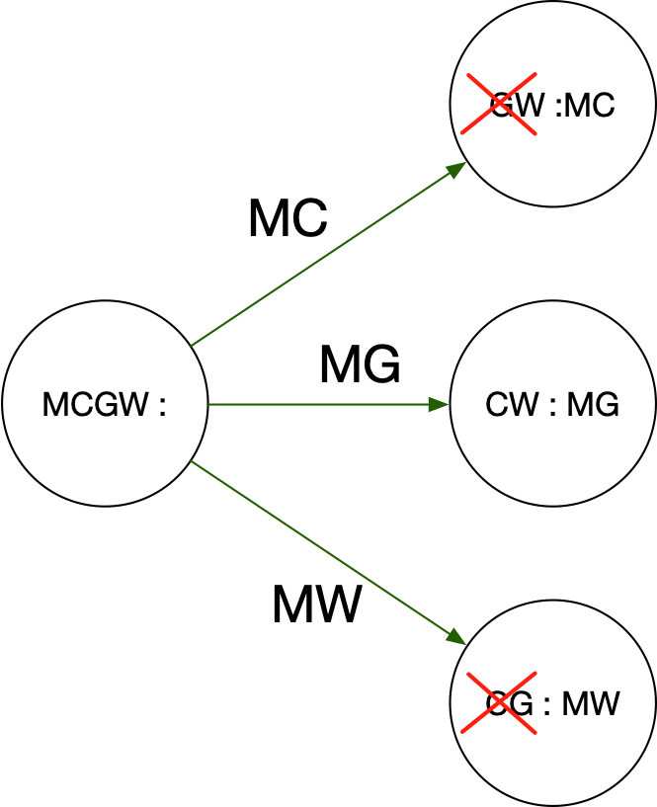
Transition Diagram
Original State : MCGW
Three possible transaction: Men moves cabbage, goat, or wolf to other side
Results in three different states, but not all of them are feasible because without the man, the wolf eats the goat and the goat eats the cabbage.

Slide 6
Transition Diagram
Transition diagram
States are circles
Transitions move system from one state to the other
Each movement is associated with a letter
The letter is the pet that the man selects to transport from one side of the river to the other

Slide 7
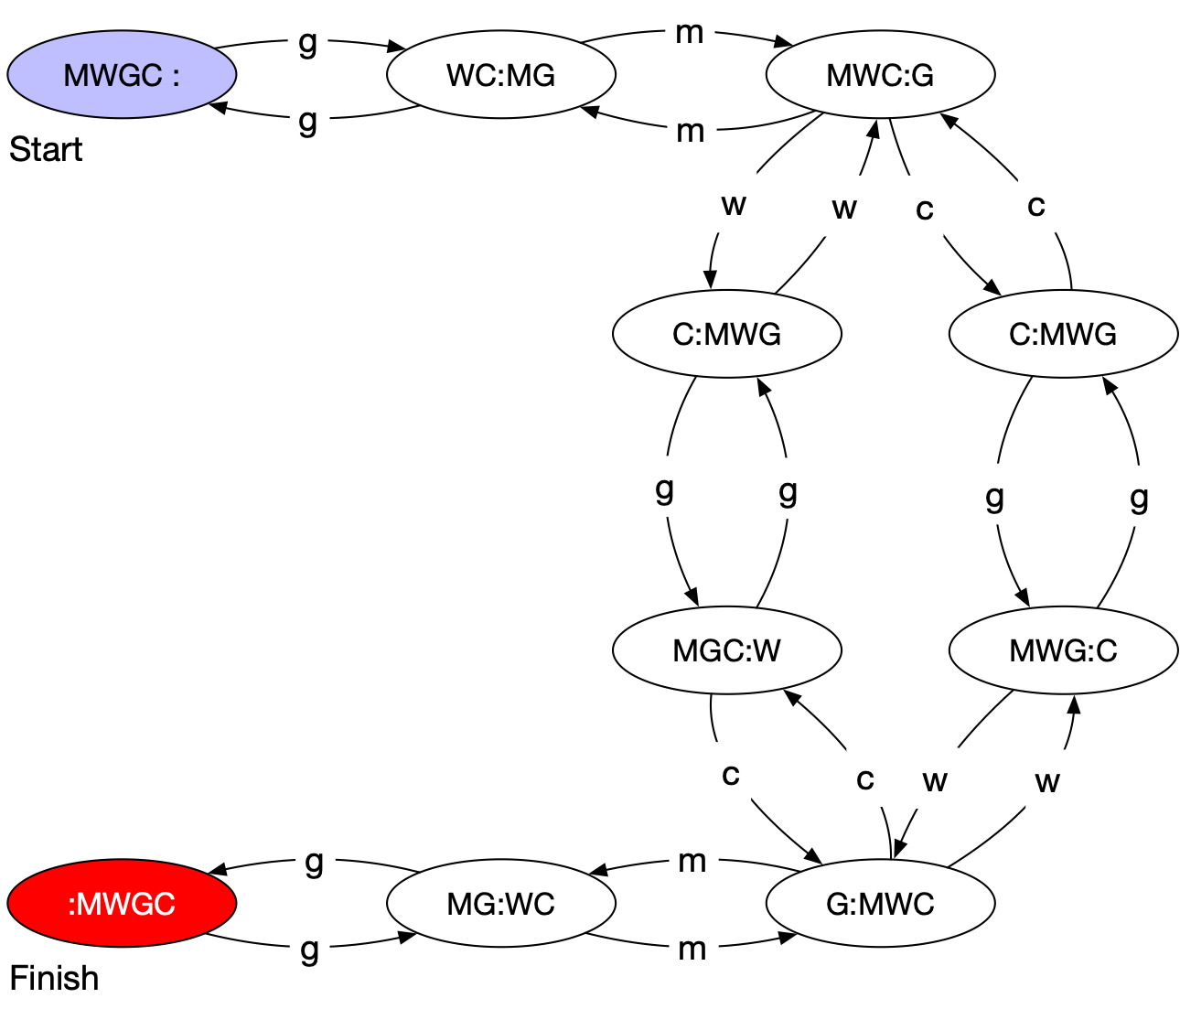
Transition Diagrams
A man with a pet-wolf, a pet-goat,
and a cabbage wants to cross a river
in a boat that can only carry him and
one passenger. If the man leaves the
wolf and the goat alone, the wolf will
eat the goat. If the man leaves the
goat and the cabbage alone, then
the goat will eat the cabbage. How
can the man transport all three
possessions to the other side of the
river?

Slide 8
Finite Automata
A finite automaton consists of
A finite set of states
A finite alphabet of inputs
An initial state
A set of final states
A set of transitions
Each transition is between two states and labelled with an input. Only one transition with a certain label can leave a state.
A string is accepted by a finite automaton if it corresponds to a path from the starting state to a final state

Slide 9
Finite Automata
Formal definition
A finite automaton is a quintuple
where is a finite “set of states”
is the “start state”
is the “set of final or accepting states”
is a finite set, the “alphabet”
is the “transition function”

Slide 10
Finite Automata
A transition moves from one state to another
and consumes a single letter of input
The new state is $δ$ of the old state and the letter

Slide 11
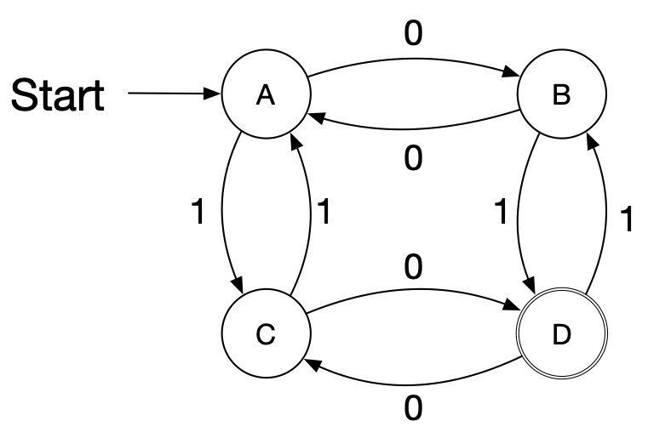
Finite Automata
A sequence of letters is processed by a series of transitions.
Assume the following automaton and the series 0001001011.

Slide 12
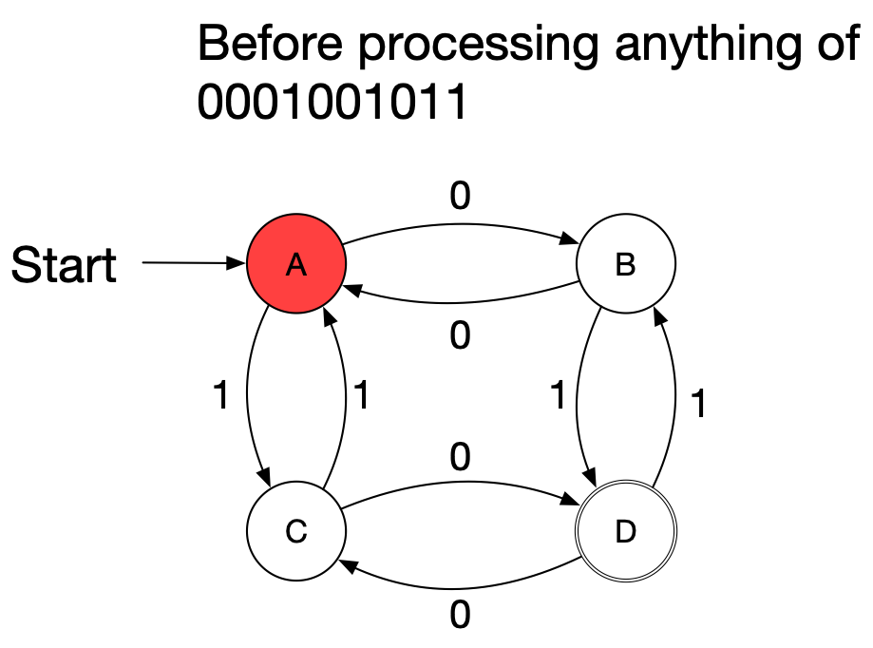
Finite Automata

Slide 13
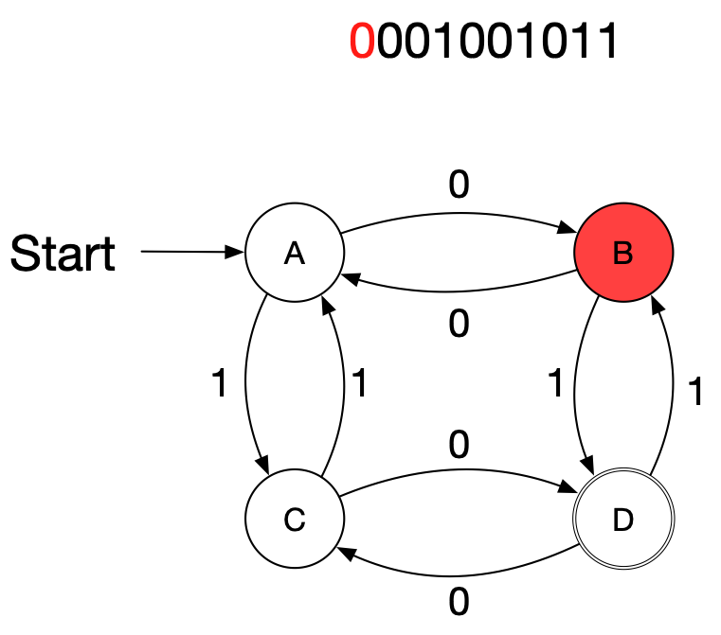
Finite Automata

Slide 14
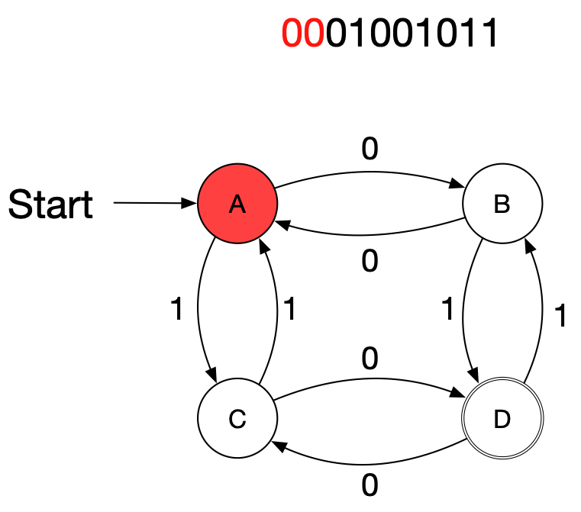
Finite Automata

Slide 15
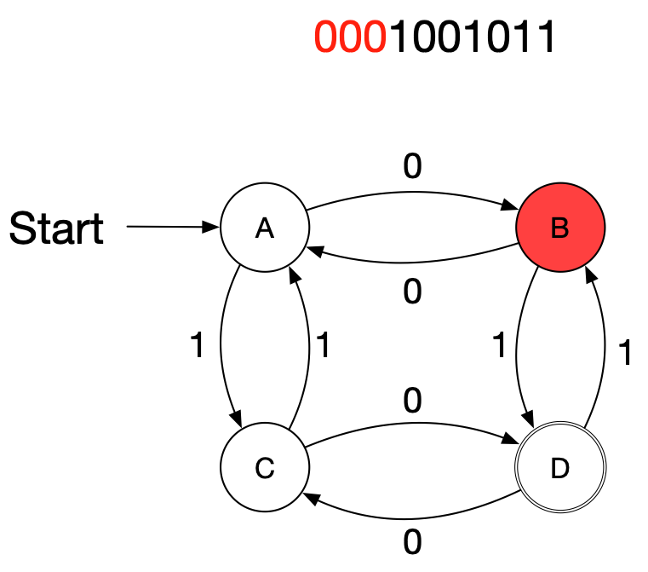
Finite Automata

Slide 16
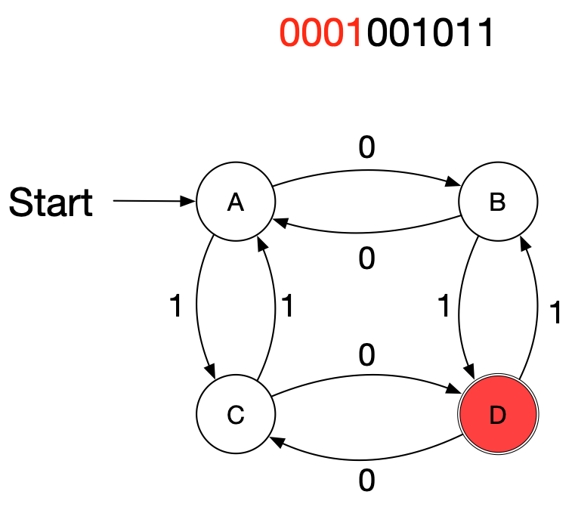
Finite Automata

Slide 17
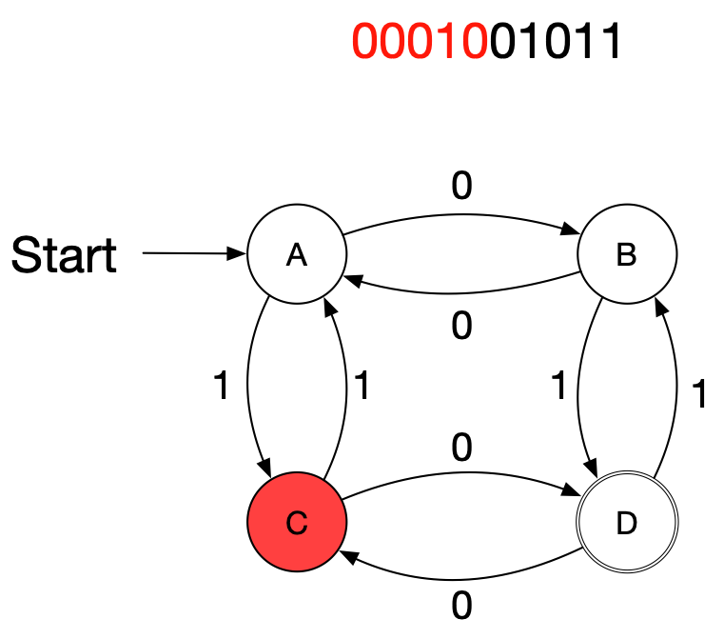
Finite Automata

Slide 18
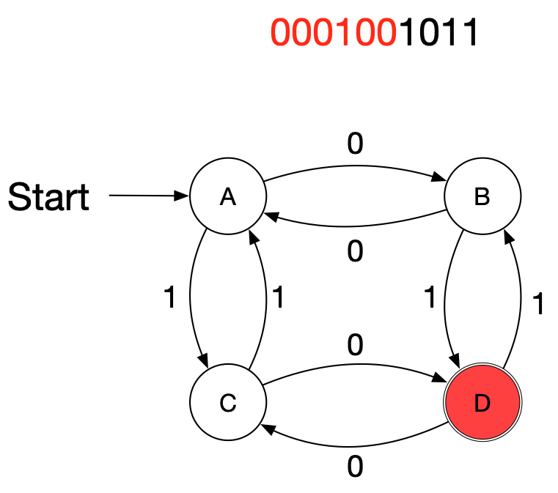
Finite Automata

Slide 19
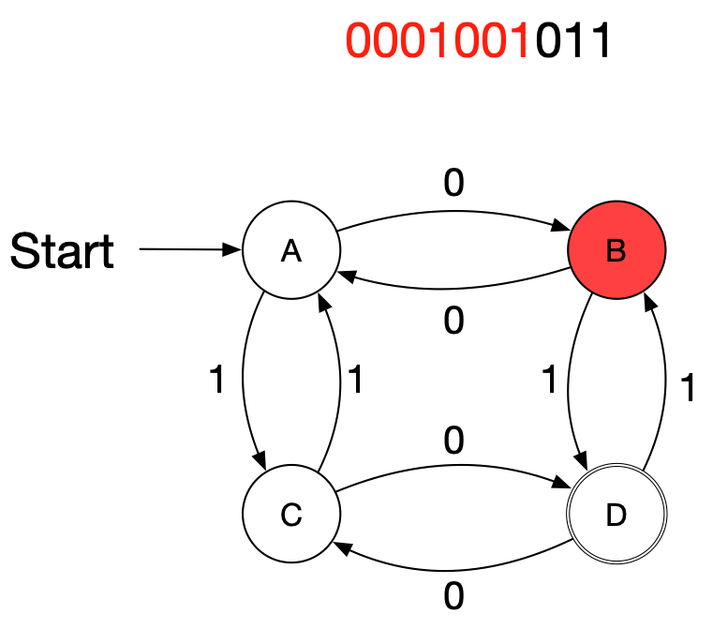
Finite Automata

Slide 20
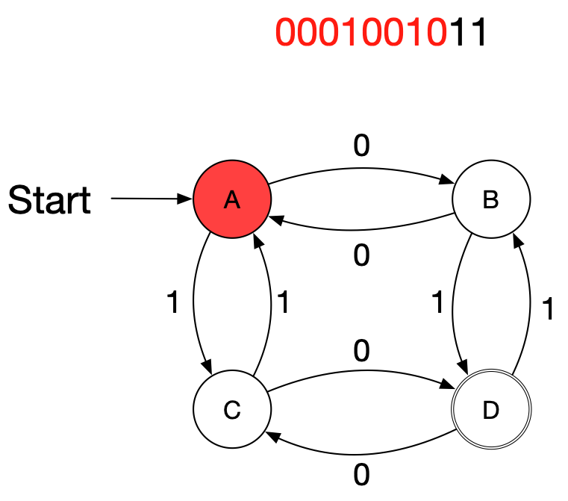
Finite Automata

Slide 21
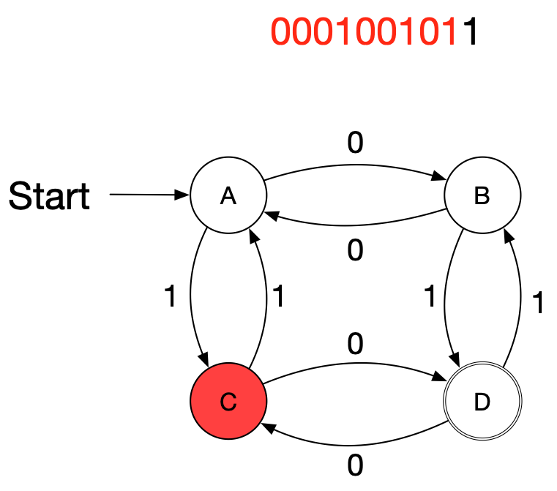
Finite Automata

Slide 22
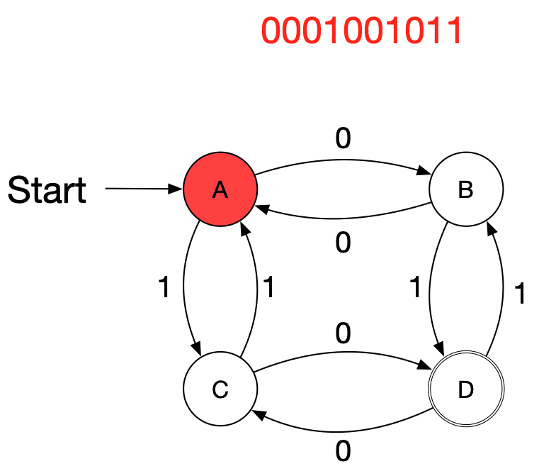
Finite Automata

Slide 23
Finite Automata
We can extend this to create a mapping
Argument:
Any state
A string
Image
The state in which we end up processing the string from the state

Slide 24
Finite Automata
Let be the set of strings with letters in the alphabet
is the empty string
Extend to by defining

Slide 25
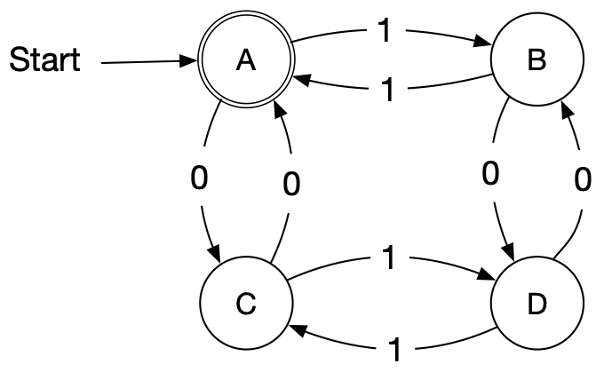
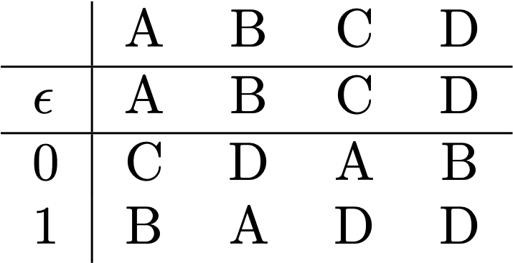
Finite Automata
Example:
First for the empty string and strings with one letter

Slide 26
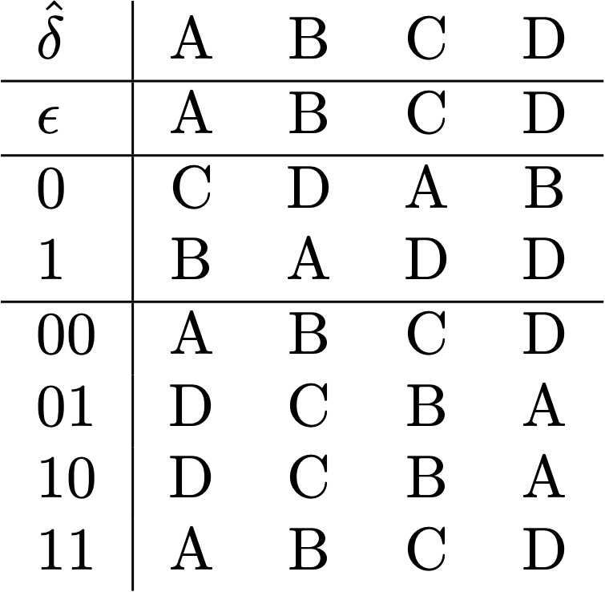
Finite Automata
Example:
Then for strings of length 2

Slide 27
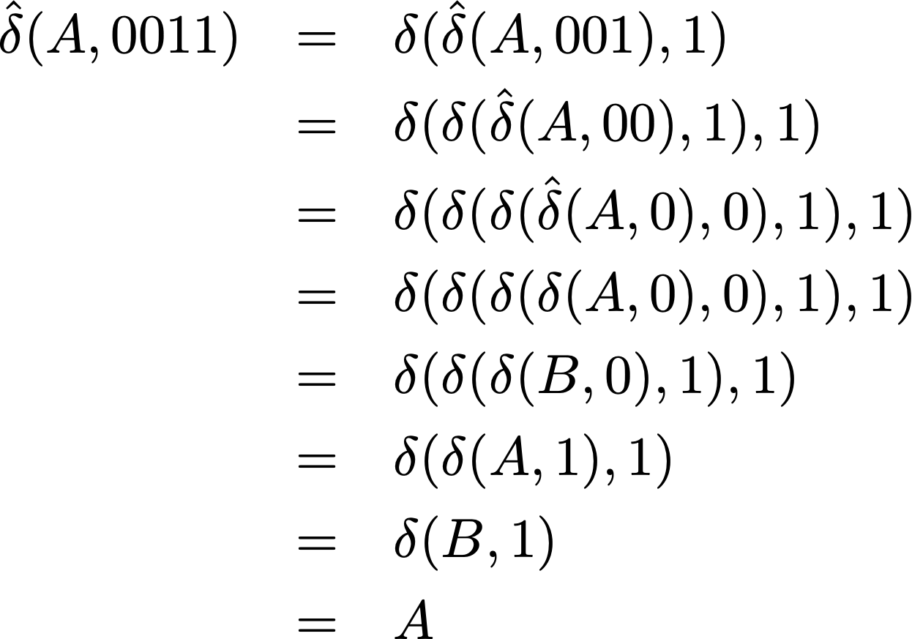
Finite Automata

Slide 28
Finite Automata
Acceptance
A string w is accepted by a finite automaton iff
With other words, the string transitions from the starting state to an accepting state

Slide 29
Finite Automata
Programming Finite State Machines
Easy if you can use goto and labels
Unfortunately, too many language designers decided that you should not be lead into temptation
Otherwise:
Use an enumeration data structure for the states
Express the transition function as a dictionary
Or in Java, as an array
Keep track of the current state

Slide 30
Finite Automata
This finite automaton accepts those strings that have an even number of ones and an even number of zeroes
Lemma: The automaton is in a left state iff it has seen an even number of ones
Lemma: The automaton is in a upper state iff it has seen an even number of zeroes
Proofs by induction on the length of a string

Slide 31
Non-deterministic Finite Automata
Non-determinism can make it easier to design finite automata
The transition function can be multivalued
It is a function whose values are subsets of Q

Slide 32
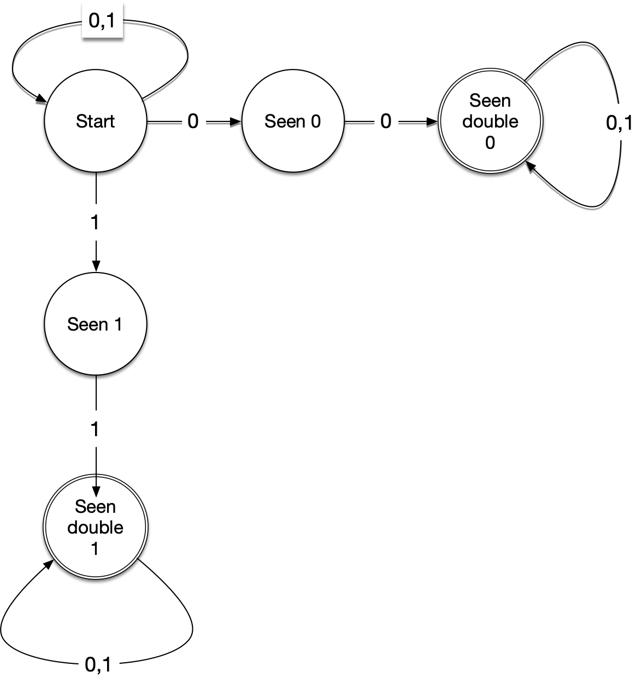
Non-deterministic Finite Automata
Recognize all strings in with a repeated 0 or a repeated 1
Rule: A string is accepted if there is a path labeled by the string from the starting state to an accepting state

Slide 33
Non-deterministic Finite Automata

Slide 34
Non-deterministic Finite Automata
As before, extend transition function to all strings

Slide 35
Non-deterministic Finite Automata

Slide 36
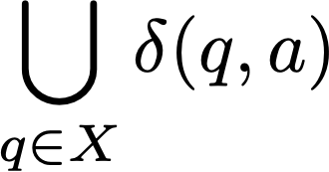
Non-deterministic Finite Automata
Proof sketch:
Key idea: The states of the deterministic automaton are the subsets of the non-deterministic automaton
To calculate a transition from a subset X of states, form
Accepting states: Those subsets that contain an accepting state
Can show: A string is accepted in the NFA only if it is accepted in the DFA

Slide 37
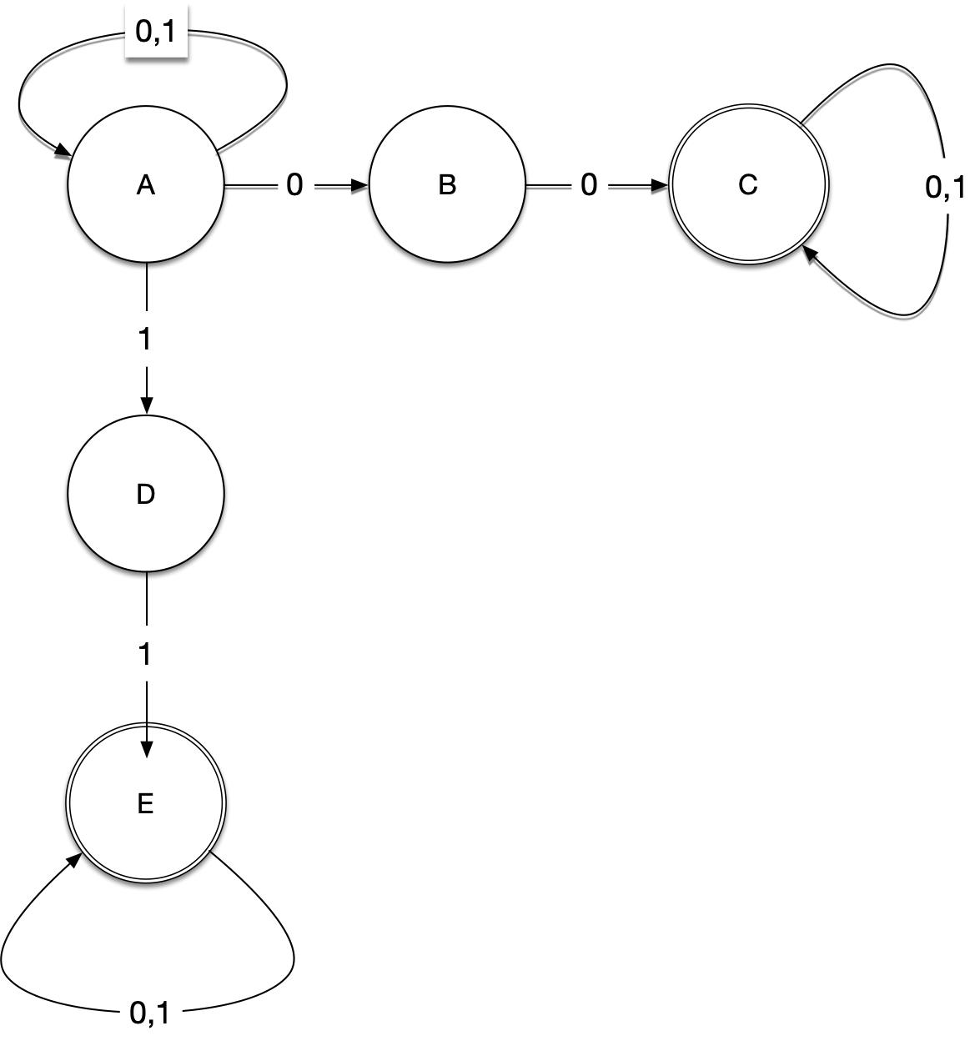
Non-deterministic Finite Automata
 | 0 | 1
{A} | {A,B} | {A,D}
{A,B} | {A,B,C} | {A,D}
{A,D} | {A,B} | {A,D,E}
{A,B,C} | {A,B,C} | {A,C,D}
{A,C,D} | {A,B,C} | {A,C,D,E}
{A,D,E} | {A,B,E} | {A,D,E}
{A,B,E} | {A,B,C,E} | {A,D,E}
{A,B,C,E} | {A,B,C,E} | {A,C,D,E}
{A,C,D,E} | {A,B,C,E} | {A,C,D,E}

Slide 38
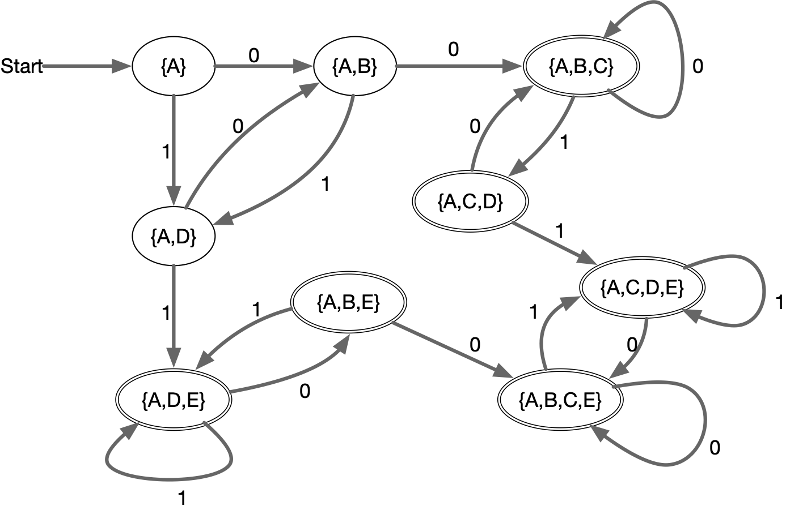
Non-deterministic Finite Automata
Resulting DFA

Slide 39
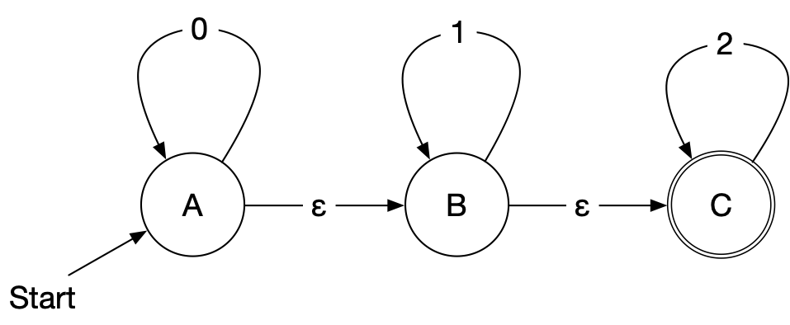
Non-deterministic finite automata with ε-moves
A further generalization of non-deterministic finite automata are non-deterministic automata with ε - moves
Example: Strings in whose digits only increase.
How does this
automaton accept
0000222?

Slide 40
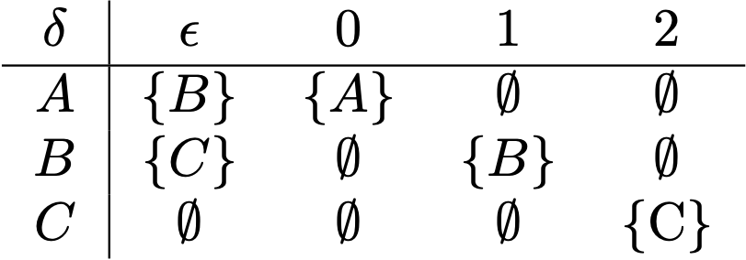
Non-deterministic finite automata with ε-moves
Transition function

Slide 41
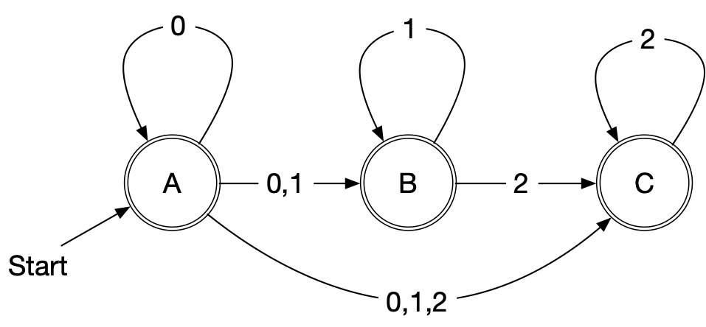
Non-deterministic finite automata with ε-moves
We can reduce non-deterministic finite automata with ε-moves to non-deterministic automata
For any state and letter of the alphabet Σ, calculate the states that can be reached by using ε-transitions and a single transition with the letter.
Any state that can reach an accepting state by ε-moves is accepting

Slide 42
Regular Expressions
Regular expressions define subsets of strings in an finite alphabet Σ
Concatenation:
Powers:
Kleene Closure

Slide 43
Regular Expressions
Example:

Slide 44
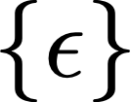
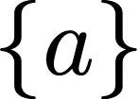
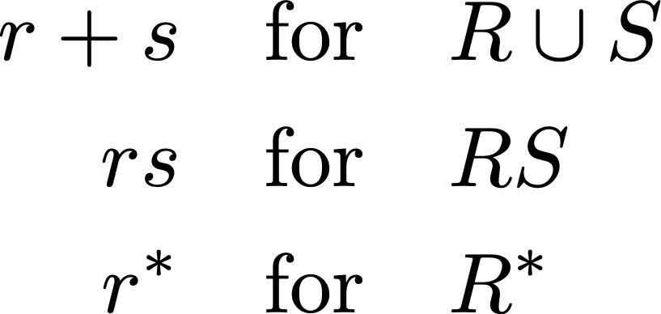
Regular Expressions
Regular expressions are defined by induction
is a regular expression and denotes the empty set
is a regular expression and denotes the set
If then is a regular expression and denotes the set
If are regular expressions for the sets then so are

Slide 45
Regular Expressions
Examples for

Slide 46
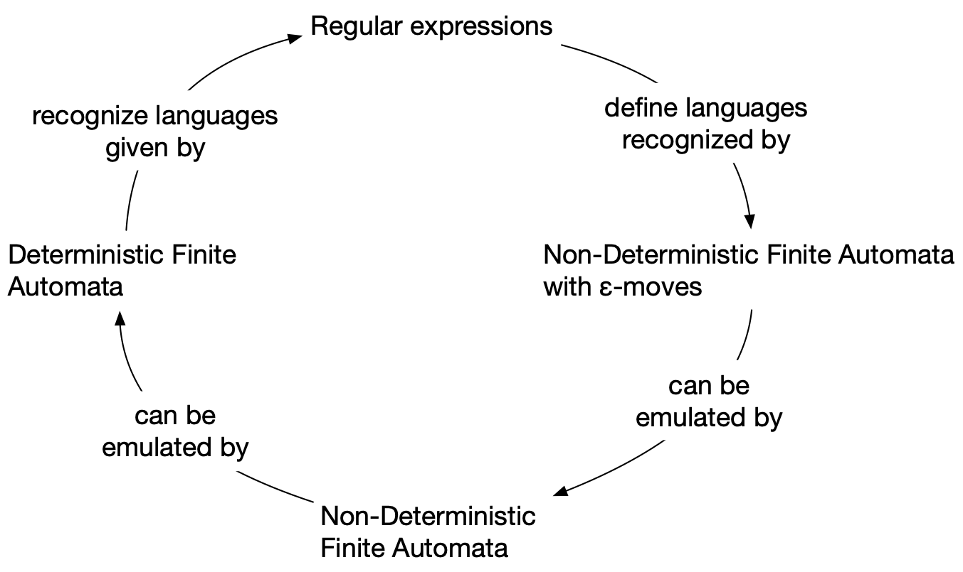
Regular Expressions
and Deterministic Finite Automata
We want to show that regular expressions are exactly those recognized by a finite automaton.
The proof follows a simple scheme

Slide 47
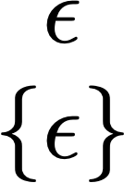
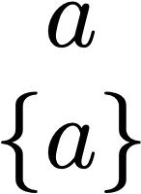
Regular Expressions
and Deterministic Finite Automata
Regular expressions are recognized by non-deterministic finite automata with ε-transitions
Base steps

Slide 48
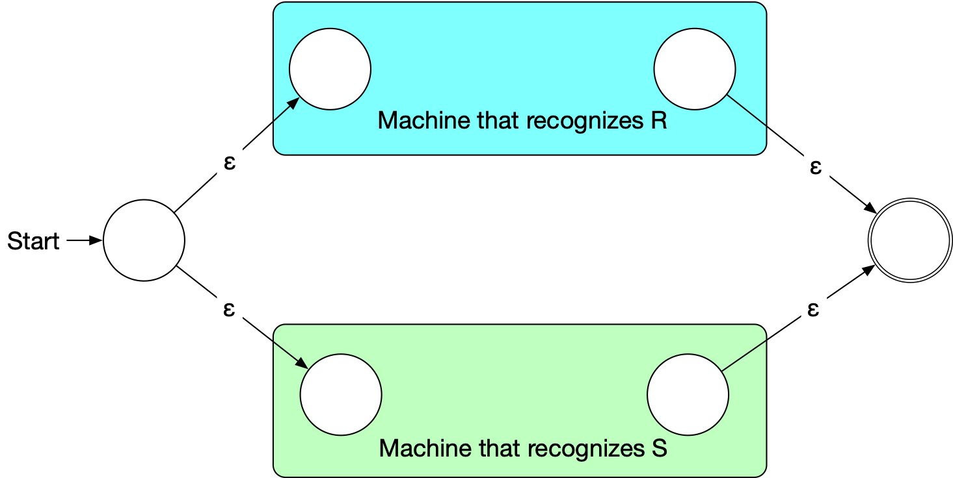
Regular Expressions
and Deterministic Finite Automata
Union r+s: Get two machines that recognize r and s
Connect a new start state to the start states of the two machines
Connect all final states with a new, single final state

Slide 49
Regular Expressions
and Deterministic Finite Automata
Concatenation

Slide 50
Regular Expressions
and Deterministic Finite Automata
Closure

Slide 51
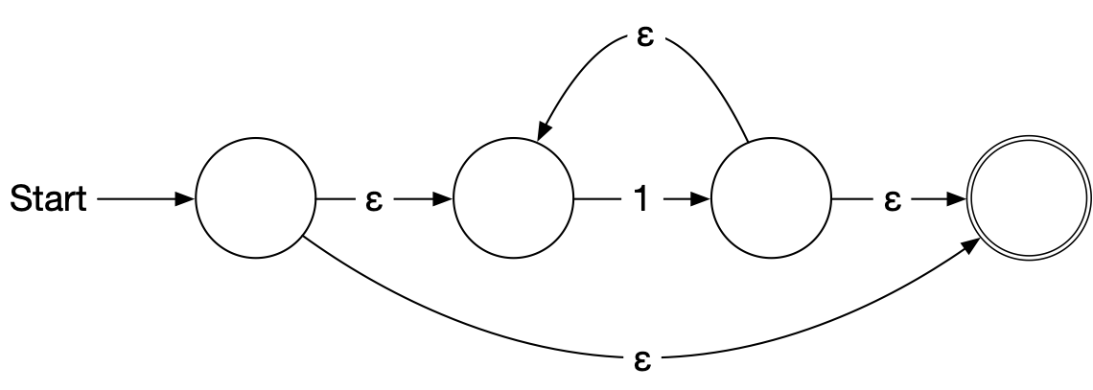
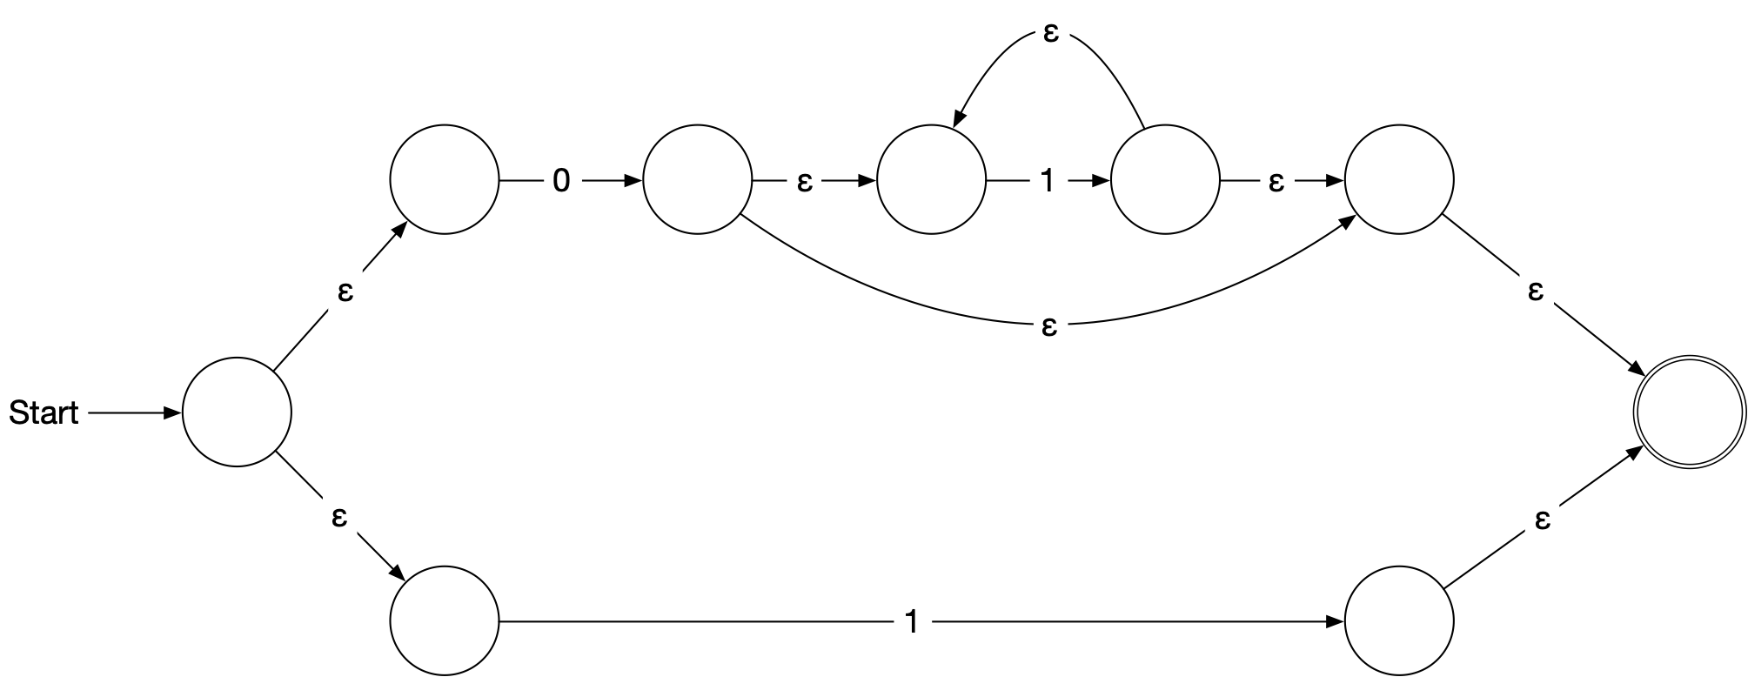
Regular Expressions
and Deterministic Finite Automata
Example

Slide 52
Regular Expressions
and Deterministic Finite Automata
Now, we need to show that every language accepted by a deterministic finite automaton is regular.
Given a DFA
Define
Set of strings that go from State i to State j without going through any state numbered higher than k
We can define by recursion

Slide 53
Regular Expressions
and Deterministic Finite Automata
Observation: is given by a regular expression
Proof by induction on k
Base: k = 0
is a finite set of strings with a single symbol or ε
Induction step: k —> k+1
By induction hypothesis, we have regular expressions such that
Simply define a regular expression for by

Slide 54
Regular Expressions
and Deterministic Finite Automata
It follows that the language accepted by a DFA is regular:

Slide 55
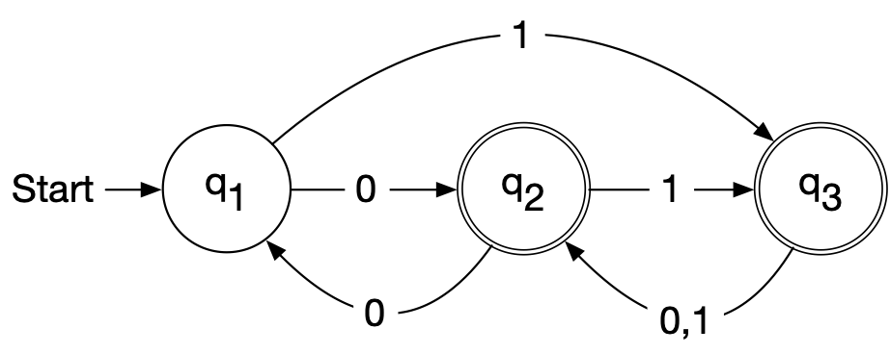
Regular Expressions
and Deterministic Finite Automata
Example:
 | k=0 | k=1 | k=2
 | 0
 | 1
 | 0
 | 1
 | 0+1

Slide 56
Regular Expressions
and Deterministic Finite Automata
Example:
 | k=0 | k=1 | k=2

Slide 57
Regular Expressions
and Deterministic Finite Automata
Example:
 | k=0 | k=1 | k=2

Slide 58
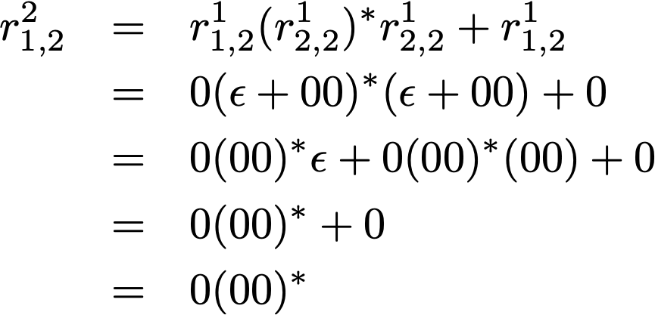
Regular Expressions
and Deterministic Finite Automata
Example:
 | k=0 | k=1 | k=2

Slide 59
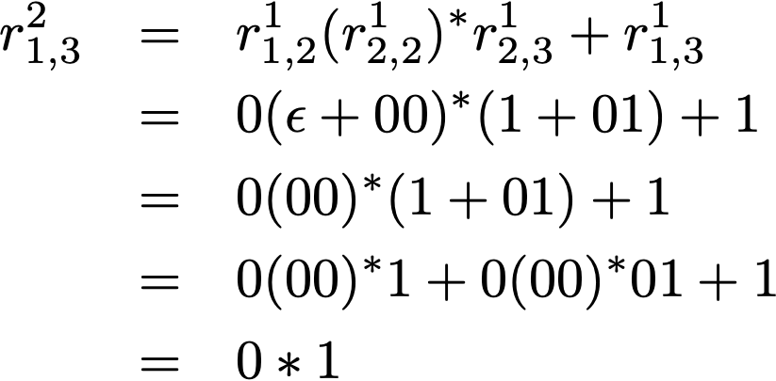
Regular Expressions
and Deterministic Finite Automata
Example:
 | k=0 | k=1 | k=2

Slide 60
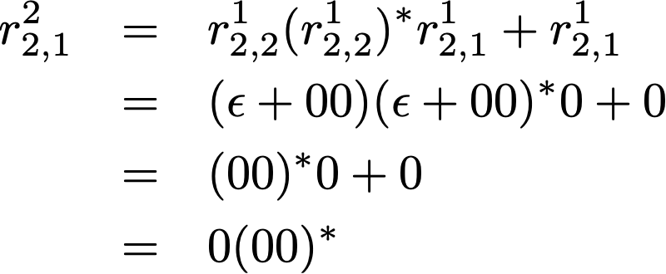
Regular Expressions
and Deterministic Finite Automata
Example:
 | k=0 | k=1 | k=2

Slide 61
Regular Expressions
and Deterministic Finite Automata
Example:
 | k=0 | k=1 | k=2

Slide 62
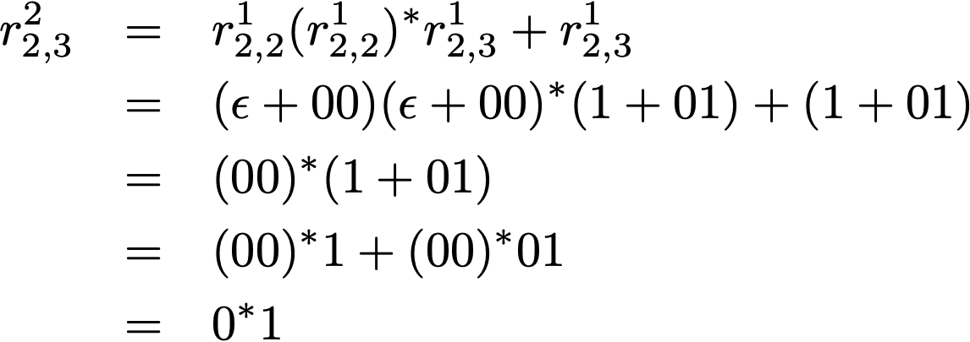
Regular Expressions
and Deterministic Finite Automata
Example:
 | k=0 | k=1 | k=2

Slide 63
Regular Expressions
and Deterministic Finite Automata
Example:
 | k=0 | k=1 | k=2

Slide 64
Regular Expressions
and Deterministic Finite Automata
Example:
 | k=0 | k=1 | k=2

Slide 65
Regular Expressions
and Deterministic Finite Automata
Example:
 | k=0 | k=1 | k=2

Slide 66
Regular Expressions
and Deterministic Finite Automata
 | k=0 | k=1 | k=2
Example:

Slide 67
Regular Expressions
and Deterministic Finite Automata
 | k=0 | k=1 | k=2
Example:

Slide 68
Regular Expressions
and Deterministic Finite Automata
Therefore

Slide 69
Finite Automata with Output
Moore machines
Whenever the machine is in state i it outputs a symbol depending on the state
Example:
A Moore machine that calculates the remainder modulo 3 of a binary number
To derive the formula, consider

Slide 70
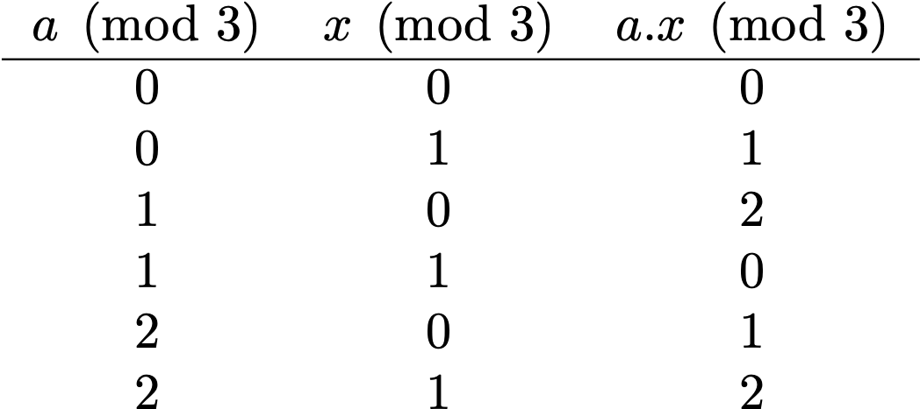
Finite Automata with Output

Slide 71
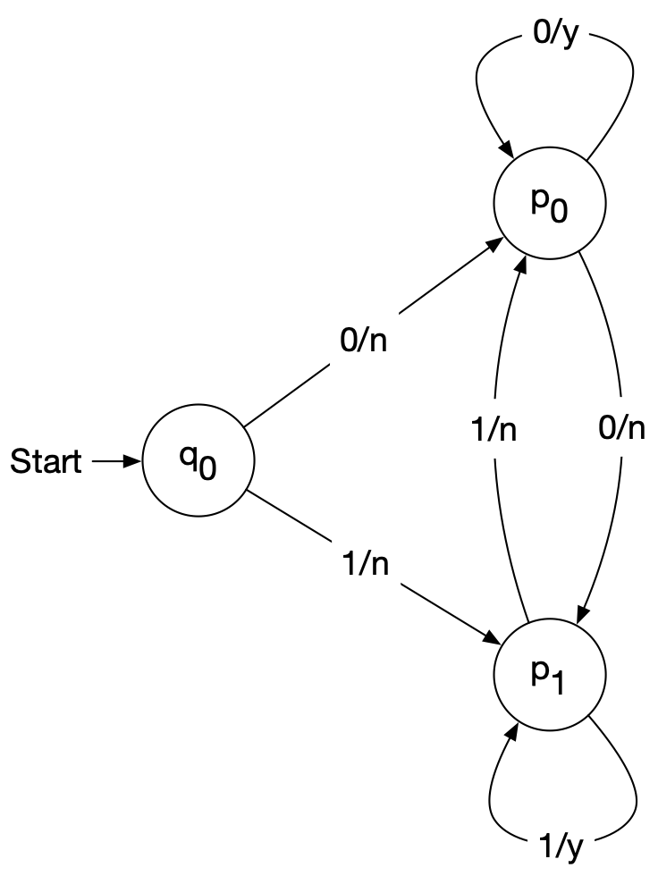
Finite Automata with Output
Mealy Machines
Output depends on the current state and the transition

Slide 72
Finite Automata with Output
It can be shown that Mealy and Moore machines are equivalent

