Slide 1
High Level Database Models
Thomas Schwarz, SJ

Slide 2
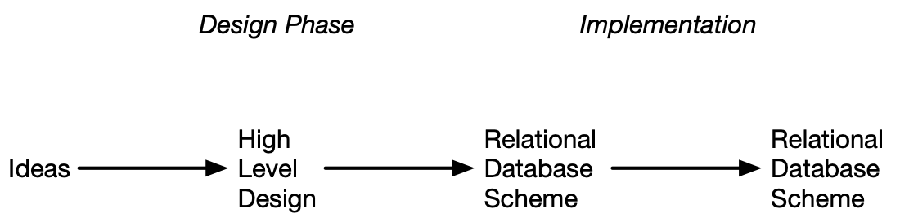
Contents
Design Language:
  Entity Relationship Model (ERM)
  Unified Modeling Language (UML)
  (Object Description Language ODL)

Slide 3
E/R Model
Entities: Abstract object
  Have Attributes
    Types can be primitive or structures
Relationships
  Connections between two or more entity sets

Slide 4
E/R Model
Graphics
  Entities are represented by rectangles
  Attributes are represented by ovals
  Relationships are represented by diamonds
  Edges connect attributes and relations

Slide 5
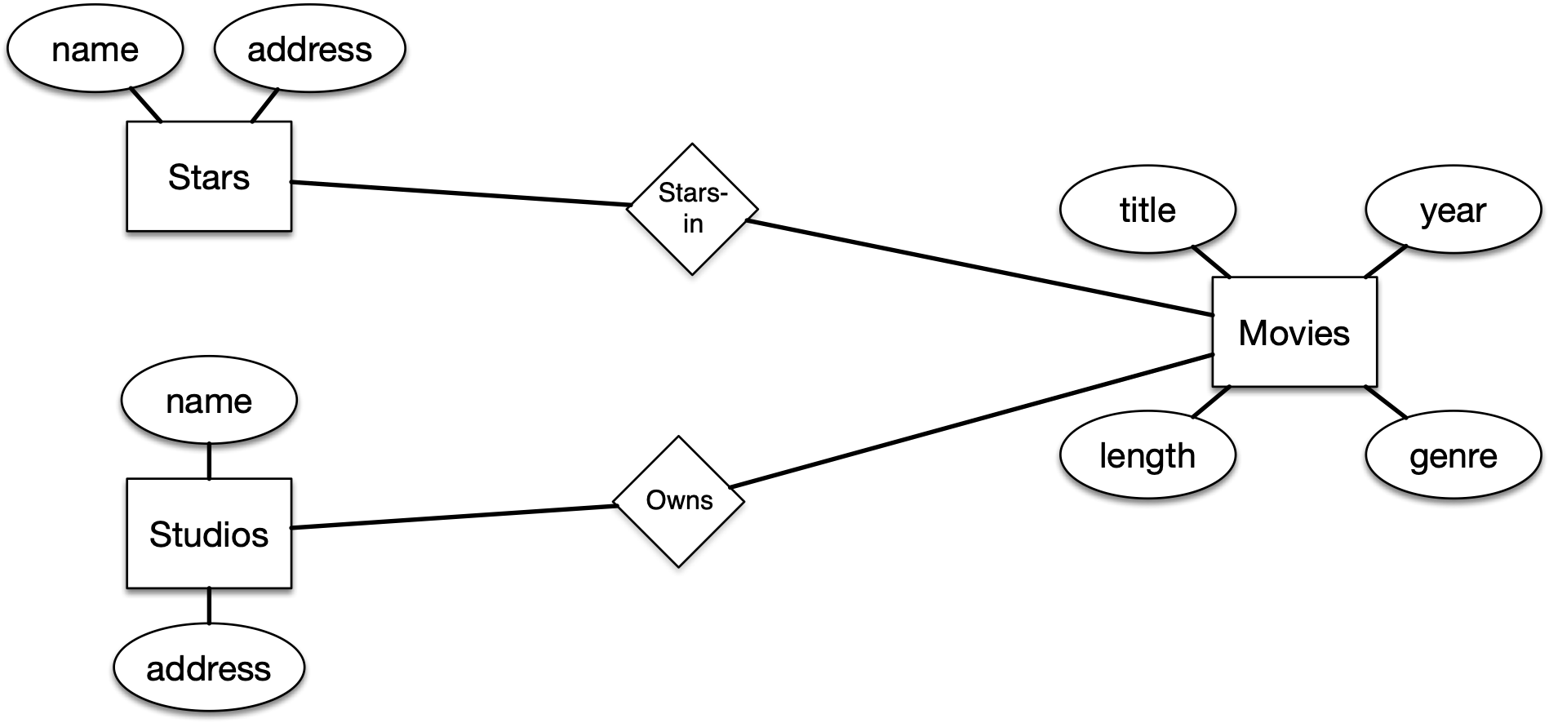
E/R Model

Slide 6
E/R Model
Type of binary E/R relationships between entities:
  Many-to-one
  One-to-one
  Many-to-many

Slide 7

E/R Model
Example:
  One president can “run” one studio
  One studio can only be ‘run” by one president
    The arrow does not guarantee existence, only uniqueness

Slide 8
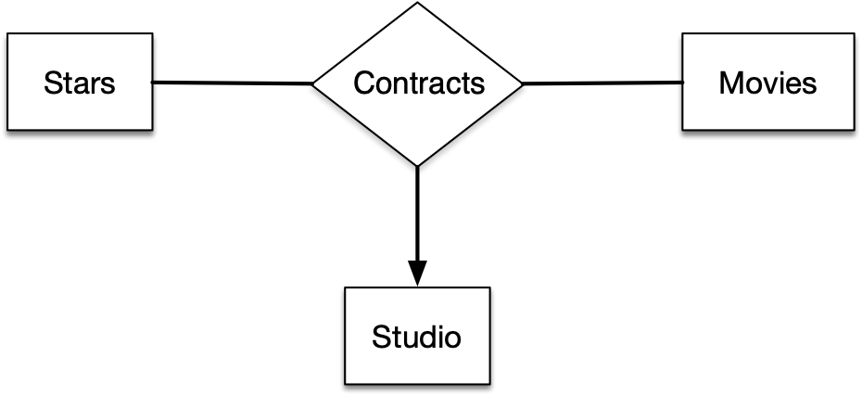
E/R Model
Ternary relationships
  Occasionally, relationships involve more than two entities
  Contracts involve a studio, a star, and a (set of) movies
    Each relationship is a triple (star, movie, studio)

Slide 9
E/R Model
The many-to-one relationship means that for a star and for a movie, there can only be one studio
However, a star can have a contract over many movies
The studio can contract with several stars for a given movie

Slide 10
E/R Model
The arrow notation is limited
  Studio is only a function of the movie
  Diagram cannot distinguish between
    Studio is a function of movie
    Studio is a function of movie and star

Slide 11
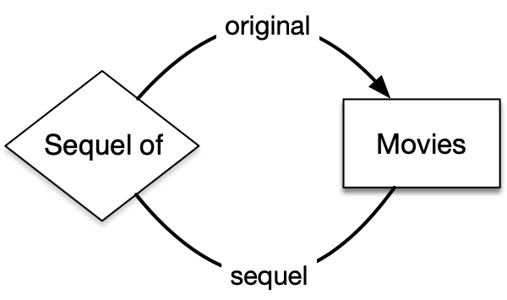
E/R Model
Roles
  Entities can appear several times in a relationship
  Question: Explain the arrow heads or their absence

Slide 12
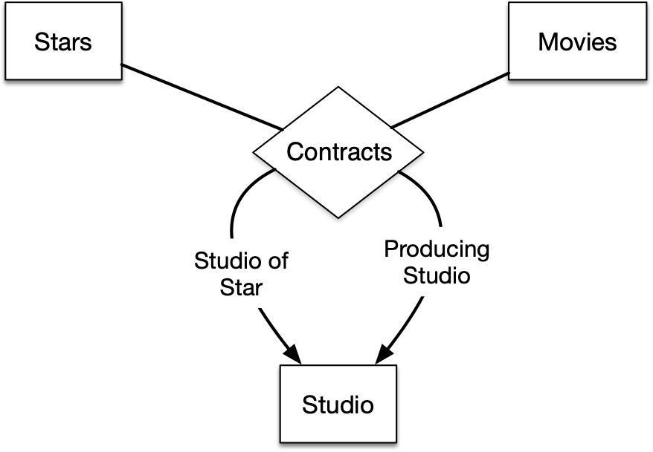
E/R Model
Example for a multi-way relationship and an entity set with multiple roles
  Hollywood stars would “belong” to a studio that could lent them out to another studio

Slide 13
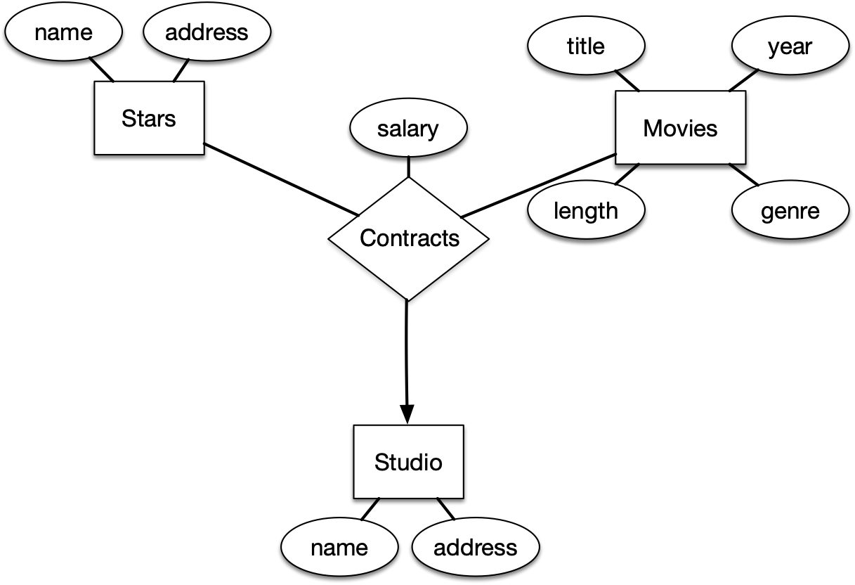
E/R Model
Relationships can also have attributes
  The attribute is functionally dependent on all parties to the relationship

Slide 14
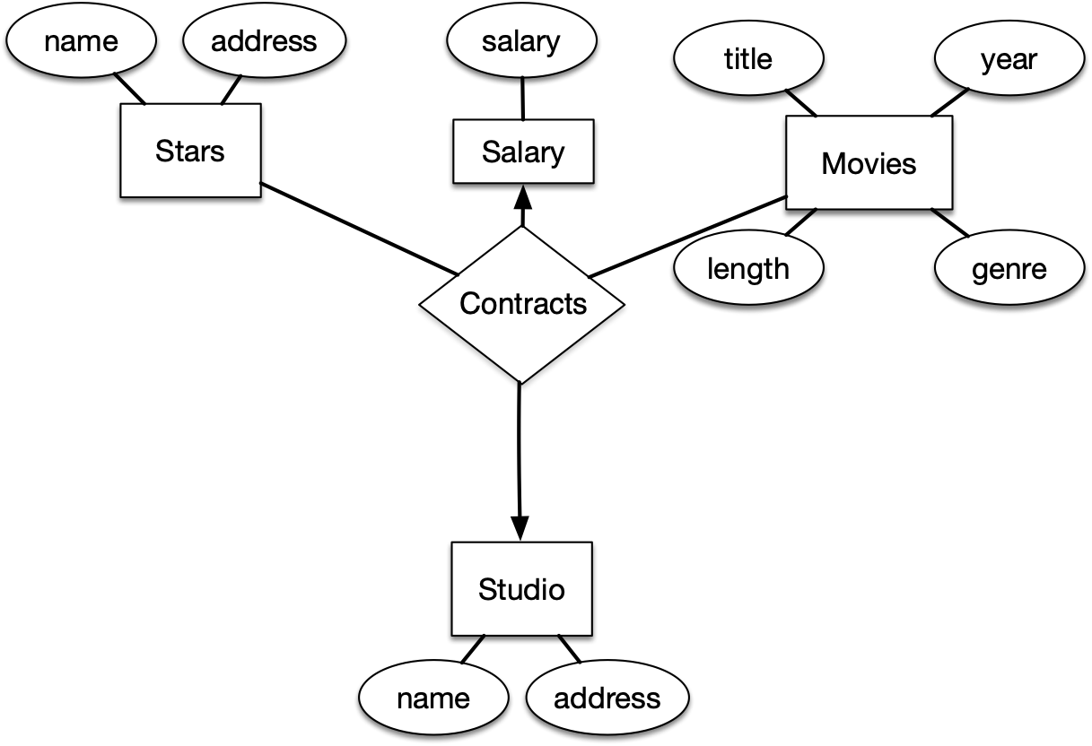
E/R Model
Some models (UML, ODL) limit relationships to binary
  Move attributes to an entity set

Slide 15
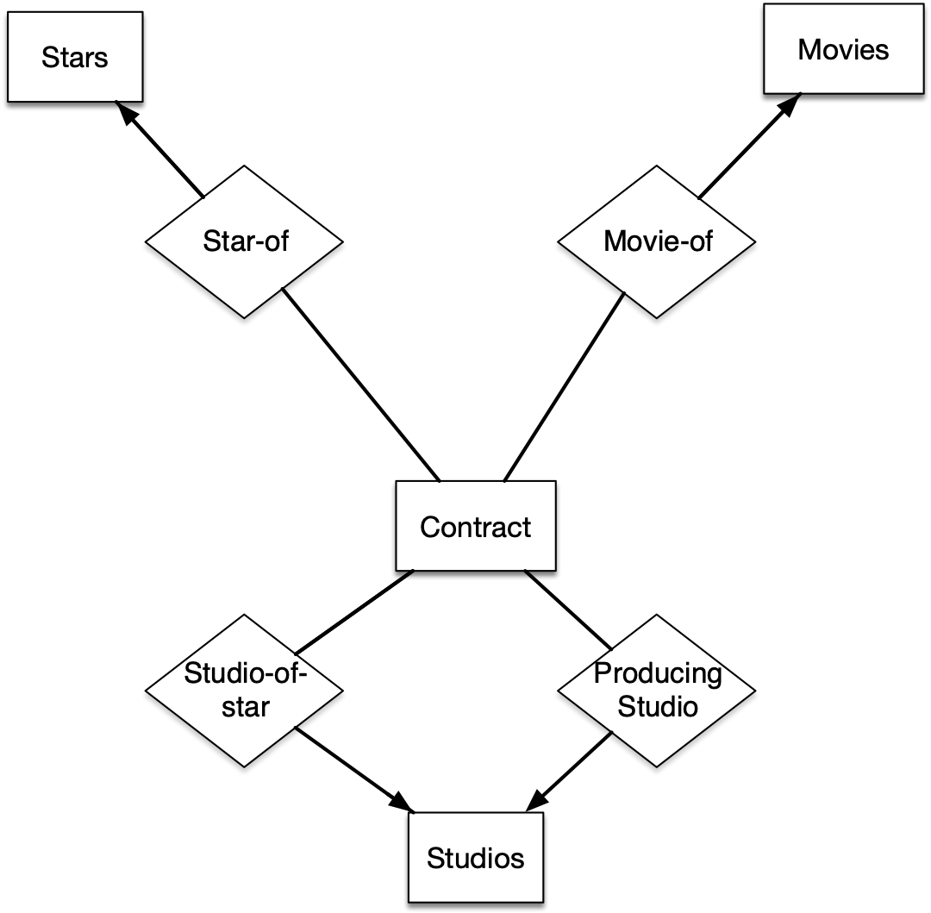
E/R Model
Multi-way relationships can be modeled through an entity as well

Slide 16
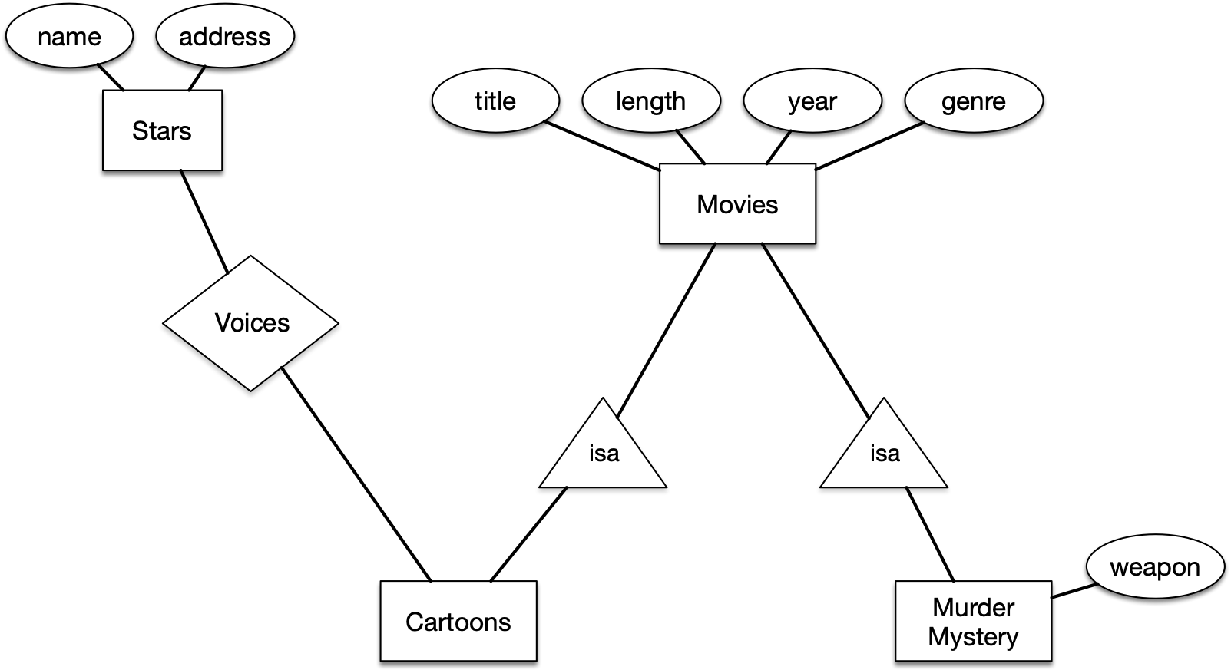
E/R Model
Subclasses
  Some entities are special
    Use an is-a relationship (a triangle)

Slide 17
Design Principles
Faithfulness
  Can be difficult: Is “teaches” between instructors and courses many to many or one to many?
Avoid Redundancy
  Example: Add relationship ‘owns’ between movies and studios and add an attribute “studio” to movies.
    This results in an update anomaly

Slide 18
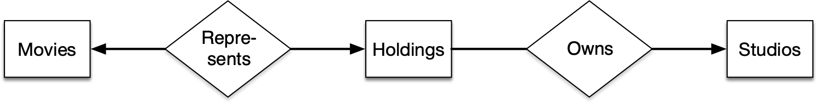
Design Principles
Simplicity
  Avoid introducing more elements than is necessary
    A studio can own movies, so each studio has a holding
    Could be represented by this diagram, but entity holdings can also be done away with
      Keeping it just means more storage space and longer computations

Slide 19
Design Principles
Smart Selection
  Not every relationship in the real world is worth-while using
  Information can be redundant
    Assume relationships contracts, stars-in, and owns
      Since a movie has an owning studio, and the owning studio has contracts for each star, we do not need the stars-in relationship

Slide 20
Design Principles
Picking the right kind of element
  Should studio be an entity set or can we add its attributes to a movie
  Depends on the number of attributes for studio
    If there is only studio name, we can incorporate it in movies
    If there are more attributes, we probably run into an update anomaly

Slide 21
Constraints in the E/R Model
Keys
  Every entity set must have a key
  There can be more than one key
  For is-a relationships:
    Root entity set needs to have all the attributes for a key

Slide 22

Constraints in the E/R Model
Representing keys: Underline attributes that make up the primary key

Slide 23
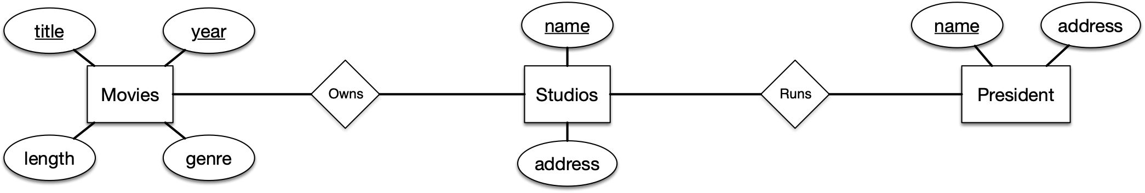
Constraints in the E/R Model
Referential Integrity Constraint
  E.g. Foreign key constraint
  Example:
    Every movie has at most one studio owning it
    Every movie is owned by a studio
    Every studio has at most one president
    Every president has a studio to run

Slide 24

Constraints in the E/R Model
Use rounded arrows to indicate existence of the foreign entity:
  Every movie is owned by a studio (existence)
  But not owned by more than one studio (uniqueness)

Slide 25
Constraints in the E/R Model
Use rounded arrows to indicate existence of the foreign entity:
  Every president needs to run a studio
  Cannot run more than one studio
  If (s)he stops running a studio, they get deleted from the president table

Slide 26
Constraints in the E/R Model
Use rounded arrows to indicate existence of the foreign entity:
  A studio cannot have more than one president
  But if the president has been fired, the studio still persists

Slide 27
Constraints in the E/R Model
Use rounded arrows to indicate existence of the foreign entity:
  A studio does not need to own a movie
  But it can own more than a single movie

Slide 28
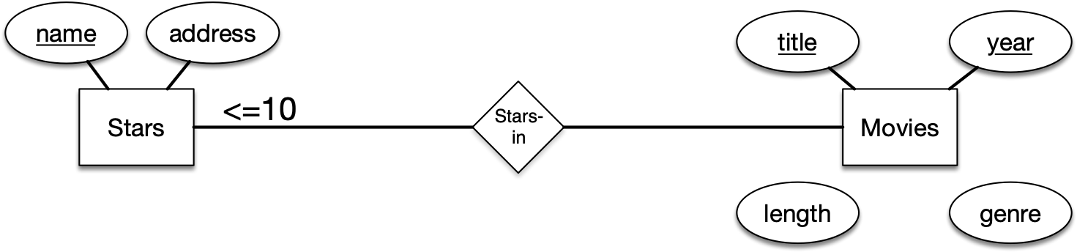
Constraints in the E/R Model
Degree constraints
  Limit the number of entities that can be connected to an entity set
  The same star can only appear in 10 movies

Slide 29
Constraints in the E/R Model
Degree constraints
  <=1 means pointed arrow
  ==1 means curved arrow

Slide 30
Weak Entity Sets
An entity’s key can be composed of attributes belonging (all or some) to another entity
Called weak entity sets

Slide 31
Weak Entity Sets
Example:
  Movie studio has several film crews, given by a number
    (First unit, second unit, ...)
  The numbering can be used also by other studios

Slide 32
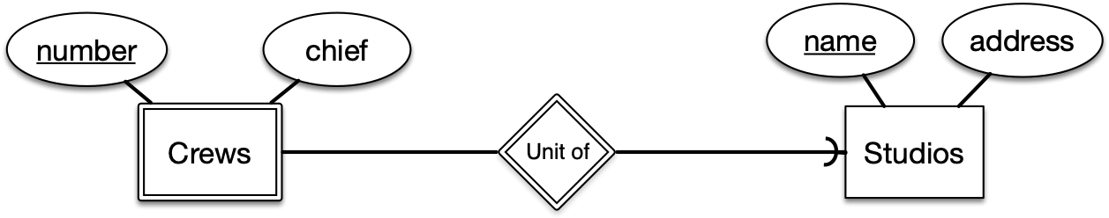
Weak Entity Sets
Double stroke indicates a weak entity set
Crews has key (number, studios.name)
Mediated through the “unit-of” relationship

Slide 33
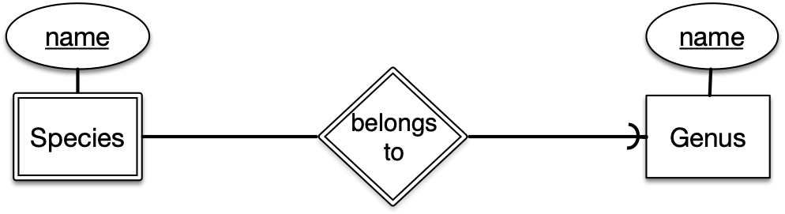
Weak Entity Sets
Biological species are given by genus and species
  Homo neanderthalensis
First is genus, then species
The species has a key (species.name, genus.name)

Slide 34
Weak Entity Sets
Connecting entity sets used to replace ternary relationships
Often have no attributes of their own
Keys are attributes of other entities

Slide 35
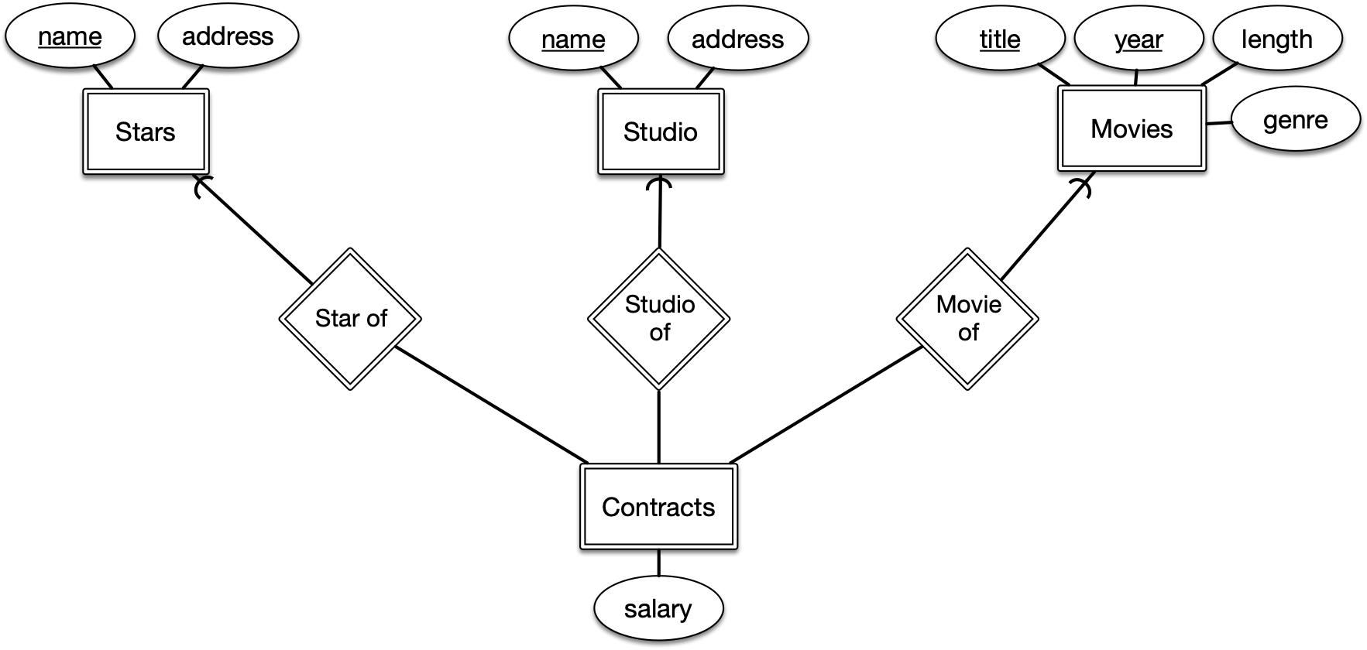
Weak Entity Sets
Contracts have a key made up of stars.name, studio.name, movies.title, movies.year
Own attribute salary is not a key

Slide 36
Weak Entity Sets
Key attributes for weak entity sets:
  Made up of zero or more of its own attributes
  Key attributes from entity sets that are reached by certain many-to relationships
    These are called supporting relationships and supporting entity sets, resp.

Slide 37
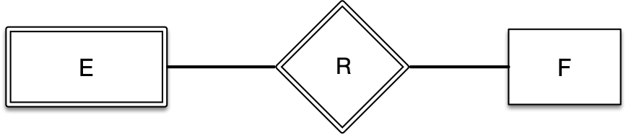
Weak Entity Sets
R is a supporting relationship for E to F if the following conditions are true
  R binary, many to one or one to one
  R must have referential integrity:
    For every E, there must be exactly one F entity in R
    The attributes in F that supply (parts of the) key for E are also keys for F

Slide 38
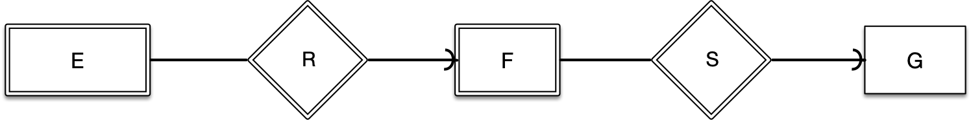
Weak Entity Sets
  However, if F itself is weak, then the key attributes for F might be supplied by an entity G, etc.

Slide 39
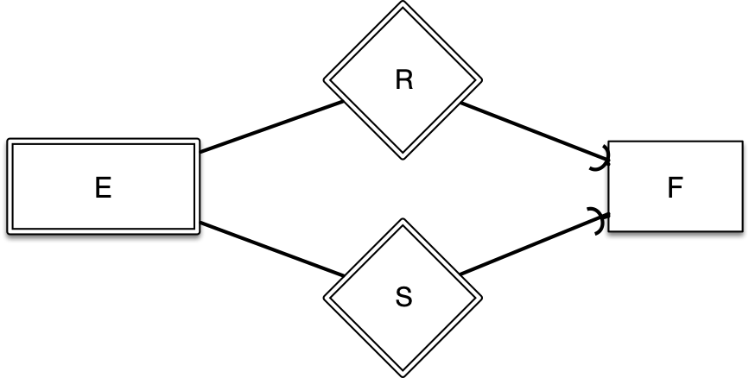
Weak Entity Sets
If there are several different supporting relationships:
  Each relationship is used to supply a copy of the key attributes of F to help form the key of E
  The relationships can associated an entity $e∈E$ with different entities $f_{1},f_{2}∈F$ and so the parts of the key of $E$ can come from different entities

Slide 40
Weak Entity Sets
Example
  Each crew is unique
  But to identify a crew, we need data from the supporting relationship
  There needs to be a deterministic process to obtain this data.

Slide 41
Weak Entity Sets
Example
  Values for a crew are obtained from their attributes and by following the relationship “Unit of”
  Thus, the supporting relationship needs to be many-to-one

Slide 42
Weak Entity Sets
In class exercise:
  Develop a university grading roster DB as an E/R diagram
  You have courses and students as entities and enrollment as a connecting entity
  Enrollment can have grade as an attribute

Slide 43
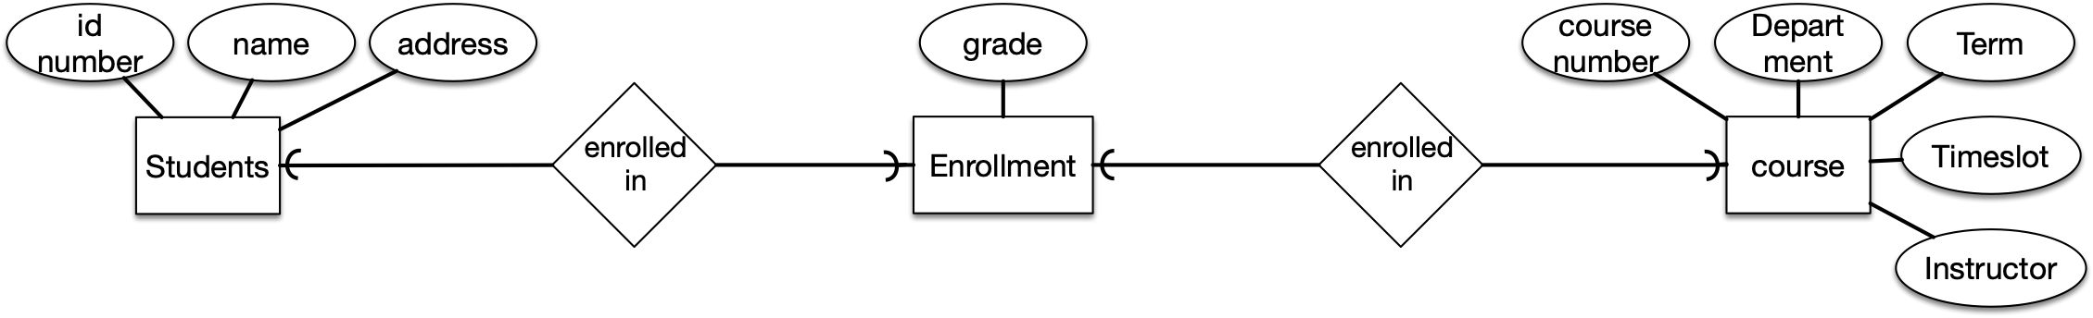
Weak Entity Sets

Slide 44
Weak Entity Sets
Every enrollment record needs to have exactly a student and exactly a course

Slide 45
Weak Entity Sets
In class exercise
  Draw E/R diagrams involving weak entity sets
    Courses and Departments
      A course is given by a unique department, but its only attribute is its number
      Different departments can offer courses with the same number

Slide 46
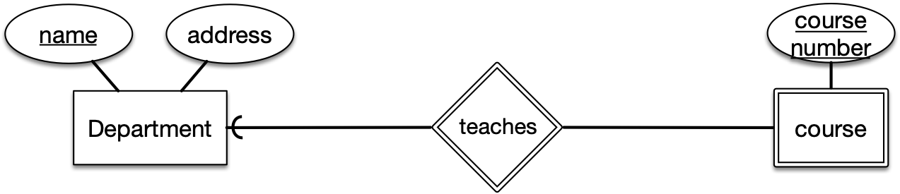
Weak Entity Sets

Slide 47
From E/R Diagrams to Relational Design
Each entity set becomes a relation with the same set of attributes
Each relationship becomes a relation with attributes being the keys for the connected entity set

Slide 48
From E/R Diagrams to Relational Design
Problems:
  Weak entity sets cannot be translated straightforwardly
  Isa relationships are difficult
  Sometimes, makes sense to combine relations when connected by a many-to-one relationship

Slide 49
From E/R Diagrams to Relational Design
In class test:

Slide 50
From E/R Diagrams to Relational Design
stars(name, address)
movies(title, year, length, genre)
studios(name, address)
starsIn(name, title, year)
owns(name, title, year)

Slide 51
From E/R Diagrams to Relational Design
In class exercise

Slide 52
From E/R Diagrams to Relational Design
stars(name, address)
movies(title, year, length, genre)
studios(name, address)
contracts(name, title, year, studioOfStar, producingStudio)

Slide 53
From E/R Diagrams to Relational Design
Handling weak entity sets
  Relation for a weak entity set needs to include key attributes of supporting entity sets
  Relation for any relationship that includes a weak entity set must use as a key all of its key attributes, including those in supporting entities
  A supporting relationship does not need to be represented in an entity itself
    This is because the rule for the weak entity already force it to have these relationships

Slide 54
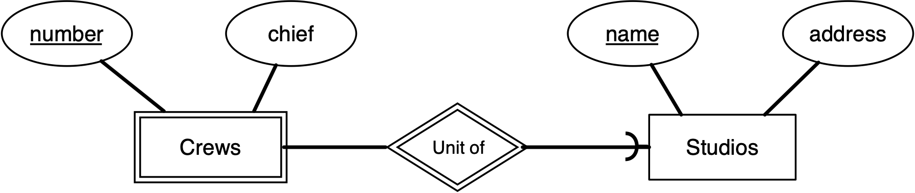
From E/R Diagrams to Relational Design
Example

Slide 55

From E/R Diagrams to Relational Design
Example
First pick:
  studios(name, address)
  crews(number, chief, studioName)
  unitOf(number, studioName, name)

Slide 56
From E/R Diagrams to Relational Design
Example
Second pick: studioName and name are the same
  studios(name, address)
  crews(number, chief, studioName)
  unitOf(number, studioName)

Slide 57
From E/R Diagrams to Relational Design
Example
Final pick: can dispense with unitOf
  studios(name, address)
  crews(number, chief, studioName)

Slide 58
From E/R Diagrams to Relational Design
Converting subclass structures to relations
  is-a relationship:
    There is a root entity
    Root entity has a key that identifies all entities in the hierarchy
    A given entity may have components that belong to the entity sets of any subtree of the hierarchy that includes root

Slide 59
From E/R Diagrams to Relational Design
Converting subclass structures to relations
  Three strategies
    Follow the E/R viewpoint
    Treat entities as objects belonging to the same class
    Use null values

Slide 60
From E/R Diagrams to Relational Design
Follow the E/R view
  Make a relation for each entity

Slide 61
From E/R Diagrams to Relational Design
movies(title, length, year, genre)
murderMysteries(title, length, weapon)
cartoons(title, year)

Slide 62
From E/R Diagrams to Relational Design
E/R view:
  movies(title, length, year, genre)
  murderMysteries(title, length, weapon)
  cartoons(title, year)
A cartoon has a tuple in two tables
“Who framed Roger Rabbit” has tuples in all three tables
Add
  voices(starName, title, year)
Would still have to retain cartoons relationship since we might have silent cartoons

Slide 63
From E/R Diagrams to Relational Design
Object-Oriented Approach to subclasses
    Entities can only belong to one class
  Enumerate all possible subtrees of the hierarchy
  Create a relationship for all of them

Slide 64
From E/R Diagrams to Relational Design
movies(title, year, length, genre)
moviesC(title, year, length, genre)
moviesMM(title, year, length, genre, weapon)
moviesCMM(title, year, length, genre, weapon)
A movie is in only one relationship

Slide 65
From E/R Diagrams to Relational Design
movies(title, year, length, genre)
moviesC(title, year, length, genre)
moviesMM(title, year, length, genre, weapon)
moviesCMM(title, year, length, genre, weapon)
Add voices:
  voices(title, year, starName)
Should we have two (depending on CMM or C)?
  Probably not, no good reason at this point

Slide 66
From E/R Diagrams to Relational Design
Using Null values
  Only have the root relation, but add to it all attributes in the hierarchy
    movies(title, year, length, genre, weapon)
  Use null value when movie not in MM

Slide 67
From E/R Diagrams to Relational Design
Comparison of approaches
  It can be expensive to answer queries involving several relations
    “Null Value” approach wins
    Different queries favor different set ups
      What films of 2008 were longer than 150 minutes?
        E/R approach is easy
        OO approach needs to access four different relations

Slide 68
From E/R Diagrams to Relational Design
Comparison of approaches
    Different queries favor different set ups
      “What weapons were used in cartoons over 120 minutes?”
        OO approach needs to access one relation, moviesCMM
        E/R approach: Access movies to find movies over 120 minutes, then access cartoons to see whether the movie is a cartoon, then access murderMysteries to find out the weapon

Slide 69
From E/R Diagrams to Relational Design
We want few relations
  “Null” approach works best
  OO approach is worst

Slide 70
From E/R Diagrams to Relational Design
We want to minimize space and avoid repetition
  Null approach avoids repetition but tuples can now be very long
  E/R approach: repeats data
  OO approach: uses one tuple per entity

Slide 71
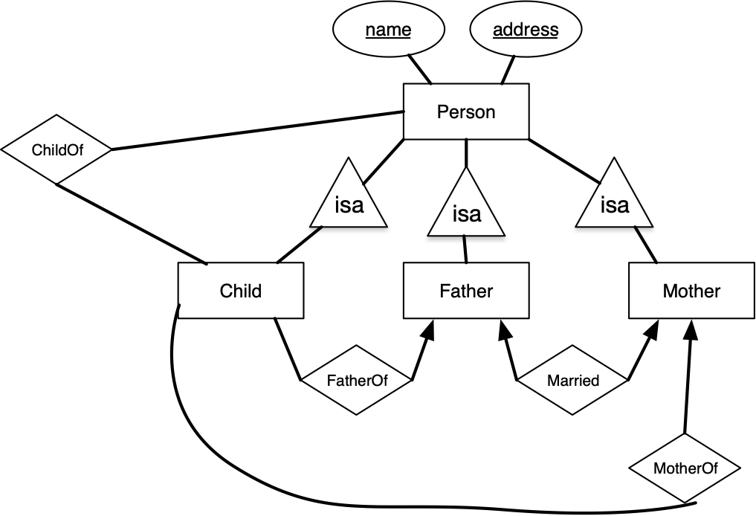
From E/R Diagrams to Relational Design
Use E/R, OO, and Null approach on

Slide 72
Unified Modeling Language
Developed as graphical notation for OO software design

Slide 73
Unified Modeling Language
UML | E/R
class | entity set
association | binary relationship
association class | attributes on a relationship
subclass | Is-a hierarchy
aggregation | many-one relationship
composition | many-one relationship with rreferential integrity

Slide 74
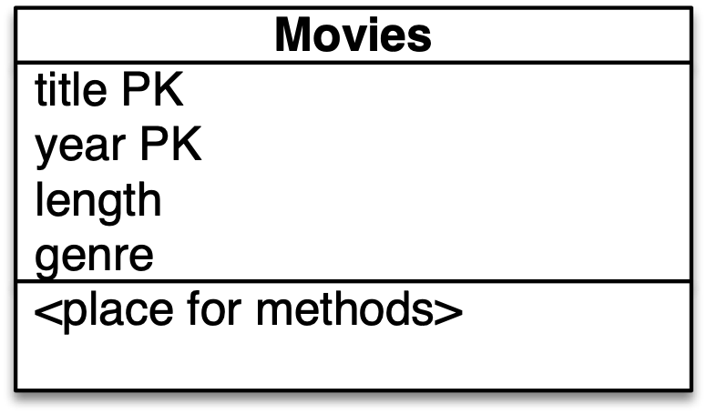
Unified Modeling Language
UML classes
  Classes:
    3 field box
      name
      instance variables (attributes)
      bottom: methods
        Used only in OO relational databases

Slide 75
Unified Modeling Language
UML keys
  Add PK (primary key) after attribute

Slide 76
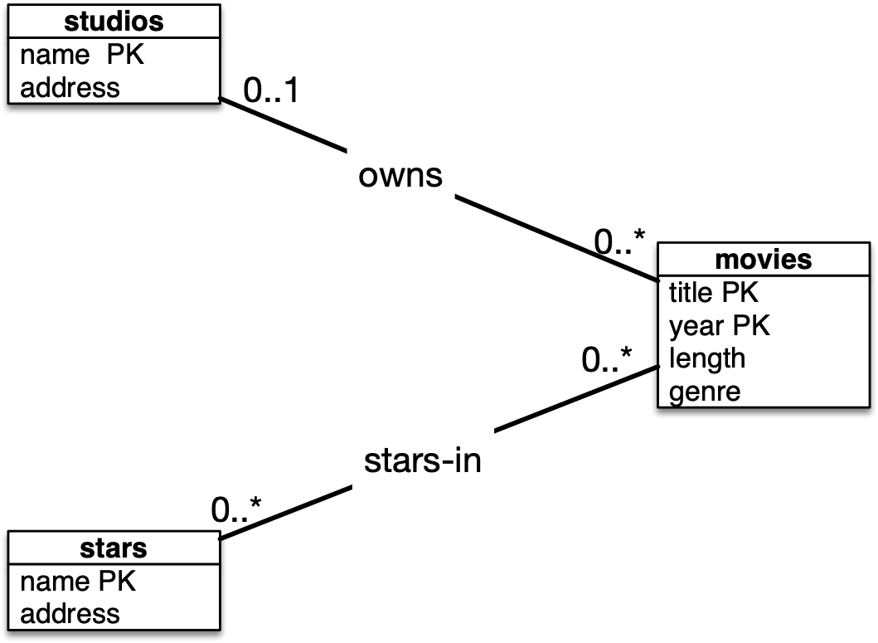
Unified Modeling Language
Binary relationships are called associations
No multiway relationships in UML

Slide 77
Unified Modeling Language
Write down numerical restriction on associations at the other end
  0..1 at most one
    a movie has at most one studio
  0..* any number
    A studio owns any number of movies
    A movie has any number of stars
    A star has any number of movies
  No label means: 1..1 (exactly one)

Slide 78
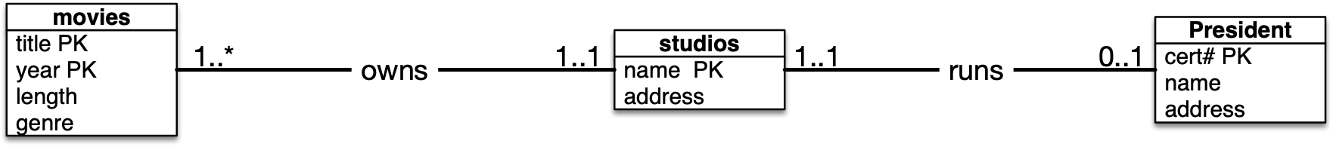
Unified Modeling Language
Each studio has to have at least one movie it owns
Each movie is owned by exactly one studio
Each president runs exactly one studio
Each studio has one or none president

Slide 79
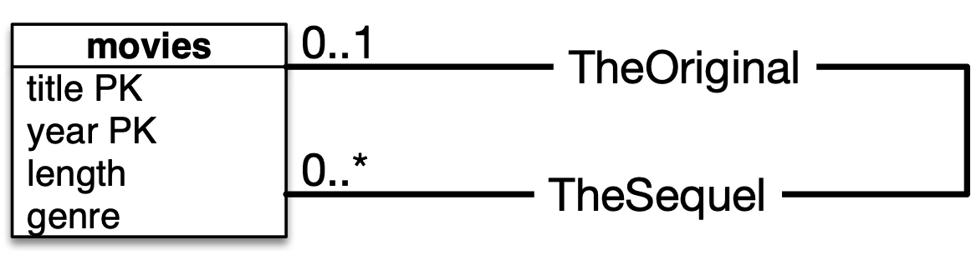
Unified Modeling Language
Each movie can have none, one, or more sequels
Each movie can be the sequel of no movie (it’s not a sequel) or one movie (it is a sequel

Slide 80
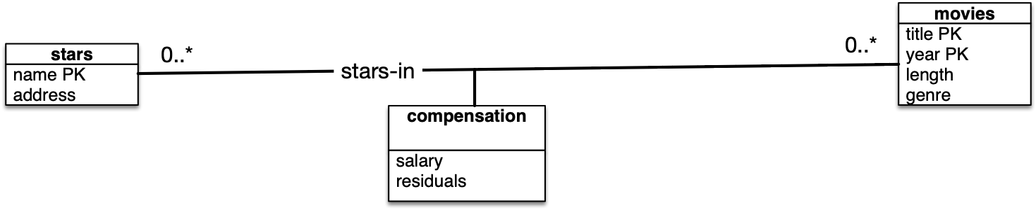
Unified Modeling Language
Association classes
There is no PK for compensation, the PK will be provided by the objects that are associated

Slide 81
Unified Modeling Language
Subclasses in UML
  UML allows four subclass relationships
    Complete versus partial
      Is every object a member of a subclass?
    Disjoint versus overlapping
      Can an object be in two sub-classes?

Slide 82
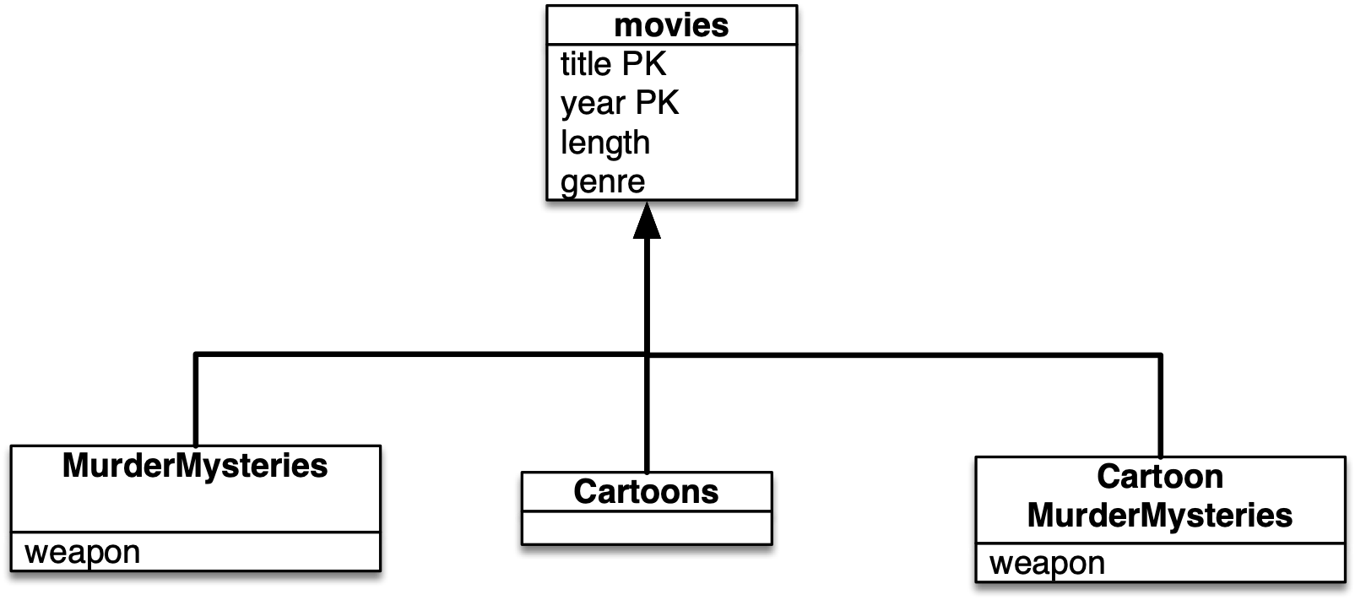
Unified Modeling Language
Subclass objects inherit attributes from the superclass
  The relationship is disjoint, but only partial

Slide 83
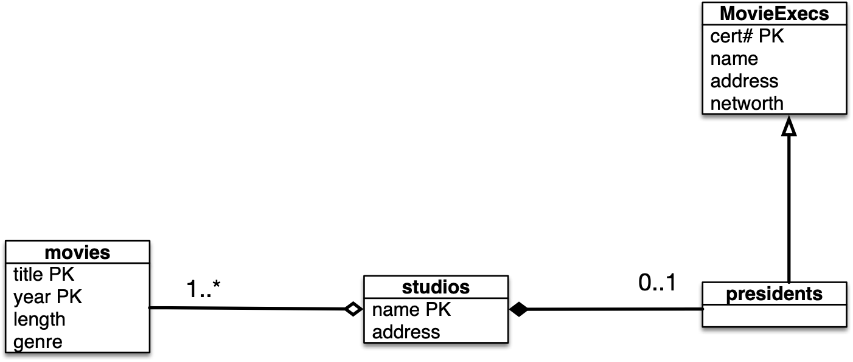
Unified Modeling Language
Aggregation (diamond) — many to one association
Composition(filled diamond) — one-to-one association
  Example:
    Every movie can be associated with at most one studio
    Every president has to have a studio, but not more than one

Slide 84
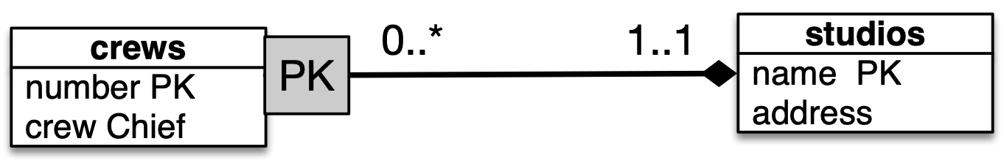
Unified Modeling Language
Equivalent of weak entities:
  Not necessary: In UML objects have their own attributes
  Can use label PK in a composition

Slide 85
Unified Modeling Language
Translating into Relations
  Each class converts into a relation
  Each association converts into a relation with the key attributes of the two connected classes
    Renaming might be necessary
    If there is an association class, relation also has attributes of the association class

Slide 86
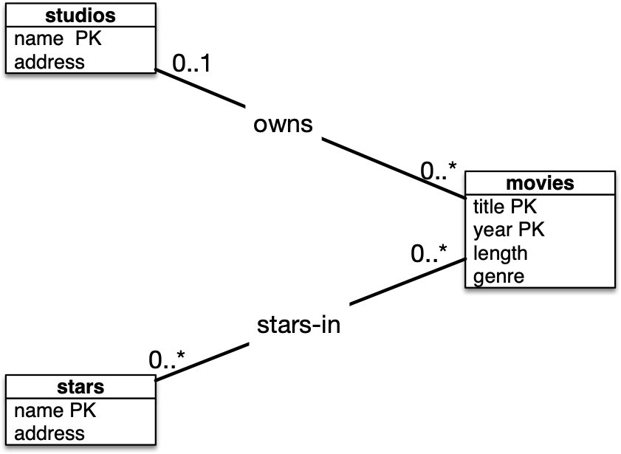
Unified Modeling Language
studios(name, address)
movies(title, year, length, genre)
stars(name, address)
owns(studioName, movieTitle, movieYear)
stars-in(starName, movieTitle, movieYear)

Slide 87
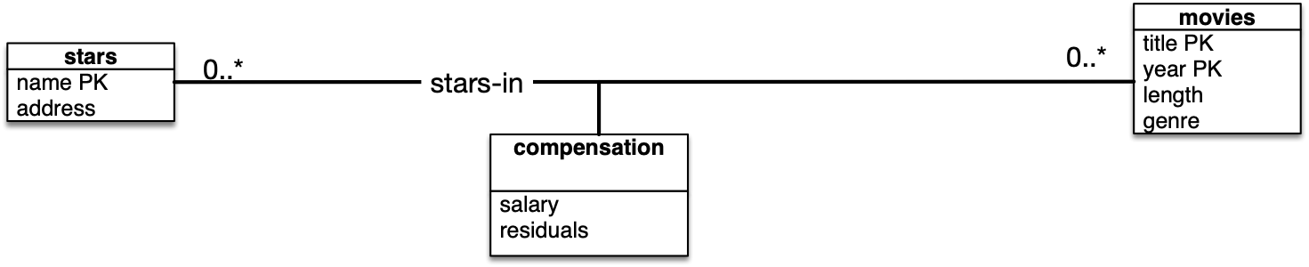
Unified Modeling Language

Slide 88
Unified Modeling Language
Subclasses
  Same possibilities as before:
    Entity/Relationship approach
    OO approach
    Null values

Slide 89

Unified Modeling Language
Use E/R approach

Slide 90
Unified Modeling Language
movies(title, year, length, genre)
studios(name, address)
movieExecs(cert#, name, address networth)
presidents(cert#)
presides(cert#, studioName)
owns(studioName, movieTitle, movieYear)

Slide 91
Unified Modeling Language
movies(title, year, length, genre)
studios(name, address)
movieExecs(cert#, name, address networth)
presidents(cert#)
presides(cert#, studioName)
owns(studioName, movieTitle, movieYear)
Obviously, the presidents relation is superfluous
What about owns?

Slide 92
Unified Modeling Language
Dealing with compositions and associations:
  They are many-to-one relationships
    Incorporate the target relation into the other
    If an aggregation, there might be no additional attributes

Slide 93

Unified Modeling Language
This leads to a simpler database scheme
movies(title, year, length, genre, studioName)
studios(name, address)
movieExecs(cert#, name, address, netWorth)
presides(cert#, studioName)

