Slide 1
No SQL Databases
Thomas Schwarz, SJ

Slide 2
Relational Model Shortcomings
Need: Greater Scalability
  High write throughput / very large datasets
Independence from few vendors — Move towards Open Source
Need for different query operations
Restrictiveness of relational schemas

Slide 3
Data at Very Large Scale
Example: Hush — HBase URL Shortener
  Hand a URL to a Shortener service
  Get a shorter URL back
    E.g. to use in twitter messages
  Shortener provides usage counter for each shortened URLs
  "Vanity URL" that incorporate specific domain names
  Need to maintain users
    log in to create short URLs
    track existing URLs
    see reports for daily, weekly, or monthly usage

Slide 4
Data at Very Large Scale
Data is too large to store at a single server
  But then:
    Limited need for transactions
    Importance of high throughput writes and reads

Slide 5
Data at Very Large Scale
Columnar Layout
  A relational database strategy often adopted in No-SQL databases
  Instead of storing data in tuples
  Store by attribute

Slide 6
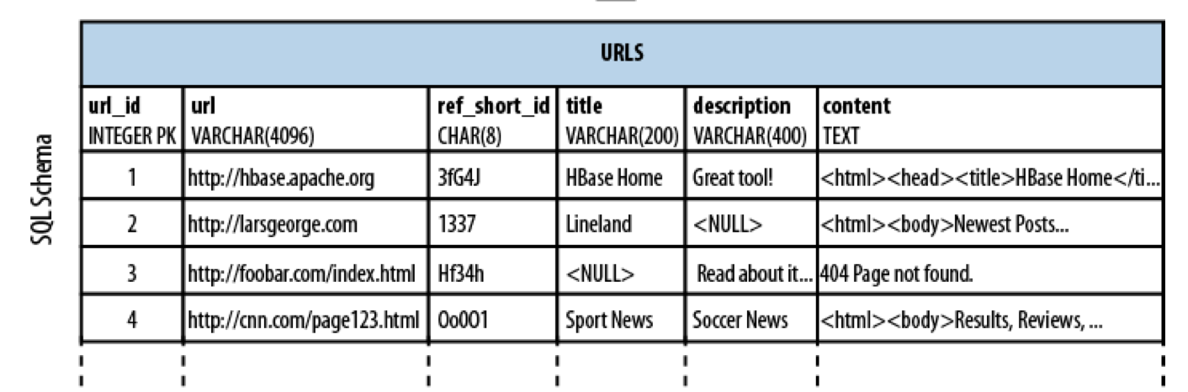
Columnar Layout
Given a SQL Table:
  We project to columns
  We select rows

Slide 7
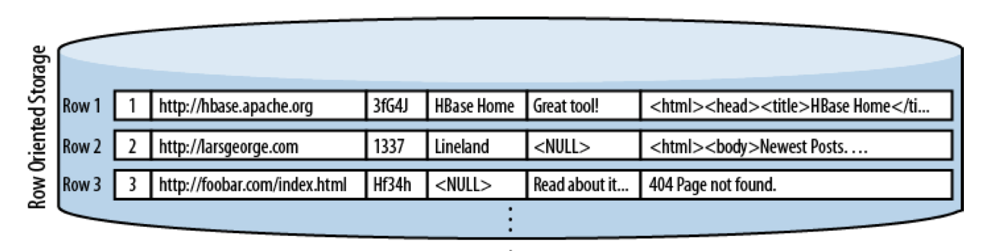
Columnar Layout
We can store it row-by-row

Slide 8
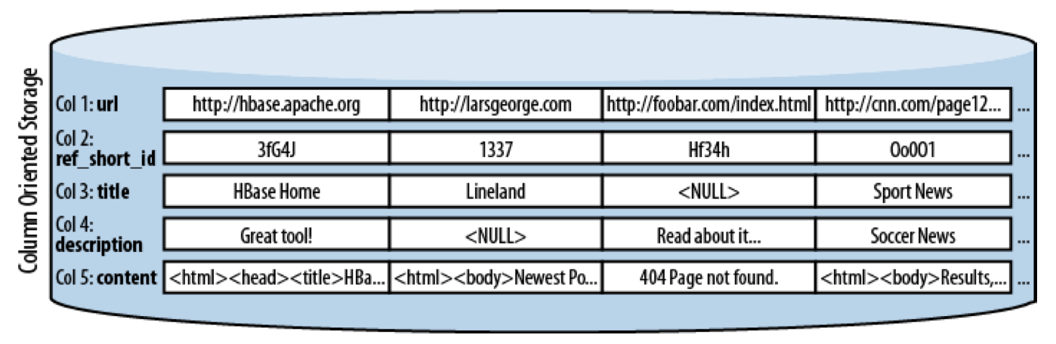
Columnar Layout
Or we can use a columnar layout

Slide 9
Data at Very Large Scale
For large HUSH:
  Can use a relational database
  Use normalization and obtain a scheme

Slide 10
Data at Very Large Scale
To deal with very large data and with high operations volume:
Principles of Denormalization, Duplication, Intelligent Keys
  Denormalize by duplicating data in more than one table
    Avoids aggregation at read time
    Pre-materialize required views

Slide 11
Data at Very Large Scale
Denormalization:
  We normalize to avoid write anomalies
    A given fact is represented in a single value
    A new fact or a changed fact affect a single tuple
    We use joins in order to recombine facts

Slide 12
Data at Very Large Scale
Example:
  Orders has OrderNumber, Dates and Status
  Orderdetails has OrderNumber, Items, Quantities and Prices
  If a status changes: only update one row in orders

Slide 13
Data at Very Large Scale
Example continued
  Price of normalization is joins for a query like:
    “What is the sales volume by a given sales person?”
  Denormalization:
    Join orders and orderdetails on orderNumber
    Creates a write anomaly: If an order is shipped, need to update several rows
    But avoids the join
  You can do this as a materialized view

Slide 14
Data at Very Large Scale
Denormalize, Duplication, Intelligent Keys (DDI) principles
  Aggregate related tables into a big table
    Prefer “tall-narrow” over “flat-wide”
    I.e. many rows, few columns over many columns, few rows
  Select the most suitable key: row key (the intelligent key)
    Candidates can be measured by the amount of times a primary key becomes a foreign key

Slide 15
Data at Very Large Scale
DDI:
  Once a tall-lean table structure is used
  Can define automatic sharding
    Horizontal fragmentation by row-key

Slide 16
Data at Very Large Scale
Example: HBase URL Shortener (Hush)
  user(id, username, credentials, rules, first_name, last_name, email) with unique username constraint
  url(id, url, refShortID, title, description, content)
  shorturl(id, userID, urlID, shortID, refShortID, description) with unique shortID and F.K. userID and urlID
  click(id, datestamp, shortID, category, dimension, counter) with F.K. shortID

Slide 17
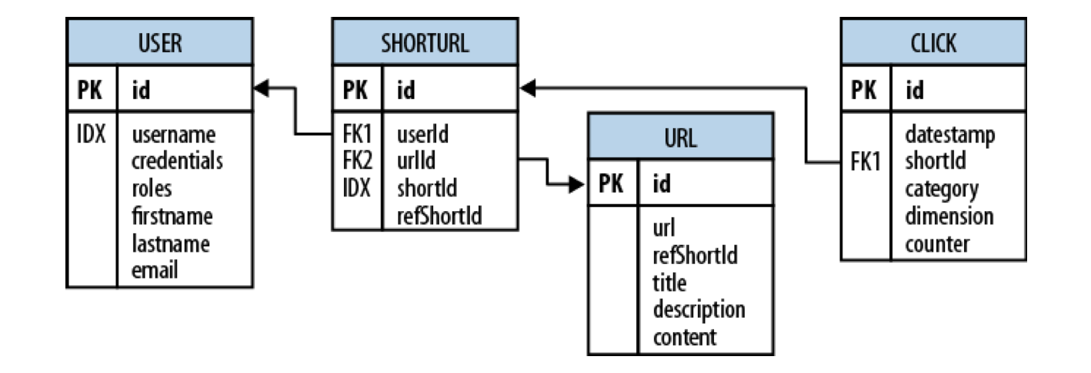
Data at Very Large Scale

Slide 18
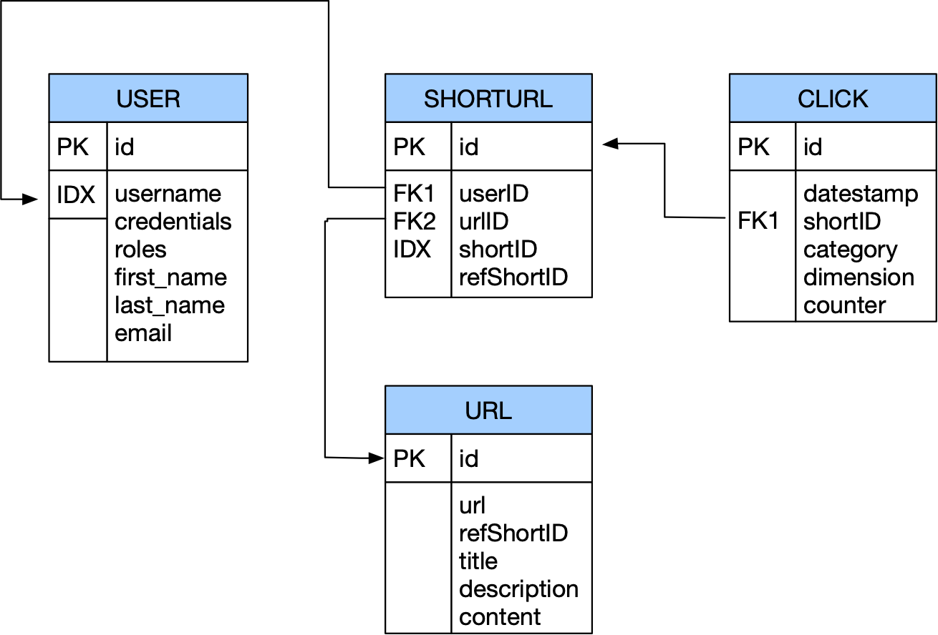
Data at Very Large Scale
Purpose: maps long URLs to short URLs

Slide 19
Data at Very Large Scale
Short URL can be given to others
This is translated to the full URL

Slide 20
Data at Very Large Scale
Each click is tracked, which aggregates to weekly usage numbers

Slide 21

Data at Very Large Scale
All these operations require joins

Slide 22
Data at Very Large Scale
Bandwidth problem
  Especially for joins
  Need to store data in joins together, not look them up separately
  But can relax on the consistency model:
    No need to serialize short URL creation or URL translations or have atomic updates
  Might be able to relax integrity constraints
    Statistics need to be approximately correct

Slide 23
Data at Very Large Scale
Denormalization:
  Key idea: Store data together that is likely to be joined
  Means:
    massive duplication of data
    relaxed consistency needed
    but faster reads / writes

Slide 24
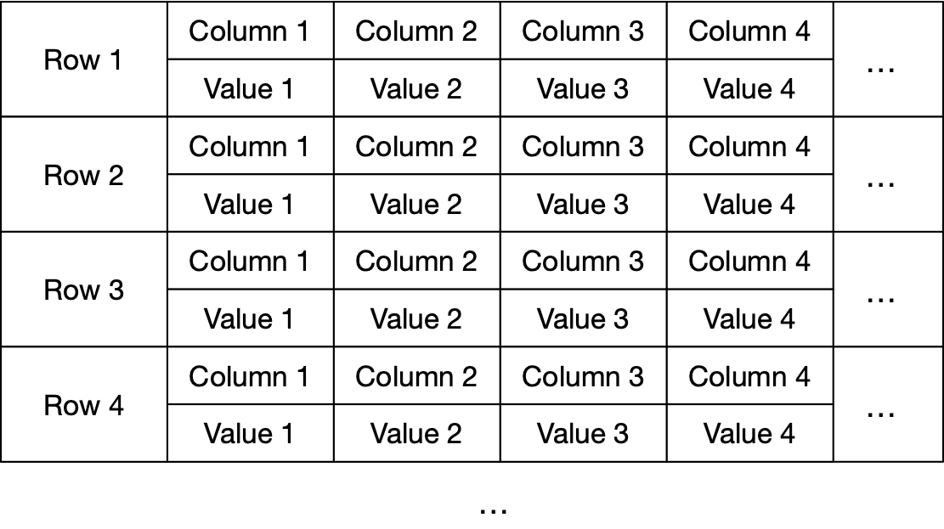
Fundamental Ideas
Wide column stores
  names and format of columns can vary from row to row
  Each row is a key-value pair
  First implemented with Google's BigTable
  Implemented by Cassandra, HBase, MS Azure Cosmos DB, …

Slide 25
Fundamental Ideas
Document databases
  Uses a format like JSON document
  MongoDB, XML databases

Slide 26
Fundamental Ideas
Key-value database
  Every record is a key-value pair
  A large set of tools predating no-sql databases in general

Slide 27
Fundamental Ideas
Graph databases
  Navigational database successor:
    information about data interconnectivity or topology as important as data itself
  See below for an example

Slide 28
NoSQL Consistency
Consistency Levels for NoSQL databases
  Strict: changes to data are atomic and (appear to) take effect immediately
  Sequential: every client sees all changes in the same order in which they are applied
  Causal: all changes that are casually related are observed in the same order by all clients
  Eventual: When no updates occur for a while, then all pending updates will occur and all replicas are consistent
  Weak: No guarantee is made

Slide 29
CAP Theorem
A distributed system can only achieve two out of the three goals of
  Consistency
  Availability
  Partition Tolerance
A. Fox and E. A. Brewer, "Harvest Yield and Scalable Tolerant Systems", Proc. 7th Workshop Hot Topics in Operating Systems (HotOS 99) IEEE CS, pp. 174-178, 1999.
Brewer, Eric. "CAP twelve years later: How the" rules" have changed." Computer 45.2 (2012): 23-29.

Slide 30
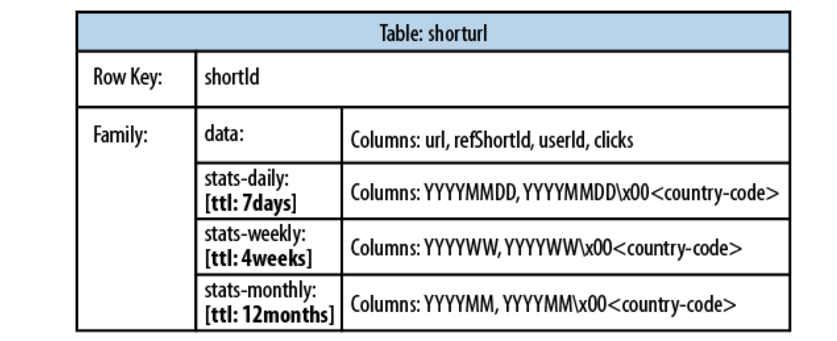
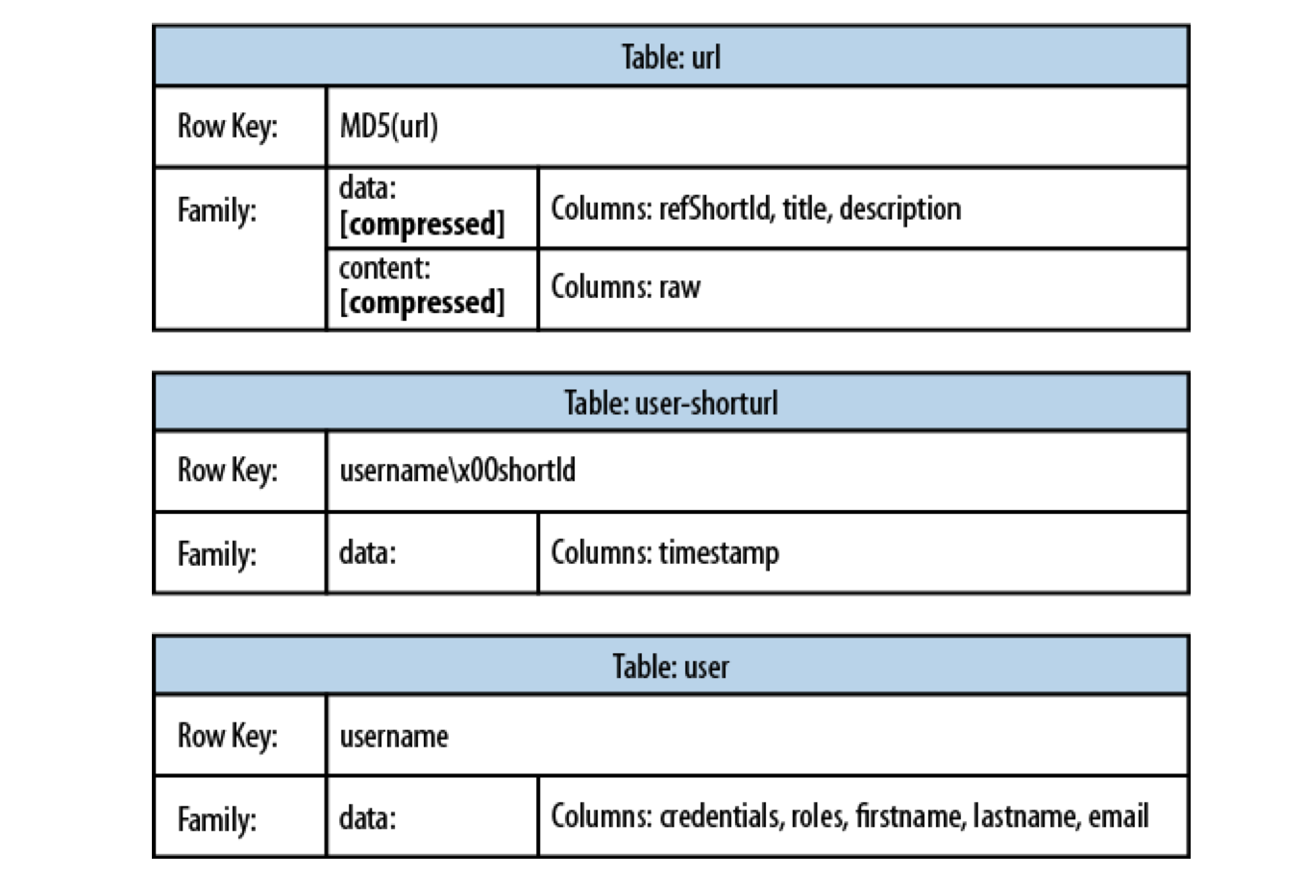
Example: HURL
HBase:

Slide 31
Alternatives to Relational Schemes: XML
Data is often structured hierarchically
Invoice = {
date : "2008-05-24"
invoiceNumber : 421
InvoiceItems : {
Item : {
description : "Wool Paddock Shet Ret Double Bound Yellow 4'0"
quantity : 1
unitPrice : 105.00
}
Item : {
description : "Wool Race Roller and Breastplate Red Double"
quantity : 1
unitPrice : 75.00
}
Item : {
description : "Paddock Jacket Red Size Medium Inc Embroidery"
quantity : 2
unitPrice : 67.50
}
}
}

Slide 32
Alternatives to Relational Schemes: XML
As an XML document
<invoice>
<number>421</number>
<date>2008-05-24</date>
<items>
<item>
<description>Wool Paddock Shet Ret Double Bound Yellow 4'0"</description>
<quantity>1</quantity>
<unitPrice>105.00</unitPrice>
</item>
<item>
<description>Wool Race Roller and Breastplate Red Double</description>
<quantity>1</quantity>
<unitPrice>75.00</unitPrice>
</item>
<item>
<description>Paddock Jacket Red Size Medium Inc Embroidery</description>
<quantity>2</quantity>
<unitPrice>67.50</unitPrice>
</item>
</items>
</invoice>

Slide 33
Alternatives to Relational Schemes: XML
Advantage of XML
  Faster to scan all data
  No joins
Disadvantages of XML
  Each record contains the full or an abbreviated scheme
  Each query needs to select from big chunks of data

Slide 34
Alternatives to Relational Schemes: JSON
JSON — JavaScript Object Notation
  Human-readable
  Organized as key-value pairs

Slide 35
Alternatives to Relational Schemes: JSON
JSON record example
{
"firstName": "John",
"lastName": "Smith",
"isAlive": true,
"age": 27,
"address": {
"streetAddress": "21 2nd Street",
"city": "New York",
"state": "NY",
"postalCode": "10021-3100"
},
"phoneNumbers": [
{
"type": "home",
"number": "212 555-1234"
},
{
"type": "office",
"number": "646 555-4567"
},
{
"type": "mobile",
"number": "123 456-7890"
}
],
"children": [],
"spouse": null
}

Slide 36
Alternatives to Relational Schemes: JSON
JSON can use a schema (type definition)
JSON was first used for data transmission as a data serialization format

Slide 37
Alternatives to Relational Schemes: JSON
Many-to-One and Many-to-Many Relationships
  Modeled by the same value for the same key
    Problem: Need to standardize / internationalize these values
    Using id-s instead of plain text to avoid problems
    Table of id-s reintroduce a relational scheme through a backdoor

Slide 38
Alternatives to Relational Schemes: JSON
Resumé
  Users present people
  People have jobs, education, and recommenders
But they share jobs, companies, degrees, schools, recommenders
  Should they stay text strings or become entities?
    Latter allows to add information to all resumés
If recommenders get a photo, then all resumés should be updated with this photo, so better to make recommenders entities

Slide 39
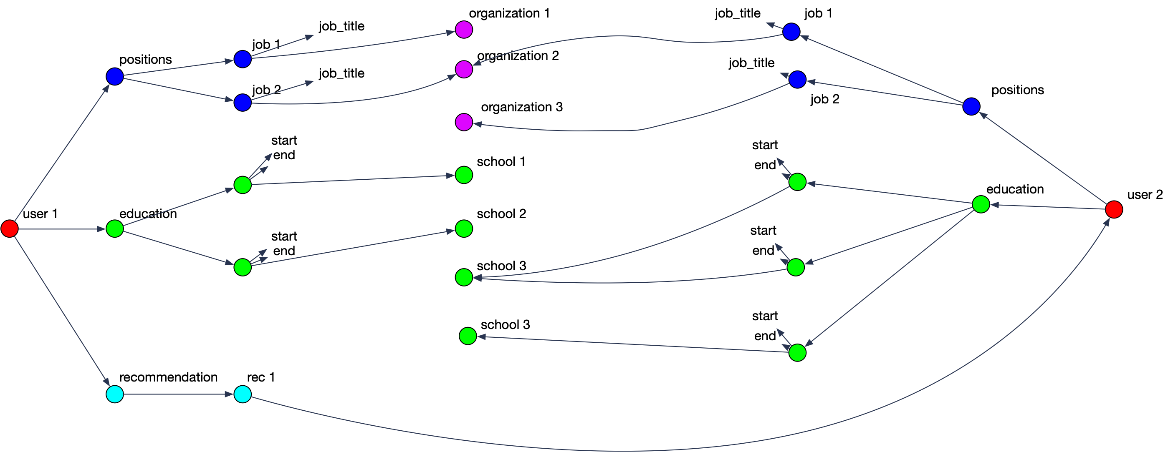
Alternatives to Relational Schemes: JSON
Data has a tendency to become less-join free

Slide 40
Document Databases
Records are documents
  Encode in
    XML
    YAML
    JSON
    BSON (Mongo DB)
  CRUD operations: create, read, update, delete

Slide 41
Document Databases
Enforcing schema
  Most document databases do not enforce schema
    —> “Schemaless”
    In reality: “Schema on Read”
    RDBMS would then use “Schema on Write”
Allows schema updates in simple form

Slide 42
Document Databases
Schema on Read:
  Advantages:
    Data might come from external sources
  Disadvantages:
    No data checking

Slide 43
Document Databases
Document database support
  Most commercial database systems now support XML databases

Slide 44
Map Reduce
Data at Scale

Slide 45
History
A simple paradigm that popped up several times as paradigm
Observed by google as a software pattern:
  Data gets filtered locally and filtered data is then reassembled elsewhere
  Software pattern: Many engineers are re-engineering the same steps
Map-reduce:
    Engineer the common steps efficiently
    Individual problems only need to be engineered for what makes them different

Slide 46
History
Open source project (in part sponsored by Yahoo!)
  Java-based Hadoop
  Eventually a first tier Apache Foundation project
Other projects at higher level: Pig, Hive, HBase, Mahout, Zookeeper
  Use Hadoop as foundation
  Hadoop is becoming a distributed OS

Slide 47
Map Reduce Paradigm
Input: Large amount of data spread over many different nodes
Output: A single file of results
Two important phases:
  Mapper: Records are processed into key-value pairs. Mapper sends key-value pairs to reducers
  Reducer: Create final answer from mapper

Slide 48
Simple Example
Hadoop Word Count
  Given different documents on many different sites
    Mapper:
      Extract words from record
      Combines words and generates key-value pairs of type word: key
      Sends to the reducers based on hash of key
    Reducer:
      Receives key-value pairs
      Adds values for each key
      Sends accumulated results to aggregator - client

Slide 49
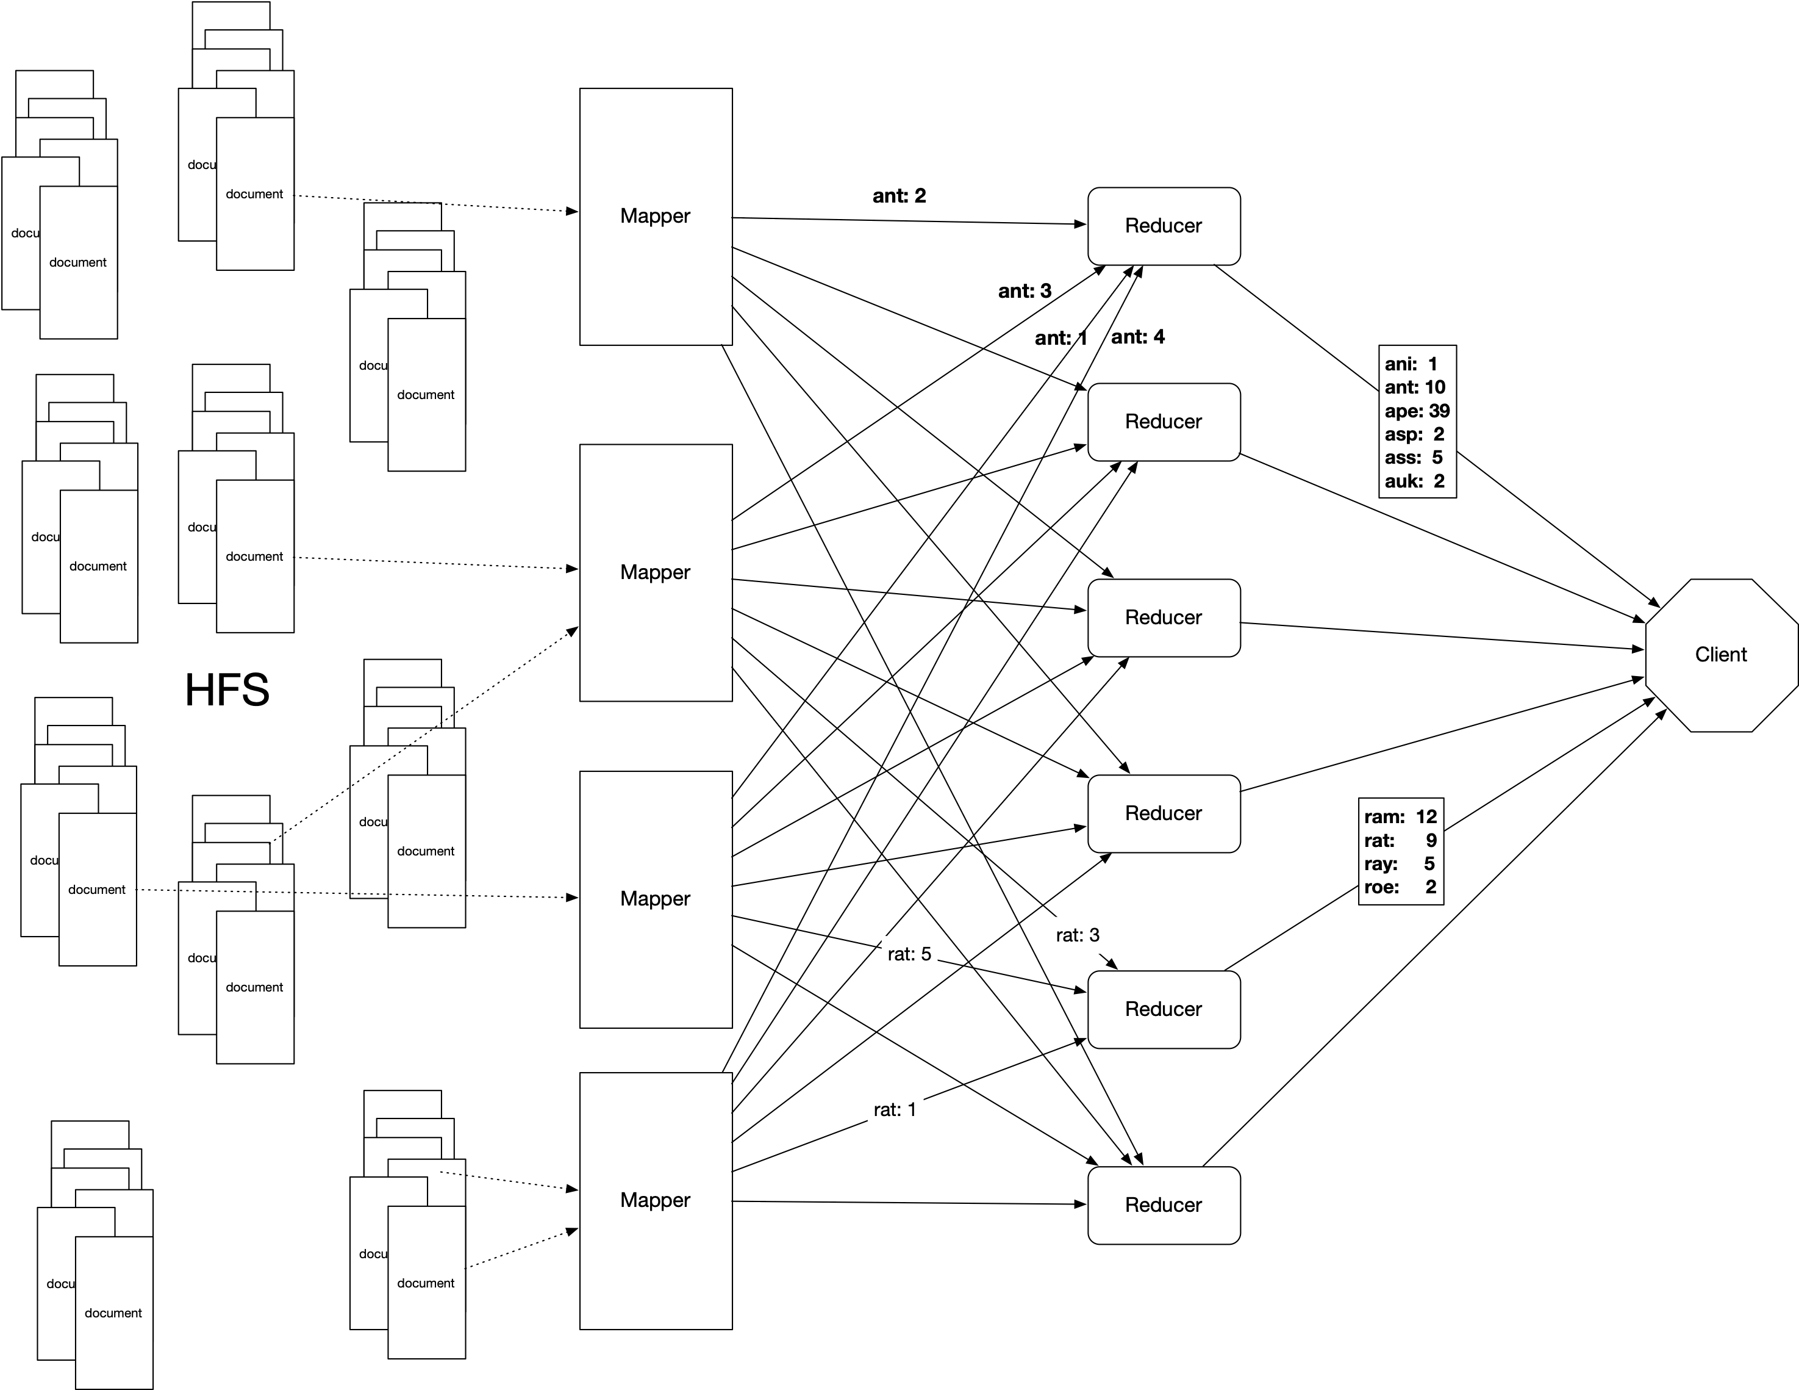

Slide 50
Map-reduce paradigm in detail
The simple mapper -reducer paradigm can be expanded into several, typical components

Slide 51
Map Reduce in Detail
Mapper:
  Record Reader
    Parses the data into records
    Example: Stackoverflow comments.
      <row Id="5" PostId="5" Score="2" Text="Programming in Portland, cooking in Chippewa ; it makes sense that these would be unlocalized. But does bicycling.se need to follow only that path? I agree that route a to b in city x is not a good use of this site; but general resources would be." CreationDate="2010-08-25T21:21:03.233" UserId="21" />
    Record reader extract the “Text=” string
    Passes record into a key-value format to rest of mapper

Slide 52
Map Reduce in Detail
Mapper
  map
    Produces “intermediate” key-value pairs from the record
    Example:
      "Programming in Portland, cooking in Chippewa ; it makes sense that these would be unlocalized. But does bicycling.se need to follow only that path? I agree that route a to b in city x is not a good use of this site; but general resources would be.”
      Map produces: <programming: 1> <in: 1> <Portland: 1> <cooking: 1> <in: 1> …

Slide 53
Map Reduce in Detail
Mapper
  Combiner — a local reducer
    Takes key-value pairs and processes them
    Example:
      Map produces: <programming: 1> <in: 1> <Portland: 1> <cooking: 1> <in: 1> …
      Combiner combines words: <programming: 1> <in: 4> <Portland: 3> …

Slide 54
Map Reduce in Detail
Combiners allow us to reduce network traffic
  By compacting the same infomrmation

Slide 55
Map Reduce in Detail
Mapper
  Partitioner
    Partitioner creates shards of the key-value pairs produced
    One for each reducer
    Often uses a hash function or a range
    Example:
      md5(key) mod (#reducers)

Slide 56
Map Reduce in Detail
Reducer
  Shuffle and Sort
  Part of the map-reduce framework
    Incoming key-value pairs are sorted by key into one large data list
    Groups keys together for easy agglomeration
    Programmer can specify the comparator, but nothing else

Slide 57
Map Reduce in Detail
Reducer
  reduce
    Written by programmer
    Works on each key group
    Data can be combined, filtered, aggregated
    Output is prepared

Slide 58
Map Reduce in Detail
Reducer
  Output format
    Formats final key-value pair

Slide 59
Map Reduce Patterns
Summarizations
  Input: A large data set that can be grouped according to various criteria
  Output: A numerical summary
  Example:
    Calculate minimum, maximum, total of certain fields in documents in xml format ordered by user-id

Slide 60
Summarization
Example:
  Given a database in xml-document format
  Determine the earliest, latest, and number of posts for each user
<row Id="193" PostTypeId="1" AcceptedAnswerId="194" CreationDate="2010-10-23T20:08:39.740" Score="3" ViewCount="30" Body="&lt;p&gt;Do you lose one point of reputation when you down vote community wiki? Meta? &lt;/p&gt;&#xA;&#xA;&lt;p&gt;I know that you do for &quot;regular questions&quot;. &lt;/p&gt;&#xA;" OwnerUserId="134" LastActivityDate="2010-10-24T05:41:48.760" Title="Do you lose one point of reputation when you down vote community wiki? Meta?" Tags="&lt;discussion&gt;" AnswerCount="1" CommentCount="0" />

Slide 61
Summarization
Mapper:
  Step 1: Preprocess document by extracting the user ID and the date of the post
  Step 2: map:
    User ID becomes the key.
    Value stores the date twice in Java-date format and adds a long value of 1
“134”: (2010-10-23T20:08:39.740, 2010-10-23T20:08:39.740, 1)

Slide 62
Summarization
Mapper:
  Step 3: Combiner
    Take intermediate User-ID — value pairs
    Combine the value pairs
      Combination of two values:
        first item is minimum of the dates
        second item is maximum of the dates
        third item is sum of third items

Slide 63
Summarization
The map reduce framework is given the number of reducers
  Autonomously maps combiner results to reducers
  Each reducer gets key-value parts for a range of user-IDs grouped by user-ID

Slide 64
Summarization
Reducer:
  Passes through each group combining key-value pairs
  End-result:
    Key-value pair with key = user-id
    Value is a triple with
      minimum posting date
      maximum posting date
      number of posts

Slide 65
Summarization
Reducer:
  Each summary key— value pair is sent to client

Slide 66
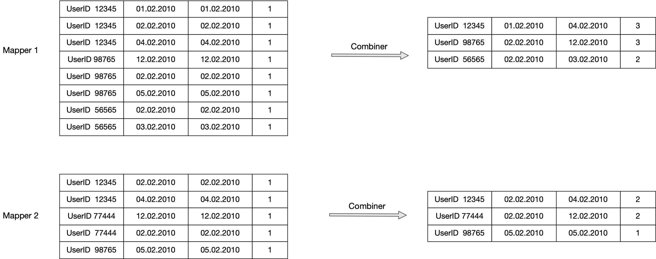
Summarization
Example (cont.)

Slide 67
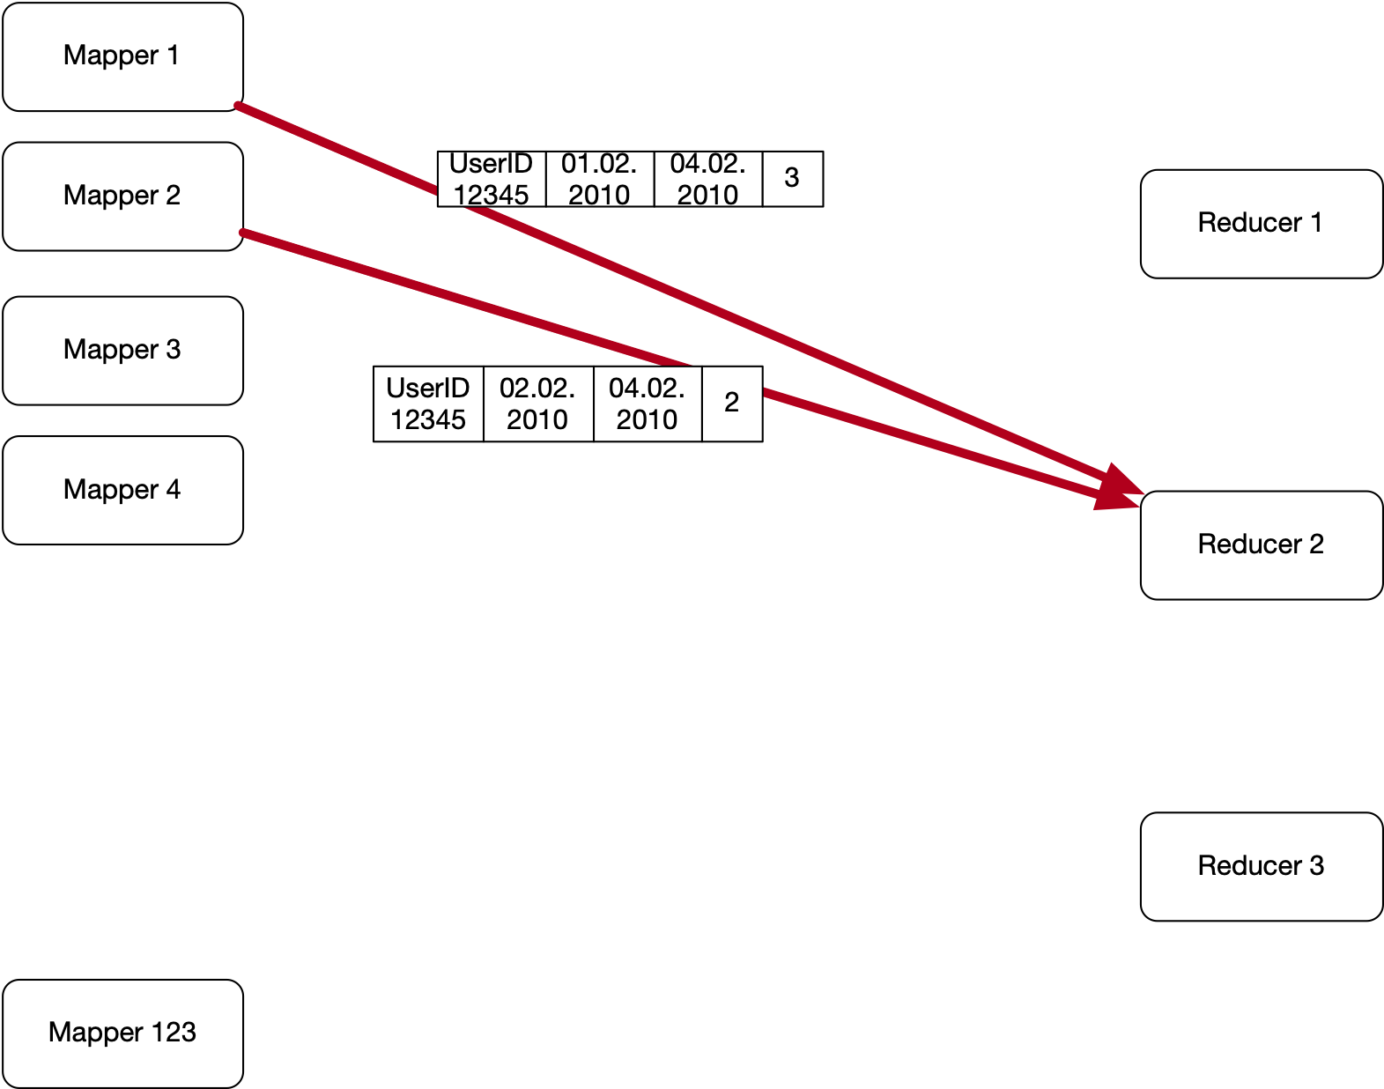
Summarization
Example (cont.) Automatic Shuffle and Sort
  Records with the same key are sent to the same reducer

Slide 68
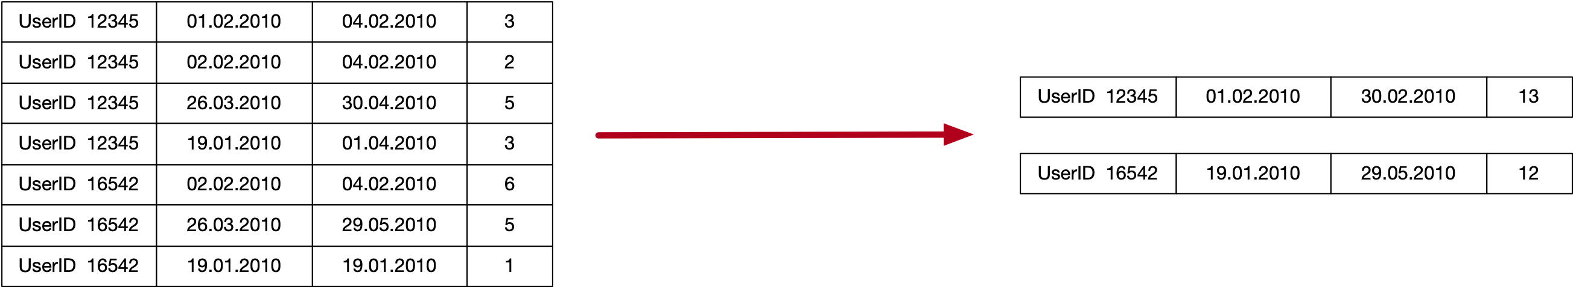
Summarization
Example (cont.)
  Reducer receives records already ordered by user-ID
  Combines records with same key

Slide 69
Summarization
In (pseudo-)pig:
  Load data
posts = LOAD ‘/stackexchange/posts.tsv.gz'
USING PigStorage('\t') AS (
post_id : long,
user_id : int,
text : chararray,
…
post : date
)

Slide 70
Summarization
In (pseudo-)pig:
  Group by user-id
  Obtain min, max, count:
post_group = GROUP posts BY user_id;
result = FOREACH post_group GENERATE group,
MIN(posts.date), MAX(posts.date),
COUNT_STAR(post_group)

Slide 71
Summarization
In (pseudo-)pig:
  Load data
orders = LOAD ‘/stackexchange/posts.tsv.gz'
USING PigStorage('\t') AS (
post_id : long,
user_id : int,
text : chararray,
…
post : date
)

Slide 72
Summarization
Your turn:
  Calculate the average score per user
  The score is kept in the “score”-field

Slide 73
Summarization
Solution:
  Need to aggregate sum of score and number of posts
  Mapper: for each user-id, create a record with score
  Combiner adds scores and counts
  Reducer combines as well
  Generates output key-value pair and sends it to the user
userid: score, 1
userid: sum_score, count
userid: sum_score/count

Slide 74
Summarization
Finding the median of a numerical variable
  Mapper aggregates all values in a list
  Reducer aggregates all values in a list
  Reducer then determines median of the list
Can easily run into memory problems

Slide 75
Summarization
Median calculation:
  Can compress lists by using counts
    becomes
    Combiner creates compressed lists
    Reducer code directly calculates median
      An instance where combiner and reducer use different code
2, 3, 3, 3, 2, 4, 5, 2, 1, 2
(1,1), (2,4), (3,3), (4,1) (5,1)

Slide 76
Summarization
Standard Deviation
  Square-root of variance
  Variance — Average square deviation from average
    Leads to a two pass solution, calculate average first
$$σ=\sqrt{\frac{1}{N}\overset{N}{\underset{i=1}{∑}}(x_{i}-\overline{x})^{2}}$$

Slide 77
Summarization
Standard Deviation
  Numerically dangerous one-path solution
$$σ_{x}^{2}=\frac{1}{N}\overset{N}{\underset{i=1}{∑}}(x_{i}-\overline{x})^{2}$$
$$=\frac{1}{N}\overset{N}{\underset{i=1}{∑}}(x_{i}^{2}-2\overline{x}x_{i}+{\overline{x}}^{2})$$
$$=\frac{1}{N}\overset{N}{\underset{i=1}{∑}}x_{i}^{2}-2\overline{x}\frac{1}{N}\overset{N}{\underset{i=1}{∑}}x_{i}+{\overline{x}}^{2}$$
$$=\frac{1}{N}\overset{N}{\underset{i=1}{∑}}x_{i}^{2}-2{\overline{x}}^{2}+{\overline{x}}^{2}=\frac{1}{N}\overset{N}{\underset{i=1}{∑}}x_{i}^{2}+{\overline{x}}^{2}$$

Slide 78
Summarization
Chan’s adaptation of Welford’s online algorithm
  Using the counts of elements, can calculate the variance in parallel from any number of partitions
  Unfortunately, can still be numerically instable
def parallel_variance(avg_a, count_a, var_a, avg_b, count_b, var_b):
delta = avg_b - avg_a
m_a = var_a * (count_a - 1)
m_b = var_b * (count_b - 1)
M2 = m_a + m_b + delta ** 2 * count_a * count_b / (count_a + count_b)
return M2 / (count_a + count_b - 1)

Slide 79
Summarization
Standard Deviation:
  Schubert & Gertz: Numerically Stable Parallel Computation of (Co)-Variance
    SSDBM '18 Proceedings of the 30th International Conference on Scientific and Statistical Database Management

Slide 80
Summarization
Inverted Index
  Analyze each comment in StackOverflow to find hyperlinks to Wikipedia
  Create an index of wikipedia pages pointing to StackOverflow comments that link to them

Slide 81
Summarization
Inverted Index is a group-by problem solved almost entirely in the map-reduce framework

Slide 82
Summarization /
Inverted Index
Mapper
  Parser:
    Processes posts
    Checks for right type of post, extracts a list of wikipedia urls (or Null if there are none)
    Outputs key-value pairs :
      Keys: wikipedia url
      Value: row-ID of post
    Optional combiner:
      Aggregates values for a wikipedia url in a single list

Slide 83
Summarization /
Inverted Index
Reducer
  Aggregates values belonging to the same key in a list

Slide 84
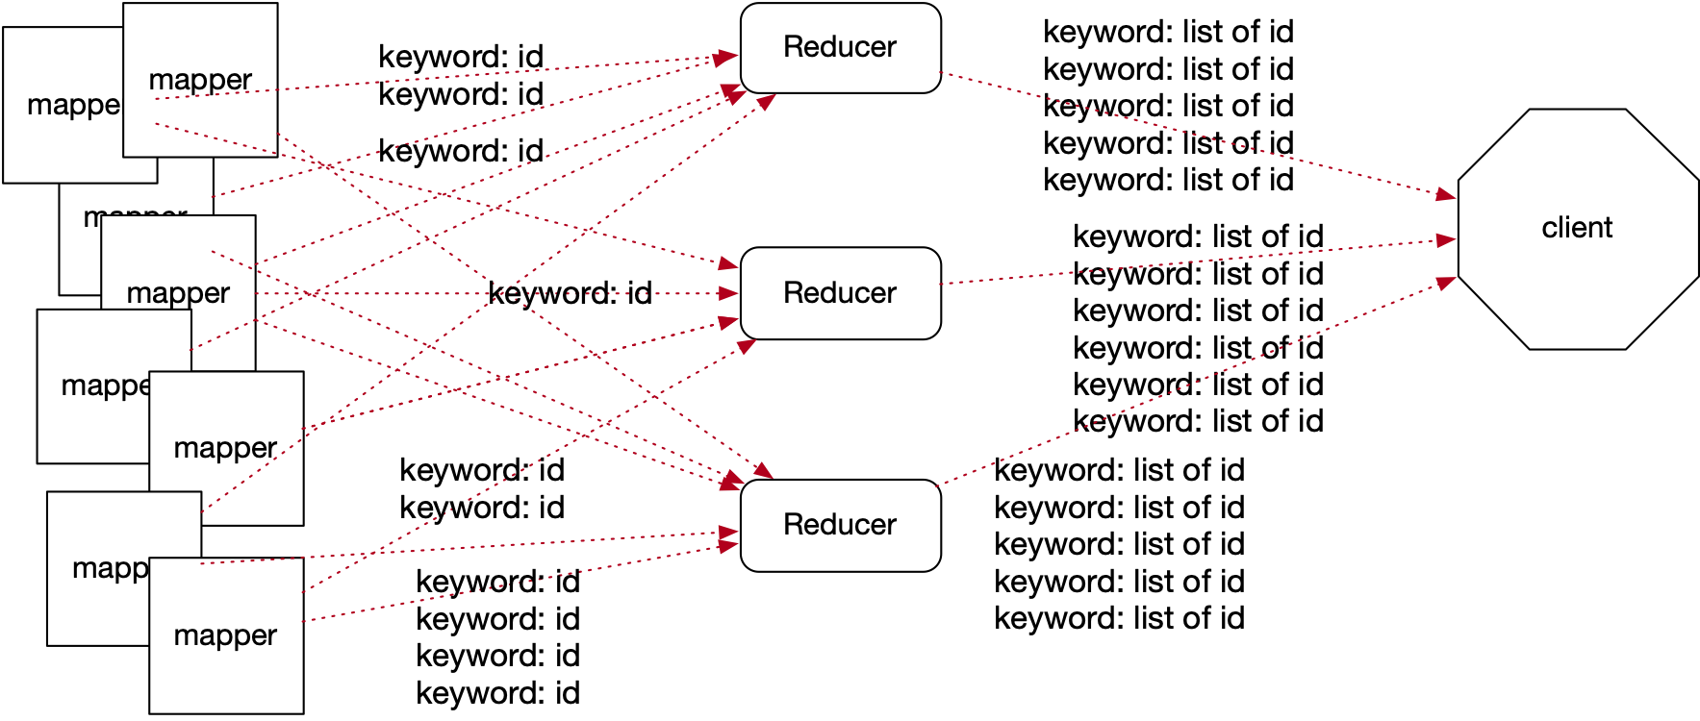
Summarization /
Inverted Index
Generic Inverted Index diagram

Slide 85
HBase
Based on BigTable (Google 2006)
Uses ideas of Map-reduce and Google File System (replication)

Slide 86
HBase
Basic unit is a column (value)
  Each column can have different versions, each stored in a separate cell
Columns form rows (with row identifier)
  Groups of columns are formed in families
  Columns accessed by family : qualifier pairs
Rows are sorted lexicographically by row key

Slide 87
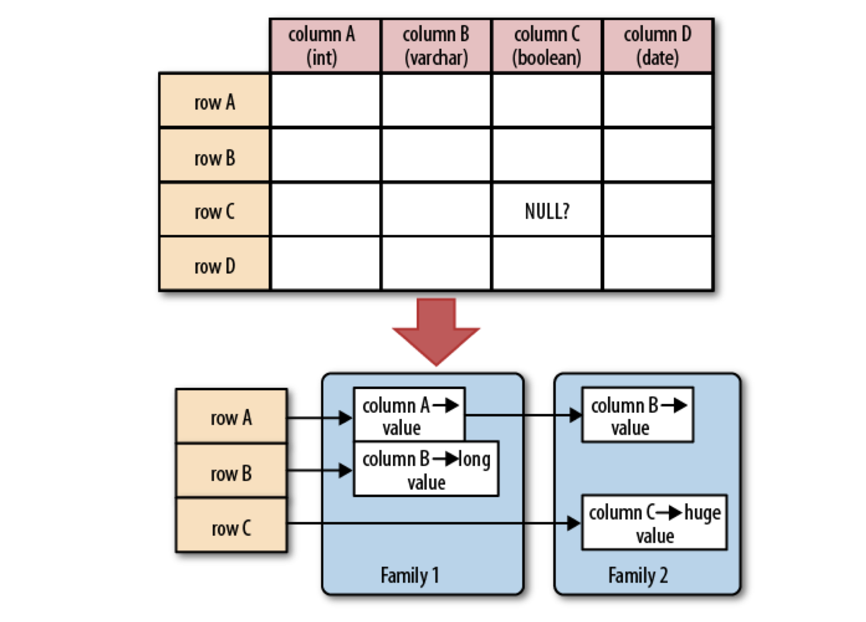
HBase

Slide 88
HBase
Conceptually:
  HBase table looks like a relational database table
  But access is organized via tags:

Slide 89
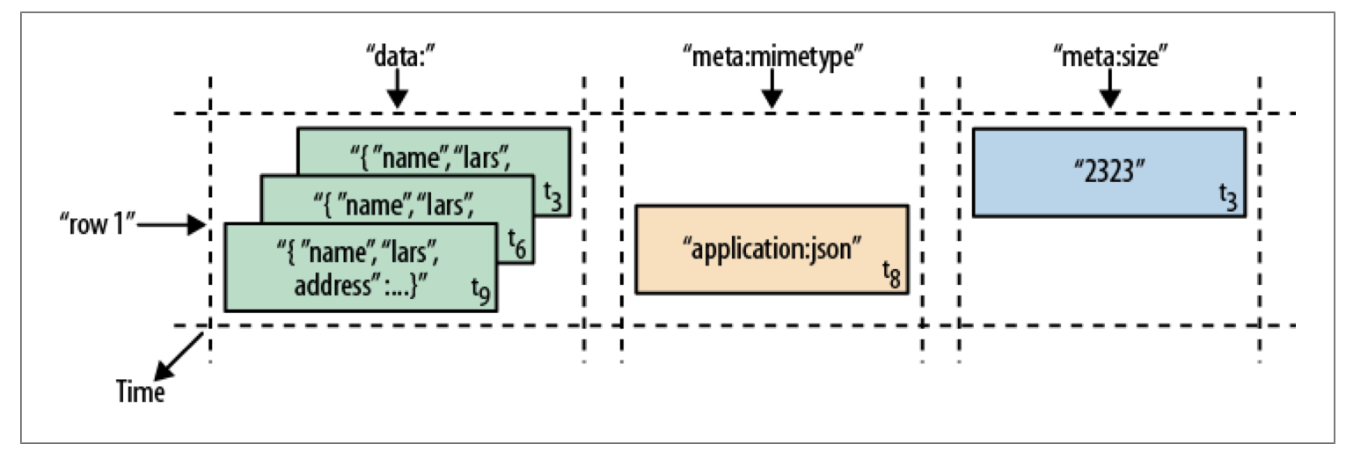
HBase
API allows you to filter data based on conditions on the time

Slide 90
HBase
Canonical example is the WebTable:
  Pages obtained crawling the internet
    Row key is the URL (in reverse order)
      Contents family: HTTP
      Anchor family: out-going urls
Time dimension allows to find pages that are updated frequently

Slide 91
HBase
Actual storage is in regions
  A region is a contiguous collection of rows and columns
  If a region becomes to big: Split it around a middle row key
Typical region size is a few GBs
Each server should have between 100 and 10,000 regions

Slide 92
HBase
API:
  Allows creation / deletion of tables
  Allows CRUD access
  Scan API
  Supports single-row transactions, but not cross-row transactions
  Map-reduce framework allows to use tables as input sources

Slide 93
HBase
Storage implementation:
  Data is stored in HFiles
    HFiles have a block index:
      Can find a row in an HFile with a single disk seek
    HFiles are immutable
  Files are stored in the Hadoop Distributed File System (HDFS)

Slide 94
HBase
To delete a value:
  Need to use a delete marker with the key (tombstone marker)
  Periodically: Go through HFiles are rewrite them, leaving out deleted rows

Slide 95
Query Languages
Documents lend themselves to object-oriented querying
  Imperative code
SQL is declarative:
  Programmer explains a solution
  System figures out the best way to find the solution
Use declarative query languages for document databases

Slide 96
Query Languages
Map-Reduce (neither declarative nor imperative):
  Consists of only two pieces of code
    Mapping: Selecting from Documents
    Reducing: Take selection elements and operate on them

Slide 97
Alternatives to Relational Schemes: Graph Models
Graphs consists of vertices and edges
  Example:
    Social graphs: vertices are people and edges are relationships such “knows”
    Web graph: vertices are pages and edges are links
    Road networks: vertices are places and edges are connections

Slide 98
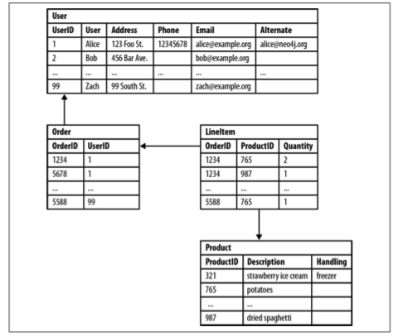
Alternatives to Relational Schemes: Graph Models
Relational Database hides semantic relationships

Slide 99
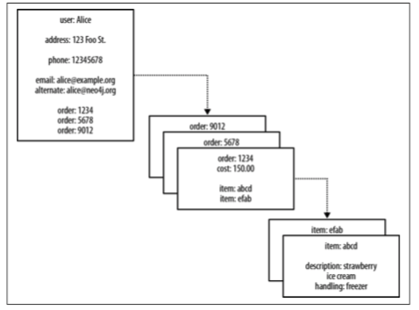
Alternatives to Relational Schemes: Graph Models
Document model hides semantic relationships

Slide 100
Alternatives to Relational Schemes: Graph Models
Some property values are really references to foreign aggregates
  Aggregate’s identifier is a foreign key
Relationships between them are not explicitly accessible
  Joining aggregates becomes expensive

Slide 101
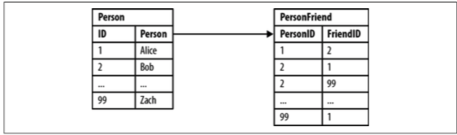
Alternatives to Relational Schemes: Graph Models
Relational Database
  Some queries are simple:
  SELECT p1.Person
  FROM Person p1 JOIN PersonFriend
  ON PersonFriend.FriendID = p1.ID JOIN Person p2
  ON PersonFriend.PersonID = p2.ID WHERE p2.Person = 'Bob'

Slide 102
Alternatives to Relational Schemes: Graph Models
Relational Database
  Some queries are more involved: Friends of Bob
  SELECT p1.Person
  FROM Person p1 JOIN PersonFriend
  ON PersonFriend.PersonID = p1.ID JOIN Person p2
  ON PersonFriend.FriendID = p2.ID
  WHERE p2.Person = 'Bob'

Slide 103
Alternatives to Relational Schemes: Graph Models
Relational Database
  Some queries others are difficult: Alice’s friends of friends
  SELECT p1.Person AS PERSON, p2.Person AS FRIEND_OF_FRIEND FROM PersonFriend pf1 JOIN Person p1
  ON pf1.PersonID = p1.ID JOIN PersonFriend pf2
  ON pf2.PersonID = pf1.FriendID JOIN Person p2
  ON pf2.FriendID = p2.ID
  WHERE p1.Person = 'Alice' AND pf2.FriendID <> p1.ID

Slide 104
Alternatives to Relational Schemes: Graph Models
Property graph model by Neon
  Each vertex consists of
    A unique identifier
    A set of outgoing edges
    A set of incoming edges
    A collection of properties — key-value pairs
  Each edge consists of
    A unique identifier
    The tail vertex
    The head vertex
    A label to describe the relationship
    A collection of properties — key-value pairs

Slide 105
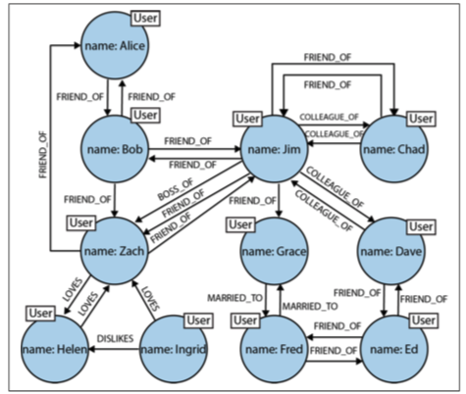
Alternatives to Relational Schemes: Graph Models

Slide 106
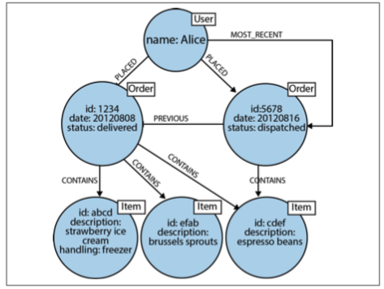
Alternatives to Relational Schemes: Graph Models
Order history as a property graph

Slide 107
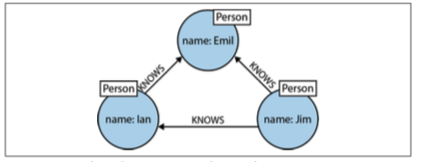
Alternatives to Relational Schemes: Graph Models
Processing queries in Neo4j
  Use Cypher (from “The matrix”)
  Can describe a path
(emil)<-[:KNOWS]-(jim)-[:KNOWS]->(ian)-[:KNOWS]->(emil)

Slide 108
Alternatives to Relational Schemes: Graph Models
(emil:Person {name:'Emil'})
<-[:KNOWS]-(jim:Person {name:'Jim'})
-[:KNOWS]->(ian:Person {name:'Ian'})
-[:KNOWS]->(emil)

Slide 109
Alternatives to Relational Schemes: Graph Models
Finding the mutual friends of Jim:
MATCH (a:Person {name:'Jim'})-[:KNOWS]->(b)-[:KNOWS]->(c), (a)-[:KNOWS]->(c)
RETURN b, c

Slide 110
Alternatives to Relational Schemes: Graph Models
Triple Stores
Information is stored as (subject, predicate, object)
  Subjects correspond to vertices
  Objects are
    A value in a primitive data type — ( jim : age : 64)
    Another vertex — (jim : friend_of : thomas)

Slide 111
Alternatives to Relational Schemes: Graph Models
@prefix : </example>
_:lucy a :Person
_:lucy :name “Lucy”
_:lucy :born_in _:idaho
_:idaho a :Location
  _:idaho :name “Idaho”
_:idaho :type “State”
  _:idaho :within _:usa

Slide 112
Alternatives to Relational Schemes: Graph Models
Triple stores are the language of the semantic web
Semantic web:
  Machine readable description of type of links
    e.g. image, text, …
  Creates web of data — a database of everything
Stored in Resource Description Framework (RDF)
SPARQL — query language for triple stores

