Slide 1
Distributed Relational Databases
Thomas Schwarz, SJ

Slide 2
Why?
Parallelism is a simple way to scale up performance
  Example: Google web searches implemented via the Google File System
    Every file is stored at at least three servers (~2010)
    Unlikely to need to access an overloaded server
    Capacity of each server only used a little
    Because bandwidth is more important than storage capacity

Slide 3
Why?
Local accesses
  A global enterprise has users around the world
    To save latencies, might create data centers around the world as well
    Central databases are then replicated in those data centers

Slide 4
Why?
Heterogeneity
  Your company buys a competitor
    Now you have two customer databases
      They contain different types of information
        Differences in the details, at the macro level same functionality
        Difficult to combine the databases
          Easier:
            "Federate them"

Slide 5
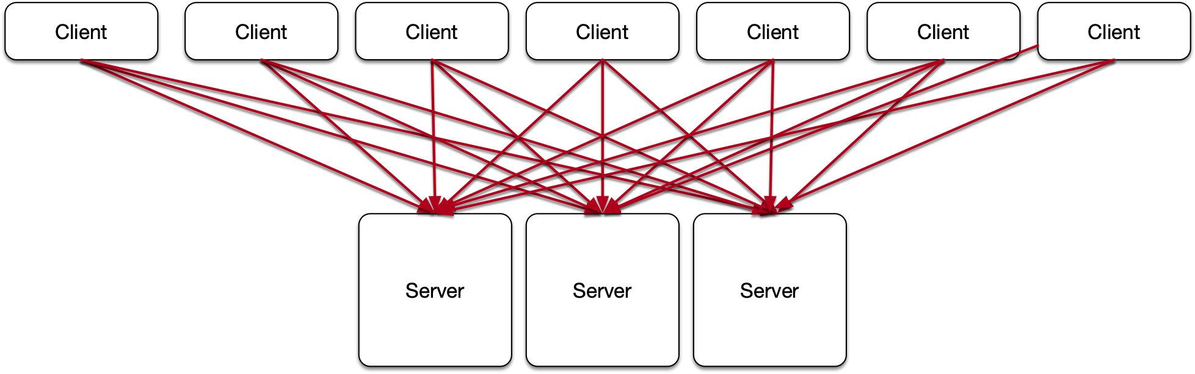
Client Server Systems
Two-tier architecture
  Client has client DBMS
    Can communicate by issuing SQL commands
  Servers have server DBMS

Slide 6
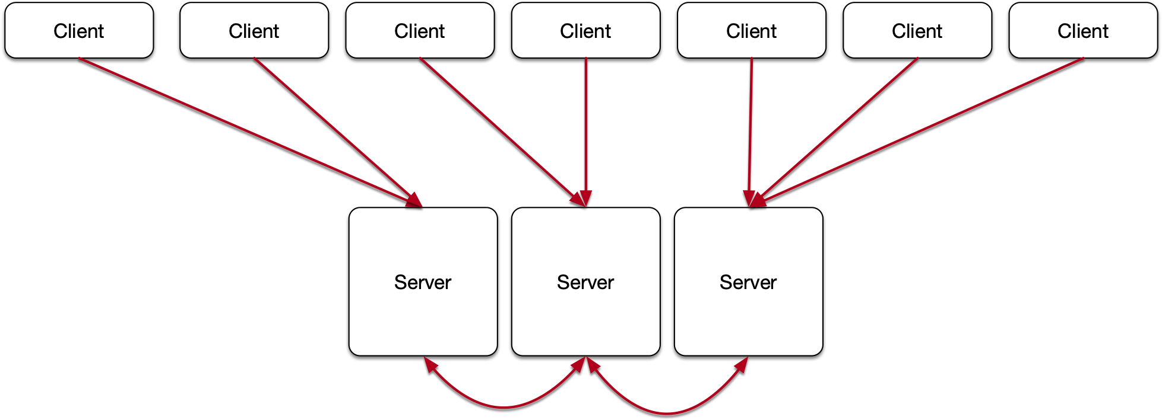
Client Server Systems
Two architectures:
  Every client can demand services from every server
  Every client has a home server that can forward demands to another server

Slide 7
P2P Systems
Server components are distributed over clients
  Might or might not have a global directory replicated at all clients

Slide 8
What Makes Distributed Databases Difficult
Finding information
Coordination
  Updating the database should leave it into a coherent state
  Example: Global email system
    Use a VPN to go to Mumbai and send an email
    Disconnect the VPN and find out that you did not yet send the email

Slide 9
Distributing Data
Replication
  Motivation: Speed of access to data
Fragmentation
  Break relations up

Slide 10
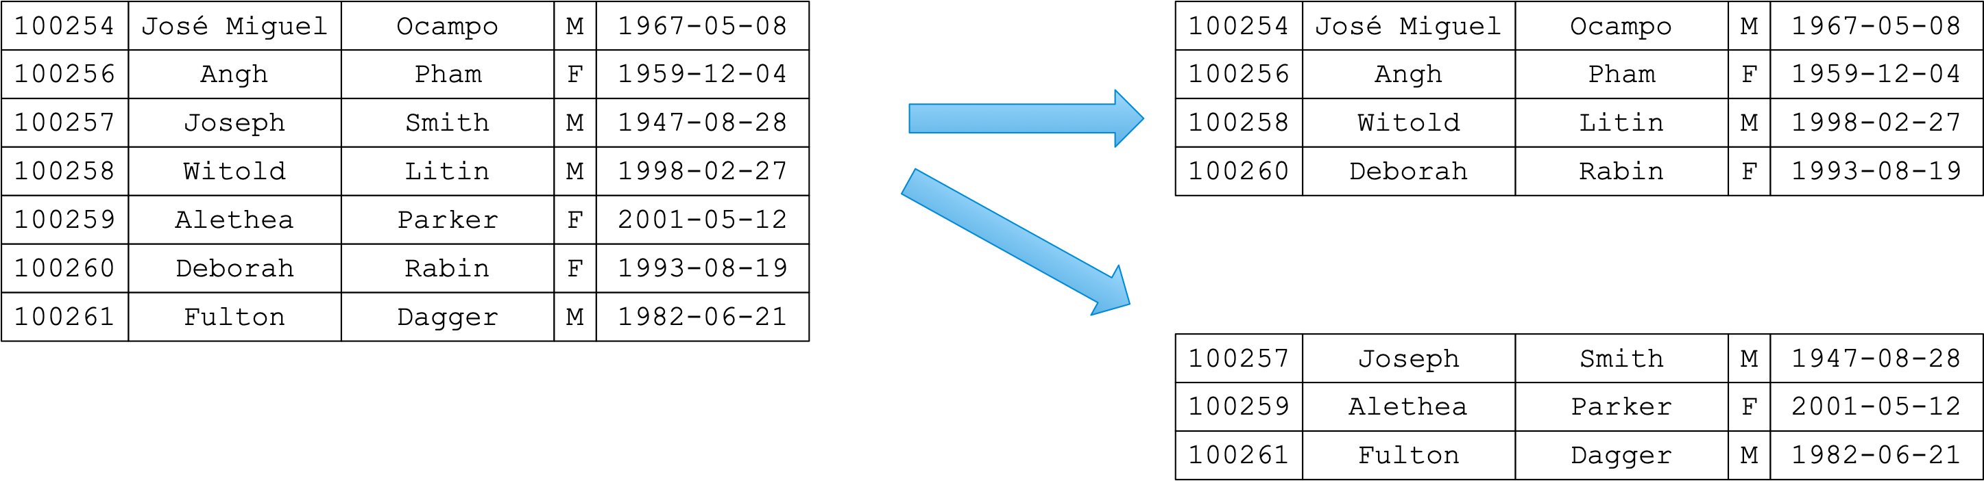
Distributing Data
Horizontal fragmentation
  Divide the rows into different fragments
  Example: Employees Database
    Primary decomposition of Employees Table based on emp_no

Slide 11
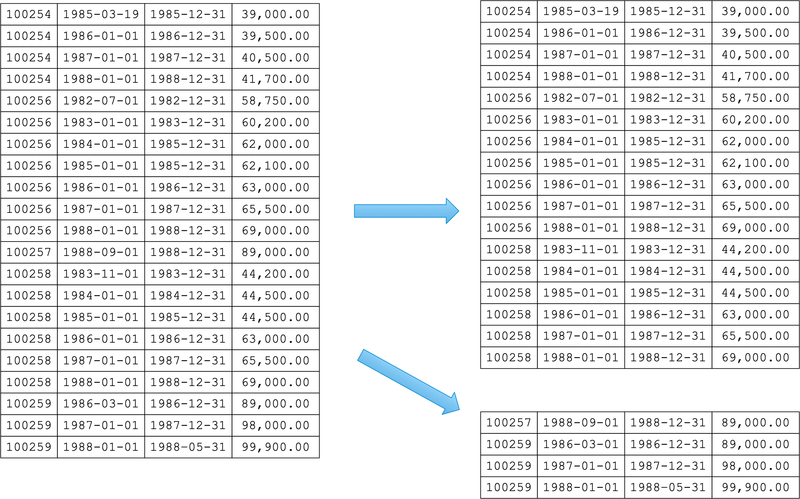
Distributing Data
Example: Employees Database
  Since we frequently join on emp_no, we should now do secondary fragmentation on emp_no of salary

Slide 12
Distributing Data
Horizontal fragmentation
  Use a (simple) predicate on a primary code on the principal relation
    In our example: emp_no % 2 == 0, emp_no%2==1
  Use derived fragmentation for other tables

Slide 13
Distributing Data
Vertical fragmentation
  Break table into different attributes
    Need to repeat primary keys
      (Or introduce a new artificial tuple identifier functioning as a primary key)
    Keep attributes together that appear in many projections and selections together

Slide 14
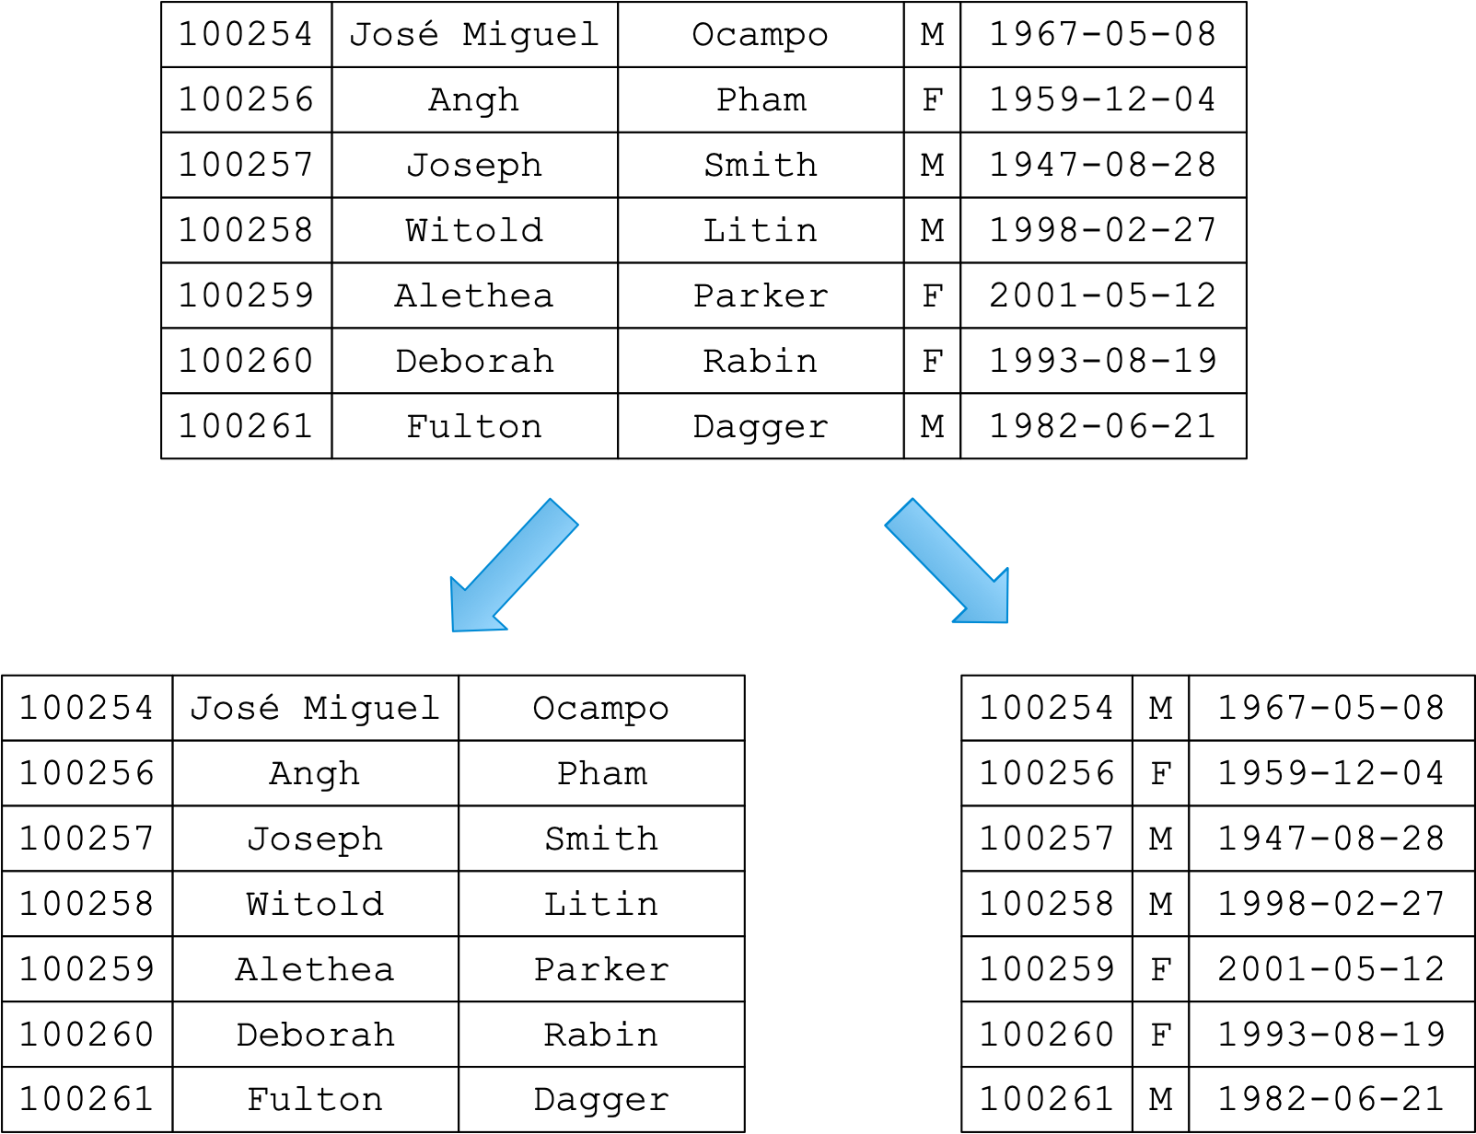
Distributing Data
Example: Employees Table

Slide 15
Distributing Data
Given statistics on queries, use a clustering algorithm to decide the break-up

Slide 16
Distributing Data
It is possible to combine vertical and horizontal fragmentation

Slide 17
Query Processing
Query plans now need to include the costs of sending data over a network
  Usually, have different costs for what was previously the same query plan

Slide 18
Transaction Processing

Slide 19
Transaction Concept
Transactions:
  Transparent concurrency
  Transparent recovery
Atomic
  Transaction is completely executed or not at all
Consistency
  Consistency constraints are preserved by a transaction
Isolation
  Each transaction behaves as if it were operating alone
Durability
  Updates made by a committed transaction are durable

Slide 20
Transaction Concept
Computational model
  Elementary operations on data objects
  Transactions are sequences of these operations
  The execution of several transactions is described by a schedule or history
  Histories where ACID properties are guaranteed are correct
  Generate algorithms / protocols

Slide 21
Transaction Concept
Computational model: Page model
  Transaction is a sequence of elementary operations
    read, write
  on a single page
  Can talk about the value of a page at each level in the history

Slide 22
Transaction Concept
Computational model
  Example transaction:
    t = r(x)r(y)r(z)w(u)w(x)
  Transaction reads three values
  Can use these values to write new values
  One value has potentially changed

Slide 23
Transaction Concept
Not necessary to assume that the steps in a transaction are sequential
Just need a partial order between the steps

Slide 24
Concurrency Control
Canonical Concurrency Problems
  Lost update problem
t1:
r(x)
x+=30
w(x)
t2:
r(x)
x+=120
w(x)

Slide 25
Concurrency Control
Inconsistent read problem
    Assume the constraint x+y==0
t1:
r(x)
r(y)
t2:
r(x)
x-=10
w(x)
r(y)
y+=10
w(y)

Slide 26
Concurrency Control
Dirty read problem (Reading uncommitted data)
t1:
r(x)
x+=100
w(x)
rollback
t2:
r(x)
x-=100
w(x)

Slide 27
Concurrency Control
History
  The sequence of all elementary operations of all transactions
Schedule
  A prefix of a history
Serial History
  A history where all elementary operations of one transaction are done before those of another transaction or where all elementary operations of one transaction are done after those of another transaction

Slide 28
Concurrency Control
Herbrand Semantics
  A notion to make precise what is the result of a history without specifying values
  Because we could change a non-serial history to a serial one by altering values written
  For example, set all transfer, withdrawal, and deposit amounts to 0 to make any history in a bank database serial

Slide 29
Concurrency Control
Herbrand value of a read is the Herbrand value of the last write
Herbrand value of a write is a generic functions of all reads of the executor of the write

Slide 30
Final state serializability
Final state serializability
  Final state equivalence
    Two histories are final state equivalent if
      They contain the same operations
      They have the same Herbrand semantics

Slide 31
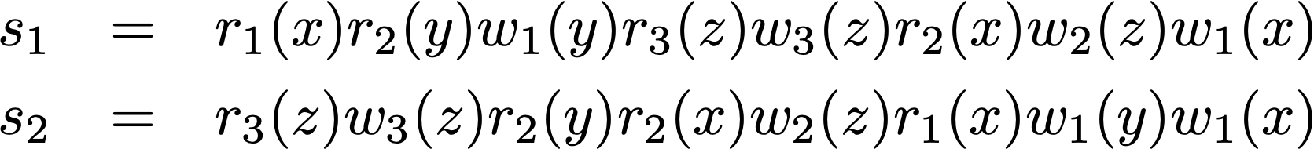
Final state serializability
Final state equivalency example

Slide 32
Final state serializability
Final state equivalency example
Herbrand value of x depends on what 1 saw, which is
x unaltered in both schedules
Herbrand value of y depends on what 1 saw
Herbrand value of z depends on what 2 saw, which is
x and y unaltered

Slide 33
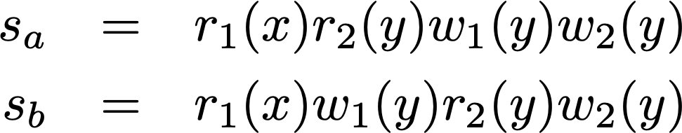
Final state serializability
Finite state equivalency example:

Slide 34
Final state serializability
Finite state equivalency example:
The Herbrand value of y is the original value of y in the
first schedule and depends on the write by 1 in the second
schedule.

Slide 35
Final state serializability
We can decide final state serializability with the Life-Reads-From relation
  Reads-from
    A transaction reads a value after it has been last written by another transaction
  Alive
    Final value depends on the transaction
Two schedules are final state serializable iff
  they consist of the same operations
  they have the same life-reads-from relation

Slide 36
Final state serializability
A schedule is final-state serializable
  IFF it is final state equivalent to a serial schedule
  IFF it has the same life-read-from relation as a serial schedule

Slide 37

View Serializability
Final state serializability is still insufficient
  Lost update anomaly is detected (good)
  Inconsistent read is still allowed by final state serializability (bad)
Transaction 1 makes an inconsistent read, but the final state ignores
it.

Slide 38
View Serializability
View equivalence
  Two schedules are view equivalent if
    They have the same set of operations
    The Herbrand values of their schedules are equal
    The Herbrand values at each read or write step are equivalent

Slide 39
View Serializability
View equivalence
  Two schedules are view equivalent
  IFF they have the same read-from relation

Slide 40
Conflict Serializability
Easier to test than view serializability
Conflict relation:
  Two operations are in conflict
    If they access the same data item
    At least one of them is a write
  Conflict relation: transitive closure
Conflict equivalence
  Two schedules are conflict equivalent
    They have the same set of operations
    Their conflict set is the same

Slide 41
Conflict Serializability

Slide 42
Conflict Serializability

Slide 43
Conflict Serializability
A schedule is conflict serializable
  IFF it is conflict equivalent to a serial schedule

Slide 44
Conflict Serializability
Algebraic notation:
  C1
  C2
  C3

Slide 45
Conflict Serializability
Two schedules with the same operations are equivalent
  Iff one can be transformed to the other using the commutativity rules

Slide 46
Commit Serializability
Conflict serializability does not detect the dirty read problem
  Since it does not pay attention to commit and abort operations
Correctness criterion should only take committed transactions into account
Since systems can crash
  All prefixes of a schedule have to be correct

Slide 47
Commit Serializability
A schedule is commit conflict serializable iff
  Projection on committed transactions is conflict serializable

Slide 48
Concurrency Control Algorithms
How to deal with bad situations:
  Strategy 1: Never get into a bad situation
  Strategy 2: Know how to get out of a bad situation (rollback)

Slide 49
Concurrency Control Algorithms
Locking scheduler: Never get into a bad situation
  Use locks on data items
    Shared / Read Locks
    Exclusive / Write Locks
Locking problems:
  Need to make sure that transactions release locks
    Kill all Zombies!!!!!
  Need to avoid deadlock
  Need to avoid life lock

Slide 50
Locking Algorithms
No restrictions on locking are hard to get right
Two phase locking (2PL)
  All transactions pass first through a phase
    where they only acquire locks
  Then through a phase
    where they only release locks
A schedule with 2PL is conflict serializable
  But not every conflict serializable schedule can be created with 2PL

Slide 51
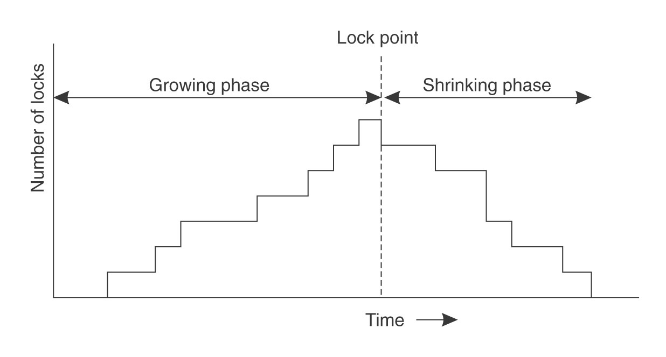
Locking Algorithms
2PL

Slide 52
Locking Algorithms
2PL
  Dirty reads:
    Allows transactions to read from transaction that are later aborted
Strict 2PL
  Release locks only at the end of a transaction
    Allows easy automatization
      Application wants to read an item
        Automatically request lock
      When committing, automatically release all locks

Slide 53
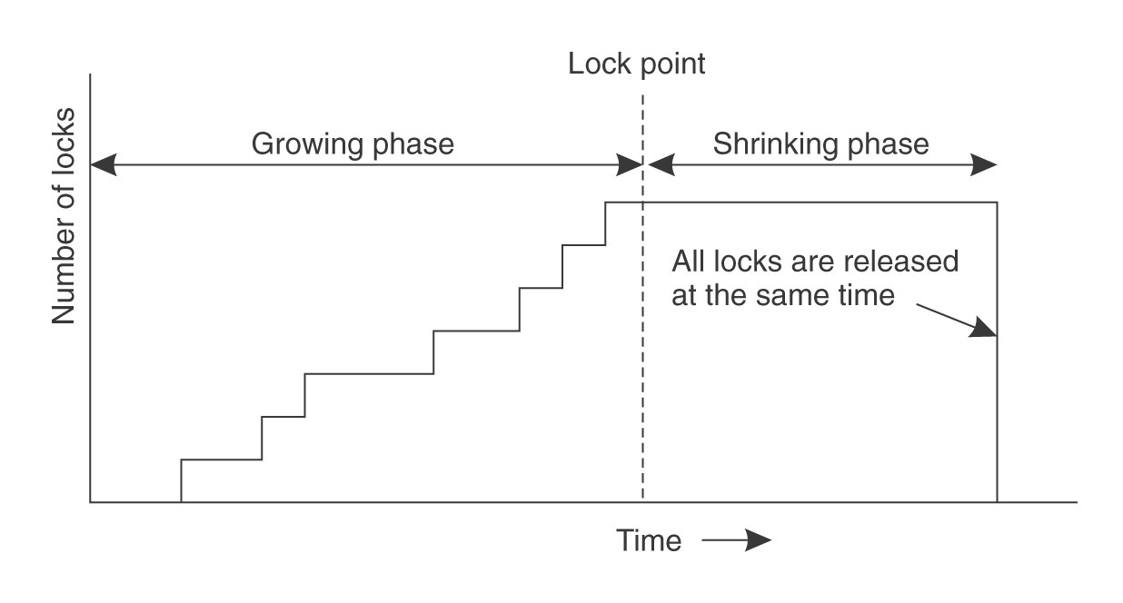
Locking Algorithms

Slide 54
Locking Algorithms
Deadlock Handling
  Normal lock requests can lead to deadlock
  Yields
    l read-lock
    L write-lock

Slide 55
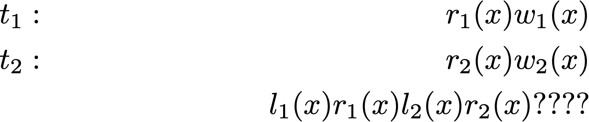
Locking Algorithms
Deadlock handling
  Lock conversion can also lead to deadlock

Slide 56
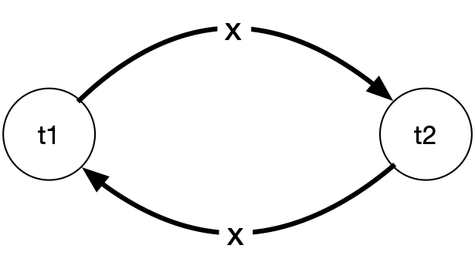
Locking Algorithms
Deadlock Detection
  Wait for graph
    Nodes are transactions
    Edges represent “waiting for”

Slide 57
Locking Algorithms
Deadlock detection
  Continuous detection
    WFT is always kept cycle free
  Periodic detection
    Check WFT for cycles periodically

Slide 58
Locking Algorithms
Deadlock detection
  If a scheduler detects a cycle:
    Aborts a victim transaction
      according to heuristics
        Last blocked
        Random
        Youngest
        Minimum locks
        Minimum work
        Most cycles
        Most edges

Slide 59
Locking Algorithms
Life-lock
  All victim selection mechanism can create live-lock
    Incarnations of the same transaction are always chosen
    Various heuristics to avoid life-lock

Slide 60
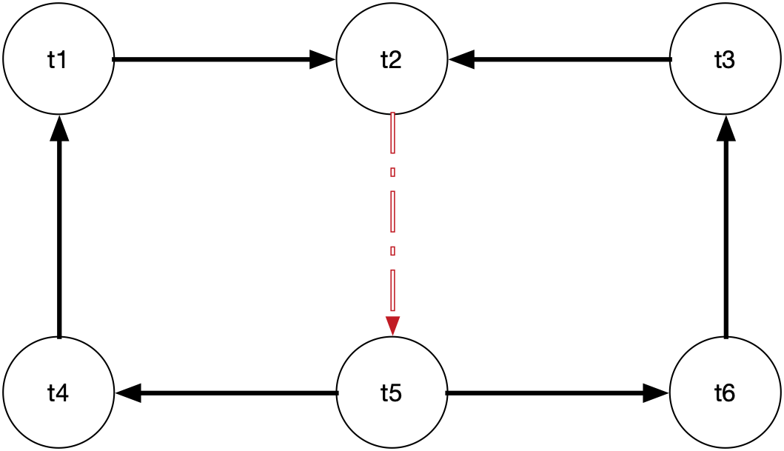
Locking Algorithms
Most cycle heuristics:
Remove dashed edge by aborting
t2 or t5

Slide 61
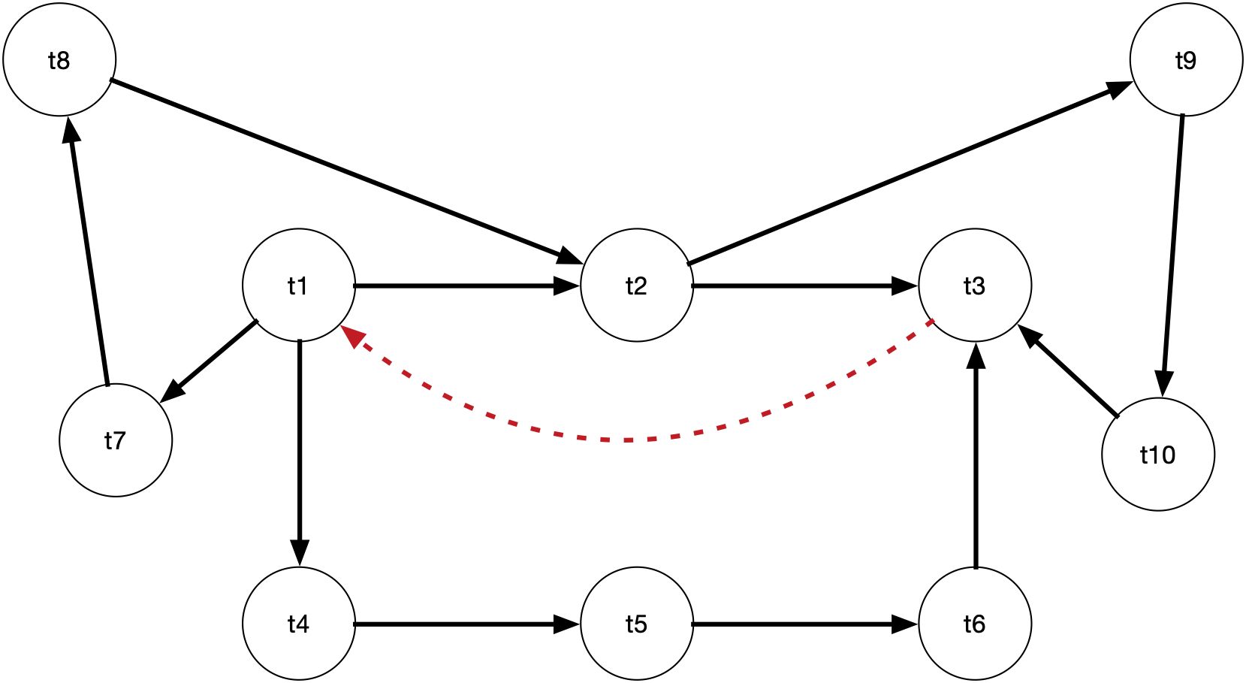
Locking Algorithms
Dashed cycle breaks the most cycles

Slide 62
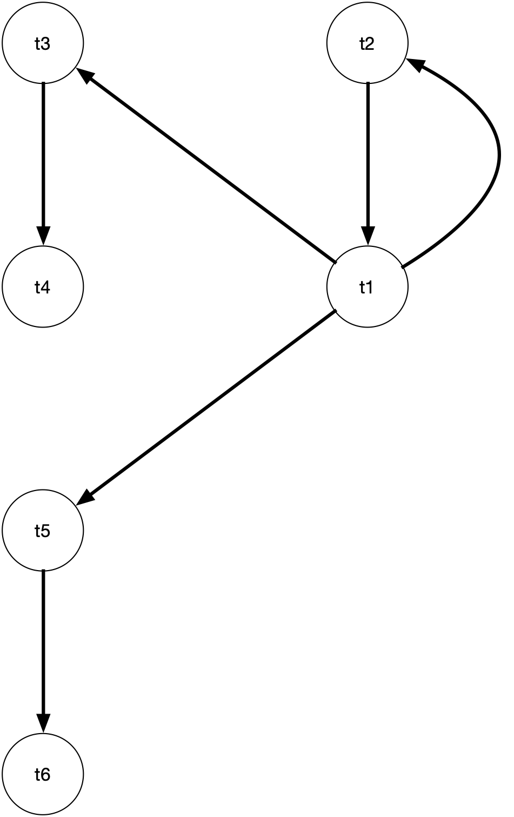
Locking Algorithms
WFG with cycle and two
candidate victims (t1, t2)
Most edges option:
Abort t1: Two edges remain
Abort t2: Four edges remain
Hence: Abort t1

Slide 63
Locking Algorithms
Deadlock prevention
  Abort transaction whose lock request would create a cycle

Slide 64
Non-Locking Algorithms
Timestamp ordering
  Each transactions gets a unique timestamp
    Timestamp Ordering rule
      All operations inherit their timestamp from the transaction
      If two operations are in conflict, then the one with the smaller timestamp has to be done first
      If this impossible, abort the offending transaction

Slide 65
Non-Locking Algorithms
Basic time-stamp ordering (BTO)
  For all data items, maintain the largest timestamp for
    a read operation: max-r-scheduled(x)
    a write operation: max-w-scheduled(x)

Slide 66
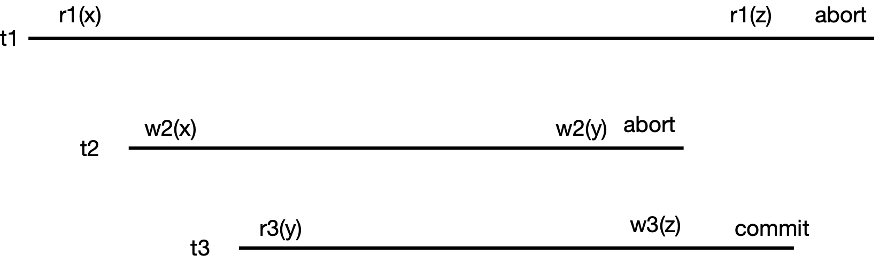
Non-Locking Algorithms
BTO: Transactions can be too late and are aborted
  w2(x) succeeds since t1 < t2
  r3(y) succeeds since t3 < t2
  w2(y) fails since t2<t3, t2 is aborted
  r1(z) fails since t1 < t3, t1 is aborted

Slide 67
Non-Locking Algorithms
Optimistic protocols
  Assume that conflicts are reasonably rare
  Let transactions go ahead
  But validate their serializability

Slide 68
Non-Locking Algorithms
Optimistic Protocols
  Read phase
    Transaction is executed, but all writes are not committed
      Write “private items”
  Validation phase
    If a transaction is ready to commit, check whether its execution has been correct
  Write phase
    Write private items to database

Slide 69
Non-Locking Algorithms
Backward oriented optimistic concurrency control (BOCC)
  Validate a transaction against those transactions already committed
Forward oriented optimistic concurrency control (FOCC)
  Validate a transaction against those transactions that are in their read phase

Slide 70
Non-Locking Algorithms
BOCC:
  The validate-write phase needs to be atomic
  Transaction j is validated if for every committed transaction i:
    i has ended before j started
  or
    The pages touched by j have not been written by i
      Thus, j had no chance to read from i

Slide 71
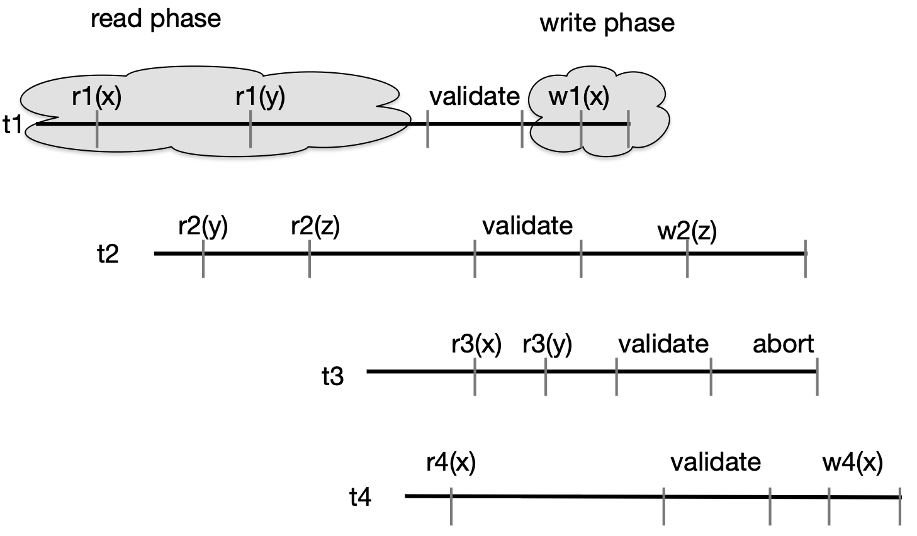
Non-Locking Algorithms
t3 is aborted because its read set {x,y} overlaps with the write set {x} of t1

Slide 72
Non-Locking Algorithms
Schedule
  … r2(x) … w1(x) …validate1… validate2 …
  t2 will get aborted as its read set overlaps with the write set of t1.
  This is clear once t1 writes
Therefore Forward-oriented optimistic Concurrency Control (FOCC)

Slide 73
Non-Locking Algorithms
Forward-oriented concurrency control
  Accept a transaction tj if for all transactions ti that are currently reading
    Writeset(tj) is disjoint from Readset(ti) at current time
Example: FOCC accepts all read-only transactions

Slide 74
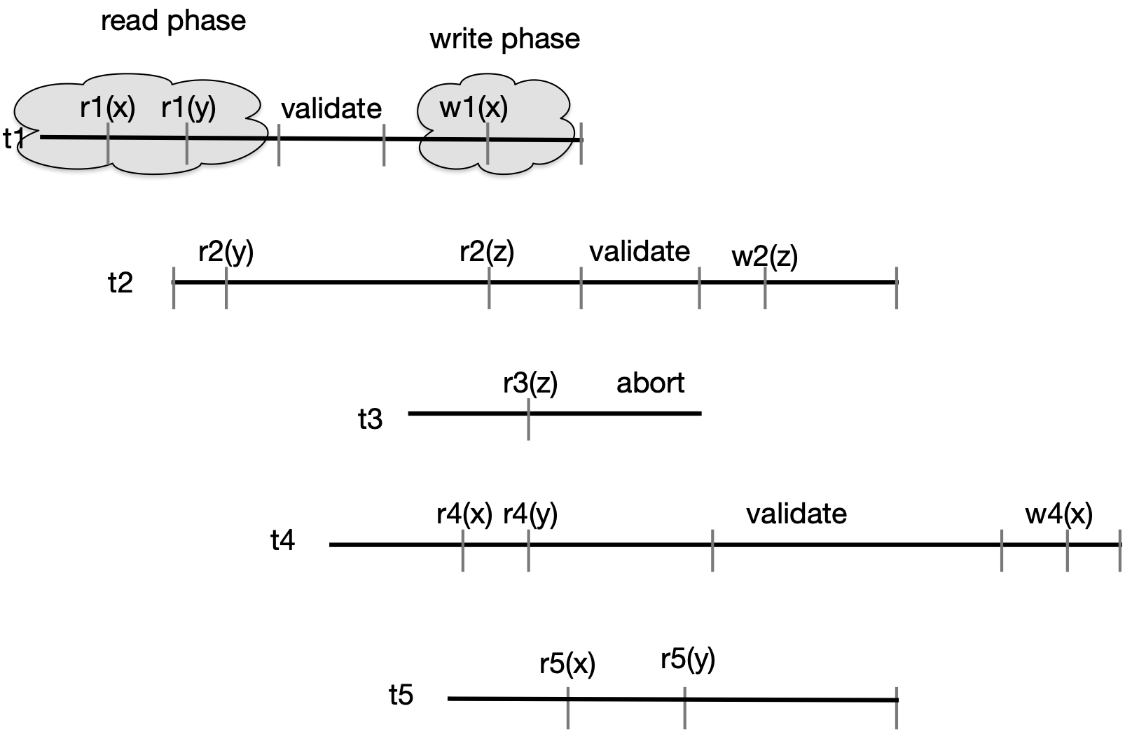
Non-Locking Algorithms
t1 validates its
write set {x} against
the current read
sets {y}

Slide 75
Non-Locking Algorithms
t2 validates its
write set {z} against
the current read
sets {z, x, y} and
discovers that they
are not disjoint.
FOCC allows:
t2 could abort
t3 could abort
Chooses to abort t3

Slide 76
Non-Locking Algorithms
t4 validates its write
set against current
read sets {x, y, z}
because of t5.
Instead of aborting,
we can have t4 wait
until t4 terminates
Then t4 validates

Slide 77
Multi-version Concurrency Control
Allow a single value to have multiple versions
Multi-version schedule
  Note values read
  Example
    r1(x0)w1(x1)r2(x1)w2(y2)r1(y0)w1(z1)c1c2
      Transaction 1 reads an earlier version than the value written by transaction 2

Slide 78
Multi-version Concurrency Control
Multi-version timestamp ordering (MVTO)
  Each version carries the timestamp of the transaction that created it
  Each read reads the last version that was written before the timestamp of the transaction
  Writes:
    wi(x)
      If there was a read rj(xk) with
        time(tk)<time(ti)<time(tj)
      abort ti
      Otherwise, write x with timestamp ts(tk)

Slide 79
Multi-version Concurrency Control
In order to avoid dirty reads:
  Delay commits until all other transactions that have written a new version of what we read have finished

Slide 80
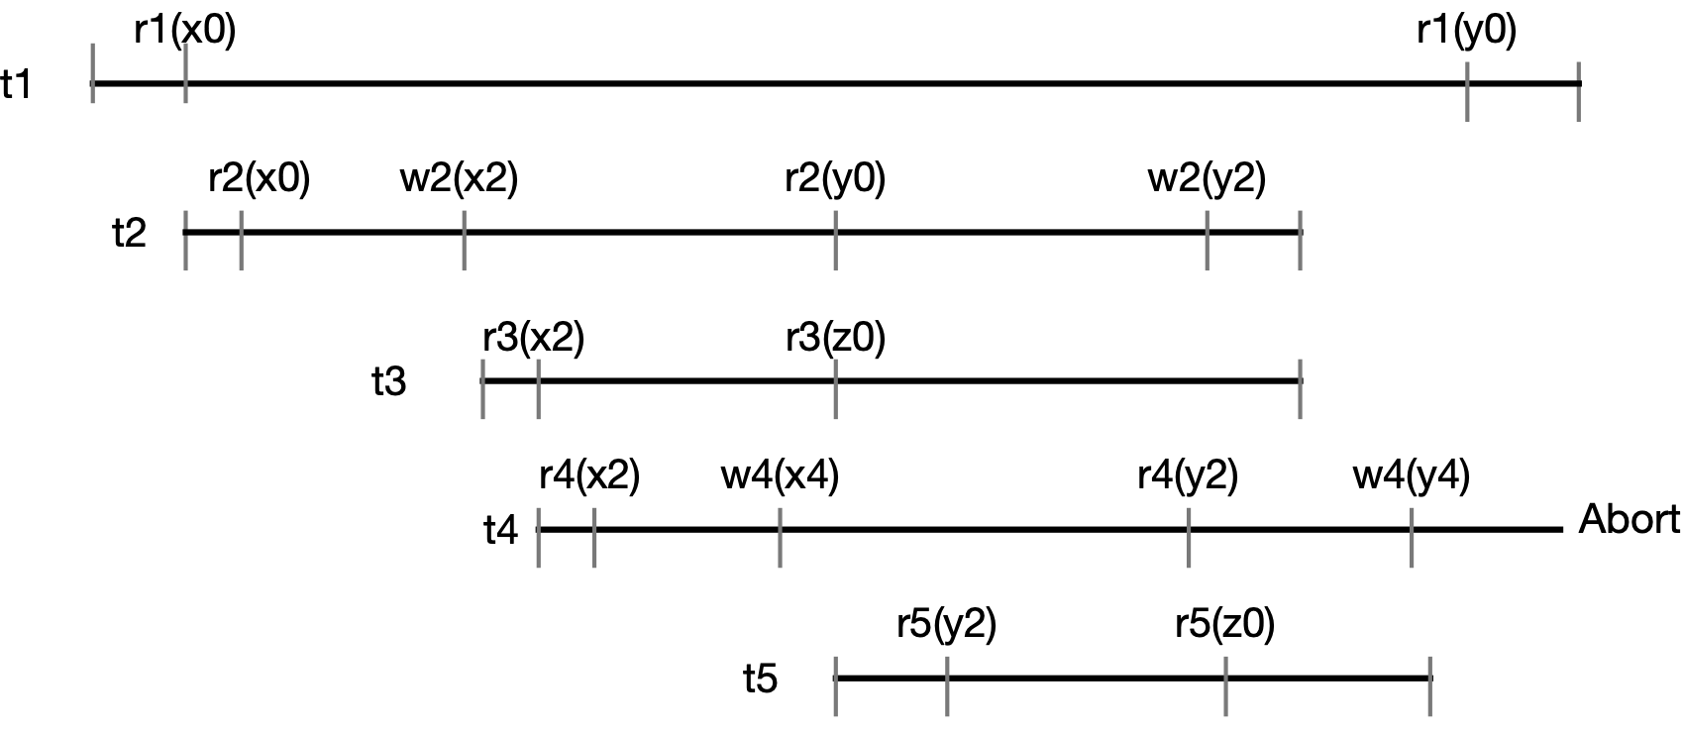
Multi-version Concurrency Control
t1 and t2 are interleaved

Slide 81
Multi-version Concurrency Control
t3 needs to wait until t2 terminates, because it read x2
Since its timestamp is larger, it has to read this value instead of x0

Slide 82
Multi-version Concurrency Control
t4 is a “late writer”. t5 (with a later timestamp) has already read y2, and t4
can no longer change it. So, t4 needs to be aborted.

Slide 83
Multi-version Concurrency Control
t1 and t2 are interleaved

Slide 84
Multi-version Concurrency Control
t1 and t2 are interleaved

Slide 85
Multi-version Concurrency Control
t1 and t2 are interleaved

Slide 86
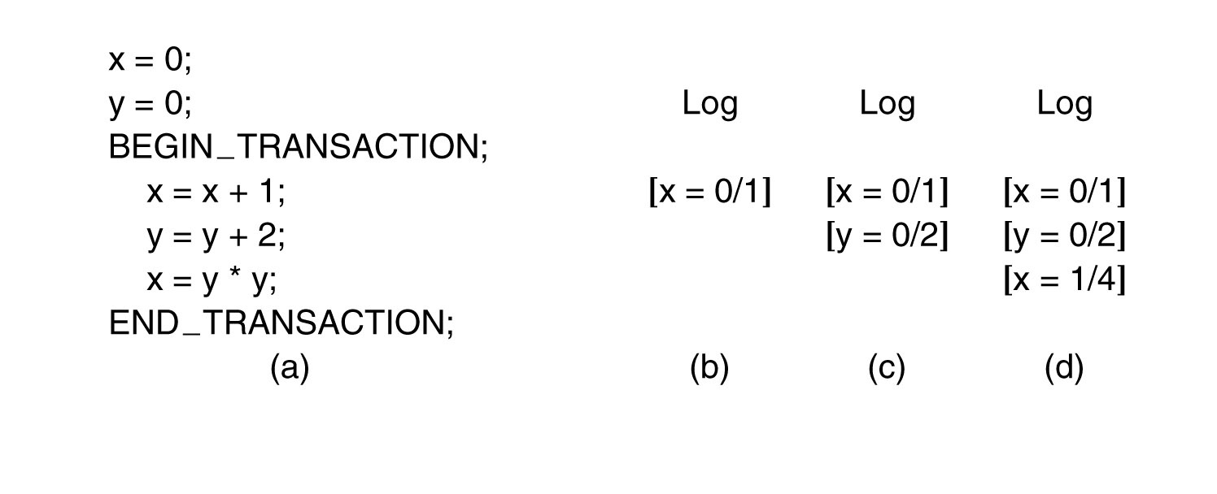
Write-Ahead Logging
A family of protocols that use a log
  Recovery after a crash
  Aborting transactions
Each site writes the operation it is about to perform on a page to the write-ahead log

Slide 87
Write-Ahead Logging
ARIES
  Write-ahead log
  Repeating history
    After crash, retrace the actions to bring database up to the moment of crash
    Undo transactions that were then pending
  Logging Undo operations
    Log undo operations in order to avoid repeating actions after repeated crashes

Slide 88
Write-Ahead Logging
ARIES
    Dirty Page Table (DPT)
    Transaction Table (TT)
    Log
      Sequence Number, Transaction ID, Page ID, Redo, Undo, Previous Sequence Number
        Redo and Undo: Information to redo and undo a transaction

Slide 89
Write-Ahead Logging
ARIES
  Analysis
    Calculate the necessary information from the log
      From last checkpoint:
        Add all transactions started to TT
        Remove transactions in the TT when finding a END LOG statement
        Update the dirty pages table

Slide 90
Write-Ahead Logging
ARIES
  Redo
    Use the DPT to calculate the minimal sequence number of a dirty page
    From this sequence number, redo operations for pages in the DPT

Slide 91
Write-Ahead Logging
ARIES
  Undo
    Undo the changes of uncommitted transactions
    Run backward through the log
      For each transaction in the TT
        Undo the change for each touched page
      Write the changes in a compensation log
      (In case of a crash during recovery)

Slide 92
Distributed Transactions
Issues:
  Distributed decision making
    by leader: Leader election
    Commit protocols
  Distributed locks:
    Deadlock detection
    Deadlock avoidance
  Distributed checkpoints

Slide 93
Distributed Transactions
Distributed commit
  All members of a group need to perform an action or none
  One phase commit:
    Single coordinator
      Sends a “commit” or a “not-commit” message
    Has no feedback from participants
    Cannot be used in practice

Slide 94
Distributed Transactions
Two phase commit (Jim Gray)
  Phase 1:
    Coordinator sends vote request
    Participants vote on whether they want to commit
  Phase 2:
    Coordinator decides vote
        Single no is a veto
    Coordinator sends participants message

Slide 95
Distributed Transactions

Slide 96
Distributed Transactions

Slide 97
Distributed Transactions
2PC can have problems with failures
  Failure of coordinator or participants leads to blocking

Slide 98
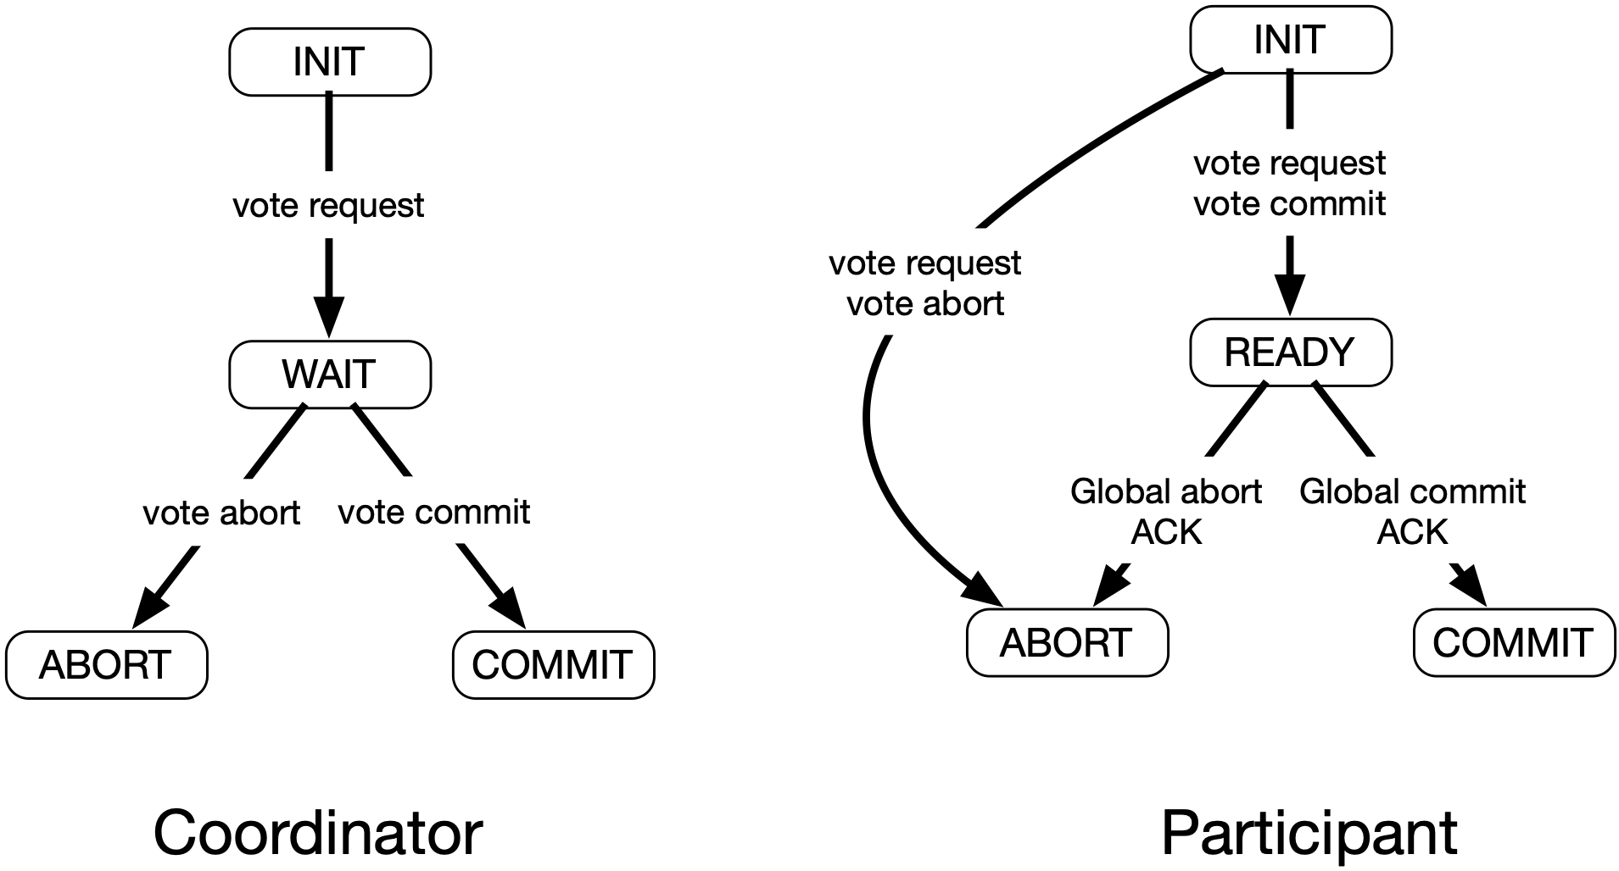
Distributed Transactions

Slide 99
Distributed Transactions
Participant in INIT waiting for request to vote
  Can locally abort transaction

Slide 100
Distributed Transactions
Coordinator in WAIT waiting for answers
Can send Global_Abort

Slide 101
Distributed Transactions
Participant in READY waiting for coordinator
Cannot decide
  Block until coordinator recovers
  Or talk to other participant
  If all participants are in state READY, no decision can be taken

Slide 102
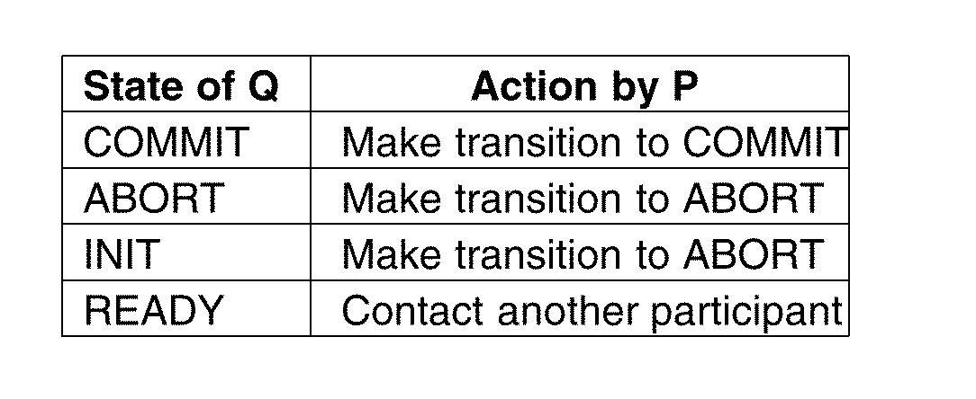
Distributed Transactions
Participant in READY waiting for coordinator
Cannot decide
  Block until coordinator recovers
  Or talk to other participant
  If all participants are in state READY, no decision can be taken

Slide 103
Distributed Transactions
Non-blocking solution
  Use multicast primitive
    Receiver immediately multicasts received message to all participants

Slide 104
Distributed Transactions
Three Phase Commit
  Crashed coordinator might leave participants hanging Solution is to add another phase

Slide 105
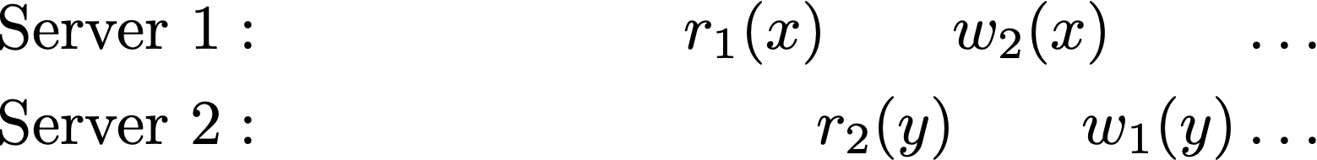
Distributed Time Order
  TO rule:
    If pi(x) and qj(x) are operations in conflict then
    Use Lamport clock to generate time stamps
    Both transactions have local timestamp 1 but are ordered so that 2nd transaction aborts

Slide 106
Distributed Transactions
Locking protocols
  Need to reach global decision when to release a lock
  Primary 2PL:
    All locking is done at a primary site
  Distributed 2PL
    Strict 2PL with commit releases locks

Slide 107
Distributed Transactions
Optimistic protocols
  Protect validation / write phase by using 2PC or 3PC

Slide 108
Distributed Transactions
Distributed deadlock handling
  Detection
    Time-outs
    Edge chasing
      Blocked transaction sends out a probe to all transactions it is waiting for
      Those forward probe
      When probe returns to sending transaction:
        Deadlock exist
        Path(s) of returned probe(s) indicates which transaction to abort
    Path pushing
      Collect local “waits-for” graphs at a single server

Slide 109
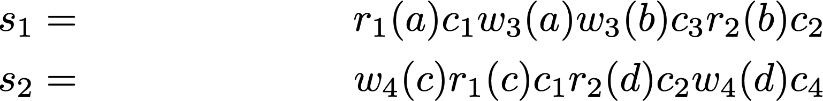
Ticket-Based Concurrency
Used in federated databases
  Need to “force" conflicts between competing local transactions.
    Example: Database D1={a,b}, D2={c,d}
    Global transactions t1=r(a)r(c), t2=r(b)r(d)
    Local transactions t3=w(a)w(b), t4=t(c)t(d)
    is incorrect

Slide 110
Ticket-Based Concurrency
Each local database maintains a ticket
  Accessed only by global transactions
  Operations are:
    Read ticket
    Take-a-ticket:
      Read ticket, write back incremented ticket value
  Each transaction takes a ticket at a local database
  Can commit only if ticket values have the same relative order at all participating sites

Slide 111
Ticket-Based Concurrency
Optimistic ticket method
  Transaction manager maintains a ticket graph
  Before commit, make sure that ticket graph has no cycles

Slide 112
Ticket-Based Concurrency
Conservative ticket method
  Insures that transactions can only get tickets in the same order

