Slide 1
Database Implementation
Thomas Schwarz, SJ

Slide 2
Memory Hierarchy
Almost stable since the 1970s
  Cache — Fast, Expensive, Volatile
  DRAM memory — Fast, Expensive, Volatile
  Storage: HDD, SDD — Slow, Cheap, Non-volatile
  Tertiary Storage: offline HDD, Tape — Very slow, very cheap, non-volatile

Slide 3
Memory Hierarchy
Database data is stored:
  Usually in storage
    Accessed not using the file system, but by direct block access
  Sometimes in virtual memory (Main Memory Databases)

Slide 4
Memory Hierarchy
Volatility implies:
  All changes to a database need to be logged
    If there is a loss of power:
      Database needs to be in a consistent state
        Use the log to rebuild the consistent state from a snapshot and a log
  Data needs to be transferred between storage and CPU

Slide 5
Memory Hierarchy
Durability with fallible components
  All storage systems are fallible
    Use mirroring or redundant storage

Slide 6
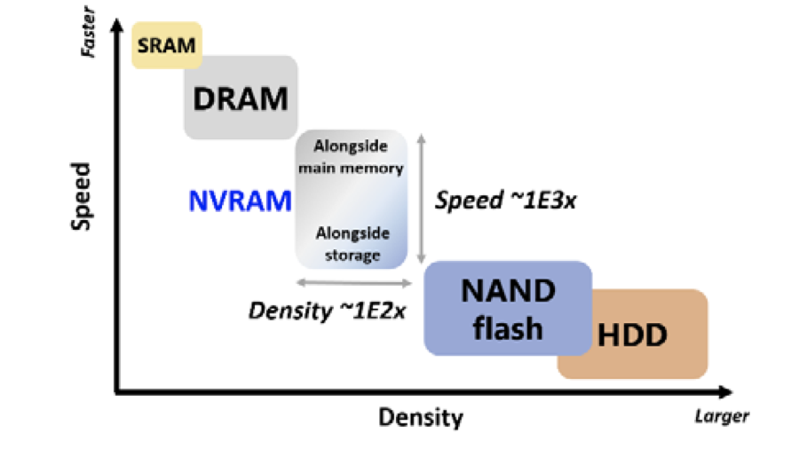
Memory Hierarchy
Memory hierarchy might be in for a big change
  Non-volatile memories
A perspective on NVRAM technology for future computing system, K. Hoya, K. Hatsadu,K. Tsuchida, Y. Watanabe, Y. Shirota, T. Kanai

Slide 7
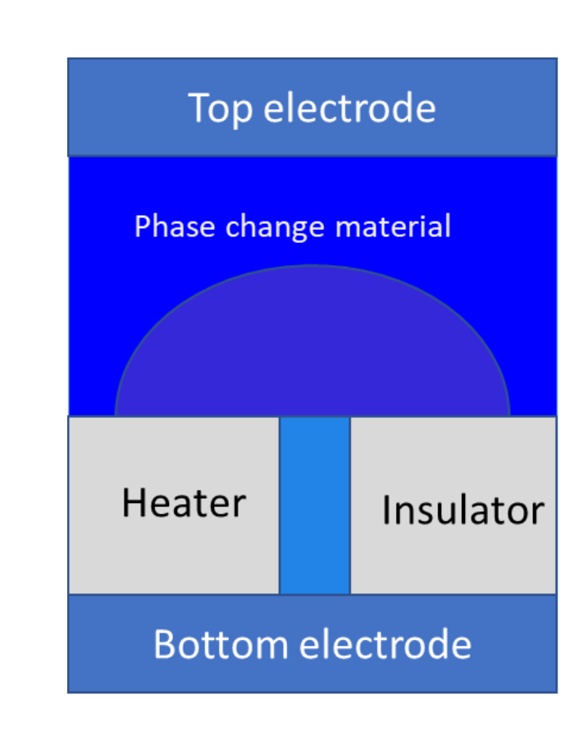
Phase Change Memories
Phase change material is in crystalline (low resistance) or amorphous (high resistance) state
To change phase:
  Short burst of current leads to amorphous state
  Longer, but lower burst of current leads to crystalline state

Slide 8
Phase Change Memories
Almost as fast as RAM
Denser than Flash —> Will become cheaper
On the market as Intel Optane

Slide 9
Memory Hierarchy
With new technologies
  Non-volatile memories might be:
    Replacing /supplementing memory
    Replacing / supplementing storage
    Replace both with a single layer
      with large implications for OS design and database design

Slide 10
Optimizing disk access
Disk access:
  Move actuator over track — seek time
  Wait for block to appear under track — rotation time
  Transfer data == transfer time
track
actuator

Slide 11
Optimizing disk access
Avoid seek times:
  Keeping table blocks together on the track
    Streaming bandwidth ~ 200 MB/sec
  Store most frequently access data in the middle tracks of the platter
  Access data track by track (elevator algorithm)
Hide access times:
  Prefetching and large scale buffering
    Example: Writes can be delayed and ordered

Slide 12
Optimizing disk access
SSD:
  No mechanical parts —> no seek times
  Can use parallelism
  But: need to use wear leveling because flash can only be safely overwritten 5000 times
    Fortunately, this is handled internally

Slide 13
Database Implementation
Access to data in storage:
  Blocks (HDD) and pages (SSD) have logical block address
    Translation between logical block address and physical block address is done within the device

Slide 14
Database Implementation
To access storage:
  Allocate space for storage blocks in memory
  Prefetch for reading
  Have a write-back queue

Slide 15
Index Structures

Slide 16
Index Data Structures
Structures for one-dimensional data
  Linear or Extensible Hashing
  B - tree / B+ - tree for ordered indices
Structures for multi-dimensional data

Slide 17
B-Trees
B-trees: In memory data structure for CRUD and range queries
  Balanced Tree
  Each node can have between d and 2d keys with the exception of the root
  Each node consists of a sequence of node pointer, key, node pointer, key, …, key, node pointer
  Tree is ordered.
    All keys in a child are between the keys adjacent to the node pointer

Slide 18
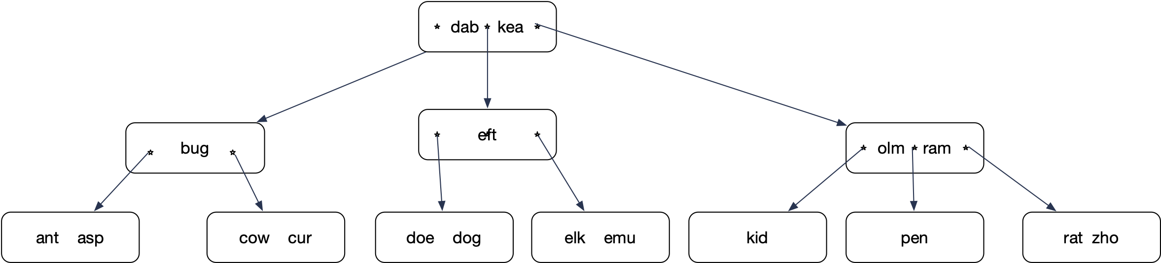
B-Trees
Example: 2-3 tree: Each node has two or three children

Slide 19
B-Trees
Read dog:
  Load root, determine location of dog in relation to the keys
  Follow middle pointer
  Follow pointer to the left
  Find “dog”

Slide 20
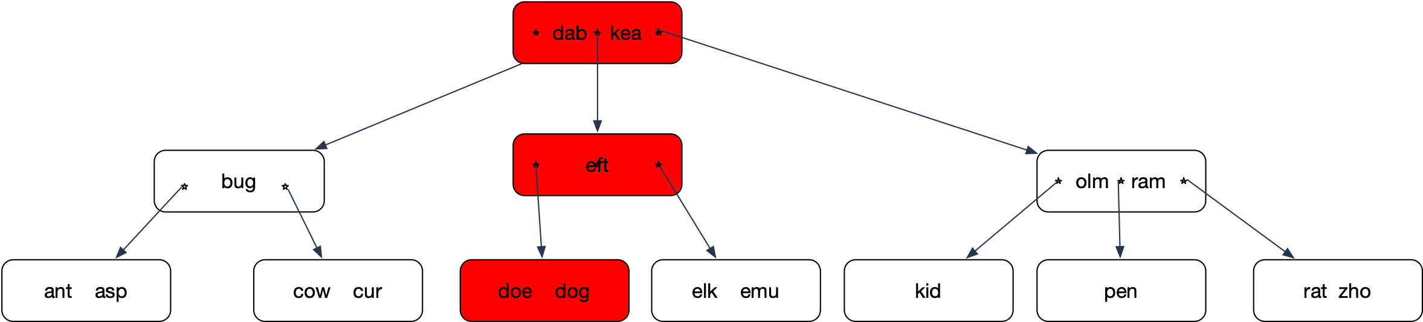
B-Trees

Slide 21
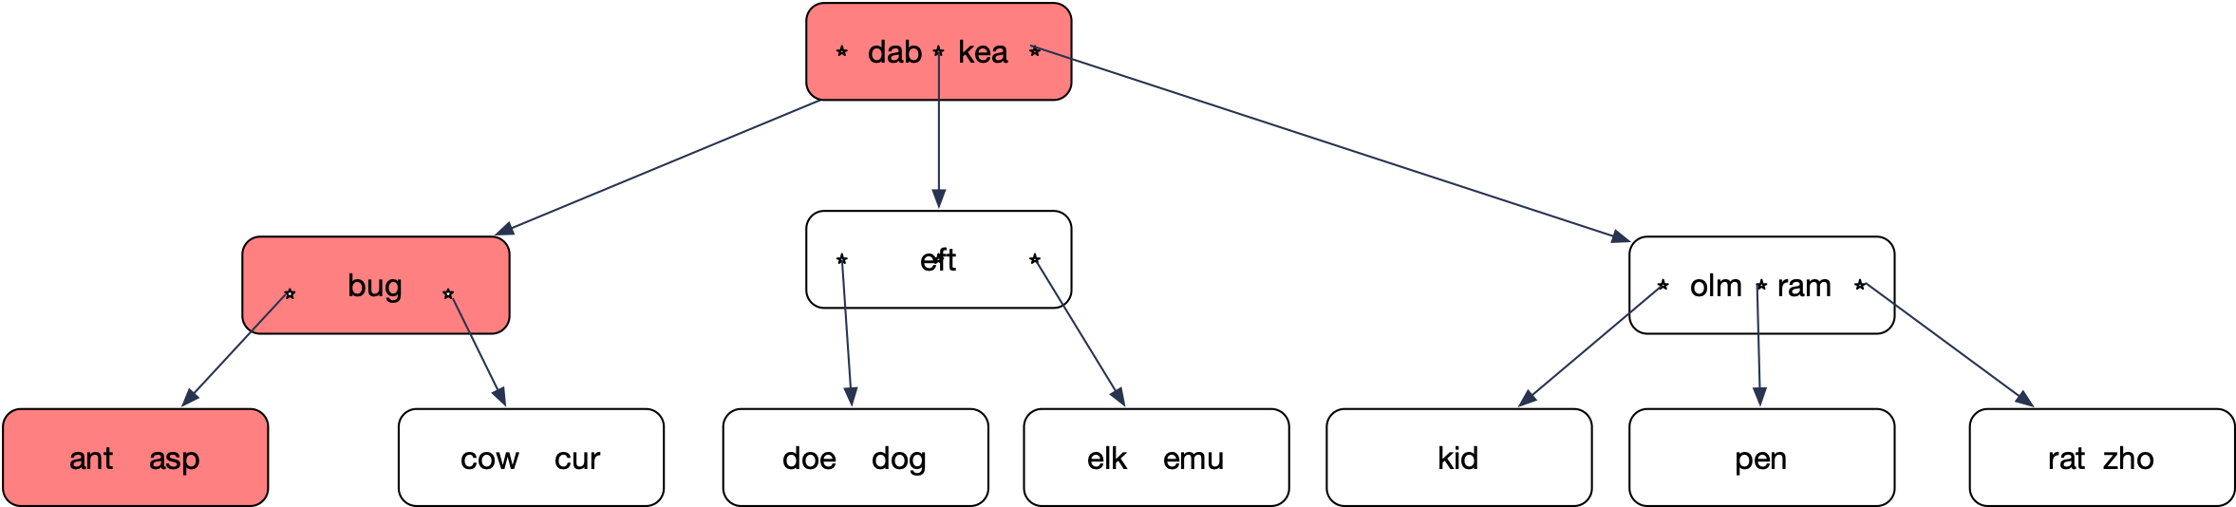
B-Trees
Search for “auk” :

Slide 22
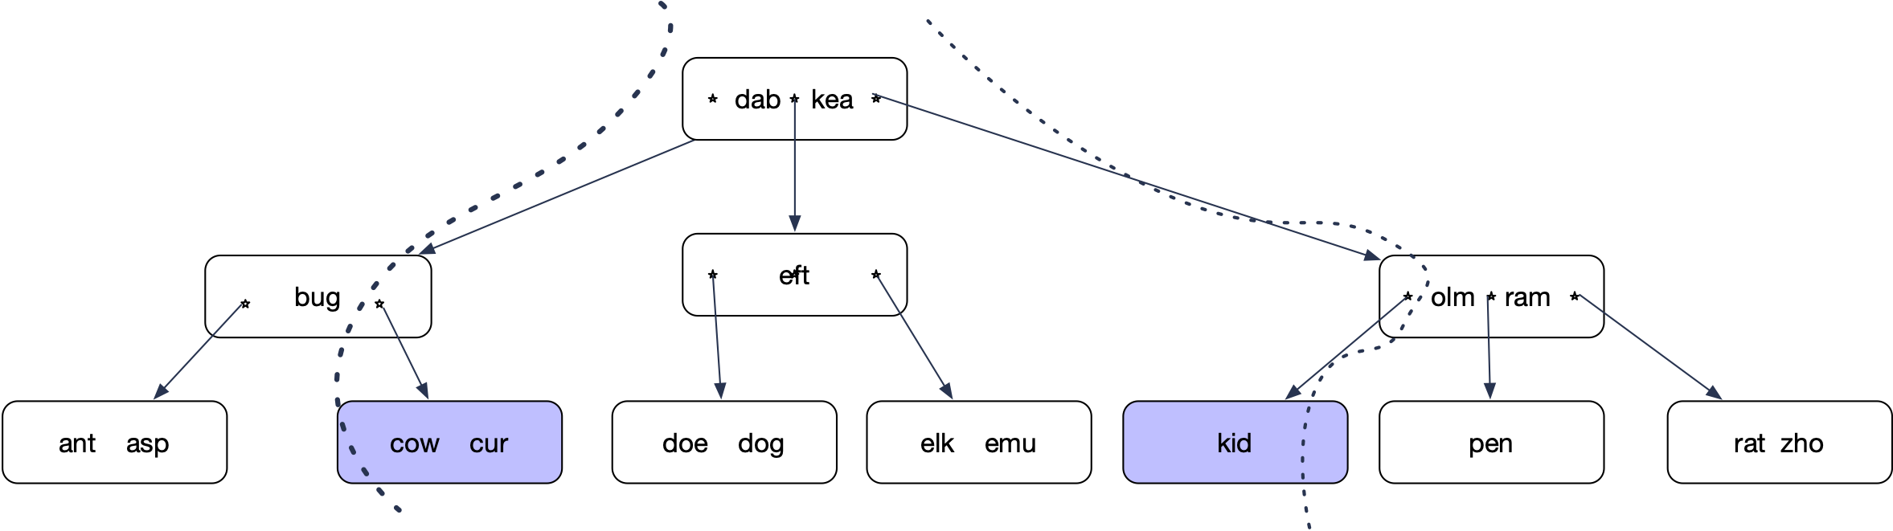
B-Trees
Range Query c - l
  Determine location of c and l

Slide 23
B-Trees
Recursively enumerate all nodes between the lines starting with root

Slide 24
B-trees
Capacity: With l levels, minimum of nodes:
  keys
Maximum of nodes
  keys
$$1+2+2^{2}+…+2^{l}$$
$$1(2^{l+1}-1)$$
$$1+3+3^{2}+…+3^{l}$$
$$\frac{2}{2}(3^{l+1}-1)$$

Slide 25
B-trees
Inserts:
  Determine where the key should be located in a leaf
  Insert into leaf node
  Leaf node can now have too many nodes
  Take middle node and elevate it to the next higher level
  Which can cause more “splits”

Slide 26
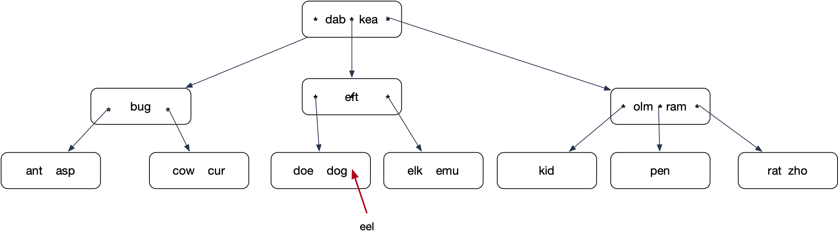
B-trees

Slide 27
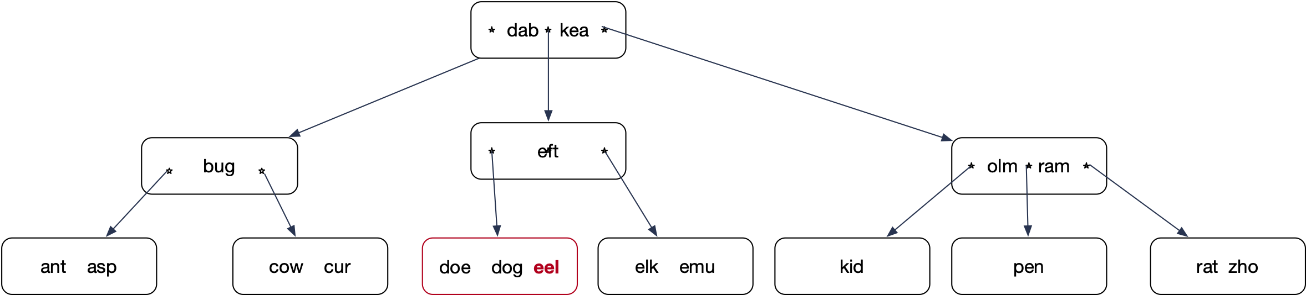
B-trees

Slide 28
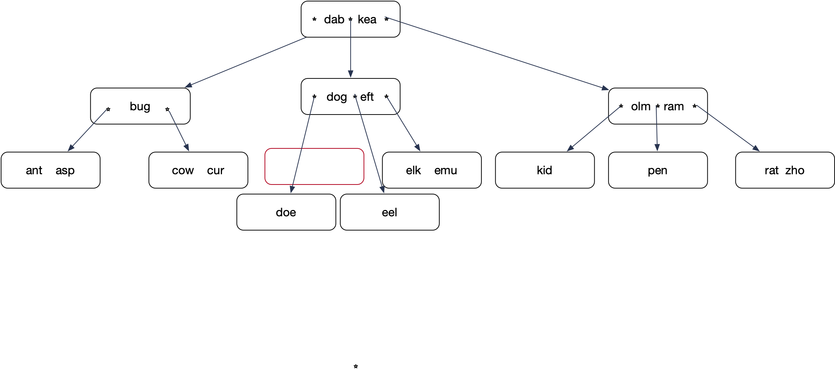
B-trees

Slide 29
B-trees
Insert: Lock all nodes from root on down so that only one process can operate on the nodes
Tree only grows a new level by splitting the root

Slide 30
B-Trees
Using only splits leads to skinny trees
  Better to make use of potential room in adjacent nodes
  Insert “ewe”.
    Node elk-emu only has one true neighbor.
      Node kid does not count, it is a cousin, not a sibling

Slide 31
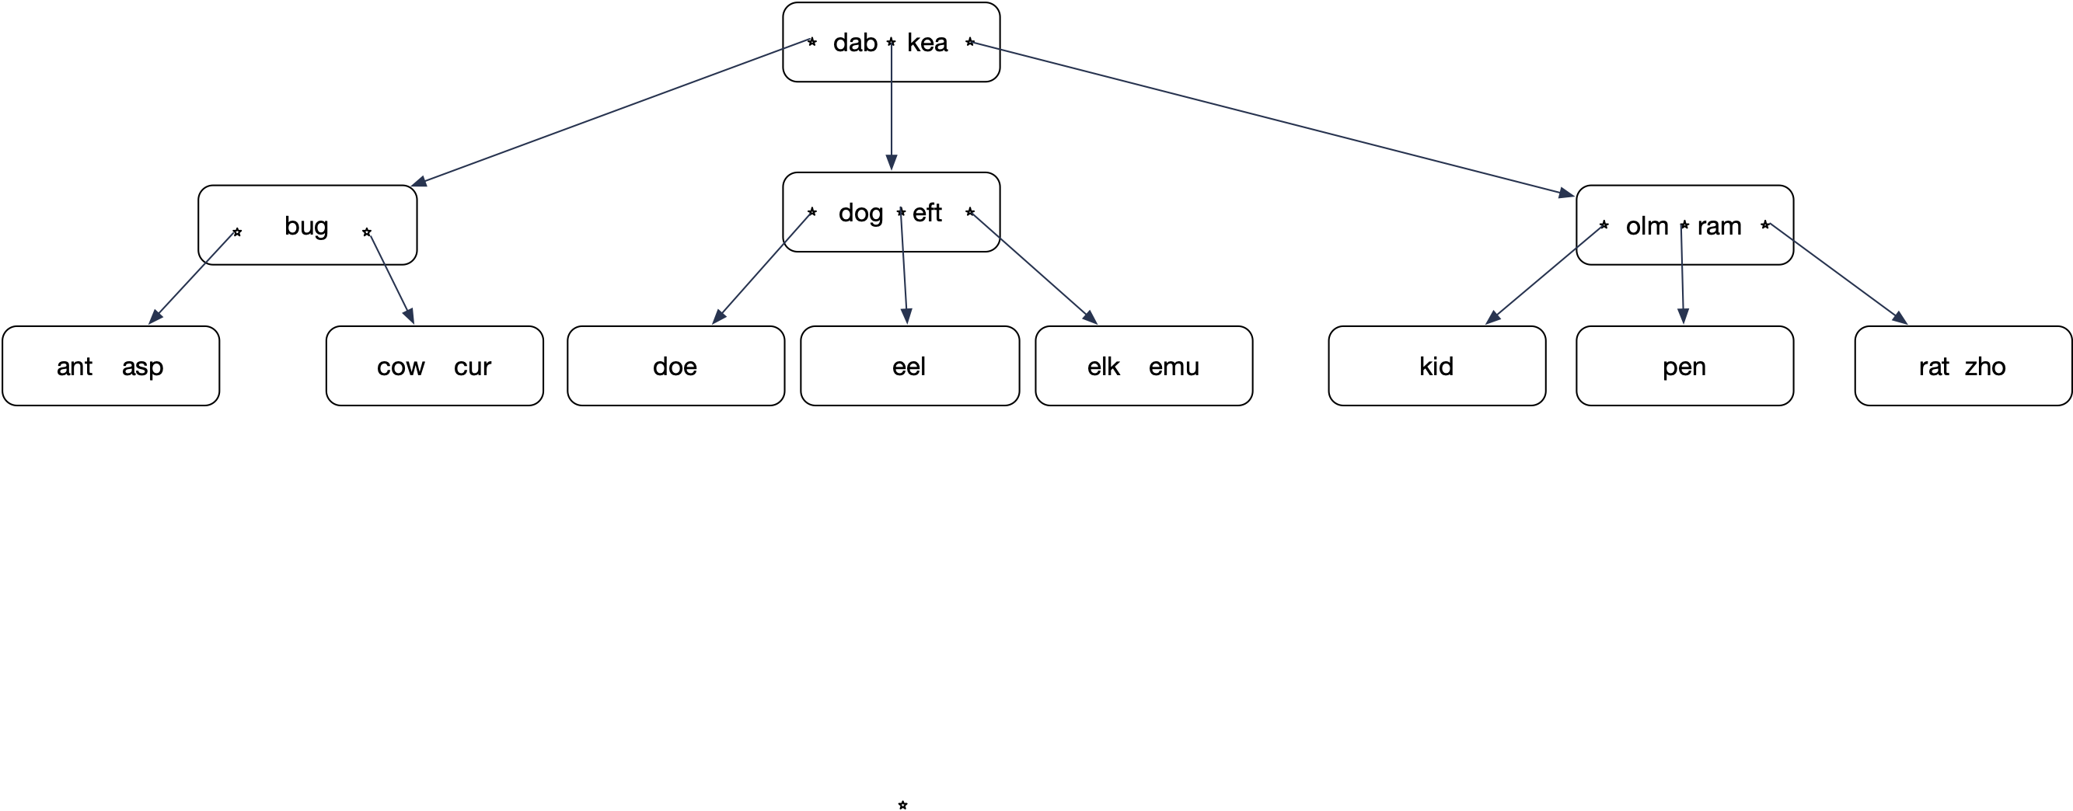
B-tree
Insert ewe into

Slide 32
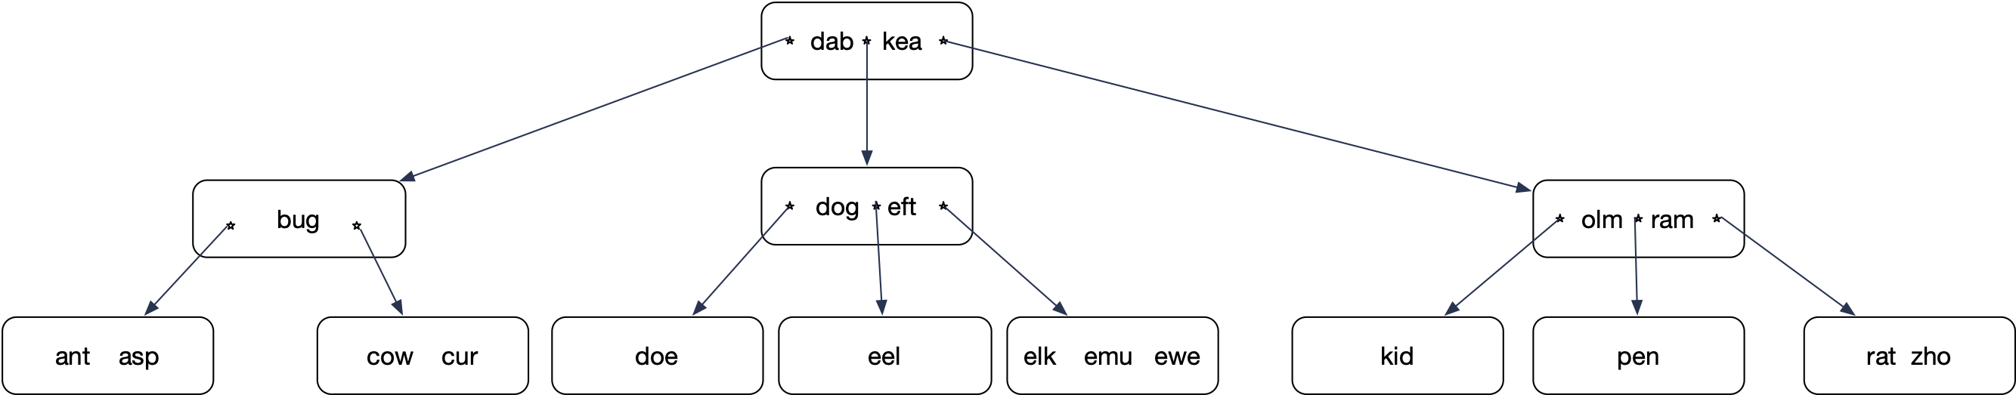
B-tree
Insert ewe

Slide 33
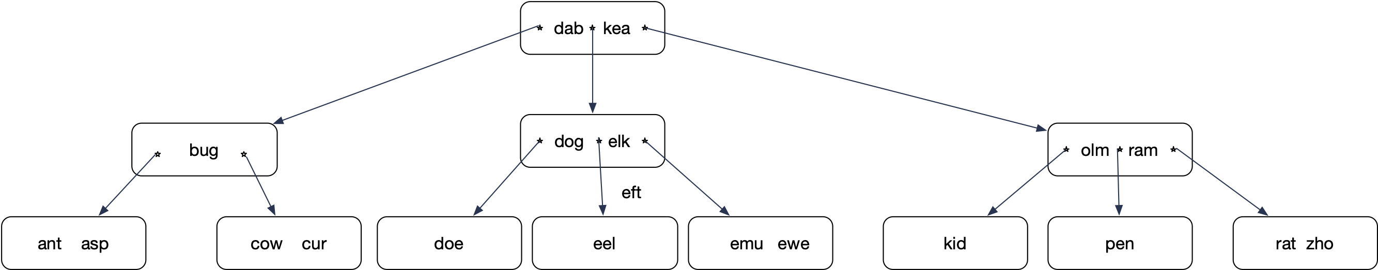
B-tree
Promote elk. elk is guaranteed to come right after eft.
Demote eft

Slide 34
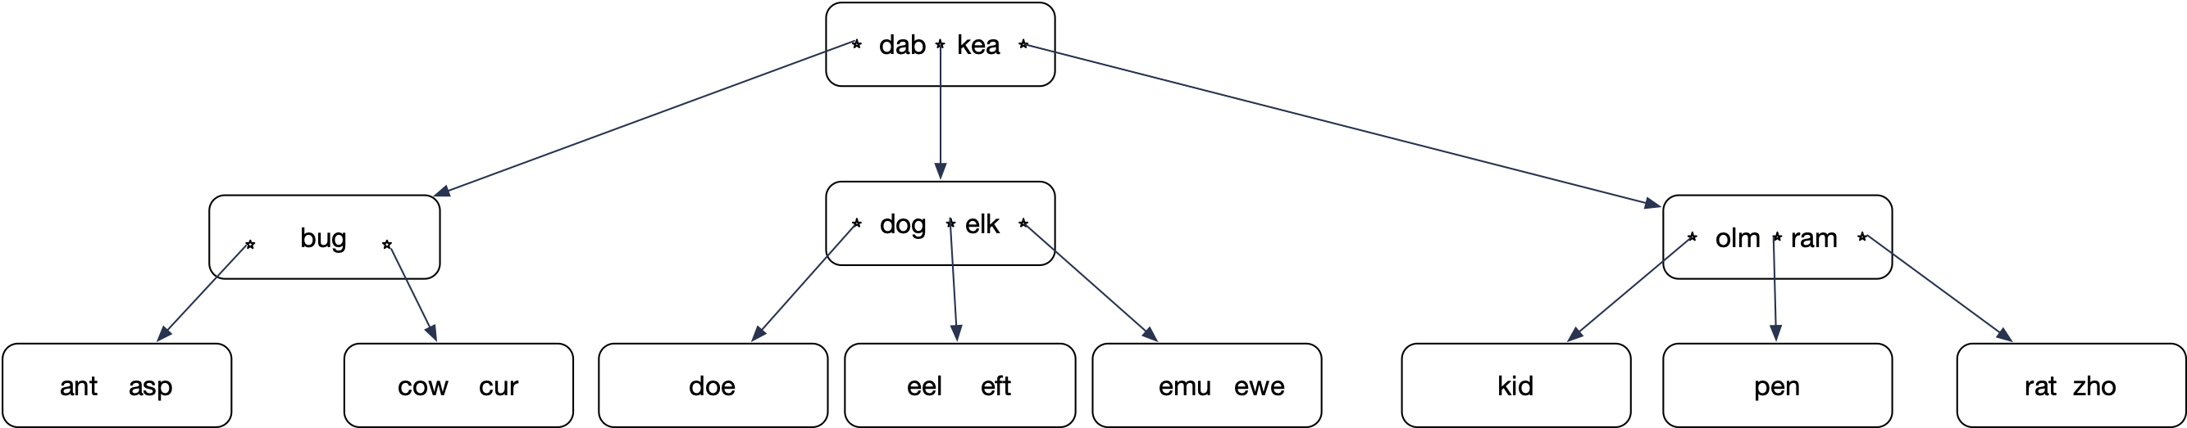
B-tree
Insert eft into the leaf node

Slide 35
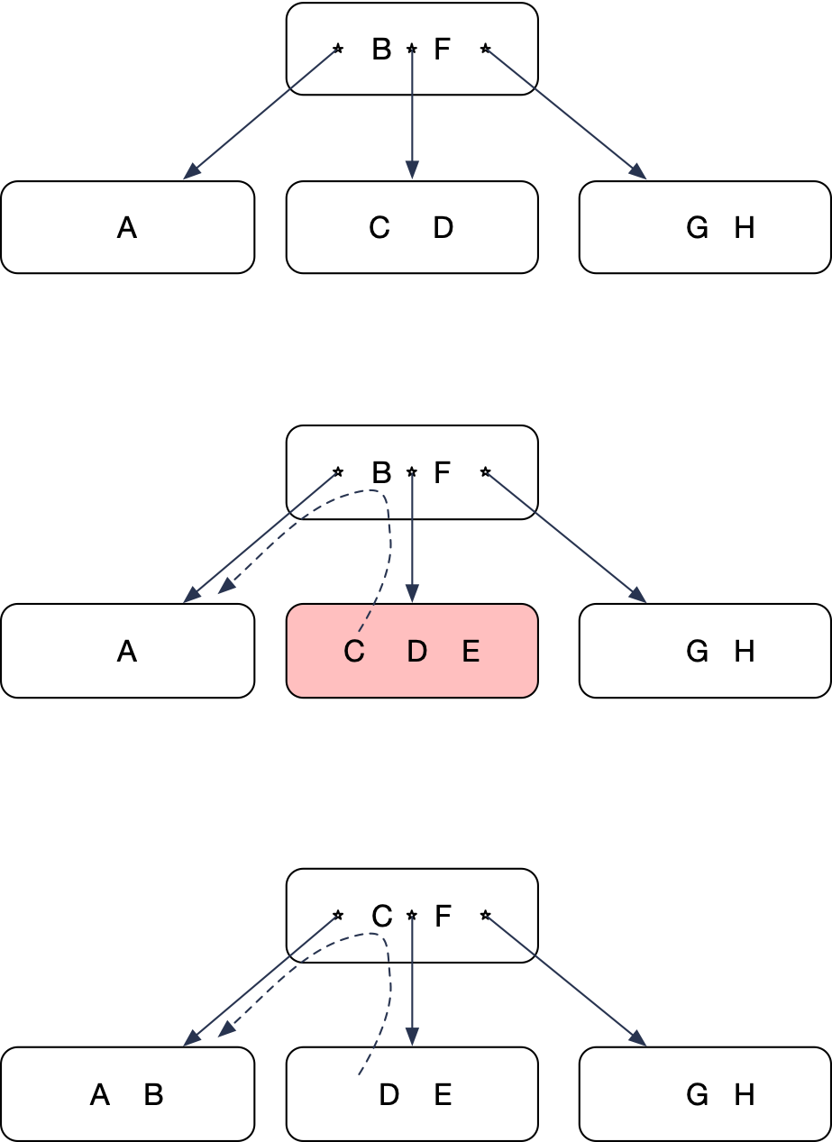
B-tree
Left rotate
  Overflowing node has a sibling to the left with space
  Move left-most key up
  Lower left-most key

Slide 36
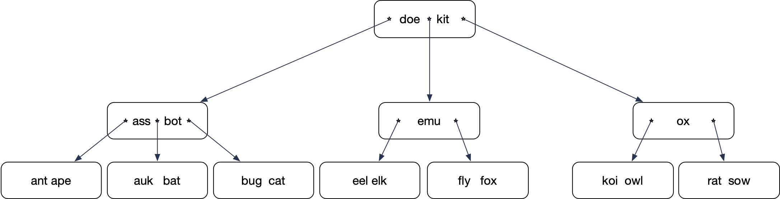
B-tree
Now insert “ai”

Slide 37
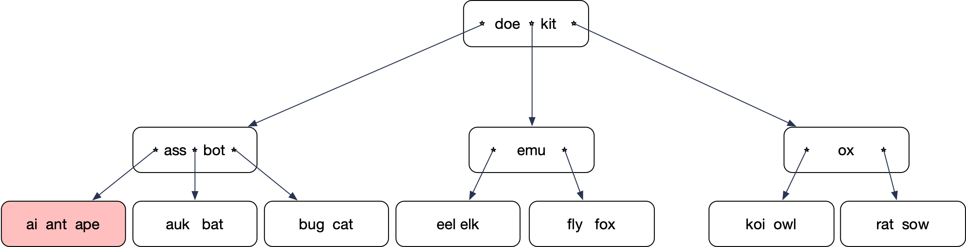
B-tree
Insert creates an overflowing node
Only one neighboring sibling, but that one is full
Split!

Slide 38
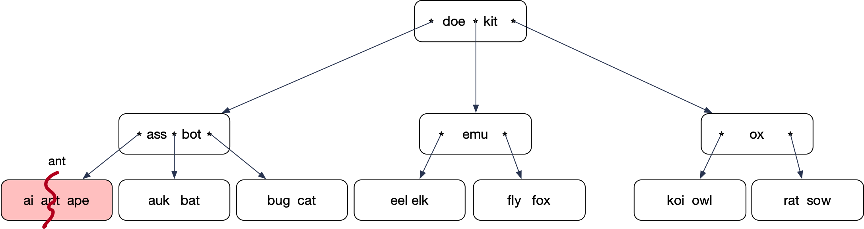
B-tree
Middle key moves up

Slide 39
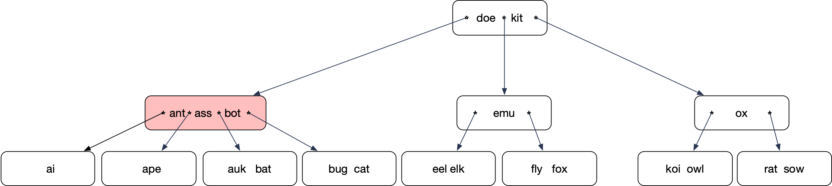
B-tree
Unfortunately, this gives another overflow
But this node has a right sibling not at full capacity

Slide 40
B-tree
Right rotate:
Move “bot” up
Move “doe” down
Reattach nodes

Slide 41
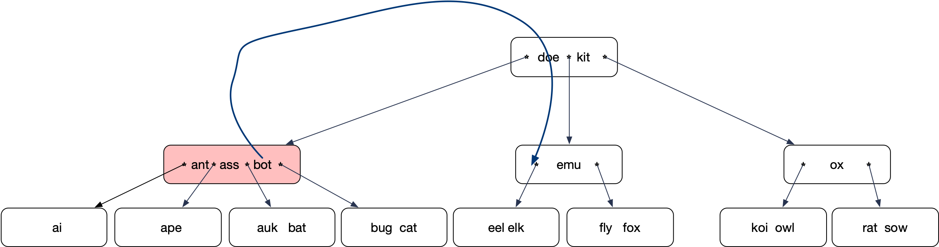
B-tree
Move “bot” up
Move “doe” down
Reattach the dangling node

Slide 42
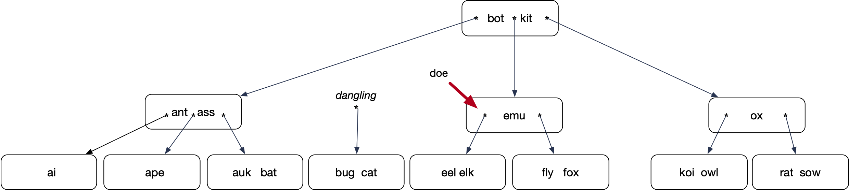
B-tree
“bot” had moved up
and replaced doe
The “emu” node needs
to receive one key and
one pointer

Slide 43
B-tree

Slide 44
B-tree
Deletes
  Usually restructuring not done because there is no need
  Underflowing nodes will fill up with new inserts

Slide 45
B-tree
Implementing deletion anyway:
  Can only remove keys from leaves
  If a delete causes an underflow, try a rotate into the underflowing node
  If this is not possible, then merge with a sibling
    A merge is the opposite of a split
  This can create an underflow in the parent node
    Again, first try rotate, then do a merge

Slide 46
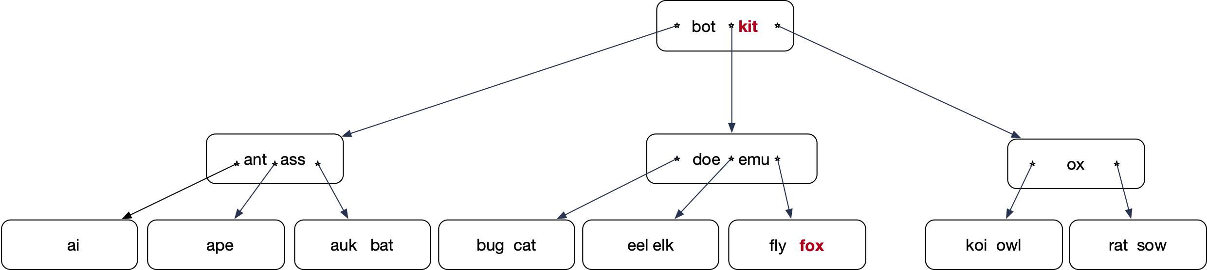
B-tree
Delete “kit”
Delete “kit”
“kit” is in an interior node.
Exchange it with the key in the leave
immediately before
“fox”

Slide 47
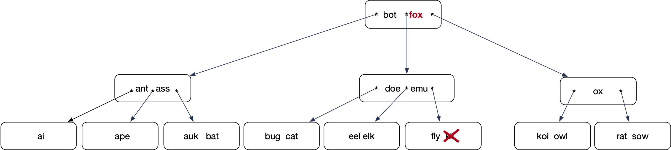
B-tree
After interchanging “fox” and “kit”, can delete “kit”

Slide 48
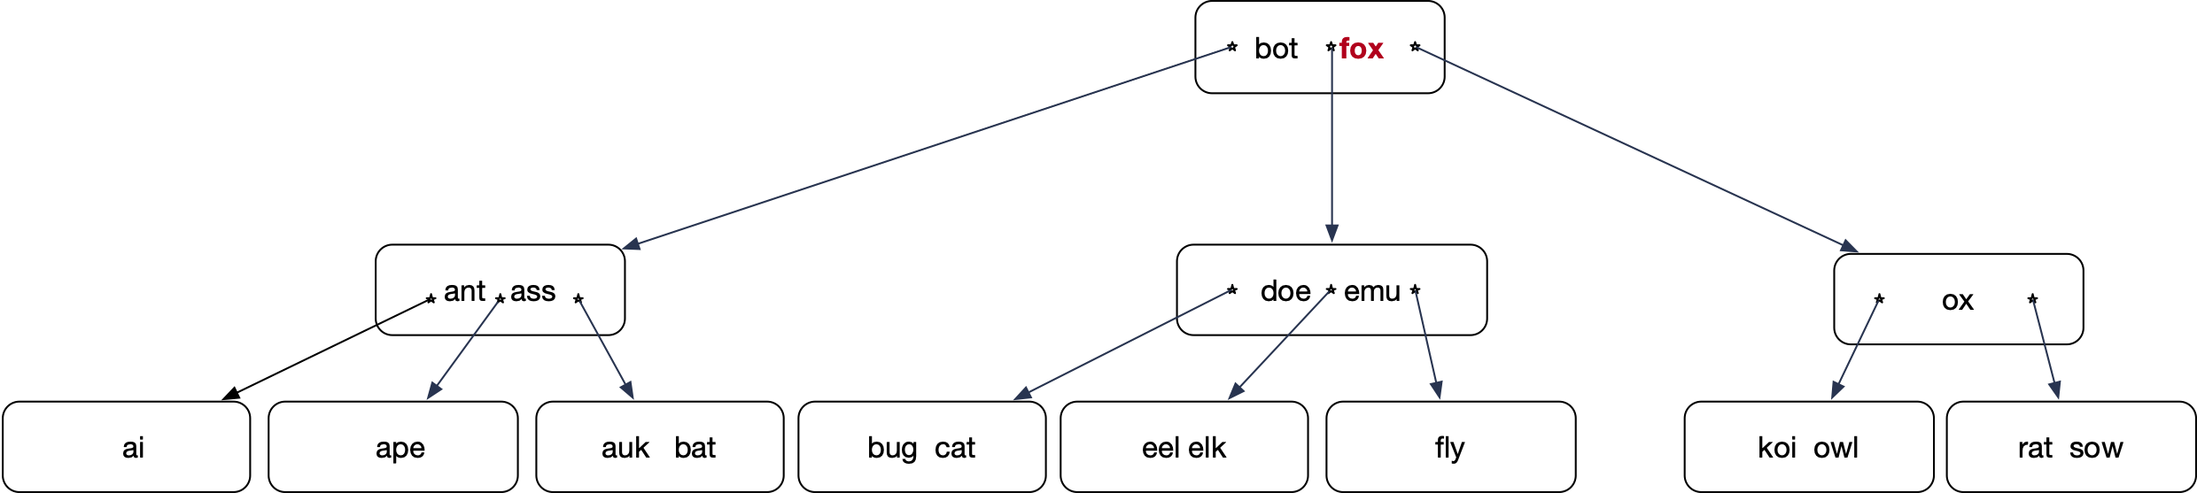
B-tree
Now delete “fox”

Slide 49
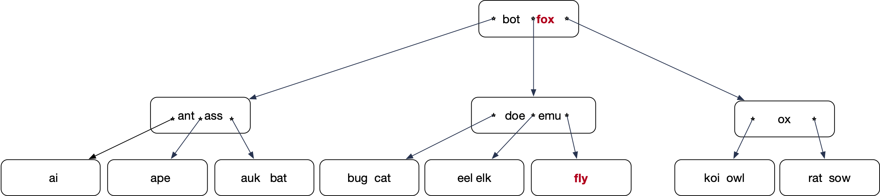
B-tree
Step 1: Find the key. If it is not in a leaf
Step 2: Determine the key just before it, necessarily in a leaf
Step 3: Interchange the two keys

Slide 50
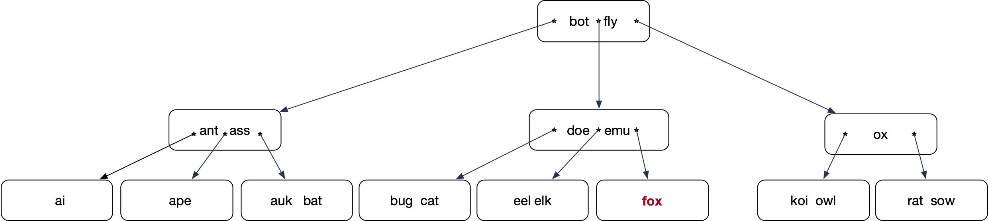
B-tree
Step 4: Remove the key now from a leaf

Slide 51
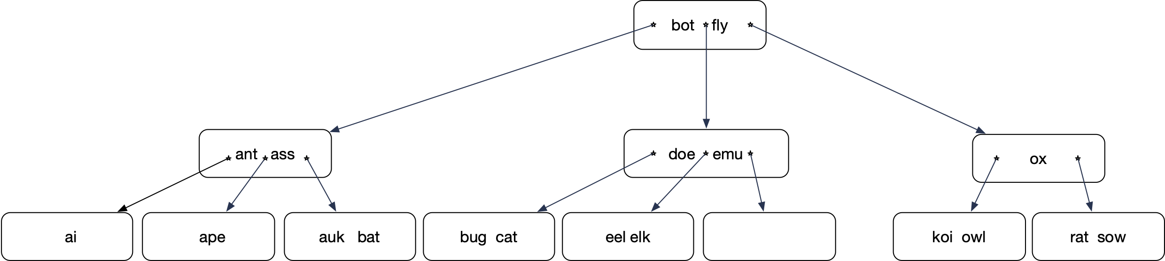
B-tree
This causes an underflow
Remedy the underflow by right rotating from the sibling

Slide 52
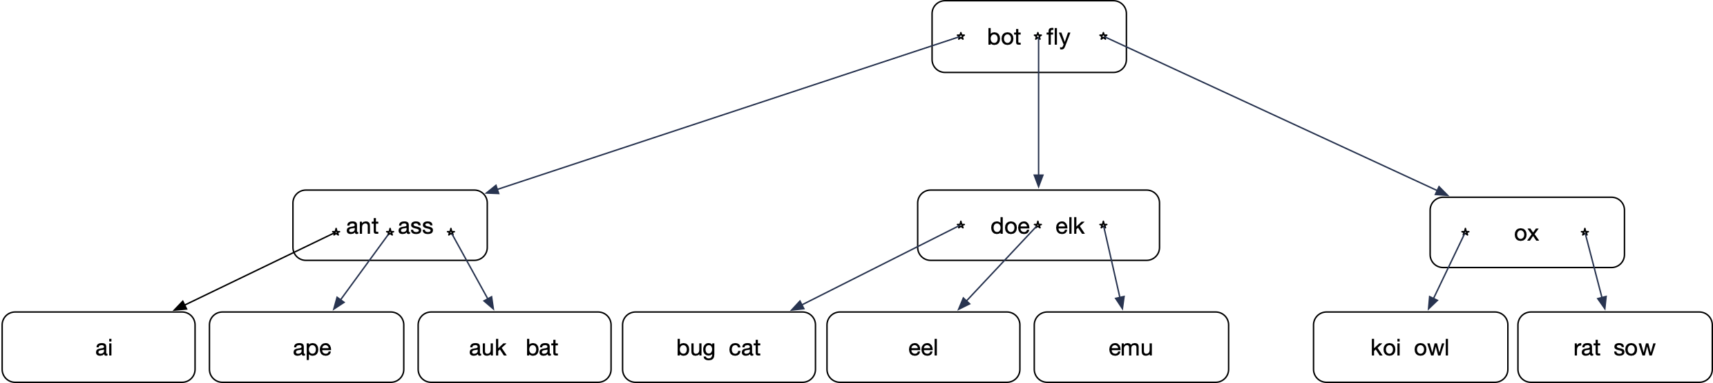
B-tree
Everything is now in order

Slide 53
B-tree
Now delete fly

Slide 54
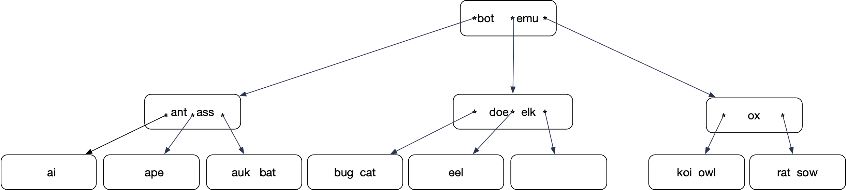
B-tree
Switch “fly” with “emu”
remove “fly” from the leaf
Again: underflow

Slide 55
B-tree
Cannot left-rotate: There is no left sibling
Cannot right-rotate: The right sibling has only one key
Need to merge: Combine the two nodes by bringing down “elk”

Slide 56
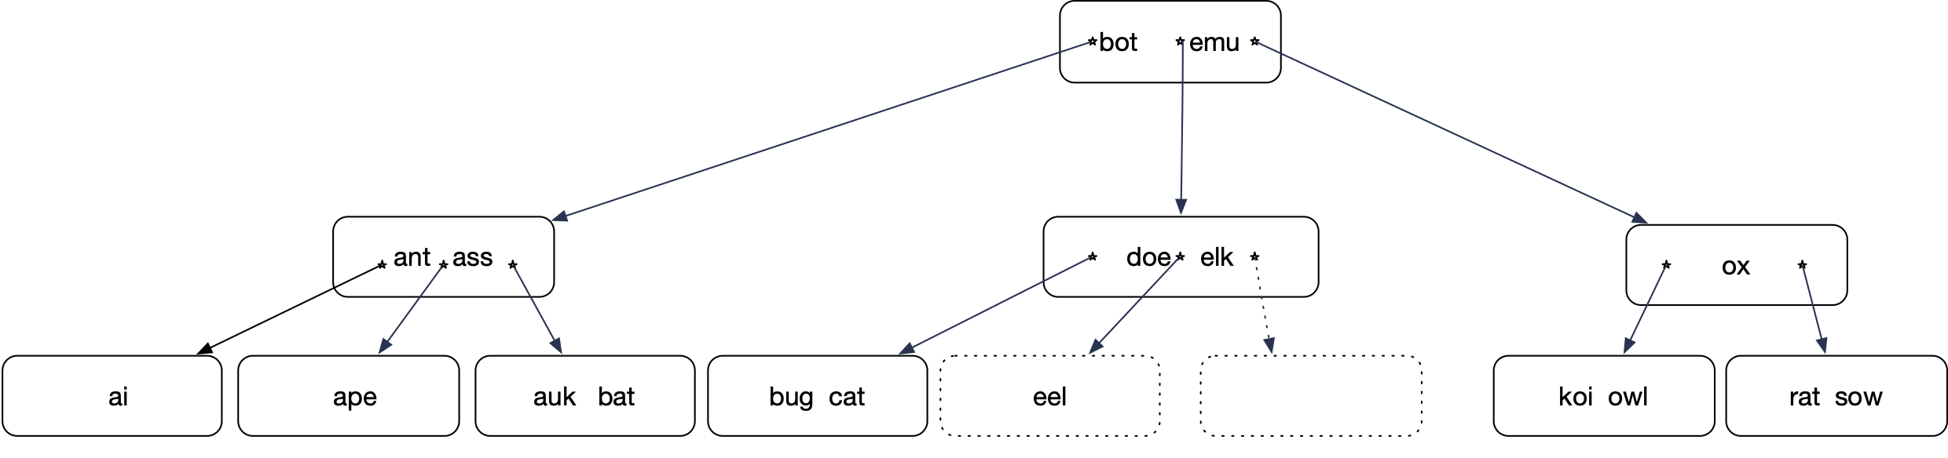
B-tree
We can merge the two nodes because
the number of keys combined is less than 2 k

Slide 57
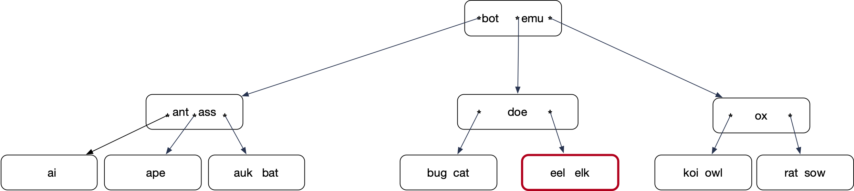
B-tree

Slide 58
B-tree
Delete “emu”

Slide 59
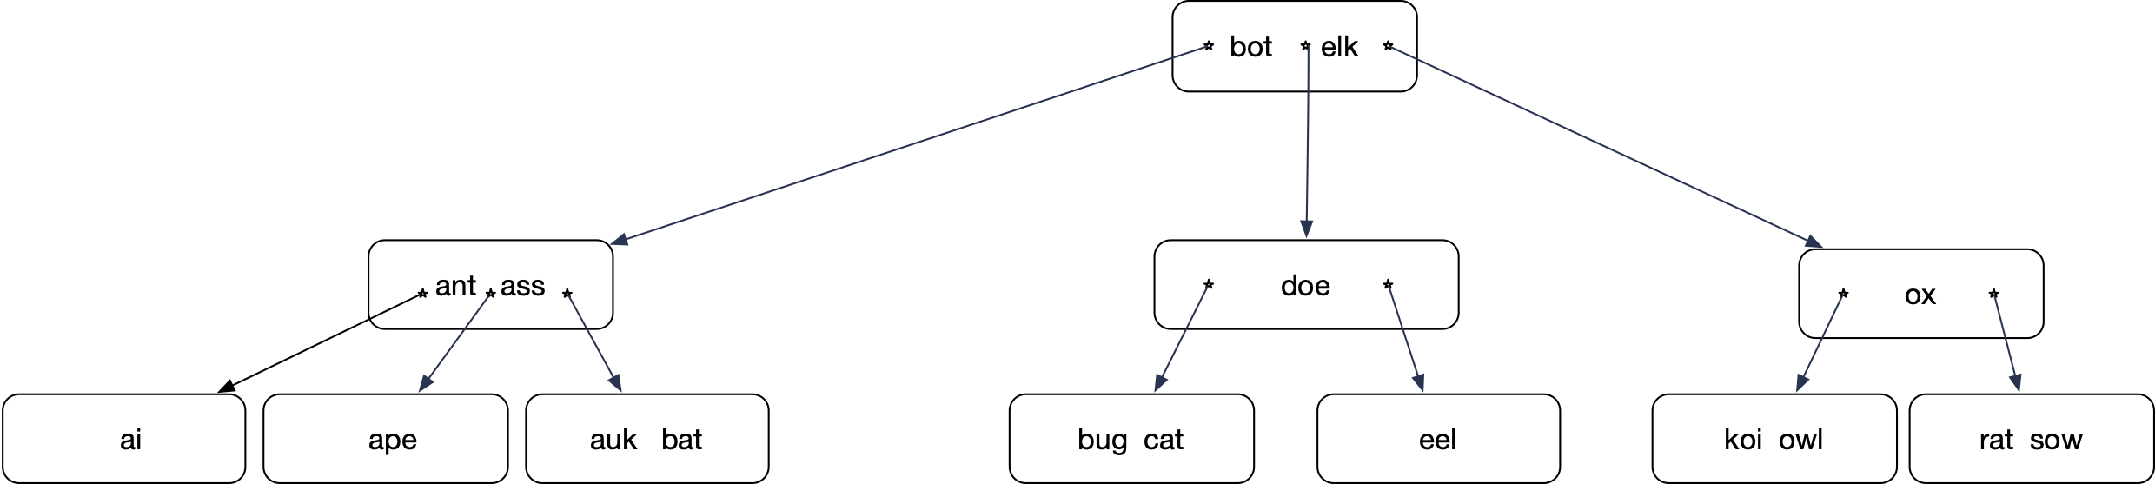
B-tree
Switch predecessor, then delete from node

Slide 60
B-tree
Now delete “elk”

Slide 61

B-tree
Results in an underflow

Slide 62
B-tree
Results in an underflow
But can rotate a key into the
underflowing node

Slide 63
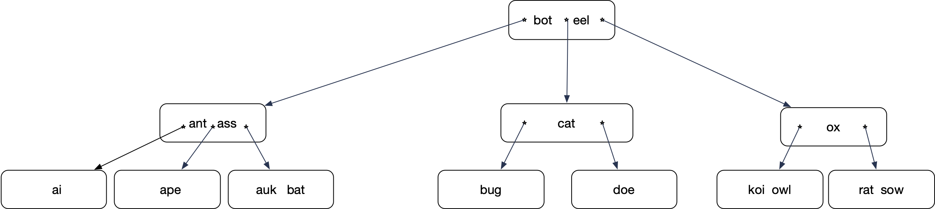
B-tree
Result after left-rotation

Slide 64
B-tree
“Now delete “eel”

Slide 65

B-tree
Interchange “eel” with its predecessor
Delete “eel” from leaf:
Underflow

Slide 66
B-tree
Need to merge

Slide 67
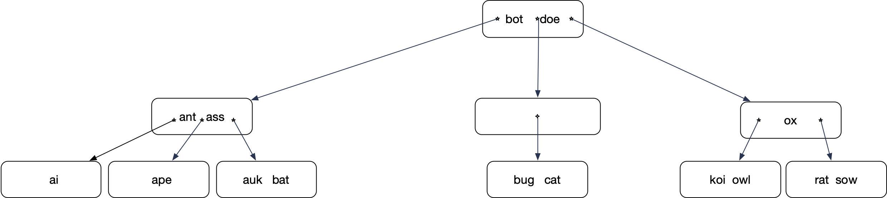
B-tree
Merge results in another underflow
Use right rotate
(though merge with right sibling
is possible)

Slide 68
B-tree
“ass” goes up, “bot” goes down
One node is reattached

Slide 69
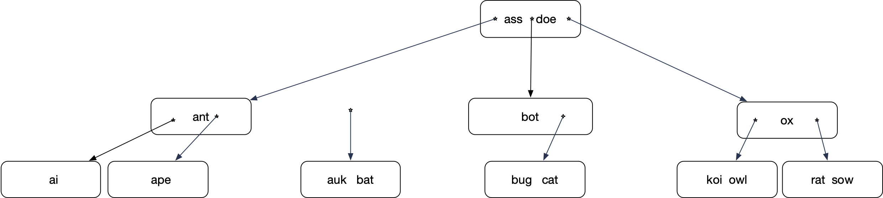
B-tree
Reattach node

Slide 70
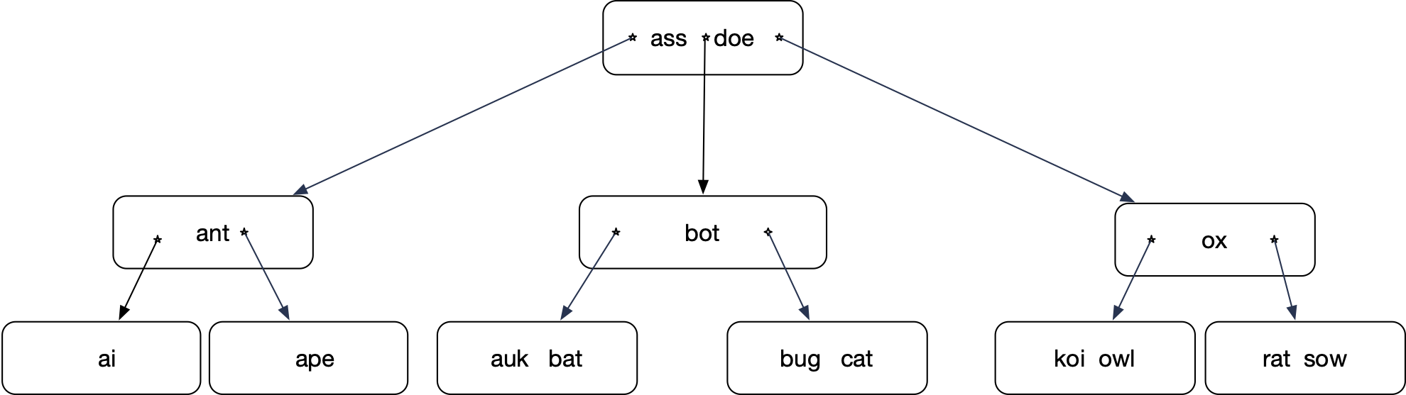
B-tree

Slide 71
In real life
Use B+ tree for better access with block storage
  Data pointers / data are only in the leaf nodes
  Interior nodes only have keys as signals
  Link leaf nodes for faster range queries.

Slide 72
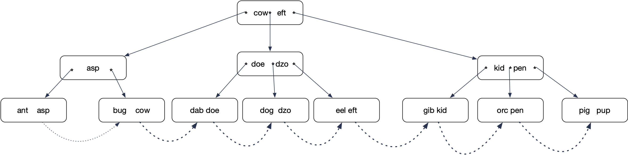
B+ Tree

Slide 73
B+ Tree
Real life B+ trees:
  Interior nodes have many more keys (e.g. 100)
  Leaf nodes have as much data as they can keep
  Need few levels:
    Fast lookup

Slide 74
Hashing
Basic idea: Place records in a bucket defined by the hash value of the key
  Hash value: Pseudo-random number
Extensible hashing:
  Number of buckets increases with number of records through bucket splits
    Extendible hashing (Fegan): Update a data structure in order to find out which buckets are split
    Linear Hashing (Litwin): Buckets split in order

Slide 75
Linear Hashing

Slide 76
Linear Hashing
Extensible Hashing:
  Uses a lot of metadata to reflect history of splitting
    But only splits buckets when they are needed
  Linear Hashing
    Splits buckets in a predefined order
    Minimal meta-data
    Sounds like a horrible idea, but …

Slide 77
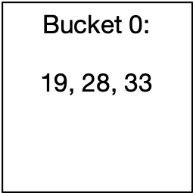
Linear Hashing
Assume a hash function that creates a large string of bits
  We start using these bits as we extend the address space
  Start out with a single bucket, Bucket 0
  All items are located in Bucket 0
Items with keys 19, 28, 33

Slide 78
Linear Hashing
Eventually, this bucket will overflow
  E.g. if the load factor is more than 2
  Bucket 0 splits
  All items in Bucket 0 are rehashed:
    Use the last bit in order to determine whether the item goes into Bucket 0 or Bucket 1
    Address is
$$h_{1}(c)=c(mod2)$$

Slide 79
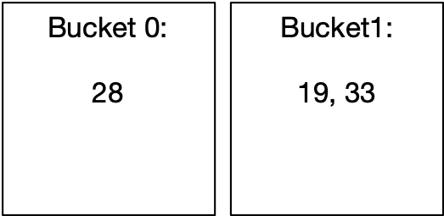
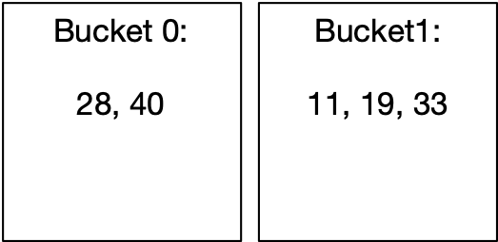
Linear Hashing
After the split, the hash table has two buckets:
After more insertions, the load factor again exceeds 2

Slide 80
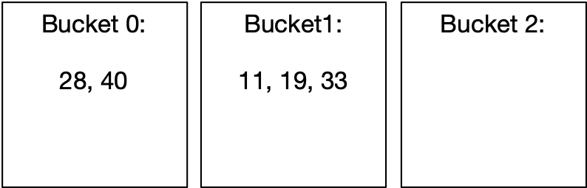
Linear Hashing
Again, the bucket splits.
  But it has to be Bucket 0
  For the rehashing, we now use two bits, i.e.
    But only for those items in Bucket 0
$$h_{2}(c)=c(mod4)$$

Slide 81
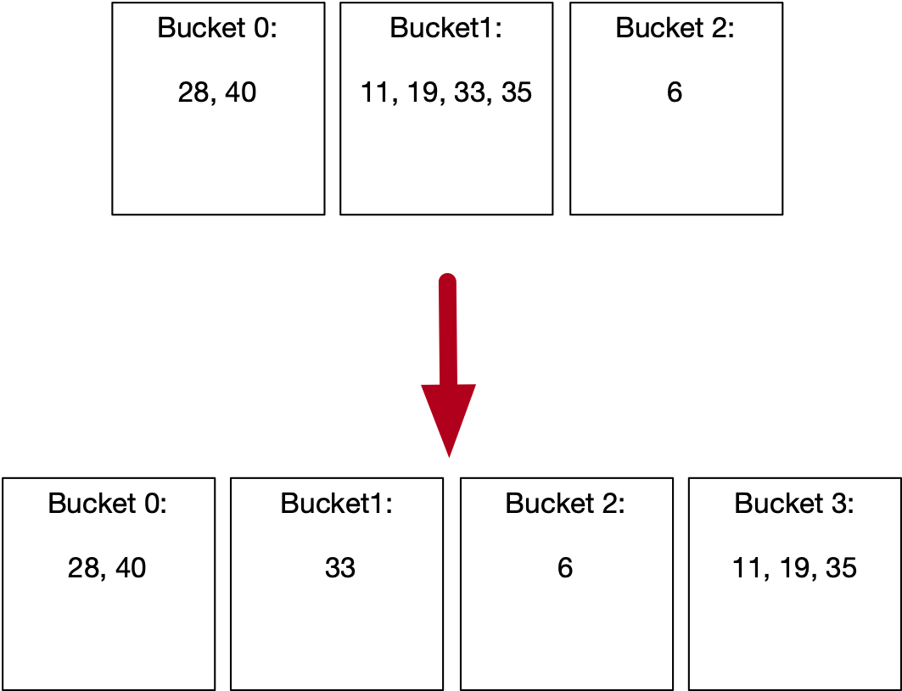
Linear Hashing
After some more insertions, Bucket 1 will split

Slide 82
Linear Hashing
The state of a linear hash table is described by the number of buckets
  The level is the number of bits that are being used to calculate the hash
  The split pointer points to the next bucket to be split
  The relationship is
    This is unique, since always
$$N$$
$$l$$
$$s$$
$$N=2^{l}+s$$
$$s<2^{l}$$

Slide 83
Linear Hashing
Addressing function
  The address of an item with key is calculated by
  This reflects the fact that we use more bits for buckets that are already split
$$c$$
def address(c):
    a = hash(c) % 2**l
    if a < s:
        a = hash(c) % 2**(l+1)
        return a

Slide 84
Linear Hashtable Evolution
$$N=1=2^{0}+0$$
def address(c):
    a = hash(c) % 2**l
    if a < s:
        a = hash(c) % 2**(l+1)
        return a
Number of buckets: 1
Split pointer: 0
Level: 0

Slide 85
Linear Hashtable Evolution
$$N=2=2^{1}+0$$
def address(c):
    a = hash(c) % 2**l
    if a < s:
        a = hash(c) % 2**(l+1)
        return a
Number of buckets: 2
Split pointer: 0
Level: 1
Add items with hashes 40 and 11
This gives an overflow and we split Bucket 0

Slide 86
Linear Hashtable Evolution
$$N=3=2^{1}+1$$
def address(c):
    a = hash(c) % 2**l
    if a < s:
        a = hash(c) % 2**(l+1)
        return a
Number of buckets: 3
Split pointer: 1
Level: 1
split Bucket 0
Create Bucket 2
Use new hash function on items in Bucket 0
No items were moved

Slide 87
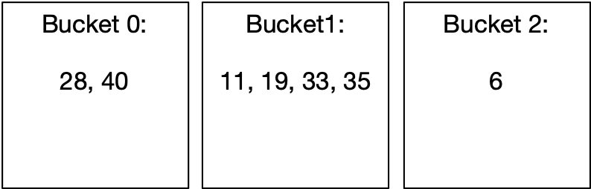
Linear Hashtable Evolution
$$N=3=2^{1}+1$$
def address(c):
    a = hash(c) % 2**l
    if a < s:
        a = hash(c) % 2**(l+1)
        return a
Number of buckets: 3
Split pointer: 1
Level: 1
Add items 6, 35
Because of overflow, we split
Bucket 1

Slide 88
Linear Hashtable Evolution
$$N=4=2^{2}+0$$
def address(c):
    a = hash(c) % 2**l
    if a < s:
        a = hash(c) % 2**(l+1)
        return a
Number of buckets: 4
Split pointer: 0
Level: 2

Slide 89
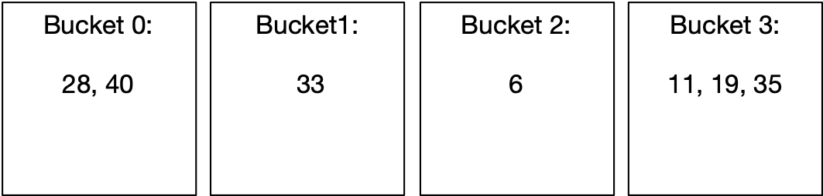
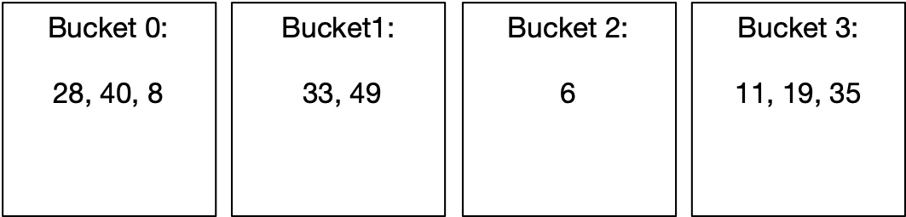
Linear Hashtable Evolution
$$N=4=2^{2}+0$$
def address(c):
    a = hash(c) % 2**l
    if a < s:
        a = hash(c) % 2**(l+1)
        return a
Number of buckets: 4
Split pointer: 0
Level: 2
Now add keys 8, 49
Creates an overflow!
Need to split!

Slide 90
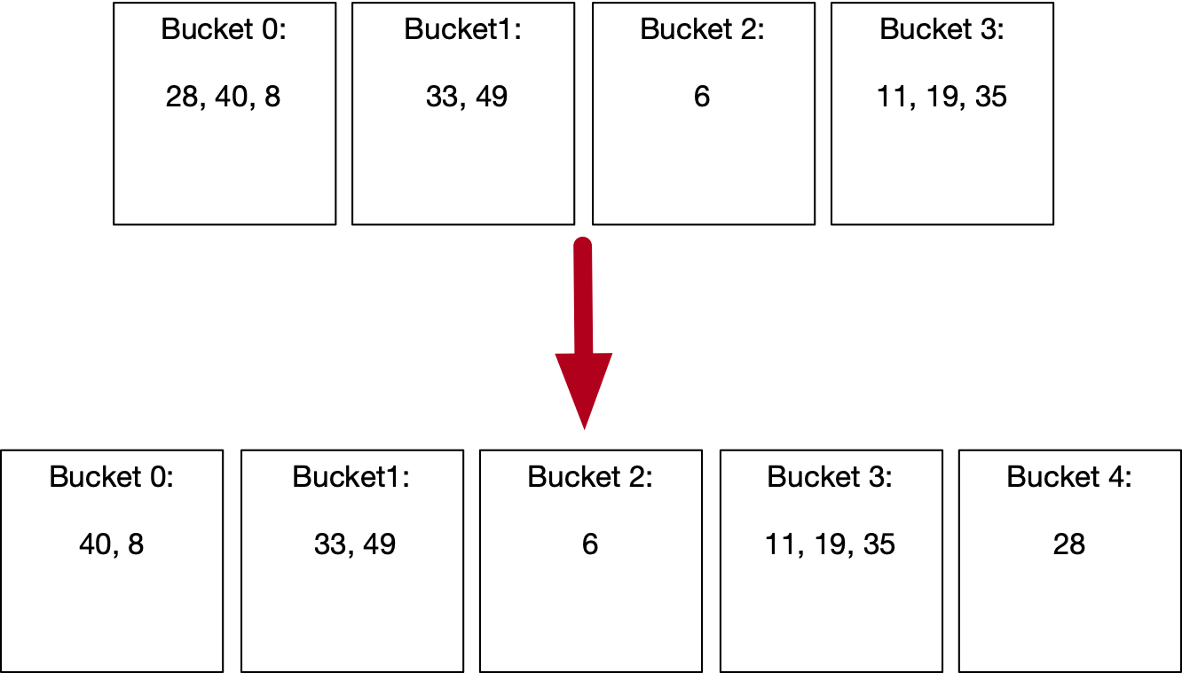
Linear Hashtable Evolution
$$N=5=2^{2}+1$$
def address(c):
    a = hash(c) % 2**l
    if a < s:
        a = hash(c) % 2**(l+1)
        return a
Number of buckets: 1
Split pointer: 1
Level: 2
Create Bucket 4.
Rehash Bucket 0.

Slide 91
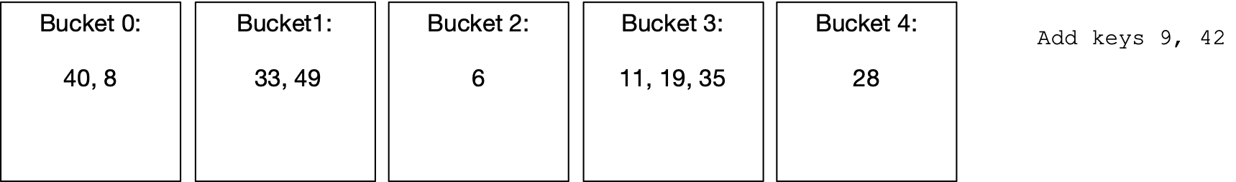
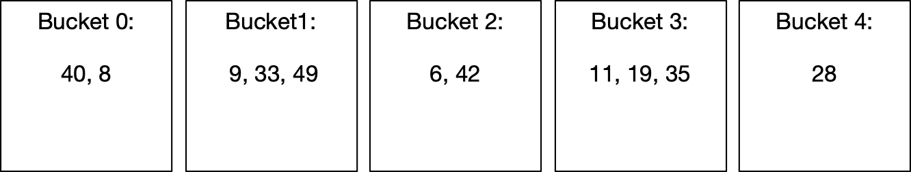
Linear Hashtable Evolution
$$N=5=2^{2}+1$$
def address(c):
    a = hash(c) % 2**l
    if a < s:
        a = hash(c) % 2**(l+1)
        return a
Number of buckets: 5
Split pointer: 1
Level: 2
Creates an overflow!
Need to split!

Slide 92
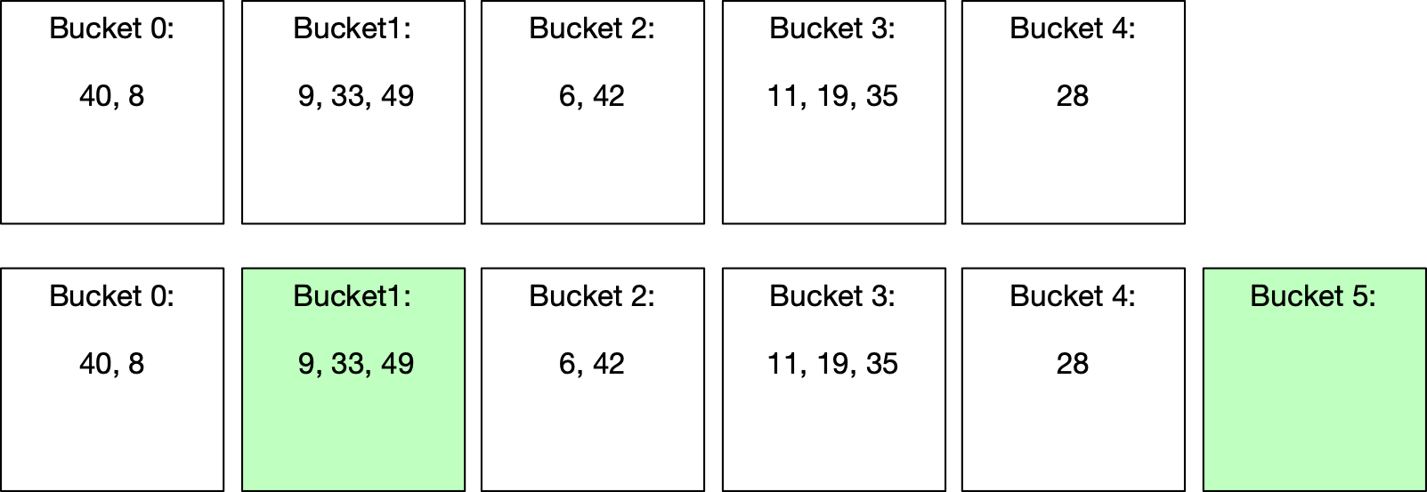
Linear Hashtable Evolution
$$N=6=2^{2}+2$$
def address(c):
    a = hash(c) % 2**l
    if a < s:
        a = hash(c) % 2**(l+1)
        return a
Number of buckets: 1
Split pointer: 2
Level: 2
Split
No item actually moved, but average load factor is now
again under 2.

Slide 93
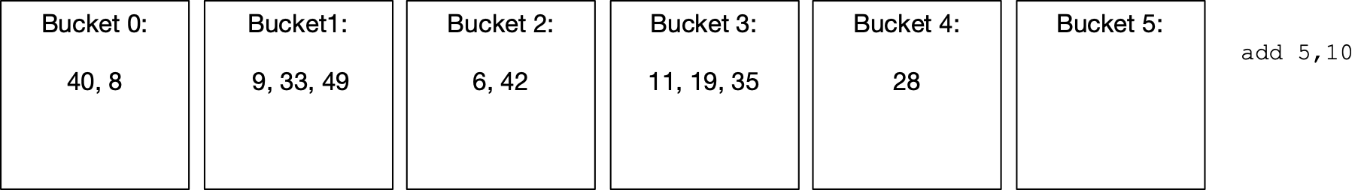
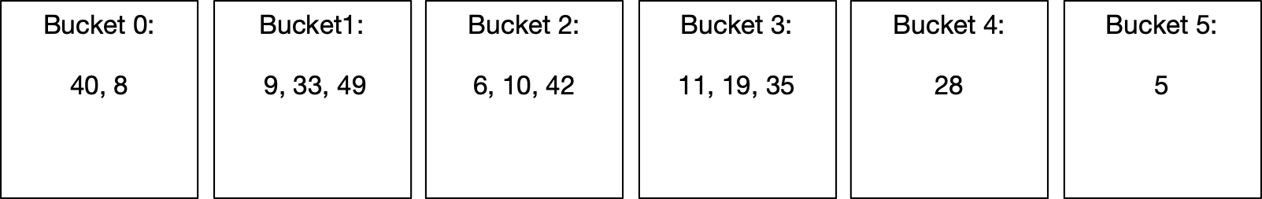
Linear Hashtable Evolution
$$N=6=2^{2}+2$$
def address(c):
    a = hash(c) % 2**l
    if a < s:
        a = hash(c) % 2**(l+1)
        return a
Number of buckets: 6
Split pointer: 2
Level: 2

Slide 94

Linear Hashtable Evolution
$$N=7=2^{2}+3$$
def address(c):
    a = hash(c) % 2**l
    if a < s:
        a = hash(c) % 2**(l+1)
        return a
Number of buckets: 7
Split pointer: 3
Level: 2

Slide 95


Linear Hashtable Evolution
$$N=7=2^{2}+3$$
def address(c):
    a = hash(c) % 2**l
    if a < s:
        a = hash(c) % 2**(l+1)
        return a
Number of buckets: 7
Split pointer: 3
Level: 2

Slide 96


Linear Hashtable Evolution
$$N=8=2^{3}+0$$
def address(c):
    a = hash(c) % 2**l
    if a < s:
        a = hash(c) % 2**(l+1)
        return a
Number of buckets: 8
Split pointer: 0
Level: 3

Slide 97


Linear Hashtable Evolution
$$N=8=2^{3}+0$$
def address(c):
    a = hash(c) % 2**l
    if a < s:
        a = hash(c) % 2**(l+1)
        return a
Number of buckets: 8
Split pointer: 0
Level: 3

Slide 98

Linear Hashtable Evolution
$$N=9=2^{3}+1$$
def address(c):
    a = hash(c) % 2**l
    if a < s:
        a = hash(c) % 2**(l+1)
        return a
Number of buckets: 9
Split pointer: 1
Level: 3

Slide 99

Linear Hashtable Evolution
$$N=9=2^{3}+1$$
def address(c):
    a = hash(c) % 2**l
    if a < s:
        a = hash(c) % 2**(l+1)
        return a
Number of buckets: 9
Split pointer: 1
Level: 3

Slide 100

Linear Hashtable Evolution
$$N=10=2^{3}+2$$
def address(c):
    a = hash(c) % 2**l
    if a < s:
        a = hash(c) % 2**(l+1)
        return a
Number of buckets: 10
Split pointer: 2
Level: 3

Slide 101
Linear Hashing
Observations:
  Buckets split in fixed order
    0, 0,1, 0, 1, 2, 3, 0, 1, 2, 3, 4, 5, 6, 7, 0, 1, 2, …, 15, 0, …
    Address calculation is modulo , i.e. the l least significant bits
    Buckets 0, 1, …, s-1 and 2**l, 2**l+1, … N-1 are already split, they have on average half the size of the buckets s, s+1, …, 2**l.
$$2^{l}$$

Slide 102
Linear Hashing
Observations:
  An overflowing bucket is not necessarily split immediately
  Sometimes, a split leaves all keys in the splitting bucket or moves them all to the new bucket
On average, a bucket will have α items in them

Slide 103
Grid Files

Slide 104
Grid Files
Many data structures support multi-dimensional indexing
  Works up to moderate dimensions
    Geometry of large dimensional spaces is weird

Slide 105
KD Trees
KD-trees are binary trees where each node is a point in a k-dimensional space
  Each point divides the space according to a hyperplane

Slide 106

KD Trees
Two-dimensional example
  Initially, the whole plane is in a single bucket
  Then we split the bucket along the y-axis,
    creating two halves

Slide 107

KD Trees
As we insert more records, we want to subdivide the buckets

Slide 108

KD-Tree
The separating axis switches from vertical to horizontal

Slide 109

KD-Tree
We select the splitting plane such that it divides the current set of points into halves

Slide 110

KD-Trees

Slide 111

KD-Trees

Slide 112

KD-Trees

Slide 113
KD-Trees
This is only one example of many multi-dimensional data structures

Slide 114
Physical Query Plan Execution

Slide 115

Overview

Slide 116
Physical Query Plan Costs
Usually completely dominated by the cost of I/O
  Will change with changes in the memory hierarchy

Slide 117
Scanning Tables
Table-scan
  Relation is stored in an area of storage
  Fetch blocks one by one (using prefetching)
Index-scan
  If the relation has an index
    Index has LBAs of all blocks storing tuples (using prefetching)

Slide 118
Scanning Tables
Sort-scan:
  As we read a table into main memory:
    Can sort it
      Using various data structures
Sometimes a by-product of the table scan
  E.g.: Index scan using a B-tree

Slide 119
Iterators
Records can be clustered or scattered
  This can make performance prediction difficult
Use iterators to implement table scanning:
  Open, Next, Close operations

Slide 120

One Pass Operations
Selection and projection just need to look at one record at a time

Slide 121

One Pass Operations
Can often be combined with full or partial duplicate elimination
  Keep seen records in efficient data structure

Slide 122
Join Implementation
Join (on equality) is the most important database operation for performance purposes

Slide 123

One Pass Join Implementation
Load smaller table into a data structure
Read larger table row by row, compare with data structure

Slide 124
One and a half pass join implementation
Nested Loop Joins
  Idea: If both tables are too big for a one pass, break one table into smaller pieces
    Can be done tuple by tuple
    Or block by block

Slide 125

One and a half pass join implementation

Slide 126

Sorting in Two Passes
Break big table into blocks
Sort each block
Merge-sort to generate single ordered table:
  Point to beginning tuple in each block
  Write the smallest tuple pointed to into the sorted table
  Advance pointer

Slide 127
Two Pass Operations
Same trick can be used for:
  duplicate elimination
  grouping and aggregation

Slide 128
Join Implementations
Sort-merge join
  Sort both tables by the joining predicate
  Create two cursors (pointers) into each table
  Advance the cursors step by step:
    emitting a new tuple whenever the cursors point to a row with the same value for the join attribute

Slide 129

Join Implementations
We join on the white attribute
We sort both tables on the
white attribute
Create two cursors
into the sorted tables.
Whenever the cursor
points to rows with
the same white
attribute value, emit a
new row. Careful if
values repeat.

Slide 130
Join Implementations
Index join
  Can create an index on both tables
    Unless index already exists
  Use the index as the target for each cursor

Slide 131

Join Implementations

Slide 132
Join Implementations
Hash Join
  Select the smaller table as the build side
    Hash the (addresses of the) tuples in the build side
    Go through the other (the probe) table row by row
      For each value, look up the hash bucket of the attribute value and see whether you need to create a row of the join

Slide 133

Join Implementations
Table 2 is hashed
For each row in Table 1,
we join with the rows in
the corresponding hash
bucket.
Here, the hash function
is attribute value modulo
4.

Slide 134
Join Implementations
If neither table fits into memory
  Need a two pass algorithm
    Example: $R$, $S$ have 5,000 and 10,000 blocks each
      We have a ridiculously low number of 101 blocks in memory

Slide 135
Join Implementation
Idea:
  We create hash buckets for each table independently
  We read a block from the table
  Each record in the table is put in one bucket
    For each bucket, we keep one block in memory
      If block is full, we move the block to disk and open up a fresh one

Slide 136

Join Implementation
One Pass Hashing for a Relational Table

Slide 137
Join Implementation
The number of buckets is limited by the number of blocks in main memory
This method reads all blocks of a table
  and writes the same number of blocks back
    unless there is a projection or selection executed simultaneously

Slide 138
Join Implementation
To join $R$ and $S$:
  Create hash table with 100 buckets each
    Costs $2×5000+2×10000=30000$ IO
    A bucket of R uses approximately 50 blocks
  Bring in one block of the corresponding bucket from $S$
    Calculate the join
    This needs only space for 52 blocks
    Adds 15000 IO for reading the hashed versions of $R$ and $S$
    Needs also write the result

Slide 139
Combined Operations

Slide 140
Pipelining vs. Materialization
Combination: Can do some tuple based operations together: e.g. selection and projection for a single table
Materialization: Write results of an operation into an intermediate table
Pipelining: Moving results from one operation to inputs of another operation

Slide 141
Pipelining vs. Materialization
Example for pipelining: Calculate $\left(R(w,x)⋈S(x,y)\right)⋈T(y,z)$
  Assume: R has 5,000 blocks, S and T 10,000 blocks
  Both joins will be implemented as hash joins
    one pass or two pass
  We only have 102 block buffers available
    This is a very low number

Slide 142

Pipelining vs. Materialization
To join $R$ and $S$:
  Neither table fits into main memory, so we need a two-pass hash-join
    Join $R$ and $S$ in $45000+k$ I/O
    If $k$ is small (<45 blocks), keep result in MM
    Materialization: use a 1-pass hash join with T: $k+10000$ I/O
    Pipeline (because the second pass of the join of $R$ and $S$ does not need all the space) we save $2k$ I/O

Slide 143
Pipelining vs. Materialization
If the output of the join of $R⋈S$ does not fit in MM, we can still pipeline with a trick
  The second phase of the join of $R⋈S$ leaves 50 blocks of MM space unused
  We use this space to hash $R⋈S$ into 50 buckets as before
  We assume that we already hashed $T$ into 50 buckets.
  We then hash-join $R⋈S$ and $T$
    This will work if a bucket of $R⋈S$ fits into 100 blocks
    Thus, $R⋈S$ should fit into 5000 blocks
Costs:
45000 IO for $R⋈S$
$k$ IO to store hashed
version of $R⋈S$
20000 IO to generate
hashed version of U
$k$ + 10000 to join U with
$$R⋈S$$
Total: $75000+2k$

Slide 144
Pipelining vs. Materialization
What happens if $R⋈S$ has $k>5000$ blocks?
  In this case, pipelining can be replaced with materialization
  Calculate $R⋈S$ using $45000+k$ I/O, storing the result on the disk
  Use $T$ as the build table, using 100 buckets, costing $20000$ I/O
  Now join with $R⋈S$, costing another $10000+2k$ I/Os

Slide 145
Query Optimization

Slide 146

Basics
Queries can be expressed as an operator tree

Slide 147
Basics
Any query can be expressed as many equivalent algebraic representation
Any algebraic representation can be represented by many operator trees
The throughput / response time of any execution of an operator tree can differ widely from timings for other operator trees
Each operator tree is a different "query plan"

Slide 148
Basics
Query optimization needs
  A "search space"
    Set of equivalent query plans
  An enumeration algorithm to search the search space
  A cost estimation technique
    Needs to deal with possibility for parallelism
      This is more important for SSD than for HDD

Slide 149
Basics
SPJ (Select Project Join) queries
  Standard SQL query consisting of select, project, and join operations

Slide 150


Basics
Linear Join
Bushy Join
The resulting queries are equivalent
  Execution times can vary considerably
  Dynamic Programming approach
    Principle of Optimality: If a subexpression is optimal, it is also best for the calculation of the whole expression

Slide 151


Basics
Principle of optimality
  If the execution of the whole tree is optimal
  then the execution of a subtree is also optimal

Slide 152
Query Cost Evaluation
Query plan costs depend on the size of the intermediate results
  For cost-estimation:
    Use heuristics
    Make assumptions on probability distributions
    Use statistics by using samples

