Slide 1
Introduction to Databases
Thomas Schwarz, SJ

Slide 2
Beginnings: Data Base Management Systems
1960: “Computerization”
Needs “totally integrated management information”
Beyond the capabilities of computation then
But:
disk storage + tapes
better processors
interactive terminals
Actually: batch processing of large files
Weekly payroll processing, accounts payable, customer statement generation

Slide 3
Beginnings: IDS
1960: General Electric: Bachman (Turing Award):
MIACS Materials/Manufacturing/Management Information and Control system
Integrated Data Store (IDS)
Problem Controller operating system
early transactional support
Data Structure Diagram

Slide 4
Beginnings: IDS
Two big problems:
Data is stored on tape in programmer defined formats
Adding a field or changing the format means rewriting all data
But the data is connected
So, one change breaks many programs
Today: We have things like file systems and standardized file formats that makes this easier

Slide 5
Beginnings: IDS
Second problem:
Using Random access storage (disks) efficiently
Easy to instruct program to pull data from a disk at a certain spot
But need to find the spot
Today: File systems make this so much easier

Slide 6
Beginnings: IDS
IDS integrates data files
Allows programming in high level programs
IDS introduces:
Storing and manipulating metadata about records
Enforces relationships between different record types
Ergo: protects database integrity
Introduces concept of transaction
A set of changes to records that need to be executed all or none at all
First system that interacts with teletypers

Slide 7
Beginnings: IDS
1964: Backup and recovery system was added
Report Generation was not integrated:
All access to database is programmatic

Slide 8
Beginnings: Codasyl
CODASYL - standards body for data processing industry
Created and promoted COBOL
1969: Report documenting foundational concepts and vocabulary:
Data Definition Language
Data Manipulation Language
Schemas
Data independence and program independence
Adds:
“Privacy locks”
Sub-schemas (like modern views)

Slide 9
Underlying technology
“Network Data Model”
Data items are collections of records
Relationships among data is represented by links
basically, pointers

Slide 10
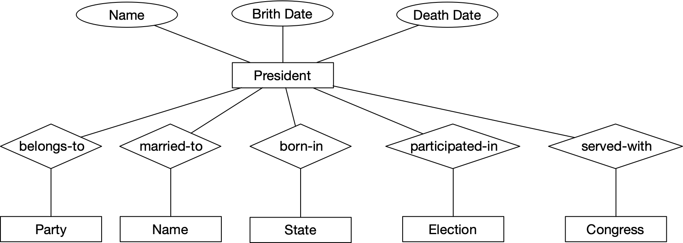
Presidents
Start out with the attributes of a president
Presidents have a name, a birth date, and a death date, though the latter might still be in the future
They belong to parties, but parties cannot be attributes, since some presidents belonged to more than one party.
Abraham Lincoln was a Whig who joined the Republican party when it was founded
Monroe did not want to belong to a party, but he was not a Federalist

Slide 11
Presidents
Start out with the attributes of a president
Some presidents where married more than once, so the spouse cannot be an attribute

Slide 12
Presidents
Relationships are with other entities.
We have an anemic entity name that stands for a person
By design, we assume that the name of the first lady (first spouse?) is the only thing that we care about.
Parties similarly are entities with only one attribute, namely their name
States, Elections, and Congresses however are more involved.
Even that is complicated: Andrew Jackson’s marriage might have been illegal and therefore void

Slide 13
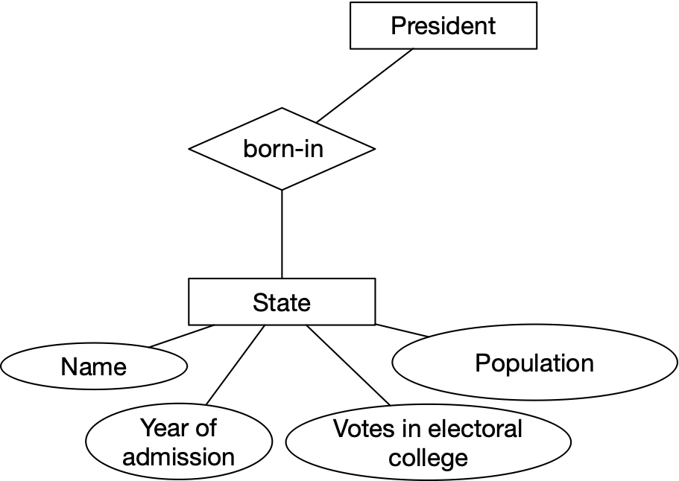
Presidents
The State-of-the-Union part of the E/R model
A state has the “born-in” or “native-son” relationship with presidents
A state has attributes: her name, the year of admission into the union (whatever that might be for Delaware or Vermont), an official population number, and the votes in the electoral college
Strictly speaking, this is not good design since the number of votes in the electoral college and the official population varies with each new census. A reelected president might span two different census and in the case of F. D. Roosevelt, three.

Slide 14
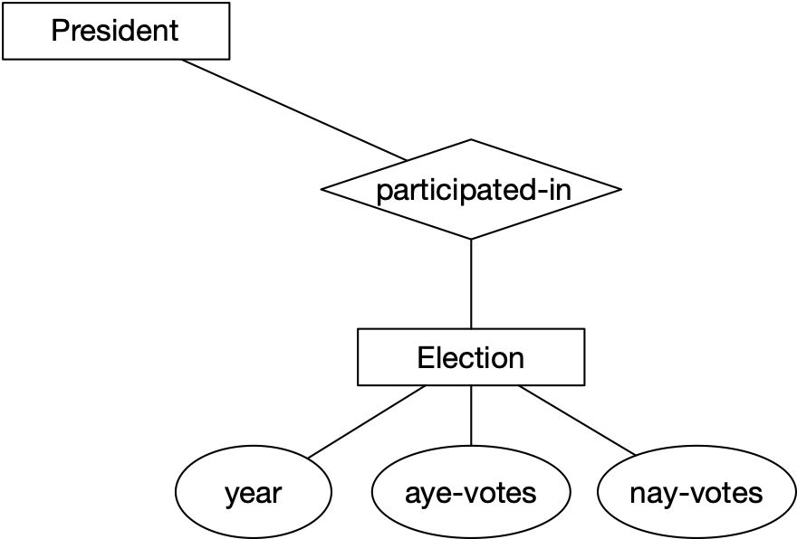
Presidents
Elections (in the electoral college) provide even more challenges.
Try to extend the data model to give information about the votes of the candidates!
In the current model, we only have votes for and votes for other than the winner
It would be nice to have the names of people with votes in the college together with their party
This is made more complicated because we can have several people. For example, Wallace got 46 electoral votes as a third-party candidate and the 1860 election had four, even though Lincoln garnered a comfortable majority in the college

Slide 15
Network Model
Attribute relationship: Between attributes of the same entity
Presidential candidate has a name
Presidential candidate is affiliated with a party
Represented by a record type: collection of data items
Entity relationship: Between two different entities
E.g. relationship between president and election
Can be represented by a graph

Slide 16
Network Model
Relationships can be:
one-to-one
one-to-many
E.g. “administrations headed”, “administrated during”
many-to-many:
E.g. Presidents - Congress
Introduce a “link record”

Slide 17
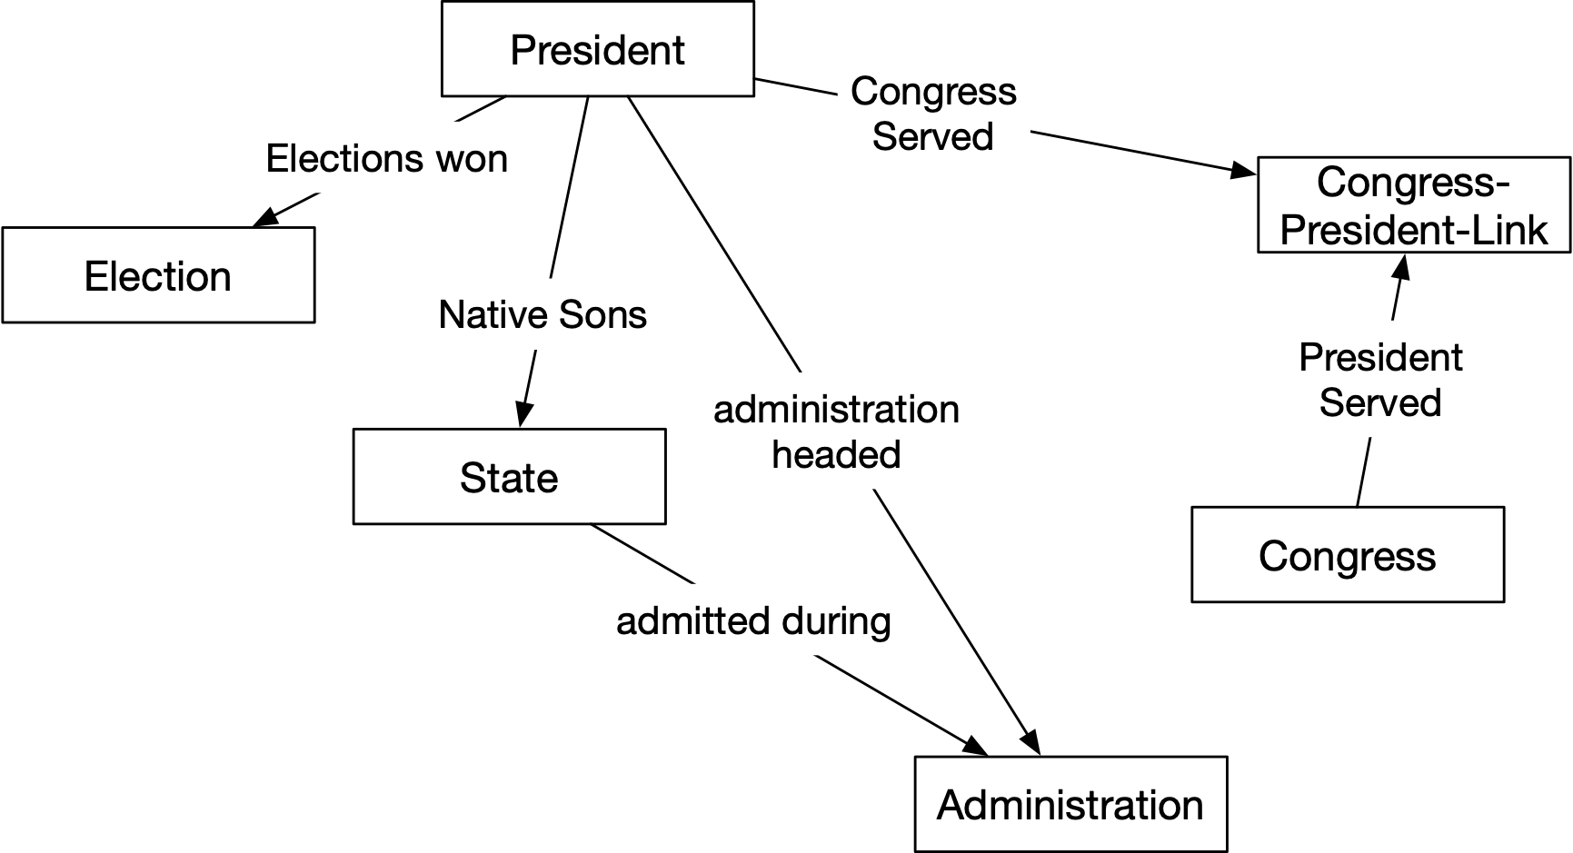
Network Model

Slide 18
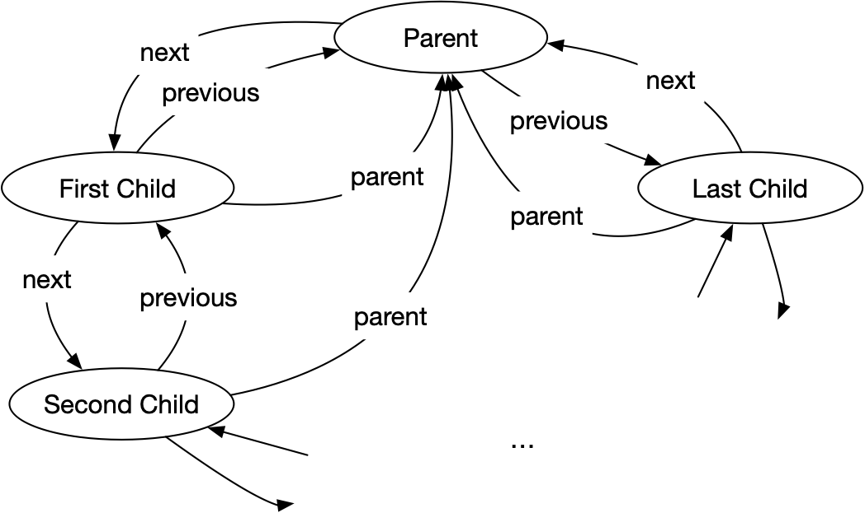
Network Model
Implementing network model:
Double linked list of record (pointers) for implementing a one-to-many relationship

Slide 19
Network Model
Programmer is a navigator

Slide 20
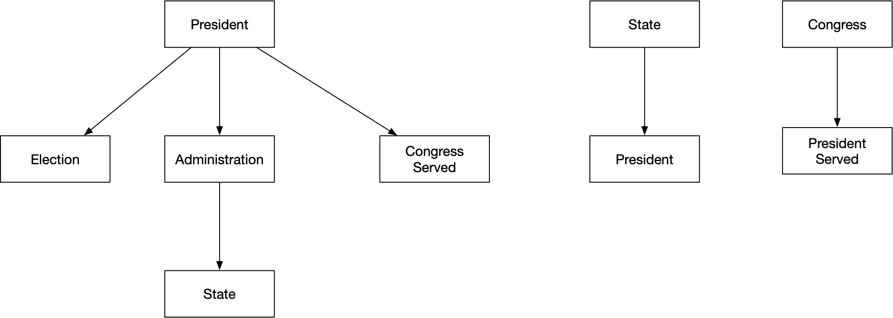
Hierarchical Model
Use only hierarchical definition trees
No need to label relationships

Slide 21
Hierarchical Model
Implement via pointers
Smart systems limit the number of pointers
E.g. Only one pointer to child, then pointers to siblings
Implement via traces
records have logical addresses based on their position in the tree (
e.g. path from root)
trace is a translation between logical and physical addresses

Slide 22
Hierarchical Model
Programmer is a navigator
Use tree traversal systems

Slide 23
Database Organization
We can observe that the hierarchical and less the network model of databases is tied to the logical organization of data access
Network model based databases were commercially successful
In order to allow untrained or untrainable users to interact with them, manipulation mechanisms became more sophisticated
Network model based databases still have problems with parallelism and record protection

Slide 24
Relational Databases
E. F. Codd (IBM, San José, CA) proposed relational databases in a 1970 paper
Pressured IBM into developing System R, with a non-relational access language called Sequel
Based on preprints of papers, Ellison founded Oracle, with a similar language called SQL

Slide 25
Relational Databases
"Future users of large data banks must be protected from having to know how the data is organized in the machine
(the internal representation). ... Activities of users at terminals and most application programs should remain unaffected
when the internal representation of data is changed and even when some aspects of the external representation are
changed. Changes in data representation will often be needed as a result of changes in query, update, and report traffic
and natural growth in the types of stored information.
"Existing noninferential, formatted data systems provide users with tree-structured files or slightly more general network
models of the data. In Section 1, inadequacies of these models are discussed. A model based on n-ary relations, a normal
form for data base relations, and the concept of a universal data sublanguage are introduced. In Section 2, certain
operations on relations (other than logical inference) are discussed and applied to the problems of redundancy and
consistency in the user's model."
Codd: ”A Relational Model of Data for Large Shared Data Banks”, CACM 1970
https://dl.acm.org/citation.cfm?id=362685

Slide 26
Relational Databases
Data is stored as tuples.
A tuple is an array of values.
Each coordinate is an attribute
Customary to present tuples as rows in a matrix
title | year | length | genre
Gone with the wind | 1939 | 231 | drama
Star wars | 1977 | 124 | SciFi
Wayne’s World | 1992 | 95 | comedy

Slide 27
Relational Databases
Columns are called attributes
Name and the set of attributes are called the scheme
Movies(title, year, length, genre)
Entries are called tuples
Strict relational model requires that all attributes are atomic: an elementary type
Movies(title:str, year:int, length:int, genre:str)

Slide 28
Relational Databases
Relational databases change over time through inserts and deletions
The state of a database at one time is called the current instance

Slide 29
Relational Databases
Keys:
Relations are not ordered
To allow fast access, need indices
Information represented by the data also needs to be coherent
A change in the information should result in a single update to a tuple
Otherwise, programming errors are likely to render the information incoherent

Slide 30
Relational Databases
Notation of keys supports both
Artificial keys: an auto-generated ID that characterizes each tuple uniquely
A or a combination of attributes that are unique to the tuple (for all eternity)
Movie database example:
Title is not sufficient, there were two King Kong movies
Underline keys in a scheme
Movies(title, year, length, genre)

Slide 31
Relational
Databases
SQL is descriptive
Does not provide a way to obtain the result
This is left to the DBMS itself

Slide 32
Database Management
System
DBMS:
Conventional users and application programs ask for data or modify data
Database administrator: define and change structure (schema) of a data base
Data Definition Language
Commands alter schema

Slide 33
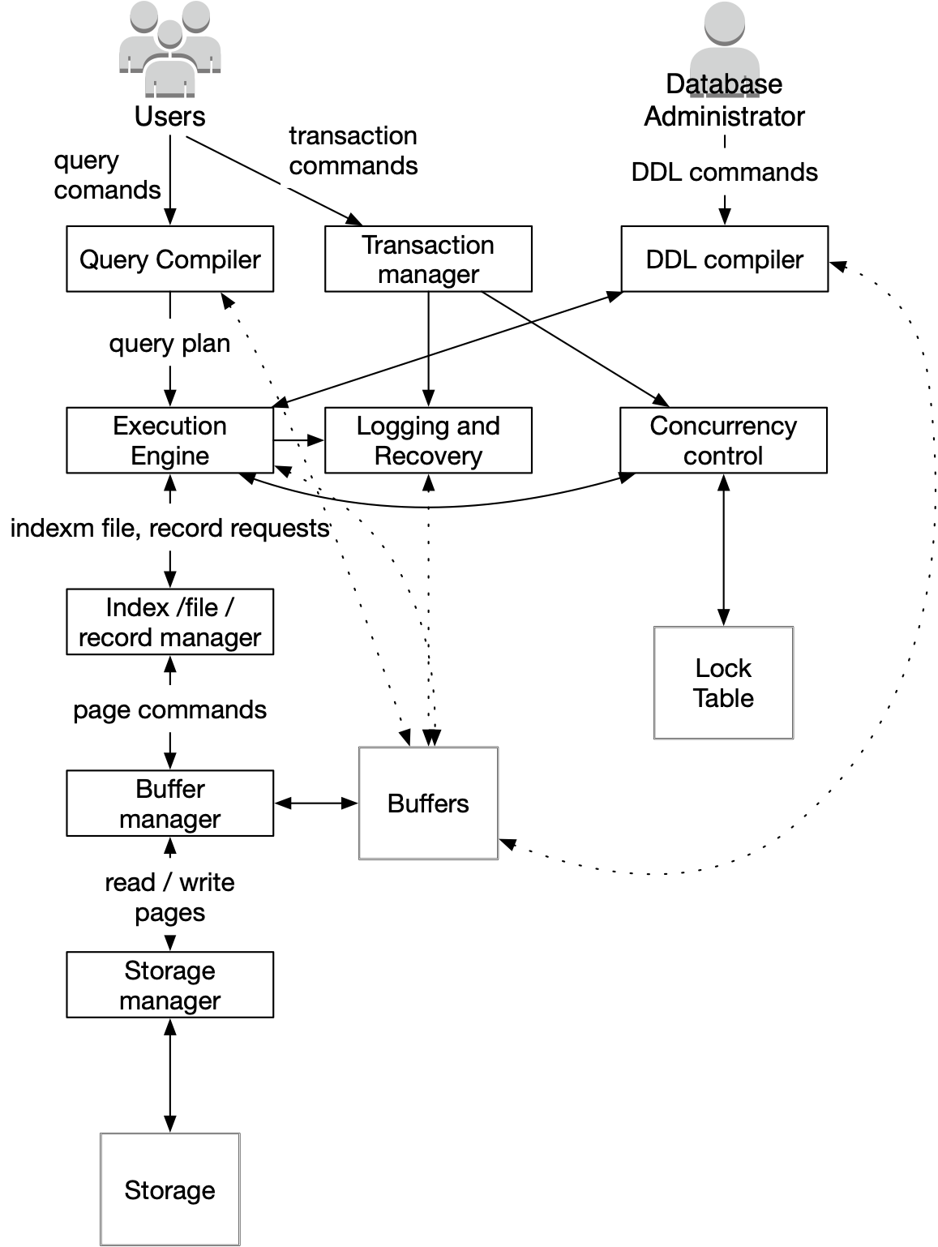

Slide 34
Database Management
System
Query Processing
Parsed and optimized by a query compiler
Results in query plan
Execution engine requests small pieces of data
Records or tuples of a relation
Made to Index / File / Record Manager
Knows about data files, format and size of records
Knows about index files (to find records faster)

Slide 35
Database Management
System
Query Processing (cont)
Requests for data are passed to the buffer manager
Buffer manager brings pages / disk blocks from storage
Mediated by storage manager

Slide 36
Database Management
System
Transaction Processing
Goal:
Atomicity
Updates either happen or do not happen at all
Isolation
Updates appear as if they were the only ones processed
Durability
Updates do not get lost
Consistency
Properties of / among data is maintained

Slide 37
Database Management
System
Transaction Processing
Concurrency control manager aka scheduler
Responsible for atomicity and isolation
Logging and recovery manager
Responsible for durability of transactions

Slide 38
Database Management
System
Storage and Buffer Management
Data usually resides in secondary storage
Hard disk
SSD
Needs to be brought into RAM for reading / processing
Storage manager controls placement of data on disk / SSD

Slide 39
Database Management
System
Buffer manager partitions main memory into buffers
(Page-sized regions of memory)
All other components interact with buffer manager for information on
Data
Metadata
Log Records
Statistics
Indexes

Slide 40
Database Management
System
Transaction processing
Transaction manager:
Logging
Concurrency control
Typically uses locks
Stored in the lock table
Deadlock Resolution
Usually involves abort or rollback

Slide 41
Database Management
System
Query processor
Query compiler generates query plan
Query compiler consists of
Query parser
Query preprocessor
Semantic checks / changes parse tree
Query optimizer
Transforms initial query plan

Slide 42
Database Management
System
Query processor
Execution Engine

