Slide 1
Views and Indices
Thomas Schwarz, SJ

Slide 2
Virtual Views
Relations can be real
CREATE TABLE …
or virtual
CREATE VIEW
Do not exist physically
Defined through a query like expression
Can be queried as if they are real tables

Slide 3
Virtual Views
SQL Programming Language:
Table: Relation that exists
View: Relation that is virtual
Temporary: Created while a query is executed and afterwards discarded

Slide 4
Virtual Views
Views are defined via CREATE VIEW
CREATE VIEW MGMMovies AS
SELECT title, year
FROM Movies
WHERE studioName = 'MGM';

Slide 5
Virtual Views
movies(title, year, length, genre, studioName, producerC#)
movieExec(name, address, cert#, netWorth)
CREATE VIEW MovieProd AS
SELECT title, name
FROM movies, movieExec
WHERE producerC# = cert#;

Slide 6
Virtual Views
Interacting with Views
A view, once defined, can be queried just like a real table
SELECT title
FROM MGMMovies
WHERE year = 1979;

Slide 7
Virtual Views
starName(title, year, name)
SELECT DISTINCT starName
FROM MGMMovies, starsIn
WHERE title = movieTitle AND year = movieYear

Slide 8
Virtual Views
We can rename the attributes in a VIEW
attribute names in the view are now movieTitle and prodName
CREATE VIEW movieProd(movieTitle, prodName) AS
SELECT title, name
FROM movies, movieExec
WHERE producerC# = cert#;

Slide 9
Exercises
movieStar(name, address, gender, birthday)
movieExec(name, address, cert#, netWorth)
studio(name, address, presC#)
A view RichExec with name address, certificate number, and net-worth of all executives with more than 10 million net-worth

Slide 10
Exercises
movieStar(name, address, gender, birthday)
movieExec(name, address, cert#, netWorth)
studio(name, address, presC#)
A view RichExec with name, address, certificate number, and net-worth of all executives with more than 10 million net-worth
CREATE VIEW RichExec(execName, execAddress, cert#, netWorth) AS
SELECT name, address, cert#, netWorth
WHERE netWorth > 10000000;

Slide 11
Exercises
movieStar(name, address, gender, birthday)
movieExec(name, address, cert#, netWorth)
studio(name, address, presC#)
A view StudioPres with name, address, netWorth of studio presidents

Slide 12
Exercises
movieStar(name, address, gender, birthday)
movieExec(name, address, cert#, netWorth)
studio(name, address, presC#)
A view StudioPres with name, address, netWorth of studio presidents
CREATE VIEW StudioPres AS
SELECT name, address, netWorth
FROM movieExec
WHERE cert# IN (
SELECT presC#
FROM studio );

Slide 13
Exercises
movieStar(name, address, gender, birthday)
movieExec(name, address, cert#, netWorth)
studio(name, address, presC#)
A view ExecutiveStar giving the name, address, gender, birth date and certificate number of movie stars that are also movie executives
Assume that executives with the same name and address as a movie star are the movie star
Even though there is no reason to assume this

Slide 14
Exercises
movieStar(name, address, gender, birthday)
movieExec(name, address, cert#, netWorth)
studio(name, address, presC#)
A view ExecutiveStar giving the name, address, gender, birth date and certificate number of executives that are also movie executives
CREATE VIEW ExecutiveStar AS
SELECT ms.name, ms.address, ms.gender,
ms.birthdate, me.cert#
FROM movieStar ms, movieExec me
WHERE ms.name = ms.name AND ms.address = me.address

Slide 15
Modifying Views
Some views can be used to update the underlying tables
View Removal
Just like Table removal
which would also make the view MGMMovies unusable
DROP VIEW MGMMovies
DROP TABLE movies

Slide 16
Modifying Views
Updatable views
SQL has clear, but complicated definitions when a view can be updated (and an underlying table changed)
View must be defined by SELECT
There is only one relation R in the definition
No subquery involving R in the WHERE clause
Enough attributes of R are involved in the view

Slide 17
Modifying Views
MGMMovies fulfills the requirements
If we insert via the view:
movies will get a new tuple
title: 'Get Shorty', year: 1995
Everything else: Null
Interestingly, because of the latter, the view itself would not be updated
INSERT INTO MGMMovies
VALUES('Get Shorty', 1995)
movies(title, year, length, genre, studioName, producerC#)

Slide 18
Modifying Views
The view insertion
has the same effect as inserting into the underlying table
INSERT INTO MGMMovies
VALUES('Get Shorty', 1995)
INSERT INTO movies
VALUES('Get Shorty', 1995)

Slide 19
Modifying Views
To address this anomaly, need to add to the view
CREATE OR REPLACE VIEW MGMMovies(name, title, studio) AS
SELECT name, title, studioName
FROM movies
WHERE studio = 'MGM';

Slide 20
Modifying Views
Now it works
which is equivalent to
and assumes that we do not have any triggers or constraints against NULL values for the other attributes
but now the view also changes
INSERT INTO MGMMovies
VALUES('Find Shorty', 1995, 'MGM')
INSERT INTO movies(name, year, studioName)
VALUES ('Find Shorty', 1995, 'MGM')

Slide 21
Modifying Views
Deletions are also passed through the underlying table
gets translated into
DELETE FROM MGMMovies
WHERE title LIKE '%Shorty%';
DELETE FROM movies
WHERE title LIKE '%Shorty%' AND studioName = 'MGM';

Slide 22
Modifying Views
becomes
UPDATE MGMMovies
SET year = 1968
WHERE title = 'Get Shorty';
UPDATE movies
SET year = 1968
WHERE title = 'Get Shorty' AND
studioName = 'MGM';

Slide 23
Modifying Views
Including all properties in a view is a kludge
Can use a trigger instead
Use the INSTEAD OF syntax
CREATE TRIGGER mgmInserts
INSTEAD OF INSERT ON mgmInserts
REFERENCING NEW ROW as newRow
FOR EACH ROW
INSERT INTO movies(title, year, studioName)
VALUES(newRow.title, newRow.year, 'MGM');

Slide 24
Modifying Views in MySQL
MySQL only started to support views in Version 5 (2008)
Supports updatable views
But not the INSTEAD trigger

Slide 25
Try It Out
Use the employees database in MySQL
You might want to turn of automatic commits, then do a commit and at the end of the session a rollback
Task 1: Convince yourself that there are no emp_no larger than 500000

Slide 26
Try It Out
USE employees;
SELECT *
FROM dept_emp
WHERE emp_no >=500000;

Slide 27
Try It Out
Task 2: Insert three persons into the employees table with employee numbers 600000, 600001, 600002. You can invent the missing dates.
The hire date should be the day of today
In MySQL that is CURDATE( )

Slide 28
Try It Out
INSERT INTO employees(emp_no, birth_date, first_name, last_name, gender, hire_date)
VALUES
(600000, '1980-01-01', 'Hector', 'Garcia Molinas', 'M', CURDATE()),
(600001, '1981-01-01', 'Ursula', 'Leyendorf', 'F', CURDATE()),
(600002, '1982-01-01', 'Bob', 'Karragher', 'M', CURDATE());

Slide 29
Try It Out
Create a view of dept_emp that only contains entries with to_date unlimited
i.e. '9999-01-01' which is used to indicate an open contract.
Call the view v_current_dept_emp
Include all attributes so that we can update

Slide 30
Try It Out
CREATE OR REPLACE VIEW v_current_dept_emp AS
SELECT emp_no, dept_no, from_date, to_date
FROM dept_emp
WHERE to_date = '9999-01-01';

Slide 31
Try It Out
Now insert the three new employees into the view
from_date is today
Department is 'd004'

Slide 32
Try It Out
INSERT INTO v_current_dept_emp(emp_no, dept_no, from_date, to_date)
VALUES
(600000, 'd004', CURDATE(), '9999-01-01'),
(600001, 'd004', CURDATE(), '9999-01-01'),
(600002, 'd004', CURDATE(), '9999-01-01');

Slide 33
Try It Out
Check that these updates made it to the dept_emp table as well as the view

Slide 34
Try It Out
SELECT *
FROM v_current_dept_emp
WHERE emp_no >=500000;
SELECT *
FROM dept_emp
WHERE emp_no >=500000;

Slide 35
Try It Out
Change the view v_current_dept_emp to have only three columns: emp_no, dept_no, from_date by recreating it

Slide 36
Try It Out
CREATE OR REPLACE VIEW v_current_dept_emp AS
SELECT emp_no, dept_no, from_date
FROM dept_emp
WHERE to_date = '9999-01-01';
The CREATE OR REPLACE clause makes it easy.
You could also say DROP VIEW and then do a CREATE VIEW

Slide 37
Try It Out
Check the table dept_emp for its definition

Slide 38
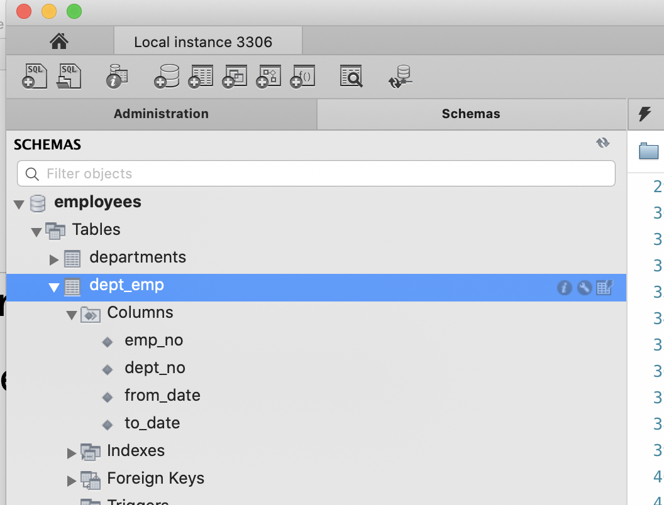
Try It Out
In MySQLWorkbench:
Click on the table and the info tab

Slide 39
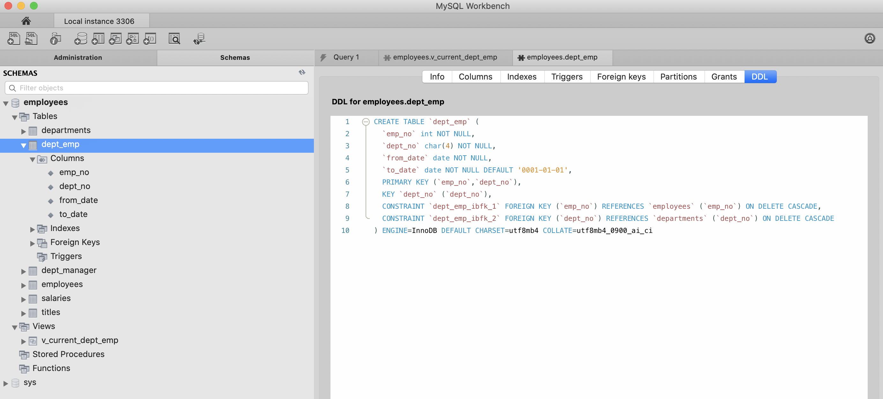
Try It Out
In the view, select DDL, which gives you the definition of the table

Slide 40
Try It Out
Alternatively, you can select columns
Both methods show that we have a NOT NULL constraint on to_date

Slide 41
Try It Out
Alter the table dept_emp to have a default value of '9999-01-01' in the to_date.
We could also remove the NOT NULL restriction

Slide 42
Try It Out
ALTER TABLE dept_emp
MODIFY COLUMN to_date date NOT NULL DEFAUlT '1-01-01';

Slide 43
Try It Out
If we try to add directly to the table with new values, we violate a foreign key constraint.
INSERT INTO v_current_dept_emp(emp_no, dept_no, from_date)
VALUES
(600003, 'd004', CURDATE()),
(600004, 'd004', CURDATE()),
(600005, 'd004', CURDATE());

Slide 44
Try It Out
Create a few more employees in the employee table
With emp_no larger than 600000

Slide 45
Try It Out
INSERT INTO employees(emp_no, birth_date, first_name, last_name, gender, hire_date)
VALUES
(600003, '1980-01-01', 'Javier', 'GPena', 'M', CURDATE()),
(600004, '1981-01-01', 'Dick', 'Murphy', 'M', CURDATE()),
(600005, '1982-01-01', 'Emilio', 'Zapato', 'M', CURDATE());

Slide 46
Try It Out
INSERT INTO employees(emp_no, birth_date, first_name, last_name, gender, hire_date)
VALUES
(600003, '1980-01-01', 'Javier', 'Pena', 'M', CURDATE()),
(600004, '1981-01-01', 'Dick', 'Murphy', 'M', CURDATE()),
(600005, '1982-01-01', 'Emilio', 'Zapato', 'M', CURDATE());

Slide 47
Try It Out
Check that this updates the dept_emp table correctly

Slide 48
Try It Out
MySQL trigger mechanisms are not so great!

