Slide 1
Relational Model of Data
Thomas Schwarz, SJ

Slide 2
Data Model
Notation for describing data
  Structure of the Data
    Conceptual level, not binary
  Operations on Data
    Limits on operations are useful!
  Constraints on Data

Slide 3
Data Model
In this class:
  Relational Data Model
  Semi-structured Data Model

Slide 4
Relational Data Model
Relational Model is based on Tables
  The tables are conceptual
    Implementations will differ
Title | Year | Length | Genre
Gone with the wind | 1939 | 231 | drama
Star wars | 1977 | 124 | scifi
Wayne’s world | 1992 | 95 | comedy

Slide 5
Relational Data Model
Operations are part of Relational Algebra
Constraints
  On individual attributes
    Non-null constraints
    Unique constraints
  On tuples

Slide 6
Semi-Structured Data Model
Data is presented (in general) using trees or graphs
  Popular formats
    XML
    JSON
  Describing metadata stored with data

Slide 7
{
"hollywood": {
"movies": [
{
"title": "Gone with the wind",
"year": "1939",
"length": "231",
"genre": "drama"
},
{
"title": "Star wars",
"year": "1977",
"length": "124",
"genre": "scifi"
},
{
"title": "Gone with the wind",
"year": "1992",
"length": "95",
"genre": "comedy"
}
]
}
}

Slide 8
Object Oriented Data Model
Values can have structure, not just primitive types
Relations can have associated methods
No consensus on how OO DBMS should look like
Industry implemented Object-Relational DBMS
  Values no longer need to be primitive

Slide 9
Relational Data Model
Attributes:
  Columns of a table are named by attributes
Schemas:
  Name of a relation and the set of attributes
Tuples:
  Rows of a table (other than header row)
Movies(title, year, length, genre)
(Gone with the wind, 1939, 231, drama)

Slide 10
Relational Data Model
Domains
  All components of a tuple are atomic
  All components of a tuple must be in domain
Movies(title:string, year:integer,
length:integer, genre:string)

Slide 11
Relational Data Model
Equivalent representation of a relation
  Tables are sets of tuples
  Attributes form a set
Can reorder rows and columns, but obtain the same table
Year | Genre | Title | Length
1977 | scifi | Star wars | 124
1992 | comedy | Wayne’s world | 95
1939 | drama | Gone with the wind | 231

Slide 12
Relational Data Model
Keys:
  A set of attributes (always non-null):
    Two tuples cannot share the same values in this set
  Example:
    Movies Table:
      title and year form a key
        No two movies in the same year have both the same title and the same year
Movies(title, year, length, genre)

Slide 13
Relational Data Model
Keys
  Can be single attribute:
    All persons working in the US (should) have a Social Security Number (SSN)
    SSN are unique
  Can be artificial tuple ids
  Are defined locally (Marquette ID numbers)

Slide 14
Relational Data Model
Example
  Movies(title: string,
  year: string,
  length: integer,
  genre: string,
  studioName: string,
  producerC#: integer)

Slide 15
Relational Data Model
Example
  MovieStar(name: string,
  year: string,
  address: string,
  gender: char,
  birthdate: date)

Slide 16
Relational Data Model
Example
  StarsIn(movieTitle: string,
  movieYear: int,
  starName: string)

Slide 17
Relational Data Model
Example
  MovieExec( name: string,
  address: string,
  cert#: integer,
  netWorth: integer)

Slide 18
Relational Data Model
Example
  Studio(name: string,
  address: string,
  presC#: integer)

Slide 19
SQL DDL
Create a database with CREATE DATABASE
CREATE DATABASE IF NOT EXISTS USNavy;

Slide 20
SQL DDL
Three type of tables in SQL
  Stored Relations, called tables
  Views: relations calculated by computation
  Temporary tables: created during query execution

Slide 21
SQL DDL
Data Types
  Character strings of fixed or varying length
    CHAR(n) - fixed length string of up to n characters
    VARCHAR(n) - fixed length string of up to n characters
      Uses and endmarker or string-length for storage efficiency
  Bit strings
    BIT(n) strings of length exactly n
    BIT VARYING(n) - strings of length up to n

Slide 22
SQL DDL
Data Types:
  Boolean: BOOLEAN: TRUE, FALSE, UNKNOWN
  Integers: INT = INTEGER, SHORTINT
  Floats: FLOAT = REAL, DOUBLE, DECIMAL(n,m)
  Dates: DATE
    SQL Standard: ‘1948-05-14’)
  Times: TIME
    SQL Standard: 19:20:02.4

Slide 23
SQL DDL
Data Types:
  MySQL: ENUM('M', 'F')

Slide 24
SQL DDL
CREATE TABLE creates a table
CREATE TABLE Movies(
title CHAR(100),
year INT,
length INT,
genre CHAR(10),
studioName CHAR(30),
producerC# INT
);

Slide 25
SQL DDL
CREATE TABLE MovieStar(
name CHAR(30),
address VARCHAR(255),
gender CHAR(1),
birthday DATE
);

Slide 26
SQL DDL
Drop Table drops a table
DROP TABLE Movies;

Slide 27
SQL DDL
Altering a table with ALTER TABLE
  with ADD followed by attribute name and data type
  with DROP followed by attribute name
ALTER TABLE MovieStar ADD phone CHAR(16);
ALTER TABLE MovieStar DROP Birthday;

Slide 28
SQL DDL
Default Values
  Conventions for unknown data
    Usually, NULL
  Can use other values for unknown data
CREATE TABLE MovieStar(
name CHAR(30),
address VARCHAR(255),
gender CHAR(1) DEFAULT '?',
birthday DATE DEFAULT '0000-00-00'
);

Slide 29
SQL DDL
Declaring Keys
  Declare one attribute to be a key
  Add one additional declaration:
    Particular set of attributes is a key
  Can use
  PRIMARY KEY
  UNIQUE

Slide 30
SQL DDL
UNIQUE for a set S:
  Two tuples cannot agree on all attributes of S unless one of them is NULL
    Any attempted update that violates this will be rejected
PRIMARY KEY for a set S:
  Attributes in S cannot be NULL

Slide 31
SQL DDL
CREATE TABLE MovieStar(
name CHAR(30) PRIMARY KEY,
address VARCHAR(255),
gender CHAR(1),
birthday DATE
);

Slide 32
SQL DDL
CREATE TABLE MovieStar(
name CHAR(30),
address VARCHAR(255),
gender CHAR(1) DEFAULT '?',
birthday DATE DEFAULT '0000-00-00',
PRIMARY KEY (name)
);

Slide 33
SQL DDL
CREATE TABLE Movies(
title CHAR(100),
year INT,
length INT,
genre CHAR(10),
studioName CHAR(30),
producerC# INT,
PRIMARY KEY (title, year)
);

Slide 34
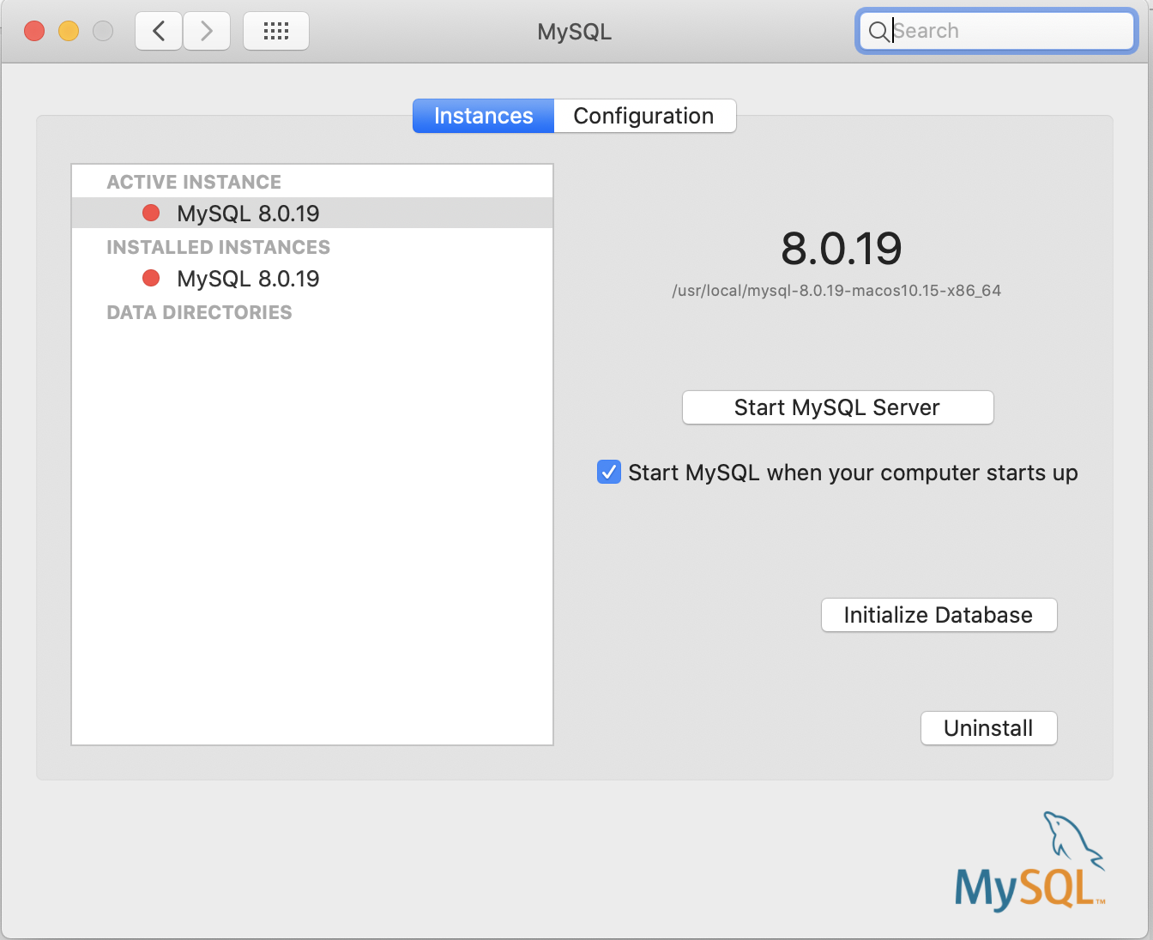
SQL Work Bench
Insure that your mysql server is running
  MAC : System Preferences —> MySQL

Slide 35
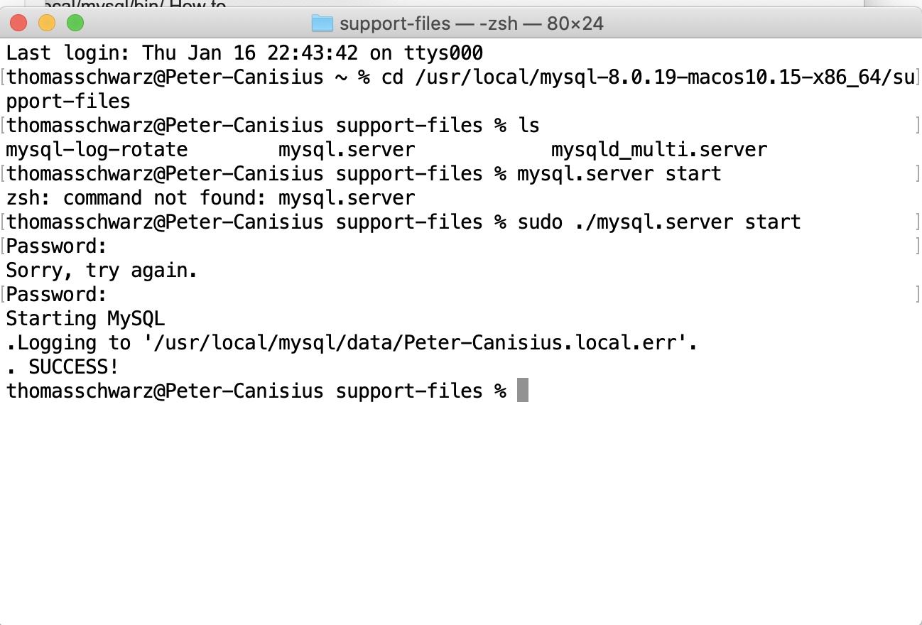
SQL Work Bench
Starting MySQL server through a terminal
  Find mysql.server

Slide 36
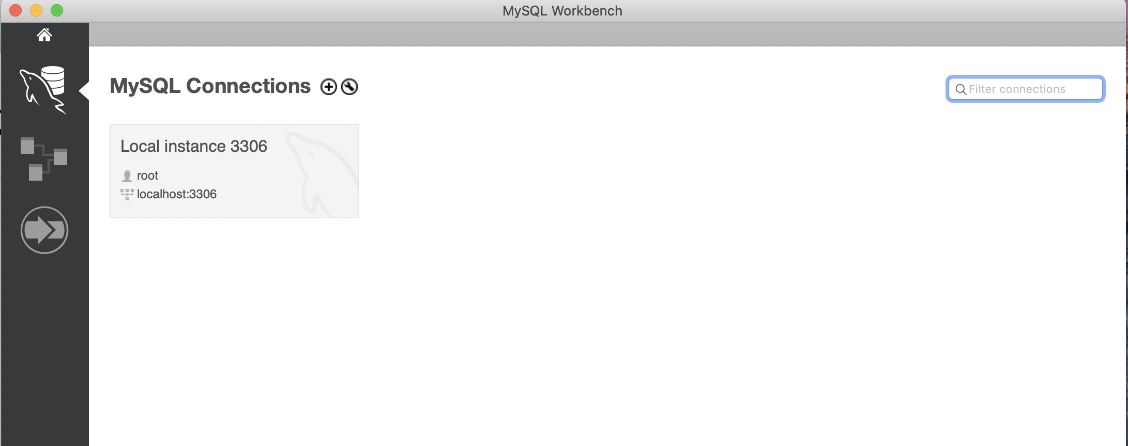
SQL Workbench
Open up SQL workbench
  Select the SQL server (should be only one)

Slide 37
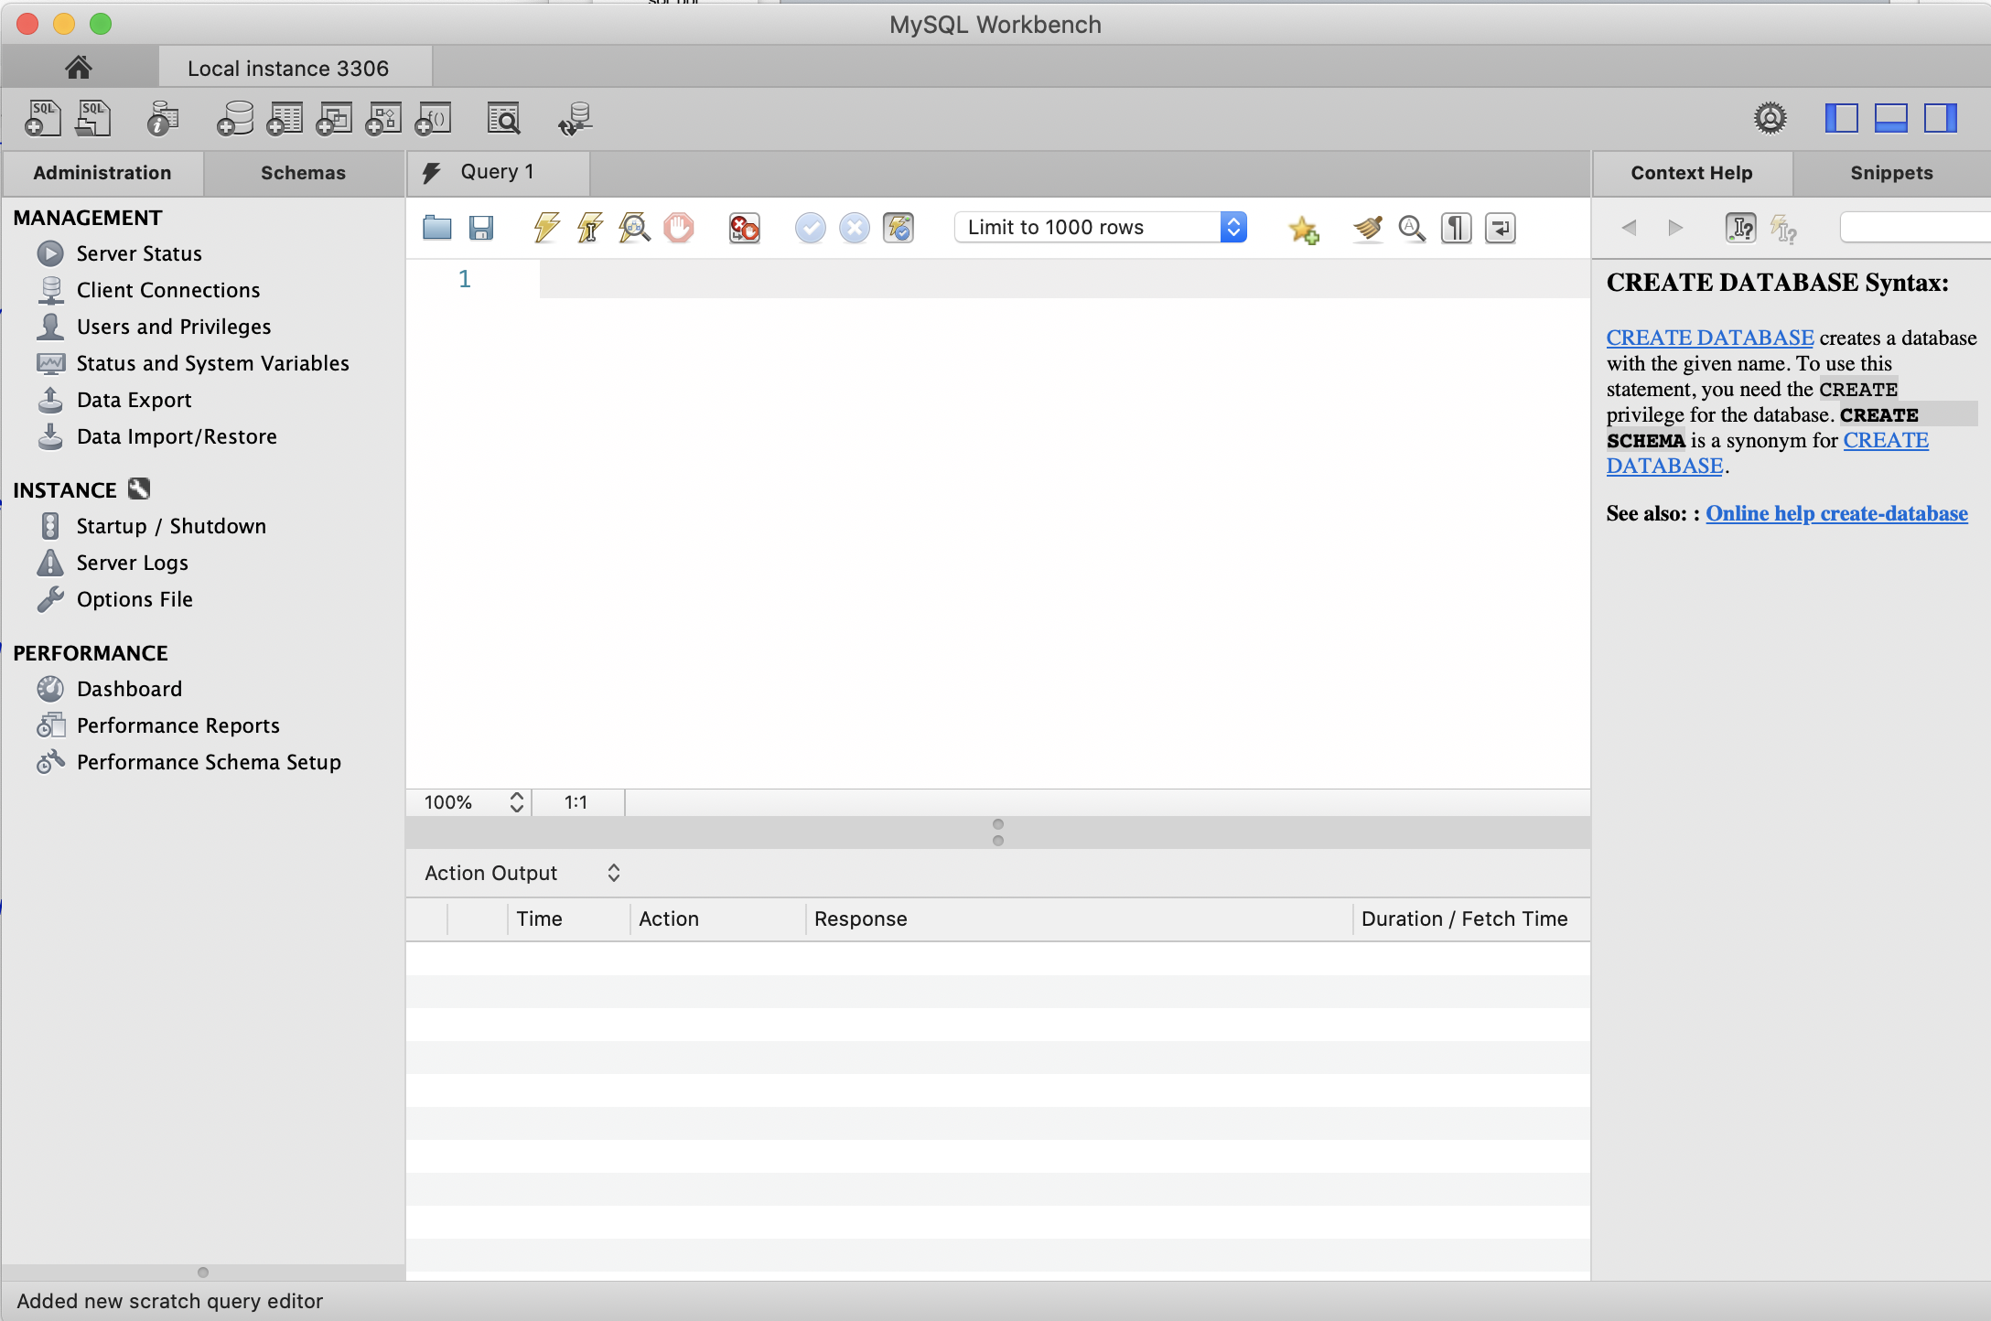
SQL Workbench
Select panels on the right

Slide 38
SQL Workbench
Select Schemas
  Should have at least one master schema calles sys

Slide 39
SQL Workbench
Write queries in middle panel
Execute them with the flash symbol
  CREATE DATABASE IF NOT EXISTS sales;

Slide 40
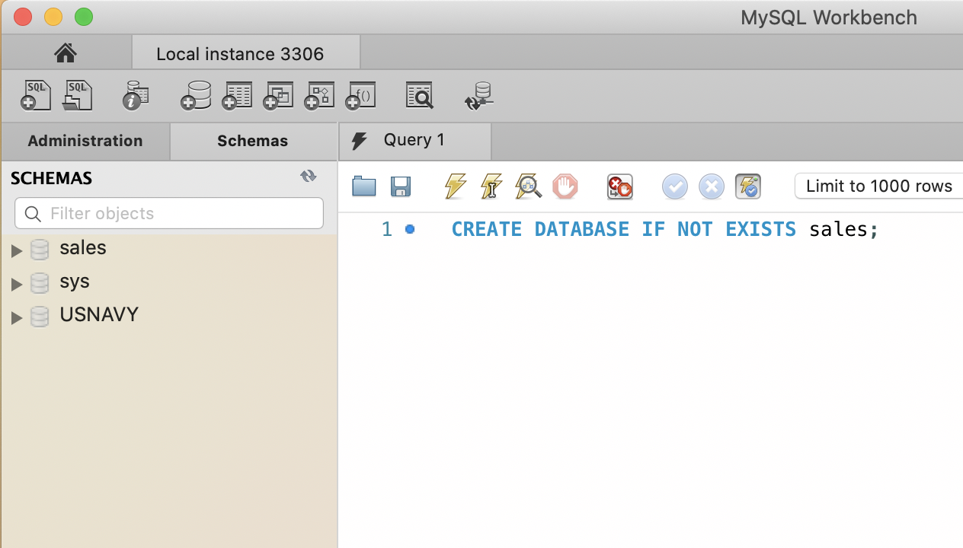
SQL Workbench
After creating a database, need to update schemas in the upper right corner

Slide 41
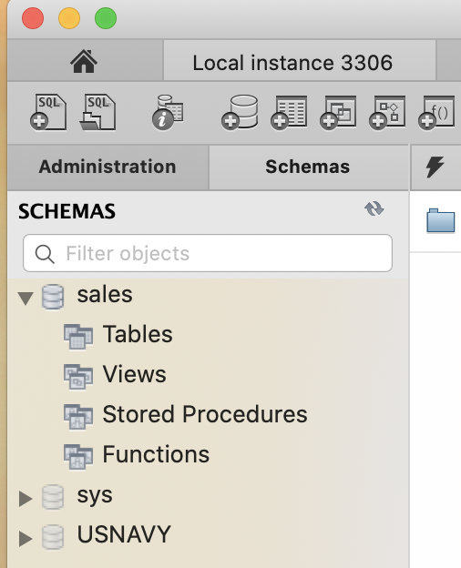
SQL Workbench
There is more information on the schema

Slide 42
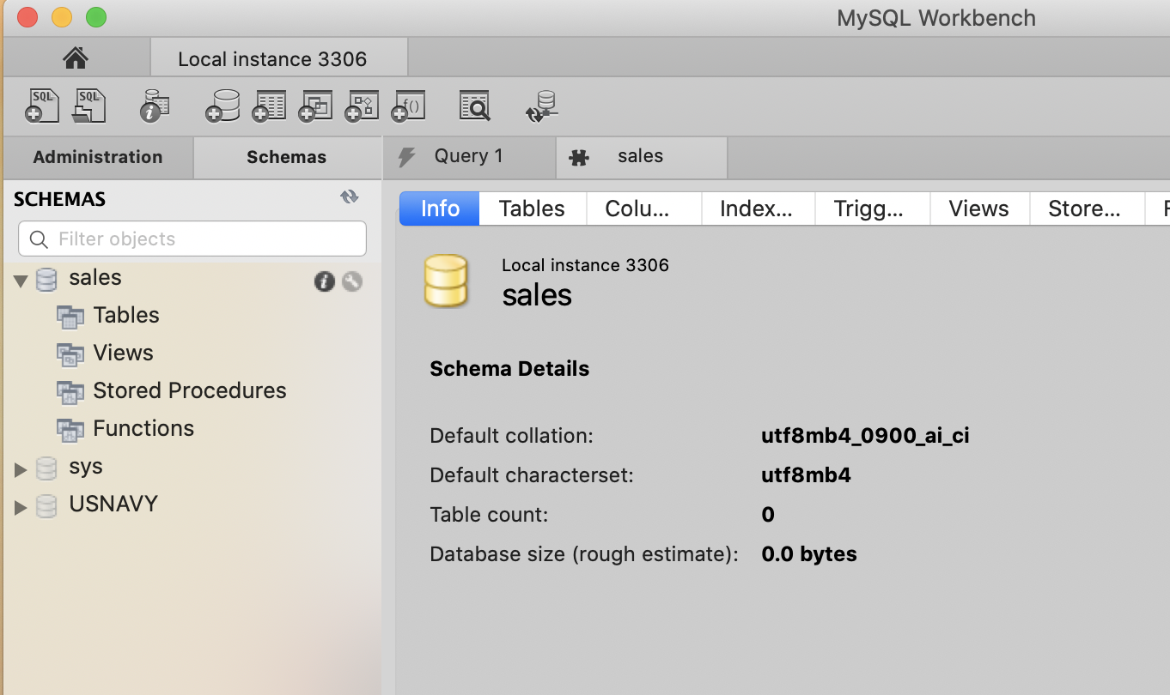
SQL Workbench
The information symbol (i) has more information

Slide 43
SQL Workbench
Execute a query
Now we can manipulate and use this database
USE sales;

Slide 44
SQL Workbench
Use queries to create a table
sales(purchase_number:int,
date_of_purchase:date,
customer_id:int,
item_code VARCHAR(10) )

Slide 45
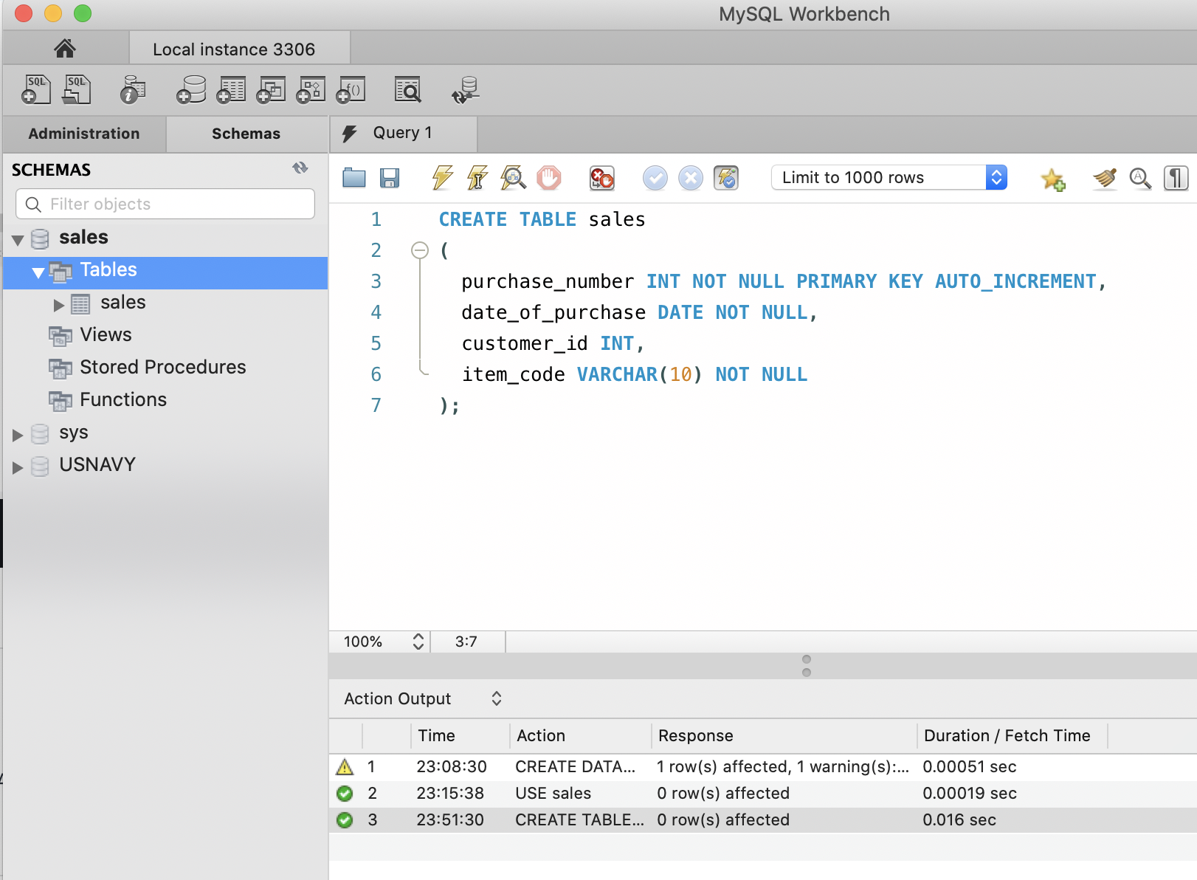
SQL Workbench

Slide 46
SQL Workbench
Create a table
customers(customer_id: int,
first_name: varchar(255),
last_name: varchar(255),
email_address: varchar(255),
number_of_complaints: int)

Slide 47
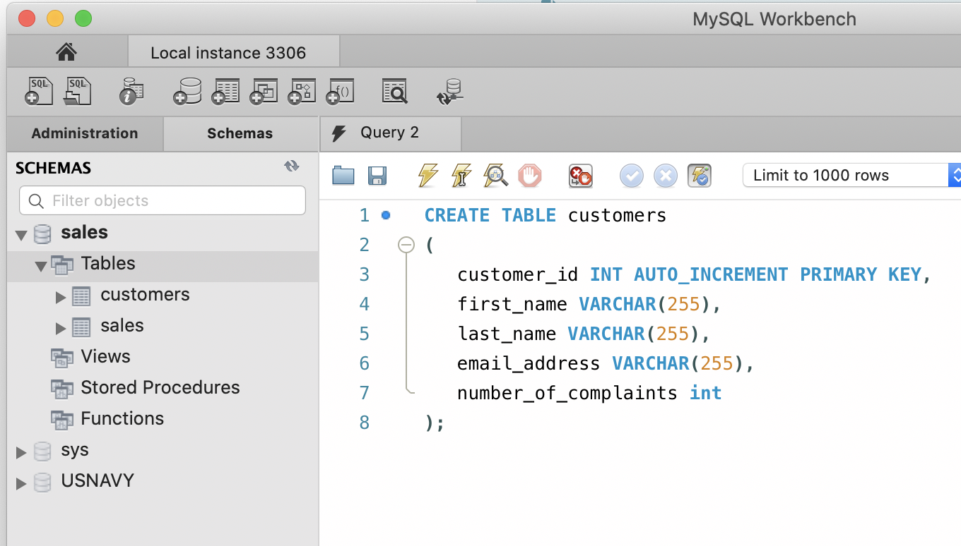
SQL Workbench

Slide 48
SQL Workbench
Referring to MYSQL objects
  Use a default database
    USE sales;
    SELECT * FROM customers;
  Use the dot notation to specify database
    SELECT * FROM sales.customers;

Slide 49
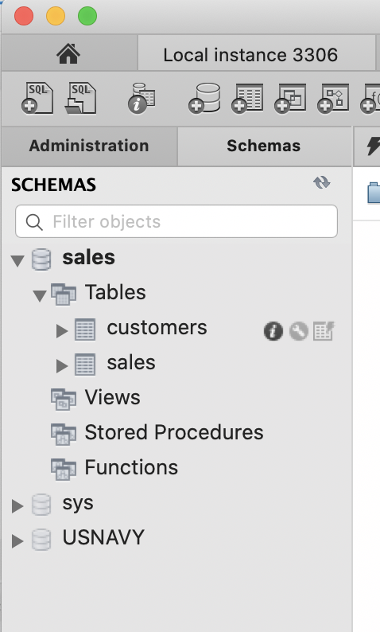
SQL Workbench
Information on Tables appears next to them in the left panel

Slide 50
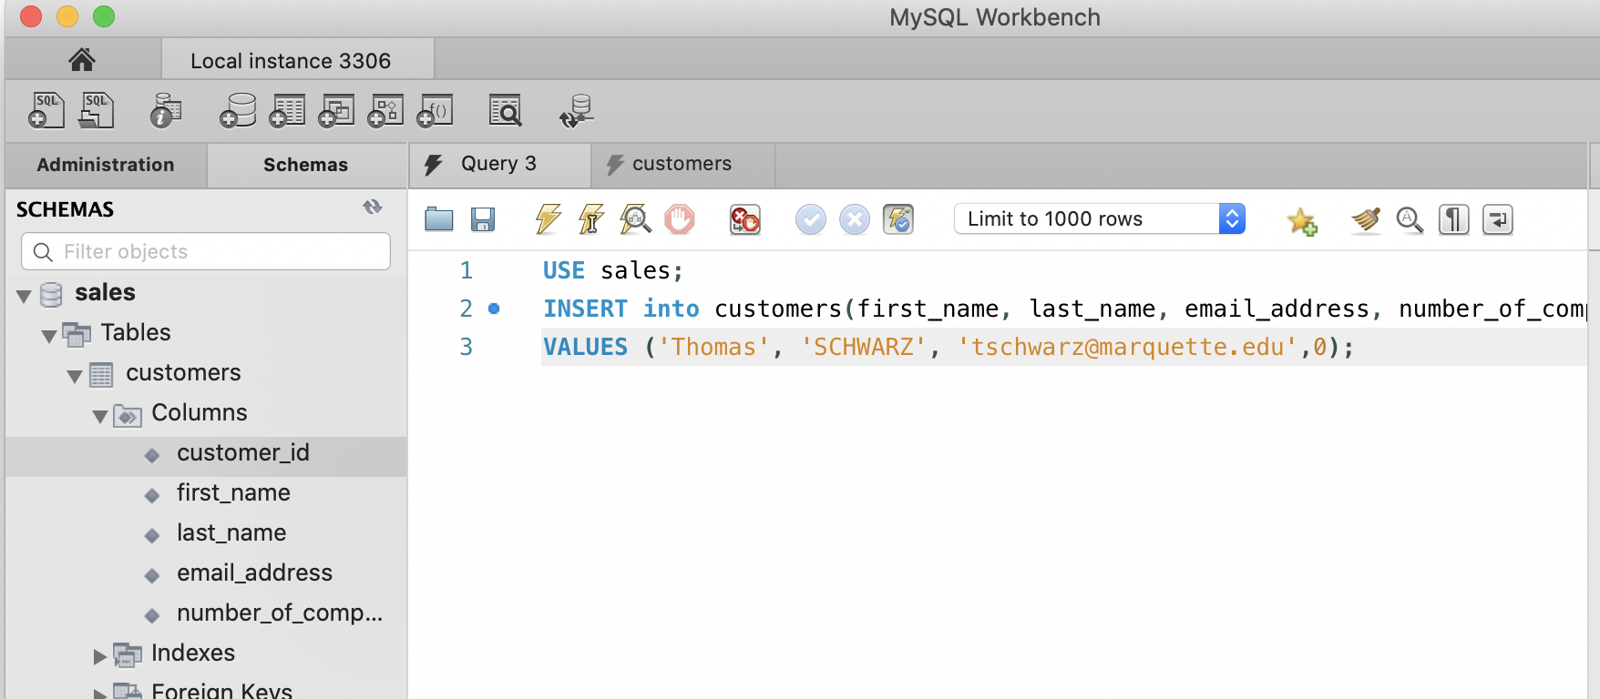
SQL Workbench
Inserting into a data base:

Slide 51
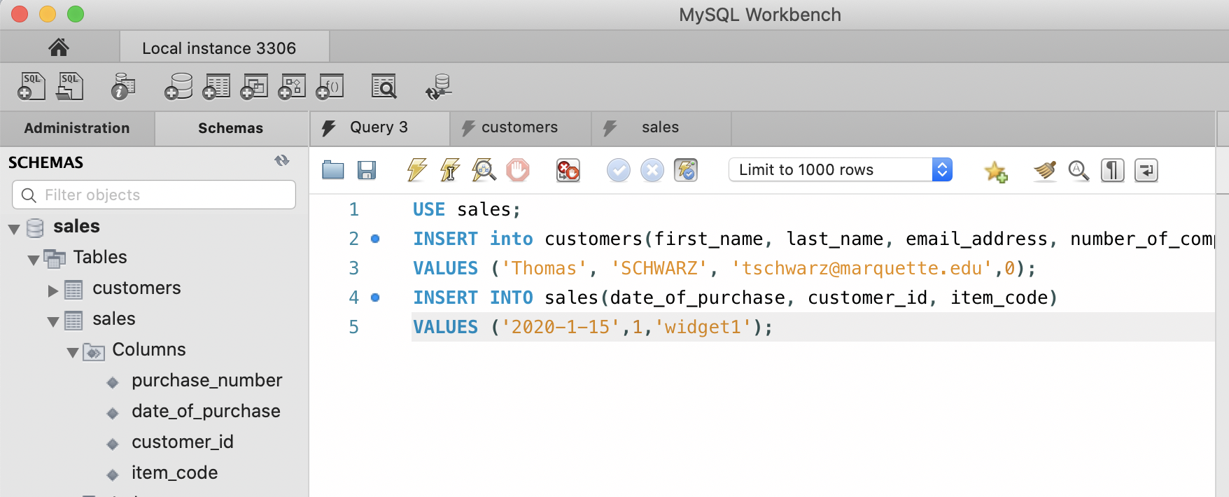
SQL Workbench

Slide 52
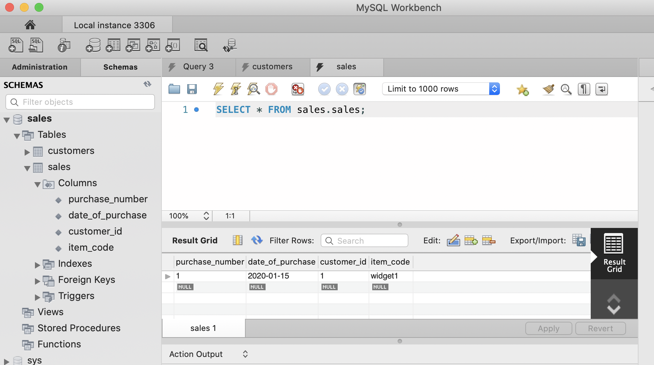
SQL Workbench

Slide 53
An Algebraic Query Language
Set operations
Selection (removes rows) and Projection (removes columns)
Combination operations: Cartesian products, joins
Renaming

Slide 54
An Algebraic Query Language
Set operations for relations
  Assume $R$ and $S$ are relations with
    identical sets of attributes
    ordered in the same way
  $R∪S$ Union
  $R∩S$ Intersection
  $R-S$ Difference

Slide 55
An Algebraic Query Language
Projection
  Creates a new relation with a subset of the attributes
  $π_{A_{1},A_{2},…,A_{n}}(R)$ is the relation with values from $R$ but only attributes $A_{1},A_{2},…,A_{n}$

Slide 56
An Algebraic Query Language
Selection
  $σ_{\text{cond}}(R)$ is a relation with the same attributes, but only tupes from $R$ that satisfy the condition

Slide 57
An Algebraic Query Language
Cartesian product $R×S$
  Assumes that set of attributes are disjoint
  The same as for sets
    $R×S=\{(r,s)|r∈R,s∈S\}$.

Slide 58
An Algebraic Query Language
Natural join $R⋈S$
  New relation with attributes that are attributes in one or the other relation
  All combinations of tuples in $R$ and $S$ that agree on all common attributes.

Slide 59
An Algebraic Query Language
Example:
Cartesian Product
  Needs to make attributes disjoint
R A B
1 2
3 4
5 6
S A C
1 4
5 6
R x S R.A B S.A C
1 2 1 4
1 2 5 6
3 4 1 4
3 4 5 6
5 6 1 4
5 6 5 6

Slide 60
An Algebraic Query Language
Example:
Natural join: Common attribute is A
  Look at common values
R A B
1 2
3 4
5 6
S A C
1 4
5 6
R $⋈$ S A B C
1 2 4
5 6 6

Slide 61
An Algebraic Query Language
Example:
Natural join: All combinations of tuples with equal values for A and B:
R A B C
1 1 2
1 1 3
1 2 4
S A B D
1 1 2
1 1 5
2 1 4
2 2 1
$R⋈S$ A B C D
1 1 2 2
1 1 2 5
1 1 3 2
1 1 3 5

Slide 62
An Algebraic Query Language
$Θ$ - Joins (Theta Joins)
  Natural joins compares sub-tuples based on equality
  Theta joins use arbitrary boolean conditions on attribute values
  The condition is indicated as a subscript under the bowtie, usually named $θ$.

Slide 63
An Algebraic Query Language
Example
  $R⋈_{θ}S$ with $θ=R.A≥S.A$
R A B C
1 2 1
0 1 2
3 3 3
S A B D
1 1 5
1 2 6
4 1 2
$R⋈_{θ}S$ A R.B S.B C D
1 2 1 1 5
1 2 2 2 6
3 3 1 3 5
3 3 2 3 6

Slide 64
An Algebraic Query Language
Example
  $R⋈_{θ}S$ with $θ=(R.A≠S.A\text{AND}R.B=S.B)$
R A B C
1 2 1
0 1 2
3 3 3
S A B D
1 1 5
1 2 6
4 1 2
$R⋈_{θ}S$ R.A S.A B C D
0 1 2 1 6
0 4 1 2 2

Slide 65
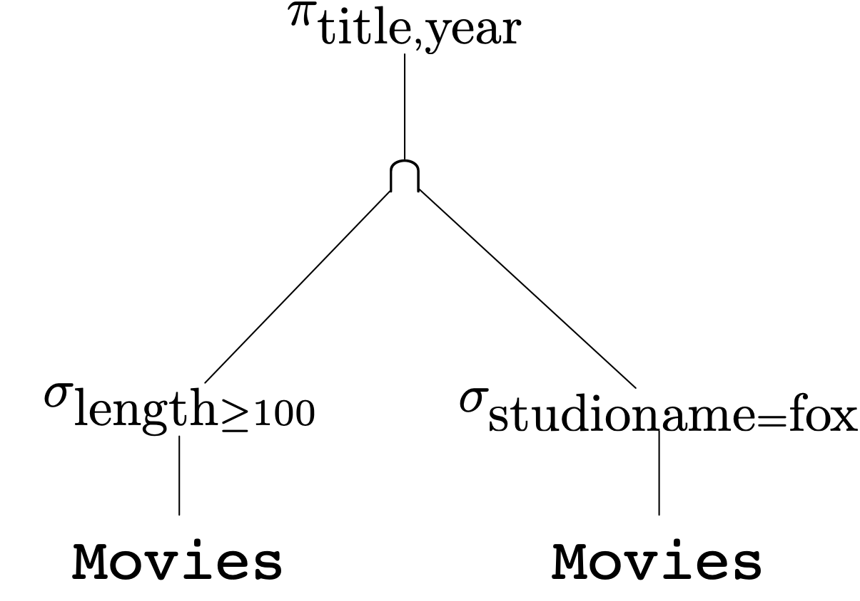
An Algebraic Query Language
Combining operations to form queries
  Example: What are the titles and years of movies made by Fox that are at least 100 minutes long

Slide 66
An Algebraic Query Language
$$π_{\text{title},\text{year}}(σ_{\text{length}≥100}(\text{movies})∩σ_{\text{studioname}=\text{fox}}(\text{movies}))$$

Slide 67
An Algebraic Query Language
Query Optimizer
  First translate query to an expression tree
  Then apply transformation rules to generate equivalent expression trees
    with lower associated run-times

Slide 68
An Algebraic Query Language
Naming and Renaming
  Instead of following a convention, we use an explicit rename operator
  $ρ_{S(A_{1},A_{2},…,A_{n})}(R)$ yields
    A relation called S
      with attributes called $A_{1}$, $A_{2}$, … , $A_{n}$

Slide 69
An Algebraic Query Language
Relationships among operations
  There are some algebraic identities
    $$R∩S=R-(R-S)$$
    $$R⋈_{C}S=σ_{C}(R×S)$$
This means that we can only use operations
  Selection
  Projection
  Product
  Renaming
  Union
  Difference

Slide 70
Constraints on Relations
Constraints restrict the ability to insert data into relations
  Necessary for maintaining data integrity

Slide 71
Constraints
Expression in Relational Algebra
  $R=∅$ for any relational algebra expression $R$
  $R⊆S$ for any relational algebra expressions $R,S$

Slide 72
Referential Integrity Constraint
Referential Integrity constraints
  An attribute value appearing in one relation should also be in another relation
    Example: A star should be the star of at least one movie
  $π_{A}(R)⊆π_{A}(S)$

Slide 73
Referential Integrity Constraint
Selftest:
  Movies(title, year, length genre, studioName, producerC#)
  MovieExec(name, address, cert#, netWorth)
  How do we insure that all producers appear in the MovieExec table?

Slide 74
Referential Integrity Constraint
Answer
  $$π_{\text{producerC\#}}(\text{Movies})⊆π_{\text{cert\#}}(\text{MovieExec})$$

Slide 75
Referential Integrity Constraint
Selftest
  Any movie in
    StarsIn(movieTitle, movieYear, starName)
  needs to appear in
    Movies(title, year, length genre, studioName, producerC#)

Slide 76
Referential Integrity Constraint
Solution
  $$π_{\text{movieTitle, movieYear}}(\text{StarsIn})⊆π_{\text{title, year}}(\text{Movies})$$

Slide 77
Key Constraints
Use Relational Algebra to express that an attribute is a key?
  Any two tuples with the same value in the key must be the same
  Create a Cartesian Product to get all pairs of tuples
    Need to rename the copies for clarity
  Then use a Select on the product

Slide 78
Key Constraints
Example:
  MovieStar(name, address, gender, birthday)
    Create two copies
      $$ρ_{\text{MS1(name, address, gender, birthday}}(\text{MovieStar})$$
      $$ρ_{\text{MS2(name, address, gender, birthday}}(\text{MovieStar})$$
    Make sure that name determines address
$$σ_{\text{MS1.name=MS2.name AND MS1.address}≠\text{MS2.address}}(\text{MS1}×\text{MS2})=∅$$
    Continue: name determines Gender
    Continue: name determines birthday

Slide 79
Constraints
Quiz:
  Value constraint:
    Gender in Moviestar can be only 'M', 'F', 'NB'

Slide 80
Constraints
Quiz:
  Given:
    MovieExec(name, address, cert#, netWorth)
    Studio(name, address, presC#)
  Express the property rule that one can only be the president of a studio if the net worth exceeds US$10,000,000.00

Slide 81
Solution

