Slide 1
Simple Description of Relational Databases

Slide 2
Simple Diagrams
A schema is represented by a networked diagram
  Nodes represent tables
    Name of the table labels the node
    Interior of the node are the name of the attributes
    Underline the primary key
    Optionally, add domain to each attribute

Slide 3
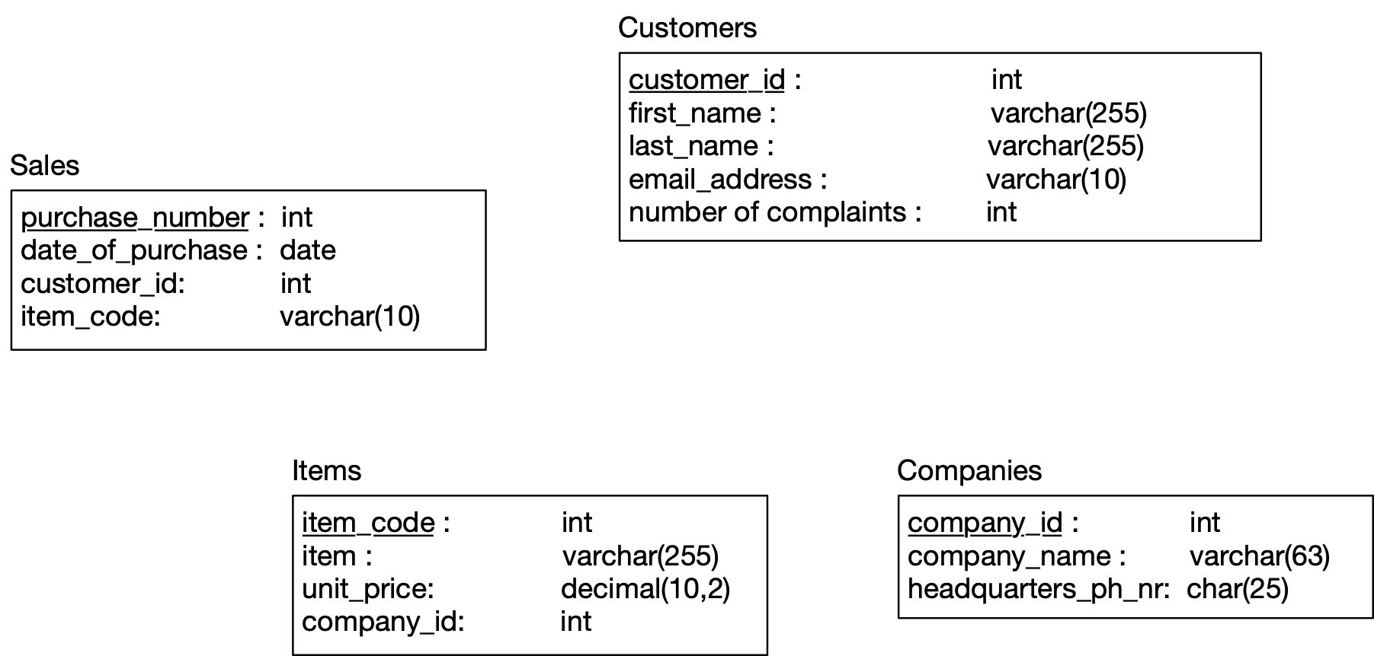
Simple Diagrams

Slide 4
Constraints in MySQL
Constraints in MySQL have names
  Often automatically generated
  Use the SHOW CREATE TABLE query
Table,"Create Table"
customers,"CREATE TABLE `customers` (
`customer_id` int NOT NULL AUTO_INCREMENT,
`first_name` varchar(255) DEFAULT NULL,
`last_name` varchar(255) DEFAULT NULL,
`email_address` varchar(255) DEFAULT NULL,
`number_of_complaints` int DEFAULT (0),
PRIMARY KEY (`customer_id`),
UNIQUE KEY `email_address` (`email_address`)
) ENGINE=InnoDB AUTO_INCREMENT=3 DEFAULT CHARSET=utf8mb4 COLLATE=utf8mb4_0900_ai_ci"

Slide 5
Constraints in MySQL
Missing values are usually a NULL
  Can automatically assign INT with AUTO_INCREMENT
  Used widely to assign artificial primary keys

Slide 6
Constraints in MySQL
NOT NULL constraint
  When inserting a tuple with NULL value in the constrained column, error will be thrown
  Considered good practice to include in all columns where a NULL value is not expected
CREATE TABLE tasks (
id INT AUTO_INCREMENT PRIMARY KEY,
title VARCHAR(255) NOT NULL,
start_date DATE NOT NULL,
end_date DATE
);

Slide 7
Constraints in MySQL
ALTER TABLE allows to introduce new / remove old constraint
  Need to check that the inserted values comply
ALTER TABLE tasks
CHANGE
end_date
end_date DATE NOT NULL;
ALTER TABLE tasks
MODIFY
end_date
end_date DATE NOT NULL;

Slide 8
Constraints in MySQL
UNIQUE
  Values in a single attribute are different
  Value groups in a group of attributes are different
Creating a constraint:
  Specify in CREATE TABLE for a single attribute
  Add a CONSTRAINT cstr_name UNIQUE(attr1, attr2, …)
    Can leave out constraint name, will be replaced by an automatically created name
  Use ALTER TABLE ADD CONSTRAINT

Slide 9
Constraints in MySQL
UNIQUE
CREATE TABLE suppliers (
supplier_id INT AUTO_INCREMENT,
name VARCHAR(255) NOT NULL,
phone VARCHAR(15) NOT NULL UNIQUE,
address VARCHAR(255) NOT NULL,
PRIMARY KEY (supplier_id),
CONSTRAINT uc_name_address UNIQUE (name , address)
);

Slide 10

Constraints in MySQL
UNIQUE constraint creates an index
  Index is a data structure with quick look-up
Access indices through the SHOW INDEX FROM table command

Slide 11
Foreign Keys
Relationships between tables are sometimes constructed with shared values
  Sales has an attribute client_id
  Customers has a primary key client_id
    Need not be named the same
      But it is usually convenient to do so

Slide 12
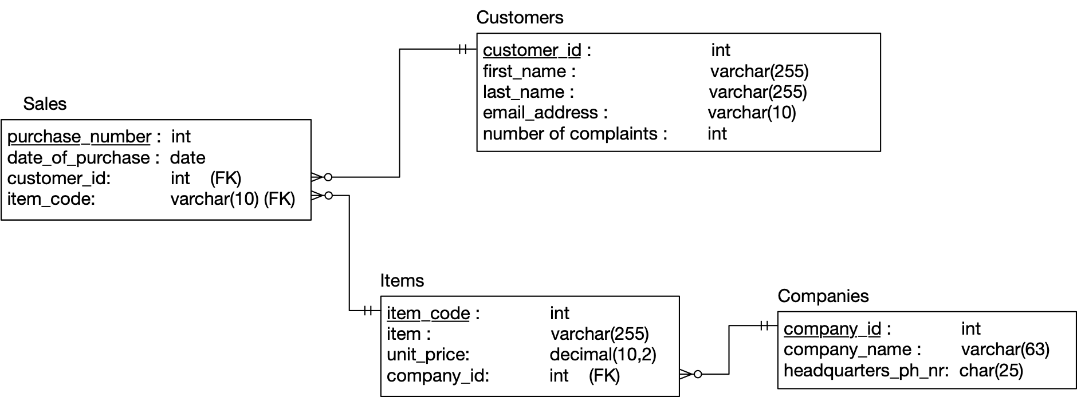
Constraints in MySQL

Slide 13
Constraints in MySQL
Example:
  A customer can have many sales
  But each sale has only one customer
  Relationship customers sales is a one-to-many relationship
  customers is the referenced (or parent) table
  sales is the referencing (or child) table
  As is typical, the referenced attribute is a primary key in the referenced table

Slide 14
Constraints in MySQL

Slide 15
Constraints in MySQL
In a diagram:
  crow-feet with ball indicate many
  double bar indicates one

Slide 16
Constraints in MySQL
Foreign key constraint
  Once established, insures that action is taken upon insertion or deletion of a record affecting the other table

Slide 17
Constraints in MySQL
Possible Actions:
  CASCADE: if a tuple from the referenced table is deleted or updated, the corresponding tuple in the referencing table is also deleted / updated
  SET NULL: If a row from the referenced table is deleted or updated, the values of the foreign key in the referencing table are set to NULL

Slide 18
Constraints in MySQL
Possible Actions:
  RESTRICT: if a row from the referenced table has a matching row in the referencing table, then deletion and updates are rejected
  SET DEFAULT: Accepted by MySQL parser but action not performed

Slide 19
Constraints in MySQL
Foreign keys constraint actions
  Are for
    ON UPDATE
    ON DELETE

Slide 20
Constraints in MySQL
Creating foreign key constraints:
CREATE TABLE categories(
categoryId INT AUTO_INCREMENT PRIMARY KEY,
categoryName VARCHAR(100) NOT NULL
);
CREATE TABLE products(
productId INT AUTO_INCREMENT PRIMARY KEY,
productName varchar(100) not null,
categoryId INT,
CONSTRAINT fk_category
FOREIGN KEY (categoryId)
REFERENCES categories(categoryId)
ON UPDATE CASCADE
ON DELETE CASCADE
);

Slide 21
Constraints in MySQL
You can drop a foreign key restraint using the ALTER TABLE statement
ALTER TABLE table_name
DROP FOREIGN KEY constraint_name;

Slide 22
Constraints in MySQL
When loading a database from (e.g.) .csv files
  Can carefully create referenced tables before referencing tables
  Temporarily disable foreign key checks
SET foreign_key_checks = 0;
SET foreign_key_checks = 1;

