Slide 1
Algebraic and Logical Query Languages
Thomas Schwarz, SJ

Slide 2
Bags, Lists, Sets
Bags are multi-sets
  An element can appear more than once
They are not sets
  In a set, each element can appear at most once
They are not lists
  In a list, elements are indexed

Slide 3
Bags, Lists, Sets
Why bags:
  Union, seletion and projection can create the same tuple many times
  Removing duplicates is difficult:
    Either use a hash table or use sorting
      Both of which are expensive in different ways

Slide 4
Bags, Lists, Sets
Why bags:
  For some temporary tables, bags are appropriate
    Aggregation query like find the average salaries of all female employees hired in 2010, 2011, 2012
    Form a temporary table with salary as only attribute
    You need to keep values separate

Slide 5
Union, Intersection, Differences of Bags
Union:
  Just concatenate the two bags
    If an element appears twice in one bag and thrice in the other, it will appear five times in the union

Slide 6
Union, Intersection, Differences of Bags
Intersection
  $R∩S$:
    Bags match each tuple with another tuple
      If a tuple appears $n$ times in $R$ and $m$ times in $S$, then it appears $min(m,n)$ times in $R∩S$.

Slide 7
Union, Intersection, Differences of Bags
Difference:
  Again, bags use one-to-one matching
    Tuple appears $n$ times in $R$
    Tuple appears $m$ times in $S$
    Tuple appears $max(0,n-m)$ times in $R-S$.
      Each occurrence in $S$ cancels out a single appearance in $R$

Slide 8
Union, Intersection, Differences of Bags
In short: bags are different from sets

Slide 9
Projection of Bags
Projection of bags:
  Each tuple in the mother relation gives rise to one tuple in the projection

Slide 10
Selection of Bags
Again: selection condition is applied to each tuple
There is no duplicate elimination

Slide 11
Products of Bags
Recall: Product assumes that attribute sets are different
Each tuple of $R$ is paired with each tuple of $S$

Slide 12
Joins of Bags
Join tuple by tuple

Slide 13
Joins of Bags
Example:
$$S$$
$$R×S$$
$$R⋈S$$
A | B
1 | 2
1 | 2
$$R$$
B | C
2 | 3
4 | 5
4 | 5

Slide 14
Joins of Bags
Example:
$$R$$
$$S$$
$$R×S$$
$$R⋈S$$
A | B
1 | 2
1 | 2
A | R.B | S.B | C
1 | 2 | 2 | 3
1 | 2 | 4 | 5
1 | 2 | 4 | 5
1 | 2 | 2 | 3
1 | 2 | 4 | 5
1 | 2 | 4 | 5
B | C
2 | 3
4 | 5
4 | 5
A | B | C
1 | 2 | 3
1 | 2 | 3

Slide 15
Joins of Bags
$$R$$
$$S$$
A | B
1 | 2
1 | 2
B | C
2 | 3
4 | 5
4 | 5
$$R⋈_{R.B<S.B}S$$
A | R.B | S.B | C
1 | 2 | 2 | 3
1 | 2 | 4 | 5
1 | 2 | 4 | 5
1 | 2 | 2 | 3
1 | 2 | 4 | 5
1 | 2 | 4 | 5

Slide 16
Joins of Bags
$$R$$
$$S$$
A | B
1 | 2
1 | 2
B | C
2 | 3
4 | 5
4 | 5
$$R⋈_{R.B<S.B}S$$
A | R.B | S.B | C
1 | 2 | 4 | 5
1 | 2 | 4 | 5
1 | 2 | 4 | 5
1 | 2 | 4 | 5

Slide 17
Relational Algebra Operators
Deduplication operator $δ$
Aggregation operators such as sum, averages are used by grouping operators
Grouping: Partitions tuples into groups
  Usually, aggregation is then applied to each group
Extended projections
  Allow to create new attributes using arithmetic operations
Sorting operator
Outer join operator

Slide 18
Aggregations
SUM
AVG
MIN, MAX
COUNT
  not necessarily distinct values in a column

Slide 19
Aggregation
Example:
  Find the aggregations of this table
A | B
1 | 2
3 | 4
1 | 2
1 | 2

Slide 20
Aggregation
Example:
  Find the aggregations of this table
A | B
1 | 2
3 | 4
1 | 2
1 | 2
SUM(A) = 6 SUM(B) = 10
AVG(A) = 1.5 AVG(B) = 2
MIN(A) = 1 MIN(B) = 2
MAX(A) = 3 MAX(B) = 4
COUNT(A) = 4 COUNT(B) = 4

Slide 21
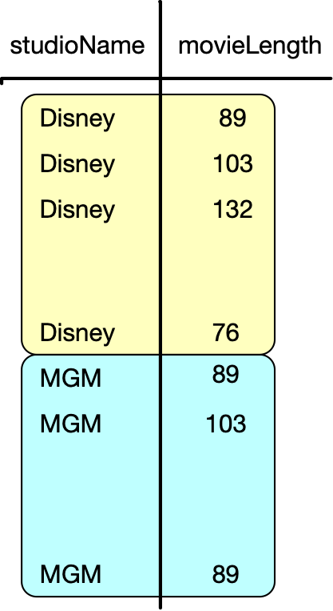
Grouping
Find the length of all movies produced by a certain studio
Project onto studio, length
Group by studioName

Slide 22
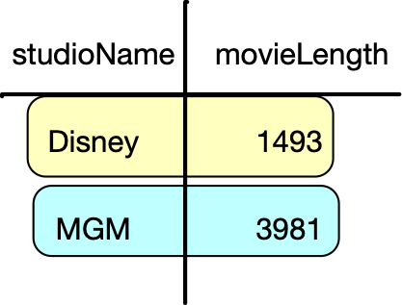
Grouping
Find the length of all movies produced by a certain studio
Project onto studio, length
Group by studioName
Aggregate on movieLength

Slide 23
Grouping Operator
$$γ_{\text{op}(A)}(R)$$
  $A$ — the grouping attribute
  $\text{op}$ — the aggregation operator (e.g. AVG)
  $R$ — the relation

Slide 24
Grouping operator
$$γ_{\text{op}(A)}(R)$$
  Partition the tuples of $R$ into groups according to values of $A$
  For each group produce one tuple with
    the grouping attributes’ values for that group
    the aggregation over all tuples of that group
Generalize to several attributes

Slide 25
Grouping Operator
Find all stars that appeared in at least three movies and the earliest year in which they appeared
$$γ_{\text{starName},\text{MIN}(\text{year})→\text{minYear},\text{COUNT}(\text{title})→\text{ctTitle}}(\text{StarsIn})$$
Result has starName, minYear, and ctTitle attributes
Then select based on the last attribute: ctTitle $≥$ 3
Finally project onto starName and minYear

Slide 26
Extended Projection Operator
Classic projection $π_{L}(R)$
  $L$ — set of attributes of $R$
Extended projection $π_{L}(R)$
  $L$
    — single attributes (as before)
    — expressions $x→y$ renaming attribute $x$ to $y$
    — expressions $E→z$ where $E$ is an expression in terms of attributes and operators

Slide 27
Extended Projection Operator
Example
A | B | C
0 | 1 | 2
0 | 1 | 2
3 | 4 | 5
$$π_{A,B+C→X}(R)$$

Slide 28
Extended Projection Operator
Example
A | B | C
0 | 1 | 2
0 | 1 | 2
3 | 4 | 5
$$π_{A,B+C→X}(R)$$
A | X
0 | 3
0 | 3
3 | 9

Slide 29
Sorting Operator
$$τ_{L}(R)$$
  $L$ is a list of attributes
  Result is $R$ but ordered according to the list $L$

Slide 30
Outer Join Operator
Inner join leaves out certain tuples
Outer join includes them with null values added

Slide 31
Outer Join Operator
Example
$$R$$
A | B | C
1 | 2 | 3
4 | 5 | 6
7 | 8 | 9
B | C | D
2 | 3 | 10
2 | 3 | 11
6 | 7 | 12
$$S$$
$$R\overset{o}{⋈}S$$

Slide 32
Outer Join Operator
Example
$$R$$
A | B | C
1 | 2 | 3
4 | 5 | 6
7 | 8 | 9
B | C | D
2 | 3 | 10
2 | 3 | 11
6 | 7 | 12
A | B | C | D
1 | 2 | 3 | 10
1 | 2 | 3 | 11
4 | 5 | 6 | NULL
7 | 8 | 9 | NULL
NULL | 6 | 7 | 12
$$S$$
$$R\overset{o}{⋈}S$$

Slide 33
Outer Join Operator
Left outer join:
  Only dangling tuples in the left relation are padded with NULL and added to the relation
Right outer join:
  Only dangling tuples in the right relation are padded with NUMM and added to the relation

Slide 34
Outer Join Operator
Example
$$R$$
A | B | C
1 | 2 | 3
4 | 5 | 6
7 | 8 | 9
B | C | D
2 | 3 | 10
2 | 3 | 11
6 | 7 | 12
$$S$$
$$R{\overset{o}{⋈}}_{l}S$$

Slide 35
Outer Join Operator
Example
$$R$$
A | B | C
1 | 2 | 3
4 | 5 | 6
7 | 8 | 9
B | C | D
2 | 3 | 10
2 | 3 | 11
6 | 7 | 12
A | B | C | D
1 | 2 | 3 | 10
1 | 2 | 3 | 11
4 | 5 | 6 | NULL
7 | 8 | 9 | NULL
$$S$$
$$R{\overset{o}{⋈}}_{l}S$$

Slide 36
Outer Join Operator
Example
$$R$$
A | B | C
1 | 2 | 3
4 | 5 | 6
7 | 8 | 9
B | C | D
2 | 3 | 10
2 | 3 | 11
6 | 7 | 12
A | B | C | D
1 | 2 | 3 | 10
1 | 2 | 3 | 11
NULL | 6 | 7 | 12
$$S$$
$$R{\overset{o}{⋈}}_{r}S$$

Slide 37
Outer Join Operator
Can also be extended to theta joins

