Slide 1
SQL

Slide 2
Repetition
Creating Schemas
Inserting
Selection
Constraints

Slide 3
Data Definition Language

Slide 4
SQL DDL
Create a database with CREATE DATABASE
CREATE DATABASE IF NOT EXISTS USNavy;

Slide 5
SQL DDL
Three type of tables in SQL
Stored Relations, called tables
Views: relations calculated by computation
Temporary tables: created during query execution

Slide 6
SQL DDL
Data Types
Character strings of fixed or varying length
CHAR(n) - fixed length string of up to n characters
VARCHAR(n) - fixed length string of up to n characters
Uses and endmarker or string-length for storage efficiency
Bit strings
BIT(n) strings of length exactly n
BIT VARYING(n) - strings of length up to n

Slide 7
SQL DDL
Data Types:
Boolean: BOOLEAN: TRUE, FALSE, UNKNOWN
Integers: INT = INTEGER, SHORTINT
Floats: FLOAT = REAL, DOUBLE, DECIMAL(n,m)
Dates: DATE
SQL Standard: ‘1948-05-14’)
Times: TIME
SQL Standard: 19:20:02.4

Slide 8
SQL DDL
Data Types:
MySQL: ENUM('M', 'F')

Slide 9
SQL DDL
CREATE TABLE creates a table
CREATE TABLE Movies(
title CHAR(100),
year INT,
length INT,
genre CHAR(10),
studioName CHAR(30),
producerC# INT
);

Slide 10
SQL DDL
CREATE TABLE MovieStar(
name CHAR(30),
address VARCHAR(255),
gender CHAR(1),
birthday DATE
);

Slide 11
SQL DDL
Drop Table drops a table
DROP TABLE Movies;

Slide 12
SQL DDL
Altering a table with ALTER TABLE
with ADD followed by attribute name and data type
with DROP followed by attribute name
ALTER TABLE MovieStar ADD phone CHAR(16);
ALTER TABLE MovieStar DROP Birthday;

Slide 13
SQL DDL
Default Values
Conventions for unknown data
Usually, NULL
Can use other values for unknown data
CREATE TABLE MovieStar(
name CHAR(30),
address VARCHAR(255),
gender CHAR(1) DEFAULT '?',
birthday DATE DEFAULT '0000-00-00'
);

Slide 14
SQL DDL
Declaring Keys
Declare one attribute to be a key
Add one additional declaration:
Particular set of attributes is a key
Can use
PRIMARY KEY
UNIQUE

Slide 15
SQL DDL
UNIQUE for a set S:
Two tuples cannot agree on all attributes of S unless one of them is NULL
Any attempted update that violates this will be rejected
PRIMARY KEY for a set S:
Attributes in S cannot be NULL

Slide 16
SQL DDL
CREATE TABLE MovieStar(
name CHAR(30) PRIMARY KEY,
address VARCHAR(255),
gender CHAR(1),
birthday DATE
);

Slide 17
SQL DDL
CREATE TABLE MovieStar(
name CHAR(30),
address VARCHAR(255),
gender CHAR(1) DEFAULT '?',
birthday DATE DEFAULT '0000-00-00',
PRIMARY KEY (name)
);

Slide 18
SQL DDL
CREATE TABLE Movies(
title CHAR(100),
year INT,
length INT,
genre CHAR(10),
studioName CHAR(30),
producerC# INT,
PRIMARY KEY (title, year)
);

Slide 19
Simple Diagrams
A schema is represented by a networked diagram
Nodes represent tables
Name of the table labels the node
Interior of the node are the name of the attributes
Underline the primary key
Optionally, add domain to each attribute

Slide 20
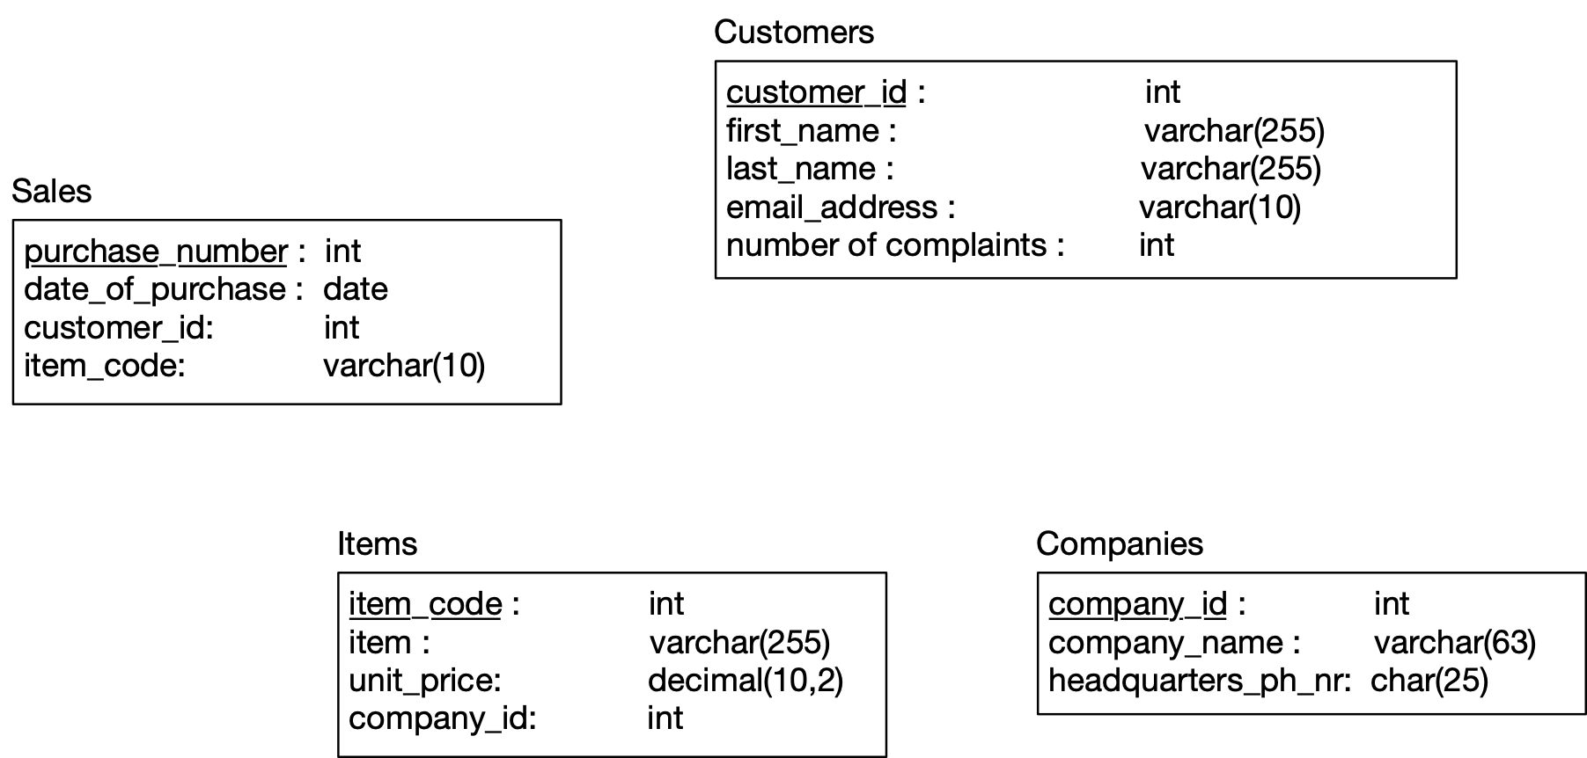
Simple Diagrams

Slide 21
Constraints in MySQL
Constraints in MySQL have names
Often automatically generated
Use the SHOW CREATE TABLE query
Table,"Create Table"
customers,"CREATE TABLE `customers` (
`customer_id` int NOT NULL AUTO_INCREMENT,
`first_name` varchar(255) DEFAULT NULL,
`last_name` varchar(255) DEFAULT NULL,
`email_address` varchar(255) DEFAULT NULL,
`number_of_complaints` int DEFAULT (0),
PRIMARY KEY (`customer_id`),
UNIQUE KEY `email_address` (`email_address`)
) ENGINE=InnoDB AUTO_INCREMENT=3 DEFAULT CHARSET=utf8mb4 COLLATE=utf8mb4_0900_ai_ci"

Slide 22
Constraints in MySQL
Missing values are usually a NULL
Can automatically assign INT with AUTO_INCREMENT
Used widely to assign artificial primary keys

Slide 23
Constraints in MySQL
NOT NULL constraint
When inserting a tuple with NULL value in the constrained column, error will be thrown
Considered good practice to include in all columns where a NULL value is not expected
CREATE TABLE tasks (
id INT AUTO_INCREMENT PRIMARY KEY,
title VARCHAR(255) NOT NULL,
start_date DATE NOT NULL,
end_date DATE
);

Slide 24
Constraints in MySQL
ALTER TABLE allows to introduce new / remove old constraint
Need to check that the inserted values comply
ALTER TABLE tasks
CHANGE
end_date
end_date DATE NOT NULL;
ALTER TABLE tasks
MODIFY
end_date
end_date DATE NOT NULL;

Slide 25
Constraints in MySQL
UNIQUE
Values in a single attribute are different
Value groups in a group of attributes are different
Creating a constraint:
Specify in CREATE TABLE for a single attribute
Add a CONSTRAINT cstr_name UNIQUE(attr1, attr2, …)
Can leave out constraint name, will be replaced by an automatically created name
Use ALTER TABLE ADD CONSTRAINT

Slide 26
Constraints in MySQL
UNIQUE
CREATE TABLE suppliers (
supplier_id INT AUTO_INCREMENT,
name VARCHAR(255) NOT NULL,
phone VARCHAR(15) NOT NULL UNIQUE,
address VARCHAR(255) NOT NULL,
PRIMARY KEY (supplier_id),
CONSTRAINT uc_name_address UNIQUE (name , address)
);

Slide 27
Constraints in MySQL
UNIQUE constraint creates an index
Index is a data structure with quick look-up
Access indices through the SHOW INDEX FROM table command

Slide 28
Foreign Keys
Relationships between tables are sometimes constructed with shared values
Sales has an attribute client_id
Customers has a primary key client_id
Need not be named the same
But it is usually convenient to do so

Slide 29
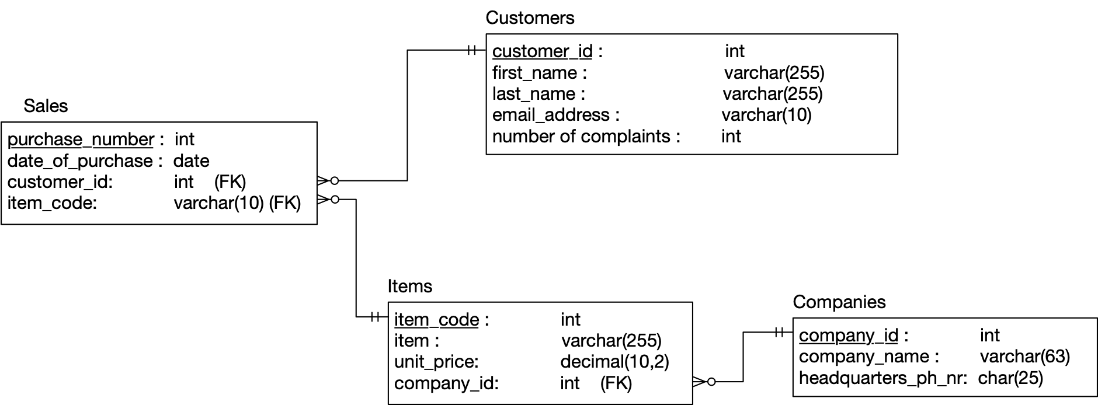
Constraints in MySQL

Slide 30
Constraints in MySQL
Example:
A customer can have many sales
But each sale has only one customer
Relationship customers sales is a one-to-many relationship
customers is the referenced (or parent) table
sales is the referencing (or child) table
As is typical, the referenced attribute is a primary key in the referenced table

Slide 31
Constraints in MySQL

Slide 32
Constraints in MySQL
In a diagram:
crow-feet with ball indicate many
double bar indicates one

Slide 33
Constraints in MySQL
Foreign key constraint
Once established, insures that action is taken upon insertion or deletion of a record affecting the other table

Slide 34
Constraints in MySQL
Possible Actions:
CASCADE: if a tuple from the referenced table is deleted or updated, the corresponding tuple in the referencing table is also deleted / updated
SET NULL: If a row from the referenced table is deleted or updated, the values of the foreign key in the referencing table are set to NULL

Slide 35
Constraints in MySQL
Possible Actions:
RESTRICT: if a row from the referenced table has a matching row in the referencing table, then deletion and updates are rejected
SET DEFAULT: Accepted by MySQL parser but action not performed

Slide 36
Constraints in MySQL
Foreign keys constraint actions
Are for
ON UPDATE
ON DELETE

Slide 37
Constraints in MySQL
Creating foreign key constraints:
CREATE TABLE categories(
categoryId INT AUTO_INCREMENT PRIMARY KEY,
categoryName VARCHAR(100) NOT NULL
);
CREATE TABLE products(
productId INT AUTO_INCREMENT PRIMARY KEY,
productName varchar(100) not null,
categoryId INT,
CONSTRAINT fk_category
FOREIGN KEY (categoryId)
REFERENCES categories(categoryId)
ON UPDATE CASCADE
ON DELETE CASCADE
);

Slide 38
Constraints in MySQL
You can drop a foreign key restraint using the ALTER TABLE statement
ALTER TABLE table_name
DROP FOREIGN KEY constraint_name;

Slide 39
Constraints in MySQL
When loading a database from (e.g.) .csv files
Can carefully create referenced tables before referencing tables
Temporarily disable foreign key checks
SET foreign_key_checks = 0;
SET foreign_key_checks = 1;

Slide 40
Select

Slide 41
Select
SELECT * FROM table
SELECT col1, col2 FROM table
SELECT * FROM table WHERE conditions

Slide 42
SELECT
= equals (comparison operator)
AND, OR
IN, NOT IN
LIKE, NOT LIKE
BETWEEN … AND
EXISTS, NOT EXISTS
IS NULL, IS NOT NULL
comparison operators

Slide 43
Comparisons with NULL
NULL in any expression gives NULL
If you compare anything with NULL in MySQL, you get NULL
IF you order, NULL values appear last
In other SQL dialects: UNKNOWN

Slide 44
SELECT
LIKE
Pattern matching
Wild cards
% means zero or more characters
_ means a single letter
[ ] means any single character within the bracket
^ means any character not in the bracket
- means a range of characters

Slide 45
SELECT
BETWEEN … AND …
Selects records with a value in the range
endpoints included
SELECT
*
FROM
employees
WHERE
hire_data between 1990-01-01 and 1999-12-31;

Slide 46
SELECT
SELECT DISTINCT
SELECT DISTINCT
gender
FROM
employees

Slide 47
Like Examples
WHERE name LIKE 't%'
any values that start with 't'
WHERE name LIKE '%t'
any values that end with 't'
WHERE name LIKE '%t%'
any value with a 't' in it
WHERE name LIKE '_t%'
any value with a 't' in second position

Slide 48
SELECT
LIMIT gives the maximum number of rows returned
Can be used for a sample
Can be used with ORDER BY ASC

Slide 49
Insert Operations
Insert Syntax
No need to insert into automatic values
If only a few attributes are set,
If all attributes are set, just list the values
Can set many tuples at once
INSERT INTO
table(attr1, attr2, …)
Values(v1, v2, …)
INSERT INTO served
VALUES
('William Howe', 'Great Britain', '1746-1-1', '1778-4-1'),
('Benedict Arnold', 'Great Britain', '1757-1-1', '1775-1-1'),
('Benedict Arnold', 'United States', '1775-1-1', '1780-9-1'),
('Benedict Arnold', 'Great Britain', '1780-9-1', '1787-1-1')

Slide 50
Queries with more than one table
SQL has explicit commands for the various joins and products
Normally, combine tables by listing them in the FROM clause
SELECT name
FROM movies, moviesExec
WHERE title = ‘Star Wars’
AND movies.producerC# = moviesExec.cert#

Slide 51
Queries with more than one table
Find all movie execs that live with a star
MovieStar(name, address, gender, birthdate)
MovieExec(name, address, cert#, netWorth)
SELECT MovieStar.name, MovieExec.name)
FROM MovieStar, MovieExec
WHERE
MovieStar.address = MovieExec.address

Slide 52
Queries with more than one table
Tuple Variables
Sometimes need to combine two tuples in the same table
Can extend the FROM clause
SELECT Star1.name, Star2.name
FROM MovieStars Star1, MovieStars Star2
WHERE
Star1.address = Star2.address
AND Star1.name < Star2.name

Slide 53
Queries with more than one table
Unions, intersections, excepts
To execute the corresponding set operations
(SELECT name, address
FROM movieStars
WHERE gender = 'F'
)
INTERSECT
(SELECT name, address
FROM movieExecs
WHERE netWorth > 1000000
)

Slide 54
Updates
Changes existing records
Syntax:
Does not need to change all attributes
If there is no WHERE condition, all records are updated
UPDATE tablename
SET attr1=val1, attr2=val2, …
WHERE conditions;

Slide 55
Commit and Rollback
A database allows us to rollback to a previous state unless we have committed
MySQLWorkbench has an auto-commit button
Rollback puts database into the state of the last commit

Slide 56
Delete
Just like an update
The Where clause is not necessary
DELETE FROM tablename
WHERE condition

Slide 57
Delete, Drop, Truncate
Drop Table:
Definite action: cannot recover with rollback
Truncate:
All records removed
Auto-increment values reset
Table description stays
Delete:
Delete removes records row by row
Auto-increment values remain
Slower than truncate

Slide 58
Subqueries
Subqueries are helper queries

Slide 59
Subqueries
Subqueries producing a scalar value
Example: Producer of Star Wars
Can achieve the same effect by first looking for the producerC#
SELECT name
From movies, movieExec
WHERE title = 'Star Wars'
AND
producerC# = cert#;

Slide 60
Subqueries
Example: Producer of Star Wars
This might be implemented with the same query execution as before
SELECT name
FROM movieExec
WHERE cert# =
(SELECT producerC#
FROM movies
WHERE title = 'star wars'
)

Slide 61
Subqueries
Subqueries with conditions involving relations
We obtain a relation $R$ as a subquery
E.g. with subquery (SELECT * FROM foobar)
Queries are:
EXISTS R
s IN R s NOT IN R
s > ALL R NOT s > ALL R
s > ANY R NOT s > ANY R

Slide 62
Subqueries
Subqueries involving tuples
Tuple is a list of scalar values
Can compare tuples with the same number of components
Example:
Finding the producers of 'Harrison Ford' movies

Slide 63
Subqueries
SELECT name
FROM movieExec
WHERE cert# IN
(SELECT producerC#
FROM movies
WHERE (title, year) IN
(SELECT movieTitle, movieYear
FROM StarsIn
WHERE starName = 'Harrison Ford'
)
);

Slide 64
Subqueries
To analyze a query, start with the inmost query
SELECT name
FROM movieExec
WHERE cert# IN
(SELECT producerC#
FROM movies
WHERE (title, year) IN
(SELECT movieTitle, movieYear
FROM StarsIn
WHERE starName = 'Harrison Ford'
)
);

Slide 65
Subqueries
This query can also be written without nested subqueries
SELECT name
FROM movieExec, movies, starsIn
WHERE cert# = producerC#
AND starsIn.title = movies.title
AND starsIn.year = movie.year
AND starName = 'Harrison Ford'

Slide 66
Subqueries
Correlated subqueries
Subquery is evaluated many times
Once for each value given
Example
SELECT title
FROM movies Old
WHERE year < ANY (
SELECT year
FROM movies
WHERE title = Old.title
);

Slide 67
Subqueries
Scoping rules
First look for the subquery and tables in that subquery
Then go to the nesting subquery
etc.

Slide 68
Subqueries
Subqueries in FROM clauses
Here we join on a subquery aliased Prod
SELECT name
FROM movieExecs, ( SELECT producerC#
FROM movies, starsIn
WHERE movies.title = starsIn.title
AND movies.year = starsIn.year
AND starName = 'Harrison Ford'
) Prod
WHERE cert# = Prod.producerC#

Slide 69
Subqueries
SQL JOIN expression
Explicit construction of various joins
CROSS JOIN (product)
NATURAL JOIN
FULL OUTER JOIN
NATURAL FULL OUTER JOIN
LEFT OUTER JOIN
RIGHT OUTER JOIN

Slide 70
Subqueries
Examples
movies FULL OUTER JOIN starsIn ON
movies.title = stars.

Slide 71
Subqueries
Examples
movieStar(name, address, gender, birthday)
movieExec(name, address, cert#, netWorth)
movieStar NATURAL FULL OUTER JOIN movieExec(
name, address, gender, birthday, cert#, netWorth)

Slide 72
Eliminating Duplicates
Use Distinct
Warning: Invoking distinct is costly
SELECT DISTINCT name
FROM movies

Slide 73
Eliminating Duplicates
Union, intersection, difference usually remove duplicates automatically
If we do not want this, but bag semantics:
Use the keyword all
(SELECT title, year
FROM movies)
UNION ALL
(SELECT movieTitle AS title,
movieYear AS year
FROM
starsIn);

Slide 74
Aggregate Functions
COUNT
numeric and non-numeric data
null values excepted
SUM, MIN, MAX, AVG - only numeric data
Exercise: Find the number of different stars in the starsIn table
SELECT COUNT(DISTINCT name)
FROM starsIn

Slide 75
Aggregate Functions
Find the combined net-worth of movieExecs
Find the average net-worth of movieExecs
SELECT SUM(networth)
FROM movieExecs
SELECT ROUND(AVG(networth),2)
FROM movieExecs

Slide 76
Aggregate Functions
Dealing if NULL values
IFNULL(EXPR1, EXPR2):
Gives EXPR1 if it is not NULL and EXPR2 if not
SELECT
name,
IFNULL(studio, 'not president') AS studio
FROM movieExecs;

Slide 77
Aggregate Functions
COALESCE(EXPR1, EXPR2, EXPR3, … EXPRn)
Gives first nonNULL expression

Slide 78
Grouping
Aggregation happens usually with grouping
To group, use GROUP BY followed by a WHERE clause
SELECT studioName, SUM(length) AS totalRunTime
FROM movies
GROUP BY studioName;

Slide 79
Grouping
Example
Computing the total run time of movies produced by a producer
SELECT name, SUM(length) AS totalRunTime
FROM MovieExec, Movies
WHERE producerC# = cert#
GROUP BY name;

Slide 80
Grouping
Aggregation and Nulls
NULL does not contribute to a sum, average, or count
Grouping and Nulls
NULL is an ordinary value for grouping purposes
Aggregation except COUNT over an empty bag gives result NULL

Slide 81
Transactions

Slide 82
Transactions
Databases have to process many operations in parallel
This means some support for inter-process communication
Usually provided by logging
DBMS differ in what they provide
Serializability:
All transactions appear to have been executed one after the other

Slide 83
Transactions
Atomicity
A single query is never interrupted:
Example:
A transfer of money from one account to another is executed completely or not at all
Both accounts have changed or none

Slide 84
Transactions
Transaction
A group of SQL statements that are all processed in the order given or not at all
SQL:
START TRANSACTION
either
COMMIT
ROLLBACK

Slide 85
Transactions
Read only transactions
By declaring a transaction as read-only, SQL can usually perform it quicker
SET TRANSACTION READ ONLY;
SET TRANSACTION READ WRITE;

Slide 86
Transactions
Dirty Reads:
Reading a record from an update that will be rolled-back
Are dirty reads bad?
Depends
Sometimes, it does not matter, and we do not want the DBMS spend time on making sure that there are no dirty reads
Sometimes, a dirty read can absolutely mess up things
Selling the same commodity to two customers, …

Slide 87
Transactions
SQL Isolation Levels:
Allow dirty reads:
SET TRANSACTION READ WRITE
SET ISOLATION LEVEL READ UNCOMMITTED

Slide 88
Transactions
SQL Isolation Levels:
Allow reads only of committed data:
SET TRANSACTION READ WRITE
SET ISOLATION LEVEL READ COMMITTED

Slide 89
Transactions
SQL Isolation Levels:
Disallow dirty reads, but insure that the reads are consistent:
SET TRANSACTION READ WRITE
SET ISOLATION LEVEL READ REPEATABLE READ

Slide 90
Transactions
SQL Isolation Levels:
Serializability (default):
SET TRANSACTION READ WRITE
SET TRANSACTION ISOLATION LEVEL SERIALIZABLE

