Slide 1
Repetition
From E/R to Database

Slide 2
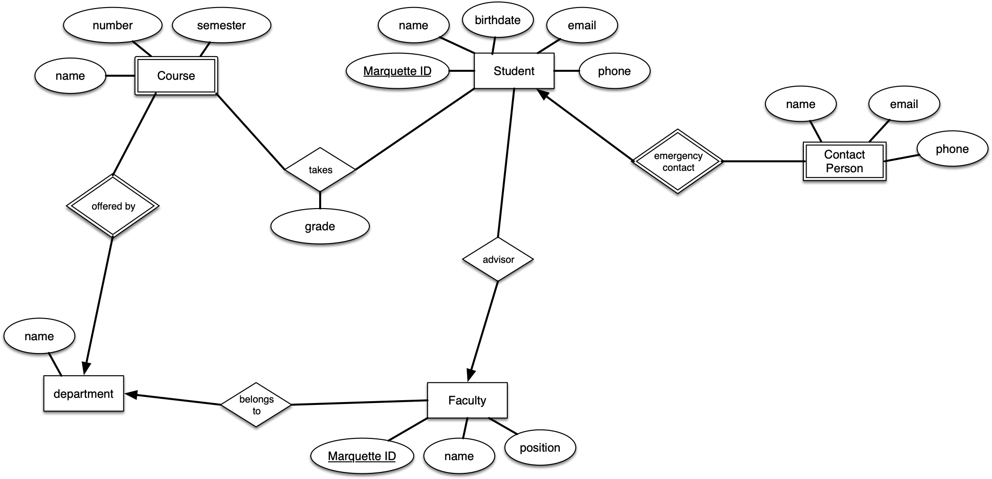
E/R Diagram

Slide 3
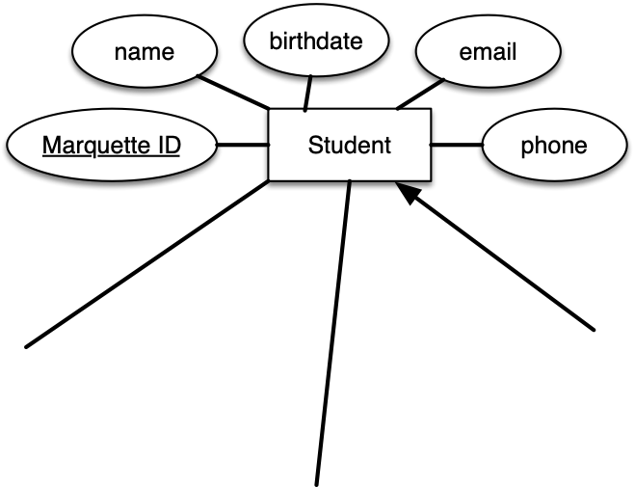
Schemata
Create a table for an entity
Attributes are properties
student(MID, name, birthdate, email, phone)

Slide 4
SQL Table
CREATE DATABASE marquette;
USE marquette;
CREATE TABLE student (
MID CHAR(12),
birthdate DATE,
email CHAR(64) NOT NULL,
name VARCHAR(64) NOT NULL,
PRIMARY KEY (MID)
);

Slide 5
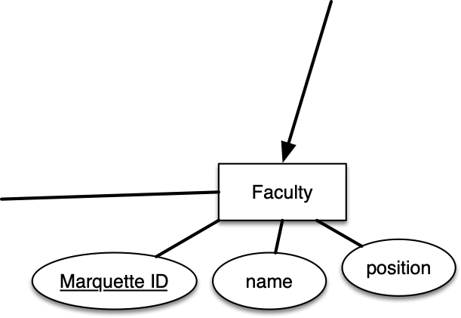
Schemata
faculty(MID, name, position)

Slide 6
SQL Table
CREATE TABLE faculty (
MID CHAR(12),
name VARCHAR(64) NOT NULL,
position VARCHAR(32) NOT NULL
);

Slide 7
Schemata
Relationships:
Create a table for the relationship set.
Add all primary keys of the participating entity sets as fields of the table.
Add a field for each attribute of the relationship. Declare a primary key using the key fields from the source entity set only.
Declare foreign key constraints for all the fields from the source and target entity sets.

Slide 8
Schemata
department(name)
faculty(MID, name, position)
belongsTo(MID, departmentName)

Slide 9
SQL Table
CREATE TABLE department (
name VARCHAR(32),
PRIMARY KEY (name)
);
CREATE TABLE belongsTo (
MID CHAR(12),
departmentName VARCHAR(32) NOT NULL,
PRIMARY KEY (MID),
CONSTRAINT fk_fac_depname
FOREIGN KEY (departmentName)
REFERENCES department (name)
ON UPDATE CASCADE
ON DELETE CASCADE
);

Slide 10
SQL Table
Modeling many-to-one relationships is a bit iffy.
To make sure that all faculty have a department, we can integrate the department table into the faculty table.
This can create problems if we need departments again

Slide 11
SQL Table
CREATE TABLE facultyAlt (
MID CHAR(12),
name VARCHAR(64) NOT NULL,
position VARCHAR(32) NOT NULL,
departmentName VARCHAR(32) NOT NULL,
PRIMARY KEY(MID)
);

Slide 12
Schemata
Weak entities:
Create a table for the weak entity
Make each attribute of the weak entity set a field of the table
Add fields for the primary key attributes of the identifying owner
Declare a foreign key constraint on these identifying owner fields
Automatically delete any tuples in the table for which there are no owners

Slide 13
Schemata
contactPerson(name, email, phone, studentMID)

Slide 14
SQL Table
CREATE TABLE contactPerson (
name VARCHAR(32),
phone CHAR(15),
email VARCHAR(64),
studentMID CHAR(12),
PRIMARY KEY (name),
CONSTRAINT fk_cp_st FOREIGN KEY (studentMID)
REFERENCES student (MID)
ON DELETE CASCADE
);

Slide 15
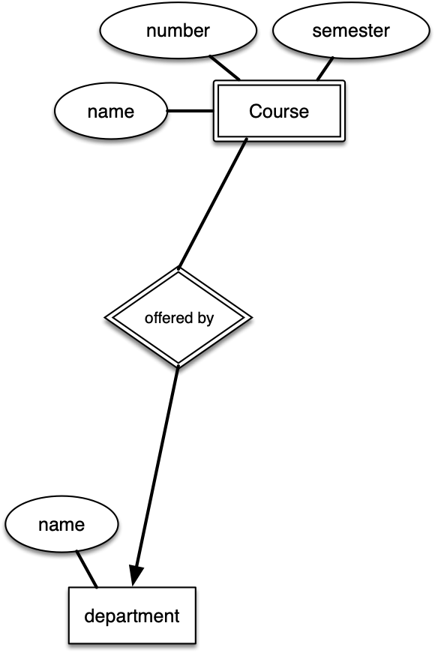
Schemata
courses(deptName, number, semester, name)

Slide 16
SQL Table
CREATE TABLE courses (
name VARCHAR(64) NOT NULL,
number CHAR(3),
deptName VARCHAR(32),
semester CHAR(5),
PRIMARY KEY (deptName , number , semester),
CONSTRAINT fk_cs_dpt FOREIGN KEY (deptName)
REFERENCES department (name)
ON DELETE CASCADE
);

Slide 17
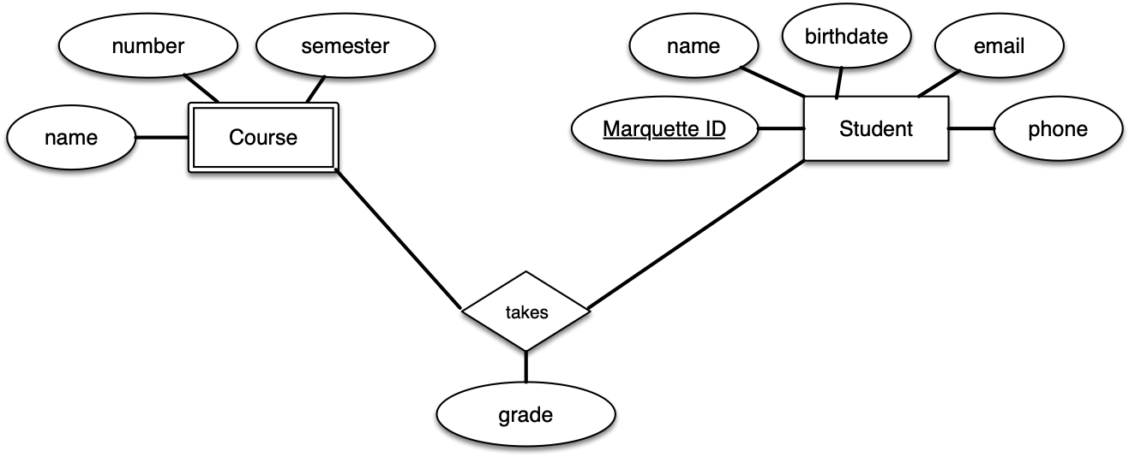
Schemata
takes(MID, deptName, number, semester, grade)

Slide 18
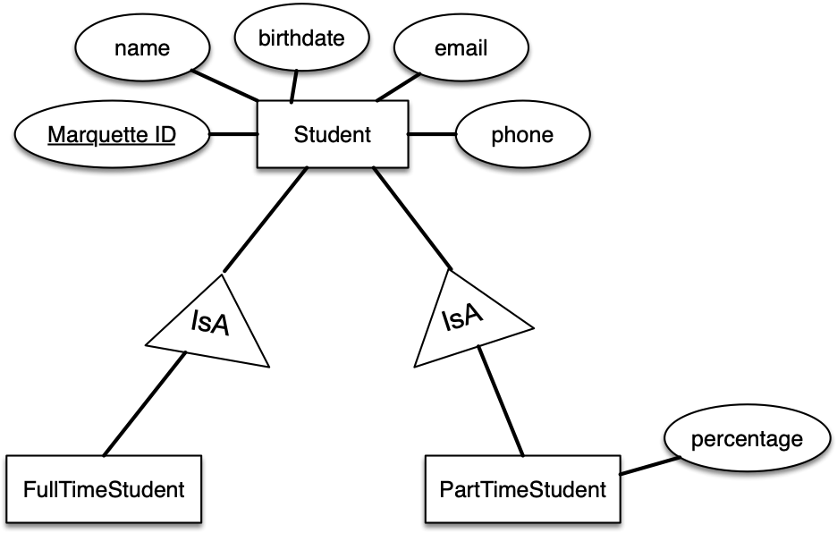
Is A Relationships
There are many ways to deal with IsA relationship
Assume we have now part-time students

Slide 19
Schemata
We create one table for the super-category and add tables for each sub-category with the additional attributes
This solution only needs one more table
We declare a foreign key constraint to ensure that the entry of a subtable corresponds to a table in the super
partTimeStudent(MID,percentage)

Slide 20
SQL Table
CREATE TABLE partTimeStudent (
MID CHAR(6),
percentage DECIMAL(2 , 2 ),
PRIMARY KEY (MID),
FOREIGN KEY (MID)
REFERENCES student (MID)
);

