Slide 1
No SQL Databases
Thomas Schwarz, SJ

Slide 2
Relational Model Shortcomings
Greater Scalability
High write throughput / very large datasets
Independence from few vendors — Move towards Open Source
Need for different query operations
Restrictiveness of relational schemas

Slide 3
Data at Very Large Scale
Hush: HBase URL Shortener
Hand a URL to a Shortener service
Get a shorter URL back
E.g. to use in twitter messages
Shortener provides counter for each shortened URLs
"Vanity URL" that incorporate specific domain names
Need to maintain users
log in to create short URLs
track existing URLs
see reports for daily, weekly, or monthly usage

Slide 4
Data at Very Large Scale
Data is too large to store at a single server
Notice:
Limited need for transactions
Importance of high throughput writes and reads

Slide 5
Data at Very Large Scale
Columnar Layout
A relational database strategy often adopted in No-SQL databases
Instead of storing data in tuples
Store by attribute

Slide 6
Data at Very Large Scale
For large HUSH:
Can use a relational database
Use normalization and obtain a scheme

Slide 7
Data at Very Large Scale
Principles of Denormalization, Duplication, Intelligent Keys
Denormalize by duplicating data in more than one table
Avoids aggregation at read time
Prematerialize required views

Slide 8
Data at Very Large Scale
Example: HBase URL Shortener (Hush)
user(id, username, credentials, rules, first_name, last_name, email) with unique username constraint
url(id, url, refShortID, title, description, content)
shorturl(id, userID, urlID, shortID, refShortID, description) with unique shortID and F.K. userID and urlID
click(id, datestamp, shortID, category, dimension, counter) with F.K. shortID

Slide 9
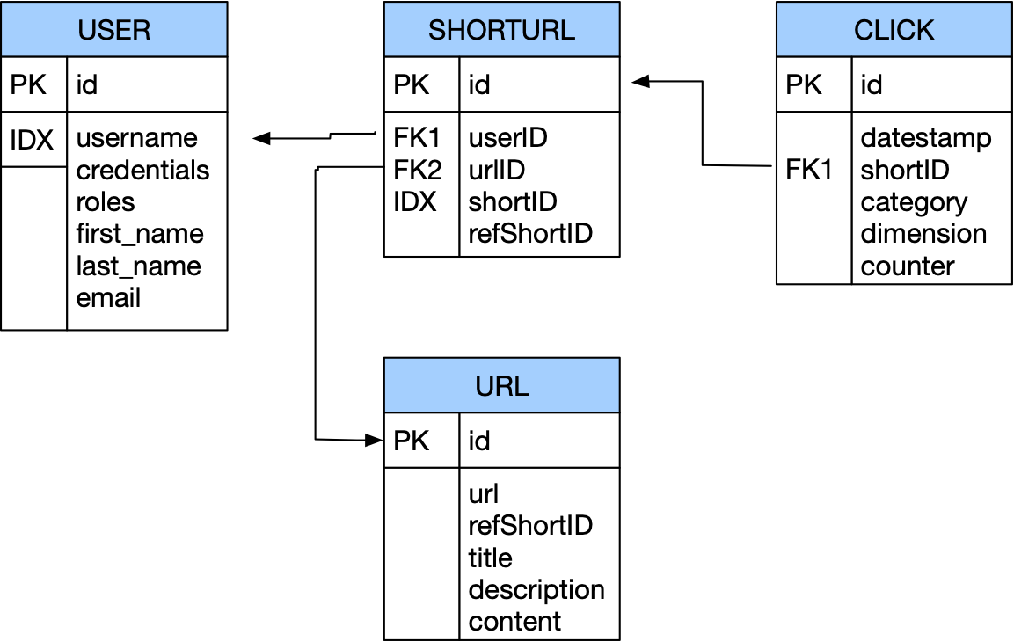
Data at Very Large Scale
Purpose: maps long URLs to short URLs

Slide 10
Data at Very Large Scale
Short URL can be given to others
This is translated to the full URL

Slide 11
Data at Very Large Scale
Each click is tracked, which aggregates to weekly usage numbers

Slide 12
Data at Very Large Scale
All these operations require joins

Slide 13
Data at Very Large Scale
Bandwidth problem
Especially for joins
Need to store data in joins together, not look them up separately
But can relax on the consistency model:
No need to serialize short URL creation or URL translations or have atomic updates
Might be able to relax integrity constraints
Statistics need to be approximately correct

Slide 14
Data at Very Large Scale
Denormalization:
Key idea: Store data together that is likely to be joined
Means:
massive duplication of data
relaxed consistency needed
but faster reads / writes

Slide 15
Data at Very Large Scale
Wide column stores
names and format of columns can vary from row to row
Google's BigTable

Slide 16
Data at Very Large Scale
Document databases
MongoDB, XML databases
see below

Slide 17
Data at Very Large Scale
Key-value database
Every record is a key-value pair
A large set of tools predating no-sql databases in general

Slide 18
Data at Very Large Scale
Graph databases
Navigational database successor:
information about data interconnectivity or topology as important as data itself
See below for an example

Slide 19
Alternatives to Relational Schemes: XML
Data is often structured hierarchically
Invoice = {
date : "2008-05-24"
invoiceNumber : 421
InvoiceItems : {
Item : {
description : "Wool Paddock Shet Ret Double Bound Yellow 4'0"
quantity : 1
unitPrice : 105.00
}
Item : {
description : "Wool Race Roller and Breastplate Red Double"
quantity : 1
unitPrice : 75.00
}
Item : {
description : "Paddock Jacket Red Size Medium Inc Embroidery"
quantity : 2
unitPrice : 67.50
}
}
}

Slide 20
Alternatives to Relational Schemes: XML
As an XML document
<invoice>
<number>421</number>
<date>2008-05-24</date>
<items>
<item>
<description>Wool Paddock Shet Ret Double Bound Yellow 4'0"</description>
<quantity>1</quantity>
<unitPrice>105.00</unitPrice>
</item>
<item>
<description>Wool Race Roller and Breastplate Red Double</description>
<quantity>1</quantity>
<unitPrice>75.00</unitPrice>
</item>
<item>
<description>Paddock Jacket Red Size Medium Inc Embroidery</description>
<quantity>2</quantity>
<unitPrice>67.50</unitPrice>
</item>
</items>
</invoice>

Slide 21
Alternatives to Relational Schemes: XML
Advantage of XML
Faster to scan all data
No joins
Disadvantages of XML
Each record contains the full or an abbreviated scheme
Each query needs to select from big chunks of data

Slide 22
Alternatives to Relational Schemes: JSON
JSON — JavaScript Object Notation
Human-readable
Organized as key-value pairs

Slide 23
Alternatives to Relational Schemes: JSON
JSON record example
{
"firstName": "John",
"lastName": "Smith",
"isAlive": true,
"age": 27,
"address": {
"streetAddress": "21 2nd Street",
"city": "New York",
"state": "NY",
"postalCode": "10021-3100"
},
"phoneNumbers": [
{
"type": "home",
"number": "212 555-1234"
},
{
"type": "office",
"number": "646 555-4567"
},
{
"type": "mobile",
"number": "123 456-7890"
}
],
"children": [],
"spouse": null
}

Slide 24
Alternatives to Relational Schemes: JSON
JSON can use a schema (type definition)
JSON was first used for data transmission as a data serialization format

Slide 25
Alternatives to Relational Schemes: JSON
Many-to-One and Many-to-Many Relationships
Modeled by the same value for the same key
Problem: Need to standardize / internationalize these values
Using id-s instead of plain text to avoid problems
Table of id-s reintroduce a relational scheme through a backdoor

Slide 26
Alternatives to Relational Schemes: JSON
Resumé
Users present people
People have jobs, education, and recommenders
But they share jobs, companies, degrees, schools, recommenders
Should they stay text strings or become entities?
Latter allows to add information to all resumés
If recommenders get a photo, then all resumés should be updated with this photo, so better to make recommenders entities

Slide 27
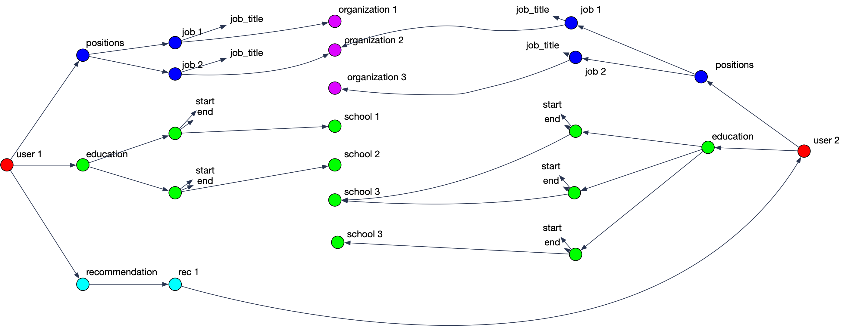
Alternatives to Relational Schemes: JSON
Data has a tendency to become less-join free

Slide 28
Document Databases
Records are documents
Encode in
XML
YAML
JSON
BSON (Mongo DB)
CRUD operations: create, read, update, delete

Slide 29
Document Databases
Enforcing schema
Most document databases do not enforce schema
—> “Schemaless”
In reality: “Schema on Read”
RDBMS would then use “Schema on Write”
Allows schema updates in simple form

Slide 30
Document Databases
Schema on Read:
Advantages:
Data might come from external sources
Disadvantages:
No data checking

Slide 31
Document Databases
Document database support
Most commercial database systems now support XML databases

Slide 32
Query Languages
Documents lend themselves to object-oriented querying
Imperative code
SQL is declarative:
Programmer explains a solution
System figures out the best way to find the solution
Use declarative query languages for document databases

Slide 33
Query Languages
Map-Reduce (neither declarative nor imperative):
Consists of only two pieces of code
Mapping: Selecting from Documents
Reducing: Take selection elements and operate on them

Slide 34
Alternatives to Relational Schemes: Graph Models
Graphs consists of vertices and edges
Example:
Social graphs: vertices are people and edges are relationships such “knows”
Web graph: vertices are pages and edges are links
Road networks: vertices are places and edges are connections

Slide 35
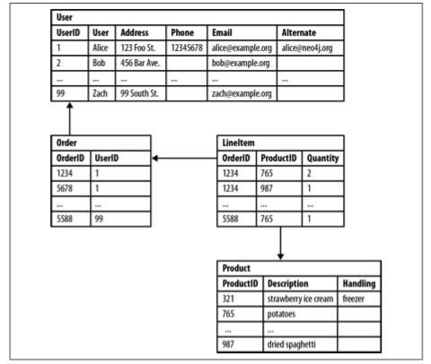
Alternatives to Relational Schemes: Graph Models
Relational Database hides semantic relationships

Slide 36
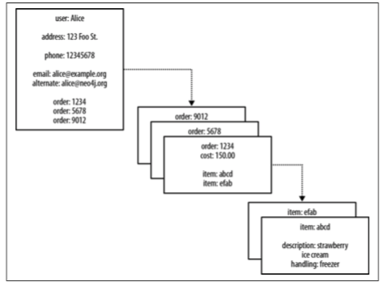
Alternatives to Relational Schemes: Graph Models
Document model hides semantic relationships

Slide 37
Alternatives to Relational Schemes: Graph Models
Some property values are really references to foreign aggregates
Aggregate’s identifier is a foreign key
Relationships between them are not explicitly accessible
Joining aggregates becomes expensive

Slide 38
Alternatives to Relational Schemes: Graph Models
Relational Database
Some queries are simple:
SELECT p1.Person FROM Person p1 JOIN PersonFriend
ON PersonFriend.FriendID = p1.ID JOIN Person p2
ON PersonFriend.PersonID = p2.ID WHERE p2.Person = 'Bob'

Slide 39
Alternatives to Relational Schemes: Graph Models
Relational Database
Some queries others are more involved: Friends of Bob
SELECT p1.Person FROM Person p1 JOIN PersonFriend
ON PersonFriend.PersonID = p1.ID JOIN Person p2
ON PersonFriend.FriendID = p2.ID
WHERE p2.Person = 'Bob'

Slide 40
Alternatives to Relational Schemes: Graph Models
Relational Database
Some queries others are difficult: Alice’s friends of friends
SELECT p1.Person AS PERSON, p2.Person AS FRIEND_OF_FRIEND FROM PersonFriend pf1 JOIN Person p1
ON pf1.PersonID = p1.ID JOIN PersonFriend pf2
ON pf2.PersonID = pf1.FriendID JOIN Person p2
ON pf2.FriendID = p2.ID WHERE p1.Person = 'Alice' AND pf2.FriendID <> p1.ID

Slide 41
Alternatives to Relational Schemes: Graph Models
Property graph model by Neon
Each vertex consists of
A unique identifier
A set of outgoing edges
A set of incoming edges
A collection of properties — key-value pairs
Each edge consists of
A unique identifier
The tail vertex
The head vertex
A label to describe the relationship
A collection of properties — key-value pairs

Slide 42
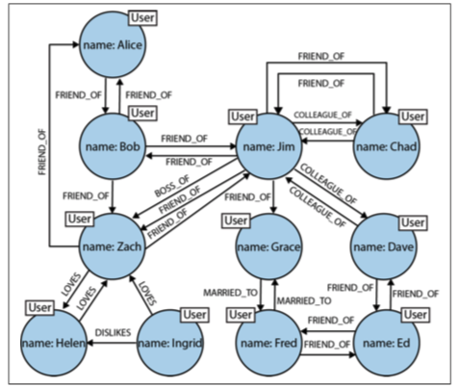
Alternatives to Relational Schemes: Graph Models

Slide 43
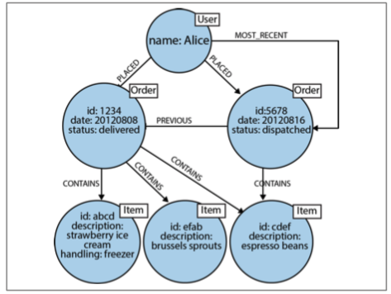
Alternatives to Relational Schemes: Graph Models
Order history as a property graph

Slide 44
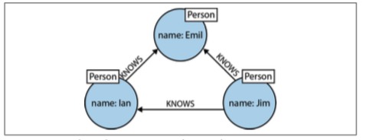
Alternatives to Relational Schemes: Graph Models
Processing queries in Neo4j
Use Cypher (from “The matrix”)
Can describe a path
(emil)<-[:KNOWS]-(jim)-[:KNOWS]->(ian)-[:KNOWS]->(emil)

Slide 45
Alternatives to Relational Schemes: Graph Models
(emil:Person {name:'Emil'})
<-[:KNOWS]-(jim:Person {name:'Jim'})
-[:KNOWS]->(ian:Person {name:'Ian'})
-[:KNOWS]->(emil)

Slide 46
Alternatives to Relational Schemes: Graph Models
Finding the mutual friends of Jim:
MATCH (a:Person {name:'Jim'})-[:KNOWS]->(b)-[:KNOWS]->(c), (a)-[:KNOWS]->(c)
RETURN b, c

Slide 47
Alternatives to Relational Schemes: Graph Models
Triple Stores
Information is stored as (subject, predicate, object)
Subjects correspond to vertices
Objects are
A value in a primitive data type — ( jim : age : 64)
Another vertex — (jim : friend_of : thomas)

Slide 48
Alternatives to Relational Schemes: Graph Models
@prefix : </example>
_:lucy a :Person
_:lucy :name “Lucy”
_:lucy :born_in _:idaho
_:idaho a :Location
_:idaho :name “Idaho”
_:idaho :type “State”
_:idaho :within _:usa

Slide 49
Alternatives to Relational Schemes: Graph Models
Triple stores are the language of the semantic web
Semantic web:
Machine readable description of type of links
e.g. image, text, …
Creates web of data — a database of everything
Stored in Resource Description Framework (RDF)
SPARQL — query language for triple stores

