Slide 1
Networking
Fall 2021

Slide 2
Digital Transmission
How to transmit data digitally
Digital to digital conversion converts digital data to a digital signal
Analog to digital conversion samples an analog signal
Transmission modes:
Serial
Parallel

Slide 3
Digital to Digital Conversion

Slide 4
Line Coding
Line coding converts digital data to digital signals
Data is given as a sequence of bits in computer memory
Sender encodes a bit sequence into a digital signal
Receiver decodes into a bit sequence

Slide 5
Signal Element vs.
Data Element
Data element is the smallest entity that represents information: a bit
Signal element: shortest unit of a signal
Typically: Data element corresponds to $r$ signal elements

Slide 6
Signal Elements
vs. Data Elements
$$r=1$$
one signal element per data bit
$$r=\frac{1}{2}$$
two signal elements (up / down) per data bit
(Manchester encoding)

Slide 7
Signal Elements
vs. Data Elements
$$r=2$$
one signal element per two data bits

Slide 8
Signal Elements
vs. Data Elements
Self-timing codes
Timing information can be obtained from a clock
which needs to be synchronized
Codes can make synchronization easier
Codes can be self-timing:
E.g. Manchester code — a transition always happen in the middle of a bit-transfer

Slide 9
Signal Elements
vs. Data Elements
Factor $r$ can depend on the data
E.g.: Long sequences of constant signal levels make it difficult to count
Common coding trick: Introduce a change of signal level every so often

Slide 10
Baseline Wandering
To distinguish voltage levels:
Receiver uses a running average of the received signal power (the baseline)
A long time of fixed levels can cause baseline wandering
Additional problem: If the voltage levels do not even out, then we send energy from one end to the other

Slide 11
DC Components
If voltage level is constant for a time:
Fourier analysis shows spectrum with very low frequencies (called DC frequencies)
Many systems cannot transport these low frequencies
E.g. telephone line cannot pass frequencies below 200 Hz

Slide 12
Self Synchronization
Bit intervals at the sender need to correspond to bit intervals at the receiver
Clocks need to be synchronized

Slide 13
Self Synchronization
Clocking:
Clock signals needed to interpret signal levels
Isochronous: clock signals are sent at the same time
Self-clocking: can derive the clock signal from the signal

Slide 14
Self Synchronization
Clocking:
Anisochronous clocking: clock signals are sent at a different time
Self-clocking: can derive the clock signal from the signal
E.g. use frames which
Or be run-length limited (no long runs of zeroes / ones)

Slide 15
Signal Elements
vs. Data Elements
Data rate: number of bits sent per second
(bits per second / bps)
Signal rate: number of signal elements sent per second
"Pulse rate", "Modulation rate", "baud rate"
Good signal engineering:
Increase data rate and lower the signal rate
Signal rate $S$, data rate $N$: $S=N/r$

Slide 16
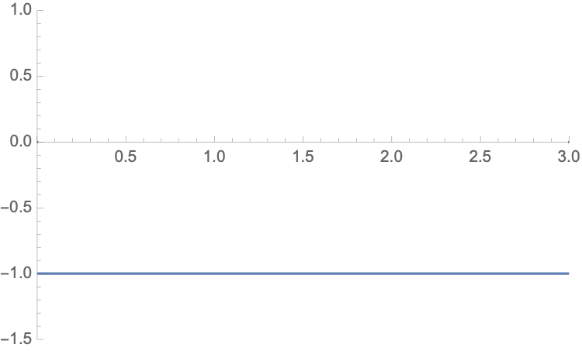
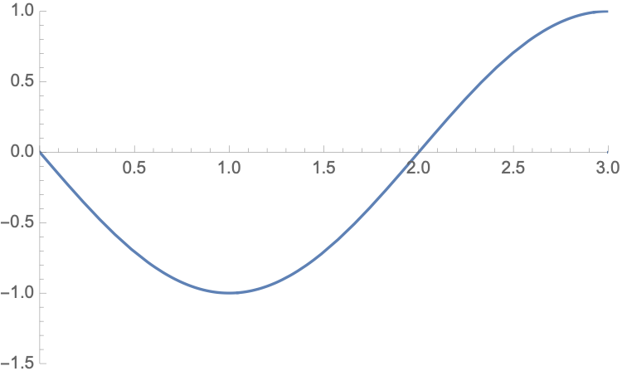
Low Pass Channel
000
f=0
p=180°
001
f=N/4
p=180°

Slide 17
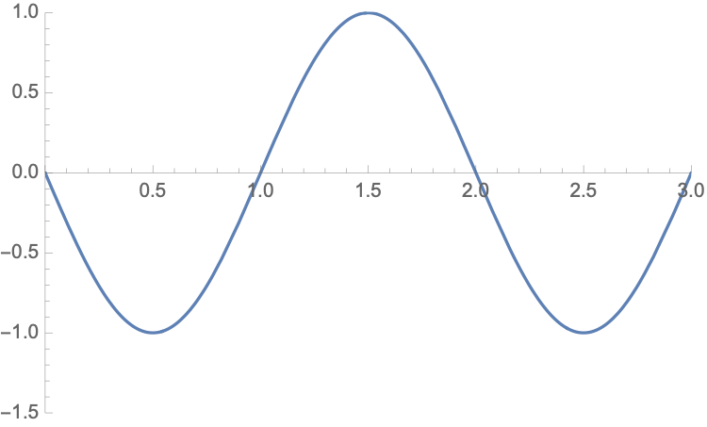
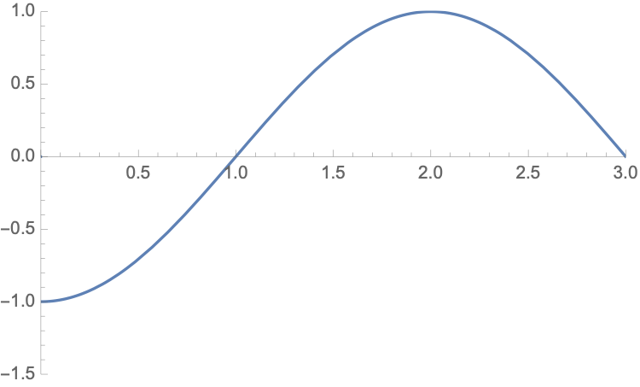
Low Pass Channel
010
f=N/2
p=180°
011
f=N/4
p=270°

Slide 18
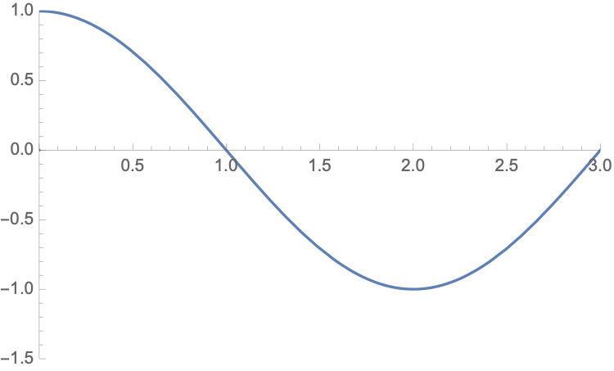
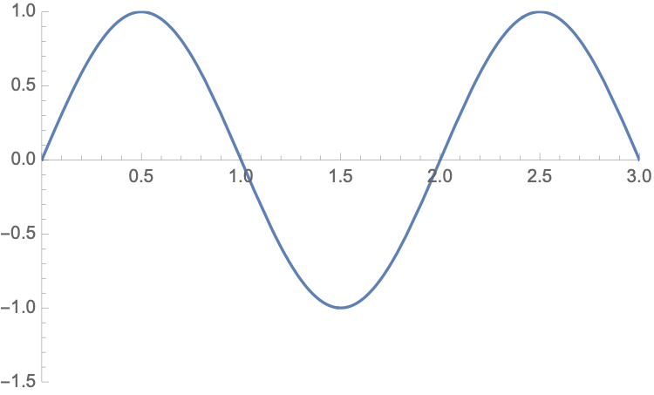
Low Pass Channel
100
f=N/4
p=90°
101
f=N/2
p=0°

Slide 19
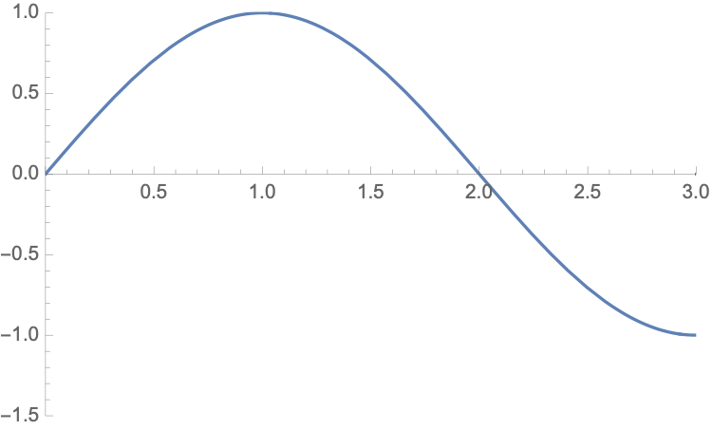
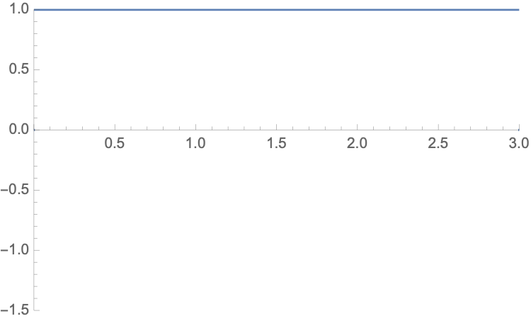
Low Pass Channel
110
f=N/4
p=0°
111
f=0
p=0°

Slide 20
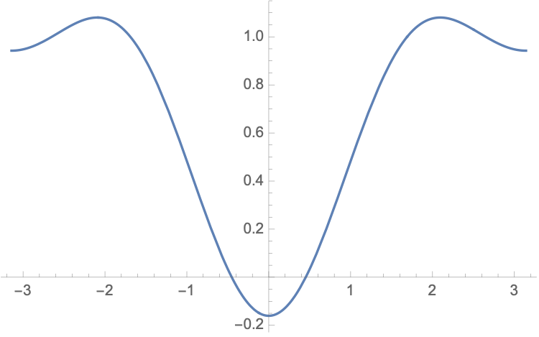
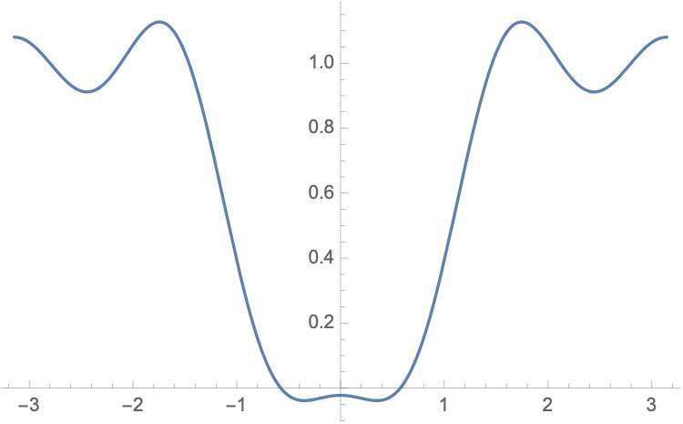
Low Pass Channel
A bandwidth of N/2 is sufficient if we sample at the middle of the interval
Higher harmonics are needed to make the signal look more digital
101 encoded with third and with third and fifth harmonic

Slide 21
Low-pass Channel
For better accuracy, we can use higher harmonics
Bandwidth requirements
Bit Rate | Harmonic 1 | Harmonics 1,3 | Harmonics 1,3,5
1 kbps | 500 Hz | 1.5 KHz | 2.5 KHz
10 kbps | 5 KHz | 15 KHz | 25 KHz
1 Mbps | 500 KHz | 1.5 MHz | 2.5 MHz

Slide 22
Quiz
How much bandwidth is required to send a 1 Gbps signal with 7 harmonics
Answer:
(1Gbps/2b) ⨉7 = 3.5 GHz

Slide 23
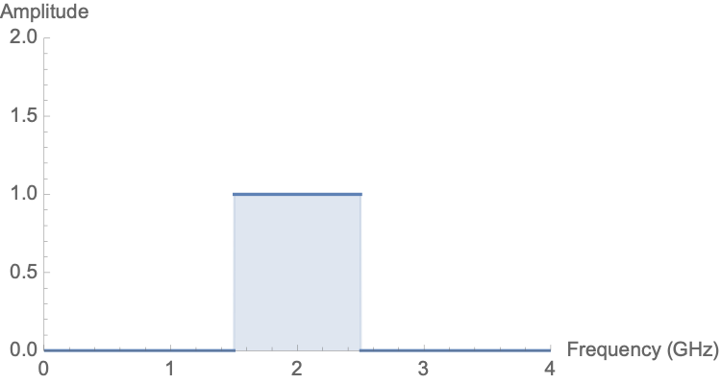
Broadband Transmission with Modulation
A bandpass channel consists of an interval of frequencies
This type of channel is more available than low—pass channels
However, digital data now needs to be encoded

Slide 24
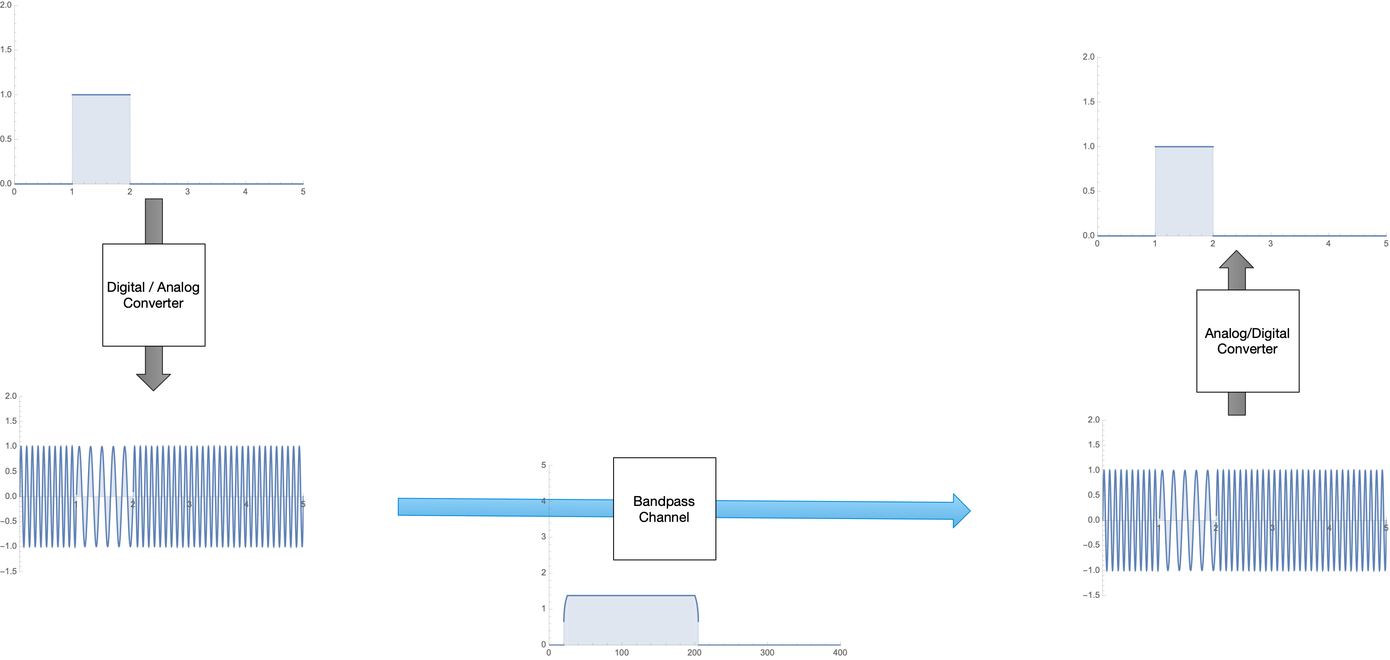
Broadband Transmission with Modulation

Slide 25
Broadband Transmission with Modulation
Sending computer data through a telephone subscriber line
Line has a bandwidth of 0 - 4 KHz
Treated as a low-pass channel:
Capacity is 8kbps
Treated as a broadband line with a modem
Digital Cellular Telephony
Analog voice is converted to a digital signal
Use multiple bandwidth channels to allow concurrent talks routed through the same hardware / medium

Slide 26
Analog to Digital
Conversion

Slide 27
Analog to Digital Conversion
Sometimes need to transmit analog data
E.g. microphone
E.g. camera
Digitization: Transform data from analog to digital
We consider:
PCM: Pulse Code Modulation
Delta Modulation

Slide 28
Analog to Digital Conversion
Pulse Code Modulation
Sampling at given time intervals $\{i⋅T_{s}|i=0,1,…\}$
Sampling frequency: $f_{s}=\frac{1}{T_{s}}$
Encoding: results in "Quantized Signal"

Slide 29
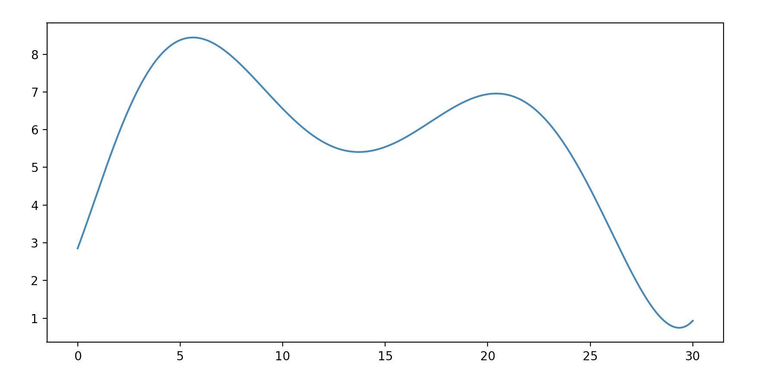
Analog to Digital Conversion
Analog Signal

Slide 30
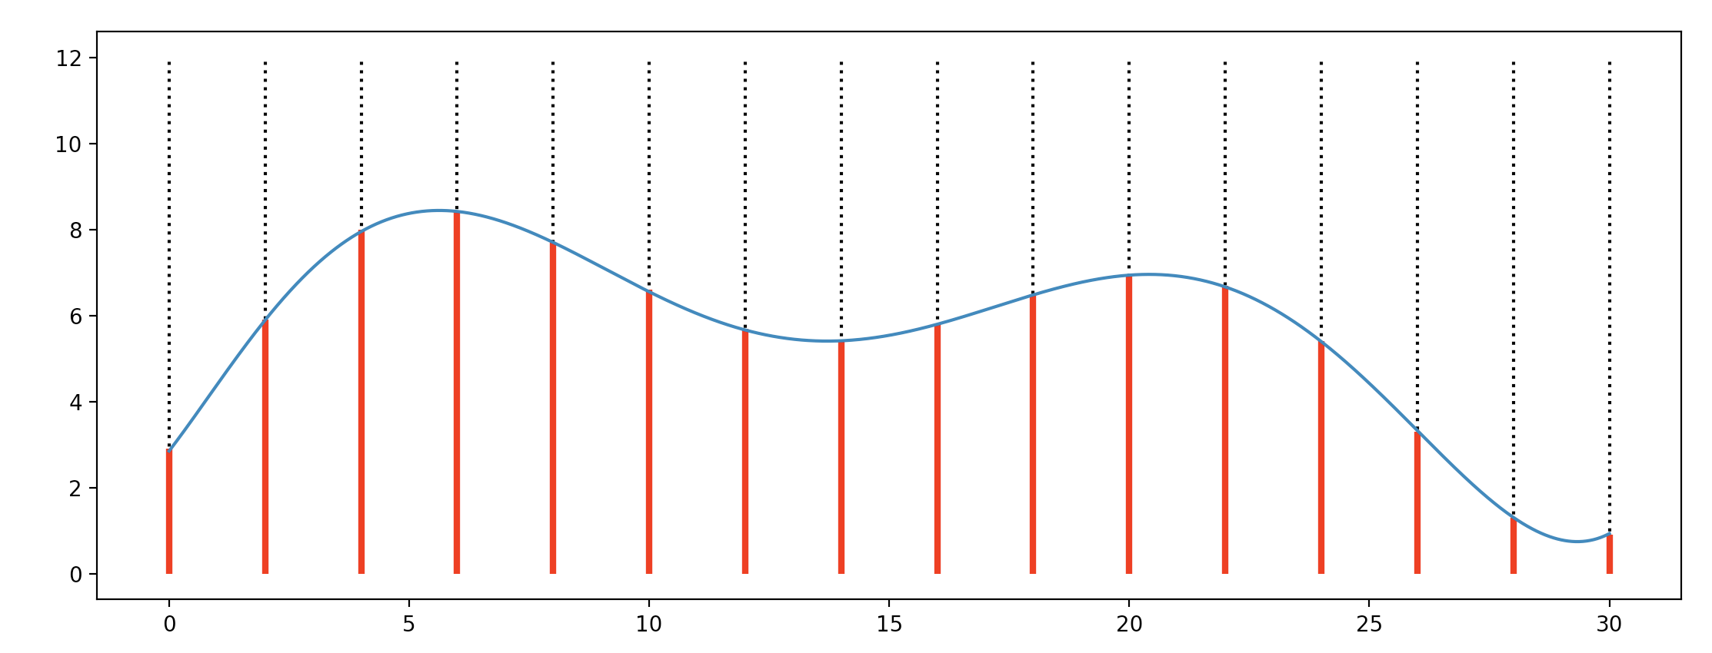
Analog to Digital Conversion
Ideal sampling: Measure pulse from analog symbols

Slide 31
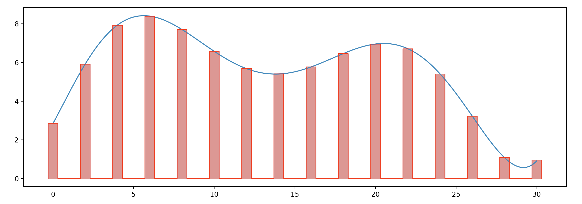
Analog to Digital Conversion
Natural sampling:
Get the average value of analog signal of a small interval
by using a high-speed switch
"Flat-top sampling"

Slide 32
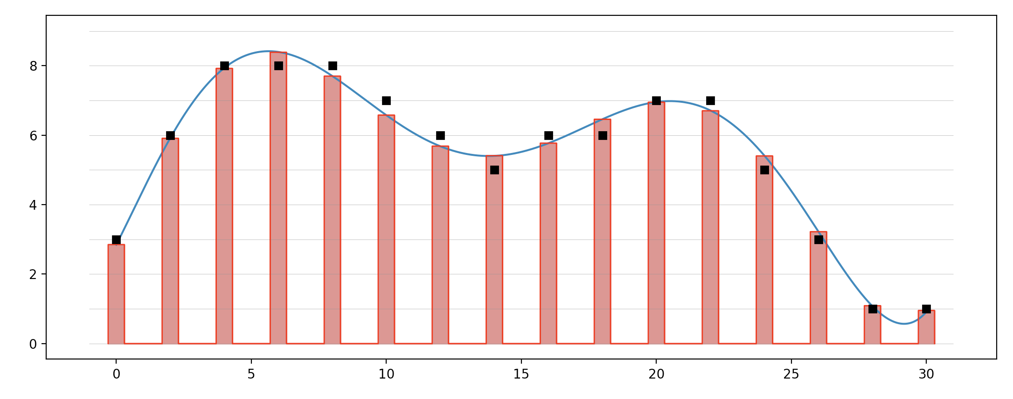
Analog to Digital Conversion
Quantize signal level
This introduces a quantization error

Slide 33
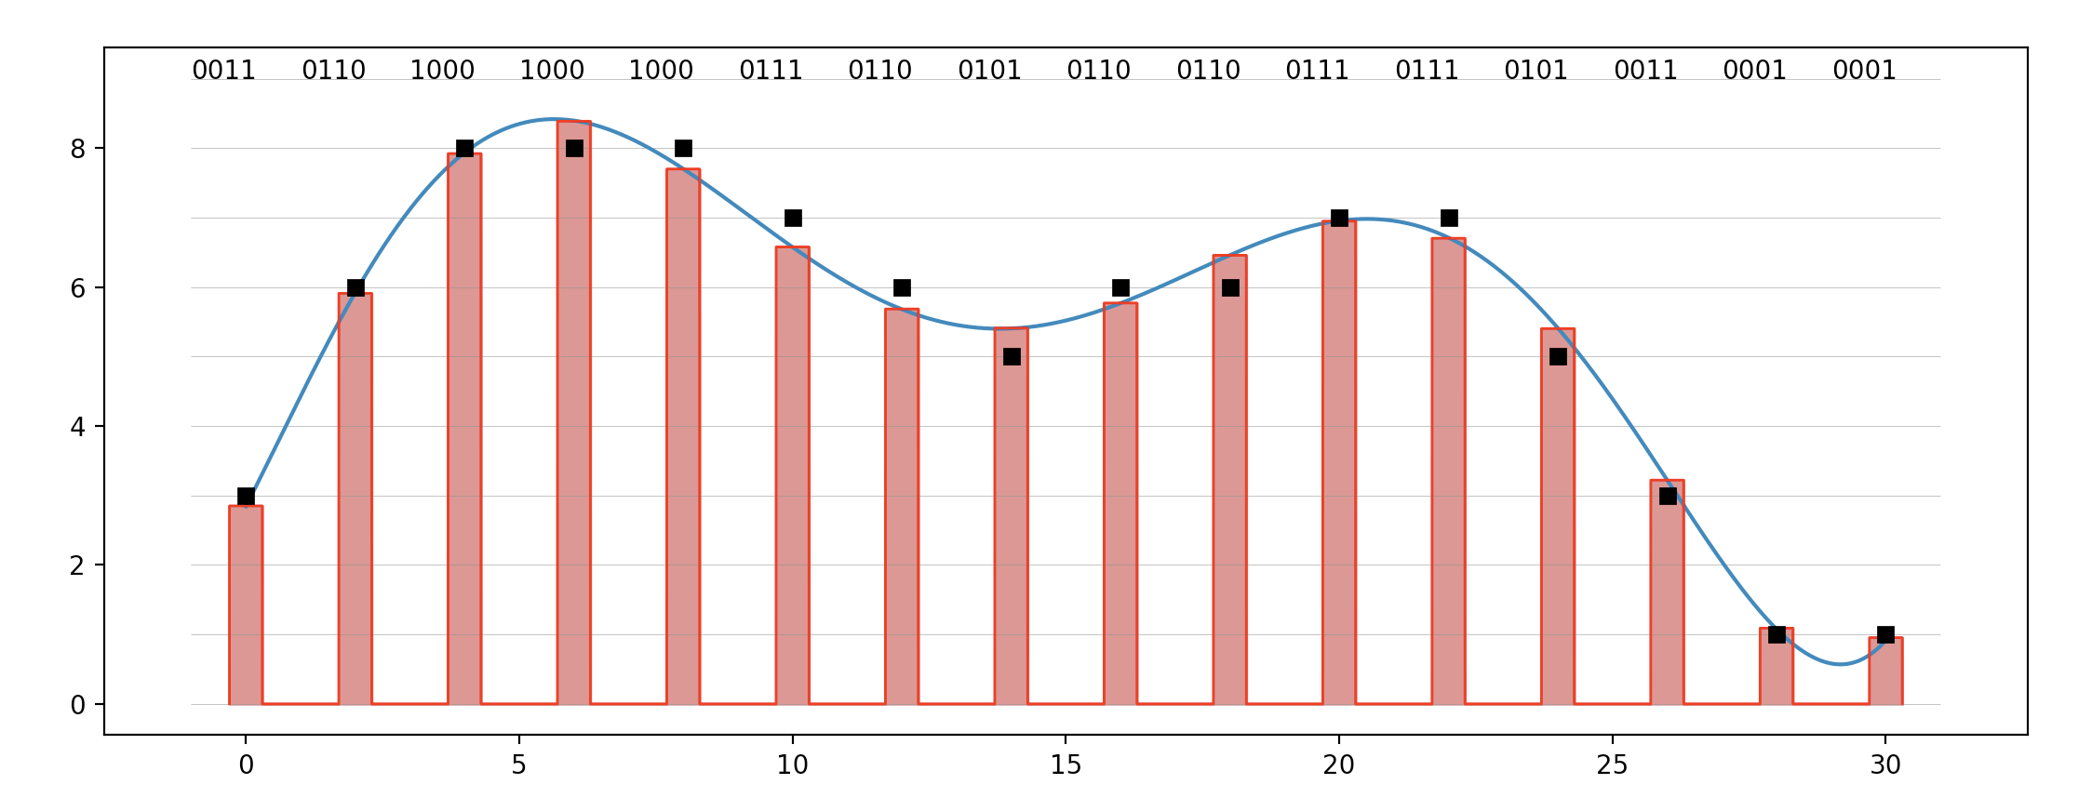
Analog to Digital Conversion
Encoding: Translate the quantized values to
digital data

Slide 34
Analog to Digital Conversion
Nyquist theorem:
Sampling rate must be at least twice as high as highest frequency contained in the signal

Slide 35
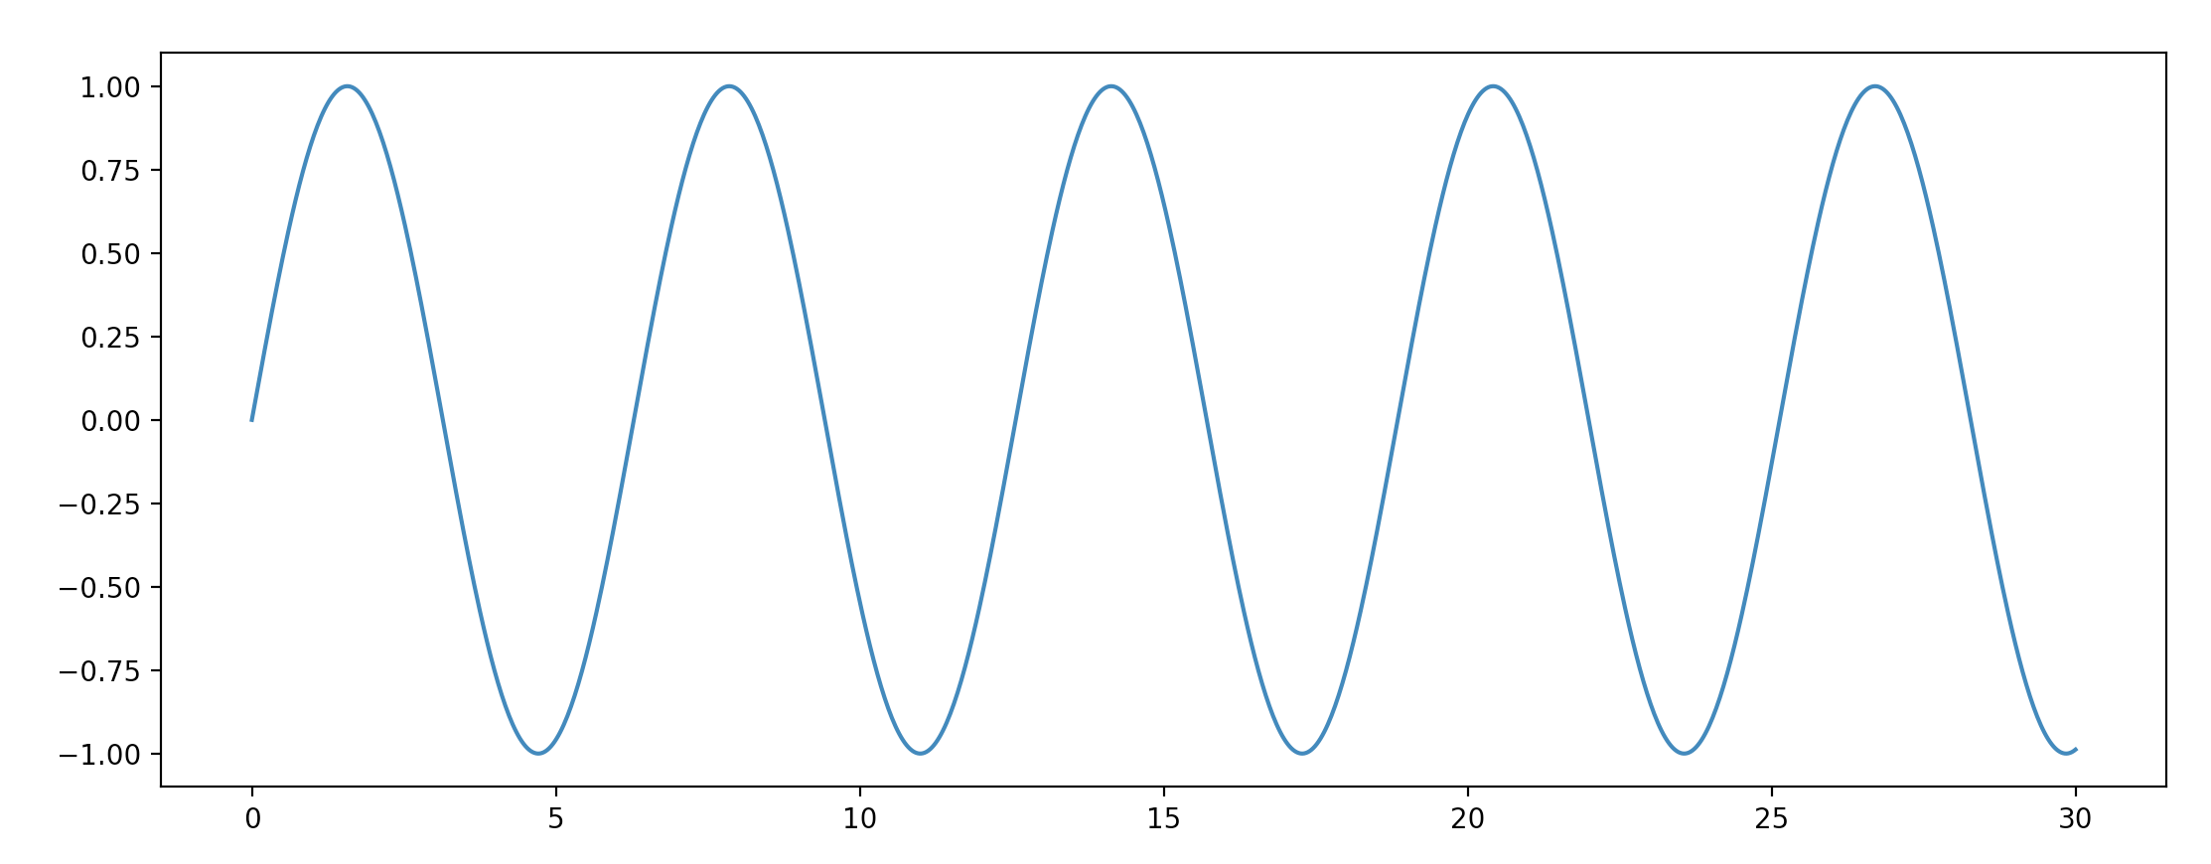
Analog to Digital Conversion
Example:
Measure the position of a clock handle

Slide 36
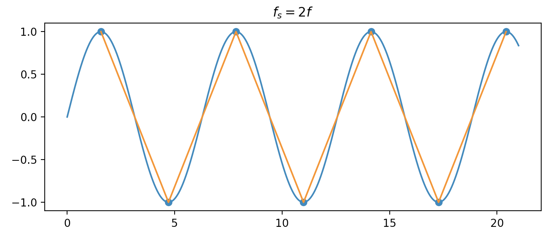
Analog to Digital Conversion

Slide 37
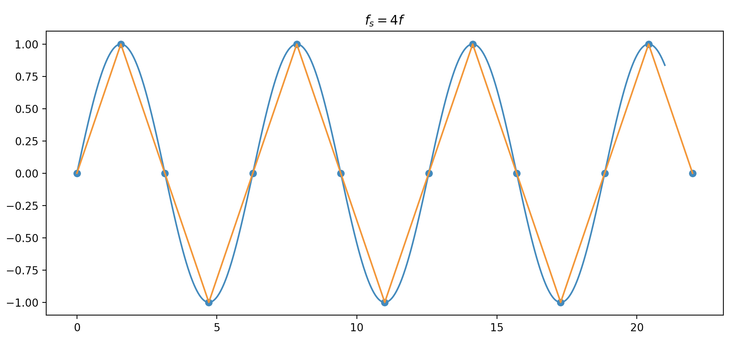
Analog to Digital Conversion

Slide 38
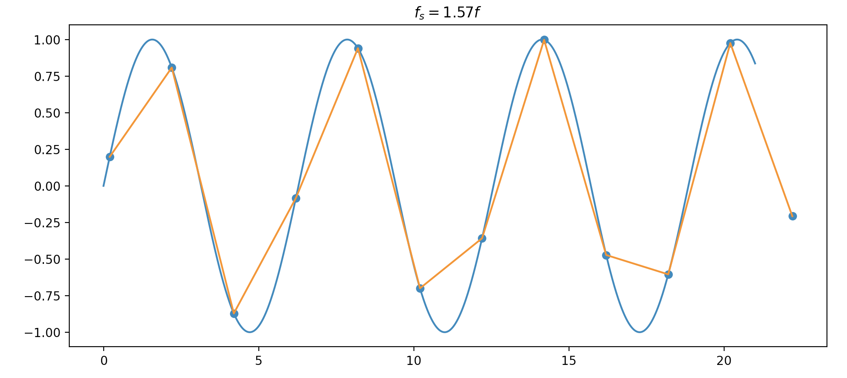
Analog to Digital Conversion

Slide 39
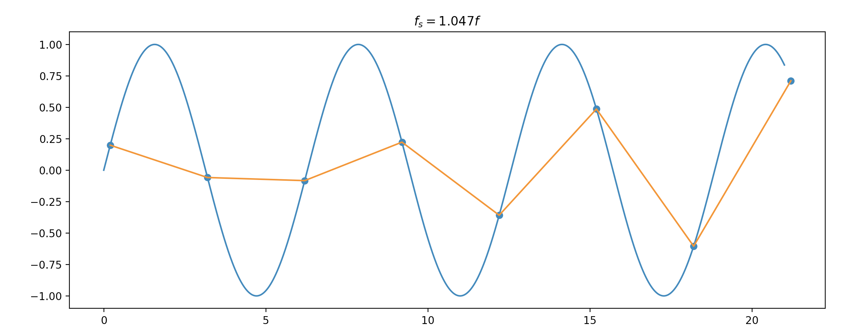
Analog to Digital Conversion

Slide 40
Analog to Digital Conversion
Encoding:
Bit-rate = Sampling rate $×$ number of bits per sample
= $f_{s}×n_{b}$

Slide 41
Analog to Digital Conversion
Quiz:
We want to digitize the human voice. The human voice has frequencies between 0 and 4000 Hz. Assume 8b per sample. What is the minimum bit rate?
Answer:
We need to sample at rate $2×4000\text{Hz}$
This gives $8000⋅8\text{bps}=64\text{Kbps}$

Slide 42
Analog to Digital Conversion
Decoding:
Generate the quantized signal and smooth it via a low-pass filter

Slide 43
Analog to Digital Conversion
Apply Nyquist sampling theorem on channel
Low-pass bandwidth channel with bandwidth $B$
Digital signal uses $L$ levels ( $r=1/\log_{2}(L)$ )
Signal is passed through a low-pass filter to frequencies above $B$ hz.
Resulting signal is sampled at $2×B$ samples per second
We can do no better than quantizing with $L$ levels
Resulting bit rate is:
$N_{\text{max}}=2×B×\log_{2}(L)\text{bps}$
This is the Nyquist Theorem

Slide 44
Analog to Digital Conversion
Quiz:
If the signal has $L$ levels.
Given a desired data rate of $N\text{bps}$, calculate the required bandwidth?
Answer:
$$N_{\text{max}}=2×B×\log_{2}(L)$$
$$B=\frac{N}{2×\log_{2}(L)}$$

Slide 45
Analog to Digital Conversion
Delta Modulation
Store previous signal value
Compare with current value:
Go up: 1, Go down: 0

Slide 46
Analog to Digital Conversion
Delta modulation:
Better version: Adaptive delta modulation
Use more bits to represent the difference

Slide 47
Transmission Modes

Slide 48
Transmission Modes
Parallel transmission:
Uses $n$ wires to transmit $n$ signals simultaneously
Can add more wires for control & clocking
If there would be no electromagnetic interference:
Could transmit $n$ times content then over a single wire

Slide 49
Transmission Modes
Asynchronous transmission
Timing is unimportant
Data is grouped
At the beginning of transmission of a group: start bit
Send data group: Each element at a fixed time
At the end: end bit(s)
Followed usually by a gap

Slide 50
Transmission Modes
Quiz:
Asynchronous transmission:
If we group data in bytes, how many bits are transferred?
Answer:
8 bits data + 1 start bit + 1 end bit (+ gap)

Slide 51
Transmission Modes
Synchronous transmission
Data is grouped into larger units: Data frames
Receiver uses timing to recover individual data units

Slide 52
Transmission Modes
Isochronous:
Real-time audio / video: Uneven delays between frames is not accepted
Data arrives at a fixed rate

Slide 53
Analog Transmission

Slide 54
Analog Transmission
Digital to analog conversion
Analog to analog conversion

Slide 55
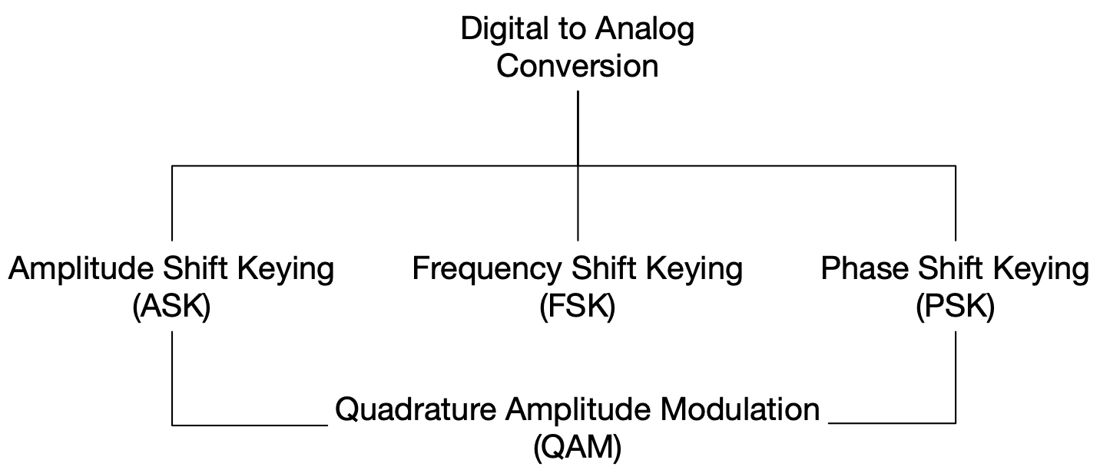
Digital to Analog Conversion
Convert digital data to bandpass analog signal

Slide 56
Digital to Analog Conversion

Slide 57
Digital to Analog Conversion

Slide 58
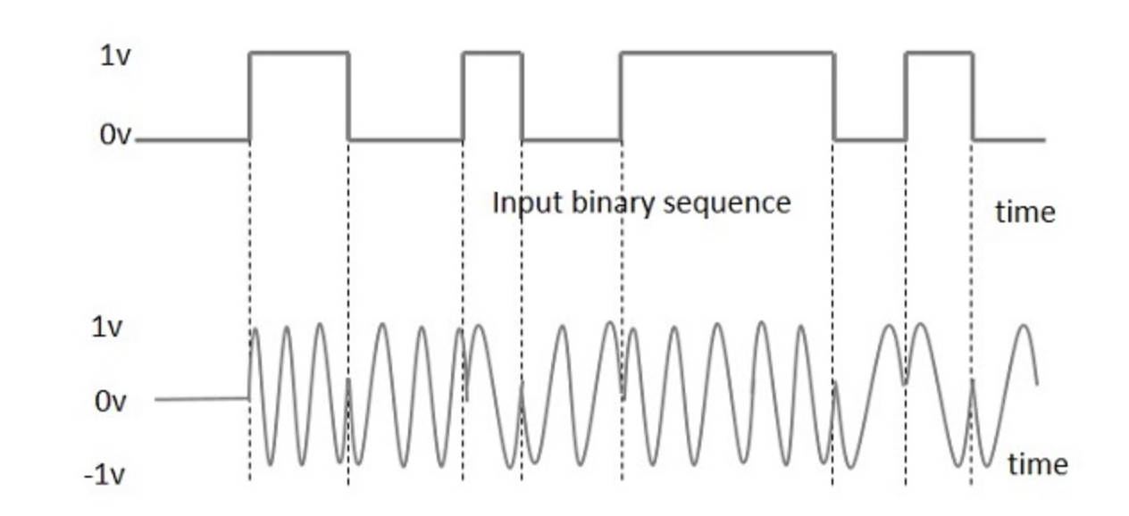
Digital to Analog Conversion
Binary Phase Shift Key

Slide 59
Digital to Analog Conversion
Quadrature Phase Shift Key
Use 2-bits at a time
Transmit one bit using amplitude modulation via signal with phase 0º
Transmit one bit using amplitude modulation via signal with phase 180º
Result is a sine wave with phase 45º, -45º, 135º, -135º

Slide 60
Analog to Analog Conversion
Analog to Analog
Make the signal fit for a bandpass medium
E.g. AM radio bands:
Amplitude Modulation
Frequency Modulation
Phase Modulation

Slide 61
Analog to Analog Conversion

Slide 62
Analog to Analog Conversion
FM Radio Bands

Slide 63
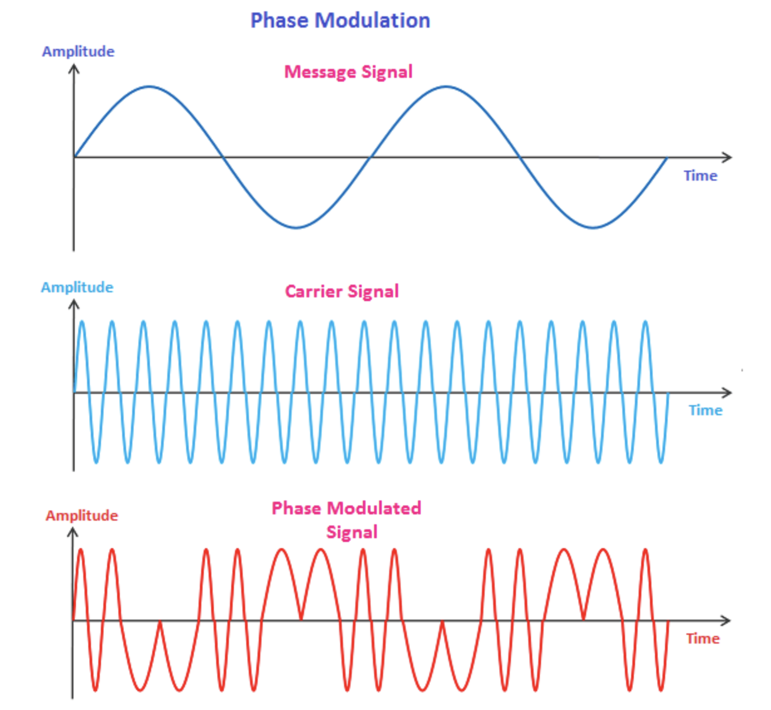
Analog to Analog Conversion
Phase modulation
Like FM with change in the frequency proportional to the derivative of the amplitude of the message signal

