Slide 1
Networking
Marquette University, Fall 2021

Slide 2
Introduction
https://www.youtube.com/watch?v=2GmLgoQBzUo

Slide 3
Data Communication
Exchange of information between two entities
  Properties
    Delivery
    Accuracy
    Timeliness
    Jitter

Slide 4
Data Communications
Components
A message has a sender and a receiver
It uses a transmission medium
The transmission follows several protocols

Slide 5
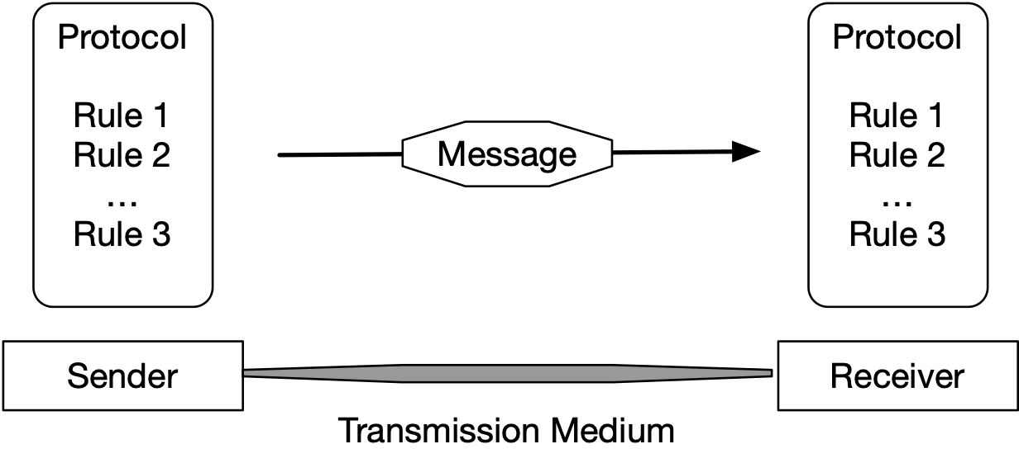
Data Communication Components
Message
Sender
Receiver
Transmission Medium
Protocol: A set of rules

Slide 6
Data Representation
Information comes in different forms
Various formats for digital data
  Text: Unicode, ASCII, Latin-1, utf-8
  Numbers: base 1, base 2, IEEE floating point format
  Images:
    Resolution determines number of pixels
    Each pixel contains various scales (e.g. $3×8$ b for color)
  Audio
  Video

Slide 7
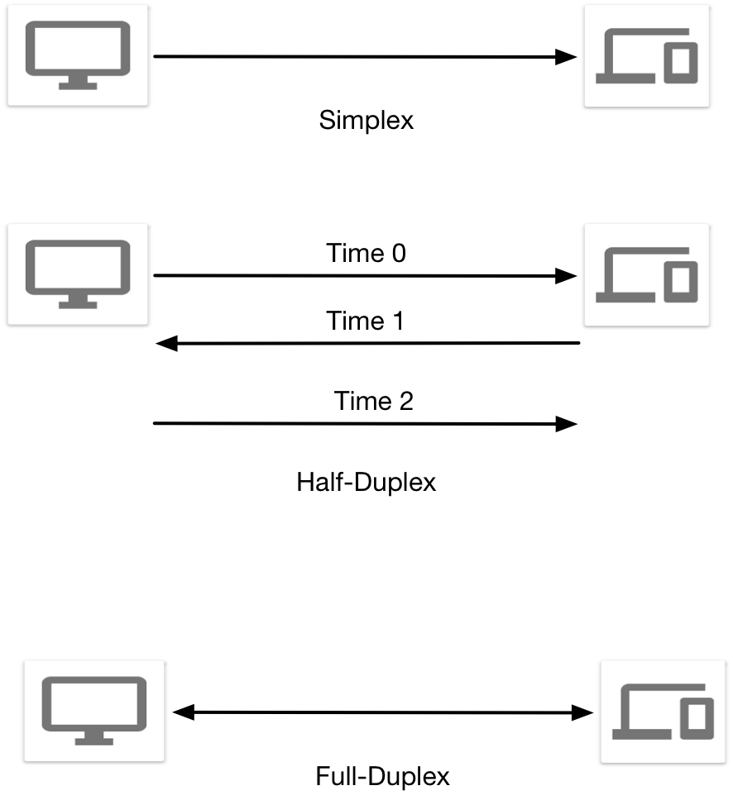
Data Flow Types
Simplex mode:
  Communication is one-directional
Half-duplex:
  Communication is one-directional for a time, then goes in the other direction
Full-duplex:
  Communication is bidirectional

Slide 8
Networks
Interconnection of a set of devices capable of communication
  Hosts (end-points) vs. Connecting Devices (e.g. routers)
Criteria
  Performance
    Throughput
    Delay
  Reliability
  Security

Slide 9
Physical Structures
Point-to-point links
  Dedicated link between two devices
Multi-point links:
  More than two devices share a link
    E.g. Token Rings (IBM / IEEE 802.5)
Physical Topology
  Two or more devices connect to a link
  Two or more links form a topology

Slide 10
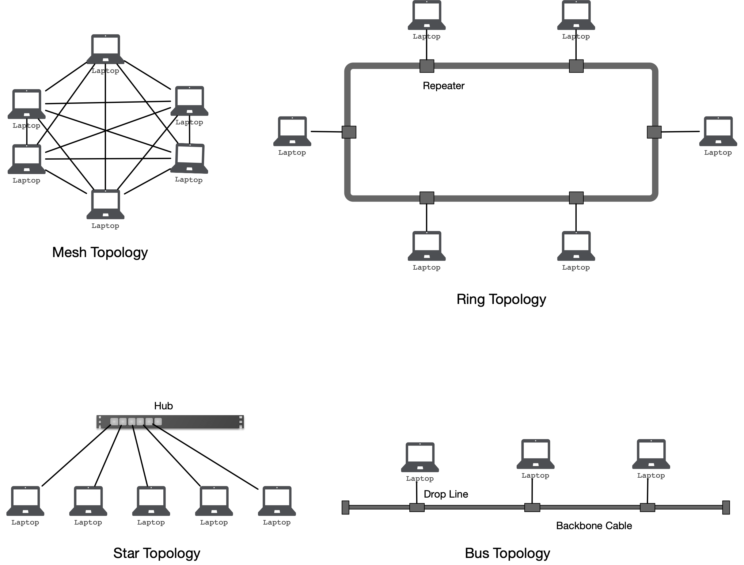
Simple Network Topologies

Slide 11
Network Types
Networks are limited by
  throughput
  delay (i.e. distance)
    Local Area Networks
    Wide Area Networks
    Internets

Slide 12
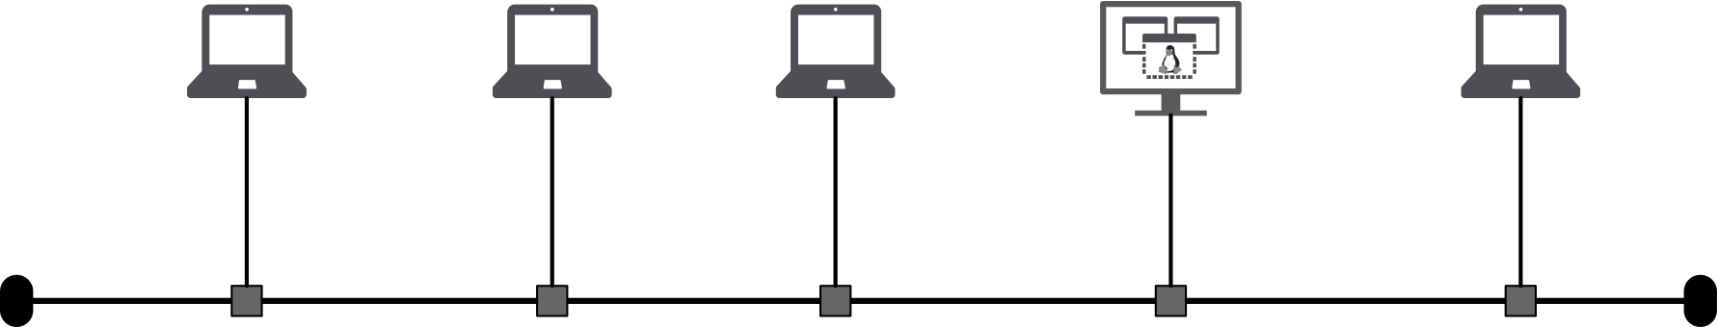
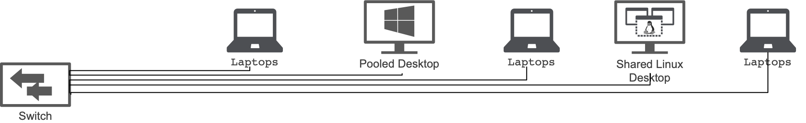
Network Types
LAN: Local Area Network
  bus
  switched

Slide 13
Network Types
WAN: Wide Area Network
  Point-to-point (two ends)
  Switched WAN (used as backbone for Internet)

Slide 14
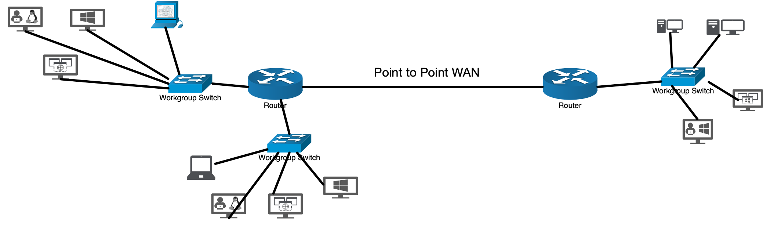
Network Types
Internets (with a small i) aka. internetworks
  Connects several LANs or WANs
  Circuit switched
  Packet switched

Slide 15
Network Types
Data communication
  Data are bursty
  No causality
  More bandwidth = faster transmission
  Data loss very bad
Circuits
  Data are streamed
  Signals are causal
  Signal has finite bandwidth
  Some signal loss tolerable

Slide 16
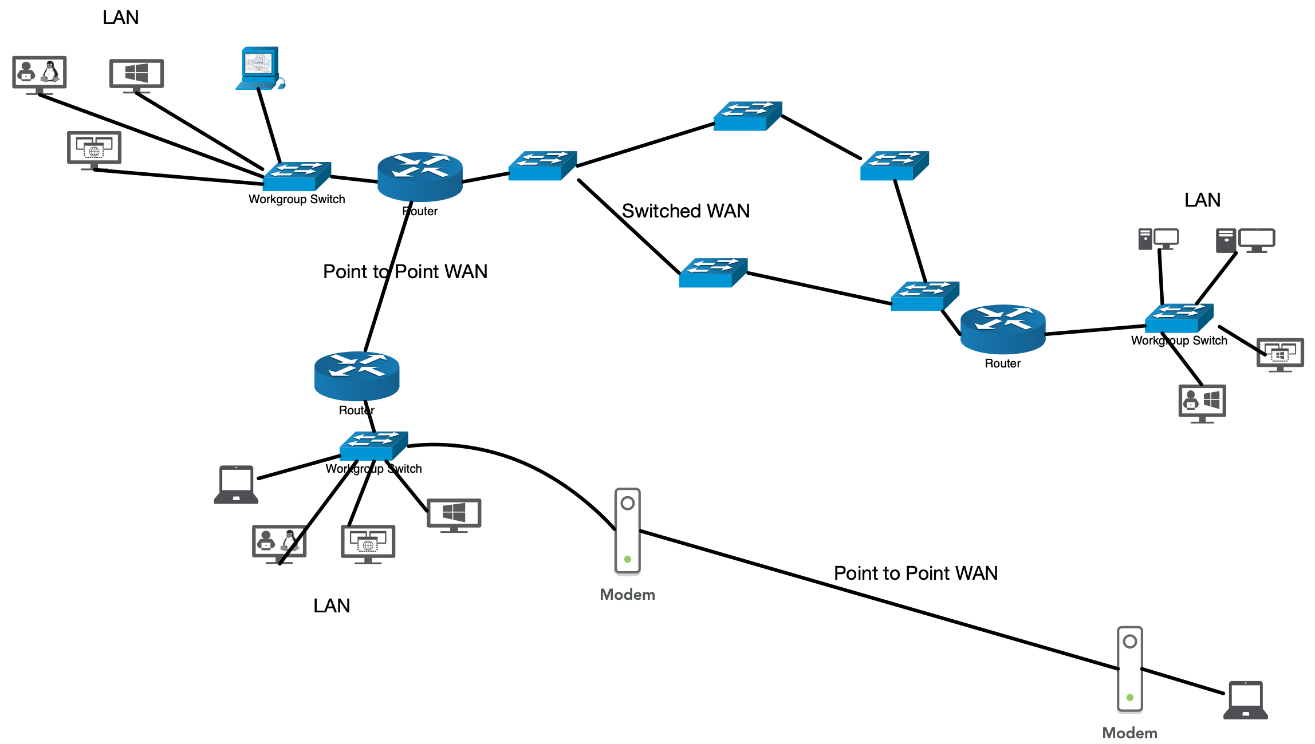
Heterogeneous Network

Slide 17
Switching
Switched networks (e.g. internet)
  Switch forwards data from one network to another
  Circuit switched networks
    Dedicated network (circuit) is always available between two systems
  Packet switched networks
    Instead of continuous connections
    Use blocks of data: packet

Slide 18
Internet
Internet (capital I)
  Consists of thousands of interconnected networks
  Has several backbones
    Owned by Sprint, Verizon, ATT, NTT, ...
    Connected via peering points
  Has a larger number of provider networks
    which use the backbones for a fee
    connected to several backbones and possible other provider networks
  Customer networks use the services of these Internet Service Providers

Slide 19
Internet Standards
Internet draft: Working document with no status and 6 month expiration date
Request for Comment is next stage:
  Proposed Standard
  Draft Standard (needs at least two interoperable implementations)
  Internet Standard: adhered by all
  Historic: never passed or superseded
  Experimental
  Informational

Slide 20
Internet Standards
RFC:
  Required (must be implemented) e.g. TCP, IP
  Recommended e.g. FTP, TELNET
  Elective
  Limited Use
  Not recommended (only for historic RFC)

Slide 21
Internet Administration
ISOC: Internet Society
  formed 1992 to provide support for Internet standard process
IAB: Internet Architecture Board
  technical advisor to ISOC using
      IETF: Internet Engineering Task Force
      IERF Internet Research Task Force
  Manages RFCs
  External Liaison to other standards organizations

Slide 22
Protocol Layering

Slide 23
Layered Architecture
Layering was invented to deal with complexity of software development
  THE Operating System
In Networking there are additional motivations
  Plethora of underlying technologies and needs
  Networking devices often do not need full functionality

Slide 24
Layered Architecture
Principles of protocol layering for networking
  Bidirectional communication implies that each layer needs to perform two opposite task, one in each direction
      Listen
      Talk
  Objects exchanged under each layer need to be identical

Slide 25
Layered Architecture
TCP/IP stack
  Application layer
  Transport layer
  Network layer
  Physical layer

Slide 26
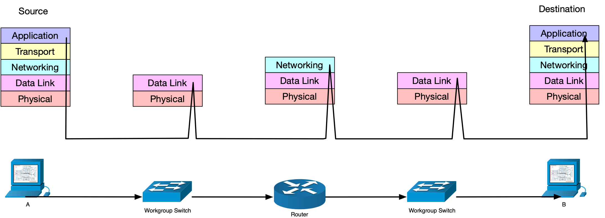
Layered Architecture

Slide 27
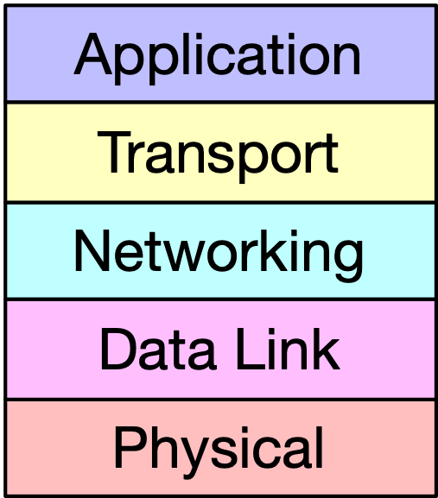
Layered Architectures
Messages
Segments / User datagrams
Datagrams
Frames
Bits

Slide 28
Physical Layer
Carries individual bits in a frame across a link
  Devices are connected by a transmission medium
    Media have different characteristics
  Bits are transformed into a signal

Slide 29
Data Link Layer
Takes datagram and moves it as a frame across the link
Different link layer protocols may provide different services
  Error detection
  Error correction

Slide 30
Network Layer
Responsible for creating a connection between source and destination (end-to-end connection)
IP - Internet Protocol
  Connectionless
  no flow control
  no error control
  no congestion control
Auxiliary protocols: Internet Control Message Protocol, Internet Group Management Protocol, Dynamic Host Configuration Protocol, Address Resolution Protocol

Slide 31
Transport Layer
Transmission Control Protocol
  Provides flow control, error control, congestion control
User Datagram Protocol
  Connectionless without flow, error, and congestion control
Stream Control Transmission Protocol
  Designed for multimedia

Slide 32
Application Layer
Two applications exchange messages
  HTTP between browser and web-server
  FTP
  Telnet
  SSH
  SNMP
  DNS
  IGMP

Slide 33
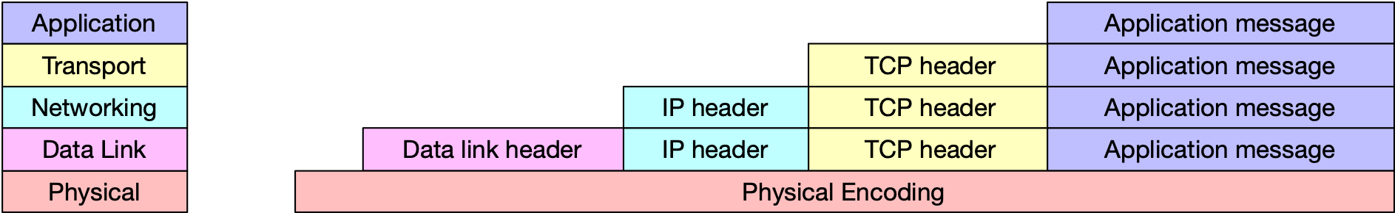
Encapsulation
Each layer adds a header (which could also be a tail or both) to a message
For receiving, each layer strips its header

Slide 34
OSI Model
Open Systems Interconnection (OSI) Model
  After TCP/IP model (late 70s)
  Established by International Organization of Standardization (ISO)
  Came to late to change TCP/IP stack
  Never defined some layers completely

Slide 35
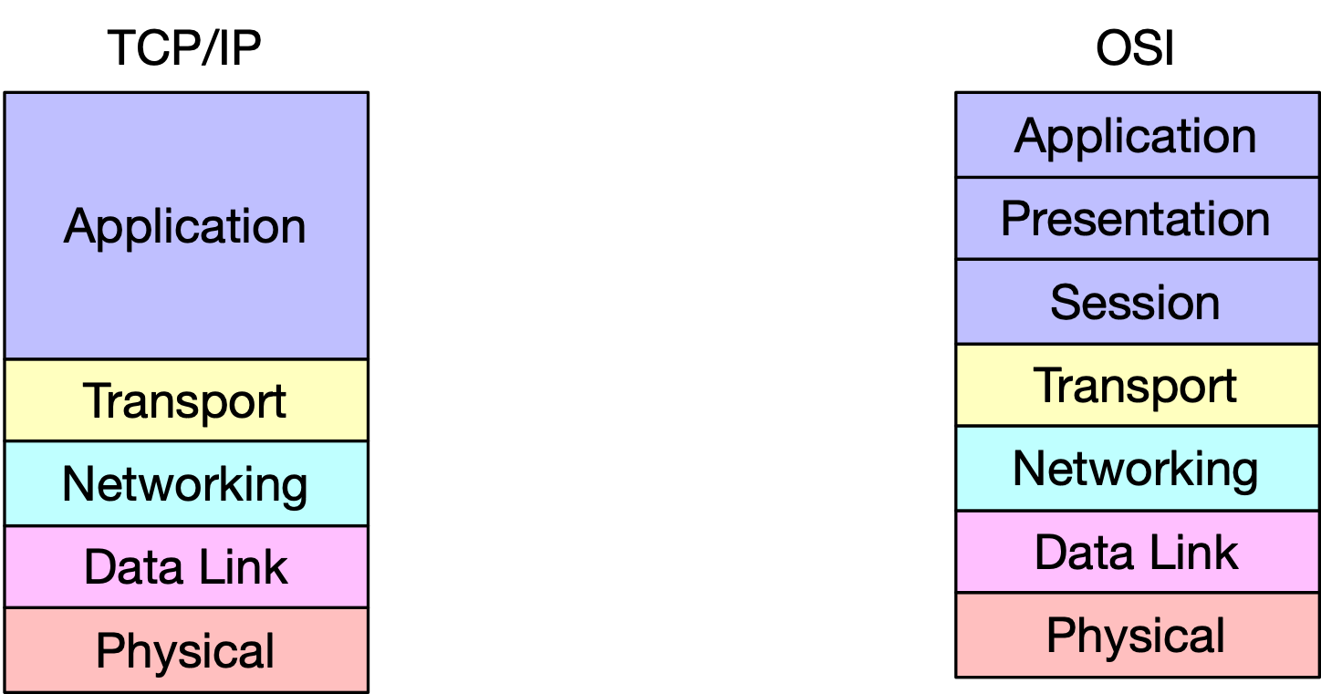
OSI vs TCP/IP

Slide 36
Internet Standards
Proposed Standard
Draft Standard (becomes RFC)
  (after >1 successful interoperable implementations)
Internet Standard
Historic RFC
  superseded or never became an Internet standard
Experimental
Informational

Slide 37
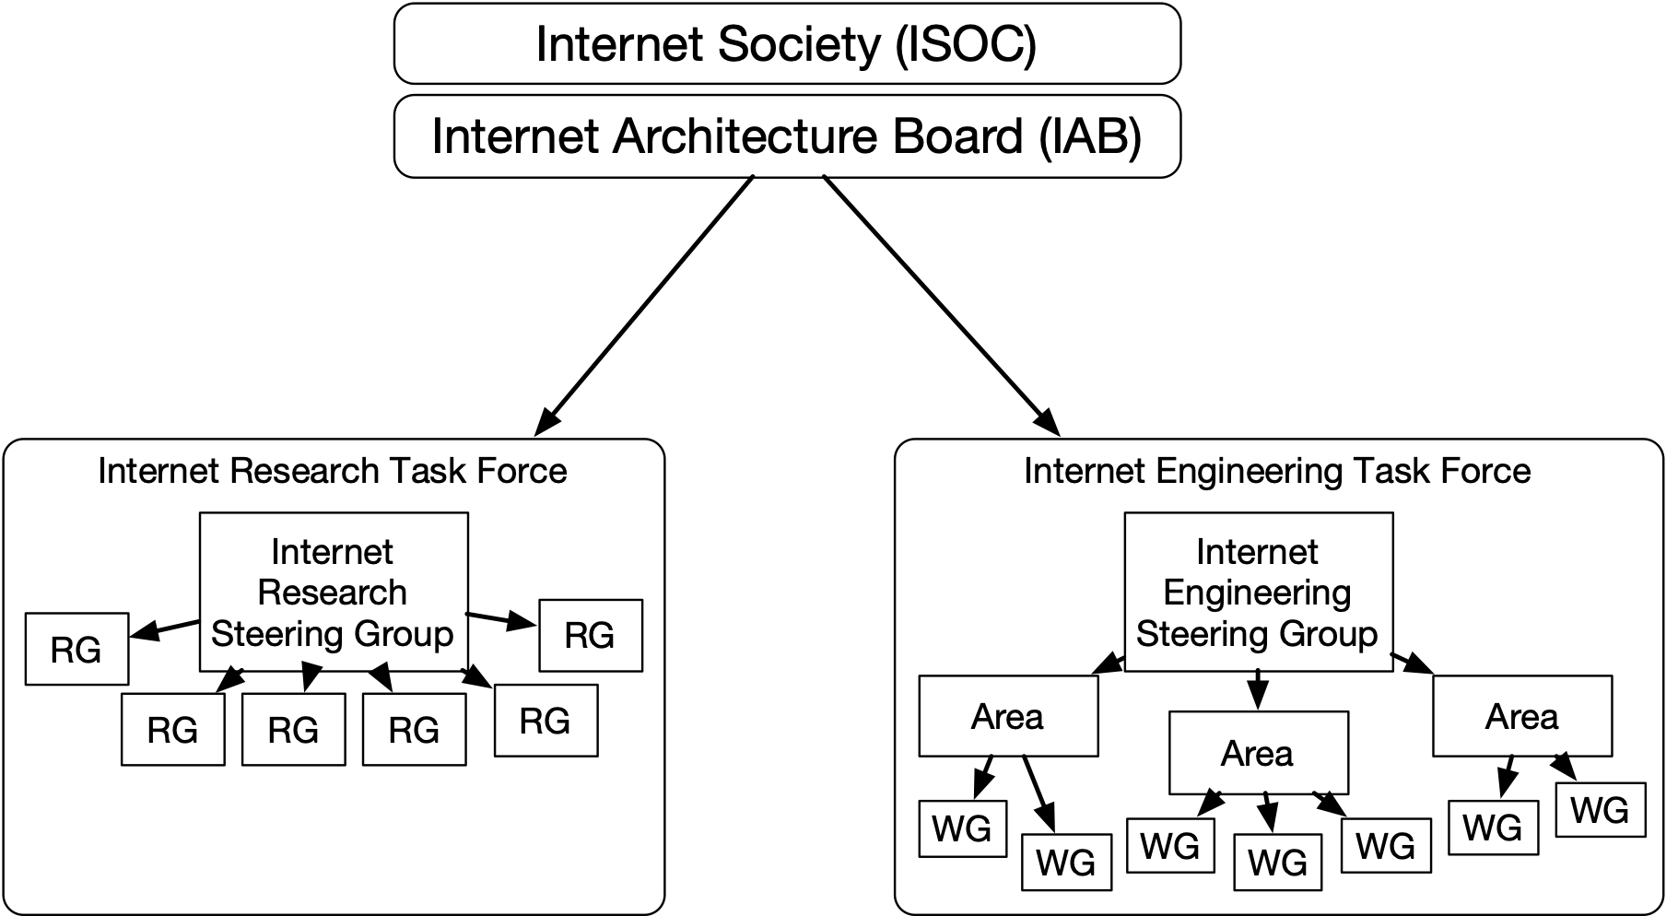
Internet Administration

