Slide 1
Networking
Marquette University
Fall 2021

Slide 2
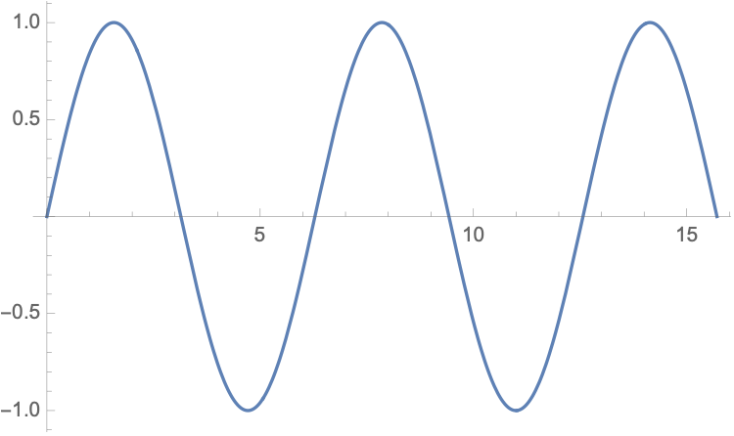
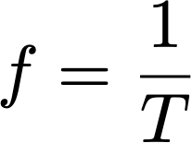
Waves
Dynamic (sine-shaped) wave
Period T
Frequency measured in herz = 1/second
period T
amplitude
peak amplitude
time

Slide 3
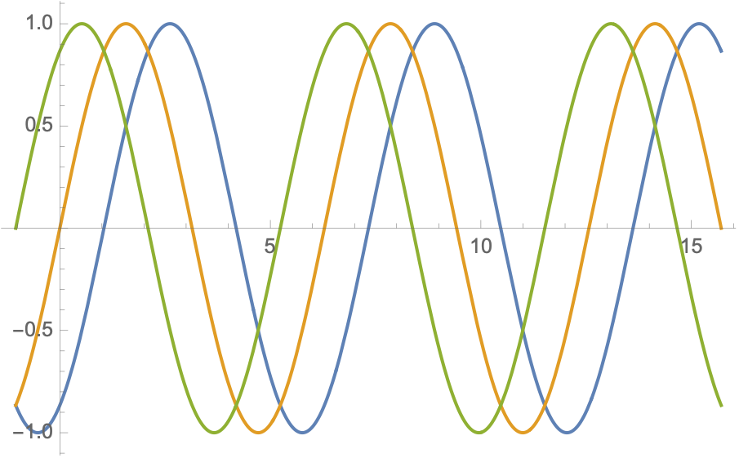
Waves
Phase:
Amount of shift in forward direction needed to align to sine wave
Orange: Phase is zero
Blue: Phase is -T/6 or -60° = 300°
Green: Phase is T/6 or 60°
T/6

Slide 4
Exercises
The period of a sine wave is 60 msec. What is the frequency?
Electricity in the US has a frequency of 60 hz. What is the period?

Slide 5
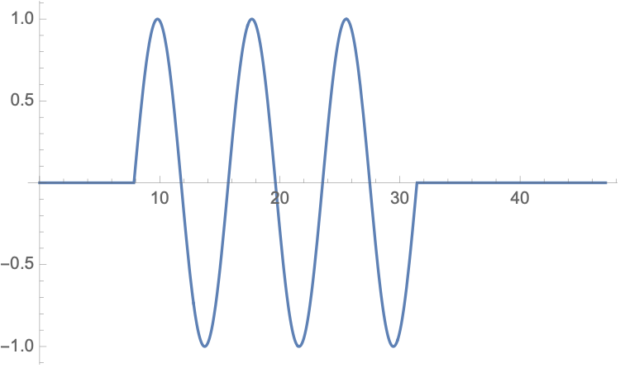
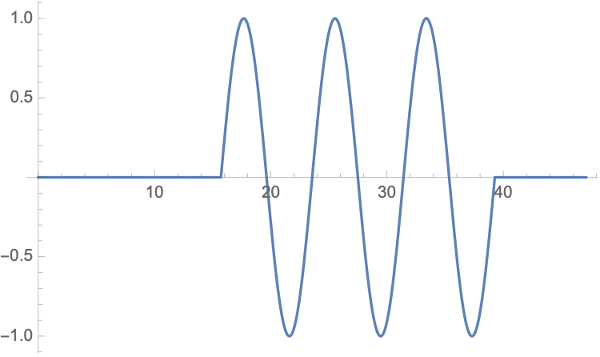
Waves
At time t
Waves propagate in a medium
During one period, the wave progresses by a wavelength λ
In vacuum, propagation speed is the speed of light, or
General formula:
$λ=\frac{c}{f}$
At time t+T
wavelength

Slide 6
Waves
Period: $T=\frac{1}{f}$
Wavelength $λ$ given by speed times travel time: $c×T$
Therefore
$$λ=\frac{c}{f}$$

Slide 7
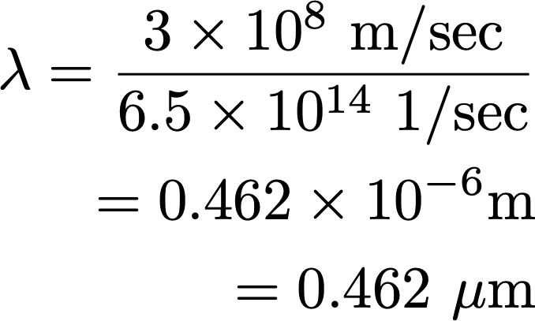
Exercises
Blue light has a frequency of about 650 Thz = $6.5×{10}^{14}\text{hz}$
What is its wavelength in micrometers?

Slide 8
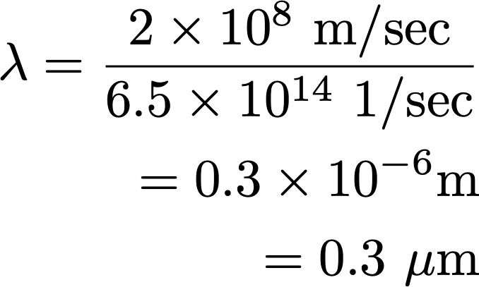
Exercises
Blue light has a frequency of about 650 Thz =$6.5×{10}^{14}$ hz.
What is its wavelength in micrometers in a coaxial cable. The propagation speed in a coax is two thirds of that in a vacuum.

Slide 9
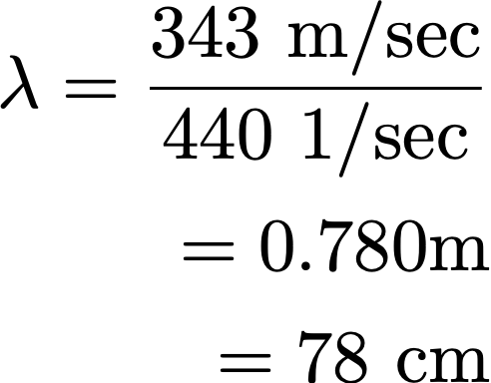
Exercises
The speed of sound is 343 m / sec (on a nice day). The standard A is 440 hz. What is the wavelength?
Half a wavelength is used for wind instruments

Slide 10
Time Frequency Domain
Fourier Analysis

Slide 12
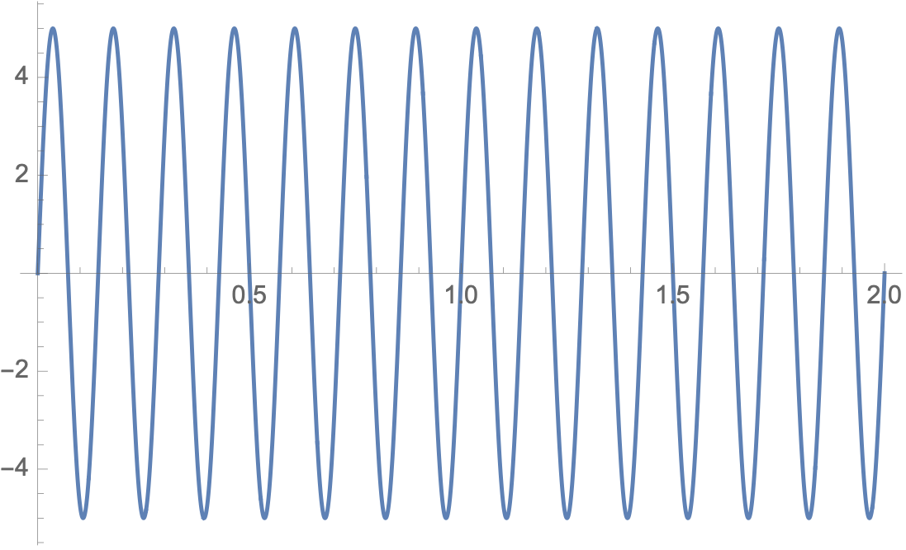
Time - Frequency Domain
If we disregard phase, then a sine-wave is determined by its frequency and peak amplitude
Peak amplitude is 5, Frequency is 7 hz. (Interval is from 0 to 2.0)

Slide 13
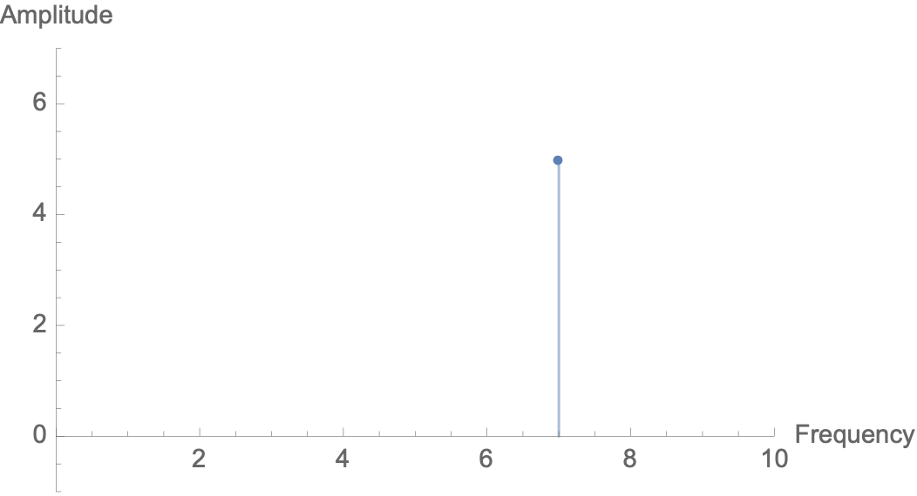
Time - Frequency Domain
Frequency Domain
Gives the amplitude for the frequency
A simple sine wave corresponds to a single spike

Slide 14
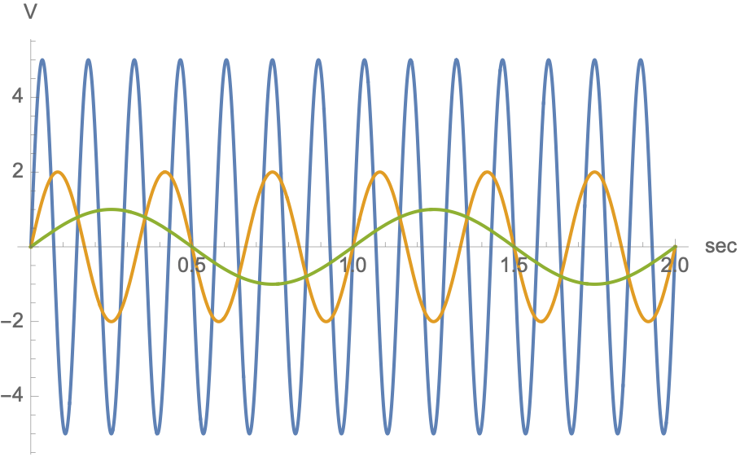
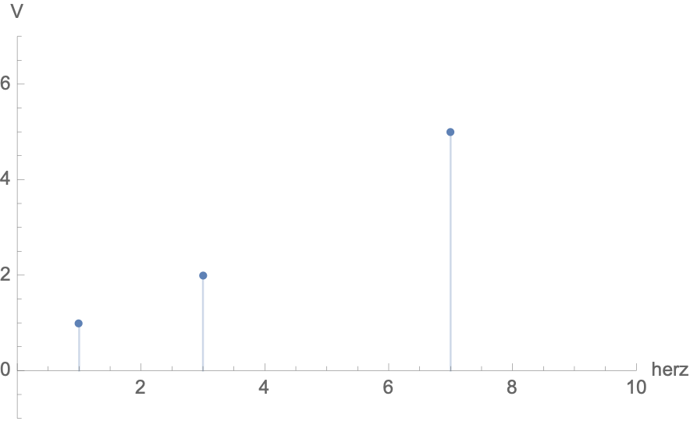
Time-Frequency Domain
Three functions with different frequencies and their frequency graph

Slide 15
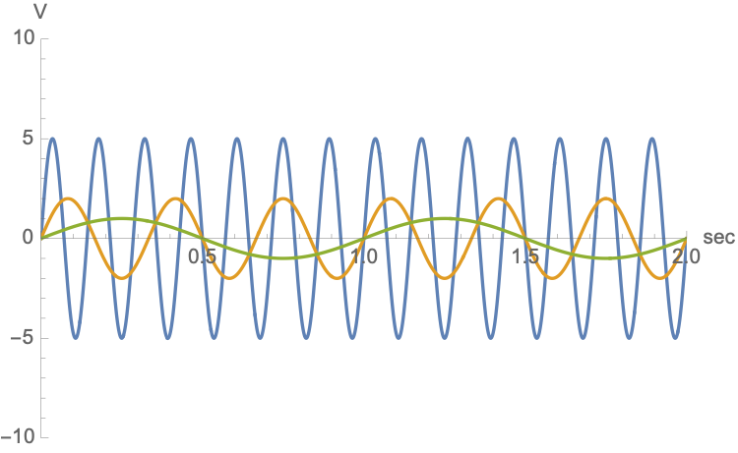
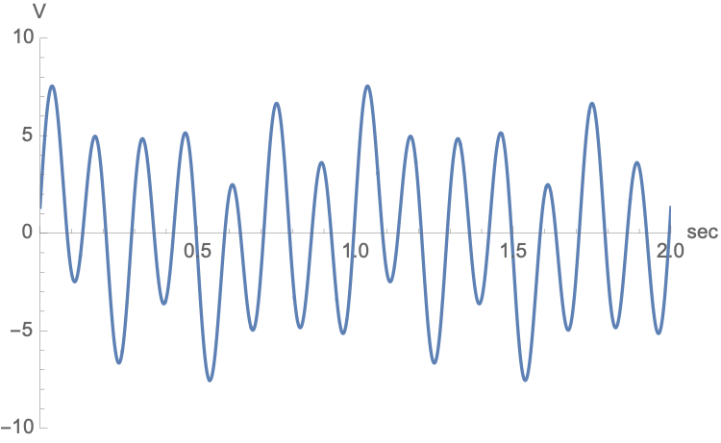
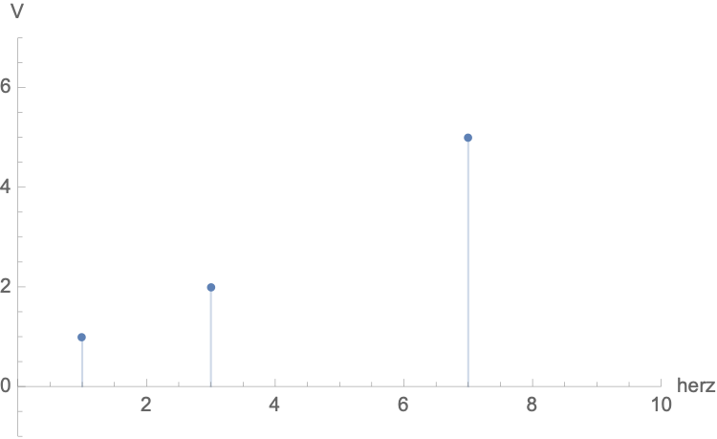
Time Frequency Domain
We superimpose these functions

Slide 16
Fourier Analysis
Any well-behaved periodic function can be written as a sum of sine functions with different frequencies, amplitudes, and phases
Assume a periodic function $f:R→R$
Periodic means
We pick $x=2π$ without loss of generality

Slide 17
Fourier Analysis
Then $f(x)=\frac{a_{0}}{2}+\overset{∞}{\underset{i=1}{∑}}a_{i}cos(ix)+\overset{∞}{\underset{i=1}{∑}}b_{i}sin(ix)$
with
$$a_{0}=\frac{1}{π}∫_{-π}^{π}f(x)dx$$
$$a_{i}=\frac{1}{π}∫_{-π}^{π}f(x)cos(ix)dx$$
$$b_{i}=\frac{1}{π}∫_{-π}^{π}f(x)sin(ix)dx$$

Slide 18
Fourier Analysis
Note that the sine is just the cosine with a phase difference of 90°
Peak amplitude is therefore just $max(a_{i}+b_{i})$

Slide 19
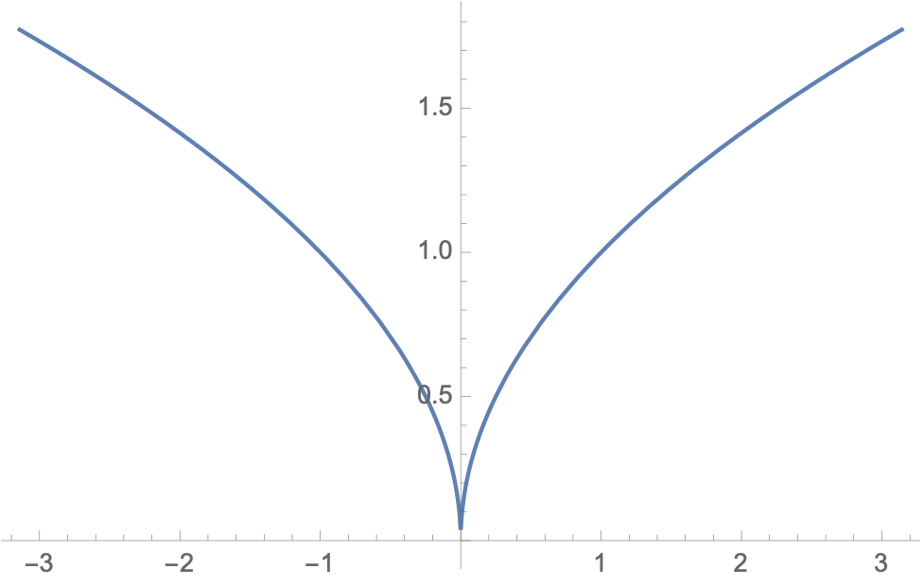
Fourier-Analysis Example
Example:
Use periodicity to extend definition to all real numbers

Slide 20
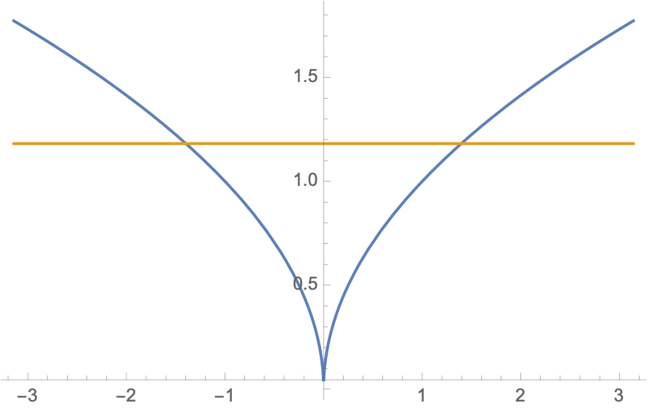
Fourier Analysis Example
Constant member of Fourier series is $a_{0}=\frac{2\sqrt{π}}{3}$
Of course, frequency 0 means a constant current
(This is actually a problem for signaling from one node to another because you are using up energy.)

Slide 21
Fourier Analysis Example
The sine components are all zero
This is because the function is even:

Slide 22
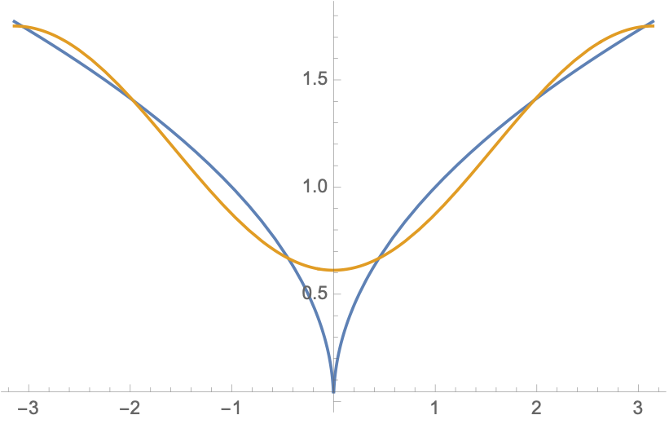
Fourier Analysis Example
First cosine coefficient is
First partial Fourier series is
(Negative cos is just the cos at a phase of 180°)

Slide 23
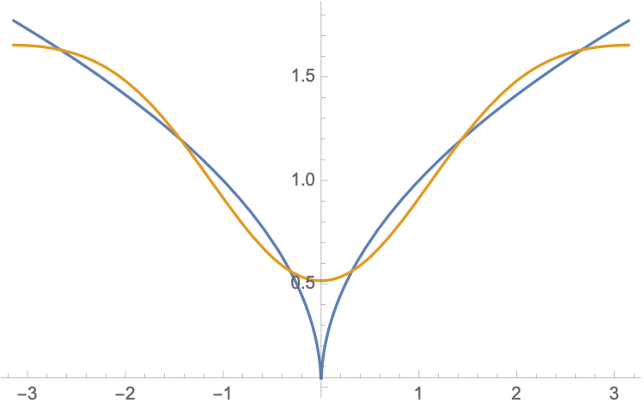
Fourier Analysis Example
Second cosine coefficient is
Second partial Fourier series is

Slide 24
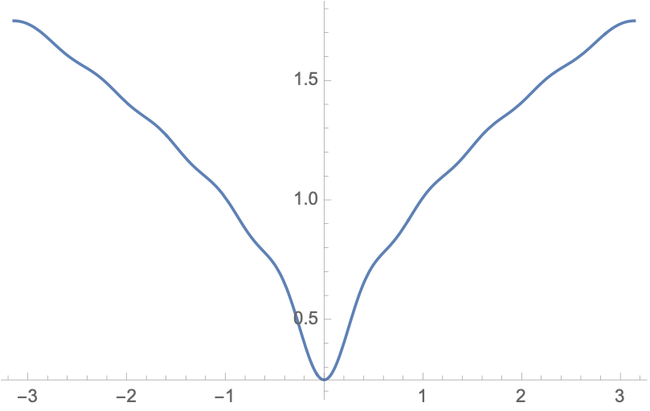
Fourier Analysis Example
List of cosine coefficients is -0.569667, -0.0968758, -0.0965755, -0.0386943, -0.0428448, -0.0221663, -0.0252003, -0.0148282, -0.0169907, -0.0108211, …
10th partial Fourier sum gives a somewhat shaky approximation

Slide 25
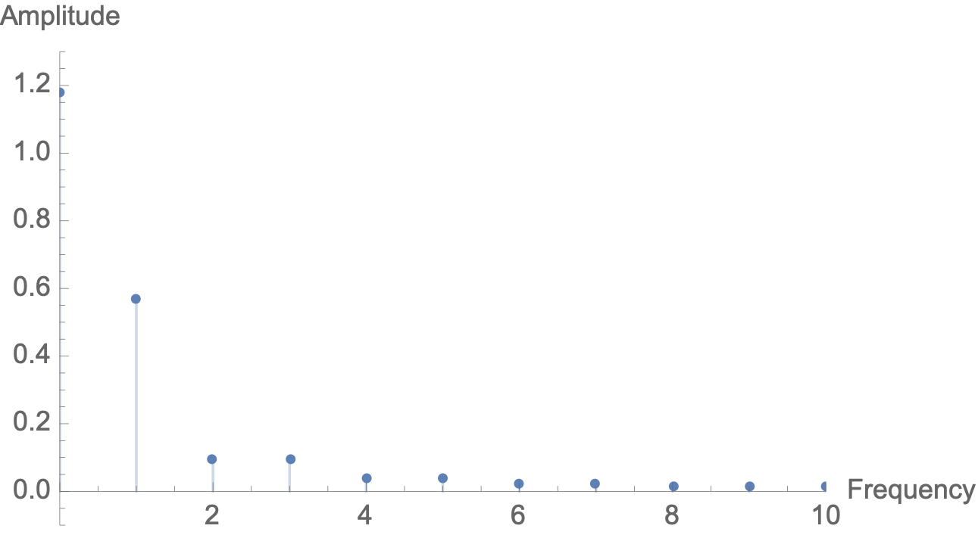
Fourier Analysis Example
We can use the coefficients to translate this function to the frequency domain

Slide 26
Fourier Analysis Example
A simpler example is the square wave
Evaluating the integrals, we obtain

Slide 27
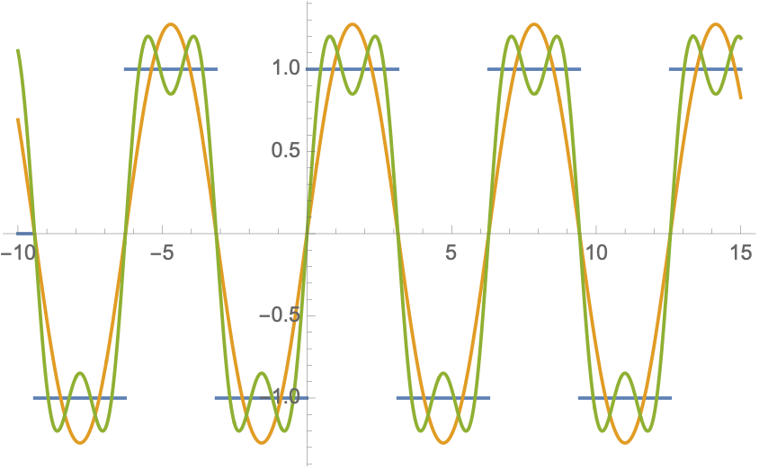
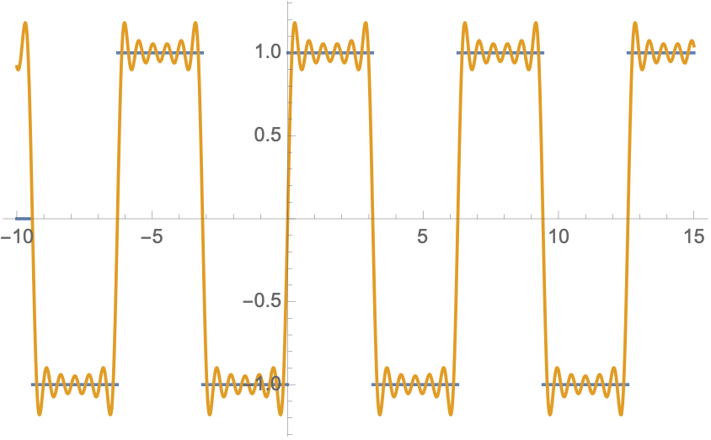
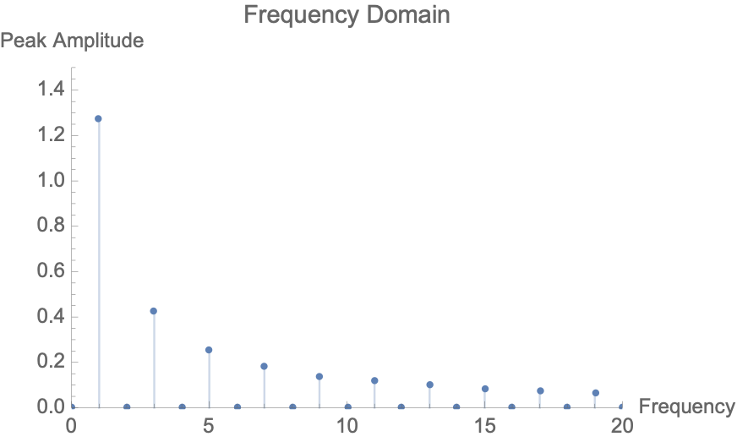
Fourier Analysis Example
Notice Gibb’s phenomenon: Ringing near discontinuities

Slide 28
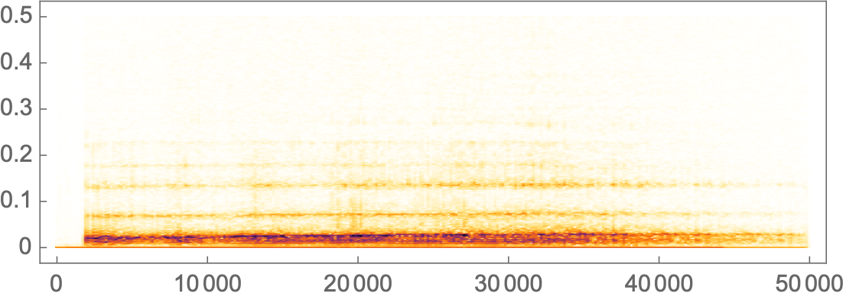
Fourier Analysis Examples
Spectograms:
Audio signal
Break into short intervals
Display Fourier transform per interval
Bear growling

Slide 29
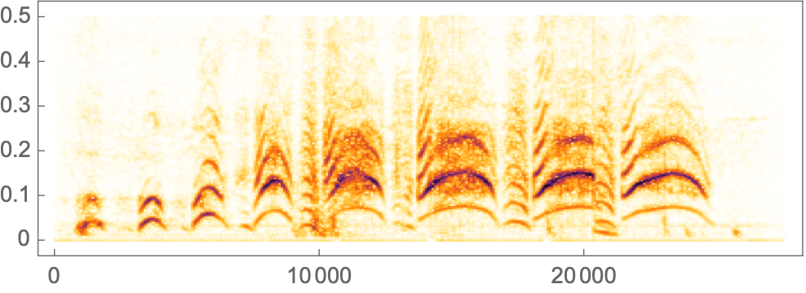
Fourier Analysis Examples
Spectograms:
Audio signal
Break into short intervals
Display Fourier transform per interval
Monkey being a monkey

Slide 30
Fourier Analysis
To transmit signals, we need more than a single sine wave
A composite signal is a combination of simple sine waves with different frequencies
Periodic signals can be decomposed into series of simple sign waves with discrete frequencies
An aperiodic signal can be decomposed into a combination of an infinite number of simple sine waves

Slide 31
Fourier Analysis
Why is this important:
Carriers offer different attenuation to different frequencies
We want to understand how carriers can subdivide their spectrum

Slide 32
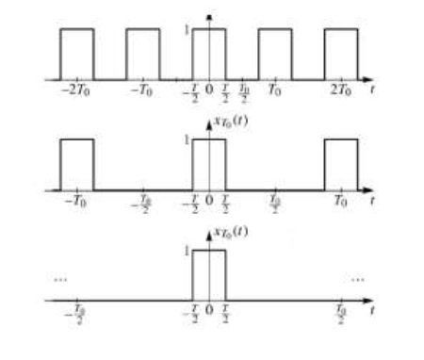
Non-periodic Signals
In reality, signals are not periodic
We can make them periodic by repeating the pattern at larger and larger distances

Slide 33
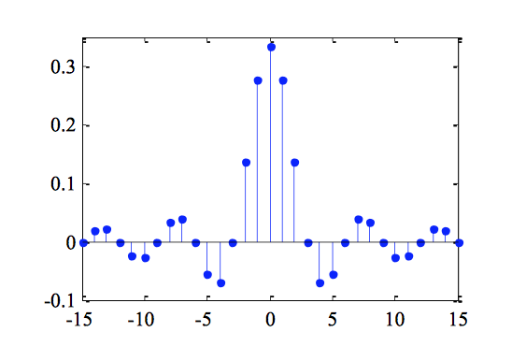
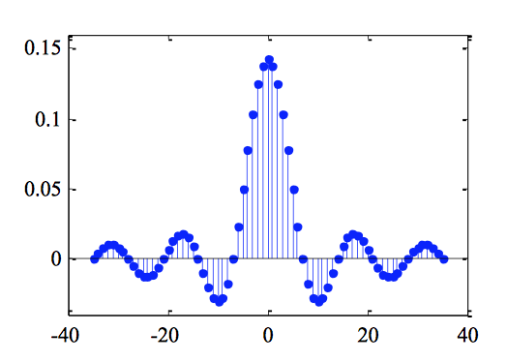
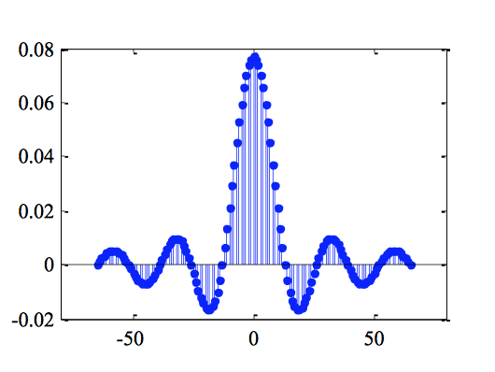
Non-periodic signals
As the period gets bigger and bigger
Frequency domain graph becomes closer and closer to continuous function

Slide 34
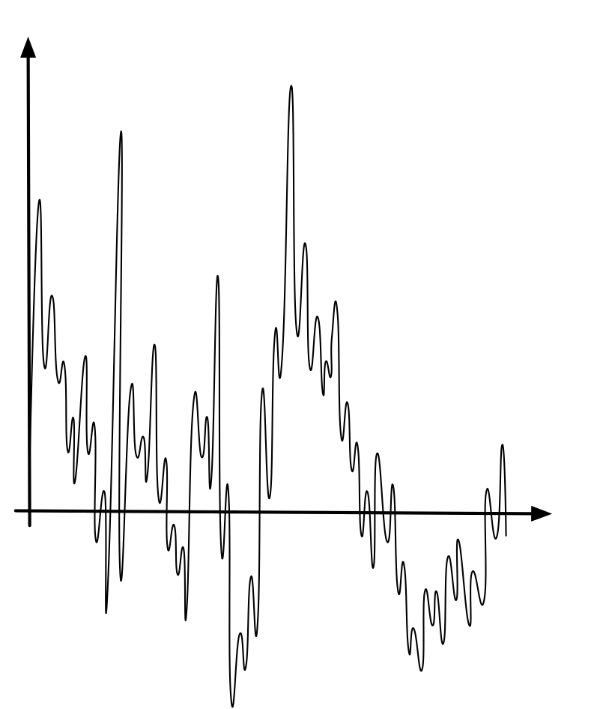
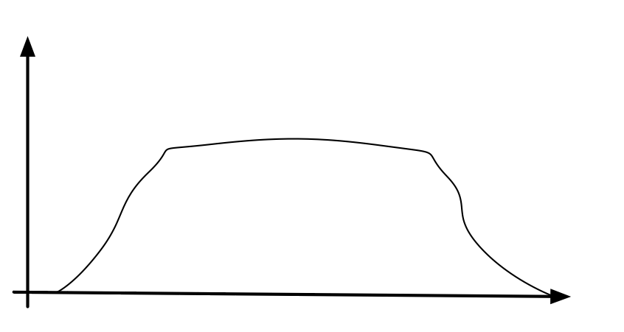
Non-periodic signal
Time Domain
Frequency Domain
4 kHz

Slide 35
Non-periodic Signal
Human voice has a continuous range of 20 to 10,000 Hz
Needs 100 to 4000 Hz to be understandable

Slide 36
Bandwidth of Physical Links

Slide 37
Physical Links
Any analog signal can be represented with a Fourier series for a limited time
Fourier series technique important because medium or electronics can limit frequencies transmitted

Slide 38
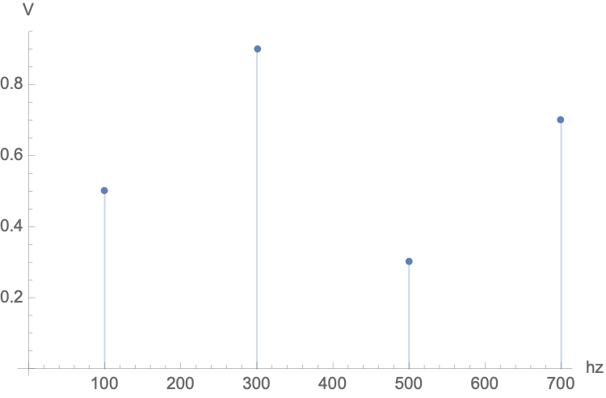
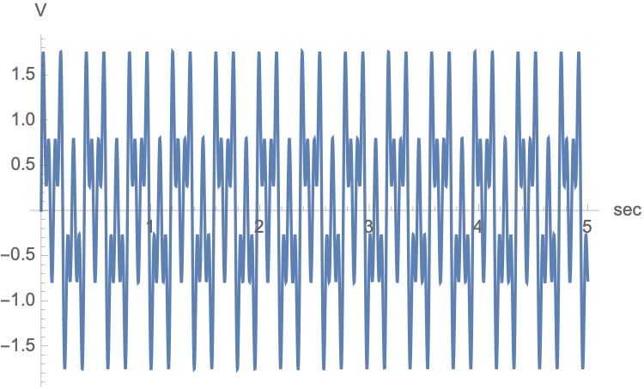
Bandwidth
Range of frequencies in a composite signal is bandwidth
Difference between highest and smallest frequency
Example:
Here: Bandwidth is 600 Hz, not 700 Hz

Slide 39
Bandwidth
Periodic signal
Bandwidth contains all integer frequencies between the lowest and the highest frequency
Non-periodic signal
Bandwidth contains all frequencies between the lowest and the highest frequency

Slide 40
Bandwidth
AM radio station in US has a bandwidth of 10 kHz
Total AM radio range is from 530 kHz to 1700 kHz
Bandwidth chosen to allow for good human speech transmission
FM radio station in US has a bandwidth of 200 kHz
FM spectrum ranges from 88 to 108 Mhz

Slide 41
Bandwidth
Analog black-and-white TV
Screen made up of pixels that are either black or white
Screen is scanned 30 times / sec
Resolution is 525 ⨉ 700 for 367,500 pixels
Need 367,500 ⨉ 30 = 11,025,000 pixels
Worst case scenario is alternating black and white pixels
Represent one color by minimum, other by maximum amplitude
Allows us to send 2 pixels per cycle
Need 11,025,000/2 = 5,512,500 cycles per second or 5.512 MHz
Best case is all one color, with frequency 0
Therefore, bandwidth needed is 5.512 MHz

Slide 42
Digital Signals

Slide 43
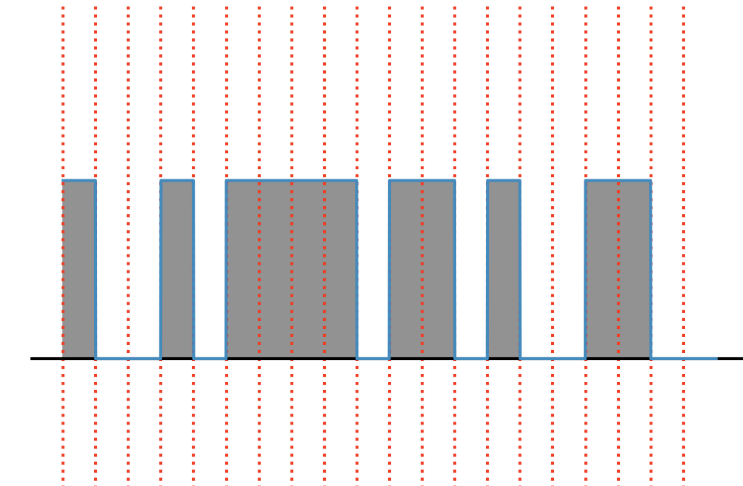
Digital Signals
Digital signals have few signal levels
Two signal levels zero and one
20 bits sent per second
bit-rate is 20bps

Slide 44
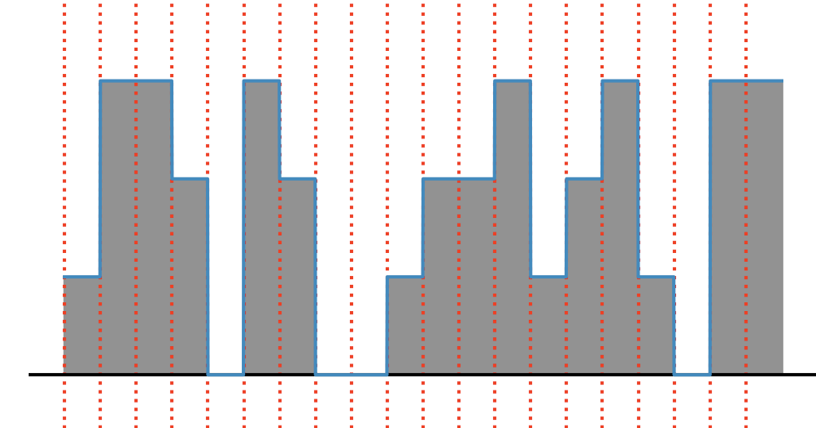
Digital Signals
Four signal levels
40 bits sent per second
40 bps

Slide 45
Digital Signals
The number of signal levels needed to send $b$ bits per time unit is
$$2^{b}$$
Reversely: With $k$ signal levels, can send $\log_{2}(k)$ bits per time unit

Slide 46
Digital Signals
Group exercise:
We download text documents at 100 pages per second
What is the bit rate needed?

Slide 47
Digital Signals
Group exercise answer:
Assume 30 lines with 80 characters per line
Each character requires 8b
Per second, we download
$30×80×8×100=1920000$ bits
Or 1.92 Mbps

Slide 48
Digital Signals
To be recognizable, human voice needs a 4-kHz bandwidth analog signal
What is the bit rate?
We need to sample at twice the highest frequency
Each sample takes 8 bits

Slide 49
Digital Signals
To be recognizable, human voice needs a 4-kHz bandwidth analog signal
What is the bit rate?
We need to sample at twice the highest frequency
Each sample takes 8 bits
$$2×4000×8=64000\text{bps}$$

Slide 50
Bit Length
Digital equivalent to wavelength
Distance one bit occupies on the transmission medium
$l=c×d$
$l$ bit length
$c$ propagation speed
$d$ bit duration

Slide 51
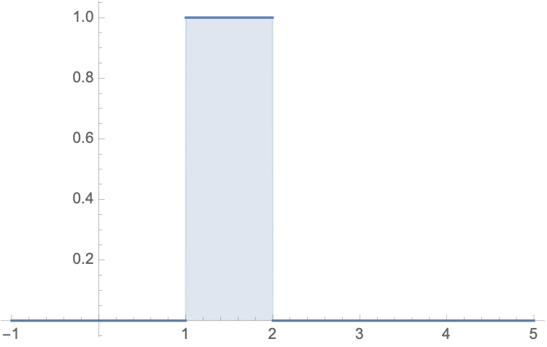
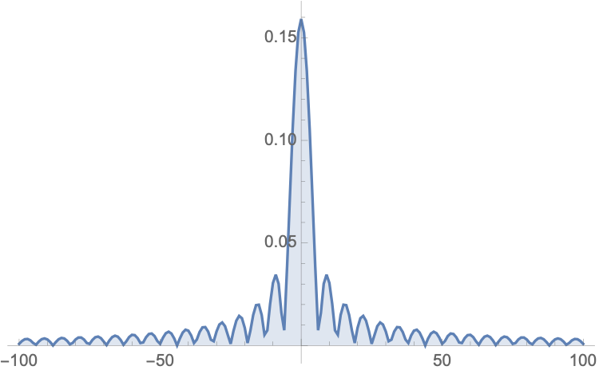
Nature of Digital Signals
Digital signal is non-periodic, so it has an infinite bandwidth (using Fourier Analysis)
Example: A single pulse

Slide 52
Transmission of Digital Signals
Baseband transmission:
Sends the digital signal over a channel without changing the digital signal to an analog signal
Needs a low-pass channel
A channel with bandwidth that starts from zero
Example: Use a dedicated cable between two computers
Example: Connect several computers to a bus, but have only one computer send at a time

Slide 53
Transmission of Digital Signals
Baseband transmission:
The digital signal is not distorted if the low-pass channel has infinite bandwidth
Otherwise:
Signal is distorted

Slide 54
Transmission of Digital Signals
Broadband transmission:
We change the digital signal to an analog signal for transmission
This allows us to use a bandpass channel
A channel where bandwidth does not start from zero

Slide 55
Transmission Impairment

Slide 56
Causes of Impairment
Attenuation: Loss of energy
Distortion: Signal changes its form
Noise: Other sources add to the signal

Slide 57
Attenuation
Measured in decibel (dB)
Compares the relative strength of signals
Signal power at two different locations
If we use voltage (power is proportional to the square of voltage)

Slide 58
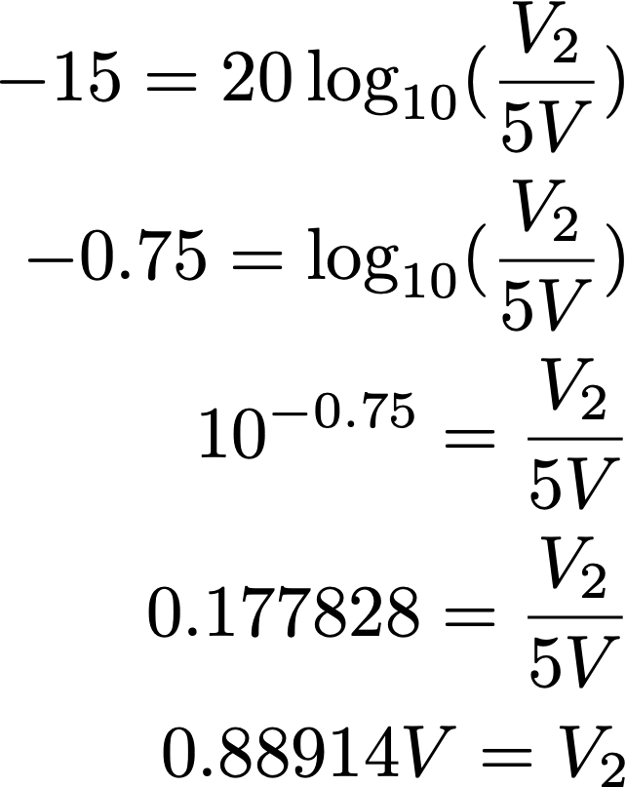
Attenuation
Group Activity
A signal suffers an attenuation of -15 decibel. The original peak amplitude is 5V. What is the peak amplitude when it is received.

Slide 59
Attenuation
Group activity
A cable suffers an attenuation of -0.5 db per km. What is the power of a signal that is original 0.7 mW after 5 km.
(This is why decibels use a logarithm, you can just multiply the length of the cable with the attenuation per km to get the attenuation of the whole cable)

Slide 60
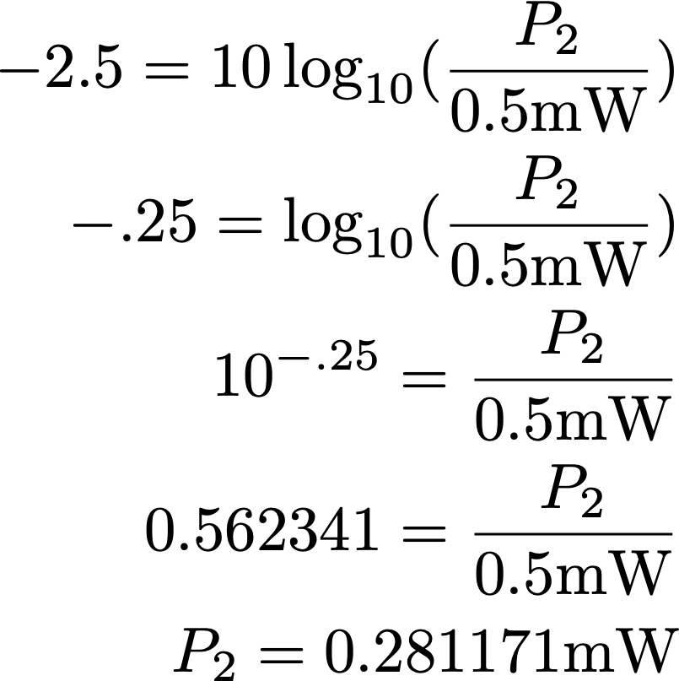
Attenuation

Slide 61
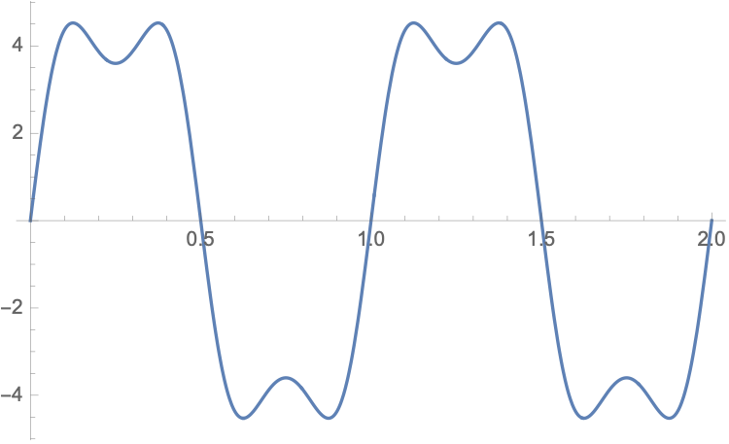
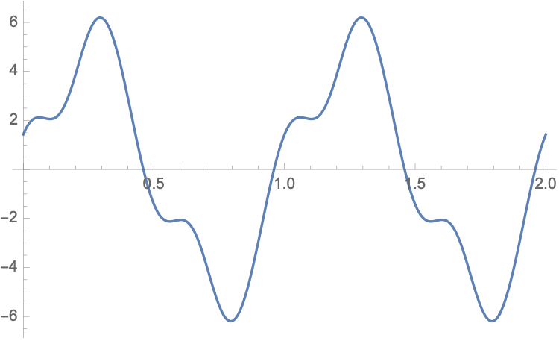
Distortion
Signal changes its form or shape.
Signal Fourier components can have their own propagation speed and the received composite signal can be different.
Result of big phase shift in the higher harmonics

Slide 62
Noise
Noise: “random" noise is added to signal
Thermal, induced, crosstalk, impulse (from lightning)
Signal to Noise Ratio

Slide 63
Noise
Activity
The power of a signal is 10 mW and the power of the noise is 1 μW. What are the values for SNR and SNR-decibel?
$$\text{SNR}=\frac{{10}^{4}μ\text{w}}{1μ\text{w}}={10}^{4}$$
$${\text{SNR}}_{\text{db}}=40$$

Slide 64
Data Rate Limits

Slide 65
Nyquest Bit Rate
For a noiseless channel:
Levels: number of signal levels
Maximum bit rate = $2×\text{bandwidth}×\log_{2}(\text{levels})$
Can increase the maximum bit rate by increasing the number of levels
But there is a practical limit to how many levels can be sustained

Slide 66
Nyquest Bit Rate
What is the maximum bit rate for two signal levels for a noiseless channel with a bandwidth of 3000 Hz?
$$2×3000×\log_{2}2\text{bps}=6000\text{bps}$$

Slide 67
Shannon Capacity
In reality, all channels are noisy
Shannon capacity for highest data rate
Depends on the Signal Noise Ratio
$$\text{bandwidth}×\log_{2}(1+SNR)$$

Slide 68
Shannon Capacity
If $SNR=0$, then Shannon capacity is
$$\text{bandwidth}×\log_{2}(1)=0$$

Slide 69
Shannon Capacity
Regular telephone line
Has bandwidth of 3000 Hz (300 Hz to 3300 Hz)
Signal to Noise ratio is $>3000$.
Shannon capacity is
$$3000×\log_{2}(3001)\text{bps}=34652\text{bps}$$
To increase the bit rate, we need to increase the bandwidth of the line or improve the signal to noise ratio

Slide 70
Shannon Capacity
Signal to Noise ratio is often given in decibel
If channel bandwidth is 2 MHz and SNR is 36 decibel:
$36=10\log_{10}(SNR)$, so $SNR={10}^{{36}/{10}}$
Maximum bandwidth is
$$2×{10}^{6}×\log_{2}(1+{10}^{3.2})\text{bps}$$
$$=23.918×{10}^{6}\text{bps}=23.918\text{Mbps}$$

Slide 71
Shannon Capacity
We have a channel with bandwidth 1-MHz. SNR is 60.
What are appropriate bit rate and signal level?
We use Shannon capacity to find the upper limit for the bit-rate:
$${10}^{6}\log_{2}(61)\text{bps}=5.931\text{Mbps}$$
For reasonable performance, we try to achieve $4\text{Mbps}$.
Nyquist tells us:
$4\text{Mbps}≤2×1\text{Mhz}×\log_{2}(L)$
So, we choose $L=4$ signal levels

Slide 72
Performance

Slide 73
Performance
Bandwidth
For analog data: in Hz
For digital data: in bps
Relationship will be discussed next week
E.g.: Telephone subscriber line
has bandwidth of $4\text{kHz}$
and 56 000 bps

Slide 74
Performance
Throughput
How fast can we actually send data through a network
Limited by bandwidth

Slide 75
Performance
Latency (Delay)
Latency consists of
propagation time = distance / propagation speed
transmission time = message size / bandwidth
queuing time : time needed for each device to hold message before it can be processed
processing delay

Slide 76
Performance
Example:
Interoceanic copper cable for a 5 MB message
Assume bandwidth is 1Mbps
Distance = 12000 km
Propagation speed is $1.8×{10}^{8}\text{msec}$

Slide 77
Performance
Propagation time is
$\frac{12000×{10}^{3}}{1.8×{10}^{8}}\text{sec}$
$$=0.667×{10}^{-2}\text{msec}=66.666\text{msec}$$
Transmission time is
$$5×{10}^{6}×8/{10}^{6}\text{sec}=40\text{sec}$$

