Slide 1
Naive Bayes
and
Gaussian Bayesian Inference
Thomas Schwarz

Slide 2
Conditional Probability
Given two events $A$ and $B$, we define the conditional probability as
$$P(A|B)=\frac{P(A∩B}{P(B)}$$
"probability of A given B"
Write also as:
$$P(A∩B)=P(A|B)P(B)$$

Slide 3
Conditional Probability
Bayes' Theorem: An observation of extreme importance
Giving rise to a new way of statistics
Theorem: $P(A|B)=\frac{P(B|A)⋅P(A)}{P(B)}$
Expresses a probability conditioned on B in one conditioned on A
Proof: $P(A|B)P(B)=P(A∩B)=P(B∩A)=P(B|A)P(A)$
Now solve for $P(A|B)$

Slide 4
Conditional Probability
We can express a probability for one event in terms of another event happening or not
$$P(A)=P(A∩B)+P(A∩\overline{B})$$
$=P(A|B)P(B)+P(A|\overline{B})P(\overline{B})$
A
$$A∩\overline{B}$$
$$A∩B$$
B

Slide 5
Conditional Probability
We can expand Bayes by calculating $P(B)$ as probabilities conditioned on $A$
$P(A|B)=\frac{P(B|A)⋅P(A)}{P(B)}$
$$=\frac{P(B|A)⋅P(A)}{P(B∩A)+P(B∩\overline{A})}$$
$$=\frac{P(B|A)⋅P(A)}{P(B|A)P(A)+P(B|\overline{A})P(\overline{A})}$$

Slide 6
Conditional Probability
Example: Medical Tests
An HIV test is positive. What is the probability that you have HIV?
Need some data: The quality of the test
Type 1 error: Test is negative, but there is illness
Type 2 error: Test is positive, but there is no illness

Slide 7
Conditional Probability
Abbreviate probabilities
T : Test is positive
H : Person infected with HIV
Interested in $P(H|T)$. The quality of the test is expressed in terms of the opposite conditional probability.
Type I error probability: $P(\overline{T}|H)$
Type II error probability: $P(T|\overline{H})$

Slide 8
Conditional Probability
We calculate
$$P(H|T)=\frac{P(T|H)P(H)}{P(T|H)P(H)+P(T|\overline{H})P(\overline{H})}$$
Assume test has 5% type I (false positive) error probability and 1% type II (false negative) error probability:
$$P(T|\overline{H})=0.95$$
$$P(T|H)=0.99$$
The probability still depends on the prevalence of HIV in the population

Slide 9
Conditional Probability
$$P(H|T)=\frac{0.99P(H)}{0.99P(H)+0.95(1-P(H))}$$
Example: HIV rate in general population in the US is 13.3/100000 = 0.000,133
After a positive test:
0.000138599 (Almost no change!)
Example 2: HIV in a high risk group in the US is 1,753.1/100000 = 0.017531
After a positive test:
0.0182557

Slide 10
Conditional Probability
The type I and type II error rates are just too bad to use this.

Slide 11
Classification with Bayes
Bayes' theorem inverts conditional probabilities
Can use this for classification based on observations
Idea: Assume we have observations $\overset{⃗}{x}$
We have calculated the probabilities of seeing these observations given a certain classification
I.e.: for each category, we know $P(\overset{⃗}{x},c_{i})$
Probability to observe $\overset{⃗}{x}$ assuming that point lies in $c_{i}$
We use Bayes formula in order to calculate $P(c_{i},\overset{⃗}{x})$
And then select the category with highest probability

Slide 12
Classification with Bayes
Document classification:
Spam detection:
Is email spam or ham?
Sentiment analysis:
Is a review good or bad

Slide 13
Classification with Bayes
Bag of words method:
Model a document by only counting words
Restrict ourselves to non-structure = non-common words
"I love this movie! It's sweet, but with satirical humor. The dialogs are great and the adventure scenes are fun. It manages to be romantic and whimsical while laughing at the conventions of the fairy tale genre. I would recommend it to just about anyone. I have seen it several times and I'm always happy to see it again"
fun 1
great 2
happy 1
humor 1
love 1
recommend 1
satirical 1
sweet 1

Slide 14
Classification with Bayes
There is a whole theory about recognizing key-words automatically
Easy out:
Use all words that are not common

Slide 15
Classification with Bayes
Recognizing words
Actual documents have misspelling and grammatical forms
Grammatical forms less common in English but typical in other languages
Lemmatization: Recognize the form of the word
Usually difficult to automatize
जाओ, जाओगे, … —> जाना
went, goes —> to go

Slide 16
Classification with Bayes
Recognizing words
Stemming
Several methods to automatically extract the stem
English: Porter stemmer (1980)
Other languages: Can use similar ideas
https://www.emerald.com/insight/content/doi/10.1108/00330330610681295/full/pdf?title=the-porter-stemming-algorithm-then-and-now

Slide 17
Classification with Bayes
Need to calculate the probability to observe a set of keywords given a classification
This is too specific:
There are too many sets of keywords
First reduction:
Only use existence of words.

Slide 18
Classification with Bayes
Want: $P(w_{1},w_{2},w_{3},…,w_{n}|c_{i})$
The probability to find a certain word in documents of a certain category depends on the existence of other words.
E.g.: "Malicious Compliance"
We make now a big assumptions:
The probabilities of a keyword showing up are independent of each other
That's why this method is called "Naïve Bayes"

Slide 19
Classification with Naïve Bayes
Want:
$$P(w_{1},w_{2},w_{3},…,w_{n}|c_{i})=P(w_{1}|c_{i})×P(w_{2}|c_{i})×P(w_{3}|c_{i})×…P(w_{n}|c_{i})$$
Can estimate this from a training set:
E.g. a set of movie reviews classified with the sentiment
Algorithm:
for document in set:
sentiment = document.sentiment
for word in document:
count[word]+=1
if sentiment=='positive':
countPos[word]+=1
else:
countNeg[word]+=1
return countPos/count, countNeg/count

Slide 20
Classification with Naïve Bayes
This algorithm has a problem:
It can return a probability as zero
Because we use multiplication in our estimator:
$$P(w_{1},w_{2},w_{3},…,w_{n}|c_{i})=P(w_{1}|c_{i})×P(w_{2}|c_{i})×P(w_{3}|c_{i})×…P(w_{n}|c_{i})$$
Would create zero probabilities
Solution: start all counts at 1
No more zero probabilities

Slide 21
Classification with Naïve Bayes
Result: Simple classifier

Slide 22
Classification with Naïve Bayes
Example: Use NLTK, a natural language processor
NLTK has several corpus (which you might have to download separately)
import nltk
from nltk.corpus import movie_reviews
import random

Slide 23
Classification with Naïve Bayes
First step: Get the documents
documents = [(list(movie_reviews.words(fileid)), category)
for category in movie_reviews.categories()
for fileid in movie_reviews.fileids(category)]
random.shuffle(documents)
train_set, test_set = featuresets[500:], featuresets[:500]

Slide 24
Classification with Naïve Bayes
Second step: Get all "features" (important words)
Strategy: Get a list of all words, then order it, then select the frequent ones with exception of the most frequent ones.
Here is all_words:
FreqDist({',': 77717, 'the': 76529, '.': 65876, 'a': 38106, 'and': 35576, 'of': 34123, 'to': 31937, "'": 30585, 'is': 25195, 'in': 21822, …})
Therefore, just drop the first ones.
all_words = nltk.FreqDist(w.lower() for w in movie_reviews.words())
word_features = list(all_words)[200:2000]

Slide 25
Classification with Naïve Bayes
Create a bag of words for each document
def document_features(document):
document_words = set(document)
features = {}
for word in word_features:
features['contains({})'.format(word)] = (word in document_words)
return features
featuresets = [(document_features(d), c) for (d,c) in documents]
train_set, test_set = featuresets[500:], featuresets[:500]

Slide 26
Classification with Naïve Bayes
Use NLTK Naive Bayes Classifier
classifier = nltk.NaiveBayesClassifier.train(train_set)
print(nltk.classify.accuracy(classifier, test_set))

Slide 27
Classification with Naïve Bayes
Results: 80.2% sentiments classified correctly
Can see how the classifier works
And already can see improvements
>>> classifier.show_most_informative_features(5)
Most Informative Features
contains(seagal) = True neg : pos = 11.3 : 1.0
contains(outstanding) = True pos : neg = 8.6 : 1.0
contains(wasted) = True neg : pos = 7.3 : 1.0
contains(mulan) = True pos : neg = 7.2 : 1.0
contains(wonderfully) = True pos : neg = 6.3 : 1.0

Slide 28
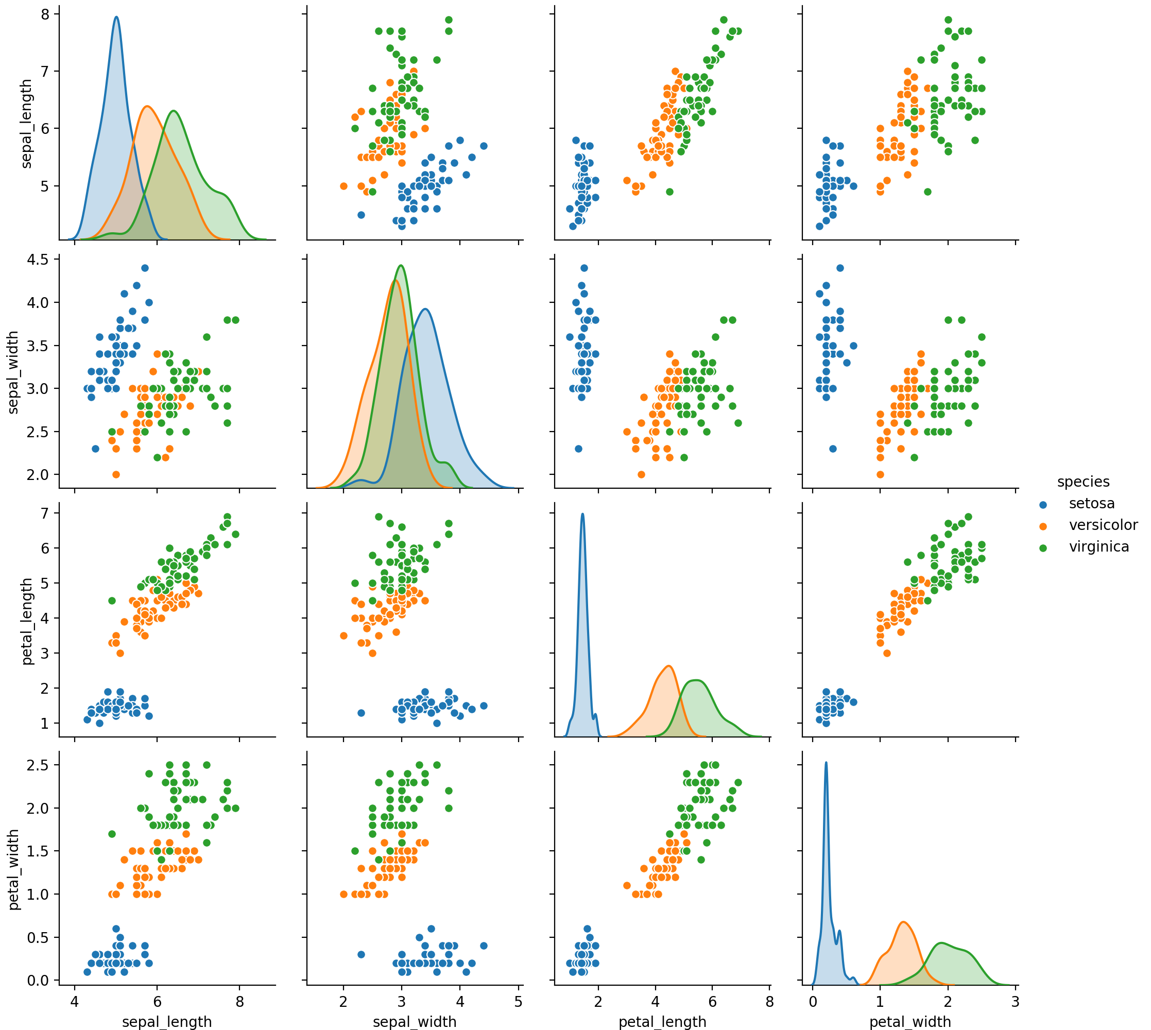
Classification with Gaussian Bayes
Continuous features
Assumption: Features are distributed normally
Example: Look again at Iris set
All features are look normally distributed

Slide 29
Classification with Gaussian Naïve Bayes
Possibility one: Disregard correlation —> Naïve
For each feature:
Calculate sample mean $μ$ and sample standard deviation $σ$
Use these as estimators of the population mean and deviation
For a given feature value x, calculate the probability density assuming that $x$ is in a category $c$
$$P(x|c)∼N(μ_{c},σ_{c})$$

Slide 30
Classification with Gaussian Naïve Bayes
Estimate the probability for observation $(x_{1},x_{2},…,x_{n})$ as the product of the densities
$$P((x_{1},…,x_{n})|c_{j})∼N(x_{1},σ_{1,c_{j}},μ_{1,c_{j}})⋅…⋅N(x_{1},σ_{n,c_{j}},μ_{1,c_{j}})$$
Then use Bayes formula to invert the conditional probabilities
This means estimating the prevalence of the categories
$$P(c_{j}|(x_{1},…,x_{n}))=\frac{P((x_{1},…,x_{n})|c_{j})P(c_{j})}{P((x_{1},…,x_{n}))}$$

Slide 31
Classification with Gaussian Naïve Bayes
The denominator does not depend on the category $c_{j}$
So, we just leave it out:
$$P(c_{j}|(x_{1},…,x_{n}))∼P((x_{1},…,x_{n})|c_{j})P(c_{j})$$
We calculate $P((x_{1},…,x_{n})|c_{j})P(c_{j})$
And select the highest value

Slide 32
Classification with Gaussian Naïve Bayes
Implemented in sklearn.naive_bayes
Example with Iris data-set
from sklearn import datasets
from sklearn.naive_bayes import GaussianNB
iris = datasets.load_iris()
model = GaussianNB()
model.fit(iris.data, iris.target)
print('means', model.theta_)
print('stds', model.sigma_)
for x,t, p in zip(iris.data, iris.target, model.predict(iris.data)):
print(x, t, p)

Slide 33
Classification with Gaussian Naïve Bayes
means [[5.006 3.428 1.462 0.246]
[5.936 2.77 4.26 1.326]
[6.588 2.974 5.552 2.026]]
stds [[0.121764 0.140816 0.029556 0.010884]
[0.261104 0.0965 0.2164 0.038324]
[0.396256 0.101924 0.298496 0.073924]]
[5.1 3.5 1.4 0.2] 0
[4.9 3. 1.4 0.2] 0
[4.7 3.2 1.3 0.2] 0
[4.6 3.1 1.5 0.2] 0
[5. 3.6 1.4 0.2] 0
[5.4 3.9 1.7 0.4] 0

Slide 34
Classification with Gaussian Naïve Bayes
There are a few errors:
Caution: We did not divide the data set into a training and verification set.
[6.9 3.1 4.9 1.5] 1 2
[5.9 3.2 4.8 1.8] 1 2
[6.7 3. 5. 1.7] 1 2
[4.9 2.5 4.5 1.7] 2 1
[6. 2.2 5. 1.5] 2 1
[6.3 2.8 5.1 1.5] 2 1

Slide 35
Classification with
Not-So-Naïve Gaussian Bayes
We did not use correlation between features
If we do, use the multi-variate probability density
Need to estimate correlation coefficients:
Then use the multi-variate normal probability density ${\text{norm}}_{μ,Σ}(x)=\frac{1}{(\sqrt{2π})^{d}\sqrt{|Σ|}}exp\left(-\frac{(x-μ)^{\text{T}}Σ^{-1}(x-μ)}{2}\right)$
$$σ_{k,l}=\frac{1}{|C_{j}|}\underset{x∈C_{j}}{∑}(x_{k}-μ_{k})(x_{l}-μ_{l})$$

Slide 36
Classification with
Not-So-Naïve Gaussian Bayes
Luckily, implemented in scipy.stats
Estimate means and correlations
Similarly to before, estimate category by looking at the multi-variate normal density for each category and updating
from scipy.stats import multivariate_normal
def diagnose(tupla):
return np.argmax(
[multivariate_normal.pdf(tupla,mean=Gl.mu_setosa, cov=Gl.sigma_setosa),
multivariate_normal.pdf(tupla,mean=Gl.mu_ver, cov=Gl.sigma_ver),
multivariate_normal.pdf(tupla,mean=Gl.mu_vgc, cov=Gl.sigma_vgc)])

Slide 37
Classification with
Not-So-Naïve Gaussian Bayes
This works slightly better: three mis-classifications
Example:
Virginica features:
Versicolor and virginica probs are similar
>>> get_probs((6.3, 2.8, 5.1, 1.5))
setosa 6.551299963143457e-116
versicolor 0.3895029363227387
virginica 0.25720254045708846

Slide 38
Classification with
Not-So-Naïve Gaussian Bayes
This works slightly better: three mis-classifications
Example:
Versicolor features:
Versicolor and virginica probs are somewhat similar
>>> get_probs((6.0, 2.7, 5.1, 1.6))
setosa 3.4601607892612445e-119
versicolor 0.09776449471242309
virginica 0.56568607797792

