Slide 1
Simple Case Study
Thomas Schwarz, SJ

Slide 2
Data Analytics Process
Discovery phase: what data do we need
Data preparation phase: Cleaning
Modeling planning phase: how to go about dealing with the data
Model building phase: build the models
Communication phase
Operationalization: build process into production

Slide 3
Data Gathering
Use Kaggle as a source of data
  https://www.kaggle.com/paultimothymooney/denver-crime-data/
  This is a huge file.

Slide 4
Understanding the Data
Read supporting information
Look at the first lines of the file
  There is a heading and examples
def head():
with open('crime.csv') as infile:
for _ in range(10):
print(infile.readline())

Slide 5
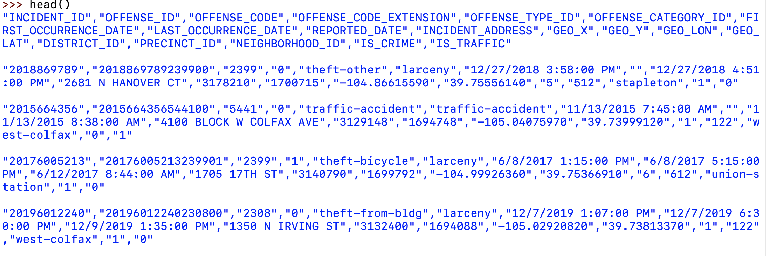
Understanding the Data

Slide 6
Transforming the data
We can look at the headers
  "INCIDENT_ID","OFFENSE_ID","OFFENSE_CODE","OFFENSE_CODE_EXTENSION","OFFENSE_TYPE_ID","OFFENSE_CATEGORY_ID","FIRST_OCCURRENCE_DATE","LAST_OCCURRENCE_DATE","REPORTED_DATE","INCIDENT_ADDRESS","GEO_X","GEO_Y","GEO_LON","GEO_LAT","DISTRICT_ID","PRECINCT_ID","NEIGHBORHOOD_ID","IS_CRIME","IS_TRAFFIC"

Slide 7
Transforming the data
Notice what we could do:
  The incidents are geo-coded
    We can use this to overlay data points on a map of Denver
    We can determine influence of neighborhood on crimes
    We will wait with this until we understand matplotlib better
  The incidents are time-stamped
    We can look at the relationship between time and incidents

Slide 8
Transforming the data
Dealing with time stamps
  Core Python has a datetime module that allows us to create and calculate with dates and times
  Comes with a strptime( ) methods that needs a description of the format
    This is because there are lot of different time formats
      The am/pm format is one of the worst

Slide 9
Transforming the data
In our case:
  The relevant time is the first time stamp in column 6
    This took quite a while to get right
dati = datetime.strptime(contents[6], "\"%m/%d/%Y %I:%M:%S %p\"")

Slide 10
Transforming the data
We can also do so 'manually':
def translate(hour, ampm):
hour = int(hour)
if hour == 12 and ampm == 'AM':
return 0
if hour == 12 and ampm == 'PM':
return 12
if ampm == 'PM':
return hour
else:
return hour+12

Slide 11
Transforming the data
def getdate(astring):
astring = astring.strip('"')
date, time, ap = astring.split()
month, day, year = date.split('/')
hour, minute, second = time.split(':')
#print(year, month, day, hour, minute, second)
return datetime(int(year),
int(month),
int(day),
translate(hour, ap),

Slide 12
Selecting the Data
Assume we only want to look at traffic problems in Denver
  First question: When do traffic accidents happen?
    Notice: Presumably winter weather (snow & ice) are important, so we should distinguish between winter month and the rest of the year
  We look up the offense code and find that all traffic related incidents have codes between 15

Slide 13
Selecting the Data
Write down all time stamps of traffic related incidents
def select_vehicular():
traffic = []
with open('crime.csv') as infile:
infile.readline()
for line in infile:
contents = line.split(',')
dati = getdate(contents[6])
code = int(contents[2].strip('"'))
if 5400 <= code <= 5499:
traffic.append(dati)
return traffic

Slide 14
Selecting the Data
Determine number of accidents during a given hour at a given week-day
A datetime object allows us access to the week-day and the hour
    One is a method, the other a field
Can use the Counter object in collections
  Because there is no need to initialize a dictionary
item.weekday()
item.hour

Slide 15
Selecting the Data
Create seven counters
  For each item (a datetime) in the traffic incident list:
    Update the counter
def process_traffic(traffic):
weekdays = [Counter() for i in range(7)]
for item in traffic:
weekdays[item.weekday()][item.hour]+=1
return weekdays

Slide 16
Displaying the Data
From within Pyhton, use matplotlib
  Developed from matlab interface with many add-ons
  If you use IDLE, need to say plt.show( ) at the end
    This will show all plot elements that you created
import matplotlib.pyplot as plt

Slide 17
Displaying the Data
Pyplot supports many different types of graphs
  We use mostly scatter and plot
  There is even support for three-dimensions

Slide 18
Displaying the Data
Create a figure with plt.figure( )
Create several line-plot elements using
  plt.plot(x-data, y-data)
  Can add a legend as a named parameter
  But we need to place the legend then
    plt.legend(loc='upper left')

Slide 19
Displaying the Data
def show(counters):
weekday = ['Monday', 'Tuesday', 'Wednesday', 'Thursday',
'Friday', 'Saturday', 'Sunday']
f = plt.figure()
for i, counter in enumerate(counters):
hours = [i for i in range(24)]
numbers = [counter[i] for i in range(24)]
s = plt.plot(hours, numbers, label=weekday[i])
plt.legend(loc='upper left')
plt.show()

Slide 20
Homework Part 1
Do something with the Denver crime base
  Example:
    Smooth the traffic data
    Use a different type of crime and show how it depends on week-day and time

Slide 21
Homework Part 2
The curse of dimensionality:
  Use Monte Carlo in order to determine the volume of an $n$-sphere of radius $1$ and of radius $1-δ$
  As the number $n$ of dimensions becomes higher and higher:
    More points are near the boundary than the center

