Slide 1
Dealing with Files
Thomas Schwarz, SJ

Slide 2
Files
Files
  Basic container of data in modern computing system
  Organized into a hierarchy of directories

Slide 3
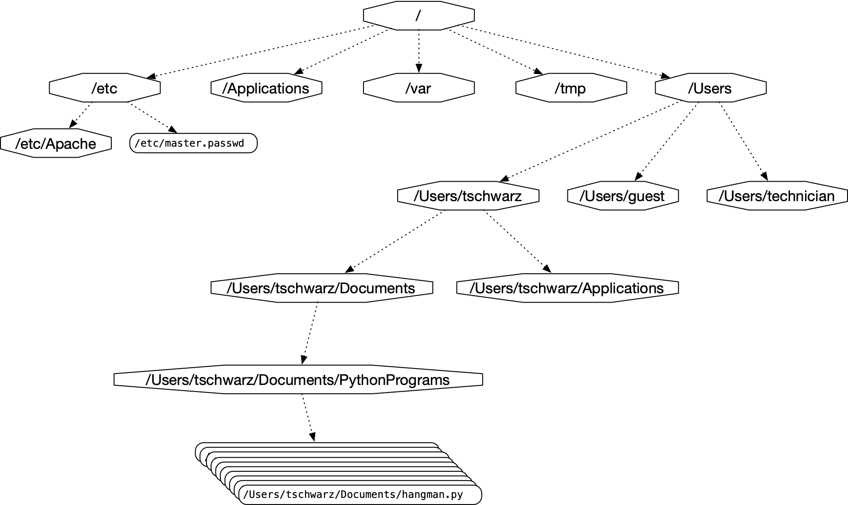
Files
A small subset of directories and files on a system

Slide 4
Files in Python
Access to file system through os module
  Discussed later in course
Files accessed in
  text mode
    Contents interpreted according to encoding
  binary mode
    Contents not interpreted

Slide 5
Files in Python
Python interacts by files through
  reading
  writing / appending
  both

Slide 6
Files in Python
Files need to be opened
  File given by name
    Relative path: Navigation from directory of the file
    Absolute path: Navigation from the root of the file system

Slide 7
Files in Python
  File Name Examples:
    Absolute path on a Mac / Unix
    /Users/tjschwarzsj/Google Drive/AATeaching/Python/Programs/pr.py
    Relate path on a Mac / Unix
      “../“ means move up on directory
    pr.py
    ../Slides/week7.key

Slide 8
Files in Python
Windows uses backward slashes to separate directories in a file name
  Sometimes need to be escaped: \\
  Absolute paths need to include drive name:
    c:\\users\\tschwarz\\My Documents\\Teaching\\temp.py
We will typically read and create files in the same directory as the python program is located

Slide 9
Files in Python
Before files are used, program needs to open them
After they are being used, program should close them
  Will automatically closed when program terminates
  Long-running programs could hog resources

Slide 10
Opening Files in Python
File objects have normal variable names
inFile = open(“data.txt”,”w”)
opens a file “data.txt” in write mode
open takes :
  file name — absolute / relative path
  mode — r (read), w (write), a (appending)
  mode — b (binary), “” (not binary)

Slide 11
Closing Files in Python
We close file by invoking close
  inFile.close()

Slide 12
Why we need to close files
Files are automatically closed when the program terminates
When one application has opened a file for writing it acquires a write lock on the file and no other application can access the file.
When one application has opened a file for reading, it acquires a read lock on the file and no other application can write to it.
If you write programs that last more than a few seconds, you do not want to hog files when you do not need them.

Slide 13
With-clauses
Python 3 allows us to open and close files in a single block (context)
with open("twoft8.11.txt") as inFile, open("twoftres8.11.txt", "w") as outFile:
            #Here you work with the file

Slide 14
Processing Files in Python
We write strings to the file
with open(‘somefile.txt’,’wt’) as f:
      f.write(str(500)+”\n")
Redirect print
with open(‘somefile.txt’,’wt’) as f:
      print(500, file = f)

Slide 15
Processing Files in Python
Reading files
  The read-instruction
        string = inFile.read(10)
        reads ten bytes of the file
  Read the entire file
        with open(‘somefile.txt’, ‘rt’ as f:
                data = f.read()

Slide 16
Processing Files in Python
Reading files
  Read line by line
      with open('somefile.txt', 'rt') as f:
  for line in f:
    #process line

Slide 17
More String Processing
To process read lines:
  strip() and its variants lstrip(), rstrip()
    Remove white spaces (default) or list of characters from the beginning & end of the string
  split() creates a list of words separated by white space (default)
      "This is a sentence with many words in it.”.split()
      ['This', 'is', 'a', 'sentence', 'with', 'many', 'words', 'in', 'it.']

Slide 18
Examples
Finding all words over 13 letters long in “Alice in Wonderland”
  Download from Project Gutenberg
import string
with open("alice.txt", "rt", encoding = "utf-8") as f:
for line in f:
for word in line.split():
if len(word) > 13:
print(word)

Slide 19
Examples
Count the number of words and of lines in “Alice in Wonderland”
  Read the file line by line
    The number of words in a line is the length of line.split.
import string
line_counter = 0
word_counter = 0
with open("alice.txt", "rt", encoding = "utf-8") as f:
for line in f:
line_counter += 1
word_counter += len(line.split())
print(line_counter, word_counter)

Slide 20
Problems with Line Endings
ASCII code was developed when computers wrote to teleprinters.
  A new line consisted of a carriage return followed or preceded by a line-feed.
UNIX and windows choose to different encodings
  Unix has just the newline character “\n”
  Windows has the carriage return: “\r\n”
By default, Python operates in “universal newline mode”
  All common newline combinations are understood
  Python writes new lines just with a “\n”
You could disable this mechanism by opening a file with the universal newline mode disabled by saying:
  open(“filename.txt”, newline=‘’)

Slide 21
Encodings
Information technology has developed a large number of ways of storing particular data
  Here is some background
Using a forensics tool (Winhex) in order
to reveal the bytes actually stored

Slide 22
Encodings
Teleprinters
    Used to send printed messages
      Can be done through a single line
      Use timing to synchronize up and down values

Slide 23
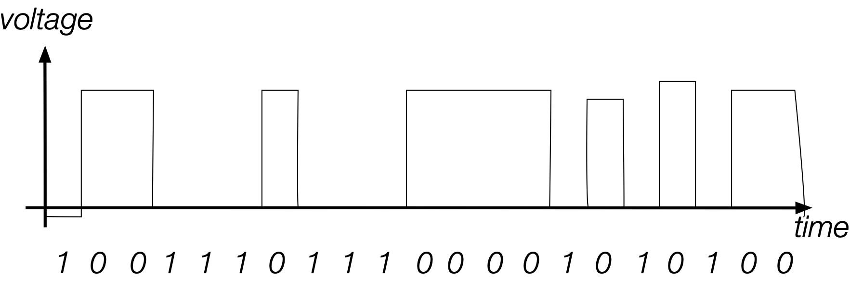
Encodings
Serial connection:
  Voltage level during an interval indicates a bit
  Digital means that changes in voltage level can be tolerated without information loss

Slide 24
Encodings
Parallel Connection
  Can send more than one bit at a time
  Sometimes, one line sends a timing signal

Slide 25
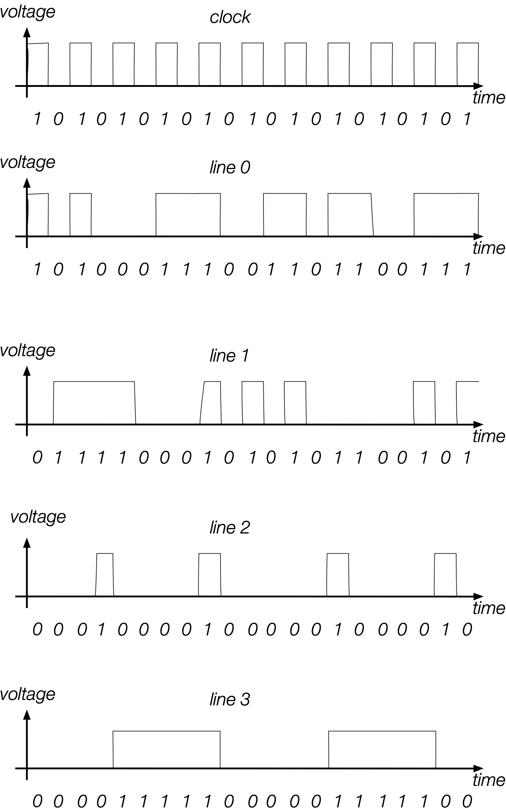
Encodings
Sending
  1000
  0100
  1100
  0100
  …
Small errors in timing and voltage are repaired automatically

Slide 26
Encodings
Need a code to transmit letters and control signals
Émile Baudot’s code 1870
  5 bit code
    Machine had 5 keys, two for the left and three for the right hand
    Encodes capital letters plus NULL and DEL
    Operators had to keep a rhythm to be understood on the other side

Slide 27
Encodings
Many successors to Baudot’s code
  Murray’s code (1901) for keyboard
    Introduced control characters such as Carriage Return (CR) and Line Feed (LF)
    Used by Western Union until 1950

Slide 28
Encodings
Computers and punch cards
  Needed an encoding for strings
    EBCDIC — 1963 for punch cards by IBM
    8b code

Slide 29
Encodings
ASCII — American Standard Code for Information Interchange — 1963
  8b code
    Developed by American Standard Association, which became American National Standards Institute (ANSI)
    32 control characters
    91 alphanumerical and symbol characters
    Used only 7b to encode them to allow local variants
  Extended ASCII
    Uses full 8b
      Chooses letters for Western languages

Slide 30
Encodings
Unicode - 1991
  “Universal code” capable of implementing text in all relevant languages
  32b-code
  For compression, uses “language planes”

Slide 31
Encodings
UTF-7 — 1998
  7b-code
    Invented to send email more efficiently
    Compatible with basic ASCII
    Not used because of awkwardness in translating 7b pieces in 8b computer architecture

Slide 32
Encodings
UTF-8 — Unicode
  Code that uses
    8b for the first 128 characters (basically ASCII)
    16b for the next 1920 characters
      Latin alphabets, Cyrillic, Coptic, Armenian, Hebrew, Arabic, Syriac, Thaana, N’Ko
    24b for
      Chinese, Japanese, Koreans
    32b for
      Everything else

Slide 33
Encodings
Numbers
  There is a variety of ways of storing numbers (integers)
    All based on the binary format
  For floating point numbers, the exact format has a large influence on the accuracy of calculations
    All computers use the IEEE standard

Slide 34
Python and Encodings
Python “understands” several hundred encodings
  Most important
    ascii (corresponds to the 7-bit ASCII standard)
    utf-8 (usually your best bet for data from the Web)
    latin-1
      straight-forward interpretation of the 8-bit extended ASCII
      never throws a “cannot decode” error
      no guarantee that it read things the right way

Slide 35
Python and Encodings
If Python tries to read a file and cannot decode, it throws a decoding exception and terminates execution
We will learn about exceptions and how to handle them soon.
For the time being: Write code that tells you where the problem is (e.g. by using line-numbers) and then fix the input.
Usually, the presence of decoding errors means that you read the file in the wrong encoding

Slide 36
Using the os-module
With the os-module, you can obtain greater access to the file system
  Here is code to get the files in a directory
import os
def list_files(dir_name):
files = os.listdir(dir_name)
for my_file in files:
print(my_file, os.path.getsize(dir_name+"/"+my_file))
list_files(“Example")

Slide 37
Using the os-module
Get a list of file names in the directory
import os
def list_files(dir_name):
files = os.listdir(dir_name)
for my_file in files:
print(my_file, os.path.getsize(dir_name+"/"+my_file))
list_files(“Example")

Slide 38
Use the os-module
import os
def list_files(dir_name):
files = os.listdir(dir_name)
for my_file in files:
print(my_file, os.path.getsize(dir_name+"/"+my_file))
list_files(“Example")
Creating the path name to the file

Slide 39
Use the os-module
import os
def list_files(dir_name):
files = os.listdir(dir_name)
for my_file in files:
print(my_file, os.path.getsize(dir_name+"/"+my_file))
list_files(“Example")
Gives the size of the file in bytes

Slide 40
Use the os-module
import os
def list_files(dir_name):
files = os.listdir(dir_name)
for my_file in files:
print(my_file, os.path.getsize(dir_name+"/"+my_file))
list_files(“Example")
List and

Slide 41
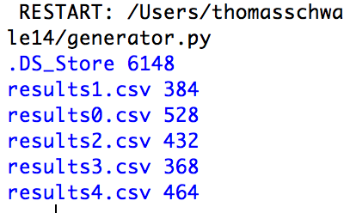
Use the os-module
Output:
  Note the Mac-trash file

Slide 42
Use the os-module
Using the listing capability of the os-module, we can process all files in a directory
  To avoid surprises, we best check the extension
  Assume a function process_a_file
    Our function opens a comma-separated (.csv) file
    Calculates the average of the ratios of the second over the first entries

Slide 43
Use the os-module
1.290, 12.495
2.295, 11.706
3.063, 9.083
4.058, 4.112
4.891, 34.675
5.737, 26.422
7.137, 13.041
7.832, 22.620
9.103, 27.732
9.885, 45.692
11.411, 59.964
11.895, 43.350
12.867, 57.141
13.633, 77.273
14.560, 85.039
16.369, 86.708
16.902,109.293
18.466,114.118
19.454,117.050
19.918,130.860
21.390,139.678
22.411,159.317
23.418,174.622
24.417,181.855
The process_a_file takes the file-name
  Calculates the average ratio
1.147, 1.093
1.997, 8.833
2.781, 10.032
4.225, 9.733
5.455, 15.820
6.151, 20.939
6.573, 26.547
8.058, 33.335
9.132, 37.546
10.474, 47.130
11.207, 50.559
12.413, 62.268
12.525, 68.175
13.826, 76.877
15.327, 84.574
15.664, 93.389
17.446,103.726
18.347,111.623
18.655,119.797
19.581,130.094
21.190,143.306
21.979,154.047
23.250,169.502
24.406,178.782
24.650,190.953
25.846,199.131
27.373,214.514
28.126,232.827
28.580,245.687
30.360,256.452
31.337,270.849
31.583,288.109
33.288,303.786
0.929, 9.373
1.858, 14.439
3.022, 21.861
3.751, 19.097
4.775, 10.838
6.253, 0.280
6.776, 37.029
8.395, 37.459
9.252, 27.295
9.602, 34.994
10.997, 37.458
11.696, 66.393
13.323, 62.255
14.480, 84.116
14.622, 87.145
16.397, 74.933
16.619,125.048
17.838,110.667
19.352,109.947
19.587,118.509
21.312,152.398
21.628,145.806
23.242,176.448
24.191,155.716
24.818,182.198
26.495,197.358
26.831,214.137
1.147, 1.093
1.997, 8.833
2.781, 10.032
4.225, 9.733
5.455, 15.820
6.151, 20.939
6.573, 26.547
8.058, 33.335
9.132, 37.546
10.474, 47.130
11.207, 50.559
12.413, 62.268
12.525, 68.175
13.826, 76.877
15.327, 84.574
15.664, 93.389
17.446,103.726
18.347,111.623
18.655,119.797
19.581,130.094
21.190,143.306
21.979,154.047
23.250,169.502
24.406,178.782
24.650,190.953
25.846,199.131
27.373,214.514
28.126,232.827
28.580,245.687
30.360,256.452
31.337,270.849
31.583,288.109
33.288,303.786
def process_a_file(file_name):
with open(file_name, "r") as infile:
suma = 0
nr_lines = 0
for line in infile:
nr_lines+=1
array = line.split(',')
suma+= float(array[1])/float(array[0])
return suma/nr_lines

Slide 44
Use the os-module
To process the directory
  Get the file names using os
  For each file name:
    Check whether the file name ends with .csv
    Call the process_a_file function
    Print out the result

Slide 45
Use of the os-module
def process_files(dir_name):
files = os.listdir(dir_name)
for my_file in files:
if my_file.endswith('.csv'):
print(my_file, process_a_file(
                “Example/{}”.format(my_file)))
Using format to create the file name

Slide 46
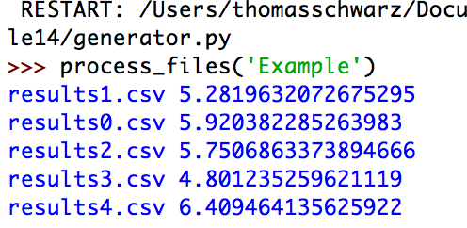
Use of the os-module

Slide 47
Encodings
Whenever you see strings:
  Think about encoding and decoding
    Example: the ë
      'ë'.encode('utf-8').decode('latin-1')
    gives
      'Ã«'
Mixing encodings often creates chaos

Slide 48
Encodings
Python is very good at guessing encodings
  Do not guess encodings
    E.g.: Processing html: read the http header:
      Content-Type: text/html; charset=utf-8
  If you need to guess, there is a module for it:
    chardet.detect(some_bytes)

Slide 49
Encodings
Thinking about encoding and decoding string allows easy internationalization

Slide 50
Bytearrays
On (rare) occasions, you might want to work with bytes directly
  Read the file in binary mode
  Bytearray allows you to manipulate directly binary data
    bytes have range 0-255
  content = bytearray(infile.read())

