Slide 1
Logistic Regression
Thomas Schwarz

Slide 2
Categorical Data
Outcomes can be categorical
Often, outcome is binary:
President gets re-elected or not
Customer is satisfied or not
Often, explanatory variables are categorical as well
Person comes from an under-performing school
Order was made on a week-end
…

Slide 3
Prediction Models for Binary Outcomes
Famous example:
Taken an image of a pet, predict whether this is a cat or a dog

Slide 4
Prediction Models for Binary Outcomes
Bayes: generative classifier
Predicts indirectly $P(c|d)$
$$\overset{̂}{c}={\text{arg max}}_{c∈C}P(d|c)P(c)$$
Evaluates product of likelihood and prior
Prior: Probability of a category $c$ without looking at data
Likelihood: Probability of observing data if from a category $c$
Likelihood
Prior

Slide 5
Prediction Models for Binary Outcomes
Regression is a discriminative classifier
Tries to learn directly the classification from data
E.g.: All dog pictures have a collar
Collar present —> predict dog
Collar not present —> predict cat
Computes directly $P(c|d)$

Slide 6
Prediction Models for Binary Outcomes
Regression:
Supervised learning: Have a training set with classification provided
Input is given as vectors of numerical features
$$x^{(i)}=(x_{1,i},x_{2,i},…,x_{n,i})$$
Classification function that calculates the predicted class $\overset{̂}{y}(x)$
An objective function for learning: Measures the goodness of fit between true outcome and predicted outcome
An algorithm to optimize the objective function

Slide 7
Prediction Models for Binary Outcomes
Linear Regression:
Classification function of type
$$\overset{̂}{y}\left((x_{1},x_{2},…,x_{n})\right)=a_{1}x_{1}+a_{2}x_{2}+…a_{n}x_{n}+b$$
Objective function (a.k.a cost function)
Sum of squared differences between predicted and observed outcomes
E.g. Test Set $T=\{x^{(1)},x^{(2)},…x^{(m)}\}$
Minimize cost function $\overset{m}{\underset{i=1}{∑}}(y^{(i)}-{\overset{̂}{y}}^{(i)})^{2}$

Slide 8
Prediction Models for Binary Outcomes
Linear regression can predict a numerical value
It can be made to predict a binary value
If the predictor is higher than a cut-off value: predict yes
Else predict no
But there are better ways to generate a binary classifier

Slide 9
Prediction Models for Binary Outcomes
Good binary classifier:
Since we want to predict the probability of a category based on the features:
Should look like a probability
Since we want to optimize:
Should be easy to differentiate
Best candidate classifier that has emerged:
Sigmoid classifier

Slide 10
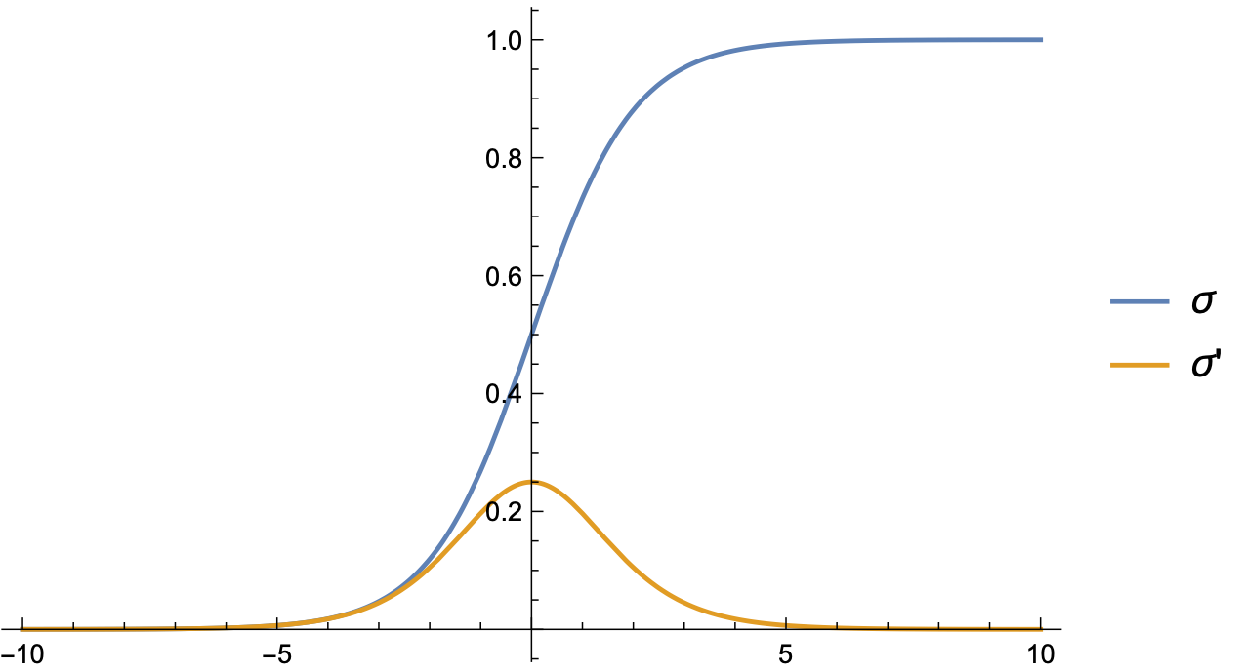
Logistic Regression
Use logistic function
$σ(z)=\frac{1}{1+exp(-z)}$

Slide 11
Logistic Regression
Combine with linear regression to obtain logistic regression approach:
Learn best weights in
$$\overset{̂}{y}\left((x_{1},x_{2},…,x_{n})\right)=σ(b+w_{1}x_{1}+w_{2}x_{2}+…w_{n}x_{n})$$
We know interpret this as a probability for the positive outcome '+'
Set a decision boundary at 0.5
This is no restriction since we can adjust $b$ and the weights

Slide 12
Logistic Regression
We need to measure how far a prediction is from the true value
Our predictions $\overset{̂}{y}$ and the true value $y$ can only be 0 or 1
If $y=1$: Want to support $\overset{̂}{y}=1$ and penalize $\overset{̂}{y}=0$.
If $y=0$: Want to support $\overset{̂}{y}=0$ and penalize $\overset{̂}{y}=1$.
One successful approach:
$$\text{Loss}(\overset{̂}{y},y)={\overset{̂}{y}}^{y}(1-\overset{̂}{y})^{(1-y)}$$

Slide 13
Logistic Regression
Easier: Take the negative logarithm of the loss function
Cross Entropy Loss
$${\text{L}}_{\text{CE}}=-ylog(\overset{̂}{y})-(1-y)log(1-\overset{̂}{y})$$

Slide 14
Logistic Regression
This approach is successful, because we can use Gradient Descent
Training set of size $m$
Minimize $\overset{m}{\underset{i=1}{∑}}{\text{L}}_{\text{CE}}(y^{(i)},{\overset{̂}{y}}^{(i)})$
Turns out to be a convex function, so minimization is simple! (As far as those things go)
Recall:
$$\overset{̂}{y}\left((x_{1},x_{2},…,x_{n})\right)=σ(b+w_{1}x_{1}+w_{2}x_{2}+…w_{n}x_{n})$$
We minimize with respect to the weights and $b$

Slide 15
Logistic Regression
Calculus:
$\frac{δ{\text{L}}_{\text{CE}}(w,b)}{δw_{j}}=\left(σ(w_{1}x_{1}+…w_{n}x_{n}+b)-y\right)x_{j}$
$=(\overset{̂}{y}-y)x_{j}$
Difference between true $y$ and estimated outcome $\overset{̂}{y}$, multiplied by input coordinate

Slide 16
Logistic Regression
Stochastic Gradient Descent
Until gradient is almost zero:
For each training point $x^{(i)},y^{(i)}$:
Compute prediction ${\overset{̂}{y}}^{(i)}$
Compute loss
Compute gradient
Nudge weights in the opposite direction using a learning weight $η$
$$(w_{1},…,w_{n})←(w_{1},…,w_{n})-η∇{\text{L}}_{\text{CE}}$$
Adjust $η$

Slide 17
Logistic Regression
Stochastic gradient descent uses a single data point
Better results with random batches of points at the same time

Slide 18
Lasso and Ridge Regression
If the feature vector is long, danger of overfitting is high
We learn the details of the training set
Want to limit the number of features with positive weight
Dealt with by adding a regularization term to the cost function
Regularization term depends on the weights
Penalizes large weights

Slide 19
Lasso and Ridge Regression
L2 regularization:
Use a quadratic function of the weights
Such as the euclidean norm of the weights
Called Ridge Regression
Easier to optimize

Slide 20
Lasso and Ridge Regression
L1 regularization
Regularization term is the sum of the absolute values of weights
Not differentiable, so optimization is more difficult
BUT: effective at lowering the number of non-zero weights
Feature selection:
Restrict the number of features in a model
Usually gives better predictions

Slide 21
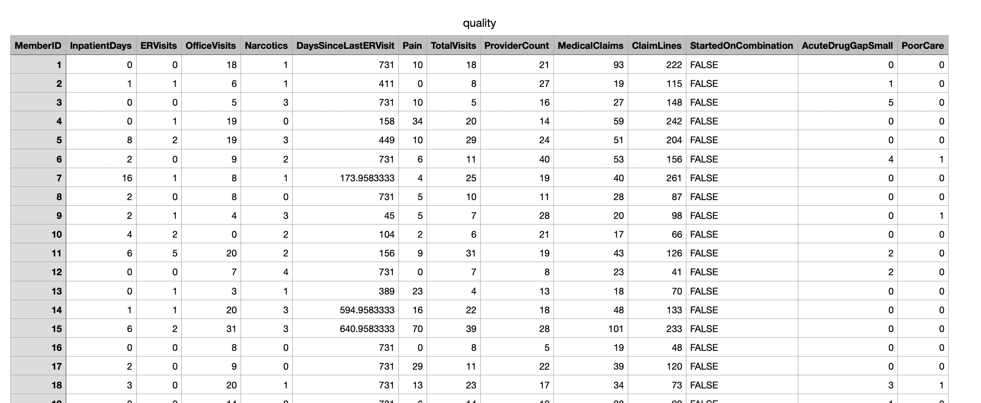
Examples
Example: quality.csv
Try to predict whether patient labeled care they received as poor or good

Slide 22
Examples
First column is an arbitrary patient ID
we make this the index
One column is a Boolean, when imported into Python
so we change it to a numeric value
df = pd.read_csv('quality.csv', sep=',', index_col=0)
df.replace({False:0, True:1}, inplace=True)

Slide 23
Examples
Farmington Heart Data Project:
https://framinghamheartstudy.org
Monitoring health data since 1948
2002 enrolled grandchildren of first study

Slide 24
Examples

Slide 25
Examples
Contains a few NaN data
We just drop them
df = pd.read_csv('framingham.csv', sep=',')
df.dropna(inplace=True)

Slide 26
Logistic Regression
in Stats-Models
Import statsmodels.api
Interactively select the columns that gives us high p-values
import statsmodels.api as sm
cols = [ 'Pain', 'TotalVisits',
'ProviderCount',
'MedicalClaims', 'ClaimLines',
'StartedOnCombination',
'AcuteDrugGapSmall',]

Slide 27
Logistic Regression
in Stats-Models
Create a logit model
Can do as we did for linear regression with a string
Can do using a dataframe syntax
Print the summary pages
logit_model=sm.Logit(df.PoorCare,df[cols])
result=logit_model.fit()
print(result.summary2())

Slide 28
Logistic Regression
in Stats-Models
Print the results
This gives the "confusion matrix"
Coefficient [i,j] gives:
predicted i values
actual j values
print(result.pred_table())

Slide 29
Logistic Regression
in Stats-Models
Quality prediction:
7 False negative and 18 false positives
[[91. 7.]
[18. 15.]]

Slide 30
Logistic Regression
in Stats-Models
Heart Event Prediction:
26 false negatives
523 false positives
[[3075. 26.]
[ 523. 34.]]

Slide 31
Logistic Regression
in Stats-Models
Can try to improve using Lasso
result=logit_model.fit_regularized()

Slide 32
Logistic Regression
in Stats-Models
Can try to improve selecting only columns with high P-values
Optimization terminated successfully.
Current function value: 0.423769
Iterations 6
Results: Logit
================================================================
Model: Logit Pseudo R-squared: 0.007
Dependent Variable: TenYearCHD AIC: 3114.2927
Date: 2020-07-12 18:18 BIC: 3157.7254
No. Observations: 3658 Log-Likelihood: -1550.1
Df Model: 6 LL-Null: -1560.6
Df Residuals: 3651 LLR p-value: 0.0019166
Converged: 1.0000 Scale: 1.0000
No. Iterations: 6.0000
----------------------------------------------------------------
Coef. Std.Err. z P>|z| [0.025 0.975]
----------------------------------------------------------------
currentSmoker 0.0390 0.0908 0.4291 0.6679 -0.1391 0.2170
BPMeds 0.5145 0.2200 2.3388 0.0193 0.0833 0.9457
prevalentStroke 0.7716 0.4708 1.6390 0.1012 -0.1511 1.6944
prevalentHyp 0.8892 0.0983 9.0439 0.0000 0.6965 1.0818
diabetes 1.4746 0.2696 5.4688 0.0000 0.9461 2.0030
totChol -0.0067 0.0007 -9.7668 0.0000 -0.0081 -0.0054
glucose -0.0061 0.0019 -3.2113 0.0013 -0.0098 -0.0024
================================================================

Slide 33
Logistic Regression
in Stats-Models
Select the columns
Get a better (?) confusion matrix:
False negatives has gone down
False positives has gone up
cols = ['currentSmoker', 'BPMeds',
'prevalentStroke', 'prevalentHyp',
'diabetes', 'totChol','glucose']
[[3086. 15.]
[ 549. 8.]]

Slide 34
Logistic Regression
in Scikit-learn
Import from sklearn
from sklearn.linear_model import LogisticRegression
from sklearn import metrics
from sklearn.metrics import confusion_matrix
from sklearn.model_selection import train_test_split
from sklearn.metrics import classification_report

Slide 35
Logistic Regression
in Scikit-learn
Create a logistic regression object and fit it on the data
logreg = LogisticRegression()
logreg.fit(X=df[cols], y = df.TenYearCHD)
y_pred = logreg.predict(df[cols])
confusion_matrix = confusion_matrix(df.TenYearCHD, y_pred)
print(confusion_matrix)

Slide 36
Logistic Regression
in Scikit-learn
Scikit-learn uses a different algorithm
Confusion matrix on the whole set is
[[3087 14]
[ 535 22]]

Slide 37
Logistic Regression
in Scikit-learn
Can also divide the set in training and test set
X_train, X_test, y_train, y_test =
train_test_split(df[cols],
df.TenYearCHD,
test_size=0.3,
random_state=0)
logreg.fit(X_train, y_train)
y_pred = logreg.predict(X_test)
confusion_matrix = confusion_matrix(y_test, y_pred)
print(confusion_matrix)

Slide 38
Logistic Regression
in Scikit-learn
Confusion matrix
[[915 1]
[176 6]]

Slide 39
Measuring Success
precision recall f1-score support
0 0.84 1.00 0.91 916
1 0.86 0.03 0.06 182
accuracy 0.84 1098
macro avg 0.85 0.52 0.49 1098
weighted avg 0.84 0.84 0.77 1098

Slide 40
Measuring Success
How can we measure accuracy?
accuracy = (fp+fn)/(tp+tn+fp+fn)
Unfortunately, because of skewed data sets, often very high
precision = tp/(tp+fp)
recall = tp/(tp+fn)
F measure = harmonic mean of precision and recall

Slide 41
Probit Regression
Instead of using the logistic function $σ$, can also use the cumulative distribution function of the normal distribution
$$\text{erf}(z)=\frac{2}{\sqrt{π}}∫_{0}^{z}exp(-t^{2})dt$$
Predictor is then
$$\frac{1}{2}\left(1+\text{erf}(b+w_{1}x_{1}+w_{2}x_{2}+…+w_{n}x_{n})\right)$$

Slide 42
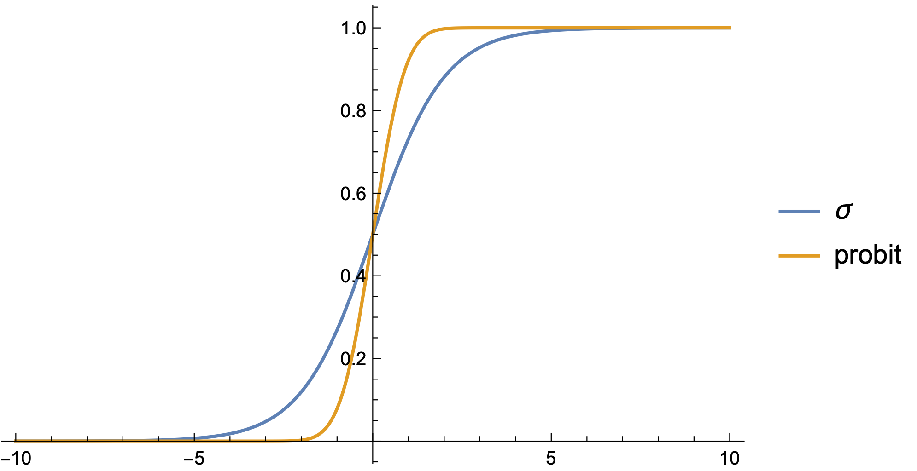
Probit Regression

Slide 43
Probit Regression
Calculations with probit are more involved
Statsmodels implements it
Fit the probit model
from statsmodels.discrete.discrete_model import Probit
probit_model=Probit(df.TenYearCHD,df[cols])
result=probit_model.fit()
print(result.summary())
print(result.pred_table())
for i in range(20):
print(df.TenYearCHD.iloc[i], result.predict(df[cols]).iloc[i])

Slide 44
Probit Regression
Confusion matrix is now
More false positives but less false negatives
[[3085. 16.]
[ 547. 10.]]

Slide 45
Multinomial Logistic Regression
Want to predict one of several categories based on feature vector
Use the softmax function $\text{softmax}\left(z_{1},z_{2},…,z_{m}\right)=\left(\frac{e^{z_{1}}}{\sum_{i=1}^{m}{e^{z_{i}}}},\frac{e^{z_{2}}}{\sum_{i=1}^{m}{e^{z_{i}}}},…,\frac{e^{z_{m}}}{\sum_{i=1}^{m}{e^{z_{i}}}}\right)$

Slide 46
Multinomial Logistic Regression
Learning is still possible, but more complicated

Slide 47
Multinomial Logistic Regression
model1 = LogisticRegression(random_state=0,
multi_class='multinomial',
penalty='none',
solver='newton-cg').fit(X_train, y_train)
preds = model1.predict(X_test)

