Slide 1
Minimization and Curve Fitting with SciPy
Thomas Schwarz, SJ

Slide 2
Curve Fitting
Want to construct a curve (mathematical function) that best fits a series of data points
First, need to select a model: what type of curve?
Then, need to determine how we measure fit
Examples:
y-values: $L(y,\overset{̂}{y})=\overset{n}{\underset{ν=1}{∑}}(y_{i}-\overset{̂}{y}(i))^{2}→min$
orthogonal least squares

Slide 3
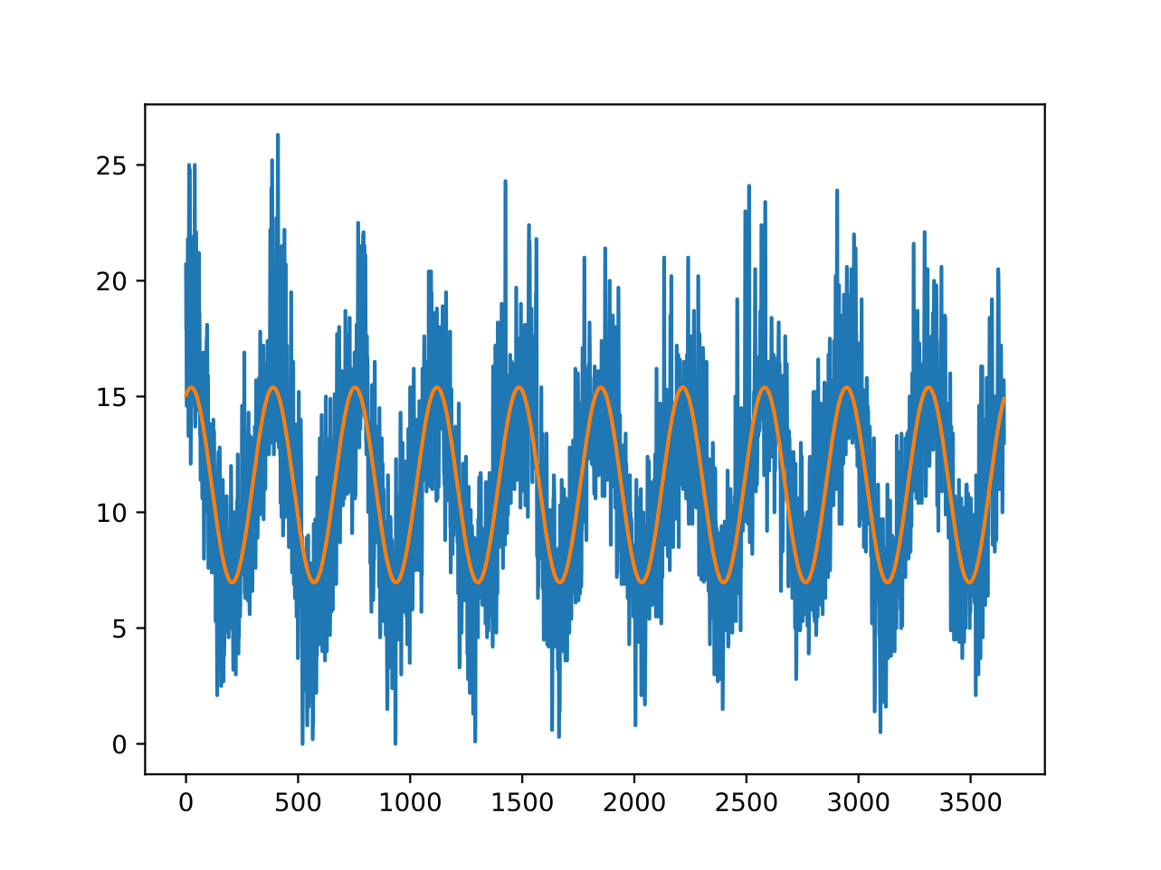
Curve Fitting
Example: Fit a sine curve to meteorological data
Minimum daily temperatures in Melbourne
$$f_{α,β,γ,δ}(t)=α+βsin(γt+δ)$$

Slide 4
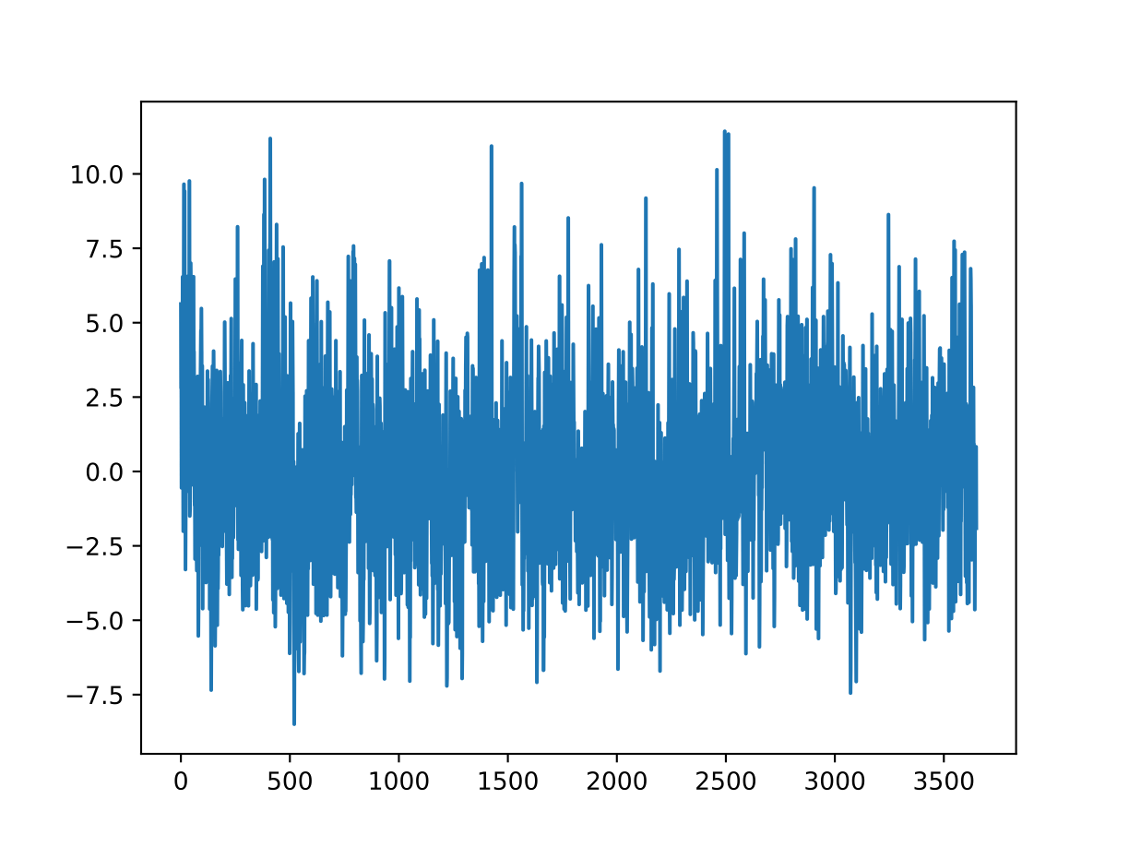
Curve Fitting
The data after removing the sine curve shows a seemingly random time series with just a little bit of seasonality

Slide 5
Curve Fitting
We can do better by including a cos
$$f_{α,β,γ,δ,ϵ}(t)=α+βsin(γt+δ)+ϵcos(γt+δ)$$

Slide 6
Curve Fitting
Residual:
Looks slightly better?

Slide 7
Curve Fitting
Find the parameters that minimize the squared difference between function and model
This is a minimization problem
Too general a model:
Optimization can be very difficult and lengthy
Overfit: The result matches the test set, but not the future
Not general a model
Fit is not good, therefore no strong predictions either

Slide 8
Program
Need to learn about minimization
One dimensional methods: Minimization along a line
Gradient Descent Methods
Minimization for Sums of Squares
Curve-fitting

Slide 9
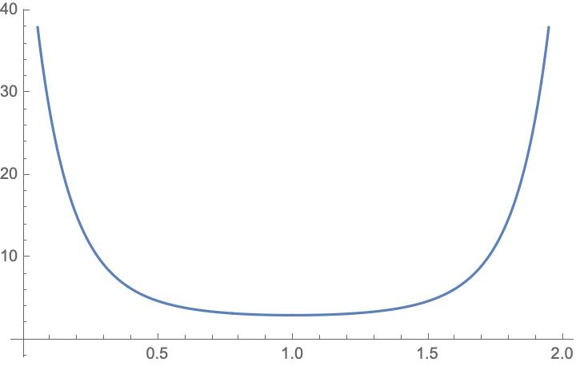
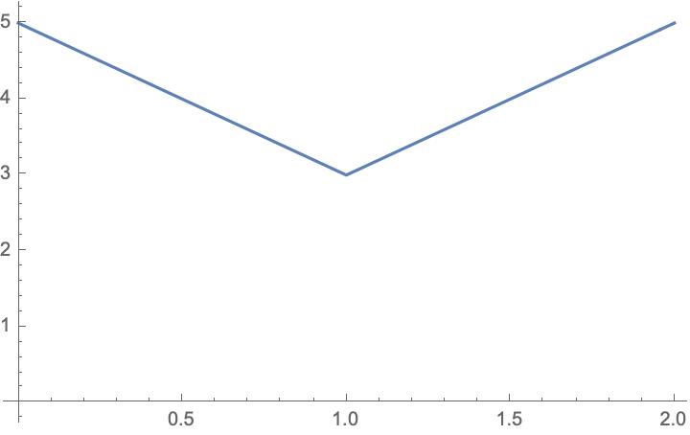
Minimization
Functions can be smooth and non-smooth

Slide 10
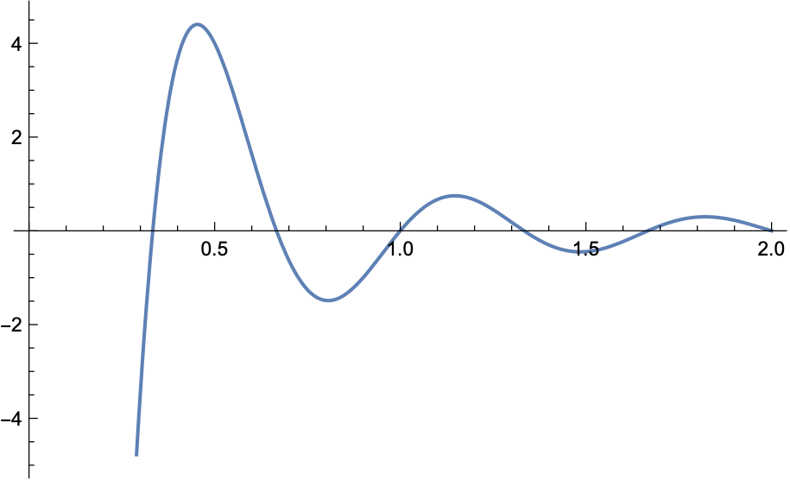
Minimization
Given a function $R^{n}→R$
Find a minimum
Potential problems:
Minimum might not exist
Minimum might be local

Slide 11
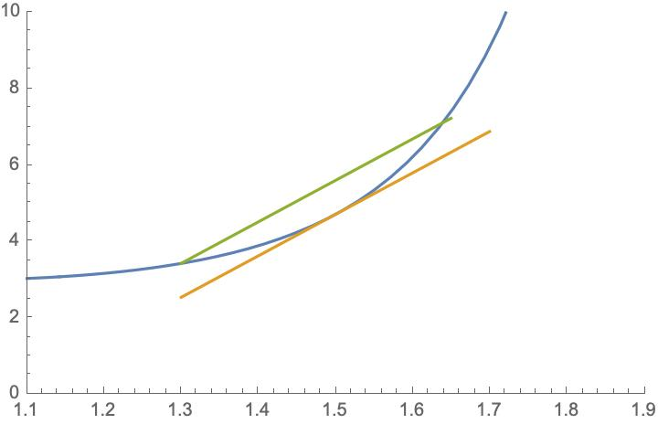
Minimization
Convex functions: For $t∈[0,1]:$
$f(\overset{⃗}{a}+t(\overset{⃗}{b}-\overset{⃗}{a}))≤f(\overset{⃗}{a})+t(f(\overset{⃗}{b})-f(\overset{⃗}{a})$
Tends to be easy
Relative minimum is unique

Slide 12
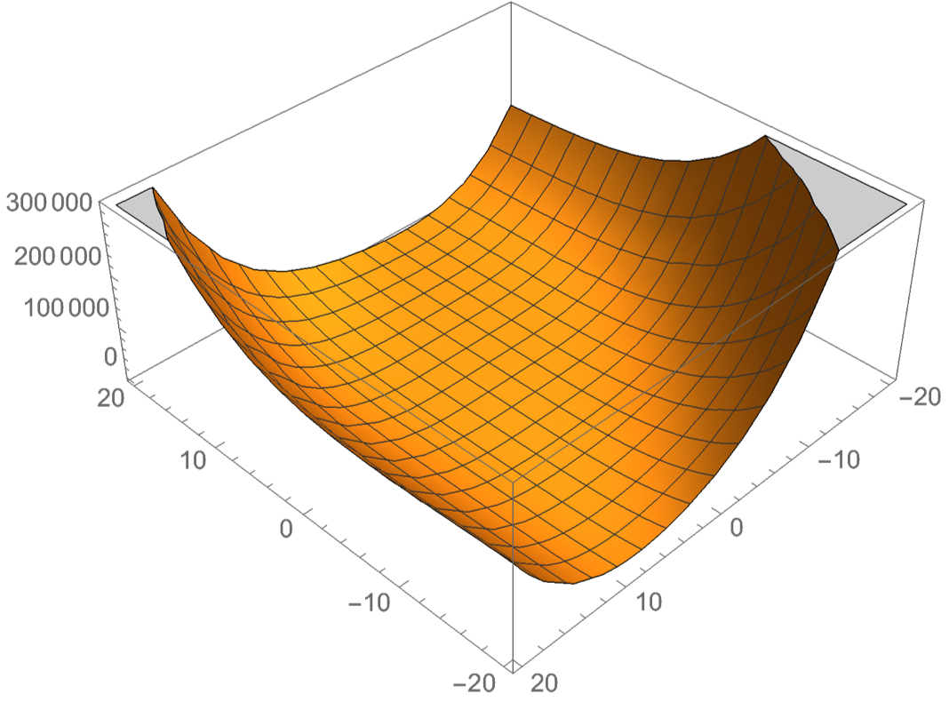
Minimization
Minimization is easier for convex functions

Slide 13
Minimization
Smooth functions are (usually) easier than non-smooth functions
Exception: Linear systems with constraints —> Linear Programming

Slide 14
Minimization
Gradient $∇f=(\frac{df}{dx_{1}},\frac{df}{dx_{2}},\frac{df}{dx_{3}},…,\frac{df}{dx_{n}})$ is always in the direction of greatest increase of a function

Slide 15
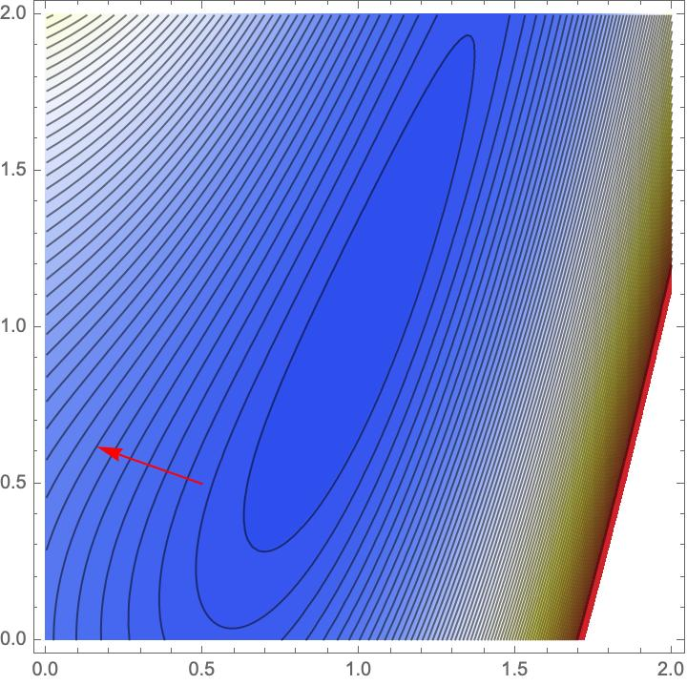
Minimization
Example: Rosenbrock Function
$$f(x,y)=1.2(y-x^{2})^{2}+1.1(1-x)^{2}$$
Gradient is $(-2.2(1-x)-4.8x(-x^{2}+y),2.4(-x^{2}+y)$
Contour graph is

Slide 16
Minimization
Descent Methods:
Choose a starting point $x_{0}∈R^{n}$
If $∥∇f(x_{k})∥<ϵ$ declare victory and return $x_{k}$
Pick a search direction $d_{k}∈R^{n}$ s.t. $∇f(x_{k})⋅d_{k}<0$
Choose a step size $α_{k}>0$ s.t. $f(x_{k}+α_{k}d_{k})<f(x_{k})$
Set $x_{k+1}=x_{k}+α_{k}d_{k}$. Go to 2

Slide 17
Minimization
This algorithm leaves two things open:
Selecting the step length $α_{k}$
Selecting the search direction $d_{k}$

Slide 18
Minimization
Finding minimum along line:
Finding minimum of function $t↦f(x_{k}+td_{k})$
Use derivative is usually dangerous:
Often function too flat
Better bracketing

Slide 19
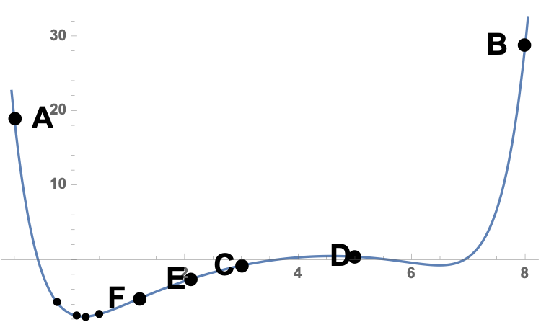
Minimization
Can use bracketing
Three points A < C < B such that $f(A)>f(C)<f(B)$
Thus, minimum guaranteed to exist
Now find another point D between A and C or C and B
Get a new bracket

Slide 20
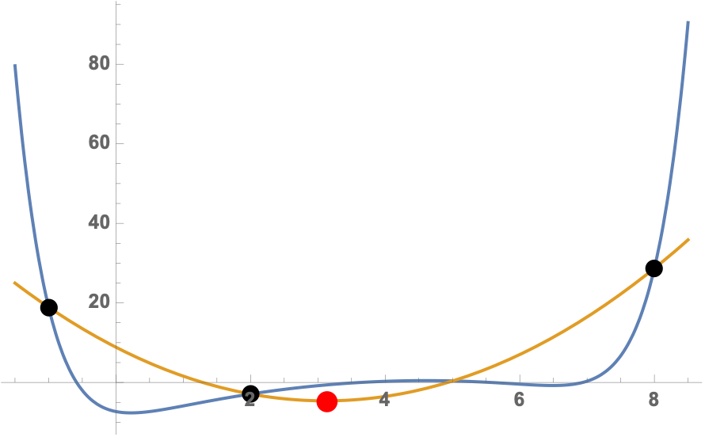
Minimization
One possibility: golden ratio: $\frac{|A-C|}{|A-B|}=\frac{|B-C|}{|A-C|}$
Other possibility: parabolic approximation
Or a combination of both

Slide 21
Minimization
Determining direction:
Can use coordinates

Slide 22
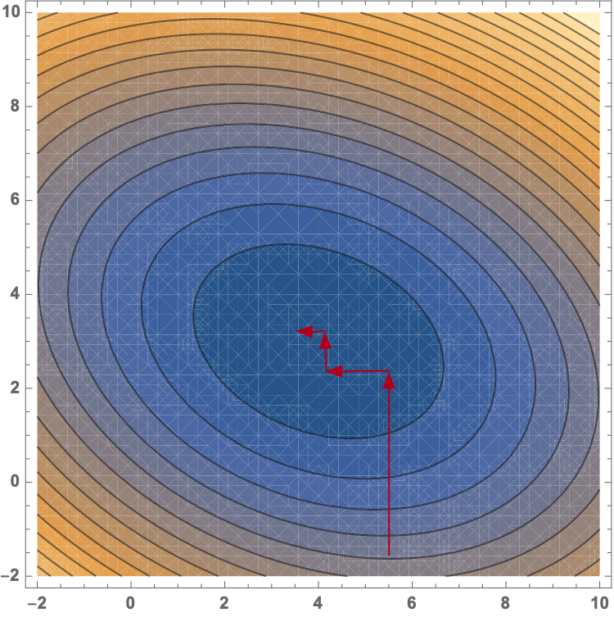
Minimization

Slide 23
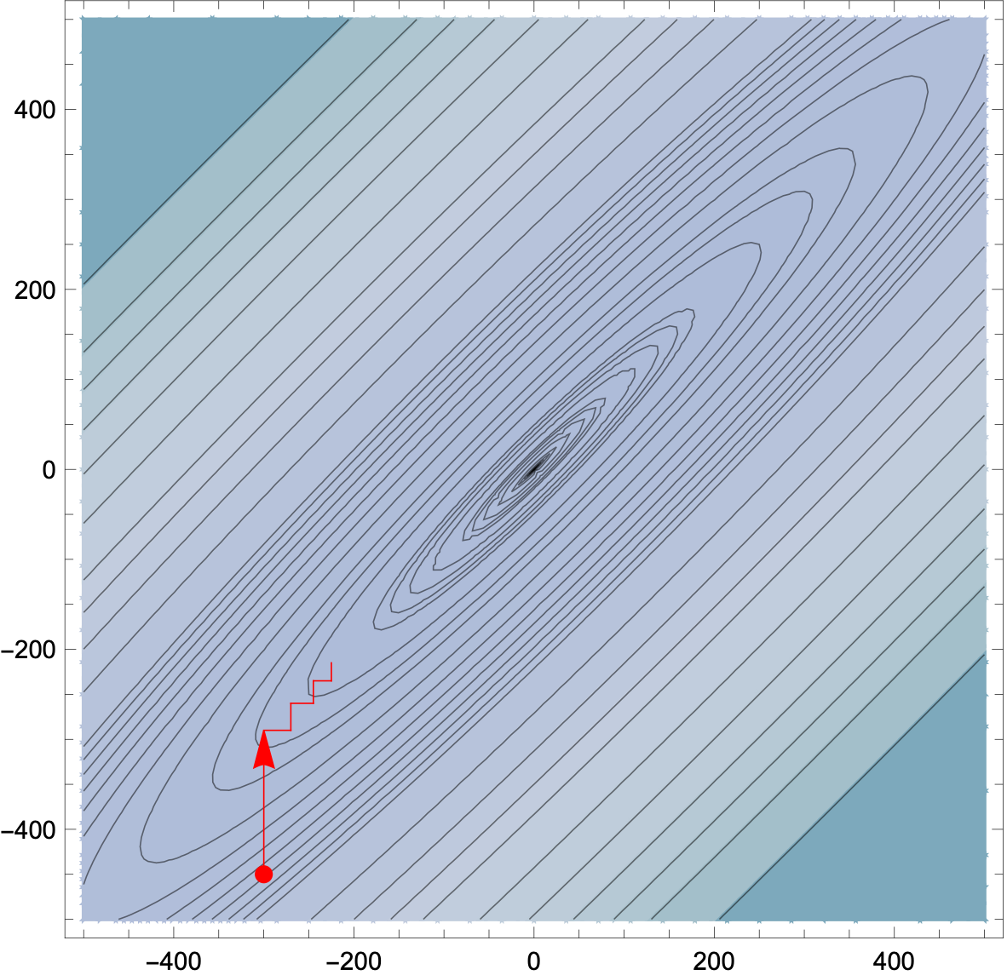
Minimization
Using coordinates
Make little progress per iteration

Slide 24
Minimization
Better use orthogonal directions:
otherwise we partially undo the previous steps
Possibilities
Canonical Directions
Steepest Descent (Cauchy)
badly affected by round-off errors and subject to zigzagging
Powell: Change set of directions every so often

Slide 25
Minimization
Selecting the step length
Finding the best step length is laborious
Often do better by guessing
Many machine learning algorithms use a steadily declining $α$
Trying out several guesses

Slide 26
Minimization
Newton Methods:
Repeatedly replace condition$∇f(x)=0$ by a sequence of linear problems
Newton-Raphson:
apply exact Newton steps
possibly does not converge
works best for convex functions
Use linear-search descent, then switch to Newton

Slide 27
Minimization
Numerical minimization of a cost function of the parameters
Various minimization methods
Line methods
Minimize along a particular line

Slide 28
Minimization
Instead of line searches: Trust Region Methods
Idea: for each iteration: replace $f$ with a quadratic model function
Quadratic model function approximates $f$ in the "trust region"
And quadratic model functions are easy to minimize!
The proposed solution can or cannot have a smaller value for $f$
Many different ways of defining the model

Slide 29
Minimization with SciPy
Can use a number of method for finding a local minimum
Some need the Jacobian and some need in addition the Hessian
Can be calculated numerically but results are better with exact functions
Jacobian $J(f)=\frac{df}{dx}=(\frac{δf}{δx_{1}},\frac{δf}{δx_{2}},…,\frac{δf}{δx_{n}})$
Hessian $H(f)={\left(\begin{aligned}\frac{δ^{2}f}{δx_{i}δx_{j}}\end{aligned}\right)}_{i,j}$

Slide 30
Minimization with SciPy
Use scipy.optimize.minimize
Needs a function that is a one-dimensional np.array
Specify a starting point, options, and method

Slide 31
Minimization with SciPy
Importing the optimizer:
import numpy as np
from scipy.optimize import minimize

Slide 32
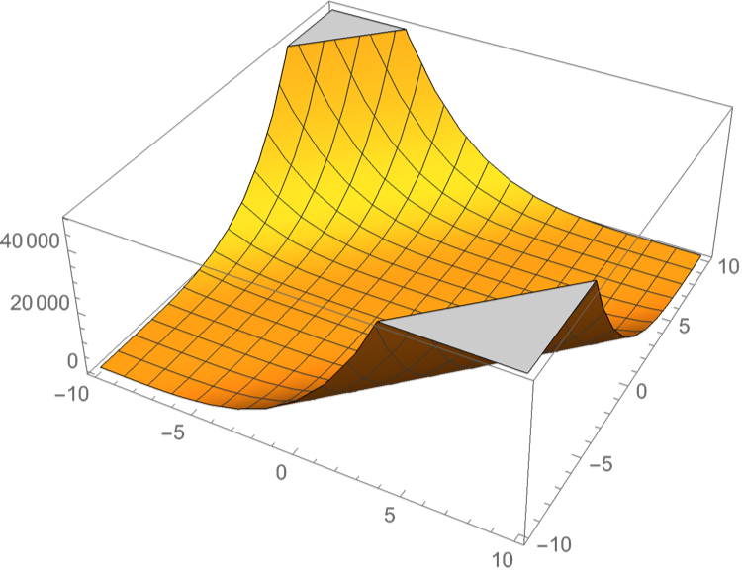
Minimization with SciPy
Defining a function to be minimized
Needs to be in "standard form", i.e. numpy array of one dimension
def func(x):
return np.sin(x[0]*x[1])+(x[0]+x[1]-1)**2+(x[0]-x[1]+1)**4

Slide 33
Minimization with SciPy
Sometimes need to give Jacobian
def jacob(x):
return np.array(
(4*(1+x[0]-x[1])**3 +
2*(x[0]+x[1]-1)+
x[1]*np.cos(x[0]*x[1]),
-4*(1+x[0]-x[1])**3 +
2*(x[0]+x[1]-1)+
x[0]*np.cos(x[0]*x[1])) )

Slide 34
Minimization with SciPy
We pick (5,5) as the starting point
res = minimize(func,
[5,5],
method = 'nelder-mead',
options = {'xatol': 1e-9, 'disp':True}
)
print(res.x)

Slide 35
Minimization with SciPy
Success: (but with lots of function evaluations)
Optimization terminated successfully.
Current function value: -0.295490
Iterations: 84
Function evaluations: 164
[-0.37249737 1.18821832]

Slide 36
Minimization with SciPy
res = minimize(func,
[5,5],
method = 'Newton-CG',
jac = jacob,
options = {'disp':True}
)
print(res.x)

Slide 37
Minimization with SciPy
Optimization terminated successfully.
Current function value: -0.295490
Iterations: 10
Function evaluations: 12
Gradient evaluations: 47
Hessian evaluations: 0
[-0.37249737 1.18821832]

Slide 38
Minimization with SciPy
res = minimize(func,
[5,5],
method = 'Powell',
options = {'disp':True}
)
print(res.x)

Slide 39
Minimization with SciPy
Optimization terminated successfully.
Current function value: -0.295490
Iterations: 5
Function evaluations: 139
[-0.37249969 1.18821518]

Slide 40
Minimization with SciPy
res = minimize(func,
[5,5],
method = 'BFGS',
options = {'disp':True}
)
print(res.x)

Slide 41
Minimization with SciPy
Optimization terminated successfully.
Current function value: -0.295490
Iterations: 15
Function evaluations: 84
Gradient evaluations: 21
[-0.37249848 1.18821848]

Slide 42
Least Square Optimization
Want to minimize a sum of squares
$$f:R^{n}→R^{m}$$
$f(\overset{⃗}{x})=\frac{1}{2}\overset{m}{\underset{j=1}{∑}}r_{j}^{2}(\overset{⃗}{x})$
(Factor of 1/2 to make derivatives look nicer)

Slide 43
Least Square Optimization
With this special form, we can calculate the Jacobian of $(r_{1}(\overset{⃗}{x}),r_{2}(\overset{⃗}{x}),…,r_{m}(\overset{⃗}{x}))^{T}$ more easily
$J^{T}=\left(\begin{matrix}\frac{δr_{1}}{δx_{1}} & \frac{δr_{2}}{δx_{1}} & … & \frac{δr_{m}}{δx_{1}} \\ \frac{δr_{1}}{δx_{2}} & \frac{δr_{2}}{δx_{2}} & … & \frac{δr_{m}}{δx_{2}} \\ ⋮ & ⋮ & ⋱ & ⋮ \\ \frac{δr_{1}}{δx_{n}} & \frac{δr_{2}}{δx_{n}} & … & \frac{δr_{m}}{δx_{n}}\end{matrix}\right)=\left(\begin{aligned}\frac{δr_{j}}{δx_{i}}\end{aligned}\right)$

Slide 44
Least Square Optimization
Then
$$∇f(\overset{⃗}{x})=J(\overset{⃗}{x})^{T}r(x)$$
$$∇^{2}f(\overset{⃗}{x})=J(\overset{⃗}{x})^{T}J(\overset{⃗}{x})+\overset{m}{\underset{j=1}{∑}}r_{j}(\overset{⃗}{x})∇^{2}r_{j}(\overset{⃗}{x})$$

Slide 45
Least Square Optimization
Now we assume that $||r(\overset{⃗}{x})||$ is linear
Then $J$ is a constant
$$∇^{2}(r_{j})(\overset{⃗}{x})=0$$
Taylor expansion is
$$f(\overset{⃗}{x})=f(x_{0})+J(f(x))|_{{\overset{⃗}{x}}_{0}}(\overset{⃗}{x}-{\overset{⃗}{x}}_{0})+\frac{1}{2}(\overset{⃗}{x}-{\overset{⃗}{x}}_{0})^{T}H(f(\overset{⃗}{x})|_{{\overset{⃗}{x}}_{0}}(\overset{⃗}{x}-{\overset{⃗}{x}}_{0})+…$$
Taking derivatives gives
$$∇f(\overset{⃗}{x})=J^{T}(J\overset{⃗}{x}+\overset{⃗}{r})=0$$
at a minimum

Slide 46
Least Square Optimization
This means we can solve for the minimum since then$J^{T}J\overset{⃗}{x}=-J^{T}r(\overset{⃗}{x})$
and so we could solve $\overset{⃗}{x}=(J^{T}J)^{-1}J^{T}r$

Slide 47
Least Square Optimization
However, calculating the inverse is
computationally expensive
numerically unstable

Slide 48
Least Square Optimization
Can use
Cholesky factorization
QR factorisation
Singular value decomposition of
$$J^{T}J$$
which are all implemented in np.linalg

Slide 49
Least Square Optimization
Levenberg Marquardt algorithm
Even if $r$ is not linear:
Assume that it is approximately
Use the above method as an approximator
Get results

Slide 50
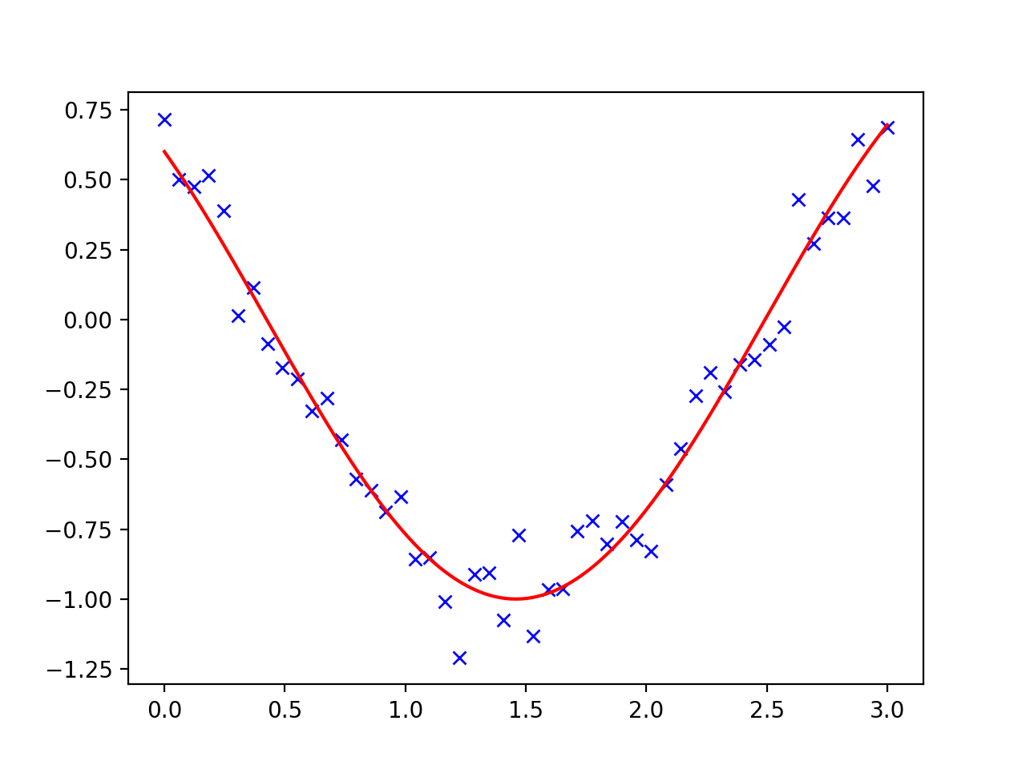
Curve Fitting
Number of numerical methods for minimization problems
Curve fitting:
Given a number of points, find a smooth curve going through it

Slide 51
Curve Fitting
Use a cosine as the test function
def f(t, omega, phi):
return np.cos(omega * t + phi)

Slide 52
Fitting with scipy
Create sample data
x = np.linspace(0, 3, 50)
y = f(x, 1.5, 1) + .1*np.random.normal(size=50)

Slide 53
Fitting with scipy
Now fit using scipy.optimize
params, params_cov = optimize.curve_fit(f, x, y)
print(params)

Slide 54
Fitting with scipy
Can almost recover parameters
y = f(x, 1.5, 1) + .1*np.random.normal(size=50)
[1.51854577 0.92665541]

Slide 55
Fitting with scipy

Slide 56
Fitting with scipy
Could also fit with a quadratic
def g(t, a, b, c):
return a*t**2+b*t+c
params, params_cov = optimize.curve_fit(g, x, y)

Slide 57
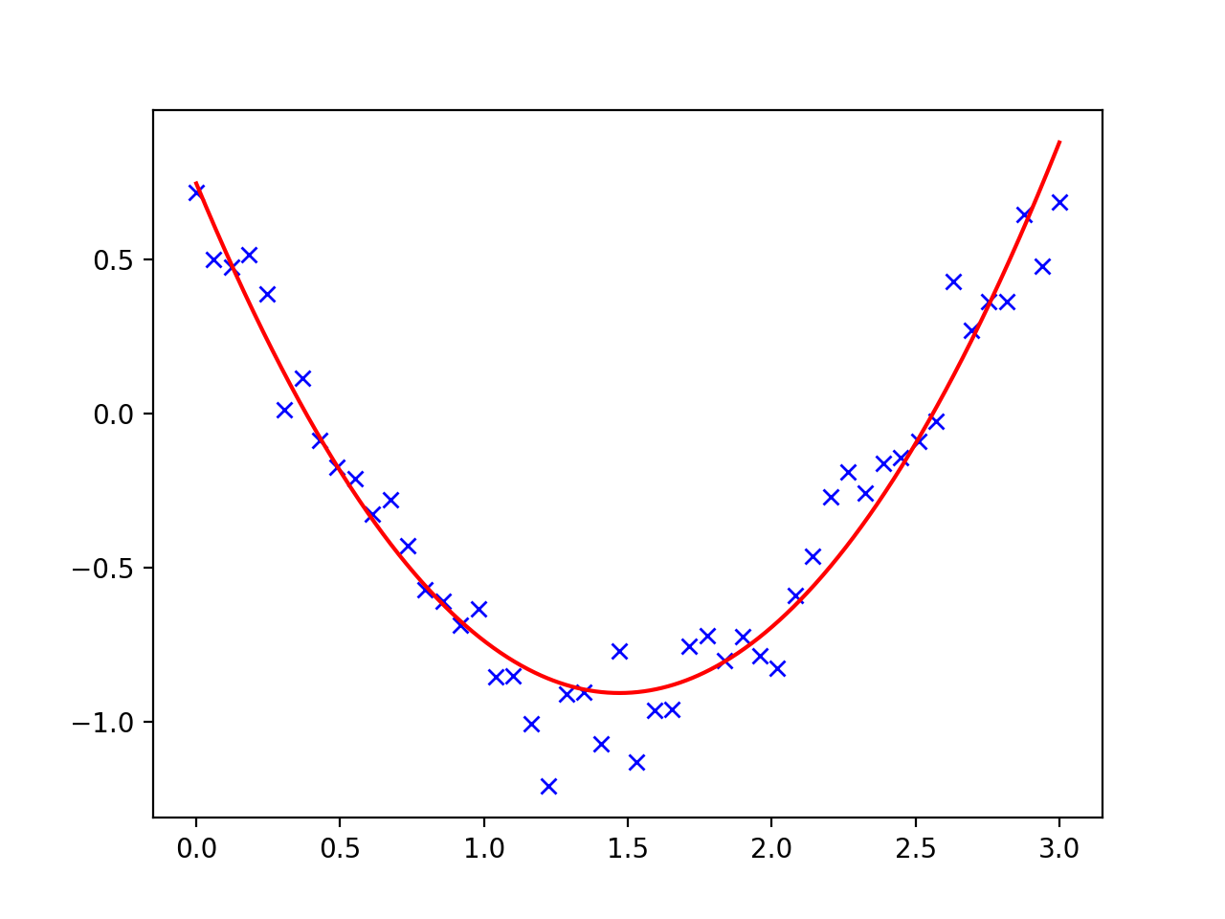
Fitting with scipy

Slide 58
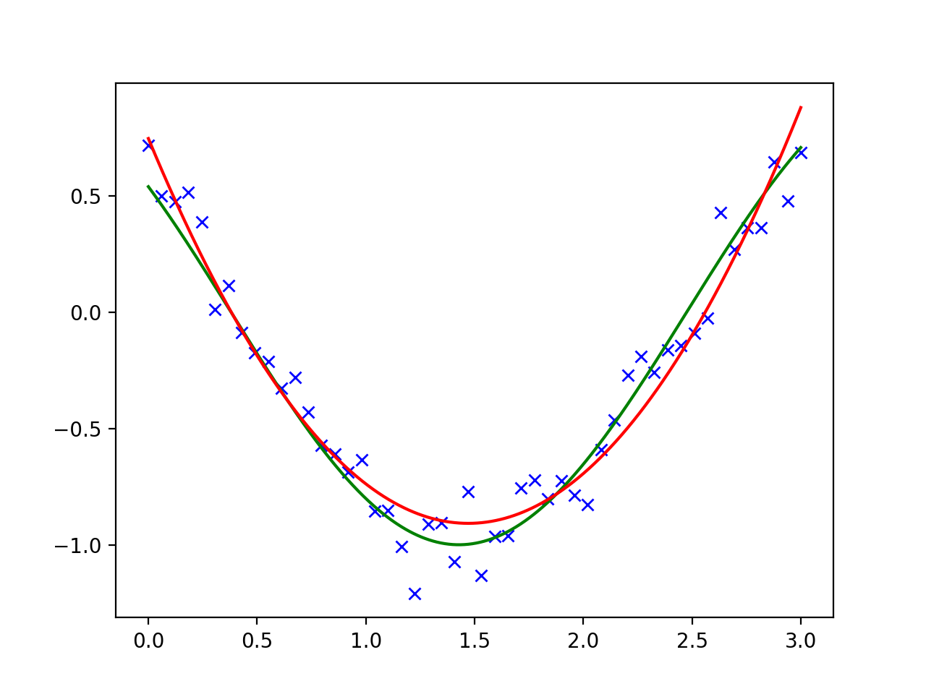
Fitting with scipy

Slide 59
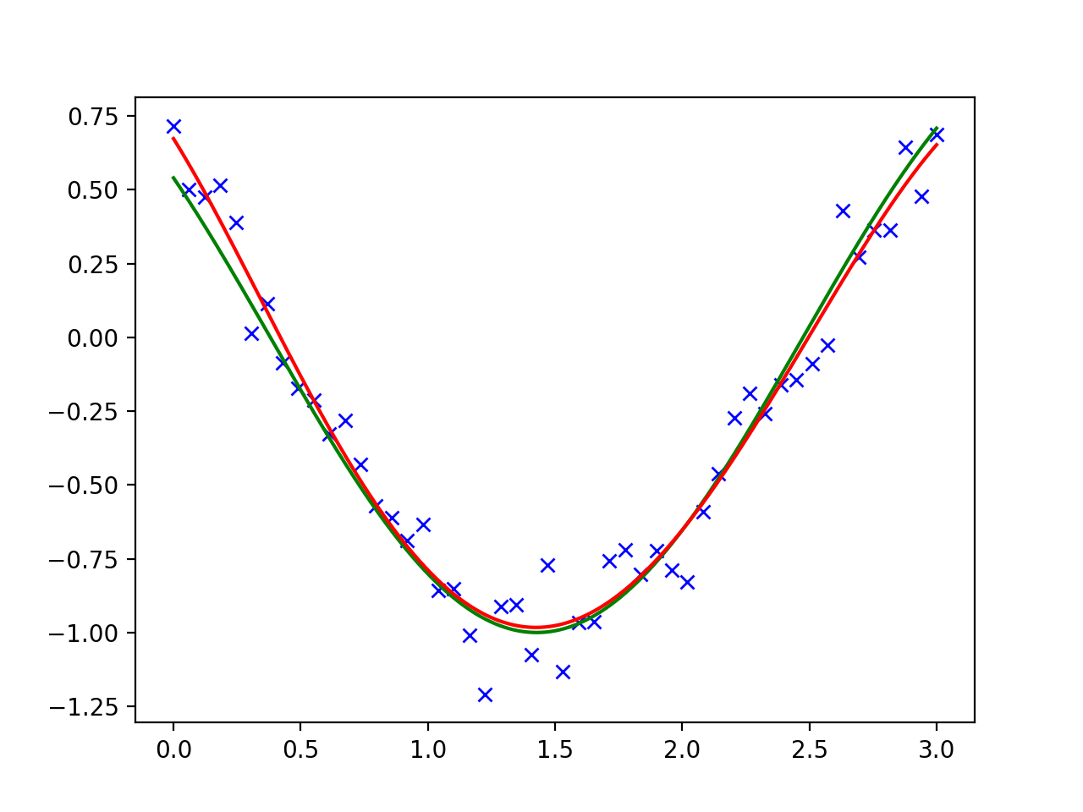
Fitting with scipy
Could also try a higher level polynomial

Slide 60
Fitting with scipy
And if we try with a polynomial with as many degrees as there are points, we would get perfect fit
And absolutely no insights!

Slide 61
Optimization
Global optimizers:
Grid search: Start out at a large number of starting positions
Try out several methods
If possible, calculate the gradient and the Hessian yourself
Can use scipy.optimize.check_grad( ) to see whether you calculated correctly

Slide 62
Curve Fitting
Need to have a good model:
Avoids under- and over-fitting
Find a way to measure success
E.g. time series: You want to remove trends and have white noise left over

Slide 63
HELP!!!!
Get Scipy Lecture notes (for free)
www.scipy-lectures.org

