Slide 1
Module 2: Loops
Thomas Schwarz, SJ

Slide 2
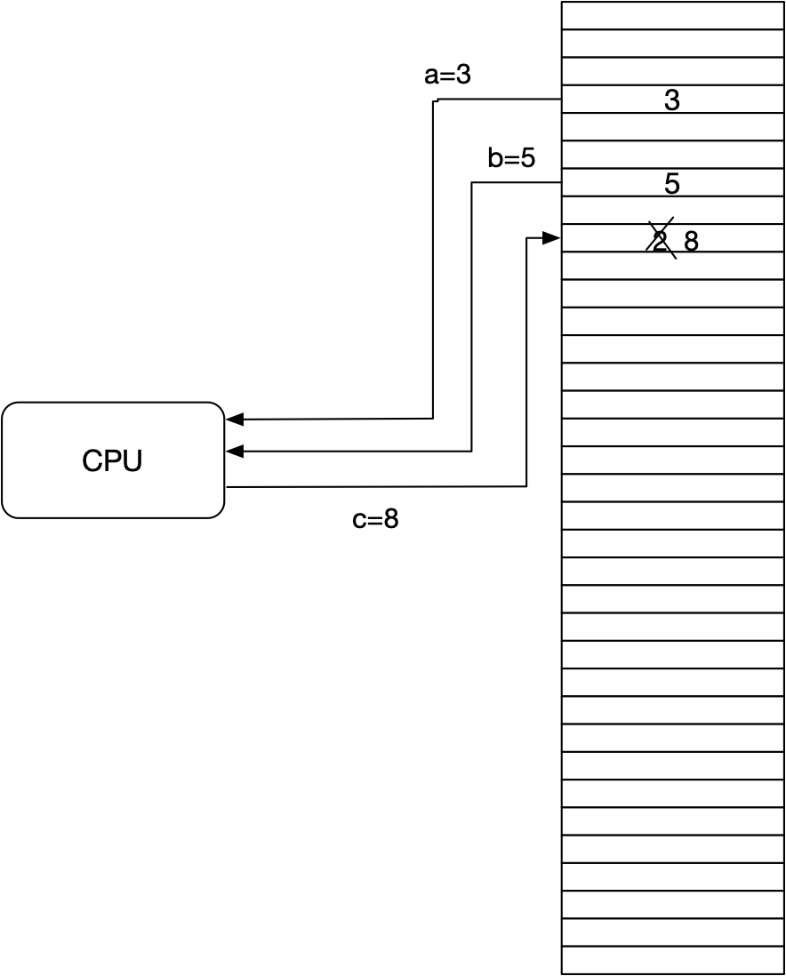
Repetition
Computational model for kindergardeners
We have a very large array of memory locations
The memory locations are variables
A program consists of a series of instructions
A typical instruction c=a+b takes a value from storage location a, a value from storage location b, does a computation, and stores in storage location c

Slide 3
Repetition
Python variables are defined by assignment
They are "strongly typed":
E.g.: Operations depend on the type
+ between numbers: addition
between strings: concatenation: 'नमस्ते'+' '+'दुनिया'
* between numbers: multiplication, between integer and string:
The same variable name can refer to entities of different types during the lifetime of a program

Slide 4
Repetition
Assignment: "="
a = 3*b/c
Operators:
Usually set: +, -, *, /, **
Binary operators: ^, |, <<, >>, &, ~
Unusual: // is integer division, % modulo operator

Slide 5
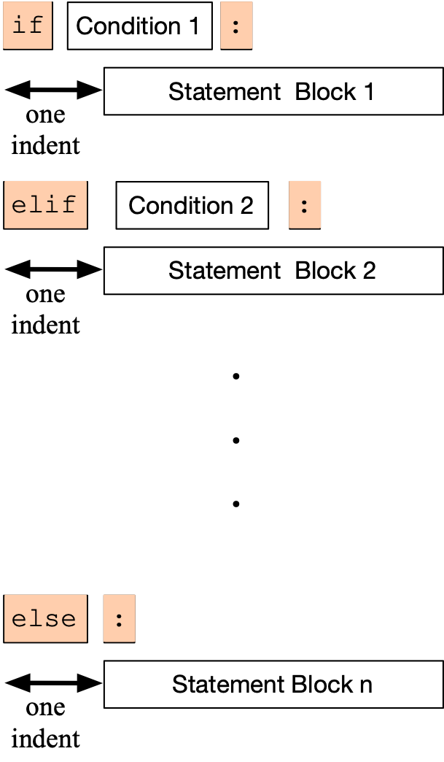
Repetition
Conditional statements
if, if else, if elif … else
Unusual:
White spaces form blocks
No parenthesis around conditions

Slide 6
Repetition
Example: (Python has no switch statement)
if temperature < -20:
print('welcome to Minnesota in the winter')
elif temperature < -10:
print('I love Milwaukee in the winter')
elif temperature < 0:
print('be careful about driving')
elif temperature < 10:
print('Finally spring in Milwaukee')
elif temperature < 20:
print("It's getting hot")
elif temperature < 30:
print('normal')
elif temperature < 45:
print('when does monsoon start')
elif temperature < 55:
print("it's hot even for Ahmedabad")
else:
print('where are you living')

Slide 7
Repetition
Python strings
Python is very flexible about the encoding that you use
Python-3 scripts should be written in utf-8
Strings can be denoted by single or double quotation marks
Python is very good at interpreting what you mean but sometimes escapes are necessary
Pep-8 style guidelines: https://www.python.org/dev/peps/pep-0008/

Slide 8
Conditions
A condition is an expression that evaluates to True or False
This type is called Boolean

Slide 9
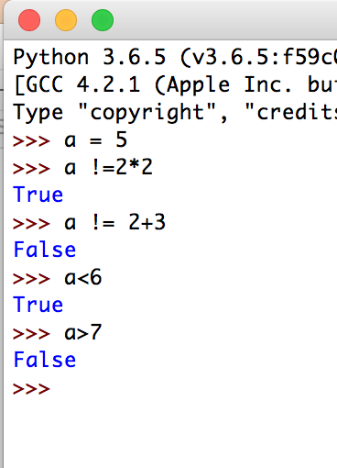
Boolean Expressions
The simplest Boolean expressions are True and False
The next simplest class are numerical comparators
< smaller
> greater
== equals (Two! equal symbols)
!= not equals
<= smaller or equal
>= larger or equal

Slide 10
Boolean Expressions
We can combine Boolean expressions using the logical operands
and
or
not
If necessary, we can add parentheses in order to specify precedence

Slide 11
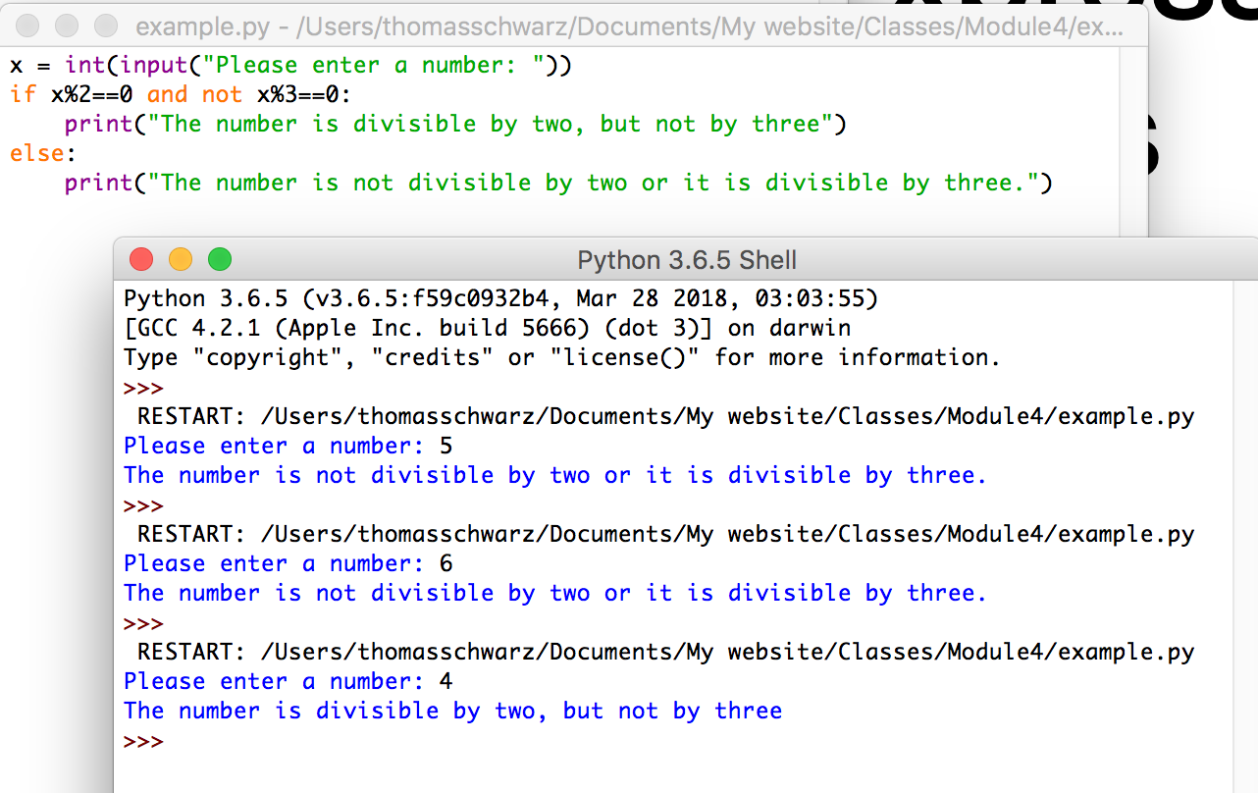
Boolean Expression Examples
A program that decides whether user input is divisible by 2, but not by 3.

Slide 12
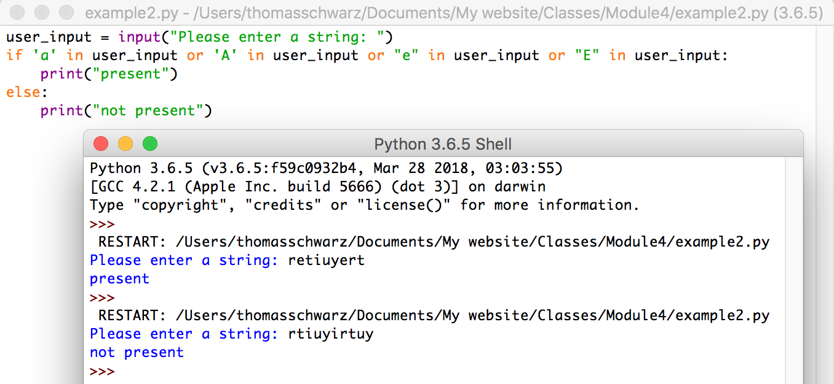
Boolean Expression Example
A program that checks whether the letter “a”, “A”, “e” or “E” is part of user input.
Python allows the keyword “in” to check for the presence of letters in strings.

Slide 13
Short-Circuit Operators
The value of an “or”- or “and” expression is evaluated from the left to the right
If the first operand of an “or” is True, then the second operand is not evaluated and True is returned.
This is because the value of the expression is already known
Similarly, if the first operand of an “and” expression is False, then the second operand is not evaluated and the value of the expression is False.

Slide 14
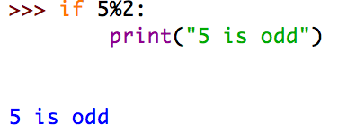
Conversion of other expressions
Any object can be tested for a truth value.
The truth value of a non-zero number is True, otherwise False.
Example:
Since 5%2 evaluates to 1, it’s truth value is True and the conditional statement (print(…)) is executed
This behavior extends to other type of objects such as strings
The empty string “” has truth value 0, every other string has truth value 1.

Slide 15
Loops
In CS: two types of for-loops
Using an index as in C, C++, Java
Using lists as in Lisp
Python for loops iterate through an 'iterator'
for(int i = 0; i < 10; i++)
* (loop for x in '(a b c d e)
do (print x) )

Slide 16
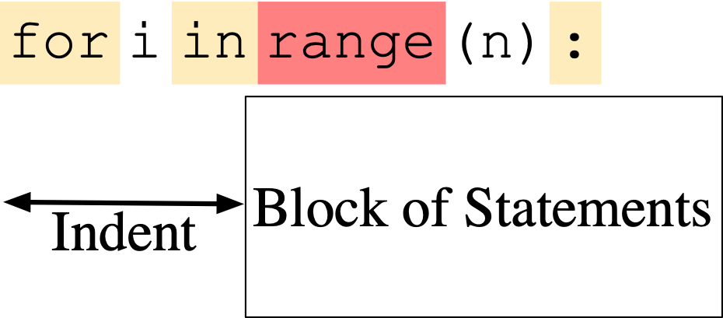
Loops
To repeat a block of statements, use

Slide 17
Loops
Range used to generate a list, but is now a generator
Like a list, but values are generated only on demand
range with a single variable: variable is the stop value
range allows a start value:
range allows a stride:
range(5)
[0,1,2,3,4]
range(2,5)
[2,3,4]
range(2,10,3)
[2,5,8]
range(10,1,-3)
[10,7,4]

Slide 18
Loops
Examples:
Calculate $\overset{100}{\underset{i=1}{∑}}i^{2}=1^{2}+2^{2}+…+{99}^{2}+{100}^{2}$
Use an accumulator to get the sum
def sum_of_squares(limit : int) -> int:
accu = 0
for i in range(1, limit+1):
accu += i*i
return accu
Notice that the sum includes 100

Slide 19
Loops
Example: Count-down
for i in range(10, -1, -1):
print(i)
10
9
8
7
6
5
4
3
2
1
0

Slide 20
Loops
Calculating the factorial $n!=\overset{n}{\underset{i=1}{∏}}i=1⋅2⋅3⋅…⋅(n-1)⋅n$
accu = 1
for i in range(1, n+1):
accu *= i
return accu

Slide 21
Calculating Sums
For loops are handy to calculate mathematical sums
Geometric series:
Calculate
Determine iterator needs to run from 0 to 10 (inclusive)
for i in range(11):
Need to accumulate fractions in a sum
Just don’t call it “sum”, because “sum” has another meaning
$$\frac{1}{2^{0}}+\frac{1}{2^{1}}+\frac{1}{2^{2}}+\frac{1}{2^{3}}+\frac{1}{2^{4}}+…+\frac{1}{2^{10}}$$

Slide 22
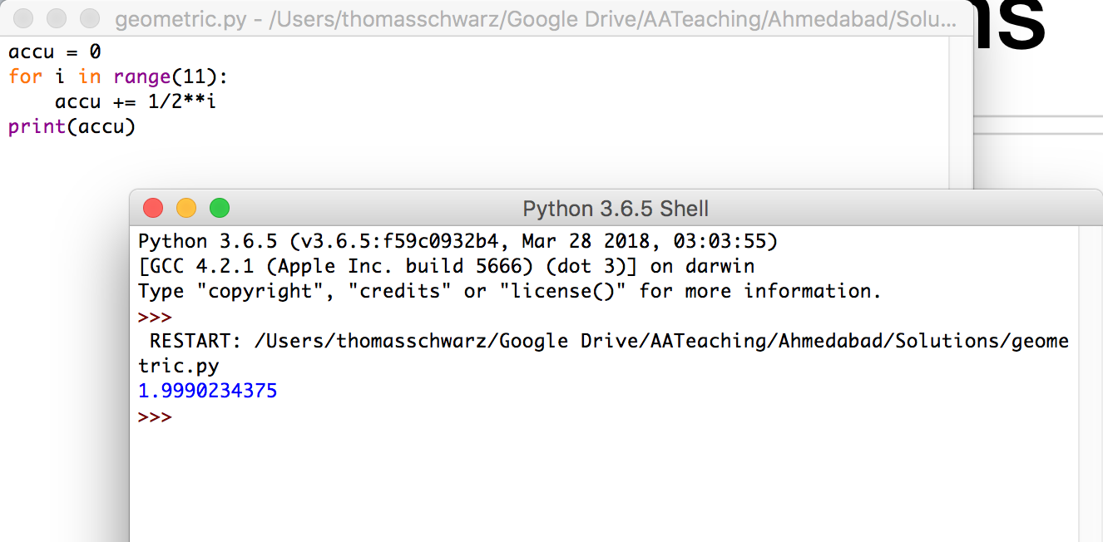
Calculating Sums

Slide 23
Calculating Sums
Admittedly, we could have used Mathematics instead
The sum is 1.1111111111 in binary.
Add 1/2**10 or 0.0000000001 in binary and we get 2.
Thus, the sum is 2 - 1/2**10

Slide 24
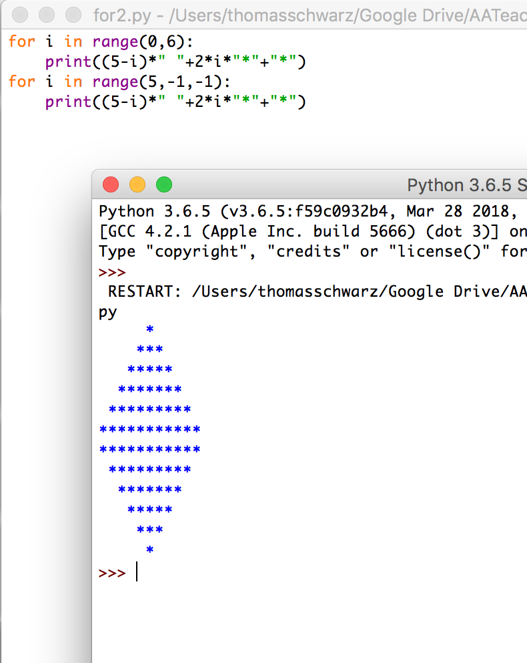
Drawing Pictures
We can use the index in a for loop in order to draw contours
The trick is to use string repetition instead of drawing each line separately.

Slide 25
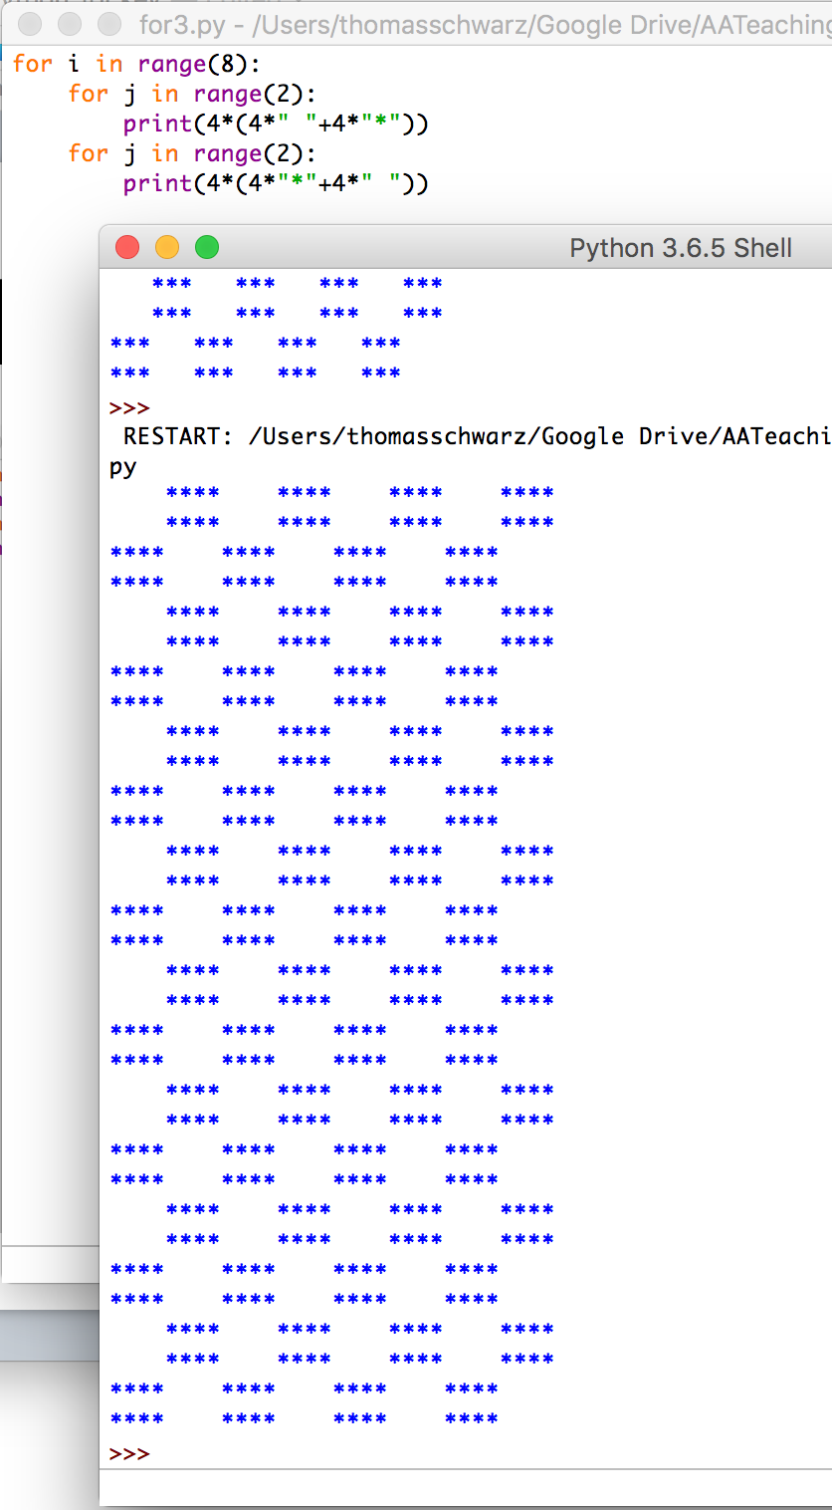
Drawing Pictures

Slide 26
While Loops
Form of the while loop:
Keyword is while
Condition needs to evaluate to either True or False
Condition is a boolean

Slide 27
While Loop Conditions
Statement block is executed as long as condition is valid.
Allows the possibility of infinite loops
Apple Inc.
One Infinite Loop
Cupertino, CA 95014
(408) 606-5775

Slide 28
An Infinite Loop
while True:
print(“Hello World”)
If this happens to you, you might have to kill Idle process.

Slide 29
While Loops can emulate for loops
Find an equivalent while loop for the following for-loop
(which calculates )
$$\sum_{ν=1}^{n}{\frac{1}{ν}}$$
n = int(input("Enter n: "))
suma = 0
for i in range(1,n+1):
suma += 1/i
print("The", n, "th harmonic number is", sum)

Slide 30
While loops can emulate for loops
Solution: the loop-variable i has to start out as 1 and then needs to be incremented for every loop iteration
We stop the loop when i reaches n+1, i.e. we continue as long as i <= n.
n = int(input("Enter n: "))
sum = 0
i = 1
while i<= n:
sum += 1/i
i += 1
print("The", n, "th harmonic number is", sum)

Slide 31
Harmonic Numbers
$$h_{n}=\overset{n}{\underset{ν=1}{∑}}\frac{1}{ν}$$
The nth harmonic number is
It is known that this series diverges.
Given a positive number x, we want to determine n such that the nth harmonic number is just above x
Solution: add while you have not reached x
$$min(\{n|h_{n}>x\})$$
$$\frac{1}{ν}$$

Slide 32
Harmonic Numbers
x = float(input("Enter x: "))
nu = 1
sum = 0
while sum <= x:
sum += 1/nu
nu += 1
print("The number you are looking for is ", nu-1,
"and incidentally, h_n =“, sum)
When we stop, we need to undo the last increment of nu, but not for sum.

Slide 33
Breaking out of a while loop
You break out of a while loop, if the condition in the while loop is False
Or by using a statement
break breaks out of the current loop
Can be used in for loops as well
A related statement is the continue statement
continue breaks out of the current iteration of the loop and goes to the next
We’ll learn them in the course of the classes.

Slide 34
Example
Find a number that fulfills the following congruences
This is Sun-Tsu’s problem and the Chinese Remaindering Theorem in Mathematics helps with solving these problems.
$$x≡2(mod3)$$
$$x≡3(mod5)$$
$$x≡2(mod7)$$

Slide 35
Example
We try out all numbers between 1 and
We check each number whether they fulfill the congruences
If we find one, we print it out and break out of the while loop.
$$3×5×7$$
x = 1
while x < 3*5*7:
if x%3==2 and x%5==3 and x%7==2:
print(x)
break
x += 1

Slide 36
While Loops
break: stop the execution of the loop
continue: stop the execution of the current iteration and go back to the evaluation of the loop condition
(Stupid) Example: Print out all even numbers from 1 to 100
for i in range(1, 101):
if i%2==1:
continue
print(i)

Slide 37
While Loops
A frequent pattern:
Have an infinite while loop
Break out if a certain condition is true

Slide 38
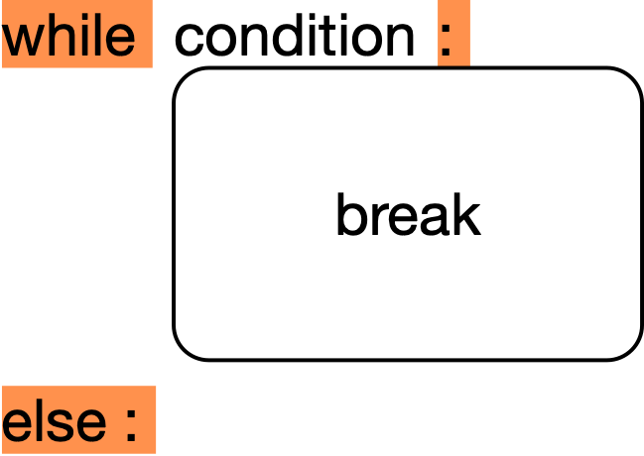
While Loops
Else clause (an example that Python is not perfect)
Executed if a break is not taken

Slide 39
While Loops
Else clause example:
Notice: 'else' belongs to the inner for, not the if statement
for n in [2,3,4,5,6,7,8,20,21,22,23,24]:
for p in range(2, n):
if p*(n//p) == n: # p devides n
print(n,'=', p, '*', n//p)
break
else:
print(n, 'is prime')

